Slide 1
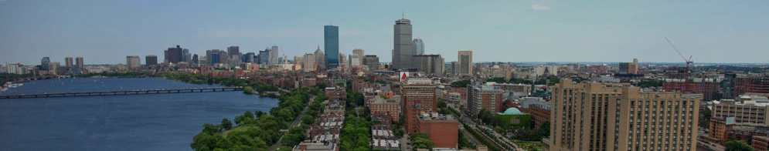


Student First Last
Internship Partner
Picture of you
Host logo or picture
Project Title
Department
your email

Slide 2
Things to Include
Presentation length: 4 minutes
Suggestion: use photos rather than text blocks when possible
Provide background for your project – what urban environmental challenge did you address? Why is this issue relevant and/or important? Who does it affect?
What did you actually work on? Who did you partner with?
What outcomes or products came from your project? What is the impact of the work you did?
What are next steps for your partner or for you, building on the work (if applicable)?
If time, what is one thing you particularly enjoyed about the project?

