Slide 1
Lets practice what you have learnt so far

Slide 2
The how and why of high-intensity, ultrashort optical pulses generation?
How can we improve a presentation?

Slide 3
Remember – a presentation needs as following:
Introduction/Motivation
Background
Results
Discussion
Summary

Slide 4
The how and why of high-intensity, ultrashort optical pulses generation?
Notes:
Today, we are going to discuss the how and why of high-intensity ultrashort optical pulses generation. The discovery that has given the 2018 Nobel Prize in Physics to its inventors.

Slide 5
Introduction
The Royal Swedish Academy of Sciences has decided to award the Nobel prize in Physics 2018 for groundbreaking inventions in the field of laser physics.
“For the optical tweezers and their applications to biological systems”
“For their method of generating high-intensity, ultra-short optical pulses”
Notes:
As you might heard, the Nobel Prize in Physics 2018 was awarded "for ground-breaking inventions in the field of laser physics" with one half to American physicist Arthur Ashkin "for the optical tweezers and their application to biological systems", the other half jointly to Gérard Mourou from France and Donna Strickland from US "for their method of generating high-intensity, ultra-short optical pulses.” The inventions being honoured this year have revolutionised laser physics. Extremely small objects and incredibly rapid processes are now being seen in a new light. Advanced precision instruments are opening up unexplored areas of research and a multitude of industrial and medical applications. Although both discoveries are very important and super interesting, in this talk we are going to focus on ultra-short optical pulses only.

Slide 6
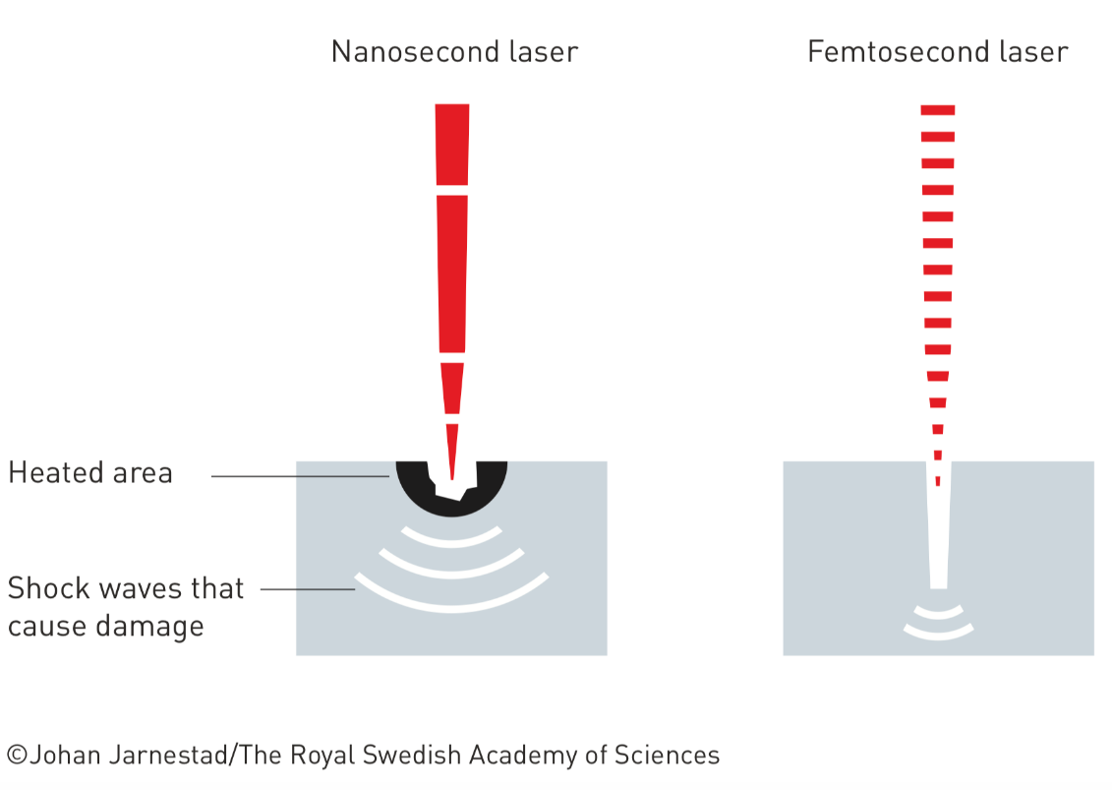
Motivation
Notes:
The access to short optical pulses, with durations matching the time-scale of various processes, for example, molecular vibrations, electron motion in atoms and molecules became gateway to entirely new areas and applications in physics, chemistry, biology and medicine. One early area of use was the rapid illumination of what happens between molecules and atoms in the constantly changing microworld. Things happen quickly, so quickly that for a long time it was only possible to describe the before and after. But with pulses as short as a femtosecond, one million of a billionth of a second, it is possible to see events that previously appeared to be instantaneous.
Moreover, the short pulses from a femtosecond laser cause less damage in the material than the million-times longer pulses from a nanosecond laser.

Slide 7
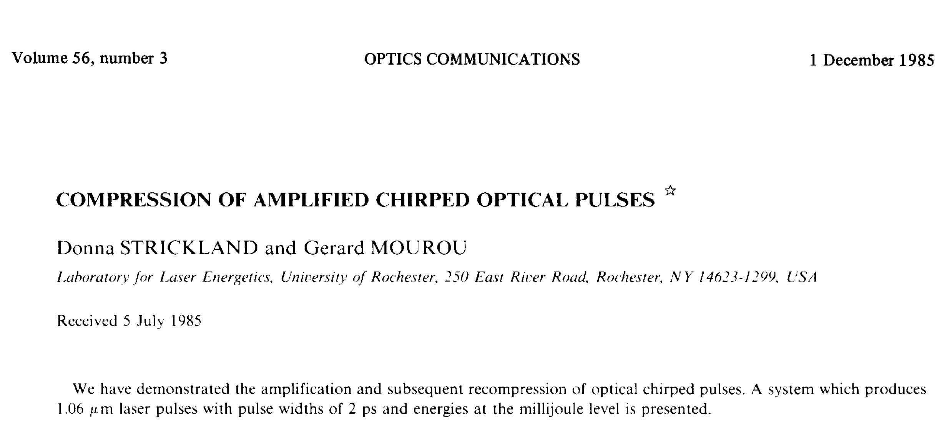
BACKGROUND
Gérard Mourou and Donna Strickland paved the way towards the shortest and most intense laser pulses ever created by mankind. Their revolutionary article was published in 1985 and was the foundation of Strickland’s doctoral thesis. Using an ingenious approach, they succeeded in creating ultrashort high-intensity laser pulses without destroying the amplifying material.
Notes:
Gérard Mourou and Donna Strickland paved the way towards the shortest and most intense laser pulses ever created by mankind. The inspiration came from a popular science article that described radar and its long radio waves. However, transferring this idea to the shorter optical light waves was difficult, both in theory and in practice. The breakthrough was described in the article that was published in December 1985 and was Donna Strickland’s first scientific publication. She had moved from Canada to the University of Rochester in the US, where she became attracted to laser physics by the green and red beams that lit the laboratory like a Christmas tree and, not least, by the visions of her supervisor, Gérard Mourou. One of these has now been realised – the idea of amplifying short laser pulses to unprecedented levels.
Laser light is created through a chain reaction in which the particles of light, photons, generate even more photons. These can be emitted in pulses. Ever since lasers were invented, almost 60 years ago, researchers have endeavoured to create more intense pulses. However, by the mid-1980s, the end of the road had been reached. For short pulses it was no longer practically possible to increase the intensity of the light without destroying the amplifying material. Using an ingenious approach, Strickland and Mourou succeeded in creating ultrashort high-intensity laser pulses without destroying the amplifying material.

Slide 8
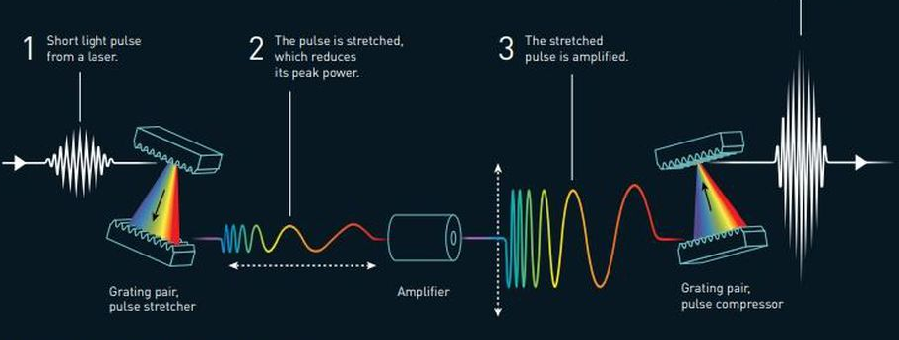
Results
Generate high energy ultrafast pulses
Combination of stretching pulses in time, amplification and compression
4
The pulse is compressed and its intensity increases dramatically.
The pulse is stretched which reduces its peak power.
Short light pulse from a laser.
2
1
3
The stretched pulse is amplified.
Grating pair, pulse stretcher
Amplifier
Grating pair, pulse compressor
@ Johan Jarnestad/The Royal Swedish Academy of Sciences
Notes:
Their simple and elegant method, called the Chirped pulse amplification (CPA) revolutionised laser technology. It enabled the emission of very intense, short pulses of light using an intricate method to avoid the risk of destroying the amplifying material. Instead of amplifying the light pulse directly, it is first stretched in time, reducing its peak power. Then the pulse is amplified and when it is compressed more light is collected in the same place – the light pulse becomes extremely intense.
In the original implementation of Strickland and Mourou in the first step, a short, low-energy, nanojoule pulse from a mode-locked Nd:YAG laser was coupled into a single-mode optical fibre and stretched to a duration of about 300 ps. The pulse was linearly chirped in the fibre by group velocity dispersion and self-phase modulation (a nonlinear optical effect inducing a varying refractive index). The dispersion in the fibre was positive, so that the low-frequency (red) part of the pulse propagated faster than the high-frequency (blue) part. In the second step, Strickland and Mourou then amplified the chirped pulse in a Nd:glass regenerative amplifier. In the final step, the long chirped pulse was compressed by a double grating compressor to 2 ps; the energy of the amplified pulse was 1 mJ.

Slide 9
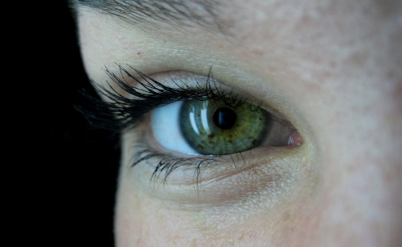
Discussion
The applications of the Nobel Prize winning technology have enabled groundbreaking impact in corrective eye surgery, with the most prominent example being LASIK.
In addition, micromachining with high intensity power has opened pathways for high precision cutting of metallic and non-metallic surfaces.
This technology has allowed manufacturing of surgical stents at the microscale.
Data storage
Notes:
The applications of the Nobel Prize winning technology have enabled groundbreaking impact in corrective eye surgery, to treat myopia and astigmatism, with the most prominent example being LASIK. In LASIK, a femtosecond laser offers high precision for making the corneal flap, which is required for the excimer laser to have access to and reshape the corneal stroma. With the introduction of an all-in-one femtosecond laser procedure, which does not require the creation of a flap, a very small incision of about 4 mm or less is created in order to remove the photo-ablated refractive lenticule. Removing the lenticule changes the shape of the cornea, so that the desired refractive correction is obtained.
A laser’s extremely high intensity also makes its light a tool for changing the properties of matter: electrical insulators can be converted to conductors, and ultra-sharp laser beams make it possible to cut or drill holes in various materials extremely precisely.
The technology is also used to manufacture surgical stents, micrometre- sized cylinders of stretched metal that widen and reinforce blood vessels, the urinary tract and other passageways inside the body.
The lasers can be used to create more efficient data storage, as the storage is not only built on the surface of the material, but also in tiny holes drilled deep into the storage medium.

Slide 10
Summary
The invention of method to generate ultrashort laser pulses has revolutionised laser physics; incredibly rapid processes are now being seen in a new light. The innumerable areas of application have not yet been completely explored. However, even now these celebrated inventions allow us to rummage around in the microworld in the best spirit of Alfred Nobel – for the greatest benefit to humankind.

