Slide 1
IT & industry concentration
James Bessen
Technology & Policy Research Initiative, BU School of Law

Slide 2
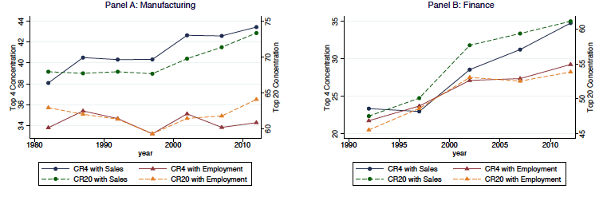
Rising concentration
5 %

Slide 3
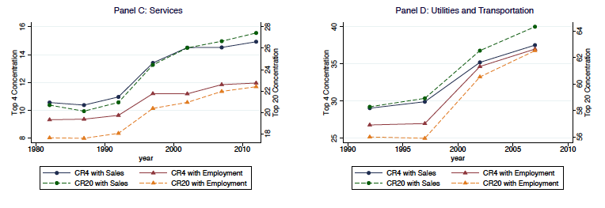
Rising concentration 2

Slide 4
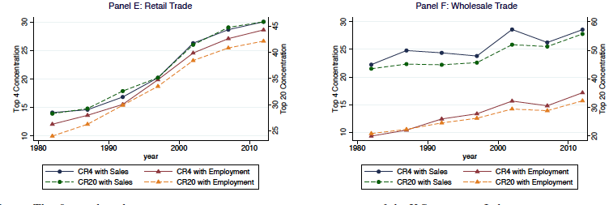
Rising concentration 3

Slide 5
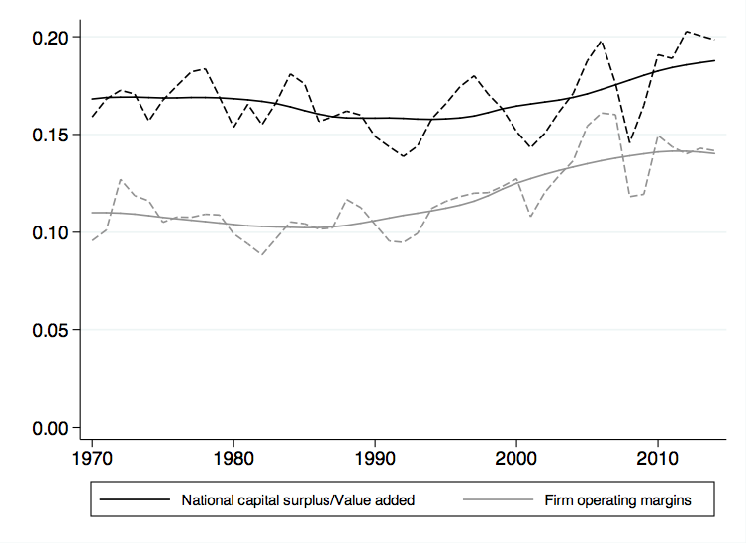
Related: rising margins

Slide 6
“Reinvigorate” narrative
Lax antitrust enforcement
Too many mergers & acquisitions
Rising industry concentration
  Less competition
  Higher prices (markups)
  Less innovation
  Wage inequality

Slide 7
“Reinvigorate” narrative
Lax antitrust enforcement
Too many mergers & acquisitions
Rising industry concentration
  Less competition
  Higher prices (markups)
  Less innovation
  Wage inequality

Slide 8
Alternative narrative
Critical investments in proprietary software
Large firm advantage
Rising industry concentration
  Unequal competition
  Slower diffusion, “barriers to technology”
  Slower average productivity growth
  Wage inequality

Slide 10
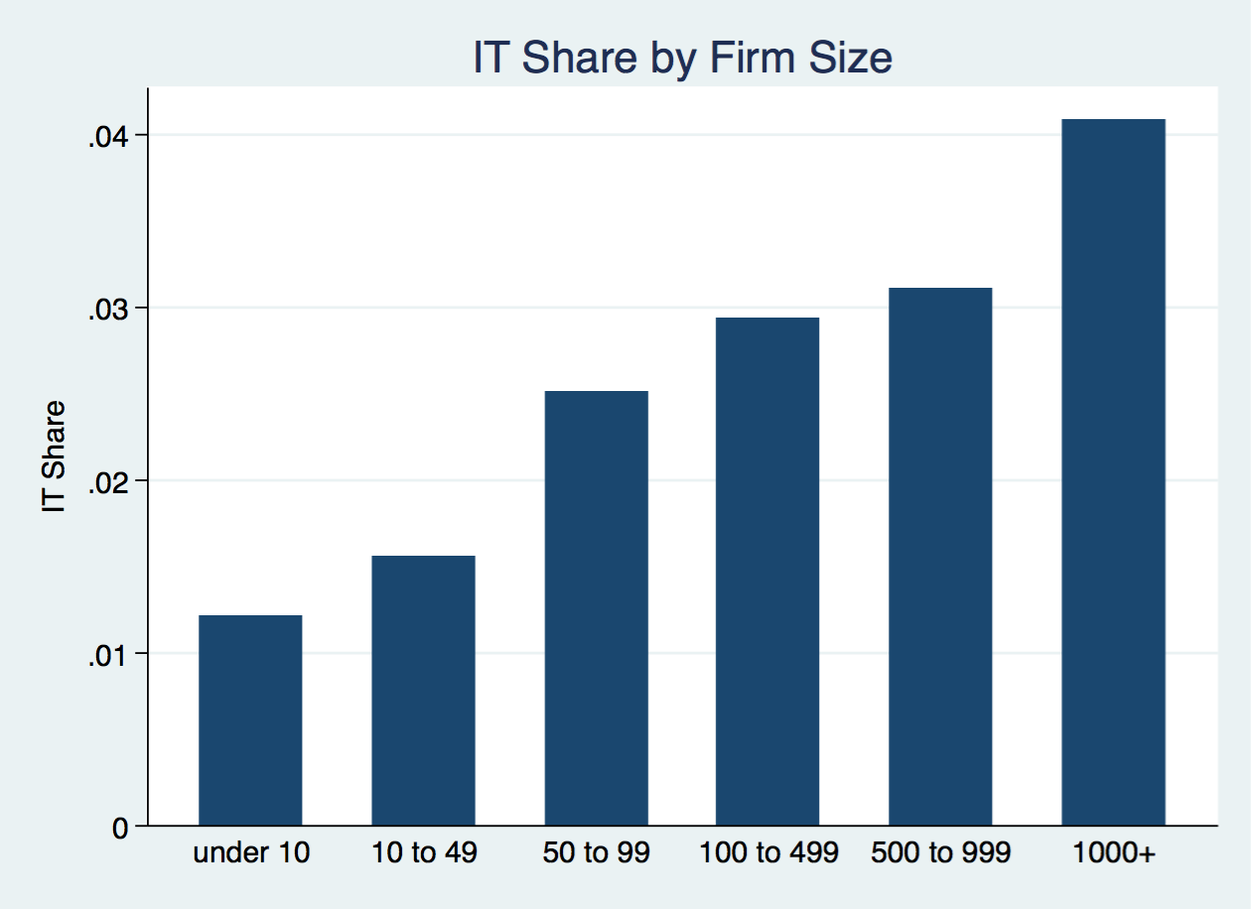
SW developers / total employees

Slide 11
Own-IT benefits larger firms more
Tambe & Hitt (2012):

Slide 12
Proprietary
Systems for own use; NOT GPT
    Self-developed or contracted
    Complementary skilled workers, managers
    Organizational investments
Examples: bank IT, Walmart, Boeing
    Large productivity gains ➔ growing market share
Slow to “diffuse”:
    Not licensed or sold
    Hard to imitate

Slide 13
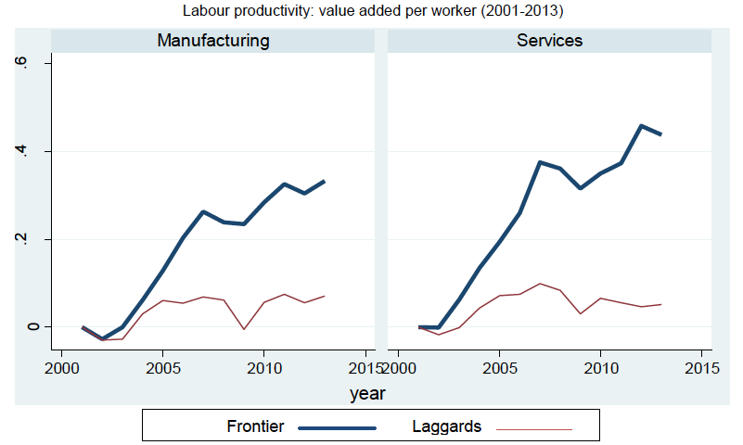
Growing productivity gap (OECD)

Slide 14
Literature
Past concern about industry concentration
  Efficiency or diminished competition?
    Demsetz (1973), Peltzman (1977), Scherer (1979)
Growing dispersion of productivity within industry
  Andrews et al. (2016), Berlingieri et al. (2017), Furman & Orszag (2015)
IT ➔ productivity disparities
    Bartel, Ichniowski, and Shaw 2007; Bloom et al. 2012; Bloom et al. 2014; Bloom et al. 2017; Bresnahan, Brynjolfsson, and Hitt 2002; Brynjolfsson et al. 2008; Caroli and van Reenen 2001; and Crespi, Criscuolo, and Haskel 2017, Bessen (2015)
    Brynjolfsson et al. 2008 ➔ rising concentration

Slide 15
Model

Slide 16
Hypotheses
Industry IT systems ➔
  Higher average productivity
  Higher relative productivity for top firms

Slide 17
Implications
IT ➔ Rising industry concentration
IT ➔ larger size
  On average, especially large firms
IT ➔ greater revenue / worker
  On average, especially large firms
  Higher operating margins, especially large firms

Slide 18
data

Slide 19
Data - Concentration
Economic Census 1977 (mfg.), 1997 - 2012
  Market share top 4, 8 20, and 50 firms
  Limitations:
    Not all markets are national
    Foreign competition

Slide 20
Data - Concentration
Economic Census 1977 (mfg.), 1997 - 2012
  Market share top 4, 8 20, and 50 firms
  Limitations:
    Not all markets are national
    Foreign competition
Other studies: concentration among publicly listed firms
  No. of listed firms changes
  Sales are worldwide sales
  Only weakly correlated with Economic Census

Slide 21
Data - Other
IT systems:
  Share of IT developers in industry workforce
    Computer scientists, systems analysts, SW developers
    Census, ACS
    Exclude IT producing industries
      E.g., NAICS 5112, software publishers
Operating margins:
  Compustat

Slide 22
findings

Slide 24
Endogeneity
More IT
Greater productivity
Firm growth

Slide 25
Endogeneity
More IT
Firm growth
Greater productivity
OR?
More admin.
Firm growth
More IT

Slide 26
Instrumental variable
Correlated with IT systems
Does not affect industry concentration except through IT

Slide 27
Instrument
Correlated with IT systems
Does not affect industry concentration except through IT
Was occupation sedentary in 1977?
  Seated occupations are easier to computerize
  1977 DOT using occupations/industry in 1980 Census

Slide 28
Instrument
Correlated with IT systems ✓
Does not affect industry concentration except through IT
  Sedentary ➔ more educated ➔ Higher industry concentration ?
    Professional occupations?
    Education?
    Wages?

Slide 29
Instrument
Correlated with IT systems ✓
Does not affect industry concentration except through IT
  Sedentary ➔ more educated ➔ Higher industry concentration ?
    Professional occupations?
    Education?
    Wages?
  In 1977, did sedentariness
    Affect concentration ?
    Affect markups ?

Slide 30
Instrument
Correlated with IT systems ✓
Does not affect industry concentration except through IT
  Industry concentration affected by
    Professional occupations?
    Education?
    Wages?
  In 1977, did sedentariness
    Affect concentration ?
    Affect markups ?
  But DID in 2000s

Slide 31
Instrument
Sedentariness
…walks, talks, and smells like an exogenous instrument

Slide 34
Long differences

Slide 35
Possible confounders

Slide 36
Possible confounders
Acquisitions / Firm
(publicly listed) for industry

Slide 37

Markups & IT
Markup: short term competition $= \frac{price − marginal cost}{price}$
  Lerner index assumes uniform marginal cost
    Marginal cost estimates assume uniform output shares
  Fixed costs can reduce marginal cost
    Capital investments
    Proprietary IT

Slide 38
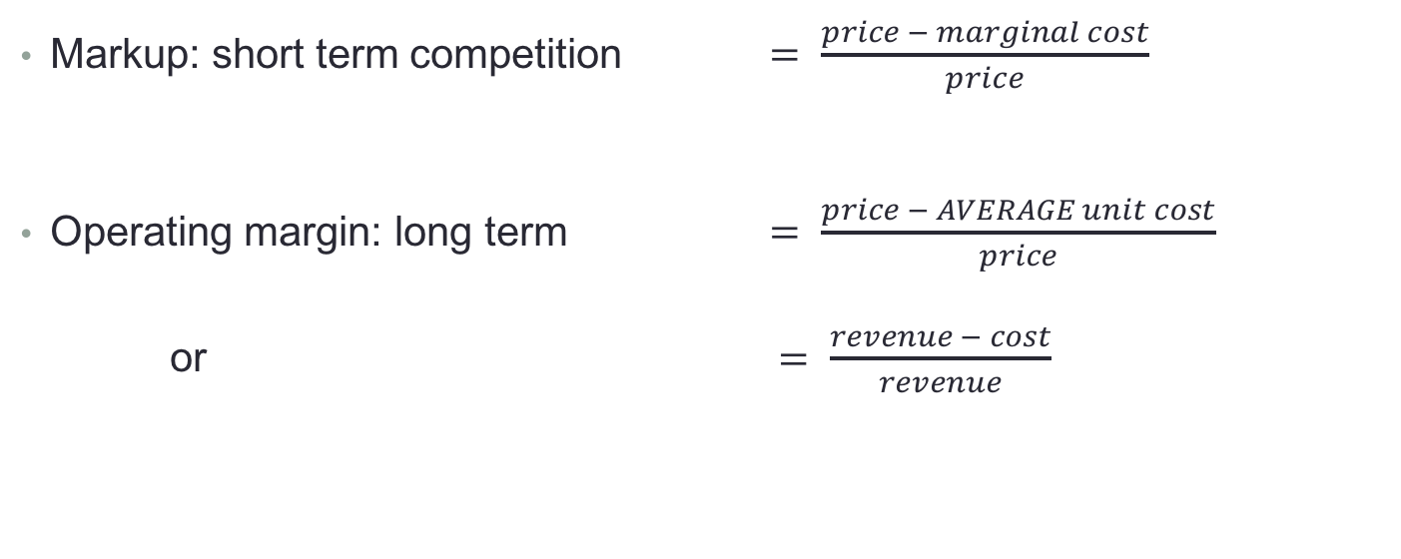
Markups & IT
Markup: short term competition $= \frac{price − marginal cost}{price}$
Operating margin: long term $= \frac{price − AVERAGE unit cost}{price}$
or $= \frac{revenue − cost}{revenue}$

Slide 39
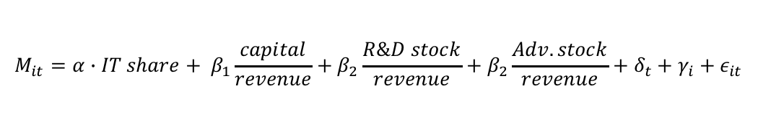
Operating margins
Estimate contribution of fixed investments
Investments
  Proprietary IT
  Tangibles & other intangibles (perpetual inventory, Compustats data)
    Physical capital
    R&D
    Advertising and marketing
$$M_{it}={α∙IT share+ β}_{1}\frac{capital}{revenue}+β_{2}\frac{R\&D stock}{revenue}+β_{2}\frac{Adv. stock}{revenue}+{δ_{t}+γ}_{i}+ε_{it}$$

Slide 40
Change in operating margin, 2000 – 2014

Slide 41
Change in operating margin, 2000 – 2014

Slide 42
Advantage: Top 4

Slide 43
Summarize
IT systems
  Account for much of rise in concentration
  Account for much of rise in margins
    Especially for large firms
  Linked to productivity divergence
  Advantage: top 4
Competition?
  Little effect seen from M&A
  No trend in margins after intangibles
    Rents from intangibles, not market power

Slide 44
conclusion

Slide 45
Conclusion
IT does NOT “level playing field”
  Growing disparity
But NOT “winner take all” either
  “winner take a bit more”

Slide 46
Conclusions
Re-invigorate antitrust?
  Not for this reason
Nevertheless:
  Slower productivity growth / diffusion
  Wage inequality
Why is technology not widely shared?
  IP?
  Employee mobility?
  Skills?

