Slide 1
Patent Examiner Specialization
Cesare Righi (BU) and Tim Simcoe (BU & NBER)

Slide 2
Question & Motivation
RQ: Do examiners specialize within art-units?
By technology, importance, scope…
Does specialization vary by technology?
Is specialization linked to examination outcomes?
Several motivations
Validity of widely used “judges” research design
Evidence on burden of knowledge (or USPC design)
Understanding examination process

Slide 3
Methods
Testing for random matching
Chi-square test has “empty cells” problem
# Class-subclass combinations >> # Examiners
Both are long vectors
Methods from agglomeration lit: D-index & MTAD
Essentially, chi-square (exact) & multinomial (simulated)
Different from IV “falsification tests”
Falsification: Rejecting grant-rate correlated with X
Agglomeration: Rejecting X randomly distributed over examiners within art-unit-year?

Slide 4
Results
Main findings
Strong evidence of technological specialization
More pronounced in chemistry than computers
Less sorting on Importance (Family Size) and Scope (Words in 1st Claim)
Specialization associated with more stringent examination (within and between examiners)
New results and puzzles
Half of class-subclass pairs change during prosecution
Some evidence of over-dispersion in biotechnology

Slide 5
Method 1: D-index
Kullback-Leibler (1951) relative entropy
Let i index categories containing N_{i} applications
Let r=1...R index examiners assigned n_{ir} apps
Random reference dist’n: p_{0r} = Σ_{i}n_{ir} / Σ_{i}N_{i}
Calculate observed dist’n: p_{ir} = n_{ir} / N_{i}
D(p_{i}|p₀) = Σ_{r}p_{ir} log(p_{ir}/p_{0r}) = -log(λ) / N_{i}
where λ is the log likelihood, so 2N_{i}D(p_{i}|p₀) has a chi-squared dist’n with R-1 degrees of freedom

Slide 6
Method 2: MTAD
Multinomial Test of Agglomeration & Dispersion (Rysman and Greenstein 2005)
Let c index categories and p_{c} = N_{c} / Σ_{c}N_{c}
Let r index examiners assigned x_{cr} apps in category c and n_{r} total applications
Likelihood for examiner r:
Sample average LogL:
Can simulate distribution of l(X,n,p) under random assignment to get mean and SEs

Slide 7
Data
Primary Sample: Regular utility patent apps filed between 2001 and 2012
Missing data: Abandoned before publication (18 months) or US-only that request non-publication
Excludes serialized continuations (CIP, CON, DIV)
2.9M applications and 12,389 examiners across 590 art-units
Patent Characteristics
Technology: Primary USPC sub-class
Applicant: Cleaned assignee
Importance: DOCDB Family > 95th percentile (within AU-FY)
Scope: Words in 1st claim < 5th percentile (within AU-FY)
Caveat: Examiners can change classes and subclasses!
Want to use “original” classification prior to assignment
Random sample => 51% change class or subclass during prosecution
SPE says to use classification on published application (c.f. Jeff Kuhn)

Slide 8
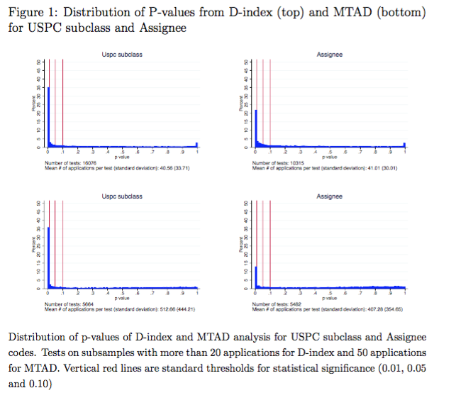
Graphical Results
D-index
MTAD

Slide 9
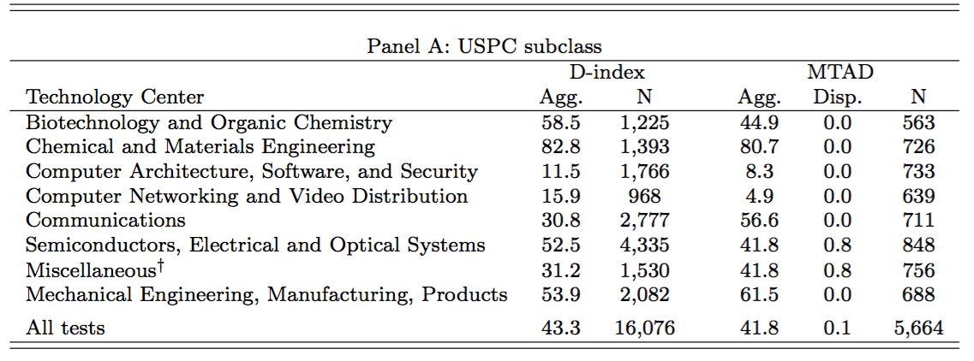
Subclass Specialization by Tech Center

Slide 10
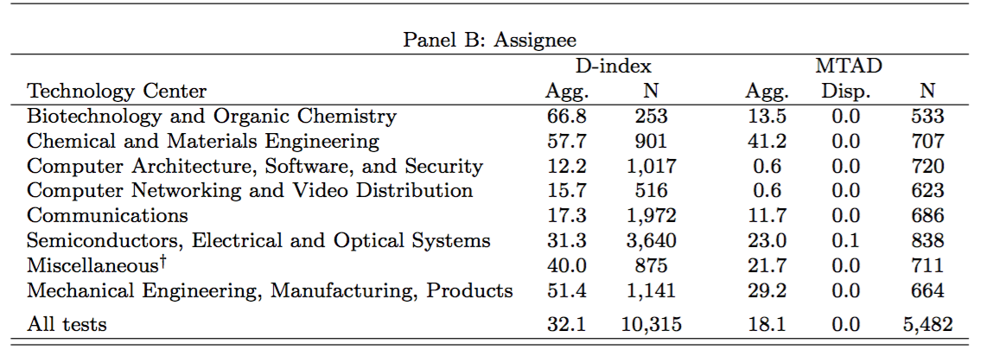
Assignee by Tech Center

Slide 11
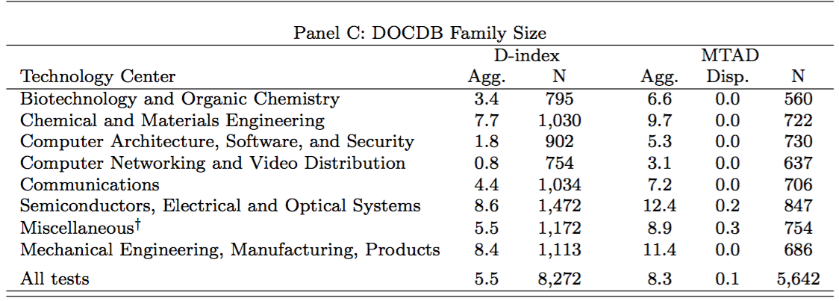
Family Size by Tech Center

Slide 12
First Claim Length by Tech Center

Slide 13
Implications for “Judges” IV
Examiner leniency could measure differences in technology
Examiner FEs measure both idiosyncratic “stringency” and variation across areas of specialization
IV plausibility is question-specific
Random allocation => Z uncorrelated with all ε
But in practice, need to assume unobserved diffs in technology are not an omitted variable
Controlling for technology-class is very important

Slide 14
Is our finding entirely technological specialization?
Re-run analysis within USPC sub-class
Sample size constraints (sub-classes are sparse)
Within vs. pooling over application years
Pooling => bias against specialization
Working on tests using secondary classes
Unclear whether they are predetermined

Slide 15
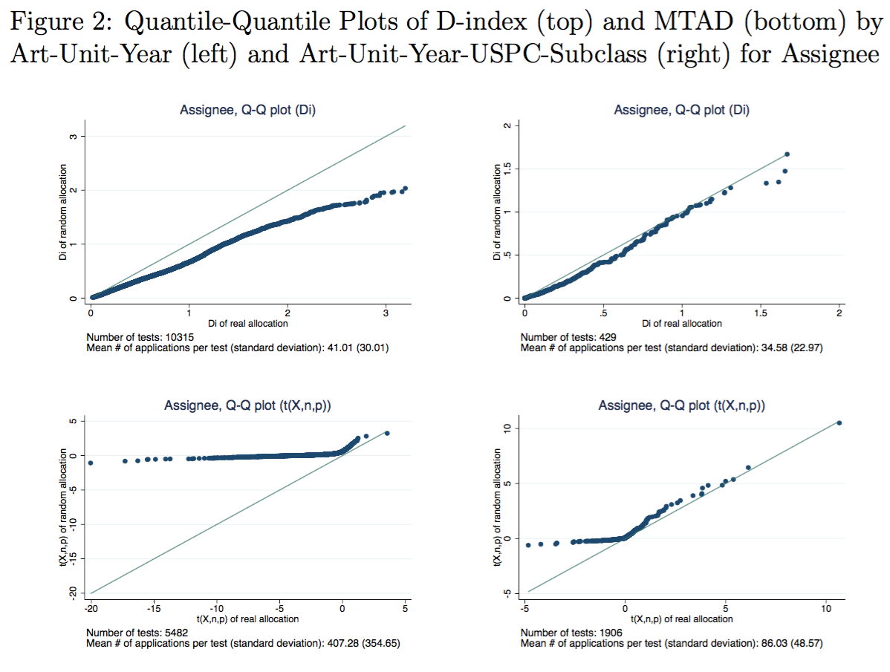
Graphical Comparisons
Art-Unit
USPC Subclass
D-index
MTAD

Slide 16
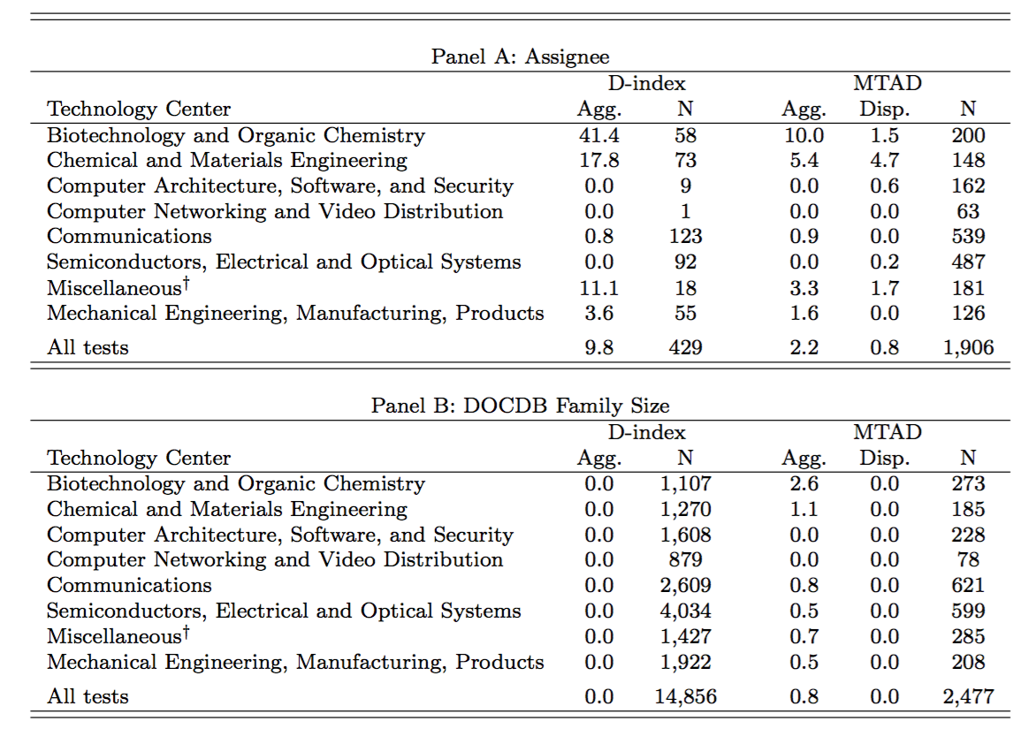
Within Subclass-Year

Slide 17
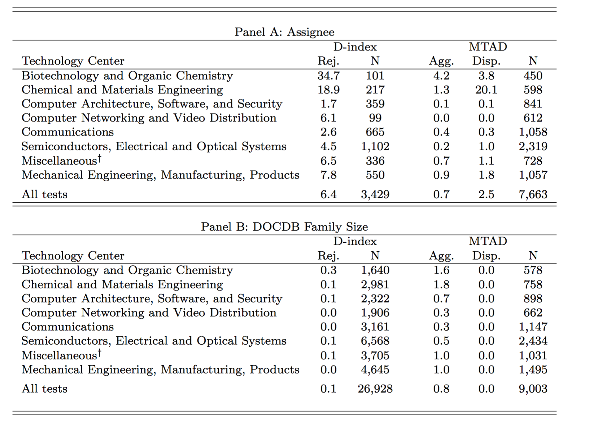
Within Subclass

Slide 18
Specialization and Leniency
Do specialized examiners behave differently?
Let Share_{ijt} = Percent of other apps assigned to examiner j within art-unit-filing-year t, having same subclass as focal application i
N.B.: Varies within and between examiners
Range = [0,1]; μ= 0.06; σ= 0.13
OLS Regression: Y_{ijt} = α_{(j)} + δ_{t} + β Share_{ijt} + ε_{ijt}
Y = 1[Grant], Words added to 1st claim, days to issue
Variables (except for grant) are standardized

Slide 19
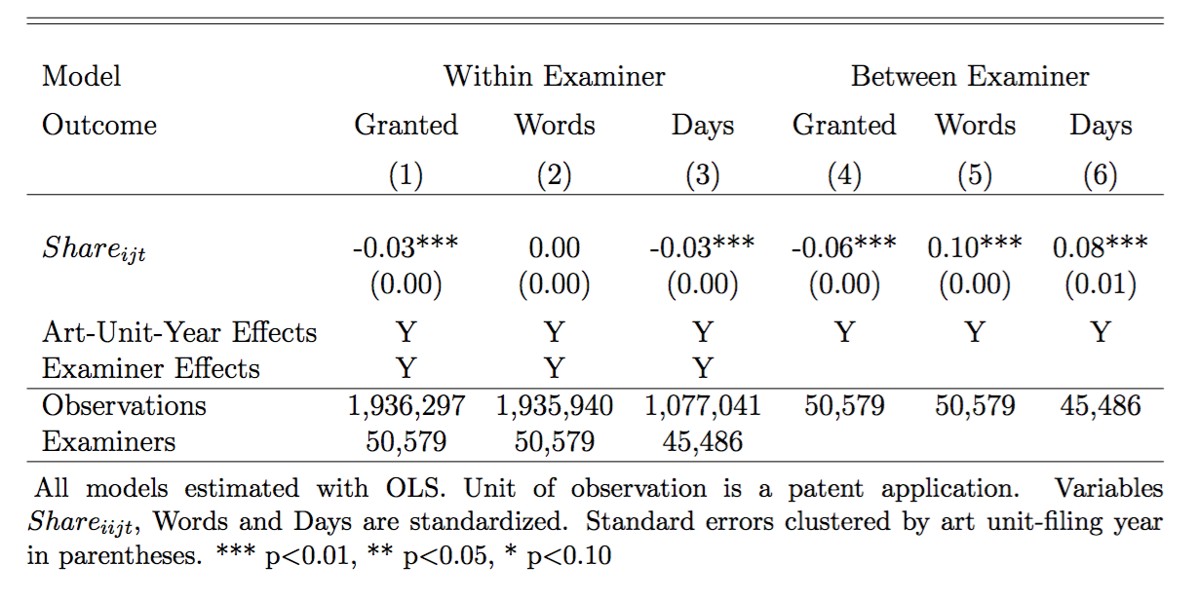
Specialization and Leniency: Results

Slide 20
Conclusions & Implications
Examiners specialize even within art units
Can’t justify judges IV based on random assignment
Strong evidence of sorting on subclass & assignee, weaker for value & scope
More specialization in Chemistry & Biotech, less in Computers
Could reflect differences in “knowledge burden” or USPC system
Technological specialization may drive agglomeration on other dimensions
Within USPC subclass sorting much weaker, but tests are low-powered
Specialized examiners are more stringent in patent prosecution (lower grant-rate and more words added)
Causal story: Easier to identify prior art
Selection story: Crowded classes routed to skeptical examiners

