Slide 1
Review of Different Technologies and Devices
Quality Of Medical Products and Public Health
Boston University
July 13th 2017

Slide 2
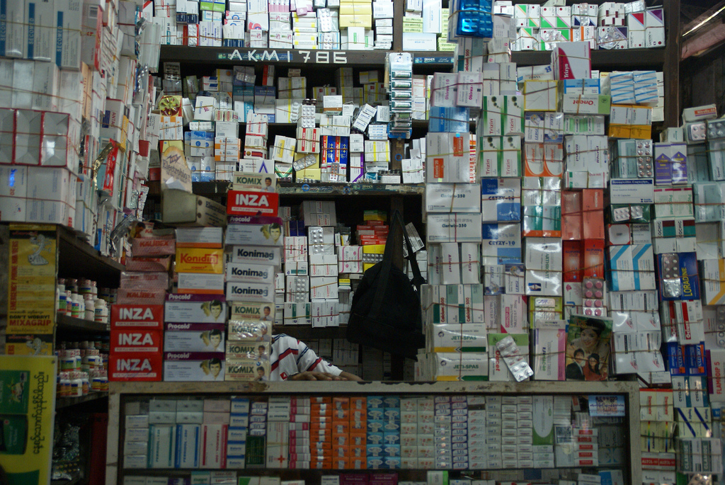
Pharmaceutical Investigations and Technology
Need Rapid Screening technologies to:
Isolate falsified or substandard medicines to remove them immediately from the market
Minimize potential backlog at the laboratory for full investigative analysis
Rapidly investigate quality to minimize both the investigators and distributors time and resources

Slide 3
Range of Different Technologies
Mass Spectrometry
Spectroscopic Techniques
High Performance
Liquid Chromatography
Mid-Infrared Instruments
Variety of Samples that can be
Detected & Capabilities
Raman Instruments
Near Infrared Instruments
UV-Vis Instruments
GPHF-MiniLab
Paper Analytical Devices
Chemical Assays-RDTs
Resource Requirements and Complexity

Slide 4
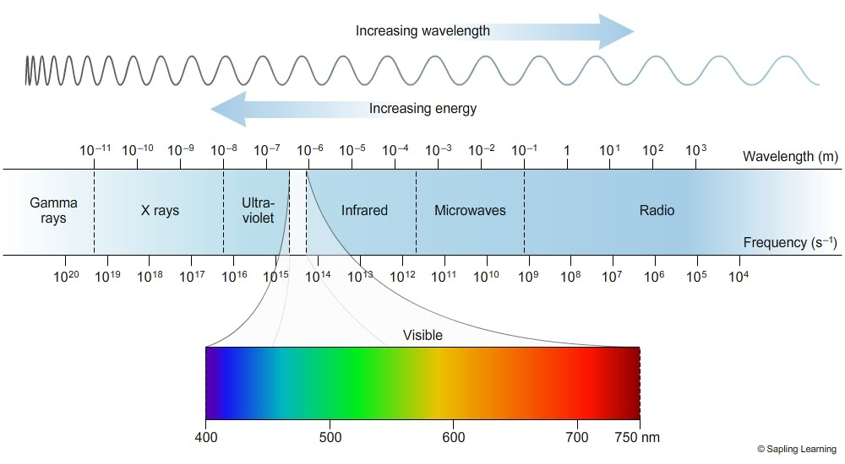
Spectroscopy
”the investigation and measurement of spectra produced when matter interacts with or emits electromagnetic radiation”.
Sapling Learning-”Electromagnetic Spectrum”

Slide 5
Spectroscopy in Pharmaceutical Analysis
(m)
Analyze the light that is absorbed or emitted by the sample
Can be a non-destructive techniques
Can scan through clear packaging
(s⁻¹)
Sapling Learning-”Electromagnetic Spectrum”

Slide 6
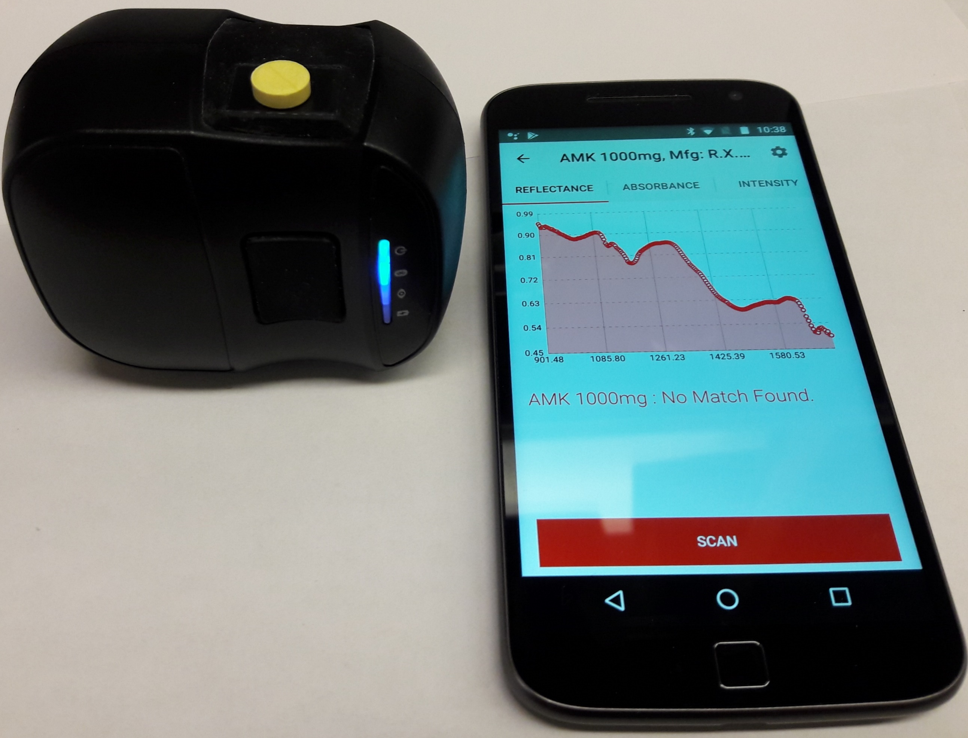
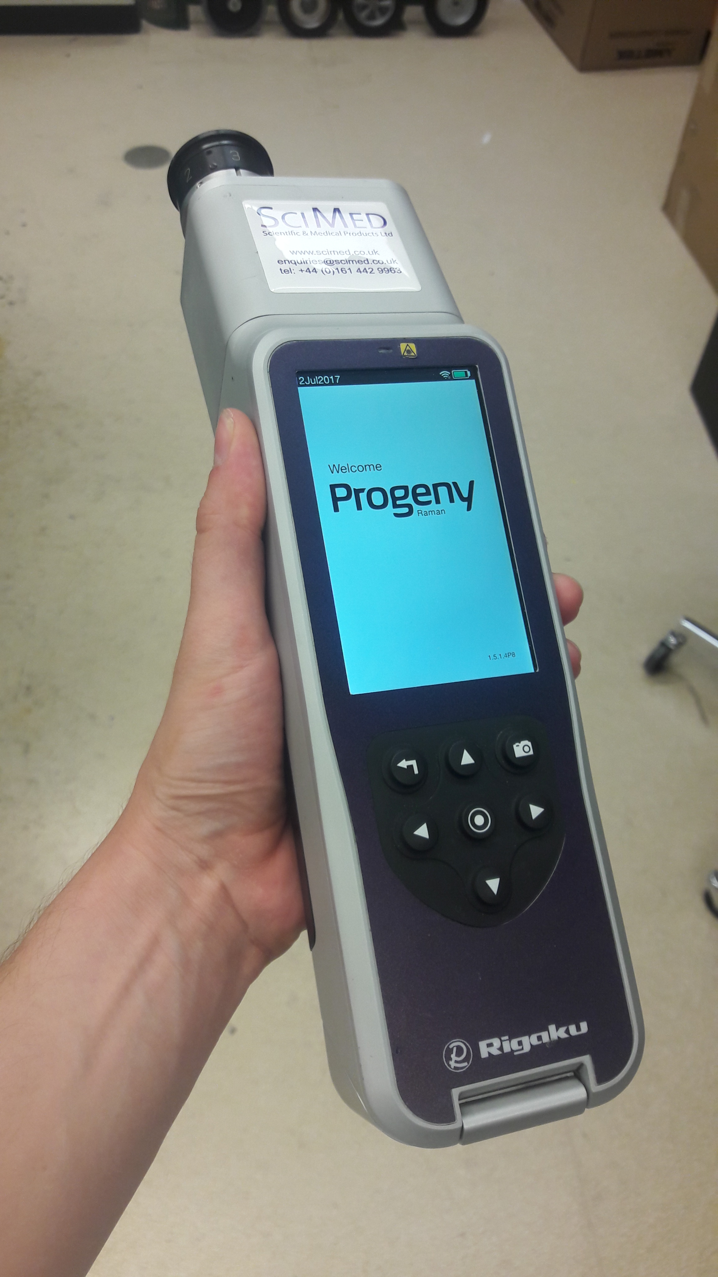
Near Infrared
(Absorption Spectroscopy)
Raman
(Emission Spectroscopy)
Rigaku Progeny
Vs.
Texas Instruments DLP NIRscan
Operated by PillscanNIR App

Slide 7
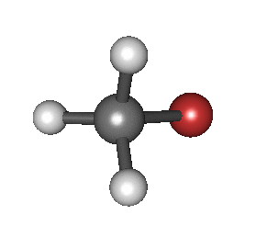
Near Infrared Intro
Infrared Radiation Causes Molecule to Vibrate
Particular wavelengths excite specific bonds in the molecule
Bond excitation absorbs the IR radiation
Absorbance Spectroscopy
(m)
Near Infrared Region
750nm to 2500nm
(s⁻¹)
Pasquini, Celio. J. Braz. Chem. Soc. 14.2 (2003): 198-219
Sapling Learning-”Electromagnetic Spectrum”
By Gaiabulbanix - Own work, CC BY-SA 4.0, https://commons.wikimedia.org/w/index.php?curid=44787581

Slide 8
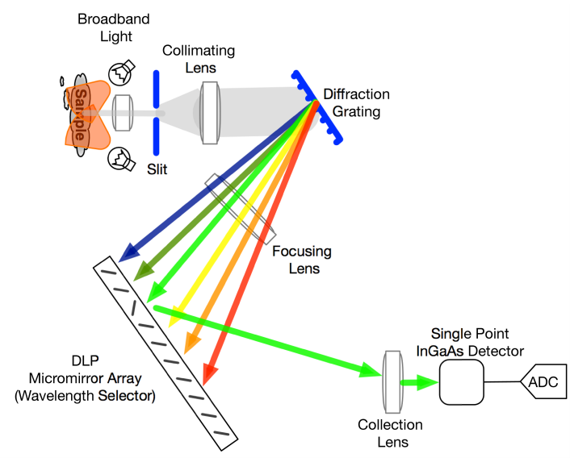
Near Infrared Operation
Shine the tungsten lamp’s light on sample
Capture light reflected from sample
Split the light into its basic wavelengths
Select a single wavelength of light
Measure the intensity of that single wavelength of light
Texas Instruments-DLP NIRScan Nano EVM (Rev. F)

Slide 9
How to use the TI NIRScan
Turn on all equipment and open the PillscanNIR App
Select the method that correlates to the sample your are analzing
Place the tablet on the NIRScan Sampling Window
Hit “Scan”
The app software's algorithm will determine if the sample spectra matched the libraries spectra.

Slide 10
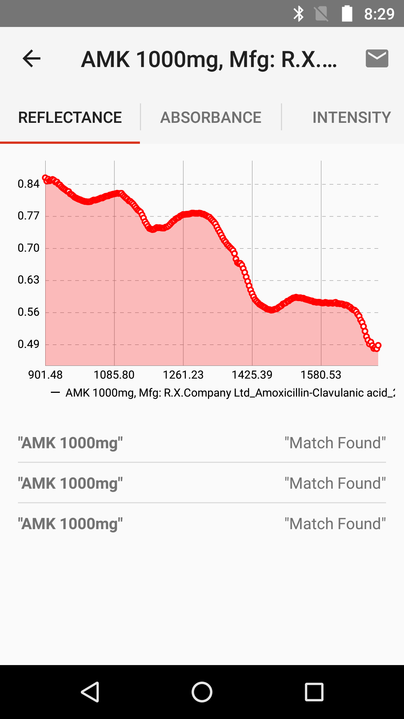
Near Infrared Data
No distinct peaks or areas that correlate with a specific bond
Need multivariate calibration the extract data to find library matches
Hard for user to compare spectra from one sample to another

Slide 11
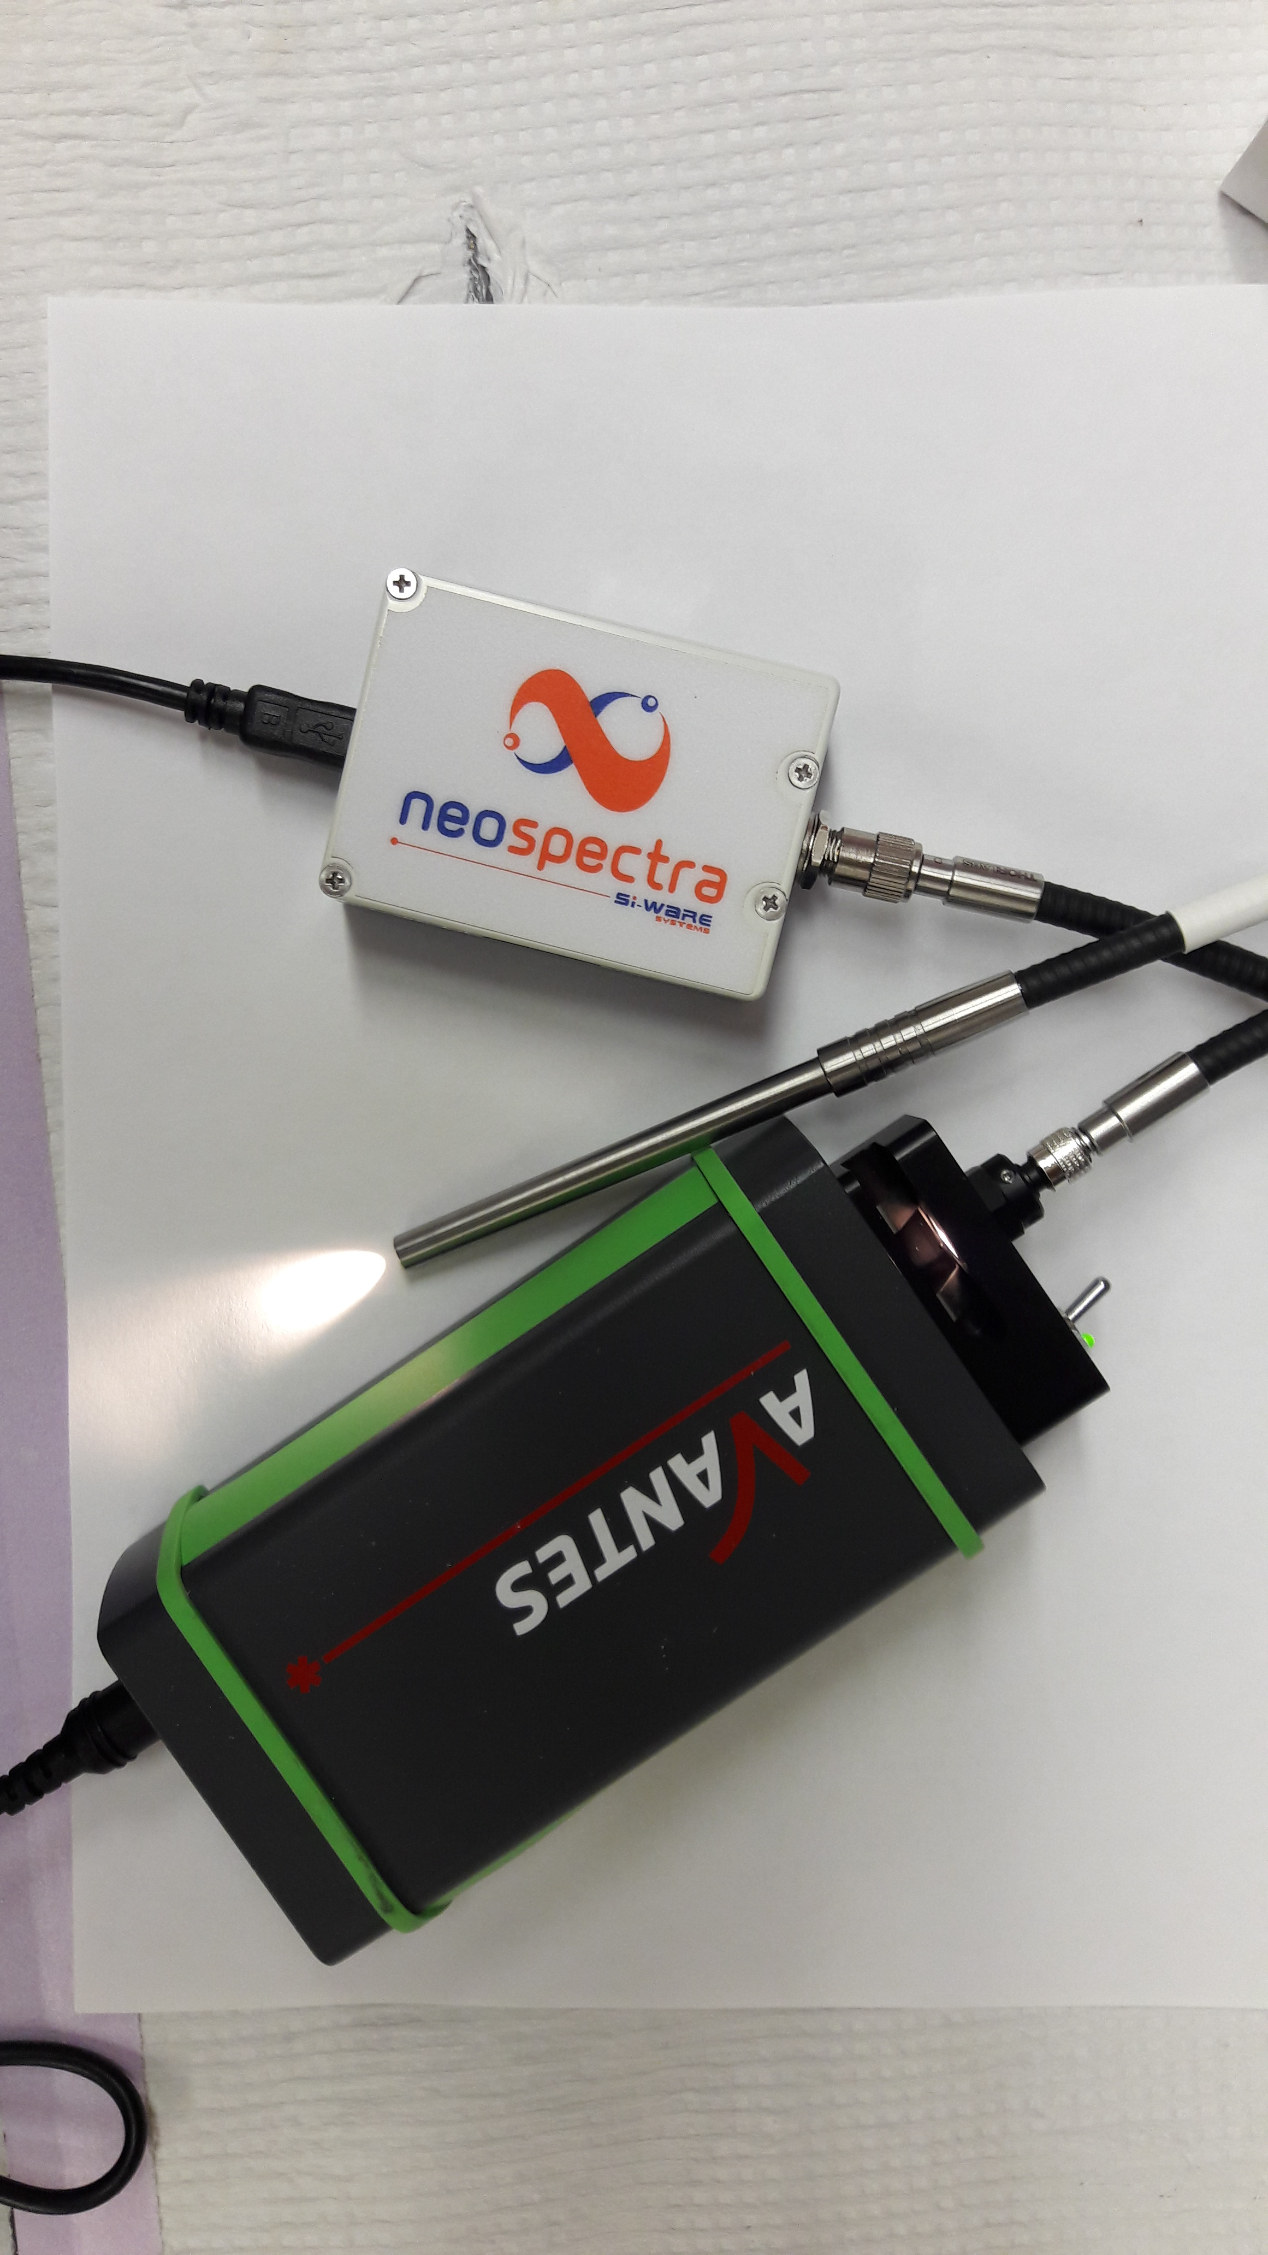
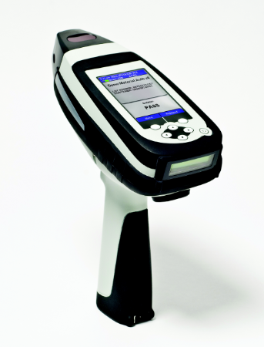
Other Near Infrared Instruments
Instrument | Texas Instrument NIRScan | Si-Ware Neospectra 2.5 | Thermo MicroPhazirRX
Spectral Range | 900nm-1700nm | 1350nm-2500nm | 1600nm-2400nm
Weight | 100 g | Depends on Build | 1.25 kg
Battery Life | Not reported, but can last about a day without charge | External Power | >5 hours
Dimesnions | 58mm*62mm*36mm | Depends on Build | 97mm*232mm*244mm
Notes:
Neospectra
Spectral Range 1350 to 2500 nm
Resolution 16nm
SnR 2500:1 @0.5 scan time
Temperature Range -5 to 40 C

Slide 12
Raman-Intro
Emission Spectroscopy
Step 1:
Irradiate the sample with a single wavelength of light (laser)
(m)
Ex. 1064nm Laser
(s⁻¹)
Sapling Learning-”Electromagnetic Spectrum”

Slide 13
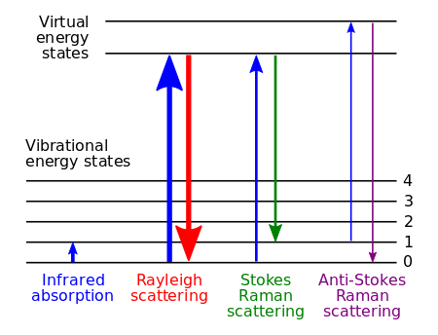
Raman-Intro
Step 2:
Analyze the light that is emitted by the sample
(m)
Region Primarily Detected
2500nm to 1mm
Compared to the Wavelength of the laser:
Rayleigh Scattering
= Same Wavelength Emitted
Stokes Scattering
= Longer Wavelength Emitted
Anti-Stokes Scattering
= Shorter Wavelength Emitted
(s⁻¹)
Primarily Detected and Used in Raman Instruments
Wikipedia-”Raman Spectroscopy”
Sapling Learning-”Electromagnetic Spectrum”

Slide 14
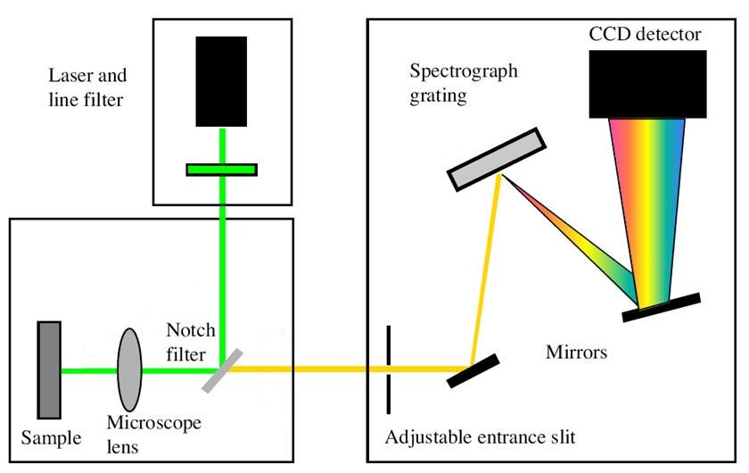
Raman-Operation
Fire the laser at the sample
Capture light emitted from sample and filter out the laser light
Split the emitted light into its basic wavelengths
Measure the intensity of the emitted light at each wavelength.
Canada Institute of Gemology – GL Gem Raman PL532

Slide 15
How to use the Rigaku Progeny
Turn on the Rigaku Progeny
a.) Select the method that correlates to the sample your are analyzing
---OR---
2. b.) Go into a scan without selecting a method
Place the tablet in front of the sample interface
Hit “Scan”
5. a.)The software's algorithm will determine if the sample spectra matched the library spectra selected
---OR---
5. b.) The software will search every library spectra in the device, and find the best match

Slide 16
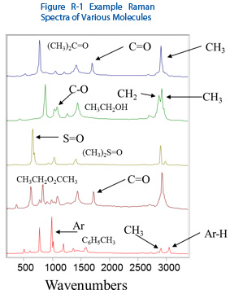
Raman-Data
High resolution and sensitivity
Peaks can be assigned to different vibrational modes
Different types of bonding and vibrations
Easier for a user to distinguish chemical differences in the sample.
BWTek-”Introduction to Raman Spectroscopy”

Slide 17
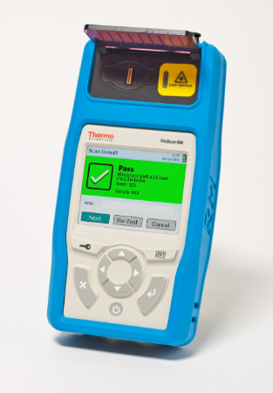
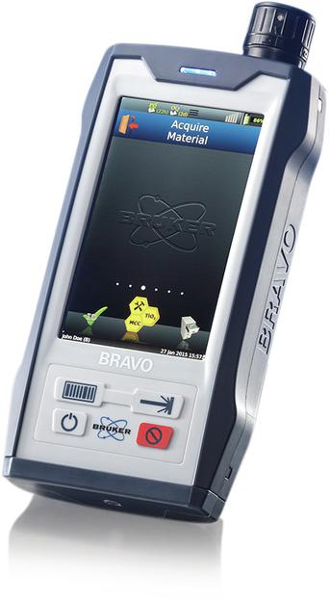
Other Raman Instruments
Instrument | Thermo TruScanRM | Rigaku Progeny | Bruker Bravo
Excitation Wavelength | 785 nm | 1064 nm | 700 nm & 1000 nm
Spectral Range | 250cm⁻¹ to 2875cm⁻¹ | 200cm⁻¹ to 2500cm⁻¹ | 300cm⁻¹ to 3200cm⁻¹
Laser Output | 250 mW | 30-490 mW | 100 mW
Battery Life | >4 hours | >5 hours | >4 hours
Dimensions | 43mm*107mm*208mm | 74mm*81mm*299mm | 62mm*270mm*156mm
ThermoScientific - TruScan RM Handheld Raman Analyzer
Analyticworld.com – Bravo – The new handheld Raman spectrometer from Bruker

Slide 18
What can both these NIR and Raman Devices do?
Scan through clear packaging
Compare spectra to a reference library for identification
Field deployable and portable
What are the shortfalls for both devises ?
Requires electricity and the batteries only last for up to 6 hours
Tablet coatings can interfere with API detection
Needs updated spectral libraries of authentic medicines

Slide 19
Near Infrared and Raman-Pros and Cons
Cons
No unknown sample library searching
Not the most sensitive spectroscopic technique
Poor resolution
Pros
Very fast sampling
Simpler mechanism of operation
Near Infrared
Pros
Higher Sensitivity
Higher Resolution
Can conduct unknown sample library searches to find the best match
Cons
Can suffer from signal interference from samples that fluoresce
Laser a potential hazard
Raman
Texas Instruments-DLP NIRScan Nano EVM (Rev. F)

Slide 20
Many Other Devices that
use the Electromagnetic Spectrum!!

Slide 21
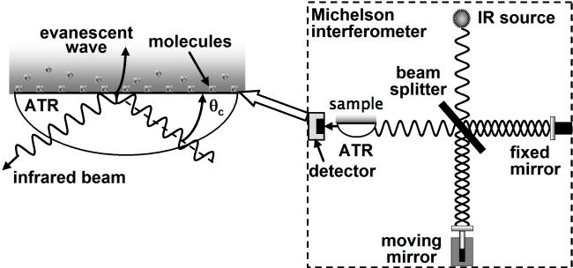
Other Spectro Techniques→ Fourier Transform Mid Infrared
Absorption Spectroscopy
Scans from 2500nm to 20000nm
Can characterize functional groups
High Resolution and Sensitivity
Cannot scan through packaging, even clear packaging
Ex. Agilent 4500 FTIR
Rossman, G.R. CalTech “GE 116-Analytical Techniques in Geochemistry”

Slide 22
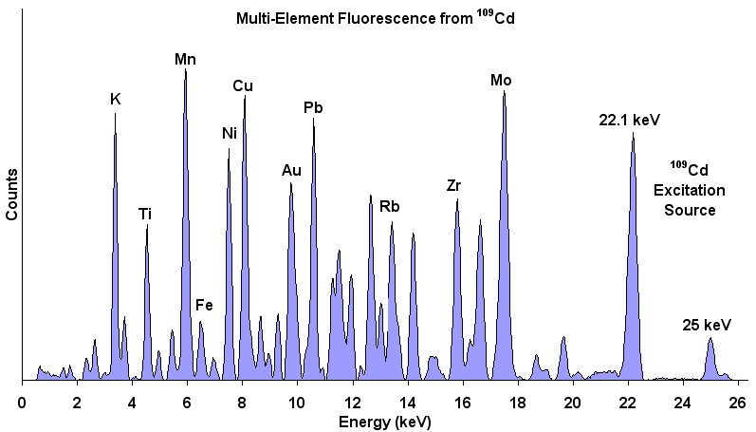
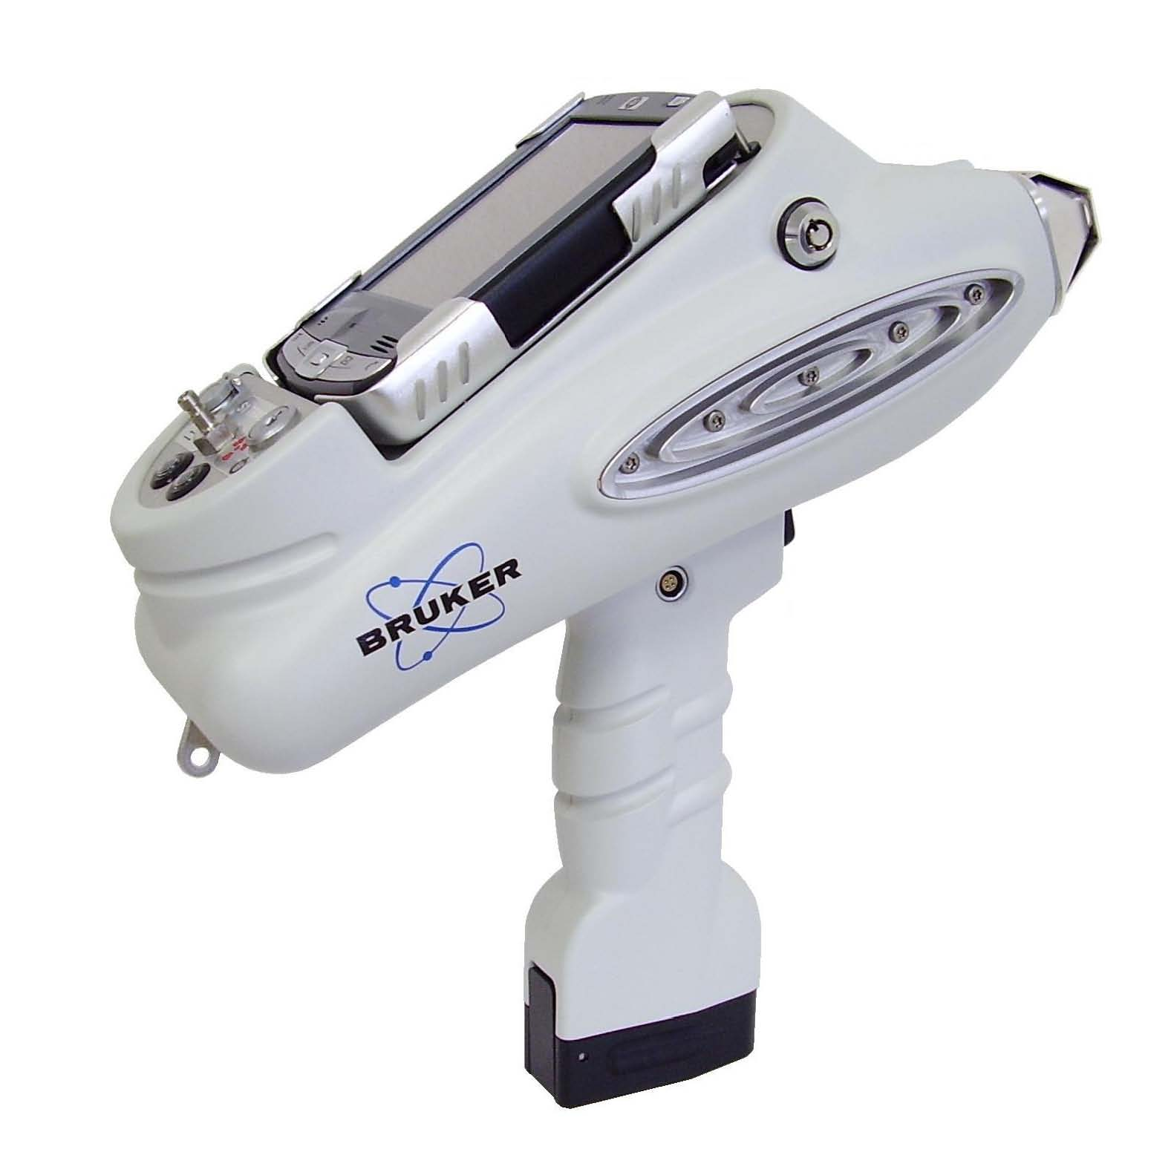
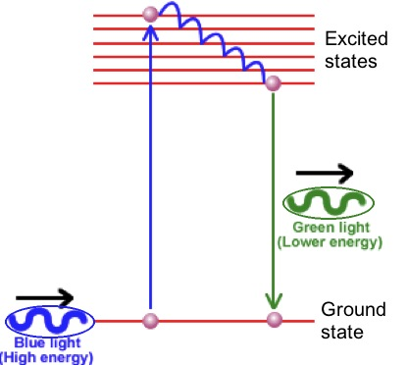
Other Spectroscopic Techniques→ X-Ray Fluorescence
Emission Spectroscopy
Gathers elemental data about the sample
Ex. Ca, Fe, Ti, Br, etc.
Ideal for APIs that have a distinct element
Difficult to distinguish between simple organic compounds

Slide 23
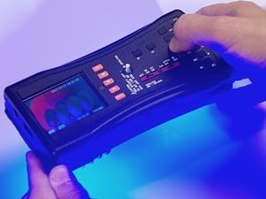
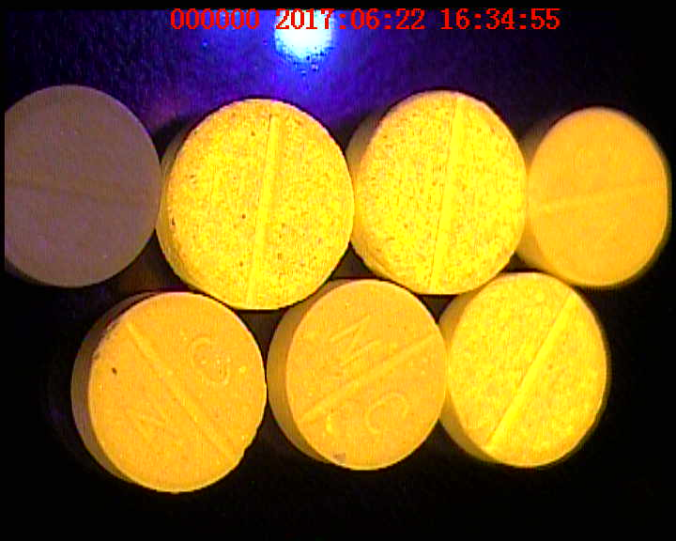
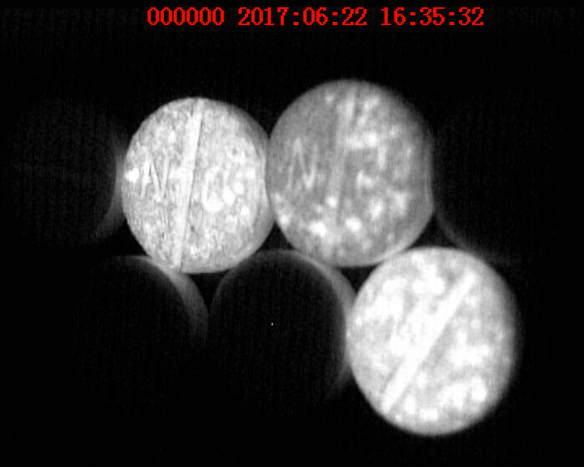
Other Spectroscopic Techniques→ CD3
Absorption and Emission
Image Analysis
Large variety of different samples to test
Pills, packaging, info sheet, etc.
Fastest method to look at large batches of samples at the same time
Screening technique only and not quantitative

Slide 24
Summary
Spectroscopic techniques offer a middle ground between capabilities and resource requirements
Spectroscopy is one of the fastest analysis techniques
Most techniques are non-destructive
These spectroscopic instruments are becoming simpler to use.

Slide 25
Thank you!!
Dr. Facundo Fernandez’s Research Group
Dr. Marcos Areces
Infectious Disease Data Observatory
Dr. Celine Caillet
Dr. Serena Vickers
Dr. Paul Newton
Former Fernandez Group Members
Dr. Matthew Bernier
The Ohio State University
Ms. Laura Winalski
Vanderbilt University

