Slide 1
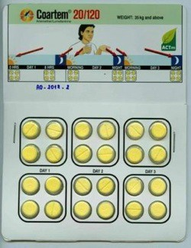
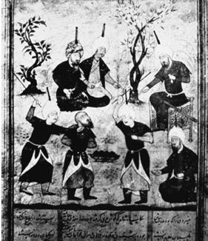






Medicine quality – definitions and public health impact: outcome & resistance
Paul Newton

Slide 2
History
Definitions
Legal aspects
Impact – Patient outcome
Impact – Economy and Society
Impact – Resistance
Impact - Trials

Slide 3

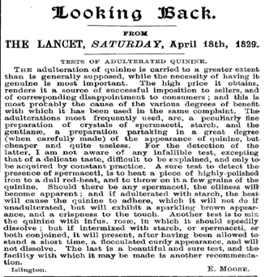
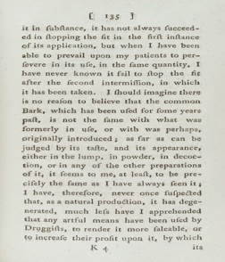

A forgotten history………

Slide 4
Indian Medical Gazette 1939

Slide 5


• Pathophysiology
• Diagnostics
Optimum therapy
& national policy
• Epidemiology
Rx
Patient use
• Drug discovery
• Clinical trials
• Meta-analyses
Prescribing Adherence Drug Quality

Slide 6
Definitions
Vary greatly between countries and people !
Highly confusing !
What do we – you – mean by substandard, fake, falsified, counterfeit, adulterated, spurious, wrongly labelled medicines ?

Slide 7
WHO 2008 - “A medical product is counterfeit when there is a false representation in relation to its identity and/or source. This applies to the product, its container or other packaging or labeling information. Counterfeiting can apply to both branded and generic products. Counterfeits may include products with correct ingredients/components, with wrong ingredients/components, without active ingredients, with incorrect amounts of active ingredients, or with fake packaging”
World Health Organization (2008) Executive Board 124th session provisional agenda item 4.11. Counterfeit medical products. EB124/14.

Slide 8
“……..Violations or disputes concerning patents must not be confused with counterfeiting of medical products. Medical products (whether generic or branded) that are not authorized for marketing in a given country but authorized elsewhere are not considered counterfeit. Substandard batches or quality defects or non-compliance with Good Manufacturing Practices/Good Distribution Practices in legitimate and medical products should not be confused with counterfeiting”
World Health Organization (2008) Executive Board 124th session provisional agenda item 4.11. Counterfeit medical products. EB124/14.

Slide 9
Seizures in EU 2009/2010 Border Regulations Measure 1383/2003

Slide 10
Counterfeit/falsified vs substandard- does it matter ?
Some have argued that the distinction does not matter – both are bad !
But murder and manslaughter are bad….. but have different origins, penalties.........
For MRAs to be able to decide how to intervene to improve the quality of the medicine supply need to know which is which

Slide 11
Degraded vs substandard
A medicine in genuine packaging but with lower (or higher) API content, degradation products or impaired dissolution/ disintegration…..
Did it leave the factory like this or has it changed during storage ?
Extraordinarily little information on what happens to medicines in hot humid tropics in real life

Slide 12
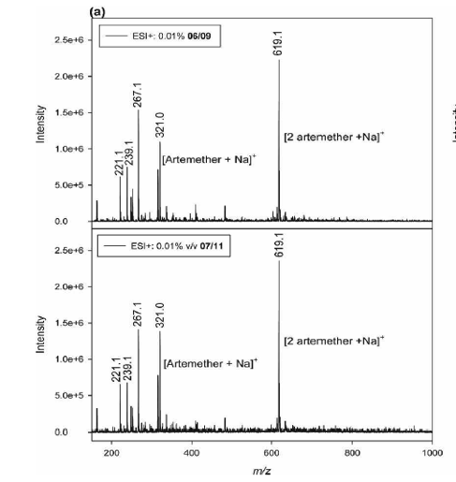
Important implications for manufacturers and the medicine distribution system
Can forensic mass spec be used to detect degradation products and distinguish substandard from degraded ?
e.g. intramuscular artemether

Slide 13
When is poor quality medicine production criminal ?
Counterfeiting/falsification is clearly criminal
But substandards ? Is the production of ‘very’ poor quality substandard medicines ‘criminal negligence’ or ‘corporate manslaughter’ ? How very is ‘very’?
“In order to establish criminal liability the facts must be such that, in the opinion of the jury, the negligence of the accused went beyond a mere matter of compensation between subjects and showed such disregard for the life and safety of others as to amount to a crime against the State and conduct deserving punishment."
If registered companies know they were making poor quality medicines then presumably this is falsification

Slide 14
All medicines that are not good quality
Intentional fraudulent production
Result from negligent factory error
Leave factory good quality but degrade due to heat etc
The relative sizes of circles are unknown

Slide 15
Legal
Illegal – Negligent Illegal – Wilful
Fails Standard
(bad treatment)
Illegitimate drugs
Regulatory Failure: “Substandard”
(various causes)
Public Health Crime: “Falsiﬁed”
Manufacturing Error
Degradation
Expiraton
MRA Approved
MRA
Unapproved
(no intentional wrong)
Illicit Diversion or Theft
(intentional wrong)
Complies With All Laws: Proprietary or Generic
Regulatory Failure: “Unregistered”
Legitimate drugs
Meets Standard
(good treatment)
Attaran et al. 2012

Slide 16
2011 – Member State Mechanism
Confusion between IP law and public health
Concern that TRIPS meaning of ‘counterfeit’ restricting access to generic medicines
All WHO Member States – new term
‘Substandard, Spurious, Falsely labelled, Falsified and counterfeit (SSFFC) Medical Products’

Slide 17
Member State Mechanism – Jan 2017

Slide 18
Queries
The three classes are stated as mutually exclusive ?
How should degraded medicines be classified ?

Slide 19

Fake medicine penalties
France =
Canada =
Norway = Netherlands =
€75,000 fine and 3 years jail
$5,000 and 3 years jail unspecified fine and 4 months jail
no punishment for a first offence, 6 months jail for the second

Slide 21
m. J. Trop. Med. Hyg., 92(Suppl 1), 2015, pp. 127–132 oi:10.4269/ajtmh.15-0154
opyright © 2015 by The American Society of Tropical Medicine and Hygiene
Stopping Murder by Medicine: Introducing the Model Law on Medicine Crime
Amir Attaran*
Faculties of Law and Medicine, Institute of Population Health, University of Ottawa, Ottawa, Ontario, Canada
Abstract. The iatrogenic pandemic of untreated illness related to falsified and substandard medicines is intolerable, but has a logical explanation; in many countries, inadequate laws make it barely illegal to manufacture or distribute poor-quality medicines. The law hardly punishes those who intentionally or recklessly deal in falsified or substandard medicine, when clearly it should criminalize these perpetrators in proportion to the grievous—even fatal—injury they inflict on public health. To solve this omission, this article presents a new Model Law on Medicine Crime, which coun- tries may freely use as a template for strengthening their national laws. The Model Law includes criminal prohibitions against manufacturing, trafficking, or selling poor-quality medicines; principles for appropriately punishing offenders; special provisions for Internet-based medicine crimes; tools for encouraging whistle-blowers to cooperate with law enforcement; incentives for developing governments to strengthen their drug regulatory capacity; and important excep- tions to prevent the law being abused, such as to prevent the prosecution of legitimate medical researchers or to pre- vent good-quality generic medicines being seized while in transit. The Model Law is discussed and explained and is offered free of charge under a Creative Commons license to any governments wanting to implement it.

Slide 22
Reports of poor quality antimalarials
Falsified
  Chloroquine
  Quinine
  Tetracycline/Doxycycline
  Sulphadoxine-pyrimethamine
  Sulphalene-pyrimethamine
  Mefloquine
  Halofantrine
  Primaquine
  Artesunate
  Intramuscular and oral artemether
  Dihydroartemisinin
  Dihydroartemisinin-piperaquine
  Artemether-lumefantrine
Substandard
Chloroquine
Quinine
Tetracycline/Doxycycline
Sulphadoxine-pyrimethamine
Primaquine
Artesunate
Intramuscular & oral artemether
Not poor quality ?
Atovaquone-proguanil and iv/im artesunate – few have looked….

Slide 23
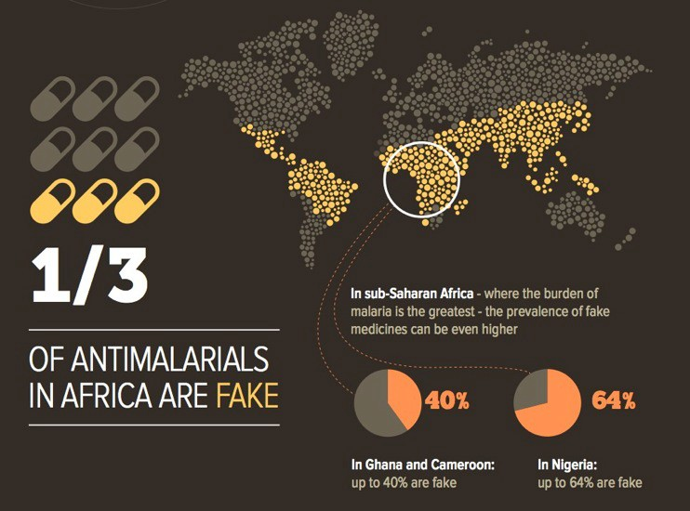
Based on back of envelope estimates – many caveats

Slide 24
Impact
• Sickness, death and disability
• Economic losses for patients and their communities
• Loss of faith in essential medicines & health systems
• Loss of faith in innovative and generic manufacturers
• Economic losses for pharmaceutical companies
• Drug resistance
• Increased disease transmission

Slide 25
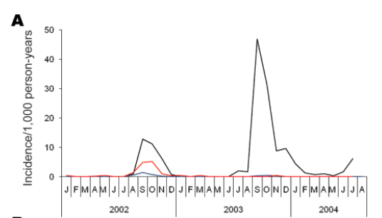
Errors in manufacture of ‘SP’ antimalarial – led to malaria epidemic in Pakistan
Leslie et al. 2009

Slide 26
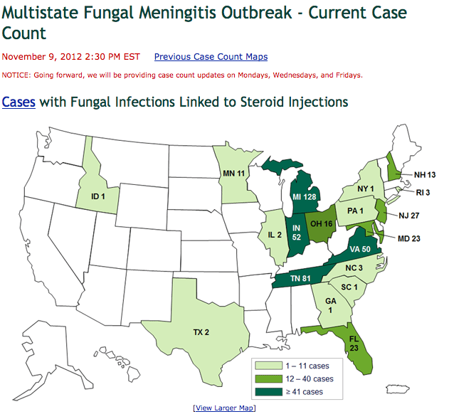

Slide 27
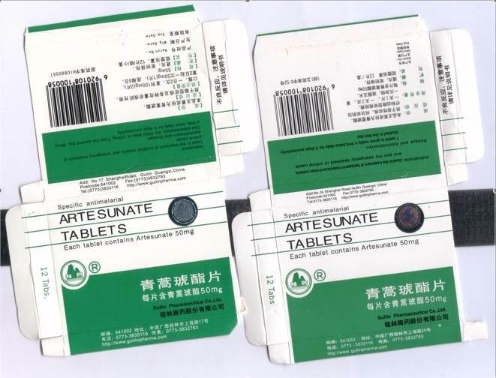

Slide 28
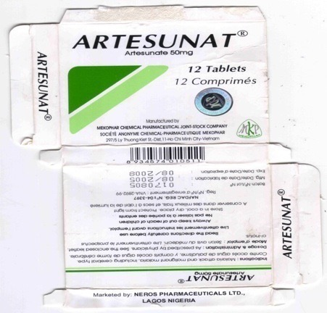
Fake ‘Mekophar‘ artesunate – Cameroon
2 different packaging & chemistry types
Wrong hologram
No artesunate
Chloroquine 58mg/tab
Bulrush pollen – production near swamp ?

Slide 29
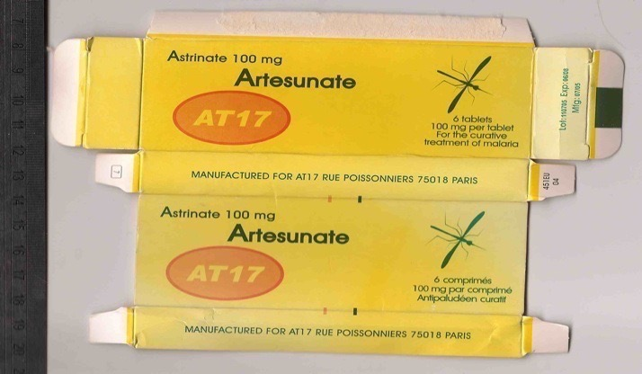
Fake ‘AT 17’ artesunate - DRC
Partial fake of ‘Arinate’ artesunate from Belgium
70-80% artesunate
Company does not exist

Slide 30

Fake ‘Mekophar‘ artesunate – Cameroon
2 different packaging & chemistry types
Wrong hologram No
No artesunate
Chloroquine 58mg/tab
Bulrush pollen – production near swamp ?

Slide 31
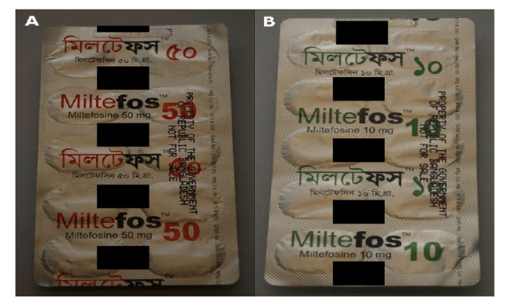
Miltefosine - Bangladesh (Dorlo et al. 2012)
Notes:
Recent reports about poor quality medicines, all of them from 2012
Going from fake anti cancer drug found in 19 pharmacies all over the US
Poor Quality Generic Drug for the treatment of visceral leishmaniasis with generic miltefosine pharmaceutical ingredient about containing no active pharmaceutical Ingredient in Bangladesh in the National Elimination Programme.
HIV drugs discovered by MSF in Kenya supply chain.
Also in Lahore in Jan 2012, 125 Cardiology patients died after taking Isosorbide mononitrate that contained antimalarial drug pyrimethamine. Is still unclear whether it was a deliberate fraudulent substitution or a gross factory manufacturing error.
In addition, alternative approaches to track medicines along the supply chain are being developed by pharmaceutical companies.
- Sproxil-
-

Slide 32
125 cardiology patients died in Lahore with bone marrow failure after taking ‘isosorbide mononitrate 20mg’
However, it contained an excessive dose of the antimalarial pyrimethamine, resulting in fatal bone marrow suppression
Gross factory error (i.e. substandard)

Slide 33
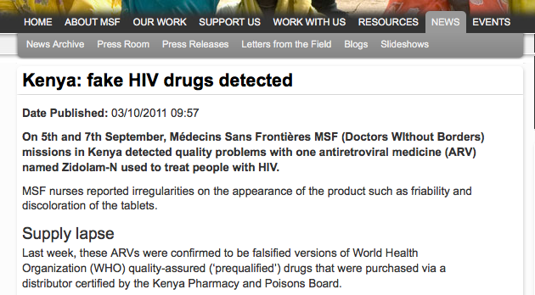
Fake ceftazidime (containing streptomycin), flu vaccine, rabies vaccine, ‘insecticide-treated’ bednets, HIV tests……………..
Non-communicable diseases: Poor quality paracetamol syrup (~ 500 deaths), insulin, blood pressure medicines, anti-cholersterol medicines, condoms, oral contraceptive pills, diabetes test strips, cardiac stents

Slide 34
Problems
Small sample size
No data from many countries
Few random surveys
Little consensus
Over-interpretation of data
Poor & slow reporting

Slide 35


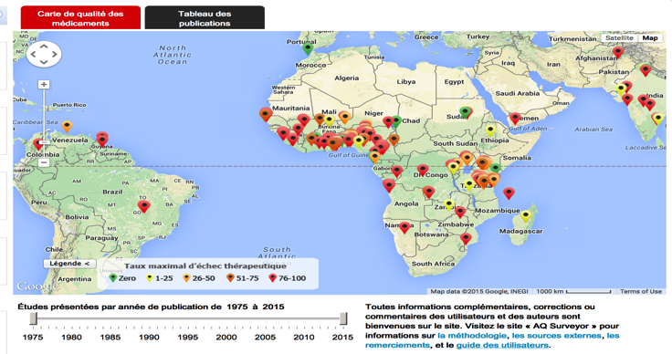
WWARN Antimalarial Quality Surveyor
Now also in French and has downloadable country reports

Slide 36
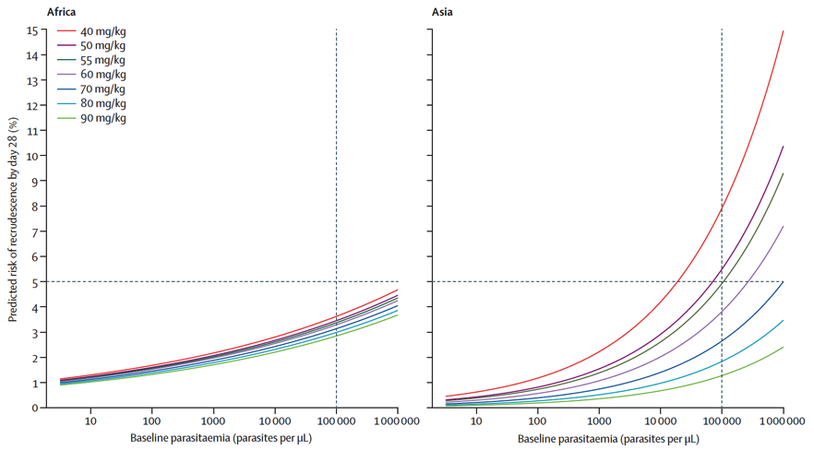
Artemether-lumefantrine dose & recrudescence (WWARN 2015)
Estimated median number of children <5y malaria deaths associated with consumption of poor-quality antimalarials in 39 African countries = 122,350 deaths (IQR: 91,577–154,736)
Declining dose
Recrudescence day 28 %
Renschler et al. AJTMH 2015
Baseline parasitaemia /uL

Slide 37
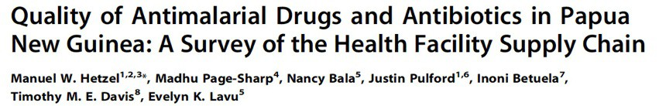
• In PNG in a random sample, 29/37 primaquine samples failed USP %API standards (93-107%)
• Mean (range) %API was 76 (60-99) %
• Risks increased P. vivax relapse and transmission and P. falciparum transmission and recrudescence

Slide 38
Loss of faith in essential medicines & health systems & manufacturers
• 2005 eastern Myanmar/Burma
• 23 year old man presents with uncomplicated P. falciparum malaria
• Treated with oral artesunate labelled as made by Guilin Pharmaceutical Co. Ltd.
• Deteriorated with cerebral malaria and died
• Analysis of remaining ‘artesunate’ demonstrated that it contained 10mg artesunate and paracetamol/tablet

Slide 39
• Entire hospital stock of oral artesunate was same batch – therefore all probably falsified
• Enormous community anger
• Village committee collected all the oral artesunate they could find in local shops and pharmacies and burnt it on a large bonfire

Slide 40
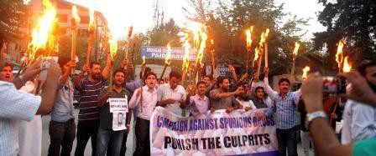
Kashmir

Slide 41
Economic losses for patients and their communities

Slide 42
Economic losses for pharmaceutical companies
17 billion USD ??
Origin of this guesstimate ?

Slide 43
White et al. (2009) Hyperparasitaemia and low dosing are an important source of anti-malarial drug resistance. Malaria Journal
Inadequate dosing of uncomplicated hyperparasitaemia provides the most likely scenario for the de novo emergence and selection of resistance
Artemisinin resistance is very unlikely to be selected by a single exposure. Repeated inadequate dosing is required for selection and spread of artemisinin resistance
Resistance will be selected if the antimalarial drug blood concentrations are not high enough to kill all the sensitive and all the resistant parasites, or are too low to kill either

Slide 44
Therefore…..
Absence of efficacious treatment risks hyperparasitaemia and hypergametocytaemia
Therefore, falsified ACTs, containing none of the stated ingredients will engender resistance as they provide no treatment, especially if patients take antimalarials with inadequate drug before/and after
Logical that poor quality antibiotics will engender AMR – but how important in comparison to poor adherence & poor prescribing ?
Very difficult to determine – mathematical modelling the way forward

Slide 45
Community A – all good quality
Community B – 50 % falsified (no API)
Blue =good
Red= falsified
Yellow = substandard
Community C – 50 % substandard
(40% API)
Community D – 50 % good, 25 % substandard (40% API), 25% falsified (no API)

Slide 46
Sub-therapeutic artesunate/artemisinin in fakes – covert drug pressure for drug resistance
Falsified artesunate from Thai/Burma border with 3-10 mg artesunate/tablet
Artemisinin in falsified halofantrine in West Africa
Pyrimethamine in fake artesunate & artemether-lumefantrine
Chloroquine in falsified artesunate - 15% of artesunate fakes
contained artemisinin … 400km from Thai/Cambodia border
However, substandards with (usually) low % active ingredient or poor bioavailability probably more important

Slide 47
Therefore…..
• Absence of efficacious treatment risks hyperparasitaemia and hypergametocytaemia
• Therefore, falsified ACTs, containing none of the stated ingredients will engender resistance as they provide no treatment, especially if patients take antimalarials with inadequate drug before/and after
• Substandard medicines, with reduced %API or bioavailability, that result in low drug levels are likely to be the most important driver for drug resistance

Slide 48
• The key variable, for most infectious diseases, for determining patient outcome and resistance is the drug levels in the blood
• Resistance is more likely to be engendered from taking substandard medicines but is independent of poor quality medicine classification - %API and bioavailability are key
• With increasing concern that AMR is a global catastrophe in the making….much more discussion
• Very difficult to obtain field evidence – needs modelling informed by field data

Slide 49
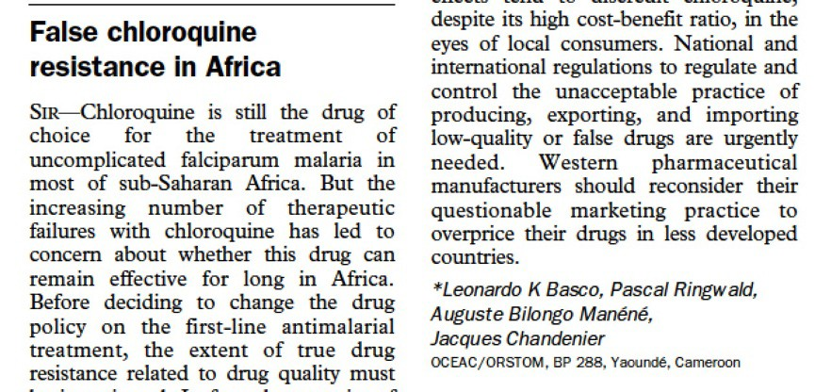
False reports of drug resistance

Slide 50
http://www.wwarn.org/molecular/surveyor/k13/
K13 - marker of Pf artemisinin resistance

Slide 51
ACT quality

Slide 52

Clopidogrel for a clinical trial in USA
2007 clopidogrel labeled as ‘Plavix’ worth £1 million shipped from a EU wholesaler to a UK wholesaler and then to a pharmaceutical company in the USA, for use as a comparator in a clinical trial
The entire consignment was found to be falsified, tablets contained only 50- 80% stated clopidogrel
Those responsible linked to the importation of 2 million doses of Plavix, Zyprexa (olanzapine) and Casodex (bicalutamide) into UK
One of the ringleaders was sentenced to eight years imprisonment

Slide 53
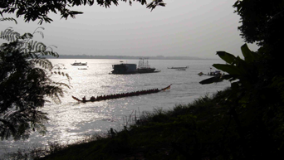


Thank you
With many thanks for the support of Wellcome Trust, ADB, French Government, WWARN-IDDO, LSHTM, Global Fund, INTERPOL, USP, Boston University, Lao FDD & University of Oxford and the help of many MRAs, organizations & colleagues, especially Céline Caillet, Chanvilay Sichanh, Patricia Tabernero, Mick Deats, Pernette Bourdillon Esteve, Souly Phanouvong, Mike Green, Facundo Fernandez, Raffaella Ravinetto, Aline Plançon, Sivong Sengaloundeth, Philippe Guerin, Dallas Mildenhall, Martin Cinammond, Ian Jefferies, David Sumo, Veronika Wirtz, Elizabeth Pisani, Susanne Lundin, Tim Muntinga and many, many others…..

Slide 54
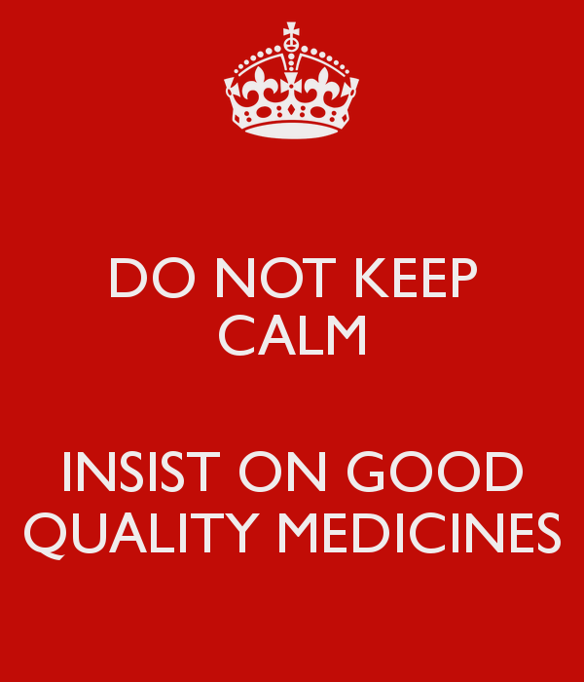

Slide 55

Medicine Quality & Public Health Conference – Oxford – September 2018
http://www.tropicalmedicine.ox.ac.uk/medicinequality2018/

