Slide 1
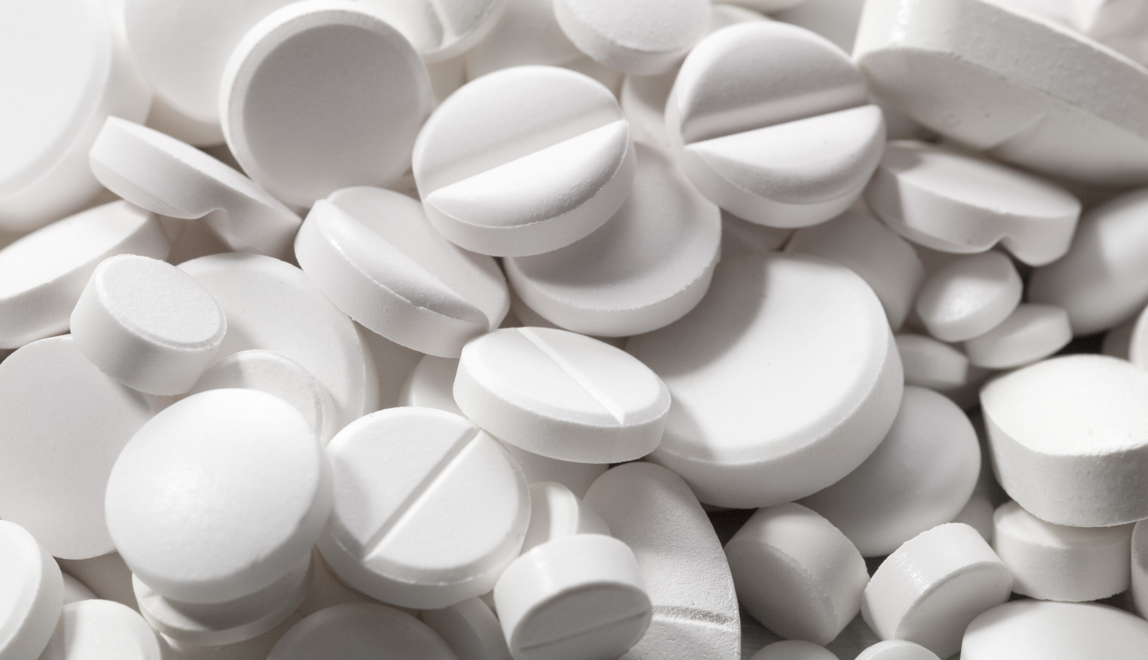

Chemical Analysis:
Mass Spectrometry
& Forensic Techniques
Quality of Medical Products and Public Health
David A. Gaul
Georgia Institute of Technology
laurent hamels - Fotolia

Slide 2
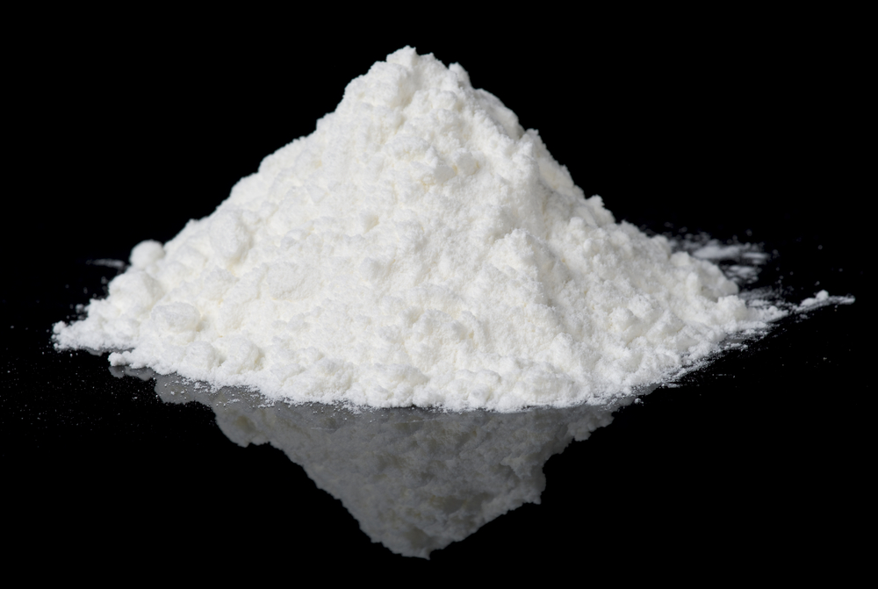
Chemical Analysis
http://suzannevince.com

Slide 3
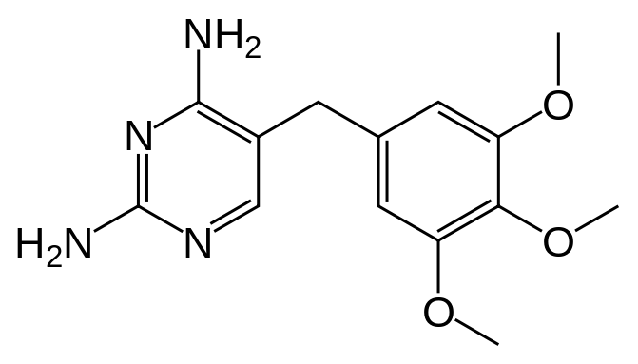
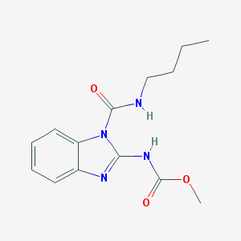
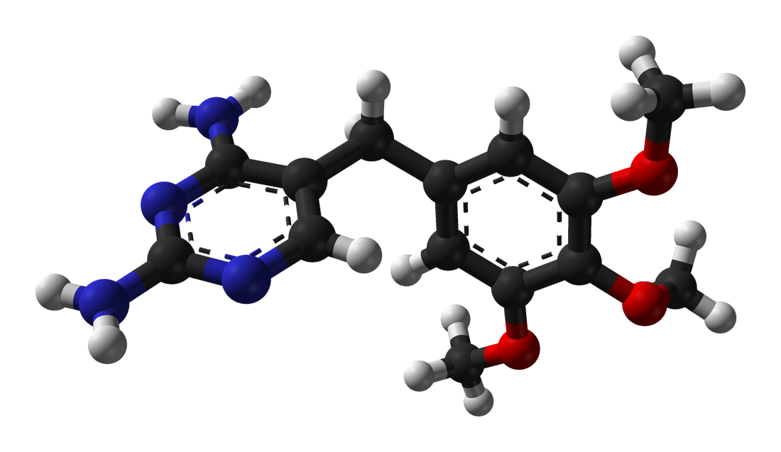
Chemical Analysis
C H N O
C₁₄H₁₈N₄O₃
Benomyl (antifungal)
Trimethoprim (antibacterial)

Slide 4
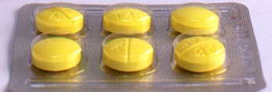
Chemistry & Packaging Simplify Definitions
Good Quality: Set of samples that did not fail chemical assays (content, dissolution, etc.) and packaging tests, if performed.
Degraded: genuine packaging + decreased quantity of correct API & chemical evidence of degradation.
Substandard: Samples with genuine packaging + incorrect quantity of correct API or other manufacturing defects.
Poor Quality: no genuine packaging to check + incorrect quantity of correct API (>zero %).
Falsified: Samples with fake packaging + right amount of API or none or “wrong API”. Also those samples with no genuine packaging available to compare with + wrong or no stated API. Definition could extend to excipients or coatings in more sophisticated cases.
wWARN AQ Surveyor. Paul Newton. Patricia Tabernero.

Slide 5
Standard Practice for Identification of Seized Drugs
ASTM E2329 & SWGDRUG
Category A confirmatory | Category B screening | Category C presumptive
Mass Spectrometry | Capillary Electrophoresis | Color Tests
Infrared Spectrophotometry | Gas Chromatography | Fluorescence Spectroscopy
Nuclear Magnetic Resonance Spectroscopy | Ion Mobility Spectrometry | Immunoassay
Raman Spectroscopy | Liquid Chromatography | Melting Point
X-ray Diffraction Analysis | Microcrystalline Tests | Ultraviolet Spectrophotometry
 | Pharmaceutical Identifiers
 | Thin Layer Chromatography
 | Cannabis Only: Macroscopic Examination Microscopic Examination
Minimum of 1x Category A, plus 1 more
SWGDRUG Recommendations 7.0
http://www.swgdrug.org/approved.htm
http://www.astm.org/FULL_TEXT/E2329/HTML/E2329.htm
Notes:
SCIENTIFIC WORKING GROUP FOR THE ANALYSIS OF SEIZED DRUGS (SWGDRUG) RECOMMENDATIONS

Slide 6
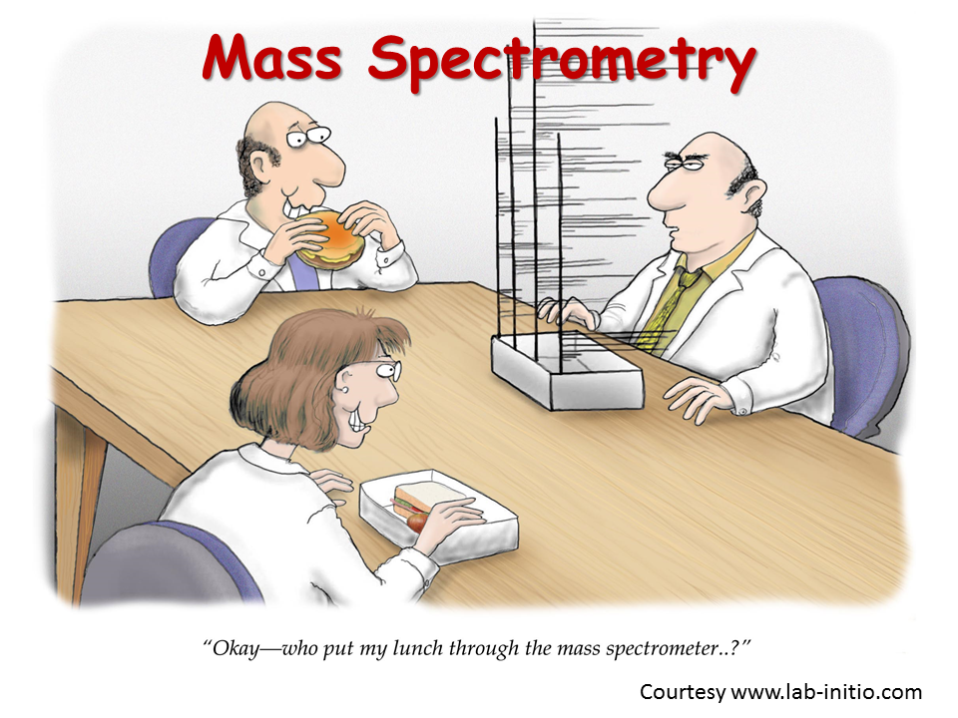
Mass Spectrometry
We gain information on:
Elemental composition of matter
Structure of inorganic, organic and biological molecules
Qualitative and quantitative composition of complex mixtures
Structure and composition of solid surfaces
Isotopic ratios of atoms in samples
Application for routine chemical analysis since early 1940s
Structural identication in organic chemistry: NMR, MS, IR
Possibility to produce ions from non-volatile or thermally labile molecules since the 1980s → biological samples, including polypeptides, proteins, nucleic acids, even intact viruses!

Slide 7
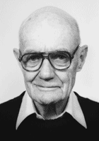
A Formal Definition
Mass spectrometry is the art of measuring atoms and molecules to determine their molecular weight. Such mass or weight information is sometimes sufficient, frequently necessary, and always useful in determining the identity of a species. To practice this art one puts charge on the molecules of interest, i.e., the analyte, then measures how the trajectories of the resulting ions respond in vacuum to various combinations of electric and magnetic fields.
Clearly, the sine qua non of such a method is the conversion of neutral analyte molecules into ions. For small and simple species the ionization is readily carried by gas-phase encounters between the neutral molecules and electrons, photons, or other ions. In recent years, the efforts of many investigators have led to new techniques for producing ions of species too large and complex to be vaporized without substantial, even catastrophic, decomposition.
John Fenn, Chemistry Nobel Laureate 2002
http://masspec.scripps.edu

Slide 8
Mass Spectrometry – Essential Components
Fixed gases or
volatile liquids
by EI, CI, or FI
Solids or
solutions
by ESI, APCI,
AP-MALDI
Ion Source
IONS
m/z Analyzer
Ions
Detector
Solids by
MALDI or
LSIMS
Vacuum
Computer/data system
A mass spectrometer determines the mass of a molecule by measuring the mass-to-charge ratio (m/z) of its ion. Ions are generated by inducing either the loss or gain of a charge from a neutral species. Once formed, ions are electrostatically directed into a mass analyzer where they are separated according to m/z and finally detected. The result is a mass spectrum.

Slide 9
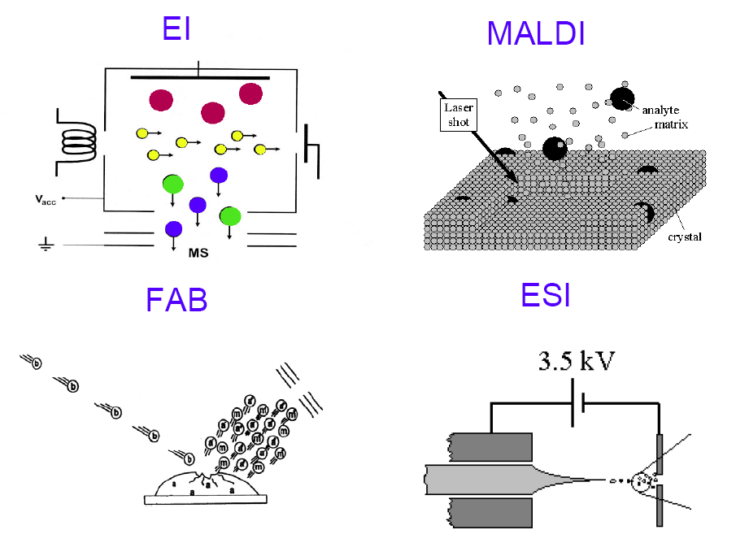
Many Types of Ion Sources!
Electron Ionization
Matrix Assisted Laser Desorption/Ionization
Fast Atom Bombardment
Electrospray Ionization

Slide 10
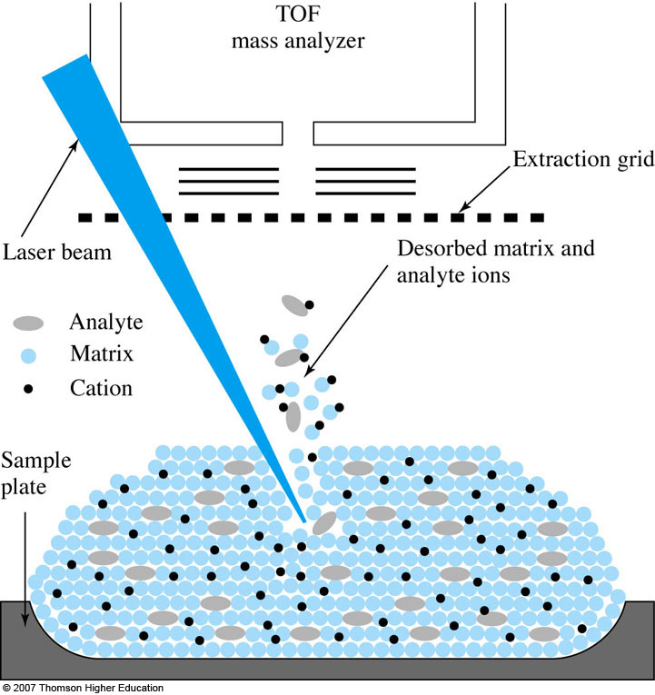
MALDI: Matrix-Assisted Laser Desorption/Ionization
Generally uses a UV laser.
IR MALDI is also used, but not that common.
Ions are formed by gas-phase proton transfer between the excited matrix ions and the analyte.

Slide 11
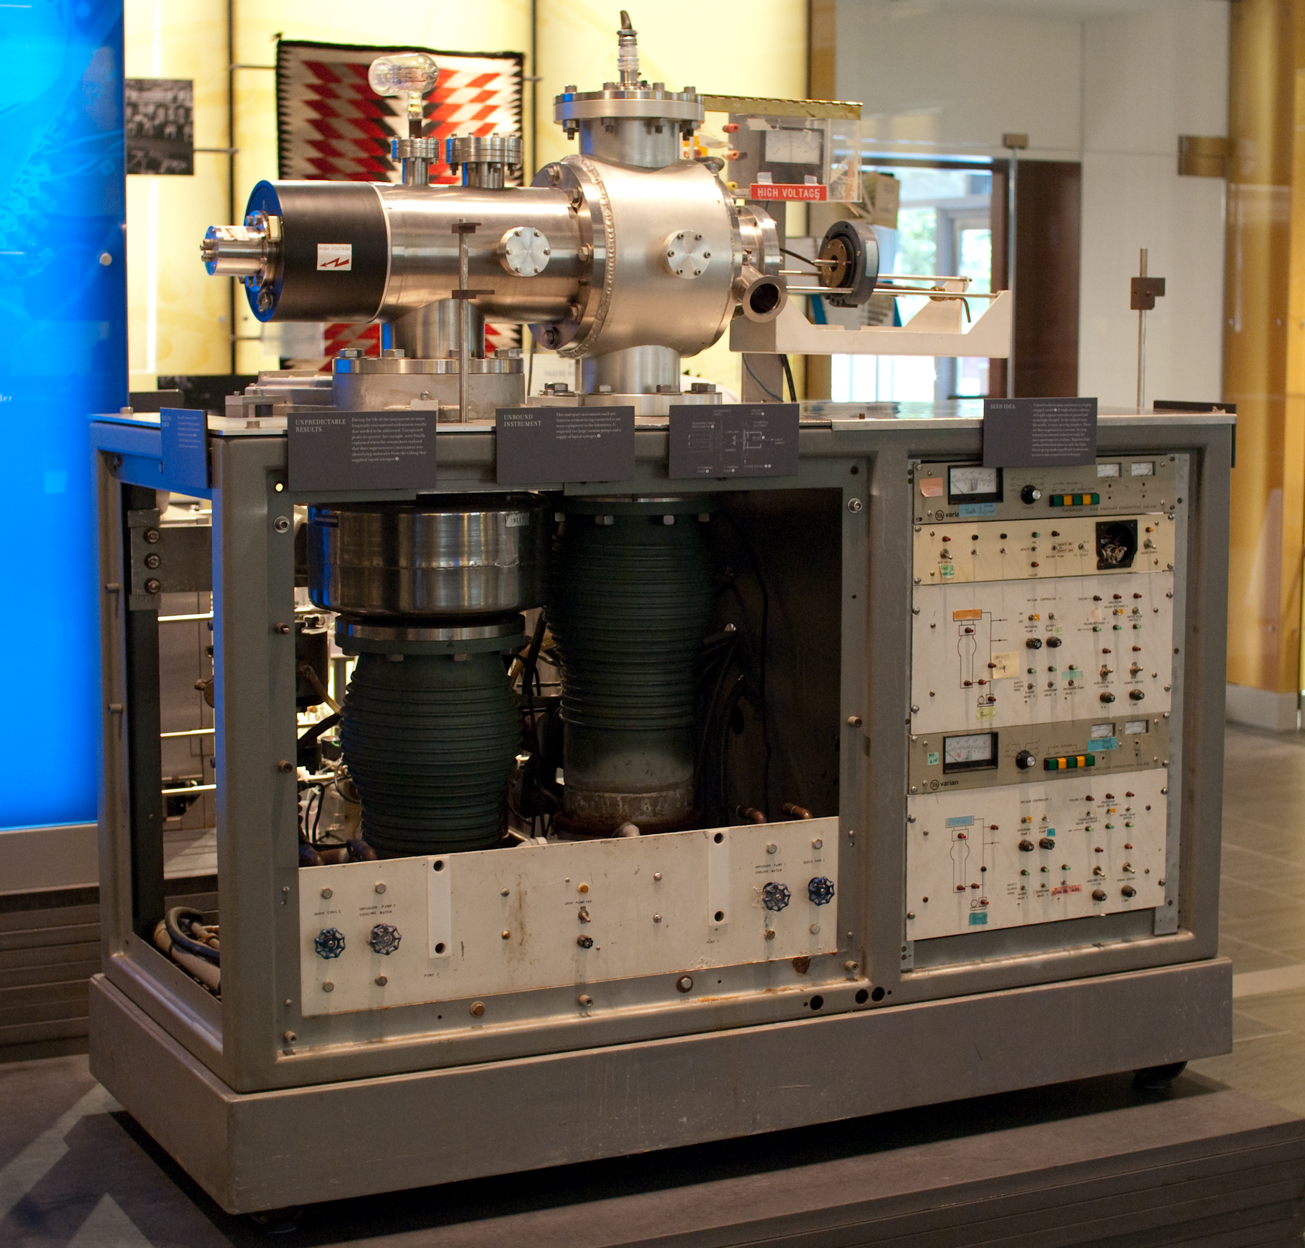
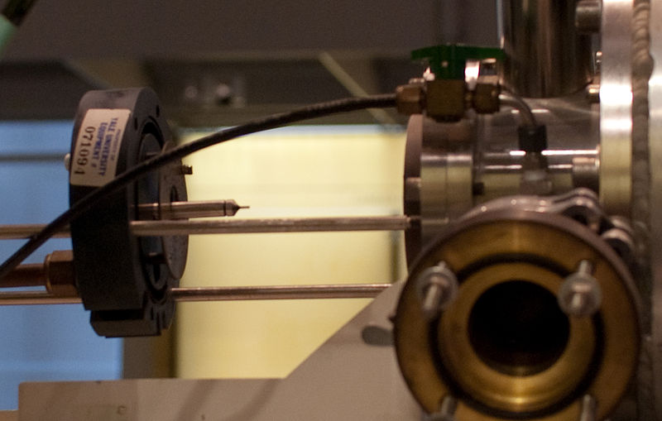
Fenn’s First ESI Source Coupled to a Quadrupole MS

Slide 12
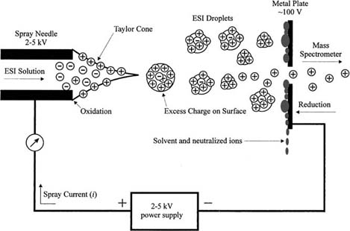
Electrospray Ionization Process
Mass Spectrometry Reviews, 2001, 20, 362– 387.

Slide 13
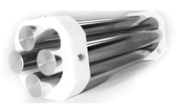
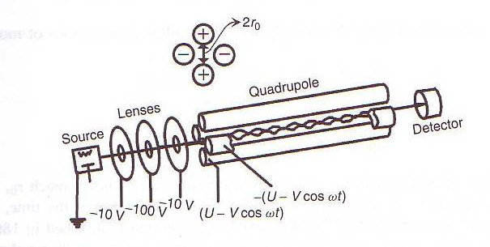
Mass Analyzer - Quadrupole
DC and RF between 100V and 1000V
Frequency: 1-4MHz
About 100 oscillations.
Z-direction
-500V
-(DC+RF)
-150V
DC Pole Bias Offset (equal in all poles and added to other voltages)
5
DC+RF
Filtering potentials

Slide 14
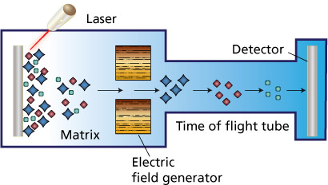
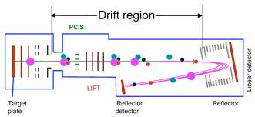
Mass Analyzers – Time of Flight (TOF)
MALDI Linear TOF. Lower R. Very Sensitive.
MALDI Reflectron TOF. Higher R. Less Sensitive.

Slide 15
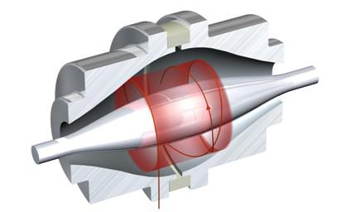
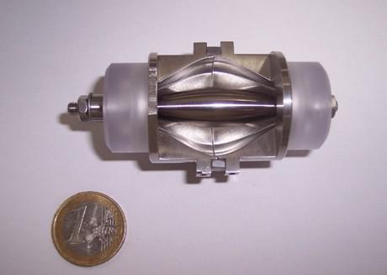
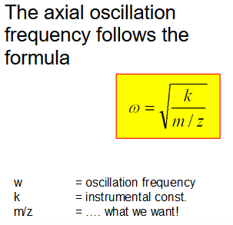
Mass Analyzers - Orbitrap
Anal. Chem. 2000, 72, 1156-1162
Anal. Chem. 2006, 78, 2113-2120

Slide 16
Mass Spectrum – 18 Amino Acids

Slide 17
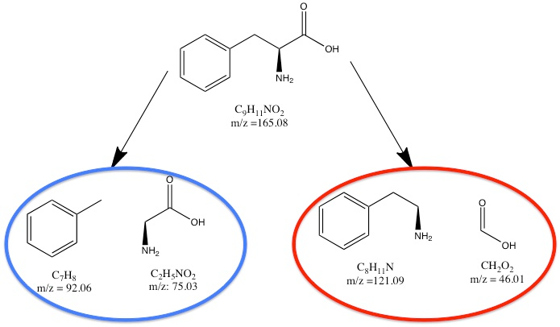
Tandem Mass (MS²) Spectrometry
MS experiments can also produce structural information by selecting a precursor ion (generated with soft ionization), activating these ions by collisions with a gas, and mass analyzing the fragments.
Two basic experiments:
  Tandem in time and tandem in space.

Slide 18
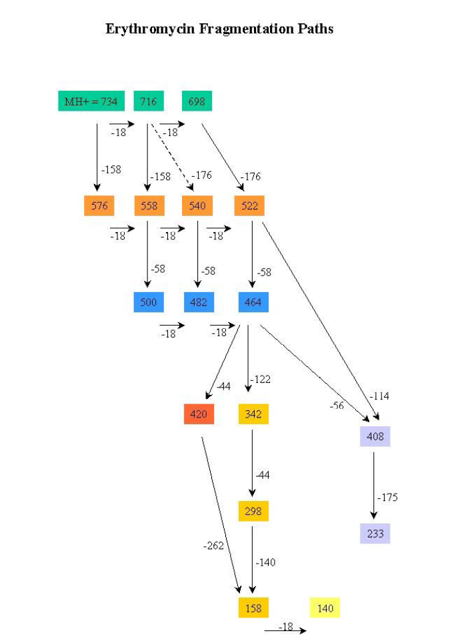
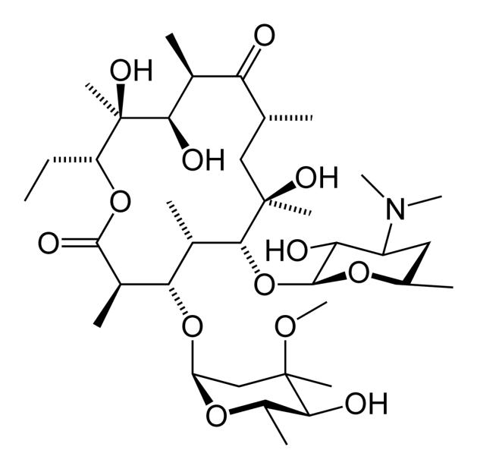
Tandem MS in Time: MS^{n}

Slide 19
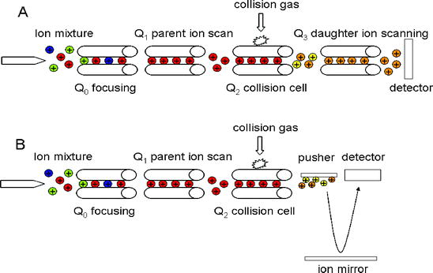
Tandem MS in Space
Roessner U., Beckles D. Plant Metabolic Networks 2009

Slide 20
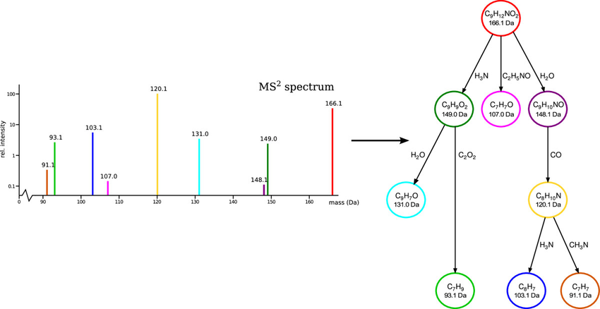
MSMS Phenylalanine
Journal of Cheminformatics 2013, 5:12

Slide 21
Introduction to Chromatographic Separations
(Skoog Ch. 26)
Introduction:
- Frequently methods for chemical analysis are selective, but not highly specific
- Separation of analyte from interferences required → Chromatography
General description:
- Separation of chemically closely related components in a complex mixture
- Sample transported in a mobile phase (gas, liquid, supercritical fluid)
- Passes stationary phase fixed in column or on solid surface
- Distribution equilibria of the analyte between mobile phase and stationary phase
- Components strongly retained in the stationary phase move only slowly with the flow of the mobile phase, components weakly retained move rapidly
- Components separate into zones (bands), which can be further analyzed

Slide 22
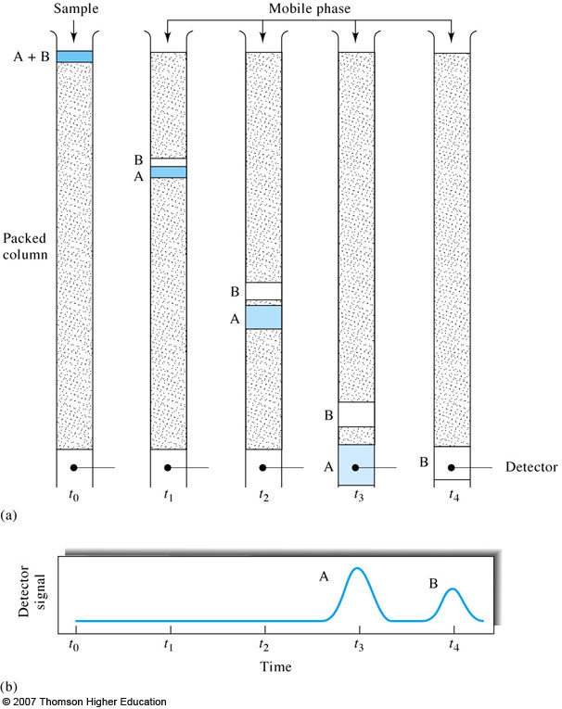
Introduction to Chromatographic Separations
Notice that the analyte zones suffer broadening and dilution.
Therefore, when a chromatographic separation is performed, detectors need to be more sensitive!
Avoid separations if possible!
How do we decide if a separation is needed? Depends on selectivity and peak capacity of the detector.

Slide 23
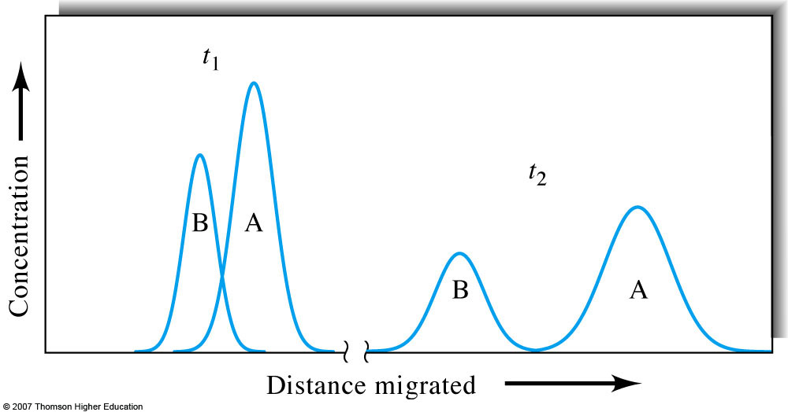
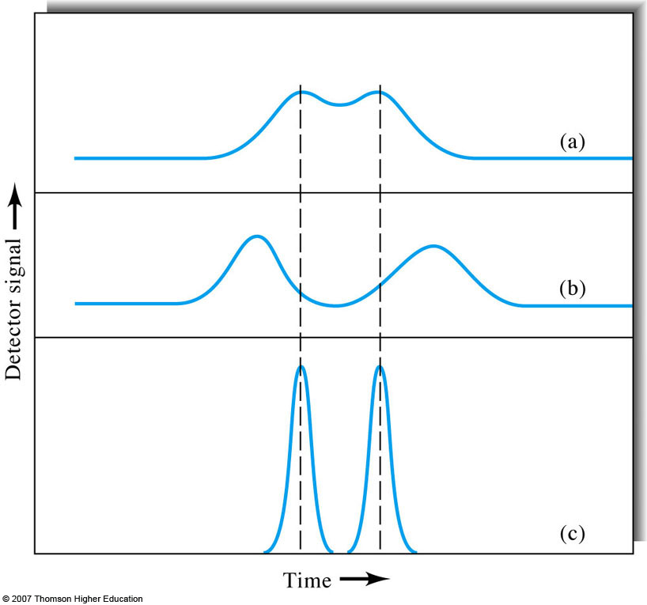
Chromatogram
Detector plots signal as function of time
Series of peaks obtained, called chromatogram
Qualitative and quantitative analysis possible
Migration rates and zone broadening simultaneously influence peak resolution
Zone broadening and analyte separation occur simultaneously! They are opposing effects

Slide 24
Liquid Chromatography
Solvent A
HP pump
Solvent B
Injection system (autosampler or manual)
HPLC high performance liquid chromatography
- operating pressure below 6,000 psi
UPLC ultra performance liquid chromatography
- operating pressure below 15,000 psi
UHPLC ultra high performance liquid chromatography
- operating pressure below 20,000 psi
Chromatographic column
Detector

Slide 25
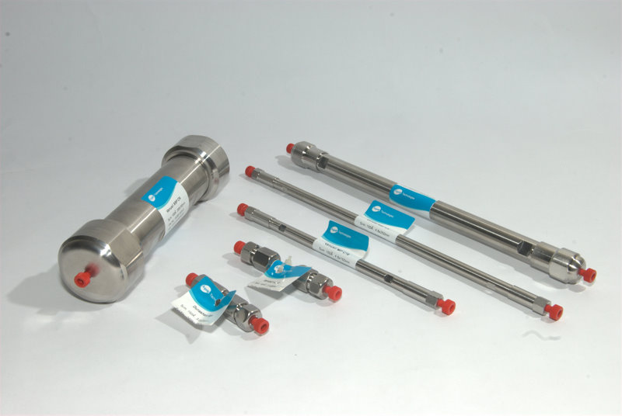
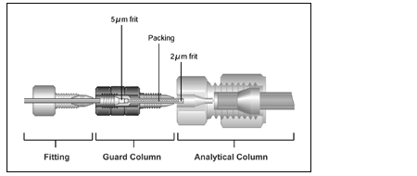
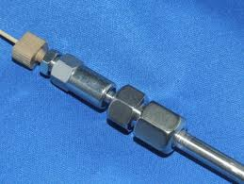
HPLC Columns
Columns:
- Stainless steel tubing
- 10-30 cm length
- Inner diameter: 1-10 mm
- Particle size of packing: 2-10 µm
- 40,000-60,000 plates per meter (much less than GC). UPLC: ~200,000
Guard columns are used before analytical column to remove particulate
matter, contaminants from solvent and components, which would
irreversibly bind to the stationary phase.

Slide 26
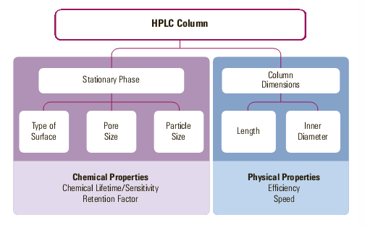
HPLC Column Selection

Slide 27
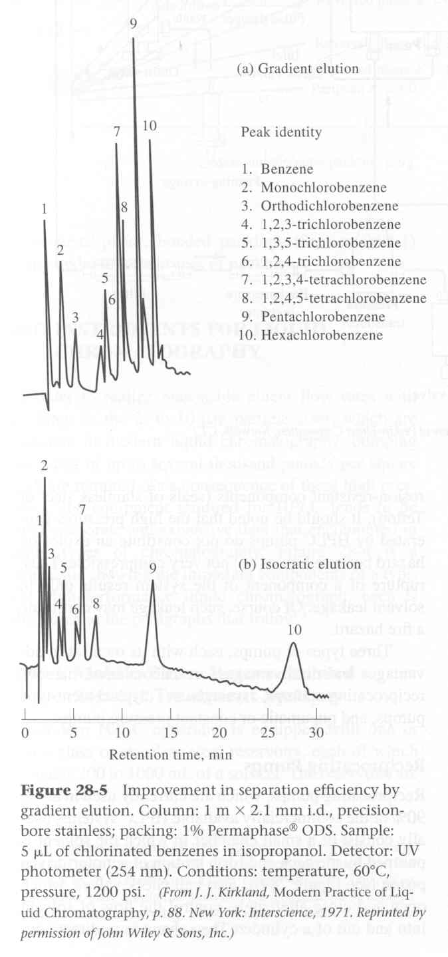
Instrumentation in HPLC
Mobile phase:
- single solvent, constant composition = isocratic
elution
- gradually or stepwise varied composition
(polarity) of mobile phase = gradient elution
- Example shows isocratic 50:50 (v:v) (bottom)
MeOH/Water in contrast to 40:60 with increased
rate of MeOH by 8%/min (top)

Slide 28
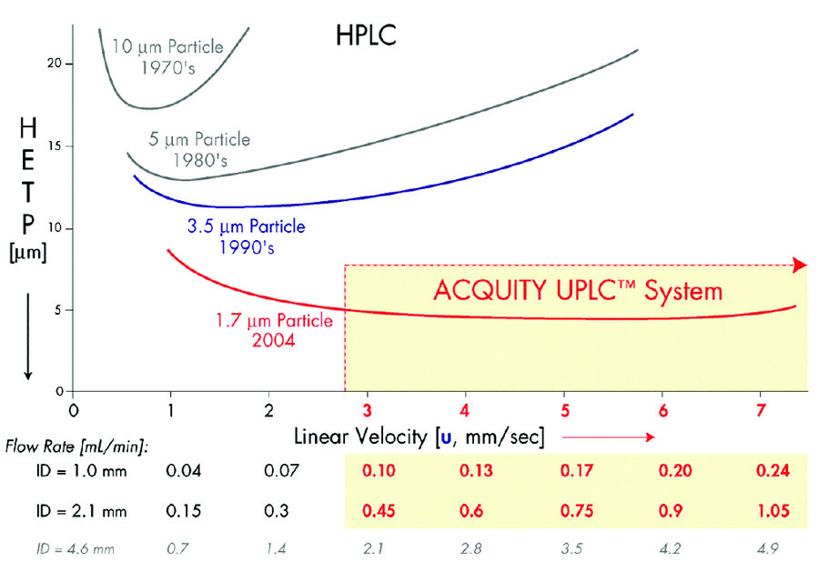
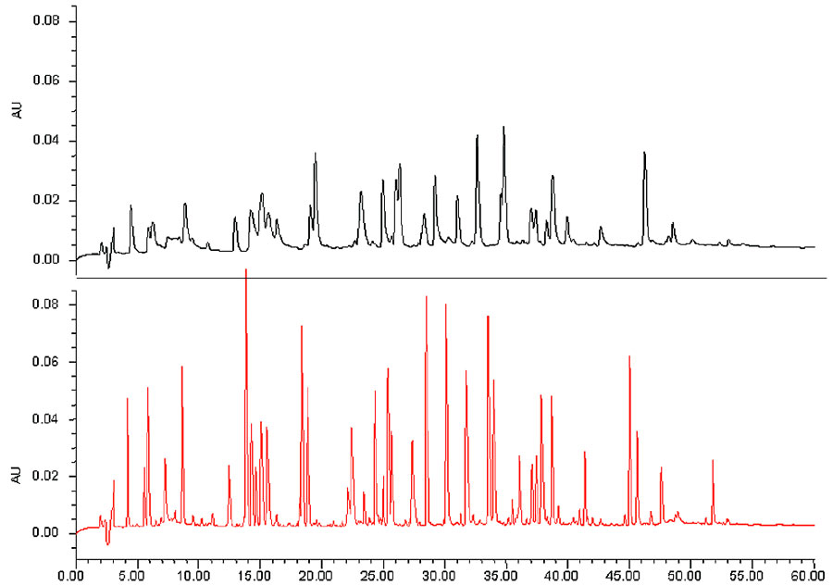
How to Reduce Band Broadening
In packed columns: reduce particle diameter.
HPLC
UHPLC

Slide 29
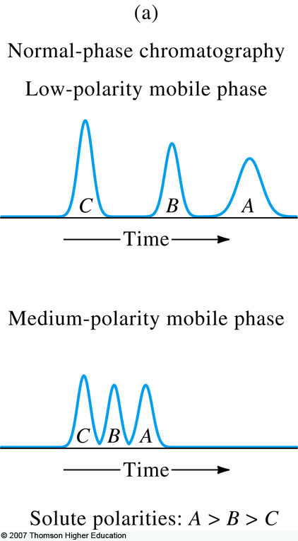
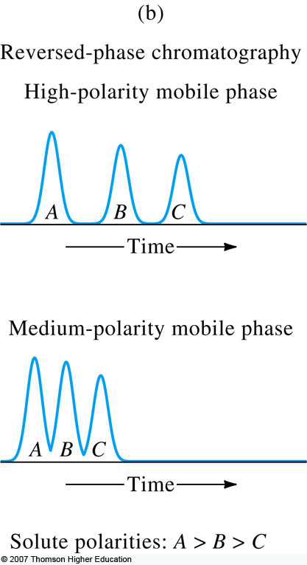
LC Columns for Partition Chromatography
Normal-phase chromatography: highly polar stationary phase and relatively nonpolar solvent.
Reversed-phase chromatography: nonpolar stationary phase (e.g. bonded
long-chain hydrocarbons, C4, C8, C18) and relatively polar solvent

Slide 30
LCMS Data: Chromatogram and Mass Spectrum

Slide 31
Laboratory Chemical Forensics
The Cadillac of Chemical Detection Technology
Attribution/Sourcing:
Palynology
IR-MS
www.codfin.org

Slide 32
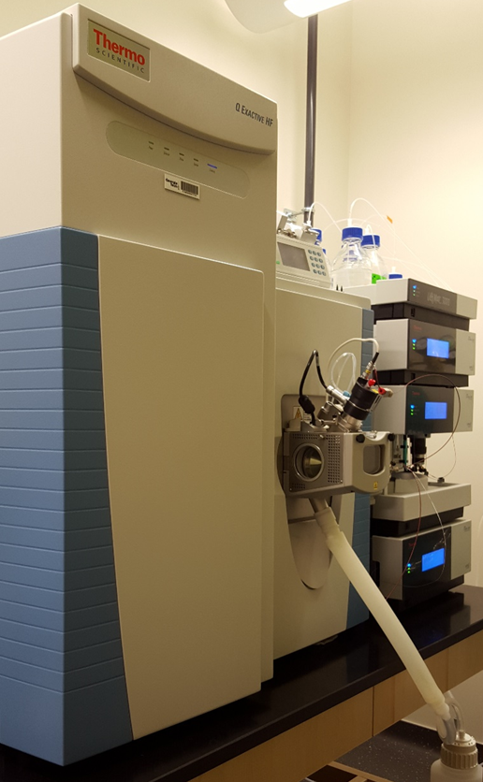
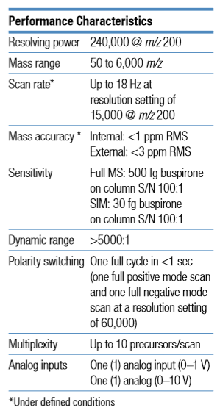
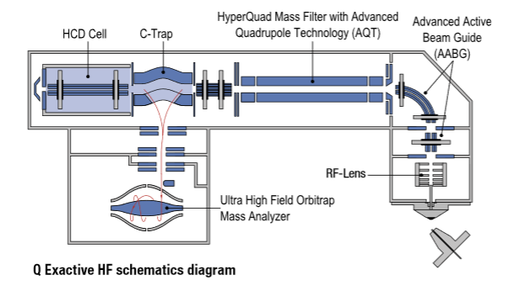
Q Exactive HF

Slide 33
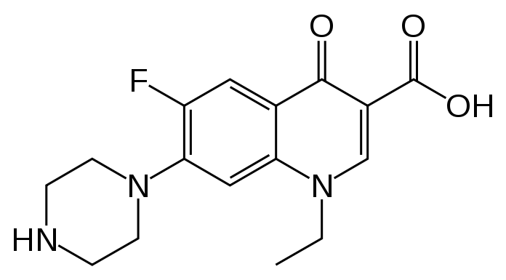
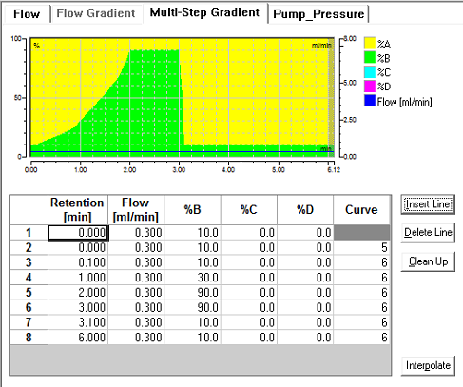
Quantitation of Norfloxacin (antibacterial)
Mobile phase A – water with 0.1% formic acid
Mobile phase B – acetonitrile with 0.1% formic acid

Slide 34
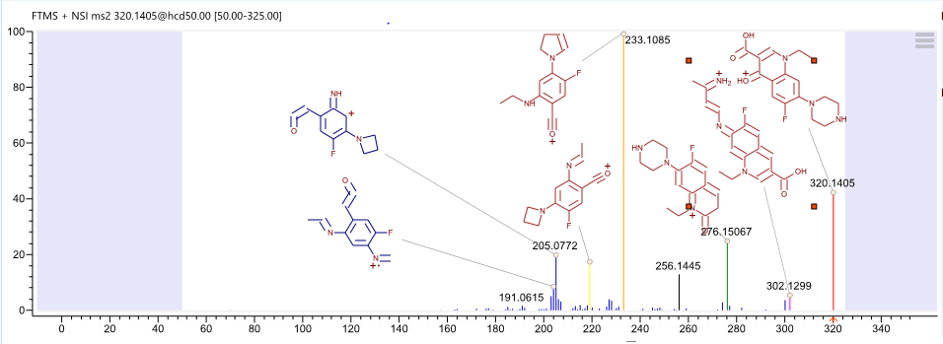
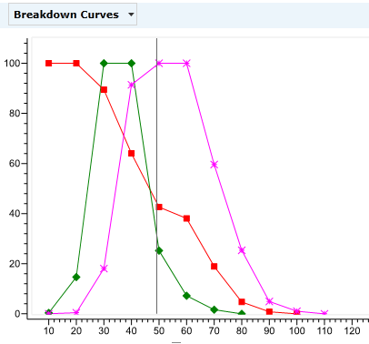

Quantitation of Norfloxacin
MS²
MzCloud
Relative Abundance
CE
m/z

Slide 35
Quantitation of Norfloxacin
Extracted Ion Chromatogram for Precursor and Transitions
Software: Skyline and Excel

Slide 36
Laboratory Chemical Forensics
The Cadillac of Chemical Detection Technology
Attribution/Sourcing:
Palynology
IR-MS
www.codfin.org

Slide 37
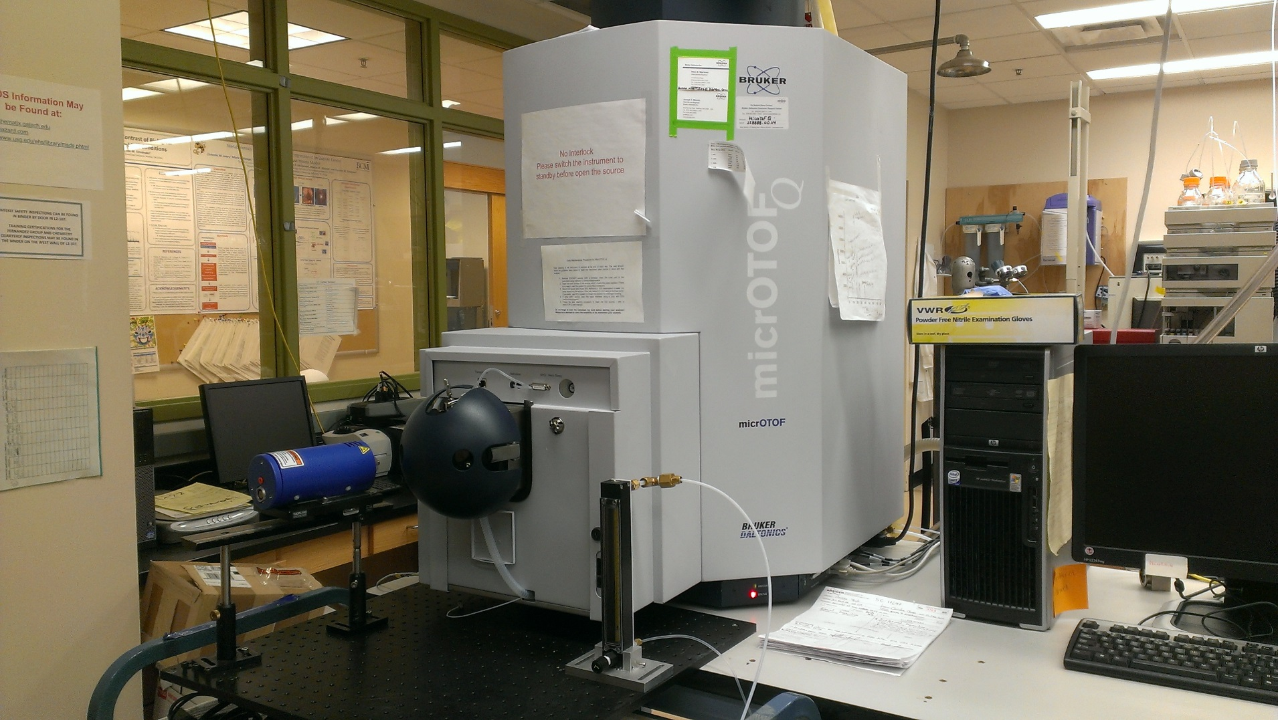
Direct Analysis in Real Time-Mass Spectrometry (DART-MS)
Time-of-flight (TOF) mass spectrometer
DART ion source
No Sample Prep! Directly from solids

Slide 38
DART Basics
Newton, PN; Fernández, FM; et al., PLoS Med., 2006, 3(6), e197
Glass tube
[M+H]⁺
[2M+H]⁺
Pv (T)
PA
DART Source
M_{(s)} M_{(g)} (M+H)⁺_{(g)}
MS Inlet
(H₂O)_{n}H+ (H₂O)_{n}
Fernández, FM; Cody, RB; et al., ChemMedChem, 2006, 1, 702–705.

Slide 39

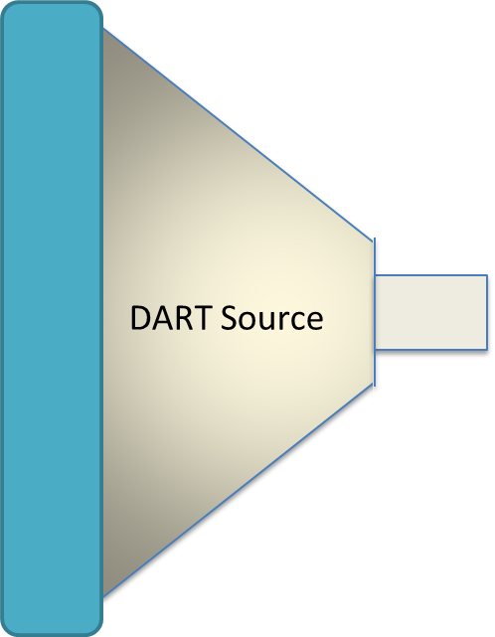
DART-TOF MS
Detection system
Ion Transportation
Ion Source
Analyser
To the data collection system
TMP2
RP
TMP1
RP

Slide 40
Nigeria ACT Results: Genuine samples-On Going ACT Consortium Study in Enugu, Nigeria
Harparkash Kaur, Michael Green, Obinna Onwujekwe, Facundo Fernandez (& teams)
DART-TOF MS
[Artemether + NH₄]⁺
[Lumefantrine + H]⁺
DART-TOF MS
[Dihydroartemisinin + NH₄]⁺
[Piperaquine + H]⁺
DART-TOF MS
[Amodiaquine + H]⁺
[Artesunate + NH₄]⁺

Slide 41
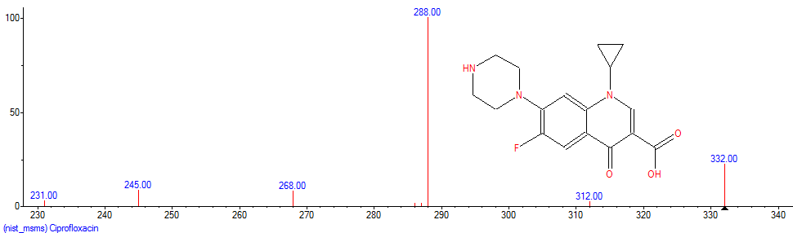
Nigeria ACT Results: Falsified samples (10/200)
DART-TOF MS
[Ciprofloxacin + H]⁺ instead of artemether
DART-TOF MS/MS
Fragmentation pattern indicates ciprofloxacin
Ciprofloxacin NIST MS/MS
antibacterial

Slide 42
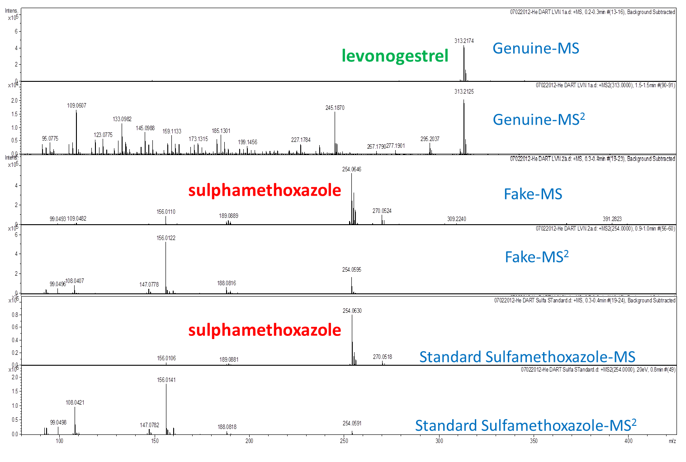
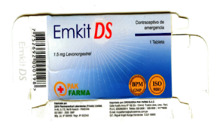
Falsified Emergency Contraceptive: Peru
David Jenkins (FHI), Facundo Fernandez (& teams)
B
A
C
B
C
B
C

Slide 43
Laboratory Chemical Forensics
The Cadillac of Chemical Detection Technology
Attribution/Sourcing:
Palynology
IR-MS
www.codfin.org

Slide 44
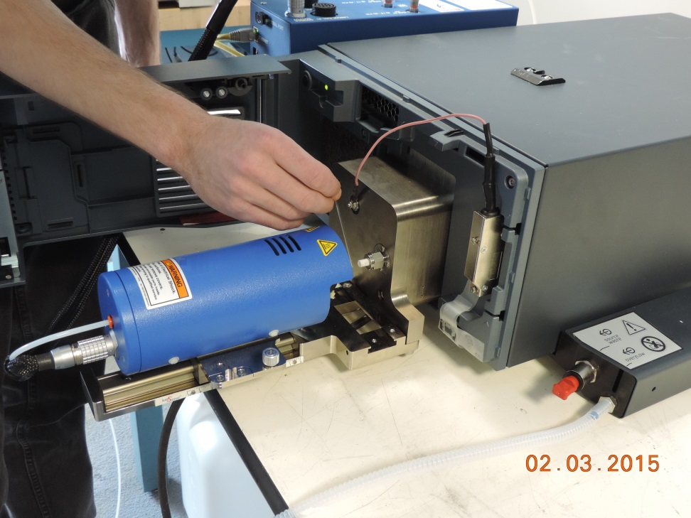
Benchtop DART-Single Quadrupole MS
Compact, low maintenance mass spectrometer (Waters QDa) with simple software.
Desktop sized system.
Energy-resolved in-source CID + DART Temperature ramping.
Spectral isotope profile fitting for elemental formula ID.
Bernier et al., Analytical Methods, 2016, accepted.

Slide 45

Benchtop DART-Single Quadrupole MS
Bernier et al., Analytical Methods, 2016, submitted.

Slide 46
DART-QDa “Fingerprinting” of Various Fake “Recipes”

Slide 47
PCA Scores Plot of “DART Fingerprints”

Slide 48



Miniature Mass Spectrometry
Yang, M.; Kim, T. Y.; Hwang, H. C.; Yi, S. K.; Kim, D. H. J. Am. Soc. Mass Spectrom. 2008, 19, 1442−1448.
www.908devices.com
Snyder, D.T., Pulliam, C. J., Ouyang, Z., Cooks, R. G., Miniature and Fieldable Mass Spectrometers: Recent Advances, Anal. Chem., 2016, 68, 2-29

Slide 49
Summary
No single analytical technique provides enough information to confirm that a drug is genuine. It is usually best to work through tests beginning with the easiest or least expensive ones. Only if samples pass these tests should the inspector move on to more difficult or expensive ones.
An understanding of the technological landscape, the range and gaps in available technologies, and the likely improvements in the near future, is essential for using technologies in developing countries.
Efforts should be focused on developing a central repository for existing and newly innovative detection, sampling, and analytical technologies.
IOM “Countering the Problem of Falsified and Substandard Drugs”, 2013.

Slide 50

Thank you!
Fernández group:
  Maru Monge, Julia Culzoni, Dana Hostetler, Christina Y. Hampton, Krystyn Alter-Hall, Leonard Nyadong, Glenn Harris, Prabha Dwivedi, Manshui Zhou
Prof. Paul Newton, Oxford
NSF CAREER Award
NSF MRI Instrument Develop
NSF-NASA Center for Chemical Evolution (Instrument Access)
Bill and Melinda Gates Foundation-ACT Consortium
WHO (WPRO)
US Pharmacopeia Fellowships
Global Fund

