Slide 1
Protecting the U.S. Drug Supply Chain
Sangeeta Vaswani Chatterjee, Pharm.D.
Branch Chief
Supply Chain Response and Enforcement Branch
Division of Supply Chain Integrity
Office of Drug Security, Integrity, and Response
CDER/Office of Compliance
Quality of Medical Products and Public Health Course
Boston University School of Public Health
July 11, 2017

Slide 2
Overview
CDER Office of Compliance
Threats to U.S. Drug Supply Chain
U.S. Drug Supply Chain Breaches
Education and Outreach
Compliance and Enforcement
Criminal Investigations
Legal Implications
International Collaboration

Slide 3
CDER/Compliance: Office of Drug Security, Integrity, and Response (ODSIR)
Address increasing supply chain threats including:
Intentional adulteration, cargo theft, counterfeiting, diversion
Focus on life-cycle of the product from drug components through to the finished dosage form delivered to the patient
Recalls
Drug Shortages
Imports
Exports
Drug Supply Chain Integrity

Slide 4
What We Do….
Promote and protect the public health through strategies and actions that minimize consumer exposure to unsafe, ineffective, and poor quality drugs.

Slide 5
Challenges We Face….
Globalization
Complex supply chains
Continued migration of manufacturing and drug development overseas
Various standards
Economic concerns regarding regulatory burdens
Increasing supply chain security threats
Counterfeit and otherwise substandard drugs found in global market
Cultural differences
Outdated legal authorities to deal with emerging issues
Strategic/efficient use of limited resources

Slide 6
Threats to U.S. Drug Supply Chain

Slide 7
Pharmaceutical Supply Chain
Who touches the product?
Where are the vulnerabilities?
What are the threats?
Protect the product Protect the patient

Slide 8
What is a Counterfeit Drug?
U.S. law defines counterfeit drugs as:
“drug which, or container or labeling of which, without authorization, bears the trademark, trade name, or other identifying mark, imprint, or device, or any likeness thereof, of a manufacturer, processor, packer, or distributor other than the person or persons who in fact manufacture, processed, packed, or distributed such drug and which thereby falsely purports or is represented to be the product, or to have been packed or distributed by, such other drug manufacturer, processor, packer, or distributor.”
Can apply to both brand name and generic products, or the bulk ingredients used to make the product
May include products without the active ingredient, with an insufficient or excessive quantity of the active ingredient, with the wrong active ingredient, or with fake packaging

Slide 9
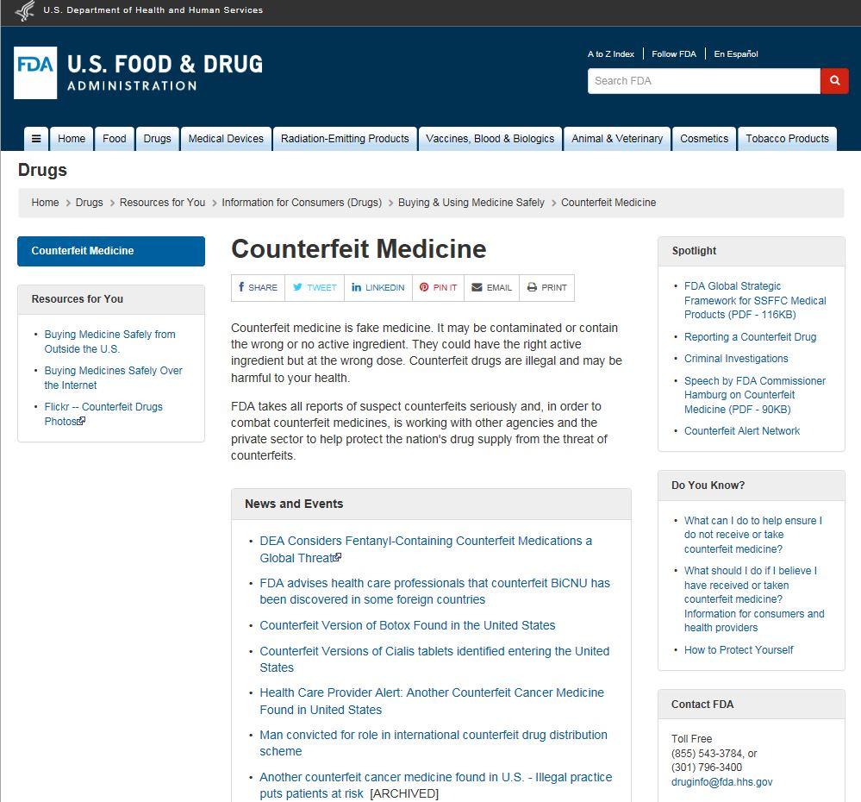
Lay Interpretation

Slide 10
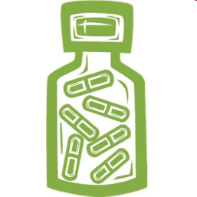
Counterfeit/Falsified, Diverted or Stolen or Unapproved Drugs may be Dangerous
May contain harmful ingredients
May be ineffective (contain no or little drug)
May cause adverse events (due to ingredients or wrong strength)
May have lost potency (due to improper storage)
May be expired
May be produced under filthy conditions
= harm to public health

Slide 11
What is Diversion?
The sale of drugs outside of the distribution channels for which they were originally intended
Can originate domestically
e.g., illegal redirection of prescription drugs from legitimate sources (drug samples, controlled substances)
Can originate internationally
e.g., donated or low-priced drugs from one country diverted to a higher-priced market
Counterfeiting is usually associated with a diversion scheme

Slide 12
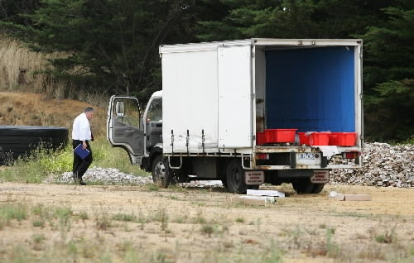
What is Cargo Theft?
Theft of truck tractor trailers containing drugs
Truck stops
Overnight parking
Theft of drugs from warehouse
Rx or OTC
UNKNOWNS
How the drugs are handled while outside legitimate supply chain
Integrity (e.g., potency) of the products

Slide 13
Public Health Concerns of Cargo Theft
Public health risk created by introduction of stolen product into the legitimate supply chain
Resurfacing of product many months or years after the theft
Improper storage
Expired products
Dilution and adulteration
Comingling with counterfeits/unapproved products
Notes:
13

Slide 14
U.S. Drug Supply Chain Breaches

Slide 15
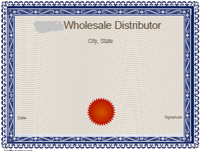
Rogue Sellers Targeting Medical Clinics Example of Scheme
PRODUCT IS DIRECTLY SHIPPED TO MEDICAL CLINIC/DOCTOR
Medical clinic/Doctor’s Office
orders/purchases product
Foreign/unlicensed supplier
ships product to medical clinic
Medical clinic/doctor’s office
receives shipment of product
UNSAFE PURCHASING PRACTICES
Doctor administers to patient
Sophisticated marketing by suppliers
Purchasing outside of the legitimate supply chain
PATIENT COULD BE HARMED BY COUNTERFEIT/ UNAPPROVED DRUGS
Licensed wholesale distributor

Slide 16
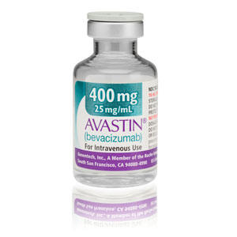
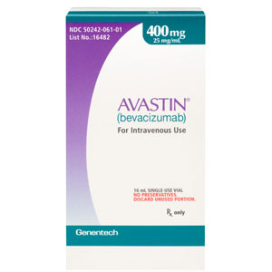
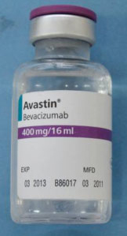
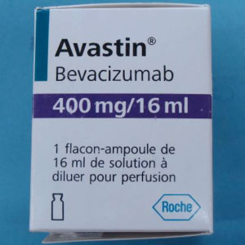
Counterfeit Avastin – Feb. 2012
Genentech Avastin
Counterfeit version of Roche Avastin*
(Images from Genentech; U.S. version)
Authentic Avastin marketed by Genentech
FDA-approved Avastin
Not the subject of the counterfeiting incident
Considered as safe and effective for intended uses
Counterfeit claimed to be Roche product
Not FDA-approved
Contained no active ingredient
Writing not all in English
*Roche Avastin approved for marketing outside of U.S.

Slide 17
Counterfeit Botox – April 2013
Outer carton – counterfeit
Vial inside – labeled as foreign version of Botox
Lot #s and expiration dates on outer carton and accompanying vial do not match
Sold by unlicensed suppliers – not part of legitimate U.S. supply chain
Example 1
Lot # | Exp Date
C3016 C3 (carton) | 10-2014
C3121 C3 (vial) | 04-2015
Example 2
Lot # | Exp Date
C3060 C3 (carton) | 01-2015
C3121 C3 (vial) | 04-2015

Slide 18
Stolen Drugs are Finding Their Way Back into the Supply Chain Through Returns Process

Slide 19
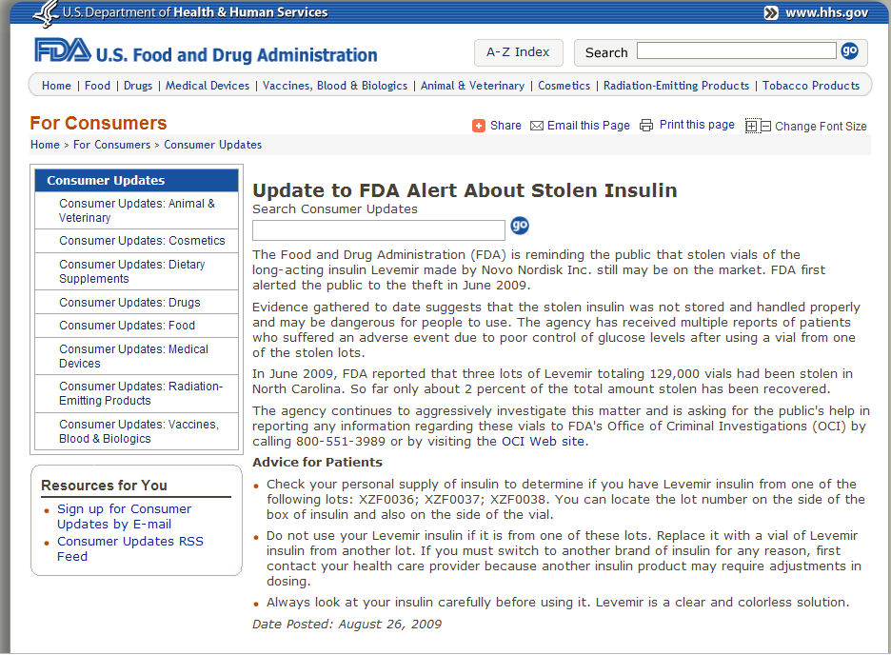
Medwatch Reports Linked to Stolen Product

Slide 20
Reselling of Rx Drugs Obtained by Doctors

Slide 21
Education and Outreach

Slide 22
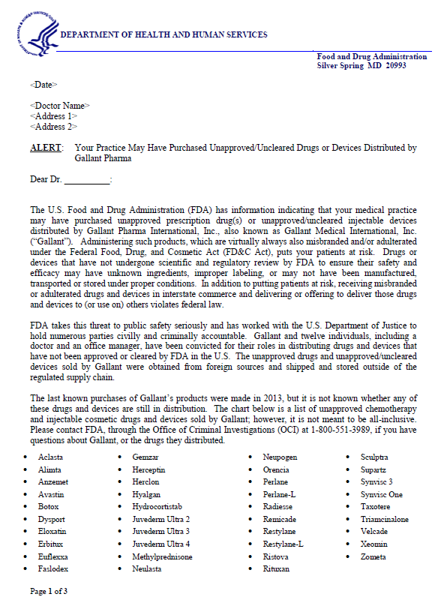
Letters to Doctors
Sent to U.S. medical practices
Warned against the use of counterfeit versions (and unapproved drugs)
Risks of purchasing from foreign and unlicensed sources
Urged medical practices to stop using any products from foreign or unlicensed suppliers
Report adverse events to MedWatch
Posted on FDA’s website
Over 3500 letters sent
Sent to medical practices in the U.S.
Warned against the use of counterfeit versions (and unapproved drugs)
Risks of purchasing from foreign and unlicensed sources
Urged medical practices to stop using any products from foreign or unlicensed suppliers
Report adverse events to MedWatch
Letters are posted on FDA’s website

Slide 23
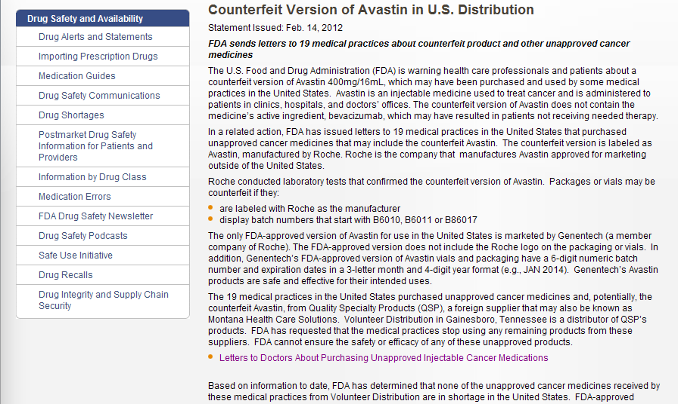
Public Notifications:
Counterfeit Avastin – February 2012

Slide 24
FDA’s Know Your Source campaign educates
healthcare professionals about:
the potential health risks to patients associated with administering counterfeit and unapproved drugs
safe purchasing practices to minimize the chance of receiving a counterfeit or unapproved drug
the legal implications associated with purchasing counterfeit or unapproved drugs

Slide 25
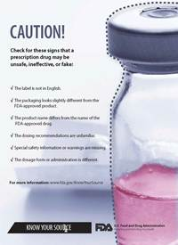
Know Your Source

Slide 26
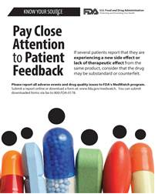
Know Your Source

Slide 28
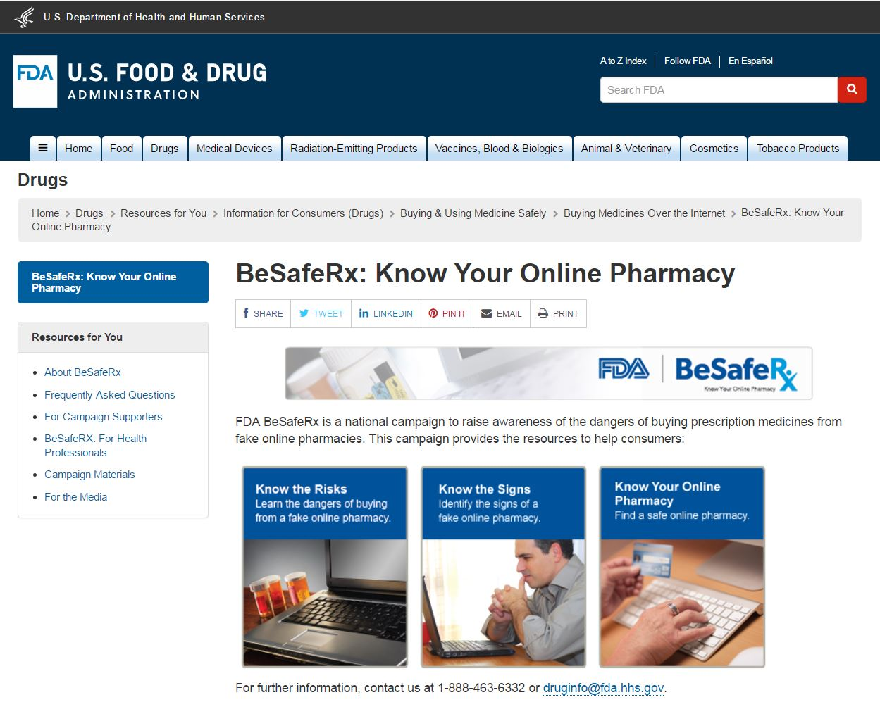
www.fda.gov

Slide 29
Know the Risks
You could receive counterfeit or substandard drugs.
!
Slight differences in your medicine can make a big difference.
You could put your personal and financial information at risk.
www.fda.gov
Notes:
29

Slide 30
Online Pharmacy Victim: Susan’s Story
www.fda.gov
www.fda.gov/Drugs/ResourcesForYou/Consumers/BuyingUsingMedicineSafely/BuyingMedicinesOvertheInternet/BeSafeRxKnowYourOnlinePharmacy/ucm318819.htm#Susan

Slide 31
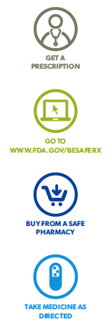
Know the Signs
WARNING! Beware of online pharmacies that:
Allow you to buy drugs without a prescription from your doctor
Offer deep discounts or cheap prices that seem too good to be true
Send spam or unsolicited email offering cheap drugs
Are located outside of the United States
Are not licensed in the United States
Tips for finding safe, legal online pharmacies:
Always require a doctor’s prescription
Provide a physical address and telephone number in the United States
Offer a pharmacist to answer your questions
Have a license with your state board of pharmacy
www.fda.gov

Slide 32
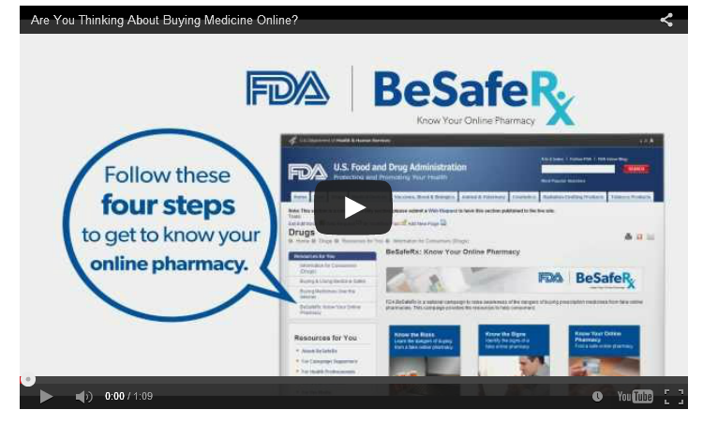
Are You Thinking About Buying Medicine Online?
http://www.fda.gov/Drugs/ResourcesForYou/Consumers/BuyingUsingMedicineSafely/BuyingMedicinesOvertheInternet/BeSafeRxKnowYourOnlinePharmacy/default.htm

Slide 33
Compliance and Enforcement
www.fda.gov

Slide 34
Strategy: tackling the problem
Prevention
Reduce manufacture of counterfeit and substandard products
Improve supply chain integrity
Focus on securing legitimate supply chain
Ensure transparency and accountability
Understand, mitigate, and contain the risks
Enhance regulatory and legal infrastructure and oversight
Detection
Improve surveillance
Efficient confirmation of products – lab capacity
Advanced technologies
Response
Enhance enforcement activities and tools
Effective notification of confirmed incidents
Efficient removal of products from the market

Slide 35
Compliance and Enforcement Tools
Regulatory meetings
Untitled letters
Warning letters
Seizures
Injunctions
Import alerts
Civil money penalties

Slide 36
Warning Letters
Goal:
Achieve voluntary compliance
Establish notice prior to enforcement actions

Slide 37
https://www.fda.gov/ICECI/EnforcementActions/WarningLetters/2016/ucm533718.htm

Slide 38
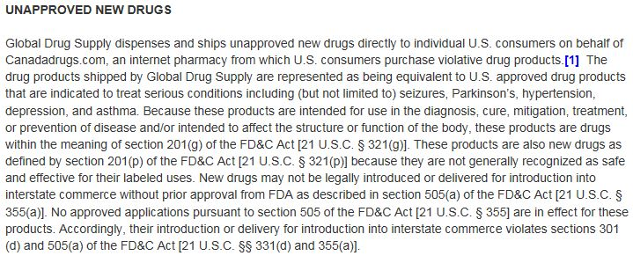
Global Drug Supply (cont.)

Slide 39
Example of Unapproved New Drug Shipped by Global Drug Supply
“While Pristiq is the name of an FDA-approved prescription drug, the product labeling for the drug shipped to the U.S. from Global Drug Supply is intended for Australia.”
Pristiq is approved for depression in the U.S.
U.S. labeling includes:
Boxed Warning regarding suicidal thoughts or actions
Reports of serotonin syndrome (a potentially life-threatening condition)
Other serious side effects (e.g., new or worsened high blood pressure, abnormal bleeding or bruising, and visual problems)

Slide 40
Example of Unapproved New Drug Shipped by Global Drug Supply (cont.)
“While Exforge is the name of an FDA-approved prescription drug…the product labeling for the drug shipped to the U.S. from Global Drug Supply states that it is distributed in Australia.”
Exforge is approved for high blood pressure in the U.S.
U.S. labeling includes:
Boxed warning regarding harm or death to an unborn baby
Warnings and precautions regarding low blood pressure, risk of heart attack or worsening chest pain, decreased kidney function, and increased potassium levels in the blood
Adverse reactions include swelling of the hands, ankles, or feet, nasal congestion or sore throat, head or chest cold, and dizziness

Slide 41
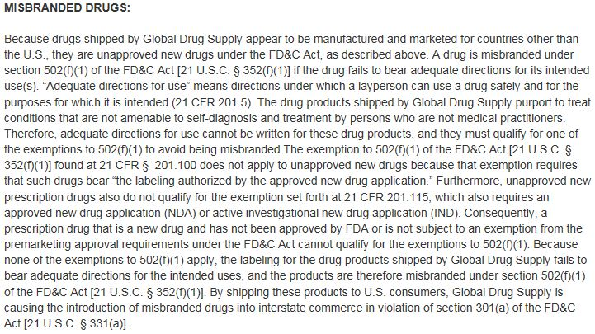
Global Drug Supply (cont.)

Slide 42
Operation Pangea
An annual international week of action led by Interpol to tackle the online sale of counterfeit and illicit medicines and highlighting the dangers of buying medicines online

Slide 43
Pangea activities target the 3 principal components used by illegal websites to conduct their trade:
Internet Service Provider (ISP)
Payment systems
Delivery service

Slide 44
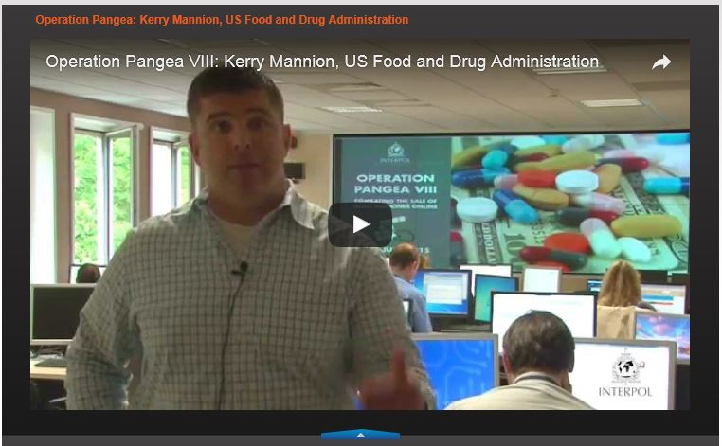
Operation Pangea
https://www.interpol.int/News-and-media/Videos/(video_id)/29433
www.fda.gov

Slide 45
Operation Pangea IX 2016
FDA sent formal complaints to domain registrars requesting the suspension of 4,402 websites
Included were 110 websites that sell the chemical 2,4-Dinitrophenol (DNP) as a weight-loss product never approved by FDA for use as a drug
FDA issued Warning Letters to the operators of 53 websites illegally offering unapproved and misbranded prescription drug products for sale to U.S. consumers
Collaborative effort between regulators and law enforcement to address public health risks

Slide 46
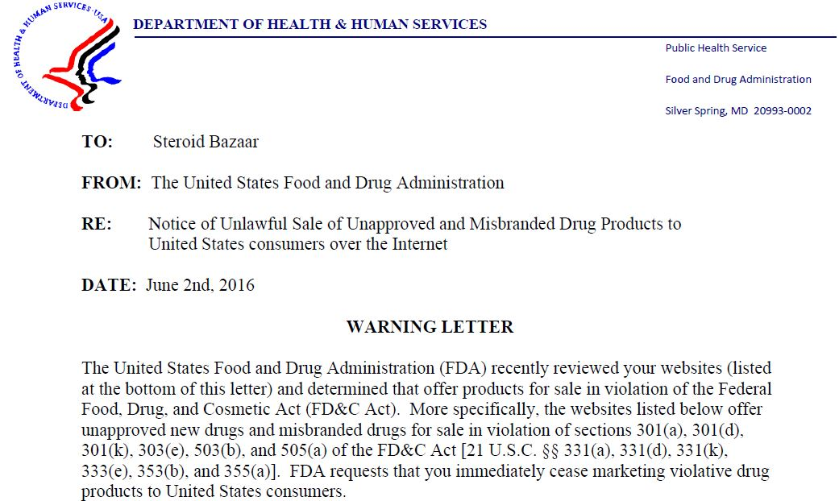
Pangea Warning Letter Example Steroid Bazaar
https://www.fda.gov/downloads/Drugs/DrugSafety/DrugIntegrityandSupplyChainSecurity/UCM505484.pdf

Slide 47
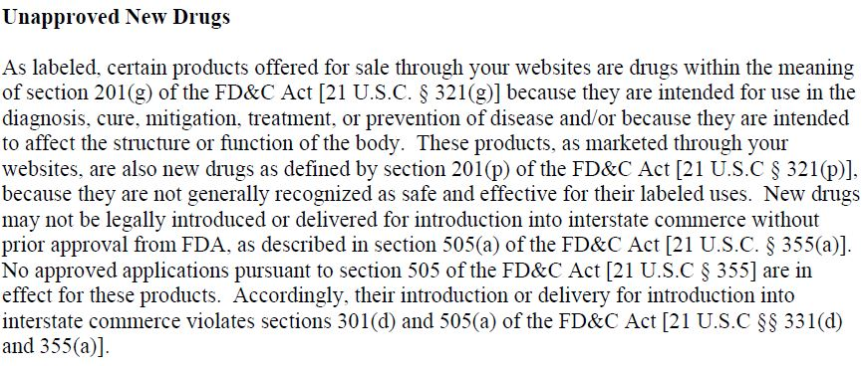
Steroid Bazaar (cont.)

Slide 48
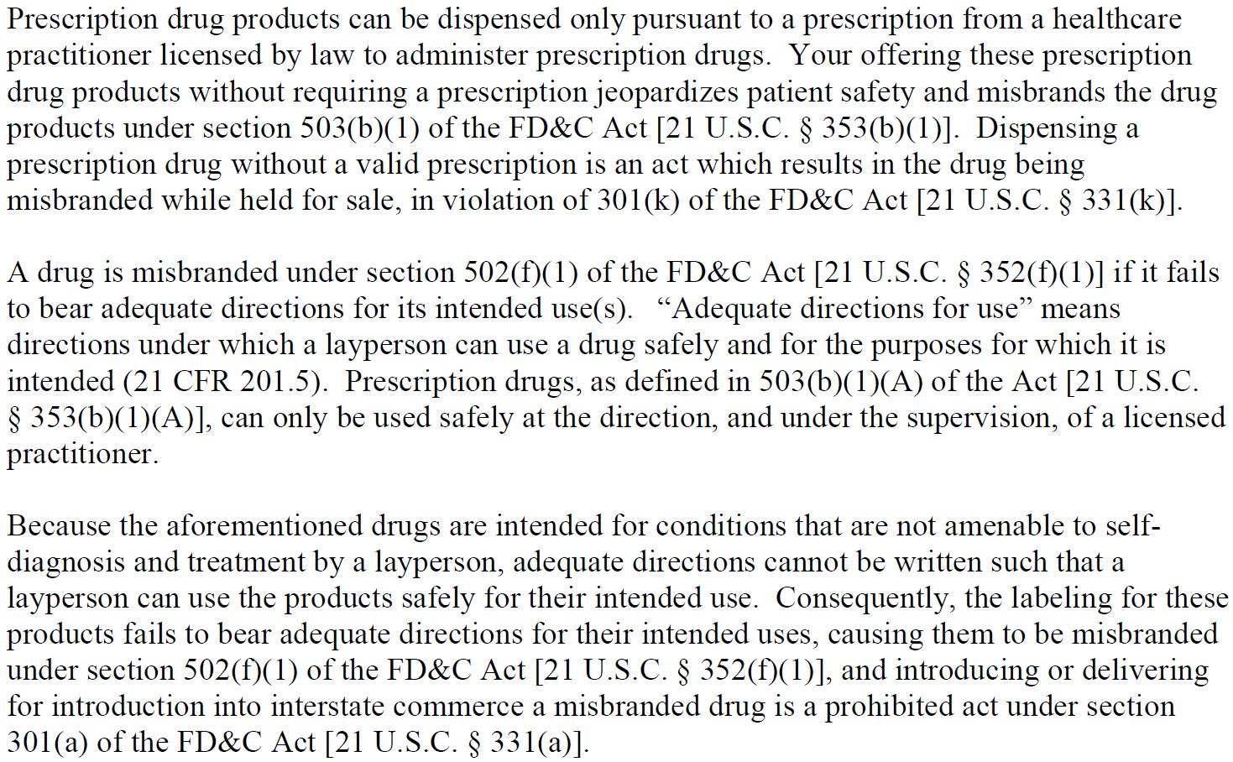
Steroid Bazaar (cont.)

Slide 49
Criminal Investigations
www.fda.gov

Slide 50
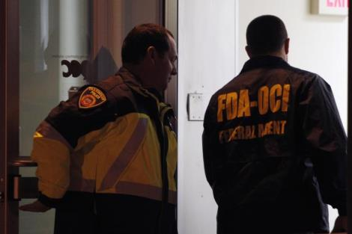
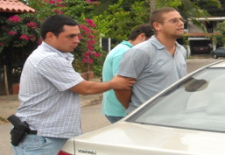
Office of Criminal Investigations
CDER FY 2016 criminal enforcement:
Arrests: 163
Convictions: 186
Fines/Restitutions: $309,442,407
www.fda.gov

Slide 51
Cybercrime Investigation Unit
Specially trained Criminal Investigators focused on dismantling illegal internet pharmacies in criminal courts
www.fda.gov

Slide 52
Legal Implications
www.fda.gov

Slide 53
Legal Implications
Defendant | Illegal Action | Result
Dr. Gayle Rothenberg | Injected more than 170 patients with unapproved drug, representing it as approved Botox Cosmetic | 27 months prison $98, 426 restitution
Dr. Mark Van Wormer | Injected patients with unapproved drug, representing it as approved Botox Cosmetic | 366 days prison $65,285 restitution
Dr. Albert Poet | Injected patients with unapproved drug without telling patients | 14 months prison
Dr. Jerome Lentini | Injected about 800 patients with unapproved drug, representing it as approved Botox Cosmetic | 18 months prison $330, 000 restitution

Slide 54
Criminal Convictions
November 18, 2016: Palm Harbor Oncologist Convicted Of Buying Unapproved Cancer Medications From Foreign Sources And Defrauding Medicare
November 10, 2016: Nurse Who Operated Spa in Laguna Niguel Agrees to Plead Guilty to Illegally Dispensing Botox Not Approved for Use in United States
July 15, 2015: Former Joplin Oncologist Sentenced for Dispensing Foreign Misbranded Drugs
December 16, 2013: Federal Jury Convicts Greeneville Oncologist And Practice Manager Of Violating Food, Drug And Cosmetic Act - Cancer Clinic Purchased Unapproved Drugs For Three Years

Slide 55
International Collaboration

Slide 56
Asia-Pacific Economic Cooperation (APEC)
Roadmap to Promote Global Medical Product Quality and Supply Chain Integrity

Slide 57
APEC is an international organization with the primary goal of facilitating sustainable economic growth and prosperity in the Asia Pacific Region
APEC provides funding for about 100 projects a year, which are open to participation for all 21 APEC member economies
The Roadmap for Global Medical Product Quality and Supply Chain Security was endorsed by the Life Science and Innovation Forum’s Regulatory Harmonization Steering Committee (RHSC) in 2013

Slide 58
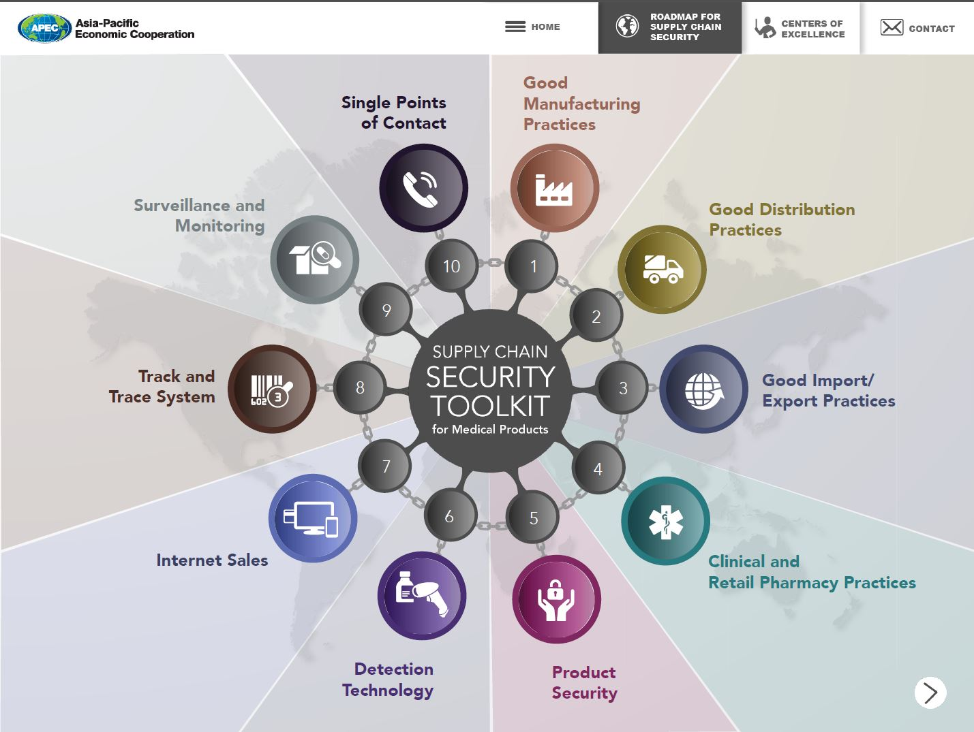

Slide 59
World Health Organization Global Surveillance and Monitoring System for Substandard and Falsified (SF) Medical Products
Platform to share information on a global scale regarding SF medical products
Purpose is to determine: 1) the scale of the issue; 2) the geographic extent; 3) the medicines affected; 4) the harm caused; 5) the value of the market; and 6) supply chain vulnerabilities
Reports of SF medical products are submitted to the WHO via an electronic rapid alert form
System immediately link reports to other known similar cases
Over 400 regulatory personnel from 126 Member States trained
Almost 1,400 SF medical products reported

Slide 60
Resources
Drug Supply Chain Integrity: http://www.fda.gov/Drugs/DrugSafety/DrugIntegrityandSupplyChainSecurity/default.htm
Know Your Source: www.fda.gov/KnowYourSource
BeSafeRx: Know Your Online Pharmacy: www.fda.gov/BeSafeRx
Report suspect products or suspect online pharmacies to FDA's Office of Criminal Investigations www.fda.gov/oci
Email: DrugSupplyChainIntegrity@fda.hhs.gov

