Slide 1
Promoting the Quality of Medicines (PQM)
Quality of Medical Products and Public Health
Boston University School of Public Health
July 12, 2017
Boston, MA
Jude Nwokike
Director | PQM Program
U.S. Pharmacopeial Convention (USP)

Slide 3
USP–USAID Cooperative Agreements
Rational Pharmaceutical Management (RPM) Worldwide
USP Drug Quality and Information Program (USP DQI)
Promoting the Quality of Medicines (PQM)
1992–2000
1993–2000
2000–2005
2005–2010
2009–2014
2014-2019
RPM Russia/NIS
DQI Extended
PQM Extended

Slide 4
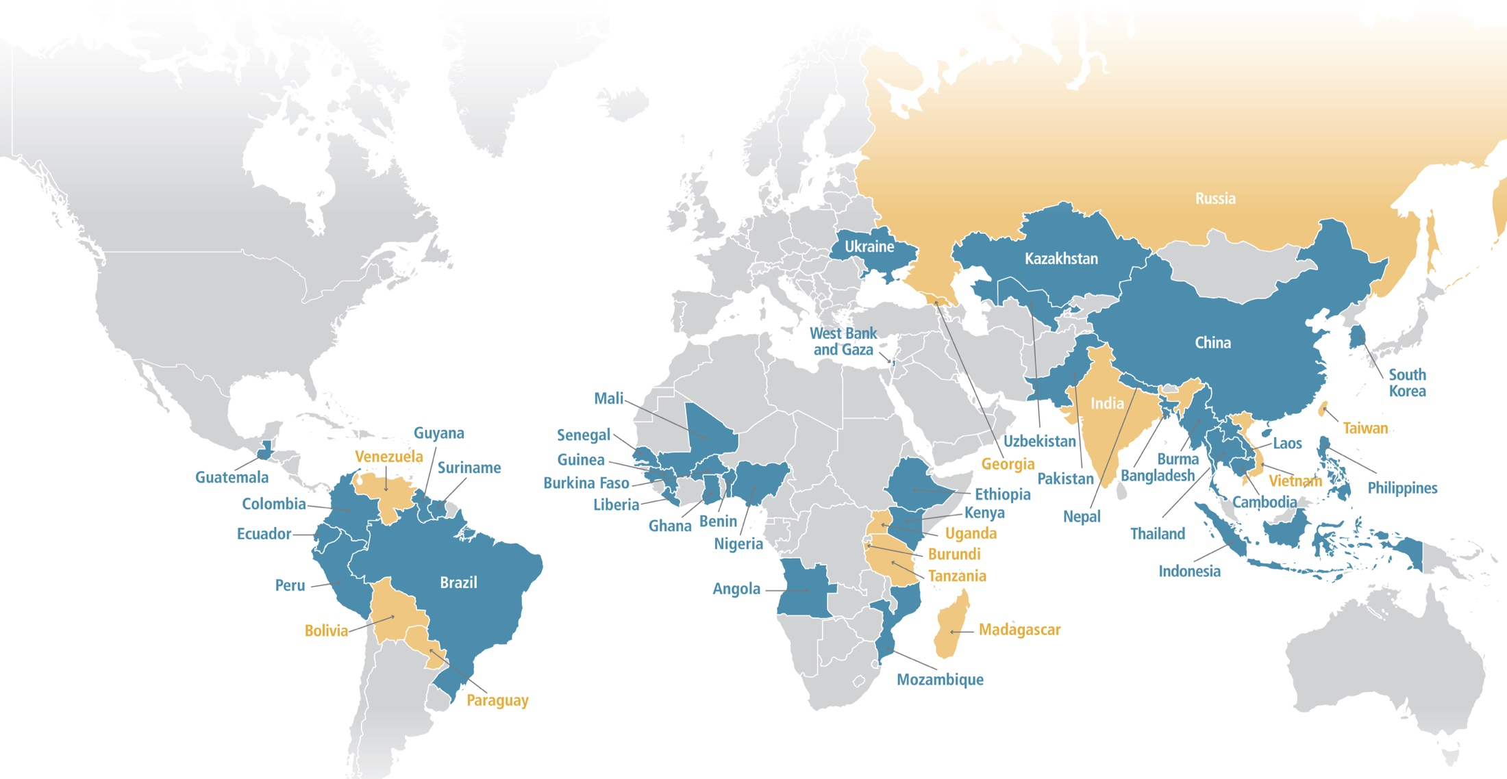
Global Footprint
Country with current PQM program activities
Country with previous PQM program activities

Slide 5
PQM Goal: Quality assurance systems strengthened to sustainably ensure quality and safety of medical products and protect public health
IR1: Medical products quality assurance systems strengthened
IR2: Supply of quality assured priority medicines increased
IR3: Utilization of medical product quality information for decision-making increased
IR 1.1 Quality assurance policies, legislation, guidelines and procedures improved
IR 1.2 Registration, inspection and licensing functions of medicine regulatory agencies sustainably improved (pre-market)
IR 1.3 Standard of practices at national quality control laboratories sustainably improved
IR 1.4 Institutional capacity for regulatory workforce sustainably improved
IR 1.5 Capacity for post-marketing surveillance of medical products sustainably improved
IR 2.1 Quality assured priority medicines produced locally increased
IR 2.2 Quality assured priority medicines produced globally increased
IR 2.3 Clinical research organization compliance with good clinical practices and good laboratory practices increased
IR 2.4 Sources of quality assured active pharmaceutical ingredients and finished pharmaceutical products diversified and supply secured
IR 3.1 Availability of information related to quality of medical products increased
IR 3.2 Enforcement actions against falsified, substandard and unapproved medical products increased
IR 3.3 Information on quality assurance of medical products used for advocacy increased

Slide 6
Medicine Quality Assurance Framework
Risk-based Regulation | Quality Manufacturing
Systems
Outcomes
Public Health Impact
Legal frameworks
Processes
Structures
Supply of safe, effective, quality-assured medical products improved
Patients protected from substandard and falsified medical products
Evidence-based decision making increased
Financial waste mitigated
Morbidity/mortality decreased
Drug resistance reduced
Confidence in health system increased
Health system efficiency enhanced
Adoption of International Standards
Standards

Slide 7
Building systems for quality-assured medical products

Slide 8
IR1 Medical Products Quality Assurance Systems Strengthened

Slide 9
Regulatory System Strengthening (RSS)
Administrative Elements
Policy, legislation, regulations
Human Resources
Finance
Infrastructure
New Legislation/Regulations, or Revise/reform existing regulations, policies as requested
Establish NRA or Strengthen regulatory workforce (define structure, competencies)
Technical Elements
Standards
Specifications
Guidelines
Procedures
Regulatory Functions
IRIMS – Content /
Guidelines / Standards
Licensing of premises, practices & persons
Inspection of manufacturers & distributors
Product assessment & registration
Quality control of labs & QC
of products
Control of drug promotion & advertising
PMS (Quality)
& PMS (PV )
Red Text Show areas of PQM core competency
Support GMP Licensing of manufacturers, distributors, warehouse and other pharmaceutical premises
Build capacity of inspectorates GMPs, GDPs, GSP, GCPs Inspections
Training in Good dossier review practices
Training in QMS, GLPs, GDPs, Testing, etc. toward WHO PQ ISO17025. Training in laboratory audits
Help develop PMS program (strategy, guidelines, and protocol). Help train on PMS

Slide 10
Liberia Case Study Developing a strong regulatory system from the ground up
Systems
THE NEED
In the post-conflict environment, Liberia did not have:
A functional regulatory authority and regulatory legislation
An operational national quality control laboratory (NCQL)
THE INTERVENTION
Advocacy/ Legislative Efforts:
Supported development of legislation leading to the establishment of the Liberia Medicines and Health Products Regulatory Authority (LMHRA)
Established guidelines and policies to regulate the market
Training and Capacity-Building:
Procured lab equipment, trainings and HR recruitment
Installed web-based registration software for regulatory systems and policies
Programs / Tools:
Established Medicines Quality Monitoring programs
Developed policies and procedures; introduced quality management system
Fostered South-South collaboration through regional trainings and knowledge sharing forums
THE IMPACT
Enforcement, including confiscation and incineration, of poor quality medicines
Operational NQCL is now able to test medicines entering and circulating within the country
Sustainability: LMHRA generates more than 60% of revenue through medicines registration fees

Slide 11
Strengthening Quality Assurance and Regulatory Workforce
Training by Year

Slide 12
Laboratory Quality Management Services
1
Works collaboratively with NQCL to build/strengthen quality management systems to international standards of practice
Systems for Facility, Equipment, Management, Personnel
Good Laboratory and Documentation Practices
Proficiency for Quality Control Testing
Internal Audit
Corrective and Preventive Action
Supports NQCLs to comply with international requirements and standards, leading to ISO/IEC 17025 accreditation and/or WHO prequalification
2

Slide 13
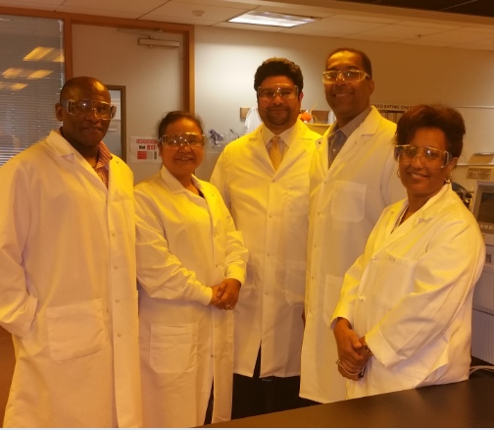
Analytical Laboratory Services
Dr. Farouk Umaru, Manager, Lab Services
PhD in Public Health, MBA
15+ years experience in QA/QC
Ms. Erwina De Castro, Scientist III
20+ years in QA/QC
B.S. Chemistry, and MBA
Mr. Shawn Hernandez, Scientist IV
Instrumentation expert; metrology, repairs, validation (10+ years exp.)
B.S. Chemical Engineering & Business Admin
Mr. Sanford Bradby III, Scientist V
20+ years QC testing of medicines
B.A. Chemistry
Ms. Ruth Habtemichael, Scientist II
16 years analytical QC testing
B.S. Chemistry
*Mr. Lukas Roth, Associate Program Manager
4+ years QC testing & MQM
Master of Public Health (MPH)
B.S. Molecular Biology & Physiology
* Provide partial support to ALS team
13

Slide 14
PQM Analytical Laboratory Services
Supports NQCLs to provide full lab services, including design, qualification, repairs, maintenance, calibration and metrology and quality control testing
Provides hands-on technical training in the quality control of medicines, to strengthen NQCL and local manufacturers, or for the purpose of ISO/IEC 17025 accreditation and/or WHO prequalification
Performs analytical tests for NQCLs who lack capacity, or for partners (UNICEF, USAID, WHO, NIH) prior to medicines procurement
Support development of monographs for public health – vitamin A liquid, zinc Sulfate, MiniLab™, etc.
Evaluate new field-based medicines detection tools, and train on existing tools such as MiniLab™, CD-3, TruScan™

Slide 15
7/2/2017
ISO 17025 Accreditation Body Identification Initiation, scope determination
WHO LIF Preparation
Milestone 3
10/13/2017
ISO 17025 Accreditation Body Visit Planning/Full w/ QMS
Milestone 5
4/12/2017
Non-Technical Training, Safety, GDP, GLP
6/12/2016
Facility Review (Accommodation/Environmental Conditions)
Milestone 1
11/13/2017
ISO 17025 Accreditation w/ QMS Milestone 6
1/30/2017
Equipment Qualifications (IQ/OQ/PQ), Use, Maintenance and Software Training
5/22/2017
Technical Analytical,
Dissolution,
HPLC UV-Vis
Milestone 2
9/29/2017
Additional Technical Training-2A
4/1/2016
Identify Technical and Managerial Staff
7/16/2016
QMS Support Visit
3/15/2017
Laboratory Equipment Calibration
8/11/2017
ISO 17043 Proficiency Testing Body Identification and Initiation
Milestone 4
2/5/2016
Initial QMS Gap Assessment
8/1/2016 – 12/31/2016
Quality Management Systems 4 & 5 Procedural and Instructional Development
12/12/2017
WHO LIF
Submission
Milestone 7
1/1/2016
4/1/2016
7/1/2016
10/1/2016
1/1/2017
4/1/2017
7/1/2017
10/1/2017
1/1/2018
9/29/2016 – 1/29/2017
Equipment/Supplies/Reagent Identification, Procurement, Acquisition and Installation
4/9/2017
Data Integrity Systems Identification and Development
8/12/2017 – 9/18/2017
ISO 17043 Testing completed
9/16/2018
OMCL Accreditation Body Surveillance Visit and Scope Expansion
Milestone 8
1/2/2018 – 1/1/2020
Continual Improvement of the ISO 17025 and WHO PQ Program
1/1/2016 – 12/31/2019
ISO QMS Reinforcement, Laboratory Sustainability and Continuity Plans Develop
11/6/2019
OMCL Full Re-accreditation
Milestone 9
1/1/2018
4/1/2018
7/1/2018
10/1/2018
1/1/2019
4/1/2019
7/1/2019
10/1/2019
1/1/2020

Slide 16
Stages Towards MQCL Strengthening
ISO AB or WHO
Inspection
Stage 5: Evaluation
Laboratory provides objective evidence of QMS implementation
Stage 4: Implementation & Monitoring
Stage 3: QMS & Analytical Skill Training
Provide training on laboratory QA functions and techniques
Develop quality, administrative
and technical policies, procedures, programs, processes, and systems for laboratory operations
Stage 2: Developing & Documenting QMS
Stage 1: Baseline Assessment
Perform gap analysis and
implementation plan development

Slide 17
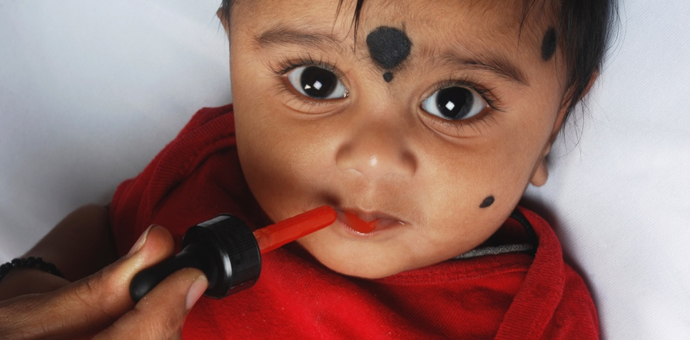
Improving organizational structure of Bangladesh’s laboratories A well-functioning and productive laboratory requires a streamlined and collaborative team. In a 2016 analysis, PQM determined that there was a lack of support for the team in place at the Directorate General of Drug Administration (DGDA) in Bangladesh.
PQM mapped expertise and skills of key NQCL staff positions, reviewed position descriptions and suggested improvements to the organizational structure of the lab that will align staff to better support DGDA’s mandate and NQCL functions.
PQM aided in the creation of an improved organizational chart of the DGDA, resulting in a proposed new structure for the DGDA/NQCL in Dhaka.
These organizational structure changes adopted by DGDA will better position the laboratory to qualify for international standard requirements. By creating a more efficient structure and properly using human resources, the laboratory will be able to fulfill its mandate more effectively.
Bangladesh
IR1

Slide 18
Peru Case Study Using a risk-based approach to promote sustainability and increase efficiency
Surveillance
THE NEED
Quality medicines surveillance activities were decentralized to regional health offices with no national strategy
Facilities and an overburdened laboratory lacked the technical and human resources needed to perform quality control in sampled medicines
THE INTERVENTION
Level 1 and Level 2 tests were performed in the field and allow for a reduction in samples that need analysis
USP developed a Three-Level Approach system that allows for rapid and cost effective analysis of medicines
THE IMPACT
Regional health offices were able to perform simple tests locally
The cost and time to get testing results was reduced
The backlog of medicines requiring analysis from a national lab were greatly reduced
This Three-Level Approach was adopted in Colombia, Ecuador, and Peru
Level 1: physical and visual inspection
Level 2: screening with simple analytical tests
Level 3: compendial analysis through the OMCL (Official Medicines Control Laboratory)
Notes:
-In Ecuador, this approach has been introduced in the PMS regulations; in Colombia and Peru, the methodology has been adopted for decentralized regions.
-Level 1: physical and visual inspection
-Level 2: screening with simple analytical tests
-Level 3: sampling with the OMCL (Official Medicines Control Laboratory)

Slide 19
Laboratory Technical Assistance
No. of Labs Receiving Assistance from PQM | ISO Certification/ WHO PQ (includes reaccreditation and requalification)
Total: 61 LAC 2 NIS 5 Asia 36 Africa 18 | 31 WHO PQ (4) ISO Certification (27)

Slide 20
NRAs took 332 actions to protect public health – using data generated with support from PQM

Slide 21
IR2 Supply of Quality Assured Priority Medicines Increased

Slide 22
Supply of Quality Assured Priority Medicines Increased
IR2 activities increase the supply and access to a steady supply of essential, locally produced, quality-assured medicines, targeting USAID priority health programs. Our goal is to deliver targeted and customized technical assistance to local manufacturers to address quality-related issues including:
good manufacturing practices
good laboratory practices
good clinical practices
IR2

Slide 23
Chemistry, Manufacturing & Controls (CMCs) & Good Manufacturing Practices (GMPs)

Slide 24
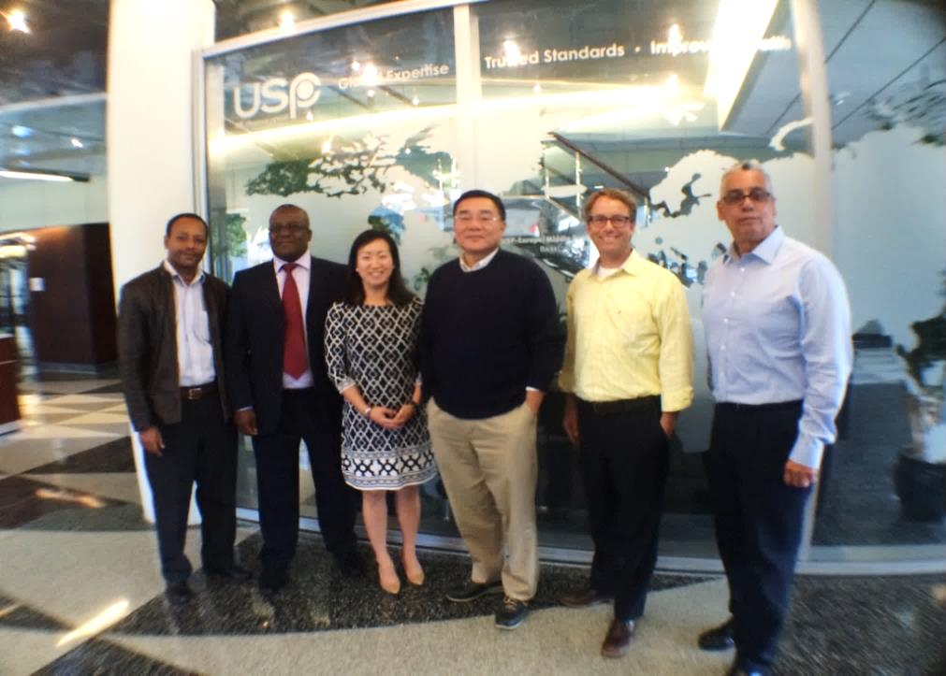
Manufacturing Services (CMC/GMP Team)
Dr. Allan Hong, Manager GMP Team 20+yrs API Process Dev/Scale-up/Launch Ph.D. Chemical Engineering
Mr. Edwin Toledo, Senior GMP Specialist GMP Inspection, FPP Development and Manufacturing; ASQ Certified; Industry experience
Mr. Teferi Bedane, Senior GMP Specialist GMP Inspection; Dossier Assessment; ASQ Certified; Former Regulator(Ethiopia)
Ms. Jennifer Derry, GMP Specialist Quality System Auditing; ASQ Certified; Industry experience
Mr. Michael Megargee, Senior GMP Specialist GMP Inspections; Validation/Qualification; Industry experience
Mr. Gabriel Kaddu, Senior GMP Specialist GMP Inspection; WHO Dossier Assessment; Former Regulator(Uganda)
Over 80+ years of combined experience
24

Slide 25
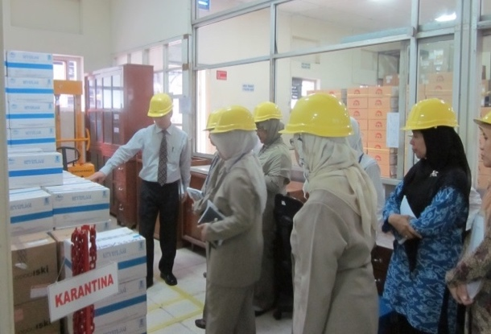
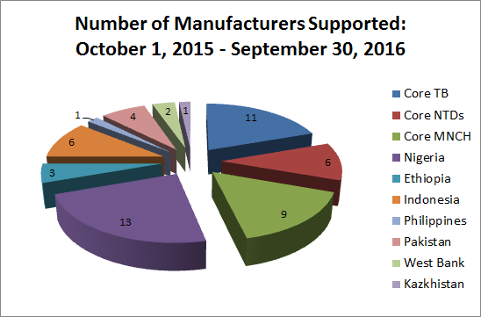
Technical Assistance to Manufacturers
Top-notch GMP experts with EU, US FDA, and WHO PQ experiences
Extensive knowledge of the API and FPP landscape of the global public health market
Strong relationship with manufacturers and CROs
Intense hands-on and results-driven technical assistance, until product is approved

Slide 26
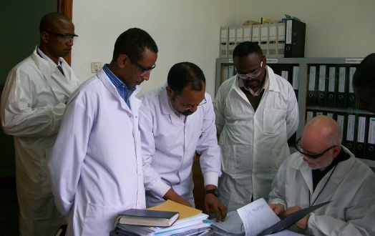
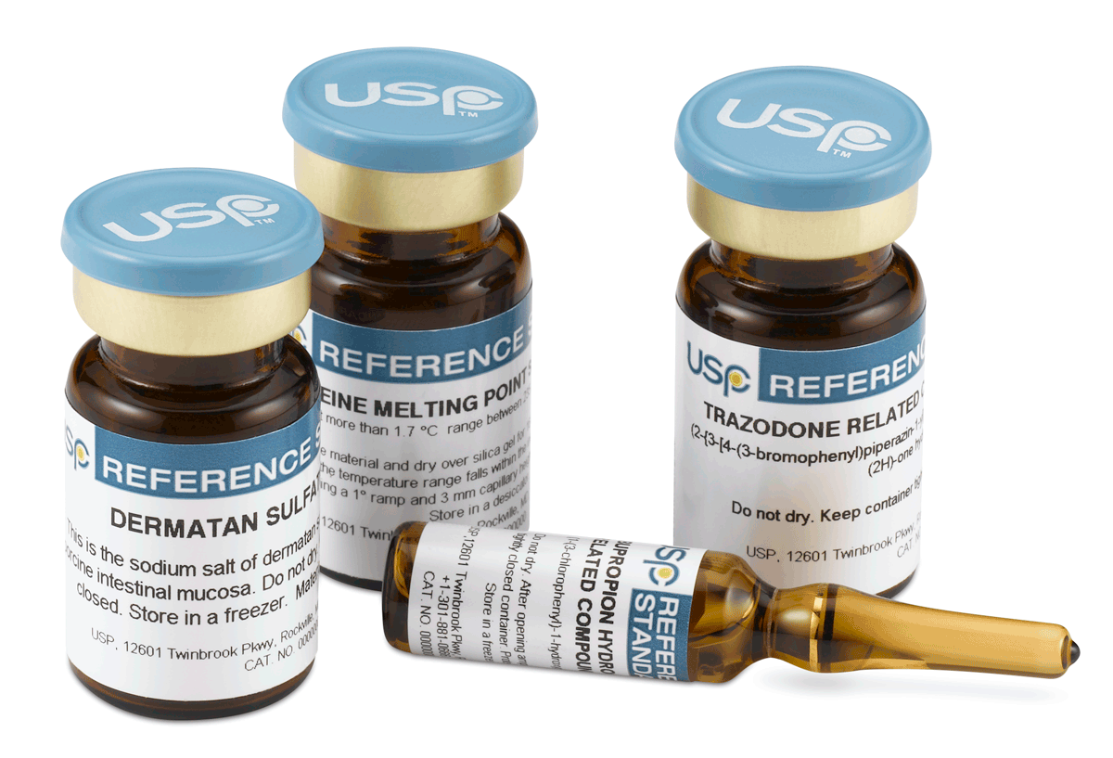
Technical Assistance to Manufacturers
Provide hands-on training and consultation to manufacturers on process/ product development and manufacturing
Provide guidance on API process development and scale-up
Provide guidance on drug product development and scale-up
Troubleshoot API and formulation process issues
Support to product dossier
Assist in the compilation of dossiers according to CTD format → CTD Module 3 (Quality) and Module 5 (BE/Clinical)
Direct critical research to fulfill dossier requirements
Support to facility GMP/GCP Compliance
Manufacturers – GMP compliance
Contract research organization – GCP/GLP compliance
Continuous follow-up and support until product approval

Slide 27
Dossier: Common Technical Document Format
Multisource (generic) products
Not part
of the CTD
CMC/cGMPs
Regional administrative information Module 1
BA/BE
Module 2
Non-clinical overview
Clinical
Overview
Quality overall
summary
Non-clinical summary
Clinical summary
The CTD
Quality
Module 3
Non-clinical study reports
Module 4
Clinical study reports
Module 5

Slide 28
CTD Module 3 (Quality): CMC/cGMPs
CMC
Product-specific, API and FPP Development/ Manufacturing (Product/Process Understanding)
cGMPs
Facility-oriented / Overall operations Quality systems
CMC and GMP compliance may overlap
but they are not the same
Notes:
Reviewing the CMC information and doing a GMP inspection are two different ways we ensure that a product has appropriate quality and controls.
CMC information is totally specific to a product – and CVM’s review of the CMC is a scientific evaluation of whether the data provided by the manufacturer demonstrates it has appropriate manufacturing procedures and controls to produce a safe and effective drug that is accurately described by the product label.
On the other hand, GMPs typically tend to encompass the manufacturer’s overall operations – for example, their record keeping, equipment cleaning and maintenance, raw materials control, validation of manufacturing processes, sampling and testing, quality control, etc. If something does go wrong with a batch of product, a GMP-compliant facility should be able to track down the cause of the problem and trace other batches that may have also been affected.

Slide 29
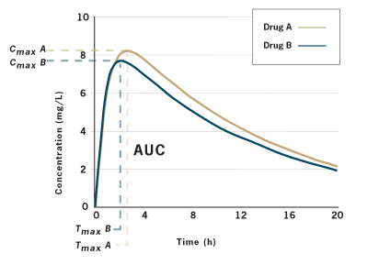
CTD Module 5 (Clinical): BA/BE Studies
High cost of BE studies and surge in notice of concern make this a key area of need
PQM provides technical support to regulators and CROs to conduct BA/BE studies, according to GCPs and GLPs
Training of regulators and CROs
BA/BE guidance and procedures
GCP Support - Protocol development, study conduct, monitoring, termination, QMS audit, PK/Stats analysis, reporting and documentation
GLPs (ISO/IEC 15189,17034)
Reference (R)
Test (T)

Slide 30
GMP Technical Assistance Activities
Manufacturers identified through workshops, request by manufacturer or PQM partners
PQM performs on-site
gap analysis of the manufacturer
(GMPs and Dossier)
PQM issues full assessment report and work with manufacturer to develop an effective CAPA plan
PQM assists with queries and CAPA implementation until product is approved
PQM conducts mock audit and verify dossier prior to regulatory submission
PQM assists the manufacturer to develop, compile and review dossier
Medicine regulatory authorities and manufacturers are trained in all aspect of dossier and cGMPs as depicted above.
PQM technical assistance assists pharmaceutical manufacturers particularly in low to middle income countries toward regulatory compliance for stringent markets such as the United States, Europe, and the WHO Prequalification program.
By obtaining the approval of a stringent regulatory authority, quality-assured high-priority medicines become available to the public health market.
Notes:
Clean up

Slide 31
Timeline Towards WHO Prequalification
Technical Questionnaire
Milestone 1
Dossier Acceptance
Milestone 4
Full WHO Prequalification
Initial GMP Gap Assessment
Milestone 2
WHO PQ Site Approval
Business Contact
PQM Mock Audit
Registration Batches
Dossier Submission
WHO Inspection
Milestone 3
WHO PQ Dossier Approval
Market Intelligence
Dossier TA
TA on Dossier Inquiries
1/1/2016
1/1/2017
1/1/2018
1/1/2019
12/31/2019
Tech Dev TA
BE Study
TA on WHO Inspection CAPA
Scale Up TA
For manufacturers experienced with the process of submitting a product dossier to a Stringent Regulatory Authority (SRA), the timeline for WHO PQ is estimated to be 18 - 24 months.
For the majority of inexperienced companies, it can take up to 36 months.

Slide 32
USP PQM Portfolio ─ Current USAID Priority Medicines By Disease Program
Tuberculosis | Maternal, Newborn, Child Health | Neglected Tropical Disease
High Priority: Kanamycin Sulfate API, Clofazimine API, Clofazimine 100mg capsules Linezolid API, Linezolid 600 mg coated (scored) Gatifloxacin API, Gatifloxacin 200mg Tablet Gatifloxacin 400mg Tablet Moxifloxacin API Rifapentine FDC (Rifapentine with INH) Pediatric first line fixed-dosed combination (preferably dispersible or crushable tablets): Rifampicin(R) 75 mg/ Isoniazid 50mg / Pyrazinamide 150mg Rifampicin(R) 75 mg/ Isoniazid 50mg Medium Priority Capreomycin API Terizidone API Terizidone, tablet/capsule 250 mg Terizidone, tablet/capsule 300 mg Rifampicin API | High Priority: Amoxicillin 250 mg scored DT 7.1% Chlorhexidine digluconate (4%) gel 7.1% Chlorhexidine digluconate (4%) sol Medium Priority: Magnesium sulfate injection 500 mg/ml, in 2-ml and 10 ml ampoule Gentamicin injection 10mg/ml and 40 mg/ml, in 2-ml vial Medium - low Priority: Oxytocin, injection 10 IU, 1-ml Low Priority: Misoprostol 200-ug tablet Betamethasone injection 5.7 mg/ml (betamethasone sodium phosphate 3.9 mg/ml solution, or betamethasone acetate 3 mg aqueous suspension) Dexamethasone injection 4 mg injection (4 mg dexamethasone disodium phosphate in 1-ml ampoule) | High Priority: Praziquantel API Praziquantel 600mg Tablet Medium Priority: Mebendazole API Mebendazole 500mg tabet (chewable*) Albendazole API Albendazole 400mg tablet (chewable*, preferably scored)

Slide 33
Cycloserine Case Study Increasing access through cost reduction and enhanced supply
Supply
THE NEED
A global supply of quality assured cycloserine – a medicine for multi-drug resistant Tuberculosis
Access to an affordable, quality assured product, as manufactured by Dong-A Pharmaceuticals (Korea)
THE INTERVENTION
Policies and Procedures:
Standard Operation Procedures (SOP) Development
QMS design and implementation
Technical Expertise:
Formulation guidance
Good Manufacturing Practices (GMP) assistance to improve quality systems
WHO Prequalification (PQ) Support
Trainings, mock audits and WHO Prequalification process facilitation
THE IMPACT
WHO PQ led to a 30% price decrease for the product, cycloserine
More than 100,000,000 quality-assured units sold since PQ
PQM worked with Dong-A to develop a product and active pharmaceutical ingredients (API) formulation for clofazimine, a new WHO-recommended short-term, 9-month, regiment for multi-drug-resistant tuberculosis (MDR-TB)
The trust built between PQM and Dong-A led the company’s leadership to integrate public health into its mission, with a focus on market-shaping versus profit margins

Slide 34
Partnering with Stakeholders to improve Ethiopian manufacturers GMP compliance Improving access to quality medicines through local production is a key goal of the Ethiopia Health Sector Transformation plan. Interventions addressing local production are built on the good manufacturing practices (GMP) roadmap developed by PQM in 2013.
In collaboration with WHO and the United Nations Industrial Development Organization (UNIDO), PQM conducted the second round of manufacturer assessments as part of the roadmap and prepared a consolidated assessment report on the good manufacturing practice status of local pharmaceutical manufacturers.
Cadilla Pharma continues to show significant GMP improvements and is expecting to undergo a WHO PQ audit for ethambutol tablets in Q3. PQM continues to support this local manufacturer.
Ethiopia
IR2

Slide 35
Expanding locally manufactured quality medicines for newborns In Pakistan, thousands of newborn children die each year from umbilical cord infections, preventable by quality-assured chlorhexidine (CHX) gel products.
To help improve the availability of quality-assured CHX, PQM provided technical assistance to local manufacturers to improve and attain current good manufacturing practices for CHX 7.1% gel.
As a result of this support, two products were approved for registration by the Drug Registration Board, marking the first time local CHX received government authorization for production.
The start of sales by two local manufacturers will result not only in use of quality-assured, locally produced CHX in Pakistan, but also allow for potential exports to other countries that also need quality-assured CHX 7.1% gel. This is a notable accomplishment in helping to combat infections and infant mortality.
Pakistan
IR2

Slide 36
Support to Manufacturers
PQM provided technical assistance to 62 manufacturers of priority medicines (anti-malarial, anti-TB, MNCH, and NTD products) in 11 countries

Slide 37
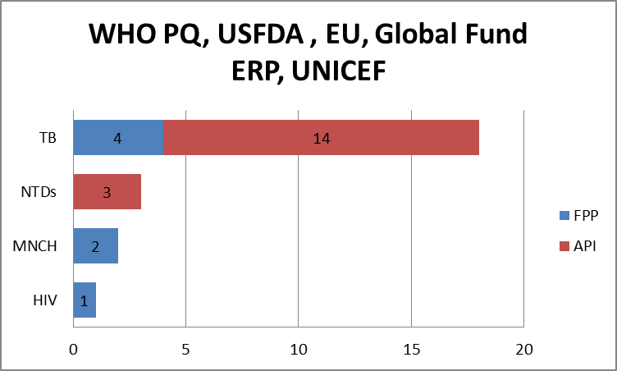
37

Slide 38
IR3 Utilization of Medical Product Quality Information for Decision-Making Increased

Slide 39
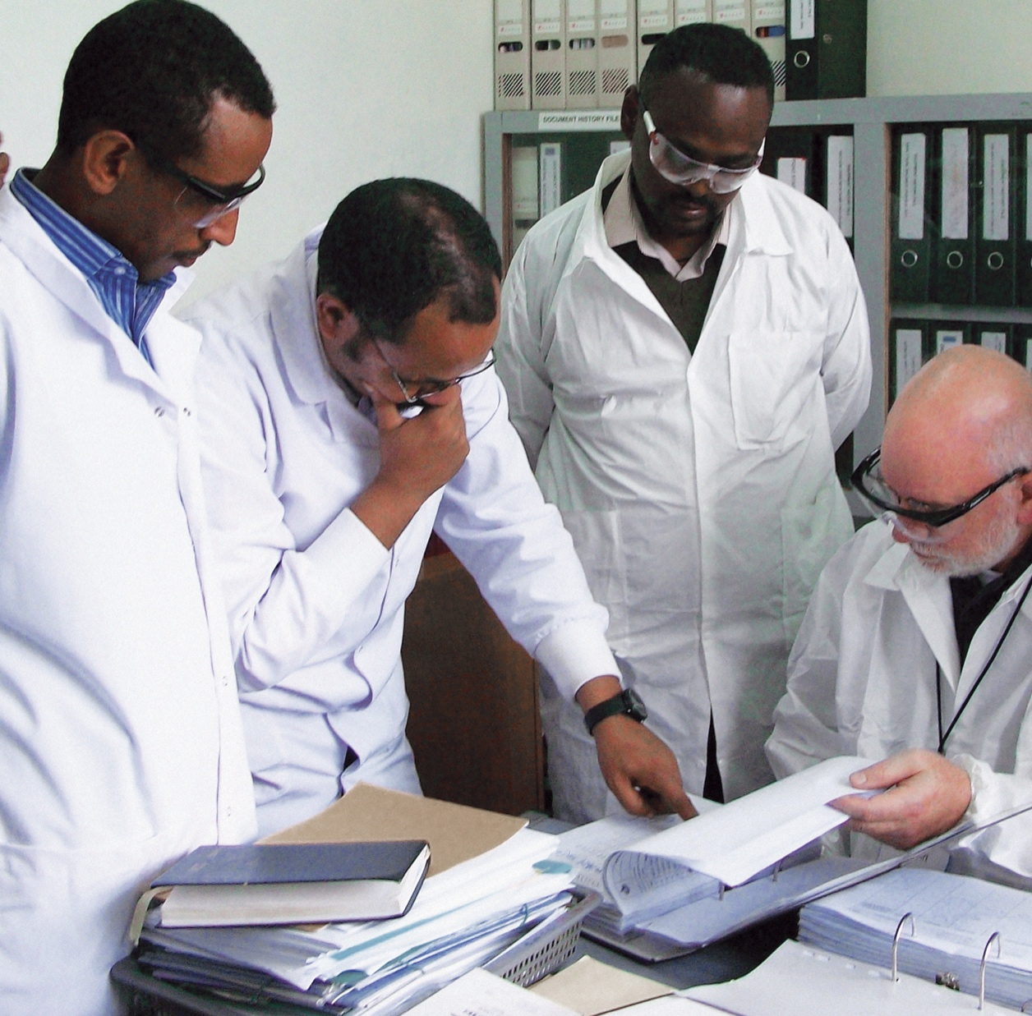
Utilization of Medical Product Quality Information for Decision-Making Increased
Through IR3, PQM serves as a global technical leader in medicines quality assurance and an advocate for medicines quality in collaboration with a number of partners. We harness technical expertise, scientific knowledge and decades of on-the-ground experience to:
provide thought leadership in quality assurance
develop and disseminate innovative and efficient quality testing techniques and approaches
advocate for the promotion of quality medicines and the eradication of falsified and substandard products
IR3

Slide 40
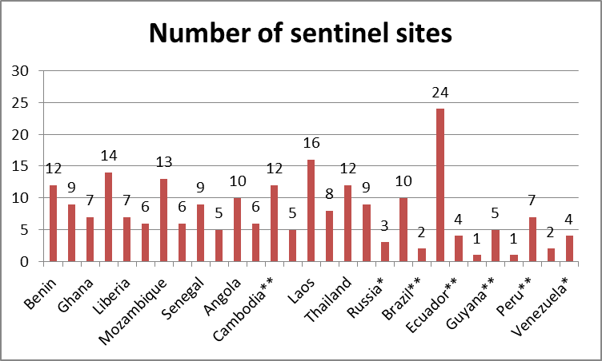
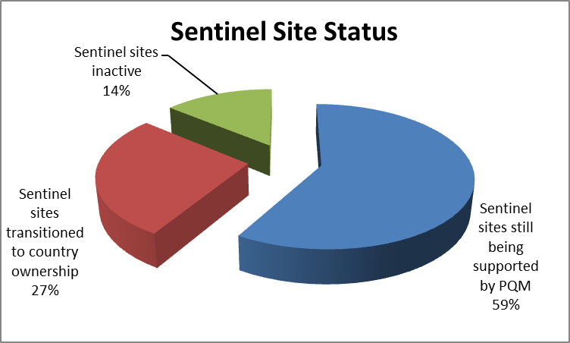

Slide 42
Collaborating with WHO on the Rapid Alert System

Slide 44
Research and Innovation Data for decision making and advocacy
USP facilitates collaboration between partners and advocates for increased commitments to medicines quality. Drawing on 200 years of experience, USP leverages its expertise to promote standards and best practices, providing data for decision-making through research and surveillance activities.
1
Medicines Quality Database (MQDB)
2
Medicines Quality & Antimicrobial Resistance Study
3
Research on the value of quality
Notes:
The initial research will be a desk-based review of literature surveying any existing links or supposed links between poor quality medicines and AMR.
Upon review of findings, USP will determine what further research is needed and how to support those efforts, with the potential hope of a strategic partner.

Slide 45
Partnerships for Workforce Development – Key to Sustainability
Curriculum
Development
Joint Drug
Quality Research
Joint Capacity Building Training
Knowledge and expertise sharing
Academic Institutions
Industry
Technology
Transfer
Internships

Slide 46
Academic Collaborations Supporting workforce development
PQM collaborates with academic institutions to strengthen quality assurance education curricula to prepare the next generation of pharmaceutical and regulatory professionals.
Examples include:
PQM Nigeria developed pharmaceutical quality assurance curricula for inclusion in undergraduate and postgraduate diplomas at institutions across Nigeria and is developing content for e-Learning academy in Nigeria
PQM Ethiopia supported development and launch a masters program in regulatory affairs
PQM Cambodia supported two universities to improve academic programs in medicines regulation and QA

Slide 47
Highlight of selected Tools MQDB, MedvigiL1

Slide 48
Acronyms
ALS – Analytical laboratory services
API – Active pharmaceutical ingredient
BA/BE – Bioavailability/bioequivalence
CAPA – Corrective and preventive action
CHX – Chlorhexidine
CMC – Chemistry, manufacturing, and controls
CRO – Clinical research organization
FDA – Food and drug authority
FPP – Finished pharmaceutical product
GCP – Good clinical practices
GLP – Good laboratory practices
GMP – Good manufacturing practices
MNCH – Maternal, newborn, and child health
MOH – Ministry of Health
MRA – Medicines Regulatory Authority
NQCL – National quality control laboratory
NTD – Neglected tropical diseases
PMS – Post-marketing surveillance
PQM – Promoting the Quality of Medicines program
QA/QC – Quality assurance/quality control QMS – Quality management systems
TB – Tuberculosis
USAID – United States Agency for International Development
USP – U.S. Pharmacopeial Convention
WHO – World Health Organization
WHO PQ – World Health Organization Prequalification

Slide 49
Questions
Please send questions to jin@usp.org

Slide 50
Thank You
This document is made possible by the generous support of the American people through the United States Agency for International Development (USAID). The contents are the responsibility of the Promoting the Quality of Medicines program and do not necessarily reflect the views of USAID or the United States government.

