Slide 1
QM222 Nov. 13 Section A1 Experiments

Slide 2
On presentations: You’ll get link for signup today
5-10 minute presentations are graded only for preparing and giving them.
I and your fellow students will give you suggestions and comments based on your presentation’s content.
My comments are NOT a substitute for my written comments.
Presentations should include:
A slide introducing your project: what the question is, making it clear who the recipient of the report is.
A table of regression results with variables names that everyone can understand. (Text boxes etc. with key take-aways are useful here.)
You could give >1 regression and can have additional tables or graphs.
A conclusion.

Slide 3
Randomized Controlled Experiments (RCT) and Lab Experiments
Businesses use experiments to figure out what works
Pricing experiments
Marketing experiments
Governments do policy experiments
Why? Because it is generally hard to be sure that you have identified “causation” in data analysis
The Internet makes RCTs very simple to do.

Slide 4
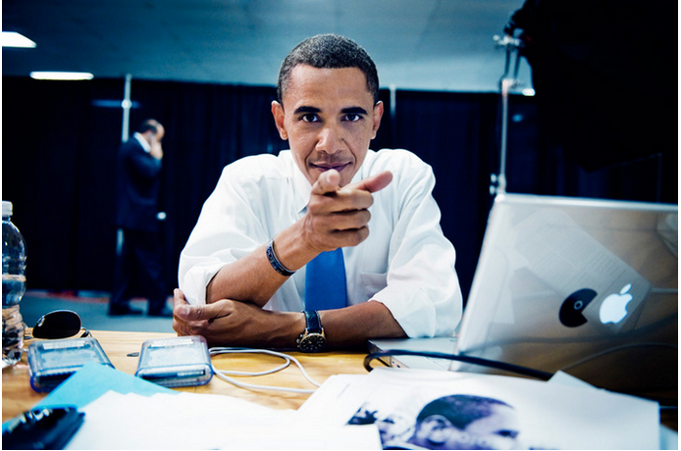
Real-world example: How Obama raised $60M by running a simple experiment
Dan Siroker was working in Google in 2007, when he decided to join the campaign as Director of Analytics.
His job was to “use data to help the campaign make better decisions”.
His task was to maximize sign-ups for campaign emails
Notes:
The best way to reach me is via email, which I check frequently.
My office hours are BUT if ever you want to meet with me at another time, just let me know and we can make an appointment. I will also be eating lunch most Wednesdays at noon in Breadwinners. I would love it if you would join me for lunch.

Slide 5
How Obama raised $60 Million by running a Simple Experiment
The experiment tested two parts of the splash page:
the “Media” section at the top and
the call-to-action “Button”
They tried four buttons and six different media (three images and three videos) – 24 combinations.
Every visitor to the splash page was randomly shown one of these 24 combinations. (Sometimes called A/B testing)
Outcome they wanted to maximize: sign-up rate
Number of Observations: 310,382 visitors to the splash page during the experiment that meant each variation was seen by roughly 13,000 people.
http://blog.optimizely.com/2010/11/29/how-obama-raised-60-million-by-running-a-simple-experiment/

Slide 6
Here were the 4 buttons

Slide 7
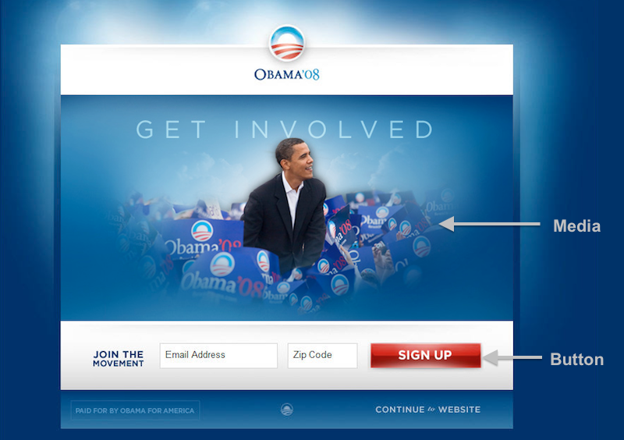
Here is one of the 24 combinations

Slide 8
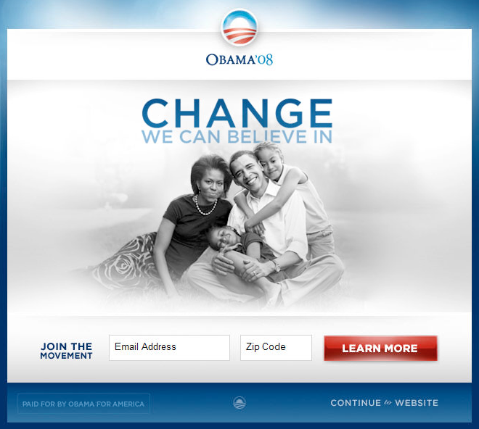
The Winner?

Slide 9
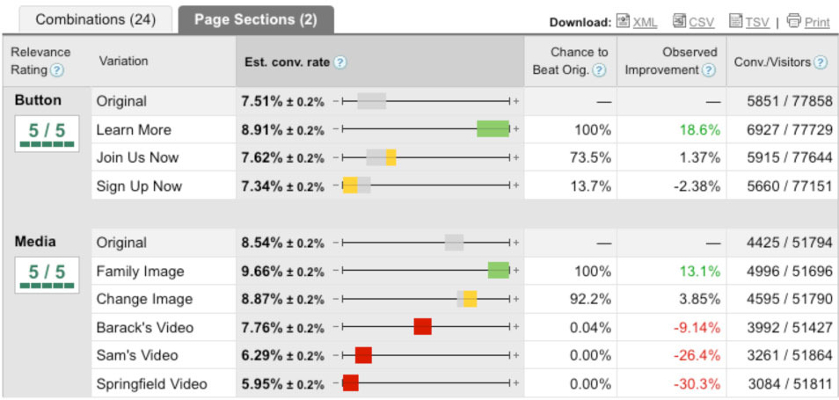
Here were their statistics (averages with 95% confidence intervals) Rather than considering the 24 combinations separately, this table separates out buttons and media

Slide 10
Impact
The sign up rate for the winning design was 11.6%
The sign up rate for the original design was 8.26%
This would create a difference of 2,880,000 emails
The average donation per email was $21
This translates into an additional $60M in donations
Notes:
The best way to reach me is via email, which I check frequently.
My office hours are BUT if ever you want to meet with me at another time, just let me know and we can make an appointment. I will also be eating lunch most Wednesdays at noon in Breadwinners. I would love it if you would join me for lunch.

Slide 11
Randomized Control Trials (RCTs)
In randomized experiments, people are randomly assigned to being in the treatment group or the control group.
Randomly assigning people to a treatment is the most important dimension of an experiment.
Random experiments are the
GOLD STANDARD of research.

Slide 12
Randomized Control Trials (RCTs)
Because assignment to the treatment group has nothing to do with the characteristics of the participants:
on average participants in the treated group will be similar to those in the untreated group
so we can be confident that the difference between the two groups is caused by the treatment.
In other words, there is no selection bias
The average level of potential confounding factors are the same on average

Slide 13
In the Obama case, before they ran the experiment, the campaign staff heavily favored one of the videos, “Sam’s Video”.
Suppose they didn’t run the experiment, but tried the Sam’s video for a couple of weeks and saw a decrease in sign-up rates.
Would that be convincing evidence that the original website was better?
What are some examples of businesses who use A/B testing?

Slide 14
Another marketing A/B example from Freakonomics podcast
A supermarket chain wanted to know which would induce people to buy more groceries when they visited the supermarket:
Fast, lively music
Slow, mellow music
No music
What kinds of things did they have to watch out for to make sure that this was truly randomly assigned?

Slide 15
Lab experiments are ones done in a lab, not “in the field” Last year, I did an experiment in class asking: Do people learn better on paper or on a computer?
We gave people some GRE vocabulary definitions
Half read them from a pdf
Half had a piece of paper.
Why did we need an experiment?
How should we have assigned the paper v. computer roles?

Slide 16
How did I use the results to figure out which method was more successful? Regression of course!
Run a regression of the outcome
on a dummy variable for treatment.
Why don’t I need to control for other factors?
How would controlling for other factors affect my estimated coefficient on treatment?

Slide 17
Result of our experiment across both classes
Regression Statistics
Multiple R | 0.1990
R Square | 0.03960
Adjusted R Sq | 0.02275
Standard Error | 1.0049
Observations | 59
ANOVA
 | df | SS | MS | F | Significance F
Regression | 1 | 2.37337986 | 2.37338 | 2.350337 | 0.130788
Residual | 57 | 57.55882353 | 1.009804
Total | 58 | 59.93220339
 | Coefficients | Standard Error | t Stat | P-value | Lower 95% | Upper 95%
Intercept | 7.2059 | 0.1723 | 41.8127 | 0.0000 | 6.8608 | 7.5510
Treatment (Computer) | -0.4059 | 0.2647 | -1.5331 | 0.1308 | -0.9360 | 0.1243

Slide 18
Another experiment: Labor Market Outcomes of Immigrants to Canada (from Oreopoulos 2011)
Recent immigrants to Canada struggle in the labor market.
Unemployment rates are twice as high.
Median wages of immigrants are 45% lower compared to native workers of the same education and experience levels
In other words, if you run a regression of wages on immigrant status, education and experience (using a method that finds median not average)…
You find that immigrants have 45% lower salaries.
Question: Can we conclude based on these numbers that there is discrimination against immigrants in Canada?

Slide 19
Are we observing otherwise similar immigrants and Canadian natives? NO!
Place of birth | Canada
Education | BA from McGill
Language skills | Perfect French and English
Networks | Strong
Driven ? | So, so
Earnings | $ 50K
Place of birth | Colombia
Education | BA from Uniandes
Language skills | Good English Little French Perfect Spanish
Networks | Weak
Driven | Very!
Earnings | $ 35K

Slide 20
The experiment
Thousands of resumes were sent online in response to job postings across multiple occupations in Toronto after randomly varying characteristics on the resume to uncover what affects employer’s decisions on whether to contact an applicant.
The resumes were constructed to plausibly represent recent immigrants to Canada from the three largest countries of origin (China, India, and Pakistan) and from Britain, as well as non-immigrants with and without foreign-sounding names
The author made different combinations of :
where applicants received their undergraduate degree
whether their job experience was gained in Canada or in their home country
whether their name sounded foreign

Slide 21
4 resumes were sent to each employer advertising a job over a 2 to 3 day period in random order
Type 0: The first represented an applicant with an English sounding name, Canadian undergraduate education, and Canadian experience
Type 1: Foreign sounding name, but still listed Canadian undergraduate education and Canadian experience
Type 2: Foreign-sounding name, foreign undergraduate degree, and Canadian experience.
Type 3: The fourth included a foreign-sounding name, foreign education, and some foreign experience.
The outcome they looked at? Whether the employer called them back (for a telephone or face-to-face interview)

Slide 22
How did they analyze the results?
Using regression, of course.
But the ONLY variable you need is the indicator variable(s) for the “treatment”
Which here means what “type” the application was.
You do NOT need to control for anything else that might possibly confounding. Why?

Slide 23
The author ran a regression on the different randomly chosen alternatives
Call Back Rate = 0.160 – 0.045 Type1 - 0.045 Type2 - 0.085 Type3
(.040) (0.012) (0.015) (0.013)
(se in parentheses)
Type 0: The first represented an applicant with an English sounding name, Canadian undergraduate education, and Canadian experience
Type 1: Foreign sounding name, but still listed Canadian undergraduate education and Canadian experience
Type 2: Foreign-sounding name, foreign undergraduate degree, and Canadian experience.
Type 3: The fourth included a foreign-sounding name, foreign education, and some foreign experience.
Interpret each coefficient.
Which types are significantly different from type 0?
Are types 1, 2 and 3 significantly different from each other?
What does all this say about discrimination against immigrants?

Slide 24
URO experiments you might have taken
In one experiment, we investigated the effects of labeling everyday consumption as “addictive”. For instance, the media will say that social media is addictive, that chocolate is addictive etc. but the actually, by definition, not addictive because there is no physiological basis. In the lab, we told subjects that products (M&M’s, peas, carrots, the internet) were addictive or told them nothing and then watched them consume. We found that labeling something as addictive decreases people’s perceived power over the situation and licenses them to eat/consume more. Summary: addictive labels on things that are not addictive make you consume more. This has public policy implications for labeling and communications.

Slide 25
In one experiment, we gave students a specific motivation and asked questions about the purchase choices they would make. Any purchase can be pursued with a hedonic goal or a utilitarian goal. For example, a massage for pleasure (hedonic) or for treatment (utilitarian). A beer to drink for pleasure or to get drunk. A hotel for pleasure or business. We looked at differences in peoples preferences for these products when they pursued the same product using one motivation or the other.

Slide 26
In another experiment, you imagined making a payment and reported your thoughts and feelings about the recipient of your payment. For example, you may have read scenarios about purchasing an umbrella and paying the business or having a meal and tipping the waiter. In these experiments, one half of the participants read about paying with cash, and the other half imagined paying with a card. The goal of this research was to see whether consumers feel more helpful when they pay in cash (rather than cards) and also to understand the psychological link between payment type and perceptions of that payment as helpful. Given that electronic payment forms are more prevalent, understanding the ramifications of this is important for both retailers and for consumers.

Slide 27
In another study we looked at bragging on social media and how using an attachment cue that signals intrinsic motivation can lead people to perceive the braggart in a better light. For instance, people constantly post about their possession or brands…these are often seen as a blatant brag and most people don’t like braggarts. So if you post a picture on Instagram of your new LV handbag with the following: My new LV handbag – isn’t it fabulous! You are seen ad a braggart, people don’t like you, and you are perceived more negatively than if you add an cue that signals personal attachment: My new LV handbag – isn’t it fabulous! I love it!

Slide 28
A final example: Homework
We are interested on the effect of doing homework (X or treatment) on student’s performance (Y or outcome).
Suppose that I gather data at the end of regular QM222 and run the following regression:
Final Grade = b₀+ b₁*Did homework
What sign do you expect b₁ to have?
If b₁ is negative, should I never assign homework?
Can I interpret b₁ as a causal effect? Why not?
Problem: Self-selection into the treatment
How could I make this into an RCT?

