Slide 1
QM222 A1 More on Excel

Slide 2
To Do:
Assignment 6 if you haven’t completed it due to the ACC test
Highly advisable 10 minute meeting with me (except those who already have me with me).
When can we meet?
Today and tomorrow: Set up a time after class
My regular office hours 12-1:45
I will NOT be available Friday after class
Priority given to those who have not yet talked to me
Assignment 7 – See the assignment for deadlines

Slide 3
Today we will
Complete discussing graphs in Excel
Demonstrate pivot tables in Excel
Demonstrate if statements in Excel
Demonstrate regression in Excel
Start talking about writing the project

Slide 4
Schedule of Classes
Today: Graphs in Excel part 2; Other Excel Statistical Tools (regression, pivot tables, if statements)
Friday(11/10): Test Recap, Project Help
Monday(11/13): Tips on writing your first draft.
Wednesday (11/15) and maybe Friday (11/17): Experiments
After that: Topics as requested, presentations.
Draft (Assignment 7) due before Thanksgiving.
Presentations will start as early as November 15, but certainly by Monday November 27.

Slide 5
Returning to visualizing data (and Excel)

Slide 6
Interpreting graphs: See the forest and not the trees (example from the QM222 test other sections)

Slide 7
Kinds of graphs
Bar graphs
Histograms
Pie charts
Line graphs
Scatter diagrams
100% stacked area chart (and other fancy things)

Slide 8
When do you use scatter diagrams?
When you want to show individual data points
and there are numerical X and Y data
When you want to show dispersion around a trend line
Do NOT use when there are lots of observations

Slide 9
Making scatter diagrams in Excel
First, place the two columns you want in your graph side-by-side. e.g. using ctl(cmd)-C and insert copied cells.
The variable you want on the x-axis should be on the left.
Make sure the top row of each column has a descriptive label for the variable.
On the Insert tab, click the picture of a scatter diagram and then click on the first scatter with only markers and with no connecting lines.
Do it with “Nov 6 Questrom etc” under our website sites.bu.edu/qm222projectcourse/othermaterials/data sets for inclass exercises – the “Use for scatter” tab
(this is data on the Pay for Performance experiment). Make a scatter with SCORE on Y-axis and Poverty Rate on the right.
Then add a trend line with the equation and R-squared

Slide 10
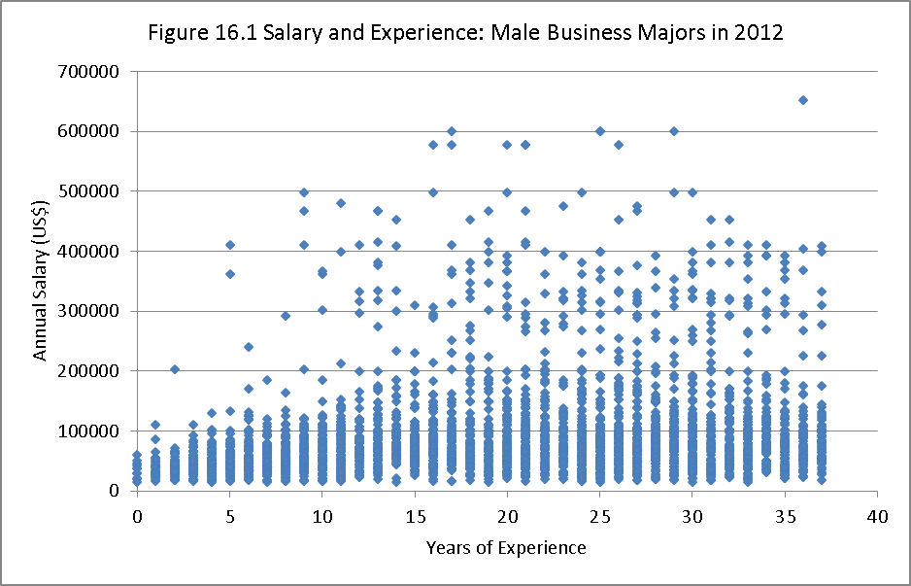
Scatter diagrams with a lot of observations are useless

Slide 11
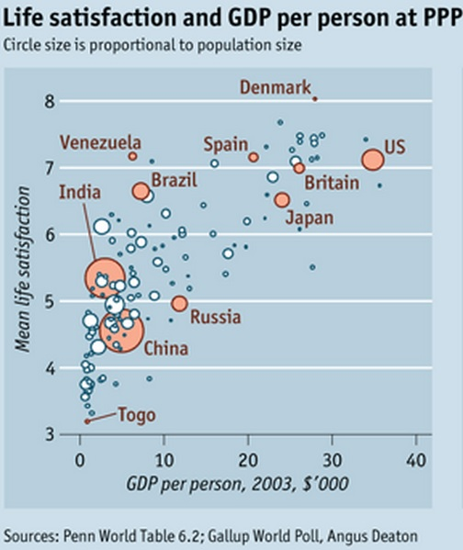
Use scatter diagrams to call out individual points, especially if you can use bubbles
For bubbles in Excel, you need advanced additional programs like Excel Power View

Slide 12
Kinds of graphs
Bar graphs
Histograms
Line graphs
Scatter diagrams
Pie charts
100% stacked area chart (and other fancy things)

Slide 13
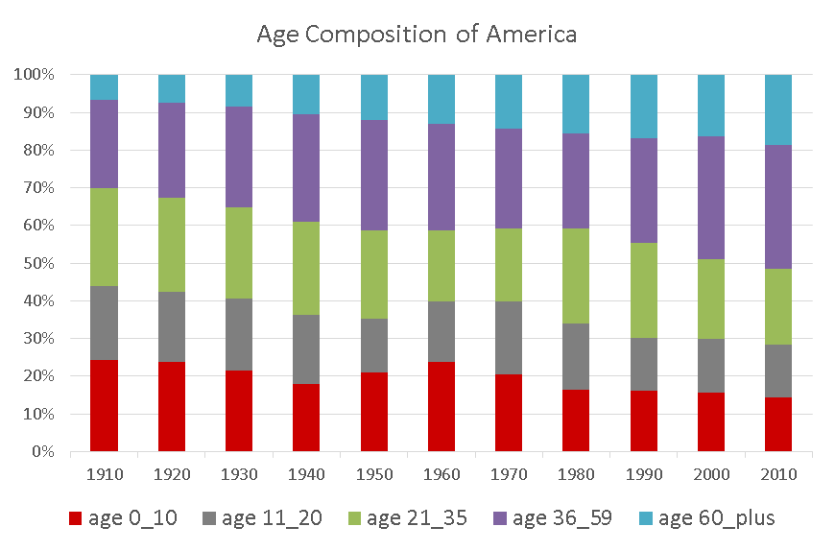
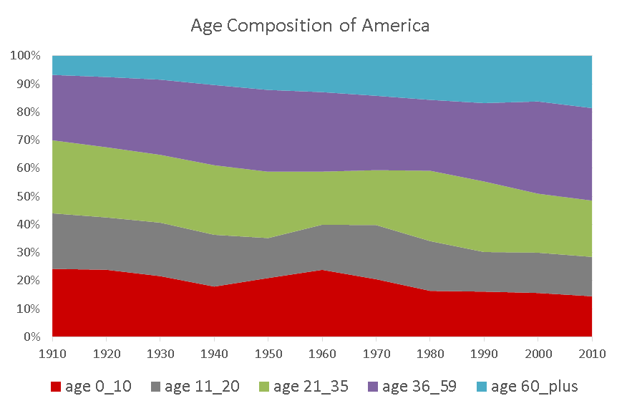
If your question is: How do proportions change over time (or across categories?)
If the question is:
You might try a 100% stacked column chart (on left)
or a 100% stacked area chart (on right). Which answers the question more clearly?

Slide 14
We mentioned last time clustered column/bar charts… here’s an example
Clustered column/bar charts are good for conveying different proportions or values across 2 kinds of categories.

Slide 15
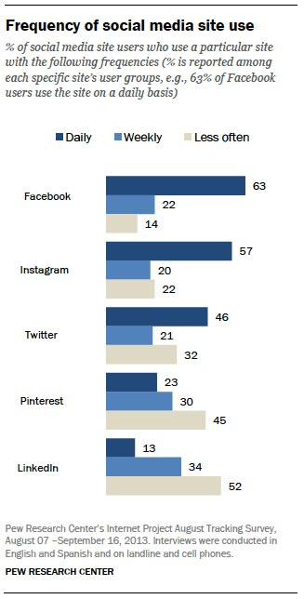
Another example of a clustered bar chart with categories
Source: Pew Research

Slide 16
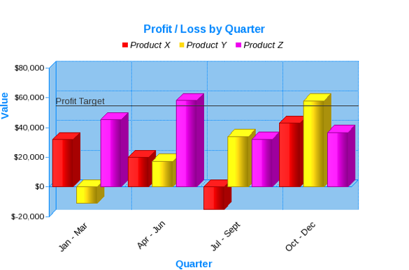
An example of a bad graph that demonstrates that the aim should be: informative and easy to read
Even 3-D bars should be avoided.
Notes:
HT: Victoria

Slide 17
Other Excel tools
If statements
Pivot tables
Regression

Slide 18
If statements in Excel
Go to the data tab of the same Excel workbook and make a dummy variable that is 1 if they are an international student
If statements in Excel look like this:
=if(logical statement, #1, #2)
If statements use the operators =, >, <, >=, <= with cell locations instead of variable names.
#1 is what happens if true
#2 is what happens if not true
If statements are most useful if combined with and and or ….

Slide 19
Pivot Tables
One of Excel’s features most commonly used in business and in summer internships
Allow us to quickly compute statistics across categories:
Counts
Sums
Means (Averages)
Max/Min
Product
Std deviation, variance
Percentage of total
You can also make charts from these pivot tables(we’ll do next class)

Slide 20
Let’s use pivot tables to answer: How many people select each main concentration? (Use Data tab)
Make sure every column has a label.
Highlight the data range including labels.
PCs: Click Insert – Pivot table (icon on far left)
Macs: Pivot Tables are either in the Analysis or Data group
A new worksheet opens with a blank pivot table fields list box.

Slide 21
Pivot tables: View of empty pivot table and pivot table field list box (list of variables here from previous version of dataset.)

Slide 22
Using pivot tables: Create a pivot table that describes how average salaries have been different in the different years for students with dual concentrations v. students with one concentration
Drag Year from the PivotTable Field List down to the Rows (or Row Labels) quadrant.
Fields dragged into this box will show up on the left of the pivot table.
You should see a row for each Year
You should also see a checkmark appear next to Year
Alternatively, you can drag it to the table where it says: Drop row fields here.

Slide 23
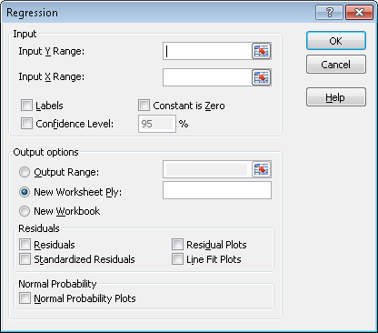
Regression in Excel
For simple regressions, you can use scatter plots with trend line( no coefficient statistics).
Otherwise use Data Analysis (under Data)
Choose
Data analysis → Regression
LHS (or dependent) variable goes in “Input Y range”
RHS (or explanatory or independent) variable goes in “Input X range”
Click labels!
Put it in a new worksheet.

Slide 24
Where to next….. Your project

Slide 25
Some additional project notes
Last Friday (Nov. 3) we discussed:
When you do NOT want to put as an explanatory (X, right hand side) variable
We introduced the term exogenous: you want your X variables to be as exogenous as possible….
How to test the statistical significance of the effect of a variable when the variable enters both as a linear term and as quadratic term (in Stata)
When you have multi-category dummies, how to test if the coefficient of two categories are statistically different (in Stata)
Multicollinearity: Why t-tests are low for both X-variables if they measure the same concept even though it is important to have at least one of them in the regression…
In light of this, when to drop an explanatory variable from the regression.

Slide 26
This Friday, some additional topics I want to talk about are
Structure of the project
How to present results in the project
How to tell how important a variable is

Slide 27
When you think you have regressions you will use in the paper
Start sketching out/writing down the story-line of your paper.
Every paper should be a story, first explaining the issue you are addressing, and then developing your approach and your results step by step.
You can think of it as an outline with the ideas in each bullet written out
I myself just start writing my points in order.

