Slide 1
QM222 A1 Visualizing data using Excel graphs

Slide 2
To Do:
Assignment 6: due Wednesday.
Highly advisable 10 minute meeting with me (except those who already have me with me).
When can we meet?
Today 11:15-3:30
Tuesday 11:15-1:45, 3:30-5
You will also need to meet with me for a second required meeting -- after you have the regressions that you plan to use (and before your presentation).
Does not need to be by November 13.
I’ll put up signup next week.

Slide 3
Schedule of Classes
Today: Graphs in Excel, Visualizing data
Wednesday(11/8): Other Excel Statistical Tools (regression, pivot tales, if statements for dummies)
Friday(11/10): Test Recap, Project Help
Monday(11/13): Tips on writing your first draft.
Wednesday (11/15) and maybe Friday (11/17): Experiments
After that: Topics as requested, presentations.
Draft (Assignment 7) due before Thanksgiving.
Presentations will start as early as November 15, but certainly by Monday November 27.

Slide 4
Graphs in Excel
You should know how to make graphs in Excel, so we will be using Excel today.
Before we start, in Excel add-ins (File→Options→Add-Ins→Manage Excel Add-ins (at bottom)→Analysis ToolPak and Analysis Toolpack VBA
You need this for histograms.

Slide 5
Visualizing Data with Graphs
A picture is worth 1000 words – or at least a lot of words.
A visualization can clarify what the data are telling us,
or obscure it.

Slide 6
Some pictures are worth 1000 words. Some are worthless or even harmful.
Making graphs in Excel is easy. If you have a table, Excel will suggest graphs for you.
However, it is your job to make sure that your graphs clearly convey the information that you want the viewer to get.

Slide 7
Steps for Making Powerful Graphics
1) Define the Question:
What question do I want the viewer to be able to answer?
2) Choose the right type of graph for your question
Should I use a scatter plot, bar chart, or other graphs?
3) Format your graph to make it viewer-friendly
Title, labels, axis, etc.

Slide 8
General Tips for Formatting User-friendly Graphs
Use a descriptive title
Label both axes so viewers understand exactly what they are.
Choose good unit intervals always asking yourself, “What most clearly conveys the information?”
Choices you make include tick marks, width between bars, thickness of lines etc.
Minimize chart-junk… Don’t include distracting information that doesn’t convey information..
Minimize eye movement: Try to make it possible for the viewer to get the message without having to look all over the graph or look back and forth.
Do not use graphics that mislead.

Slide 9
Kinds of graphs
Bar graphs
Histograms
Pie charts
Line graphs
Scatter diagrams
100% stacked area chart (and other fancy things)

Slide 10
What is the best type of graph for what purpose?
If the question is:
How do average values vary across categories?
The bar chart seems best.
Can have horizontal or vertical bars
Can have different sets of bar graphs, or divide up bars, etc.
Often most useful if you order the values.
Ordering is a good idea (from small to large or vice versa.)

Slide 11
Making Bar graphs in Excel
Work along with me and save your Excel for future reference
Open sites.bu.edu/qm222projectcourse→Options→Other Materials→Data Sets for In-Class Exercises →Nov6_Questrometc in Excel – tab “Use for bar charts”
Make a bar chart of starting salaries by main concentration
Work along with me

Slide 12
Here’s a bar graph of average salary in each concentration (using 2016 & 2017 Questrom salaries)
What question would you want to answer with this graph?
Is this the right kind of graph to answer this question?
How could you make this graph better and clearer?

Slide 13
Graph of average salary in each concentration (using 2016 & 2017 Questrom salaries)
A bar graph is appropriate.
BUT to make it better answer the question, it should be ordered from high to low (or vice versa).
How to do this? Sort by salary.
In terms of formatting:
Put a more descriptive title
Label X- axis
Maybe make gaps between bars a bit smaller
Unfortunately, different Excels have different shortcuts for editing graphs

Slide 14
I’ve done some of these improvements here
Should I start the Y-axis at a higher number (not at zero)?
Some people do, to accent the differences
Others don’t, so people know the scale

Slide 15
Which way should the graph be oriented?
Which bar chart do you prefer and why?

Slide 16
Kinds of graphs
Bar graphs
Histograms
Pie charts
Line graphs
Scatter diagrams
100% stacked area chart (and other fancy things)

Slide 17
In Excel, histograms are part of “Data Analysis”
Histograms like bar graphs, but the Y-variable is the frequency or percentage of cases in each range of X-values.
You need to divide the entire range of the data into intervals, typically of equal widths.
You decide how wide each range, or “bin” should be.
It’s good to have about 8-12 bins in most cases (depending on what you want to show.
You never want to put most of the cases in 3 or fewer bins.
Then Excel will count how many data points (observations) fall into each interval.
And make a bar chart where the height of the bar is equal to this count.

Slide 18
Why Bin size matters

Slide 19
Let’s make bins for Salary
Start on tab “Data” of Questrom Starting Salaries
Make a column for bins (off to the right)
First look at the values to see the overall range
The first number will be the highest value of the first bin.
The last number should be the highest value of the second to last bin.
Excel adds a final bin that it labels “more”
Label this column (usually, the same name as the data… In our case, Salaries).
Them click DATA → (on the far right) Data-Analysis →Histogram
Put in the data range (called the Input Range) and the bin range including labels.
Click labels.
Click “Chart Output”
Choose to put the histogram in a new worksheet (e.g. labeled “histogram.”)

Slide 20
What can you do to make the histogram better?
Change chart labels.
Change width of bars? Often histograms have no spce between bars.
Make bin values into the actual ranges they represent
When would you use this histogram?

Slide 21
Kinds of graphs
Bar graphs
Histograms
Pie charts
Line graphs
Scatter diagrams
100% stacked area chart (and other fancy things)

Slide 22
What is the best type of graph for what purpose?
If the question is:
What proportion (or count) is in each category?
A pie chart can tell you how many cases are in each category
But so can bar charts
Pie charts should be avoided unless you have
few categories.

Slide 23
Kinds of graphs
Bar graphs
Histograms
Pie charts
Line graphs
Scatter diagrams
100% stacked area chart (and other fancy things)

Slide 24
What is the best type of graph for what purpose?
If the question is:
How did a variable change – either over time, or as another variable changes?
Typically a line chart works best here.
Which shows the trend most clearly?

Slide 25
More on line graphs
You must have both numerical X and Y variables!!!
Example of a very bad line graph:

Slide 26
Making a Line graph in Excel
Use tab J Crew data
If you don’t put an X-variable, Excel will go from the beginning to the end of the column
Insert a line graph
How would you change the axis labels?
For X-axis, make a column of labels, then right click and select

Slide 27
Kinds of graphs
Bar graphs
Histograms
Pie charts
Line graphs
Scatter diagrams
100% stacked area chart (and other fancy things)

Slide 28
When do you use scatter diagrams
When you want to show individual data points – and there are numerical X and Y data
When you want to show dispersion around a trend line
Don’t use when there are lots of observations

Slide 29
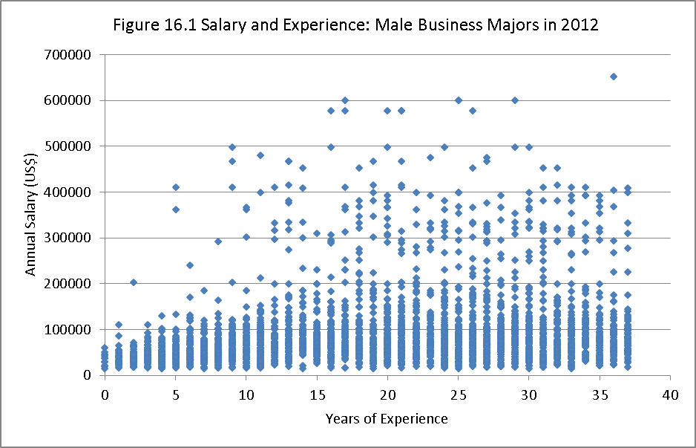
Scatter diagrams with a lot of observations are useless

Slide 30
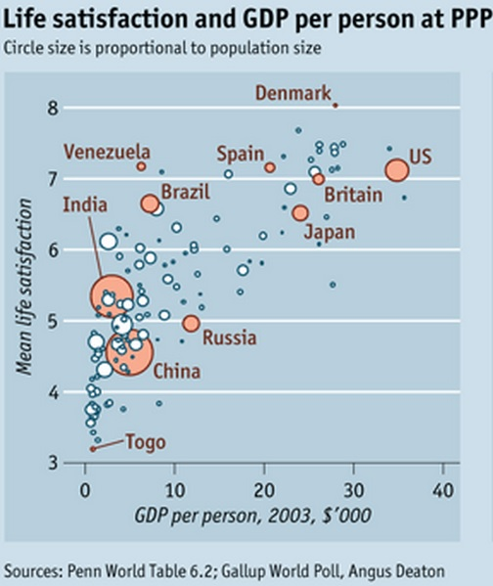
Use scatter diagrams to call out individual points, especially if you can use bubbles

Slide 31
Kinds of graphs
Bar graphs
Histograms
Pie charts
Line graphs
Scatter diagrams
100% stacked area chart (and other fancy things)

Slide 32
Kinds of graphs
Bar graphs
Histograms
Line graphs
Scatter diagrams
Pie charts
100% stacked area chart (and other fancy things)

Slide 33
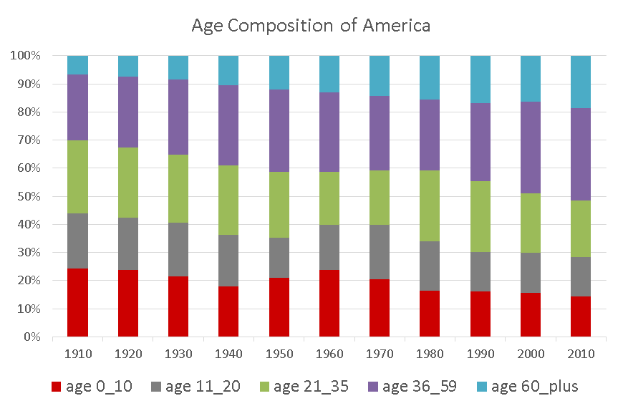
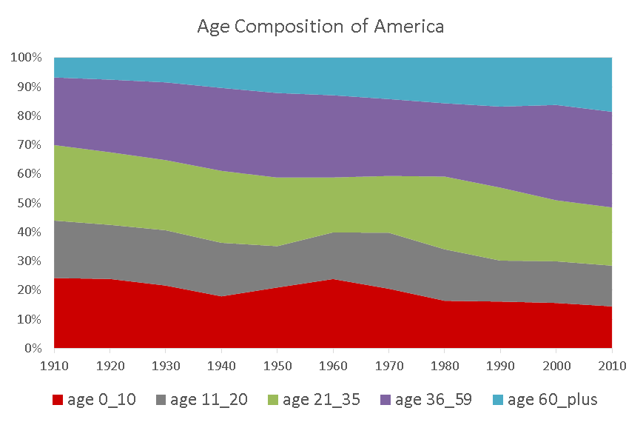
What is the best type of graph for what purpose?
If the question is:
How do proportions change over time (or across categories?)
You might try a 100% stacked column chart (on left)
or a 100% stacked area chart (on right). Which answers the question more clearly?

