Slide 1
QM222 A1 How to proceed next in your project Multicollinearity

Slide 2
To Do:
Assignment 6: I can extend the due date to next Wednesday.
I think that those who came to the last class and met with me for 10 minutes really made progress on the direction they should go next in their project. I hope that each of you meet with me sooner rather than later.
When can we meet?
Monday 11:15-3:30
Tuesday 11:15-1:45, 3:30-5
You will also need to meet with me for a second required meeting -- after you have the regressions that you plan to use (and before your presentation).
Does not need to be by November 13.
I’ll put up signup next week.

Slide 3
Schedule of Classes
Monday(11/6): Graphs in Excel, Visualizing data
Wednesday(11/8): Other Excel Statistical Tools (regression, pivot tales, if statements for dummies)
Friday(11/10): Test Recap, Project Help
Monday(11/13): Tips on writing your first draft.
Wednesday (11/15) and maybe Friday (11/17): Experiments
After that: Topics as requested, presentations.
Draft (Assignment 7) due before Thanksgiving.
Presentations will start as early as November 15, but certainly by Monday November 27.

Slide 4
Assignment 6: What to try next
Run additional multiple regressions. Specifically:
Think hard about whether there are additional omitted variables (i.e. confounding factors) that you can measure that are likely to be biasing your key coefficient(s). If you can find data on them, add them into the regressions. (If you really cannot think of anything beyond what you have, just write that.)
Also, identify at least one omitted variable that you cannot measure, reason out the sign of the omitted variable bias and explain here (Ass.6) in 1-3 sentences why and in what direction it will bias your key coefficient.

Slide 5
What you do NOT want to put as an explanatory (X, right hand side) variable
Usually, you do NOT want to include a variable that is just another version of Y
Example: Suppose you want to see who is a good baseball hitter
So you use RBI (runs batted in) as your Y variable
You do NOT want to use slugging percentage (which is another measure of how good a baseball hitter is)
Slugging percentage does not predict or affect Y.
It is just another way to measure Y
It will be highly correlated with Y
But so what? You do not learn anything.

Slide 6
Important terms to know related to this: Endogenous v. Exogenous
An exogenous factor X is something that happens and then changes your Y
Its change is started “from the outside”
Exo means outside, as in exoskeleton
An endogenous factor X is something that happens as Y happens
Like RBIs and Slugging percentage
Endo means “from inside”: endoscopy examines your innards (GI tract)
You want your X variables to be as exogenous as possible….
So you see how they affect Y
Rather than how they are affected by Y or happen along with Y

Slide 7
Assignment 6 cont.: nonlinear terms
If you have any numeric explanatory (X) variable, add a quadratic term in addition to your other variables to test if this nonlinear specification fits better.
Try other non-linear terms for numeric variables if you think they solve your problem better:
If you use log X, it means that you think that a 1% increase in X will give a constant change in Y.
If you use log X and log Y, it means that you think that a 1% increase in X will give a constant percentage (%) change in Y.
Using top coding if after a certain point, it doesn’t matter how much more X you have
Explain what you learn from these results.
It is easiest to show quadratics with a graph.

Slide 8
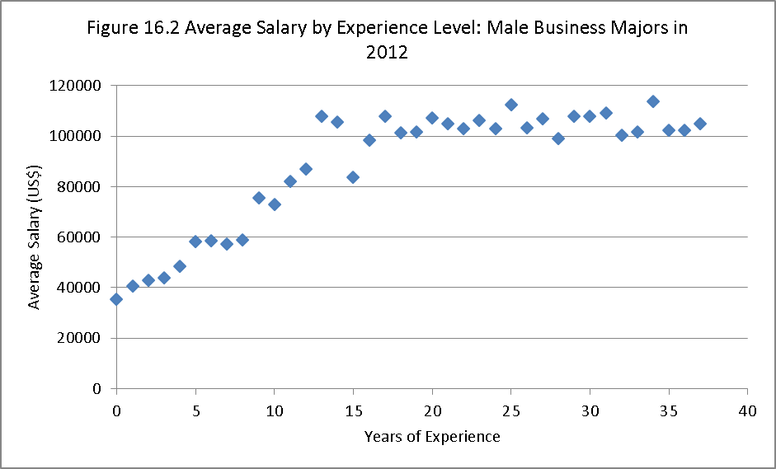
Nonlinear example: Here we plotted average salaries at each experience level
Would a straight line fit well?

Slide 9
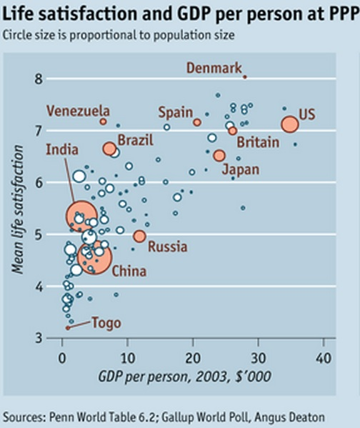
Evidence: Can Money Buy Happiness?
What is the relationship here between money and happiness? Is it linear?
Happiness increases in income but at an decreasing rate; the slope is becoming less steep as income increases.
Extra income “buys” us less happiness when we have more of it.

Slide 10
A helpful stata tip related to quadratics
Let’s say you run a regression of salary on experience and experience squared.
Salary = b₀ + b₁ experience + b₂ experience_squared
(b₁ is probably positive, b₂ is probably negative)
You want to know the impact of experience:
d Salary/ d Experience= b₁ + 2 * b₂ * experience
(do the calculus: if Y = a x^{b} dY/dX = b a x ^{b-1} )
But you do not have a t-test for this slope! And it depends on the value of experience. What to do?
In Stata, after you run the regression, type:
effect at exp=5: lincom experience + 2* experience-squared*5
effect at exp=10: lincom experience + 2* experience-squared*5
This tests whether the linear combination above = 0, where Stata plugs in the coefficients b₁ for “experience” and b₂ “experience-squared”

Slide 11
Another approach if you think the relationship between Y and X is really really nonlinear
You could try a set of dummy variables for different ranges of the variable.
Even though it is a numerical variable.
Only use this approach if you believe that the relationship between Y and X changes so much at every value that it can’t be estimated as a quadratic (or cubic etc.)
Education sometimes is better as a set of dummies.
Remember how to easily make a set of dummies in Stata, e.g. for number of children numchildren:
xi: regress yvariable xvariable i.numchildren

Slide 12
Assignment 6 cont.: Use “interaction terms” (like Scifi*Budget & nonscifi*Budget)
When to use them? If you think that the effect of one thing depends on the slope of another. Example: Matt.
The simplest way to add this in a regression is (if X₂ is a dummy): 1. Make an additional variable by multiplying X₁ * X₂
2. Make an additional variable by multiplying X₁ * (1-X₂)
Recalling that (1-X₂) is 1 if X₂=0
3. Run a regression of Y on 3 variables:
X₁*X₂ This is X₁ for observations where X₂ =1
X₁*(1-X₂) This is X₁ for observations where X₂ =0
X₂ This is X₂
I ask in Assignment 6 to explain what you learn from your interaction terms.

Slide 13
A helpful stata tip related to these interaction terms
Let’s say you think that experience affects men and women differently.
You make the variables:
male_experience = maledummy * experience
female_experience = (1-maledummy) * experience
You run the regression:
Salary = b₀ +b₁female + b₂ male_experience + b₂ female_experience
But to test whether the slopes are different for male_experience and female_experience, after you run the regression, type:
lincom male_experience - female_experience
Stata will test whether this equals zero, i.e. whether there is no difference.

Slide 14
Multicollinearity

Slide 15
Multicollinearity
Recall that the interpretation of a coefficient in a multiple regression is:
The effect on Y of X changing by 1 if the other variables stay the same
And the t-test tests the null H0: Could this coefficient be zero?
Sometimes you run a regression with two very very correlated variables like #toothbrushes sold and amount of toothpaste sold in a country in a year.
The t-tests will both be very low.
Because each coefficient could be zero and the regression would predict approximately the same thing.
But if you drop one of them, the other would become highly significant.
E.g. GDP and Unemployment

Slide 16
What to do if you find that variables that you believe should be significant are not
If you believe that several variables are really measuring the same concept, drop one of them if its |t-stat| is less than ONE.
If you drop a variable with a |t-stat| <1, the adjusted R-squared increases.
Which do you drop? The one with the lowest |t|.
In other words, let the computer tell you which of the two variables you need.
If you are right, the other variable will become more significant.
NEVER DROP MORE THAN ONE VARIABLE AT A TIME. If you do, you might drop BOTH highly correlated variables.
You can test if two (or more) insignificant variables together are significant but writing this after you run the regression:
test varname1 varnname2

