Slide 1
QM222 Your regressions and the test

Slide 2
Test
6 pm SAR 104
2 hours
Bring a simple calculator and a sheet of paper
Office hours:
Today 11-3:30
Tomorrow 3:30-5:30
Class Wednesday? No – In-class project help?

Slide 3
1 sheet of paper
This sheet should have 2 regressions from your project:
A simple regression with 1 explanatory variable (your key one)
A multiple regression with 2 explanatory variables (your key one, and a second variable that is a confounding factor)
Ideally, when you add this second variable, the coefficient on your key variable will change.
If you don’t have regressions of your own, I will supply some.
These regressions need to use exactly the same number of observations.

Slide 4
How to get the same number of observations in both regressions
Run the multiple regression
Run the simple regression adding an if statement:
regress myyvariable myxvariable if e(sample)==1
e(sample) is a dummy variable Stata makes =1 for observations included in the previous estimation.

Slide 5
How to print out your regressions in word: make them courier new 9 font remove space after paragraphs
. regress GDP beforeafter
Source | SS df MS Number of obs = 59
-------------+---------------------------------- F(1, 57) = 2.04
Model | 1.1075e+11 1 1.1075e+11 Prob > F = 0.1591
Residual | 3.1003e+12 57 5.4392e+10 R-squared = 0.0345
-------------+---------------------------------- Adj R-squared = 0.0175
Total | 3.2111e+12 58 5.5364e+10 Root MSE = 2.3e+05
------------------------------------------------------------------------------
GDP | Coef. Std. Err. t P>|t| [95% Conf. Interval]
-------------+----------------------------------------------------------------
beforeafter | 18044.23 12645.66 1.43 0.159 -7278.267 43366.73
_cons | 472139.9 30490.36 15.48 0.000 411084 533195.8
------------------------------------------------------------------------------

Slide 6
Moer on this piece of paper
It can include anything else you want on the other side (i.e. can be a “cheat sheet”

Slide 7
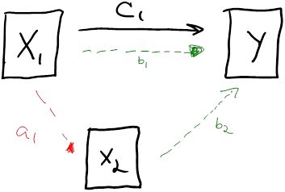
Be able to do something like this with your 2 regressions (graph or algebra or logic)
The combined effect c₁ includes both X_{­1}‘s direct effect b₁.
And the indirect effect (blue arrow) working through X_{­2}.
i.e. when X_{­1} changes, X₂ also tends to change (a₁)
This change in X_{­2} has another effect on Y (b₂)
The indirect effect (blue arrow) is the omitted variable bias and its sign is the sign of a₁ times the sign of b₂

