Slide 1
QM222 Class 18 Omitted Variable Bias

Slide 2
To-dos
Assignment 5 is due on Monday involves doing multiple regression.
Friday in lab – Assignment 5 help.
Test 6pm Oct 31 (location TBD)
Still not have your Stata data set? Let me help you.
This afternoon – for shorter meetings (<=15 minutes)
Tomorrow – I have lots of time 3:30 – 6. (Also, 11:30-1:30 for shorter meetings <=15 minutes.
If you are still painstakingly collecting data, let me try and speed it up.
I do realize that you won’t have Assignment 5 on time – better late and good. (This does not apply to those with their data set).

Slide 3
Today we will…
Introduce the idea of omitted variable bias
Understand why it occurs
Understand how to measure its sign
Explain it with a graph

Slide 4
What is omitted/missing variable bias?
Omitted (or missing) variable bias is how a coefficient is biased if it picks up the impact of a confounding factor not included in the multiple regression.
e.g. If we run a regression:
Drownings = b0 + b1 Icecream
b1 will pick up the impact of temperature, because temperature is omitted from the regression (yet correlated with both drownings and Icecream)
e.g. If we run a regression:
Condo Price = b0 + b1 BeaconSt.
b1 will pick up the impact of condo size, because size is omitted from the regression (yet correlated with both condo price and Beacon)

Slide 5
Omitted variable = Possibly confounding factor Why learn again about this? What is new?
We have tried to explain the bias due to omitted factors due to intuition.
If your intuition about this isn’t so good, this will help you:
Measure omitted variable bias.
Predict what you think the sign of the bias due to an omitted variable is (which is especially important if you can’t measure the confounding factor).
Learn about the correlation between X’s from the omitted variable bias.
In your projects, this will help you figure out why coefficients change in multiple regressions when you add variables.
Finally, it will be on the test.

Slide 6
Multiple regression measures the individual impacts of different factors on Y….
Multiple regression helps us to measure the individual impacts of different factors on our dependent variable Y…
Holding the other factors constant
So isolating each factor’s effect

Slide 7
Basketball
In a previous semester, a student Jonathan Wong wanted to know how injuries affected later basketball performance.
He measured basketball performance by Win Share 48 (WS48), a basketball statistic that measures how much a player contributes to winning on average during a 48 minute game. WS48 “takes into account the various things a basketball player does to win or lose a game.”
He measure INJURY by whether a basketball player only played part of the previous season (then stopped – presumably because of injury)

Slide 8
First regression: simple 1 explanatory variable
. regress WS48 INJURED
Source | SS df MS Number of obs = 1,051
-------------+---------------------------------- F(1, 1049) = 40.15
Model | .121434921 1 .121434921 Prob > F = 0.0000
Residual | 3.1730123 1,049 .003024797 R-squared = 0.0369
-------------+---------------------------------- Adj R-squared = 0.0359
Total | 3.29444722 1,050 .003137569 Root MSE = .055
------------------------------------------------------------------------------
WS48 | Coef. Std. Err. t P>|t| [95% Conf. Interval]
-------------+----------------------------------------------------------------
INJURED | -.032542 .0051359 -6.34 0.000 -.0426198 -.0224641
_cons | .1203435 .0018132 66.37 0.000 .1167855 .1239015
------------------------------------------------------------------------------
Each injury decreases WS48 by .0325 .
To put this in perspective, average WS48 is .116, so this is a decrease of almost a third.
However, he thought of an obvious confounding factor, Age.
Probably, older basketball players perform worse (lower WS48).
Probably, older basketball players are more likely to get injured.

Slide 9
Regressions without and with Age
Regression (1)
WS48= .1203 - .0325 INJURED
(66.37) (-6.34) adjRsq=.0359
Regression 2:
WS48= .1991 - .0274 INJURED - .00279 Age
(18.38) (-5.41) (-7.37) adjRsq=.0826
(t-stats in parentheses)
Adding age changed the coefficient on injured, making it a smaller negative.

Slide 10
Omitted variable bias
In a simple regression of Y on X₁, the coefficient b₁ measures the combined effects of:
the direct (or often called “causal”) effect of the included variable X₁ on Y
PLUS
an “omitted variable bias” due to factors that were left out (omitted) from the regression.
Often we want to measure the direct, causal effect. In this case, the coefficient in the simple regression is biased.

Slide 11
Regressions without and with Age
Regression (1)
WS48= .1203 - .0325 INJURED
(66.37) (-6.34) adjRsq=.0359
Regression 2:
WS48= .1991 - .0274 INJURED - .00279 Age
(18.38) (-5.41) (-7.37) adjRsq=.0826
(t-stats in parentheses)
Putting age in the regression (2) added .051 to the INJURED coefficient (i.e. made it a smaller negative.)
The omitted variable bias in Regression (1) was - .051
More generally: Omitted variable bias occurs when:
The omitted variable (Age) has an effect on the dependent variable (WS48) AND
2. The omitted variable (Age) is correlated with the explanatory variable of interest (INJURED).

Slide 12
Another example: How does getting more education affect salaries?
Let’s say you run this regression:
Income = 20,000 + 4000 Education (in years).
But, the coefficient 4000 may pick up the fact that more intelligent people have both more education and higher income.
If you could add the variable IQ to the regression, the coefficient on education would hold IQ constant, taking out the omitted variable bias.
Omitted variable bias occurs because:
The omitted variable (IQ) has an effect on the dependent variable (Income) AND
2. The omitted variable (IQ) is correlated with the explanatory variable of interest (Education).

Slide 13
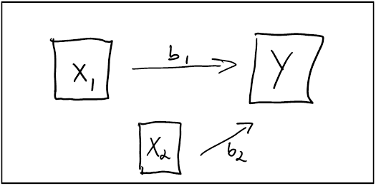
We are going to learn several methods so that you can understand Omitted Variable Bias- today using with graphs
Really, both being injured and age affect WS48 as in the multiple regression
Y = b₀ + b₁X₁ + b₂X₂
This is drawn below.
Let’s call this the Full model.
Let’s call b₁ and b₂ the direct effects.

Slide 14
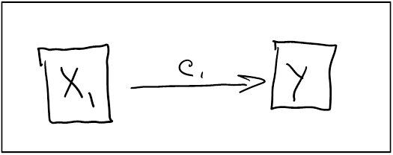
The mis-specified or Limited model
However, in the simple (1 X variable) regression, we measure only a (combined) effect of injured on price. Call its coefficient c₁
Y = c₀ + c₁X₁
Let’s call c₁ is the combined effect because it combines the direct effect of X1 and the bias.

Slide 15
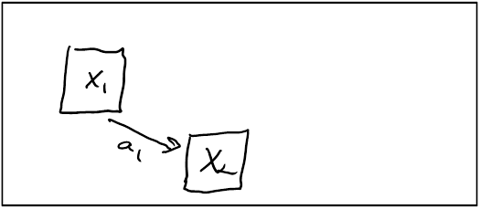
The reason that there is an omitted variable bias in the simple regression of Y on X_{­1} is that there is a Background Relationship between the X’s
We intuited that there is a relationship between X_{­1} (Injured) and X₂ (Age).
We call this the Background Relationship:
correlate WS48 INJURED Age
(obs=1,051)
| WS48 INJURED Age
-------------+---------------------------
WS48 | 1.0000
INJURED | -0.1920 1.0000
Age | -0.2425 0.1388 1.0000
This background relationship,
shown in the graph as a₁,
is positive.

Slide 16
So if we want the direct effect only
We should include both X_{­1} and X₂ in a multiple regression, so we get the coefficient b₁ – the direct effect of X_{­1}.

Slide 17
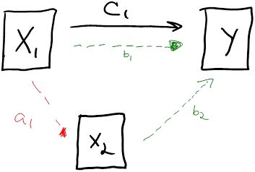
But in the limited model without an X₂ in the regression,
The combined effect c₁ includes both X_{­1}‘s direct effect b₁.
And the indirect effect (blue arrow) working through X_{­2}.
i.e. when X_{­1} changes, X₂ also tends to change (a₁)
This change in X_{­2} has another effect on Y (b₂)

Slide 18
But in the limited model without an X₂ in the regression,
The combined effect c₁ includes both X_{­1}‘s direct effect b₁.
And the indirect effect (blue arrow) working through X_{­2}.
i.e. when X_{­1} changes, X₂ also tends to change (a₁)
This change in X_{­2} has another effect on Y (b₂)
The indirect effect (blue arrow) is the omitted variable bias and its sign is the sign of a₁ times the sign of b₂

Slide 19
In the basketball case
WS48= .1203 - .0325 INJURED (limited model)
WS48= .1991 - .0274 INJURED - .00279 Age (full model)
The effect of Injured on WS48 has two channels.
The first one is the direct effect b₁ (-.0274)
The second channel is the indirect effect working through X₂.(Age)
When X_{­1} (INJURED) changes, X₂ (Age) also tends to change (a₁) (correlation +.1388)
This change in X_{­2} has its own effect on Y (b₂) (-.0274)
The indirect effect (blue arrow) is the omitted variable bias and its sign is the sign of a₁ times the sign of b₂ : pos*neg=neg

Slide 20
In-Class exercise (t-stats in parentheses)
Regression 1:
Score = 61.809 – 5.68 Pay_Program adjR2=.0175
(93.5) (-3.19)
Regression 2:
Score = 10.80 + 3.73 Pay_Program + 0.826 OldScore adjR2=.6687
(6.52) (3.46) (31.68)

Slide 21
Today we …
Introduced the idea of omitted variable bias
Understood why it occurs
Understood how to measure its sign
Explained it with a graph

Slide 22
We will continue discussing omitted variable bias on Monday
The algebra
More examples
Then we will start experiments

