Slide 1
QM222 Class 9 Section A1 Coefficient statistics

Slide 2
To-dos
Assignment 2 is due today
But you lose only a tiny fraction of points for each day late so it’s better to hand in a completed assignment.
If you don’t have a topic+data set, come see me today: before 1:15 or after 4:30.
Have you signed up for your first URO? Do it today.

Slide 3
Today:
We learn how to read and use the statistics about regressions coefficients (listed in the same line as the coefficient).
Standard errors
95% confidence intervals
t-tests
P-values

Slide 4
Regression Coefficients’ Statistics
How certain are we that the coefficients we measured are accurate in light of the fact that we have limited numbers of observations?

Slide 5
Review slide: Notation for a regression equation
predicted Y intercept coefficient, slope
(Y-hat, Y’)
Ŷ = b₀ + b₁ X
Y variable X variable
LHS variable RHS variable
dependent variable independent variable
explanatory variable
the regression line

Slide 6
Review slide: Regression in Stata
regress yvariablename xvariablename
For instance, to run a regression of price on size, type:
regress price size
Note: _cons is constant, intercept
price = 12934 + 407.45 size
If size increases by 1 sqft, sales price increases by $407

Slide 7
Result of regression with a dummy X variable
. regress price Beacon_Street
Source | SS df MS Number of obs = 1085
-------------+------------------------------ F( 1, 1083) = 3.31
Model | 2.2855e+11 1 2.2855e+11 Prob > F = 0.0689
Residual | 7.4673e+13 1083 6.8951e+10 R-squared = 0.0031
-------------+------------------------------ Adj R-squared = 0.0021
Total | 7.4902e+13 1084 6.9098e+10 Root MSE = 2.6e+05
-------------------------------------------------------------------------------
price | Coef. Std. Err. t P>|t| [95% Conf. Interval]
--------------+----------------------------------------------------------------
Beacon_Street | -46969.18 25798.41 -1.82 0.069 -97589.71 3651.345
_cons | 520728.9 8435.427 61.73 0.000 504177.2 537280.5
-------------------------------------------------------------------------------
Write the regression equation: price = 520729 – 46969 Beacon_Street
What is the predicted price of a condo on Beacon Street? 520729–46969=$473,760
What is the predicted price of a condo that’s not on Beacon Street? $520,729
What is the difference in prices between those on Beacon St. and NOT? -$46,969

Slide 8
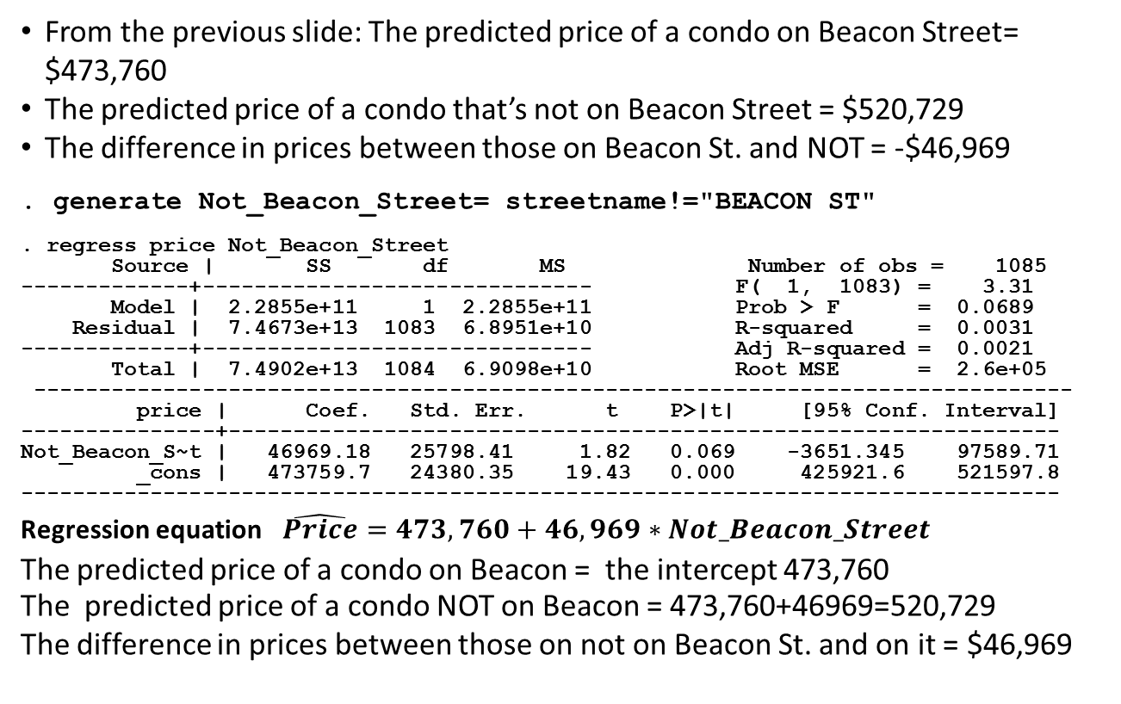
You get the same predictions whichever category you choose to exclude (i.e. to be the reference category)
From the previous slide: The predicted price of a condo on Beacon Street= $473,760
The predicted price of a condo that’s not on Beacon Street = $520,729
The difference in prices between those on Beacon St. and NOT = -$46,969
. generate Not_Beacon_Street= streetname!="BEACON ST"
. regress price Not_Beacon_Street
Source | SS df MS Number of obs = 1085
-------------+------------------------------ F( 1, 1083) = 3.31
Model | 2.2855e+11 1 2.2855e+11 Prob > F = 0.0689
Residual | 7.4673e+13 1083 6.8951e+10 R-squared = 0.0031
-------------+------------------------------ Adj R-squared = 0.0021
Total | 7.4902e+13 1084 6.9098e+10 Root MSE = 2.6e+05
--------------------------------------------------------------------------------
price | Coef. Std. Err. t P>|t| [95% Conf. Interval]
---------------+----------------------------------------------------------------
Not_Beacon_S~t | 46969.18 25798.41 1.82 0.069 -3651.345 97589.71
_cons | 473759.7 24380.35 19.43 0.000 425921.6 521597.8
--------------------------------------------------------------------------------
Regression equation $\hat{Price}=473,760+46,969∗Not_Beacon_Street$
The predicted price of a condo on Beacon = the intercept 473,760
The predicted price of a condo NOT on Beacon = 473,760+46969=520,729
The difference in prices between those on not on Beacon St. and on it = $46,969

Slide 9
How certain are we that the coefficients we measured are accurate in light of the fact that we have limited numbers of observations?

Slide 10
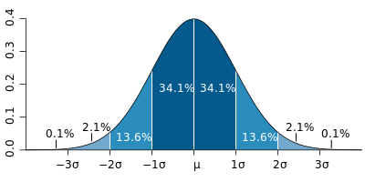
Let’s remember means and standard deviations with normally distributed variables
Approximately 68% (or around 2/3rds) of a variable’s values are within one standard deviation of the mean.
We call this this the 68% confidence interval (CI), because 68% of the time, the value falls in this range.
Approximately 95% of the values are within two standard deviations of the mean.
We call this this the 95% confidence interval,
2.0 is just 1.96 rounded. Use either!
Notes:
Do problem sets on your own – it is the best way to learn the material. Mistakes on problem sets are not excessively penalized
There may be a pop quiz on the problem set in section when it is due (with p=.5)

Slide 11
Central Limit Theorem (QM221)
The Central Limit Theorem tells us that if you took many samples from a population, the sample means are always distributed according to a normal distribution curve
The average of the sample means (across many samples) is the same as the population mean (μ)
The standard deviation of the sample means (across many samples) is the standard error (se)
-3SE -2SE -1SE μ +1SE +2SE +3SE

Slide 12
Standard errors more generally
Sample means have a standard error that tells us how much the means vary if we had lots of different samples.
Any statistic estimated on a sample has a standard error that tells us how much that statistic would vary if we had lots of different samples.
Regression coefficients also have standard errors.
We are (approximately) 68% certain that the true regression coefficient (if estimated on the entire population) will be within one standard error of the estimated coefficient.
We are (approximately) 95% certain that the true regression coefficient (if estimated on the entire population) will be within two standard errors of the estimated coefficient.

Slide 13
Standard errors of coefficients
price = 12934 + 407.45 size
Source | SS df MS Number of obs = 1085
-------------+------------------------------ F( 1, 1083) = 3232.35
Model | 5.6104e+13 1 5.6104e+13 Prob > F = 0.0000
Residual | 1.8798e+13 1083 1.7357e+10 R-squared = 0.7490
-------------+------------------------------ Adj R-squared = 0.7488
Total | 7.4902e+13 1084 6.9098e+10 Root MSE = 1.3e+05
------------------------------------------------------------------------------
price | Coef. Std. Err. t P>|t| [95% Conf. Interval]
-------------+----------------------------------------------------------------
size | 407.4513 7.166659 56.85 0.000 393.3892 421.5134
_cons | 12934.12 9705.712 1.33 0.183 -6110.006 31978.25
Next to each coefficient is a standard error. We use it to make confidence intervals
We are approximately 68% certain that the true coefficient (with an infinitely very large sample) is within one standard error of this coefficient.
407.45 +/- 7.167
We are approximately 95% certain that the true coefficient (with an infinitely very large sample) is within two standard errors of this coefficient.
407.45 +/- 2 * 7.167

Slide 14
The regression results even give you the 95% confidence interval for each coefficient
Source | SS df MS Number of obs = 1085
-------------+------------------------------ F( 1, 1083) = 3232.35
Model | 5.6104e+13 1 5.6104e+13 Prob > F = 0.0000
Residual | 1.8798e+13 1083 1.7357e+10 R-squared = 0.7490
-------------+------------------------------ Adj R-squared = 0.7488
Total | 7.4902e+13 1084 6.9098e+10 Root MSE = 1.3e+05
------------------------------------------------------------------------------
price | Coef. Std. Err. t P>|t| [95% Conf. Interval]
-------------+----------------------------------------------------------------
size | 407.4513 7.166659 56.85 0.000 393.3892 421.5134
_cons | 12934.12 9705.712 1.33 0.183 -6110.006 31978.25
The 95% confidence interval for each coefficient is given on the right of that coefficient’s line.

Slide 15
One way you can use this 95% confidence interval of the coefficient
Source | SS df MS Number of obs = 1085
-------------+------------------------------ F( 1, 1083) = 3232.35
Model | 5.6104e+13 1 5.6104e+13 Prob > F = 0.0000
Residual | 1.8798e+13 1083 1.7357e+10 R-squared = 0.7490
-------------+------------------------------ Adj R-squared = 0.7488
Total | 7.4902e+13 1084 6.9098e+10 Root MSE = 1.3e+05
------------------------------------------------------------------------------
price | Coef. Std. Err. t P>|t| [95% Conf. Interval]
-------------+----------------------------------------------------------------
size | 407.4513 7.166659 56.85 0.000 393.3892 421.5134
_cons | 12934.12 9705.712 1.33 0.183 -6110.006 31978.25
If the 95% confidence interval of a coefficient does not include zero,
we are at least 95% confident that the coefficient is NOT zero,
so we are at least 95% of the sign of that coefficient
and we are at least 95% certain that size affects price.
For instance, we are more than 95% confident that the variable size has a positive “impact” on the condo price
(if we don’t worry about confounding factors.)

Slide 16
t-statistics
In QM221, you tested hypotheses regarding the mean with the t-test calculation.
t-test = X - hypothesized value of mean
standard error of the mean (or s/√n)
(where X is the mean)
When the absolute value of the t-statistic is greater than 2.0 (or 1.96 ), we reject the hypothesis (2-tailed test)

Slide 17
t-statistics of coefficients
Similarly, we might have hypotheses about a regression coefficient. If you had a hypothesis that a regression coefficients was truly β, you’d make this t-test:
t-test = b - hypothesized true β coef.
standard error
where b is the estimated coefficient.

Slide 18
What hypothesis is the t-statistic of the coefficient in the regression output about?
Source | SS df MS Number of obs = 1085
-------------+------------------------------ F( 1, 1083) = 3232.35
Model | 5.6104e+13 1 5.6104e+13 Prob > F = 0.0000
Residual | 1.8798e+13 1083 1.7357e+10 R-squared = 0.7490
-------------+------------------------------ Adj R-squared = 0.7488
Total | 7.4902e+13 1084 6.9098e+10 Root MSE = 1.3e+05
------------------------------------------------------------------------------
price | Coef. Std. Err. t P>|t| [95% Conf. Interval]
-------------+----------------------------------------------------------------
size | 407.4513 7.166659 56.85 0.000 393.3892 421.5134
_cons | 12934.12 9705.712 1.33 0.183 -6110.006 31978.25

Slide 19
What hypothesis is the t-statistic of the coefficient in the regression output about?
The t-stat next to the coefficient in the regression output tests the hypothesis that:
H: β =0 i.e. that the true coefficient is actually zero:
t-statistic = b – 0
s.e.
Note that this simplifies to:
t-statistic = b
s.e.
If | t | > 2 , we are more than 95% certain that the true coefficient is NOT zero.
If | t | < 2 , we are NOT more than 95% certain that the true coefficient is NOT zero.

Slide 20
What hypothesis is the t-statistic of the coefficient in the regression output about?
Source | SS df MS Number of obs = 1085
-------------+------------------------------ F( 1, 1083) = 3232.35
Model | 5.6104e+13 1 5.6104e+13 Prob > F = 0.0000
Residual | 1.8798e+13 1083 1.7357e+10 R-squared = 0.7490
-------------+------------------------------ Adj R-squared = 0.7488
Total | 7.4902e+13 1084 6.9098e+10 Root MSE = 1.3e+05
------------------------------------------------------------------------------
price | Coef. Std. Err. t P>|t| [95% Conf. Interval]
-------------+----------------------------------------------------------------
size | 407.4513 7.166659 56.85 0.000 393.3892 421.5134
_cons | 12934.12 9705.712 1.33 0.183 -6110.006 31978.25
-------------------------------------------------------------------------------
The t-statistic on size is > 2 (in absolute value).
We are more than 95% certain that this coefficient is not zero.
In other words, we are more than 95% certain that size has
a positive “impact” on the condo price.

Slide 21
More
If I know with at least 95% certainty that a coefficient in NOT zero, I say it is statistically significant.

Slide 22
p-values: The p–value tells us exactly how probable it is that the coefficient is 0 or of the opposite sign.
Source | SS df MS Number of obs = 1085
-------------+------------------------------ F( 1, 1083) = 3232.35
Model | 5.6104e+13 1 5.6104e+13 Prob > F = 0.0000
Residual | 1.8798e+13 1083 1.7357e+10 R-squared = 0.7490
-------------+------------------------------ Adj R-squared = 0.7488
Total | 7.4902e+13 1084 6.9098e+10 Root MSE = 1.3e+05
------------------------------------------------------------------------------
price | Coef. Std. Err. t P>|t| [95% Conf. Interval]
-------------+----------------------------------------------------------------
size | 407.4513 7.166659 56.85 0.000 393.3892 421.5134
_cons | 12934.12 9705.712 1.33 0.183 -6110.006 31978.25
------------------------------------------------------------------------------
This p-value says that it is less than .0005 (or .05%) likely that the
coefficient on size is 0 or negative. (Higher than this & it would be .001 rounded)
I am more than 100% - .05% = 99.95% certain that the coefficient is not zero.

Slide 23
Today we:
Learned how to read and use the statistics about regressions coefficients (listed in the same line as the coefficient).
Standard errors – we can use to make confidence intervals
95% confidence intervals
t-tests – tests if the coefficient = 0
P-values – is the probability that the coefficient could be zero (or the opposite signe)
Statistically significant:
0 is not in the 95% confidence interval
| t | > 2 means we’re >=95% certain the coefficient is not zero
P-value <= .05 means we’re >=95% certain the coefficient is not zero

