Slide 1
QM222 Class 5 Section A1 Using Stata – Basics and inputting Data (see Chapter 28 and 29)
Assignment 1 due Monday – in class, or under my office door (518C), or in my mailbox (531)
Have you signed up (or had) your meeting?

Slide 2
Today’s Agenda
Background on Computers and Data Types
Missing Values
In-Class Exercise on:
the Stata screen
reading in different kinds of data sets into Stata
a variable of commands to describe the data
Keeping a log of what you have done
Some additional basic commands for looking at the data, editing the data, creating new variables (including if statements)

Slide 3
Background on Computers and Data Types
Some data is numbers that computer saves as numbers.
Computer programs can use these variables in calculations.
Some data has non-numerical characters. Computer programs call these strings.
Computer programs cannot use these in calculations.
However, in Stata or Excel, when you want to refer to a value of a string variable, you need to put it in quotation marks, e.g. “government”. This string is different than “Government” because one character (g v. G) is different.
If a variable has a single observation that is non-numerical, Stata will consider it a string.
Let’s say there is a typo so one observation has a letter but all the rest are numbers. You can correct this observation, and then tell Stata to consider this a numerical variable (with a destring command).

Slide 4
Background on Data Types: Missing values
If you are missing a value for one observation of a variable, the computer cannot use this observation in calculations.
Stata has a special code for missing values for a numerical variable, a period (.)
Stata has a special code for missing values for a string variable, two quotation marks with nothing in between ““
However, sometimes Excel considers an empty cell as a zero (in calculations).
Data sets like surveys use their own codes to signify missing values. They might use a ridiculous number like -9 for age.
Before you can use this variable in calculations, you need to change this to a .
Or they might use a string like “na” for a missing value.
Before you can use this variable in calculations, you need to change this to a . AND then tell Stata that the variable is now numeric.

Slide 5
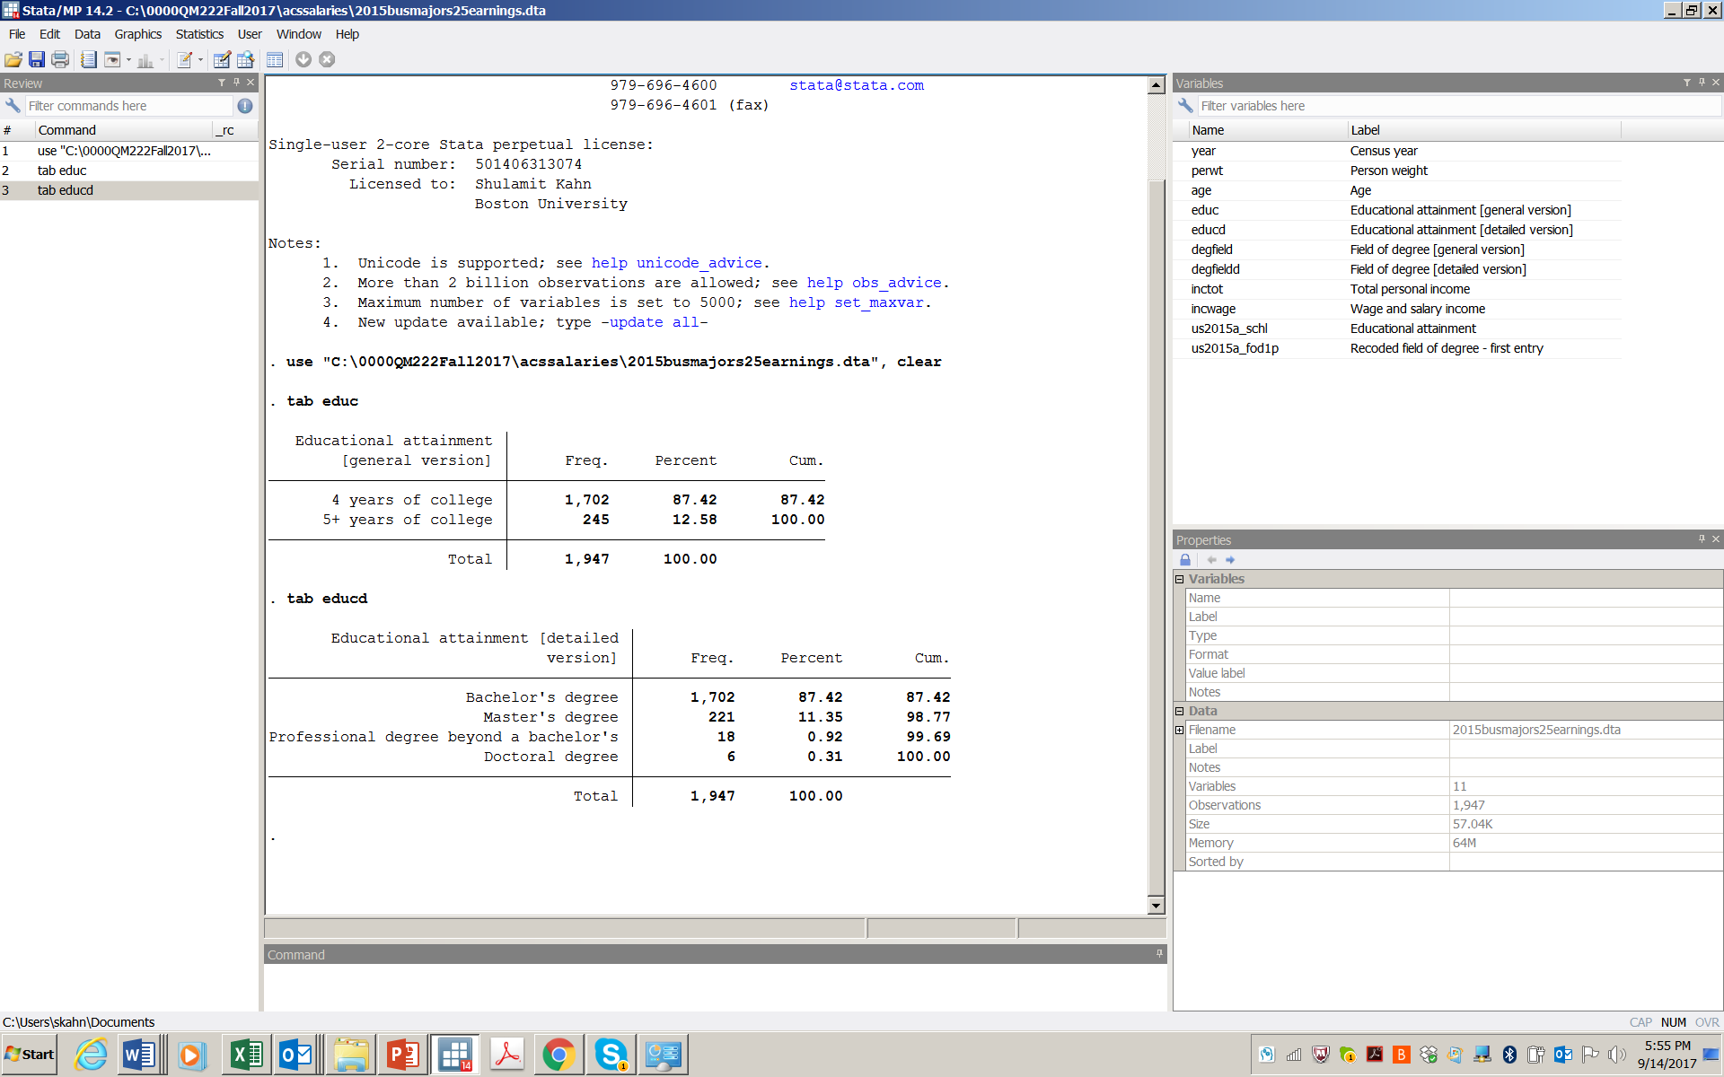
The Stata Screen has several windows
Results window
Review window
Variables window
Properties window
Command window

Slide 6
You can change windows’ dimensions by dragging edges, or click window to change what shows up
Results window
Review window
Variables window
Properties window
Command window

Slide 7
A few things to remember
The help icon (or just typing help or help topic) is very useful.
You can click icons, click on menus, or type commands.
Stata usually accepts the first few letters of a typed command (as long as this is the only command that starts with these letters.)
In variable names, Stata cares about capital letters. The variable Education is not the same as the variable education. Suggestion: always use lower case for variable names.
Stata commands can only be typed in lower case.
Stata will not let you open a new data set if you already have one open. Only one can be opened at a time.

Slide 8
Logical (if) statements
Many commands in Stata can be applied to a subset of the data only with an if statement. “If” statements are also called logical statements.
In Stata logical statements (only), you can use these “operators”:
== ( double equal signs) equals (use in logical statements only)
& and
| or
!= not equal to
< > <= >= obvious
Example: sum wagp if agep>=25
If you have a comma in your command (e.g. sum varname, detail), put the if statement before the comma:
sum wagp if agep>=25, detail

