Slide 1
QM222 Class 4 Section A1 Summarizing the Relationship between Two Variables, and Why Correlation doesn’t tell us what causes what
Sit in your permanent seat
Open NYCUniversityAdmissionsScores.xlsx in sites.bu.edu/qm222projectcourse/Other Materials/Data and other materials used in class
(then close your computer)

Slide 2
Some to-do’s
Do the Excel checklist with a TA (any QM222 TA) by the end of this week.
Assignment 1 is due next Monday:
For two topics (although you need only do 1 if you and I have already agreed on one)
What specific question or questions will your project address?
What is the data set you plan to use?
You are going to measure a relationship between two variables. What are these 2 variables? (Note: a variable can be categorical, such as gender.)
What company, governmental body or other organization would be interested in knowing the answer to this question?

Slide 3
Today’s Objectives
Scatter diagrams as one way to study the relationship between two variables
Making scatter diagrams in Excel
Correlation coefficients as a numeric way to measure the relationship between two variables.
Making correlation coefficients in Excel
Correlation is not causality: part 1

Slide 4
Scatterplots can tell us
The direction (sign) of relationship between two variables (is the slope positive or negative?)
The form of the relationship: linear vs. curved
The strength of relationship
If there are outliers

Slide 5
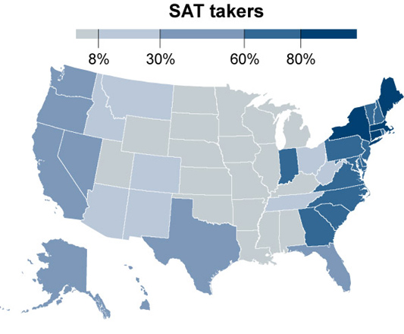
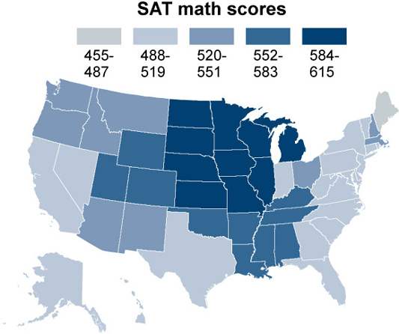
Example: The Midwest seems to have the best SAT math scores. But is this because fewer high schoolers in the Midwest take the SAT?

Slide 6
Example: The Midwest seems to have the best SAT math scores. But is this because fewer high schoolers in the Midwest take the SAT?

Slide 7
Use a scatter plot! Each dot represents one “observation”, one data point

Slide 8
Use a scatter plot! Each dot represents one “observation”, one data point
What is an observation in this data set?
A state.
If I made a line, would the slope be positive or negative?
Negative
Would a line or a curve fit better?
Probably a curve.
Is the relationship strong?
Hmmm…. kind of
Are there outliers?
Not really far out
ones.

Slide 9
Making scatter diagrams in Excel
In class exercise: open NYCUniversityAdmissionsScores.xlsx (a data set on average SAT scores from each NYC high school) in on sites.bu.edu/qm222projectcourse/Other Materials/Data and other materials used in class
Make a scatter diagram with the math score on the Y-Axis and the reading score on the X-axis.
You need to place the two columns you want in your graph side-by-side.
The variable you want on the x-axis should be on the left.
Make sure the top row of each column has a descriptive label for the variable.
On the Insert tab, click the picture of a scatter diagram and then click on the first scatter with only markers and with no connecting lines.
What does each observation represent?
Make a scatter diagram with the school’s math mean score on the Y-axis and the school’s reading score on the X-axis.

Slide 10
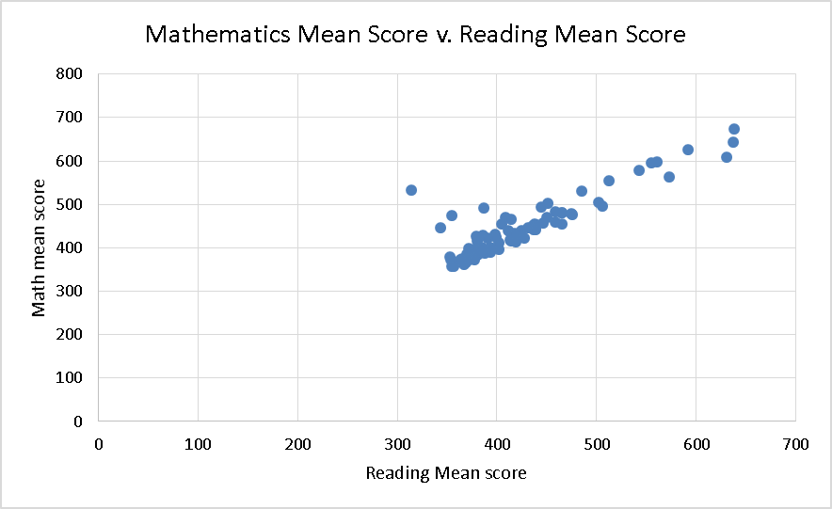
Your scatter diagram from Excel…

Slide 11
Today’s Objectives
Scatter diagrams as one way to study the relationship between two variables
Making scatter diagrams in Excel
Correlation coefficients as a numeric way to measure the relationship between two variables.
Making correlation coefficients in Excel
Correlation is not causality: part 1

Slide 12
We’d also like a numerical measure of how closely two variables move together: the Correlation coefficient
The correlation (coefficient) tells us two things:
The direction of association: When X goes up, does Y go up or down?
The strength of the association: How closely related are Y and X, or, how strong is the link?
It doesn’t tell us if the relationship is linear or curved –
In fact, it assumes that the relationship is linear.

Slide 13
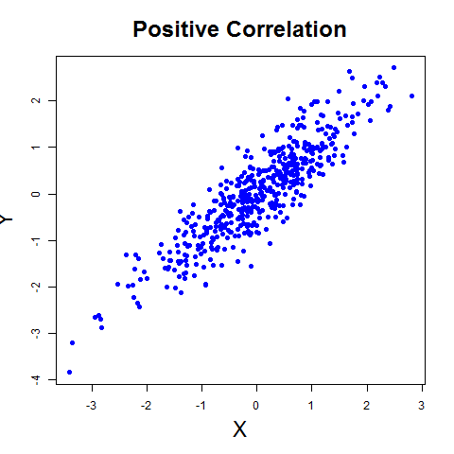
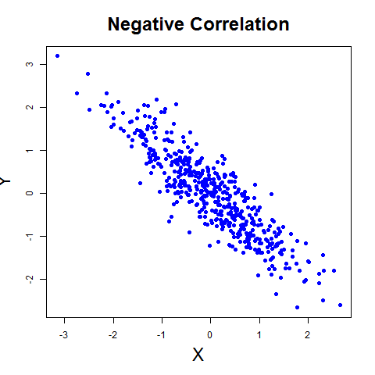
Correlation coefficient: notation r or ρ
A positive correlation coefficient means:
that when we see a higher value for one variable, we also tend to see a higher value for the other variable.
A negative correlation coefficient means
that when we see a higher value for one variable, we tend to see a lower value for the other variable.

Slide 14
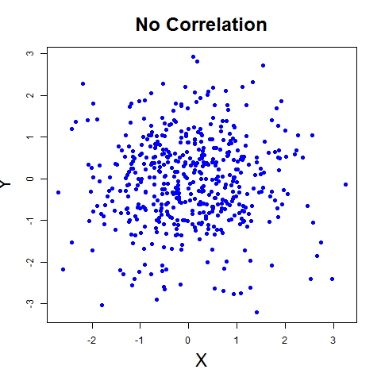
Correlation coefficient
A correlation coefficient that is zero means
that there is no correlation
If you did a scatter of X and Y, the dots would seem to have no relationship.

Slide 15
The correlation coefficient is between 1 & -1 Closer to |1| means a stronger association
When r = 1
there is perfect positive correlation; if you did a scatter of X and Y, the dots would all lie exactly on an upward sloping line.
When r = -1
there is perfect negative correlation; if you did a scatter of X and Y, the dots would all lie exactly on a downward sloping line.
When r = 0
there is no correlation; if you did a scatter of X and Y, the dots would seem to have no relationship with each other. If you were to fit a line to the dots, it would be flat (since Y doesn’t change as X changes).

Slide 16
Interpreting the values of correlation
Measured correlations are almost never exactly 0, 1, or –1
A claim that two variables are uncorrelated typically means that the correlation is “near” 0
No absolute standard for what is a strong correlation, what is a weak correlation, and what is no correlation

Slide 17
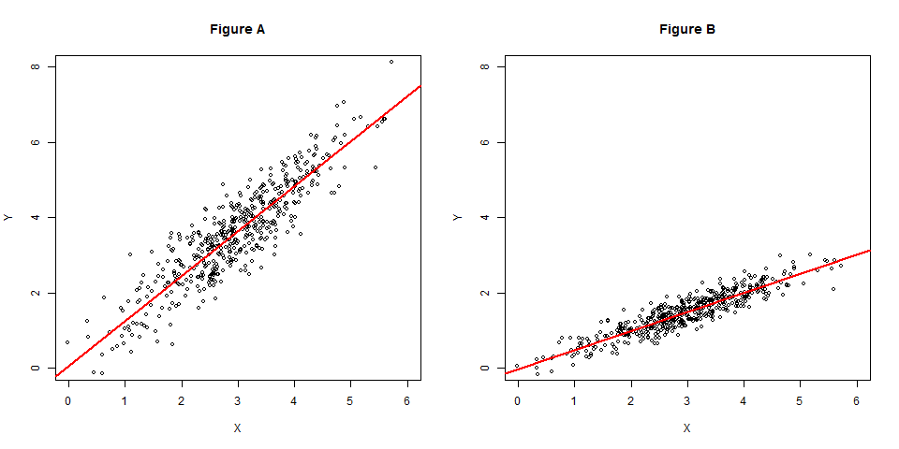
How do you think the correlation coefficients compare in Figure A and Figure B below?

Slide 18
How do you think the correlation coefficients compare in Figure A and Figure B below?
Both are positive.
Figure B fits more tightly around the line – its correlation coefficient is closer to 1.
The fact that one is steeper doesn’t affect the correlation.

Slide 19
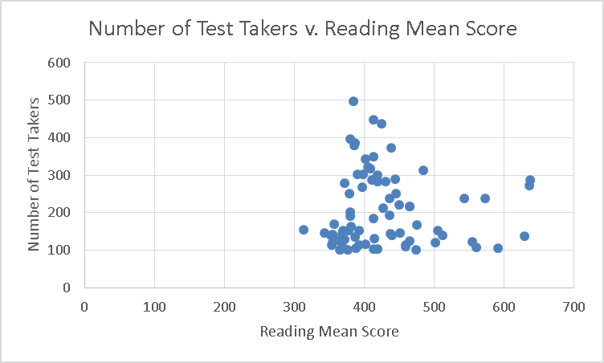
Correlation in Excel
To get the correlation (between 2 variables in Excel,
=CORREL(range X, range Y)
In-Class exercise: with NYCUniversityAdmissionsScores.xlsx again:
1. Get the correlation between schools’ math and reading mean scores.
2. Get the correlation between the number of test takers and the reading mean scores.

Slide 20
Correlation in Excel
To get the correlation between all pairs of a bunch of variables in Excel, choose Excel Data→In Data Analysis → Correlation.
Highlight all columns
Do it with NYCUniversityAdmissionsScores.xlsx
 | Mathematics Mean | Reading Mean | Number of Test Takers
Mathematics Mean | 1
Reading Mean | 0.88312 | 1
Number of Test Takers | 0.07117 | -0.00327 | 1
Understanding this:
Why are there 1’s along the diagonal?
Why are there no numbers above the diagonal?

Slide 21
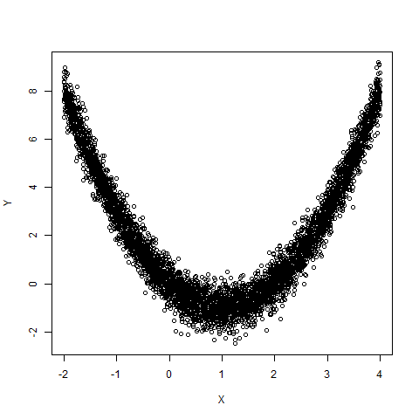
Correlation v. relation
The correlation coefficient measures the strength of linear relationship.
A low value is not enough to conclude a lack of a strong link between the two variables.
This picture has a near zero correlation … The two variables are very related, but it’s not a line with a single slope, but.

Slide 22
Today’s Objectives
Scatter diagrams as one way to study the relationship between two variables
Making scatter diagrams in Excel
Correlation coefficients as a numeric way to measure the relationship between two variables.
Making correlation coefficients in Excel
Correlation is not causality: part 1

Slide 23
Correlation does not mean Causation (i.e. one thing causes another)
https://www.youtube.com/watch?v=8B271L3NtAw

Slide 24
Why correlation does not imply causation
Possible explanations for correlation between x and y:
X causes Y
a change in X will change Y.
Y causes X
a change in Y will change X
X causes Y AND Y causes X
this is known as simultaneity
Another variable(s) cause both X and Y
this is called a confounding factor

Slide 25
Let’s go through the examples in the video… which is it?:
A. X causes Y
B. Y causes X
C. X causes Y AND Y causes X (simultaneity)
D. Another variable(s) cause both X and Y (confounding factor)
Ice cream (X) causes drownings (Y).
Married men live longer than single men.
Infants who sleep with the lights on tend to grow up short-sighted.
Self esteem causes good grades.

