Slide 1
QM222 Class 3 Section A1 Descriptive Statistics and Distributions
Where you sit will be your permanent KCB seat
Name cards?

Slide 2
Some to-dos
Sign up for an appointment (see signup, Sept 20 is the last day)
https://docs.google.com/a/bu.edu/spreadsheets/d/188IrHsjGhE758eIQ1Jcru-1WGKFmJJYrmD1ppcdcMhY/edit?usp=sharing
Many of you have not yet signed up. If you just want to shoot around ideas, I have office hours today 2:15-3:15. Or make an appointment at another time.

Slide 3
Some to-dos
Excel Checklist: Do by the end of next week (Sept. 15)
Go to our TA’s office hours… or any other ones and do/learn an Excel checklist about using Excel for formulas
Checklist at: http://sites.bu.edu/qm222projectcourse. Click on tab: QM222 Project Course – General
QM222 TA Office Hours in Room 206A (off Undergrad Lounge) |  |  |  |  |  |  | Project Section A1
 | Wednes |  | Thursdays | Fridays |  |  | Tuesdays | Wednes | Fridays | Sundays
9-10am |  | 9-10am |  |  |  | 9-10am
10-11am |  | 10-11am | Lexi Klein |  |  | 10-11am
10:45-11:45am | Shogo | 11-12pm | Lexi Klein |  |  | 11-12pm | James |  | James
11:45-12:45pm | Shogo Y | 12-1pm | Cristiane |  |  | 12-1pm
12:45-1:30pm |  | 1-2pm | Cristiane |  |  | 1-2pm
1:30-2:30pm | Roland | 2-3pm | Sanya Seth | Rachel |  | 2-3pm |  | Ata` |  | Ata
2:30-4pm |  | 3-4pm | Sanya Seth | Nick Lord
4-5pm | Maciej | 4-5pm | Nick Lord
5-6pm | Maciej | 5-6pm | Rachel Mann
6-7pm | Roland

Slide 4
Today’s Objectives
Checking your knowledge: Data sets and data characteristics
Descriptive statistics and Excel on a single variable (QM221 review):
Measuring a variable’s middle
How the difference between these measures depend on the distributions of the variable
What we learn from each different measure
Measuring a variable’s spread
How the difference between these measures depend on the distributions of the variable
What we learn from each different measure

Slide 5
A survey of companies in various different countries:
country | 5-year sales change | log of num employees | public? | ID code
uk | -0.6620443 | 6.663133 | 0 | 4159
uk | 0.3003899 | 6.791222 | 0 | 4151
uk | 0.7102566 | 8.056109 | 1 | 4149
uk | 1.539853 | 6.120297 | 1 | 4148
uk | -0.1417196 | 5.273 | 0 | 4147
uk | -0.2546803 | 5.459586 | 0 | 4109
uk | 0.1707842 | 8.941415 | 1 | 4106
uk | 1.361145 | 6.951772 | 1 | 4091
uk | 0.2348493 | 7.252762 | 0 | 4082
uk | 0.4187952 | 6.510258 | 0 | 4038
uk | 0.3203718 | 6.51323 | 0 | 4023
uk | 0.07127 | 5.209486 | 0 | 4021
uk | -0.1238539 | 4.736198 | 0 | 4020
uk | -0.2245746 | 5.236442 | 0 | 4019
uk | 0.2948269 | 8.518393 | 0 | 4018
1. What does an observation in this dataset represent?
2. Which variables in this data set are numerical?
3. Which variables in this data set are categorical?
4. What kind of dataset is this:? A. Cross-section B. Time-series C. Cross section-Time series D. Panel/Longitudinal

Slide 6
What if we redid this survey every year for 8 years (and had a new variable year?) Then which answers would change?
country | 5-year sales change | log of num employees | public? | ID code
uk | -0.6620443 | 6.663133 | 0 | 4159
uk | 0.3003899 | 6.791222 | 0 | 4151
uk | 0.7102566 | 8.056109 | 1 | 4149
uk | 1.539853 | 6.120297 | 1 | 4148
uk | -0.1417196 | 5.273 | 0 | 4147
uk | -0.2546803 | 5.459586 | 0 | 4109
uk | 0.1707842 | 8.941415 | 1 | 4106
uk | 1.361145 | 6.951772 | 1 | 4091
uk | 0.2348493 | 7.252762 | 0 | 4082
uk | 0.4187952 | 6.510258 | 0 | 4038
uk | 0.3203718 | 6.51323 | 0 | 4023
uk | 0.07127 | 5.209486 | 0 | 4021
uk | -0.1238539 | 4.736198 | 0 | 4020
uk | -0.2245746 | 5.236442 | 0 | 4019
uk | 0.2948269 | 8.518393 | 0 | 4018
1. What does an observation in this dataset represent?
2. Which variables in this data set are numerical?
3. Which variables in this data set are categorical?
4. What kind of dataset is this:? A. Cross-section B. Time-series C. Cross section-Time series D. Panel/Longitudinal

Slide 7
Today’s Objectives
Checking your knowledge: Data sets and data characteristics
Descriptive statistics and Excel on a single variable (QM221 review):
Measuring a variable’s middle
How the difference between these measures depend on the distributions of the variable
What we learn from each different measure
Measuring a variable’s spread
How the difference between these measures depend on the distributions of the variable
What we learn from each different measure

Slide 8
Measuring the middle
Mean
Add up all the values and dividing by the number of observations
Median
Half the observations are greater than the median, half the observations are smaller than the median.

Slide 9
Getting these statistics in Excel (for a variable with data in cells a2:a64)
Mean: =average(a2:a64)
Median: =median(a2:a64)

Slide 10
Now let’s think about these descriptive statistics: Mean v. Median
Are they always equal? When and when are they not?
They are not equal when the probability distributions are the same to the right and left of the median.
Let’s first see this with an example.

Slide 11
When do people arrive at a party? (Note that this is a sideways histogram, showing the percent from smallest to largest value)
When do you think it is best to arrive at a party?
What do you think is larger—the median or the mean?

Slide 12
When do people arrive at a party?
Mean arrival: 67 minutes late
Median arrival: 45 minutes late

Slide 13
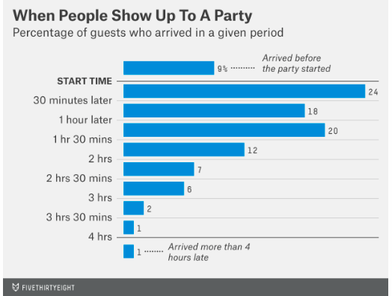
Percentiles and distribution
That bar graph of arrival times gives you the whole distribution
It puts it in ranges: We call that a histogram
Histograms rotate that graph so bars are vertical:
The histogram of a variable X has the values of X on the X-axis.
It has the frequency/relative frequency (percentage) for each class/category on the Y-axis.
You can make histograms in Excel or Stata

Slide 14
Percentiles and distribution
Why does this distribution give us a different mean and median?
Because the probability distributions are the same to the right and left of the median: It is not symmetric.

Slide 15
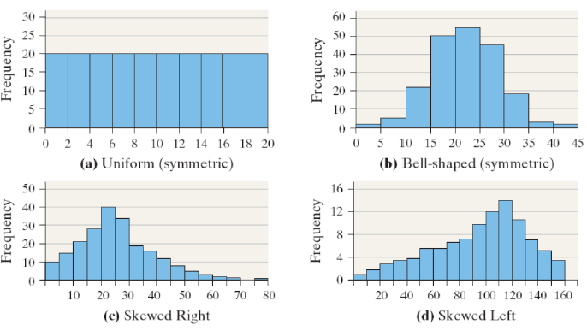
Here are some kinds of distributions. (There are many other possible types of distributions) Note which are symmetric… and which aren’t
Notes:
We will use graphs of distributions to illustrate concepts. A histogram (bar graph) showing the frequency of distribution of our data can be a powerful tool.

Slide 16
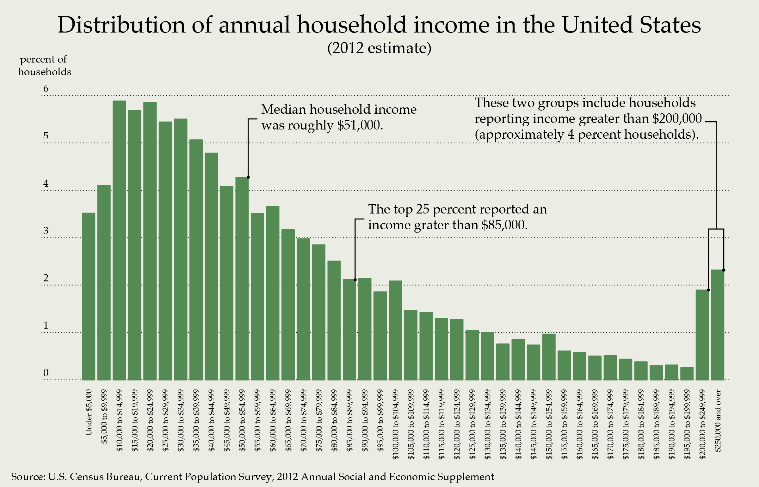
A very important case skewed case where mean and median are different
To foreshadow what is coming later in lecture…
it helps to look at the distribution of income
The mean was $76,836.

Slide 17
Let’s think about Measures of the Spread
Range: Max – Min
Pro’s: Simple
Con’s: Can be highly affected by ONE unusual observations.
Standard deviation
Measures how far is the data spread out around the mean
Pros: A single measure based on all observations
Cons: Not as intuitive to some people.

Slide 18
Low and high standard deviations
The larger the SD, the more spread out the data are.
Here, we show a smooth (continuous) distribution.

Slide 19
For Discussion
If I give you the bad news that you got 65 in the exam and the class average was 78, in which situation would you rather be:
Std deviation of the class was 5
Std deviation of the class was 13
Or are you indifferent?

Slide 20
Getting these statistics in Excel (for a variable with data in cells a2:a64)
Range: =max(a2:a64 ) – min (a2:a64)
Standard deviation: =stdev(a2:a64) or =stdev.s(a2:a64)
both are for a sample

Slide 21
But giving the value of a variable at various percentiles can also be used as a measure
This is the distribution of all 2000 observations of 25 year-olds salaries.
We can measure the spread by looking at the income at pairs of percentiles.
50% of people are between the 25th and the 75th percentiles.
80% of people are between the 10th and the 90th percentiles.
We can calculate income at different percentiles.
Which is larger here, the mean or the median? Why?

Slide 22
Getting percentiles in Excel (for a variable with data in cells a2:a64)
25th and 75th percentiles:
=percentile(a2:a64,0.25) gives the value at the 25th percentile of the data set
=percentile(a2:a64,0.75) gives the value at the 75th
percentile of the data set.

Slide 23
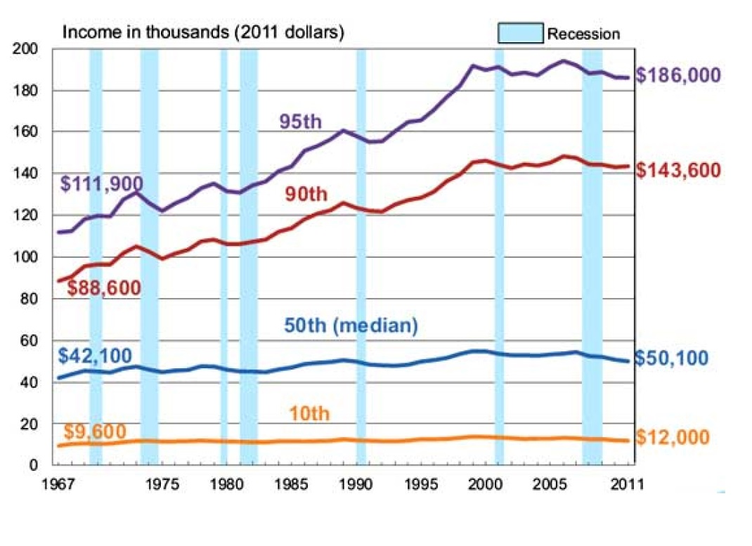
Growing inequality has increased income at the higher percentiles, but not the median wage much. What has happened to the MEAN?

Slide 24
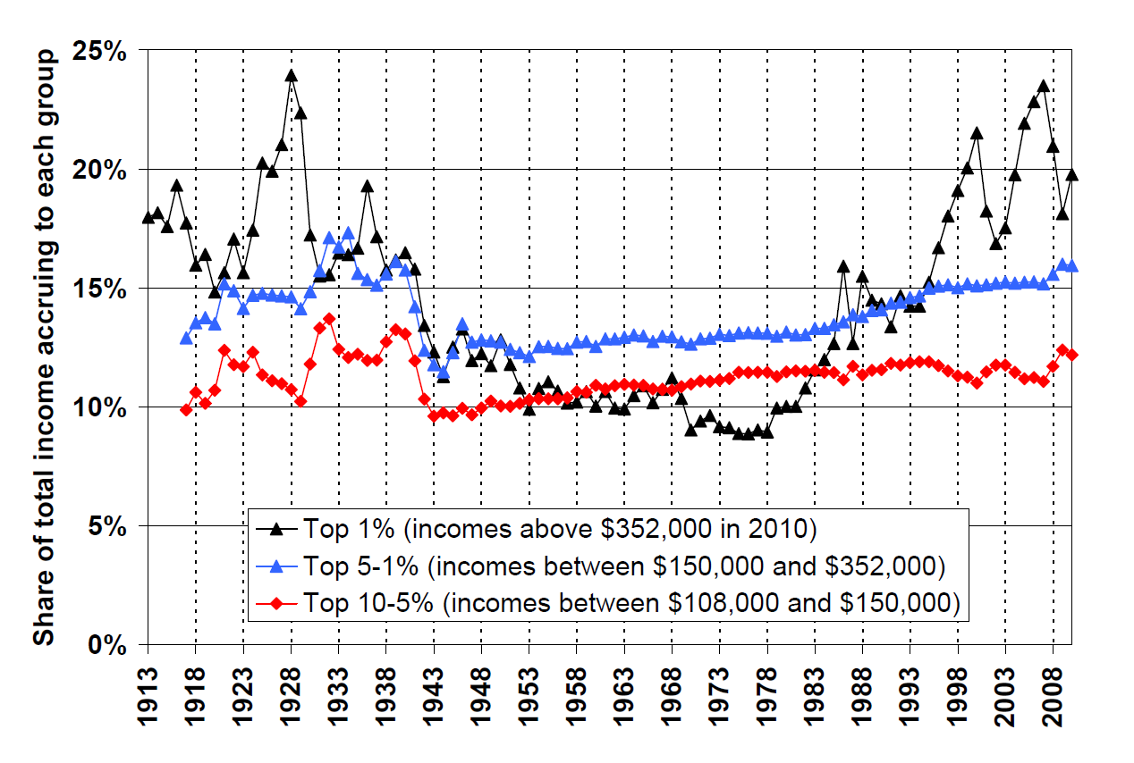
The top 1% are getting increasingly rich
Source: March 2012 Update to Piketty and Saez (2003)

Slide 25
The most used distribution? The normal distribution

Slide 26
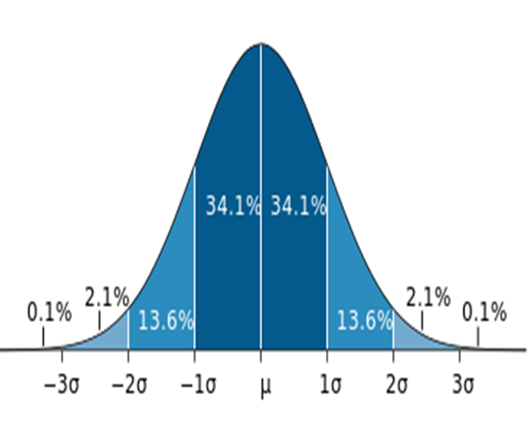
Normal Distribution
A “Normal distribution” looks like a symmetric bell curve
Symmetric means that the right side of the mean is a mirror image of the left side
Bell curves look like a bell.
Notation here: μ is the mean, and σ is the standard deviation
Approximately 68% (or around 2/3rds) of the observations are within one standard deviation of the mean.
Approximately 95% of the observations are within two standard deviations of the mean.
Notes:
Do problem sets on your own – it is the best way to learn the material. Mistakes on problem sets are not excessively penalized
There may be a pop quiz on the problem set in section when it is due (with p=.5)

Slide 27
Example of normal distributions Weather : Climate change by graphs
This plot shows temperature patterns in the Northern Hemisphere for each decade from the 1950s through the 2000s.
What is happening to the mean of the distribution over time?
What is happening to the standard deviation of the distribution?
What does this suggest about climate change?

Slide 28
Today we
Learned when we might use mean and when we might use median
Learned about the usefulness of percentiles
Reviewed idea of (probability) distributions
Learned more on distributions
Symmetric v. skewed
Bell shaped v. uniform v. other
Normal distributions and their characteristics

