Slide 1
Welcome to QM222 A1 (Project Section) Making Decisions with Data Class 1
Professor Shulamit (Shu) Kahn skahn@bu.edu
TAs: Ata Leblebici leblat@bu.edu
James Stuart jdstuart@bu.edu

Slide 2
Today’s Agenda
Introductions
Go over syllabus together.
What this course, your project, (and most data analysis) is about.

Slide 3
Self-introduction card: Fill in and then introduce yourself to your neighbors
(Front)
Your full name.
What I should call you in class.
An interesting fact about yourself.
(Back) Make a 3x2 table and fill in
In 1-2 words, what’s your main emotion when you think about statistical data analysis?

Slide 4
My self-introduction
Full name: Shulamit Kahn
What you should call me in class: Professor Kahn, Shu, Professor, Prof.
Interesting fact:
I am on the Board of Trustees of a school for street children in Kenya.

Slide 5
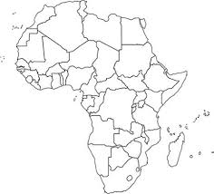
Where is Kenya?

Slide 6
My self-introduction
Full name: Shulamit Kahn
What you should call me in class: Professor Kahn, Shu, Professor, Prof.
Interesting fact:
I am on the Board of Trustees of a school for street children in Kenya.
In 1-2 words, what’s your main emotion when you think about statistical data analysis?
excitement

Slide 7
More about me
PhD in Economics from MIT
Recently, I’ve been doing (statistical) quantitative research using methods we’ll be learning, on: Entrepreneurship and immigration, How macroeconomics affect whether foreign graduate students return home, the gender gap in PhD Science salaries, Science and careers etc.

Slide 8
Let’s agree to be professional and respectful of each other
Come and leave on time
Not leave in the middle of “lecture”
Not doing other things to distract anyone in class
I’ll try to give you lots of way to learn – particularly by doing
You should try to learn in real time, i.e. to think: during “lecture”, during in-class exercises, thinking about your project
Tell me – in class or after, in office hours, what you don’t understand

Slide 9
Today’s Agenda
Introductions
What this course (and most data analysis) is about.
Go over syllabus together.

Slide 10
QM222 is different than QM221
We mostly measure whether things happen at the same time, are “correlated.”
QM222 is about understanding what we can learn from these correlations
and what we can’t.
3. It’s about how to interpret numbers/statistics/facts you are given, and to create the numbers/statistics/facts you need from data.

Slide 11
Example 1.
I used to let students have their computers open. But the evidence says that it is not a good way to learn:
Brookings Institute 8/10/17 “For better learning in college lectures, lay down the laptop and pick up a pen”
https://www.brookings.edu/research/for-better-learning-in-college-lectures-lay-down-the-laptop-and-pick-up-a-pen/
Break into 4 person groups to discuss this question:
Let’s say that you have access to all professors teaching sections of QM222 this year and can ask them questions about grades, computer use among students in classes etc.
What data would you collect and what calculations would you make to establish whether this Brookings conclusion applies for QM222?
(Only suggest calculations/statistics that you learned in QM221 or basic ones like percentages and means).
After you get your answer, think again about whether you can really conclude this based on your evidence.

Slide 12
How this section is different from other QM222s
The best way to learn data analysis is to do it.
The best way to do it is to be interested in what you are researching.
This section revolves around one major project of your choice.
In this section, you prepare your own data set.
Rather than problem sets, it has assignments that are stages of this project
It has one midterm but no final, and tests are worth less.
It has a smaller class-size and 2 TA’s so we can supervise you.
(We’d do them all this way if we could supervise 300 projects.)
I don’t think about a grade distribution here – I’d be happy with all A’s and A-’s.
It is easier to do well on the project than tests because I give you feedback and chances to improve.

Slide 13
Today’s Agenda
Introductions
What this course (and most data analysis) is about.
Go over syllabus together.
Datasets.

Slide 14
Syllabus – Reaching Me and TAs
Me: Professor Shulamit Kahn
Email: skahn@bu.edu
Office 518C
Office Hours: Mon 2:15-3:30, Th 12-1:30 (or by appointment – just email with “A1 appointment” in the subject)
Teaching Assistants
James Stuart jdstuart@bu.edu
Office hours: Tues and Fri. 11-12. Room 206A
Ata Leblebici leblat@bu.edu
Office hours: Wed and Sunday 2-3. Room 206A

Slide 15
Two Websites
The main website for this course is http://sites.bu.edu/qm222projectcourse.
Here you will find this syllabus and schedule, lecture slides, information on datasets, assignments, instructions on using Stata, practice tests etc.
The website for handing in online assignments or seeing grades is our section’s QuestromTools (QM222 A1 Fall2017) website.

Slide 16
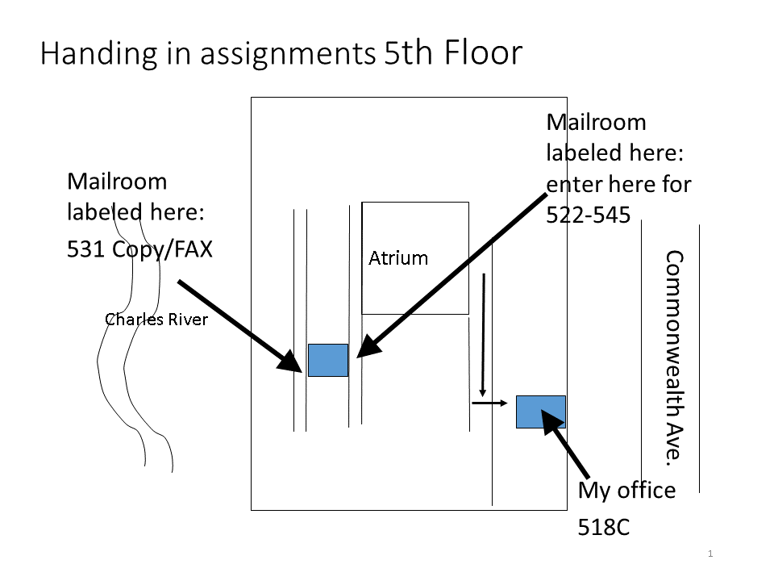
Hand in assignments in Class OR …

Slide 17
Course Material
Required reading: QM222: Making Decisions with Data – PROJECT SECTION A1 ONLY Fall 2017 Edition (course notes). FedEx at 115 Cummington St.
You need to buy the RED COURSE NOTES
Do buy those that are a different color and have 2 parts
Do NOT use notes from previous semesters.

Slide 18
Also, we use different – Statistical software – Stata rather than Excel
We use different software that costs $45.
It is very simple and quick to do statistical analysis in Stata, compared to Excel.
Excel does only limited kinds of statistical analysis and limited numbers of variables.
Excel cannot deal with large data sets.
Statistical programs allow you to retain a “log” of everything that you have done so you can go back and look at it.
Statistical programs allow you to put commands you want into a file and run them at the same time.
We will also use some Excel (to prepare you for QM323 and because graphs are easier in Excel).

Slide 19
Getting Stata
Buy Stata/IC.
DO NOT BUY SMALL STATA – IT WILL NOT FIT MOST DATA SETS you will want to use.
It costs $45 for one semester, or for $89 for a year.
Here’s the website to go to buy Stata:
http://www.stata.com/order/new/edu/gradplans/student-pricing/

Slide 20
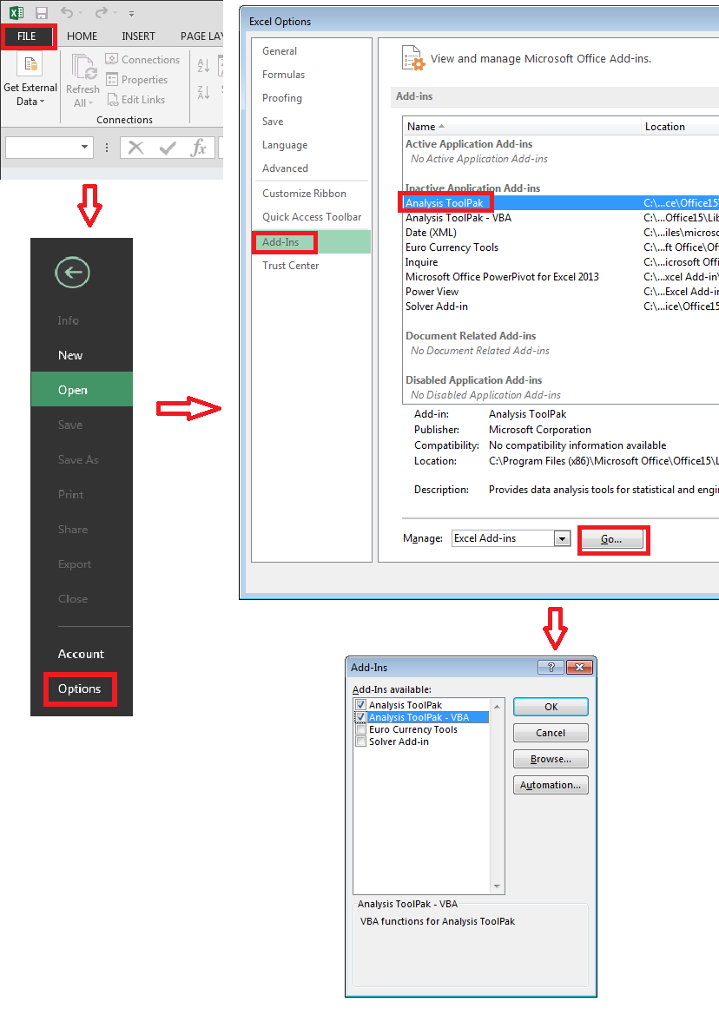
We will start with Excel You will need a relatively recent version of Excel. You can download this current version for free from this website: http://www.bu.edu/tech/services/support/desktop/distribution/microsoft/studentoffice/ Then you will need to install add-in Data Analysis This week or next, visit a TA during office hours and demonstrate that you can do the tasks on the TA’s Excel checklist.

Slide 21
Course Policies
Attendance policy
Accommodations for students with special needs
Academic integrity policy
Test
Projects

Slide 22
Course Components and Grading
You’ll get the higher of these two grades:
Course Component | Weight in Final Grade V1 | Weight in Final Grade V2
Project | 44% | 68%
Test | 43% | 20%
(Timely) assignment and apptmt completion | 6% | 6%
Attendance, Class Participation, Presentation | 5% | 4%
Ungraded Research Obligation (URO) | 2% | 2%

Slide 23
More on course components: Test
One test Mon. October 30, Tues. October 31 or Wednesday November 1, 6 pm
Test is closed book except for 1-2 sheets of paper (to be clarified)
Let me know in Sept. if you get extra time for tests or if you cannot make the time we choose.
Bring a plain calculator, NOT a cell-phone or laptop, to the test.
There is no final exam. However, those unhappy with their test score can choose to take parts of the regular QM222 final to replace it.
You will have to inform Prof Kahn by December 8th if you plan to do this.

Slide 24
Final Project logistics
The final project is due December 15th 6pm.
Assignments before that lead up to the final project.
A full draft is due November 20.
I will read ONE draft of your final project and give you comments (and preliminary score, achievable score)
If you hand it in by Nov. 20, I’ll give feedback by Dec. 4.
If hand in by Dec. 4, I’ll give feedback in the order I receive them but certainly by Dec. 11th.
The earlier you get me that draft, the earlier you’ll get my comments and the more complete they will be.
Grades are MUCH higher when you can revise your paper.

Slide 25
Timely assignment and appointment completion of Assignments
There are 7 assignments including the final draft, together worth 6 pts of your grade.
All assignments are available on the website.
Assignments are graded only for completion and timeliness of all parts.
Each assignment has different numbers of points
Assignment 1 is due Sept 18 (6 pm) and is worth ½ point.
If you hand any assignment in late, you lose 5% each day.
See schedule, syllabus for other due dates.
All assignments ask for a hard copy, a few ask for an on-line component… Why?
I respond to the content on the hard copy.
Online, I need your computer dataset or output.
There are 2 required meetings with me, first Mon Sept 11th– Sept 20th to discuss your topic and dataset. When you have ideas, we can meet.

Slide 26
Final Project
Your project should use regression and any other relevant statistics to answer a question of your choice, whose answer will be useful to your client. The regression(s) will be measuring relationships between variables in order to answer the question. Your topic must be approved by Prof. Kahn.
Your final project should be written in the form of a report to a client who would be interested in knowing your results. The client can be one or more people at a company, governmental unit, or other organization.
The final project should include a 1 page executive summary* and an 8-20 page report (including tables or graphs.) More is not better. You don’t need 20 pages to get an A, but you do need a well-written motivation, data description, and appropriate statistical analysis where the answer to the question is developed and elaborated on.
You will also need to include at least one graph created by Excel.

Slide 27
Classroom participation
Class participation reflects:
Attendance. You are allowed 2 absences. (max 2 pts)
Your presentation (max 1 pt).
Contributions to class discussions – questions, answers, thoughtful comments (max1 ½ pt.)
This includes respectful and professional behavior in class.
Your two appointments with me.
You lose a lot for having an appointment and not showing up.
Pick the seat you want and sit there in next class.
Please bring a tent card with your name.

Slide 28
URO (ungraded research obligation) is worth 2 points
URO: Everyone in QM222 must participate in two Friday experiments (45 minutes, 10 am to 6pm)
One experiment Sept 8th – Oct 13th
One experiment Oct. 20th – Dec. 1th.
You can replace it by asking for extra assignments, but I need to know this month if you plan to do that.
Sign up today!

Slide 29
Finding a topic: some tips
It needs to be about how variables relate to each other.
It should be a topic about something you are interested in.
Sometimes, students get ideas by looking at what data sets are available.
On Friday, you will learn about what is meant by a “dataset”
And I will give some suggestions of available data sets
Some data sets you might think about using are on the website sites.bu.edu/qm222projectcourse/data-set.

Slide 30
Some of previous years’ questions/topics:
Predicting job satisfaction in the work place.
How do working long days affect people’s happiness with their marriage?
What kinds of household tend to own more vehicles?
Who is the typical smoker?
Predicting Flow of the Elbow River at Bragg Creek during the spring/summer
What drives dividends?
Financial Ratios and Profitability in the Apparel Industry.
Impact of Advertising on Sales of … (student’s own product he sold to students)
International Students in the United States: A Statistical Analysis.
How MPG affects sales prices of cars.
Factors that affect whether a pregnant woman 18-26 years old will have an abortion.
Lots of sports topics: How injuries affect a basketball player’s later performance, the impact of offensive coordinators on team success in the NFL, what’s more important to winning golf tournaments – putting or long drives. Etc.
What drives dividends?

Slide 31
Important things to know about the schedule & logistics
Next class, sit where you want to sit all semester (with anyone you particularly want to be in your 4-person team.)
Class is cancelled Friday Sept. 20
You need to load the option Excel Data Analysis on your computer, visit TA office hours and demonstrate that you can do the tasks on the TA’s Excel checklist.
Fridays classes are either in Room 315 or 314 (latter has computers).
When we are not in 314, bring computers when the schedule says to.
Fall 2017 QM222 Section A1 Project Schedule
Date |  | Class | Topic | Chapter | Computer day? (bold= essential) | Room
Wednesday, September 6 |  | 1 | Introduction to QM222 and the Course Project | 1 |  | KCB 104
Friday, September 8 |  | 2 | Data; Descriptive statistics in Excel | 2, 3 | Yes | HAR 315
Monday, September 11 |  | 3 | More on descriptive statistics and distributions | 3 | Yes | KCB 104
Wednesday, September 13 |  | 4 | Summarizing the Relationship between Two Variables, and why correlation doesn't tell us what causes what | 4 | Yes | KCB 104
Friday, September 15 |  | 5 | Introduction to Stata: Inputting, manipulating and cleaning data | 26 |  | HAR 314
Monday, September 18 | Assignment 1 | 6 | Choosing the right measure and avoiding bias | 5 | Yes | KCB 104
Wednesday, September 20 | Required Meeting #1 by end of day | 7 | Simple regression | 6 |  | KCB 104

