Slide 1

BE700 Spring 2022
SYSTEMS BIOLOGY AND ARTIFICIAL INTELLIGENCE (AI)
USING AI TO ADVANCE PERSONALIZED MEDICINE

Slide 2

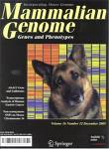
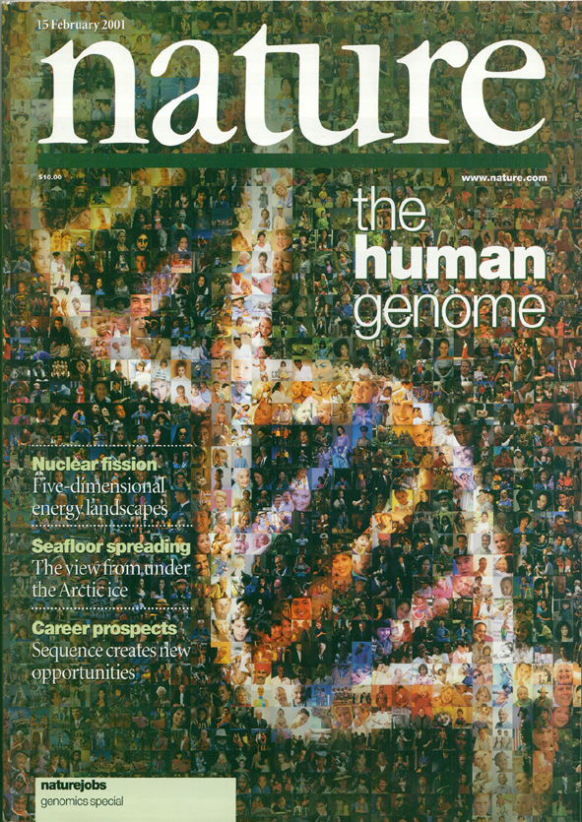
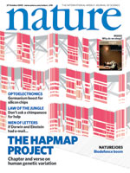
Nature unveiled….
Human genome…… chimp genome ……dog genome ….. human mutations…...
Our group was part of the public human genome project
Tarjei Mikkelsen (former student is first author)
BU PhD student was a leading author
2001
We now know the parts (with important QUALIFICATIONS)
What is next?
Notes:
During the last decade we have witnessed a revolution in biological science
The revolution began when the first bacterial genome H. influenzae was sequenced by Craig Venter in collaboration with Ham Smith (who is the person that introduced me to Biological Genomics).
A major milestone in the history of genomics was the sequencing of the human genome by the public consortium and the parallel project by Craig Venter’s team at Celera.
I was fortunate to be part of the public consortium that competed with the commercial effort.
No small part the challenge was the fact one of my very best PhD students Art Delcher was on the Celera team..competing with his academic mentor.
The next important milestone was sequencing of the chimp genome. This genome and the other subsequent genomes (like the dog genome) were important in starting to decipher the major puzzle of genomic science
what makes us human?
The first author on the chimp genome was Tarjei Mikkelsen who was an intern in my human genome project group and since then became of of the most prolific and infulential young scientists working in epigenetics of stem cells.
The HAPMAP was another significant milestone that led the medical genetics community to many scientifically difficult
explorations. However it was important in identifying the SNP that document the common variation in human population.

Slide 3
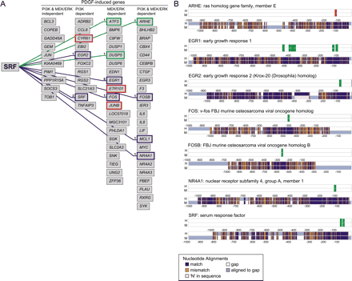
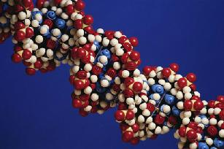
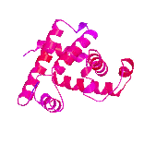
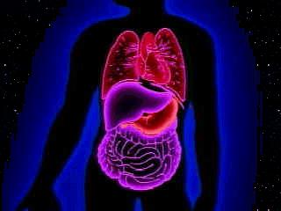
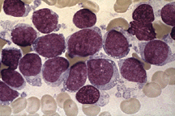
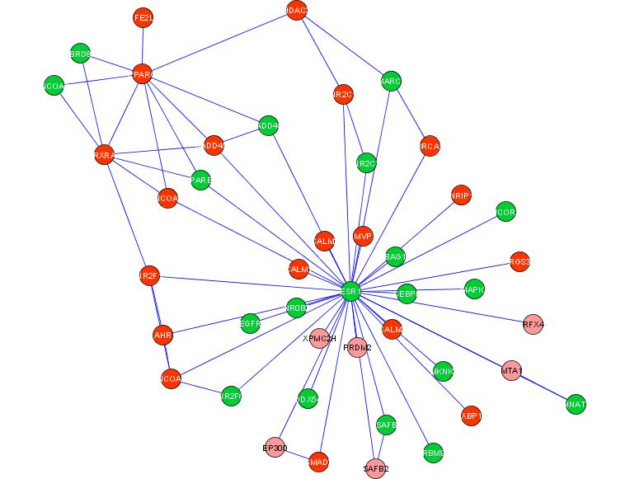
Deciphering Nature
F?
Genome
Phenotype
Cells
Organs
Tissues
Species
Biomedcical/Biophysical phenotypes
Parts
  Gene Finding
  Gene Annotation
Modules
  Gene Regulation
  Protein-Protein Interaction Networks
Pathways: Learning and Discovering and Modeling Gene Modules
Learning Pathways/Modules associations with Biomedical Phenotypes
Causal Network Models of Disease and Biology
Notes:
The next natural step in genomic sciences was to speed up the process of decoding the human genome.
The community has a number of ambitious scientists who are not shy of major challenges.
After solving the “whole genome assembly problem” which allows us to sequence and assemble genomes.
The next challenge was to attempt to attempt other whole genome solutions such as
Whole genome gene identification, whole genome gene annotation, whole genome regulation, and so forth.
Todays talk will focus on 2 & 4 but we have touched on most of these probelms

Slide 4
Big Question
If we assume that the relationship between genotype and phenotype is a Function F
Can an ML algorithm learn it from data and prior knowledge compiled into a computable representation

Slide 6
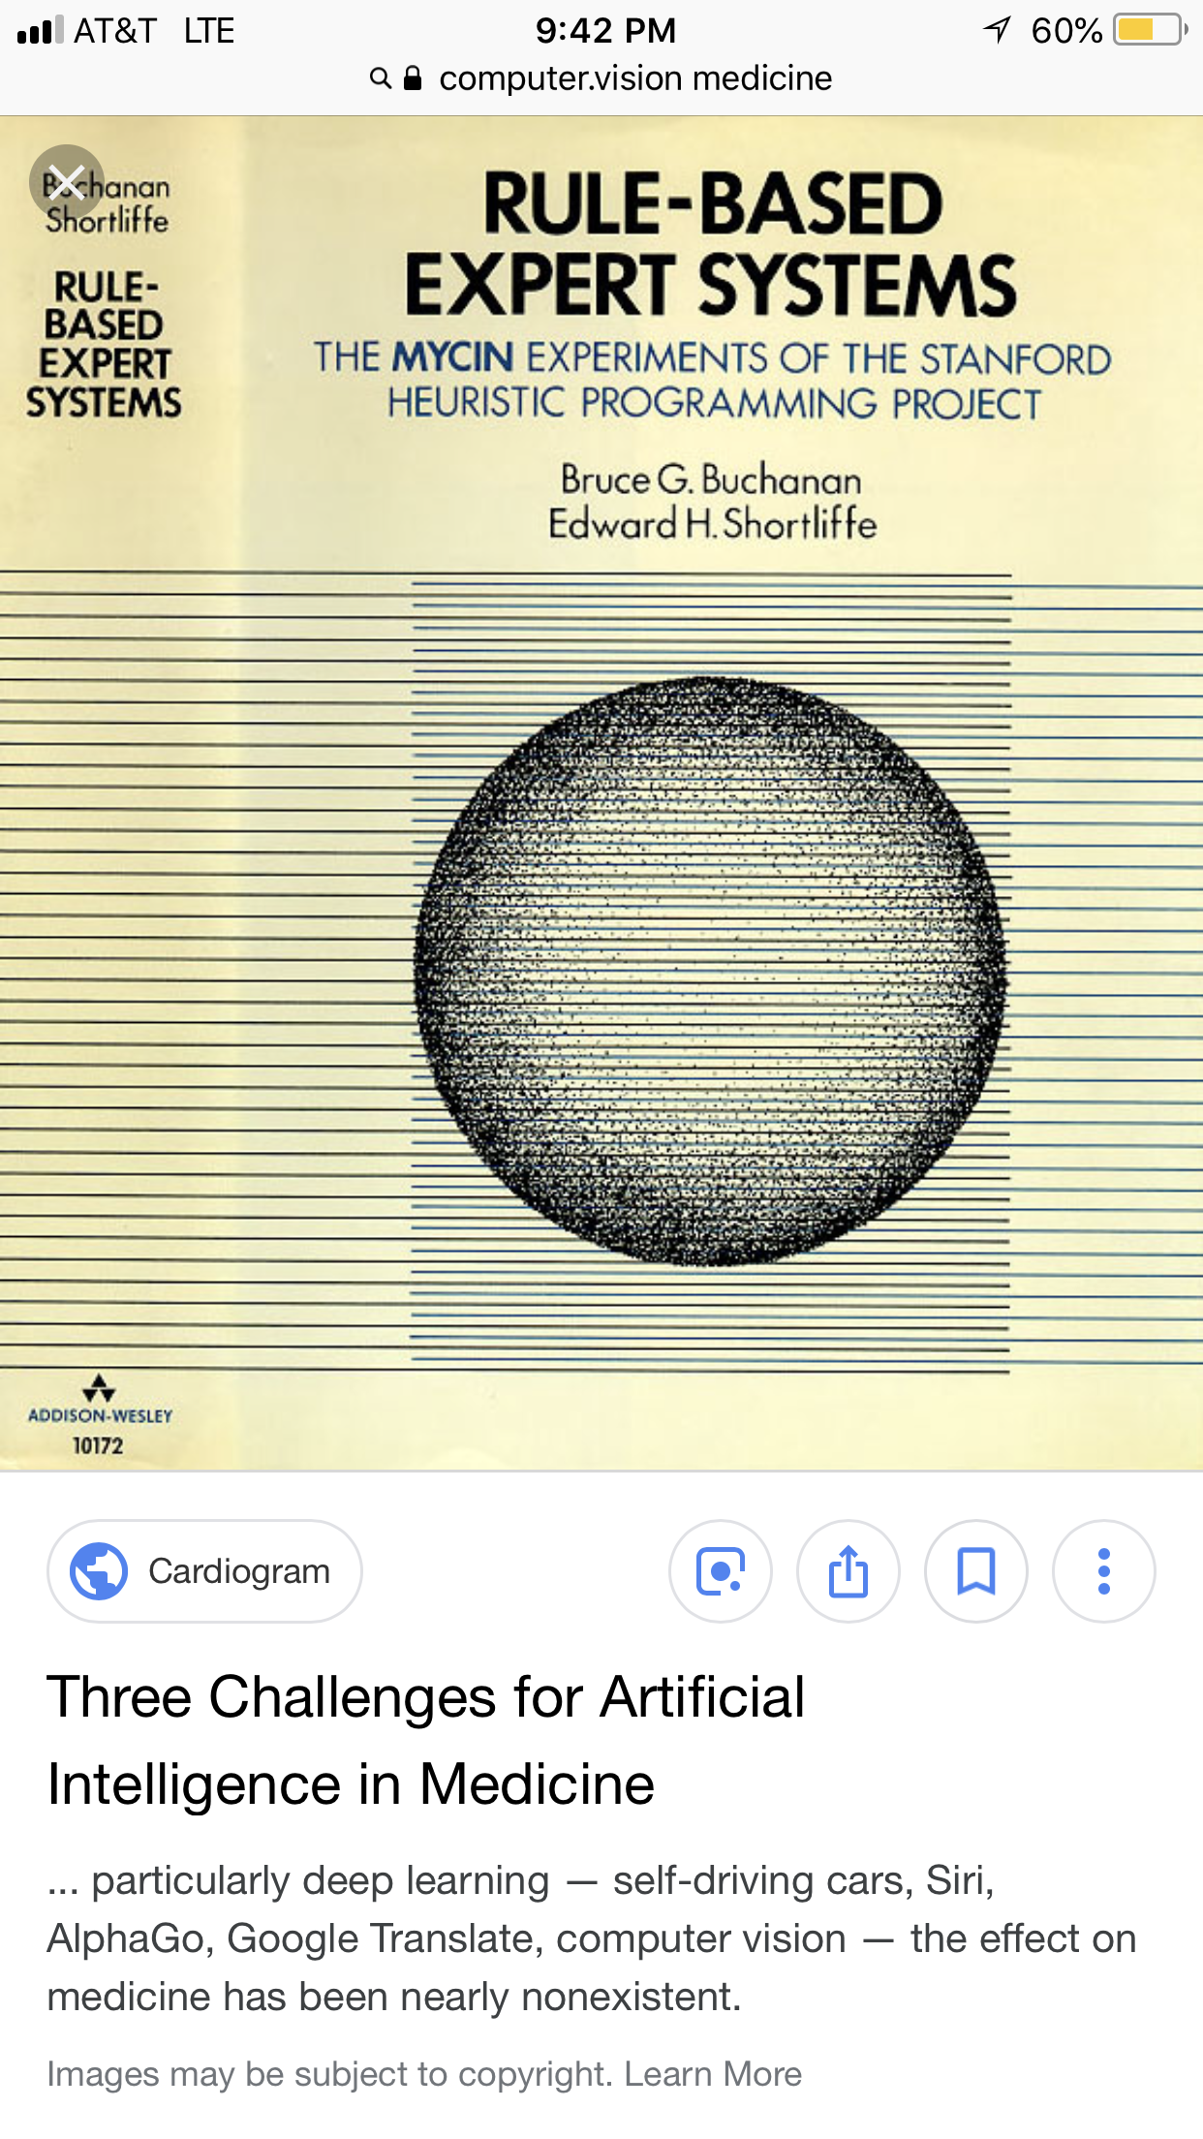
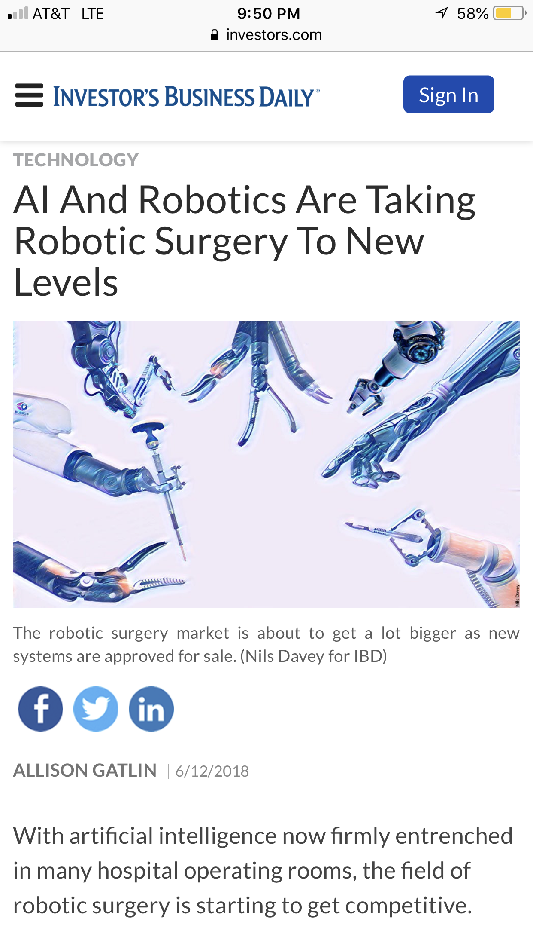
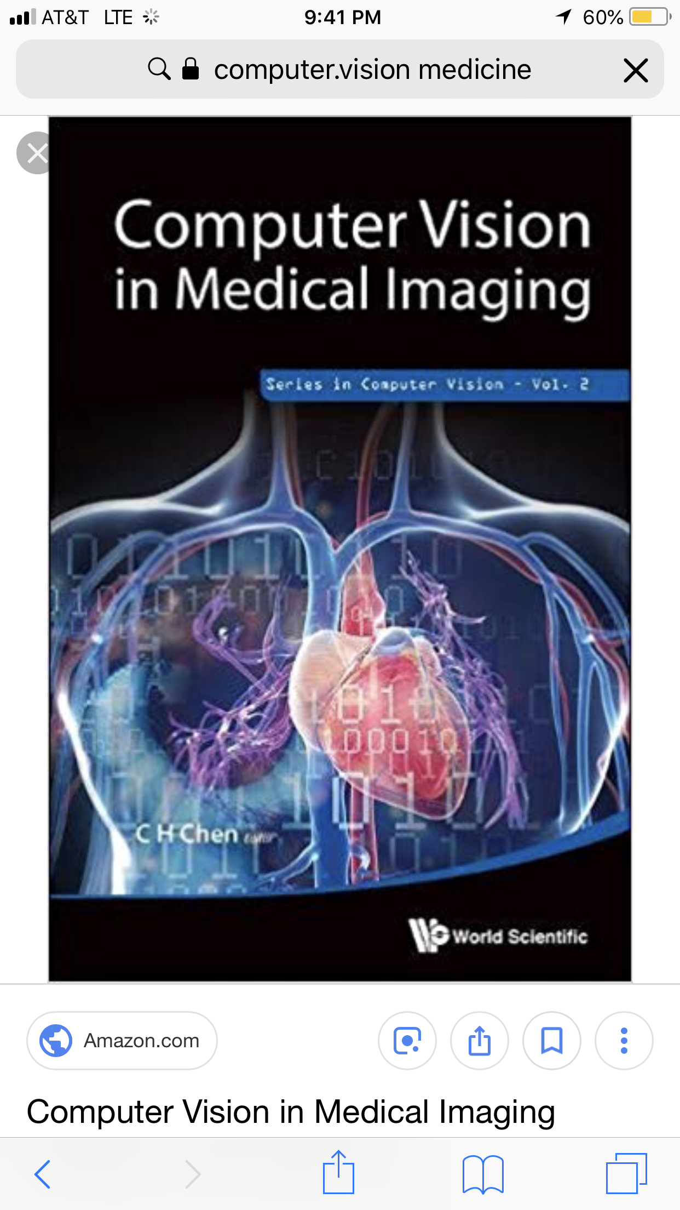

AI and Medicine

Slide 7
Computational/Evolutional Thinking about Biology and Disease
“Biology is a software process. Our bodies are made up of trillions of cells, each governed by this process. You and I are walking around with outdated software running in our bodies, which evolved in a very different era”.
Ray Kurzweil

Slide 8
What is AI ?
AI has many subfields ☺
Core applications: speech, language, vision, robotics
Core AI
  Machine Learning (ML) : Inductive Inference, Classification
  Knowledge Representation and Acquisition
  Automated Reasoning (AR): Deductive Inference
  Planning, Decision Making
Machine learning is very trendy
Reasoning and Planning are equally IF NOT MORE challenging
Many types of Reasoning
  Probabilistic (e.g. graphical models, Bayes)
  Logic
Our focus:
  INTEGRATION OF ML + AR + BIOLOGY

Slide 9
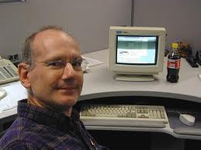
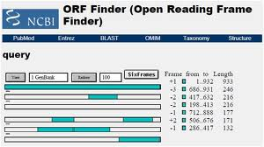
GLIMMER is a Microbial Gene Finder
GLIMMER LEARNS FROM DATA in a Semi-Supervised Fashion Using a Speech Understanding Technique (Interpolated Markov Models – from Speech)
PREDICTS regions of the genome that code for proteins (e.g. ENZYMES).
GLIMMER contributed the majority of the microbial genes we know today (millions of enzymes in thousands of organisms)
Microbial Enzymes are very important for medicine: CRISPR, OPTOGENETICS..
AI IN ACTION:
GLIMMER: A MACHINE LEARNING SYSTEM THAT IDENTIFIES GENES IN NEW GENOMES
Implemented by Arthur Delcher
(Art was my 1st PHD Student at Johns Hopkins)
In collaboration with Steven Salzberg and Owen White at TIGR
98% accuracy on gene identification

Slide 10
Planning Beyond Human Reach
Computer Is Pushed to Edge To Solve Old Chess Problem
By THE ASSOCIATED PRESS 1990
A 25-year-old graduate student has solved a long-standing chess problem by taking a computer to places no computer has gone before.
The double feat, by Lewis Stiller, a computer science student at Johns Hopkins University, not only settled an old chess conundrum, but also opened the door for analysis once believed to be too complicated for even the fastest computers.
By performing one of the largest computer searches ever conducted, Mr. Stiller found that a king, a rook and a bishop can defeat a king and two knights in a maximum of 223 moves, ending centuries of uncertainty over whether the position is a draw.
Lewis was my 3rd PhD Student ☺
He programmed on the Connection Machine Built by Danny Hillis (MIT)

Slide 11
MedWatcher: A Machine Learning System that Mines Social Networks for Adverse Drug Events
Acquisition: collect posts from online forums (e.g. Twitter) via search for product generic and brand names.
Apply natural language processing and machine learning algorithms to filter posts and identify adverse events.
Clark Freifeld, PhD 2014 MS Media Lab
(co-advised by J. Brownstein (HMS) and S. Kasif)
Notes:
Twitter stream API requires continual automated monitoring.
English-language only.

Slide 12
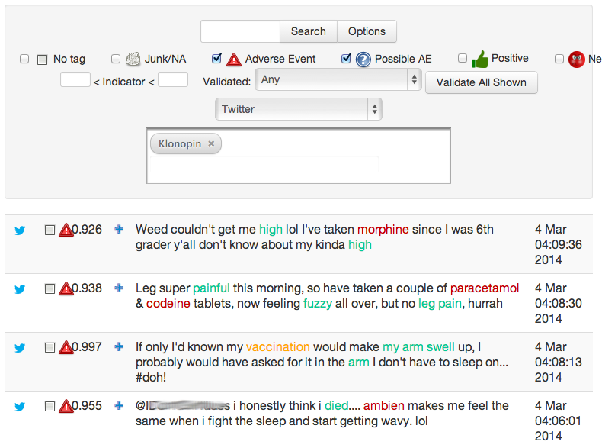
Curation Tool
Notes:
Preliminary implementation, results, timeline

Slide 13
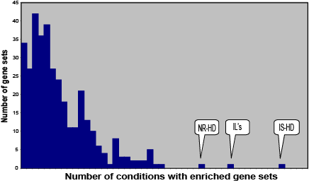
Discovery of a Wellness Network ?
Manway Liu (double major MIT) co-mentored by Zak Kohane (HMS) and Simon Kasif
Insulin signaling, interleukins (inflammation), and nuclear receptors (hormone receptors).
Insulin signaling is consistent with the given disease models. Was not identified using standard techniques.
Interleukins and nuclear receptors consistent with the inflammation and disordered metabolism associated with type 2 diabetes.
Insulin signaling
Nuclear Receptors
Nuclear receptors: 31 of 67
(many hormone receptors)
Interleukins: 38 of 67
JNK, SMAD
Insulin signaling: 45 of 67.
Inflammation
Notes:
When we apply Gene Network Enrichment Analysis to the 67 different conditions, three classes of genes sets appear over-represented in a significant number of conditions. Namely, the insulin signaling, interleukins and nuclear receptor gene sets.
Given the fact that a number of the 67 conditions involve a knockout of insulin receptor or one of its substrates, the insulin signaling result is not too surprising. But we were more surprised by the interleukin and nuclear receptor results.
BLOW UP THE 31, 38, 45 or add legend.
Check insulin signaling.
COMMENT
I think you need to be prepared here to discuss the various conditions – are they all obese? Suggest giving some examples of the included comparisons. You have eliminated the insulin deficiency sets, yes?
RESPONSE
The 67 conditions includes a few Streptozotocin treated mice, which are insulin deficient. It also includes mice that could be considered models of obesity (i.e. high fat diets) rather than IR. I fixed the description according. ← DONE.
COMMENT
You also need to say something about how the sets were identified (set size, etc)
Need some description of the 67 conditions. ← DONE
IS is often insulin secretion ← DONE.
IR is insulin resistance ← DONE.
What is the HD? ← DONE.
Try not to use these acronyms-you have room on the graph, and with the mixed audience, try not to make them work on the small details so they can concentrate on your message. ← DONE.
The main message is that there are very few pathways that are consistant across the sets. Put this in your title. ← DONE.

Slide 14
Discovery of a Network that Inhibits Differentiation?
Alfred Ramirez et al, to appear 2020
Alfred is a double major Biology & Physics from MIT
co-mentored by Simon Kasif and Ron Kahn (HMS,Joslin)

Slide 15
The AI Space
AI Dimensions
Learning
Reasoning/Planning
Multi-Domain Analogy
Abstraction
Explanation
Self Reflection
Computational Complexity
Representational Complexity, e.g., learning to program in Python or synthesize new organisms
General AI
LEARNING
PERCEPTRONS
DECISION TREES
DEEP NNS
GRAPHICAL MODELS
RL
√
CYC
FOL
RELATIONAL MODELS
MULTI DOMAIN
ANALOGY
DEDUCTIVE DATABASES
REASONING/PLANNING

Slide 16
AI and Biology: Slice of the Past
Protein Structure
Bacterial Gene Identification
Drosophila Gene Finding
Human Gene Finding
Human Genome
Mouse Genome **
Network Based Function Prediction
Interaction Prediction
Bacterial Regulatory Prediction
Human Regulatory Network Prediction
Cancer Module Prediction
Gene X Phenotype Prediction
Bacterial Systems
Integration
Drug Discovery
Neural Nets Sejnowsky et al /
Interpolated Markov Models Delcher et al
Neural Nets, Haussler et al
Generalized HMMs, Burge et al
Human Genome
Paired HMMs, Brent et al, Berger/Lander et al
MRFs, Diffusion, Gene Mania (Mostafavi et al)
Bayes Nets, Troyanskaya et al, Gerstein et al
Bayes Nets, Many methods, Faith et al
Causal Inference Califano et al, BNs - Peer et al
Segal/Koller/Friedman
Too many to list …
Too many to list, Overbeek et al, Peter Karp
Bayes Nets, Kasif et al, Gifford/Jakkola et al
Many and most recently Jim Collins et al MIT
** Tarjei Mikkelsen et al
Tarjei was an undergrad at MIT when he joined my HGP group ☺
…MUCH MORE ……. ☺

Slide 17
Logistics
No Exams
Homework
Project in Groups (SUBJECT TO CHANGE)
Reading Assignments
Project Presentations
Grading
  Homework: 75%
  Project 25%
  Class Participation Extra 10%
TA ?
All email with the subject line: BE700 Fall 2020
All class materials will be posted on BB

Slide 18
Machine Learning INTRODUCTION

Slide 19
BOOKS
NOT REQUIRED
T. Mitchell, Machine Learning,
McGraw-Hill
R. Duda, P. Hart & D. Stork, Pattern Classification (2nd ed.), Wiley (A CLASSIC BUT MORE TECHNICALLY CHALLENGING)
Readings provided on the BB (required)

Slide 20
Machine Learning in
Popular Press
“A breakthrough in machine learning would be worth
ten Microsofts” (Bill Gates, Chairman, Microsoft)
“Machine learning is the next Internet”
(Tony Tether, Director, DARPA)
“Web rankings today are mostly a matter of machine learning” (Prabhakar Raghavan, Dir. Research, Yahoo)
“Machine learning today is one of the hottest aspects of computer science” (Steve Ballmer, CEO, Microsoft)

Slide 21
Computer Programming
Machine Learning in the future
Data
Computer
Output
Program
Program
mapping
input into
output
Data
ML
Input &
Output

Slide 22
Examples
Past Tense Learning
  Input → Output
  Go → Went
  Do → Did
  Love → Loved
  Learn → Learned
  Forget → ??
  Memorize → ??

Slide 23
Systems Biology Example
Gene 1 Gene 2 Class
0.9 0.88 Normal
2.3 -1.3 Cancer
1.2 1.1 Normal
2.8 -1.5 Cancer
2.5 -1.2 ??

Slide 24
Representation
Memories
Decision trees
Rules / Logic
Classifiers
Hierarchies
Graphical models (Bayes Networks)
Neural networks with many layers
Perceptrons and Support vector machines
Programs

Slide 25
Evaluation
Accuracy (true/false positives and negatives)
Precision and recall
Error
Likelihood
Posterior probability
Entropy
K-L divergence
AUC
More

Slide 26
ML Current State
Hundreds of thousands of machine learning programs
Thousand of papers every year
Most machine learning algorithms
  Choosing knowledge representation
  Clever Algorithm – mostly standard with tweaks
  Training / Testing / Evaluation of Accuracy
  Optimization
High salaries !

Slide 27
Optimization
Combinatorial optimization
  E.g.: Simulated Annealing or search
Convex optimization
  E.g.: Stochastic Gradient descent
Constrained optimization
  E.g.: Quadratic programming

Slide 28
Types of Learning
Supervised (inductive) learning
  Training data includes class labels or output for every input
Unsupervised learning
  Training data does not include class labels or output for every input
Semi-supervised learning
  Training data includes some labelled and many un-labelled inputs
Other Learning (not covered in class)

Slide 29
Inductive Learning
Given examples of a function (X, F(X))
Predict function F(X) for new examples X
  Discrete F(X): Classification
  Continuous F(X): Regression
  F(X) = Probability(X): Probability estimation

Slide 30
What We’ll Cover
Supervised learning
  Decision tree induction
  Rule induction
  Instance-based learning
  Bayesian learning
  Neural networks
  Support vector machines
  Model ensembles
  Learning theory
Unsupervised learning
  Clustering
  Dimensionality reduction

Slide 31
ML in Practice
Choosing Representations (or Models) the ML program will learn
Data integration, feature selection, pre-processing, normalization, identifying outliers, and more .
Learning
Interpreting results (key emphasis in the class)
Deployment and Improvement

Slide 32
Supervised Learning From Measurements
Gene1 Gene2 Gene3.... Class Label
Patient 1 2.1 1.1 1.3 normal
Patient 2 10.2 0.51 3.2 cancer
Patient 3
…
…
Patient N….
Aim: Automatically Produce a classifier that predicts class label given the input gene expression profile of a biopsy

Slide 33
Simple Learning Method of Gene/Protein Function using 1-NN
Given a new gene expression profile X produce the class label of X, f(X) as follows:
Identify the most similar profile X’ in the training set D
Most similar = smallest Euclidean distance i.e., X’ = min |X-X’| of all X’ in D.
Let f(X’) → f(X) Done !!

Slide 34
K-NN
+
o
+
?
o
o
o
+
o
o
o
o
o
o
+
o
+
+
+
o
o
+
o
o
o
o
o

Slide 35
K-NN
+
o
+
?
o
o
o
+
o
o
o
o
o
o
+
o
+
+
+
o
o
+
o
o
o
o
o
Data points are labelled + and 0
Compute the distance of the query data point to each point in the training set
Make a class prediction based on the nearest K points

