Slide 1
ULLYSES Data Products for T Tauri Stars
Charting Young Stars’ Ultraviolet Light with Hubble
Jo Taylor
ODYSSEUS Meeting– Nov 11 2021

Slide 2
Outline
Explanation of ULLYSES data product types
Data Release 3
Future data releases

Slide 3
ULLYSES Resources
All official documentation on ULLYSES website: https://ullyses.stsci.edu/
Low-mass star specific pages:
https://ullyses.stsci.edu/index.html#lowmass
https://ullyses.stsci.edu/ullyses-targets-ttauri.html
Description of data products: https://ullyses.stsci.edu/ullyses-data-description.html
Download data: https://ullyses.stsci.edu/ullyses-download.html
Citations: https://ullyses.stsci.edu/ullyses-cite.html

Slide 4
ULLYSES Data Accessibility
Data can be downloaded from:
ULLYSES website: https://ullyses.stsci.edu/ullyses-download.html
ULLYSES search & download web application: https://ullyses.stsci.edu/search/
MAST Portal: https://mast.stsci.edu/portal/Mashup/Clients/Mast/Portal.html
Astroquery
Coming soon:
ULLYSES search and download form using new Missions-MAST application

Slide 5
ULLYSES Data Products

Slide 6
ULLYSES Data Product Types
Data product naming convention:
hlsp_ullyses_<telescope>_<instrument>_<target>_<opt_elem>_<version>_<product-type>
Level 0 products: custom calibrated STIS spectra (_spec.fits) and parameter files (_spec.yaml)
hlsp_ullyses_hst_stis_cvso-107_g750l_dr3_spec.fits
hlsp_ullyses_hst_stis_cvso-107_g750l_dr3_spec.yaml
Level 2 products: coadded spectra of common instrument and grating ( _cspec.fits)
hlsp_ullyses_hst_stis_cvso-107_g750l_dr3_cspec.fits

Slide 7
ULLYSES Data Product Types
Level 3 products: coadded spectra of common instrument, different gratings grouped by resolution ( _cspec.fits)
hlsp_ullyses_hst_stis_cvso-107_g230l-g430l-g750l_dr3_cspec.fits
Level 4 products: abutted spectra of all instruments and settings ( _sed.fits)*
hlsp_ullyses_hst_cos-stis_cvso-107_uv-opt_dr3_sed.fits
Level 5 products: time-series spectra, exposure-level ( _tss.fits) and subexposure-level ( _split-tss.fits)
hlsp_ullyses_lcogt_04m_cvso-107_v-iprime_dr3_tss.fits
hlsp_ullyses_hst_cos_v-tw-hya_g230l_dr3_split-tss.fits
* Will be renamed to emphasize intended visual usage

Slide 8
Coaddition and Abutment Methodology
Combining spectra/orders of a common grating (level 2 & 3 products, _cspec.fits)
Output flux is a weighted average of all flux measurements within a wavelength bin
Weighting factor is throughput (net count rate divided flux) times exposure duration
Only measurements with Data Quality (DQ) flags that are not serious contribute to output flux
Error is square root of total counts that contribute to an output wavelength bin, converted to flux by multiplying by flux/net counts, interpolating if necessary
SNR is simply flux/error
Abutting spectra of different gratings or instruments (level 4 products, _sed.fits)
If spectra overlap, they are truncated and abutted at transition wavelength
If no overlap, spectra are abutted as is (discontinuous wavelength)

Slide 9
Custom STIS calibration
All STIS NUV and optical data are manually calibrated for T Tauri stars
Custom hot pixel identification and flagging
Defringing for G750L data
Custom spectral extraction when necessary
If companion(s) in slit, additional calibration may be necessary
Deblending companion and intended target spectra
Additional defringing
Custom spectral extraction always necessary
All custom calibration parameters recorded in level 0 parameter files (_spec.yaml)
Custom calibrated 1D spectra in level 0 FITS files (_spec.fits)

Slide 10
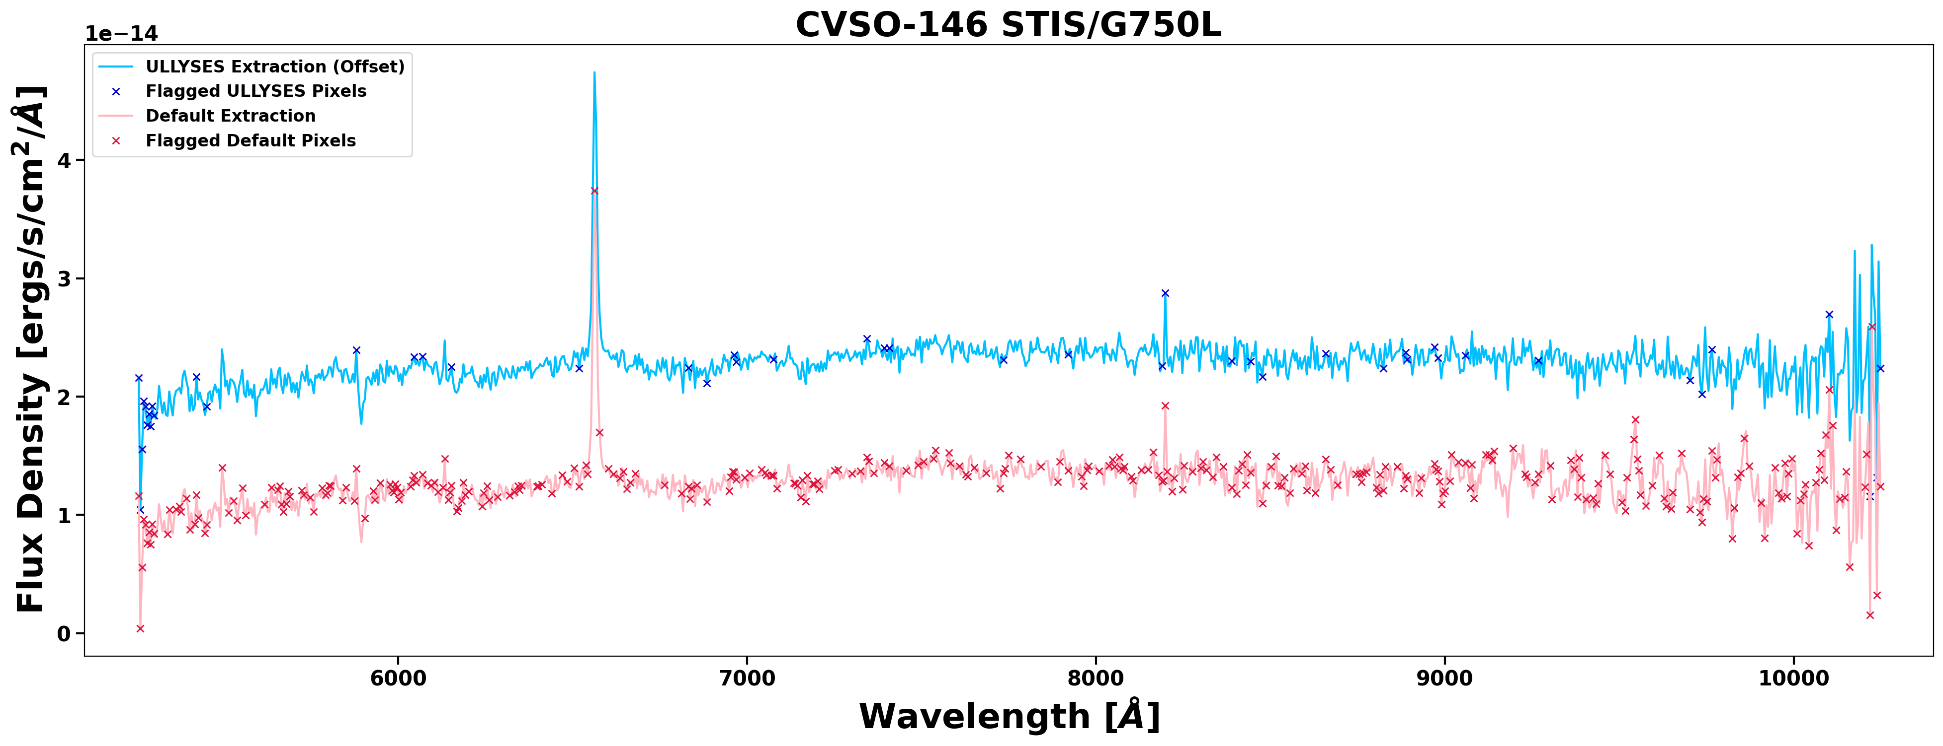
Custom STIS calibration example

Slide 11
Time-series Spectra
Both HST and LCOGT data are used to created time-series spectra (TSS), level 5 products (_tss.fits and _split-tss.fits)
Products are essentially stacked 1-D spectra, designed for easy out of the box analysis of features over time
Two flavors of TSS:
Exposure-level, each spectrum’s exposure time is the commanded time (HST and LCOGT, monitoring and survey stars)
Subexposure-level, each spectrum’s exposure is less than commanded time (HST only, monitoring stars only)

Slide 12
Time-series Spectra Data
HST observations used to create TSS:
Monitoring stars only (TW Hya, BP Tau, RU Lup, GM Aur)
COS/G160M/(1589,1623) and COS/G230L/(2635,2950) spectra. Targets are observed with each setting 24 times, taken in two epochs separated by ~1 year
LCOGT observations used to create TSS:
Images taken 90 and 10 days before, during, and 10 and 90 days after HST observations
Monitoring stars get u’, V, and i’ images
Survey stars get V and i’ images
Aperture photometry and flux calibration performed on images

Slide 13
Time-series Spectra Wavelength and Time Sampling
LCOGT (exposure-level only)
“wavelength” arrays are central wavelengths of each filter
exposure time of each “spectrum” is commanded exposure time
HST, exposure-level
native wavelength sampling used (i.e. no binning)
exposure time of each spectrum is commanded exposure time
HST, subexposure-level
Time and wavelength bins are optimized to probe smallest time interval while maintaining S/N >= 5 per resolution element at the peak of most important lines- C IV (1548 Å) and Mg II (2800 Å)
Exact time and wavelength values will depend on S/N of each monitoring star

Slide 14
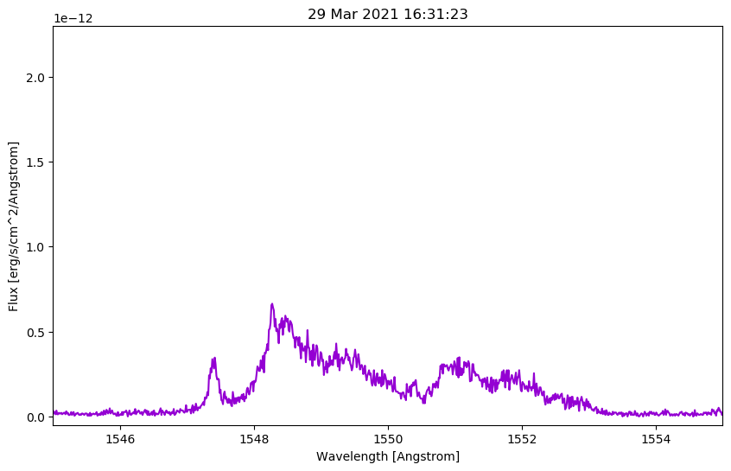
TW Hydra Time Series Spectra
HST/COS/G160M
subexposure-level TSS
Centered on C IV
11 visits
44 individual _x1d files, each 300s
Time binning = 30s
Wavelength binning = 7km/s (3pix)
440 total sub-exposure spectra
Filename = hlsp_ullyses_hst_cos_v-tw-hya_g160m_dr3_split-tss.fits

Slide 15
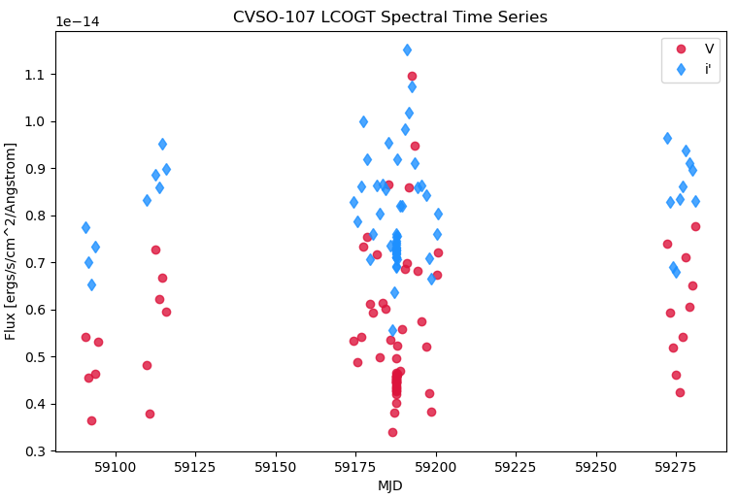
CVSO-107 Time Series Spectra
LCOGT exposure-level TSS
72 v images
70 i’ images
Each v image is 30s long
Each i’ image is 15s long
Each plotted point is photometric measurement of CVSO-107 from a single image

Slide 16
Data Release 3

Slide 17
Data Release 3 (DR3)
Data Release 3 published August 31 2021
T Tauris by numbers in DR3:
47 survey stars- 34 new to DR3
20 of 47 are purely archival and do not include STIS NUV or optical data yet*
27 of 47 do have STIS NUV and optical spectra
13 have LCOGT data (-> time-series spectra)
1st epoch of 1 monitoring star (TW Hydra -> time-series spectra)
6 non-ULLYSES slit companions- 1 new to DR3
Products delivered to aid in any de-contamination efforts
* Custom calibration is very time-intensive for ULLYSES team, archival data takes extra time

Slide 18
Future Data Releases

Slide 19
Data Release 4 (DR4)
DR4 will be published Dec. 14 2021
Anticipated T Tauri products
4 more custom-calibrated survey stars
1st epoch of 3 remaining monitoring stars (-> time-series spectra)
GM Aur only has 7/12 visits due to safing, remaining 5 to be rescheduled
V and i’ LCOGT time-series spectra for TW Hydra’s 1st epoch
u’ calibration is more time-intensive
LCOGT data for the 13 new survey stars from DR3 (-> time-series spectra)

Slide 20
Data Release 4 (DR4)
The S/N of FUV time-series spectra for new monitoring stars (RU Lup, BP Tau, GM Aur) does not meet requirements when using the TW Hya wavelength and time samples. NUV S/N is fine
TW Hya FUV bins: time=30s, wavelength=7km/s (3pix)
Question for the ODYSSEUS group:
To meet the S/N requirements, we will need to increase either the time or wavelength bin for new DR4 monitoring target
Which solution is preferred?
More time samples, but increase wavelength binning
E.g. t=30s, wl=14 km/s (6pix)
Fewer time samples, but wavelength bins remain the same
E.g. t=50/60s, wl=7 km/s (3pix)

Slide 21
Future T Tauri Products
2nd epoch of TW Hydra in Apr 2022
u’ data for all monitoring stars (-> time-series spectra)
v and i’ data for BP Tau, RU Lup, and GM Aur (-> time-series spectra)
Opportunistic time-series spectra for repeated observations of survey stars
STIS/NUV and Optical data for archival survey stars
ULLYSES search and download web app
DR5 date is unknown, but will likely be late spring/early summer

Slide 22
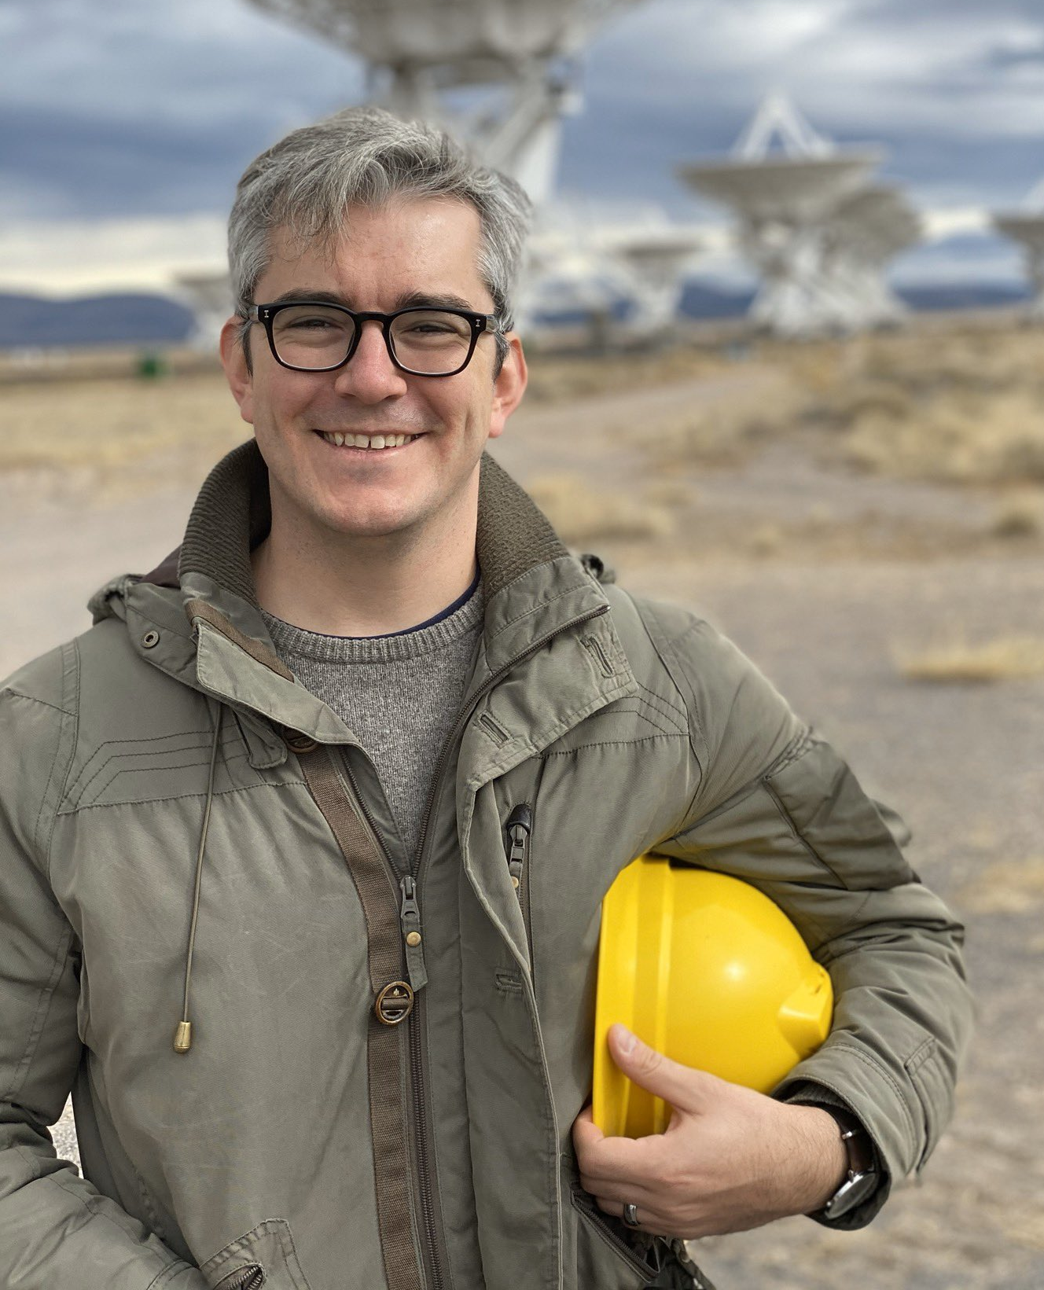
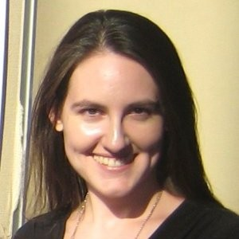
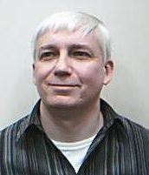
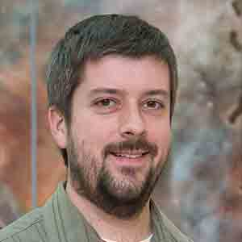
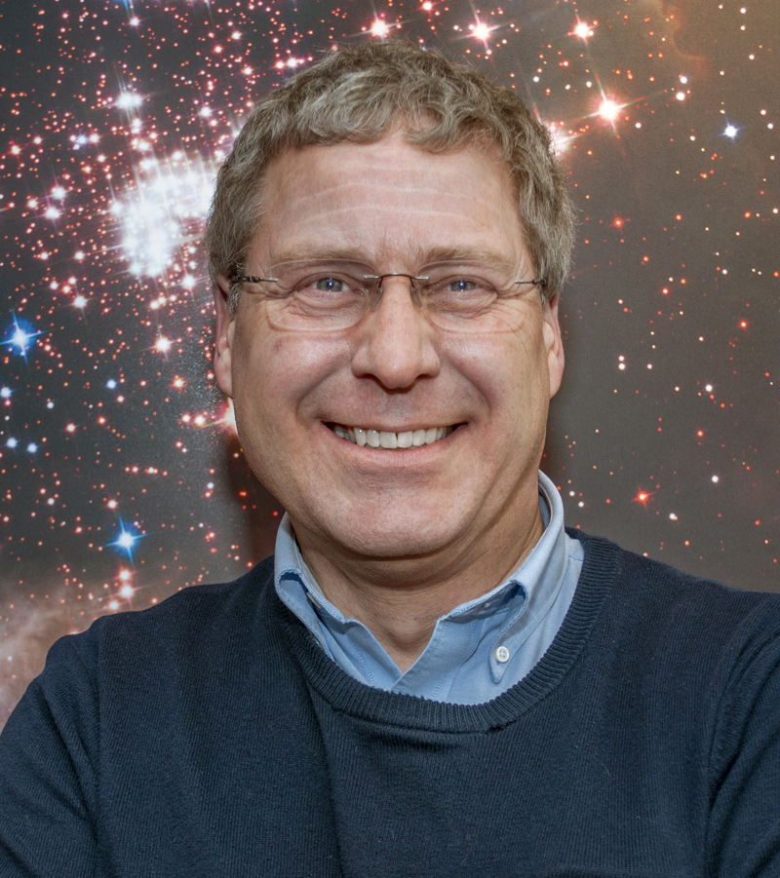
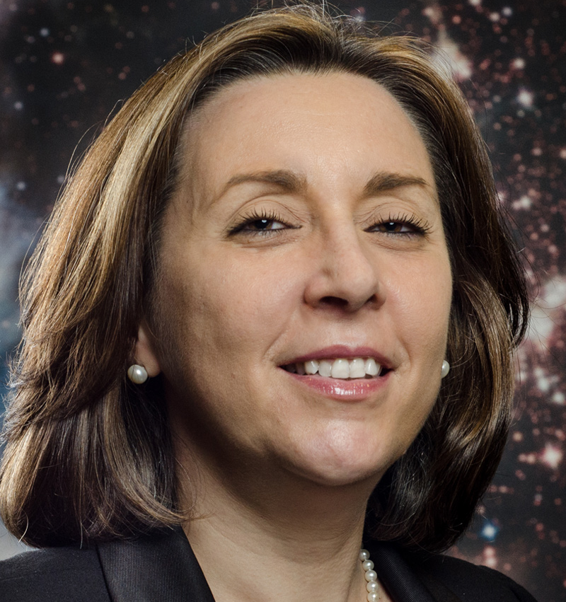
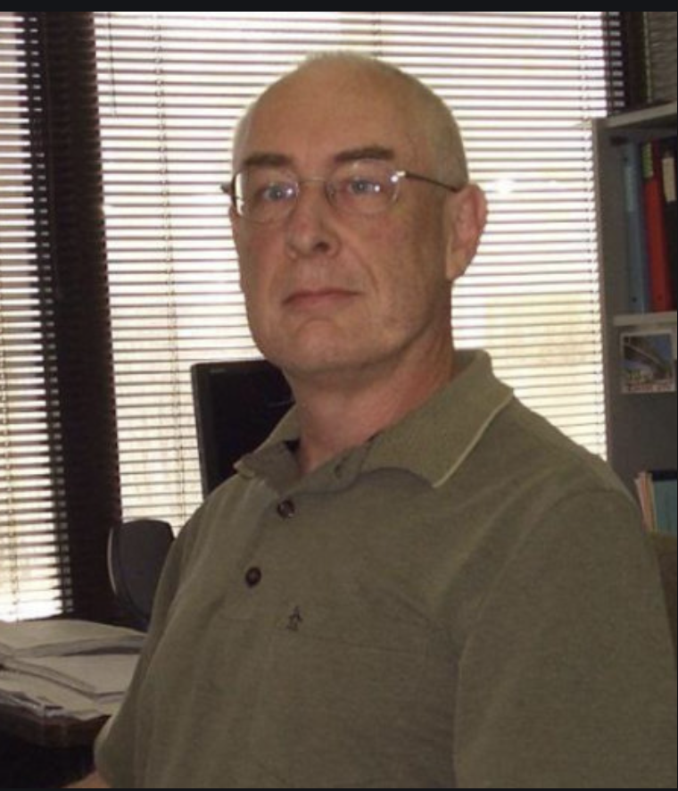
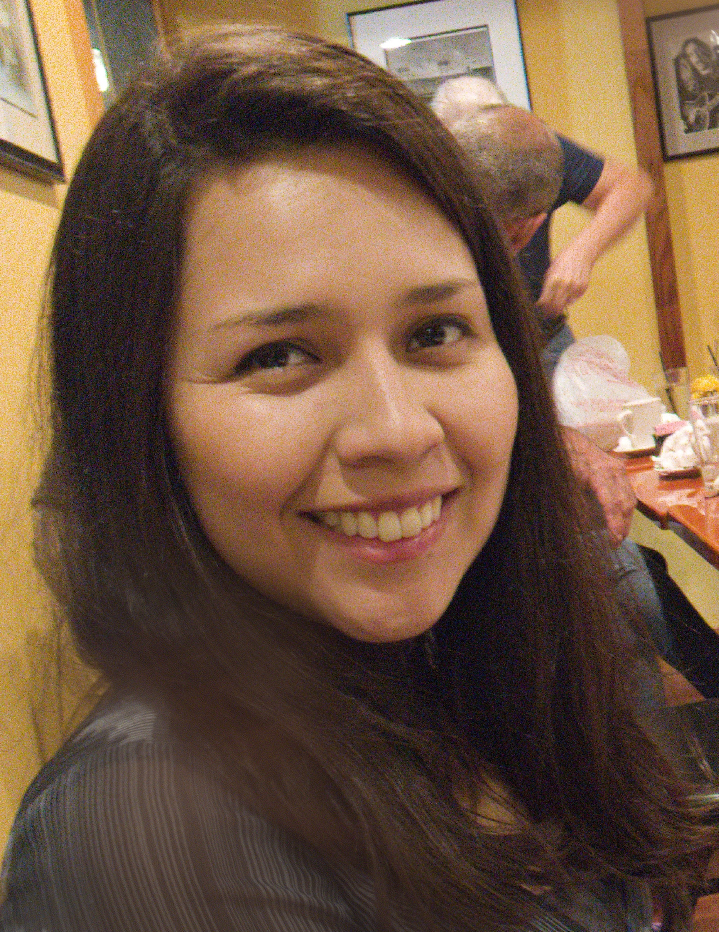
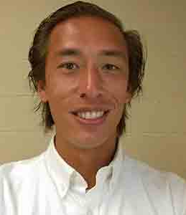
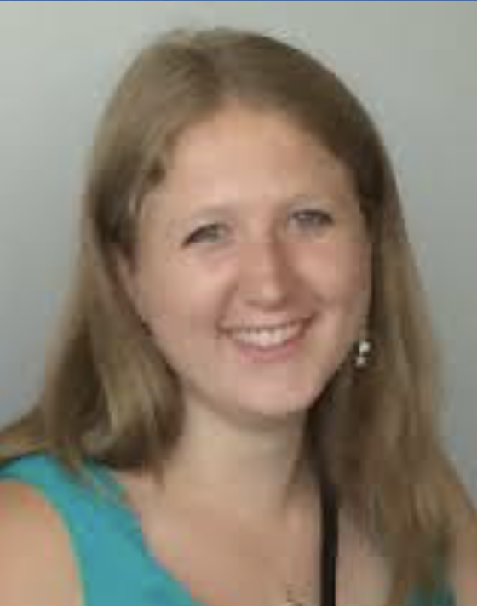
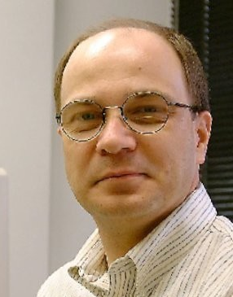
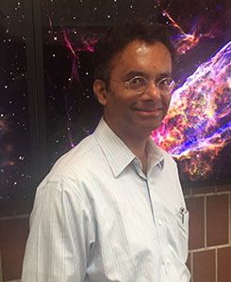
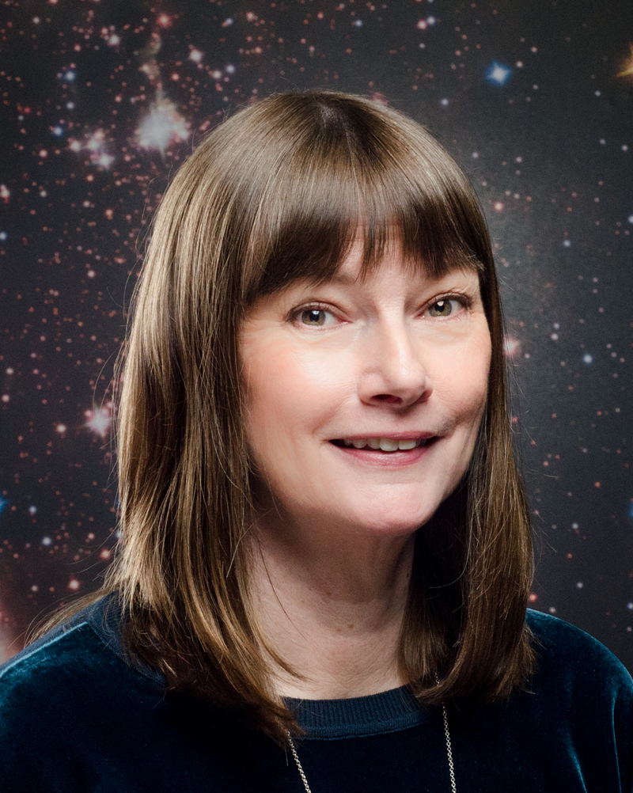
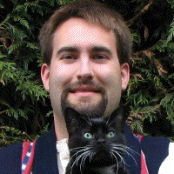
ULLYSES Core Implementation Team (CIT)
Julia Roman-Duval (CIT Lead)
Jo Taylor
(DP Lead)
Travis Fischer
(DP Deputy Lead)
TalaWanda Monroe
(Observing Lead)
Charles Proffitt
(Observing)
Will Fischer
(T Tauri star Lead Expert)
Alex Fullerton
(Massive Star Lead Expert)
Alessandra Aloisi
(Pre-imaging)
Chris Britt
(Public Outreach)
Ivo Busko
(DP/software)
Svea Hernandez
(DP)
Alec Hirschauer
(Oberving)
Robert Jedrzejewski
(DP, software)
Sean Lockwood
(ETC, Obs)
Elaine Frazer
(DP)
Rachel Plesha
(Targets, Obs, DP)
Adric Riedel
(Targets, DP)
David Sahnow
(Observing)
Richard Shaw
(DP)
Ravi Sankrit
(Observing)
Linda Smith
(Targets)
Debopam Som
(Observing)
Leonardo Ubeda
(Website)
Dan Welty
(Targets, Obs, DP)
Brian York
(DP)

