Slide 1


From Mechanisms to Medicines: realizing the DREAM of an Alzheimer’s cure
Madhav Thambisetty, MD, PhD
Clinical and Translational Neuroscience Section
Laboratory of Behavioral Neuroscience
National Institute on Aging (NIA)
National Institutes of Health (NIH)
thambisettym@mail.nih.gov

Slide 2
Outline
1. Why have we failed to find cures for Alzheimer’s disease (AD)?
2. Establishing a pipeline for identifying drug targets in AD through systems biology
Unbiased proteomics identifies an APOE ε4 associated signature of incipient AD and implicates cytokine signaling as a drug target
Phenotypic screening and efficacy studies of candidate AD drugs: PREVENT-AD study
Translating disease mechanisms to medicines: the DREAM study

Slide 3
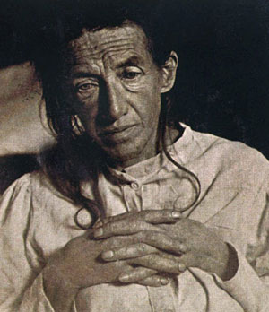
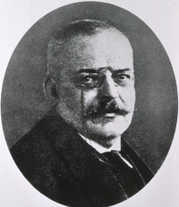
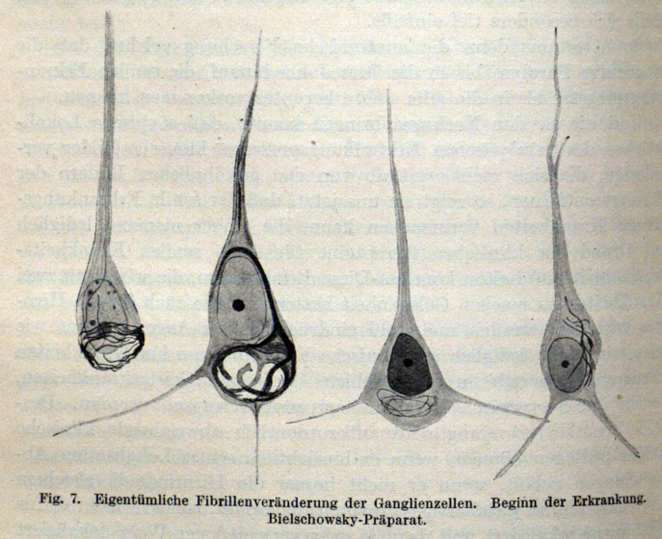
"A characteristic disease of the cerebral cortex”
(Über eine eigenartige Erkrankung der Hirnrinde, 1907
37th meeting of SouthWest German psychiatrists, Tübingen, Germany; 1906

Slide 4
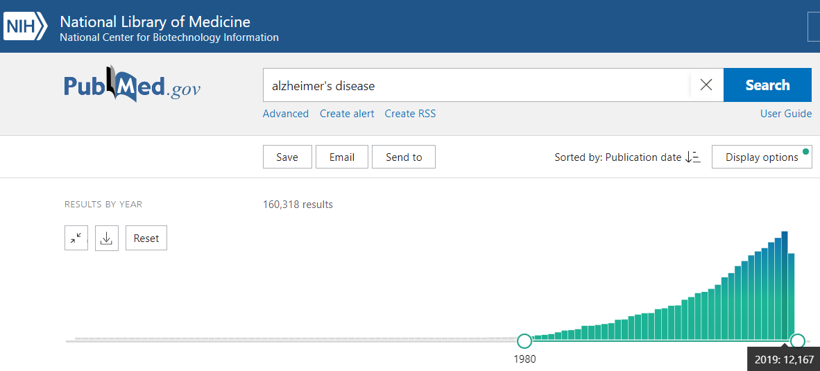
Alzheimer’s Disease: a lot learned but…
Rate of publication: >1000/month

Slide 5
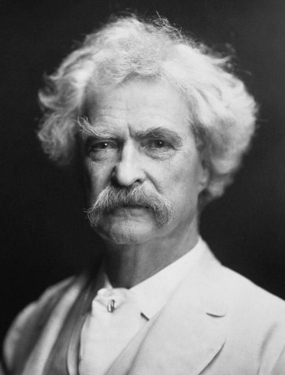
Little gained…
Drug Name | Brand Name | Approved for | FDA Approved
Donepezil | Aricept | All stages | 1996
Rivastigmine | Exelon | All stages | 2000
Galantamine | Razadyne | Mild-Moderate | 2001
Memantine | Namenda | All stages | 2003
**Aducanumab accelerated approval June 2021
“Researchers have already cast much darkness on the subject,
and if they continue their investigations, we shall soon know
nothing at all about it.”

Slide 6
Clinical and Translational Neuroscience Section: Translating Biological mechanisms in AD to Drug Targets
Goal: Establish a flexible, scalable pipeline to identify targets for disease modification in ADRD.

Slide 7
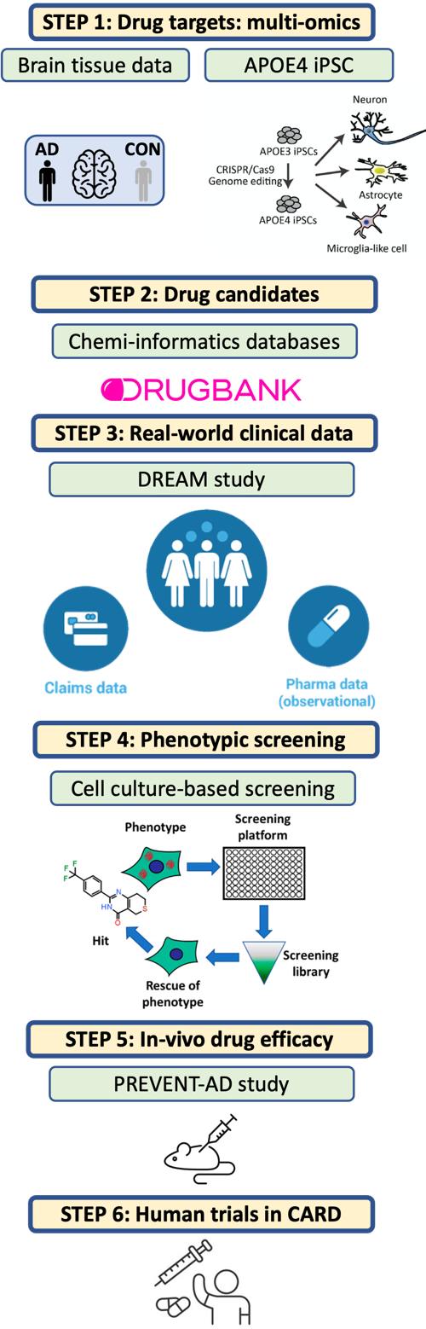
A flexible and scalable pipeline for drug discovery in ADRD

Slide 8
A flexible and scalable pipeline for drug discovery in ADRD
Ongoing initiatives for target validation and drug discovery in AD in the NIA IRP
Supported by the Scientific Director’s ‘Special-AD’ mechanism from Congressional monies dedicated to ADRD

Slide 9
Drug Repurposing for Effective Alzheimer’s Medicines (DREAM)
Two-year multi-center study for identifying novel repurposing candidates for AD leveraging both deep molecular phenotyping of human brain and blood and big-data analyses of real-world clinical outcomes
Centers of excellence in Pharmacoepidemiology at Harvard Medical School, Johns Hopkins University and Rutgers University
Two large real-world clinical datasets with over 20 million older individuals with clinical diagnoses and prescription data
Converging results from independent analyses will ensure reliability of findings and support their confirmation in RCTs of candidate AD treatments

Slide 10
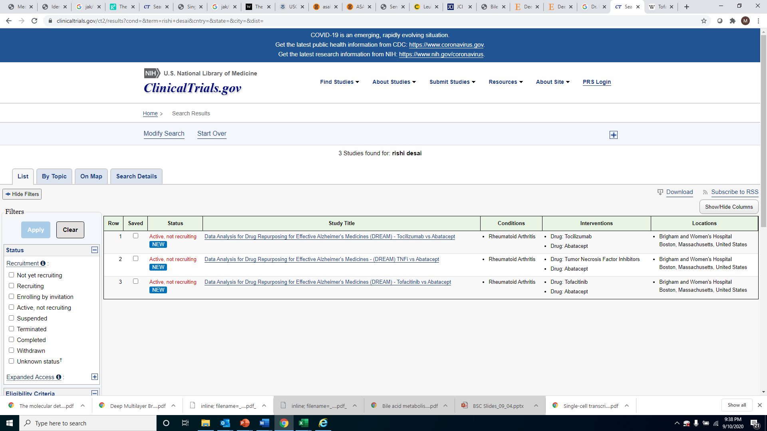
Drug Repurposing for Effective Alzheimer’s Medicines (DREAM)
Testing JAK/STAT signaling modulation in AD
R.Desai et al. Targeting Abnormal Metabolism in Alzheimer’s Disease: the Drug Repurposing for
Effective Alzheimer’s Medicines (DREAM) study. Alzheimer's & Dementia: Translational Research
& Clinical Interventions, 2020

Slide 11
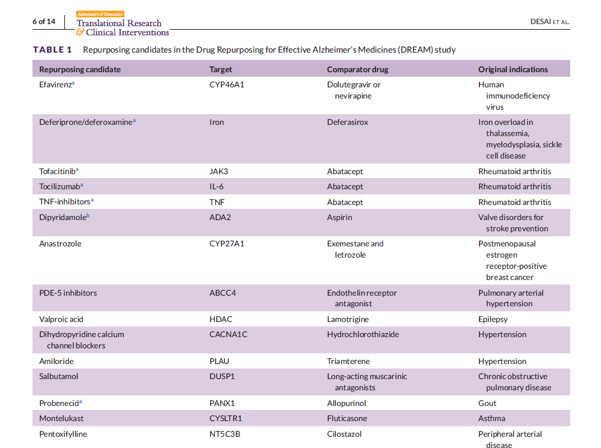
R.Desai et al. Targeting Abnormal Metabolism in Alzheimer’s Disease: the Drug Repurposing for
Effective Alzheimer’s Medicines (DREAM) study. Alzheimer's & Dementia: Translational Research
& Clinical Interventions, 2020

Slide 12
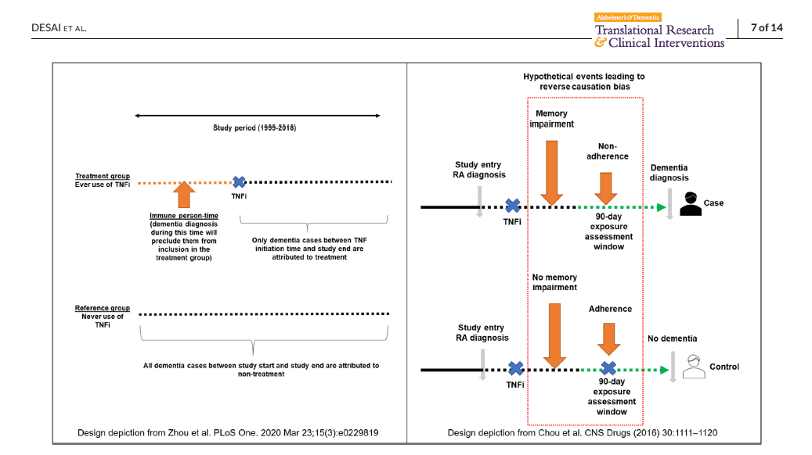
Overcoming “uncertainties” in Pharmacoepidemiologic analyses
R.Desai et al. Targeting Abnormal Metabolism in Alzheimer’s Disease: the Drug Repurposing for
Effective Alzheimer’s Medicines (DREAM) study. Alzheimer's & Dementia: Translational Research
& Clinical Interventions, 2020

Slide 13
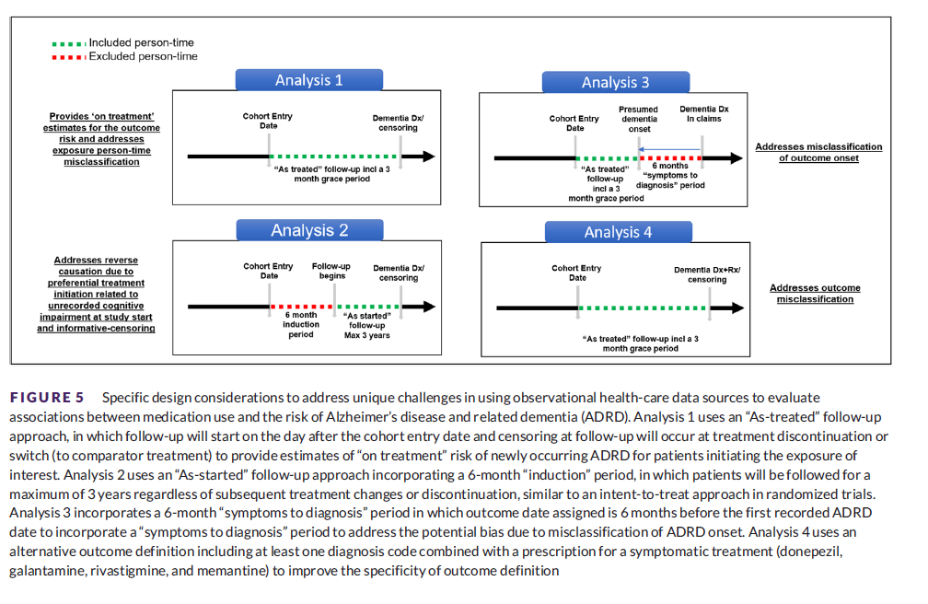

Slide 14
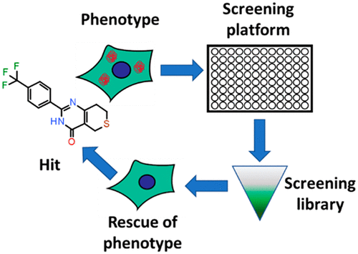
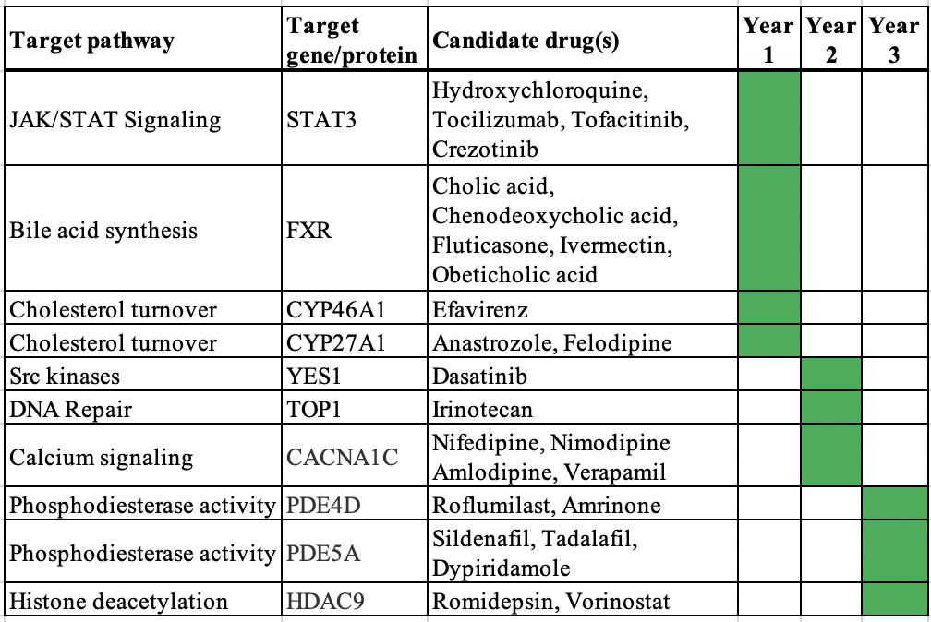
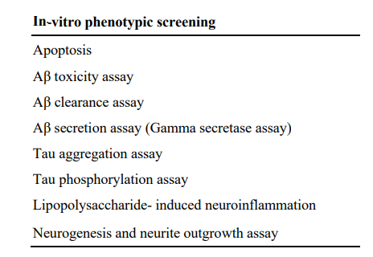
Specific Aim-1
Preclinical Validation of Emerging Novel Treatments for Alzheimer’s Disease
(PREVENT-AD) STUDY
Phenotypic drug screening

Slide 15
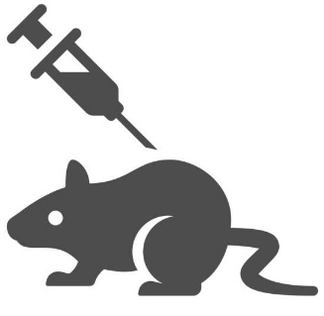
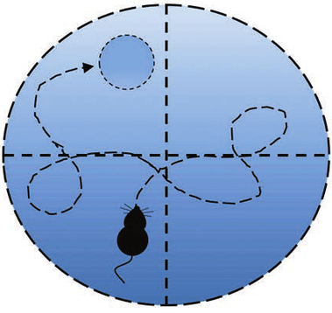
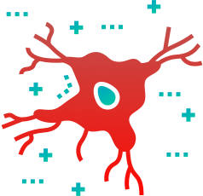
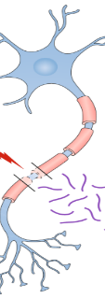
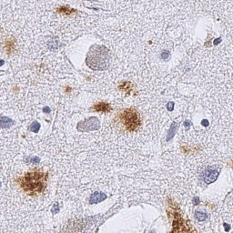
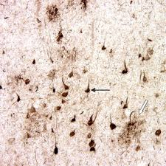
Specific Aim-2
Preclinical Validation of Emerging Novel Treatments for Alzheimer’s Disease
(PREVENT-AD) STUDY
Drug efficacy in transgenic mouse model
48 mice (5xFAD: n=32; WT: n=16)
27-week duration
Tx: intraperitoneal application 1/week
In-vivo blood sampling
Histologic processing
Cognitive performance
Amyloid plaques
Tau
tangles
Neuro-inflammation
Axonal damage

Slide 16
A flexible and scalable pipeline for drug discovery in ADRD

Slide 17


A Brain proteomic signature of incipient AD implicates
STAT3 as a drug target
Jackson Roberts
The ε4 allele of the apolipoprotein E gene (APOE) is the most robust risk factor for sporadic AD
APOE ε4 carriers have a dose-dependent increase in risk for AD and a lower age of onset (Genin 2011 & Sando 2008)
APOE ε4 likely confers risk prior to middle age and decades before age of AD onset: However, the mechanisms by which APOE ε4 confers risk decades prior to AD onset remains unknown
The promise of APOE-directed AD therapies remains unrealized
Jackson Roberts et al. A Brain Proteomic Signature of Incipient Alzheimer’s Disease in Young APOE ε4 Carriers identifies novel drug targets 2021 SCIENCE Advances

Slide 18
Understanding APOE ε4-associated AD risk to identify plausible drug targets
Establish a proteomic signature of APOE ε4 carrier status in a young non-demented cohort (YAPS).
Determine which of these protein alterations are shared in AD in two older cohorts (ROS & BLSA) with neuropathologically confirmed cases of AD.
Explore this proteomic signature in association with ante-mortem cognitive trajectories, AD pathology, and biological functional categorization.
Test whether FDA-approved and experimental drugs that target abnormal signaling pathway(s) implicated in the APOE4-AD signature are AD treatments.

Slide 19
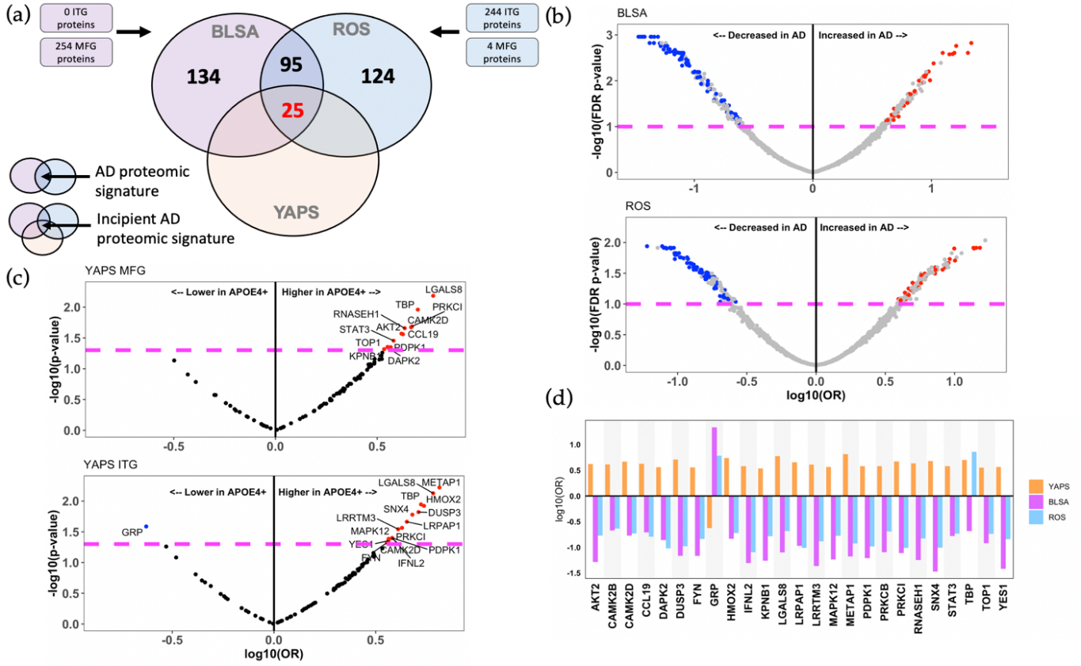
STAT3 is an AD drug target: establishing a brain proteomic signature of incipient AD
Jackson Roberts et al. A Brain Proteomic Signature of Incipient Alzheimer’s Disease in Young APOE ε4 Carriers identifies novel drug targets 2021 SCIENCE Advances

Slide 20
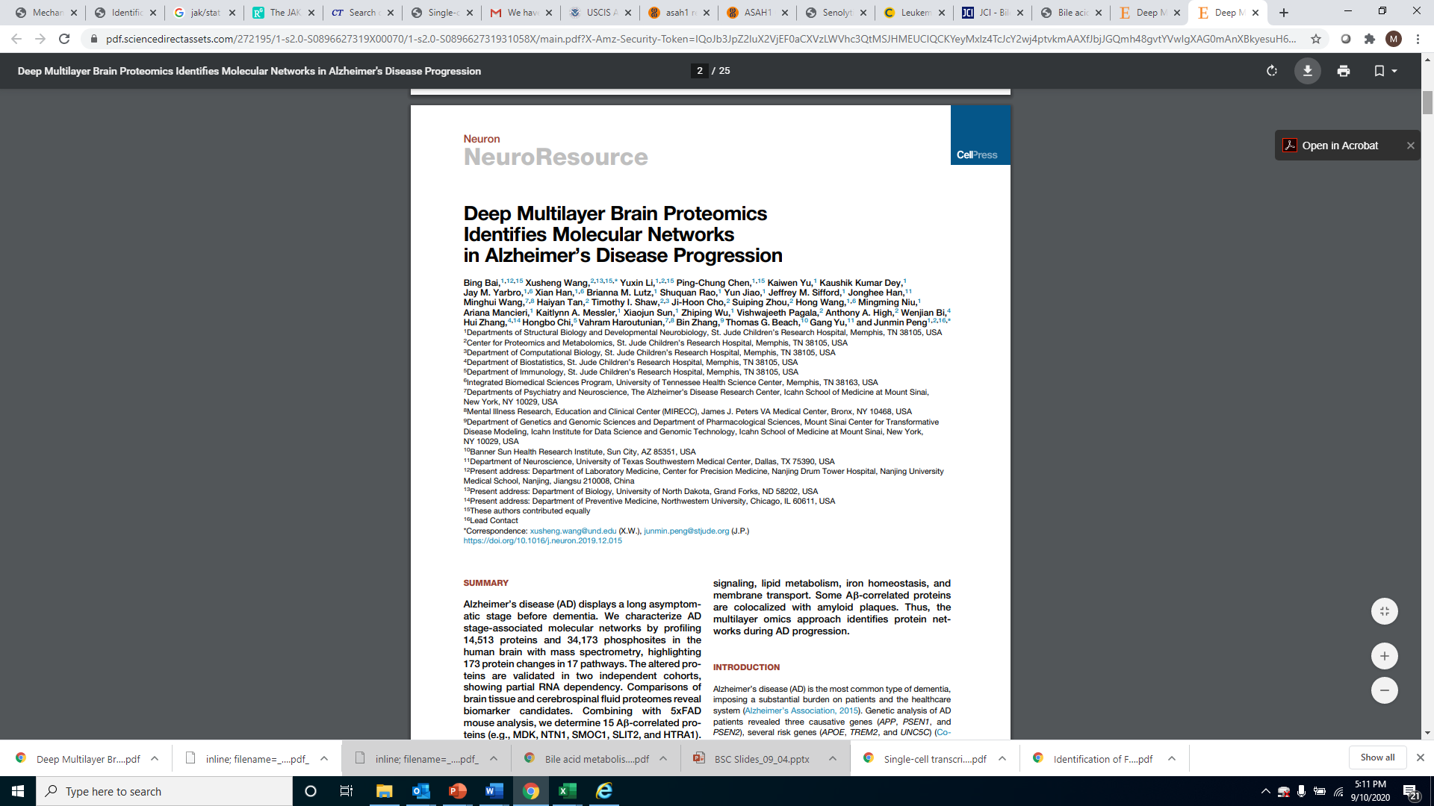
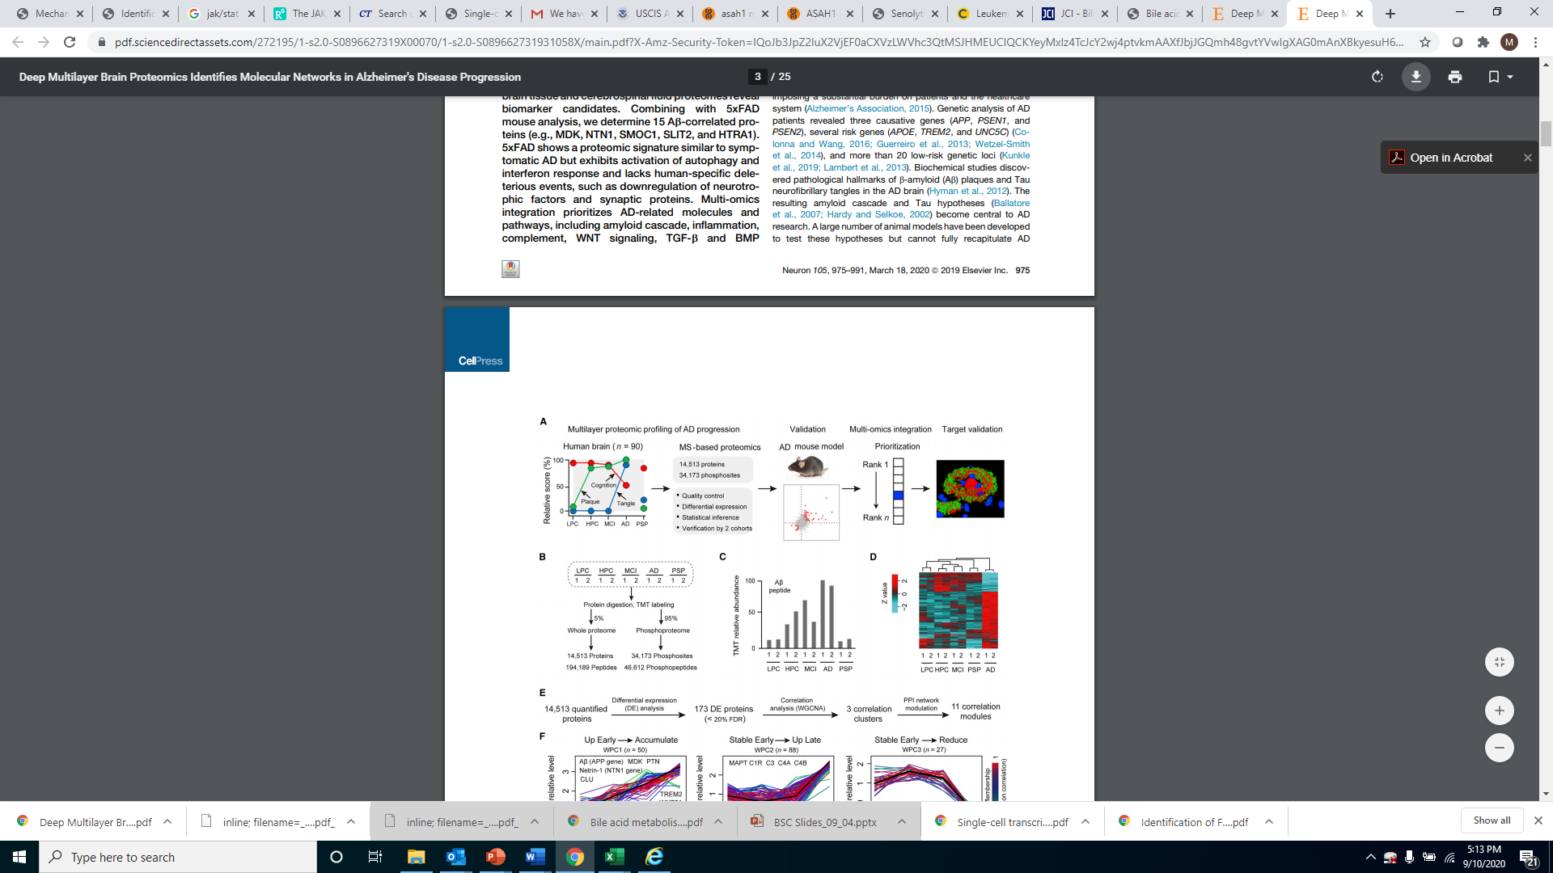
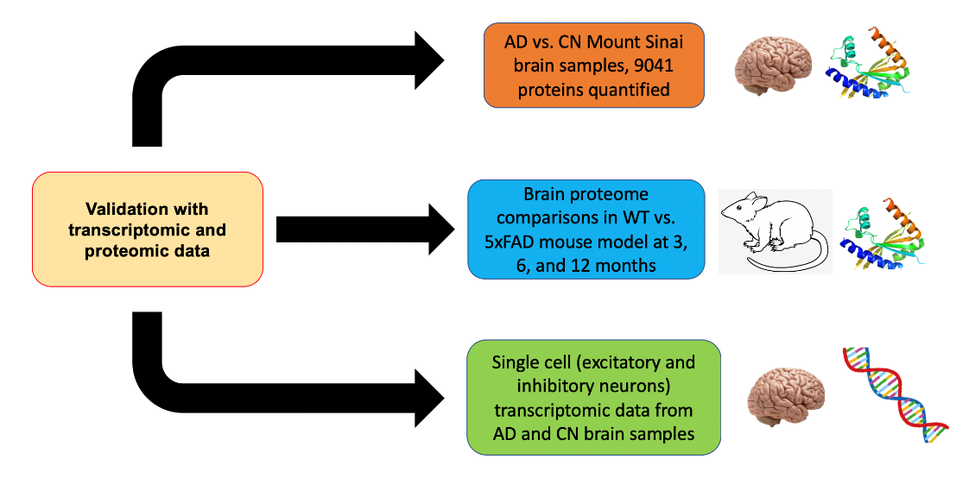
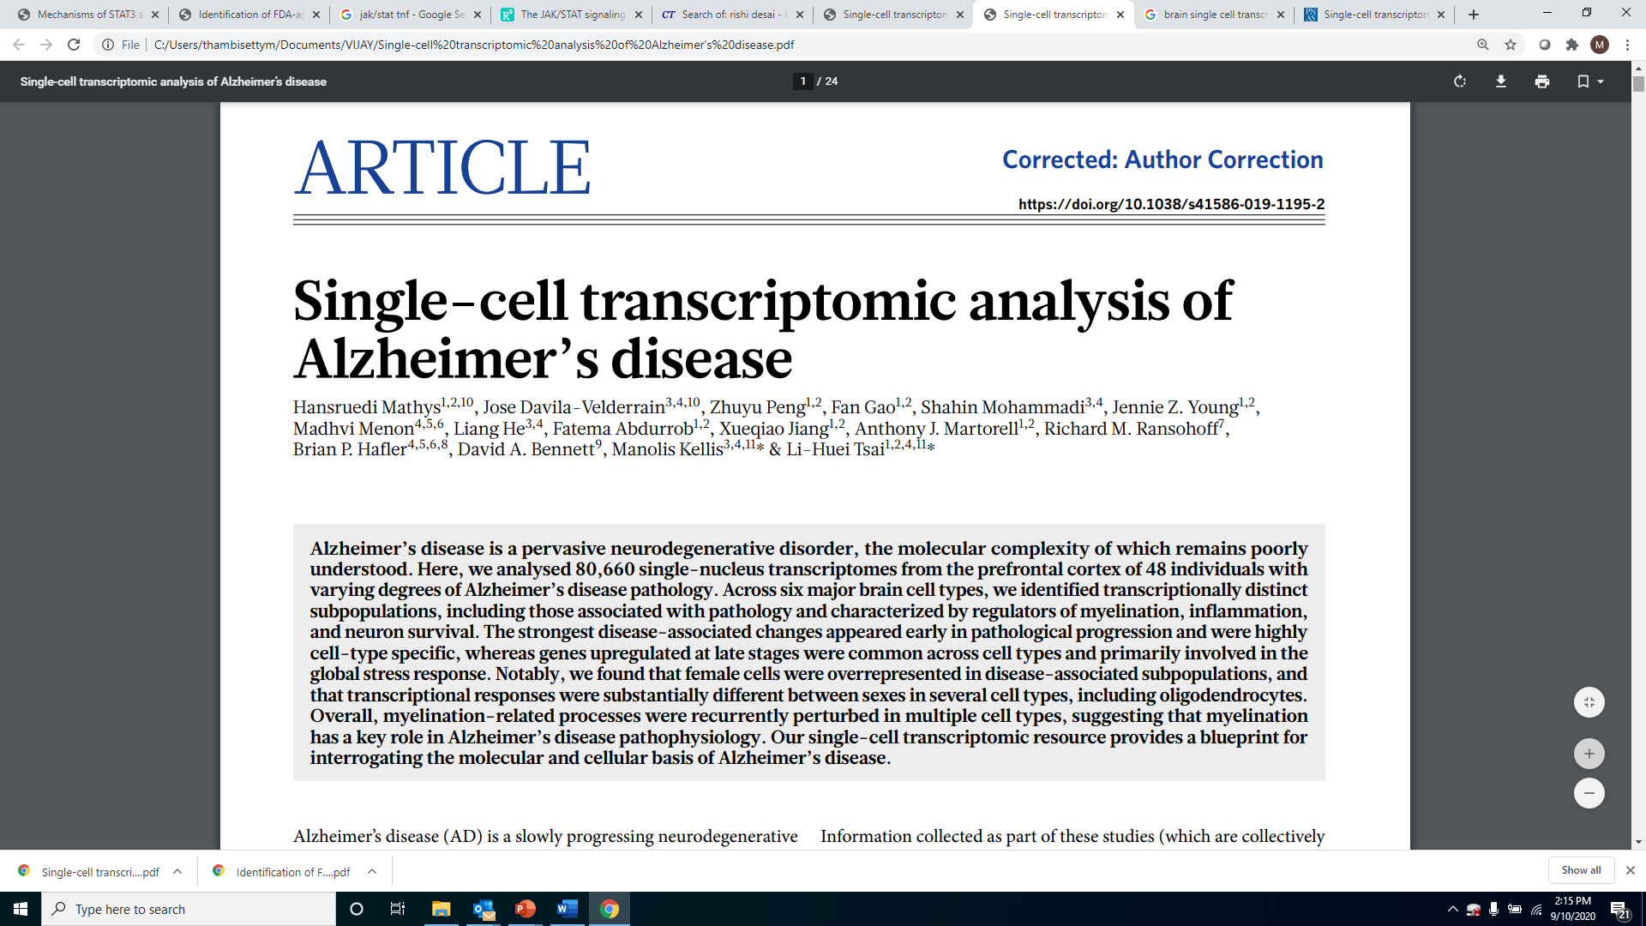
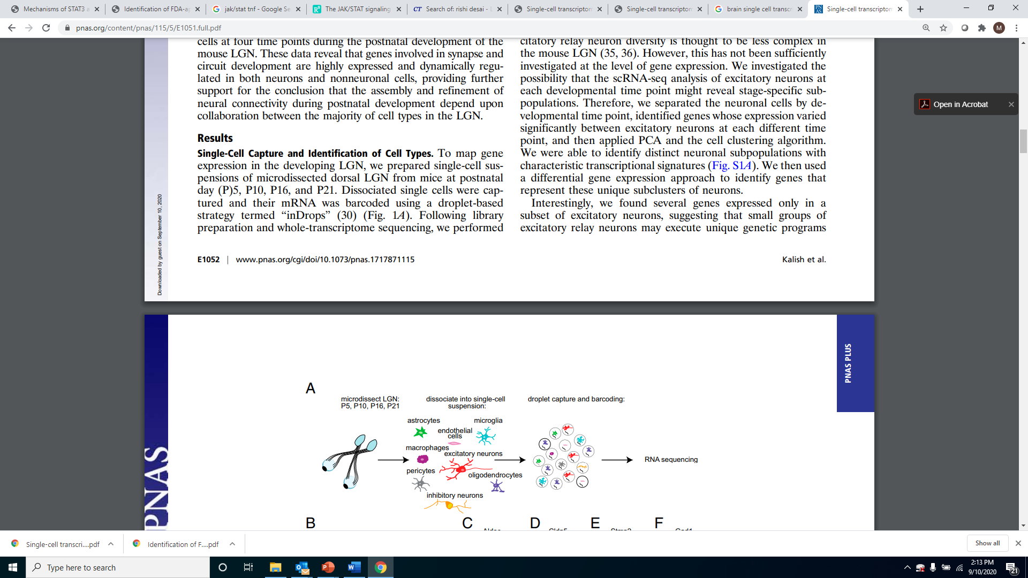
Dr. Junmin Peng, St. Jude Children’s Research
Hospital, Memphis
Dr. Li-Huei Tsai, MIT, Boston

Slide 21
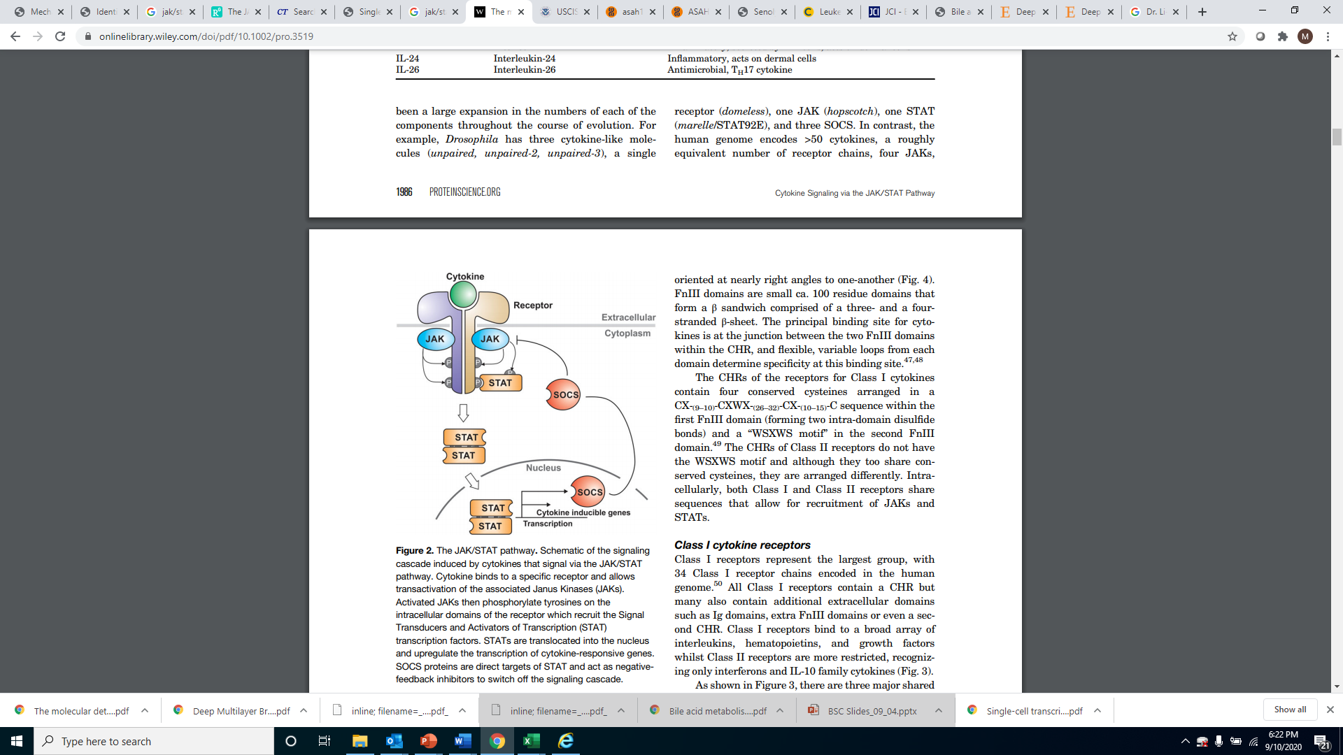
Cytokine signaling through STAT3 is a druggable target
Drug | Indication | Status
Crizotinib | Lung cancer | FDA-approved
Napabucasin | Colorectal cancer | FDA-orphan status
TTI-101 | Hepatocellular cancer | In ongoing phase-1 trials
Jackson Roberts et al. A Brain Proteomic Signature of Incipient Alzheimer’s Disease in Young APOE ε4 Carriers identifies novel drug targets 2021 SCIENCE Advances

Slide 22
Does TTI-101 alter molecular outcomes relevant to AD?
Jackson Roberts et al. A Brain Proteomic Signature of Incipient Alzheimer’s Disease in Young APOE ε4 Carriers identifies novel drug targets 2021 SCIENCE Advances

Slide 23
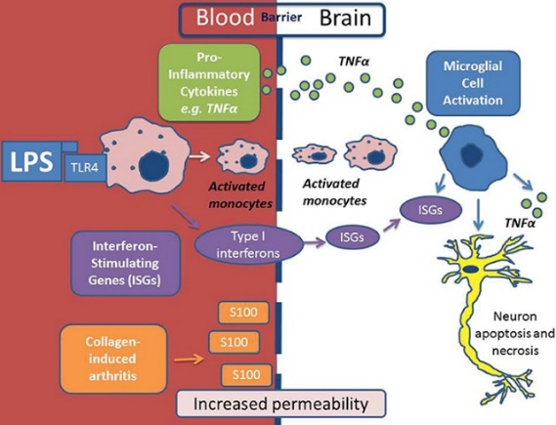
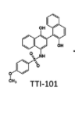
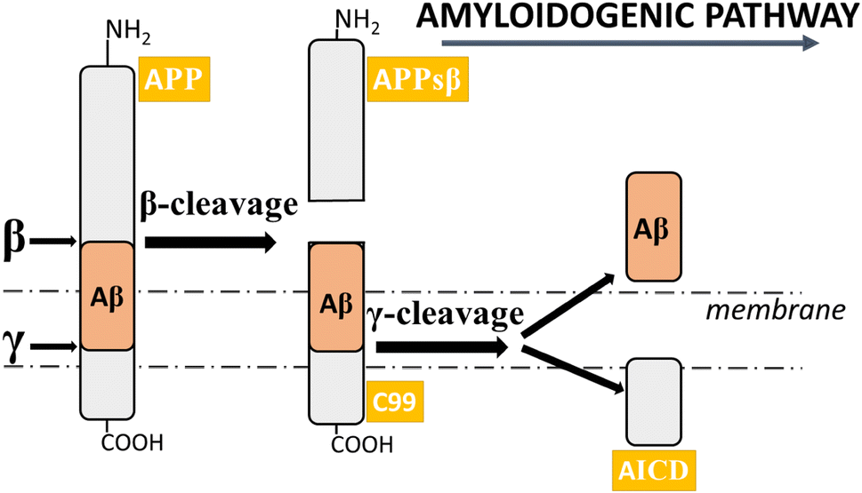
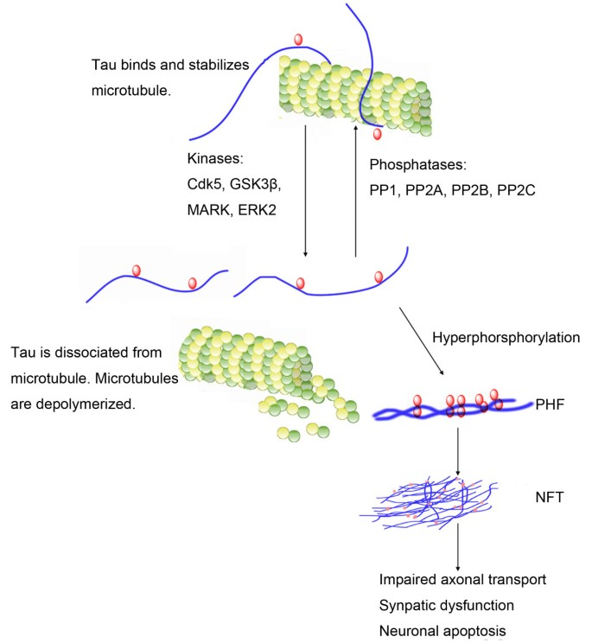
TTI-101 rescues multiple AD phenotypes
Lowers IL-6, IL-1β release
in BV-2 microglia
Lowers Aβ₄₂ secretion in hAPP
over-expressing H4 cells
Lowers p-Tau levels in hTau441
over-expressing Neuroblastoma
cells
Jackson Roberts et al. A Brain Proteomic Signature of Incipient Alzheimer’s Disease in Young APOE ε4 Carriers identifies novel drug targets 2021 SCIENCE Advances

Slide 24
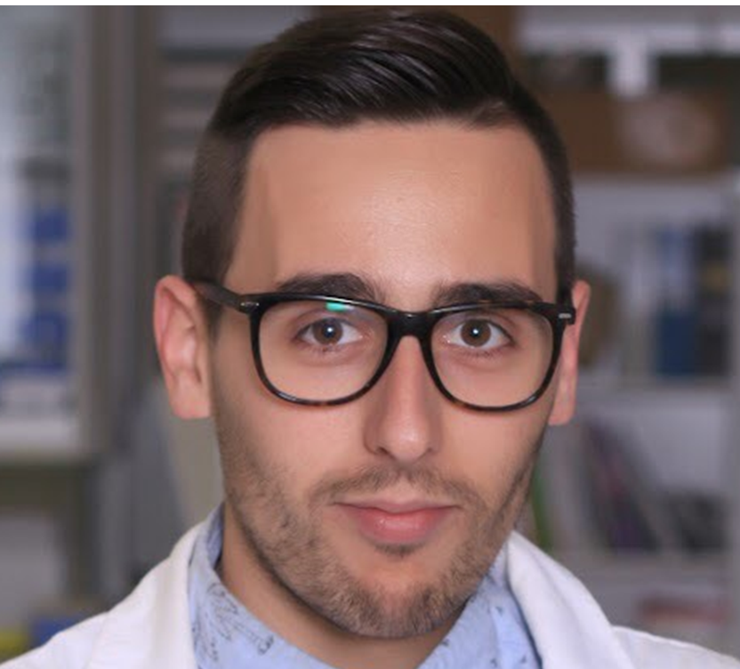

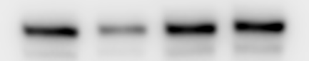
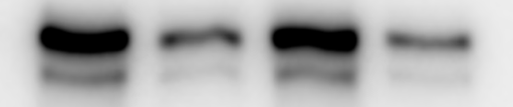
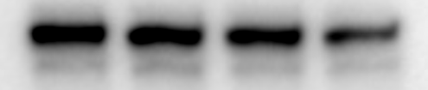
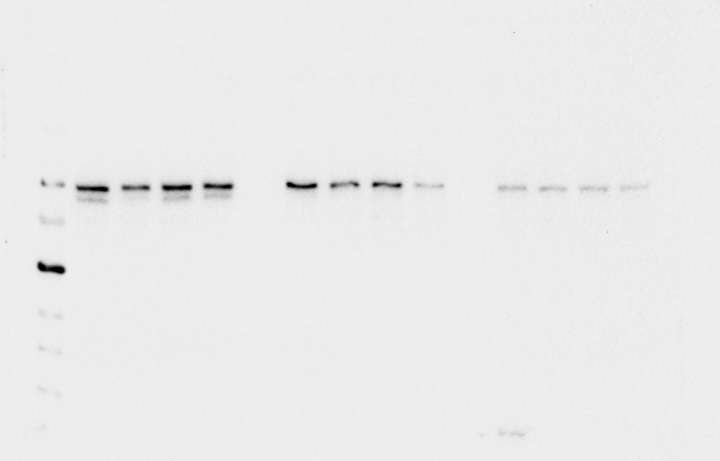
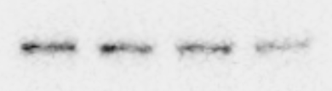
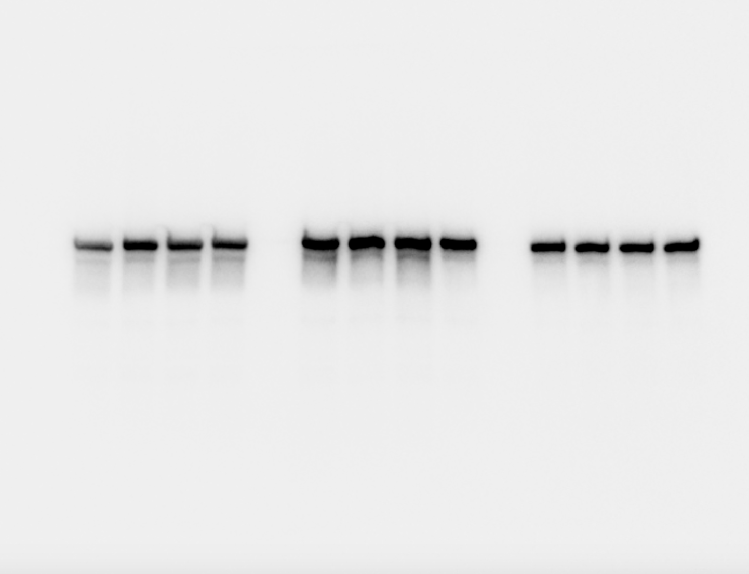
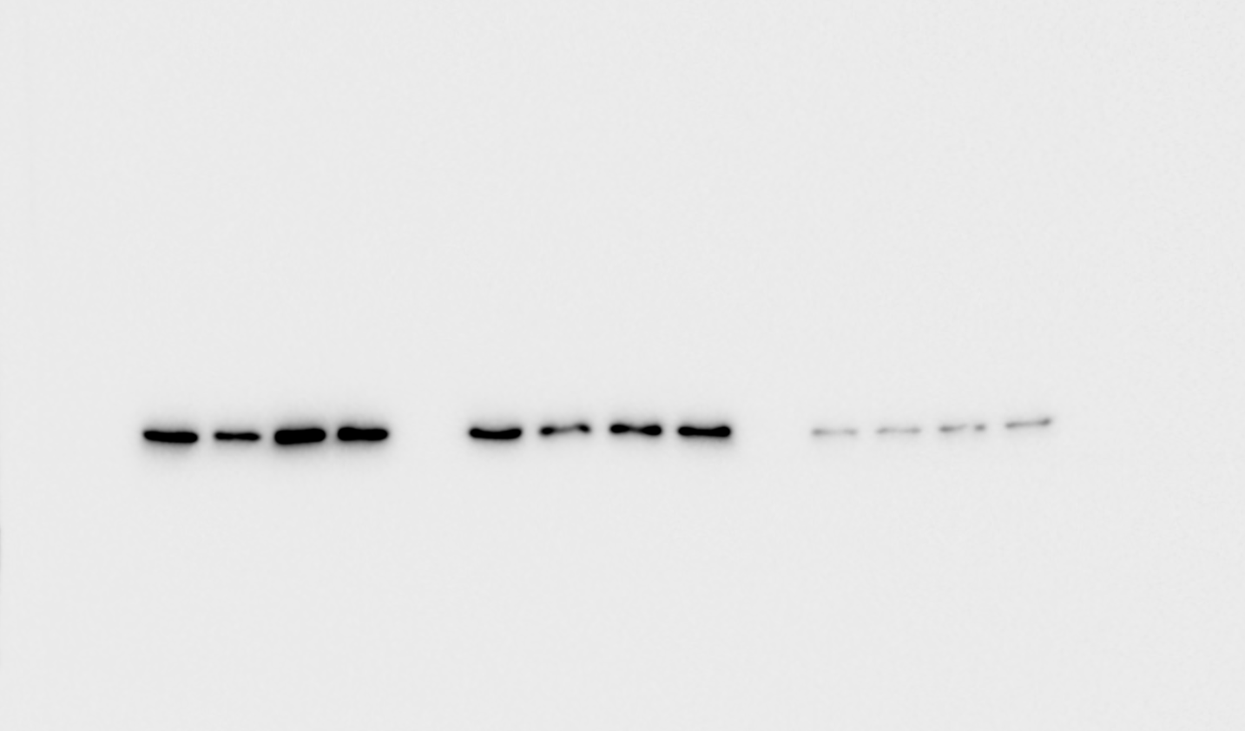
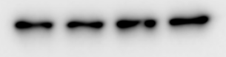
Dr. Carlos Anerillas, LGG
Dr. Myriam Gorospe, LGG
A commonly used RA drug (RAX) inactivates STAT3 in Microglia and Astrocytes
HMC3 (Microglia)
1321N1 (Astrocytes)
BE(2)-M17 (Neuroblasts)
RAX 50 µM
MTX 50 nM
RAX 50 µM
MTX 50 nM
RAX 50 µM
MTX 50 nM
-
+
-
+
-
+
-
+
-
+
-
+
p-STAT3 (Tyr705)
p-STAT3 (Ser727)
STAT3
ACTB
Interpretation: RAX inactivates STAT3 in microglia and astrocytes.

Slide 25
Does RAX alter molecular outcomes relevant to AD?

Slide 26
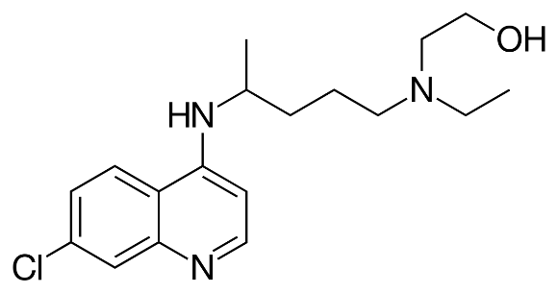
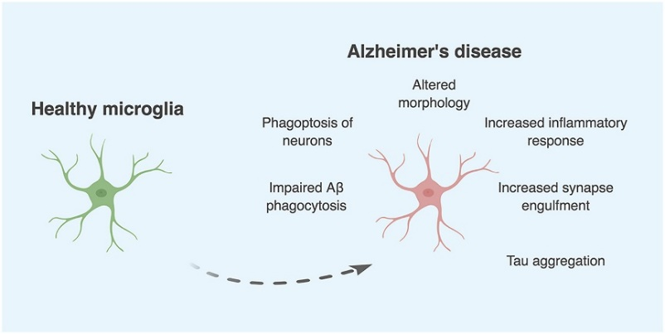
RAX rescues multiple AD phenotypes
Increases Aβ₄₂ clearance
in BV-2 microglia
Lowers TNF-α, IL-6, IL-1β release
in BV-2 microglia
Lowers p-Tau levels in hTau441
over-expressing Neuroblastoma
cells

Slide 27

Does RAX rescue impaired hippocampal synaptic plasticity in a transgenic AD model?
Dr. Sajikumar Sreedharan, NUS
Long-term potentiation (LTP) is a process involving persistent strengthening of synapses that leads to a long-lasting increase in signal transmission between neurons. It is an important process in the context of synaptic plasticity. LTP recording is widely recognized as a cellular model for the study of memory.
LTP is impaired in the APP/PS1 transgenic mouse model of AD
Rescue of impaired LTP is a relevant neurophysiological read-out of disease-modifying AD treatments

Slide 28
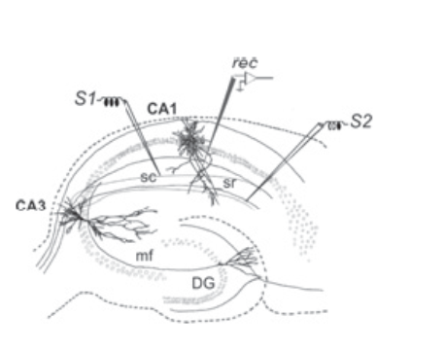
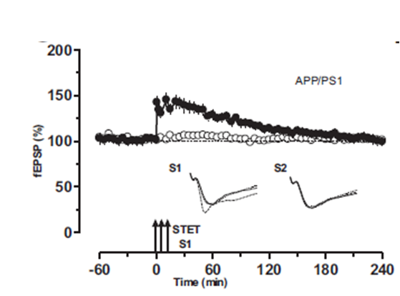
RAX rescues impaired LTP in the hippocampus of APP/PS1 mice
A
B
WT
C
APP/PS1
D
APP/PS1
STAT3-I 50 μM
Dr. Sheeja Navakkode (Electrophysiology), Dr. Wong Lik Wei (Western blots) Dr. Sajikumar Sreedharan, National University, Singapore
Notes:
A. Scheme representing hippocampal slice with the location of two independent stimulating electrode and one recording electrode to stimulate and record late-LTP from CA1 pyramidal neurons. B. Typical late-LTP from APP/PS1 mice ( taken from Li et a.l, 2017, PMID: 28484012 ). C. Rescue of late-LTP by RAX (50 µM), applied 30 min before and 30 min after the induction of LTP by strong tetanization protocol (STET: 100 Hz, 100 pulses , 0.2 ms at 0’, 10’ and 20’ min) in synaptic input S1. S2 served as a control. X axis represents percentage of field excitatory post synaptic potentials (fEPSP) recorded from hippocampal CA1 pyramidal neurons from 4-5 months old male APP/PS1 mice. Y axis represents time in minutes. D. Late-LTP + 25 µM RAX. E. Typical late-LTP from Wild type (WT)mice F. Effects of RAX (50 µM) on late-LTP from WT mice. G. Effects of Mtx on late- LTP from APP/PS1 mice. ‘n’ represents number of slices.

Slide 29
Drug Repurposing for Effective Alzheimer’s Medicines (DREAM)
Does RAX lower AD risk in real world clinical practice?
R.Desai et al. Targeting Abnormal Metabolism in Alzheimer’s Disease: the Drug Repurposing for
Effective Alzheimer’s Medicines (DREAM) study. Alzheimer's & Dementia: Translational Research
& Clinical Interventions, 2020

Slide 31
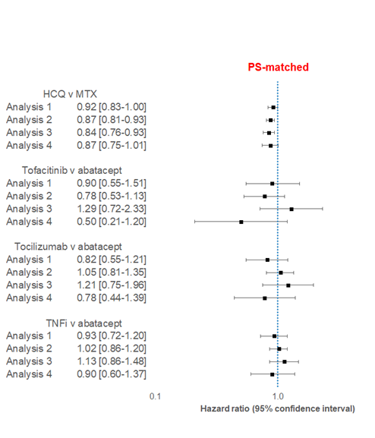
RAX lowers cumulative incidence of AD by 8-16% in the DREAM study
RAX vs MTx
RAX; N=71,029 MTx; N=54,562

Slide 32
RAX lowers cumulative incidence of AD by 8-16% in the DREAM study
RAX
MTx
RAX; N=71,029 MTx; N=54,562

Slide 33
Conclusions
Elevated STAT3 signaling is a plausible AD drug target
An experimental STAT3 inhibitor (TTI-101) and the commonly used, FDA-approved RA-drug (RAX) rescue molecular phenotypes relevant to AD including neuroinflammation, Aβ clearance/secretion and tau phosphorylation.
RAX restores impaired synaptic plasticity in APP/PS1 mice and lowers AD risk in older individuals
These results suggest that STAT3 inhibition is a promising therapeutic target in AD and merits confirmation in RCTs.

Slide 34
Specific Aim-2
Preclinical Validation of Emerging Novel Treatments for Alzheimer’s Disease
(PREVENT-AD) STUDY
Drug efficacy in transgenic mouse model
48 mice (5xFAD: n=32; WT: n=16)
27-week duration
Tx: intraperitoneal application 1/week
In-vivo blood sampling
Histologic processing
Cognitive performance
Amyloid plaques
Tau
tangles
Neuro-inflammation
Axonal damage

Slide 35

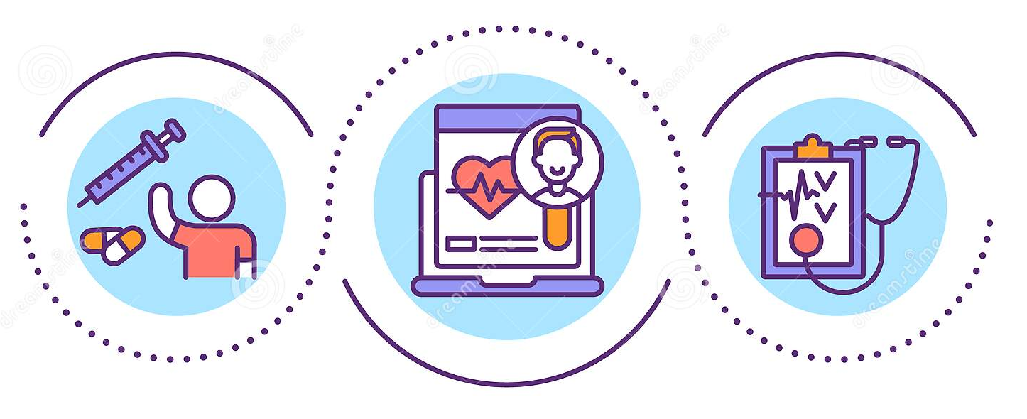
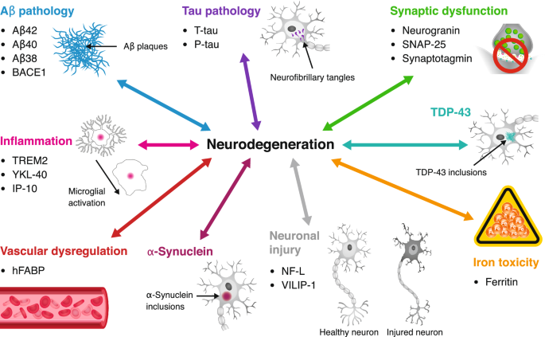
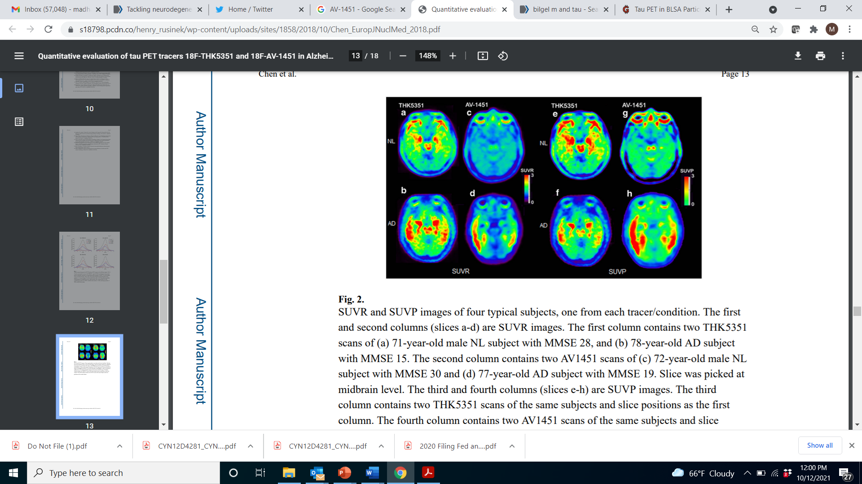
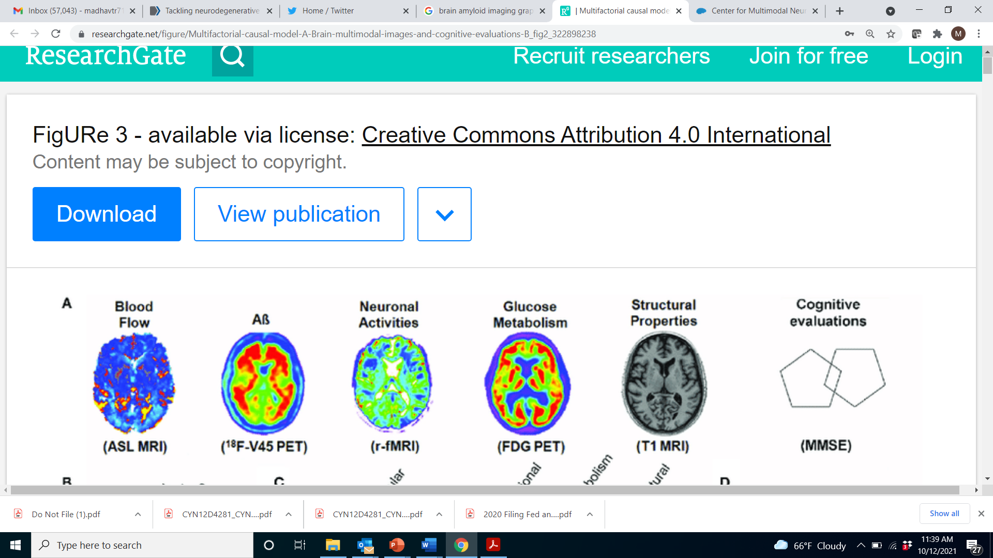
CARD Dementia Clinical Trials Unit, NIH Clinical Center
Proof-of-concept studies of promising ADRD drugs emerging from preclinical pipeline
AV-1451
Neuroimaging and fluid biomarkers as surrogate indicators of target engagement and efficacy
Experimental treatments moving imaging/fluid biomarkers therapeutic directions will be prioritized
for further confirmation in larger multi-center trials
Goal is to test at least 1 FDA-approved drug per year in the first 5 years.
Advance at least two experimental drugs in the first 5 years

Slide 36
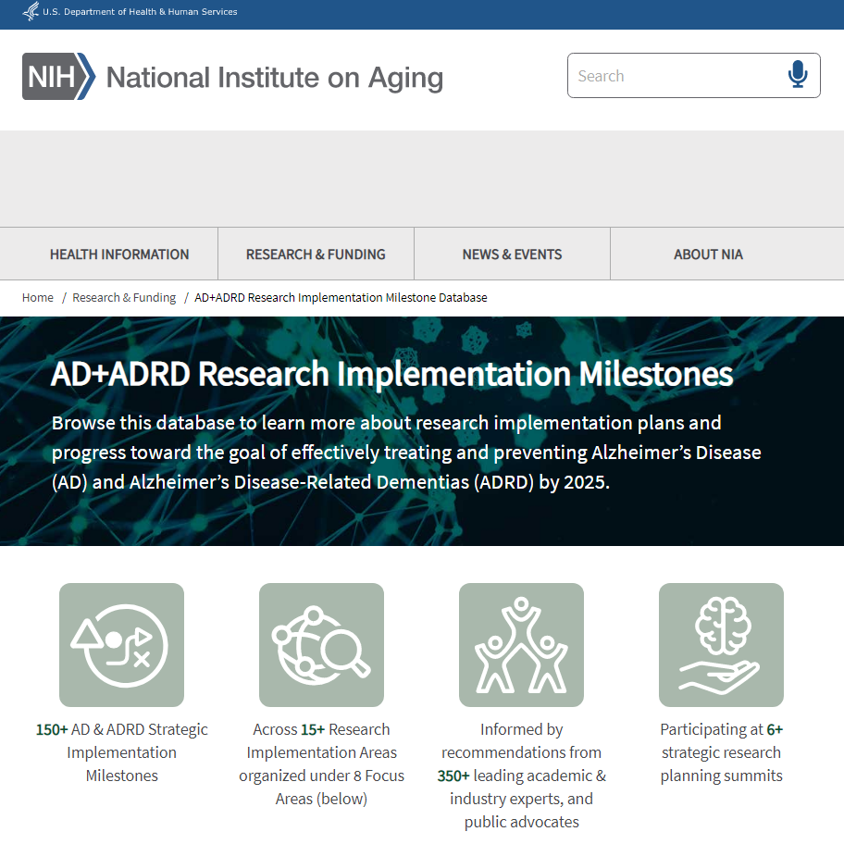
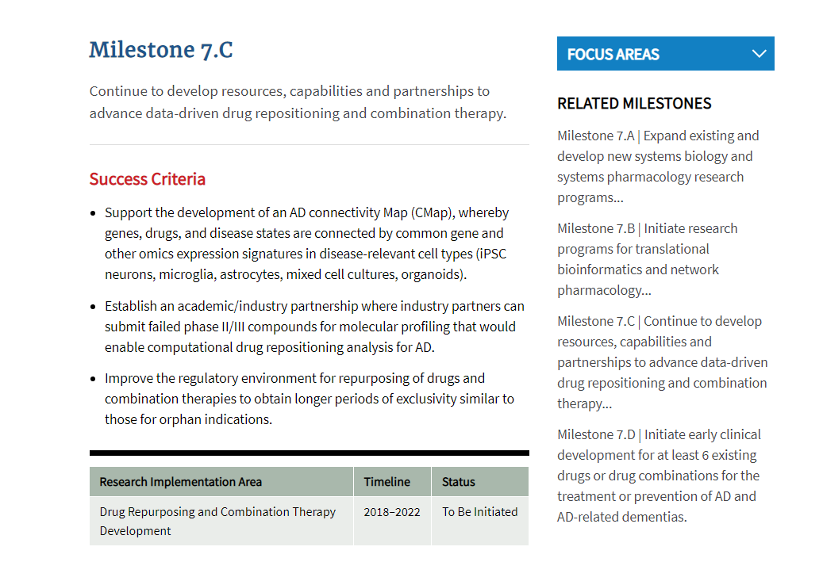
Continue to develop resources, capabilities and partnerships to advance data-driven drug repositioning and combination therapy

Slide 37
Colleagues and collaborators
    Unit of Clinical & Translational Neuroscience
    Madhav Thambisetty
    Vijay Varma
    Sayantani Roy
    Jackson Roberts
    Jong Shin
    Andrew Williamson
    Laboratory of Behavioral Neuroscience
    Susan Resnick (Chief)
    Yang An
    Lori Beason-Held
    Melissa Kitner-Triolo
    Longitudinal Studies Section
    Luigi Ferrucci
    Toshiko Tanaka
    HiThru Analytics
    Sudhir Varma
    DREAM Study
    Rishi Desai
    Sebastian Schneeweiss
    Tobias Gerhard
    Jodi Segal
    NIDDK
    Priyanka Narayan
    U Miss Medical Center
    Michael Griswold
    Chad Blackshear
    Johns Hopkins University SOM
    Marilyn Albert
    Juan Troncoso
    Olga Pletnikova
    MIT
    Li-Huei Tsai
    Hansruedi Mathys
    Manolis Kellis
    Jose Davila Valderrain
    St. Jude
    Junmin Peng
    Emory University
    Allan Levey
    Nicholas Seyfried
    ROSMAP
    David Bennett
    Gregory Klein
    NCI
    Shahinaz Gadalla
    Youjin Wang
    Gebze Technical University, Kocaeli Turkey
    Tunahan Çakır
    H. Büşra Lüleci
    KCL, London
    Cristina Legido-Quigley
    National University of Ireland
    Anup Oommen
    AMP-AD Consortium
    Andrew & Lillian A. Posey Foundation
    We are grateful to BLSA participants for their invaluable contributions

