Slide 1
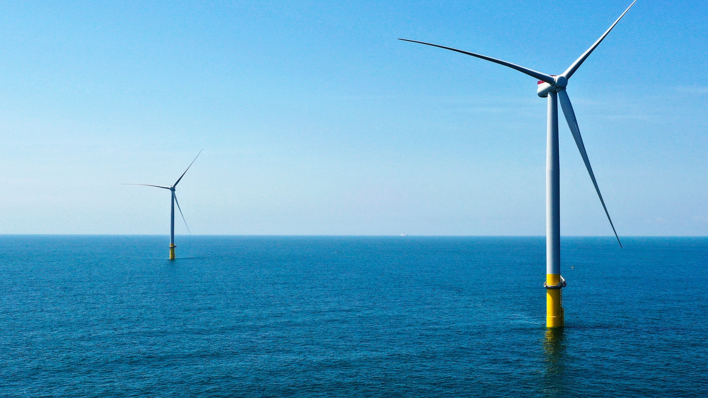
Offshore Wind Policy in Massachusetts
Presented by Rep. Jeffrey Roy (10th Norfolk)
House Chair of Joint Committee on Telecommunications, Utilities, and Energy

Slide 2
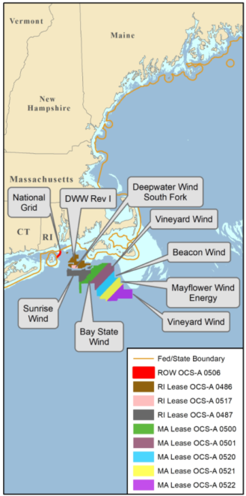
Massachusetts Offshore Wind Overview
Roadmap Bill: MA to solicit 5600 MW by 2027
  Also made a $12 million annual commitment to offshore wind and other clean energy workforce development
Biden administration announced national goal of 30 GW by 2030
MA has largest technical offshore wind potential of any state in contiguous US
Notes:
*5600 MW currently authorized is enough wind to power as many as 2.8 million homes
- nearly every US state on the east coast is involved in developing offshore wind projects off of their coasts
- MA is Saudi Arabia of offshore wind
7 lease areas off the coast of Massachusetts representing 11,000 MW of wind energy

Slide 3
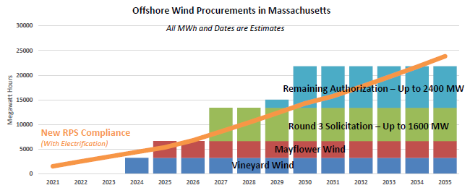
Notes:
Procurement I (2017): Vineyard Wind (800 MW)
Procurement II (2019): Mayflower Wind (800 MW)
Procurement III (2021): 1200 MW Commonwealth (Vineyard) Wind project and 400 MW Mayflower Wind project (TOTAL: 1600 MW)

Slide 4
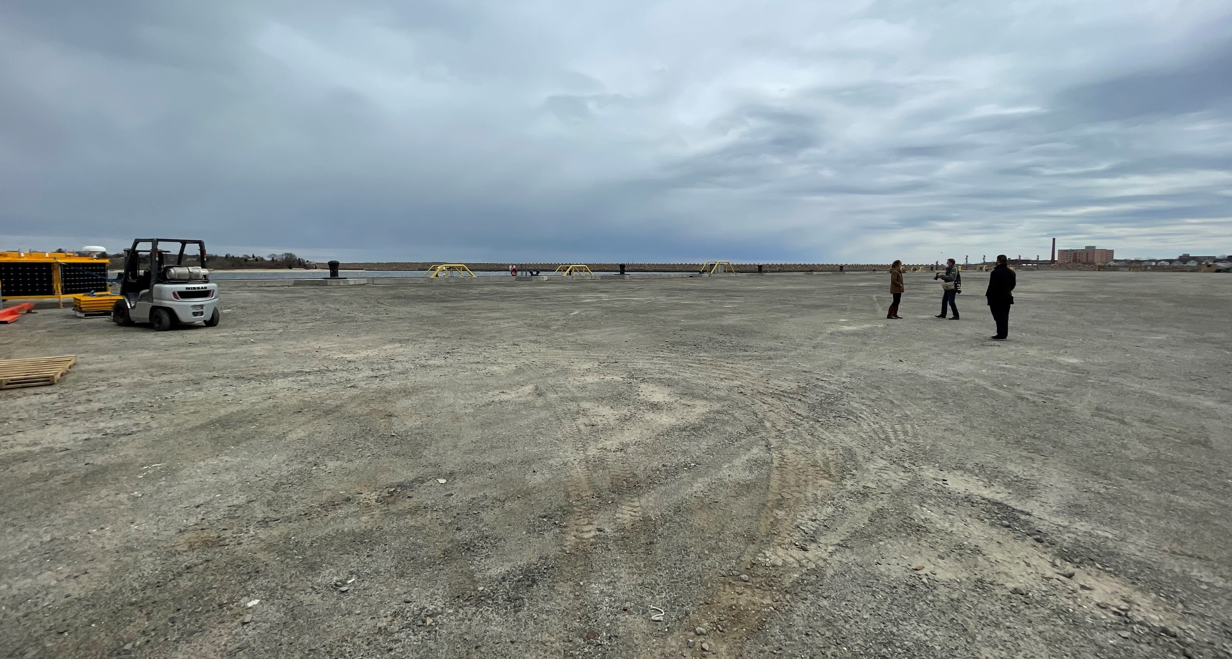
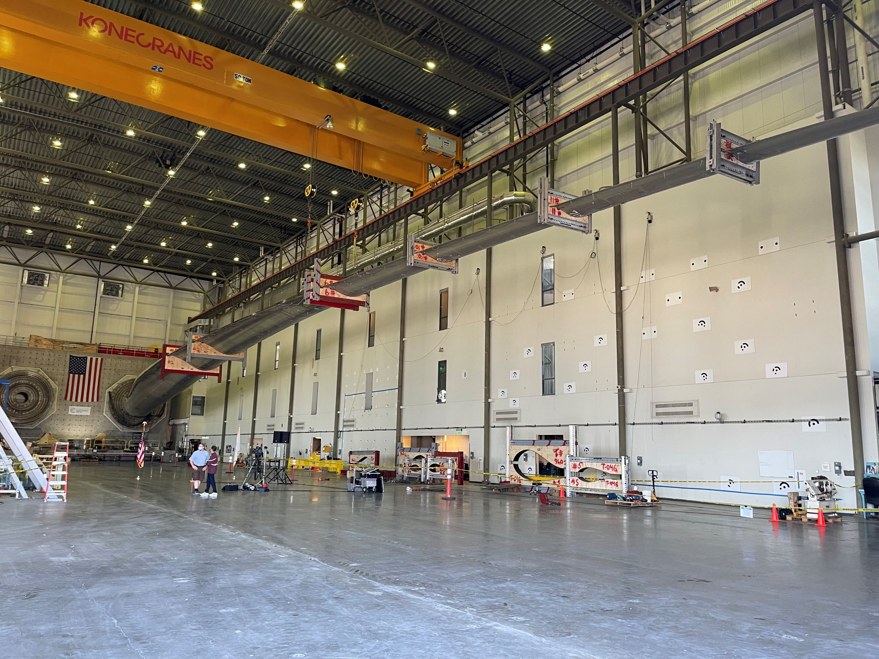
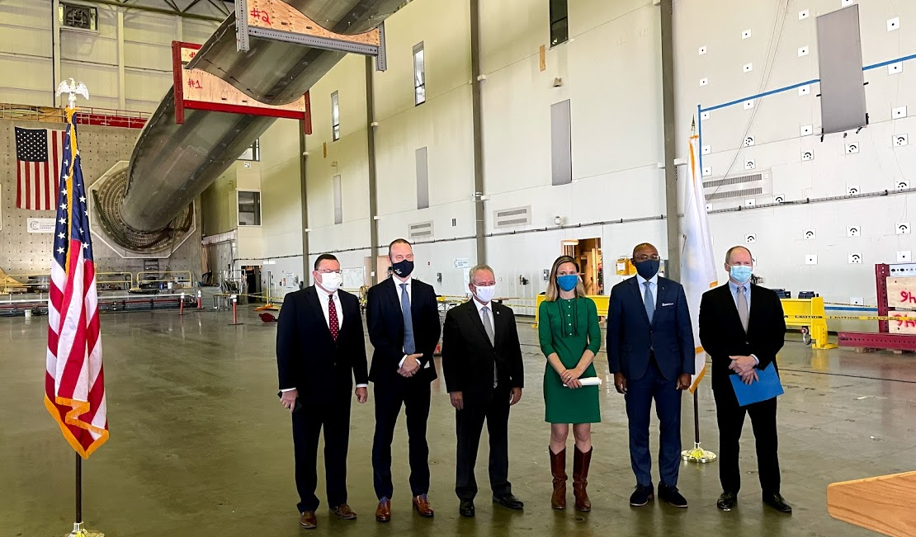
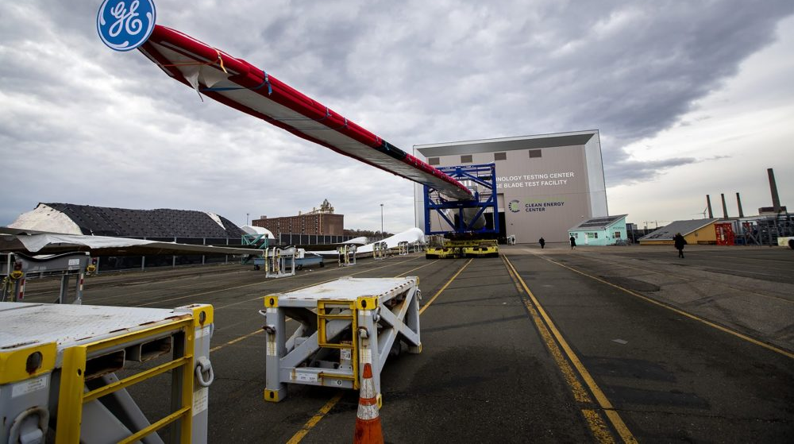
Notes:
May 11 – federal approval of Vineyard Wind
First large-scale project in US
Power hundreds of thousands of homes while helping us attain our emissions reduction goals
Enough to power 400,000 homes and equivalent to taking 325,000 cars off the road
Make Massachusetts a regional hub of the offshore wind industry
will generate 3600 jobs

Slide 5
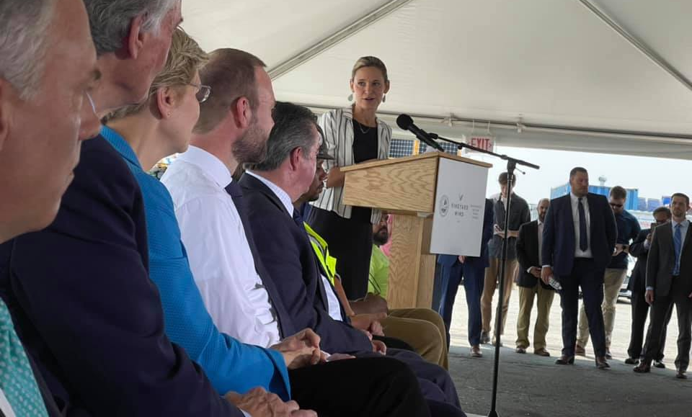
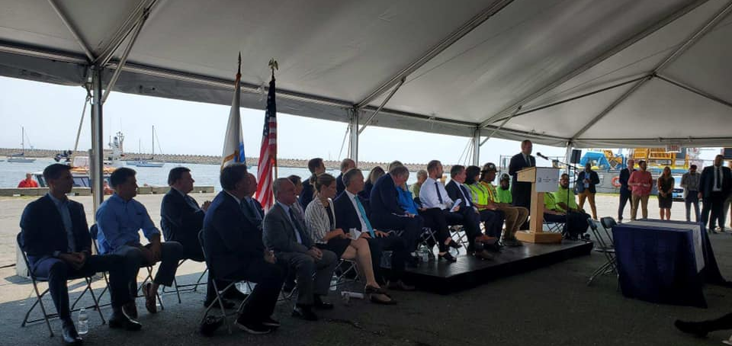
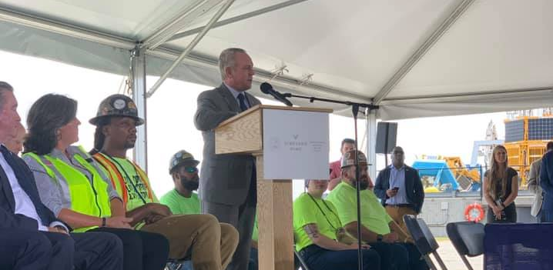
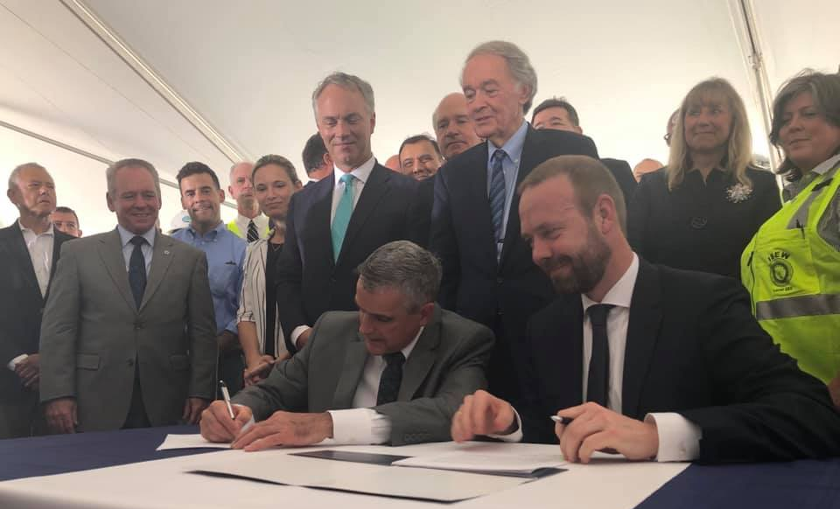
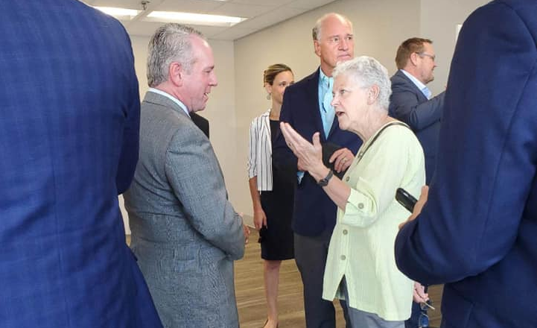
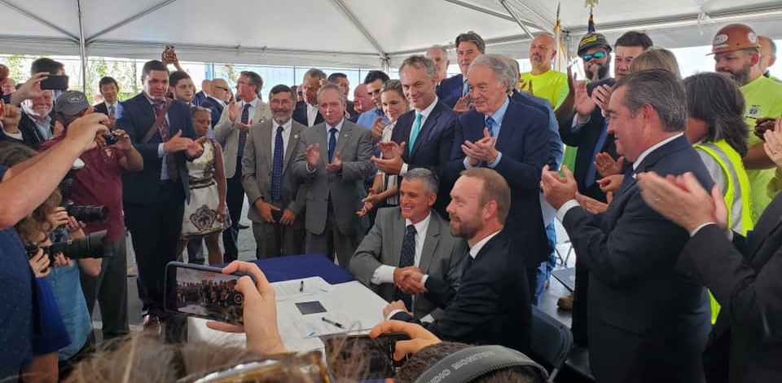
Notes:
July 16 - nation’s first offshore wind Project Labor Agreement
500 union jobs highlighted at the signing
MassCEC Marine Terminal in New Bedford

Slide 6
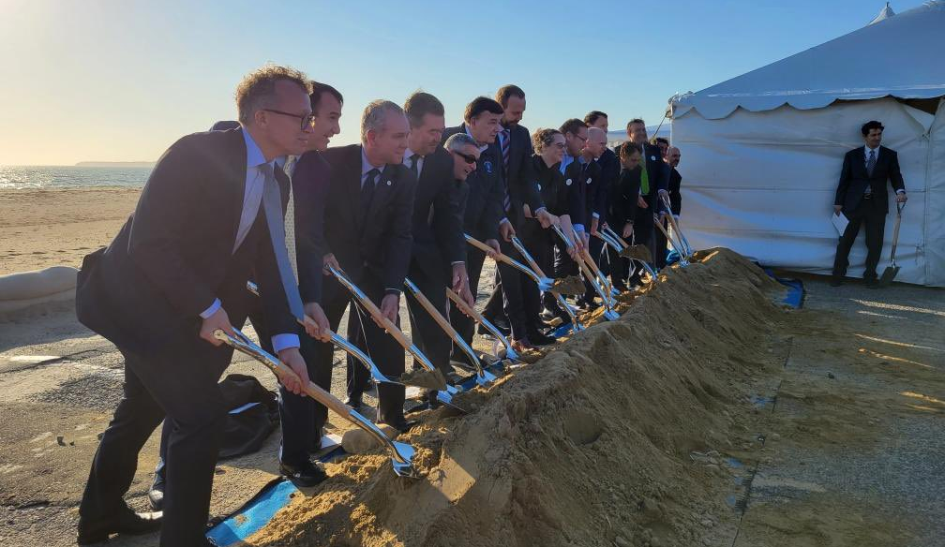
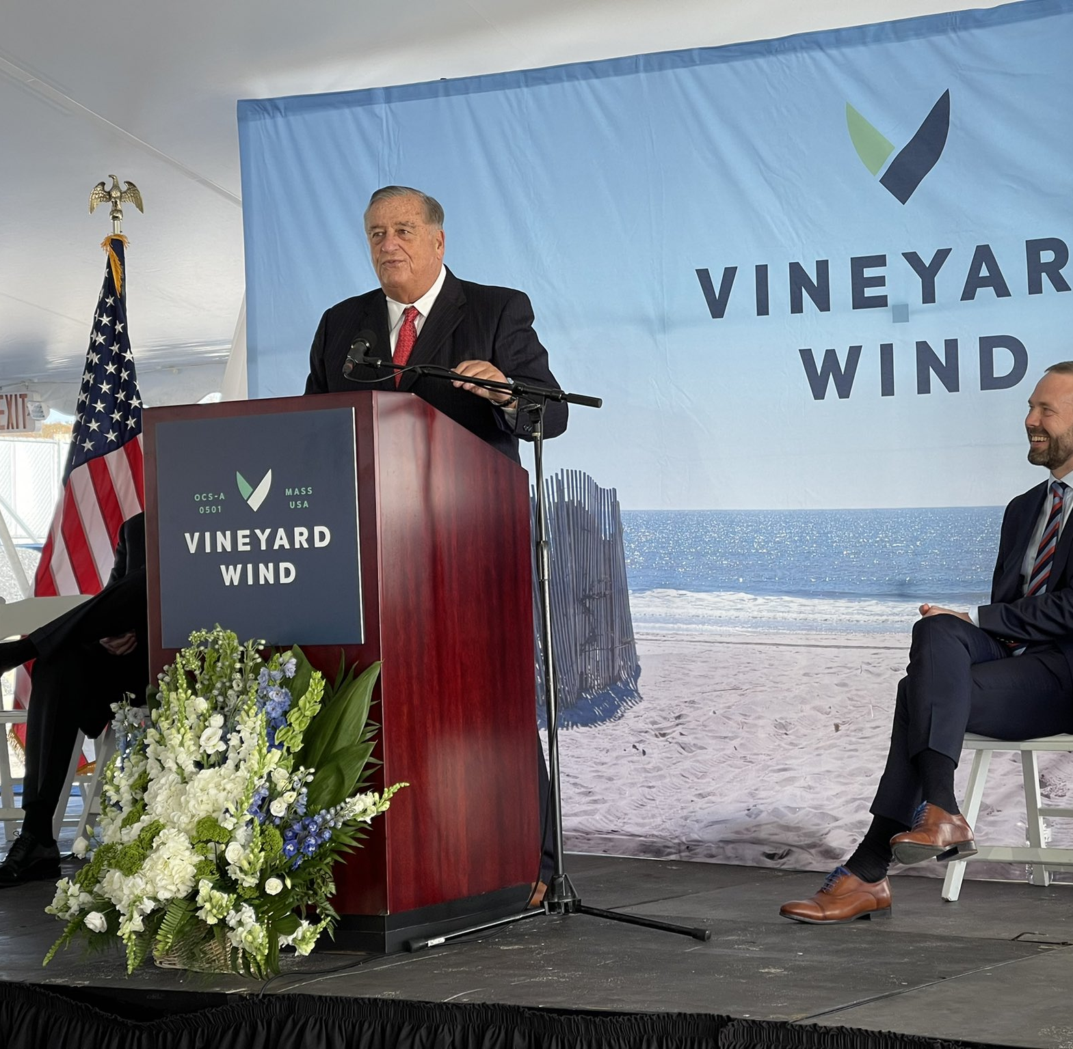
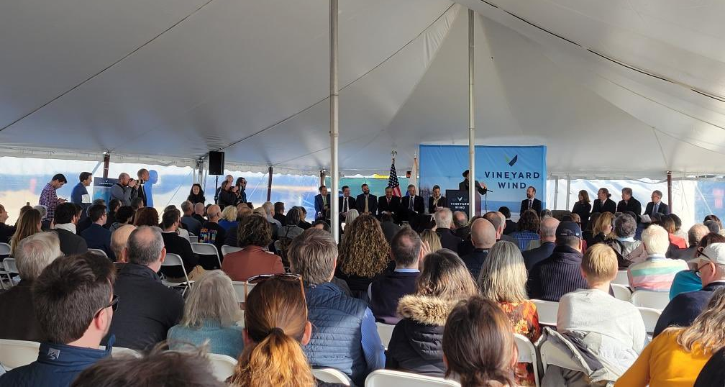
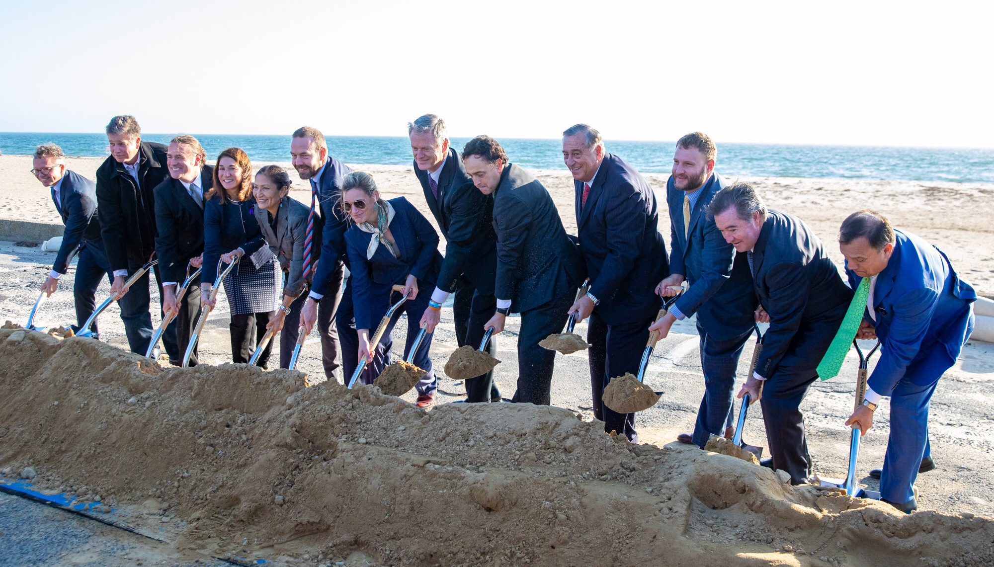
Notes:
November 19 – groundbreaking for nation’s first large-scale offshore wind project
Covell’s Beach in Barnstable, the site where two cables will make landfall and connect to the grid at a substation further inland on Cape Cod

Slide 7
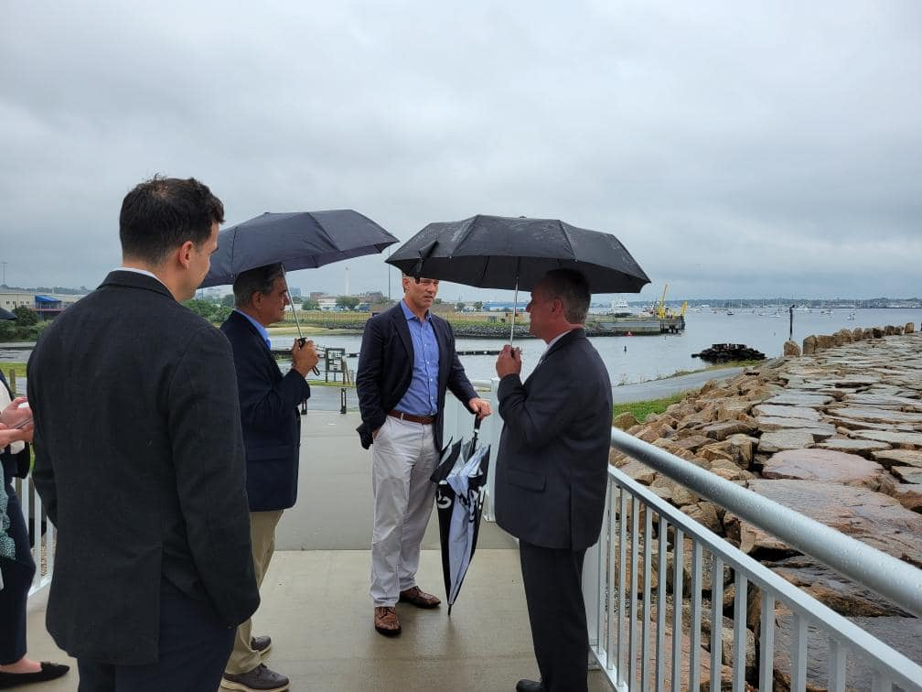
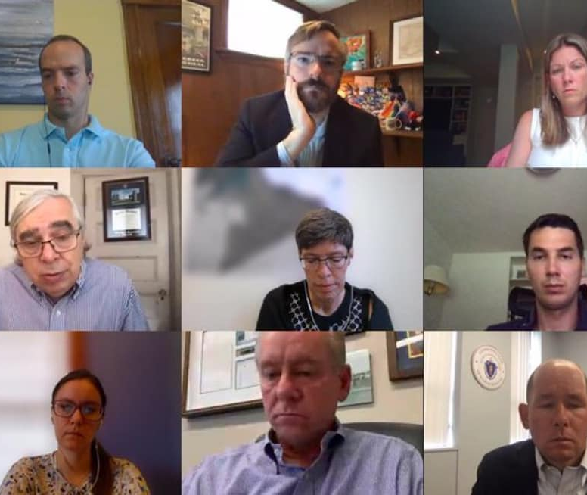
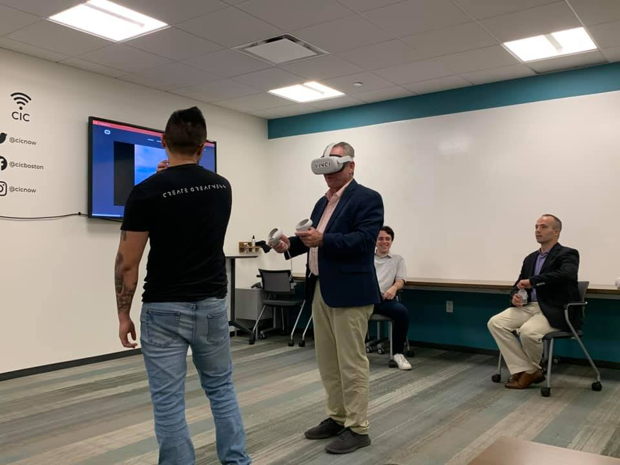
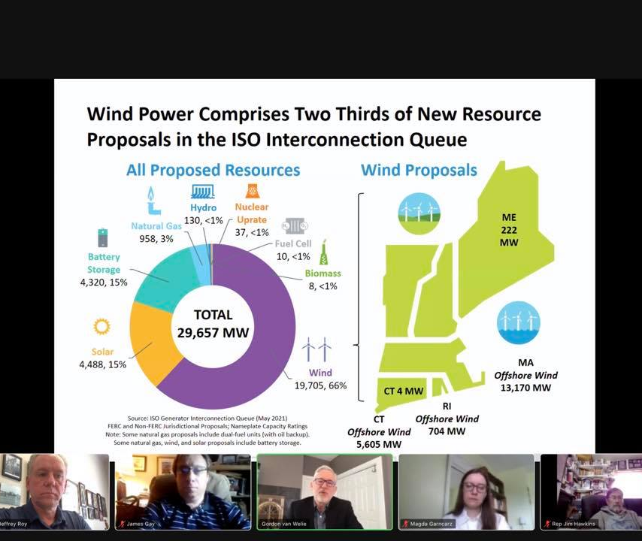
Stakeholder Meetings
Notes:
In February, Speaker tasked me with deep dive in offshore wind industry
Met with dozens of industry representatives over 6 months
Topics include workforce development, supply chain, transmission, procurement process, port infrastructure, storage
Pictured: New Bedford ports, ISO-NE, Sec. Ernie Moniz, VINCI VR

Slide 8
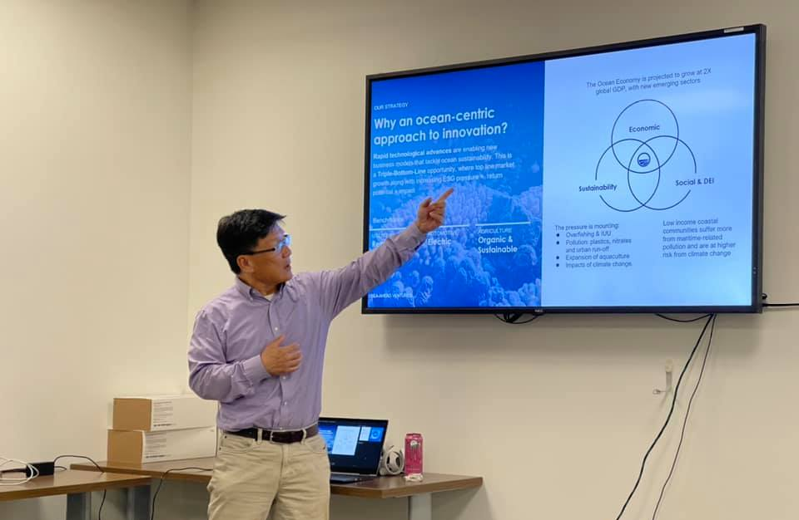
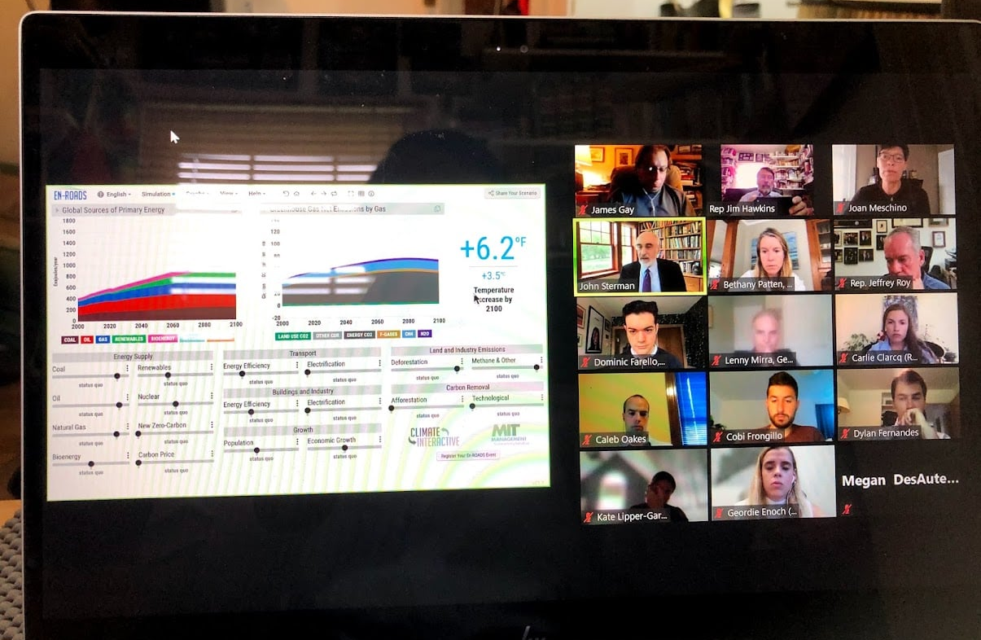
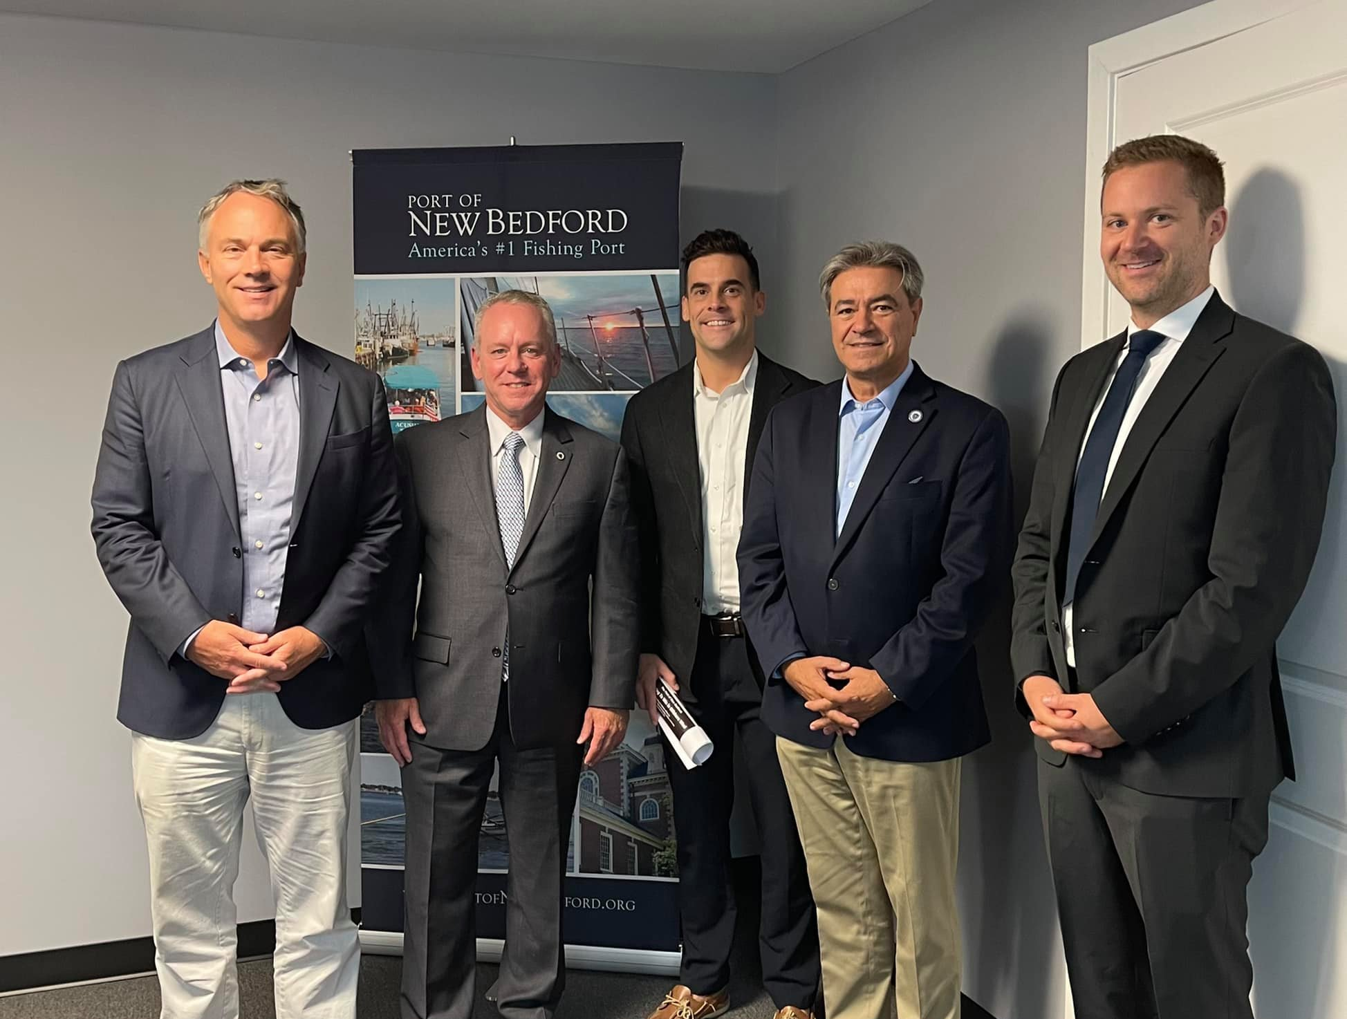
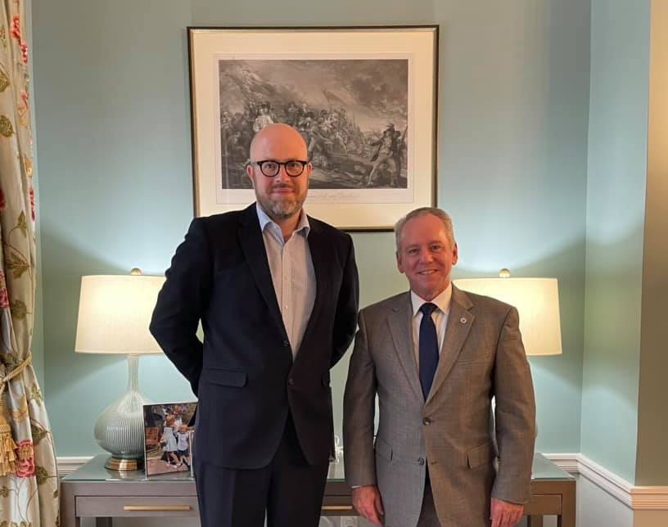
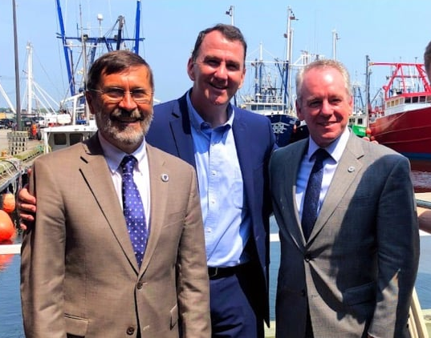
Notes:
Pictured: blue economy cluster, MIT, New Bedford, UK Consulate

Slide 9
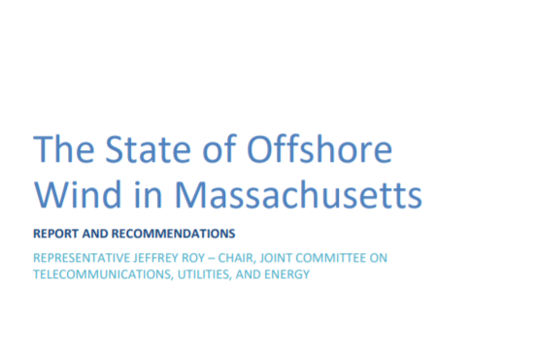
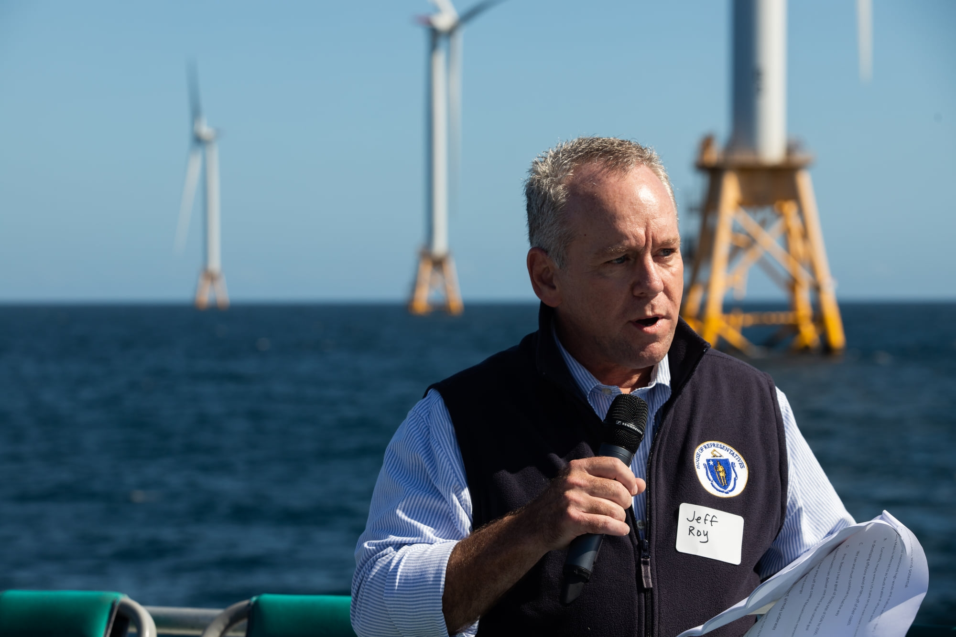
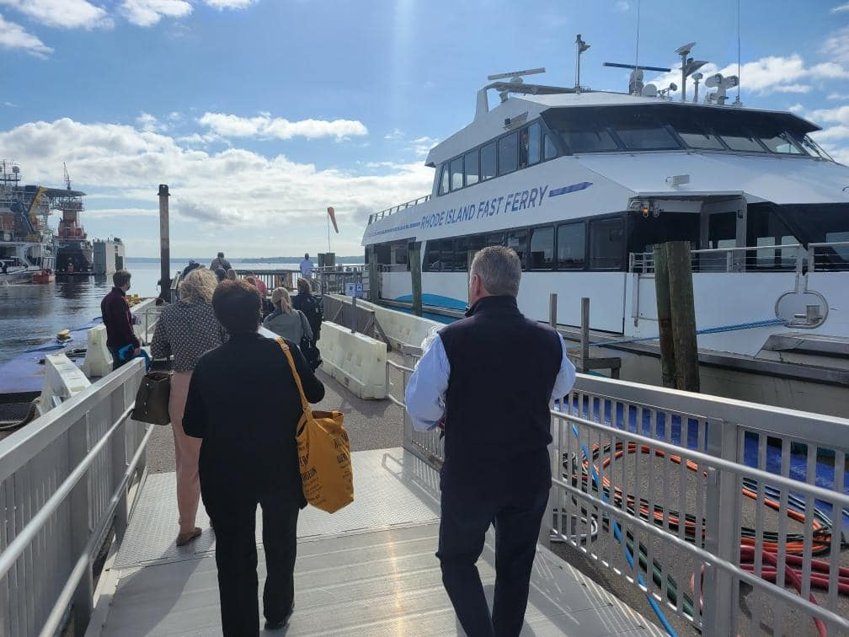
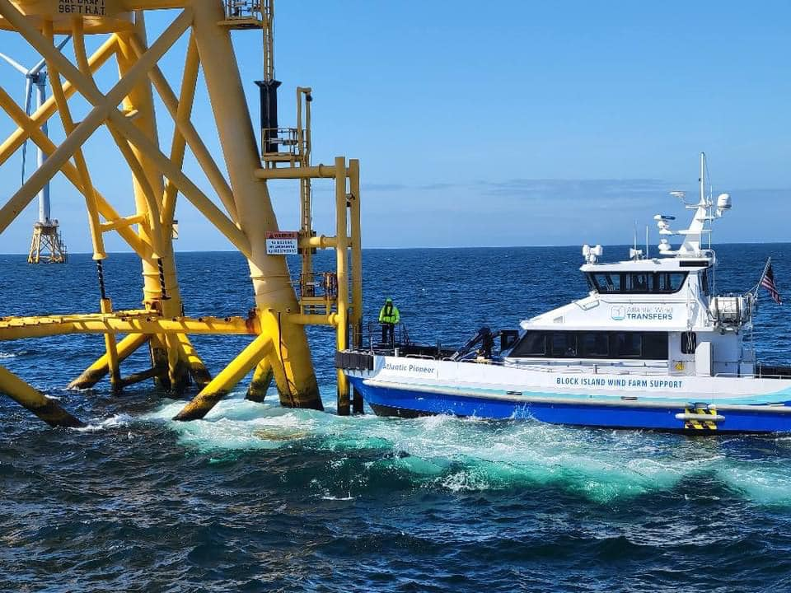
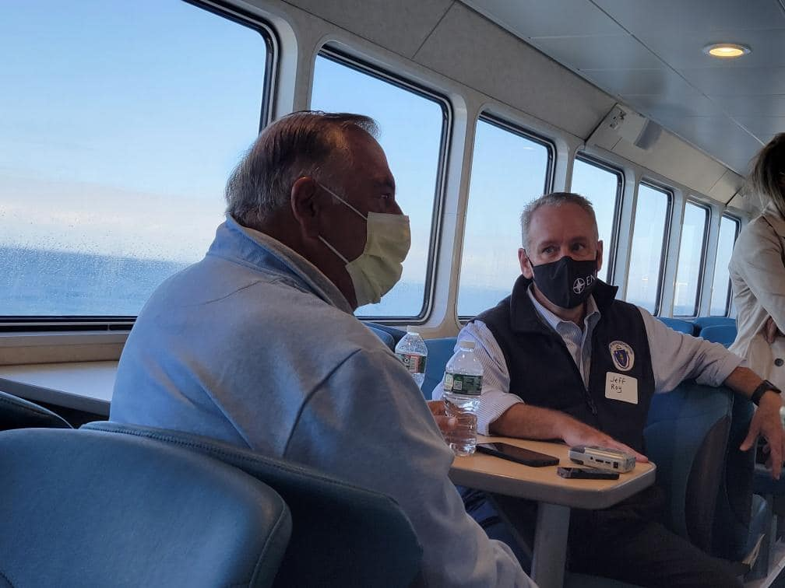
Notes:
September 21 – tour of Block Island wind turbines
Speaker and 2 dozen representatives
I shared our detailed and comprehensive 100-page report, with analyses and recommendations for further legislative action
Speaker announced House plan to produce offshore wind legislation

Slide 10
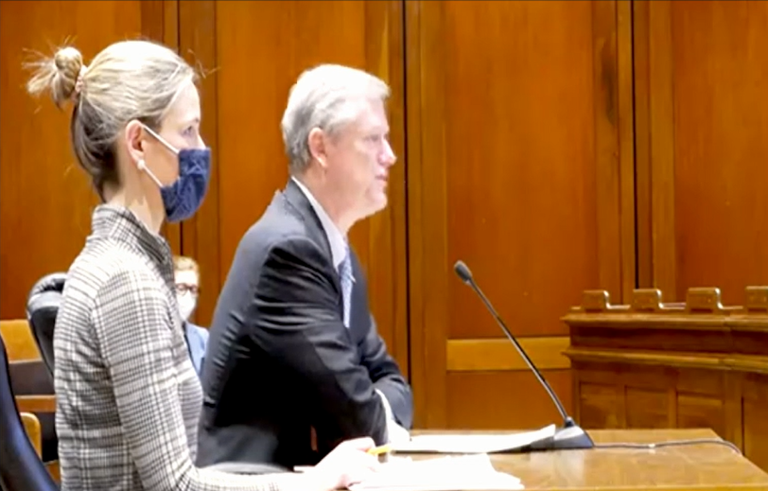
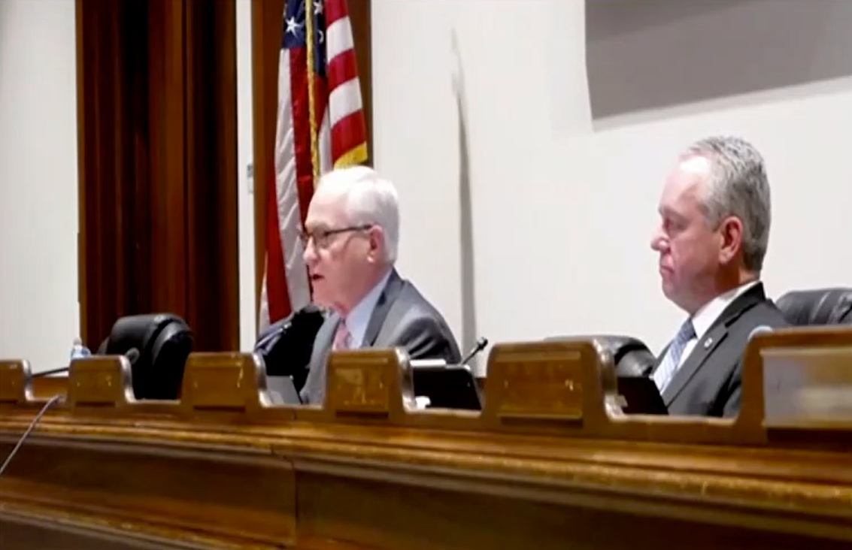
H.4204
An Act to power Massachusetts’s clean energy economy
Notes:
October 2021 – Gov Baker recommended legislation
Heard last Wednesday, January 11
Widespread industry support
Includes many of the provisions we included in our legislation (though ours goes further)

Slide 11
Lessons Learned
Price cap
Economic development
Workforce development
Port infrastructure
Transmission
Storage
Selection committee
Environment and fisheries
Remuneration
Municipal engagement
And more…
Notes:
Really did deep dive and learned a lot about where Massachusetts has succeeded and where we can improve
Commonwealth has done well to move quickly and secure cheap projects
However, we’ve started to lose out on many of the major economic development and innovative pieces that other East Coast states have been able to secure
Prompt 1: As the first state to move forward with a federally approved commercial-scale project, what have we learned through that process of bidding, selection, and siting that you included in the legislation?
In a second, I’ll elaborate on all things we addressed in our legislation but for now will highlight two pieces:
Price Cap
The price cap included in the 2016 Energy Diversity Act was a good safety measure to protect ratepayers back when offshore wind in Massachusetts was still unchartered territory, and the Legislature wanted to take bold action on climate change but also ensure ratepayer protections
To keep costs down, the price cap was put in place to ensure that each successive offshore wind procurement and associated offshore wind transmission costs were less expensive than the previous procurement
Since 2016, the success of our offshore wind procurements and advancements within the industry have brought offshore wind bid prices down more than anyone had imagined, and experts project that prices will continue to fall
And while the price cap has been great at keeping costs down, we now find ourselves in new circumstances
The bid prices have become so competitive that Massachusetts only received two bids in our last round of solicitations
Additionally, the bids that we have received since we began procuring for long-term contracts have included fewer economic development benefits for our local communities than the bids being put forth in our neighboring states
This led us to remove the price cap in the offshore wind bill that we just reported out of the Telecommunications, Utilities, & Energy Committee in order to ensure that we aren’t stifling progress and competition with a very low ceiling price, and to allow future bids a little more flexibility to work in much needed economic development into their bids
Economic development components of bids
While we removed the price cap, we required long-term contracts to be cost-effective and to maximize economic development
The new bid selection committee established by this legislation is required to produce a numerical economic development score to be used in evaluating and ranking each bid
The intent here was to ensure that Massachusetts can attract valuable bids that will help support local economic development to create a thriving offshore wind industry in Massachusetts

Slide 12
H.3310
Establishes Offshore Wind Industry Investment Fund for MassCEC to invest in manufacturing, interconnection, innovation, research, infrastructure, and workforce development
  Funded through electricity and gas surcharges
Establishes certification program (akin to Life Sciences) for offshore wind organizations to receive investments and tax credits
  Provides refundable tax credit for commitments of 50+ new jobs
Requires utilities to work with a Grid Modernization and Planning Council to proactively upgrade transmission and distribution
Directs DOER (with possible regional coordination) to solicit transmission proposals to deliver authorized offshore wind generation to existing grid
Requires carbon reduction research center to recommend Roadmap benchmarks for long-duration energy storage
  Requires utilities to file a tariff for standalone energy storage
Creates DESE pilot for offshore wind credential training in high schools
An Act advancing offshore wind and clean energy
Notes:
Prompt 3: One of the major challenges we face is transmission, getting the power from the turbines to shore and then connecting to the grid for efficient distribution. Wind farm developers currently build their own transmission lines to shore, but the bill calls for exploring whether a centralized transmission line serving multiple wind farms would make more sense. Can you provide some of the reasons why and how this would be accomplished?
When we first started with commercial-scale OSW and the enabling legislation of 2016, we didn’t require our state energy agency DOER to conduct transmission solicitations because we didn’t want to slow down an industry that we were just figuring out how to get started.
In 2019, we studied the benefits of independent transmission but found that the limited authorization at the time rendered the procurement process economically-inviable
Now in 2022, with 3200 MW of projects contracted or about to be contracted, and with visibility of 2400 MW on the way, it’s the right time to be talking about long-term transmission solutions
With only so many “plugs” into our onshore grid, we are at risk of using up all the relatively cheap ones, burdening all future projects
ISO-NE forecasted per-MW interconnection costs to increase 86-fold and found that interconnection costs may vary by tens of millions of dollars depending on a project’s queue position.
Continuing to build transmission independently for each new project may lead to overbuild, system inefficiency, avoidable fishery and EJ impacts, and duplicative costs for ratepayers
An integrated offshore wind transmission system with strategically interconnected generation could save ratepayers many millions of dollars.
Other countries and states have already begun moving toward independent transmission
But it has to be done right
Our legislation authorizes regional collaboration to further reduce duplicative efforts and costs
We also include consumer protections, allowing DOER to (a) select multiple proposals, (b) select no proposals, and (c) terminate the process at any time.
The bill calls for a solicitation this summer, prior to the next procurement process, to allow (if the procurement process is successful) for future projects to have a clear offshore interconnection point
With more and more projects coming online up and down the East Coast, anything we can do to remove obstacles to deploying offshore wind is a win

Slide 13
H.3310
Removes price cap
  allows DPU to reject bids if a single company participates
Creates a selection committee to determine the winning offshore wind bid
  Includes EEA, EOHED, an independent evaluator, a House appointment, and a Senate appointment
  Utilities become technical advisors
Requires utilities to demonstrate a “quantitative level of incremental risk” to receive up to 2.5% remuneration
Requires bids be both cost-effective and “maximize economic development”
  Selection committee to numerically score economic development
Requires bids to include an environmental and fisheries plan
  DOER to establish an environmental and a fisheries working group
Provides preference to bids that include:
  the greatest economic and employment contributions to Massachusetts
  impact mitigation for wildlife, habitat, and maritime industries
    At least 5% of overall bid score
  energy storage
  optimal interconnection locations
  commitments to allow municipalities, businesses, or non-profits to serve as off-takers
  labor standards
  benefits to EJ communities and low-income ratepayers
An Act advancing offshore wind and clean energy
(CONTINUED)
Notes:
Changes to 83C
Prompt 4: Changing the selection process of winning bidders from utilities to an independent body seems like a major change. Who is on the body and what is their charge? Will there be more transparency?
Now having gone through three offshore wind procurements, there is widespread consensus that the utilities need to be removed from their position as decision-maker for the winning offshore wind bid. It addresses any appearances of a conflict of interest that arises when a utility participates on one side of the table in drafting the RFP, evaluating bids, and selecting a winner, while an affiliate of the utility potentially participates on the other side of the table in submitting offshore wind bids.
The selection committee would be chaired by the EEA secretary or their designee – the most logical designee would be DOER (H.4204 puts DOER in charge of deciding the winning bid as well but doesn’t include a selection committee). The other committee members include the EOHED secretary, the independent evaluator selected jointly by DOER and the AGO, an appointment from the House Speaker, and an appointment from the Senate President.
We believe that this selection committee will provide vastly improved transparency and accountability over the status quo. This is in part because it simply removes the appearance or possibility of a conflict of interest.¹ We require that no selection committee member can have a financial interest in any OSW bids. By simply removing this potential opportunity for undue influence we can buttress bidder confidence in the process.
The selection committee also builds on policy we passed in the Next-Generation Roadmap bill where we added the Secretary of Housing & Economic Development to the process of reviewing offshore wind proposals. The goal with having the EOHED secretary join DOER in reviewing OSW submitted proposals was to increase our emphasis on economic development.
The Next-Gen provision was a step in the right direction, but as we dove into OSW in the fall, we realized that we really needed to make wholesale changes. We’re looking at a once in a lifetime opportunity for MA to really be a premier player in OSW. We made a host of changes seeking to improve economic development, but the selection committee was one of those key items to ensure that we really are getting the kind of economic development that we envisioned in the Legislature when we required these offshore wind procurements in law.
We are also looking for other key aspects as well, including avoiding environmental harm and securing a project that makes investments to promote a diverse, equitable, and inclusive workforce, and commit to high-quality paying jobs by complying with labor standards.
The Legislature, and particularly Speaker Mariano and the House, are deeply committed to seizing the opportunity to responsibly advance offshore wind, drive economic development, and build a premier local workforce to support offshore wind. I know colleagues in the Senate that share that same sentiment. By giving the Speaker and the Senate President each a pick to the selection committee, it indirectly helps ensure that the winning bid reflects the intent of the Legislature in creating. I say indirectly because we don’t allow a member of the Legislature themselves to serve on the committee. But the picks can allow someone who understands the Legislature’s vision for OSW to have a voice in the final outcome.
Adding the EOHED secretary was a logical next step to what we did in the Next-Gen Roadmap bill. They are already now assisting DOER in reviewing OSW proposals. Having their expertise in economic development on the committee will be a welcome contribution.
Finally, we think the addition of the independent evaluator, who has done terrific job of monitoring all of the offshore wind RFPs and even hydro RFPs, and providing reports with lessons that can be learned, will be an invaluable voice to have on the selection committee. They follow the whole process so they will have a wholistic view that will be incredibly helpful.
Further, we preserve the Attorney General’s role as ratepayer advocate to examine the OSW contracts when they are before DPU for final approval, so you have that important voice on behalf of consumers continuing to be able to advocate on behalf of their interests.
Prompt 2: Can you describe the new environmental components?
The bill has a number of environmental provisions that build on the efforts by the offshore wind projects so far and codifies environmental safeguards that will help ensure the responsible development of offshore wind for all future projects:
Requires that offshore wind proposals include an environmental and fisheries plan for the construction and operation of offshore wind facilities.
Requires that financial and technical assistance to support robust monitoring of wildlife and habitat represent no less than 5 percent of a bid’s overall score in a solicitation.
Requires preference be given to OSW proposals that include avoidance, minimization, and mitigation of impacts to wildlife, habitat, and water-dependent uses.
Requires the environmental and fisheries plan in subsection (d) of 83C include an explicit description of the best management practices and any mitigation the developer will employ for impacts to wildlife (including threatened or endangered species such as North Atlantic right whales), coastal and marine habitats, natural resources, ecosystems, and traditional or existing water-dependent uses (including commercial and recreational fishing) and pre- and post-construction monitoring to understand the effects of facilities on marine and avian species.
Directs DOER to establish both an environmental working group and a fisheries working group to provide input on best practices, conduct ongoing review of implemented monitoring and mitigation programs, and provide feedback and recommendations on an as-needed basis.
Requires DOER, in consultation with the environmental and fisheries groups, to determine how to use the funds submitted by developers to responsibly advance offshore wind.

Slide 14

Questions?
Notes:
Continuing to meet with stakeholders, solicit feedback, and make amendments as necessary
Look forward to enacting this critical legislation in the very near future

