Slide 1

Applications of Fourier Transforms in Pitch and Rhythmic Spaces
Jason Yust, .
Maths and Music Day at IRMA, May 14, 2025
Strasbourg
Download slides at https://sites.bu.edu/jyust/

Slide 2
Outline
Fourier in Rhythmic Space
Fourier theory: Frequencies, Coordinate spaces, Spectra
Maximal even rhythms
Microtiming and the Heisenberg principle
Interaction of frequencies: Gankogui pattern, Ligeti Piano Concerto I
Ligeti’s creative process: Piano Concerto II
Flexibly defined interval categories
Music analysis in diatonic space: Debussy Cahier des Esquisses
Windowed analysis of pc distributions: Midiverto, corpus analysis
Fourier in Pitch-Class Space

Slide 3
Fourier theory
Coordinate Spaces and Spectra

Slide 4
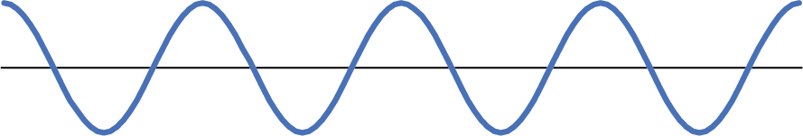
Rhythm as Periodic Stimulus
Premises:
• The features of a rhythm of primary interest are
periodicities (frequencies)
• Periodicities are represented by continuous functions, not discrete ticking clocks.
• Sinusoidal functions represent “atomic” periodicities:
A rhythm has this periodicity to the extent its onsets fall where the function has larger positive values, and not where it has larger negative values.
(Sharper functions are combinations of integer multiples of a fundamental frequency)
Period
Frequency = 1/Period

Slide 5
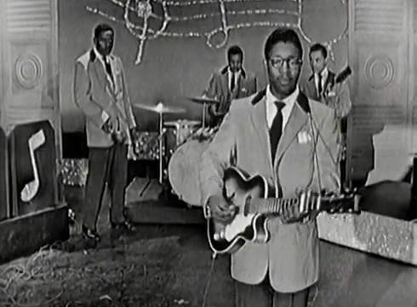
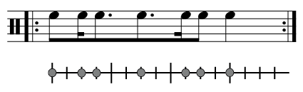

Example: Bo Diddley
Full Bo Diddley rhythm:
Simplified
(Clave rhythm):
Bo Diddley on Ed Sullivan, 1955

Slide 6
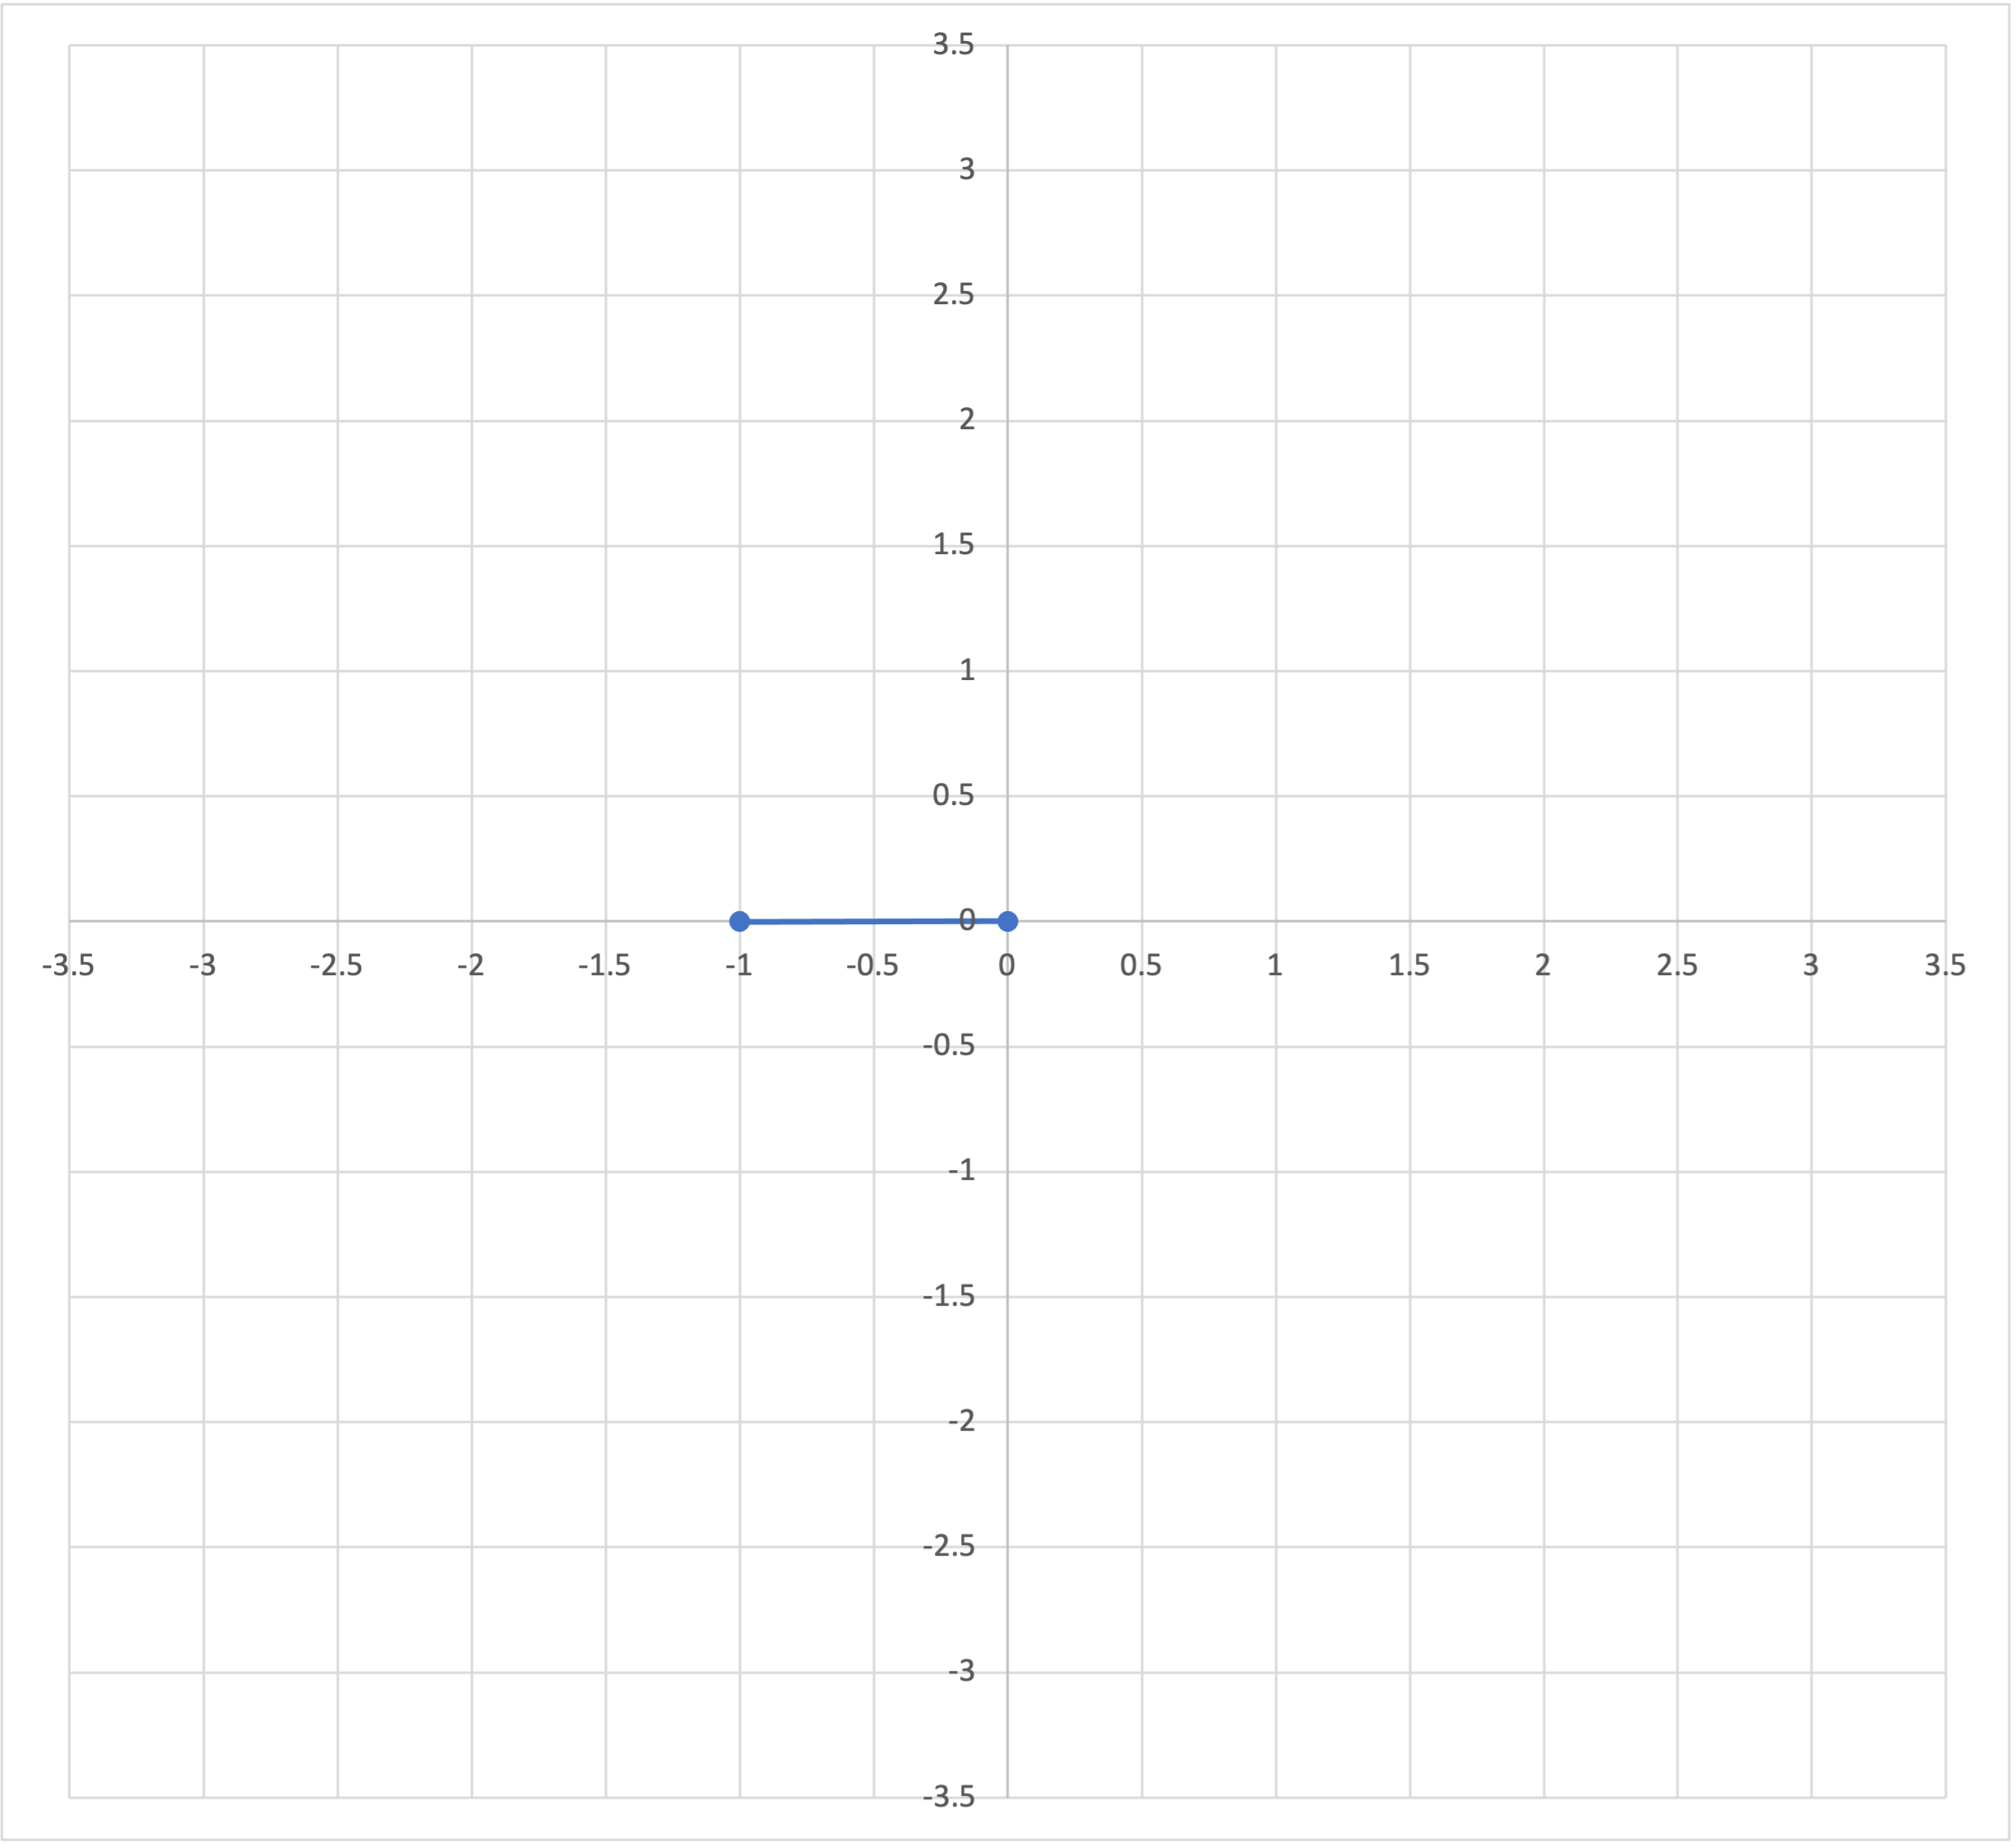
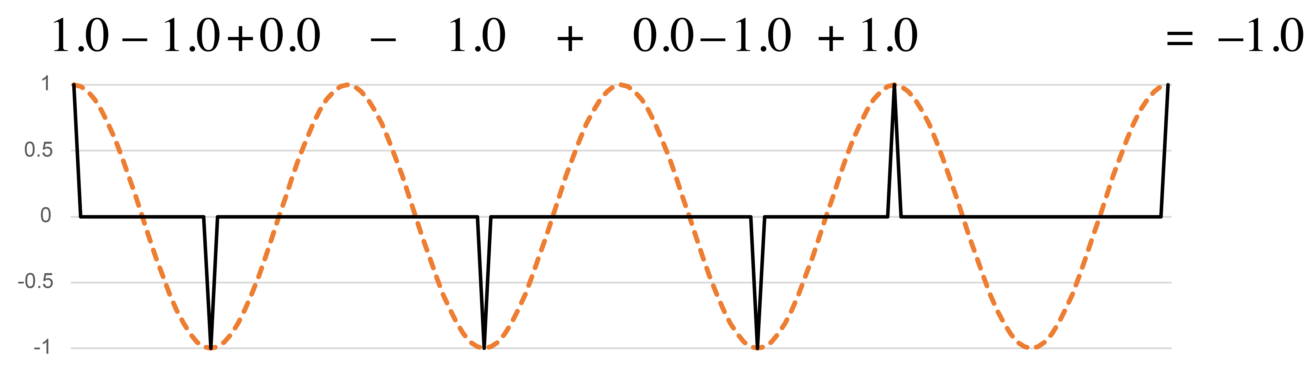
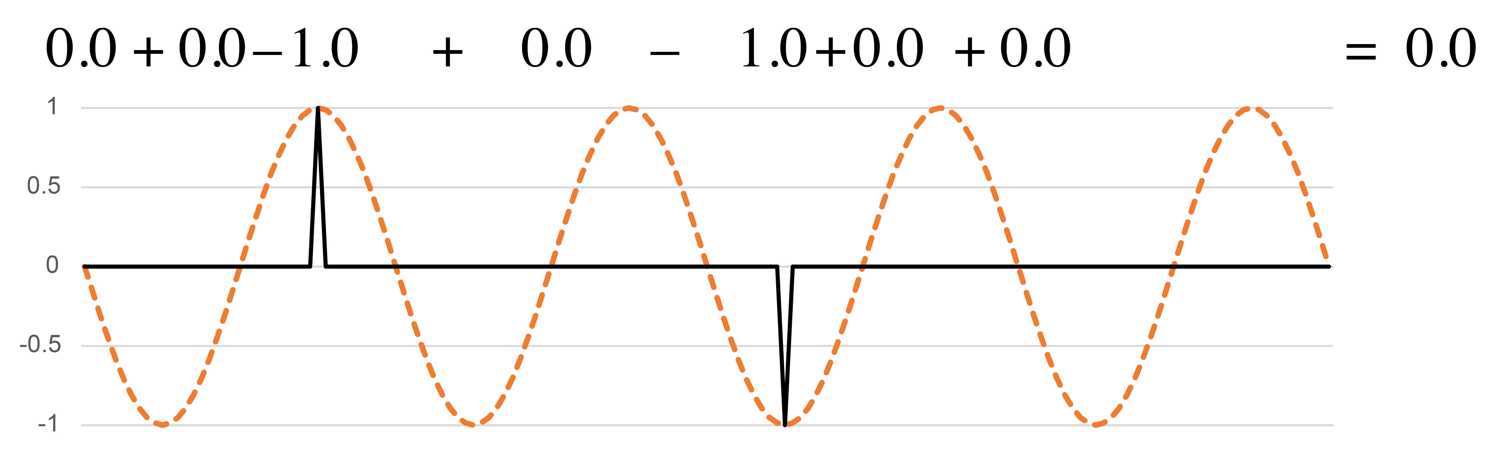
Coefficient spaces:
Analyzing a single frequency
On complex plane:
Before beat
q periodicity
(cosine):
Off beat
On beat
q periodicity
(–sine):
After beat
f₄
Notes:
Let's have a look at how simple periodic functions act as interpretive filters. These two functions both have a wavelength that corresponds to the quarter note beat. I'll refer to that as the periodicity of the functions. I will also sometimes refer to the frequency of the function, which here is 4, meaning that it divides the full cycle by 4. The first function, the cosine has its peaks lined up with the beats, and valleys at the midway point of the beats. This rhythm has more onsets in the valleys, so when we multiply the rhythm by the cosine function, it sums to a negative value. The minus-sine function below is the same as the cosine shifted back by a quarter cycle. The peaks and valleys of this function line up with the zeros of the cosine function. They show if onsets happen more often before or after the beats.
The two resulting sums give a point in a two-dimensional space which tells us how the rhythm expresses this frequency. [Animation 1] Moving to the left in the space corresponds to more on-beat onsets, to the right more off-beat onsets. [Animation 2] Upward indicates more onsets ahead of beats, downward more onsets after the beats. [Animation 3] This version of the Bo Diddley rhythm is a little more off-beat, and is balanced between the two sides of the beat. The point in the 2-dimensional space shows this.

Slide 7
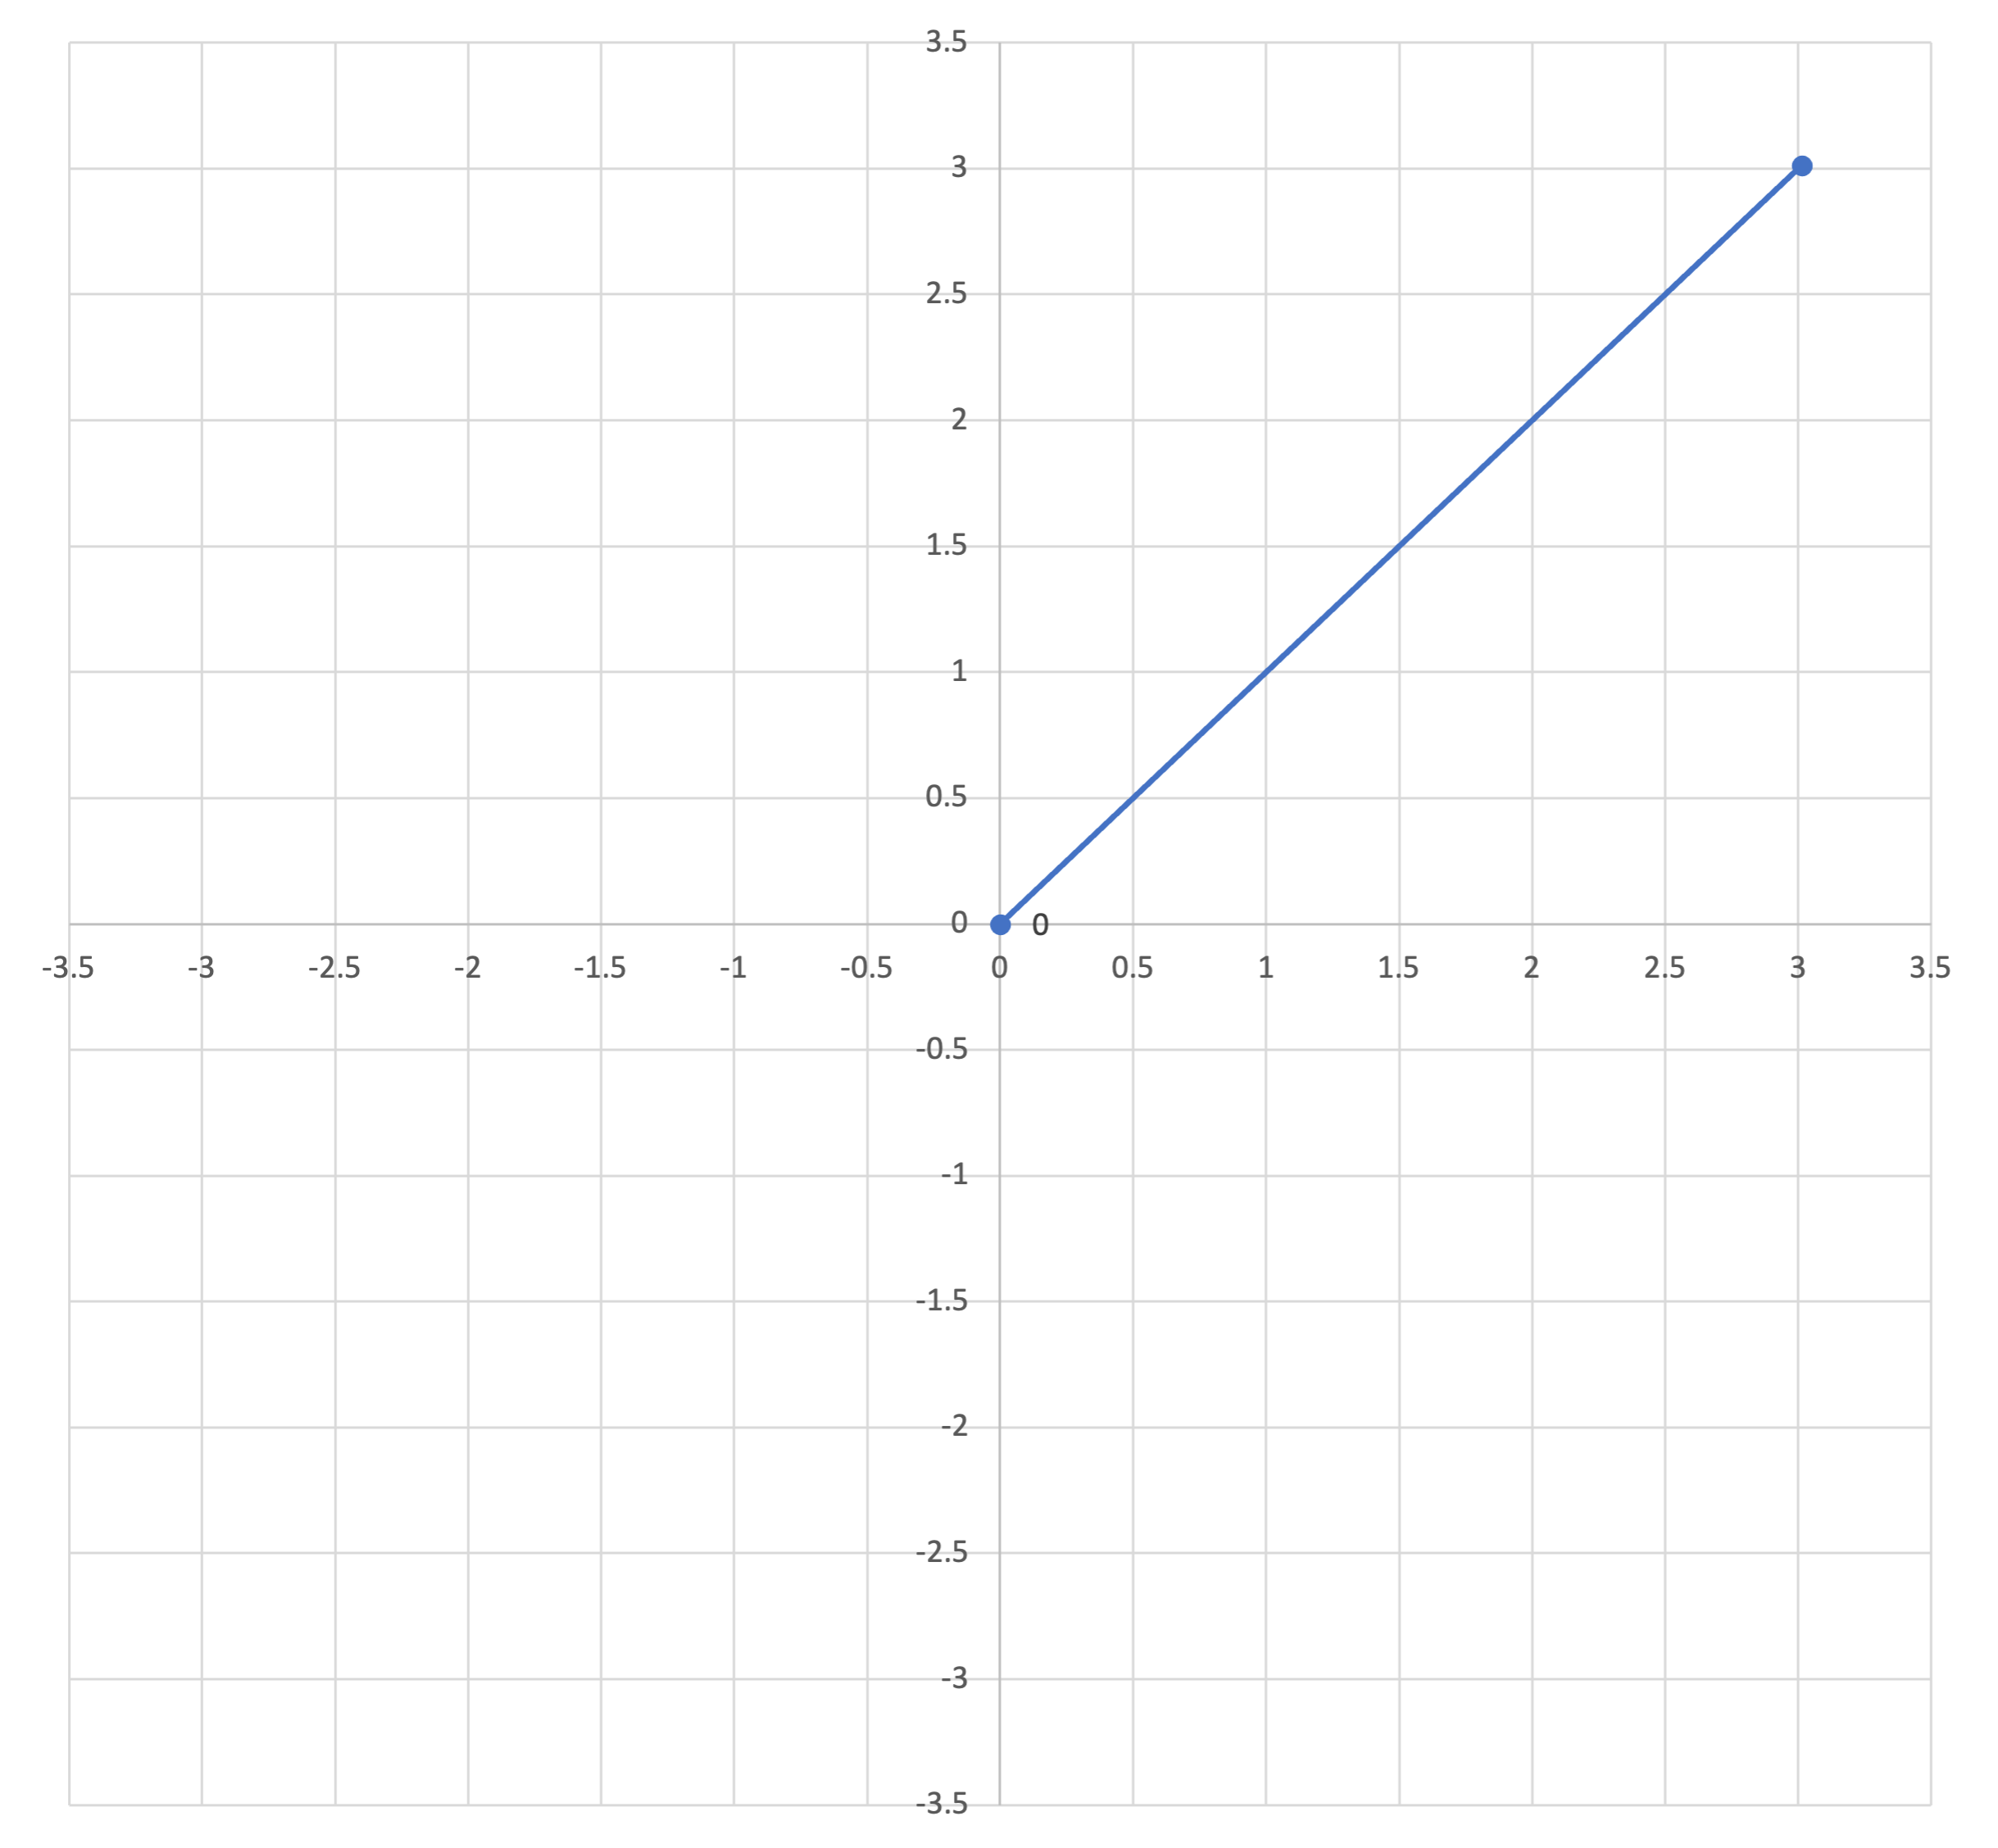
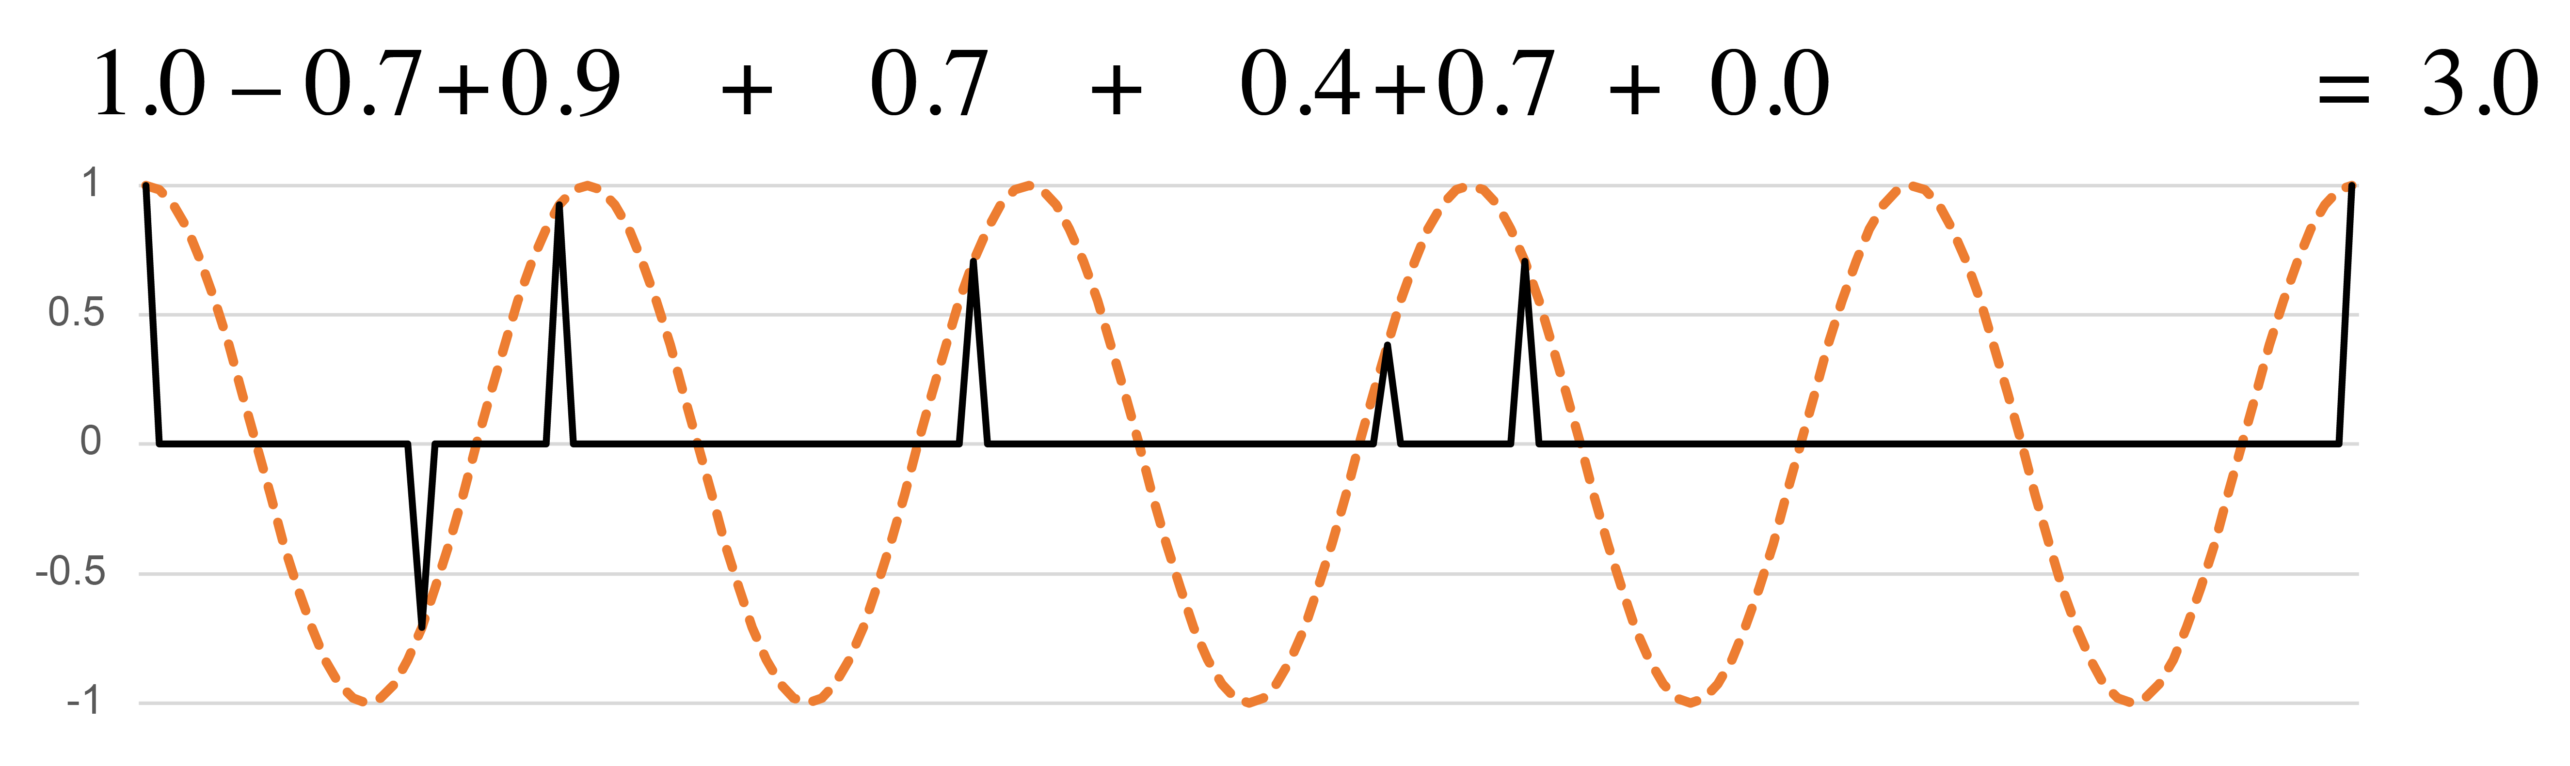
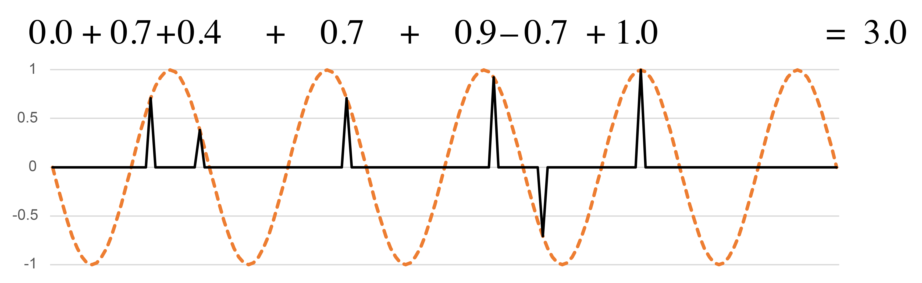
Coefficient spaces
Periodicities need not be integer multiples of the minimal duration.
On complex plane:
⅘q periodicity
(cosine):
⅘q periodicity
(–sine):
f₅
Notes:
Here's another periodicity that doesn't line up with the sixteenth-note grid, a division of the measure by 5. The rhythm has a very strong profile on this periodicity. A lot of notes line up with the peaks of both the cosine and sine functions. These are at distances of 3 sixteenth notes from one another, or multiples of that. Three sixteenth notes is a best approximation to the wavelength of 4/5 quarter note. The corresponding point on the xy plane is far away from the origin and in the upper left quadrant.

Slide 8
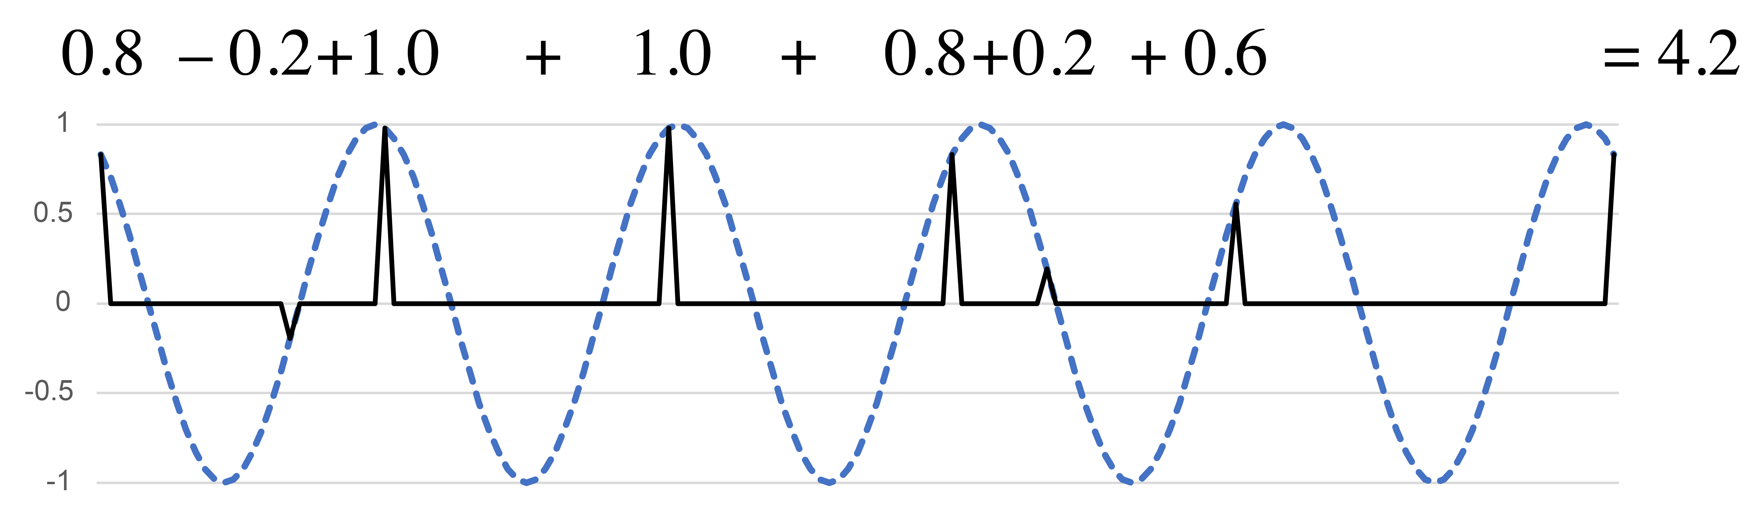
Phase and magnitude
Angle in 2-d space corresponds to the phase of the best-matching simple sinusoid.
Length
Magnitude
Phase
Angle
Notes:
I located all of these rhythms on the xy plane using two simple periodic functions, but once we know where a point is in the space, we can express it with just a single simple periodic function, because a rotation in the xy-plane corresponds to a phase shift in the sine curve. Here, because the point is at a 45 degree angle from the positive x axis, shifting the sine curve back by one-eighth of a cycle gives a curve that aligns as well as possible with all of the onsets of the rhythm. [Animation 1] This is what we call the phase of the rhythm at that frequency. The way that a rhythm expresses each possible periodicity can thus be expressed using two numbers, a magnitude, giving the total weight of the rhythm at that periodicity [Animation 2], and a phase showing where it is oriented within the cycle.
These two-dimensional spaces are the first of two tools of rhythmic analysis that I want to share today. They give a complete description of the rhythm, but they have the drawback that we have to consider each possible periodicity one at a time. The other tool I will share summarizes all of the possible frequencies at once.

Slide 9
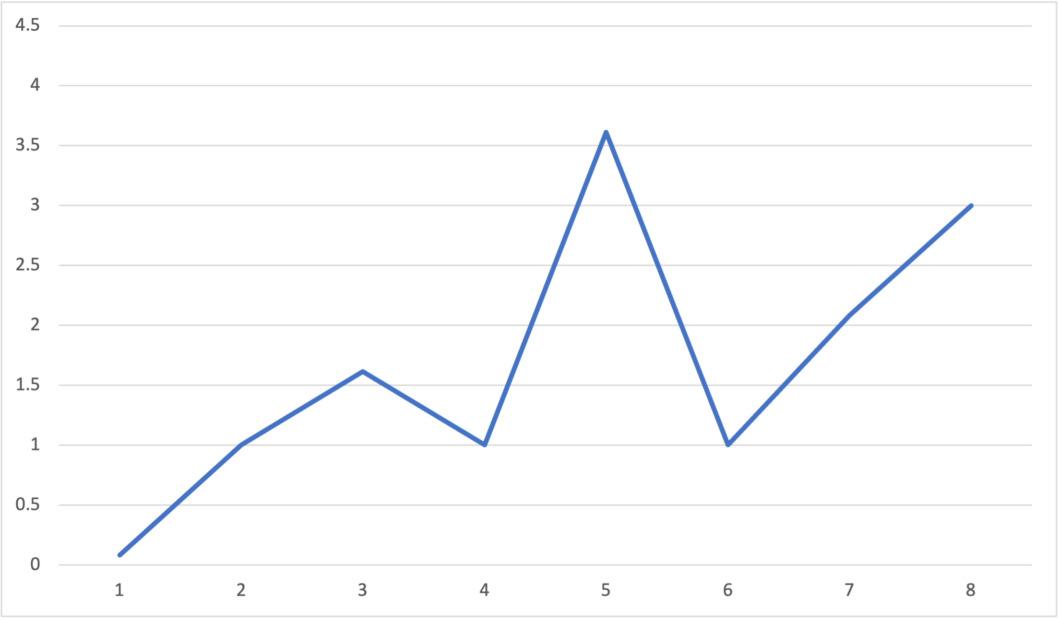
Rhythmic spectrum
The rhythmic spectrum shows the magnitudes at all possible frequencies
The strongest frequency (periodicity w/5) shows that
clave is close to 5 equally spaced onsets
Rhythmic spectrum for the clave rhythm:
e. e. q e q |
Mostly on-beat at e level
Magnitude
Mix of on- and off-beat at q level
Low w periodicity:
Relatively even distribution of onsets
Frequency (/16e)
N.B.: Periodicities are the reciprocals of frequencies
Spectra are invariant with respect to rotation, retrograde, complementation
Notes:
This is called the rhythmic spectrum. It is a function that shows the magnitude of the rhythm at each possible frequency. Frequency is on the x axis, and magnitude on the y axis. All of the rhythms I'll consider in this paper are cyclic, meaning they can be understood to repeat indefinitely. Most of them will also be restricted to some isochronous grid within that cycle. For instance, the clave rhythm here has onsets that all fall on a sixteenth-note grid. Since there are sixteen possible positions in the cycle, the number of ways to divide that cycle is limited to 8, half the length of the cycle. If we were to continue the spectrum with frequencies larger than 8, then we would simply repeat information that is already shown. However, I have just argued that it is important to have a theory that doesn't limit us to isochronous grids like this, and allows us to imagine what happens when we make microrhythmic variations in the rhythm. It's also possible to make spectra for these, the difference being that there is not necessarily a limit on how high of frequencies we could consider. We can extend the spectrum as far as we want to the right without duplicating information.
Let's explore what we can learn from the spectrum of the clave rhythm shown here. [Animation 1] The largest frequency is the fifth. This indicates that the five onsets of the clave rhythm are relatively evenly spaced.
[Animation 2] The next largest frequency is 8, which corresponds to the eighth-note periodicity. This is because the onsets of the clave mostly fall on the eighth-note grid.
[Animation 3] On the other hand, onsets fall in a variety of places in relation to the quarter-note grid, so frequency 4, which corresponds to quarter-note periodicity, is small.
[Animation 4] The smallest coefficient is the first, showing that the rhythm has a balanced distribution throughout the entire cycle.
[Animation 5] Finally, there is another smaller peak at frequency 3. This comes from the embedded tresillo rhythm in the first, third, and fifth onsets. The addition of the other two onsets weakens frequency 3, but doesn't eliminate it completely.

Slide 10
Maximally Even Rhythms
Notes:
In the next part of the talk I would like to explore the phenomenon of rhythmic maximal evenness and use the tools I've just described to explain why it is an important and common musical feature.

Slide 11
Maximally even vs. Isochronous
Traditional metrical theory only recognizes isochrony, not approximate evenness
4
4
4-in-8
Maximally even and isochronous
q q q q |
4
4
h h |
2-in-8
Maximally even and isochronous
4
4
3-in-8 (Tresillo)
Maximally even, not isochronous
q. e( q q |

Slide 12
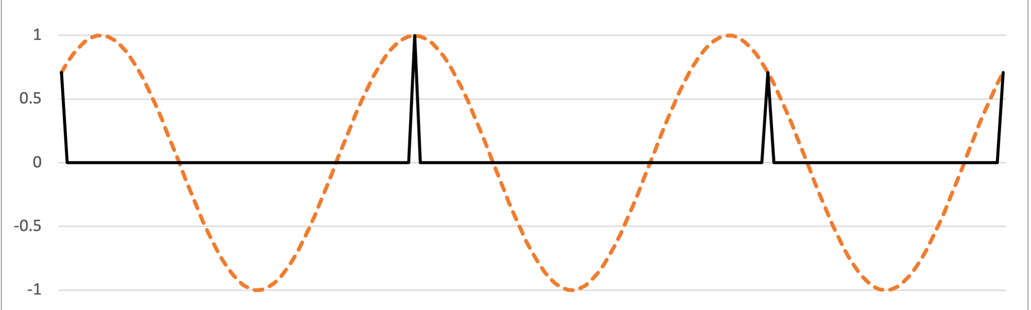

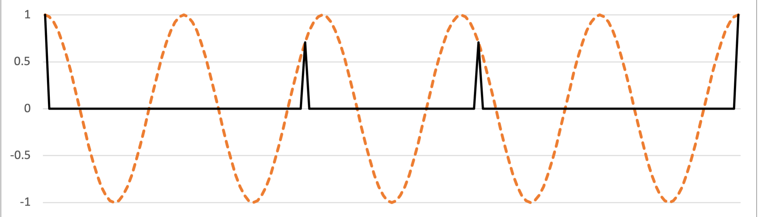


Maximally even rhythms
Example: Tresillo (3-in-8) and Cinquillo (5-in-8)
Complement
Rotate
Complementation and rotation affect phases only
Notes:
A lot of very common and very important rhythms are maximally even. The 3-in-8 maximally even rhythm, commonly known as the tresillo, is ubiquitous in Latin music, American popular music, and elsewhere. The complement of a maximally rhythm is also maximally even, and the larger maximally even rhythm always contains the smaller one, so we can think of it as an extension. The complement of the tresillo is known as the cinquillo and is also a common rhythm in many types of music.

Slide 13
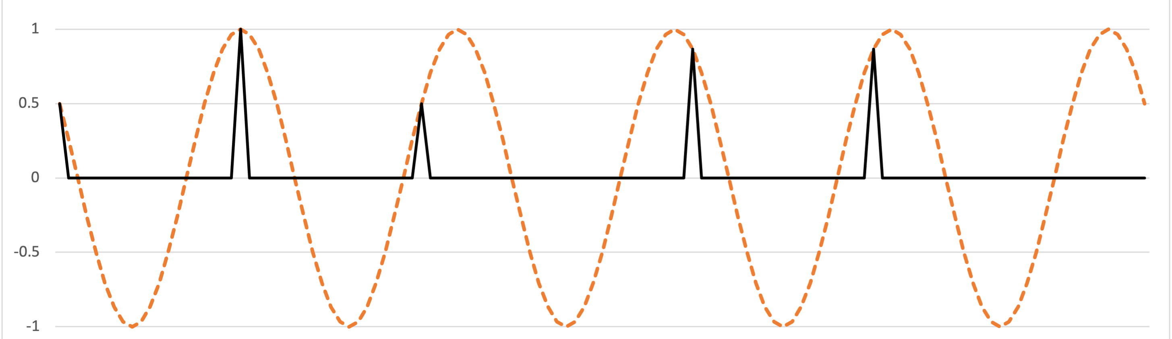

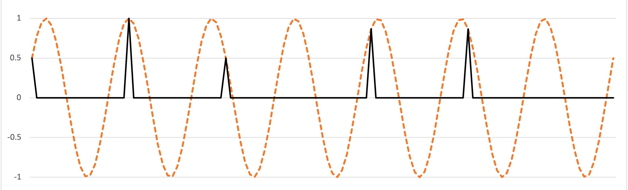

Maximally even rhythms
Example: Standard Pattern (Gankogui rhythm) (7-in-12, 5-in-12)
Rotated
complement
Notes:
Another important maximally even rhythm is the standard pattern, which occurs as a timeline in many African and African-diasporic musics. The standard pattern is 7-in-12 maximally even and is often referred to as the diatonic rhythm, because it's the rhythmic analogue of a diatonic scale. The 5-in-12 complement substitutes for it in many contexts.

Slide 14
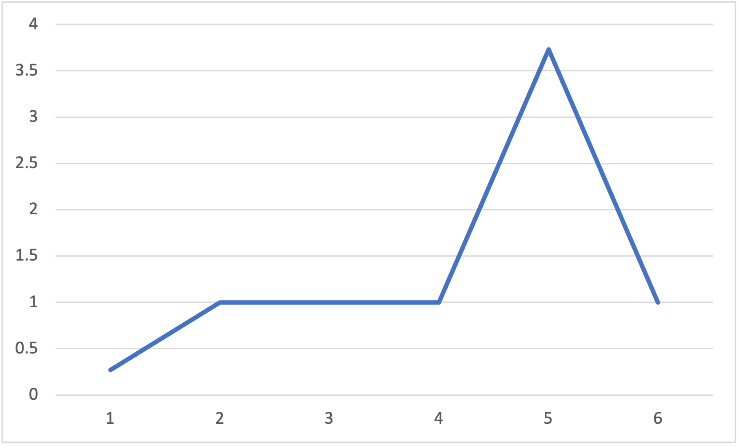
Spectrum of a maximally even rhythm
Maximally even rhythms emphasize a single frequency
High value at principal periodicity (w./5)
Rhythmic spectrum for the standard pattern:
q q eq q q e
Or its complement:
q q q. q q. .
(w./4 = q. )
(w./6 = q )
Especially low value at 1
Low values at nearby periodicities
Magnitude
Frequency (/12e)
N.B.: Periodicities are the reciprocals of frequencies
Notes:
Maximally even rhythms all have similar spectra, with one prominent spike at the frequency corresponding to the number of onsets. All of the other values are low, especially coefficient 1.

Slide 15
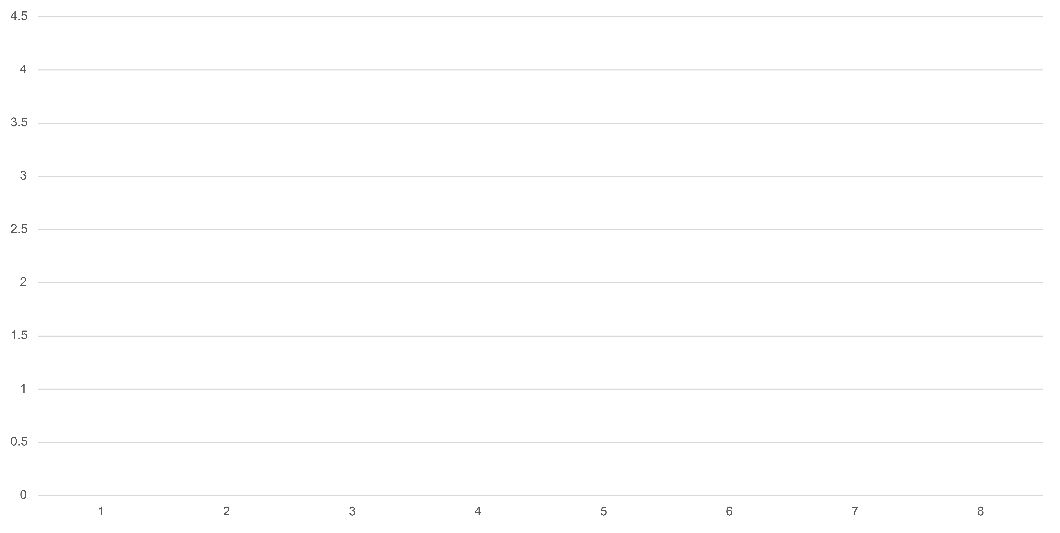
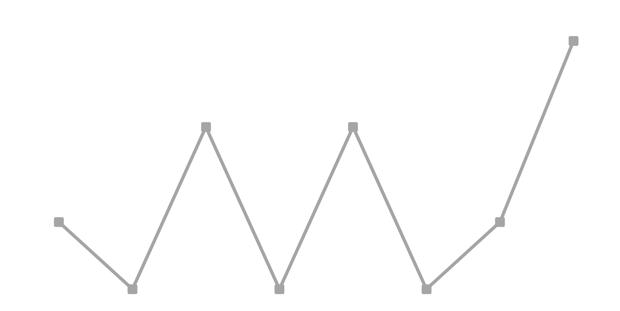
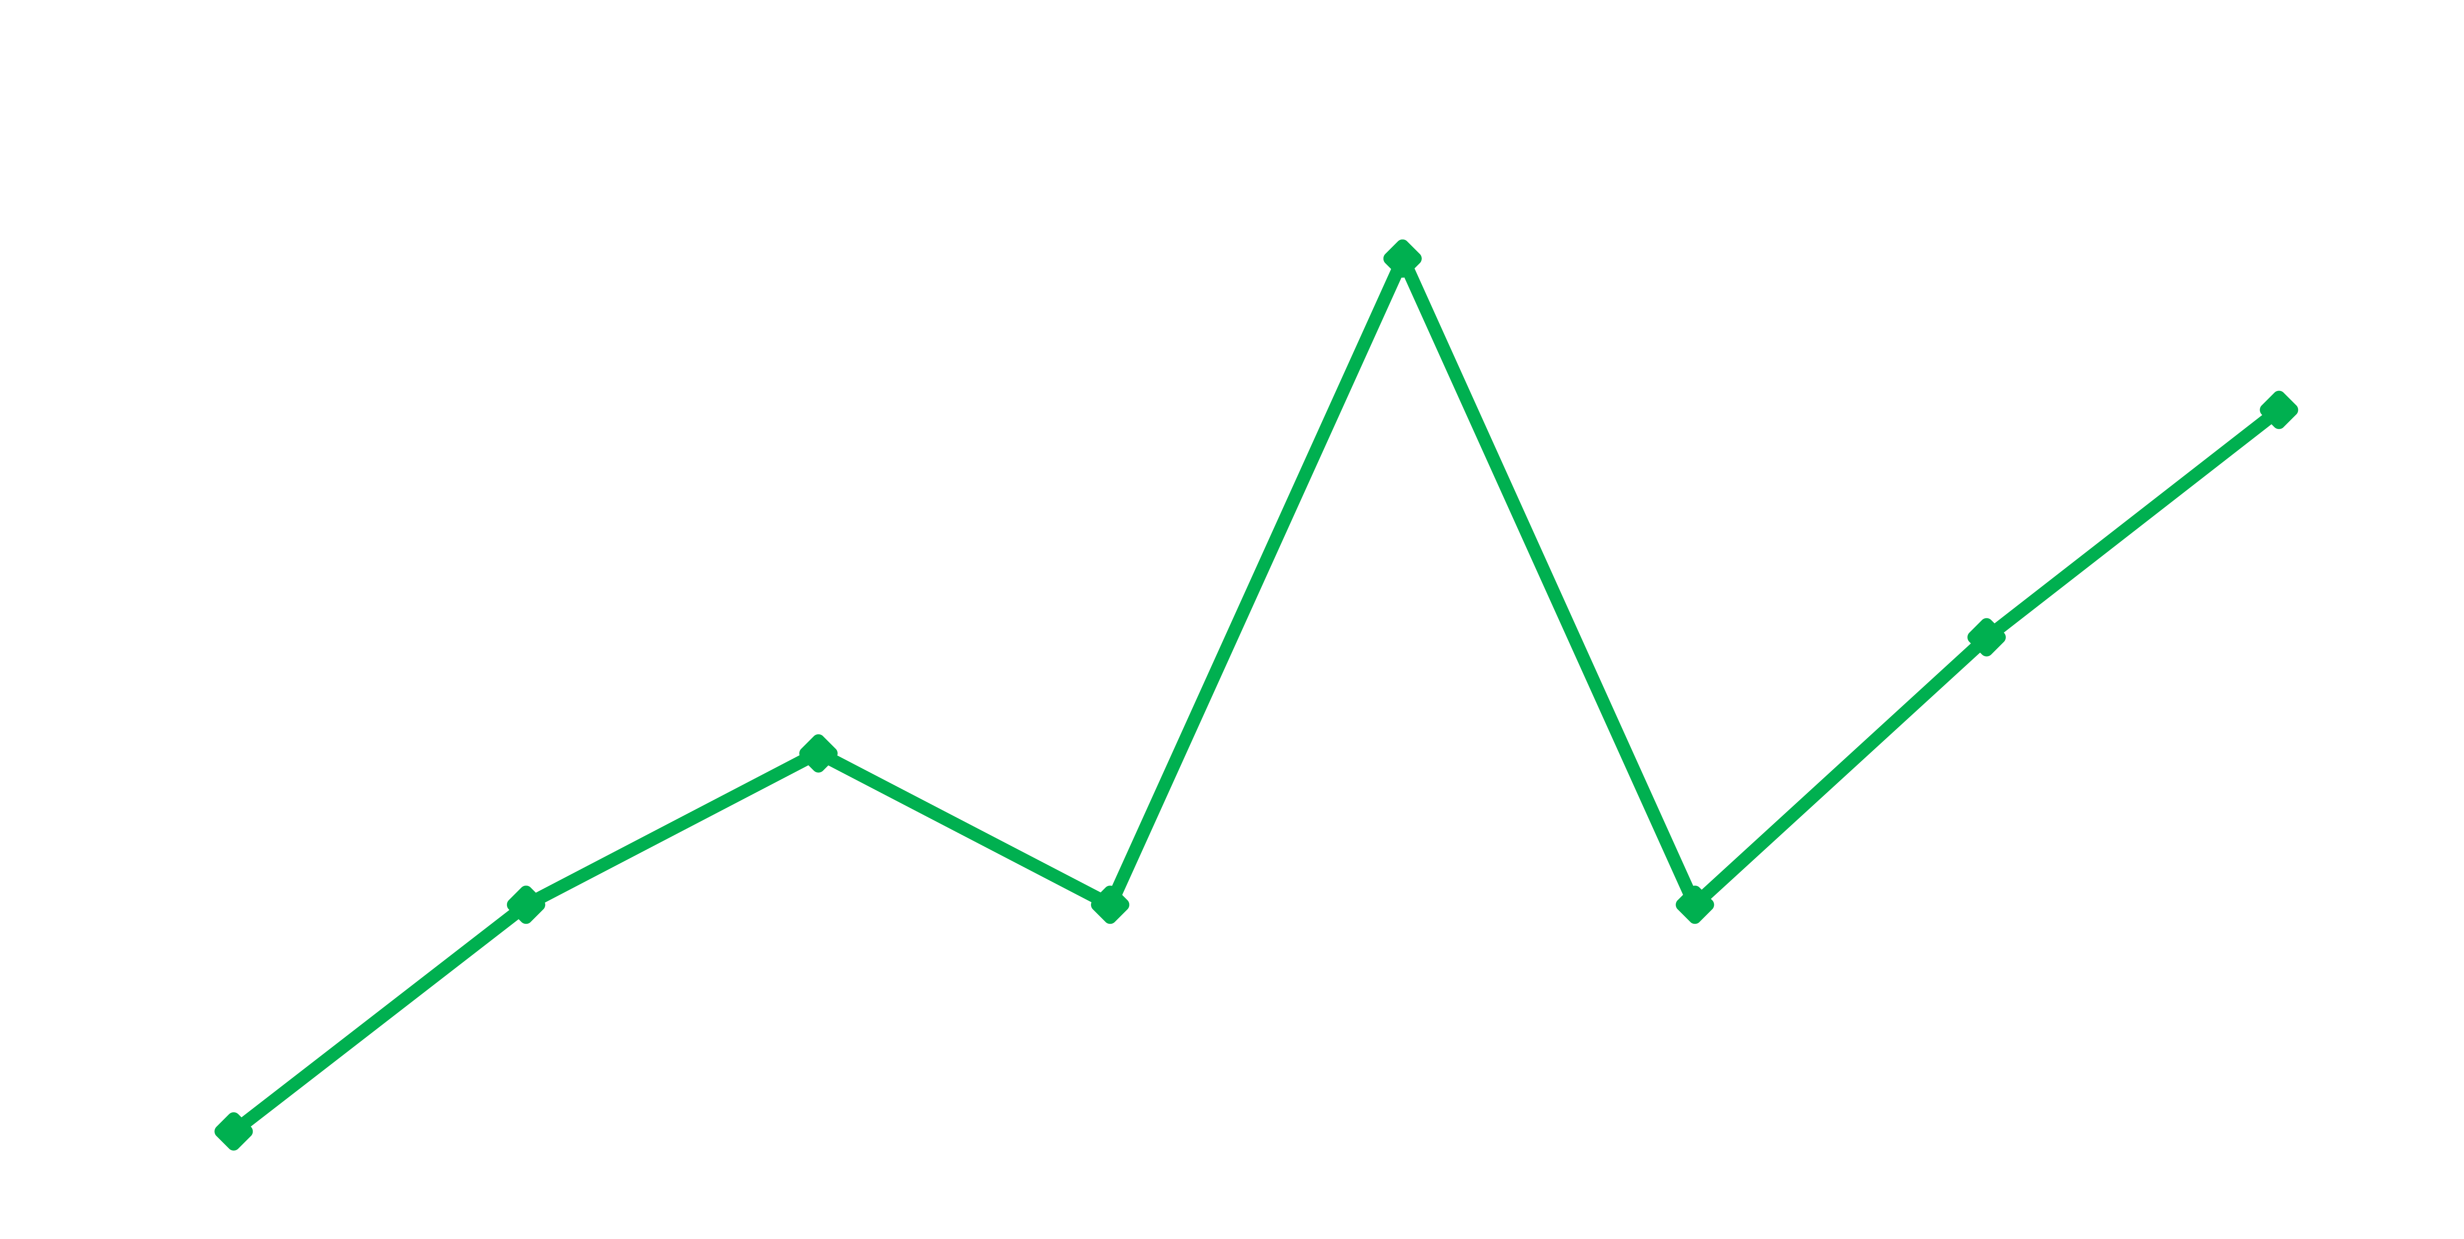
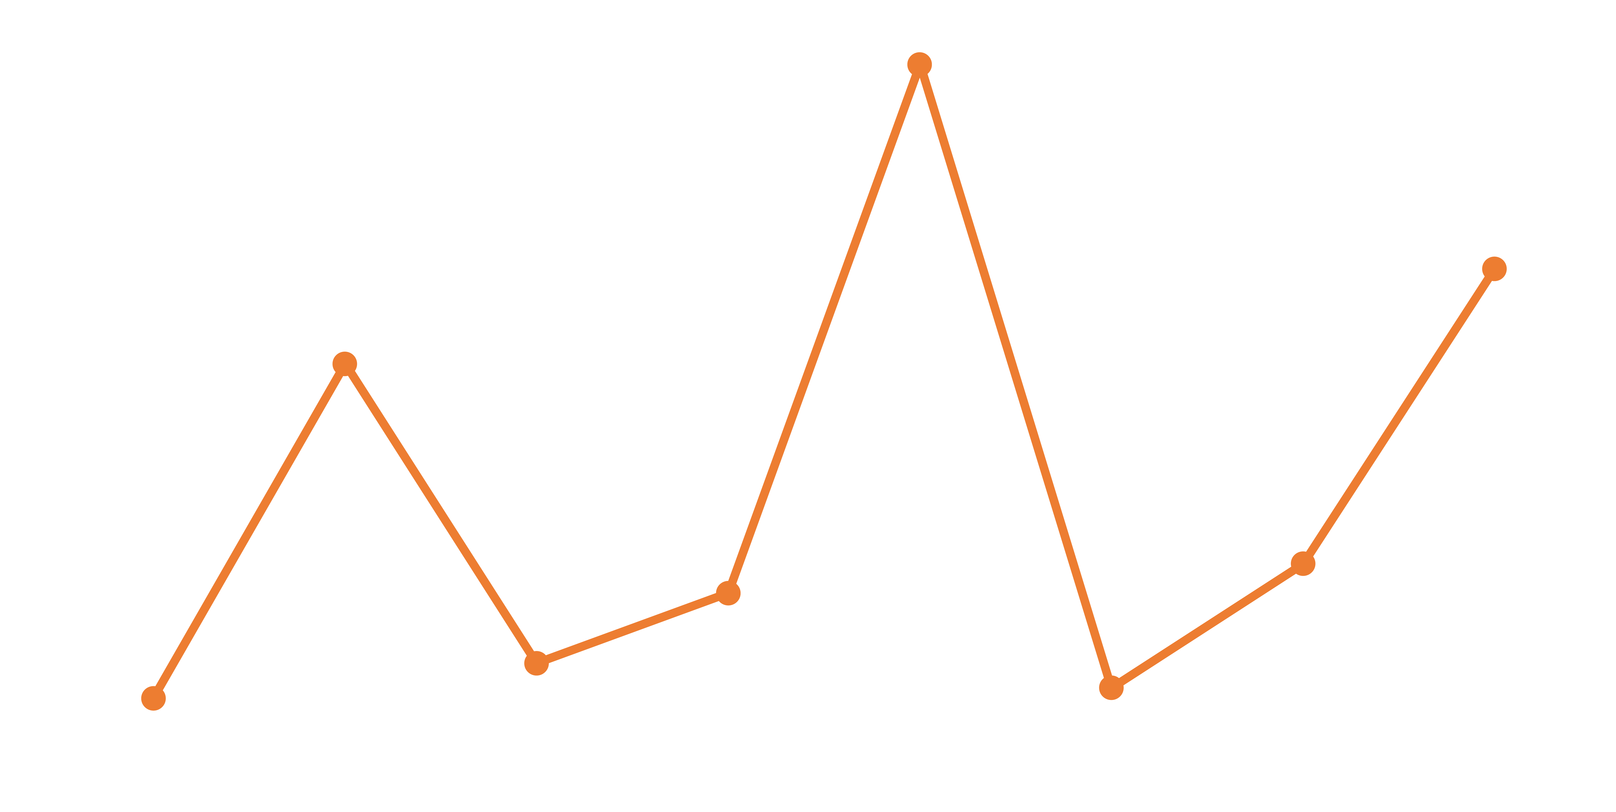
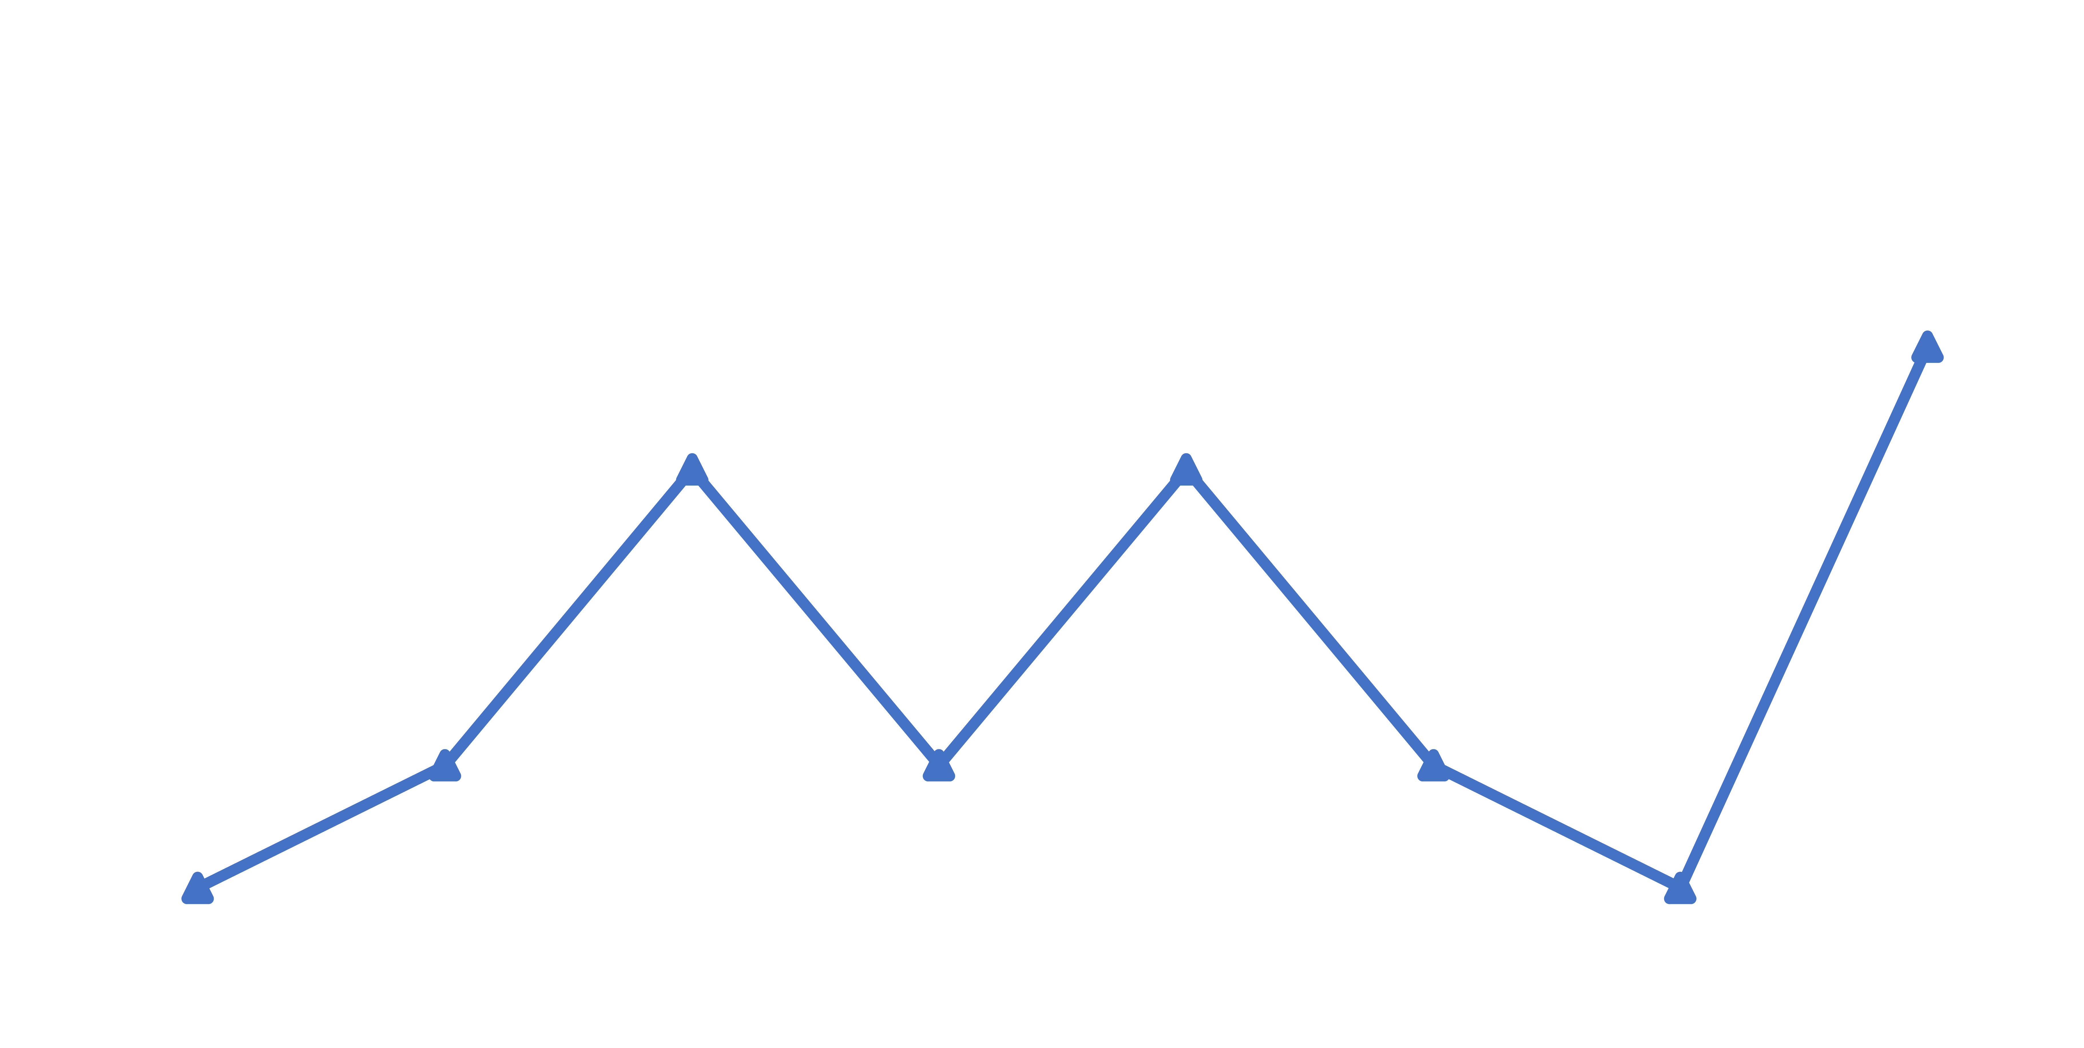

Layers of the Bo Diddley rhythm
Frequency 5
3⅕x periodicity
Frequency 8
e periodicity
4 emphasized
onsets
Full 7-onset
rhythm
Frequency 3
5⅓x periodicity
Added onsets:
Clave
• Reduce frequency 3
Tresillo
• Enhance frequency 5
• Preserve balance at q level
Frequency 4
q periodicity
• Preserve weighting on e grid
Rhythmic spectra
Notes:
Now let's come back to the Bo Diddley rhythm with the tools I've just described. Here's the spectrum for the tresillo rhythm.
[Animation 1] and the four note that Diddley emphasizes. These both have mirror symmtery because they are fully on the eighth-note grid.
[Animation 2] Here's he five-note clave.
[Animation 3] and the full 7-onset rhythm.
[Animation 4] First we see that the strength of frequency 3, the main peak of the tresillo rhythm, gradually diminishes as we add notes.
[Animation 5] On the other hand the peak at frequency 5 does the opposite and gets more intense.
[Animation 6] The peaks corresponding to metrical qualities are relatively unaffected. Frequency 4, the quarter-note periodicity, is relatively weak,
[Animation 7] And the eighth-note periodicity remains relatively strong.

Slide 16
Microtiming and the Heisenberg principle

Slide 17
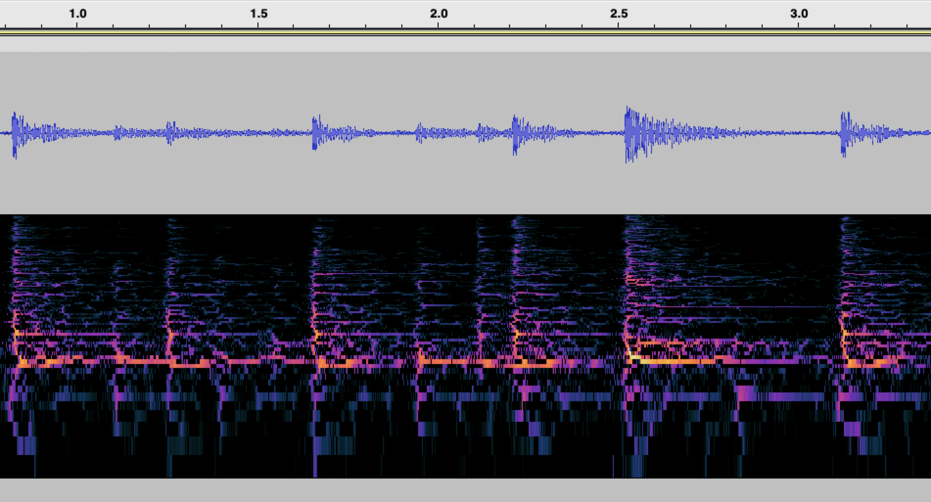
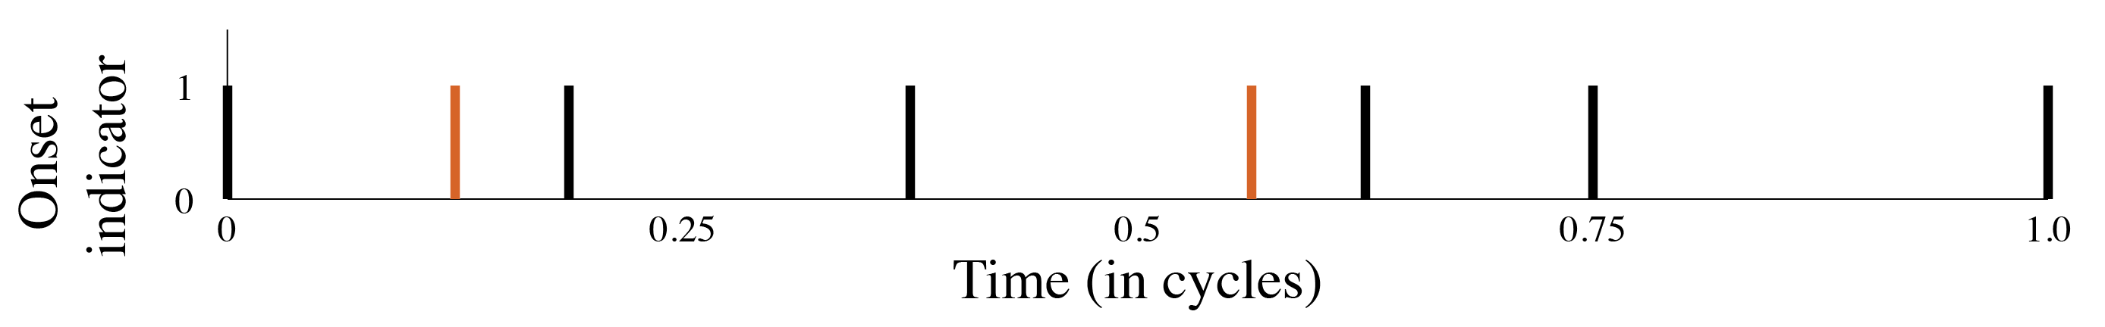
Microtiming: Bo Diddley
Early strikes
Notes:
Another thing about sound is that it represents time as continuous, and where the onsets occur doesn't totally line up with the isochronous grid implied by the notation. These deviations from isochrony are consistent, and they are not measured in rational notatable quantities.

Slide 18
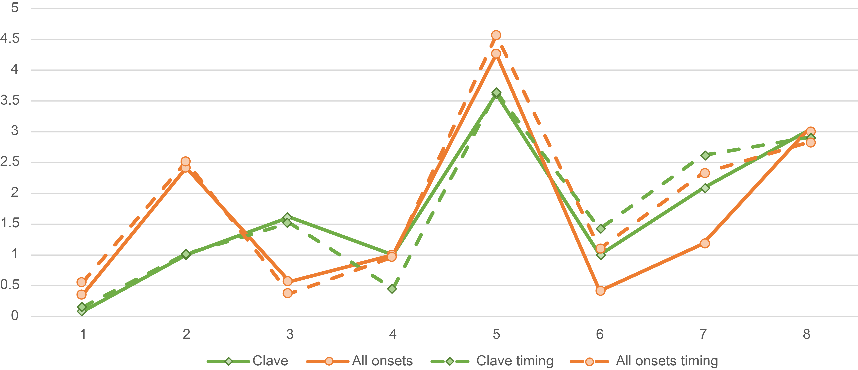
Microtiming: Bo Diddley
. . . and increases
coefficients 5 and 7
Microtiming decreases
coefficients 3 and 4

Slide 19
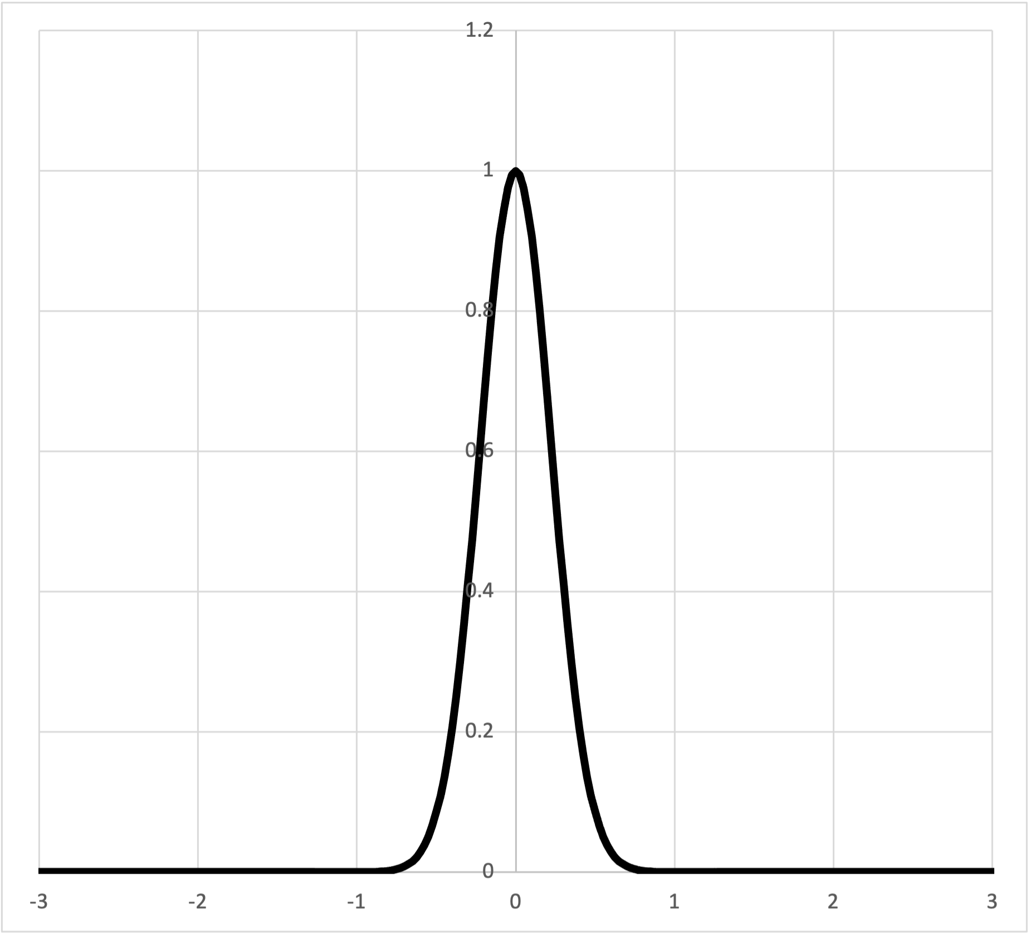
Beat bins and Heisenberg Uncertainty
Anne Danielsen’s concept of beat bin or Chris Stover’s beat span
can be represented as a Gaussian filter:
Notes:
Many other theorists have noticed the problems with the discreteness of the notation based concept of meter, especially as research on microrhythmic aspects of music performance has grown. One proposed solution is Anne Danielsen’s concept of beat bin, or Chris Stover's similar idea of beat span. Thinking in functions, we might say that a beat bin is a Gaussian function, also known as a normal curve or bell curve. If we replace the instantaneous spikes of our indicator functions with Gaussian curves, they allow onsets to fall in some region around the idealized metrical position, and they say how close the onset is to the center of the beat bin.
I will return to this idea in a moment and show that it is helpful to think of beat bins in terms of simple periodic functions also.

Slide 20
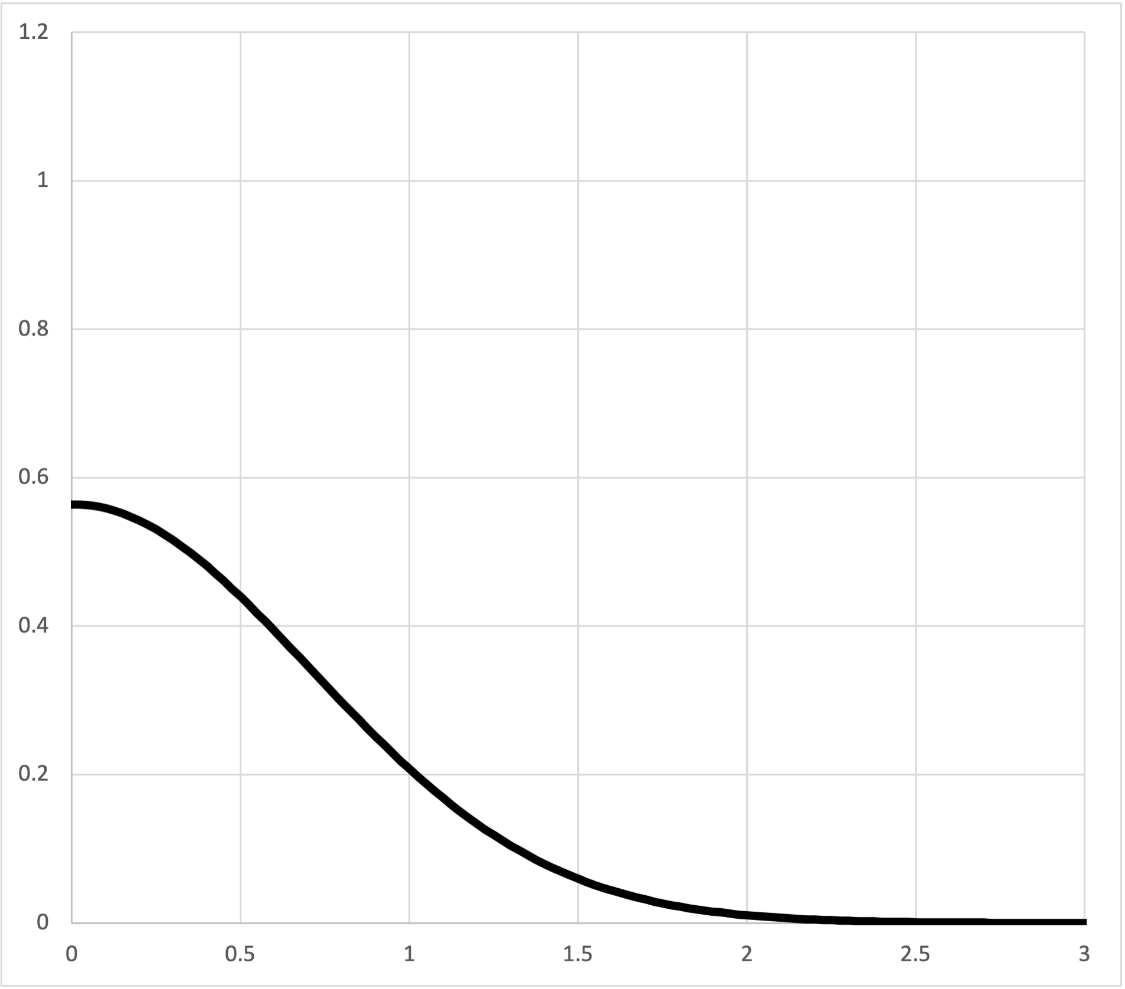
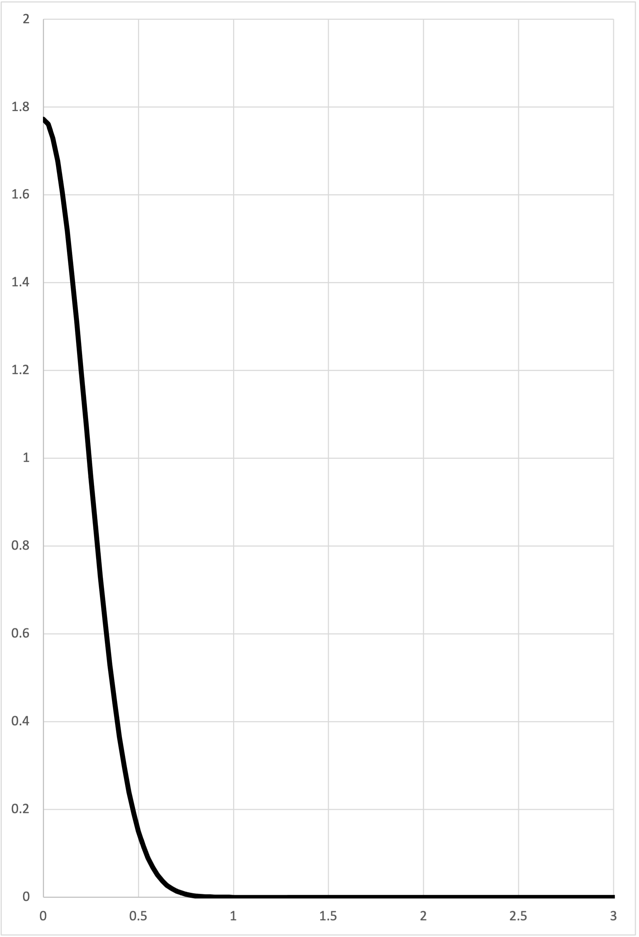
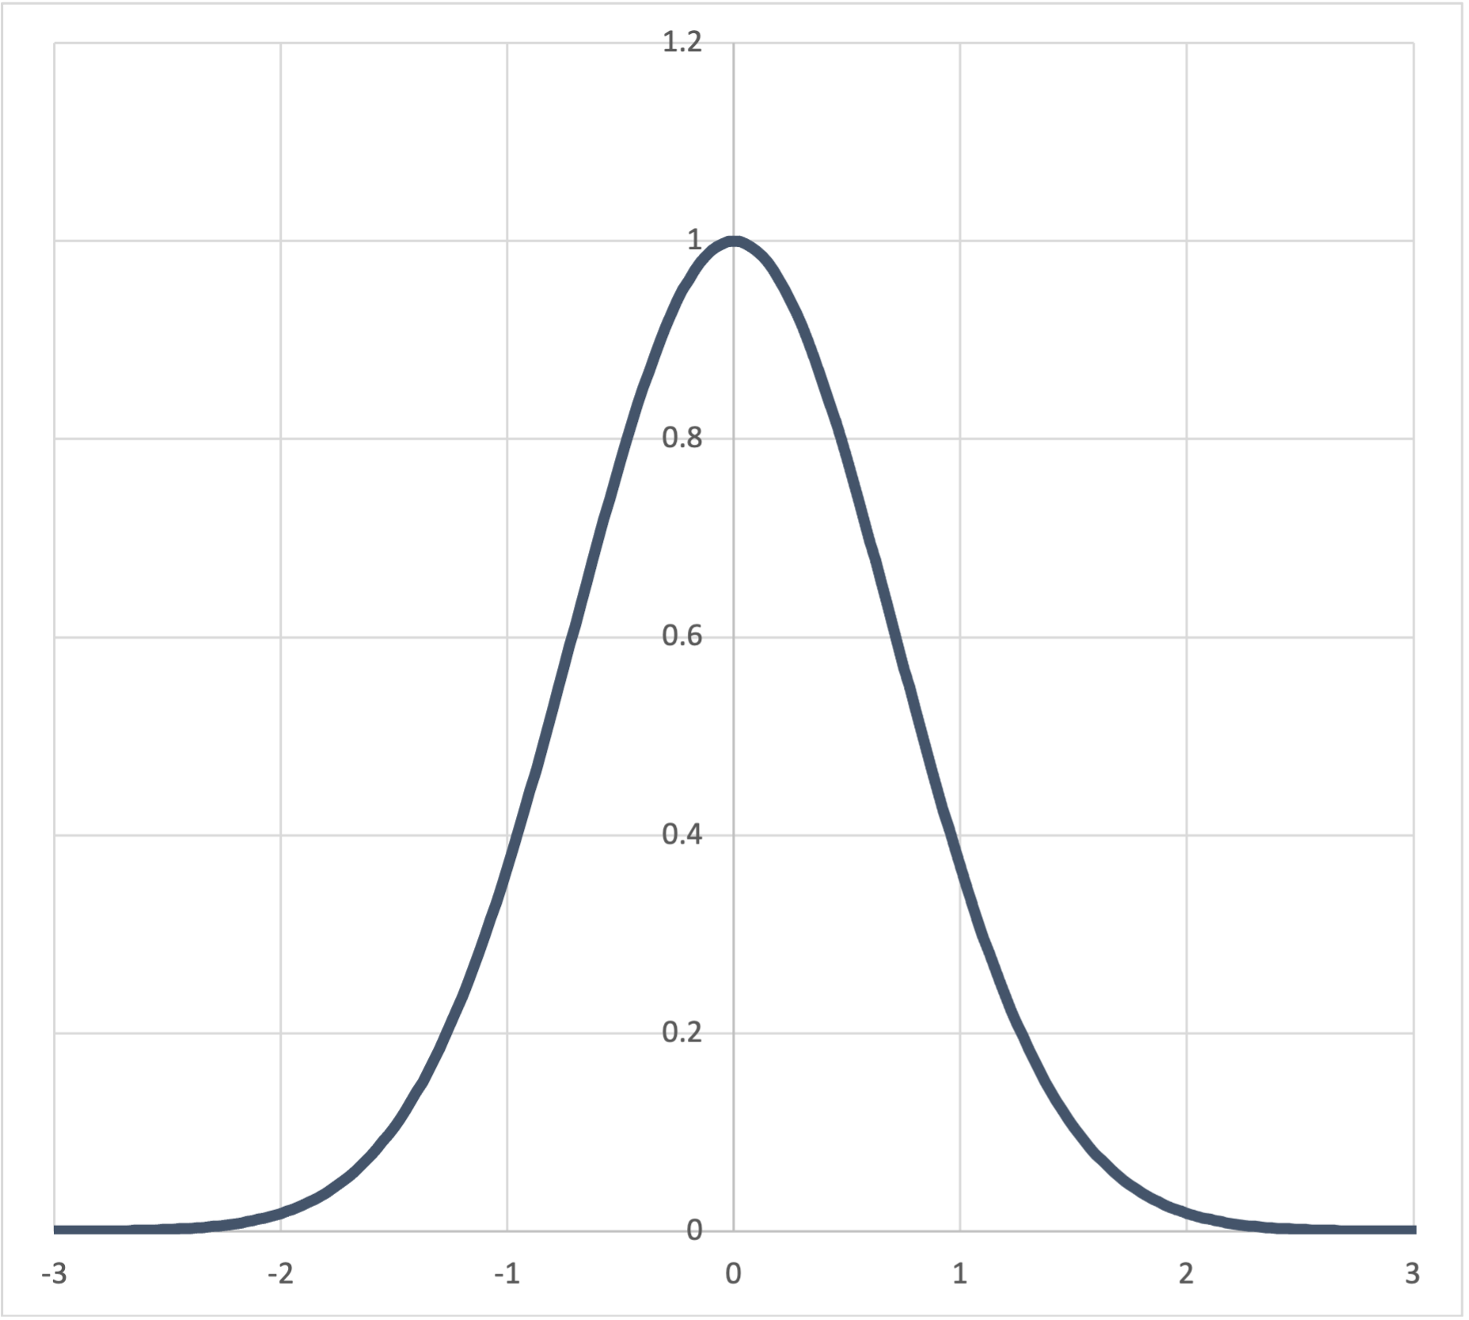
Beat bins
The spectrum of a Gaussian function is another Gaussian function with inverse width
⇒
Time
Frequency
⇒
This is Heisenberg uncertainty for rhythm:
More precision in time ⇔ Less precision in frequency
More precision in frequency ⇔ Less precision in time
Time
Frequency
Notes:
Now to return to the topic of beat bins briefly. I suggested before that we could model beat bins with Gaussian functions. We could also model onsets themselves with Gaussian functions, in recognition of the fact that we can never pinpoint their location with 100% precision. Fortunately there's simple way to represent a Gaussian function with simple periodic functions. The spectrum of a Gaussian function is itself a Gaussian function. As we narrow the temporal curve the spectral curve gets wider and vice versa, meaning that the more precisely we locate events in time the flatter the frequency curve gets and the more high frequencies we can take into account. This is a statement of the Heisenberg uncertainty principle, which, although it comes from particle physics, is actually a mathematical fact about the relationship between time and frequency.

Slide 21
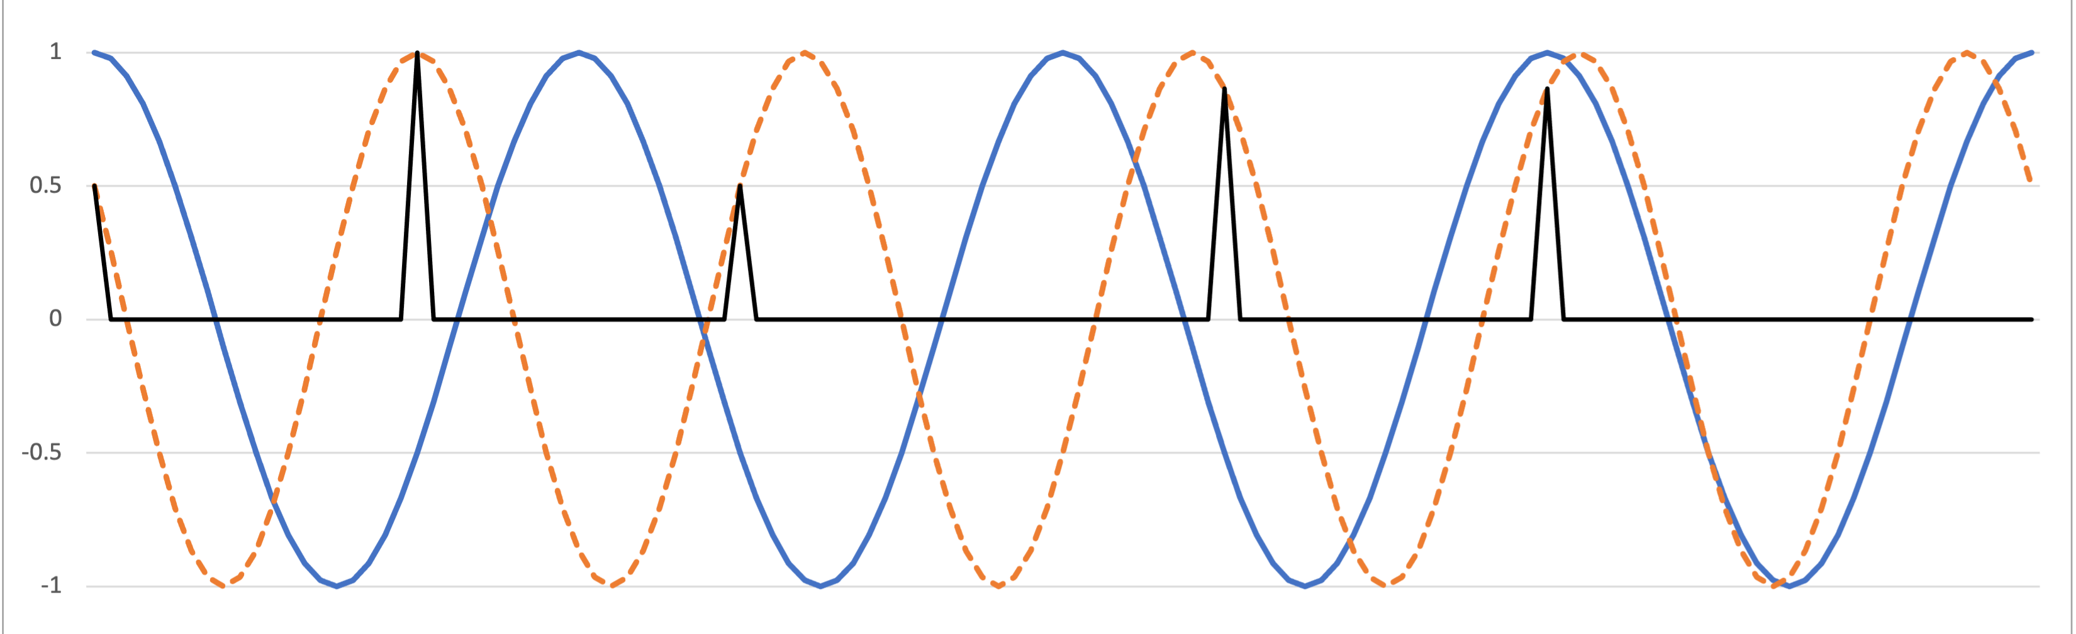
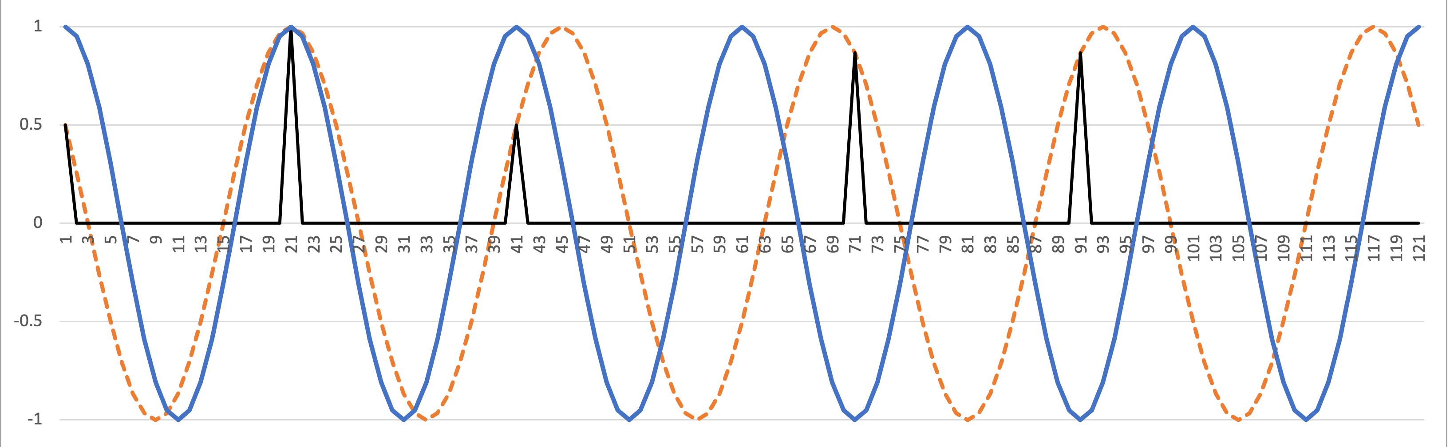
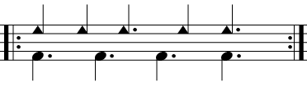
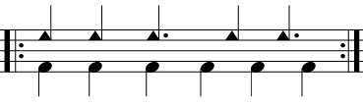
Interaction of frequencies
When two frequencies are close together, we get a slow phase shift.
Example: Standard pattern against 4 main beat, 6 secondary beats
Out of phase
In phase
In phase
Out of phase
C.K. Ladzekpo (1995): “A moment of resolution or peace occurs when the beat schemes coincide and a moment of conflict occurs when the beat schemes are in alternate motion. [ . . . ] A moment of resolu-tion is expressed as a human being standing firm or exerting force by reason of weight alone without motion while moment of conflict is expressed as a human being travelling forward alternating the legs.
Notes:
This might be a familiar phenomenon to some of you: it's the same phenomenon as acoustical beats. If you heard Miles tuning his guitar yesterday you heard acoustical beats. I'm going to talk about the same thing at the timescale of rhythm. When two frequencies are close together, they gradually go in and out of phase. That phase shift occurs at a frequency corresponding to the difference between the two frequencies, so the closer together they are, the slower the phase shift.
This is an important feature of timeline music, such as African dance drumming. Many authors describe how the standard pattern gradually goes off the beat and back on to the beat. This is true whether we consider the actual beats, four per measure, or the six-beat cross rhythm. We already saw how the standard pattern maximizes frequency 5. This is one more than four, and one less than six. So in both cases, the frequency of the phase shift is one, meaning over a period of one measure.

Slide 22
Interaction of Frequencies
Bo Diddley and the quarter-note beat
Frequencies 5 – 4 = 1
⇒
1-meas. phasing cycle
Ahead
Behind
Out of sync
In sync

Slide 23
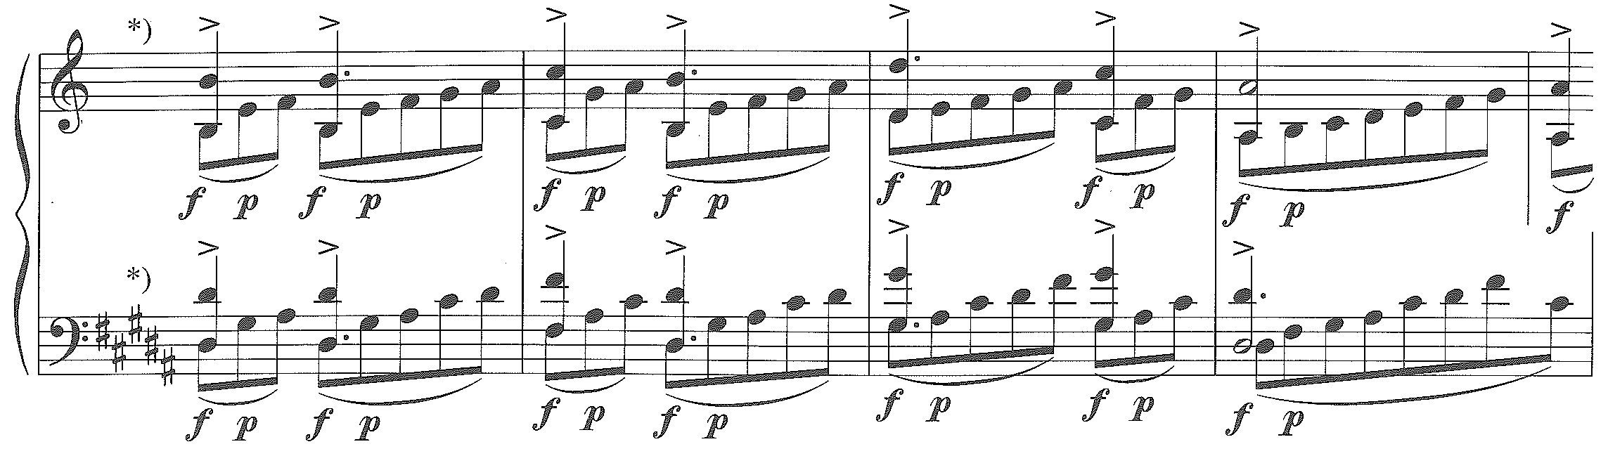
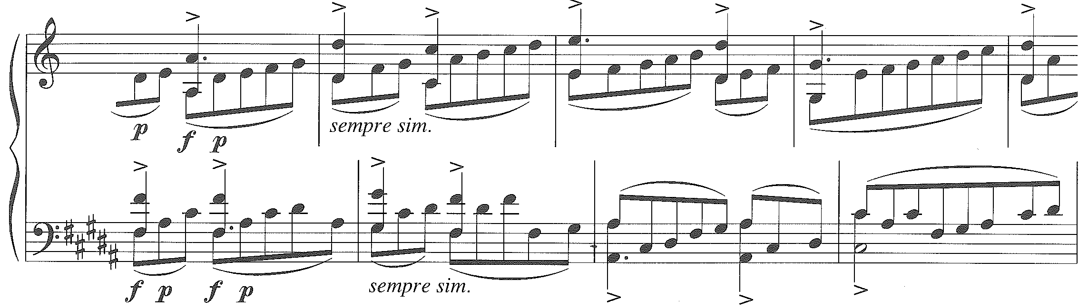
Interaction of frequencies
In “Désordre” (Etude 1) Ligeti creates a slow phase shift by repeating patterns of slightly different lengths:
31e
32e
The first move-ment of the Piano Concerto, based on “Désordre,” gets a similar effect with secondary frequen-cy relations. . . .
Offset

Slide 24
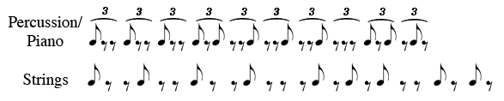
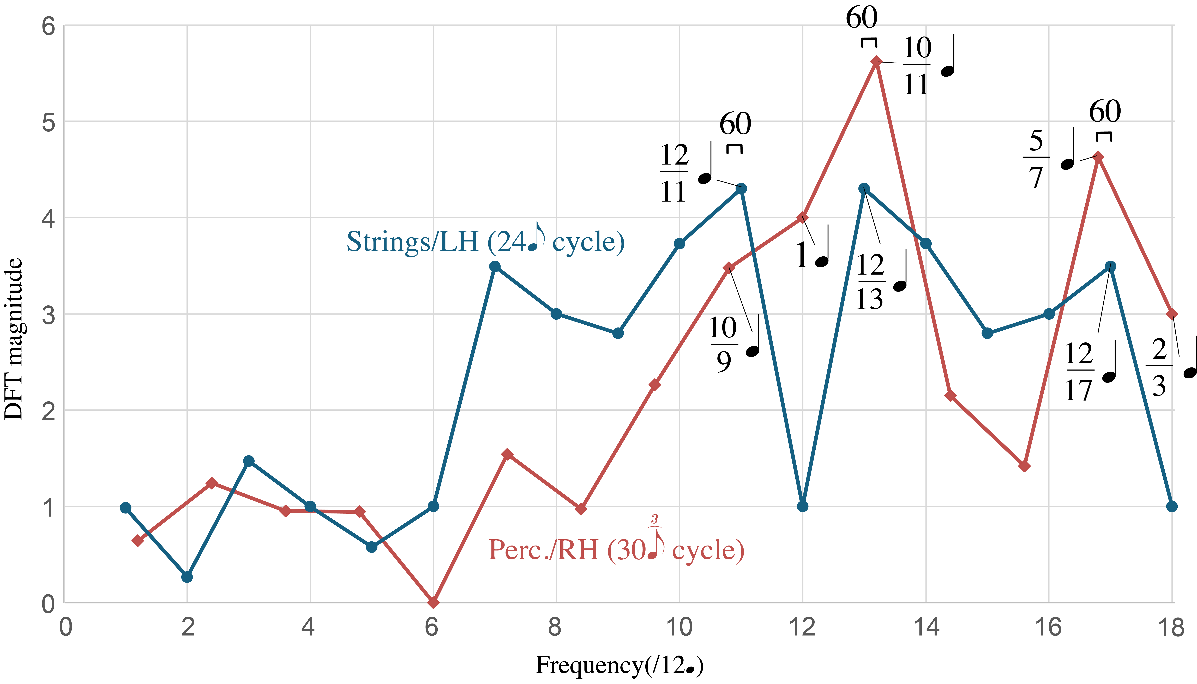
Interaction of frequencies
Ex.: Ligeti, Piano Concerto Mvt. 1
Frequency
differences of ¹/₆₀
(period = 60q)
3 3 3 2 3 3 3 4 2 2 2
3 3 3 4 2 2 3 2 2
The two ostinati differ by 2 beats, but the rhythms contain frequencies closer together:
Notes:
1 Animation

Slide 25
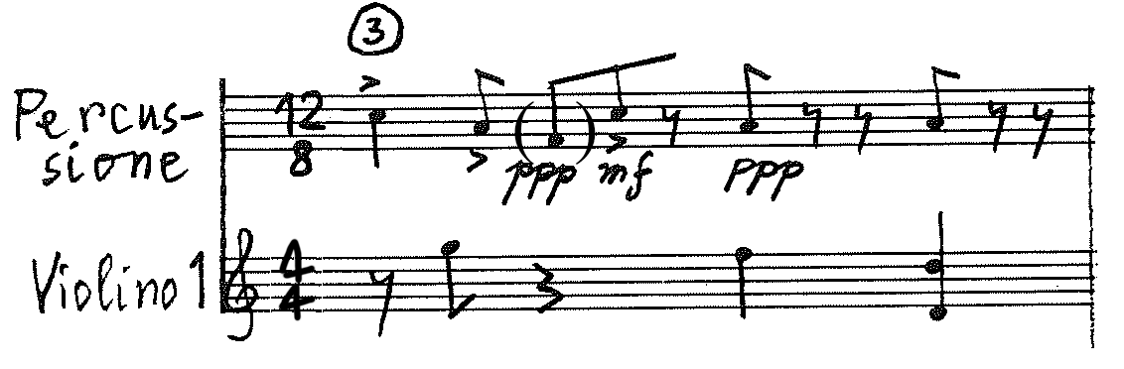
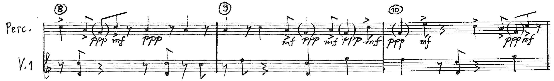
Interaction of frequencies
Ex.: Ligeti, Piano Concerto Mvt. 1
. . . 2 2 2 3 3
. . . 2 2 2 3 3 3 2 3 3 3 4 2 2 2
. . .
. . . 2 3 2 2
. . . 4 2 2 3 2 2 3 3 3
Interlocking
Coinciding attacks

Slide 26
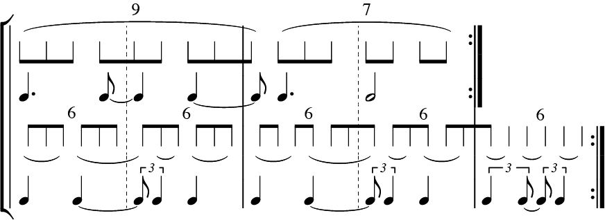
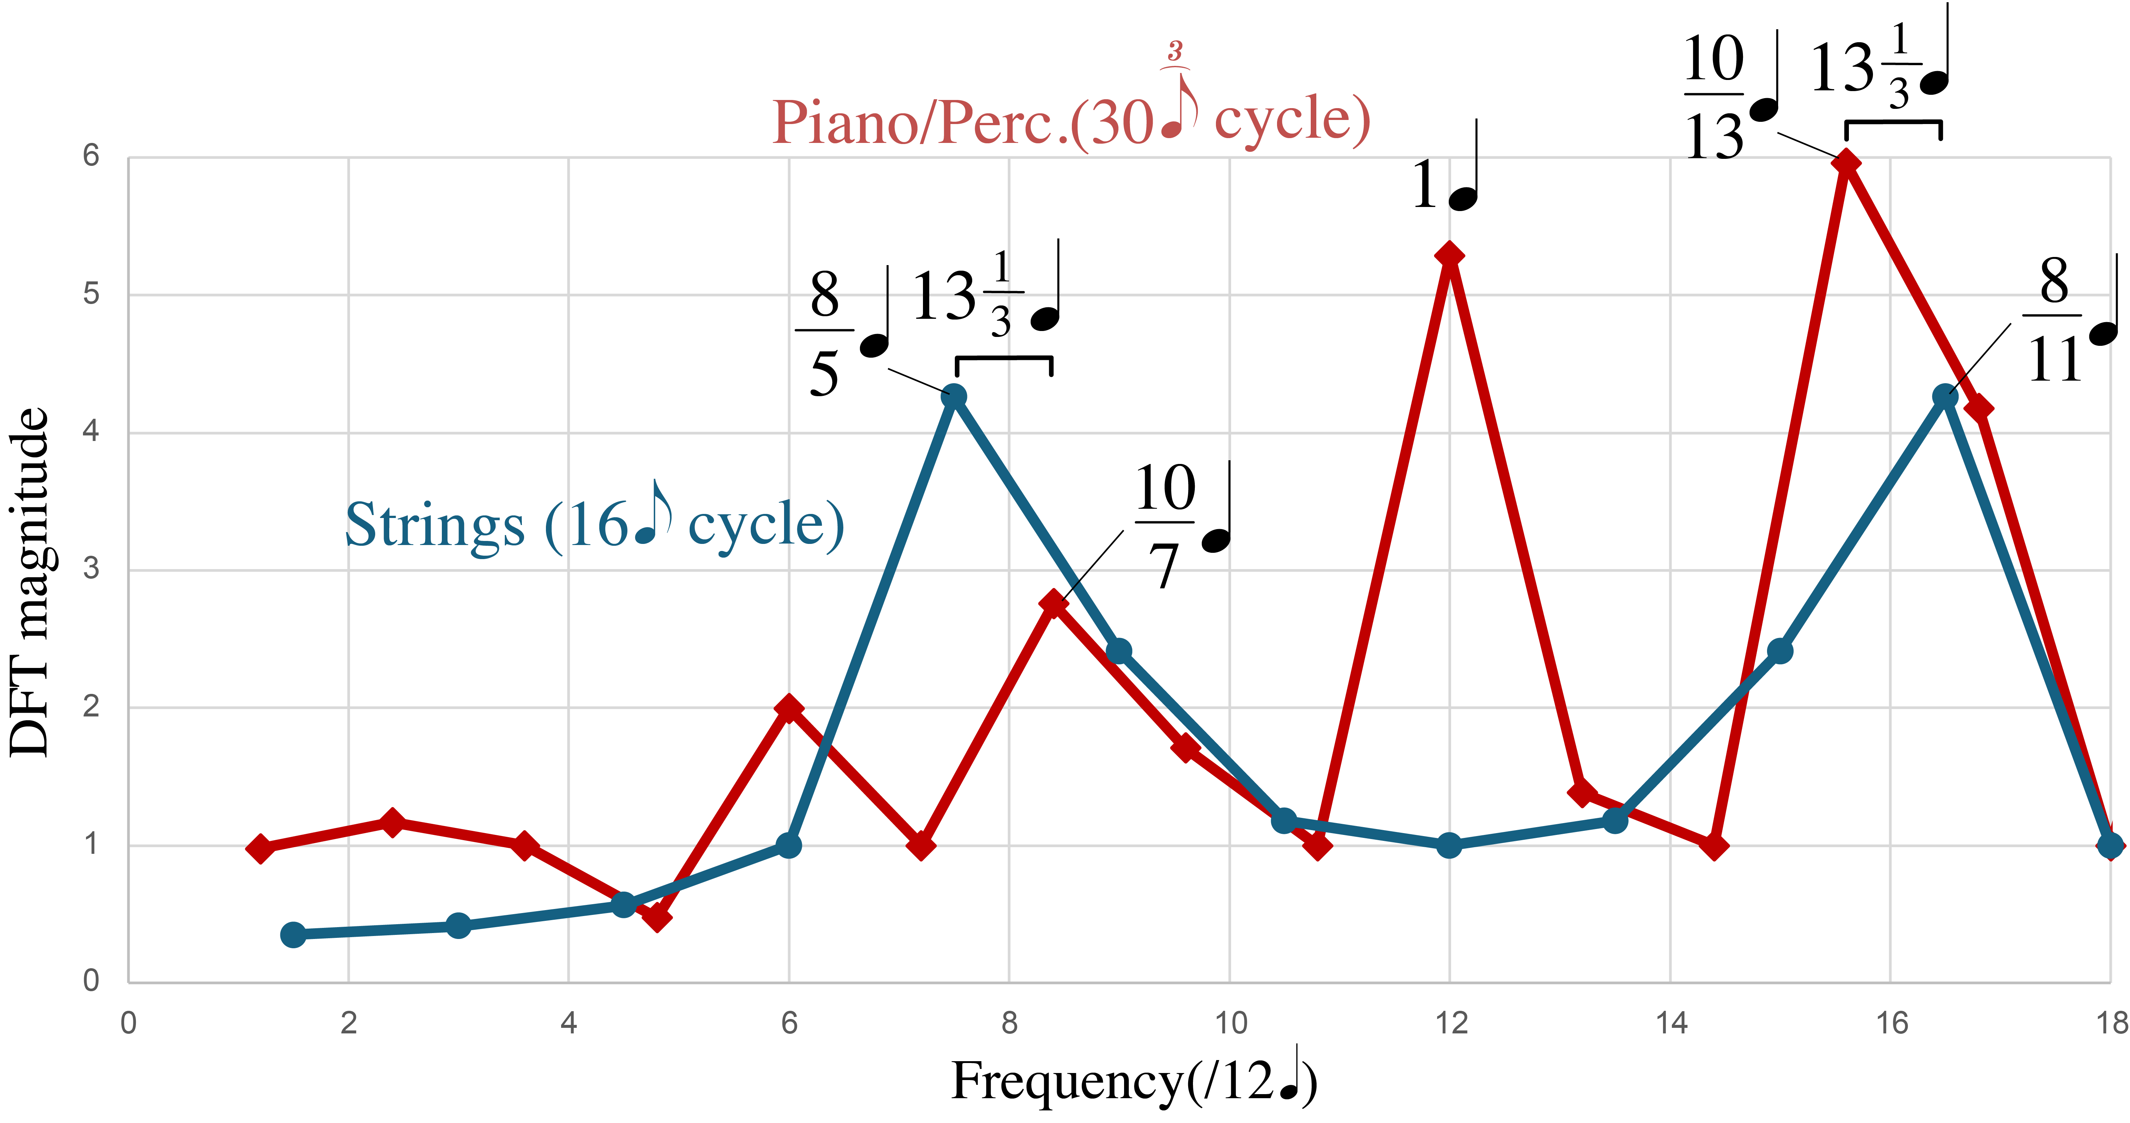
Earlier versions of Piano Concerto ostinato (my transcription from Ligeti’s notes at the Paul Sacher Stiftung)
The strings rhythm is maximally even. Its main frequency of ⁸/₁₁q is close to one peak in the piano rhythm, but the piano also has a 1q frequency not close to any in the strings rhythm. The 1q frequency is not ideal because it divides both cycles.

Slide 27
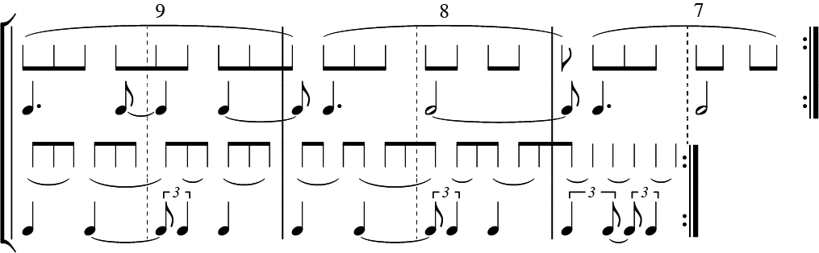
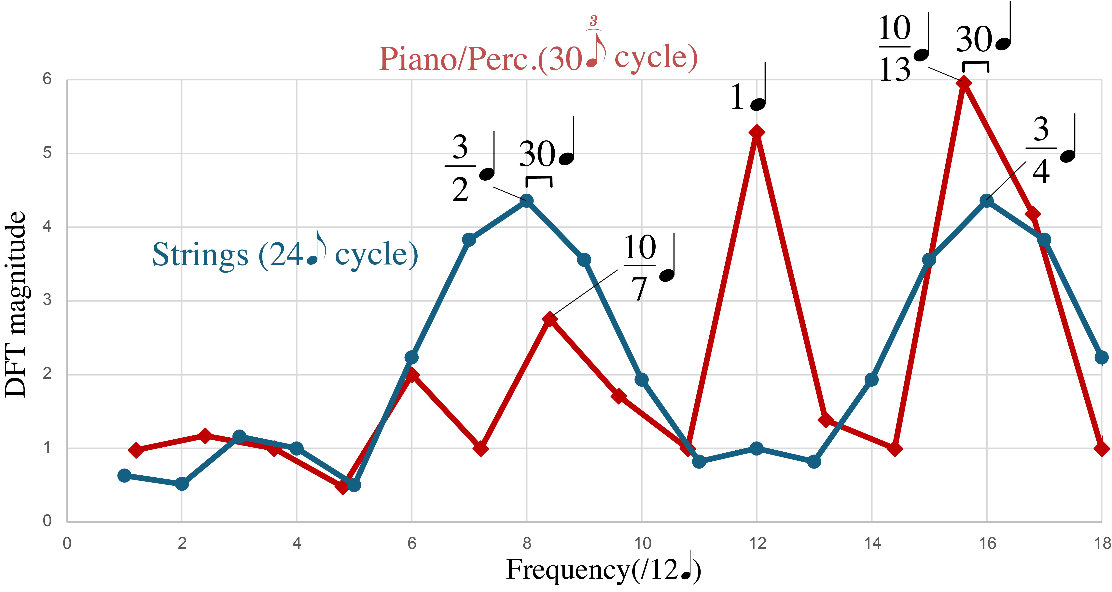
Earlier versions of Piano Concerto ostinato (my transcription from Ligeti’s notes at the Paul Sacher Stiftung)
The first change extends the strings rhythm and leaves the piano alone. The strings now have a peak closer to the larger piano-rhythm frequency, but still nothing near the 1q frequency.

Slide 28
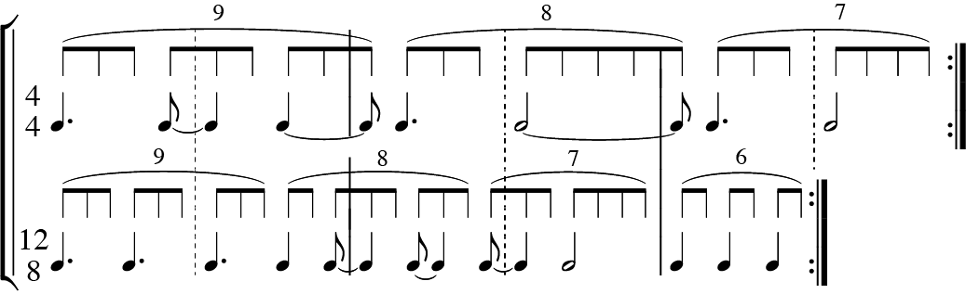
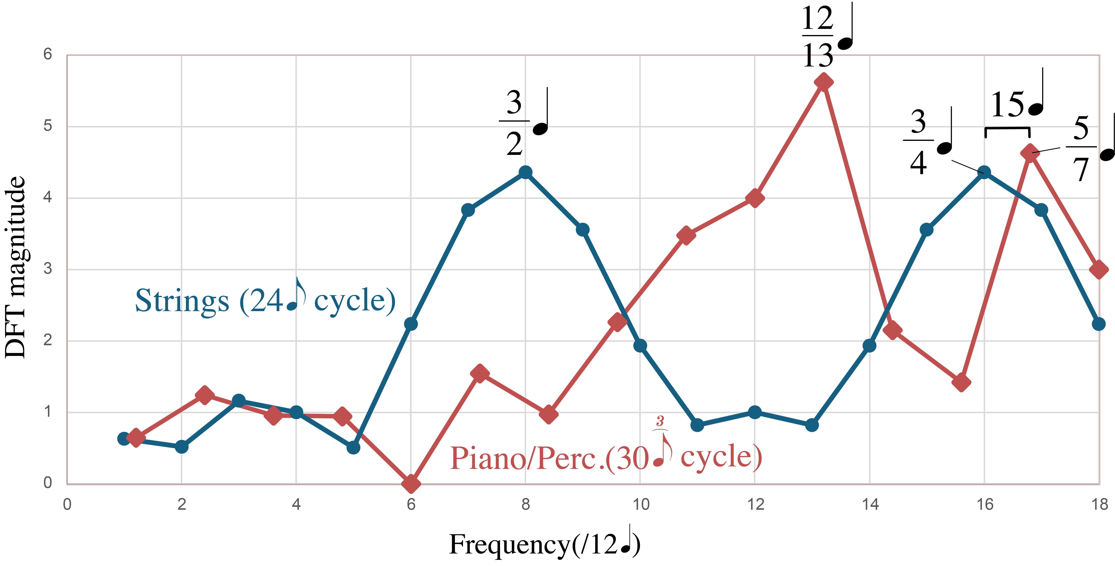
Earlier versions of Piano Concerto ostinato (my transcription from Ligeti’s notes at the Paul Sacher Stiftung)
The next change shifts the two peaks of the up so that there is now a stronger frequency at a non-integer value just above 1q

Slide 29
Piano concerto ostinato: Penultimate to final version
The final version adjusts the strings rhythm, introducing frequencies ¹²/₁₃q and ¹²/₁₇q maximally close to the two main frequencies of the piano rhythm.

Slide 30
Ligeti’s Creative Process
Piano Concerto Mvt. II

Slide 31
Ligeti Piano Concerto II: Rhythmic design (bottom right of p. 2)
[Omitted: 4 slides with facsimiles from Ligeti’s draft of the movement, which show that he preruled the score with colored barlines that mark out a different repeating rhythm or each part. The patterns are hard to discern in the finished score because Ligeti does not place a note in every subdivision. ]
Piano: 5 + 4 + 3 = 12 (e = x.)
Piccolo, Ocarina: 4+3+2 = 9
Bassoon: 4+3 = 7
Horn: 3+2+1 = 6
Slide whistle: 3+2 = 5
[Trombone: 3+3+2 = 8]
(Oboe: 4+3+2+2 = 11
→ 3+2+2+3 = 10)

Slide 32
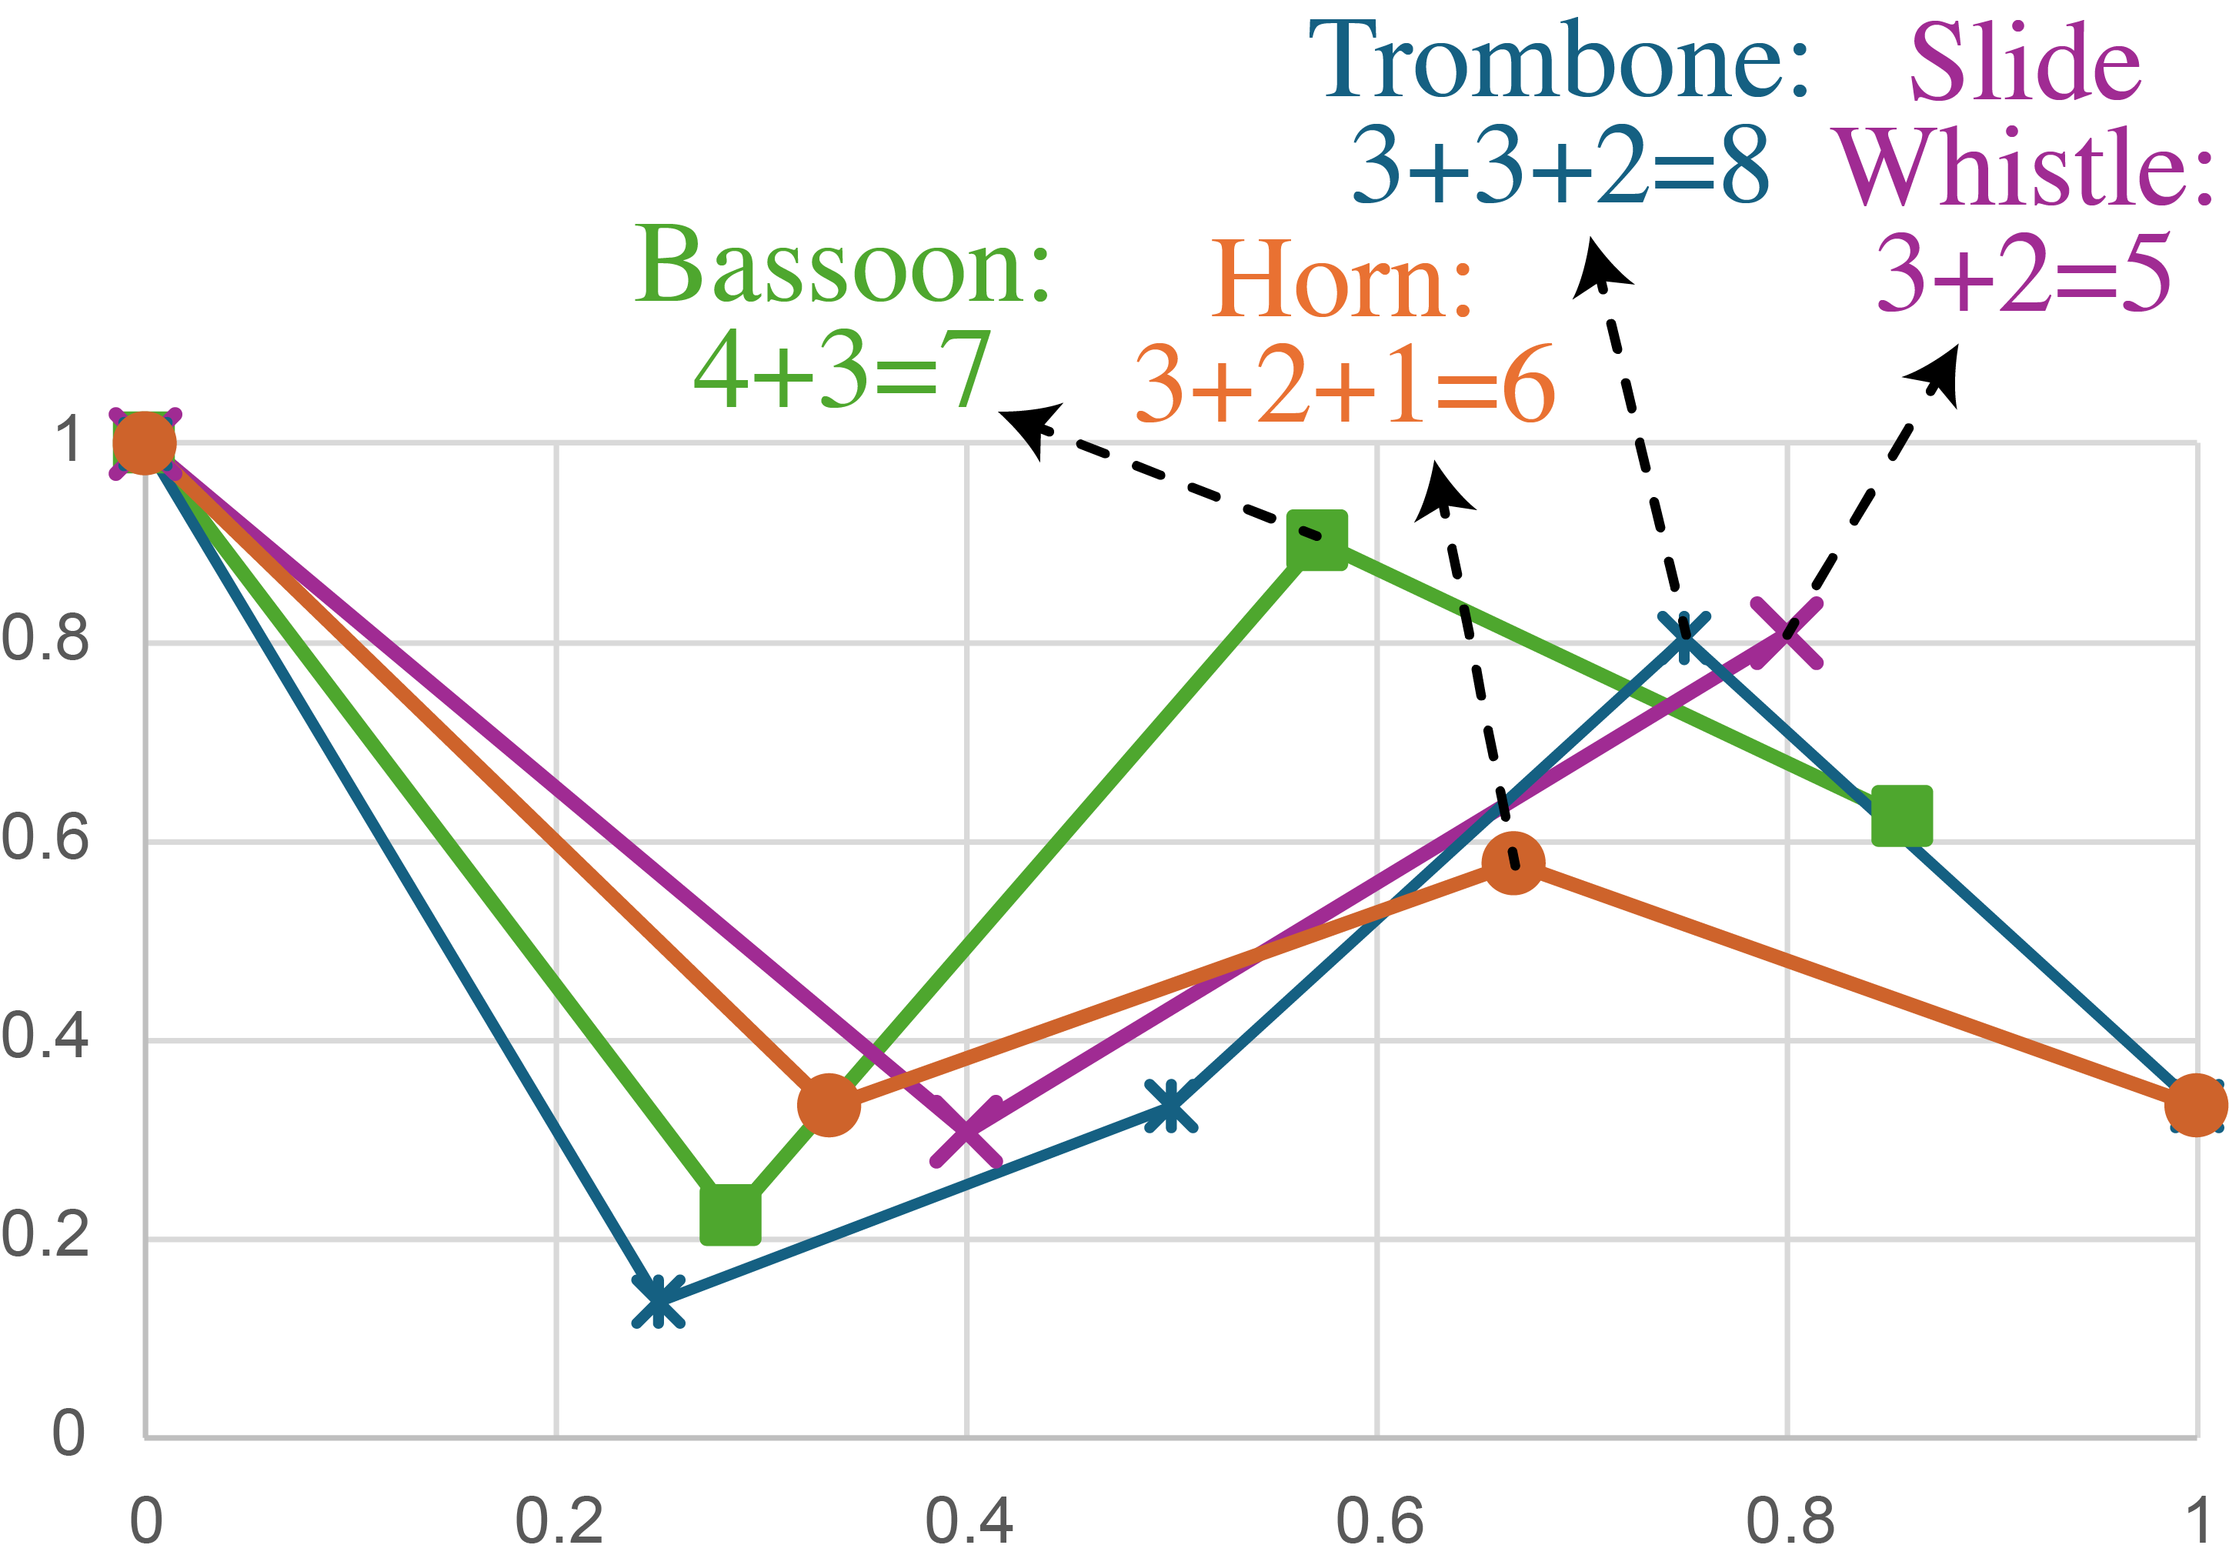
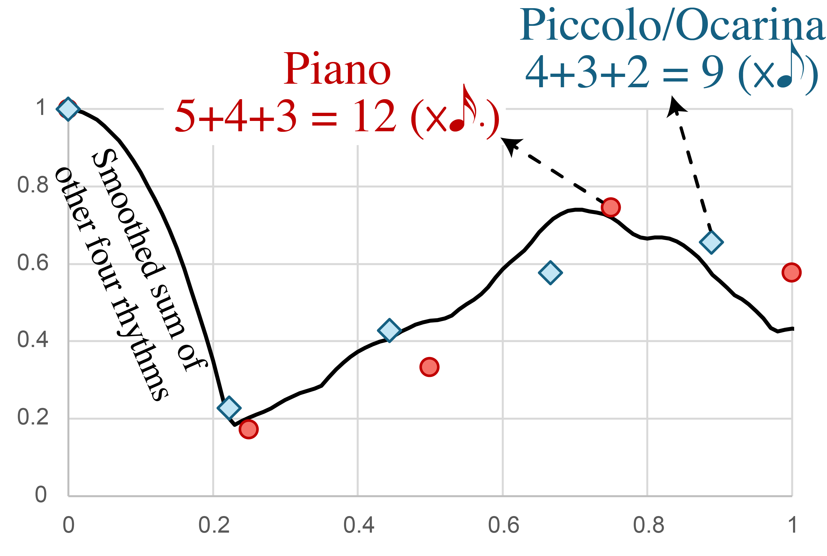
Ligeti Piano Concerto II: Rhythmic design
Spectra of the background rhythms
Normalized magnitude
Normalized magnitude
Frequency/q
Frequency/q

Slide 33
Fourier Analysis in Pitch Space
Flexibly defined interval categories
Analysis in coefficient space
Windowed analysis: Midiverto
Corpus analysis

Slide 34
Fourier analysis in pitch-class space
Pitch class is cyclic at the octave
Case 1: Assume 12-tone equal temperament
⇒ Use discrete Fourier transform on 12-place pc-vector
⇒ Only coefficients f₀ – f₆ are independent
These coefficients are associated with familiar harmonic qualities:
f₅ (f₇) = diatonicity, f₄ = octatonicity, f₃ = hexatonicity/triadicity . . .
Case 2: Assume flexible intonation
⇒ Coefficients all independent. E.g. f₇ = heptatonicity ≠ f₅,
f₁₂ ≠ f₀ (cardinality), measures conformity to ET
⇒ Same-numbered coefficients still comparable to ET cases (8ve is fixed)
(e.g. f₇ = heptatonicity with diatonicity as special case)
Notes:
This method can be used for pitch also, with similar consequences. Notation has a similar way of modeling pitch as a discrete function. This is okay for prescriptive uses of notation which only need to specify an approximate target for the performer, but for descriptive uses it is a distortion. All performances have variable realizations of pitches, such as vibrato, regardless of their attitude towards tuning. The problems are more acute, however, for performances that take more advantage of expressive uses of pitch.

Slide 35

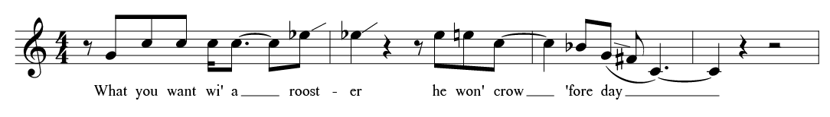
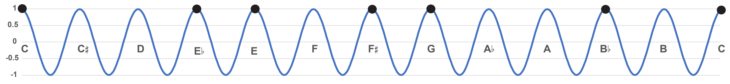
Flexibly Defined Interval Categories
An attempted transcription (after Titon) of Charlie Patton “Banty Rooster Blues”
+5
+3
–4
–2
–3
–7
8ve/12 categorization of intervals:
+3
+4
+5
1
Notes:
We can see the notation problem as a classification using a function of frequency 12 over the octave. The height of the function indicates how well the pitch fits the corresponding pitch class. We can classify intervals by the number of categories they span. [animation] This categorization distinguishes intervals of a fourth [animation] and the E and E-flat. [animation] These are in different categories, separated by an interval of 1.

Slide 36
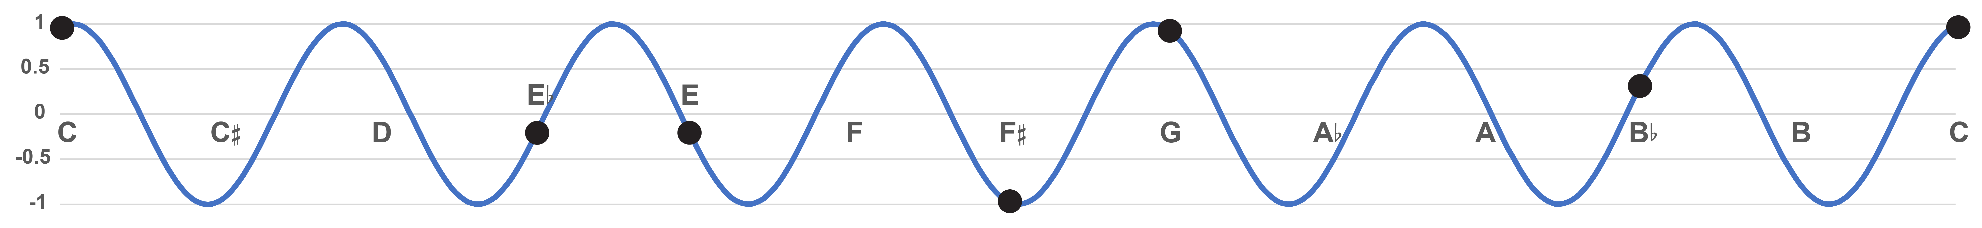
Flexibly Defined Interval Categories
An attempted transcription (after Titon) of Charlie Patton “Banty Rooster Blues”
+3
+2
–2
–1
–2
–4
8ve/7 (heptatonic) categorization of intervals:
+2
+3
0
Low value =Weak, ambiguous position
High value = Clear,
central heptatonic position
Notes:
But we could also classify these intervals heptatonically. [animation] The fourth, spanning 3 steps, [animation] and the thirds, spanning 2 steps, are still distinguished, but the E and E-flat are not. [animation] These are separated by an interval of zero, indicating that they are understood as variable intonation of a single heptatonic category. [animation] The height of the curve distinguishes strong representatives of their categories, like C and G, [animation] to more weak representatives like the F-sharp.

Slide 37
Flexibly Defined Interval Categories
Flexibility of intonation is inversely related to the number of interval categories.
Chromatic categories restrict intonational flexibility
Heptatonic categories allow for greater flexibility
Notes:
The European tradition negatively frames intonational flexibility, as out-of-tuneness. But it is essential to performance techniques that make styles like the blues possible. The frequency of a categorization can be seen as a trade-off. More categories gives the categorization more precision.

Slide 38
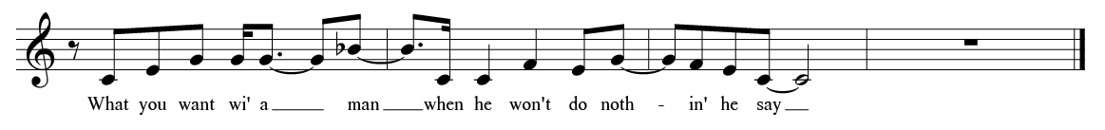

Flexibly Defined Interval Categories
B phrase of “Banty Rooster Blues”
+1
+1
+1
0
+1
8ve/3 (triadic) categorization groups multiple scale tones
→ flexibility allows for harmonic changes
0
Notes:
We can also put notes into triadic categories. Now the note F also belongs to the same category as E. It is a more ambiguous representative, which relates to the sense of the F to E interval as a resolution.

Slide 39

Heptatonic coordinates in 12t-ET (diatonicity)
12-tET sets are arranged in circle-of-fifths order in a heptatonic space.
This diatonic space is a useful analytical tool.
Eb major scale
C minor triad
C major triad
C major scale
Notes:
These functions can be used as coordinates in a two dimensional space. Here’s the C major scale, [animation] a different major scale, and two triads. The goodness of fit for the collection is the distance from the center. The angle varies with transposition.

Slide 40
Tonal space for 12t-ET
Krumhansl’s tonal space is a torus of DFT phases
N.B.: Assume relatively large |f₃| and |f₅ | !
←Phase of f₃→
←Phase of f₅→
Krumhansl and Kessler Tonal Space

Slide 41
Music analysis in diatonic space
Debussy D’un cahier d’esquisses

Slide 42


Example:
Debussy
The piece begins alternating two chords close to the home collection of the 5b-diatonic

Slide 43


Cb maj.
D⁷
Db maj.
Db pent.
Bbb
=A
Enharmonicism (here reflected in the change of spelling from Bbb to A§) is a move through the center of the space, which violates the logic of the Krumhansl tonal space.
Meas. 5–11
Example:
Debussy

Slide 44

Eb⁹
Bb⁹
Bb acoustic
{Ab,Bb,C,D,E}
Moving oblique to the center of the space preserves the heptatonic logic of keys and accidentals
Meas. 11–28
Example:
Debussy

Slide 45

Bb acoustic
Db pentatonic
WT1
Cb acoustic
Db maj^{add6}
In this passage Debussy uses the complete whole-tone collection, which is directly at the center of the space.
Meas. 15–35
Example:
Debussy

Slide 46
Windowed pc distributions

Slide 47

Midiverto (Harasim, Affatato, & Moss)
Online tool for windowed analysis of midi files.
Wavescapes:
Color: Phase
Vertical: Window size
Horizontal: Time
(Ex: Liszt Consolation II)
https://dcmlab.github.io/midiVERTO/#/

Slide 48

Midiverto (Harasim, Affatato, & Moss)
Online tool for windowed analysis of midi files.
Coefficient spaces:
Fixed window size
Real-time analysis synced with audio
(Ex: Liszt Consolation II)
https://dcmlab.github.io/midiVERTO/#/

Slide 49

Corpus analysis of windowed PC distributions
Minuets from Haydn’s Piano Sonatas
Power-normed f₀ indicates chromatic saturation
f₅ (diatonicity) is the largest non-zero coeff. for all 18th-c. corpora, and increases with window size.
f₃ (triadicity) is second largest non-zero coeff. for all 18th-c. corpora, across all window sizes.
f₂ and f₄ swap places with increasing window size.
f₄ is higher for chords, f₂ for scales
f₄–f₂ crossing point (here between 4q and 8q) is an indicator of harmonic density.

Slide 50


Corpus analysis of windowed PC distributions
Minuets from Haydn’s Early String Quartets
Minuets from Haydn’s Late String Quartets
Larger f₀: more chromatic
f₄–f₂ crossing at 8q window
(broader harmony)
f₄–f₂ crossing at 4q window

Slide 51


Corpus analysis of windowed PC distributions
Handel Minuets
Bach Minuets
Larger f₀: more chromatic
f₄–f₂ crossing at 8q window
(broader harmony)
f₄–f₂ crossing at 4q window
Lower f₃:
less triadic

Slide 52


Corpus analysis of windowed PC distributions
Mozart Divertimento Minuets
Mozart Elf Minuets

Slide 53


Corpus analysis of windowed PC distributions
Mozart Zwanzig Minuets
Mozart String Quartet Minuets
Slightly larger f₀
Slightly higher f₄–f₂ crossing point (between 4 and 8q)

Slide 54
Thanks!
For these slides and other stuff:
http://sites.bu.edu/jyust

