Slide 1

Maximally Even Rhythms in Música Popular Brasileira
Jason Yust, .
7th meeting of Associação Brasileira de Teoria e Análise Musical
June 18, 2026
Slides at http:/sites.bu.edu/jyust

Slide 2
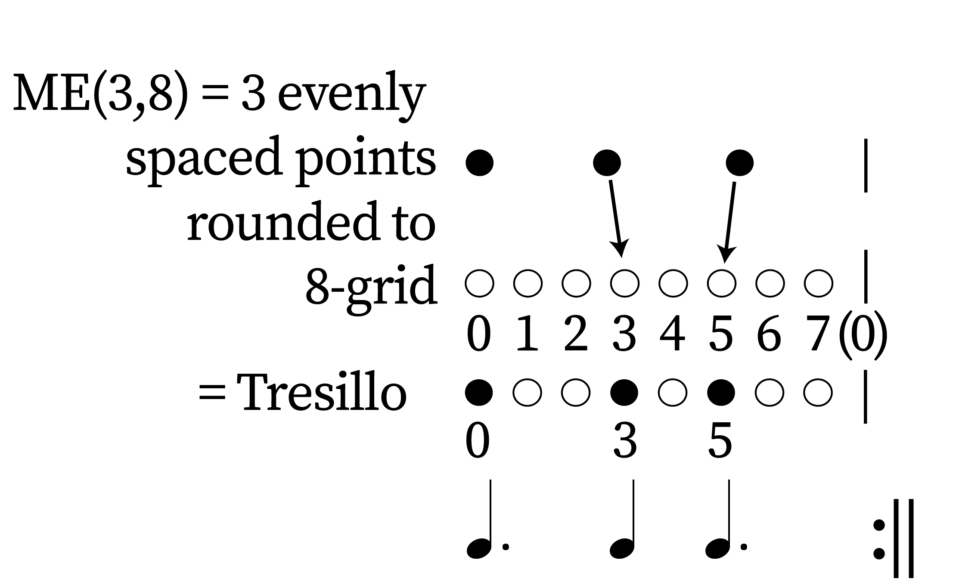
Example of a maximally even rhythm: Tresillo
A m-in-n maximally even rhythm (ME(m,n)) is the most even possible
distribution of m onsets in an n-cycle.
It’s defined by rounding m equally spaced points to the n-grid.

Slide 3
Perfectly even rhythms
When m divides n, ME(m,n) is perfectly even
Example: ME(2,8)
Example: ME(4,8)

Slide 4
Maximally even rhythms of the 8 cycle
All maximally even rhythms with n = 8:

Slide 5
All ME rhythms have a generator
The generator is the multiple of cycle/n that best approximates a multiple of cycle/m
The generator of the tresillo is 3/8 (≅ 1/3)
The complementary ME rhythm has the same generator:

Slide 6
Rotations by the generating interval
Bossa Nova
guitar rhythm
Tango rhythm

Slide 7
Rotations of ME rhythms
Rotations by the generating interval produce closely related ME rhythms
Rotations correspond to positions around a generator cycle
+3
–3
Phase 0:
v
v
i
i
Phase 7: Bossa Nova
Phase 1: Tango

Slide 8
Rotations of ME rhythms
The complementary ME rhythms use the same generator cycle
–3
+3
Phase 0:
Phase 7
Phase 1

Slide 9
Rotations of ME rhythms
The maxixe rhythm of early samba is ME(5,8) at phase = 2

Slide 10
Rotations of ME rhythms
The maxixe rhythm of early samba is ME(5,8) at phase = 2
ME(5,8) rhythms are also sums of ME(2,8) and ME(3,8)

Slide 11
Caninha, “Não é como elle quer,” ca. 1930
The earliest form of samba (1920s–1930s) is based on the maxixe rhythm
Phrase 1 (mm. 1–4)
ME(6,8)
phase = 0
ME(5,8)
Maxixe pattern
phase = 2
Phrase 2 (mm. 9–12)
ME(4,8)
phase = 0
ME(5,8)
Maxixe pattern
phase = 2

Slide 12
Proximate ME rhythms: Maxixe
ME rhythms with nearby frequencies (m±1) go in and out of phase once per cycle
=> ME(m,n) resembles alternation of ME(m+1, n) and ME(m–1, n)
ME(4,8) (beats)
phase = 0
ME(5,8) (Maxixe)
phase = 2
ME(6,8)
phase = 0

Slide 13
ME rhythms of the 12 cycle
Perfectly
even . . .
West
African
bell
patterns
(timelines)

Slide 14
African “standard pattern”

Slide 15
Interacting ME rhythms: Standard pattern vs. Maxixe
ME(4,12) (beats)
phase = 0
ME(5,12) (Standard pattern)
phase = 2
ME(6,12) (cross rhythm)
phase = 0
ME(4,8) (beats)
phase = 0
ME(5,8) (Maxixe)
phase = 2
ME(6,8)
phase = 0

Slide 16
Geneology of samba vs. son clave
The Maxixe and Cuban clave rhythms can both be understood as duple versions of the 5-onset African standard pattern.
The Maxixe preserves maximal evenness while the Cuban clave preserves orientation with respect to the beats.

Slide 17
5-note ME patterns

Slide 18

Bossa Nova “clave” from Tresillo
The ME(5,16) rhythm can be built from
alternating Tresillo rhythms.
(Proximity of frequencies 5 and 6)
Ex.: Astrud Gilberto, “Só tinha de ser com Você”

Slide 19
ME(5,16) from nearby frequencies
The ME(5,16) rhythm is also an alternation of the
ME(6,16) tresillo and ME(4,16) offbeats
(similar to ME(5,8), ME(6,8), and ME(4,8)).

Slide 20
ME rhythms of the 16-cycle
All of the possible ME(x,16) play some role in Bossa Nova

Slide 21
ME(7,16) rhythms in Bossa Nova
Jobim, “Red Blouse,” guitar pattern (phase 14):
Gilberto, “Águas de Março,” guitar pattern (phase 13):

Slide 22
Ben Jor, “Quem foi que roubou a sopeira”
The clave is ME(9,16) (phase 15)

Slide 23
Cartola, “Alvorada”
The basic tamborim rhythms are ME(7,16)
And ME(9,16)
The generator is 7

Slide 24
Gilberto: Bossa Nova guitar patterns
ME(6,16)
phase = 14
ME(6,16)
phase = 12
A common pattern results from alternating tresillos in two neighboring phases
Not ME
Ex.: Gilberto “Chega de Saudade”

Slide 25
Gilberto: Bossa Nova guitar patterns
ME(3,16)*3
Generator cycle for ME(3,16):
–3
This pattern can also be described as two ME(3,16) patterns separated by 3.

Slide 26
Interaction of rhythms: “Da maior importância”
The multitracked guitars in Caetano Veloso’s “Da Maior Importançia” are ME(12,16) (complement of ME(4,16)) and ME(5,16) (Bossa clave).
The nearby frequencies (4 and 5) result in a slow phasing cycle.
ME(12,16), phase 0
ME(5,16), phase 0

Slide 27
Interaction of rhythms: “Outrez Vez”
In Sérgio Mendes’s version of “Outrez Vez” a
typical Bossa Nova guitar rhythm interacts with a ME(5,16) clave in the percussion
Guitar rhythm:
Phase-shifted tresillos
ME(3,16)*2

Slide 28
Thanks!
More at http:/sites.bu.edu/jyust

