Slide 1

Harmonic Qualities of Generic Sets
Jason Yust .
sites.bu.edu/jyust
Mathematics and Computation in Music
10th International Conference, June 24, 2026

Slide 2
Generic Reduction in Voice-Leading Space

Slide 3
Generic Reduction
Specific pitch classes (12)
0 4 7
0 3 7
0 1 4
Spelled pitch classes (84)
C E G
C Eb G
C D# E
C Eb E
Remove accidentals
Generic Pitch Classes (7)
C E G
C D E
C E E

Slide 4
Generic Reduction via Voice Leading
• Represent generic sets with 7-tET
• Generic reduction is a voice leading from 12-tET to 7-tET
• Size of the voice leading measures plausibility of the resulting spelling
Euclidean distance:
0.42 semitones
Generic (024)
(+0.24, –0.33, +0.10)
C E G
(0.24, 3.67, 7.10)
(0, 4, 7)
Generic (034)
(–0.33, +0.81, –0.48)
C Fb G
(–0.33, 4.81, 6.52)
Euclidean distance:
1.00 semitones

Slide 5
Generic Reduction via Voice Leading
Some pcsets are close to multiple 7-tET sets (corresponding
to multiple plausible spellings).
0.91 semitones
Generic (012)
C Db E
(–0.05, 1.67, 3.38)
(–0.05, +0.67, –0.62)
(0, 1, 4)
0.71 semitones
Generic (002)
C C# E
(+0.52, –0.48, –0.05)
(0.52, 0.52, 3.95)
(–0.62, 0.10, 0.52)
Generic (013)
0.82 semitones
B# C# E
(–0.62, 1.10, 4.52)

Slide 6
Generic Trichords
There are only four trichord types without doubling,
three of which are generated
012 Generated by step Scalar
024 Generated by third Tertian
014 Generated by fourth Quartal
013 Flat interval distribution Mixed
Trichords
without
doubling
Trichords
with
doubling
001 Doubled step
002 Doubled third
003 Doubled fourth

Slide 7
Specific-to-Generic Trichords
Trichords with one close 7-eq trichord
12-eq to 7-eq reduction | Voice-Leading distance | Ex. Spelling
(027)₁₂ → (014)₇ | 0.20 | CDG
(025)₁₂ → (013)₇ | 0.31 | CDF
(024)₁₂ → (012)₇ | 0.40 | CDE
(037)₁₂ → (024)₇ | 0.42 | CEbG
(013)₁₂ → (012)₇ | 0.51 | CDbEb
(015)₁₂ → (013)₇ | 0.53 | CDbF
Trichords can be classified as scalar, tertian, quartal, or mixed based on the nearest 7-eq trichord

Slide 8
Specific-to-Generic Trichords
Ambiguous trichords with two or three 7-eq sets nearby
V-L distance | Ex. Spelling
0.61 | CEbGb
0.93 | CD#F#
0.62 | CDF#
0.84 | CDGb
0.65 | CDbGb
0.76 | CC#F#
0.71 | CC#E
0.82 | B#C#E
0.91 | CDbE
(024)₇
(036)₁₂
(013)₇
(013)₇
(026)₁₂
(014)₇
(014)₇
(016)₁₂
(003)₇
(002)₇
(014)₁₂
(013)₇
(012)₇

Slide 9
Specific-to-Generic Trichords
Symmetrically ambiguous trichords
V-L distance | Ex. Spelling
0.73 | CC#D
 | CDbD
0.81 | CEG#
 | CEAb
 | CFbAb
(001)₇
(012)₁₂
(011)₇
(024)₇
(048)₁₂
(025)₇
(035)₇

Slide 10
Specific-to-Generic Tetrachords
Tetrachords with one close 7-eq set
12-eq to 7-eq redux | V-L dist. | Ex. Spelling
(0257)₁₂ → (0134)₇ | 0.32 | CDFG
(0247)₁₂ → (0124)₇ | 0.42 | CDEG
(0358)₁₂ → (0135)₇ | 0.45 | CEbFAb
(0235)₁₂ → (0123)₇ | 0.52 | CDEbF
(0237)₁₂ → (0124)₇ | 0.53 | CDEbG
(0135)₁₂ → (0123)₇ | 0.55 | CDbEbG
(0158)₁₂ → (0135)₇ | 0.59 | CDbFAb
(0258)₁₂ → (0135)₇ | 0.62 | CDFAb
(0246)₁₂ → (0123)₇ | 0.64 | CDEF#
(0157)₁₂ → (0134)₇ | 0.65 | CDbFG
(0136)₁₂ → (0124)₇ | 0.65 | CDbEbGb
(0137)₁₂ → (0124)₇ | 0.68 | CDbEbG
(0156)₁₂ → (0134)₇ | 0.72 | CDbFGb

Slide 11
Generic Reduction in Harmonic Qualities

Slide 12
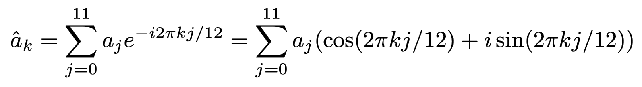
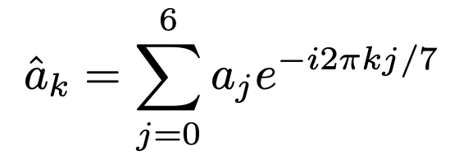
Quick Intro to Harmonic Qualities
Pitch-class vector: Each place in vector corresponds to a pitch-class.
1 = present, 0 = absent
Example:
C major triad:
C C# D Eb E F F# G Ab A Bb B
( 1, 0, 0, 0, 1, 0, 0, 1, 0, 0, 0, 0)
Generic-pc vector: The same with 7 places.
Example:
C triad:
C D E F G A B
( 1, 0, 1, 0, 1, 0, 0)
The discrete Fourier transform (DFT) of this vector converts it in periodic functions at divisions of the octave into 1–11 or 1–6 parts.
0 ≤ k ≤ 11
0 ≤ k ≤ 6

Slide 13
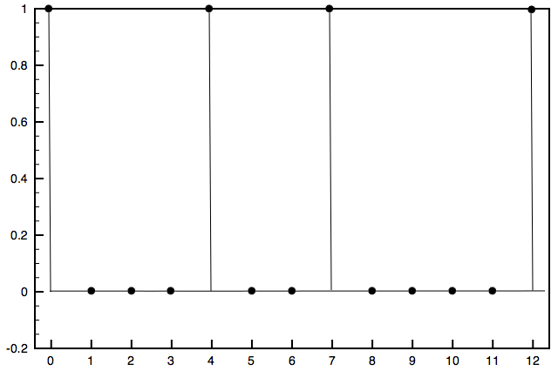
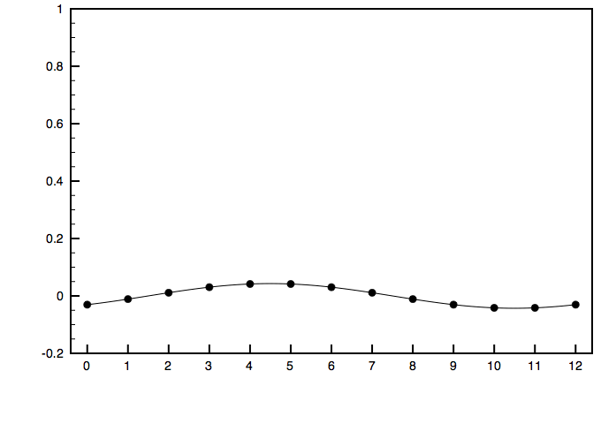
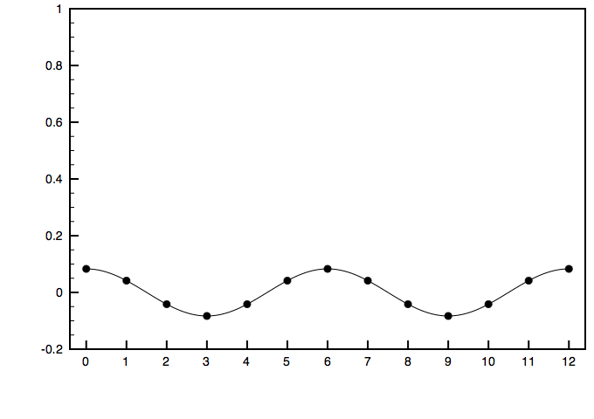
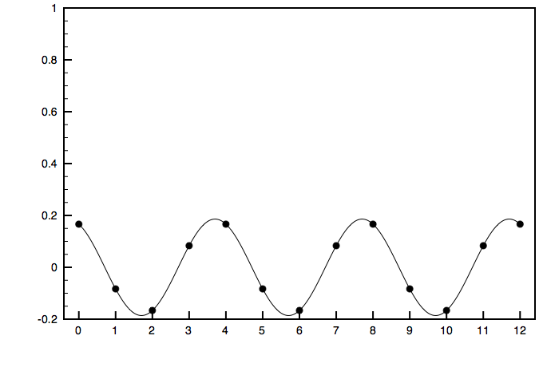
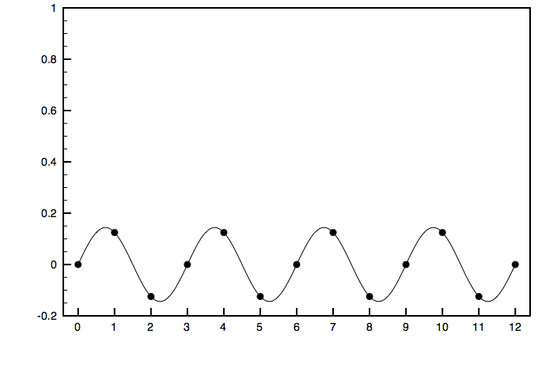
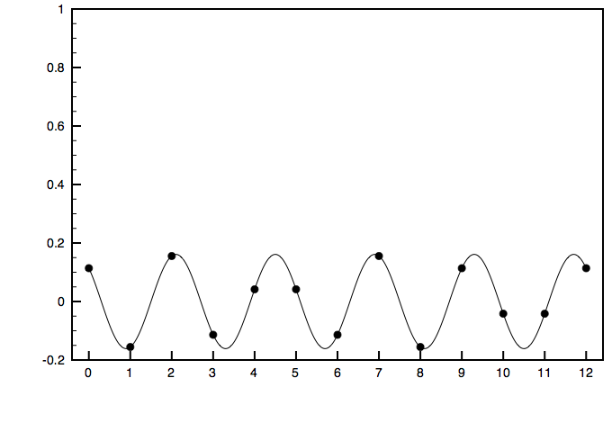
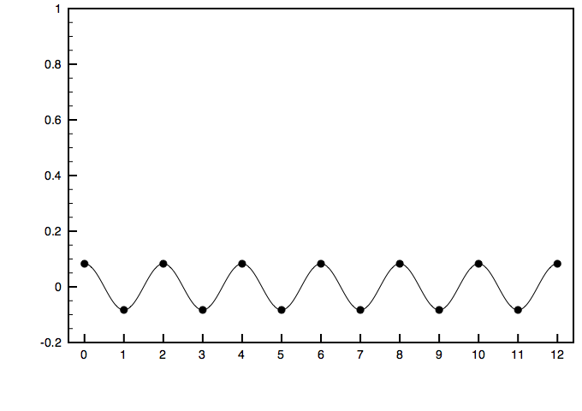
Quick Intro to Harmonic Qualities
C major triad =
^a₁ +
^a₂ +
^a₃ +
^a₄ +
^a₅ +
^a₆ + . . .
The DFT is a lossless transformation from a pitch-class vector to a sum of periodic functions dividing the octave into 1 to (n–1) parts.

Slide 14
Harmonic Qualities of Generic Triad
Generic C triad, (024)₇ = 0.43 +
^a₁ +
^a₂ +
^a₃ +
^a₆ +
^a₅ +
^a₄
Note aliasing! (values for ^a_{k} same as for ^a_{7–k})

Slide 15
Coefficient spaces
For generic C triad, (024)₇:
^a₁:
^a₂:
^a₃:
Magnitude
Phase

Slide 16
Comparing specific and generic sets
We can directly compare specific to generic sets in each of the coefficient spaces
^a₃:
^a₁:
^a₂:
(013)₇
(012)₇
(014)₁₂
(013)₇
(002)₇
(014)₁₂
(012)₇
(014)₁₂
(002)₇
(002)₇
(012)₇
(013)₇

Slide 17
Voice-leading vs. quality space distances
Lines show the theoretical maxima

Slide 18
VL distance vs. quality magnitude differences
Lines show the theoretical maxima

Slide 19
Diatonicity vs. Generic-Specific VL distance
Ex.: Tetrachords and correlation (dotted line)

Slide 20
Star Charts

Slide 21
Star chart for harmonic qualities
Each magnitude (as % share of power) multiplied by unit vector at 6 equally spaced points around unit circle
Based on an idea from Pereira, Bernardes, & Martins 2025

Slide 22
Star chart: Trichords and dyads
—Choice of circular order of qualities is crucial.
—Mod-7 complements are opposite.
—Lower numbered qualities are on the left.
—Color coding:
Purple = even
Green = odd

Slide 23
Star chart: Tetrachords
—Choice of circular order of qualities is crucial.
—Mod-7 complements are opposite.
—Lower numbered qualities are on the left.
—Color coding:
Purple = even
Green = odd

Slide 24
“Proverb I” from Britten’s Blake Songs

Slide 25

Britten: Proverb I
[2347]
(0125)
[e016]
(0127)
Voice: t-2-0-6, [0248]
[589t]
(0125)

Slide 26
Generic-to-specific for ^a₁–^a₃
Britten’s spellings change harmonic qualities more than one that includes a generic doubling.
^a₁
^a₃
^a₂

Slide 27
VL distance vs. |^a₇| for “Proverb” tetrachords
Britten’s sets have relatively high |^a₇| for their distance to the nearest generic set

Slide 28
“Proverb” sets, ^a₅ in complex space
• The tetrachords are evenly spaced (necessary for aggregate completion).
• The bass notes are opposite their tetrachords.
• The entire design (and m. 2 by itself) is symmetrical around the C–F# axis.
DEbFbG (m. 1)
A (m. 3 bass)
BCDbF#
(m. 2)
C
(m. 2 bass)
Eb (m. 1 bass)
G#ABbF (m. 3)

Slide 29
“Proverb” set classes on star chart
The piano sets are closer to their chromatic subsets, farther from the diatonic subsets (with bass omitted).
Piano tetrachords are roughly opposite the voice tetrachord.
(Balance)

Slide 30
Thanks for listening!
Jason Yust .
sites.bu.edu/jyust

