Slide 1

Antiblackness in Foundational Music Theory Concepts: Tonality, Meter, and Rock Music
Jason Yust, .
Leading Voices: Northeastern University
Thursday, Mar. 26, 2026
Notes:
That’s the outline: three parts!

Slide 2
Outline
Three important concepts: • Tonality, • Meter, • Rock music
For each:
—Racialized historical origin of term
—Attempts to redefine, universalize
• Role of cognition
• Original meaning remains
→ Universalizing of predominantly white music
represents non-white creators negatively
(music described by what it is not, deviant)
Notes:
In this talk I’m going to draw upon an essay I published recently on the first topic, tonality, and an extension of similar ideas to two other concepts, meter and rock music, drawing from a chapter forthcoming in a Routledge collection on antiblackness edited by Phil Ewell and Joe Feagin.
The talk will be divided into three parts, one on each of these concepts. Each argument runs on roughly parallel tracks.
Each term is racialized in some way in its origins.
There is a subsequent attempt to universalize each term. However, if the intent of universalizing is to mitigate the ethnic discrimination inherent in the term, the effect is the opposite. Rather than shedding its racialized elements, the effect is to treat features of mostly white-created music out as basic and features of more non-white music deviant.

Slide 3
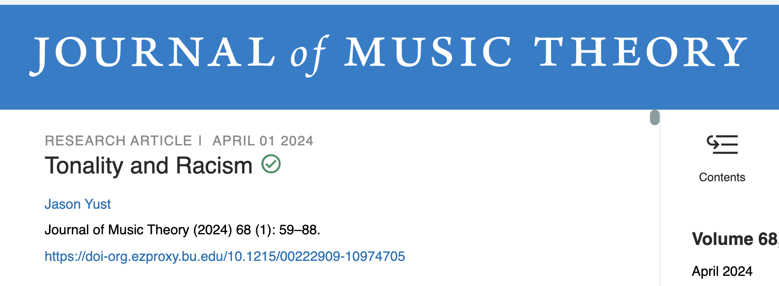
Tonality
(1) Claim: Tonality is an antiblack concept
(2a) Response 1: Stop using the words “tonality” and “tonal music”
(2b) Response 2: Redefine the word tonality
(2c) Response 3: Acknowledge antiblackness when using “tonality”/“tonal music”
Notes:
In the essay for the Journal of Music Theory, I argued first that tonality is antiblack as a concept. Most readers who I heard from or wrote in response to the article agreed with this in one way or another.
I also made the case that, if we agree with claim 1 we should avoid using these terms altogether, and that doing so would be productive both for music theory and for antiracism. This is where some readers disagreed. Many feel that option 2b is a better response, to just use the word differently. I’m skeptical of this response, because one of my observations about tonality is that there have already been ample attempts to redefine it and they have, in my assessment, increased the antiblack effects of the term.
However, I’m not opposed to the compromise response 2c: we don’t need language police, but we do need to use a term like this only in full recognition of its antiblack effects.
Trigger warning: Fétis quotes coming.

Slide 4
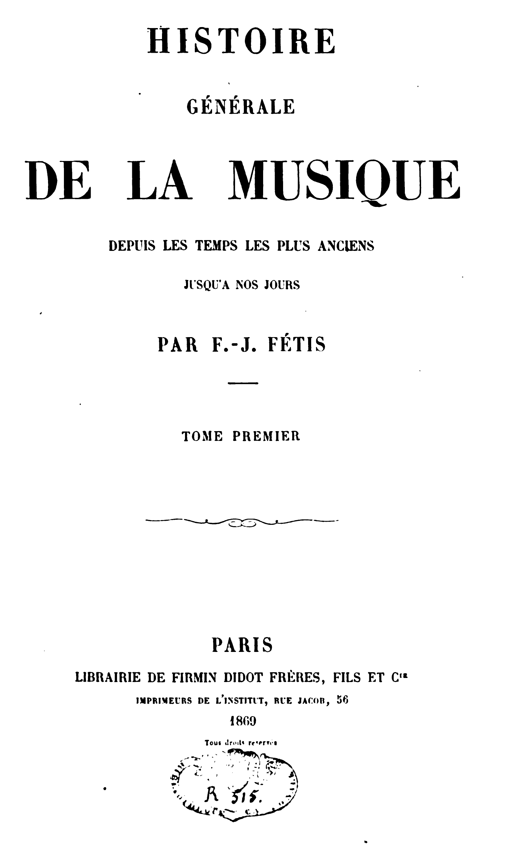
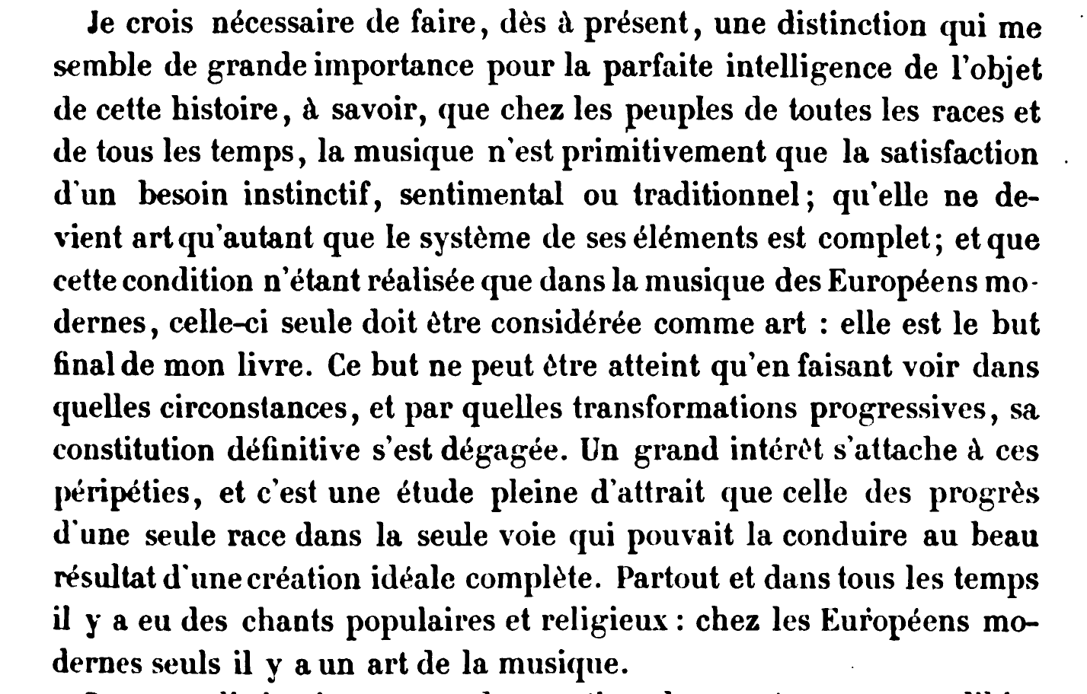
Among peoples of all races and all times, music is not only the primitive satisfaction of an instinctive, sentimental or traditional need; that it only becomes art when the system of its elements is complete; and that this condition being realized only in the music of modern Europeans, only this should be considered as art. This is the ultimate goal of my book. This goal can only be achieved by showing under what circumstances, and by what progressive transformations, its definitive constitution emerged. These adventures are of great interest, and it is a fascinating study, that of the progress of a single race in the only way which could lead it to the beautiful result of a complete ideal creation.
p. 5
Notes:
The word tonality became a keystone of music theory because of the efforts of nineteenth century theorist François-Joseph Fétis. Fétis was instrumental in developing the concept of tonality, as a way of explaining systems of keys and functional harmony in European classical music and how they developed from the fifteenth to the nineteenth centuries. At the time, in the mid-nineteenth century, European colonialism was bringing a steady stream of knowledge about non-European music into the continent. Theorists had to assimilate this new knowledge one way or another. Up to that point they could theorize one style of music and call it, simply, a theory of music. Confronted with new kinds of music, they did their best to apply existing theory, developed for European music, to these sometimes very different cultural practices
Fétis drew especially fallacious and abhorrent conclusions from this. His last project was a huge and ambitious multivolume work entitled Histoire générale de la musique. He dedicated this work to the premise that the music of Europeans reflected racial superiority. His argument for this centered on the concept of tonalité, which he had earlier developed in the context of the development of European music from liturgical chant to the nineteenth century. His use of this concept as a pseudoscientific defense of racial determinism was inspired by white supremacist writers like Arthur de Gobineau and Ernest Renan. Where they claimed that physiology proved the inferiority of non-white races, Fétis claimed that the impoverished tonalities of non-white races proved their inherent inferiority.

Slide 5
If we examine the state of music or song among certain populations still existing, and analogous or identical, in the form of the head, to the races antediluvian or prior to historical times, whose skulls and traces of social state, we will be able, by these connections and by the number of the specimens, to come to probable conclusions on what were the rudiments of the art at the first ages of the world. Our studies on this subject will undoubtedly lead us to the discovery of the law of musical capacity of races, on account of their cerebral conformation.
p. 10
Notes:
One of the crucial components of Fétis’s white supremacist argument is the characterization of contemporaneous cultures in places like India and China as primitive. By claiming that these cultures are unchanged from prehistoric times, he places them at the bottom of a racialized evolutionary ladder of progress. In the Histoire Générale he clearly references the notoriously racist pseudo-scientific theory of phrenology, the false claim that the size and shape of skulls differ between races. This pseudo-science was very popular in mid 19th-century western Europe.

Slide 6
The inhabitants of Europe and those of the colonies founded by them have, in general, the necessary aptitude for seizing the relations of tonality of certain series of sounds; an aptitude which develops by the habit of hearing music and which study perfects, because the law of progress is inherent in the nature of this race.
Savage populations . . . also have the memory of sounds and the faculty of reproducing them by the singing voice as they do by the spoken voice, but always imperfectly. Hence it is that their songs are only composed of a small number of determined sounds, which rarely rise above four, and that the sterility of their imagination does not allow them to vary the successions.
p. 12
Notes:
Fétis is proposing his own pseudo-science in the book, the pseudo-science of tonality.
Tonality, which he introduces in this passage, is the centerpiece of Fétis’s argument. His claim is that the lack of harmony and limited scales of non-European music is a kind of musical phrenology, “proving” that they represent an earlier stage of musical evolution.
Notice that he discusses tonality as an aptitude and as something that exists psychologically in the imagination of a population of people. This is an essential feature of his concept of tonality.
This way of evaluating the music on non-Europeans, to count the number of notes in their scales, was a typical habit of early ethnomusicology, and still remains prevalent in our way of thinking about non-European music. This is where the concept of tonality leads.

Slide 7
The meditations which I engaged in some years later—in my search for the principle of harmony and my study of idealist philosophies—marked the beginning of a reformation of my ideas; gradually, they ultimately led me onto the path of historical and philosophical truth.
I have recounted elsewhere the circumstances under which all my doubts were dispelled in 1831, and I have described how I arrived at the conviction that music owes its origin to the synthesis of relationships between sounds with the emotional and imaginative faculties of a specific human race.
p. II
Notes:
This is going back to the preface to show that Fétis recounts the logic that led him to the white supremacist thesis of the Histoire. He traces it back to the beginning of his theory of tonality in 1831. That revelation came about by thinking of the theory of harmony in the context of Hegelian philosophy (which is what “idealist philosophy” refers to). The year 1831 is crucial to his self-mythologizing (see Christensen p. 11): it is the year he cites as the moment of revelation in the Bois de Boulogne. The concept of tonality existed before that, as a purely historical concept. The revelation is uniting that with Hegelian philosophy. First, that is a way to make psychology and anthropology the basis of music theory rather than physics (i.e.. overthrow Rameau). Second, it provides an evolutionary logic that allows us to distinguish some music as superior to other music, by its place on the evolutionary ladder.
In a response to my essay about tonality, historian Thomas Christensen made the point that the Histoire Générale was a late work and not so influential as Fétis’s earlier writings. All the essential elements leading to the racist conclusions are there in the earlier writings however, just without the references to other notorious white-supremacist theories. There is an earlier draft of the Histoire Générale from 1837 that also places Indian and Chinese music at the bottom of an evolutionary account of music on the basis of their tonalities. These elements are also present in his influential writings about tonality in 1832.

Slide 8
Why is Fétis relevant to us today?
Many musicians still believe in the Hegelian “ladder of progress” evolutionary story (the basis of 20th-century avant-gardism)
Tonality (as a conceptual structure) still equates non-European music with “primitive” (“pre-tonal”) European music. → Assumption that “scales” are foundational to other musical traditions (octave equivalence, mode) → Music theory’s institutional tonal/atonal division: —Ambiguous status of non-atonal music of 20th/21st c. —Music outside the European diaspora can only contribute at the most basic level (scales and tunings).
Notes:
This history is essential to understanding the situation in music and music theory today. Throughout the 20th century and still today many composers classify music as tonal or atonal and associate atonal with more advanced, exactly as Fétis framed it. Music theory curricula and many research careers are built around this distinction, relabeled as tonal versus post-tonal. The change in terminology actually doubles down on the problem, emphasizing the temporal aspect of the distinction. The temporal aspect was essential to how Fétis described tonality and the implicit evolutionary ladder of musical progress it supposedly represented. The other end of this evolutionary ladder consists of tonalities which only have scales and lack functional harmony. That’s basically every kind of music not derived from Euro-classical music, and gave Fétis justification to call them primitive. In short, the cultural chauvinism of Fétis is now built into academic music theory, essential training for composers in the Euro-classical tradition. Composers throughout the twentieth century to today commonly reflect the evolutionary ladder model created by Fétis in how they conceptualize their own place in music history.
Consider jazz and popular music: as 20th /21st-c “tonal” music it faces the first problem. As Euro-diasporic it doesn’t face the second problem, but that still lurks in the background. It can only contribute at the level of a theory for music 100+ years earlier.
Many people think scales are a very basic concept that applies to all music, but this idea has distorted the theories of music like Indian, Arabic, Persian, and Turkish music for more than a century. The concept of scale carries with it elements specific to the unusual harmony-based music of Europe, octave equivalence and mode, which are not universal.
As long as music theory is divided into tonal and post-tonal, non-Euroclassical music will always remain where Fétis put it, at the bottom of the evolutionary ladder.

Slide 9
Why is Fétis relevant to us today?
Music theory institutions remain structured by tonality → music falling outside the tonal–atonal binary is excluded • Music theory curricula (esp. graduate degrees) • Research profiles of music theorists
Avant-gardist philosophy remains prevalent, with atonality and ladder-of-progress evolution at its core N.B. Fétis was largely responsible (via Liszt) for the atonal movement of the early 1900s!
Notes:
Tonality also plays a foundational role in the structuring of music-theory institutions. For example, almost all of the music-theory teaching for performance students at my institution, BU, is divided into tonal and post-tonal topics. It’s very hard to figure how non-Euroclassical music can fit into this curriculum, and if it is incorporated arbitrarily, the effect is forced and continues to send the message that this music is not important or serious.
Fétis may be the single most important theorist of the 19th century for the future of music theory and music. The atonal movement was inspired by his theory shaped classical music of the 20th century, and led it down a long path towards cultural irrelevance. Music that inherited European harmony, jazz and popular music, took its place, but the concept of tonality continued to persuade generations of music theorists that this music was not worthy of their attention.

Slide 10
Why is Fétis relevant to us today?
(3) Those who forget the past are doomed to repeat it!
We can still reproduce Fétis’s logic:
—Tonality as a cultural competency
→ reject explanations from biology, physics
—Tonality is a property of all music (many “tonalities”)
—Non-European “tonalities” will always be deficient, because the motivation for the concept remains grounded in 18th–19th c. European classical music
Notes:
This is the most counter-intuitive part of the argument I made in the JMT article, and the one that has met the most resistance. Many theorists believe that talking about a multiplicity of tonalities, one for every kind of music, is a possible solution to the problems I just outlined. But rejecting scientific modes of explanation is exactly what led Fétis down this path in the first place. Science offers a possible off-ramp, because it forces us to deconstruct and operationalize concepts, which can help isolate the parochial elements of them.
No effort at redefining the word tonality will change the fact that it references 18-19th century European harmony. We use the word because it brings prestige, and it is tempting to want other non-European music we care about to share in that prestige. But the prestige of the term is derived from the political power of European classical music, and so other music will always only share in that prestige to the extent that they share features with that music. The word will always highlight those elements and hide or negatively characterize what is distinct about other music.

Slide 11
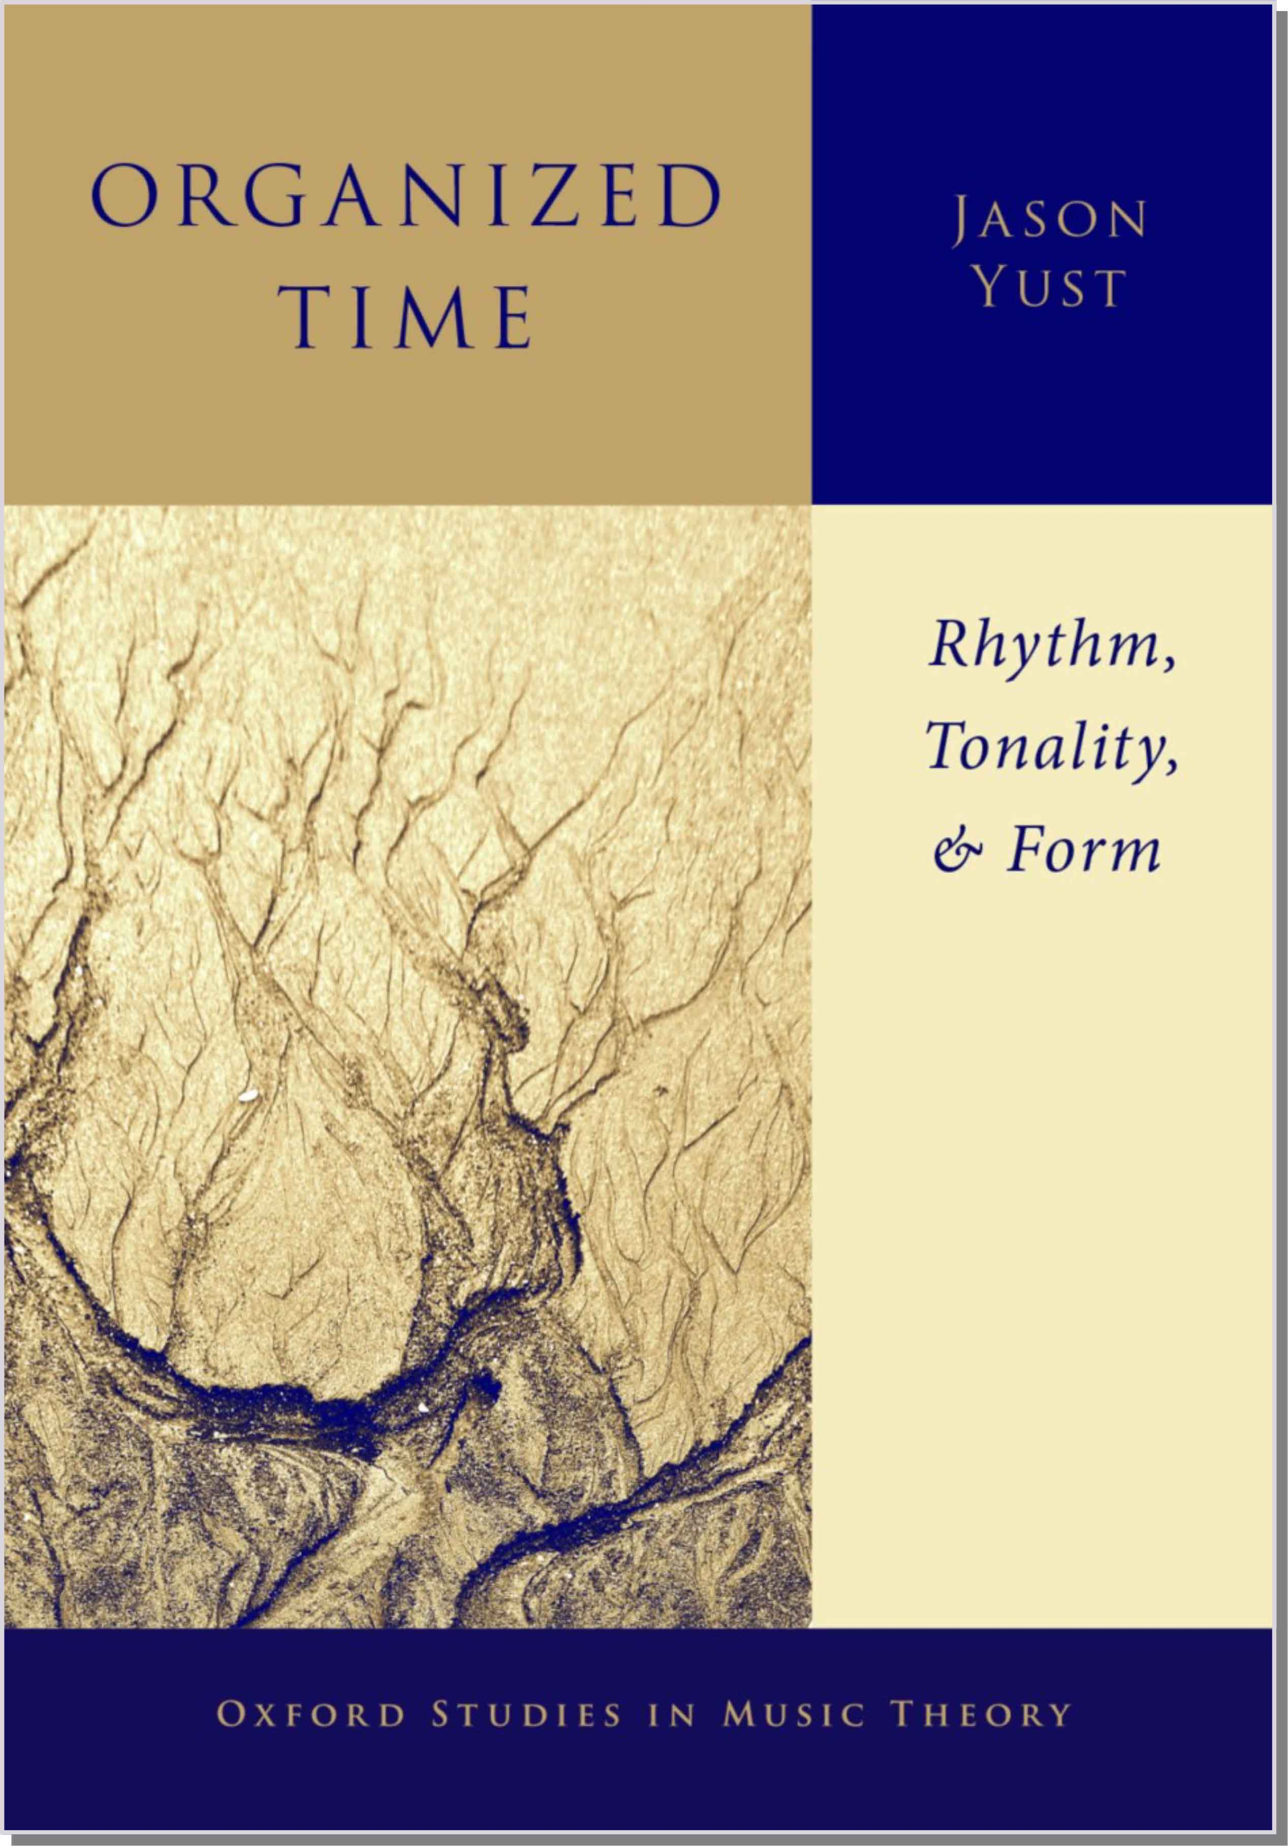
Tonality: Can we live without it?!?
Suppose you’re writing a music theory book. Do you put “tonality” in the title?
What does this tell the potential reader?
Subject matter
• Music theory
✓
• Euroclassical music of 18th and/or 19th c.
✓
• Jazz or rock music
? (maybe)
• Non-European music
?? (probably not)
⇒ If there is other music it will share a theoretic framework with 18th–19th c. Euroclassical music
Notes:
So should we stop using the term? Maybe a better question is, why do we want to use it in the first place.

Slide 12
Tonality: Can we live without it?!?
Suppose you’re writing a music theory book. Do you put “tonality” in the title?
What does this tell the potential reader?
Methodology
• Music theory
✓
? (maybe)
• Schenkerian
• Harmonic function
? (maybe)
• Cognitive science
? (maybe)
• Computational analysis
? (maybe)
Notes:
The point here is: it doesn’t tell you much!

Slide 13
Music Cognition and Antiblackness
✓
Rigor and precision demanded by science eliminate many antiblack biases
Participant populations: —WEIRD
—“Musically trained”
Research questions that rely on Euroclassical theory
!
!

Slide 14
Music Cognition, Tonality, and Antiblackness
“
Most research in neuroscience has been conducted on WEIRD participants—that is, individuals who hail from Western, Educated, Industrialized, Rich, and Democratic societies. . . . Music psychology shares this sampling bias: participants are almost always recruited from WEIRD societies, experimental materials are usually drawn from Western music, and studies tend to investigate constructs such as harmonic progressions that are disproportionately relevant to Western music.
This situation gives rise to at least two fundamental problems. First, it biases the understanding of human mechanisms for music perception and production, because WEIRD populations do not necessarily constitute a representative sample along multiple critical dimensions ranging from basic visual and spatial perception to social cognition. . . Second, important questions regarding the biological and cultural origins of music, its relation to language and other activities, and the diversity and commonality of human music making require the kind of comparative cross-cultural approaches already common in other fields such as linguistics and anthropology.
”
Jacoby, Margulis, Clayton, Hannon, Honing, Iverson, Klein, Mehr, Pearson, Peretz, Perlman,
Polak, Ravignini, Savage, Steingo, Stevens, Trainor, Trehub, Veal, Wald-Fuhrmann 2020
Notes:
This quote comes from a recent article entitled “Cross-Cultural Work in Music Cognition” authored by a large group of prominent scientists. The article focuses on the important problem of relying heavily on Western subjects in empirical research. I would add to this that stimuli and research questions often come out of Euro-classical theory, which also skews research designs towards the concerns of that theory. The true goal of music cognition research is to understand the human capacity for music. Such culture-specific research can advance that understanding, to be sure. But without generalizing beyond Western musical traditions, we can never draw any firm conclusions. Research has gradually begun to make steps in this direction.

Slide 15
Music Cognition, Tonality, and Antiblackness
Euro-classical music is weird
• It has harmony and counterpoint
• It relies heavily upon highly specific system of notation
• It has many divisions of labor
. . . between composer and performer,
performer and listener
performer and theorist
Notes:
To understand where this took Fétis, it helps to consider a few of the ways that nineteenth-century European music is weird.
• Harmony
Perhaps the most strikingly weird feature of Euro-classical music is the pervasive role of harmony. Harmony is correspondingly a fixation of music theory as practiced in institutions like mine. We can see this in undergraduate curricula, whose required theory courses traditionally teach harmony almost exclusively. This feature of Euro-classical music is so taken for granted that it is difficult to answer the question, do non-European musical traditions have harmony? To do so we have to deconstruct the concept. Despite so much effort put into theorizing harmony, when our universe is Euro-classical music we can take the concept for granted and never have to deconstruct it. Clearly no traditions, except those partially derived from Euro-classical music, use harmony in the specific way that it does. But some aspects of harmony like modulation or the sounding of multiple tones simultaneous do exist independently in other traditions.
• Notation
Notation exists in various forms in different musical traditions, but it takes on a role in Euro-classical music far beyond any other tradition, in the specificity of scores and the identification of music with score. This has also left a deep impression on academic music theory, which relies heavily on scores. As I will explain shortly, I think that this has led to some serious problems, but they are not the obvious ones. Analyzing from score is enormously more efficient, and the vast majority of music theorists take the imperative to experience a score as aural imagery very seriously.
• Division of labor
Another feature of Euro-classical music that stands out in a global context is the division of labor between composer and performer. This is intimately related to the role of notation: the complexity and high degree of specificity of European notation developed as a way for the composer to communicate with the performer. This is not the only division of labor that is unusually strong in Euro-classical music. The division between performer and listener is also stark, with the average listener being very far removed from the ability to perform or compose the music. Another division of labor that hardly exists outside of the Euro-classical tradition is between theorist and musician, which is, of course, what has led to the situation I’m addressing in this talk.
Nineteenth-century Europeans inherited a music theory in which the features I just described were understood simply as features of music. When theorists who had deeply internalized this mentality encountered music that lacked features like harmony and notation, they concluded that it was primitive and underdeveloped. The new music they encountered may have been highly refined in other respects, but without the mental schemas to recognize these features, and with no theoretical framework that could accommodate them, they ignored them.

Slide 16
The Problem of Universals
✓
Biological constraints on human perception → musical universals
Cognitive theory based on Euroclassical music can easily misrepresent culturally specific features as biological.
!
Are significant cross-cultural theories of pitch relationships possible?
Does “tonality” help us discover or talk about them?
Notes:
This is a danger created by cognitive science (if existing music theory is the starting point), because it looks for biological explanations.

Slide 17
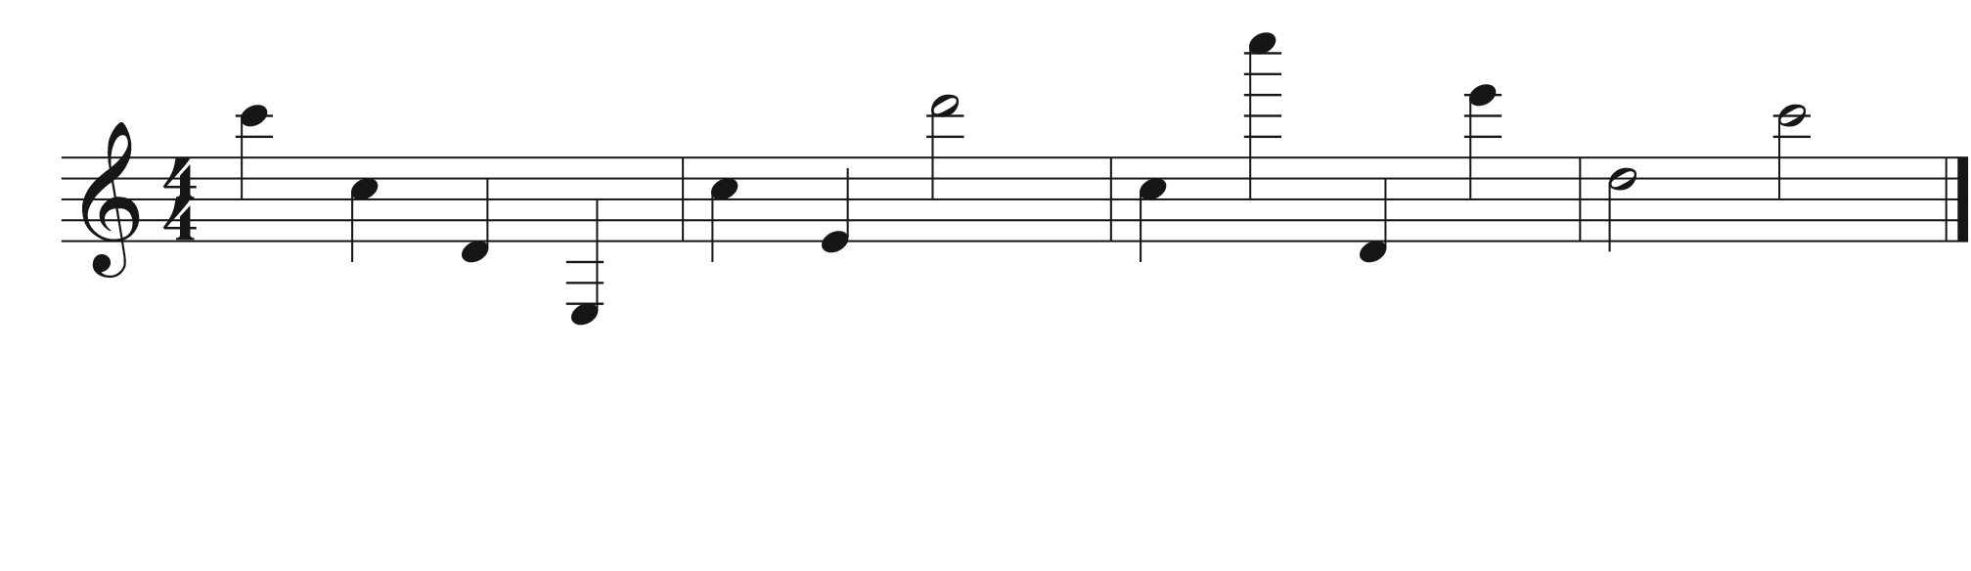
Octave equivalence as a universal
Do you recognize the tune?
C C D E C E D C C D E D C
Notes:
When people think about musical universals, octave equivalence usually comes up early on the list. This is a good example of why being clear about our definitions is essential. Broadly construed octave equivalence is not even a feature of Western music. For instance, can you recognize this melody?
[play]
Most people can’t. [animation] Here's the notation for what I played. Now if I simply write down the letter of each note, see if you recognize it. [animation]
It’s Yankee Doodle with the octaves scrambled. Octave equivalence in Euro-classical music is a feature of harmony and keys, but is not a principle across the board, for instance in melody recognition. As I mentioned before harmony is one of the weird features of Euro-classical music. This should make us suspicious of the claim that octave equivalence is universal.

Slide 18
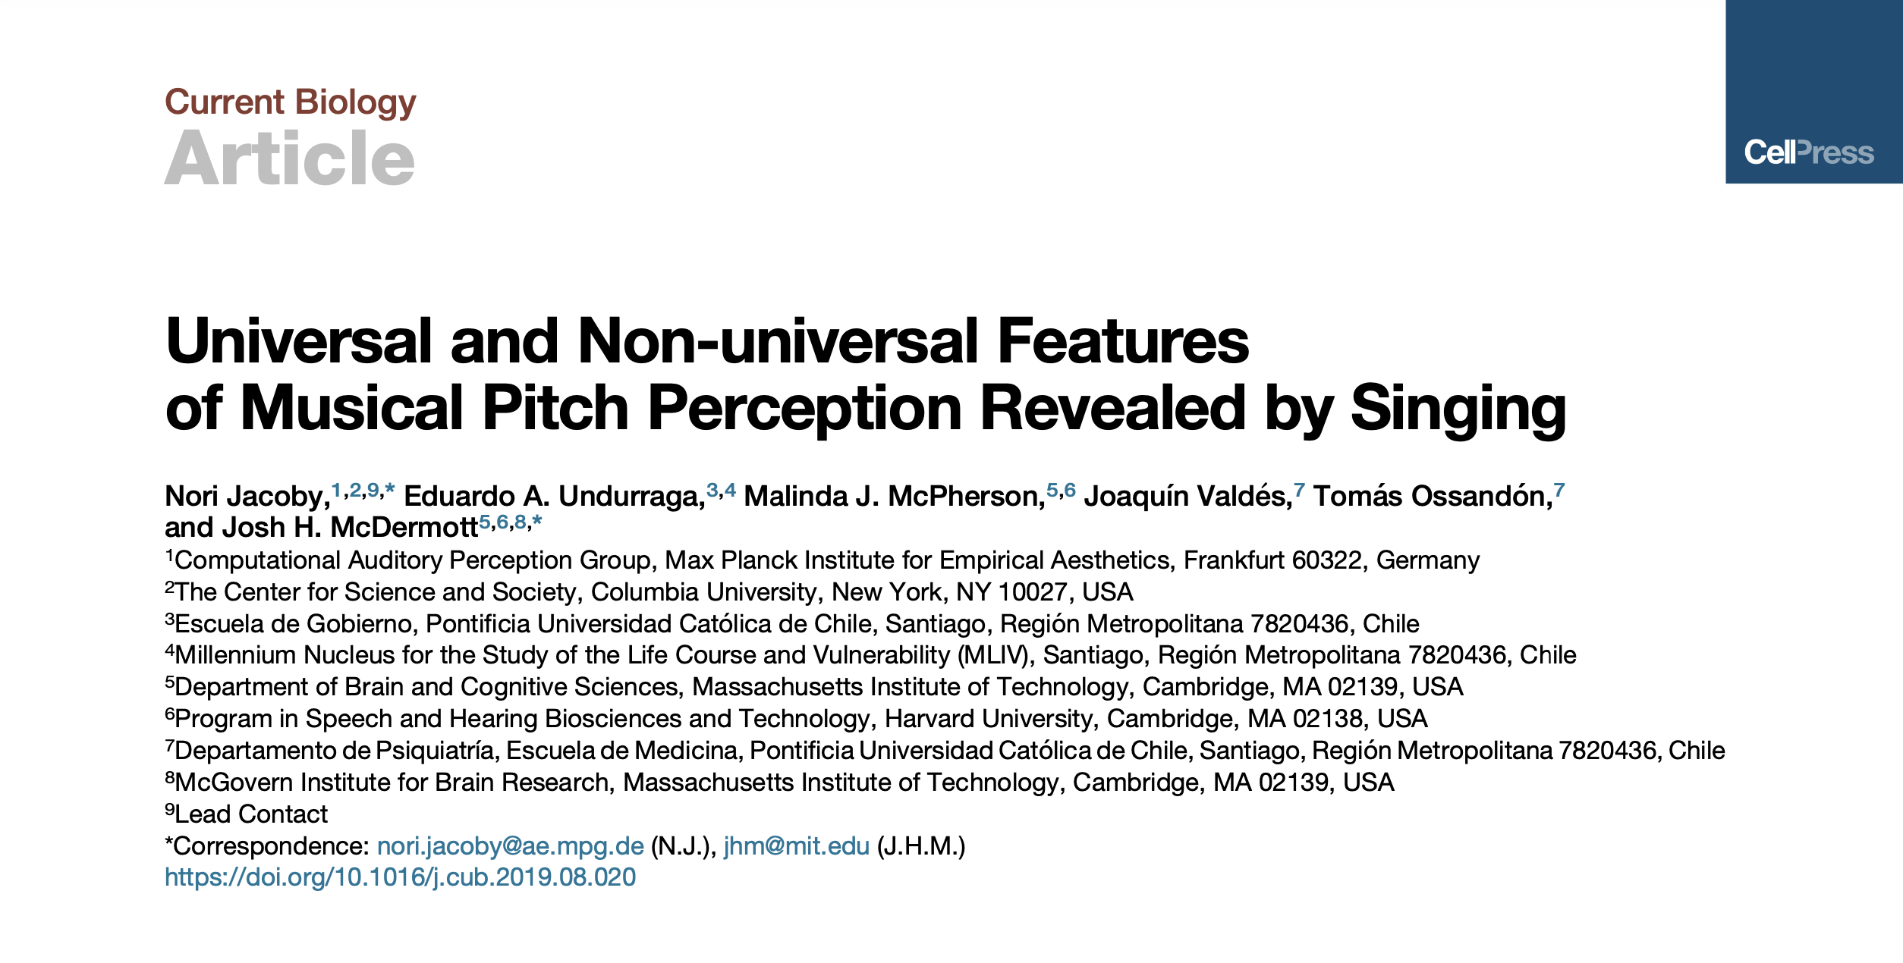
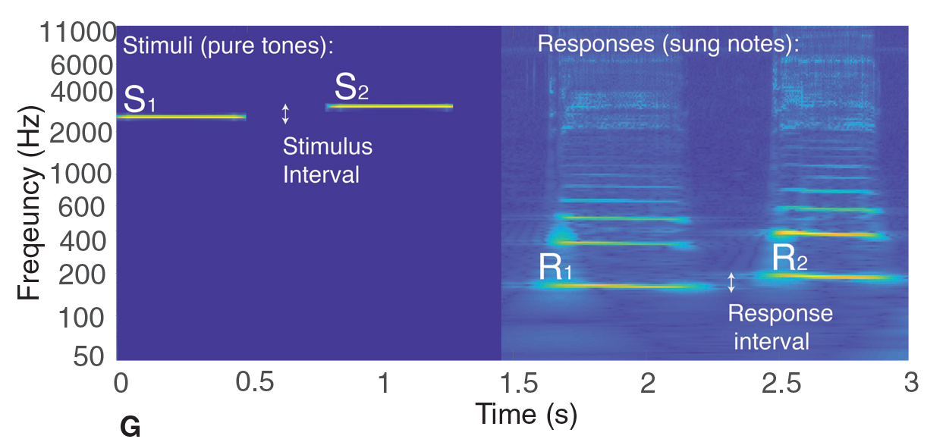
Notes:
In fact it isn’t, as this recent study has shown. The study compares US participants to Tsimane participants, an indigenous tribe living in a remote village in the Bolivian rainforest. The task was simply to sing back musical intervals played outside the participants’ vocal range.

Slide 19
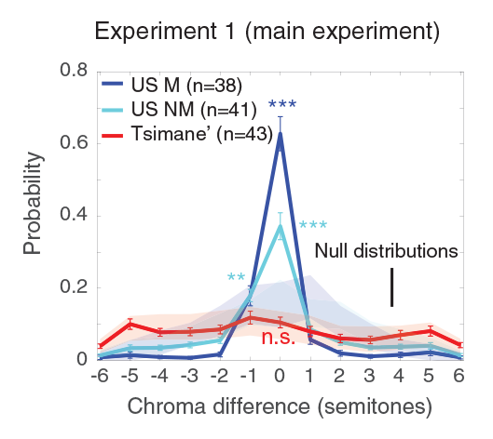
Results: Jacoby et al. 2019
Notes:
When US participants do this they match the chroma of the stimulus, shifting it by octave. The Tsimane participants, though they accurately reproduced the interval, did so by choosing a starting note in their vocal range that was not necessarily an octave transposition of the stimulus. This form of octave equivalence therefore relates to peculiarities of Western music and is not shared by all human societies.
So is there in fact no universal here? I just got finished claiming that organization by fifths is universal and now I’m calling octave equivalence into question. Actually, the problem is not with octaves but with the meaning of equivalence. Psychoacoustics provides a good explanation of why we should expect the perception of octaves to be universal. Pitch-based musical systems do almost always include octaves and treat them as a special interval. There’s little beyond this, though, to suggest a psychoacoustic basis for treating octave-related notes as equivalent. The evidence suggests that treating octaves as a special interval is a universal, in the sense that originates in the human capacity for music, rather than historical contingencies of specific styles. By the same logic, the special status of fifths is also universal. Octave equivalence, on the other hand, is based on a historical contingency. That contingency is the system of tonality that developed in Europe and is unique to that tradition and its progeny.
I mentioned already that a dramatic transition is underway in music theory to decenter the topics of harmony and tonality that I’ve been discussing in favor of other musical parameters. Theorization of rhythm
In recent years cross-cultural research in music cognition has grown rapidly, with rhythm and meter as an especially dominant topic.

Slide 20
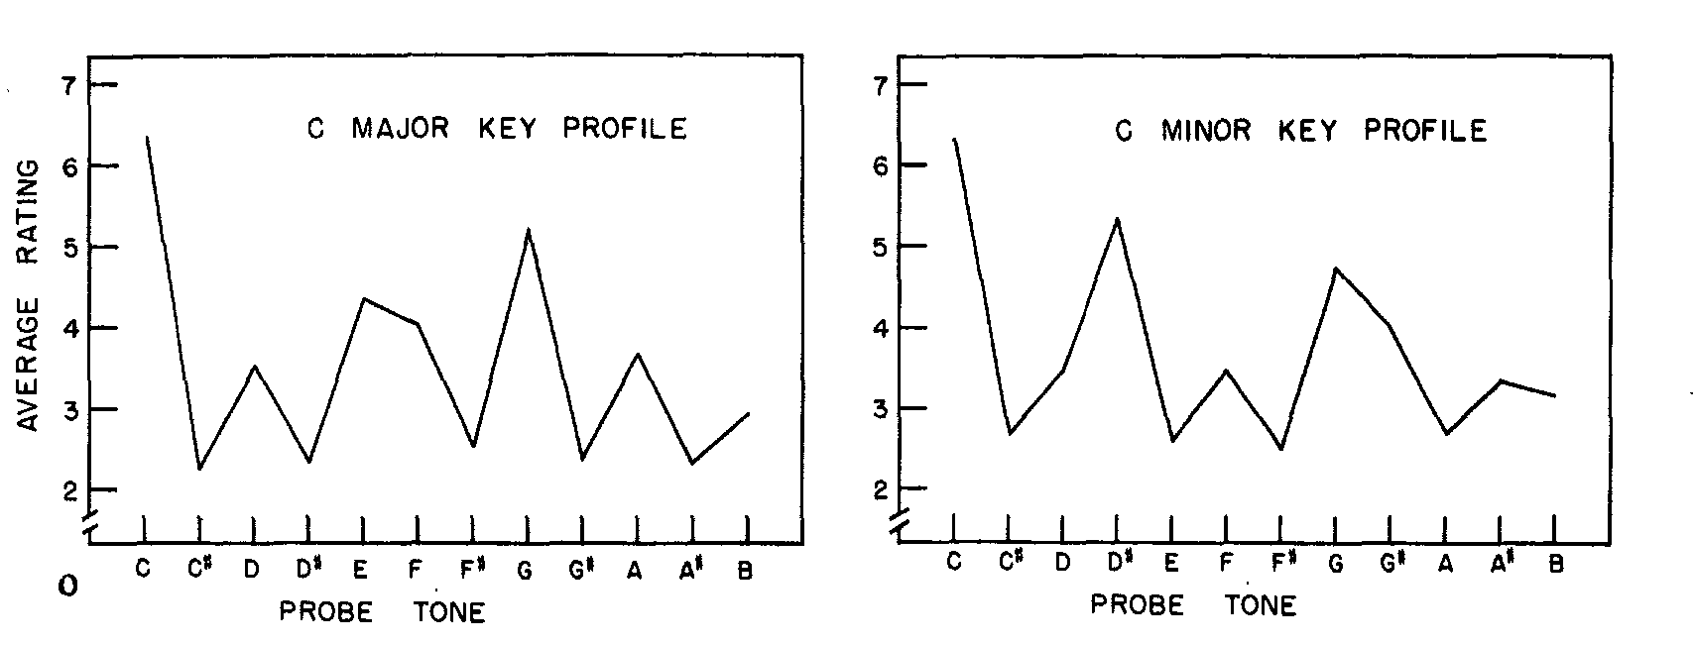
Key profiles (Krumhansl & Kessler 1982)
Like most music psychology: Euroclassical contexts, WEIRD participants
. . . BUT: Probe-tone methodology generalizes!
Notes:
One topic that produced some of the earliest cross-cultural studies is Carol Krumhansl’s theory of tonal hierarchy. The original version of her theory operated only within the Euro-classical framework, relying on its concepts of key, stability, and musical conventions associated with them. The theory claims that the psychological phenomenon of being in a key corresponds to an assignment of stability values to each of the twelve notes of the chromatic scale with the highest values for the tonic note, followed by the tonic triad, then the basic scale. The original experiments to validate this theory used a probe-tone method. This method involves establishing some musical context and then asking subjects to rate the fit of all twelve pitch-classes following that context.
To make this method applicable to outside of the Euro-classical context requires some adjustments. The easiest is to generalize the contexts beyond ones derived from Euro-classical major and minor constructs. More problematic is the probe-tone set, which relies on the Euro-classical convention of 12-tone equal tempered tuning. In addition, the basis for rating probe tones must be meaningful and consistent across participants’ different musical backgrounds.

Slide 21
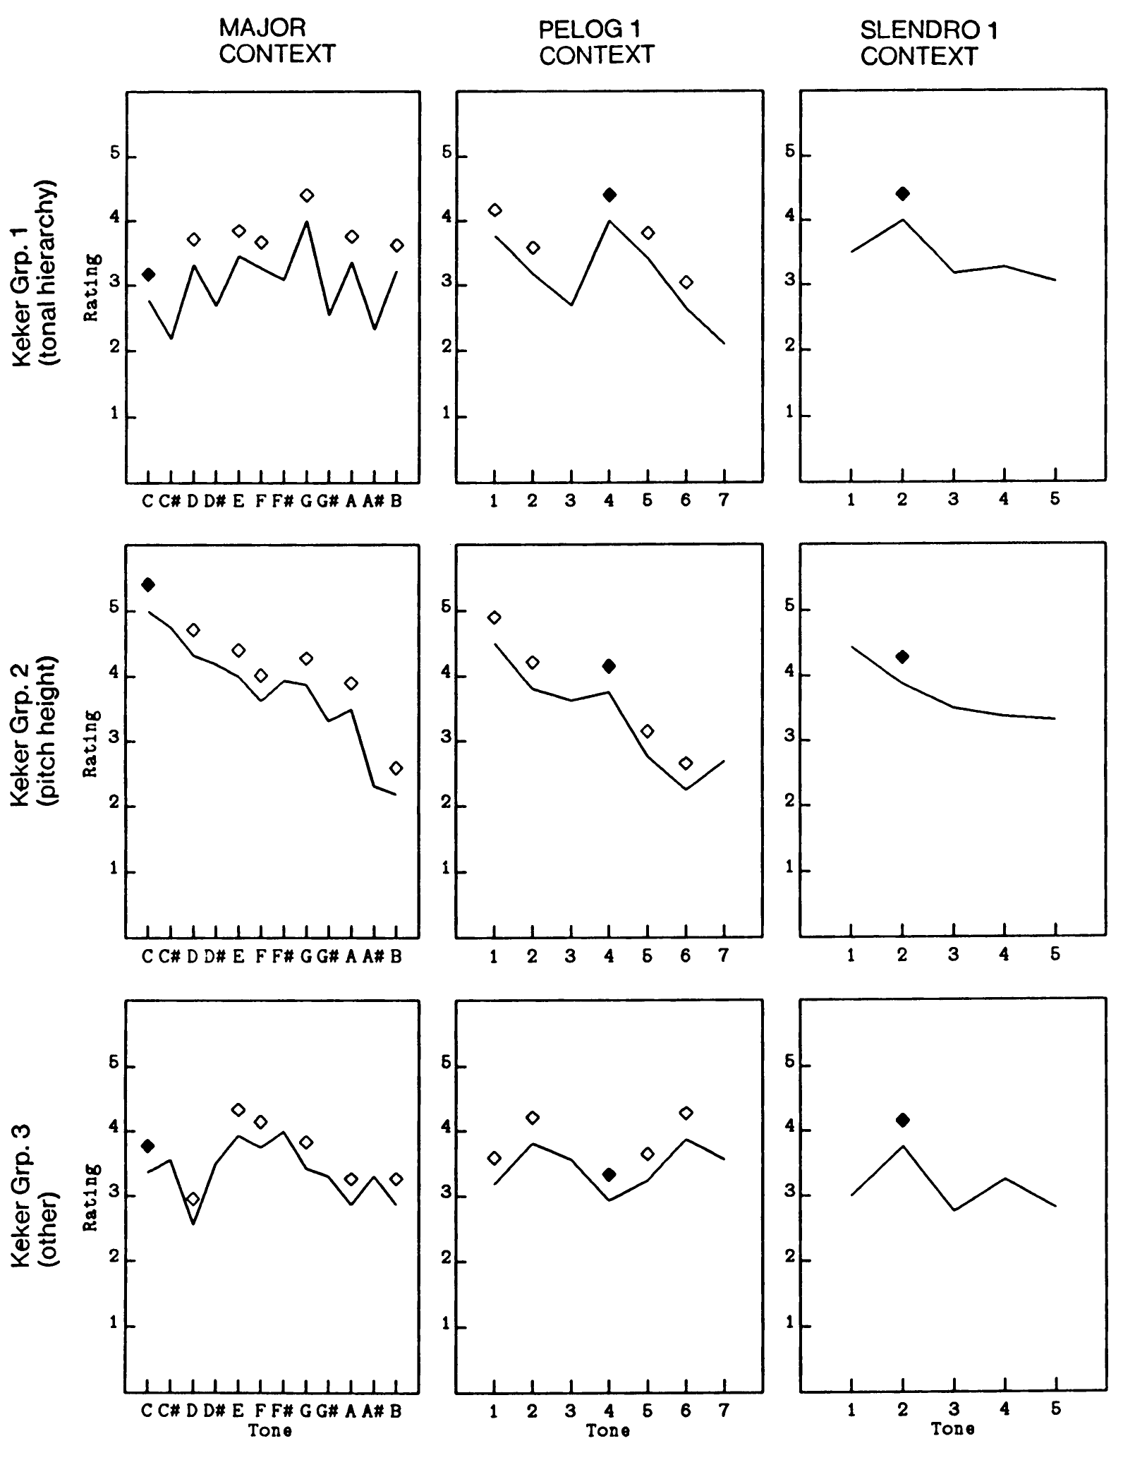
Kessler, Hansen, & Shepard 1984
Participants:
• Western, no exposure to Balinese music
• Balinese conservatory musicians
• Balinese remote village musicians
Notes:
The other extant cross-cultural study compares Western listeners to Balinese listeners, and is especially notable for the inclusion of a subject population with little to no exposure to Western music. The generalization of the probe-tone paradigm is more strained here. While the concept of out-of-scale tones exists in Balinese music, it is much less prevalent. The pelog tuning theoretically contains seven tones with the scale being a five-note subset, but many gamelans include only the five tones. The slendro tuning has only five tones and no out-of-scale tones. Furthermore, the two systems do not have fixed tunings. Balinese musicians prize the variability of pelog and slendro tunings from one gamelan to another.
The results of the study reveal that a group of Balinese musicians from a conservatory and familiar with Western music understood the instructions and rated probe tones similarly to Western listeners. The listeners from a remote village without exposure to Western music disagreed on how they understood the instructions. The authors divided these participants into three groups, one that produced results similar to the conservatory musicians, one that rated probe tones by pitch height, and a third whose answers fit no discernable pattern. Overall, the lack of agreement indicates that the Euro-classical concept of tonal stability does not generalize to all musical traditions. It is cross-cultural but not universal.
The fact that we find this only when seeking out populations without exposure to Western music suggests that the concept of tonal stability may be a European cultural export. This is made all the more interesting by the fact that we can trace the practice of characterizing world musics by their scales to Fétis. His assumption that each musical tradition had its own tonality was a colonialist attempt to interpret all musics within a Euro-classical theoretical framework. The fact that those traditions looked impoverished within this framework, at best having scales, but not implicative tones or functional harmony, occasioned the explicitly racist premise of Fétis’s last major work. It is also the beginning of a process where traditions like Hindustani raga and Arabic maqam began to adopt concepts of scale and tonal stability from Euro-classical theory.

Slide 22
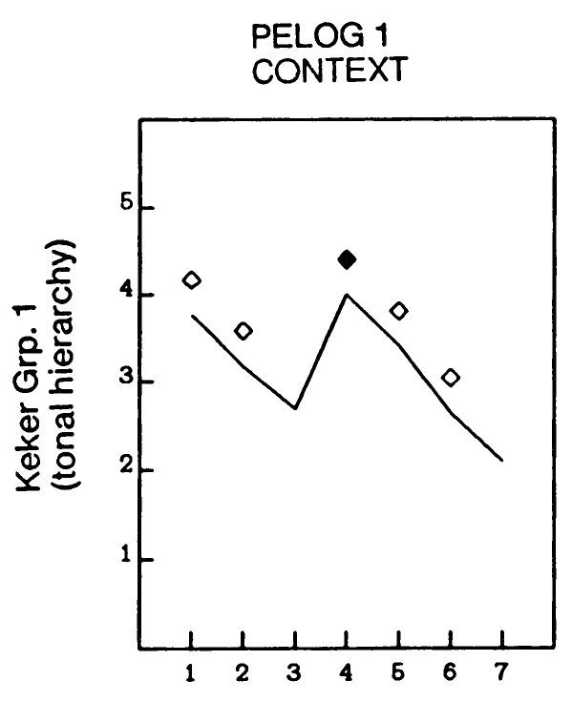
Kessler, Hansen, & Shepard 1984
Notes:
On a closer look, however, the results of this study are also evidence for a possible deeper cross-cultural theory. If the idea of tonal stability is not universal, and if Hinustani and Balinese conservatory musicians use the term meaningfully and consistently because of their familiarity with Western music, then it is remarkable that a subset of the remote villagers produced rating patterns that matched the conservatory students.

Slide 23
Kessler, Hansen, & Shepard 1984
Circle of fifths
(ngempang, kempyung)
Notes:
Furthermore the pattern is striking in that it seems to be based on a generalized circle of fifths, with ratings decreasing regular with fifths distance from the gong tone. These intervals only very roughly approximate acoustical fifths in tuning but they all span four scale steps and are called ngempat in Balinese and kempyung in Javanese, playing a special role in the traditional theory of both styles. The organization of pitch materials by fifths is very widespread and found in musical practices that are not historically related. It is probably, therefore, a part of the general human capacity for music.

Slide 24
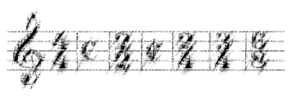
Meter

Slide 25
Meter: Conceptual features
The concept of meter originates as a feature of European notation.
Features associated with it come from the needs and constraints of notation:
• Time-discreteness • Isochrony • Hierarchy
4
4
h q iq | q q h |
Notes correspond
to timepoints
Strict
containment
hierarchy
between
levels
v
Equally paced time measurement
Time

Slide 26
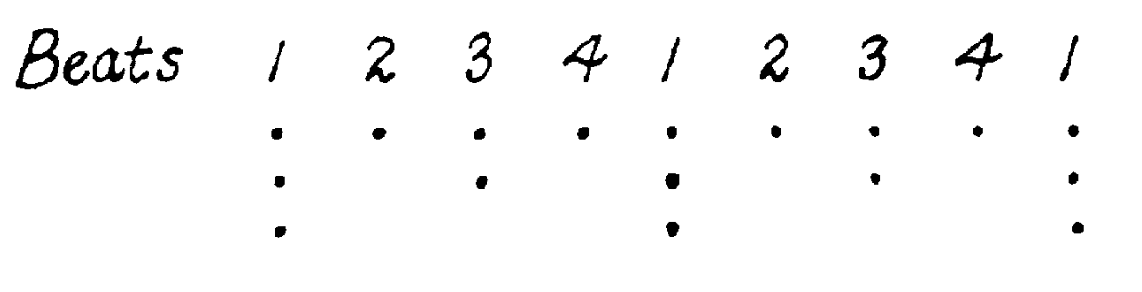
Meter in music theory: the myth of isochrony
Lerdahl and Jackendoff, A Generative Theory of Tonal Music (1983):
Metrical well-formedness rules:
(4) “Each metrical level must consist of equally spaced beats”
(Isochrony)
(2) “Every beat at a given level must also be at all smaller levels”
(Hierarchy)
Notes:
Time-discreteness is an unstated premise

Slide 27
Entrainment
Sensori-motor synchronization (e.g. tapping along)
Self-sustaining, predictive
Meter: • Time-discrete • Isochronous • Hierarchical
Entrainment: • Time-continuous • Periodic ?
Entrainment is typically viewed as the psychological correlate of meter, but nothing about entrainment implies the hierarchy constraint of the traditional concept of meter.
Notes:
The concept of meter has changed from something specific to notation to something psychology. The cognitive capacity associated with it is entrainment, the ability of humans to synchronize to regularity in a stimulus. Entrainment is often equated with meter, but what many people miss is that the theory of entrainment only implies that humans are sensitive to periodicities, not that there is a hierarchy constraint on those periodicities. But because that’s an essential component of the theory of meter, we often assume that research on entrainment supports it, even if it does not.
Ed Large is working on this, but even if he has an explanation of why hierarchical meters are likely, it does not imply they are a logically necessary (a well-formedness constraint)

Slide 28
Is meter universal?
Periodicity is a common characteristic of music everywhere in the world, but metrical hierarchy may not be.
“The treatment of metric organization as implying a series of weak and strong beats does not apply particularly well to West African or African-American musics. In these contexts there is not always such a thing as a metric accent, from the point of view of performance variation.” (Vijay Iyer, 2001)

Slide 29
Rhythm and periodic functions
ω = 4
0
0.25
0.50
0.75
1.00
1.25
1.50
1.75
2.00
2.25
2.50
2.75
3.00
Time →
Notes:
Let’s start by modeling entrainment with sinusoidal functions. There are other kinds of functions we might use, but the important feature is that the function is smooth and continuous in time. Sinusoidal functions are the simplest periodic function of this kind. The function here is a possible psychological model for a simple beat at 80 BPM. The height of the curve might represent expectancy, how strongly the listener expects an event at that timepoint. It also might represent physical or virtual body movement in coordination with some musical stimulus.

Slide 30
Rhythm and periodic functions: traditional meter
4 is a divisor of 8
ω = 8
ω = 4
+
=
0
0.25
0.50
0.75
1.00
1.25
1.50
1.75
2.00
2.25
2.50
2.75
3.00
Time →
Notes:
This model of an expectancy function over time makes it easy to represent multiple metrical levels. For instance the expectancy function for a duple subdivision of this 80 BPM beat is a sinusoidal function at twice the frequency. The combined expectancy function is just a sum of these.

Slide 31
Rhythm and periodic functions: Tresillo
3 is not a divisor of 8
ω = 8
ω = 3
+
=
Time →
Notes:
For instance, instead of combining our frequency-8 function with a frequency-4 function, we could combine it with a frequency of 3. If we put a rhythmic event at each peak of this function, we get the tresillo rhythm, a foundational rhythm for many diverse musical styles. If we want to add more rhythmic events, we could use the next two peaks and get the related cinquillo rhythm. These two rhythms also result from combining functions at frequencies 8 and 5.
Making the model time-continuous is crucial. With a time-discrete model, combinations of functions like these would result in a polyrhythm, greatly increasing the complexity of the metrical model. Psychologists have rightly resisted the idea that polymeter could be a psychological phenomenon because of this complexity. However, the complexity does not compound this way with the time-continuous model. The tresillo can be a plausible psychological meter.
This is very different than the conventional account, which claims that the tresillo is a kind of syncopation. According to this description, the meter has four beats per cycle and the rhythm goes against the meter. The assumptions built into the traditional Euro-classical concept leave no alternative. If, as I conjecture here, it is possible for the tresillo to act as a meter for music based on it, then the Euro-classical theory is acting as a colonialist force when we claim that the tresillo can only be a syncopated rhythm, not a meter. What I find especially notable about this example of colonialist music theory is that it operates quite effectively without individuals having any colonialist intent. It requires an active deconstruction of the received concept of meter to become aware of the colonialist regime.
Although I do not have direct psychological or neurological evidence for this tresillo meter, there is plenty of circumstantial evidence. Tresillo-based music is common and occurs in musics with no direct phylogenic connection, such as Balinese and Carribean styles. These musics can maintain a tresillo groove while articulating a variety of rhythms, much as we typical sustain conventional meters despite syncopations and unarticulated beats. According to conventional metrical theory, the tresillo is just a rhythm. There is no obvious reason it should be privileged among the many rhythms possible in an 8-beat cycle. According to the model of continuous periodic functions, on the other hand, the tresillo is special; it is one of the simplest of small set of possible meters based on co-prime frequencies.

Slide 32
Non-hierarchical periodicities: Tresillo + Backbeat
Kick and snare drive frequency 2 in conflicting phases:
Snare:
Kick:
Kick and snare
also drive frequencies
4 and 8 (multiples of 4)
in the same phase:
Grid:
Bass:
Tresillo pattern in bass drives frequency 3 despite being on 8-grid (not a polyrhythm!):

Slide 33
Non-hierarchical periodicities: Tresillo + Backbeat
Another common drum pattern:
Snare:
Kick:
Grid:
Kick drives frequency 3 as well as 2:

Slide 34
Cognitive Critique of Polymeter
“If one has two meters in conflict with each other, then from a cognitive point of view one is saying that the listener is simultaneously using two distinct attending strategies; she or he is maintaining multiple grounds for the construal of melodic figures.” (Justin London, Hearing in Time, 2012)
N.B. “Meter” → “Attending Strategy”
Dynamic attending theory (DAT) → periodic fluctuations in attention synchronized to periodicities of rhythm
but
→ attention is the only such response to periodicities of rhythm
/

Slide 35
Syncopation
Definitions:
“The regular shifting of each beat in a measured pattern by the same amount ahead of or behind its normal position”
(New Grove)
“a momentary contradiction of the prevailing meter” (New Harvard Dictionary of Music)
“the absence of a note onset in a relatively strong metric position compared with the preceding note onset” (Huron and Ollan 2006)
“a syncopated rhythm is one that is low in probability given the prevailing meter (by the norms of common-practice rhythm)” (Temperley 2010)
Meter is essential to all definitions, syncopations in opposition to meter

Slide 36
Syncopation
Older definition: “regular shifting” —Specific to Euroclassical music
Ragtime doesn’t fit into metrical–syncopated binary
Solution: Generalize
→ Newer definition (“contradiction of the prevailing meter”)
Joplin,
School of
Ragtime
Ex. 2
Contradicts meter, but not a regular shifting

Slide 37
Ragtime rhythm
Second strain from Joplin’s “The Sycamore,” phrases 1 and 2
Rhythmic spectra show the strength of each possible frequency in the rhythm
1 meas. freq.
2 meas. freq.
Phrase 1
Phrase 2
Meas./3: tresillo

Slide 38
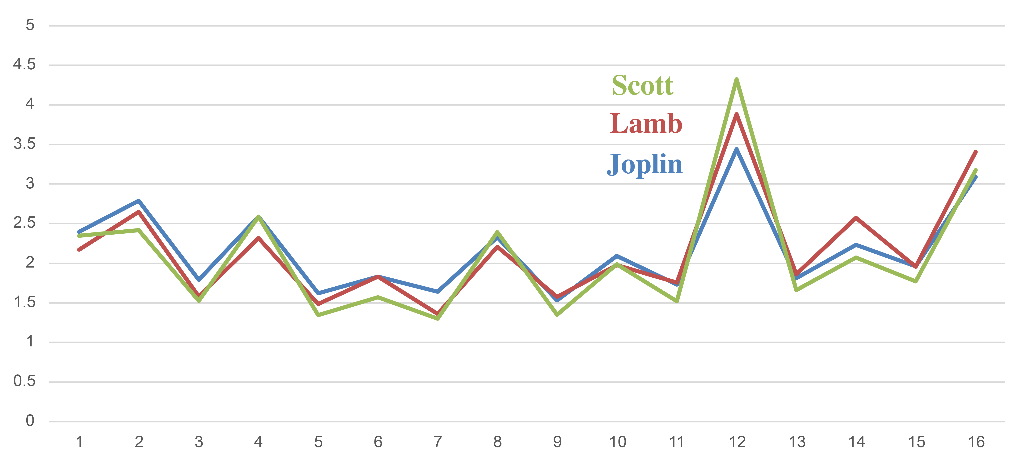
Ragtime rhythm
Averaged spectra over 4-measure phrases
⅓ meas. (tresillo)
1 meas.
Beat
½ meas.
Size
from Yust & Kirlin 2021
Frequency (per 4-m. phrase)
“Syncopated” (implying flat spectrum) is a poor description!
Ragtime melodies consistently emphasize the ⅓-measure frequency
Notes:
By the generalized definition, “syncopated” rhythm would just lead to a more flat spectrum. This one is decidedly not flat.

Slide 39
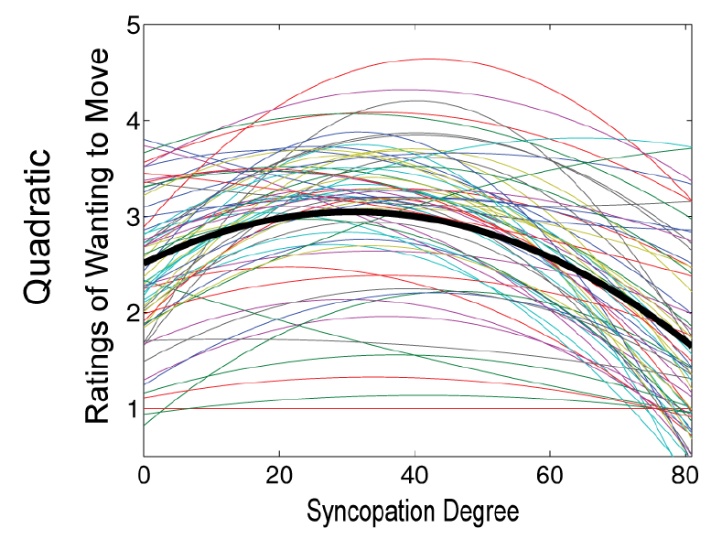
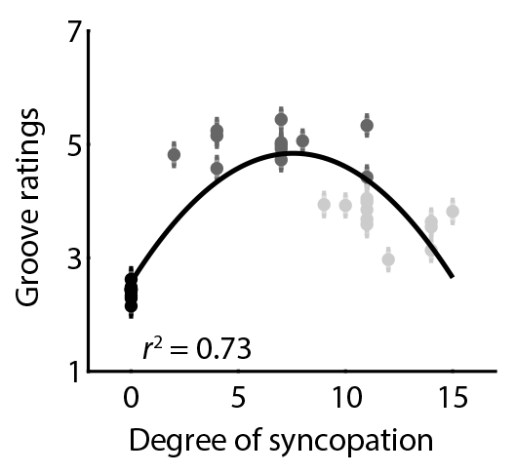
Empirical Studies of Groove
“Syncopation works against the meter by emphasizing a weak beat and deemphasizing a strong beat. This creates tension with the established meter, violating expectations. Listeners rate syncopated sequences as more enjoyable and sounding happier than non-syncopated sequences, but this depends on the degree of syncopation. An inverted U-shaped relationship has been shown between degree of syncopation, and ratings of pleasure and the desire to move, where moderately syncopated rhythms are rated higher than rhythms with low or high degrees of syncopation” (Matthews, Witek, Heggli, Penhune, Vuust 2019)
Witek et. al 2014
Zalta et al 2024

Slide 40
Reanalysis of data from Witek et al.
The result in favor of the “inverted U” effect of syncopation is driven almost entirely by experimental-composed stimuli.
Rating
Rating
Distance from average syncopation
Distance from average syncopation
r = –.60
r = –.35
Experimenter-composed
Experimenter-composed removed

Slide 41
Reanalysis of data from Witek et al.
A multiple regression technique compares the explanatory value of various rhythmic features
A single feature, the distance between kick and snare rhythms in frequency 12, is much more explanatory than Witek et al.’s syncopation measure
Whether the stimuli are experimenter-composed is also highly predictive . . .
But ultimately we get a better model relying only on rhythmic features
Notes:
As you go up in a single column, features are added to the model.
The first column picks the best features excluding Experimenter Composed, the second starts with Experimenter composed, and the third shows Witek et al’s syncopation measure.
R-squared gives the percentage of variance explained by each model.
The features included are the strength of frequencies 1–16 for the kick drum rhythm, the snare, and the composite rhythm, and distances between the kick and snare rhythms in each of these frequency spaces. The latter set of features measures how the kick and snare rhythms complement each other.
We can get a remarkably predictive model with 10–13 rhythmic features.
The feature most predictive by itself is the kick-snare distance for frequency 12, which can explain over half the variance by itself.

Slide 42
Rhythm and periodic functions: Adowa
ω = 12
+
ω = 5
=
0
0.25
0.50
0.75
1.00
1.25
1.50
1.75
2.00
2.25
2.50
2.75
3.00
Notes:
Another relatively simple possibility is to combine frequencies of 5 and 12. This gives a meter corresponding to the so-called African standard pattern, a timeline found in many ethnically diverse traditions of West and Central Africa. We get a similar function by combining frequencies of 7 and 12. Notice that this meter can characterize not only music based on the 7-beat standard pattern, but also common 5- and 6-beat variants.

Slide 43
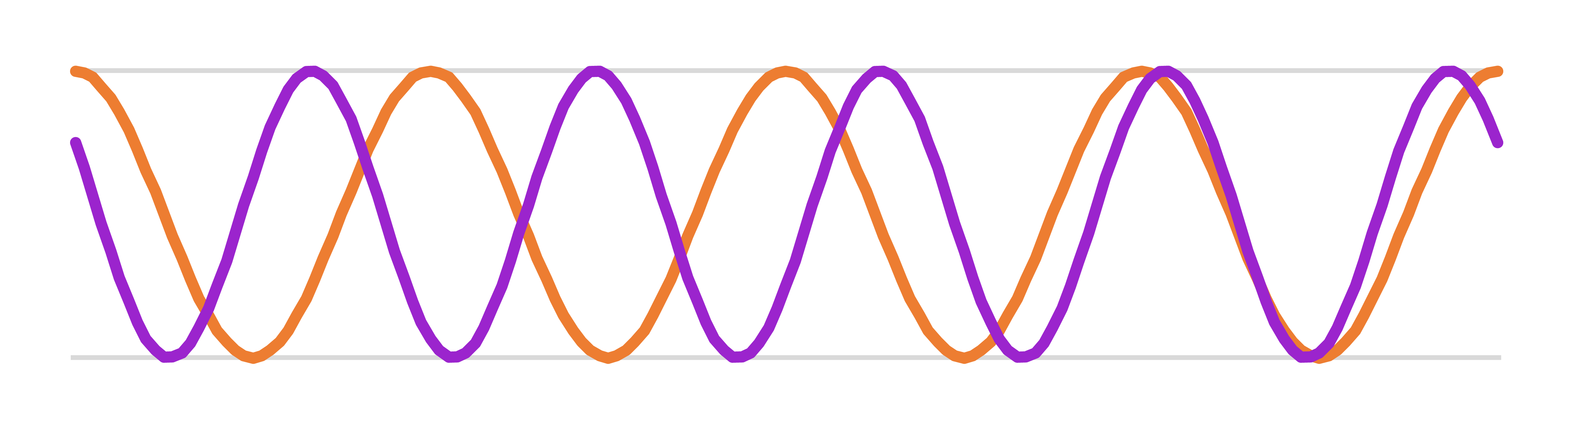
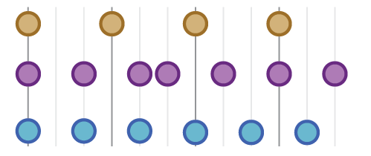
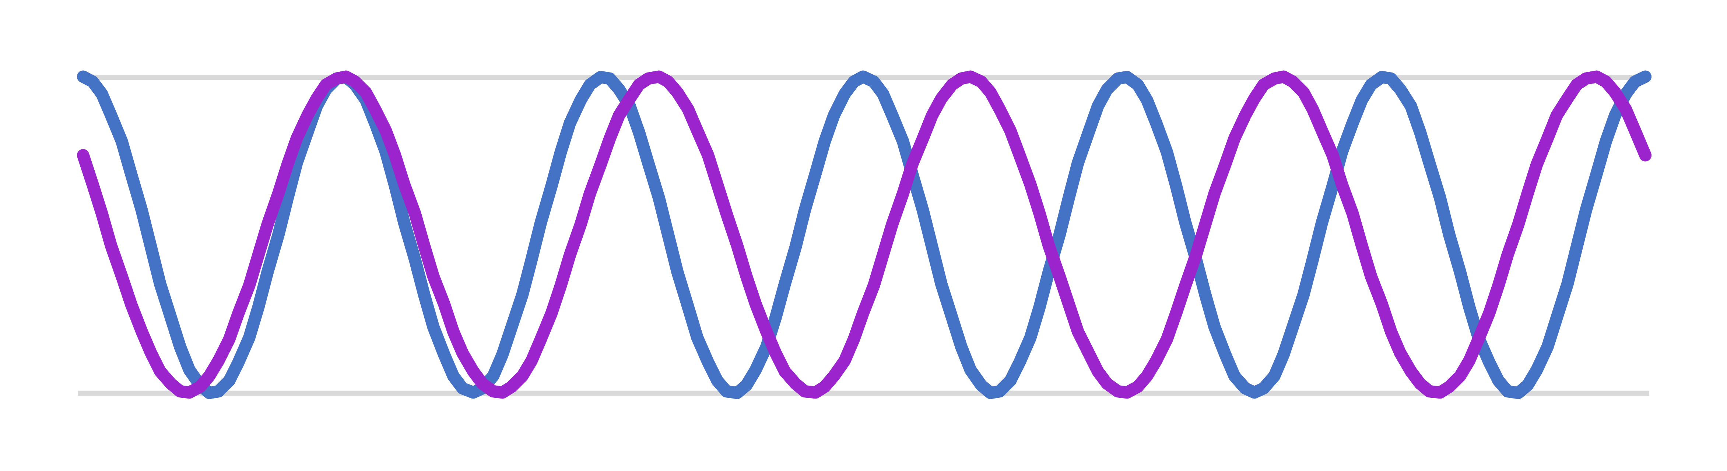
Ghanaian dance drumming
The standard bell pattern for West African dance drumming approximates a frequency of 5 interacting with polyrhythmic layers in frequencies of 4 and 6
t
Out of phase
In phase
• This is a general feature of timeline (clave) patterns in Afro-diasporic music (e.g. Afrocuban, Afrobrazilian)
• African musicians (see Ladzekpo) talk about these cyclic processes of rhythms going in an out of coordination as a positive aesthetic feature.
Agbadzo dance
“Lagu Duto Adu Bese”:
Beats
Bell
Afrikania Cultural Group of Anlo-Afiadenyigbi,
Recorded by
David Locke
Clap
In phase
Out of phase

Slide 44
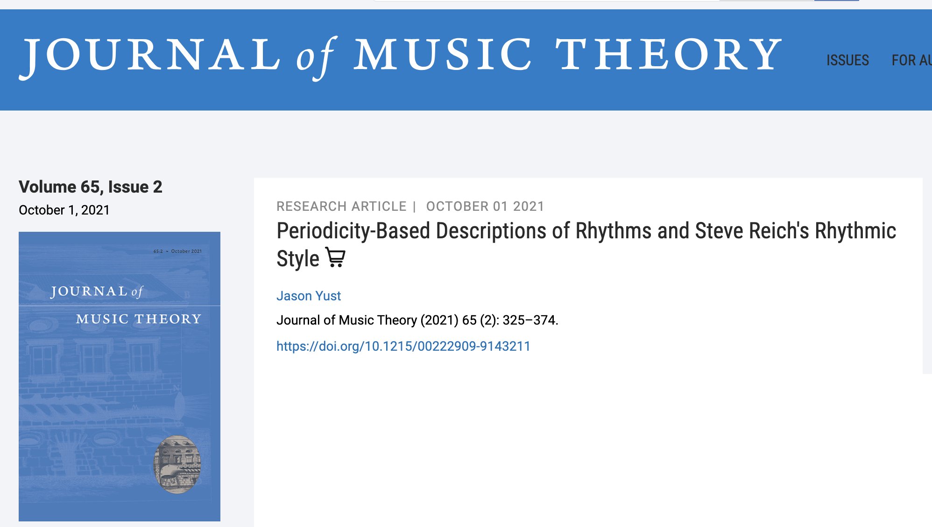
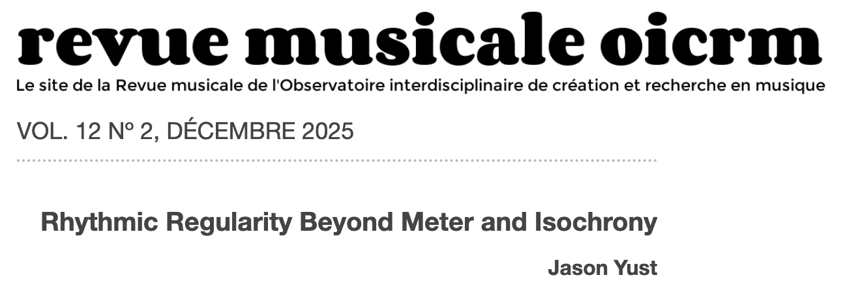
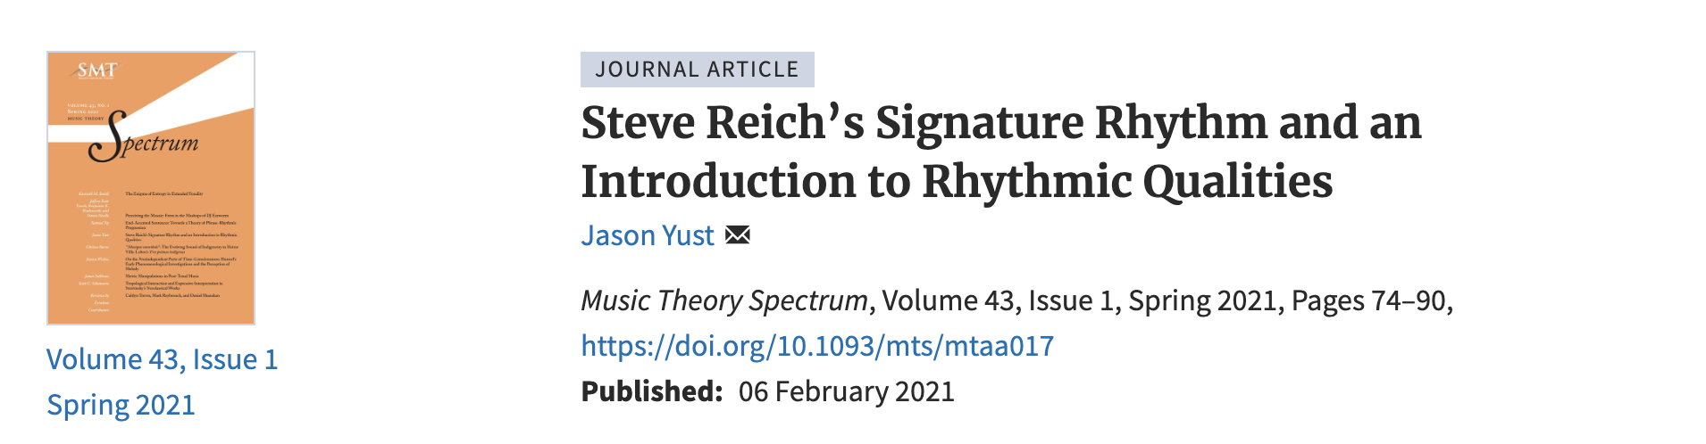
Fourier analysis of rhythms
Notes:
This is just scratching the surface of the modeling of rhythms and pitch collection using periodic functions. I’ve written about the topic at length. The process of building a rhythm by combining sinusoidal functions can be reversed, decomposing a rhythm into its constituent frequencies. This process is known as a Fourier transform. There are many useful analytical tools we can derive from this method. If you are interested in investigating this topic further I refer you to these articles in Music Theory Spectrum and the Journal of Music Theory, and one that will be published next year in Revue Musicale.

Slide 45
Rock Music

Slide 46
Rock Music
Unlike “tonality” and “meter,” genre labels are created by critics and the record industry and maintained by musicologists.
So:
(Q) Are music theorists responsible for the antiblackness of “rock”?
When “rock” is understood to refer to features of the music.
• Music theorists have developed analytical techniques specifically for “rock.”
• Prominent recent books by music theorists claim that “rock” is a distinct musical language.

Slide 47
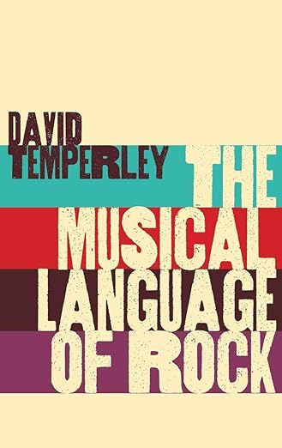
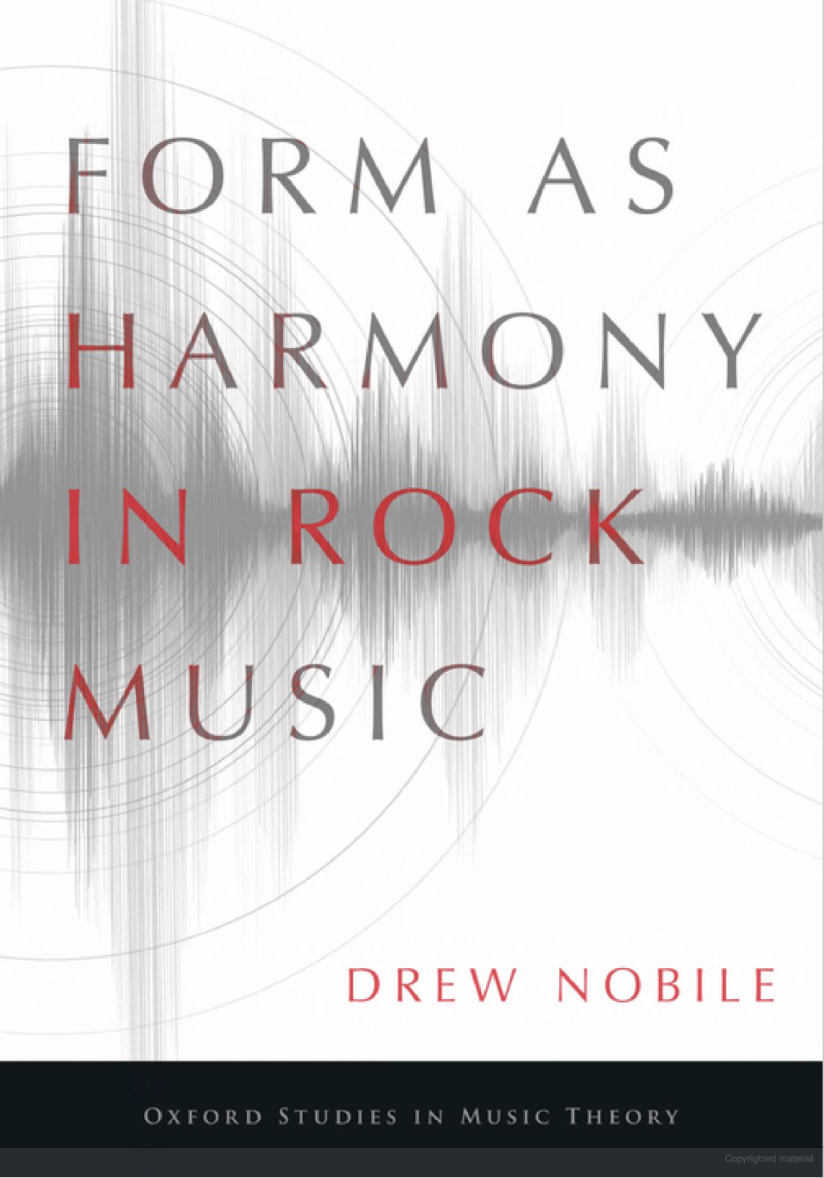
Theory and “Rock” Music
Popular music is an increasingly common subject of music theory.
A crucial premise of music of this is that there is a language (esp. a harmonic language) of “rock” music
2018
2020

Slide 48
But . . . What is Rock Music?
“[This question] is highly problematic, and I shall begin by refusing to offer a definition, in the belief that all readers will bring with them commonsense, and highly diverse understandings of what ‘rock’ is to them.”
Rock: The Primary Text (Moore and Martin 2018)

Slide 49
Defining “Rock”
Popularized by DJ Allan Freed in the 1950s Musically synonymous with “R&B” without racial associations
→ There was never any musical necessity to the term Its original purpose was to allow whites to play and listen to music created by African Americans.
Its purpose remains to put white musicians at the center of the story.
“You know the blues got sold . . . ” —Muddy Waters

Slide 50
Histories of “Rock” Music
Dates covered in
What’s that Sound?: An Introduction to Rock and its History (Covach and Flory 2015)

Slide 51
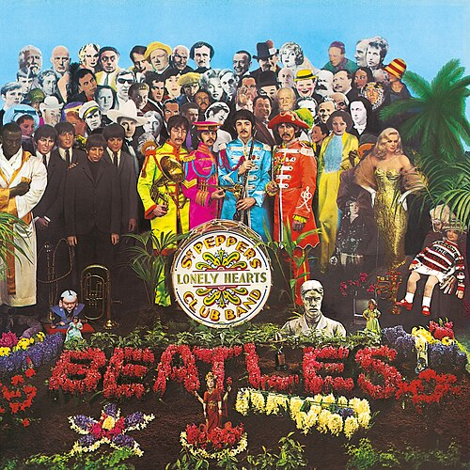
Two musical events of 1967
James Brown: Cold Sweat
https://www.youtube.com/watch?v=b0p1JR3nEy8
Which of these is the most important to the history of music?
Which of these is more talked about in histories of rock?
Which of these is more necessary for explaining where features of later music come from?
Notes:
If you’re a sociologist you would certainly pick the left, but it’s equally clear that a music theorist has to pick the right.

Slide 52
Histories of “Rock” Music
Dates covered in
What’s that Sound?: An Introduction to Rock and its History (Covach and Flory 2015)

Slide 53
Early Scholarly Analysis of Popular Music
1974: Wilfrid Mellers, Twilight of the Gods: The Music of the Beatles
“The Beatles’ music is more open, whiter, fresher, tenderer than the age-old black blues, for its Anglo-Irish affiliations lead it towards innocence rather than ecstasy, pleasure rather than pain, wholeness rather than blueness” (p. 42)
1976: Charles Stetzer, “Four Aspects of Music of the Beatles: Instrumentation, Harmony, Form, and Album Unity”
“the evolution of rock and roll from its roots as a simple, dance-oriented music towards a complex form of art-entertainment is evident in music of the Beatles” (p. 4)

Slide 54
It starts with the critics . . .
“One of the most interesting phenomena of the rock movement in recent years has been the attempt to establish rock’s position as a valid aesthetic form within the Western cultural tradition. The Beatles probably began this quest for legitimacy in the summer of 1965 when they used a string quartet to back up their recording of “Yesterday.” Since then, the use of serious musicians has become more common, and we now have those one-time enfants terribles of rock, the Rolling Stones, using the London Bach Choir on their most recent album.” (Barry Gewen, 1970)

Slide 55
Analysis of “Rock”
The Foundations of Rock: From Blue Suede Shoes to Suite: Judy Blue Eyes (Everett 2008)
Form as Harmony in Rock Music (Nobile 2020)

Slide 56
Thanks for listening!
Preprints and powerpoints here:
sites.bu.edu/jyust
Soon to be available from Routledge Press:
American Antiblackness
edited by Philip Ewell and Joe Feagin

