Slide 1

Musical Rhythm as Signal
Jason Yust, .
King’s College London, March 25, 2025

Slide 2
Outline
Meter vs. entrainment
Fourier analysis of rhythms
Maximal evenness and rhythmic qualities
Corpus analysis: ragtime rhythm
Coherence (Fourier coefficient products)
Analysis: Adowa master drum performance
Corpus analysis: Arabic Iqa’at

Slide 3
Meter and Notation
The concept of meter originates as a feature of European notation.
Features of metrical notation:
• Time-discreteness • Isochrony • Hierarchy
4
4
h q iq | q q h |
Notes correspond
to timepoints
v
Strict
containment
hierarchy
between
levels
Equally paced time measurement
Time

Slide 4
Entrainment
Sensori-motor synchronization (e.g. tapping along)
Self-sustaining, predictive
Often viewed as the psychological correlate of meter, but . . .
Meter: • Time-discrete • Isochronous • Hierarchical
Entrainment: • Time-continuous • Periodic ?

Slide 5
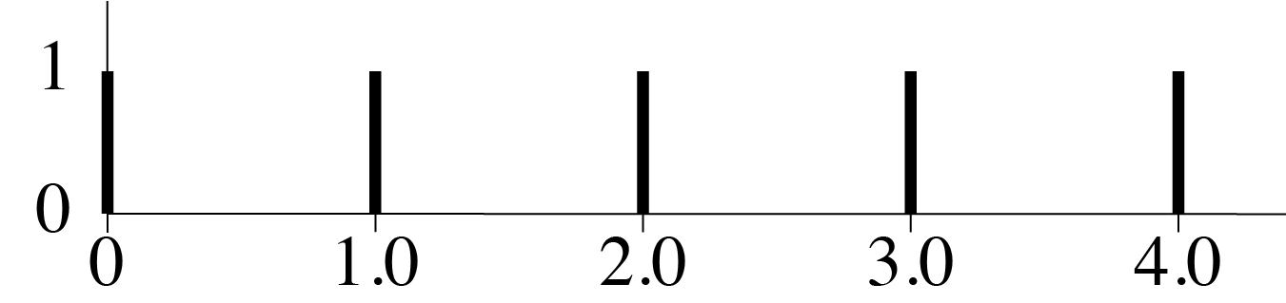
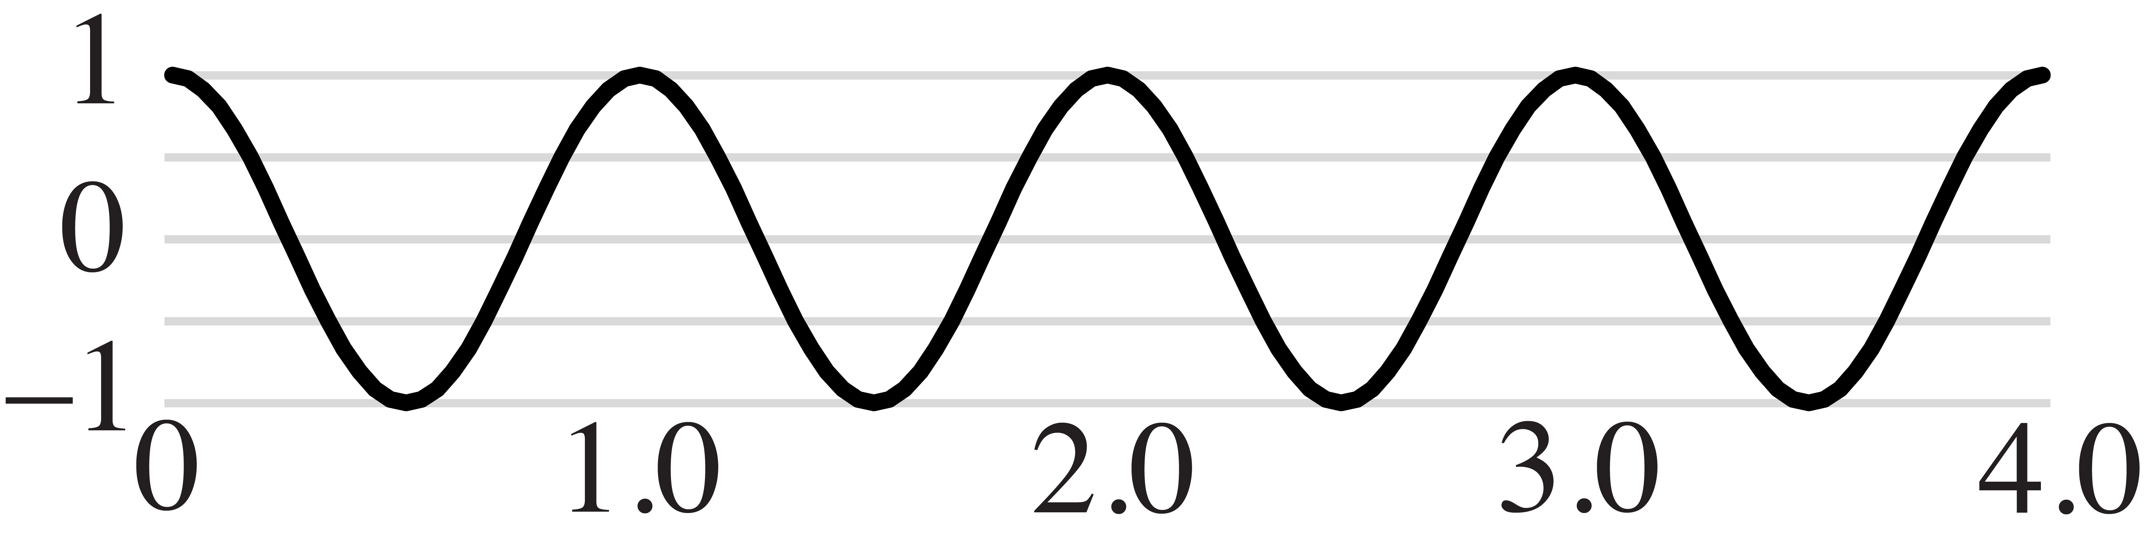
Isochrony (discrete) vs. Periodicity (continuous)
Beats of a 4/4 bar:
4
4
q q q q | q
As an isochronous
function:
As a continuous
periodic function:
Notes:
When notation is used to produce music, the isochronous model is okay. When it is used to represent or interpret music, it becomes problematic .

Slide 6
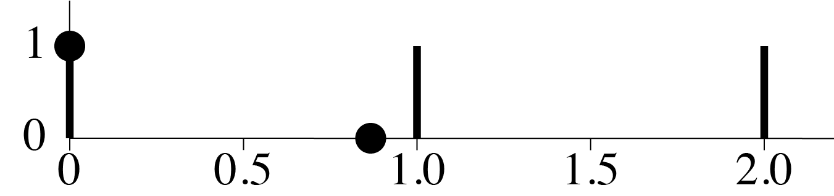
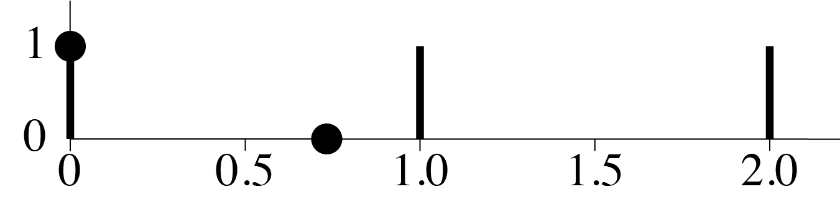
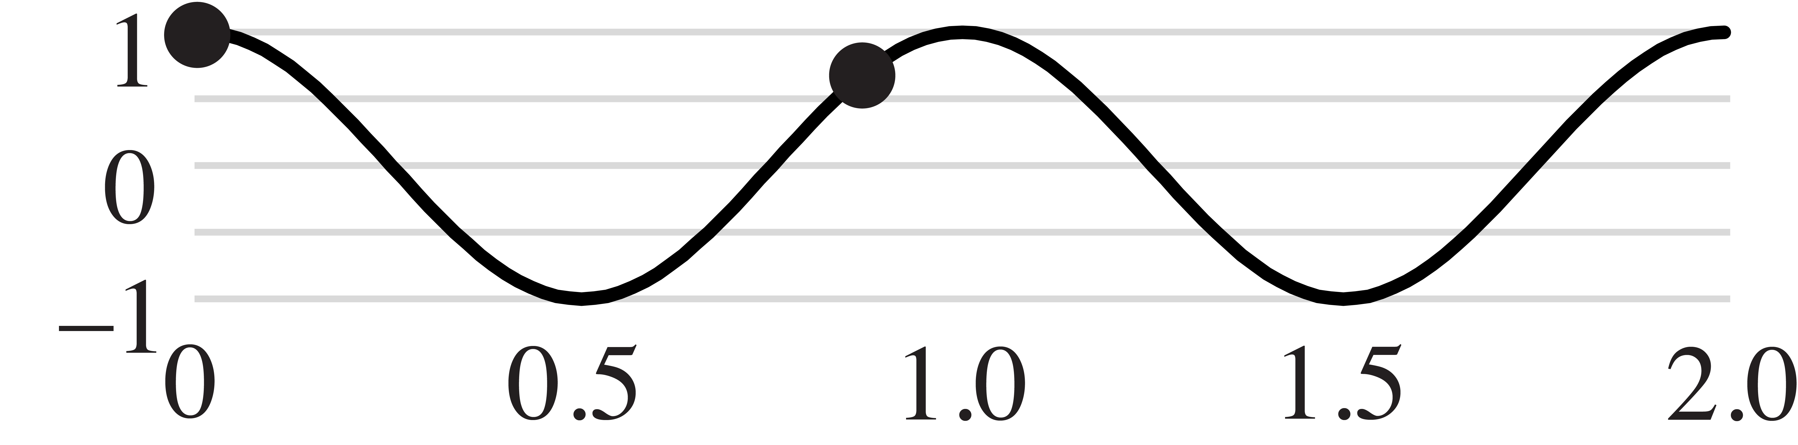
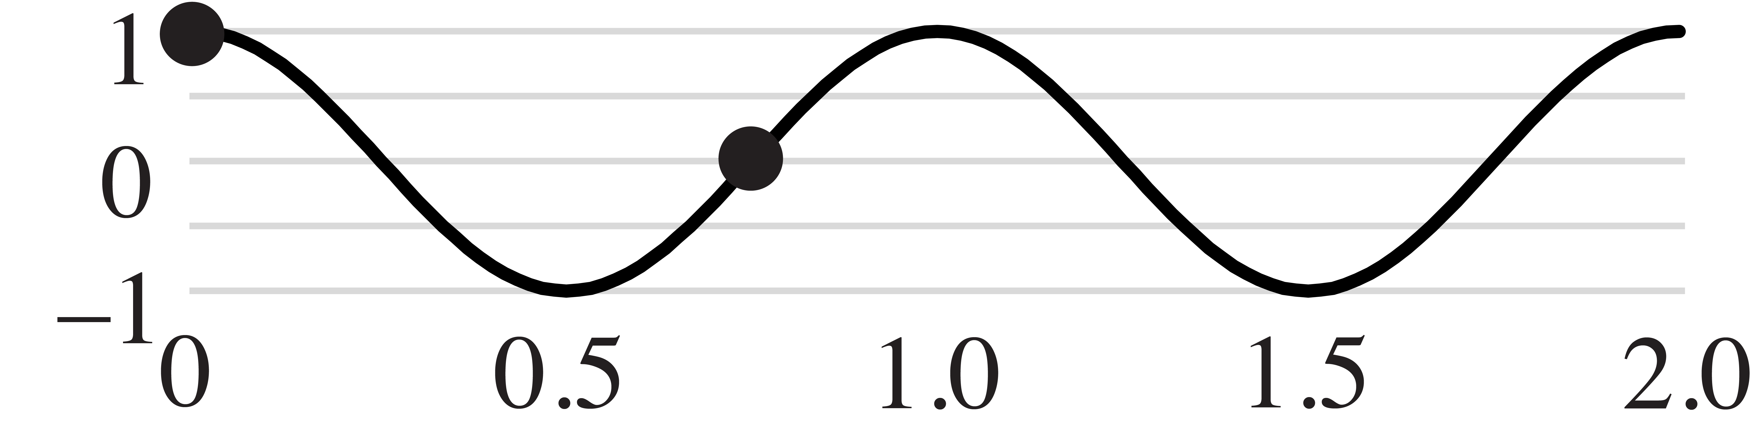
Isochrony (discrete) vs. Periodicity (continuous)
Periodic functions recognize proximity
2
2
2
2
q. e( h |
q.. x( h |
1 + 0 = 1
1 + 0 = 1
1 + 0.71 = 1.71
1 + 0 = 1

Slide 7
Entrainment
Cognitive
processing
Rhythm: Signal
Neural activation
Motor behavior,
Prediction
?
q. e( q q |
Fourier
transform

Slide 8
Fourier theory tools
Coordinate Spaces and Spectra

Slide 9
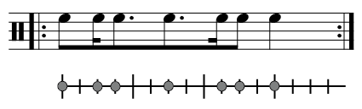
Rhythm as Periodic Stimulus
Suppose you hear the following rhythm:
What frequencies does the rhythm present
for you to entrain to?
Answer: Fourier analysis of the rhythm

Slide 10
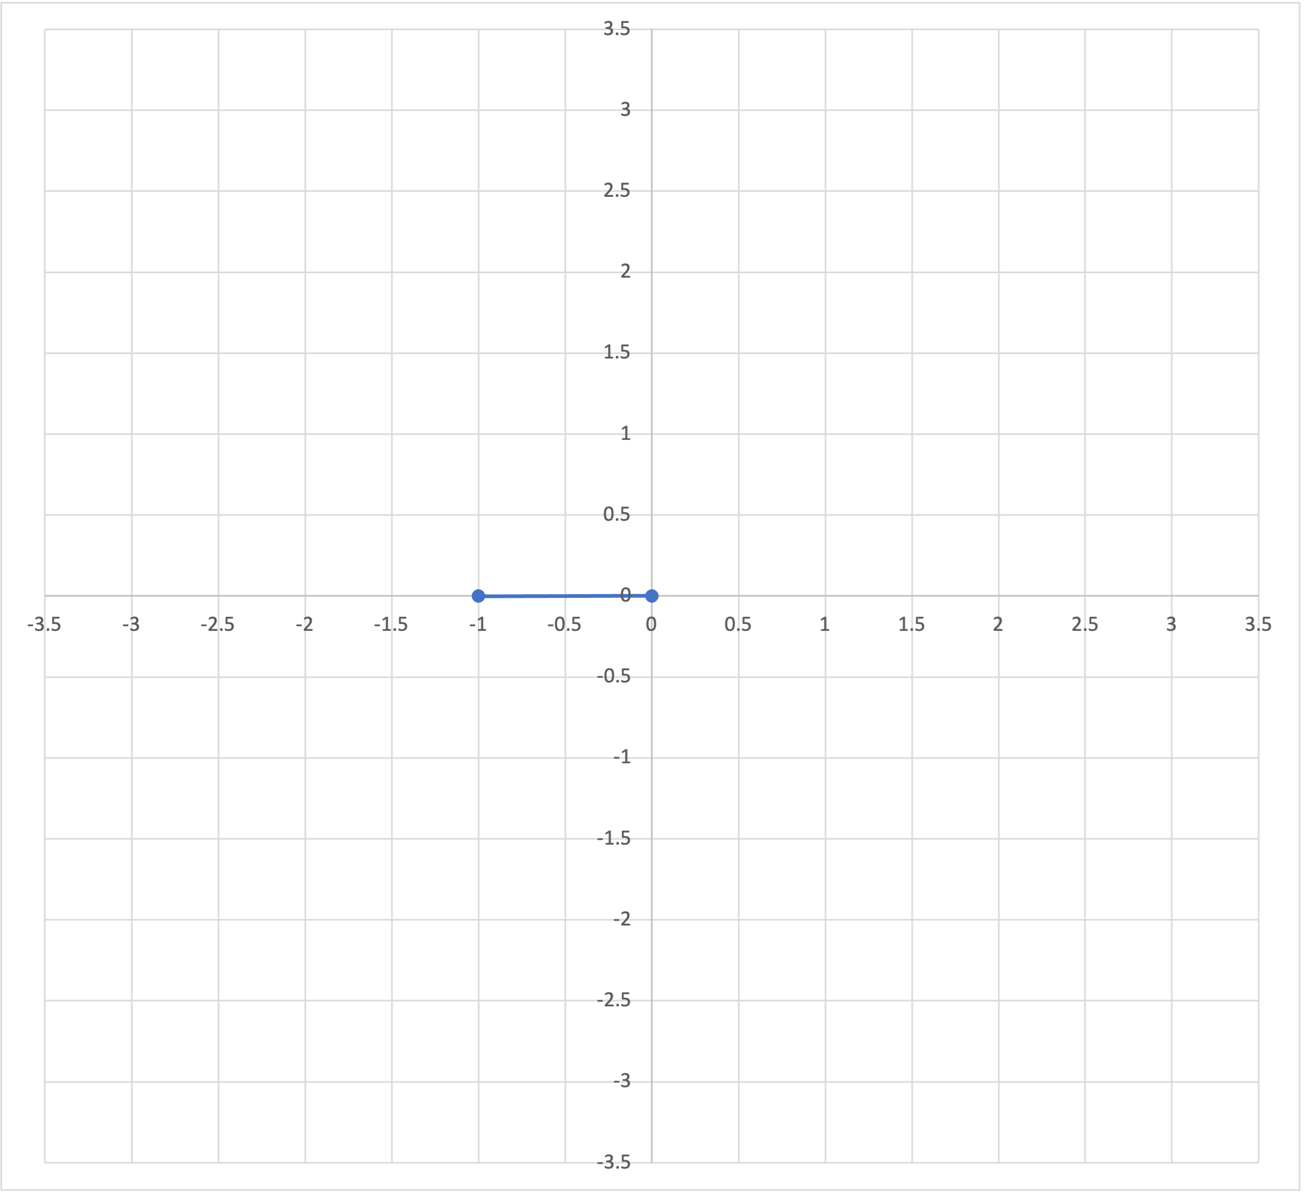
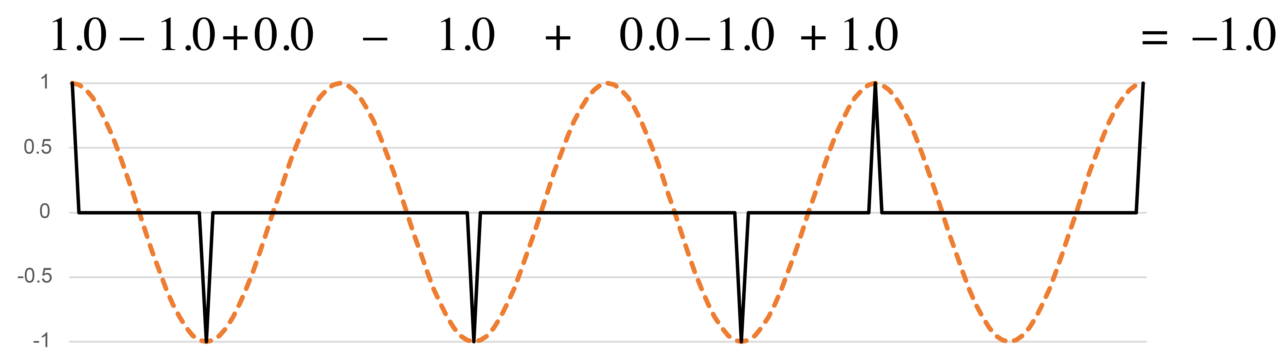
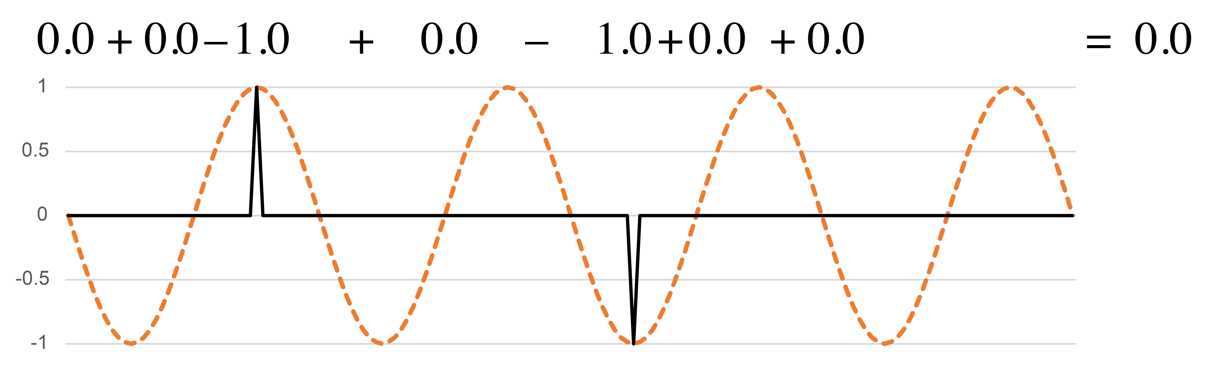
Sine and Cosine functions
Periodicities are two-dimensional.
On complex plane:
Before beat
q periodicity
(cosine):
Off beat
On beat
q periodicity
(–sine):
After beat
f₄
Notes:
Let's have a look at how simple periodic functions act as interpretive filters. These two functions both have a wavelength that corresponds to the quarter note beat. I'll refer to that as the periodicity of the functions. I will also sometimes refer to the frequency of the function, which here is 4, meaning that it divides the full cycle by 4. The first function, the cosine has its peaks lined up with the beats, and valleys at the midway point of the beats. This rhythm has more onsets in the valleys, so when we multiply the rhythm by the cosine function, it sums to a negative value. The minus-sine function below is the same as the cosine shifted back by a quarter cycle. The peaks and valleys of this function line up with the zeros of the cosine function. They show if onsets happen more often before or after the beats.
The two resulting sums give a point in a two-dimensional space which tells us how the rhythm expresses this frequency. [Animation 1] Moving to the left in the space corresponds to more on-beat onsets, to the right more off-beat onsets. [Animation 2] Upward indicates more onsets ahead of beats, downward more onsets after the beats. [Animation 3] This version of the Bo Diddley rhythm is a little more off-beat, and is balanced between the two sides of the beat. The point in the 2-dimensional space shows this.

Slide 11
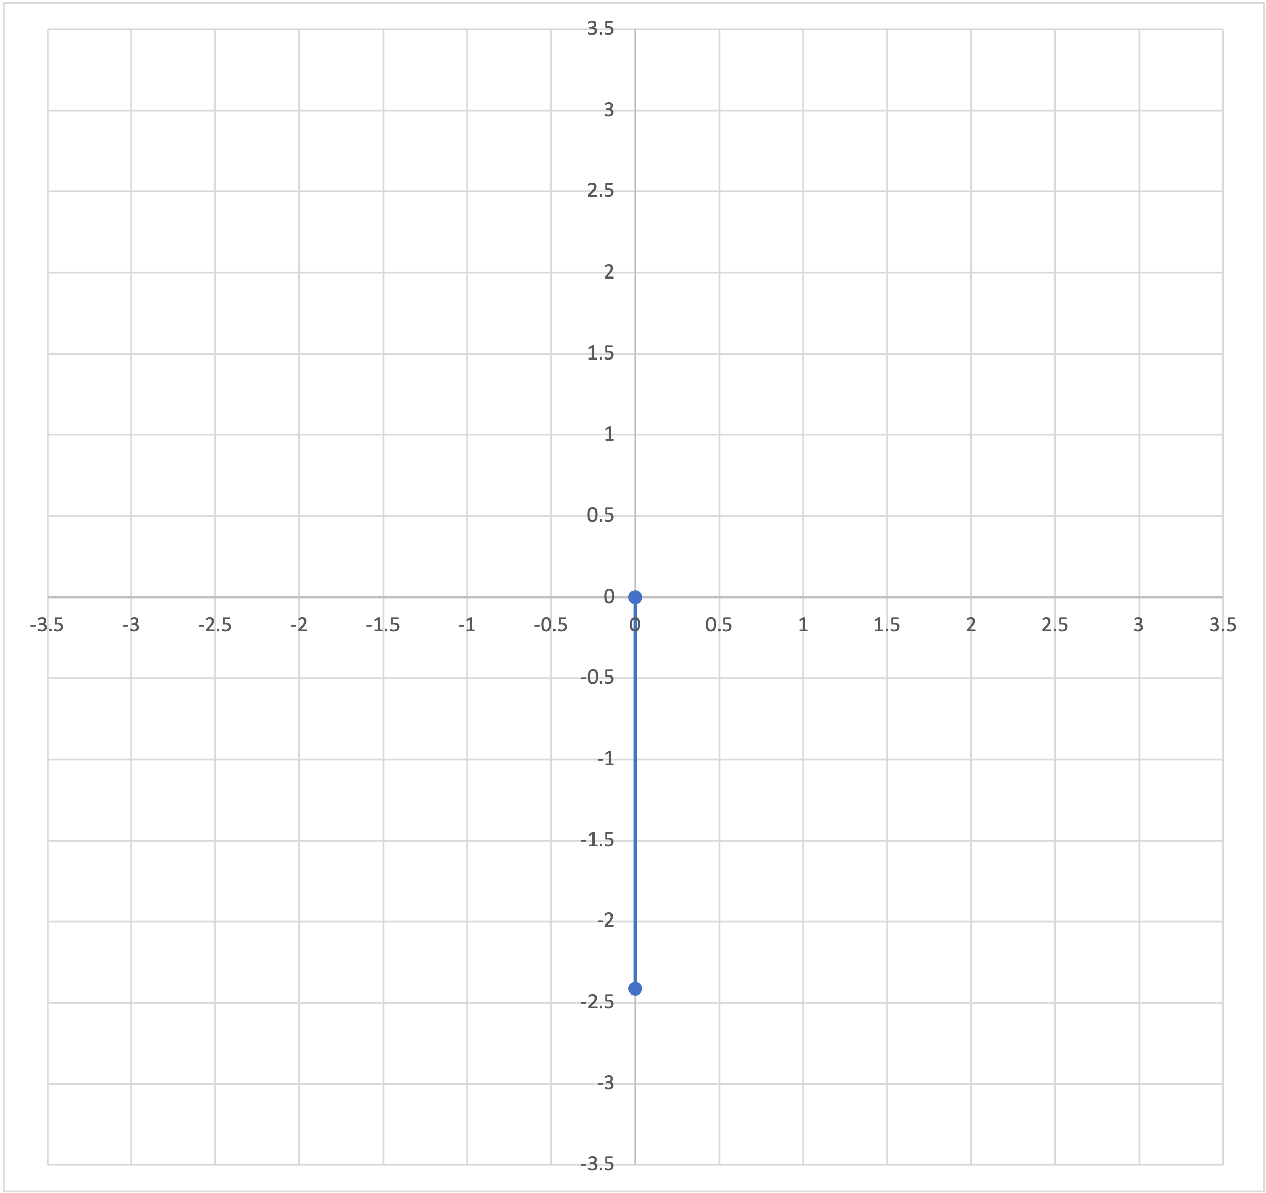
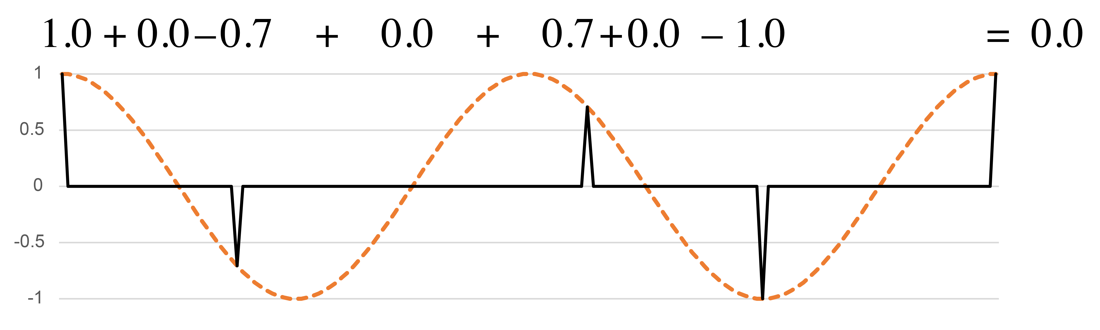
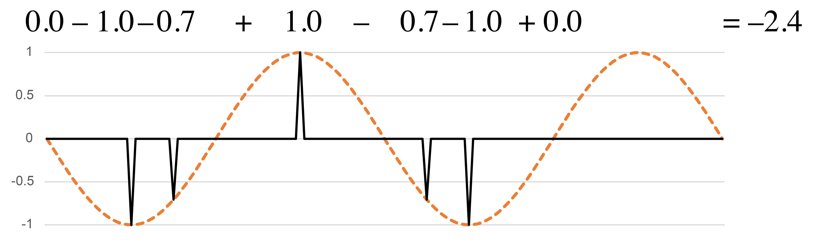
Sine and Cosine functions
Periodicities are two-dimensional.
On complex plane:
h periodicity
(cosine):
h periodicity
(–sine):
f₂
Notes:
We can do the same thing for other periodicities. Here we consider frequency 2, or a half-note periodicity. The position of a rhythm in the space is totally independent of where it falls in the space for the quarter-note periodicity. A rhythm could be off-beat at one level and on-beat at the other. This rhythm gives zero on the cosine function, meaning it is balanced between strong and weak beats. But it strongly favors the zone after the strong beat to the zone before it, because the two double-strums, the sixteenth notes, both fall ahead of strong beats.

Slide 12
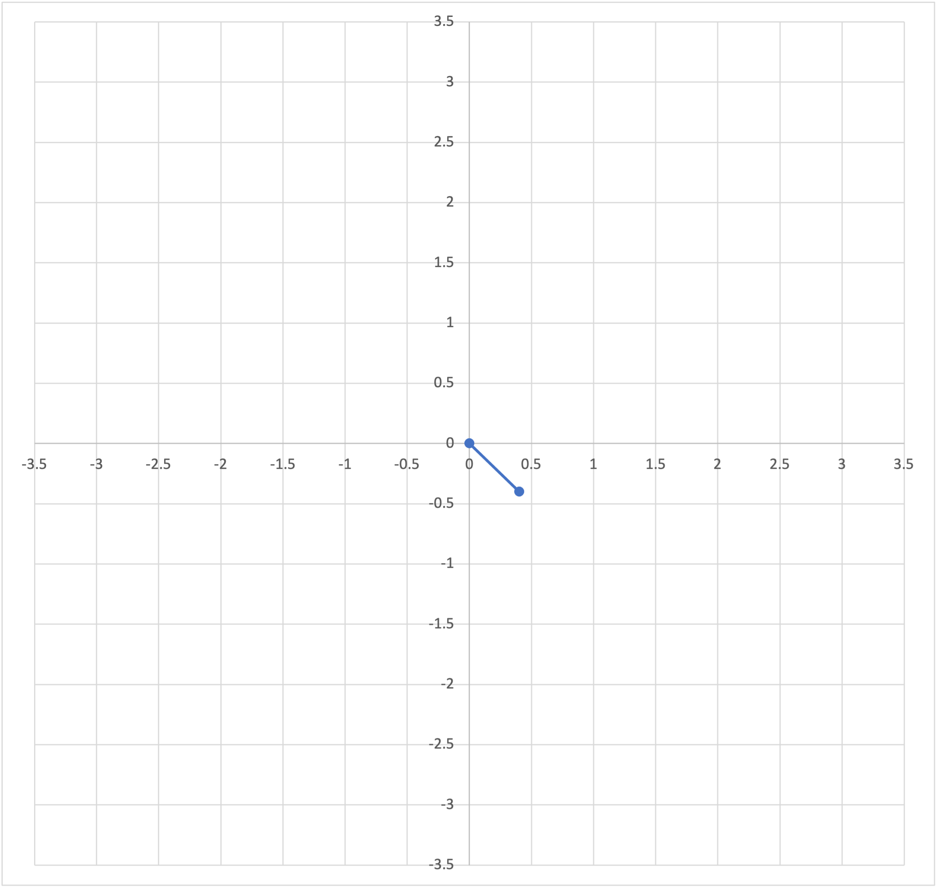
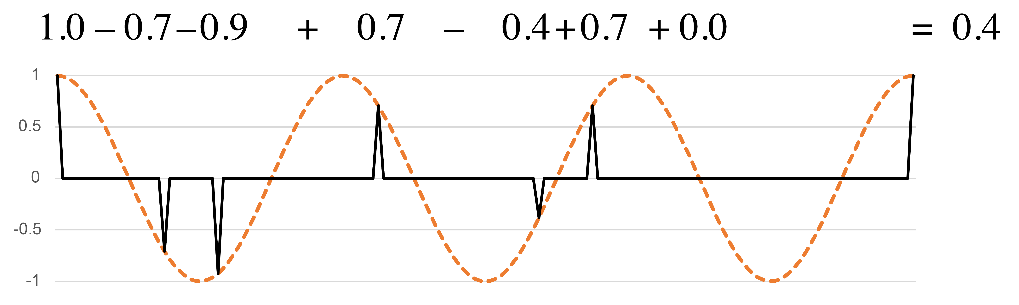
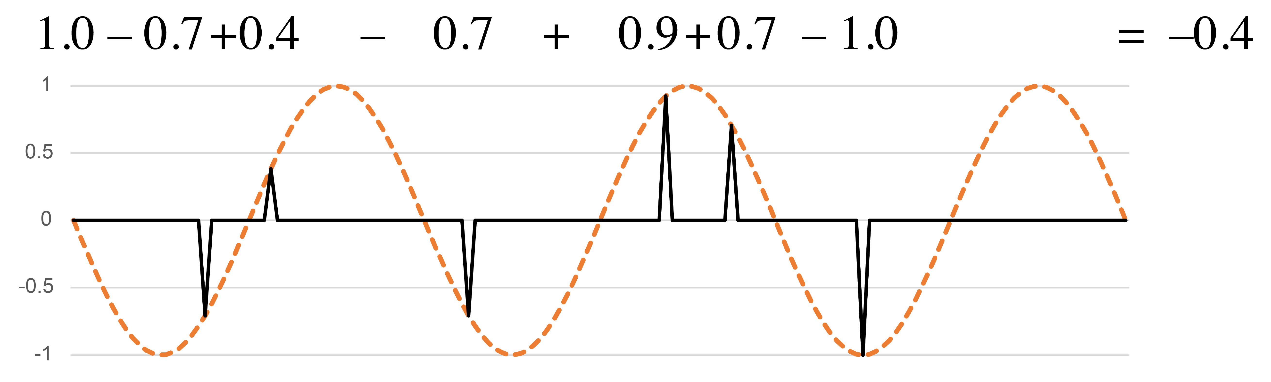
Sine and Cosine functions
Periodicities need not be integer multiples of the minimal duration.
On complex plane:
1⅓q periodicity
(cosine):
1⅓q periodicity
(–sine):
f₃
Notes:
The two periodicities we just considered correspond to traditional metrical levels. There are periodicities for any possible division of the cycle, however. For example, we can divide the measure by three. The resulting periodicity is not an integer multiple of sixteenth notes. If a rhythm is limited to a sixteenth-note grid, it can get close to the peaks of this function, but not exactly coincide with them except at the downbeat. This rhythm is relatively balanced at this frequency. The closest approximation to the wavelength using sixteenth notes is an interval of 5 sixteenth notes, and that interval does not occur anywhere in the rhythm.

Slide 13
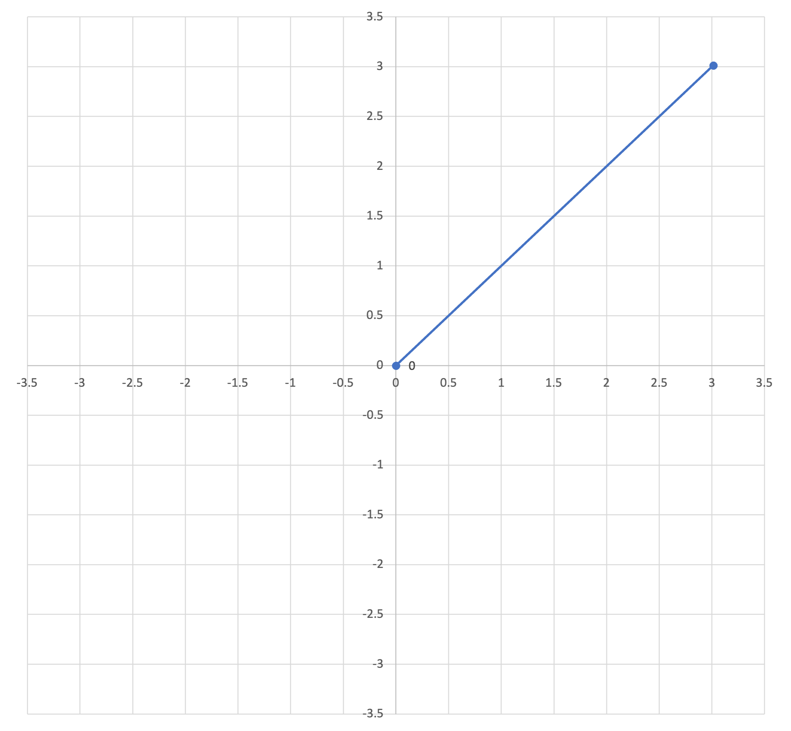
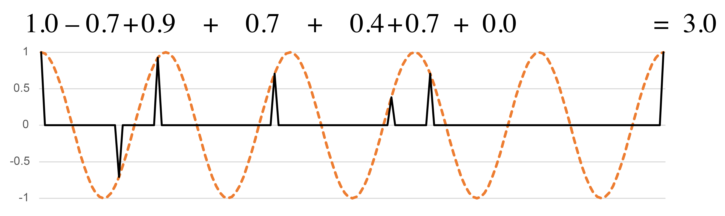
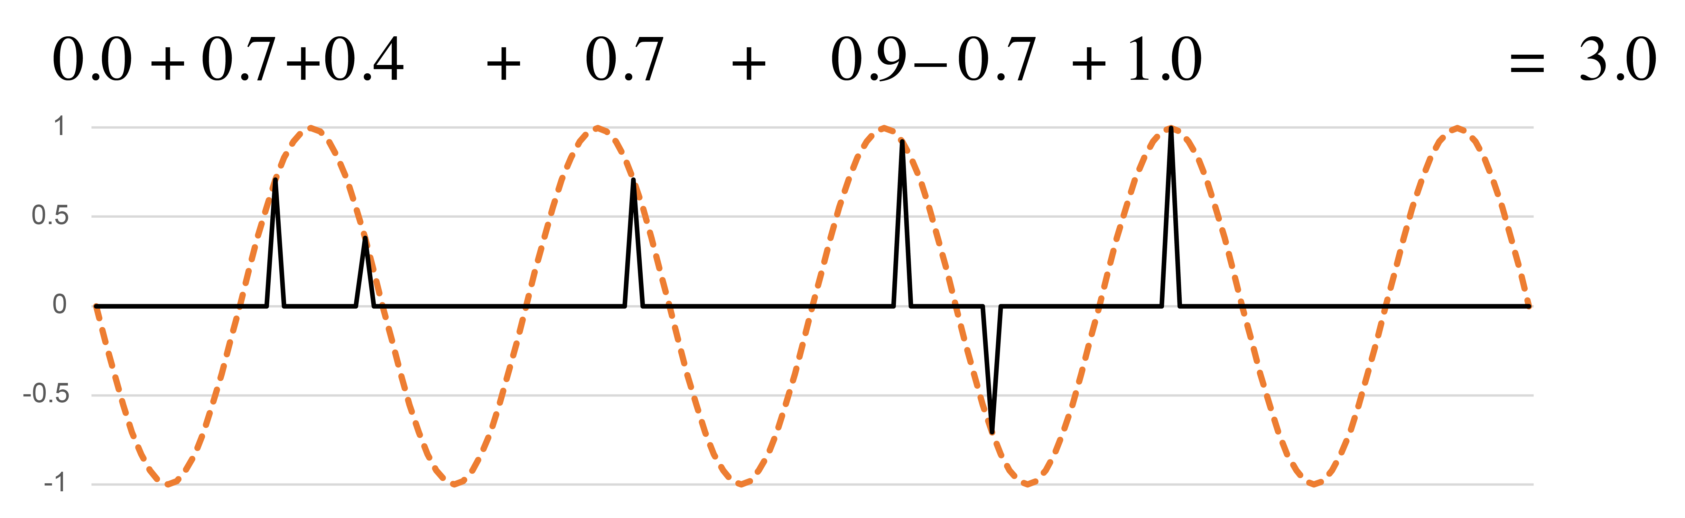
Sine and Cosine functions
Periodicities need not be integer multiples of the minimal duration.
On complex plane:
⅘q periodicity
(cosine):
⅘q periodicity
(–sine):
f₅
Notes:
Here's another periodicity that doesn't line up with the sixteenth-note grid, a division of the measure by 5. The rhythm has a very strong profile on this periodicity. A lot of notes line up with the peaks of both the cosine and sine functions. These are at distances of 3 sixteenth notes from one another, or multiples of that. Three sixteenth notes is a best approximation to the wavelength of 4/5 quarter note. The corresponding point on the xy plane is far away from the origin and in the upper left quadrant.

Slide 14
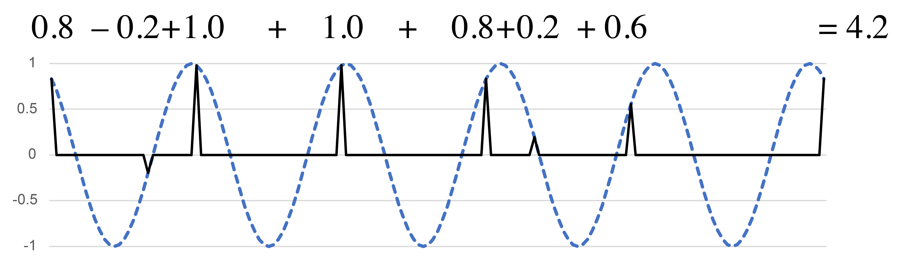
Phase and magnitude
Angle in 2-d space corresponds to the phase of the best-matching simple sinusoid.
Length
Magnitude
Phase shift
Angle
Notes:
I located all of these rhythms on the xy plane using two simple periodic functions, but once we know where a point is in the space, we can express it with just a single simple periodic function, because a rotation in the xy-plane corresponds to a phase shift in the sine curve. Here, because the point is at a 45 degree angle from the positive x axis, shifting the sine curve back by one-eighth of a cycle gives a curve that aligns as well as possible with all of the onsets of the rhythm. [Animation 1] This is what we call the phase of the rhythm at that frequency. The way that a rhythm expresses each possible periodicity can thus be expressed using two numbers, a magnitude, giving the total weight of the rhythm at that periodicity [Animation 2], and a phase showing where it is oriented within the cycle.
These two-dimensional spaces are the first of two tools of rhythmic analysis that I want to share today. They give a complete description of the rhythm, but they have the drawback that we have to consider each possible periodicity one at a time. The other tool I will share summarizes all of the possible frequencies at once.

Slide 15
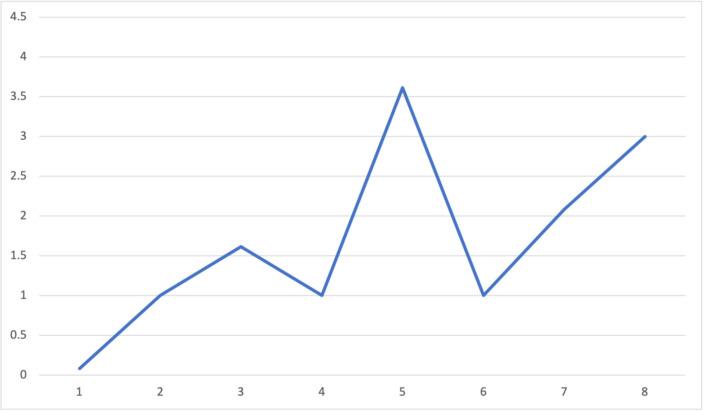
Rhythmic spectrum
The rhythmic spectrum shows the magnitudes at all possible frequencies
The strongest frequency (periodicity w/5) shows that
clave is close to 5 equally spaced onsets
Rhythmic spectrum for the clave rhythm:
e. e. q e q |
Mostly on-beat at e level
Magnitude
Mix of on- and off-beat at q level
Low w periodicity:
Relatively even distribution of onsets
Frequency (/16e)
N.B.: Periodicities are the reciprocals of frequencies
Spectra are invariant with respect to rotation, retrograde, complementation
Notes:
This is called the rhythmic spectrum. It is a function that shows the magnitude of the rhythm at each possible frequency. Frequency is on the x axis, and magnitude on the y axis. All of the rhythms I'll consider in this paper are cyclic, meaning they can be understood to repeat indefinitely. Most of them will also be restricted to some isochronous grid within that cycle. For instance, the clave rhythm here has onsets that all fall on a sixteenth-note grid. Since there are sixteen possible positions in the cycle, the number of ways to divide that cycle is limited to 8, half the length of the cycle. If we were to continue the spectrum with frequencies larger than 8, then we would simply repeat information that is already shown. However, I have just argued that it is important to have a theory that doesn't limit us to isochronous grids like this, and allows us to imagine what happens when we make microrhythmic variations in the rhythm. It's also possible to make spectra for these, the difference being that there is not necessarily a limit on how high of frequencies we could consider. We can extend the spectrum as far as we want to the right without duplicating information.
Let's explore what we can learn from the spectrum of the clave rhythm shown here. [Animation 1] The largest frequency is the fifth. This indicates that the five onsets of the clave rhythm are relatively evenly spaced.
[Animation 2] The next largest frequency is 8, which corresponds to the eighth-note periodicity. This is because the onsets of the clave mostly fall on the eighth-note grid.
[Animation 3] On the other hand, onsets fall in a variety of places in relation to the quarter-note grid, so frequency 4, which corresponds to quarter-note periodicity, is small.
[Animation 4] The smallest coefficient is the first, showing that the rhythm has a balanced distribution throughout the entire cycle.
[Animation 5] Finally, there is another smaller peak at frequency 3. This comes from the embedded tresillo rhythm in the first, third, and fifth onsets. The addition of the other two onsets weakens frequency 3, but doesn't eliminate it completely.

Slide 16
Rhythmic Maximal Evenness
Notes:
In the next part of the talk I would like to explore the phenomenon of rhythmic maximal evenness and use the tools I've just described to explain why it is an important and common musical feature.

Slide 17
Maximally even vs. Isochronous
Traditional metrical theory only recognizes isochrony, not approximate evenness
4
4
4-in-8
Maximally even and isochronous
q q q q |
4
4
h h |
2-in-8
Maximally even and isochronous
4
4
3-in-8 (Tresillo)
Maximally even, not isochronous
q. e( q q |

Slide 18
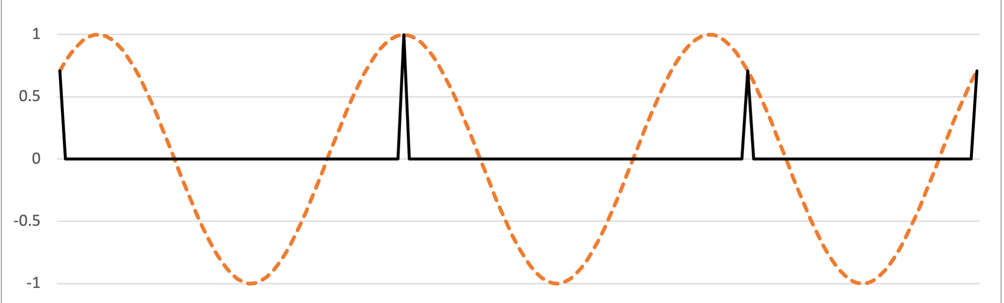

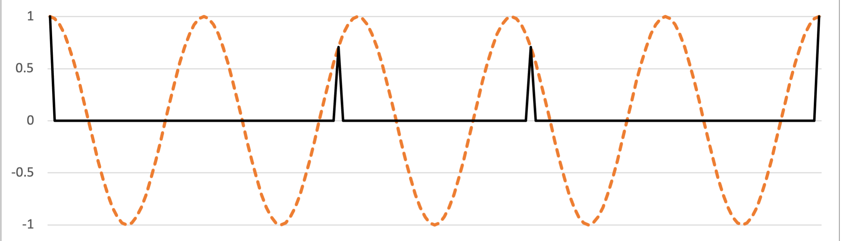


Maximally even rhythms
Example: Tresillo (3-in-8) and Cinquillo (5-in-8)
Complement
Rotate
Complementation and rotation affect phases only
Notes:
A lot of very common and very important rhythms are maximally even. The 3-in-8 maximally even rhythm, commonly known as the tresillo, is ubiquitous in Latin music, American popular music, and elsewhere. The complement of a maximally rhythm is also maximally even, and the larger maximally even rhythm always contains the smaller one, so we can think of it as an extension. The complement of the tresillo is known as the cinquillo and is also a common rhythm in many types of music.

Slide 19
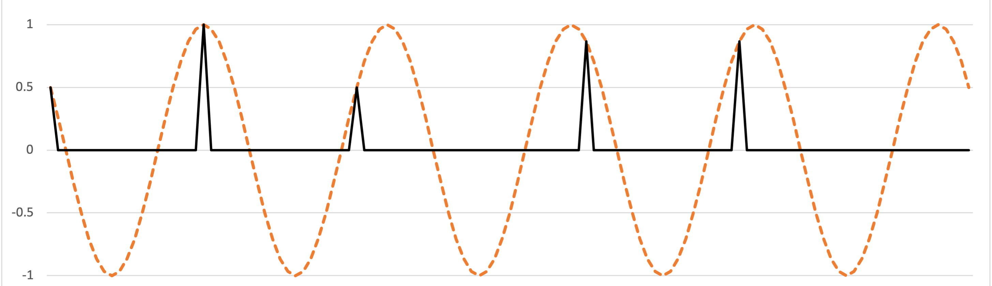

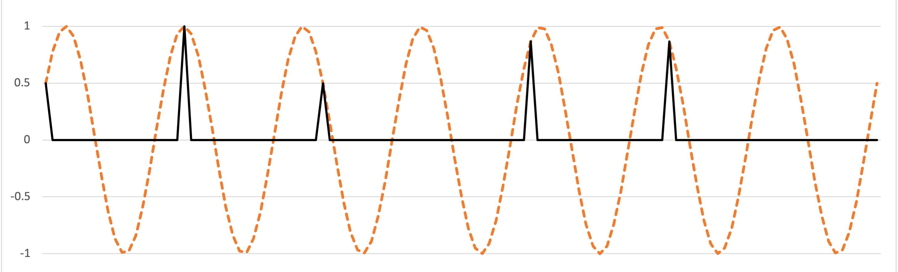

Maximally even rhythms
Example: Standard Pattern (7-in-12 and 5-in-12)
Rotated
complement
Notes:
Another important maximally even rhythm is the standard pattern, which occurs as a timeline in many African and African-diasporic musics. The standard pattern is 7-in-12 maximally even and is often referred to as the diatonic rhythm, because it's the rhythmic analogue of a diatonic scale. The 5-in-12 complement substitutes for it in many contexts.

Slide 20
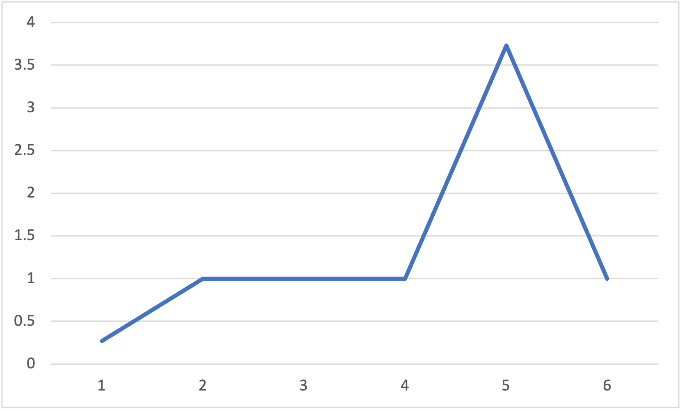
Spectrum of a maximally even rhythm
Maximally even rhythms emphasize a single frequency
High value at principal periodicity (w./5)
Rhythmic spectrum for the standard pattern:
q q eq q q e
Or its complement:
q q q. q q. .
(w./4 = q. )
(w./6 = q )
Especially low value at 1
Low values at nearby periodicities
Magnitude
Frequency (/12e)
N.B.: Periodicities are the reciprocals of frequencies
Notes:
Maximally even rhythms all have similar spectra, with one prominent spike at the frequency corresponding to the number of onsets. All of the other values are low, especially coefficient 1.

Slide 21

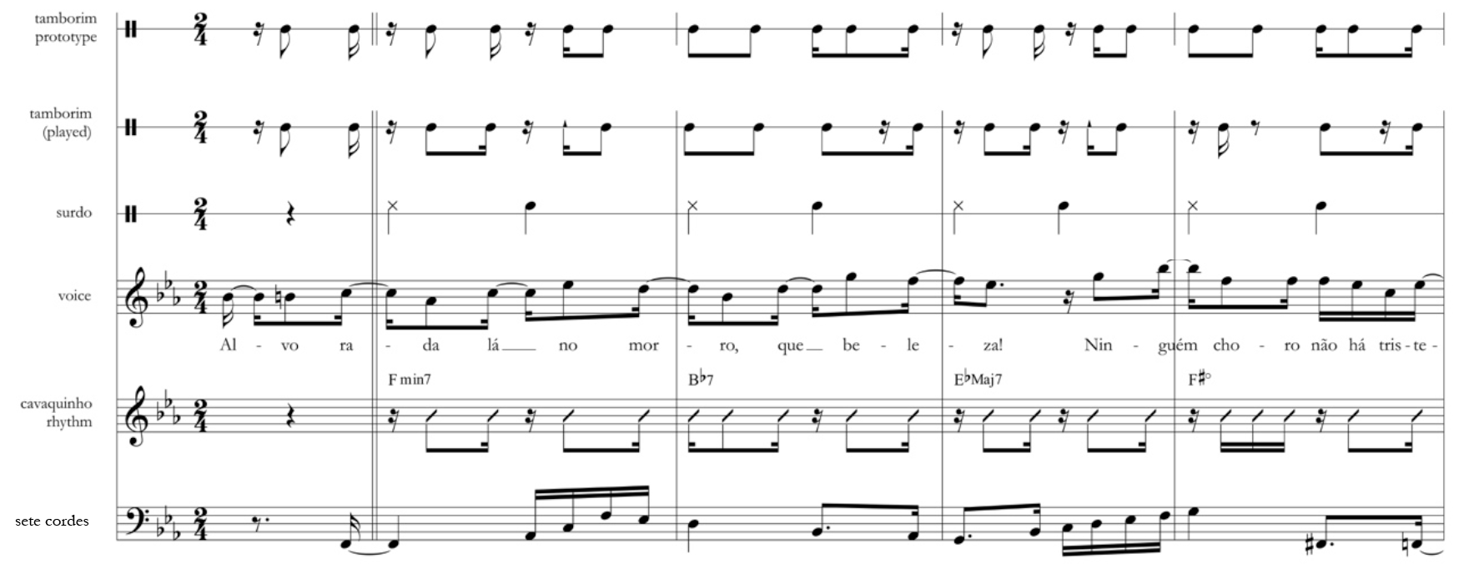
Maximally even rhythms
Example: Samba Timeline (9-in-16) (from Stover forthcoming)
“Alvorada” by Cartola
Notes:
The two examples we've just considered are maximally even with one more or one fewer onset in the rhythm than half the size of the metric grid. The three onsets of the tresillo is one less than 4, which is half of 8, and the 7 onsets of the standard pattern is one more than 6, which is half of 12. In this example from the Samba repertoire, which I'm borrowing from Chris Stover's forthcoming book on timeline music, the timeline is maximally even with 9 out of 16 onsets, also one more or less than half the total. The song is Alvorada by the important Samba composer and singer Cartola. The tamborim, on the second line, plays the timeline.
[Play example]

Slide 22
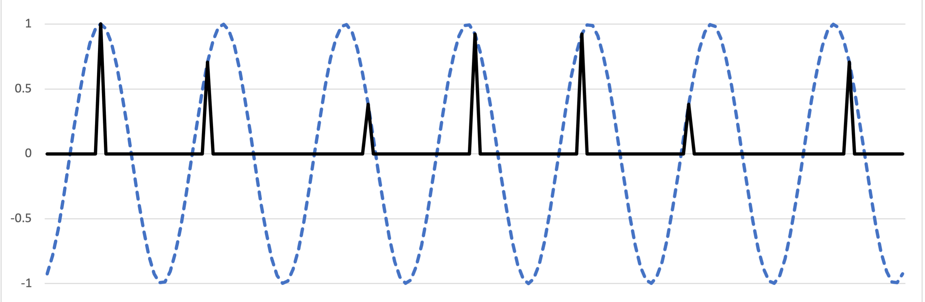
Maximally even rhythms
Example: Samba Timeline (9-in-16) (from Stover forthcoming)
Stover’s prototype:
9-in-16 ME
Complements
2 2 1 2 2 2 1 2 2
Performed rhythm:
7-in-16 ME
2 3 2 2 2 3 2
Notes:
Stover gives an idealized prototype rhythm in addition to transcribing the player's variations in the recording. The prototype is 9-in-16 maximally even, while the performed rhythm in the initial bars is a 7-in-16 maximally even subset.

Slide 23
Ragtime Syncopation
Part 1

Slide 24
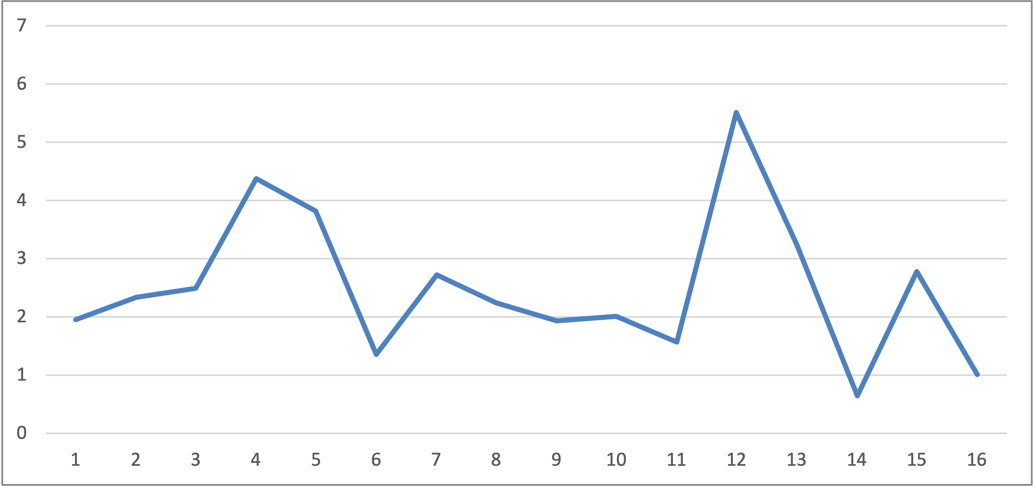
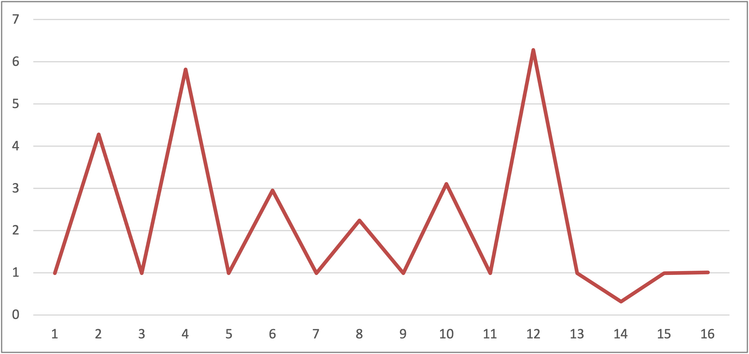
Ragtime Syncopation
Second strain from Joplin’s “The Sycamore,” phrases 1 and 2
Spectrum, phrase 1
Spectrum, phrase 2
Notes:
Phrase 1 is approximately anticoherent between the whole-note and half-note levels. Whole note ahead of the beat, half-note behind the beat.
Phrase 2 is coherent; both layers syncopated at the eighth-note level.

Slide 25
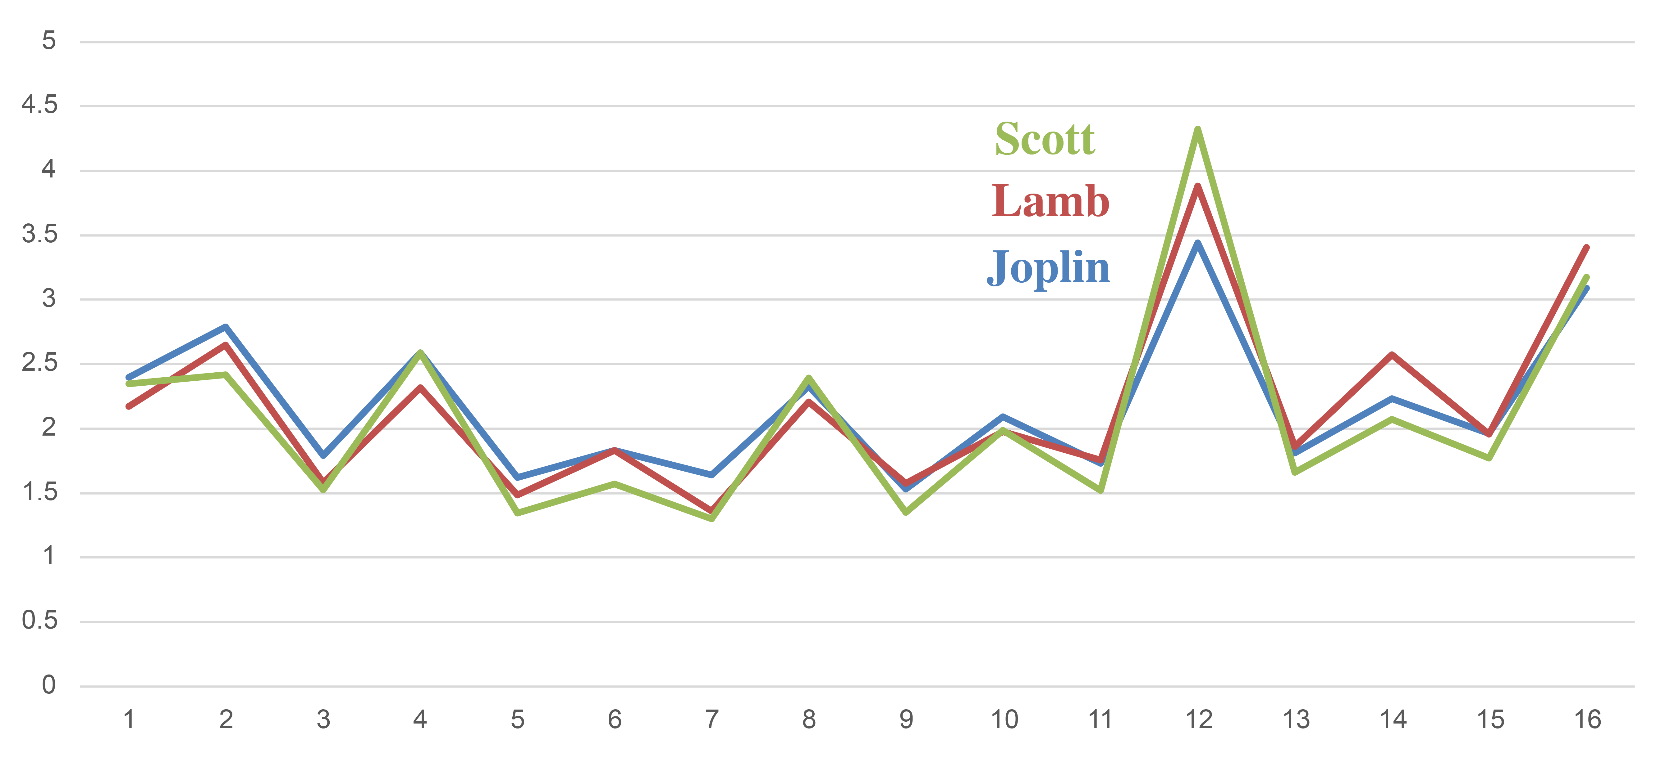
Ragtime Syncopation
Averaged spectra over 4-measure phrases
= f₃/meas.
= f₁/meas.
= f₂/meas.
= f₄/meas.
Ragtime melodies consistently emphasize f₃ (f₁₂ across 4-meas. phrase)
Tresillo and cinquillo rhythms are prototypes of this quality.
from Yust & Kirlin 2021

Slide 26
Ragtime Syncopation
Phases: circular averages and standard deviations
8th note
(f₄/meas.)
Measure
(f₁/meas.)
Beat (f₂/meas.)
Tresillo
(f₃/meas.)

Slide 27
Fourier Analysis, Meter, and Coherence

Slide 28
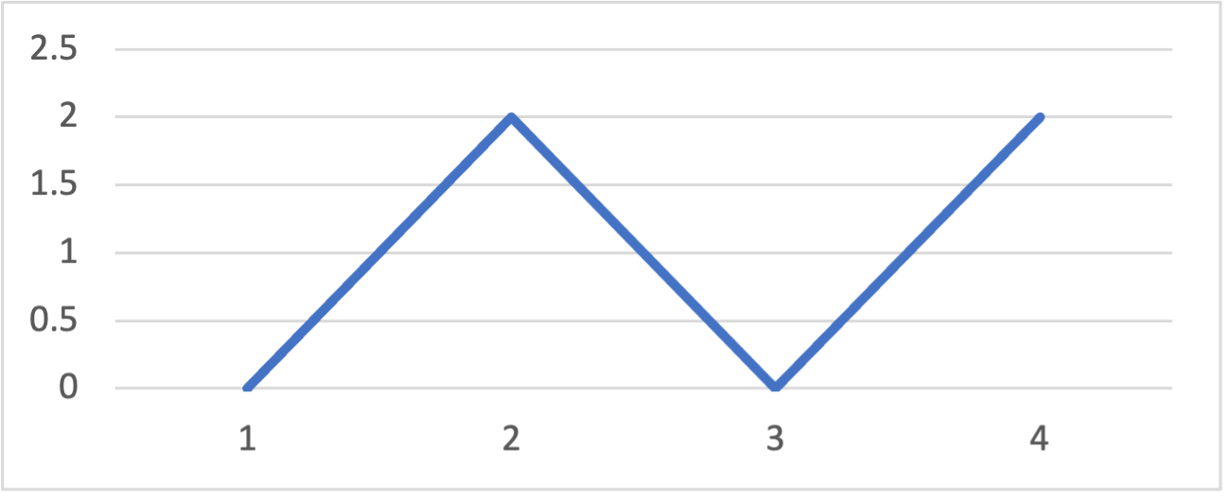
Coherence of Metrical Levels
Suppose you’re given the following spectrum (for a measure of 8es):
What rhythm did it come from?
You’d probably guess this:
But it could also be this:
h h :||
eq eeq e:||

Slide 29
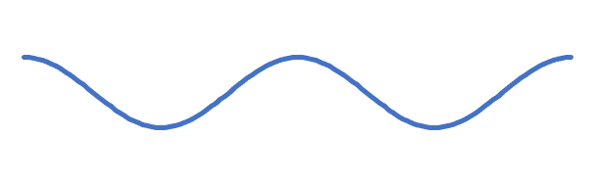
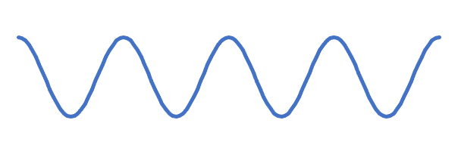
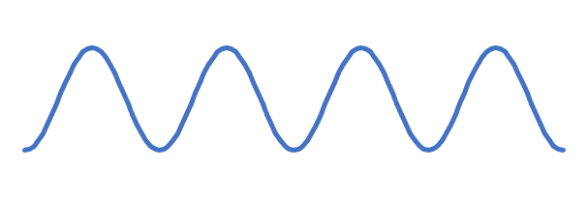
Coherence of Metrical Levels
What’s the difference?
Aligned coefficients:
f₄ syncopated against f₂:
h h :||
e q e e q e :||
f₂:
f₂:
f₄:
f₄:
Peaks of f₂ lined up with peaks of f₄
Peaks of f₂ lined up with troughs of f₄
⇒ Coherence
⇒ Anticoherence

Slide 30
Coherence of Metrical Levels
What’s the difference?
Aligned coefficients:
f₄ syncopated against f₂:
h h :||
e q e e q e :||
f₂:
f₂:
f₄:
f₄:
Coherence is a difference of phases:
2ϕ₂ – ϕ₄ = 0
2ϕ₂ – ϕ₄ = π

Slide 31
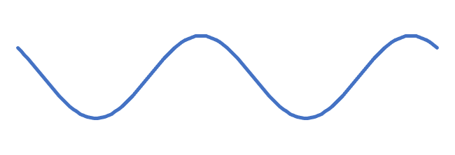
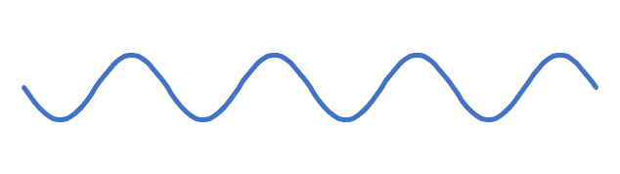
Coherence of Metrical Levels
Coherence is invariant w.r.t. rotation!
(q.) e( q. e( :||
q e e q e e :||
f₂:
f₂:
f₄:
f₄:
Both coefficients syncopated by e
f₂ syncopated by e, f₄ unsyncopated
2ϕ₂ – ϕ₄ = 0
2ϕ₂ – ϕ₄ = π

Slide 32
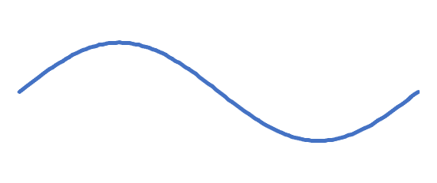
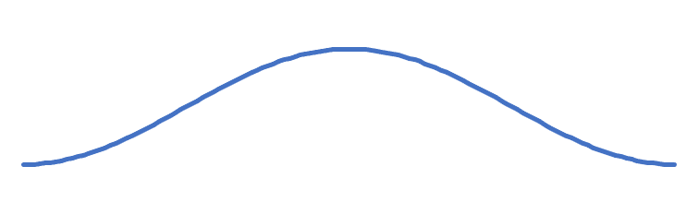
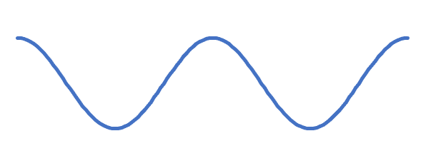
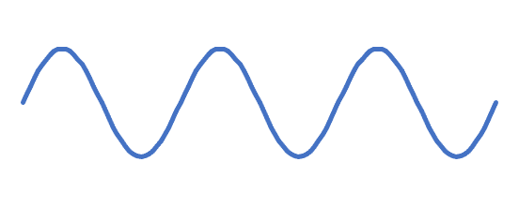
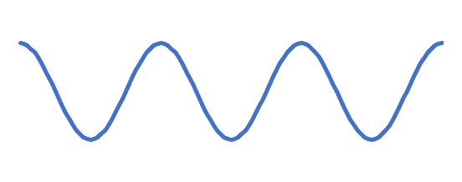
Coherence of three coefficients
e q e h :||
q. e e q. :||
f₁:
f₁:
opposed
agree
opposed
agree
f₂ , f₃:
f₂ , f₃:
Coherent: ϕ_{1∙2/3} = 0
f₁ peaks where f₂ and f₃ agree,
f₁ troughs where f₂ and f₃ opposed.
Anticoherent: ϕ_{1∙2/3} = π
f₁ peaks where f₂ and f₃ opposed,
f₁ troughs where f₂ and f₃ agree.

Slide 33
Coherence
Coherence is the phase of a product of Fourier coefficients, f_{a} ✕ f_{b} ✕ f—_{c} ,
ϕ_{a∙b/c} , where a + b = c.
Properties:
• ϕ_{a∙b/c} is rotation invariant but depends only on the phases, not the magnitudes of the Fourier coefficients (independent of spectrum)
• Retrograde of a rhythm conjugates the coefficient product, so:
ϕ_{a∙b/c} (I(A)) = –ϕ_{a∙b/c} (A)
• Complementation of a rhythm rotates the product 180°:
ϕ_{a∙b/c} (Complement(A)) = ϕ_{a∙b/c} (A) + π
• For a maximally even rhythm of size c, ϕ_{a∙b/c} = π
See Yust & Amiot 2022, Amiot 2024

Slide 34
Coherence from a non-linear filter
Cognitive processing
Rhythm: Signal
Neural activation
Motor behavior,
Prediction
?
q. e( q q |
Fourier
transform
Non-linear
Power series approximation
^
^
^
^
^
^
X = x₀ + x₁ + . . . + x_{n–1}
^
X + X² + . . .
= Y = y₀ + y₁ + . . . + y_{n–1}
^
^
^
Coherent coefficient products

Slide 35
Coherence
Example:
This rhythm is dominated by f₁ (balanced in f₂, f₄, nearly balanced in f₃):
h e e e e |
Squaring f₁ creates a f₂ coefficient
Mag.
Phase
Freq. (= 1/8)
DFT:
4 + (2.61)e^{2πi(1.5/8)}e^{2πi(x/8)} + . . .
f₀
f₁
The resulting f₂ coefficient has a phase that is coherent with f₁
Mag.
Phase
Freq. (= 2/8)
DFT²:
. . . + (6.83)e^{2πi(3/8)}e^{2πi(2x/8)} + . . .
ϕ₁ + ϕ₁ – ϕ₂ = 0
f₁²

Slide 36
Ragtime Syncopation
Part 2

Slide 37
Ragtime Syncopation
Phases: circular averages and standard deviations
f₁ ✕ f₁ ✕ f—₂
f₂ ✕ f₃ ✕ f—₅
anticoherent
anticoherent
Measure
Beat
Tresillo
8th note

Slide 38
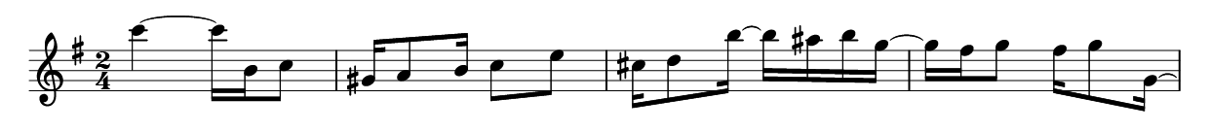
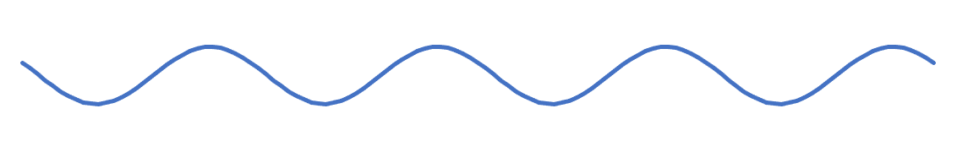
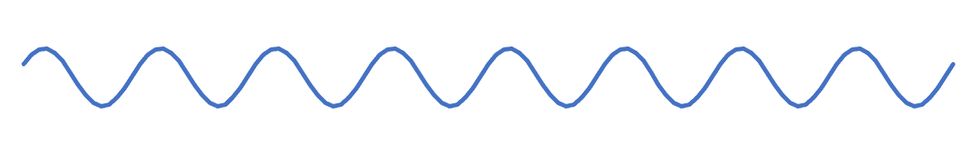
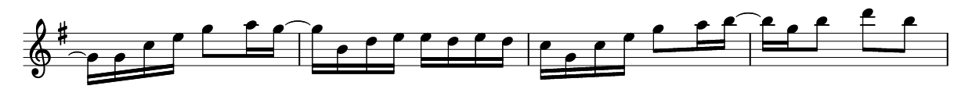
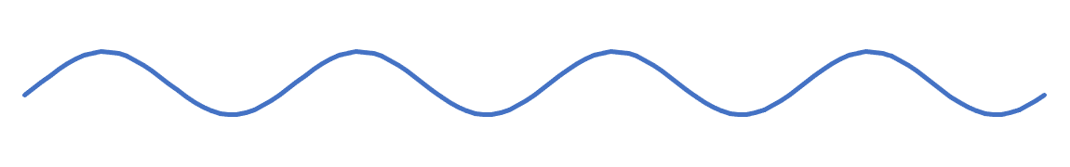
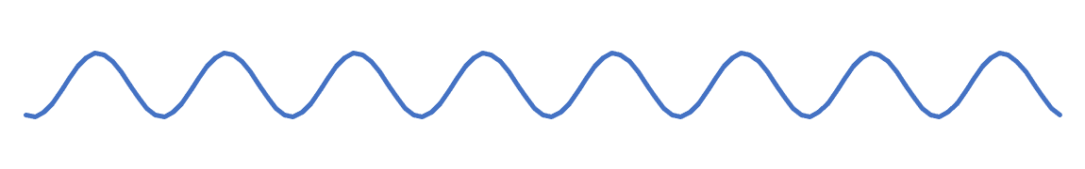
Ragtime Syncopation
Second strain from Joplin’s “Weeping Willow Rag,” phrases 1 and 2
f₁:
Approx.
Anticoherent
f₂:
f₁:
Approx.
Coherent
f₂:
Notes:
Phrase 1 is approximately anticoherent between the whole-note and half-note levels. Whole note ahead of the beat, half-note behind the beat.
Phrase 2 is coherent; both layers syncopated at the eighth-note level.

Slide 39
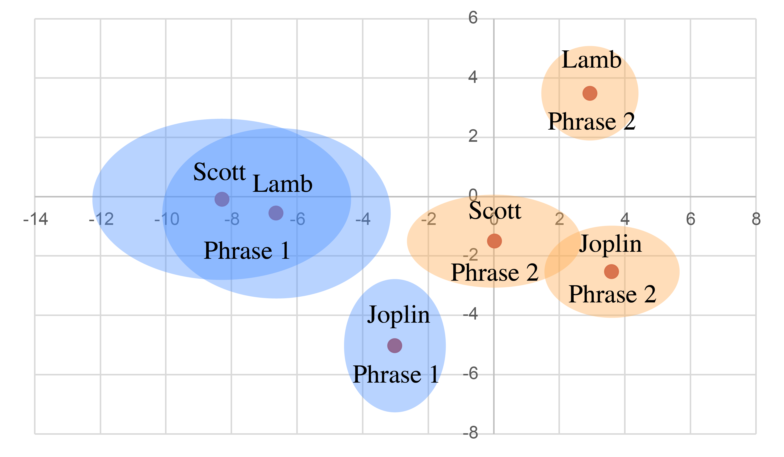
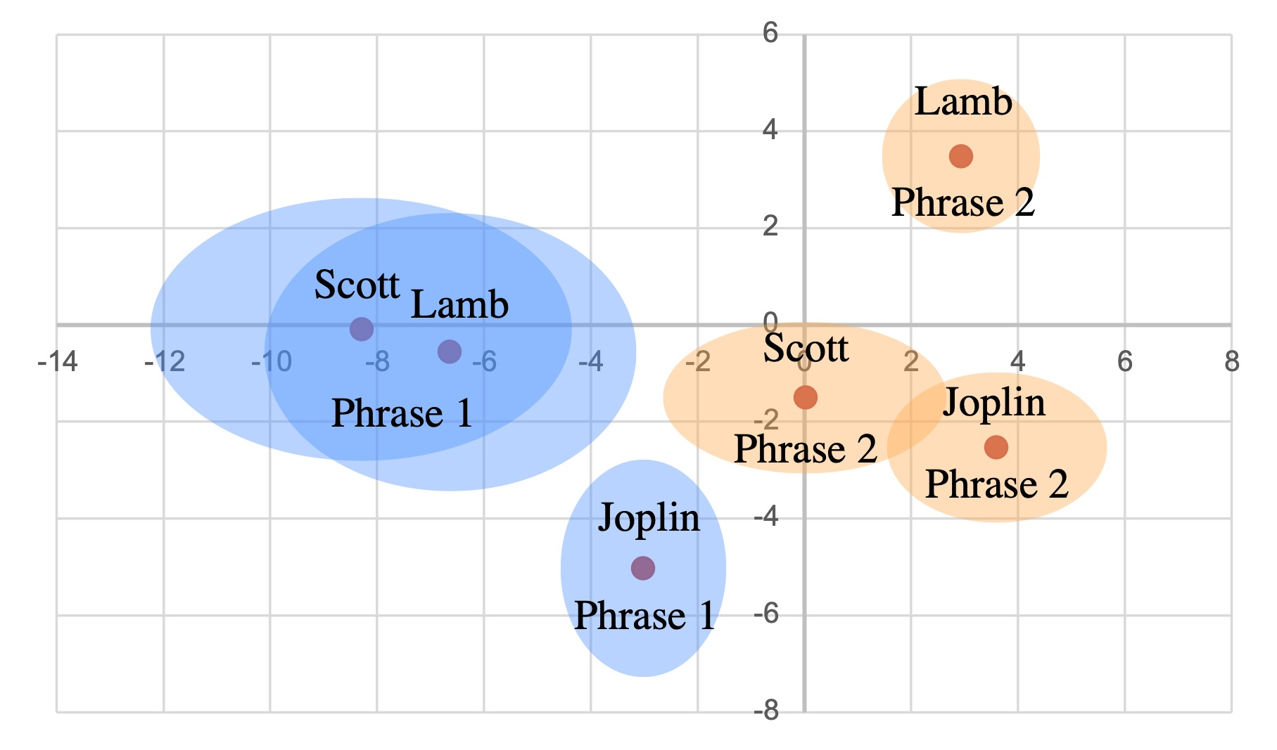
Ragtime Syncopation
Descriptive stats. for 71 pieces (4–5 strains each) by Scott Joplin, James Scott, Joseph Lamb
f₁ ✕ f₁ ✕ f—₂
All of the composers tend to anticoherent w and h levels in phrase 1, and coherent in phrase 2.
Ovals show standard errors

Slide 40

Ragtime Syncopation
Second strain from Joplin’s “Weeping Willow Rag,” phrase 1
f₂:
Approx.
Anticoherent
f_{3,} f₅:
Anticoherence of f₂ ✕ f₃ ✕ f—₅ is a feature of the cinquillo (5-in-8 ME) rhythm that differentiates it from the spectrally indistinguishable tresillo (3-in-8 ME) rhythm.
The tresillo has a coherent f₂ ✕ f₃ ✕ f—₅ .
Notes:
Phrase 1 is approximately anticoherent between the whole-note and half-note levels. Whole note ahead of the beat, half-note behind the beat.
Phrase 2 is coherent; both layers syncopated at the eighth-note level.

Slide 41


Ragtime Syncopation
Descriptive stats. for 71 pieces (4–5 strains each) by Scott Joplin, James Scott, Joseph Lamb
f₂ ✕ f₃ ✕ f—₅
All phrases are characterized by strong anticoherence of f₂ ✕ f₃ ✕ f—₅ (more like cinquillo than tresillo)
Ovals show standard errors

Slide 42
Rhythmic Qualities and Coherence in Adowa
Analysis of a transcription by Willi Anku
Notes:
Akan traditional dance

Slide 43













Adowa
The Adowa ensemble (in Anku’s transcription)
Rhythmic spectra:
Bell 2
Petia
Apentemma
Donno 2
Donno 1
Bell 1
f₄ and f₅ prominent, represented by multiple parts
Notes:
6 Animations and sound

Slide 44

Adowa
The Adowa ensemble in coefficient spaces
f₂
f₂ and f₅
(periodicities h. and ⅘q.)
are both represented by two parts only, with similar phases.
f₅
Bell 1:
Donno 2:

Slide 45
Adowa
The adowa ensemble in coefficient spaces
f₄ represents the periodicity of the beat (q.) and here multiple parts cover different regions of the space (on-beat, off-beat, ahead of beat, behind beat).
f₄
Bell 1:
Donno 1:
Anpentemma:
Petia:

Slide 46
Adowa: Atumpan (lead drum)
Anku’s transcription of a performance by Solomon Amonquandoh divided into 4 sections
Amonquandoh begins centered beats 1 and 3.
Then he explores each region of the space in turn:
off-beats, ahead of the beat, then behind the beat.
f₂
mm. 38–58
mm. 1–19
mm. 20–37
mm. 59–74
(Values summed over 3½ cycles)

Slide 47
Adowa: Atumpan (lead drum)
Anku’s transcription of a performance by Solomon Amonquandoh divided into 4 sections
Frequency 4 measures orientation with respect to the main 4 q. beats.
The performance also explores all the regions of this space in sequence.
The first two sections are consistently ahead of the beat,
the third section behind, and the last section on the beat.
f₄
mm. 20–37
mm. 1–19
mm.
38–58
mm. 59–74
(Values summed over 3½ cycles)

Slide 48
Adowa: Atumpan (lead drum)
Anku’s transcription of a performance by Solomon Amonquandoh divided into 4 sections
f₅ is the frequency articulated by the timeline rhythm of the bell, which is in the upper right quadrant of the space. Amonquandoh starts in the vicinity of the bell and explores all the adjacent regions, avoiding the half of the space across from the bell.
mm. 1–19
mm. 59–74
mm. 38–58
f₅
mm. 20–37
(Values summed over 3½ cycles)

Slide 49

Amonquandoh’s Atumpan in f₂ ✕ f₅ ✕ f—₇ space
While exploring different regions of f₂ and f₅ spaces,
Amonquandoh maintains a consistent ϕ_{2∙5/7} of about 3π/2.
f₂ ✕ f₅ ✕ f—₇

Slide 50

Amonquandoh’s Atumpan in f₂ ✕ f₂ ✕ f—₄ space
Similarly while exploring different regions of f₂ and f₄ spaces,
Amonquandoh maintains a consistent ϕ_{2∙2/4} of about π/2.
f₂ ✕ f₂ ✕ f—₄

Slide 51
Iqa’at
Comparing with different cycle lengths

Slide 52

Arabic Iqa’at
Examples are all taken from Farraj and Shumays, Inside Arabic Music, and maqamworld.com (excellent resources!)
Musicians describe rhythmic types as a pattern of “Dums” (low resonant strokes), “Taks” (high-energy strikes) and rests.
Um Kulthum, Darit el-Ayyam:
Example: Maqsum
Spectra
Sum
Tak
Normalized magnitude
Dum
The Dum rhythm has only even frequencies. The Tak rhythm emphasizes the odd frequencies and this is preserved in the sum

Slide 53

Arabic Iqa’at
Examples are all taken from Farraj and Shumays, Inside Arabic Music, and maqamworld.com (excellent resources!)
Hassan al-Hafar,
Talumuni Wa Lam Tarthu Li Hali
Example: Baladi
Spectra
Sum
Normalized magnitude
Dum
The sum is a cinquillo rhythm
Tak

Slide 54

Arabic Iqa’at
Examples are all taken from Farraj and Shumays, Inside Arabic Music, and maqamworld.com (excellent resources!)
Ensemble Markos
Muwashah Jalla Man Qad Sagha Badran
Example: Nahwakht
Spectra
Tak
Frequency 2 is prominent in all components of the rhythm.
Normalized magnitude
Sum
Dum

Slide 55


Arabic Iqa’at: 8-cycles
Farraj and Shumays (Inside Arabic Music) include 14 8-cycle Iqa’at
Average of
normalized
spectra
Average and standard deviation
of individual coefficients
f₂
f₃
Tresillo quality is prominent overall in Tak and sum, and consistent in phase. Parts are constructive in f₃.
Parts are destructive in f₂, with on-beat Dum and off-beat Tak.

Slide 56

Arabic Iqa’at: 12-cycles
Farraj and Shumays (Inside Arabic Music) include 6 12-cycle Iqa’at
Average of
normalized
spectra
Dum and Tak both tend to have strong f₄, with opposed phases (destructive).
The sums tend to have dominant f₆ through constructive addition in the parts.
f₄
Average and standard deviation

Slide 57



Arabic Iqa’at: 16-cycles
Farraj and Shumays (Inside Arabic Music) include 7 16-cycle Iqa’at
f₄
f₂
f₅
f₅ of 16-cycles behaves like f₃ in 8-cycles. The destructive interference in f₂ is also similar.

Slide 58

Arabic Iqa’at
Analysis across 37 iqa’at included by Farraj and Shumays (Inside Arabic Music) of different cycle lengths.
Here I average frequencies as divisions of the cycle.
The even-numbered frequencies clearly favor Dum while 3 and 5 favor Tak.
Destructive interference at f₂, f₈.
Averaged spectra
(unadjusted frequency numbers)
Normalized magnitude

Slide 59

Arabic Iqa’at
Averaging values in coefficients space shows phase values.
Frequency 2 (Averages and standard deviations)
–A clear on-beat/off-beat division between Dum and Tak.
–The resulting sums are weakly on-beat.

Slide 60

Arabic Iqa’at
Averaging values in coefficient spaces shows phase values.
Frequency 4 (Averages and standard deviations)
–Frequency 4 has a similar division between Dum and Tak, although Tak is not exclusively off-beat.

Slide 61

Arabic Iqa’at
Averaging values in coefficient spaces shows phase values.
Frequency 6 (Averages and standard deviations)
The Dum-Tak division is also very clear in Frequency 6

Slide 62

Arabic Iqa’at
Averaged spectra
Grouped by periodicity
Here I align spectra for the 37 iqa’at based on periodicity (multiples of e) rather than frequency number.
This requires grouping nearby periodicities into 8 bins, so periodicities are approximate.
The lower frequencies tend to have destructive interference.
Both individual parts peak at h and Dum peaks at q
Normalized magnitude
q
h
w
0
0.06
0.12
0.18
0.25
0.31
0.38
0.44
0.5

Slide 63

Arabic Iqa’at
Averaging values in coefficient spaces shows phase values.
Periodicity ≅ w (Averages and standard deviations)
We get similar Dum-Tak divisions grouping by approximate periodicity.

Slide 64
Arabic Iqa’at
Averaging values in coefficient spaces shows phase values.
Periodicity ≅ h (Averages and standard deviations)
Of the periodicity-grouped data, the h periodicity has the clearest Dum-Tak division.

