Slide 1

Music Theory in the 21st Century
Jason Yust, .
Brazilian Society for Music Theory and Analysis (TeMA)
Friday, Oct. 18, 2024
Notes:
My goal in this talk is to think about where music theory is going and what its future looks like. My central claim is that music theory is globalizing: in the past it has been built upon practical knowledge from a single musical tradition, Euro-classical music; in the future it will embrace the entire universe of music. I will touch upon other major trends, but I believe that they are secondary to the trend towards globalization. One clear trend is towards more theorizing of features like rhythm and timbre and less of harmony and form. This is helping to make theory relevant to more types of music, and therefore is directly related to globalization. Another trend I will discuss is the increasing alliance with scientific disciplines, which I will argue is also essential to globalization.

Slide 2
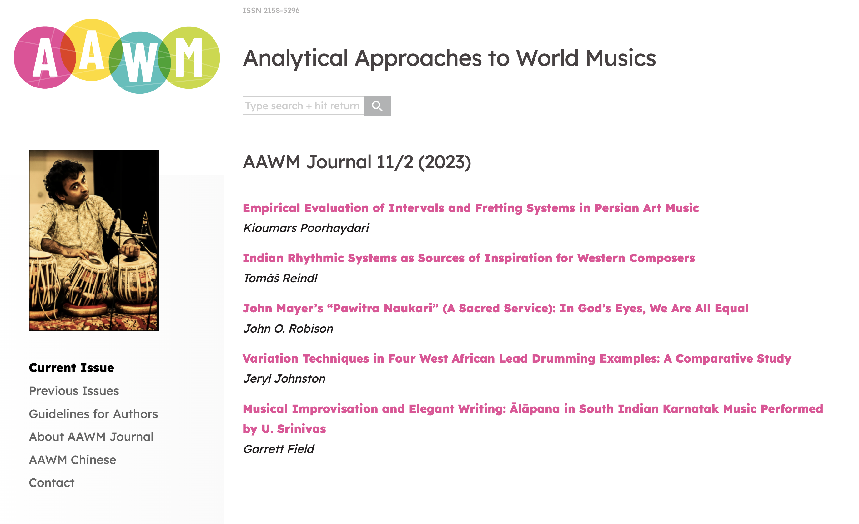
Notes:
This expansion is already happening. More and more scholars identify as music theorists and participate in organizations like the Society for Music Theory while working primarily or exclusively on non-Euro-classical-derived repertoires. For example, Michael Tenzer, Kofi Agawu, Jay Rahn, Chris Stover, Eshantha Peiris, Anna Yu Wang. The Analytical Approaches to World Music conference has met biannually since 2010, and its journal of the same name has published two issues a year starting in 2011.

Slide 3
Regimes
Past and present
Apartheid: Each musical tradition has its own independent theory.
Colonialist: The theories of one musical tradition are used to describe others.
Present and future
Cross-cultural: Theories apply to multiple distinct traditions.
Universal: Theories describe the human capacity for music,
independent of cultural differences.
Notes:
Globalization of the repertoire does not automatically imply globalization of the theories, however, so I will aim in this talk to distinguish a few possibilities. One is a kind of music-theory apartheid, where each musical tradition has its own independent theory. Another I will call colonialist music theory, where theories developed for one tradition are applied to others. Both of these arrangements exist in music theory’s past and present. For its future I envisage cross-cultural and global music theories, in which music theory addresses human capacities for making and cognizing music, not bound to the rules and conventions of a single style.
Expanding the scope of music theory requires us to reconsider how define it. Our conception of it is determined by its history. So before we can look into music theory’s future we need to look into its past.

Slide 4

Can you define music theory? . . .
Notes:
Usually we look for an abstract definition when explaining what music theory does, but this is surprisingly hard. Sources like the Grove dictionary and Wikipedia do not attempt to define music theory. If you try to find a definition using google, one of the first hits you'll get is a reddit thread, which is not a good sign. But let's examine the answers that get upvoted on that thread to identify some of the common tactics and problems.

Slide 5
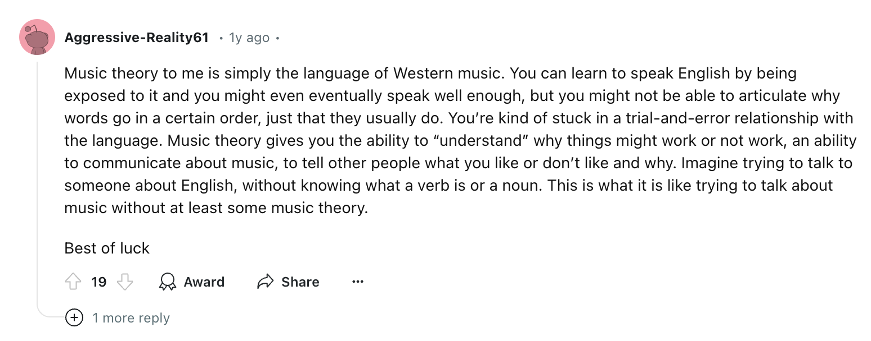
Can you define music theory? . . .
1
Notes:
The internet has an uncanny way of amplifying the worst comments. This attempt at a definition is little more than a raw expression of what’s wrong with music theory. A first step to defining something is usually to look at examples of that thing. If we look for examples of music theory we are likely to find only examples of Euro-classical music theory. This comment reflects that by limiting music theory to Western music. It’s obvious, though, if we want a principled general definition that music theory should be able to apply to all music, not just Western music. It is this gap between the idea of music theory and its actualization that I believe is motivating the most far-reaching changes happening in the discipline now.
The vague term “Western music” compounds the problem. This term technically encompasses multiple traditions, including rock, folk, and jazz music. But it prioritizes the Euro-classical tradition, since the condition of membership is the presence of Euro-classical elements and influences.
The other thing this definition does is to use the word “language,” identifying music theory as talk about music. This feature is common to many definitions, including the next one:

Slide 6
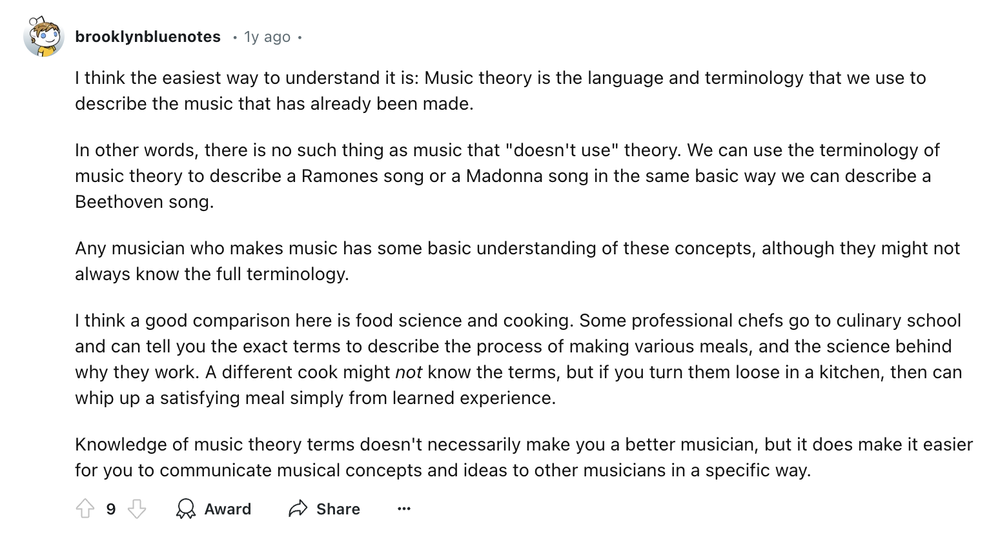
Can you define music theory? . . .
2
Notes:
The point about language and terminology is helpful but not sufficient. Language we use to talk about music includes things like histories of music, biographies of musicians, and social functions of music, which are not typically understood as music theory. This could be taken as a definition of musicology in the inclusive sense, encompassing music history, ethnomusicology, and music theory.
This commenter also references the centrality of analysis to concepts of music theory. This is interesting although not helpful in the categorical way the commenter applies it. There are certainly uses of music theory that are not analytical. For instance we can use music theory to identify and classify hand positions for chords on the guitar for the purpose of writing a song. These hand positions don't necessarily have to be ones that have been used in an existing song.

Slide 7
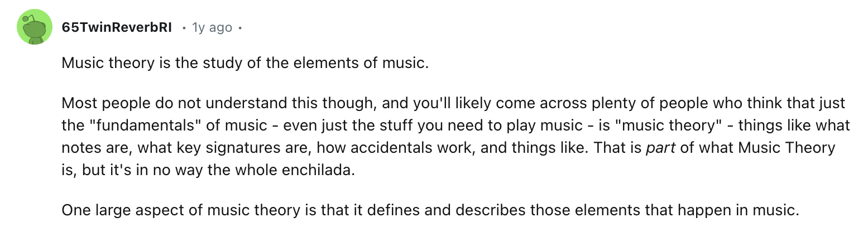

Can you define music theory? . . .
3
4
Notes:
“Elements of music” hints at an attempt to distinguish music theory from music history and ethnomusicology, but it effectively shifts the burden to defining what are the elements of music, which is also hard to do.
(Comment 4): “Description not prescription.”
The fourth comment is not really a definition but it does also reference analysis. Analysis alone is too narrow to capture music theory though. Music theorists spend a lot of time making prescriptions, so a definition excluding prescriptive activity is incomplete.

Slide 8
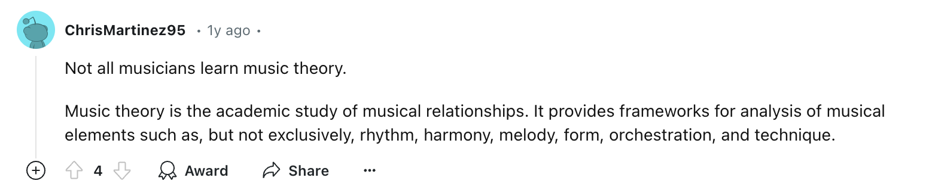
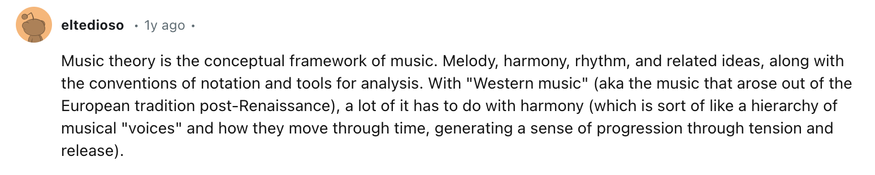
Can you define music theory? . . .
5
6
Notes:
The reference to academic study is also interesting but clearly not helpful. Certainly there is music theory being done outside of academia.
(Comment 6): “Music theory is the conceptual framework of music.”
This definition seems good but also casts too wide a net. Conceptual frameworks clearly include history, social functions, and so forth. For example, my conceptual framework for the Sex Pistols includes rebellious youth, spiky hairdos, and drug use. Probably for this reason commenters 5 and 6 both follow their initial definitions with lists of topics:
(Comment 5): “It provides frameworks for analysis of musical elements such as, but not exclusively, rhythm, harmony, melody, form, orchestration, and technique.”
(Comment 6): “Melody, harmony, rhythm, and related ideas, along with the conventions of notation and tools for analysis.”
These are attempts to specify the “elements of music.” Commenter five certainly has a better, more complete list. But, as the words “not exclusively” imply, a list can never be complete.

Slide 9
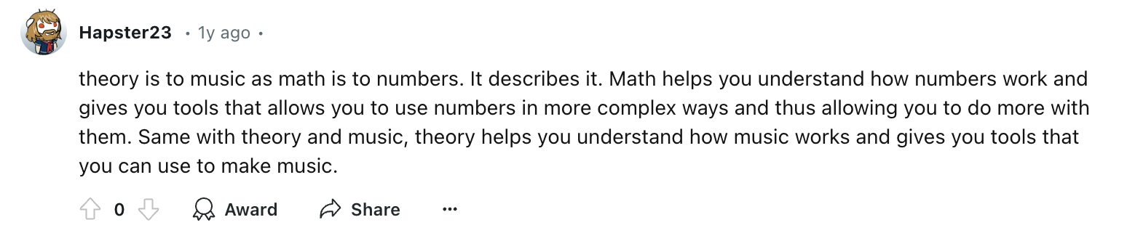
Can you define music theory? . . .
7
Notes:
References to math are also interestingly common in these definitions. It might seem like it would be easy to shoot this one down like I’ve done to the others, but I kind of like this one so I’ll leave it alone. I’ll come back to this topic at the end of the presentation.

Slide 10
Can you define music theory? . . .
Elements of possible definitions
Categorical, accurate,
but overly broad
• Language, concepts, terminology
• Conceptual frameworks
• About elements of music
Associative,
potentially productive
• Analysis
• Rhythm, melody, harmony, form, etc.
• Notation
• Math
Associative,
unproductive
• Western
• Academic
Notes:
To summarize, let's separate these ideas into a few bins: some of them are categorical and accurate, but insufficient. Others don’t help with a categorical definition, but do indicate some things that are associated with music theory. These could lead to a kind of Wittgensteinian family resemblance definition. But while some may be helpful and productive in that direction, others are clearly unproductive, so I've separated the productive from the unproductive.
Another way to go about trying to define music theory is to look at institutions and practices, which are contingent upon the history of the discipline. Immediately the unproductive elements of the definitions come into focus. Historically, music theory as a practice has been siloed within individual musical traditions, what I described earlier as an apartheid regime. Academic music institutions grew out of European conservatories, and therefore defined music theory as a practice within that tradition. In the apartheid regime music theories are separate but not equal. For centuries Euro-classical theory has held a very clear place of prestige.
Historians of European music theory often divide it into two distinct traditions, the practical and the speculative. The practical tradition emerges out of composition pedagogy and is largely regulative, giving rules rather than explanations. The process of formulating such rules creates a body of theory. The speculative tradition instead comes out of attempts to explain music. It is essentially the science of music, although most speculative theory from before the twentieth century would not count as “scientific” in the modern sense of that word.

Slide 11
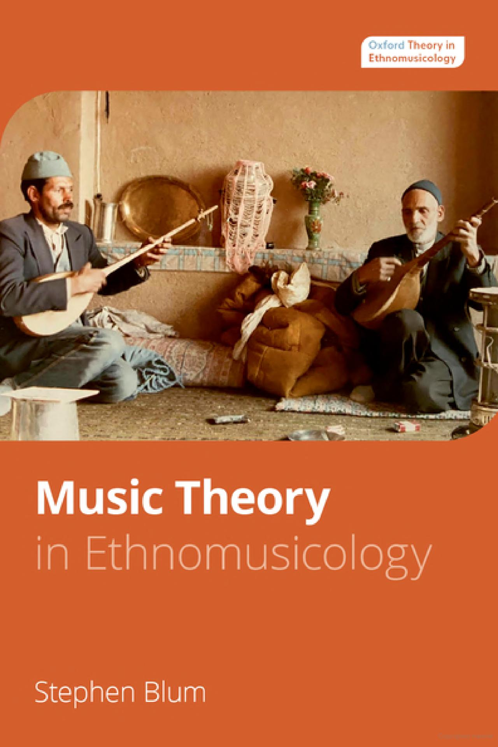
Oxford University Press, 2023
Notes:
Practical and speculative theory exist in other musical traditions as well, in some cases with a history going back at least as far, in some cases farther, than the European one. Notable ancient documents of speculative theory include ones from China, India, and Indonesia. We also find documentation of practical theory in a variety of traditions, and we can reasonably conclude from the work of ethnomusicologists like Stephen Blum that every musical tradition includes practical theory, whether documented or not.
In short, the history of music theory is not a history of one music theory, but a history of many music theories. In looking to the future of music theory, an essential question is whether this is a necessary or contingent situation. Is music theory necessarily culturally circumscribed, definable only within specific musical traditions, or is there a music theory that transcends cultural boundaries and exists independently of individual musical practices?
As society has globalized over the nineteenth and twentieth centuries, music has as well, including music theory. The siloing of music theory has persisted over this period, leading to music-theory colonialism.

Slide 12
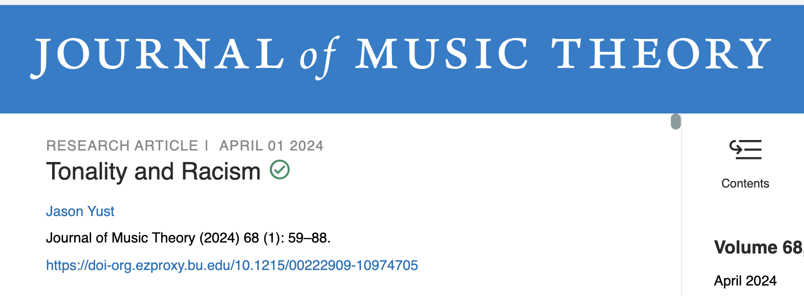
Notes:
I’ve written about one especially clear example of colonialist music theory in a recent essay for the Journal of Music Theory, nineteenth century theorist François-Joseph Fétis. Fétis was instrumental in developing the concept of tonality, as a way of explaining systems of keys and functional harmony in European classical music and how they developed from the fifteenth to the nineteenth centuries. At the time, in the mid-nineteenth century, European colonialism was bringing a steady stream of knowledge about non-European music into the continent. Theorists had to assimilate this new knowledge one way or another. Up to that point they could theorize one style of music and call it, simply, a theory of music. Confronted with new kinds of music, they did their best to apply existing theory, developed for European music, to these sometimes very different cultural practices.

Slide 13
Euro-classical music is weird
• It has harmony and counterpoint
• It relies heavily upon highly specific system of notation
• It has many divisions of labor
. . . between composer and performer,
performer and listener
performer and theorist
Notes:
To understand where this took Fétis, it helps to consider a few of the ways that nineteenth-century European music is weird.
• Harmony
Perhaps the most strikingly weird feature of Euro-classical music is the pervasive role of harmony. Harmony is correspondingly a fixation of music theory as practiced in institutions like mine. We can see this in undergraduate curricula, whose required theory courses traditionally teach harmony almost exclusively. This feature of Euro-classical music is so taken for granted that it is difficult to answer the question, do non-European musical traditions have harmony? To do so we have to deconstruct the concept. Despite so much effort put into theorizing harmony, when our universe is Euro-classical music we can take the concept for granted and never have to deconstruct it. Clearly no traditions, except those partially derived from Euro-classical music, use harmony in the specific way that it does. But some aspects of harmony like modulation or the sounding of multiple tones simultaneous do exist independently in other traditions.
• Notation
Notation exists in various forms in different musical traditions, but it takes on a role in Euro-classical music far beyond any other tradition, in the specificity of scores and the identification of music with score. This has also left a deep impression on academic music theory, which relies heavily on scores. As I will explain shortly, I think that this has led to some serious problems, but they are not the obvious ones. Analyzing from score is enormously more efficient, and the vast majority of music theorists take the imperative to experience a score as aural imagery very seriously.
• Division of labor
Another feature of Euro-classical music that stands out in a global context is the division of labor between composer and performer. This is intimately related to the role of notation: the complexity and high degree of specificity of European notation developed as a way for the composer to communicate with the performer. This is not the only division of labor that is unusually strong in Euro-classical music. The division between performer and listener is also stark, with the average listener being very far removed from the ability to perform or compose the music. Another division of labor that hardly exists outside of the Euro-classical tradition is between theorist and musician, which is, of course, what has led to the situation I’m addressing in this talk.
Nineteenth-century Europeans inherited a music theory in which the features I just described were understood simply as features of music. When theorists who had deeply internalized this mentality encountered music that lacked features like harmony and notation, they concluded that it was primitive and underdeveloped. The new music they encountered may have been highly refined in other respects, but without the mental schemas to recognize these features, and with no theoretical framework that could accommodate them, they ignored them.

Slide 14
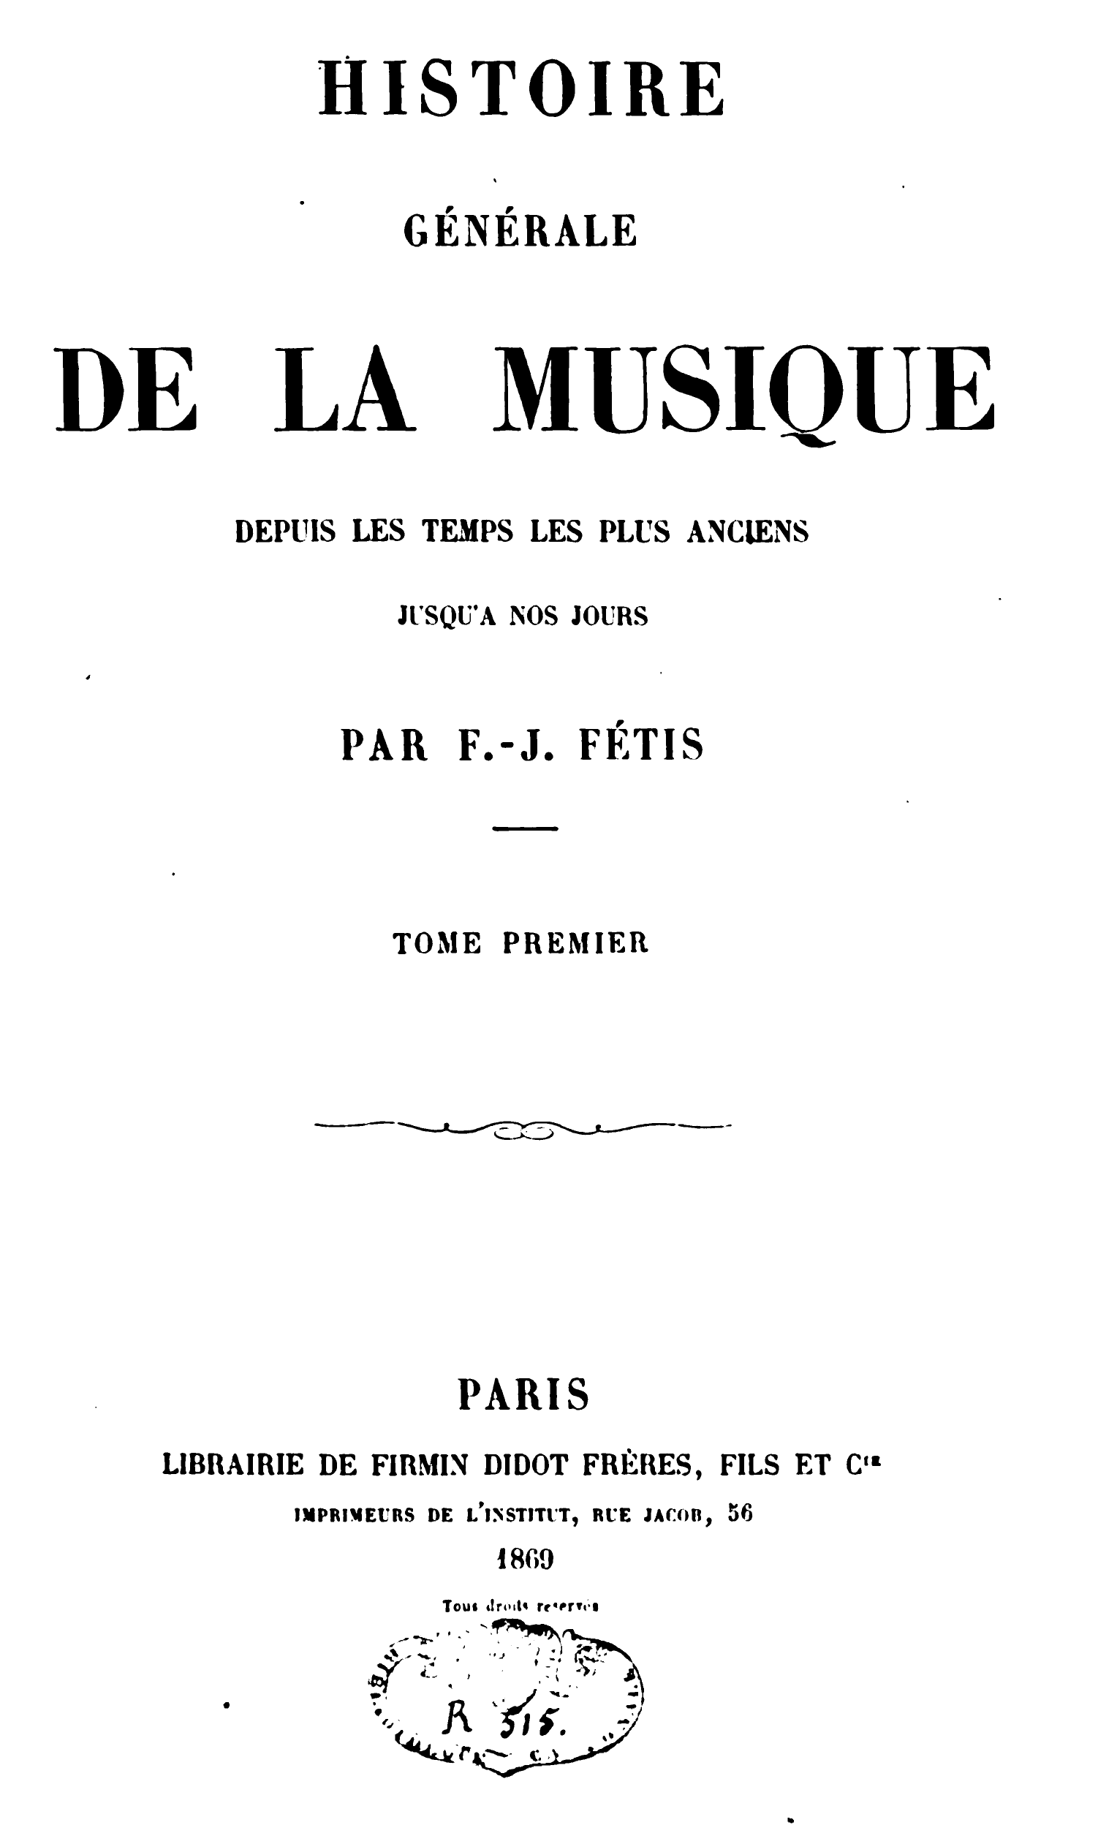
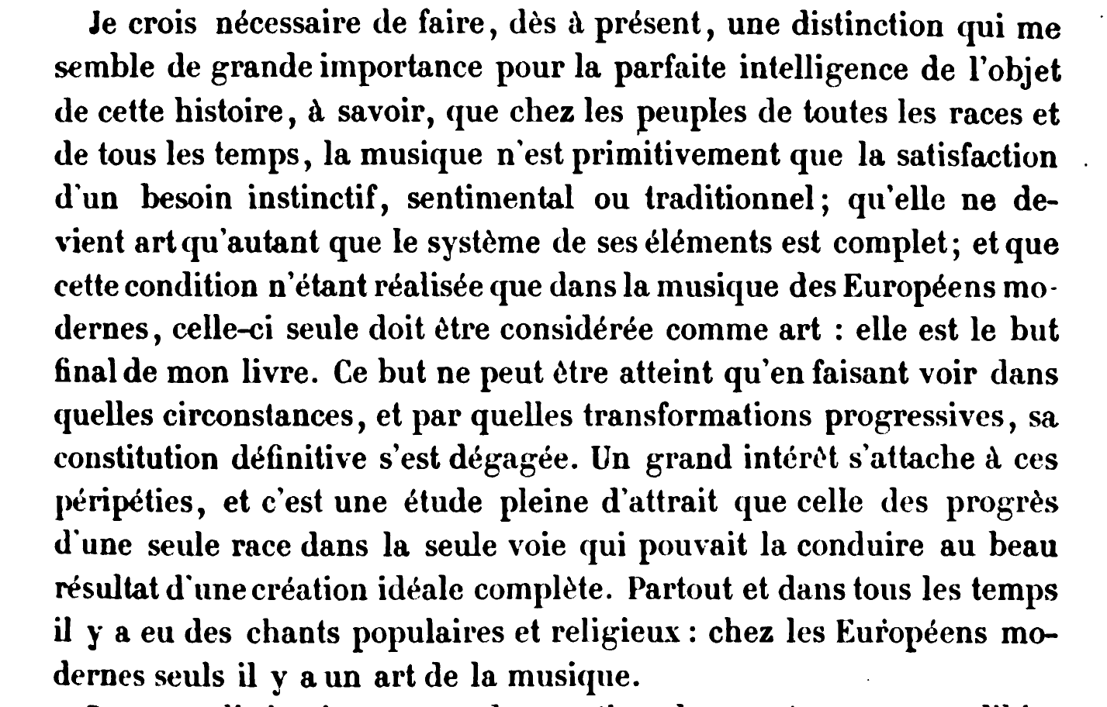
Notes:
Fétis drew especially fallacious and abhorrent conclusions from this. His last project was a huge and ambitious multivolume work entitled Histoire générale de la musique. He dedicated this work to the premise that the music of Europeans reflected racial superiority. His argument for this centered on the concept of tonalité, which he had earlier developed in the context of the development of European music from liturgical chant to the nineteenth century. His use of this concept as a pseudoscientific defense of racial determinism was inspired by white supremacist writers like Arthur de Gobineau and Ernest Renan. Where they claimed that physiology proved the inferiority of non-white races, Fétis claimed that the impoverished tonalities of non-white races proved their inherent inferiority.
This history is essential to understanding the situation in music and music theory today. Throughout the 20th century and still today many composers classify music as tonal or atonal and associate atonal with more advanced, exactly as Fétis framed it. Music theory curricula and many research careers are built around this distinction, relabeled as tonal versus post-tonal. The change in terminology actually doubles down on the problem, emphasizing the temporal aspect of the distinction. The temporal aspect was essential to how Fétis described tonality and the implicit evolutionary ladder of musical progress it supposedly represented. The other end of this evolutionary ladder consists of tonalities which only have scales and lack functional harmony. That’s basically every kind of music not derived from Euro-classical music, and gave Fétis justification to call them primitive. In short, the cultural chauvinism of Fétis is now built into academic music theory, essential training for composers in the Euro-classical tradition. Composers throughout the twentieth century to today commonly reflect the evolutionary ladder model created by Fétis in how they conceptualize their own place in music history.
In his talk yesterday Nathan Holder made a valuable point about how familiar things in our environment were often once constructed with a lot of intention. After we are so used to seeing them and taking them for granted, we forget about those intentions, but they are still there in the design of the thing. This is very much true of the concept of tonality, which was designed to convince us that some music is more advanced than other music, and to use that as evidence of racial superiority. We have grown so accustomed to the concept that we take it for granted, and have forgotten that it is a concept whose design was quite intentional. The structure of the concept continues to work as originally intended, to exclude non-White music for places of prestige, even if it does so outside of our conscious awareness.
Nathan also made another point that I think is significant here. He said “education is setting us up to see the world in certain ways.” Sometimes this learning is implicit, when it comes from the structuring of our curricula. The exclusionary design of music theory curricula, divided into tonal and post-tonal topics, works this way.
Tonality is speculative theory that Fétis assembled from practical, regulative theory: keys, dissonance treatment, and rules of voice leading and harmonic succession. By its nature speculative theory calls for scientific reasoning and methods. If done well, science can be an antidote to the excesses of colonialist music theory like Fétis’s. Yet nineteenth-century racist pseudoscience, like phrenology and social Darwinism, is a cautionary lesson that poor scientific reasoning can also exacerbate colonialism. Similar kinds of bad science can happen in music theory.

Slide 15
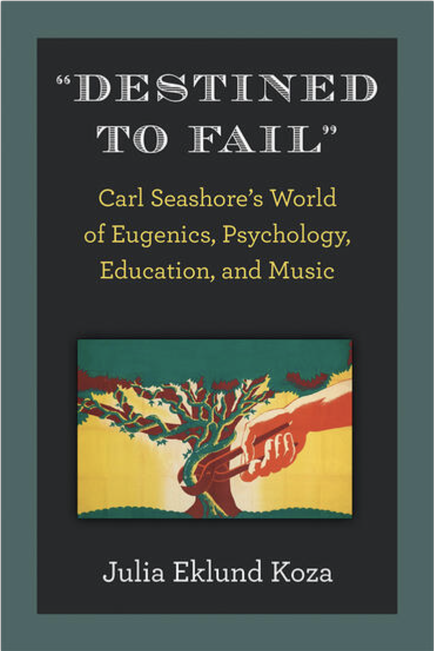
Notes:
For instance, Carl Seashore, who still today is highly regarded as a pioneer of music psychology, was also a eugenicist. A recent book by Julia Koza outlines how Seashore’s eugenicism influenced his music psychology work. Seashore drew on Euro-classical theoretical frameworks to define musical talent. Colonialist music theory led to a biased definition that he then used to conclude, fallaciously, that musical talent is innate. His methods appeared to be rigorous basic science, and his tests of musical ability remain standards, but the underlying colonialist music theory leads to serious and highly consequential flaws in his conclusions.

Slide 16
“
Most research in neuroscience has been conducted on WEIRD participants—that is, individuals who hail from Western, Educated, Industrialized, Rich, and Democratic societies. . . . Music psychology shares this sampling bias: participants are almost always recruited from WEIRD societies, experimental materials are usually drawn from Western music, and studies tend to investigate constructs such as harmonic progressions that are dis- proportionately relevant to Western music.
This situation gives rise to at least two fundamental problems. First, it biases the understanding of human mechanisms for music perception and production, because WEIRD populations do not necessarily constitute a representative sample along multiple critical dimensions ranging from basic visual and spatial perception to social cognition. . . Second, important questions regarding the biological and cultural origins of music, its relation to language and other activities, and the diversity and commonality of human music making require the kind of comparative cross-cultural approaches already common in other fields such as linguistics and anthropology.
”
Jacoby, Margulis, Clayton, Hannon, Honing, Iverson, Klein, Mehr, Pearson, Peretz, Perlman,
Polak, Ravignini, Savage, Steingo, Stevens, Trainor, Trehub, Veal, Wald-Fuhrmann 2020
Notes:
This quote comes from a recent article entitled “Cross-Cultural Work in Music Cognition” authored by a large group of prominent scientists. The article focuses on the important problem of relying heavily on Western subjects in empirical research. I would add to this that stimuli and research questions often come out of Euro-classical theory, which also skews research designs towards the concerns of that theory. The true goal of music cognition research is to understand the human capacity for music. Such culture-specific research can advance that understanding, to be sure. But without generalizing beyond Western musical traditions, we can never draw any firm conclusions. Research has gradually begun to make steps in this direction.

Slide 17
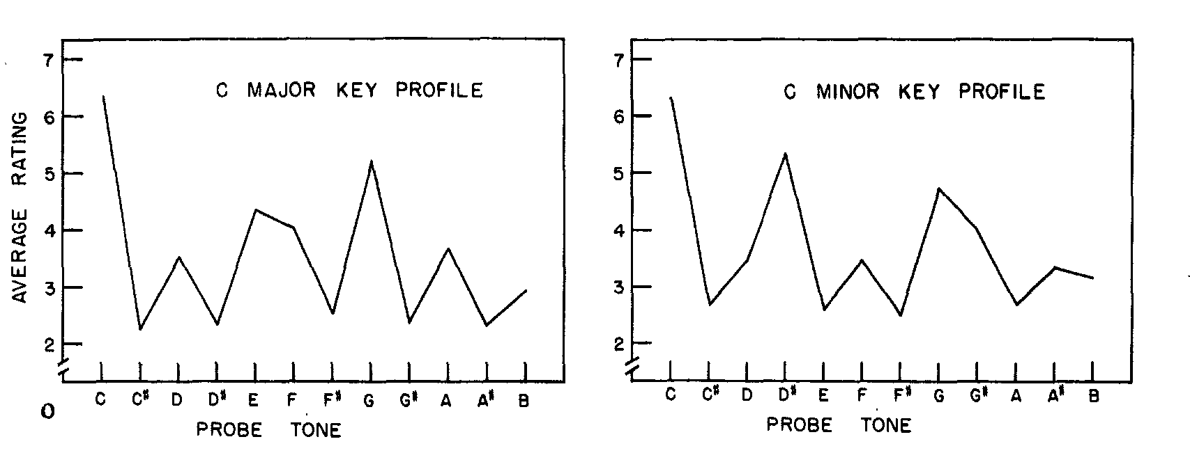
Key profiles (Krumhansl & Kessler 1982)
Notes:
One topic that produced some of the earliest cross-cultural studies is Carol Krumhansl’s theory of tonal hierarchy. The original version of her theory operated only within the Euro-classical framework, relying on its concepts of key, stability, and musical conventions associated with them. The theory claims that the psychological phenomenon of being in a key corresponds to an assignment of stability values to each of the twelve notes of the chromatic scale with the highest values for the tonic note, followed by the tonic triad, then the basic scale. The original experiments to validate this theory used a probe-tone method. This method involves establishing some musical context and then asking subjects to rate the fit of all twelve pitch-classes following that context.
To make this method applicable to outside of the Euro-classical context requires some adjustments. The easiest is to generalize the contexts beyond ones derived from Euro-classical major and minor constructs. More problematic is the probe-tone set, which relies on the Euro-classical convention of 12-tone equal tempered tuning. In addition, the basis for rating probe tones must be meaningful and consistent across participants’ different musical backgrounds.

Slide 18
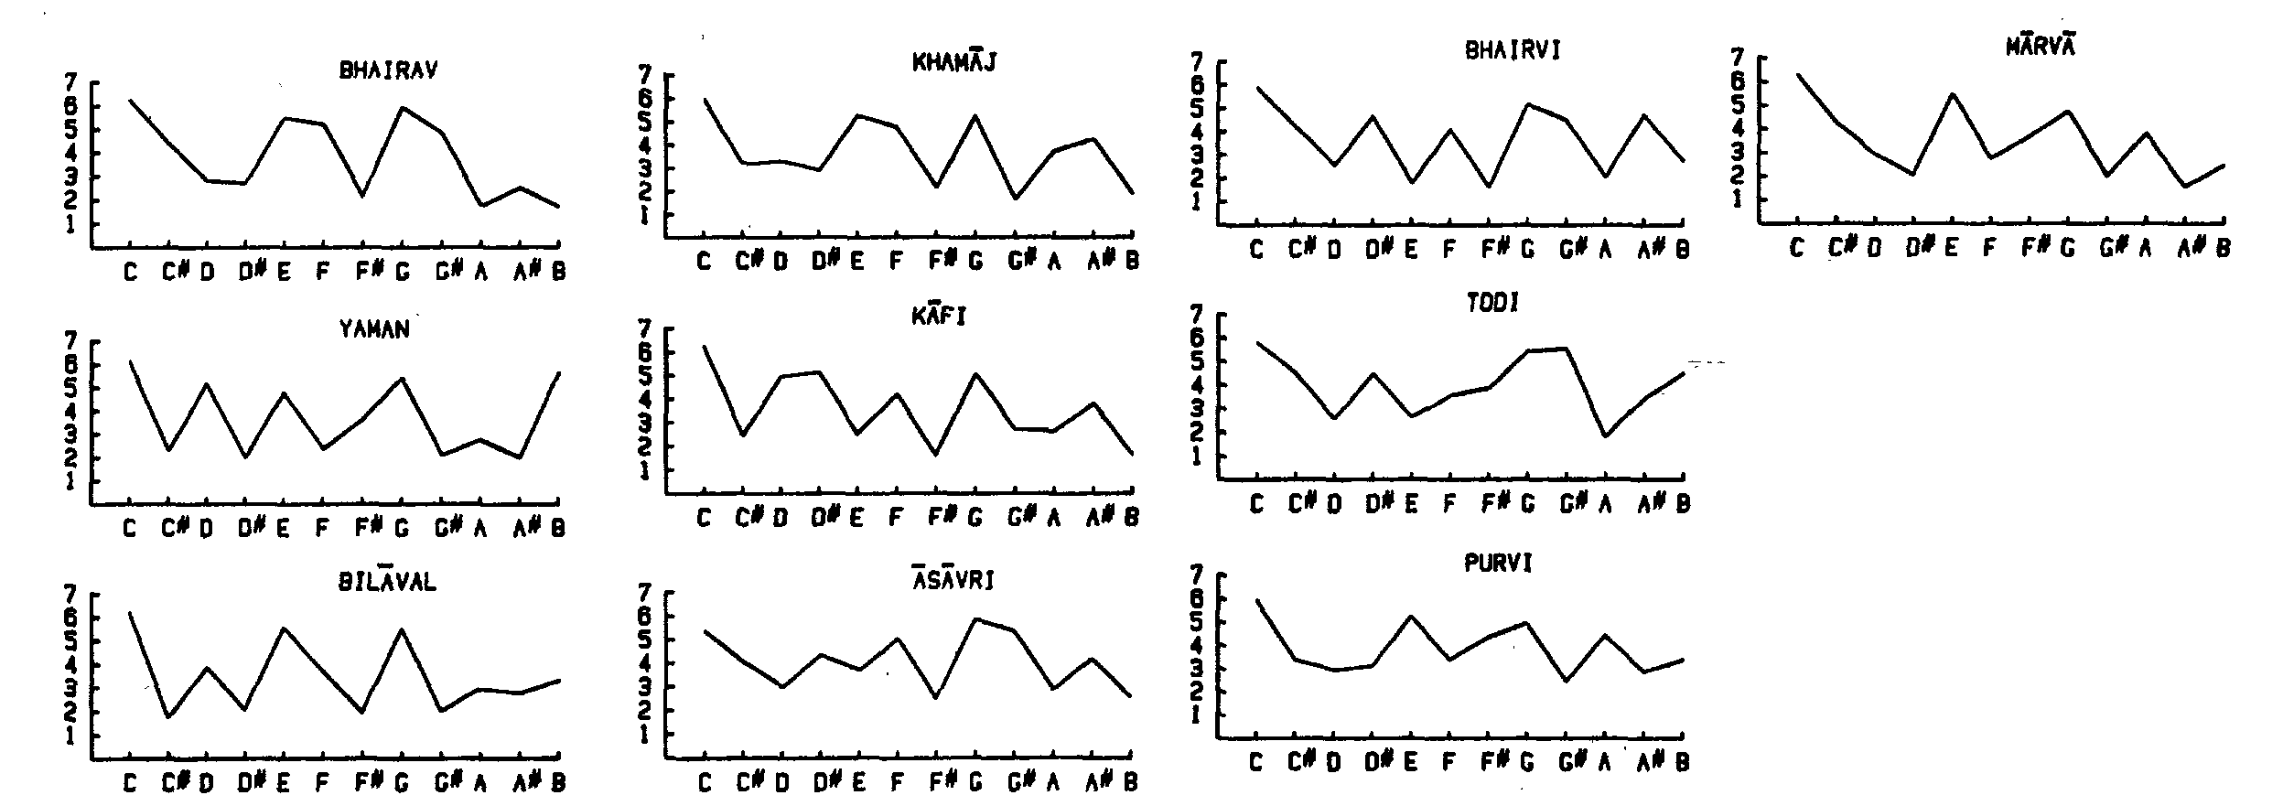
Probe tone ratings of ragas
—Castellano, Bharucha, & Krumhansl 1984
Notes:
Two cross-cultural probe tone studies were published in 1984. One uses Hindustani melodies as contexts and compares listeners with an exclusively Western musical background to listeners with backgrounds in Hindustani music as well as Western music. The choice of Hindustani music mitigates some of the potential problems with generalizing the probe tone paradigm. The long colonial history of Hindustani music and its consequent adoption of European equal temperament justifies the use of a twelve-tone pitch set for probe tone responses. The concept of rating tones for fit seems to be meaningful and consistent across participants in this study. This could also be attributable to the colonial history of Hindustani music. The concept of thaat was invented by Hindustani musicians during the British colonial period on the model of the European concept of scale. Many decades later this concept has been well absorbed into the tradition. We could also attribute the agreement on the concept of fit to the fact that both subject groups had extensive familiarity with Western music. The main result of the study was that rating patterns between the two groups was broadly similar, with only subtle differences elicited by post-hoc tests. The response patterns reflected the claims of raga theory well.

Slide 19
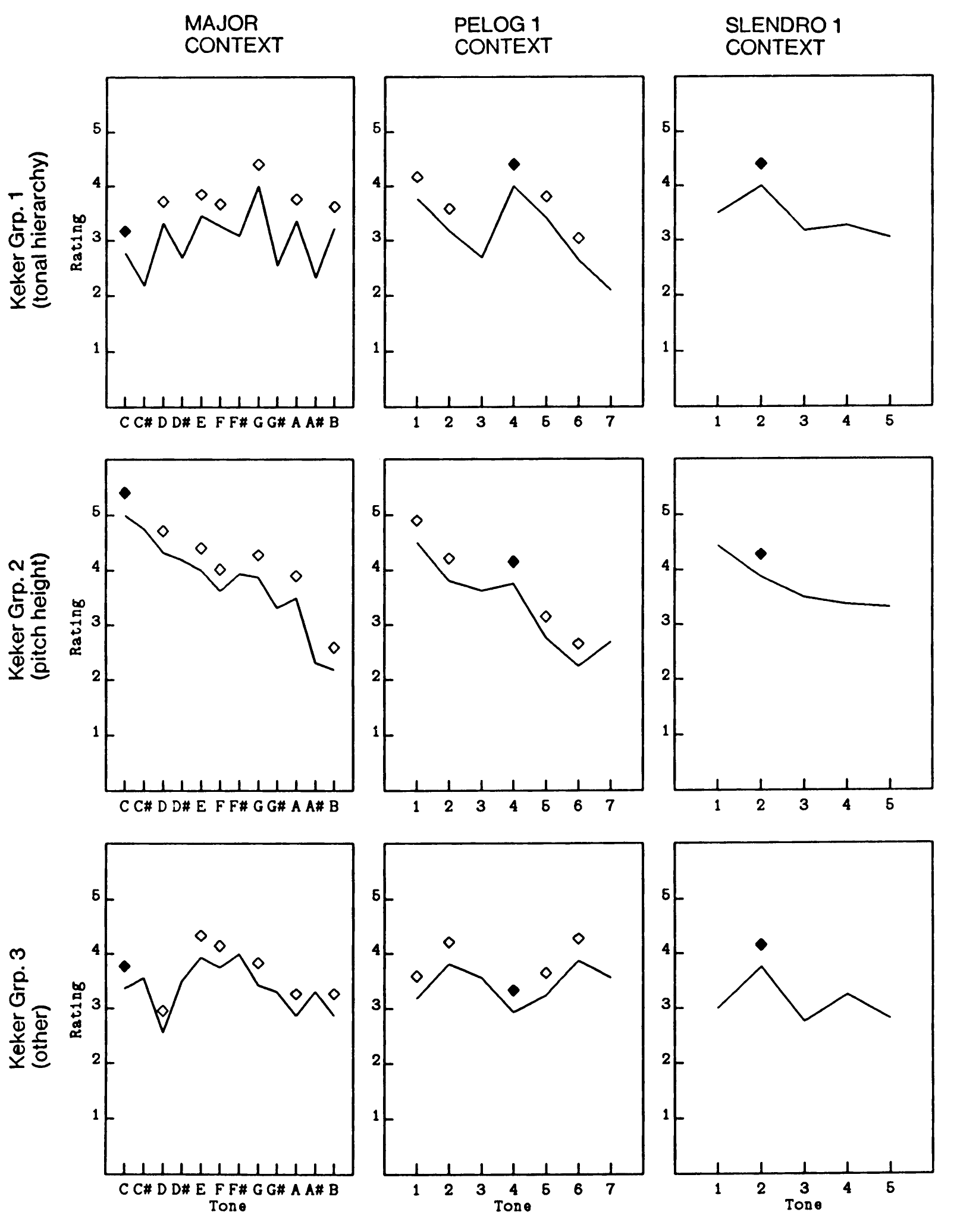
Kessler, Hansen, & Shepard 1984
Notes:
The other extant cross-cultural study compares Western listeners to Balinese listeners, and is especially notable for the inclusion of a subject population with little to no exposure to Western music. The generalization of the probe-tone paradigm is more strained here. While the concept of out-of-scale tones exists in Balinese music, it is much less prevalent. The pelog tuning theoretically contains seven tones with the scale being a five-note subset, but many gamelans include only the five tones. The slendro tuning has only five tones and no out-of-scale tones. Furthermore, the two systems do not have fixed tunings. Balinese musicians prize the variability of pelog and slendro tunings from one gamelan to another.
The results of the study reveal that a group of Balinese musicians from a conservatory and familiar with Western music understood the instructions and rated probe tones similarly to Western listeners. The listeners from a remote village without exposure to Western music disagreed on how they understood the instructions. The authors divided these participants into three groups, one that produced results similar to the conservatory musicians, one that rated probe tones by pitch height, and a third whose answers fit no discernable pattern. Overall, the lack of agreement indicates that the Euro-classical concept of tonal stability does not generalize to all musical traditions. It is cross-cultural but not universal.
The fact that we find this only when seeking out populations without exposure to Western music suggests that the concept of tonal stability may be a European cultural export. This is made all the more interesting by the fact that we can trace the practice of characterizing world musics by their scales to Fétis. His assumption that each musical tradition had its own tonality was a colonialist attempt to interpret all musics within a Euro-classical theoretical framework. The fact that those traditions looked impoverished within this framework, at best having scales, but not implicative tones or functional harmony, occasioned the explicitly racist premise of Fétis’s last major work. It is also the beginning of a process where traditions like Hindustani raga and Arabic maqam began to adopt concepts of scale and tonal stability from Euro-classical theory.

Slide 20
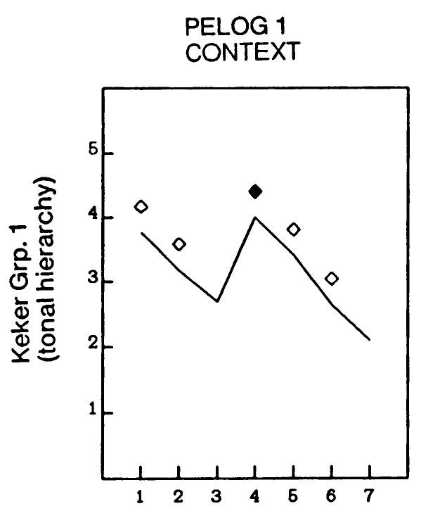
Kessler, Hansen, & Shepard 1984
Notes:
On a closer look, however, the results of this study are also evidence for a possible deeper cross-cultural theory. If the idea of tonal stability is not universal, and if Hinustani and Balinese conservatory musicians use the term meaningfully and consistently because of their familiarity with Western music, then it is remarkable that a subset of the remote villagers produced rating patterns that matched the conservatory students.

Slide 21
Kessler, Hansen, & Shepard 1984
Circle of fifths
(ngempang, kempyung)
Notes:
Furthermore the pattern is striking in that it seems to be based on a generalized circle of fifths, with ratings decreasing regular with fifths distance from the gong tone. These intervals only very roughly approximate acoustical fifths in tuning but they all span four scale steps and are called ngempat in Balinese and kempyung in Javanese, playing a special role in the traditional theory of both styles. The organization of pitch materials by fifths is very widespread and found in musical practices that are not historically related. It is probably, therefore, a part of the general human capacity for music.

Slide 22

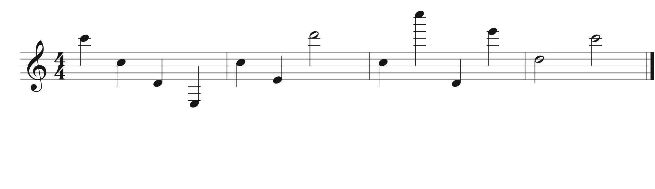
Octave equivalence as a universal
Do you recognize the tune?
C C D E C E D C C D E D C
Notes:
When people think about musical universals, octave equivalence usually comes up early on the list. This is a good example of why being clear about our definitions is essential. Broadly construed octave equivalence is not even a feature of Western music. For instance, can you recognize this melody?
[play]
Most people can’t. [animation] Here's the notation for what I played. Now if I simply write down the letter of each note, see if you recognize it. [animation]
It’s Yankee Doodle with the octaves scrambled. Octave equivalence in Euro-classical music is a feature of harmony and keys, but is not a principle across the board, for instance in melody recognition. As I mentioned before harmony is one of the weird features of Euro-classical music. This should make us suspicious of the claim that octave equivalence is universal.

Slide 23
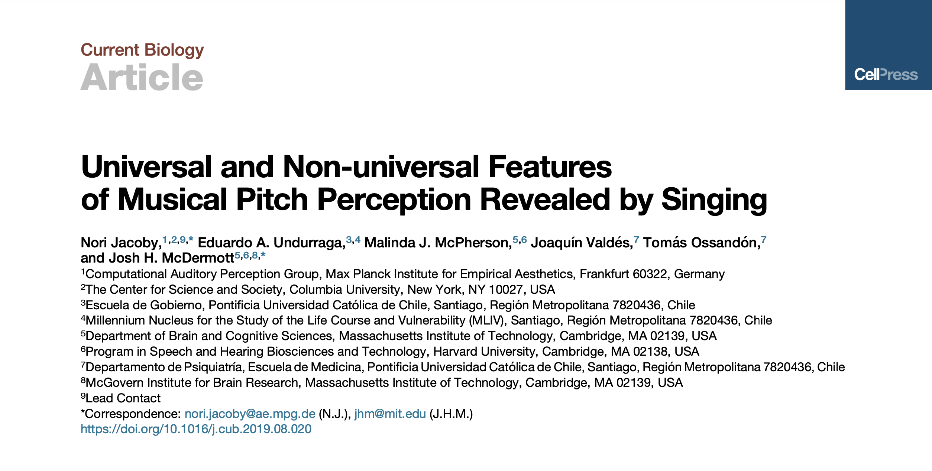
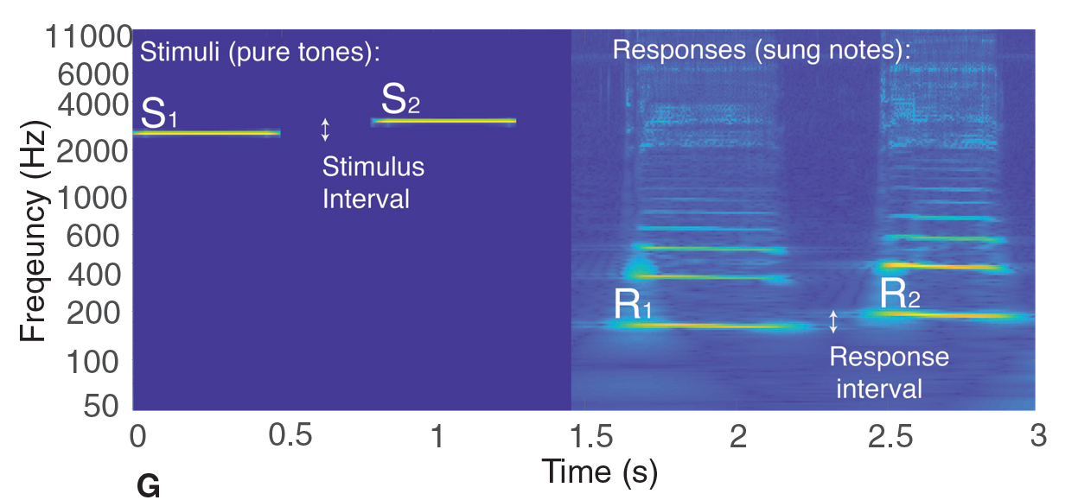
Notes:
In fact it isn’t, as this recent study has shown. The study compares US participants to Tsimane participants, an indigenous tribe living in a remote village in the Bolivian rainforest. The task was simply to sing back musical intervals played outside the participants’ vocal range.

Slide 24
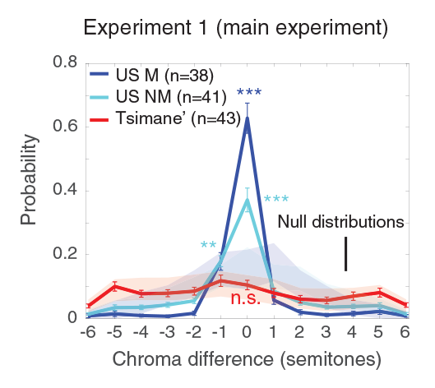
Results: Jacoby et al. 2019
Notes:
When US participants do this they match the chroma of the stimulus, shifting it by octave. The Tsimane participants, though they accurately reproduced the interval, did so by choosing a starting note in their vocal range that was not necessarily an octave transposition of the stimulus. This form of octave equivalence therefore relates to peculiarities of Western music and is not shared by all human societies.
So is there in fact no universal here? I just got finished claiming that organization by fifths is universal and now I’m calling octave equivalence into question. Actually, the problem is not with octaves but with the meaning of equivalence. Psychoacoustics provides a good explanation of why we should expect the perception of octaves to be universal. Pitch-based musical systems do almost always include octaves and treat them as a special interval. There’s little beyond this, though, to suggest a psychoacoustic basis for treating octave-related notes as equivalent. The evidence suggests that treating octaves as a special interval is a universal, in the sense that originates in the human capacity for music, rather than historical contingencies of specific styles. By the same logic, the special status of fifths is also universal. Octave equivalence, on the other hand, is based on a historical contingency. That contingency is the system of tonality that developed in Europe and is unique to that tradition and its progeny.
I mentioned already that a dramatic transition is underway in music theory to decenter the topics of harmony and tonality that I’ve been discussing in favor of other musical parameters. Theorization of rhythm
In recent years cross-cultural research in music cognition has grown rapidly, with rhythm and meter as an especially dominant topic.

Slide 25
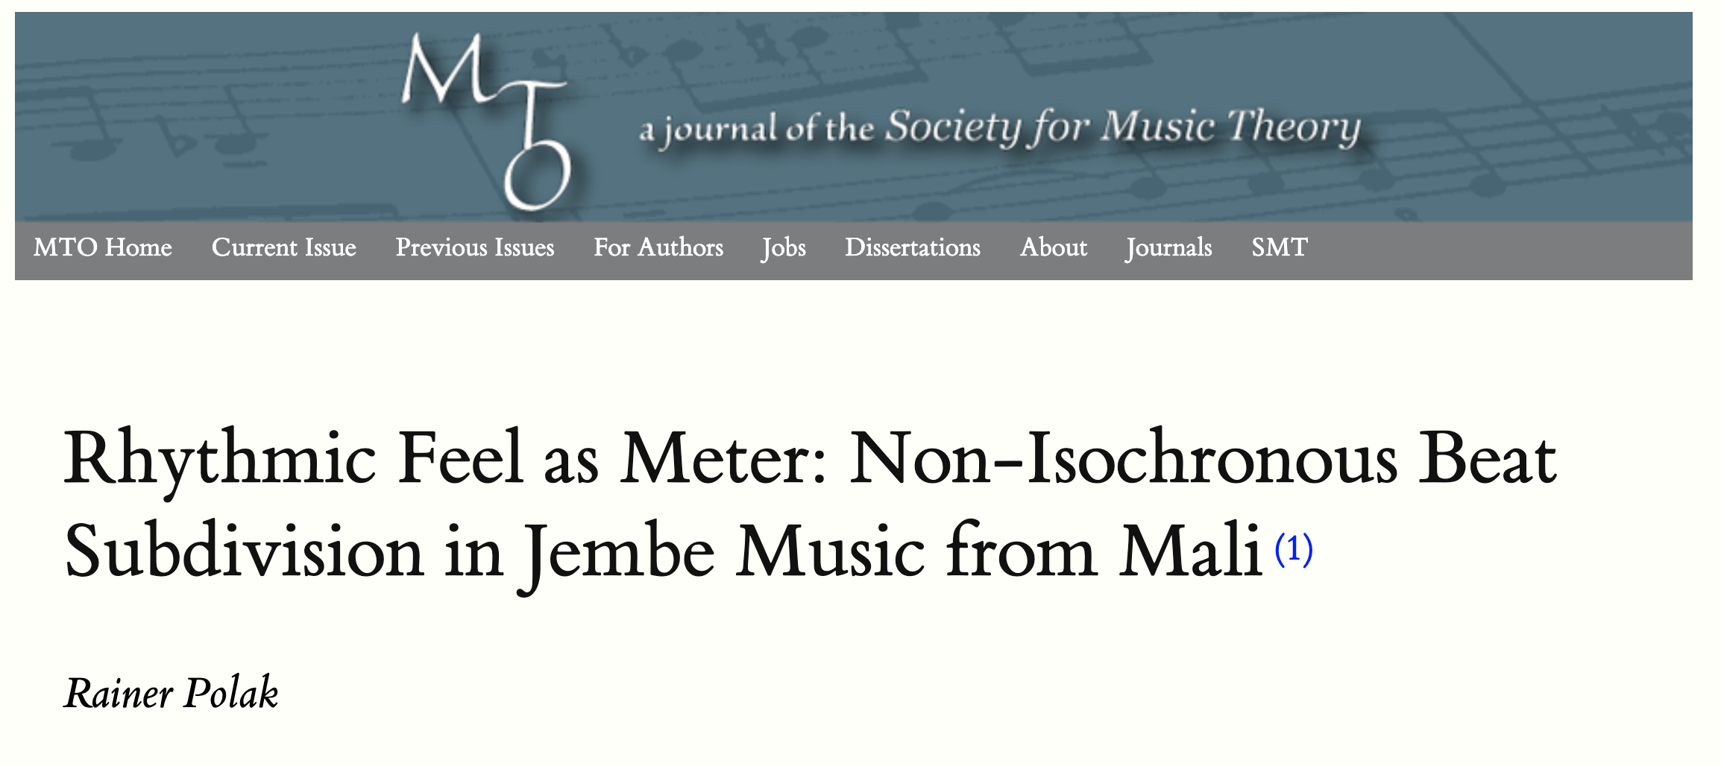
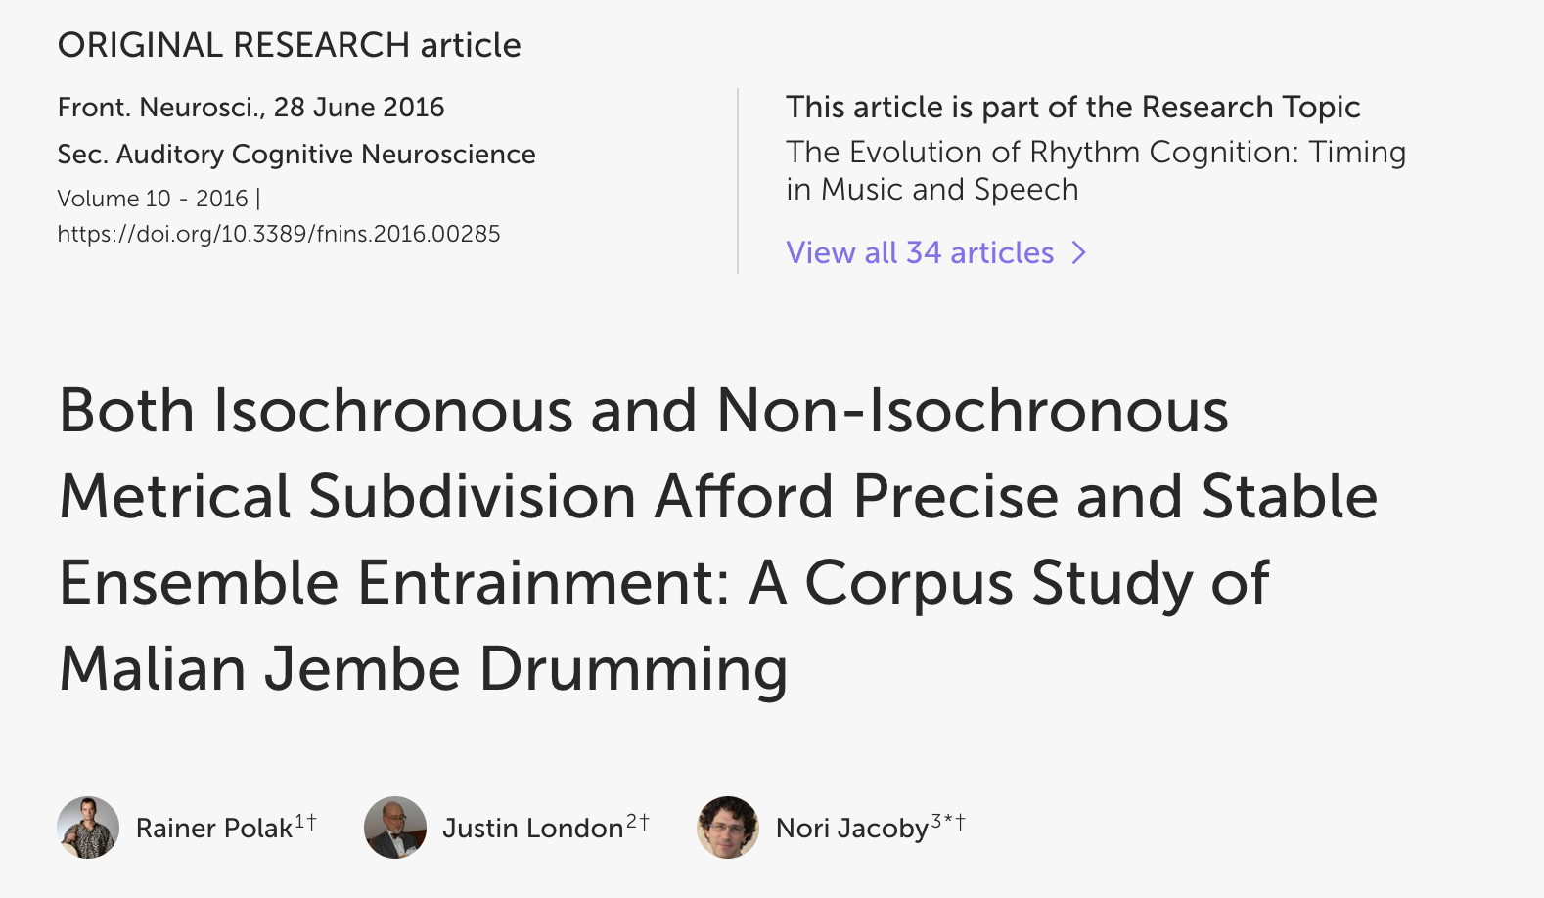

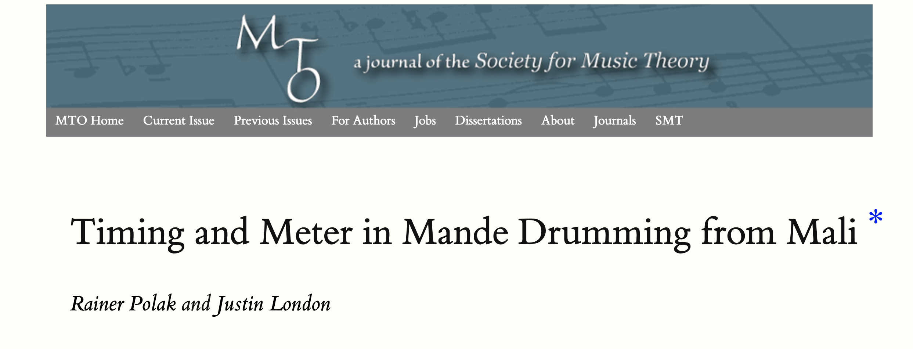
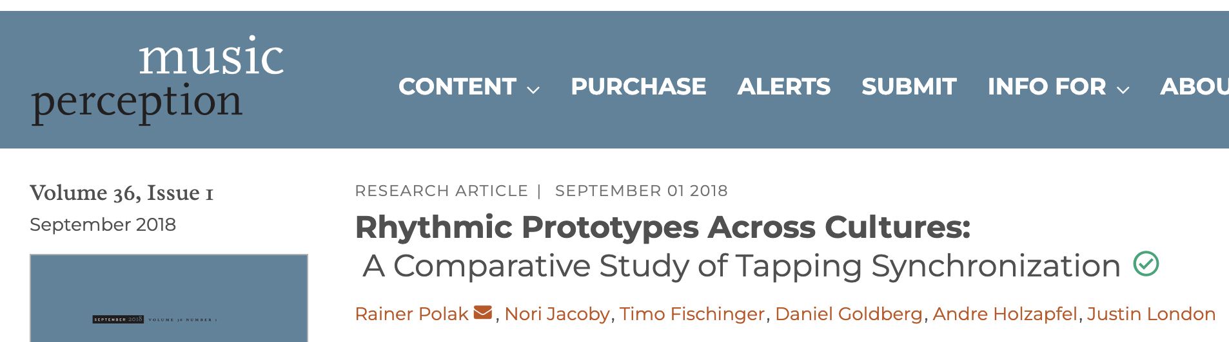
Polak on Malian Rhythm
Notes:
Rainer Polak’s studies on non-isochronous meter stand out, for example. These have challenged the idea, grounded in Euro-classical conceptions, that meter always involves isochronous subdivisions of beats. Malian drummers produce extremely consistent timing of subdivisions at values that do not always correspond to even subdivisions.

Slide 26
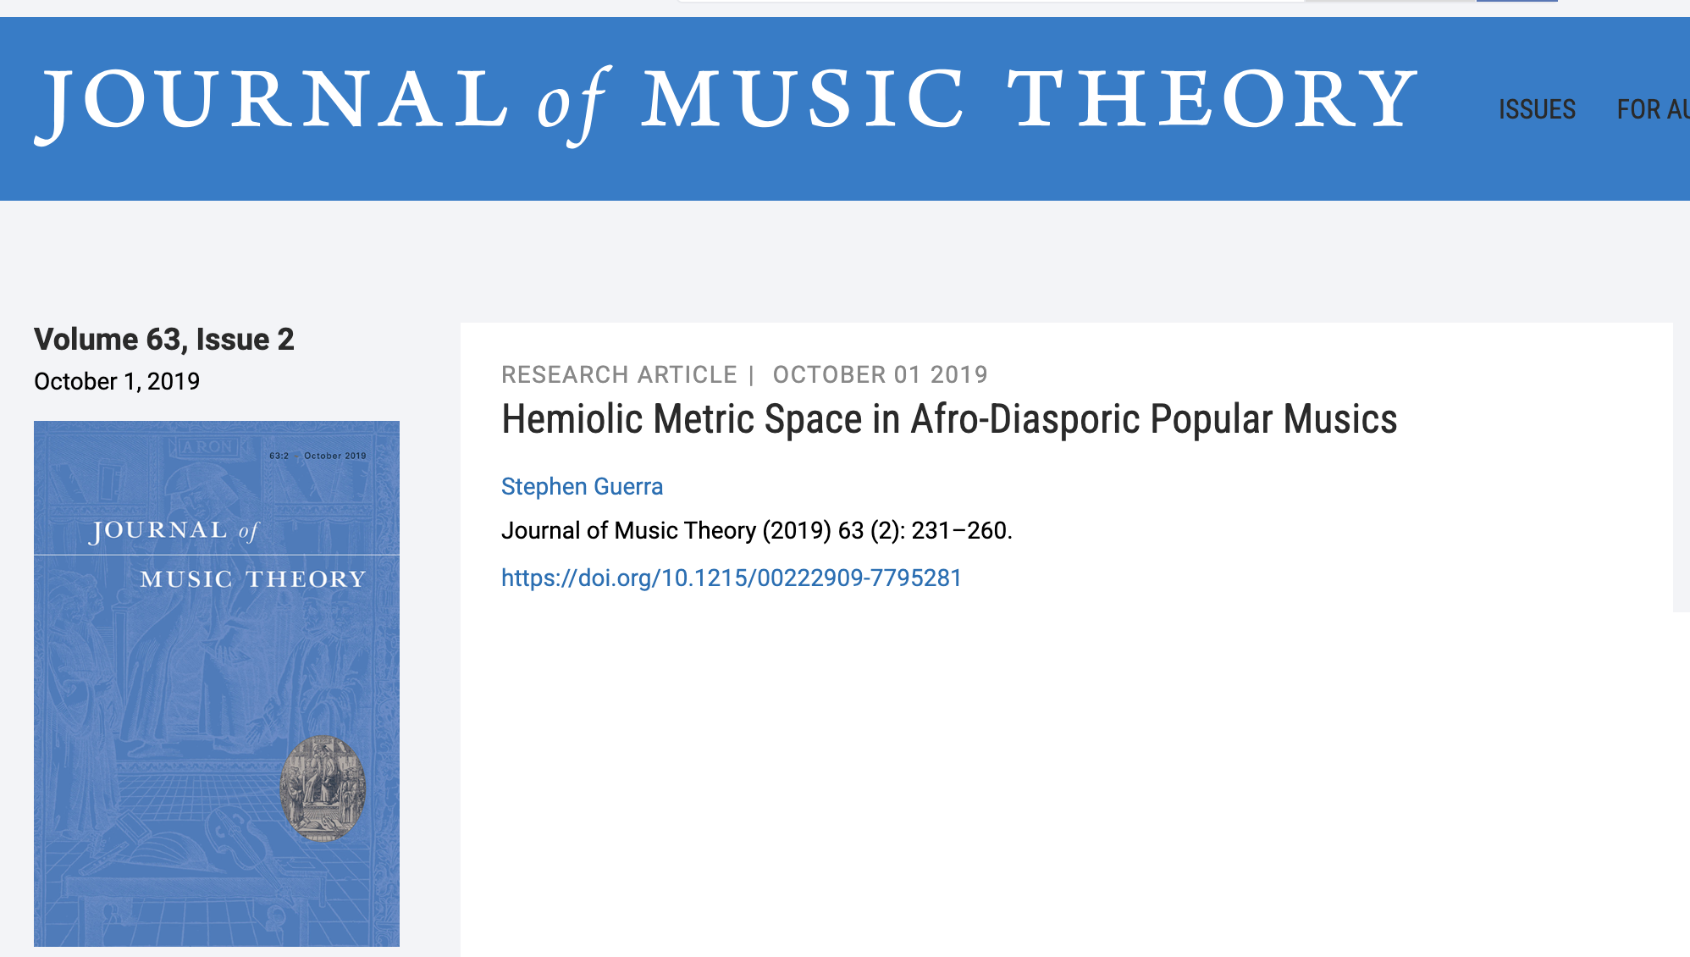
Notes:
Theorist, guitarist, and choro composer Stephen Guerra has recently published a theory article interpreting the music of Baden Powell through non-isochronous meters.

Slide 27
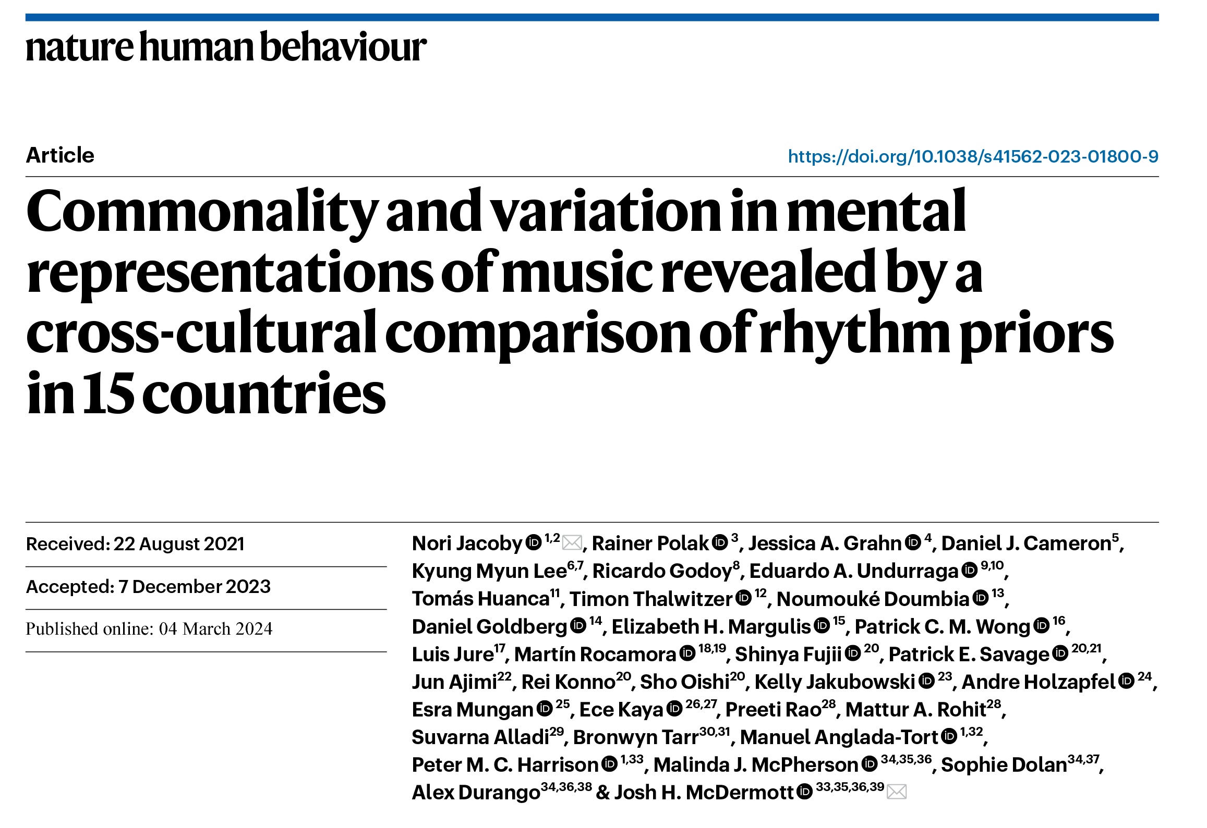
Notes:
A massive cross-cultural study published this year in Nature gave results that contrast with Polak and Guerra’s work. This study is an excellent example of cross-cultural research at its best. The stimuli are cyclically repeating three-interval rhythms allowed to vary continuously in timing. The task is well suited to a cross-cultural study because it’s easy to understand regardless of cultural background. Participants tap along with a seed rhythm, and their timings are recorded. The participant’s average timing from the previous trial then is presented back to them and they tap along with this. After five iterations the timing stabilizes, and the resulting rhythm is recorded as an element of what the authors call a rhythmic prior.

Slide 28
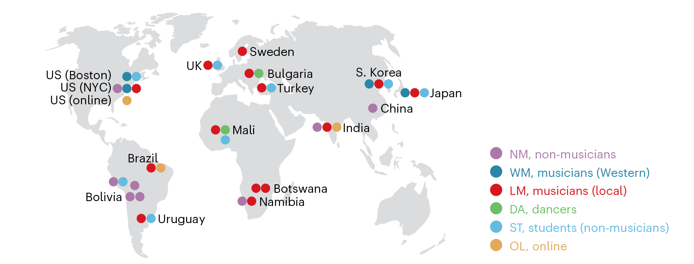
Jacoby et al 2024
Notes:
The authors conducted the study all over the world, with musicians and non-musicians of different backgrounds in a variety of local styles.

Slide 29
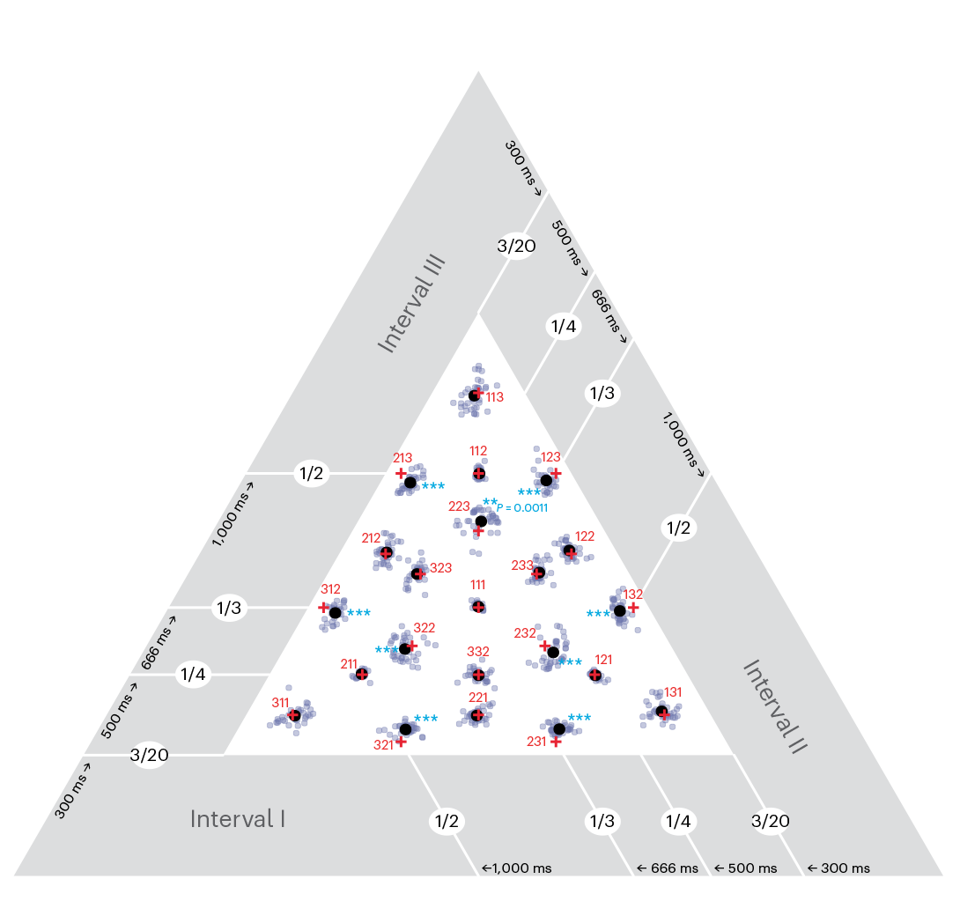
Jacoby et al 2024
Overall results in the rhythm triangle. Red crosses show rhythms with integer proportions. Black dots show average priors across all groups.
Systematic deviations widen the small interval in rotations of 1:2:3 and 3:2:1 and widen the large interval of 2:2:3 and rotations.
Notes:
The main result of the study is that rhythmic priors consistently coalesce around simple-integer proportions. This is therefore a very general feature of human rhythmic perception.
An important feature of the design is to select rhythms from a continuous temporal space. They illustrate this with the rhythm triangle. These are barycentric coordinates where each dimension is the size of one of the three intervals. The reason to use barycentric coordinates is that the sum of the three intervals is fixed, so there are only two real degrees of freedom. [explain how triangle works, three intervals along each axis, more even towards the middle, etc.] If you have even dealt with voice-leading spaces, this is basically a voice-leading space on three-onset rhythms. The seed rhythms are randomly sampled from this temporally continuous space, so there is no bias towards any concept of meter. The participant responses are also free in principle to go anywhere in the space. But they consistently gravitate towards simple integer proportions, which are shown here with red crosses.

Slide 30
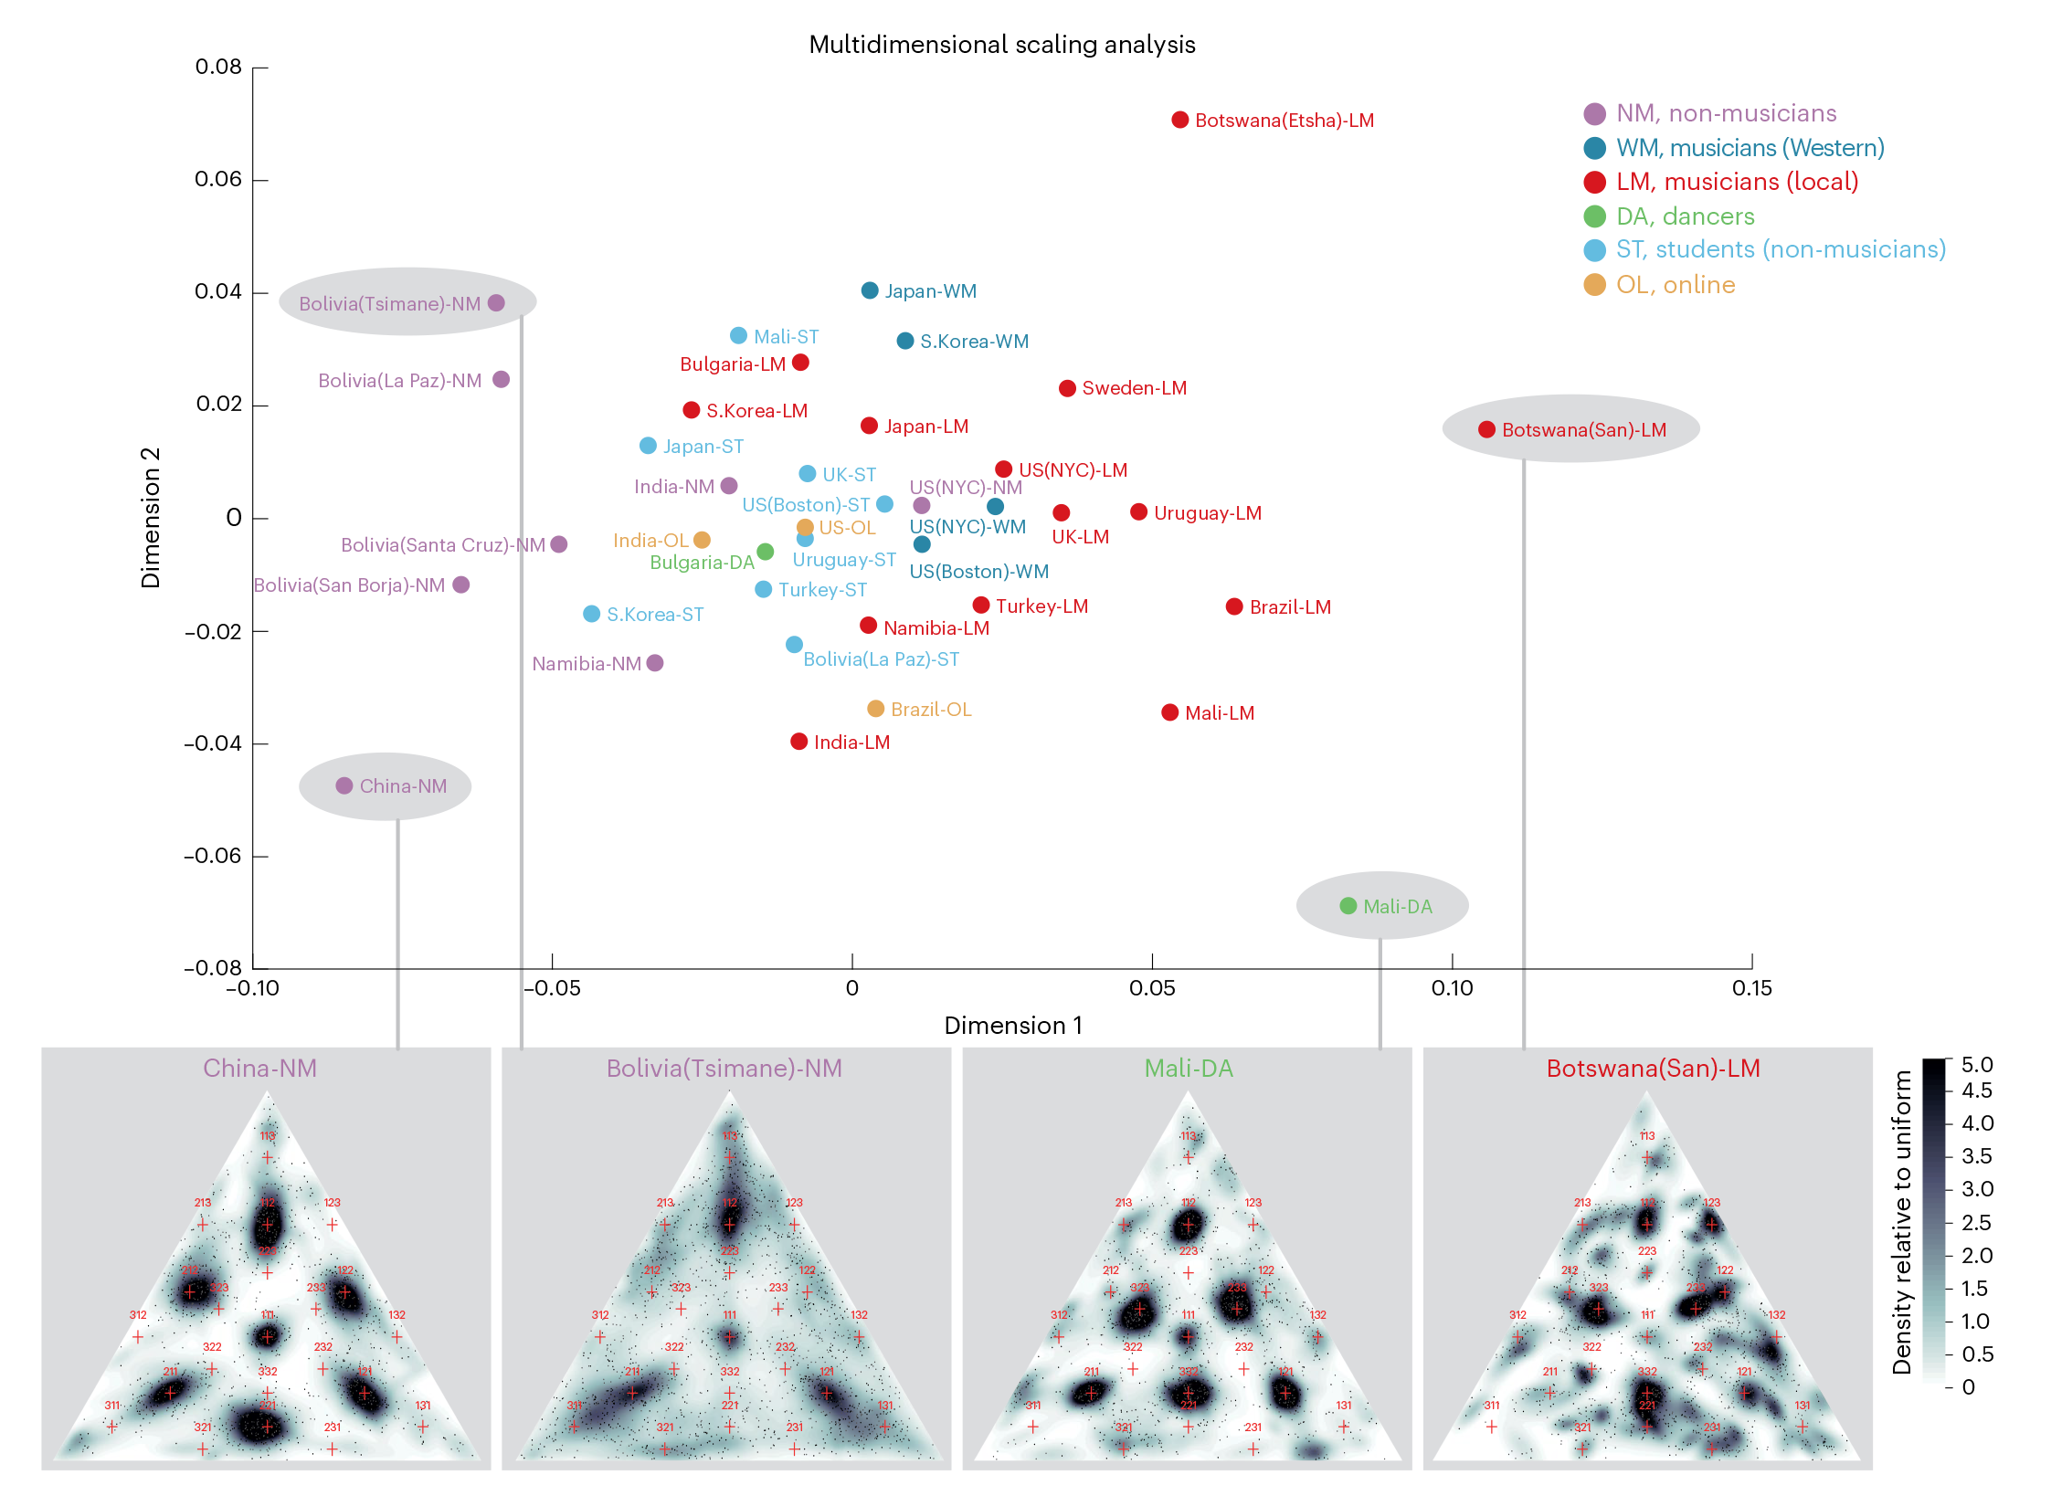
Jacoby et al 2024
Example data:
—Chinese participant priors include the simplest ratios (1:1:1, 2:1:1, 2:2:1)
—Bolivian Tsimane people gravitate toward continuously varying short-short-long patterns
—Malian partipants prefer the tresillo pattern 3:3:2
—Botswana San musicians have a greater variety of rhythmic patterns in their priors.
Notes:
While the headline result is a common pattern across all the populations studied, suggesting a human musical universal, the study also found differences between groups. While Western musicians and university-student populations all over the world responded similarly, local musicians reflected aspects of their musical backgrounds in response patterns.
This slide shows results of four of the most distinct populations. These are all non-Western and non-online participants, and they come from three different continents.

Slide 31
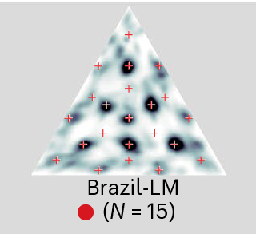
Jacoby et al 2024
Example data:
Results from Brazilian musicians (Maracatu-naçāo musicians from Recife) resemble Malian results, favoring the tresillo (3:3:2) rhythm.
1:1:2
2:3:3
1:3:2
Notes:
Here is another result from a group of Brazilian musicians, which resembles the Malian dancers on the previous slide, who also had strong presence of 3:3:2 in their priors.
Designing studies like this is not easy. There are the formidable logistical challenges, of course, but the conceptual hurdles are also significant. Breaking out of Euro-classical theoretical frameworks can be more difficult than it appears.

Slide 32
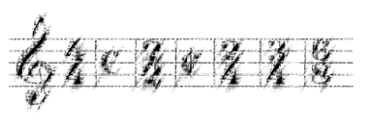
Meter
Problematic assumptions:
• Time discreteness
• Isochrony
• Hierarchy
Notes:
The concept of meter is a good case in point. This concept is originally grounded in the notational practice of time signatures. Music theory has abstracted the term to refer to beats, beat groupings, and subdivisions. This generalization makes it possible to speak of disagreements between notated meter and “true” meter, and identify unnotated hypermeters. Music psychology has introduced a third meaning by equating meter with entrainment, psychological synchonization to a beat. There are distinct advantages to locating music in the mind of a listener or musician rather than in the music as sound or notation. We can describe how the same music can be heard in multiple different metrical frameworks. And psychological entrainment is potentially a universal feature of music perception, which notated time signatures clearly are not.
[Animation]
Identifying meter with psychological entrainment creates problems, though, when we unwittingly transfer aspects of the traditional conception of meter onto the psychological phenomenon. One flaw of the notation-based concept is time-discreteness. European musical notation can only show discrete timepoints measured along isochronous grids. This works well for notation’s prescriptive function, but for its descriptive function it’s a shortcoming. Music unfolds in continuous time, as does our perception of it.
[Animation]
A second shortcoming of European rhythmic notation is its reliance on isochrony. As the Jacoby et al. Nature article I just discussed shows, this may indeed reflect a cross-cultural truth about rhythmic perception, which is that we assimilate rhythms to internalized simple integer-ratio templates. However, that study, as well as Polak’s work on Malian percussion, also demonstrates that in some exceptional circumstances musicians can have rhythmic schemas that are not based on isochronous grids.
[Animation]
In the remainder of my talk I will focus on a third problem, which is that the traditional conception of meter requires a strict containment hierarchy between metrical levels. While experimental evidence does illustrate that listeners entrain at multiple levels, experiments are designed on the assumption that these levels must be related hierarchically, the way they are in European notation. This premise has therefore not been properly tested, although most discussions of meter as a psychological phenomenon assume it to be the case.

Slide 33
Metrical functions
ω = 4
0
0.25
0.50
0.75
1.00
1.25
1.50
1.75
2.00
2.25
2.50
2.75
3.00
Time →
Notes:
Let’s start by modeling entrainment with sinusoidal functions. There are other kinds of functions we might use, but the important feature is that the function is smooth and continuous in time. Sinusoidal functions are the simplest periodic function of this kind. The function here is a possible psychological model for a simple beat at 80 BPM. The height of the curve might represent expectancy, how strongly the listener expects an event at that timepoint. It also might represent physical or virtual body movement in coordination with some musical stimulus.

Slide 34
Metrical functions
ω = 4
+
ω = 8
=
0
0.25
0.50
0.75
1.00
1.25
1.50
1.75
2.00
2.25
2.50
2.75
3.00
Time →
Notes:
This model of an expectancy function over time makes it easy to represent multiple metrical levels. For instance the expectancy function for a duple subdivision of this 80 BPM beat is a sinusoidal function at twice the frequency. The combined expectancy function is just a sum of these.

Slide 35
Metrical functions
ω = 2
+
ω = 4
+
ω = 8
=
0
0.25
0.50
0.75
1.00
1.25
1.50
1.75
2.00
2.25
2.50
2.75
3.00
Time →
Notes:
We can add more metrical levels the same way, such as a duple grouping and subdivision of the beat.

Slide 36
Metrical functions
ω = 4
+
ω = 12
=
0
0.25
0.50
0.75
1.00
1.25
1.50
1.75
2.00
2.25
2.50
2.75
3.00
Time →
Notes:
Or use a different frequency for a triple subdivision.
A virtue of this model is that it removes two of the problematic assumptions associated with meter, time discreteness and hierarchy. There is no requirement that the frequencies representing metrical levels be simple multiples of one another.

Slide 37
Metrical functions: Tresillo meter
ω = 8
+
ω = 3
=
or +
ω = 5
=
0
0.25
0.50
0.75
1.00
1.25
1.50
1.75
2.00
2.25
2.50
2.75
3.00
Notes:
For instance, instead of combining our frequency-8 function with a frequency-4 function, we could combine it with a frequency of 3. If we put a rhythmic event at each peak of this function, we get the tresillo rhythm, a foundational rhythm for many diverse musical styles. If we want to add more rhythmic events, we could use the next two peaks and get the related cinquillo rhythm. These two rhythms also result from combining functions at frequencies 8 and 5.
Making the model time-continuous is crucial. With a time-discrete model, combinations of functions like these would result in a polyrhythm, greatly increasing the complexity of the metrical model. Psychologists have rightly resisted the idea that polymeter could be a psychological phenomenon because of this complexity. However, the complexity does not compound this way with the time-continuous model. The tresillo can be a plausible psychological meter.
This is very different than the conventional account, which claims that the tresillo is a kind of syncopation. According to this description, the meter has four beats per cycle and the rhythm goes against the meter. The assumptions built into the traditional Euro-classical concept leave no alternative. If, as I conjecture here, it is possible for the tresillo to act as a meter for music based on it, then the Euro-classical theory is acting as a colonialist force when we claim that the tresillo can only be a syncopated rhythm, not a meter. What I find especially notable about this example of colonialist music theory is that it operates quite effectively without individuals having any colonialist intent. It requires an active deconstruction of the received concept of meter to become aware of the colonialist regime.
Although I do not have direct psychological or neurological evidence for this tresillo meter, there is plenty of circumstantial evidence. Tresillo-based music is common and occurs in musics with no direct phylogenic connection, such as Balinese and Carribean styles. These musics can maintain a tresillo groove while articulating a variety of rhythms, much as we typical sustain conventional meters despite syncopations and unarticulated beats. According to conventional metrical theory, the tresillo is just a rhythm. There is no obvious reason it should be privileged among the many rhythms possible in an 8-beat cycle. According to the model of continuous periodic functions, on the other hand, the tresillo is special; it is one of the simplest of small set of possible meters based on co-prime frequencies.

Slide 38
Metrical functions: Adowa meter
ω = 12
+
ω = 7
=
or +
ω = 5
=
0
0.25
0.50
0.75
1.00
1.25
1.50
1.75
2.00
2.25
2.50
2.75
3.00
Notes:
Another relatively simple possibility is to combine frequencies of 5 and 12. This gives a meter corresponding to the so-called African standard pattern, a timeline found in many ethnically diverse traditions of West and Central Africa. We get a similar function by combining frequencies of 7 and 12. Notice that this meter can characterize not only music based on the 7-beat standard pattern, but also common 5- and 6-beat variants.

Slide 39
Metrical functions: Clave meter
ω = 16
+ 0.5
ω = 8
+
ω = 5
=
0
0.25
0.50
0.75
1.00
1.25
1.50
1.75
2.00
2.25
2.50
2.75
3.00
Notes:
We already noted that combining frequencies of 5 and 8 gives a tresillo meter. If we add another frequency subdividing the 8, 16 per cycle, we get a meter corresponding to another important African and Caribbean timeline, the clave. Notice, again, that the curve shows not only the clave rhythm, but also other possible rhythms with more or fewer onsets that reinforce the same meter. These include the augmented tresillo and a seven-onset extension of the clave, both prevalent rhythms in clave music.

Slide 40
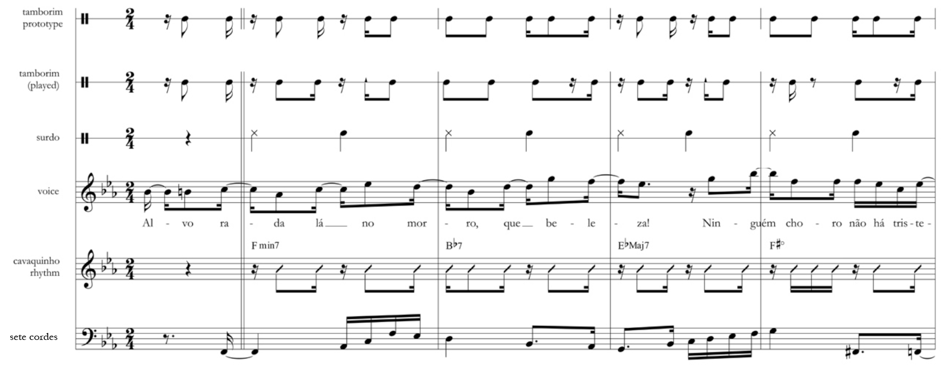
Samba Timeline
“Alvorada” by Cartola, transcription from Stover (forthcoming)
Notes:
Here’s another example, a famous Samba by Cartola. I’ve borrowed a transcription from Chris Stover. The tamborim part provides a Samba timeline.

Slide 41
Samba Timeline
“Alvorada” by Cartola, transcription from Stover (forthcoming)
Timborim:
Stover’s prototype:
2 2 1 2 2 2 1 2 2
Performed rhythm:
2 3 2 2 2 3 2
Notes:
The tamborim plays variants suggested by a metrical combination of frequencies 16 and 9.

Slide 42
Metrical functions: Samba meter
ω = 16
+
ω = 9
=
0
0.25
0.50
0.75
1.00
1.25
1.50
1.75
2.00
2.25
2.50
2.75
3.00
Prototype:
Played:
Notes:
Here’s how we can model the tamborim part with metrical functions. The metrical function describes both Stover’s prototype rhythm and the performed rhythm.

Slide 43
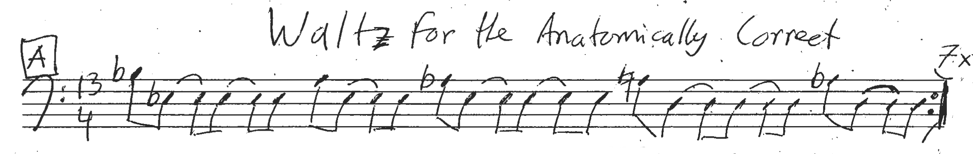
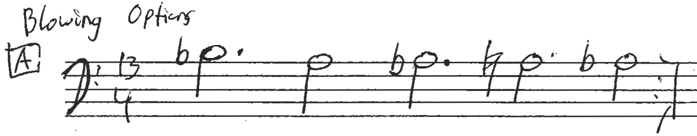
Rudresh Mahanthappa, Waltz for the Anatomically Correct
Notes:
For a more unusual and elaborate example, consider this tune by jazz saxophonist Rudresh Mahanthappa. There are two rhythms of interest here, the rhythm of the tune for the head, and the simplified rhythm that he uses for the harmonic changes.

Slide 44
Meter for Waltz for the Anatomically Correct
ω = 26
+ 0.2
ω = 13
+
ω = 8
+
ω = 5
=
0
0.25
0.50
0.75
1.00
1.25
1.50
1.75
2.00
2.25
2.50
2.75
3.00
Notes:
Despite the unusual meter it is possible to model it using sums of sinusoidal functions. This may be important to the function of the tune as a vehicle for improvisation. The bass line rhythm can be produced by functions of frequency 13 along with either 8 or 5 alone. To get the 16th-note syncopation of the head I’ve included a sixteenth note layer of frequency 26 and shifted the eighth-note layer by half a wavelength.

Slide 45
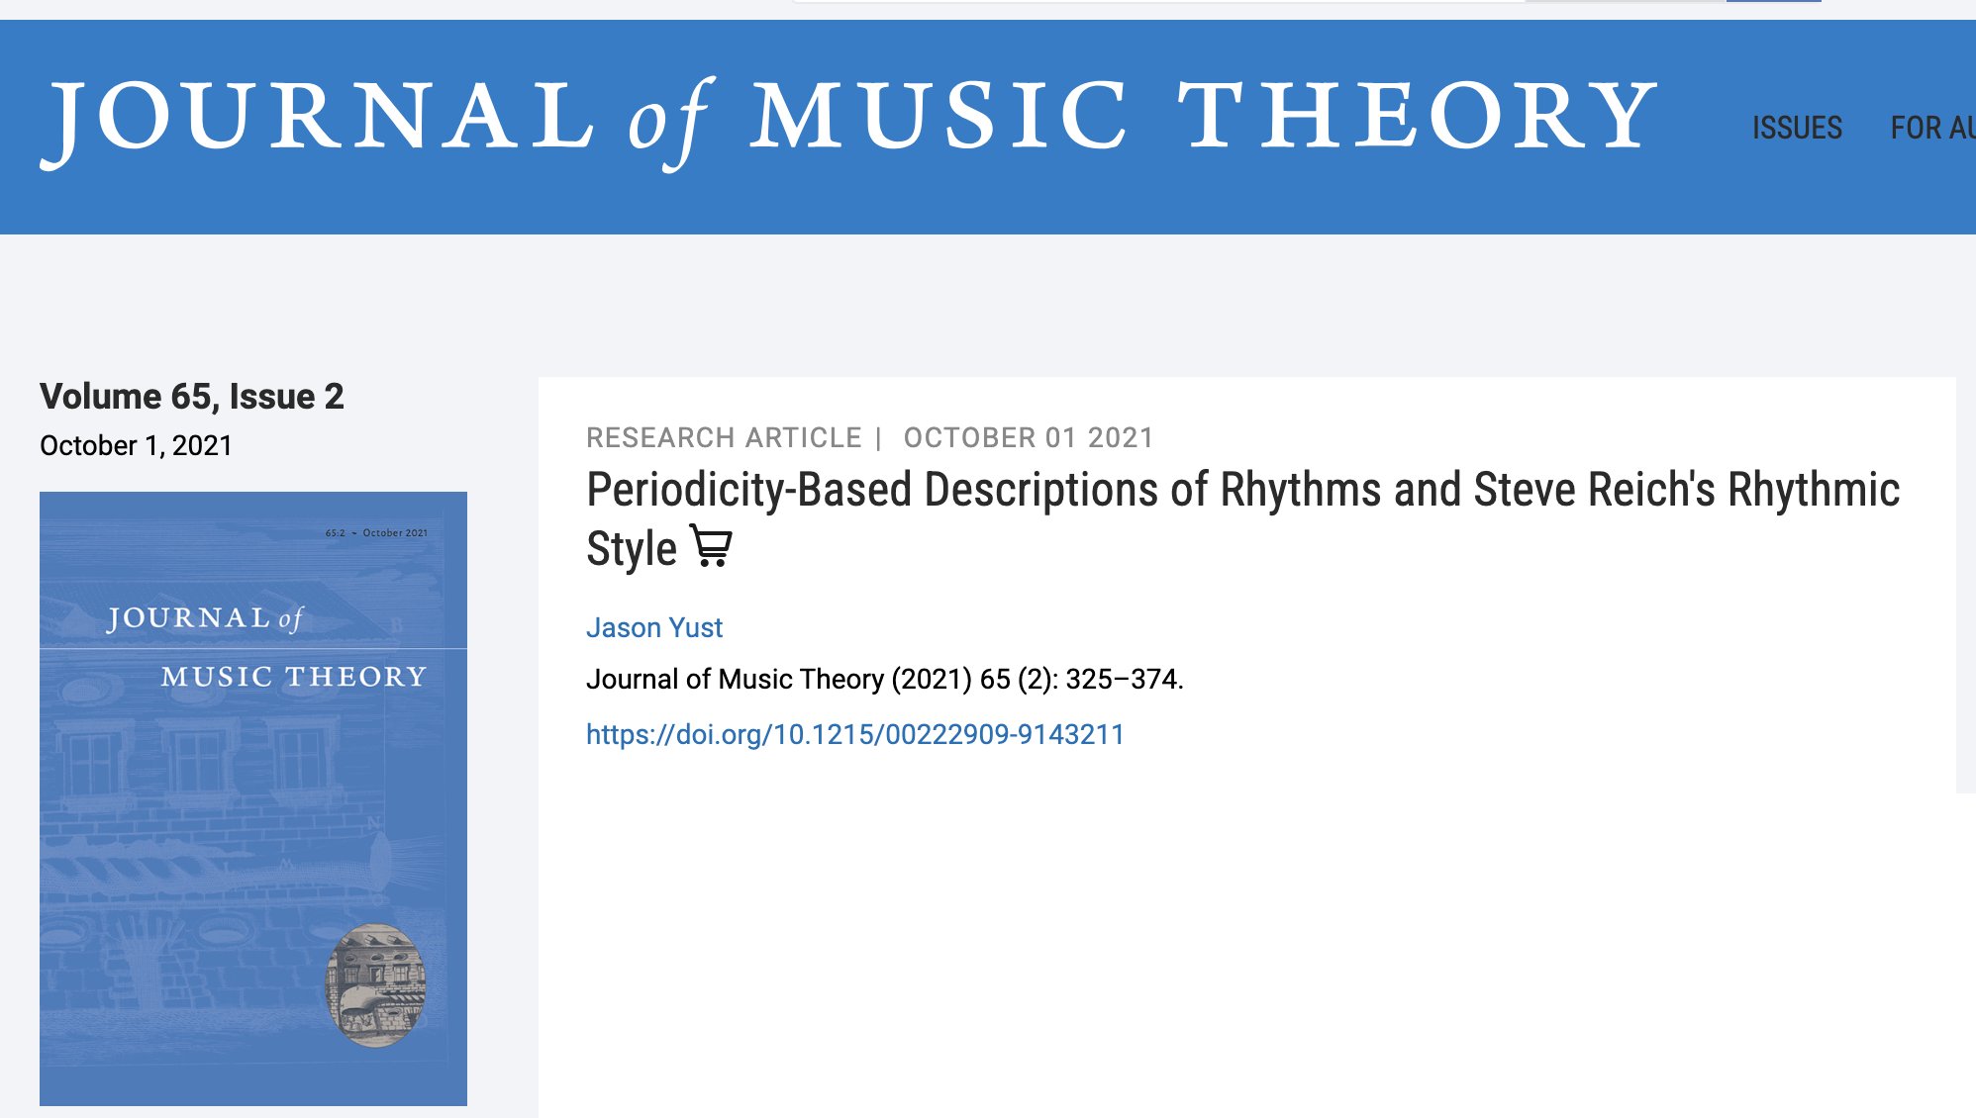
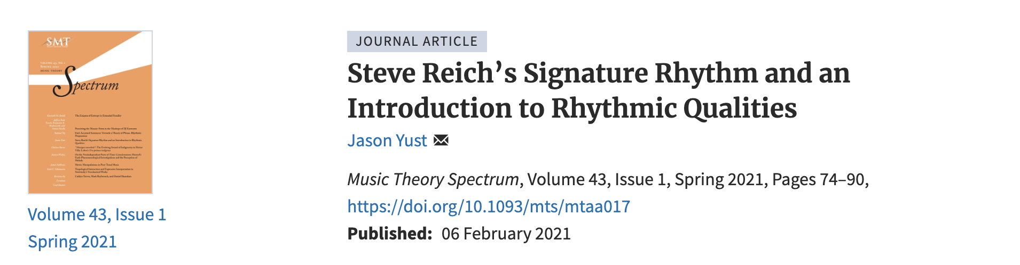
Fourier analysis of rhythms
Also forthcoming next year in Revue Musicale,
“Rhythmic Regularity beyond Meter and Isochrony”
Notes:
This is just scratching the surface of the modeling of rhythms and pitch collection using periodic functions. I’ve written about the topic at length. The process of building a rhythm by combining sinusoidal functions can be reversed, decomposing a rhythm into its constituent frequencies. This process is known as a Fourier transform. There are many useful analytical tools we can derive from this method. If you are interested in investigating this topic further I refer you to these articles in Music Theory Spectrum and the Journal of Music Theory, and one that will be published next year in Revue Musicale.

Slide 46
Discrete mappings in pitch
Music notation implies a mapping from note to pitch
Problems for representational use of notation:
• Sounded versions of the “same” note vary in pitch.
• Note may be ambiguous.
• Pitch of a single note may not be constant over its duration.
These problems are more serious in some situations than others:
• Musical style (e.g. contemporary classical vs. R&B)
• Instrumentation (e.g. piano vs. voice)
Notes:
This method can be used for pitch also, with similar consequences. Notation has a similar way of modeling pitch as a discrete function. This is okay for prescriptive uses of notation which only need to specify an approximate target for the performer, but for descriptive uses it is a distortion. All performances have variable realizations of pitches, such as vibrato, regardless of their attitude towards tuning. The problems are more acute, however, for performances that take more advantage of expressive uses of pitch.

Slide 47
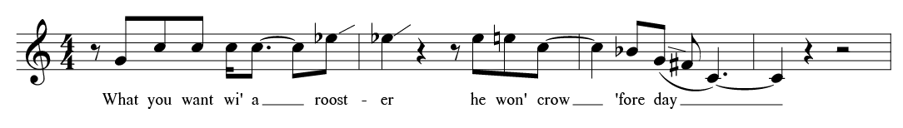
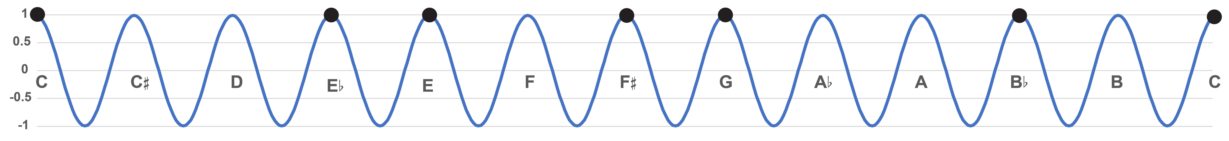
Flexibly Defined Interval Categories
An attempted transcription (after Titon) of Charlie Patton “Banty Rooster Blues”
+5
+3
–4
–2
–3
–7
8ve/12 categorization of intervals:
+3
+4
+5
1
Notes:
We can see the notation problem as a classification using a function of frequency 12 over the octave. The height of the function indicates how well the pitch fits the corresponding pitch class. We can classify intervals by the number of categories they span. [animation] This categorization distinguishes intervals of a fourth [animation] and the E and E-flat. [animation] These are in different categories, separated by an interval of 1.

Slide 48
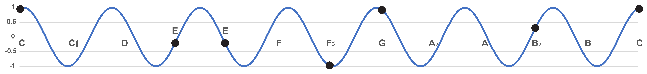
Flexibly Defined Interval Categories
An attempted transcription (after Titon) of Charlie Patton “Banty Rooster Blues”
+3
+2
–2
–1
–2
–4
8ve/7 (heptatonic) categorization of intervals:
+2
+3
0
Low value =Weak, ambiguous position
High value = Clear,
central heptatonic position
Notes:
But we could also classify these intervals heptatonically. [animation] The fourth, spanning 3 steps, [animation] and the thirds, spanning 2 steps, are still distinguished, but the E and E-flat are not. [animation] These are separated by an interval of zero, indicating that they are understood as variable intonation of a single heptatonic category. [animation] The height of the curve distinguishes strong representatives of their categories, like C and G, [animation] to more weak representatives like the F-sharp.

Slide 49
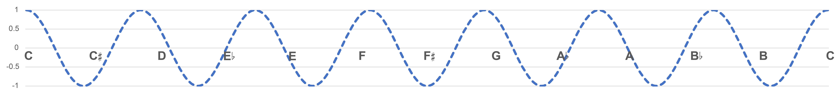
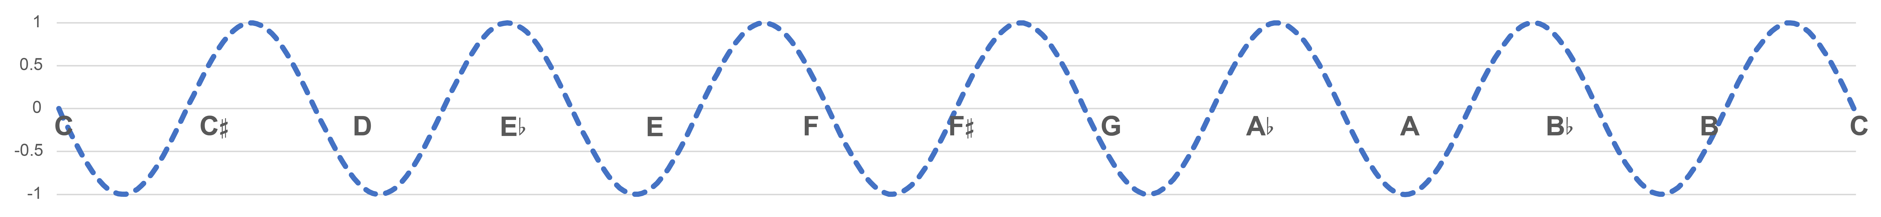
Heptatonic coordinates
Heptatonic coordinates of a C major scale
1.0 + 0.5 + –0.5 + 0.87 + 0.87 + 0 + –0.87 = 1.87
Cos
0 + –0.87 + –0.87 +0.5 + –0.5 + –1.0 + –0.5 = –3.23
Sin
Notes:
Here’s an illustration of how we can calculate the overall fit of a collection of pitches for a certain categorization scheme. We evaluate all the notes on two oblique sinusoidal functions and sum the values. Here’s an example for a diatonic scale.

Slide 50
Heptatonic coordinates
Heptatonic coordinates of a C major triad
1.0 + –0.5 + 0.87 = 1.37
Cos
0 + –0.87 + –0.5 = –1.37
Sin
Notes:
And here’s an example for a major triad. The interval categories do not all need to be represented, and some can be multiply represented.

Slide 51
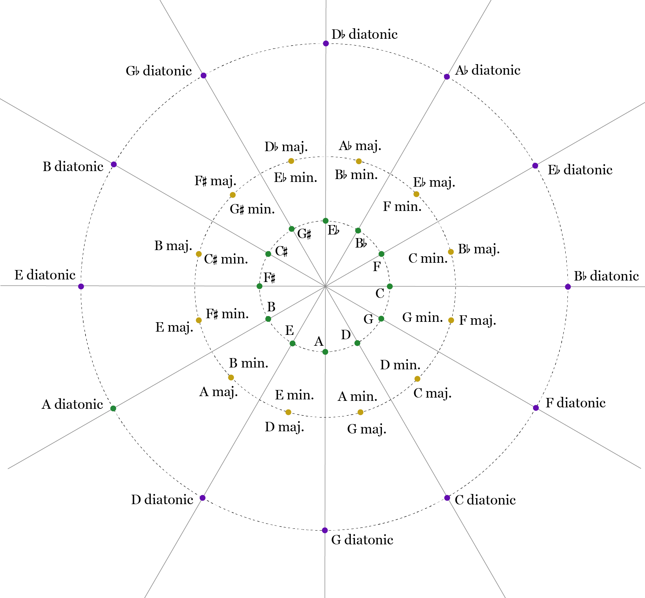
Heptatonic coordinates
Sets are arranged in circle-of-fifths order in a heptatonic space
Eb major scale
C minor triad
C major triad
C major scale
Notes:
These functions can be used as coordinates in a two dimensional space. Here’s the C major scale, [animation] a different major scale, and two triads. The goodness of fit for the collection is the distance from the center. The angle varies with transposition.

Slide 52
Flexibly Defined Interval Categories
Flexibility of intonation is inversely related to the number of interval categories.
Chromatic categories restrict intonational flexibility
Heptatonic categories allow for greater flexibility
Notes:
The European tradition negatively frames intonational flexibility, as out-of-tuneness. But it is essential to performance techniques that make styles like the blues possible. The frequency of a categorization can be seen as a trade-off. More categories gives the categorization more precision.

Slide 53
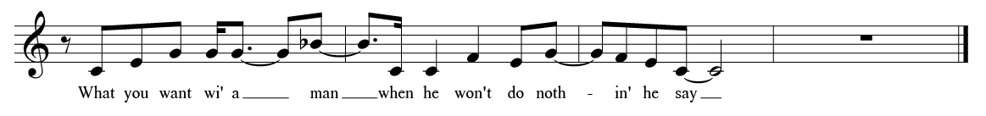
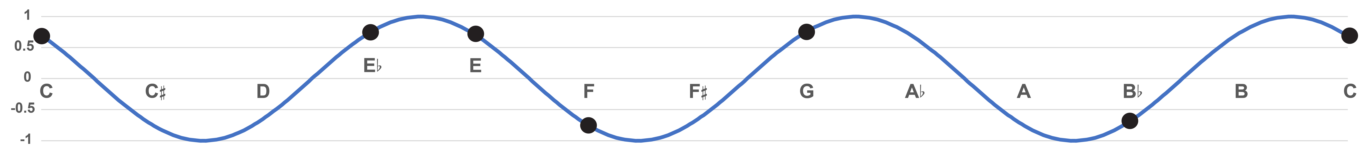
Flexibly Defined Interval Categories
B phrase of “Banty Rooster Blues”
+1
+1
+1
0
+1
8ve/3 (triadic) categorization groups multiple scale tones
→ flexibility allows for harmonic changes
0
Notes:
We can also put notes into triadic categories. Now the note F also belongs to the same category as E. It is a more ambiguous representative, which relates to the sense of the F to E interval as a resolution.

Slide 54
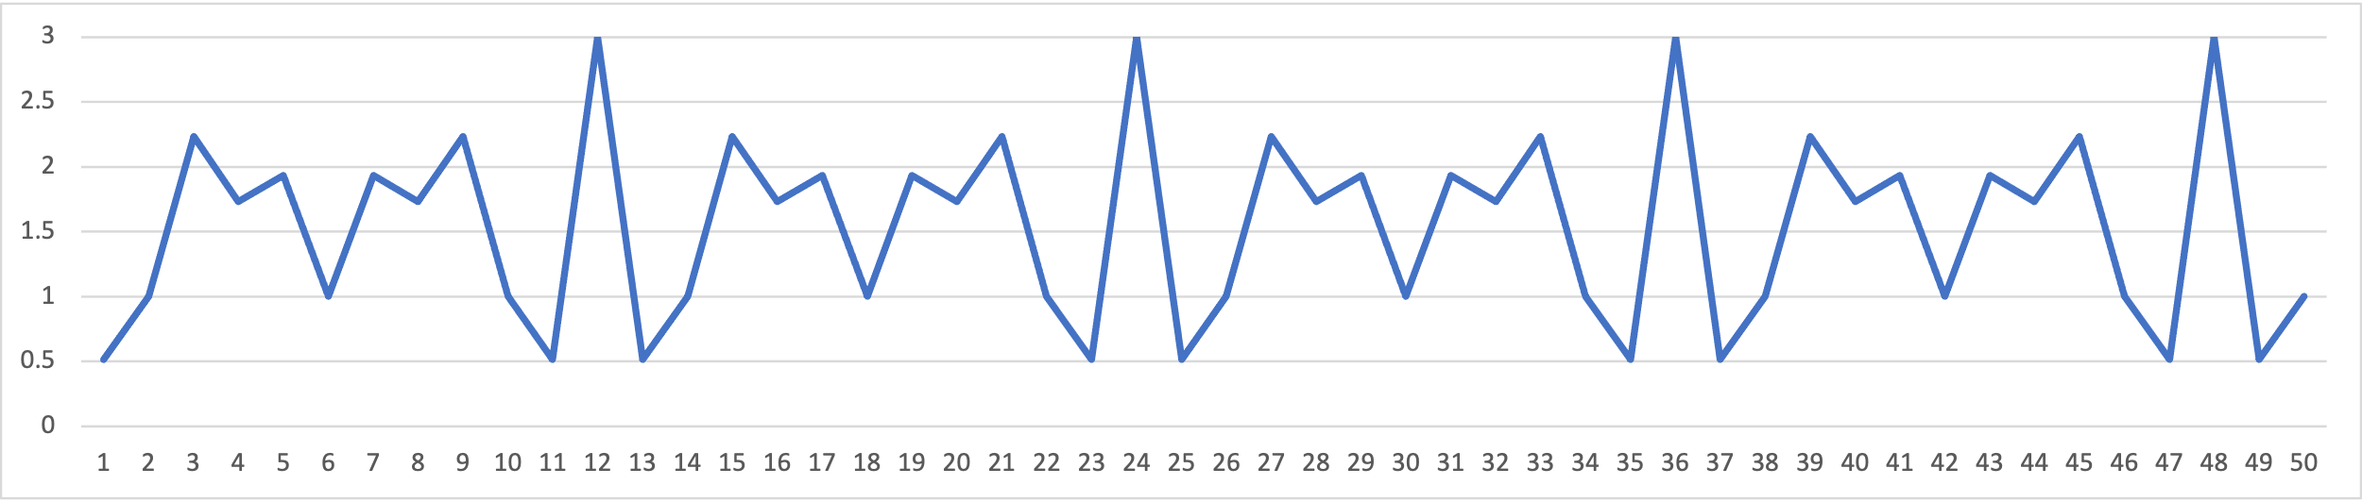
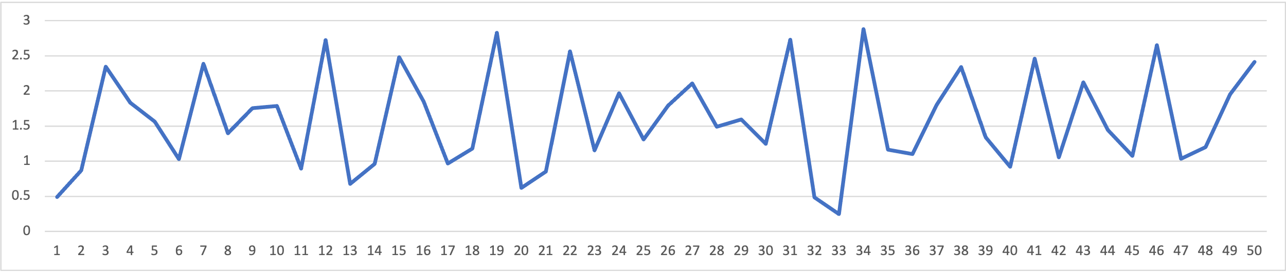
Spectra
The spectrum of a pitch-class vector shows the magnitudes of all its Fourier coefficients (ignoring phases)
The spectrum is invariant with respect to transposition and inversion (i.e. it is a set class property)
Examples:
12tET
major
triad
Just
major
triad
Notes:
Another tool we can use based on this theory is a spectrum. This allows us to consider all possible categorization schemes at once, and gives the goodness of fit for each one.

Slide 55
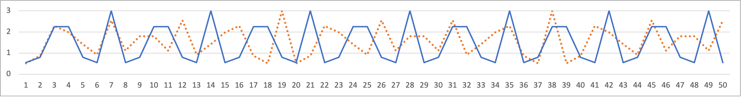
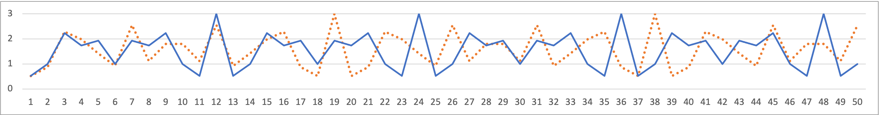
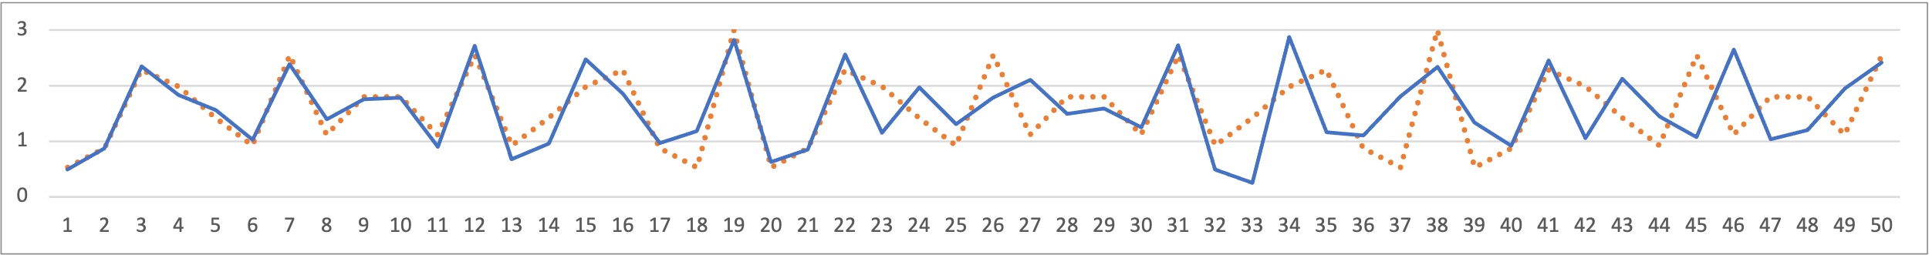
Spectra
Small tuning differences effect higher frequencies in the spectrum
Examples: Just triad (dotted) compared to . . .
7tET
triad
12tET
triad
19tET
triad
Notes:
As we go higher in the spectrum, we get finer-grained detail about the pitches. Here is an illustration of a series of equal-tuning approximations to a just major triad. The spectra match for low frequency values and diverge after that. The divergence happens later for closer approximations.

Slide 56
Example: Balinese Kebyar Pelog Spectra
Peaks at f₂, f₇, and f₉ and troughs in between are consistent.
Above f₉, little discernable consistency.
Using Andrew Toth’s measurements of 50 gamelans across all regions of Bali
See Vitale and Sethares, “Balinese Gamelan Tuning: The Toth Archives” Analytical Approaches to World Music.
Notes:
Here’s another example, an average of tunings of 50 kebyar gamelans from across Bali. Balinese pelog tunings vary considerably. Musicians and instrument builders prize the differences f intonation between gamelans. An average of many gamelans tells us what these different tunings share, what makes them all examples of pelog. They are characterized by high values at 2, 7, and 9. The high value at 9 indicates that pelog has a consistent representation as a subset of a hypothetical even 9-tone tuning. The high value at 7 reflects the larger 7-tone scale of which the pentatonic pelog is a subset. The high value at 2 indicates that the tones split into two groups of tones separated by about a half-octave. Above 9 there is little consistency, indicating that the nuances that distinguish individual gamelans can be found at this level. The relatively low value of 9 that determines the identity of pelog shows that there is a lot of space for variability of intonation, which instrument builders take advantage of to distinguish their gamelan from others.

Slide 57
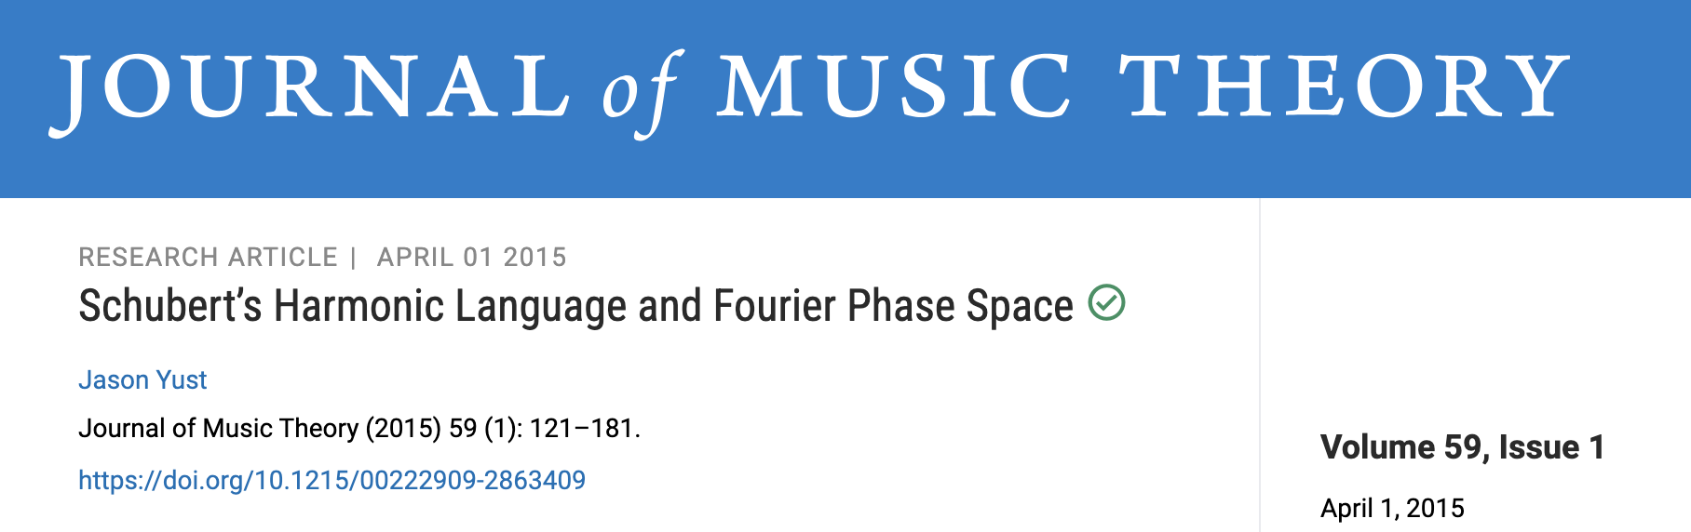


Notes:
I’ve written a lot about the topic of Fourier transforms of pitch-class sets. Here are some references if you’re interested in exploring it further. The tools that I just quickly introduced here, two-dimensional coordinate spaces for a specific frequency, and spectra, can be used for rhythms as well as pitch-class sets, and the articles I cited earlier explore this.

Slide 58
Final thoughts
The role of mathematics in globalized theory
Globalized theory and within-tradition theory
Notes:
Having shifted from a more big-picture philosophical mode to some specific theorizing in this last part of the talk, I’m prepared to address an aspect of the topic I left out in the earlier part of the paper. My research has primarily been in mathematical music theory, and the question of how this fits into music theory for the twenty-first century is important to me. I hope this brief last example has shown how mathematics can help us ask and think through more abstract questions about music. This is, after all, essentially what mathematics is, the art of abstraction. The globalization of music theory is fundamentally about abstraction. It requires us to deconstruct received Euro-classical theory to find the elements of commonality with other ways of thinking in music, and to target and discard the elements that are masquerading as universal while really being special to the Euro-classical framework. The examples I’ve explored today have given this treatment to aspects of notation, an unusual feature of the Euro-classical tradition, discreteness and hierarchy. Mathematics has helped me think through theoretical possibilities that retain features of the old concepts of meter and scale, periodicity and evenness, while modeling time and pitch continuously.
Finally I would like to point out that globalization of theory is not a zero-sum proposition. It is obviously good for previously marginalized musical traditions, taking them on their own terms and beginning to erase false disparities of prestige. It is also good for theory, expanding our knowledge and opening up opportunities to understand human musicality generally, not confined to one way of making music. But it is also good for Euro-classical music itself. We can see this music in a new light from the more global perspective. This has the potential for giving us insight into this music achievable in no other way, since it helps us understand what features of the music relate to the human capacity for music, and what relate to special concerns of the Euro-classical tradition. Even if you are only interested in analyzing Bach and Beethoven, you should welcome the globalization of theory.

Slide 59
Thanks for listening!
Preprints and powerpoints here:
sites.bu.edu/jyust

