Slide 1

Coherence of Harmonic and Rhythmic Qualities
Jason Yust, .
Mathemusical Encounters in Singpore, Feb. 19, 2024

Slide 2
Outline
Fourier Analysis, Meter, and Coherence
—Introducing coherence and coefficient products via concepts of metrical level and syncopation
Ragtime Syncopation
—Statistical analysis of a corpus of ragtime rhythms
Maximal Evenness and Coherence, PC Distributions of Major and Minor Keys
—Coherence theorem for maximally even sets
—Balance and major/minor
—Corpus data: Bach, Scarlatti, Debussy
Balinese Pelog
—Toth data, coefficient products distinguish regional tunings
Analysis of an Adowa Performance
—Coherence in a master drum (atumpan) performance

Slide 3
Fourier Analysis, Meter, and Coherence

Slide 4
Fourier Analysis and Meter
Can we equate metrical level with Fourier coefficient?
Yes and no . . .

Slide 5
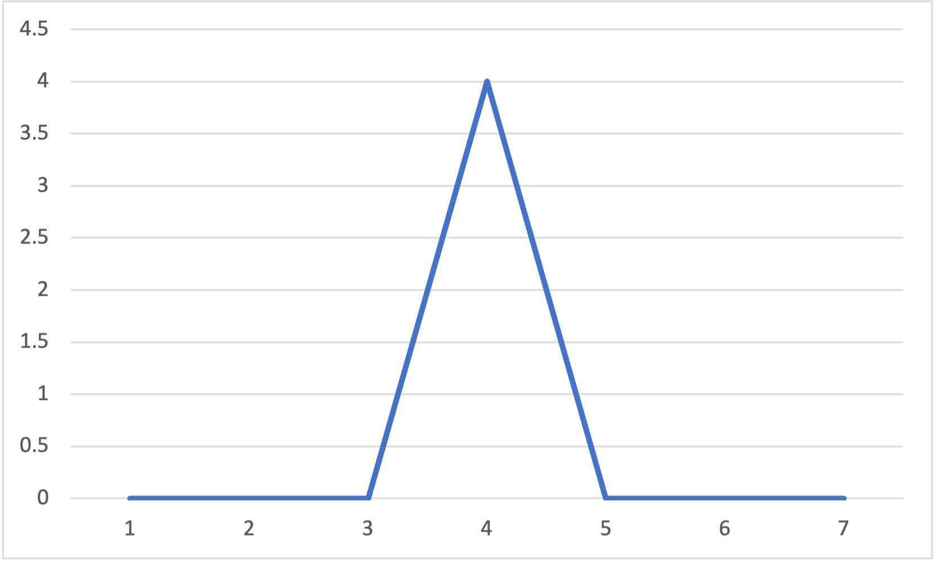
Fourier Analysis and Meter
Can we equate metrical level with Fourier coefficient?
Similarities:
• Fourier prototypes (max. magnitude) are prototypes of metric level
Spectrum:
q q q q :||

Slide 6
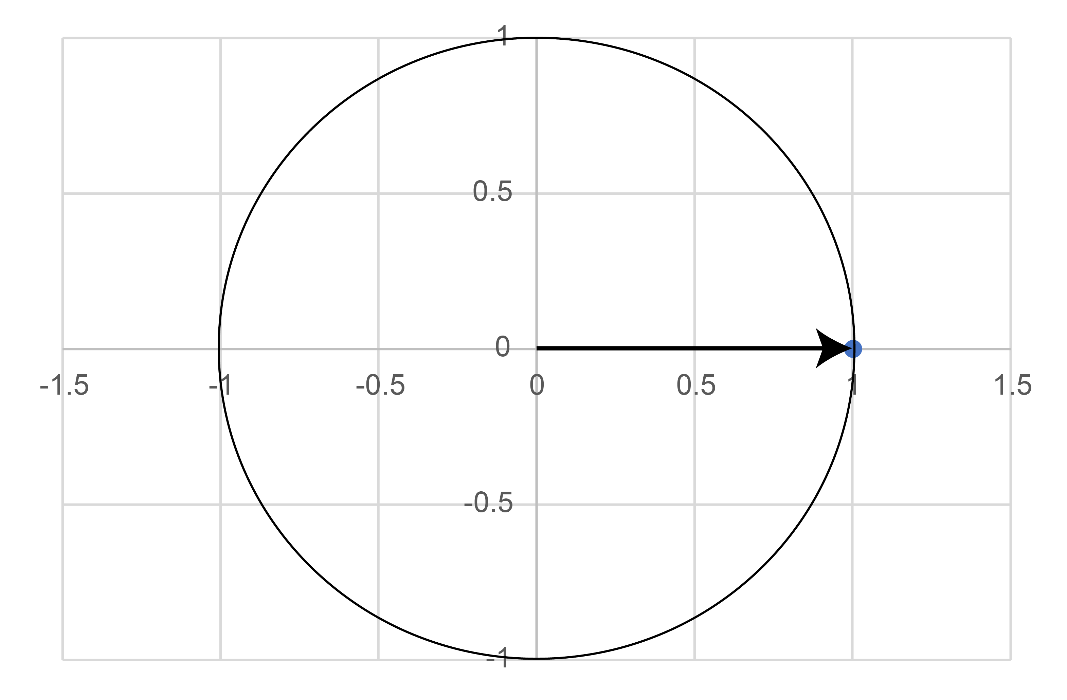
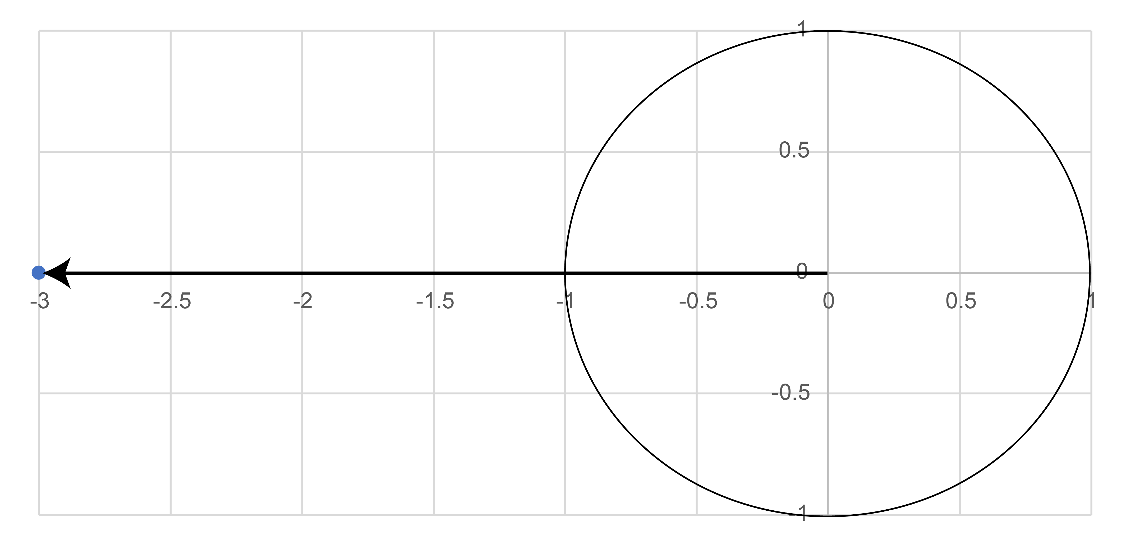
Fourier Analysis and Meter
Can we equate metrical level with Fourier coefficient?
Similarities:
• Phase of Fourier coefficient corresponds to syncopation
f₁:
f₄:
eq q q e:||
Phase = 0
Phase = π

Slide 7
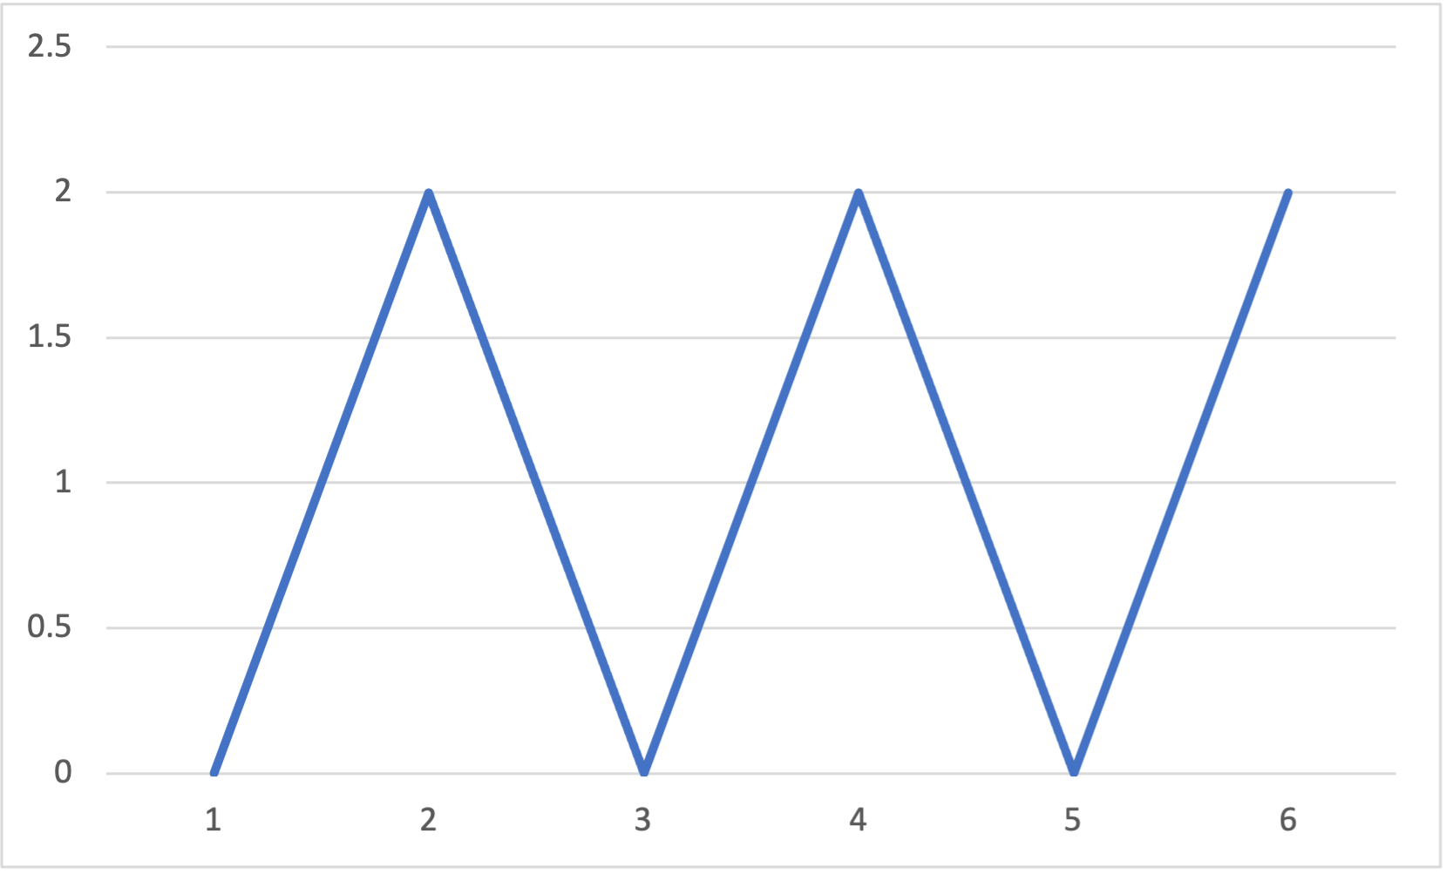
Fourier Analysis and Meter
Can we equate metrical level with Fourier coefficient?
Differences:
• Prototype of metrical level also weights possible subdivisions
Spectrum:
h. h. :||

Slide 8
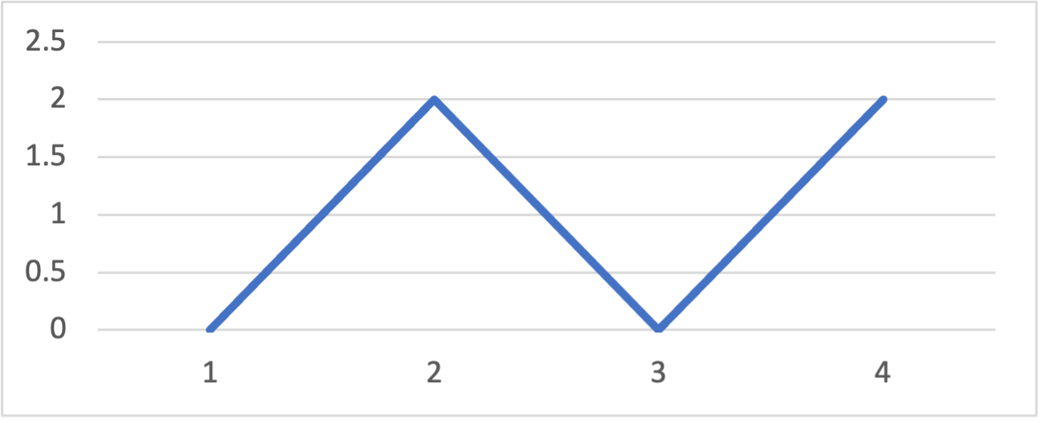
Coherence of Metrical Levels
Suppose you’re given the following spectrum (for a measure of 8es):
What rhythm did it come from?
You’d probably guess this:
But it could also be this:
h h :||
eq eeq e:||

Slide 9

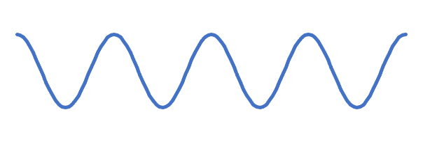
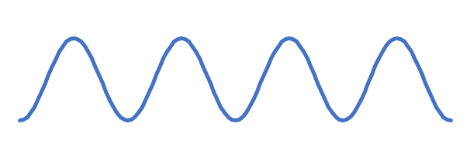
Coherence of Metrical Levels
What’s the difference?
Aligned coefficients:
f₄ syncopated against f₂:
h h :||
e q e e q e :||
f₂:
f₂:
f₄:
f₄:
Peaks of f₂ lined up with peaks of f₄
Peaks of f₂ lined up with troughs of f₄
⇒ Coherence
⇒ Anticoherence

Slide 10
Coherence of Metrical Levels
What’s the difference?
Aligned coefficients:
f₄ syncopated against f₂:
h h :||
e q e e q e :||
f₂:
f₂:
f₄:
f₄:
Coherence is a sum of phases:
2ϕ₂ – ϕ₄ = 0
2ϕ₂ – ϕ₄ = π

Slide 11

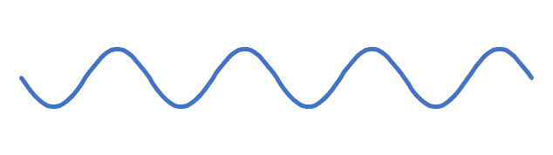
Coherence of Metrical Levels
Coherence is invariant w.r.t. translation!
(q.) e( q. e( :||
q e e q e e :||
f₂:
f₂:
f₄:
f₄:
Both coefficients syncopated by e
f₂ syncopated by e, f₄ unsyncopated
2ϕ₂ – ϕ₄ = 0
2ϕ₂ – ϕ₄ = π

Slide 12
Coherence of Metrical Levels
Coherence is invariant w.r.t. translation!
(q.) e( q. e( :||
q e e q e e :||
f₂:
f₂:
f₄:
f₄:
Notice also that the first rhythm
is 2-in-8 maximally even . . .
. . . while the second is 6-in-8 maximally even

Slide 13
Coherence
Coherence is the phase of a product of Fourier coefficients,
f_{a} ✕ f_{b} ✕ f—_{c} ,
ϕ_{a∙b/c} , where a + b = c.
Properties:
• ϕ_{a∙b/c} is transposition invariant but depends only on the phases, not the magnitudes of the Fourier coefficients (independent of spectrum)
• Inversion of a pcset conjugates the coefficient product, so:
ϕ_{a∙b/c} (I(A)) = –ϕ_{a∙b/c} (A)
• Complementation of a pcset rotates the product 180°:
ϕ_{a∙b/c} (Complement(A)) = ϕ_{a∙b/c} (A) + π
See Yust & Amiot 2022

Slide 14

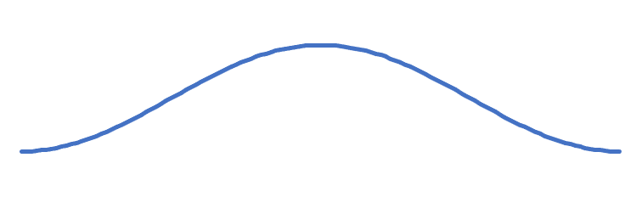
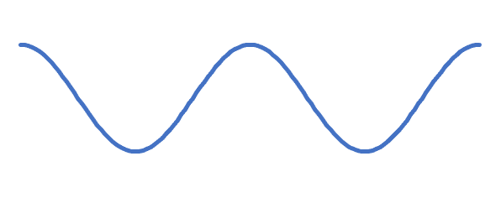
Homometry
Coherence can distinguish homometric sets.
Spectrum, (|f₁|, |f₂|, |f₃|, |f₄|) = (1.41, 2, 1.41, 0)
e q e h :||
q. e e q. :||
f₁:
f₁:
f₂:
f₂:
Anticoherent: ϕ_{1∙1/2} = π
Coherent: ϕ_{1∙1/2} = 0

Slide 15
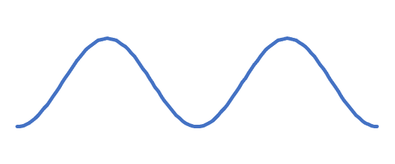
Homometry
Homometric multisets (> = ✕ 2), Spectrum = (1.41, 2, 1.41, 4)
q e e e e q :||
q e e e e q :||
>
>
>
>
f₁:
f₁:
f₂:
f₂:
Coherent: ϕ_{1∙1/2} = 0
Anticoherent: ϕ_{1∙1/2} = π

Slide 16
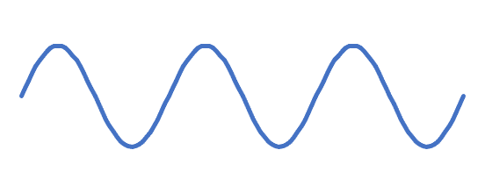
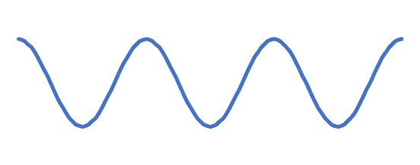
Products of three coefficients
e q e h :||
q. e e q. :||
f₁:
f₁:
opposed
agree
opposed
agree
f₂ , f₃:
f₂ , f₃:
Coherent: ϕ_{1∙2/3} = 0
f₁ peaks where f₂ and f₃ agree,
f₁ troughs where f₂ and f₃ opposed.
Anticoherent: ϕ_{1∙2/3} = π
f₁ peaks where f₂ and f₃ opposed,
f₁ troughs where f₂ and f₃ agree.

Slide 17
Products of three coefficients
e q e h :||
q. e e q. :||
Subset of cinquillo (5-in-8 ME ):
Superset of tresillo (3-in-8 ME ):
e q e q q :||
q. q q. :||
(c = 8 – 5)
(c = 3)
Coherent: ϕ_{1∙2/3} = 0
Anticoherent: ϕ_{1∙2/3} = π

Slide 18
Ragtime Syncopation

Slide 19
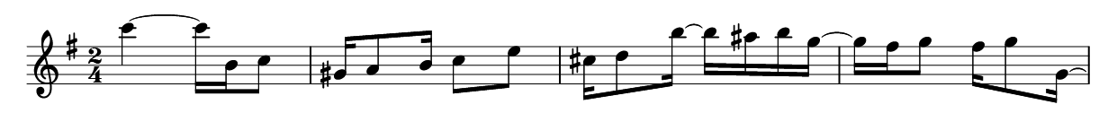

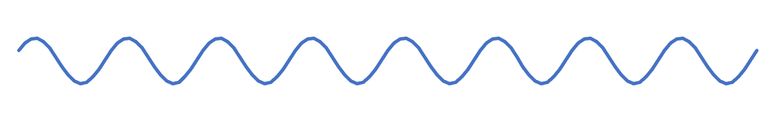

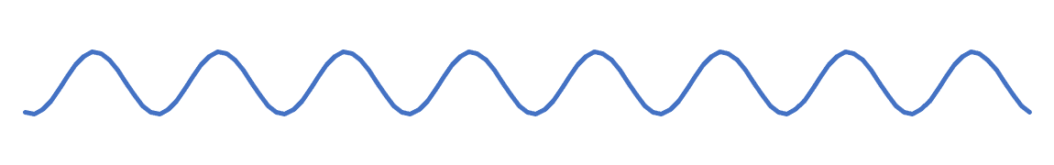
Ragtime Syncopation
Second strain from Joplin’s “Weeping Willow Rag,” phrases 1 and 2
f₄:
Approx.
Anticoherent
f₈:
f₄:
Approx.
Coherent
f₈:
Notes:
Phrase 1 is approximately anticoherent between the whole-note and half-note levels. Whole note ahead of the beat, half-note behind the beat.
Phrase 2 is coherent; both layers syncopated at the eighth-note level.

Slide 20
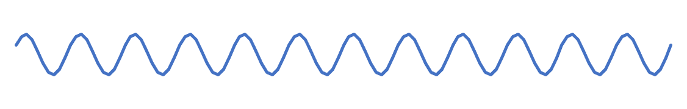
Ragtime Syncopation
Second strain from Joplin’s “Weeping Willow Rag,” phrases 1 and 2
f₈:
Approx.
Anticoherent
f_{12,} f₂₀:
Anticoherence of f₂ ✕ f₃ ✕ f—₅ is a feature of the cinquillo (5-in-8 ME) rhythm that distinguishes it from the spectrally indistinguishable tresillo (3-in-5 ME) rhythm.
The tresillo has a coherent f₂ ✕ f₃ ✕ f—₅ .
Notes:
Phrase 1 is approximately anticoherent between the whole-note and half-note levels. Whole note ahead of the beat, half-note behind the beat.
Phrase 2 is coherent; both layers syncopated at the eighth-note level.

Slide 21
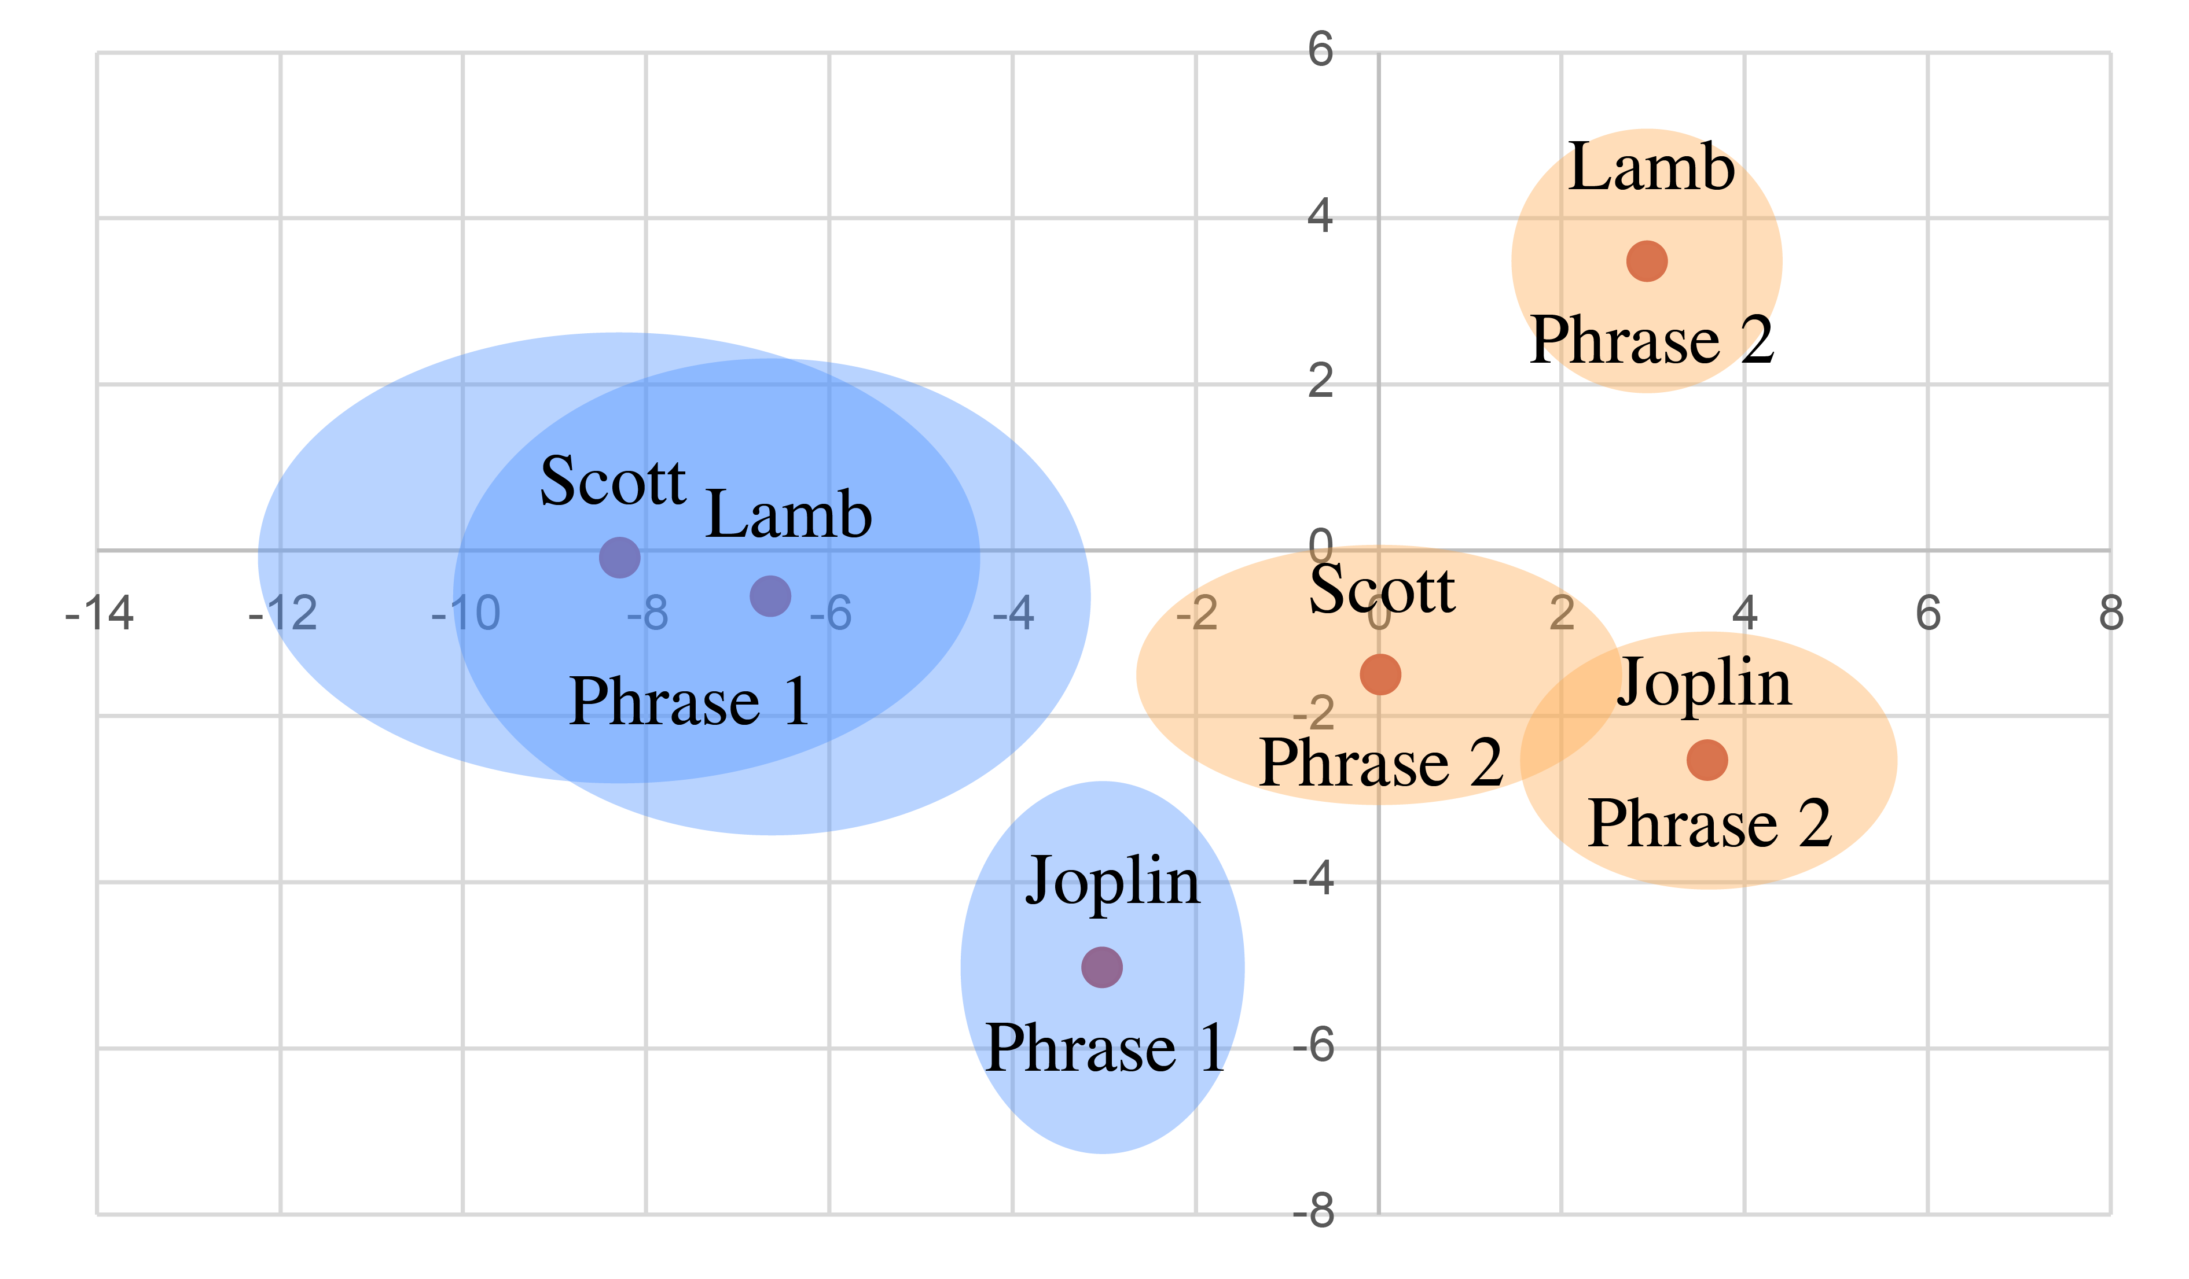
Ragtime Syncopation
Descriptive stats. for 71 pieces (4–5 strains each) by Scott Joplin, James Scott, Joseph Lamb
f₁ ✕ f₁ ✕ f—₂
All of the composers tend to anticoherent w and h levels in phrase 1, and coherent in phrase 2.
Ovals show standard errors

Slide 22
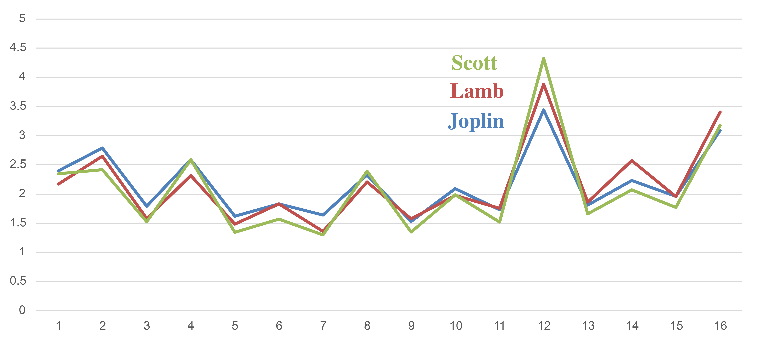
Ragtime Syncopation
Averaged spectra over 4-measure phrases
= f₃/meas.
= f₁/meas.
= f₂/meas.
= f₄/meas.
Ragtime melodies consistently emphasize f₃ (f₁₂ across 4-meas. phrase)
Tresillo and cinquillo rhythms are prototypes of this quality.
from Yust & Kirlin 2021

Slide 23
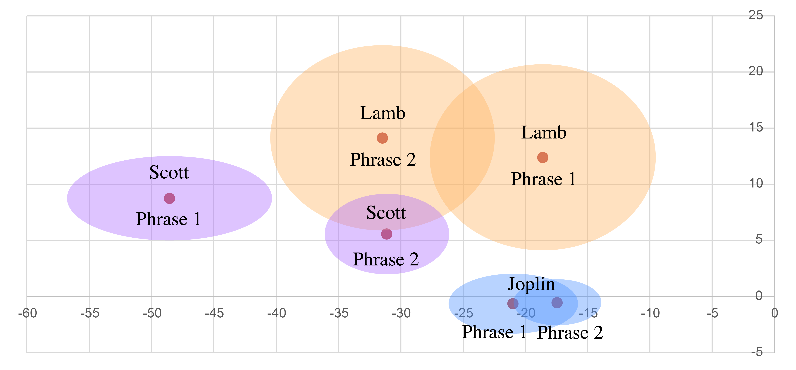
Ragtime Syncopation
Descriptive stats. for 71 pieces (4–5 strains each) by Scott Joplin, James Scott, Joseph Lamb
f₂ ✕ f₃ ✕ f—₅
All phrases are characterized by strong anticoherence of f₂ ✕ f₃ ✕ f—₅ (more like cinquillo than tresillo)
Ovals show standard errors

Slide 24
Maximal Evenness and Coherence

Slide 25
Maximal Evenness and Coherence
Theorem: Let A be c-in-d maximally even (c,d coprime).
Then ϕ_{a∙b/c} (A) = π.
—proven recently by E. Amiot
Note, this implies that, for the (d – c)-in-d ME complement,
ϕ_{a∙b/c} (compl(A)) = 0.
Example: Cinquillo (5-in-8 ME): ϕ_{1∙2/3} (A) = 0, ϕ_{2∙3/5} (A) = π.
Tresillo (3-in-8 ME): ϕ_{1∙2/3} (A) = π, ϕ_{2∙3/5} (A) = 0.
Example: Diatonic (7-in-12 ME): ϕ_{2∙3/5} (A) = 0, ϕ_{3∙4/7} (A) = π.
Pentatonic (5-in-12 ME): ϕ_{2∙3/5} (A) = π, ϕ_{3∙4/7} (A) = 0.

Slide 26
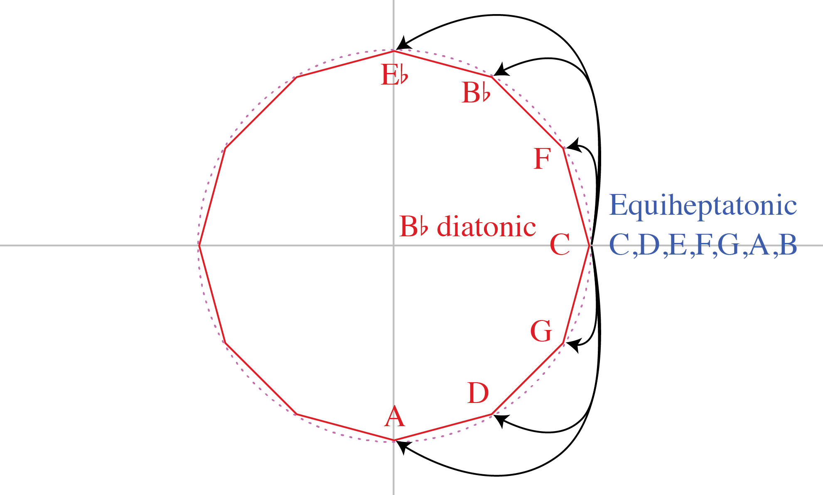
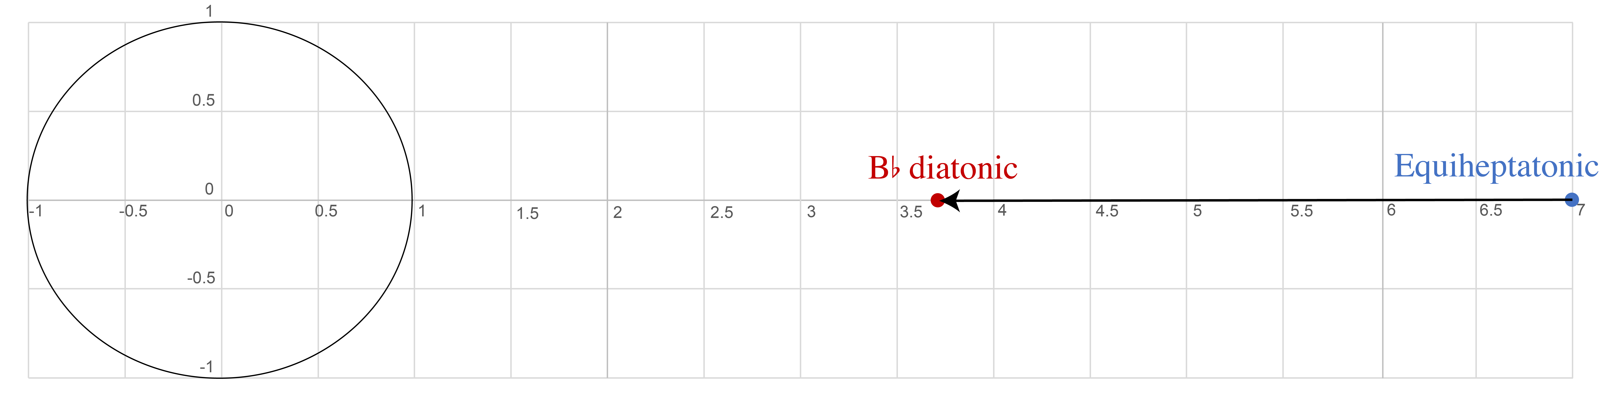
Maximal Evenness and Coherence
A diatonic scale is a symmetrical displacement of an equiheptatonic one.
All equiheptatonic pcs are at ϕ₇ = 0.
The displacement is not large enough to change the ϕ₇ = 0 value.
f₇

Slide 27
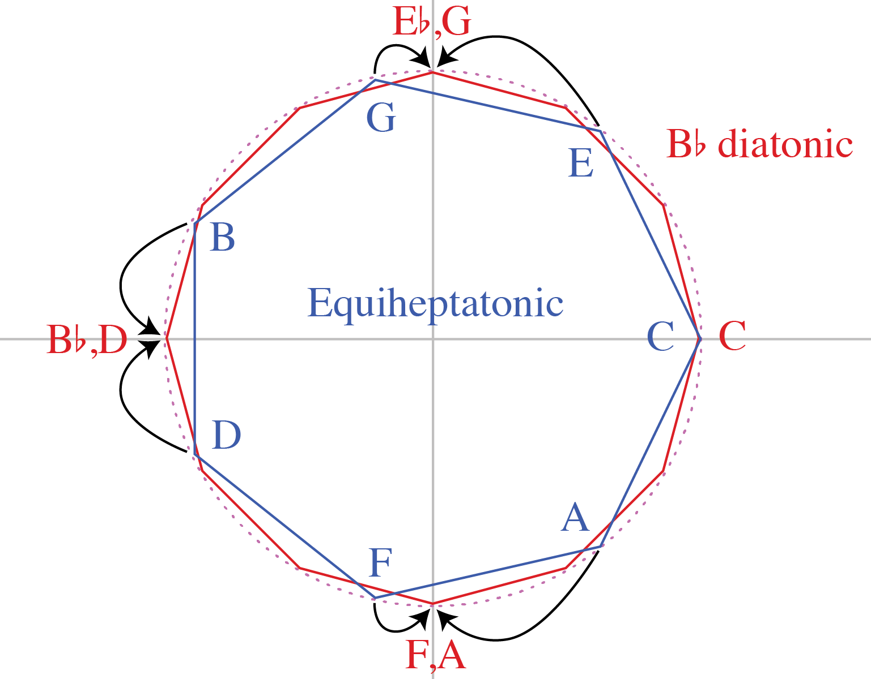
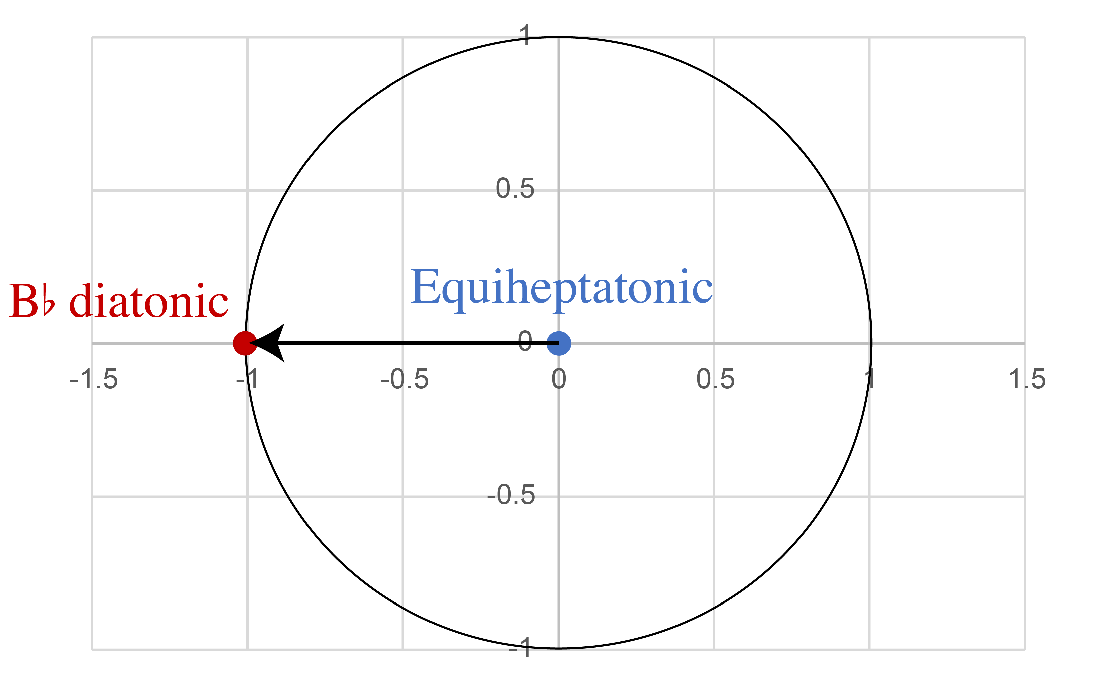
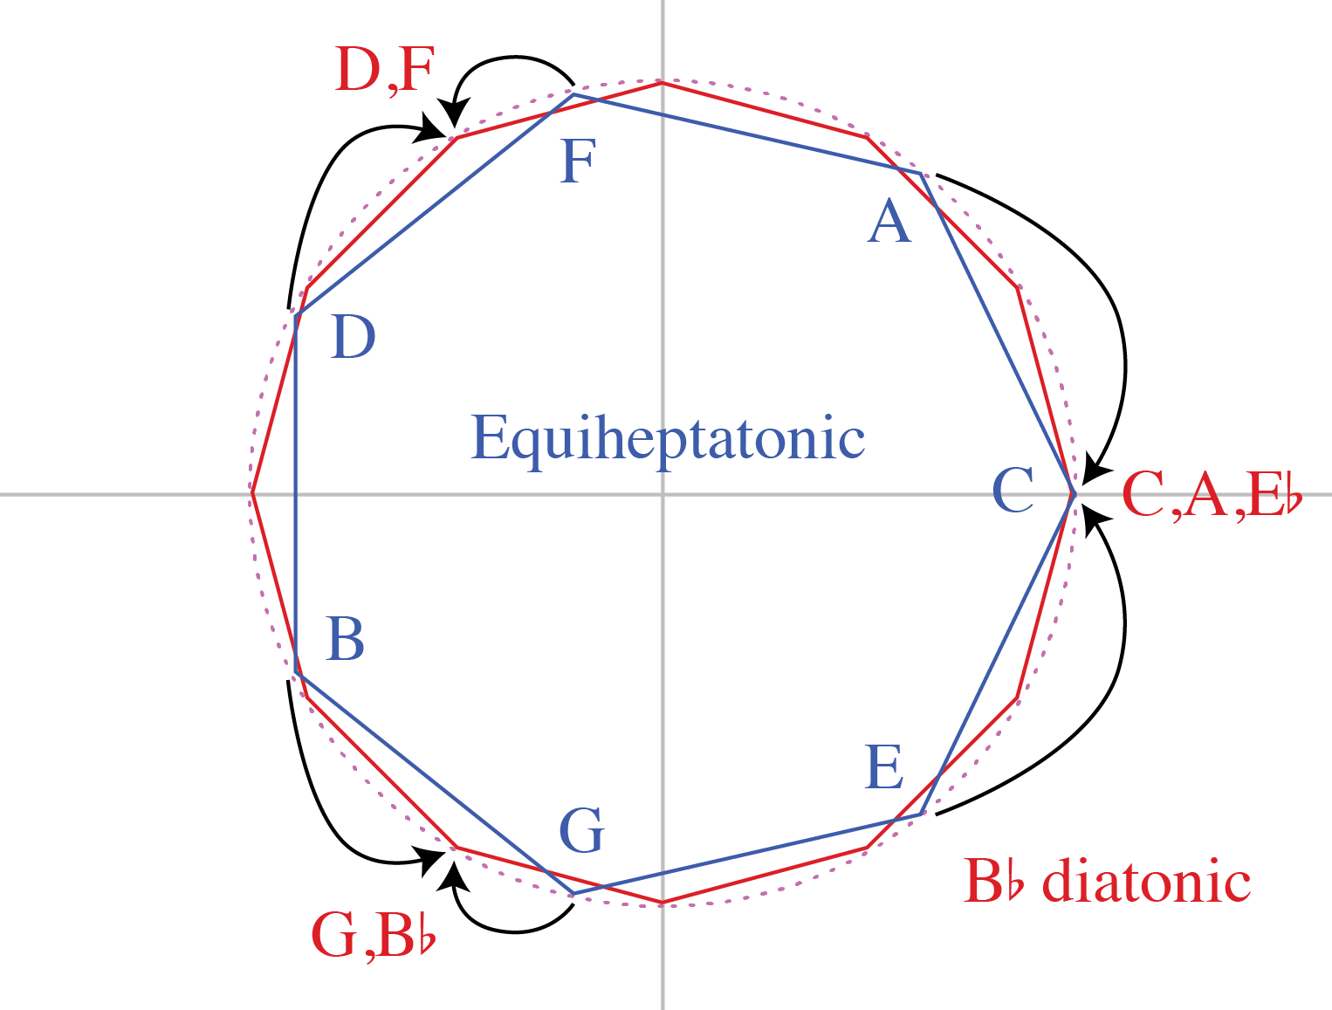
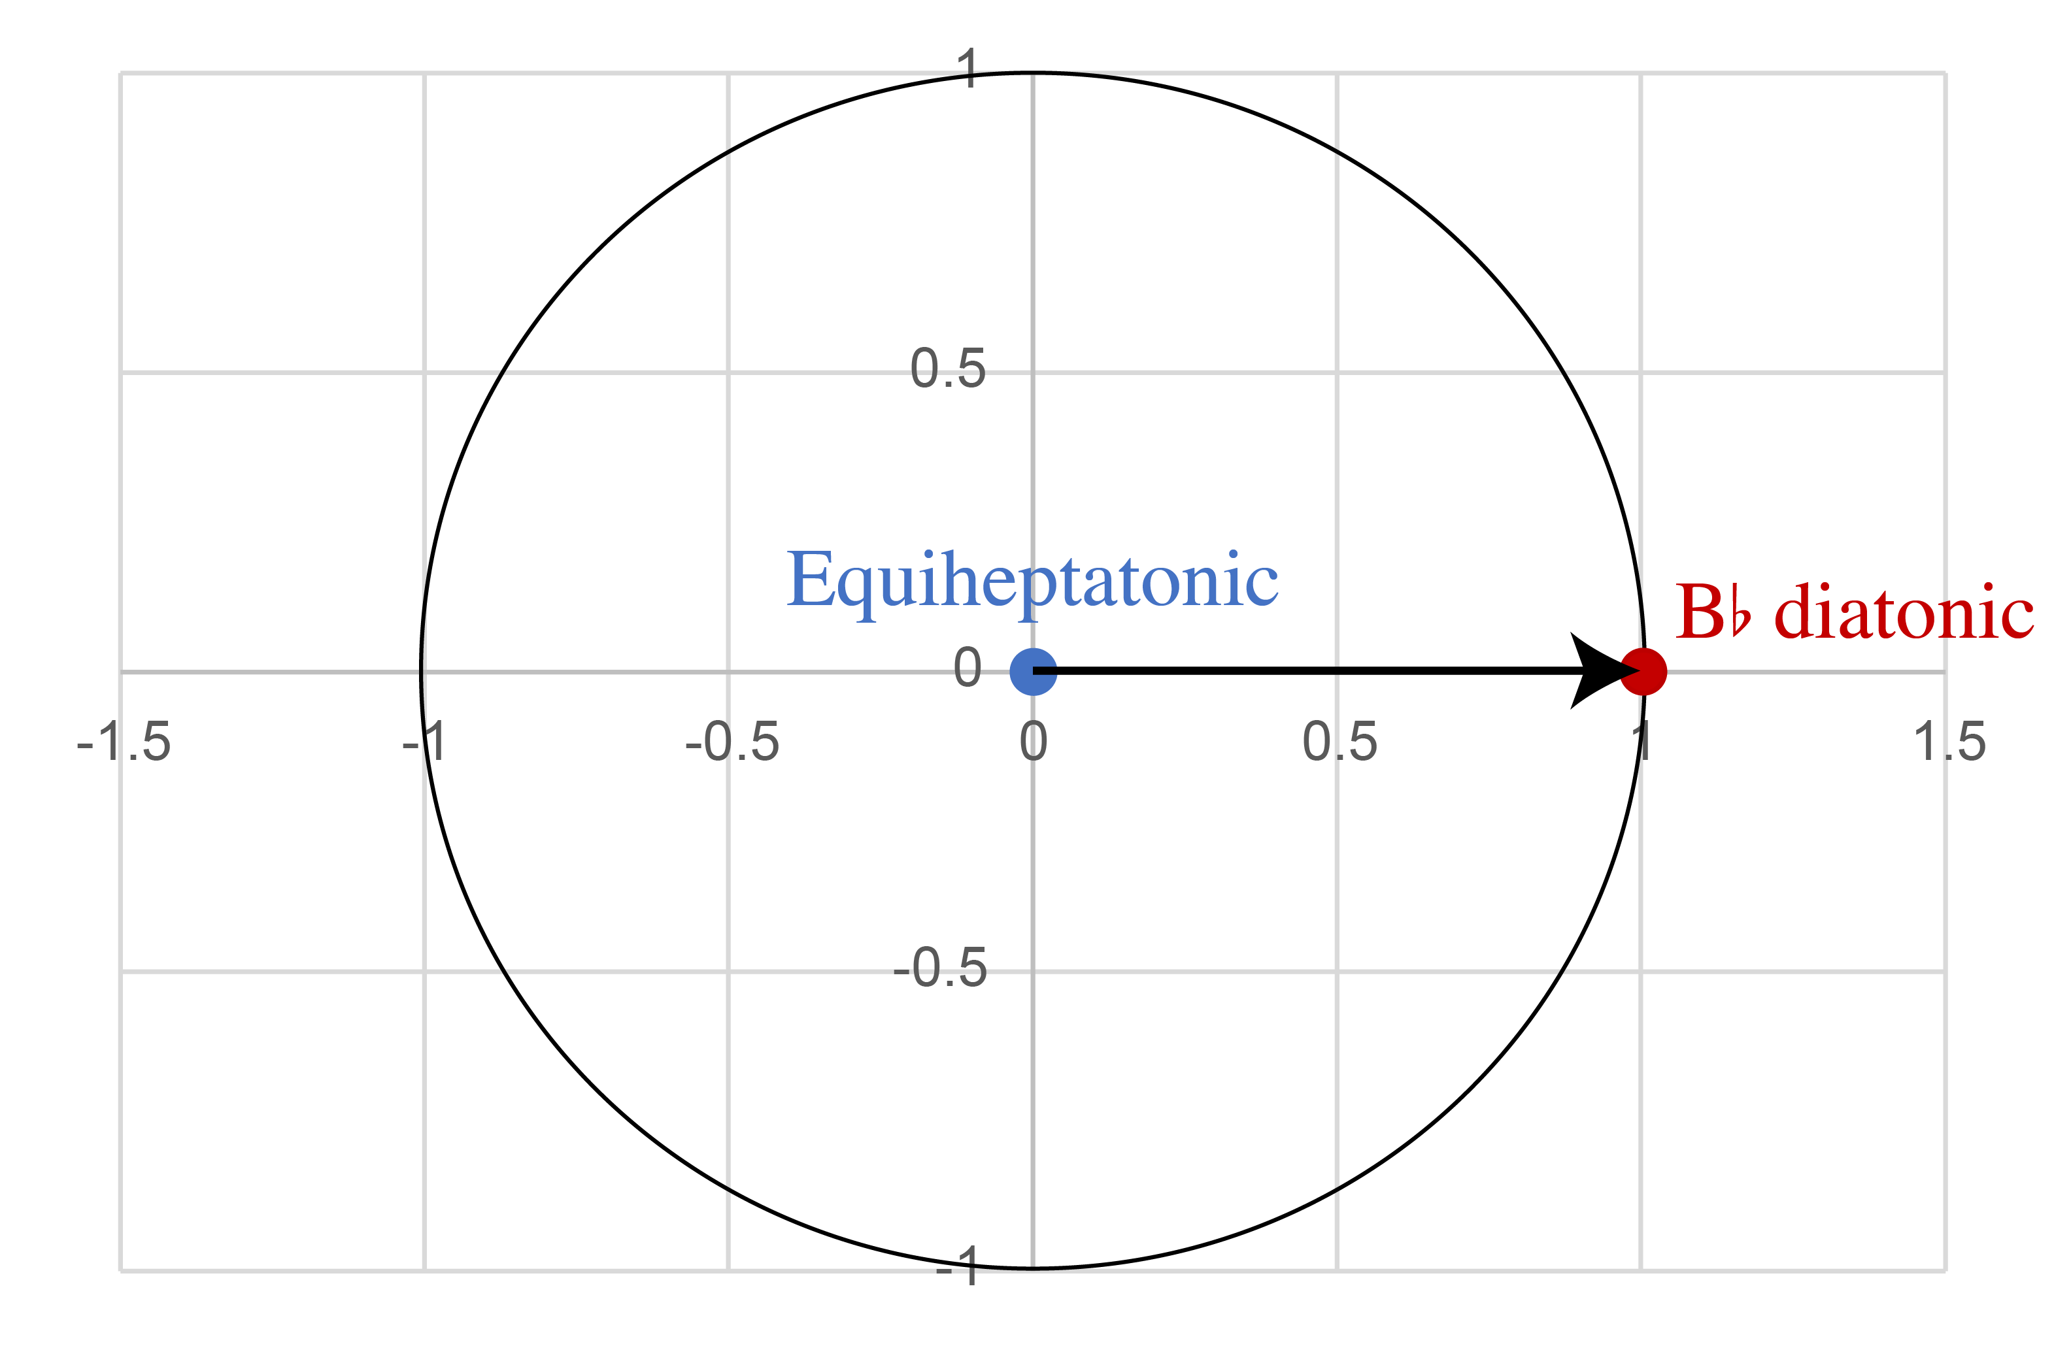
Maximal Evenness and Coherence
For coefficients a + b = 7, positions of equiheptatonic pcs are reflected over real line.
The displacement has opposite effects, so that one of ϕ_{a}, ϕ_{b} is 0 and the other is π.
⇒ ϕ_{a∙b/7} = 0 + π + 0 = π
e.g.:
ϕ_{3∙4/7} = π
f₃
f₃
f₄
f₄

Slide 28
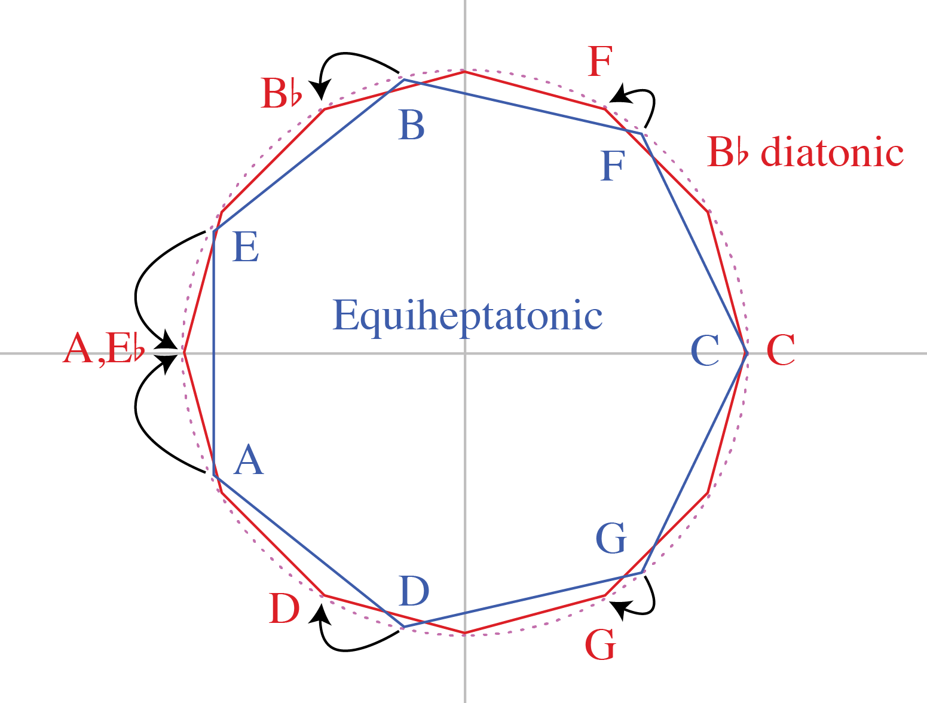
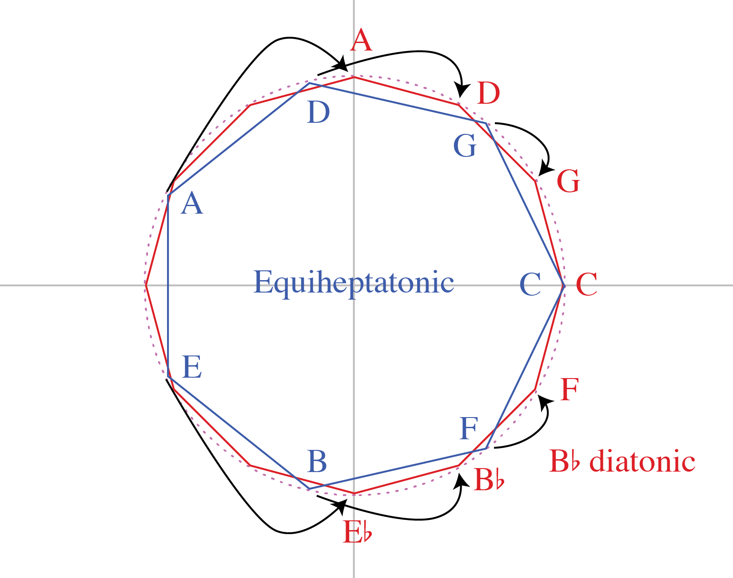
Maximal Evenness and Coherence
f₂
f₂
Similarly
ϕ_{2∙5/7} = π
f₅
f₅

Slide 29
Diatonic vs. Pentatonic
Diatonic and pentatonic collections have equivalent spectra, emphasizing f₅/f₇.
They are distinguishable by coherence:
Diatonic:
ϕ_{1∙4/5} = 0
ϕ_{2∙3/5} = 0
ϕ_{1∙6/7} = π
ϕ_{2∙5/7} = π
ϕ_{3∙4/7} = π
Pentatonic:
ϕ_{1∙4/5} = π
ϕ_{2∙3/5} = π
ϕ_{1∙6/7} = 0
ϕ_{2∙5/7} = 0
ϕ_{3∙4/7} = 0

Slide 30
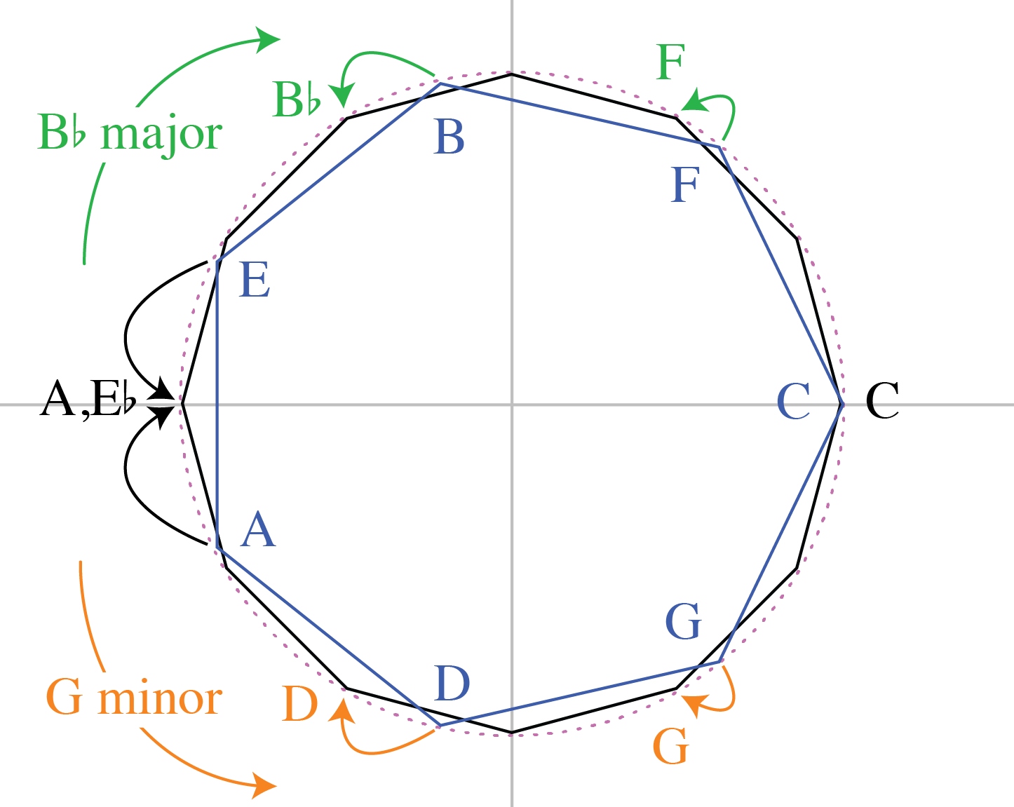
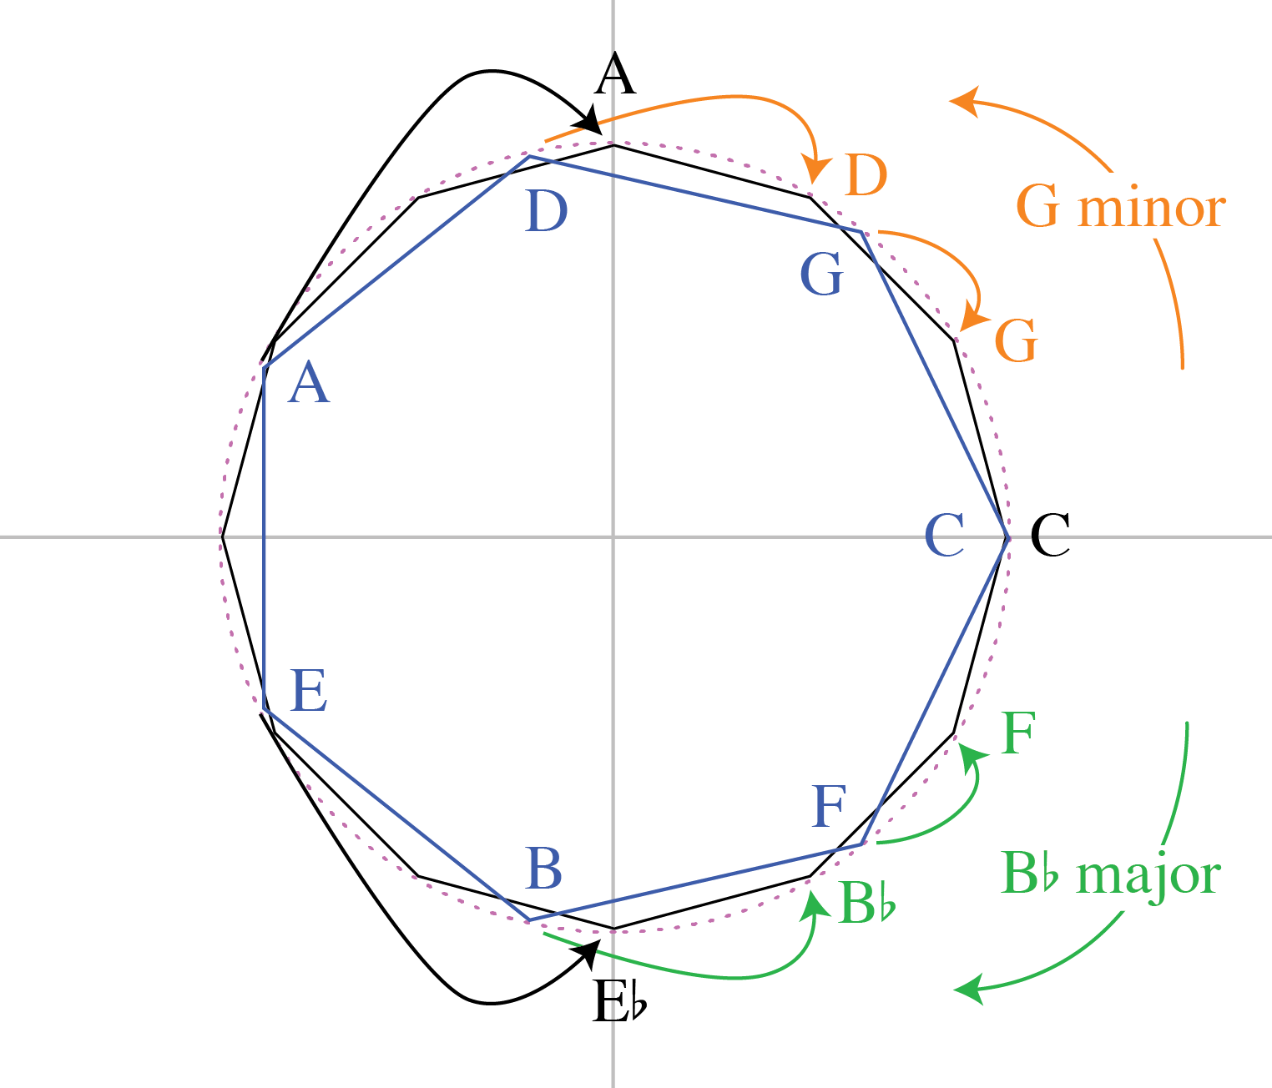
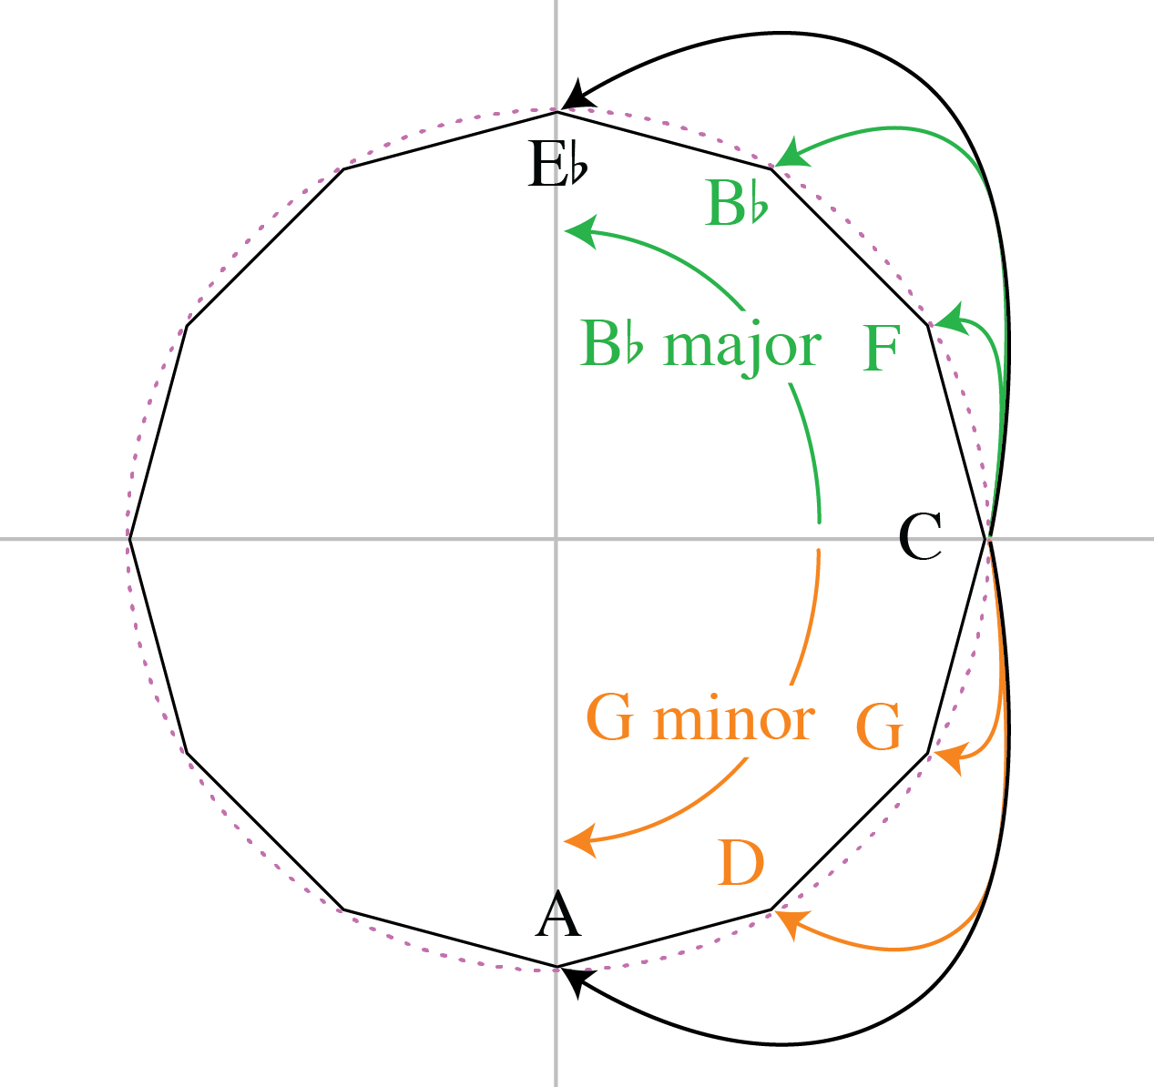
Major vs. Minor
The major and minor tonic–fifth are precisely opposite the balance point of the diatonic.
f₂
f₅
f₇
For ϕ_{2∙5/7} the effects reinforce one another (lower ϕ₂, ϕ₅, higher ϕ₇ for major).

Slide 31
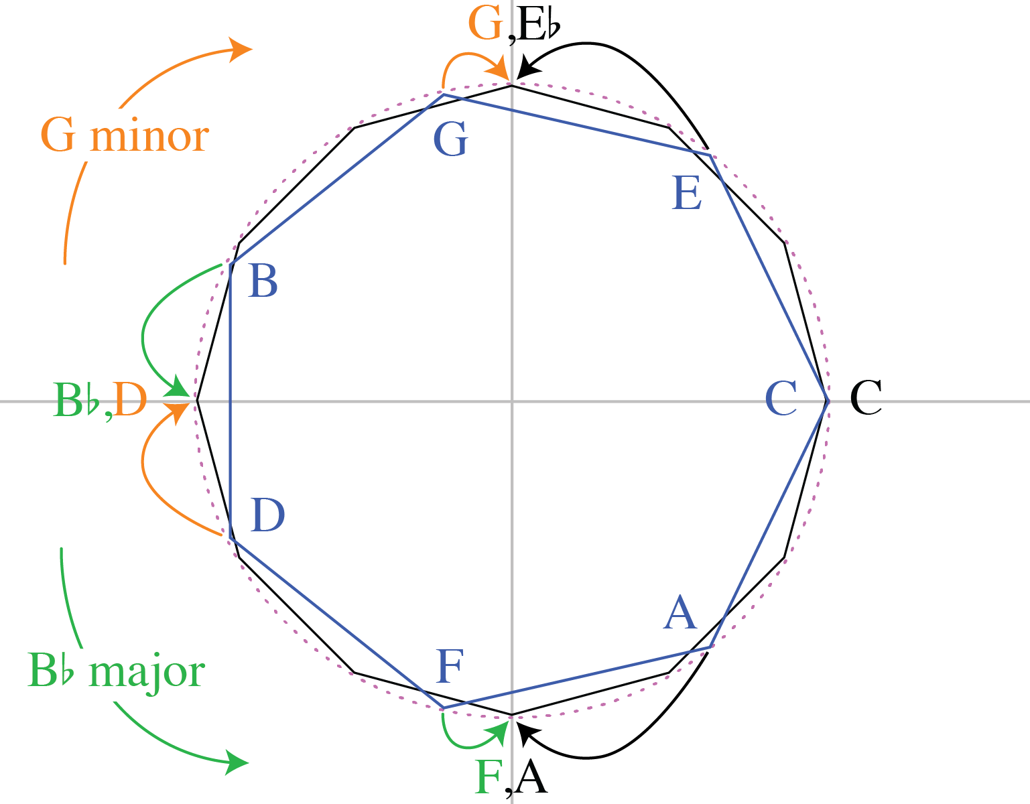
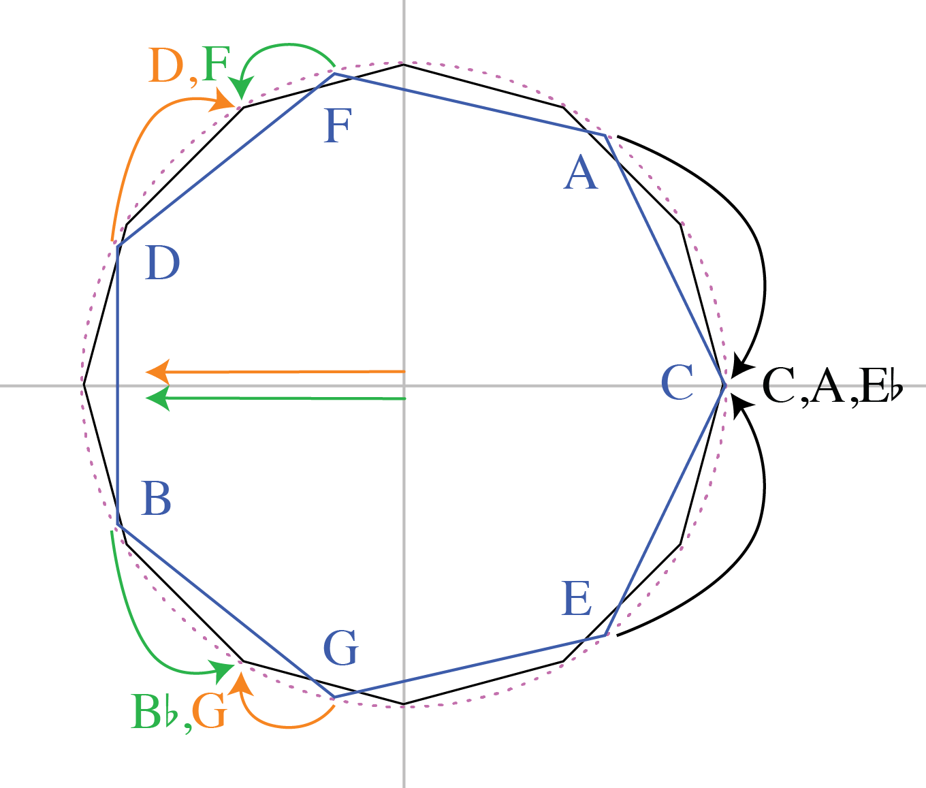
Major vs. Minor
The major and minor tonic–fifth are precisely opposite the balance point of the diatonic.
f₃
f₄
f₇
Mode effects are less pronounced for ϕ_{3∙4/7} (higher ϕ₃ for major counteracts higher ϕ₇).

Slide 32
Major vs. Minor
The major and minor tonic–fifth are precisely opposite the balance point of the diatonic.
f₂
f₃
f₅
For ϕ_{2∙3/5}, effects of ϕ₂ partially counteract ϕ₃ and ϕ₅.

Slide 33
Corpus data: Bach partitas
All movements of Bach’s 6 Partitas (3 major, 3 minor) on the complex plane for f_{2∙5/7} (normalized for share of power)
Modes are clearly distinct.
f_{2∙5/7}
Major
Arrows point from smaller (white arrow) to larger (Filled arrow) window sizes.
Minor
With increasing window size in both modes:
• Magnitudes get larger,
• Phase moves towards π.

Slide 34
Corpus data: Bach partitas
f_{3∙4/7} also differentiates modes, but less consistently.
f_{3∙4/7}
Most pieces go from coherent at smaller windows to anticoherent at larger windows.

Slide 35
Corpus data: Bach partitas
f_{2∙3/5} also differentiates modes, and is coherent at all window sizes.
f_{2∙3/5}

Slide 36
Corpus data: Bach partitas
A phase space on ϕ_{2∙3/5} ✕ ϕ_{2∙5/7} shows modal and diatonic/pentatonic contrasts.
The highly restricted range of ϕ_{2∙3/5} shows that the repertoire is exclusively diatonic.
Mode differences are evident in the positive and negative values of ϕ_{2∙5/7}.
The tendency for larger windows to be less coherent is also evident in ϕ_{2∙5/7}.
← ϕ_{2∙3/5} →
← ϕ_{2∙5/7} →

Slide 37
Corpus data: Bach French Suites
f_{2∙5/7}
We see similar patterns in f_{2∙3/5} and ϕ_{2∙3/5} ✕ ϕ_{2∙5/7} spaces for a similar corpus.
Major
← ϕ_{2∙3/5} →
← ϕ_{2∙5/7} →
Minor

Slide 38
Corpus data: Scarlatti sonatas
f_{2∙5/7}
In a corpus of Scarlatti sonatas the use of minor dominant vs. relative major
secondary keys has an influence (also parallel minor in secondary themes).
The range of variation of ϕ_{2∙5/7} is lower than for Bach, but still much more than ϕ_{2∙3/5.}
Major
Minor i–III
← ϕ_{2∙3/5} →
Minor i–v
← ϕ_{2∙5/7} →
Notes:
Go to midiverto for Scarlatti example: No. 9, minor at 32e window goes for minor (pos. real, neg. imag. 2-5-7) to sequential (negative real) to major (pos-pos)

Slide 39
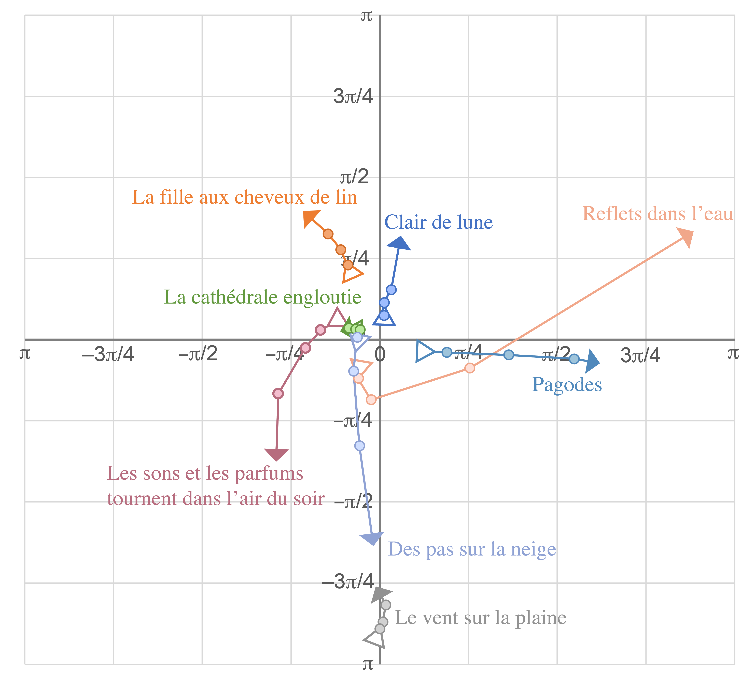
Corpus data: Debussy
Debussy’s music uses all parts of the ϕ_{2∙3/5} ✕ ϕ_{2∙5/7} space. Some pieces reflect diatonic organization and traditional major–minor distinctions, while it reveals pentatonic organization in pieces like “Reflets dans l’eau” and “Pagodes”.
← ϕ_{2∙3/5} →
← ϕ_{2∙5/7} →
Notes:
Go to midiverto for Pagodes example

Slide 40
Balinese Pelog
Gamelan Kebyar Tunings: Toth data

Slide 41
Andrew Toth’s Data
Toth measured 50 gamelans across all regions of Bali
Thanks to Wayne Vitale and Bill Sethares for data. (“Balinese Gamelan Tuning: The Toth Archives” Analytical Approaches to World Music, 2021)
Processing:
• Average across instruments.
• Average step sizes between second and third octave.
• Stretch/compress to a 1200¢ octave.

Slide 42
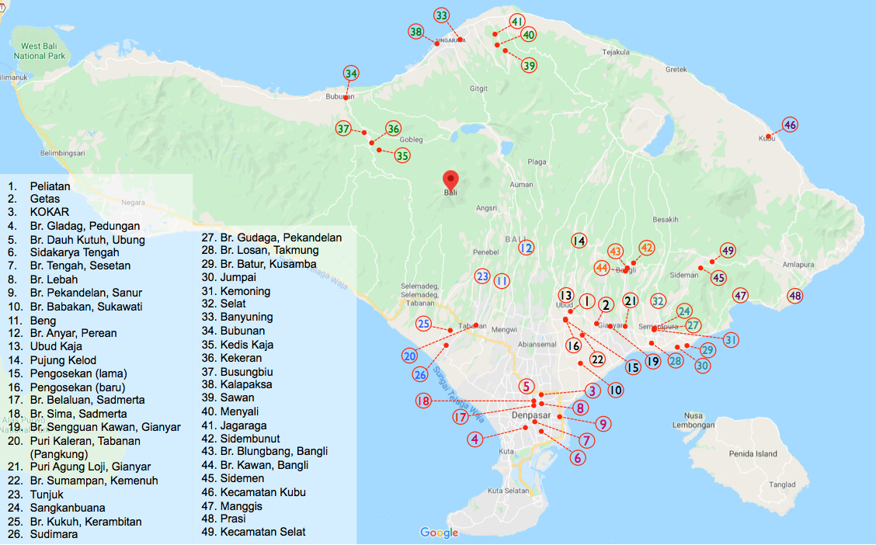
Regions of Bali (Toth data)
Buleleng
Karangasem
From Vitale and Sethares 2021
Bangli
Tabanan
Klungkung
Gianyar
Badung

Slide 43
Pelog Spectra
Peaks at f₂, f₇, and f₉ and troughs in between are consistent.
Above f₉, little discernable consistency.

Slide 44
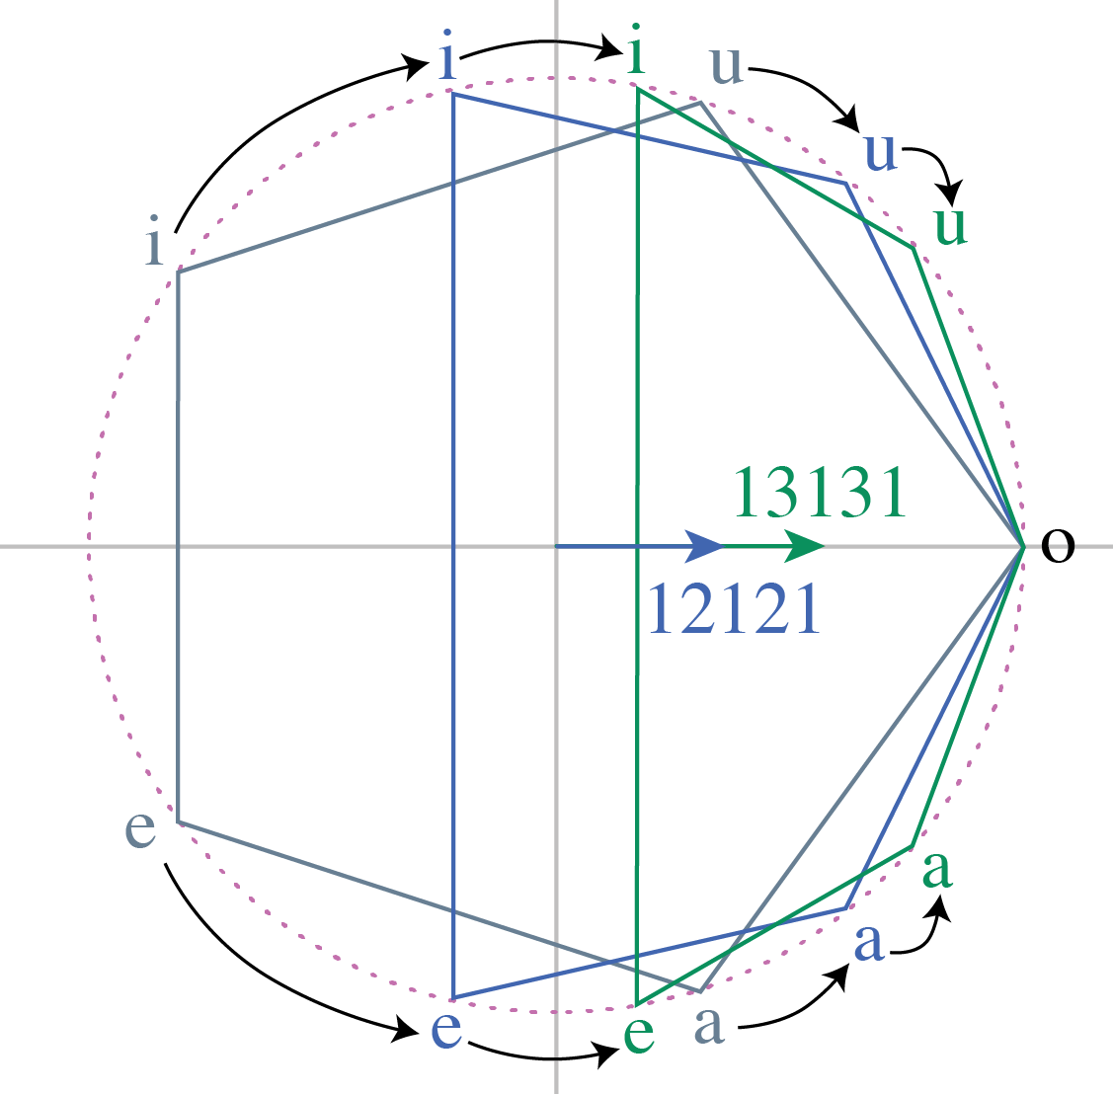
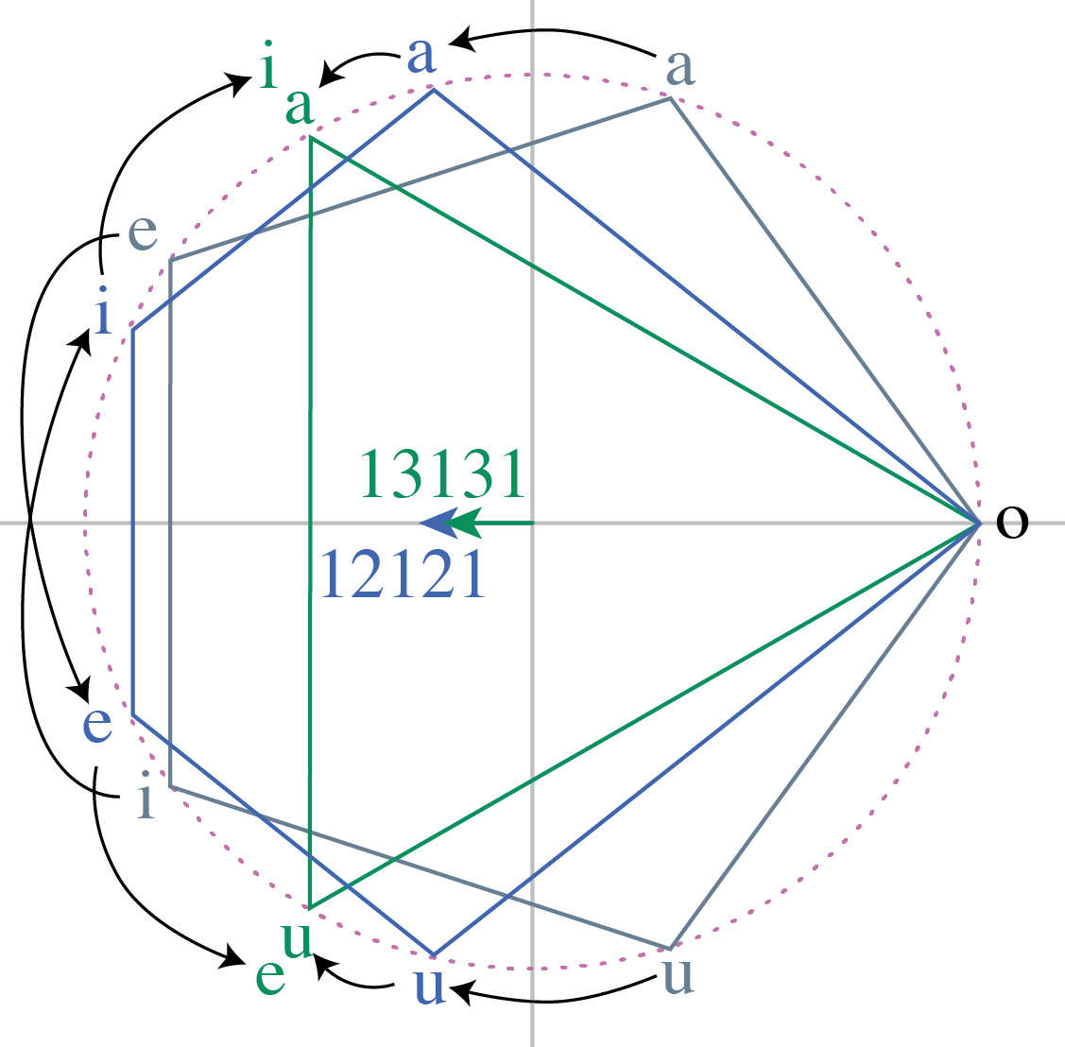
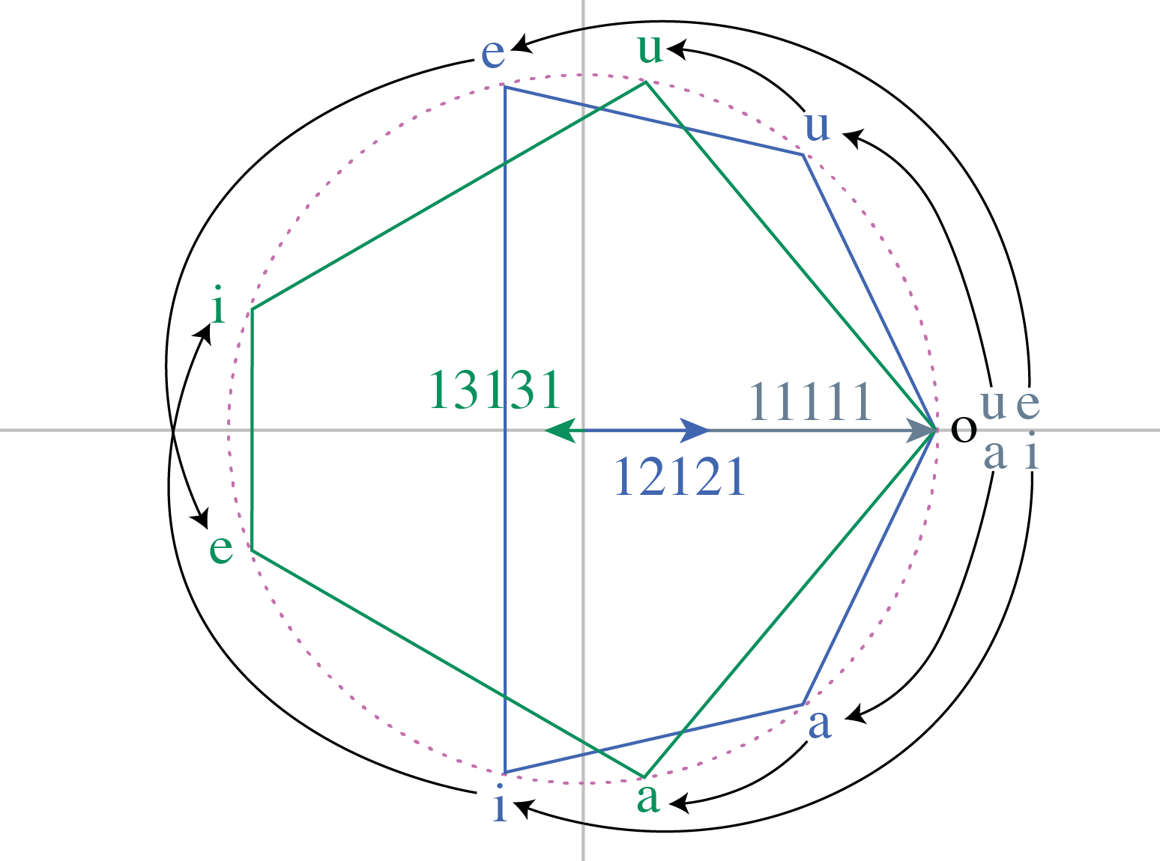
Generated Pentatonics
The maximally even 5-in-7 pentatonic (12121) has the expected ϕ_{2∙3/5} = π,
but as the generator gets closer to ½-octave, ϕ₅ flips so that ϕ_{2∙3/5} = 0.
f₂
f₃
f₅

Slide 45
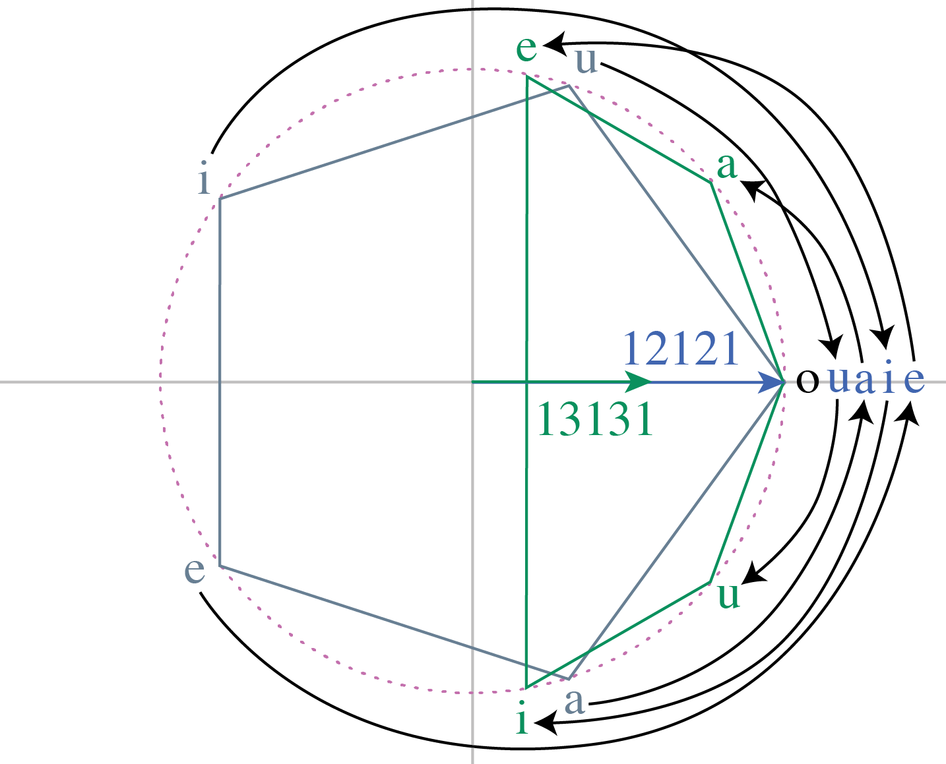
Generated Pentatonics
The ϕ₅ flip has the opposite effect on ϕ_{2∙5/7},
which is 0 for 12121 (pentatonic mod 7), but π for 13131 (subset of 7-in-9 ME)
f₂
f₅
f₇

Slide 46
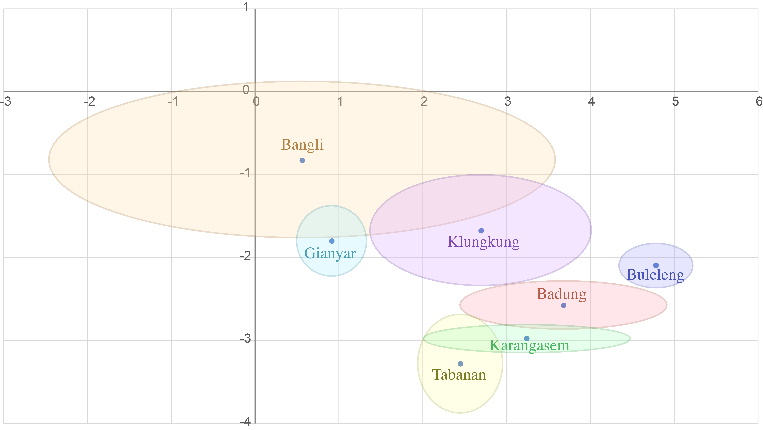
Pelogs in f₂ ✕ f₃ ✕ f—₅ space
Average and standard error for Toth data by region
All the major regions (Gianyar, Buleleng, Badung, Klungkung, Tabanan) are distinguishable.
f_{2∙3/5}
Gianyar:
Buleleng:
Badung:
Klungkung:
Tabanan:
Karangasem:
Bangli:
n
11
9
9
7
6
5
3

Slide 47
Pelogs in f₂ ✕ f₅ ✕ f—₇ space
Anticoherence of ϕ_{2∙5/7} indicates that pelog is more like a gapped 7-note ME scale than a 5-note ME scale.
f_{2∙5/7}
Gianyar:
Buleleng:
Badung:
Klungkung:
Tabanan:
Karangasem:
Bangli:
n
11
9
9
7
6
5
3
All the major regions except Klungkung are distinguishable.

Slide 48
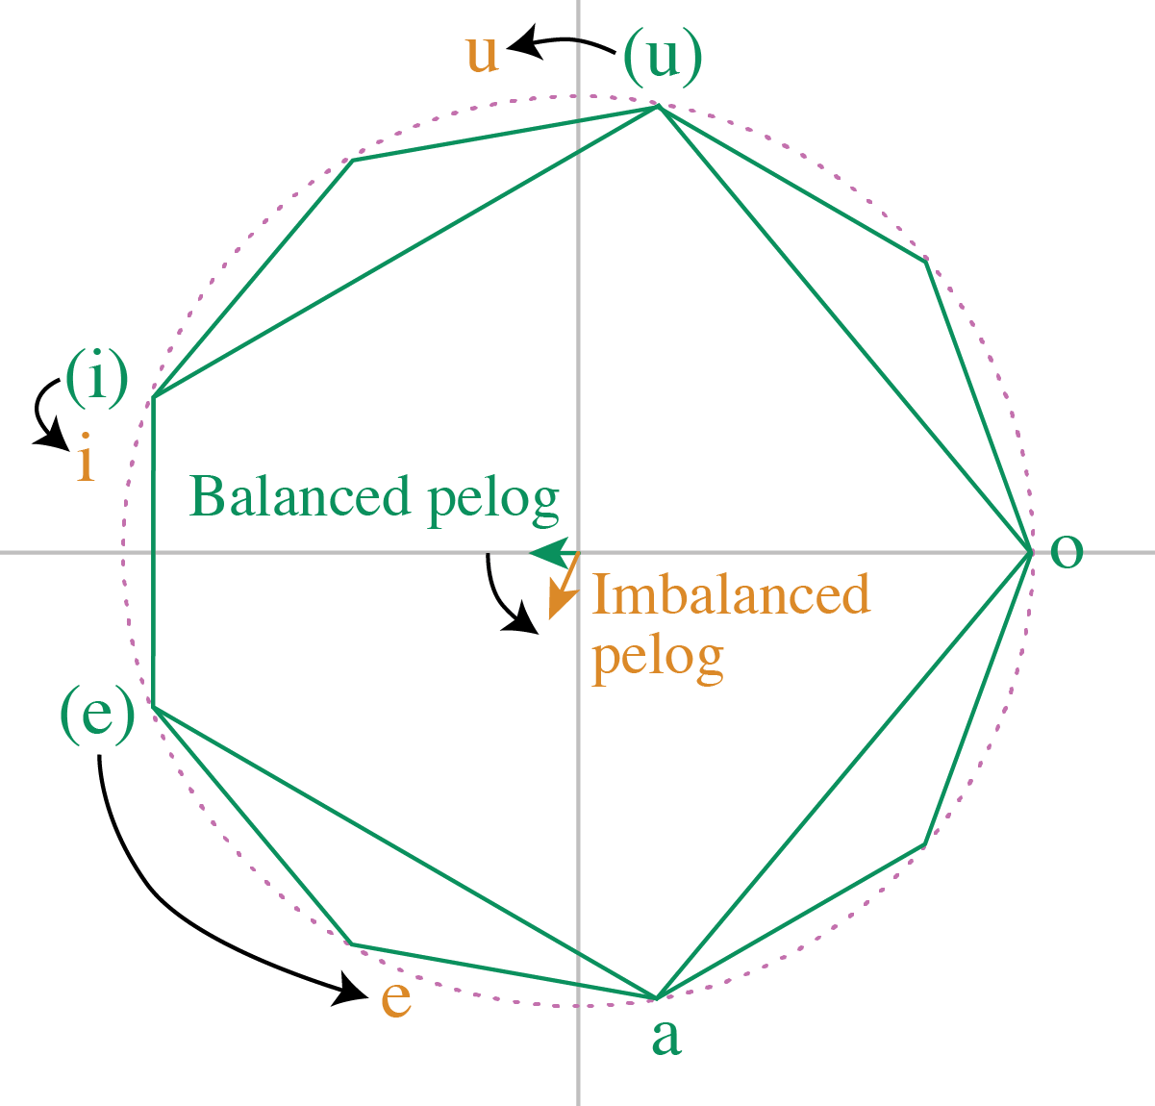
Imaginary part of f_{2∙3/5} and f_{2∙5/7}
The data also show that a negative imaginary part of f_{2∙3/5} and f_{2∙5/7} is a feature of pelog.
This reflects an asymmetry:
dong–deng > ding-dong
dong–dung > dang-dong,
f₅
a — i – o – e — u
<
>
⇒ ϕ_{2∙3/5} > 0, ϕ_{2∙5/7} < π.
Imbalance helps distinguish regions:
Larger in Gianyar, smaller in Buleleng

Slide 49
Rhythmic Qualities and Coherence in Adowa
Analysis of a transcription by Willi Anku
Notes:
Akan traditional dance

Slide 50

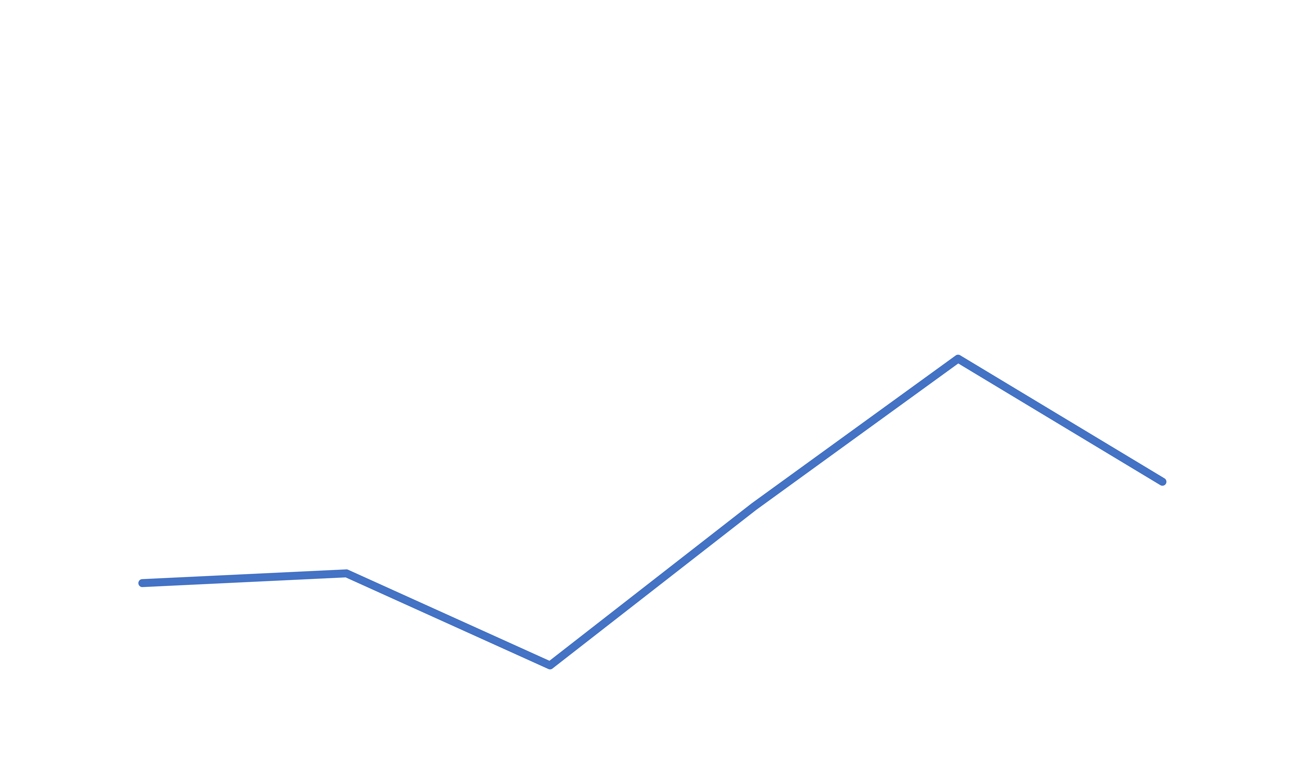

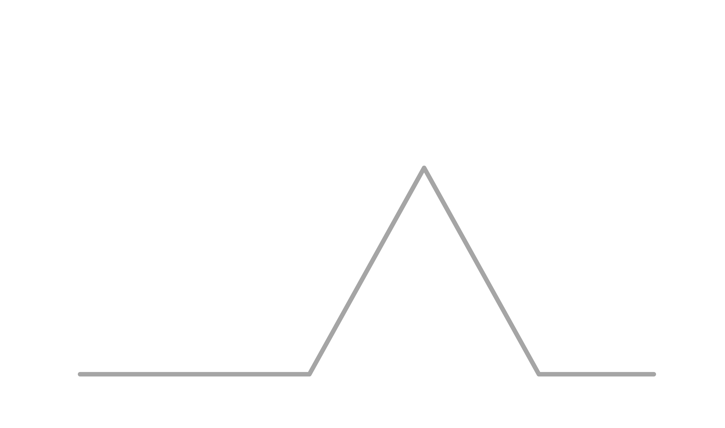
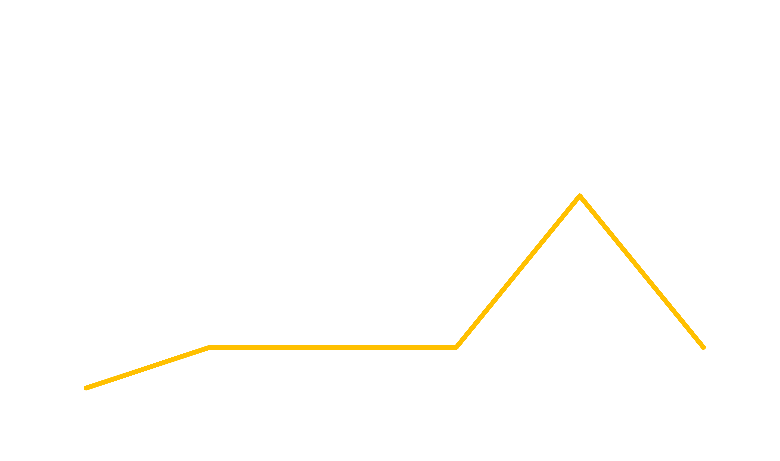
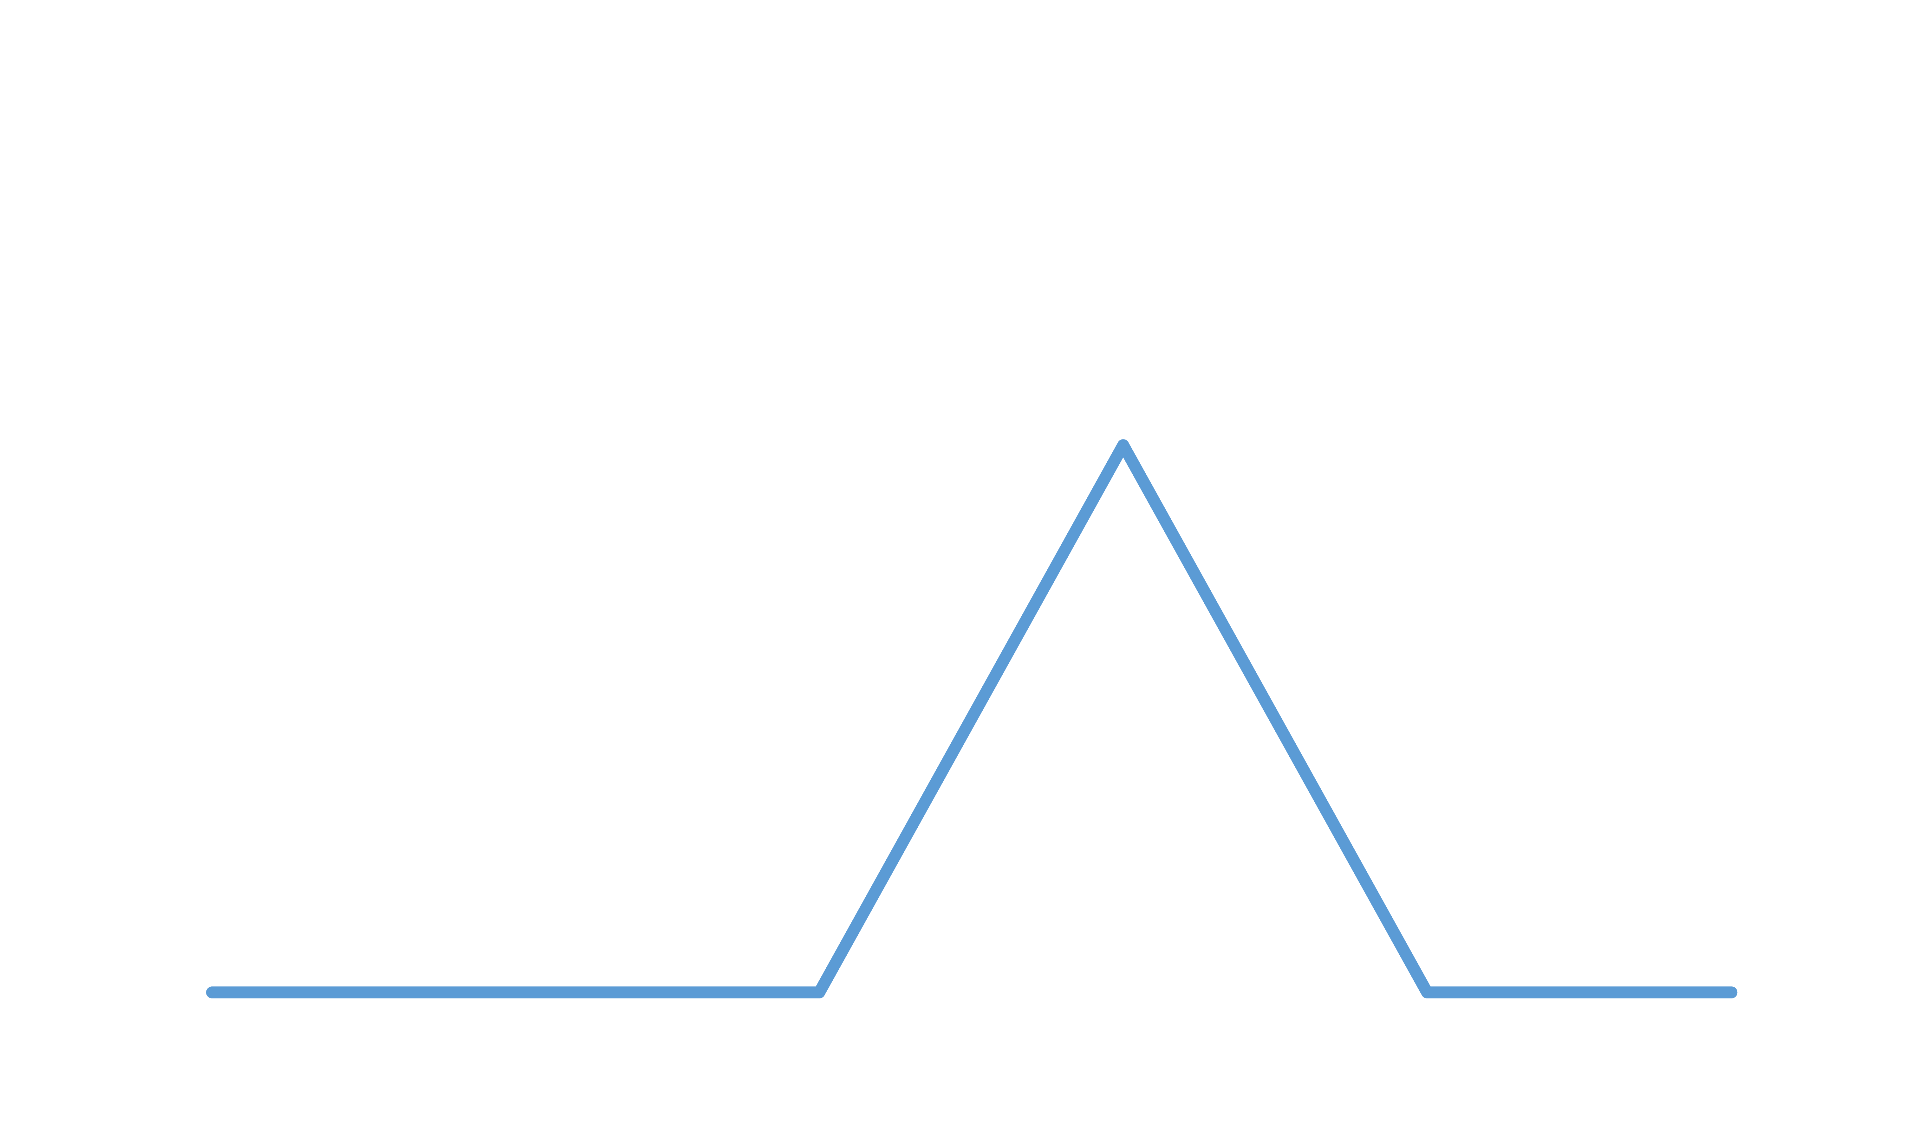
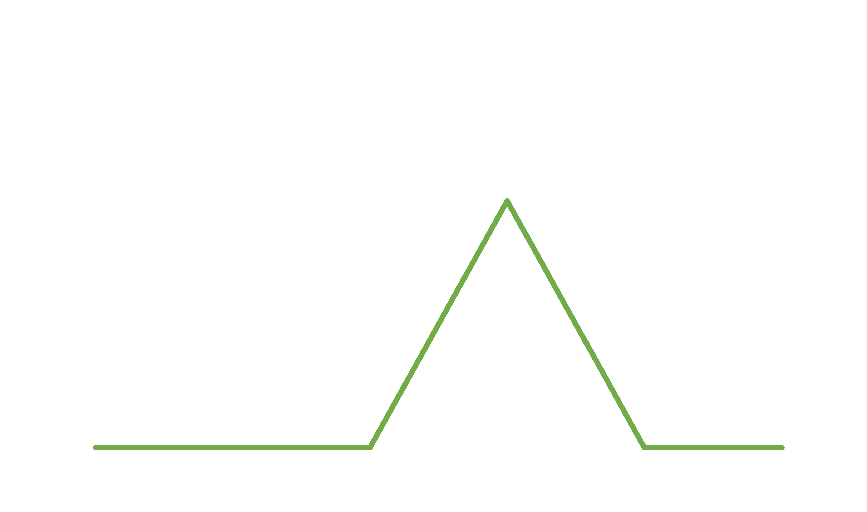
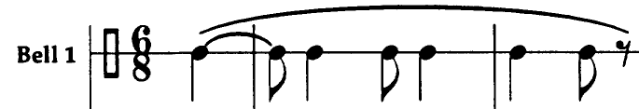
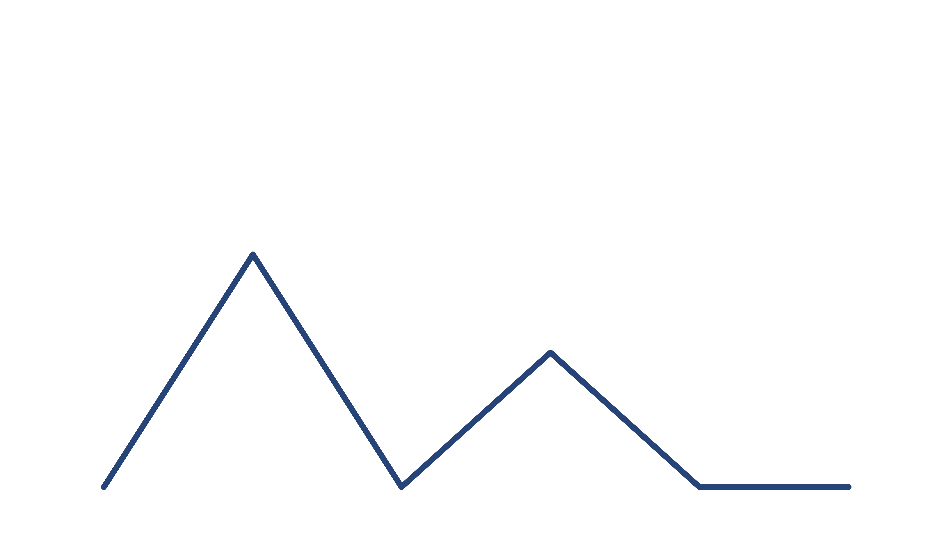
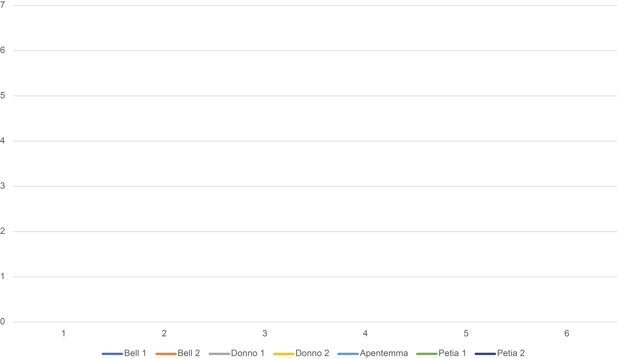
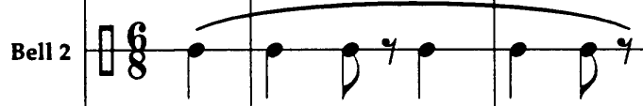





Adowa
The Adowa ensemble (in Anku’s transcription)
Rhythmic spectra:
Bell 2
Petia
Apentemma
Donno 2
Donno 1
Bell 1
Petia alt.
f₄ and f₅ prominent, represented by multiple parts
Notes:
6 Animations and sound

Slide 51


Adowa
The Adowa ensemble on 2-d. planes
f₂ and f₅ (periodicities h. and ⅘q.) are both represented by just 2–3 parts, similar in phase.
f₅
f₂

Slide 52
Adowa
The adowa ensemble on 2-d. planes
f₄ represents the periodicity of the beat (q.) and here multiple parts cover different regions of the space (on-beat, off-beat, ahead of beat, behind beat).
f₄

Slide 53
Adowa: Atumpan (lead drum)
Anku’s transcription of a performance by Solomon Amonquandoh divided into 4 sections
Amonquandoh begins centered on the main two beats.
Then he explores each region of the space in turn: off-beats, ahead of the beat, and behind the beat.
f₂
mm. 38–58
mm. 1–19
mm. 20–37
mm. 59–74
(Values summed over 3½ cycles)

Slide 54
Adowa: Atumpan (lead drum)
Anku’s transcription of a performance by Solomon Amonquandoh divided into 4 sections
Frequency 4 measures orientation with respect to the main 4 q. beats.
The performance also explores all the regions of this space in sequence.
The first two sections are consistently ahead of the beat,
the third section behind, and the last section on the beat.
f₄
mm. 20–37
mm. 1–19
mm.
38–58
mm. 59–74
(Values summed over 3½ cycles)

Slide 55
Adowa: Atumpan (lead drum)
Anku’s transcription of a performance by Solomon Amonquandoh divided into 4 sections
This is frequency articulated by the timeline rhythm of the bell, which is in the upper right quadrant of the space. Amonquandoh starts in the vicinity of the bell and explores all the adjacent regions, avoiding the half of the space across from the bell.
mm. 1–19
mm. 59–74
mm. 38–58
f₅
mm. 20–37
(Values summed over 3½ cycles)

Slide 56

Amonquandoh’s Atumpan in f₂ ✕ f₅ ✕ f—₇ space
While exploring different regions of f₂ and f₅ spaces,
Amonquandoh maintains a consistent ϕ_{2∙5/7} of about 3π/2.
f₂ ✕ f₅ ✕ f—₇

Slide 57

Amonquandoh’s Atumpan in f₂ ✕ f₂ ✕ f—₄ space
Similarly while exploring different regions of f₂ and f₄ spaces,
Amonquandoh maintains a consistent ϕ_{2∙2/4} of about π/2.
f₂ ✕ f₂ ✕ f—₄

Slide 58
Thanks!
Powerpoint and more here:
sites.bu.edu/jyust

