Slide 1

Rhythmic Regularity beyond Meter and Isochrony
Jason Yust, .
Rhythm in Music since 1900, McGill, Sept. 22–24
Keynote Presentation

Slide 2
What is rhythm?
Abstracted from timbre, pitch, loudness?
Separate from meter or is meter a feature?
Sound vs. notation
On an isochronous grid?
Discrete vs. continuous time
These questions all impinge on how we conceptually model rhythm!
Notes:
My ultimate goal this morning is to present a specific approach to understanding and analyzing rhythm, and to demonstrate some tools for analyzing rhythm on a lot of different kinds of repertoire. So there will be some technical details ahead. But before we go there, I would like to think a little bit more broadly about what rhythm is and how our conceptual apparatus around it influences how we behave, whether it is how we compose music, or analyze music, or design psychological experiments. If you're like me you have a lot of habits of thought around rhythm that are governed by the European notational system. And like any deeply engrained habits they feel natural, and we take them for granted. This can blind us to where this thinking can cause problems or lead us astray.
So like Peter earlier this morning start by reflecting a bit on just what we're talking about when we talk about rhythm. We imagine that rhythm can be abstracted from other musical parameters like pitch or timbre, but is this always the case? We think of meter as a kind of container for rhythm, but is that how it works? Could rhythm instead be a container for meter? Is a rhythm an aspect of sound, an aspect of musical action, or something notated? We would like it to be all of these things, but actually maybe the way that rhythm manifests in each domain is quite different. For instance one problem we will encounter with notation is that it requires rhythm to exist in some kind of isochronous grid. It requires time to be discrete, but is it possible to think of rhythm existing in continuous time?

Slide 3
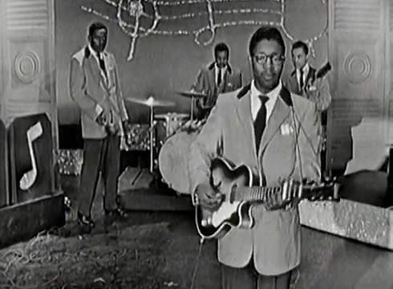
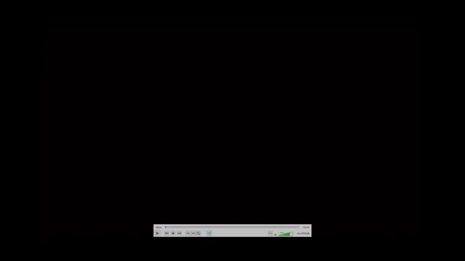
What is rhythm?
Example: Bo Diddley rhythm
[Ed Sullivan video]
[Story of Bo Diddley video]
Bo Diddley on Ed Sullivan, 1955
Bo Diddley in “All You Need is Love: The Story
of Popular Music,” 1977
Notes:
To move these thoughts along, let's consider a simple example. The R&B musician Bo Diddley recorded a song with the same name in 1955, and this is an important milestone in the history of American popular music. The song has no chord progression, no distinct memorable melody, and throwaway lyrics. It's value and identity all derive from its rhythm. This is a rhythm that would become closely identified with Bo Diddley himself from that point onward. But what is the Bo Diddley rhythm exactly? Let's listen to two examples, from a 1956 television broadcast and a demonstration that Diddley later did for a documentary.

Slide 4

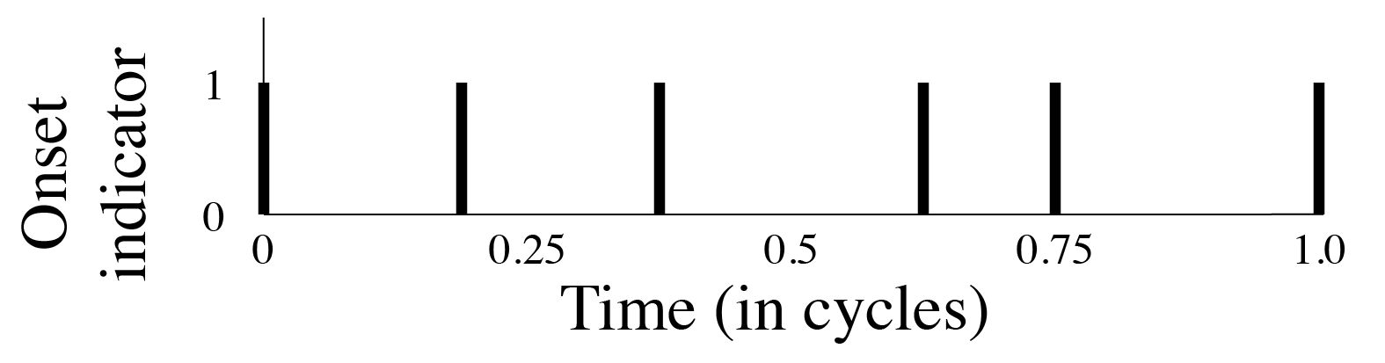
What is rhythm?: Bo Diddley
Is this an adequate representation?:
Notation can be:
• Instruction for performance
• Descriptive: A summary of what
musicians play (generalize over
performances, different players)
As a function over time:
What’s missing:
• Other things the musicians play
• Patterns of emphasis
• Meter
• Microtiming
Notes:
One might be inclined to respond to the question with musical notation, something like this. The rhythm here is also known as Son clave, an important basic rhythm in Cuban music and Latin jazz. Hence this notation could lead to the claim that Bo Diddley's rhythm is just clave, not something that he invented. Whatever is distinctive about the sound, that makes it sound like Bo Diddley, would have to be, according to this way of thinking, something other than the rhythm itself. But there's a lot missing from this representation that might actually be aspects of the rhythm.
I'm using notation descriptively here, but it's not really a tool that was not designed to describe sound. Notation developed as a way to give instructions for performance, and there's no reason it should also be optimized as a descriptive tool.
I will be translating notated rhythms in this talk into functions over time, where each onset in the rhythm is represented by an instantaneous spike in the function.

Slide 5
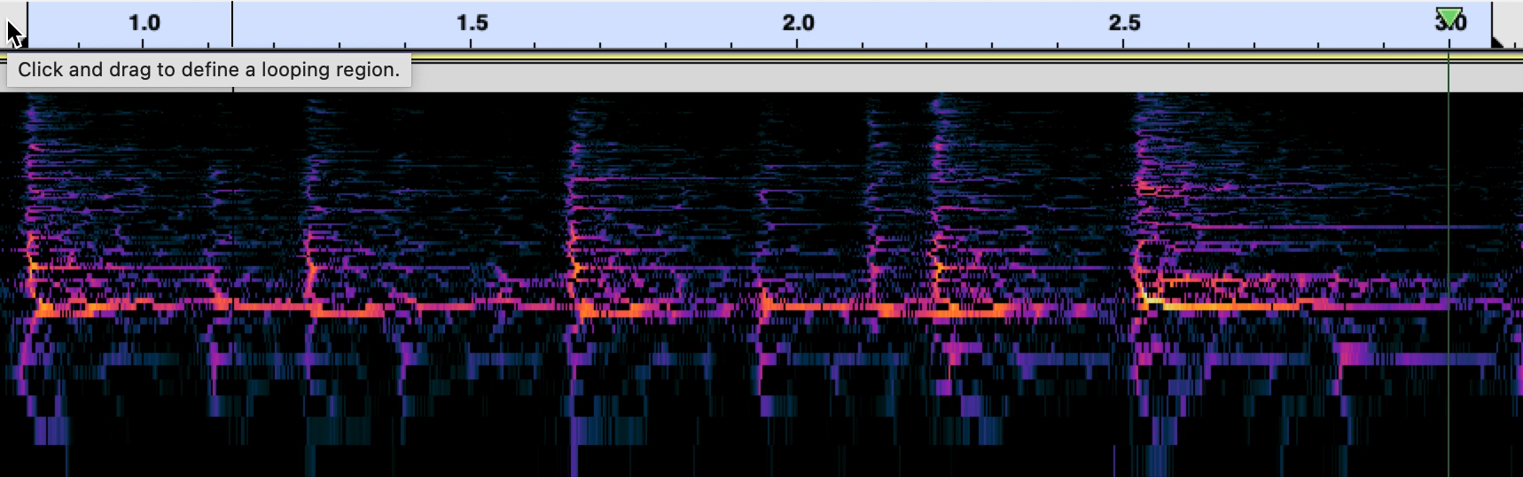
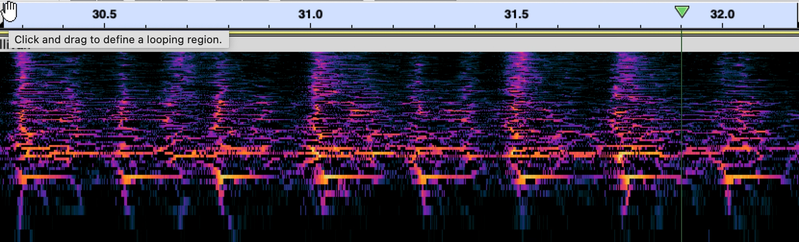
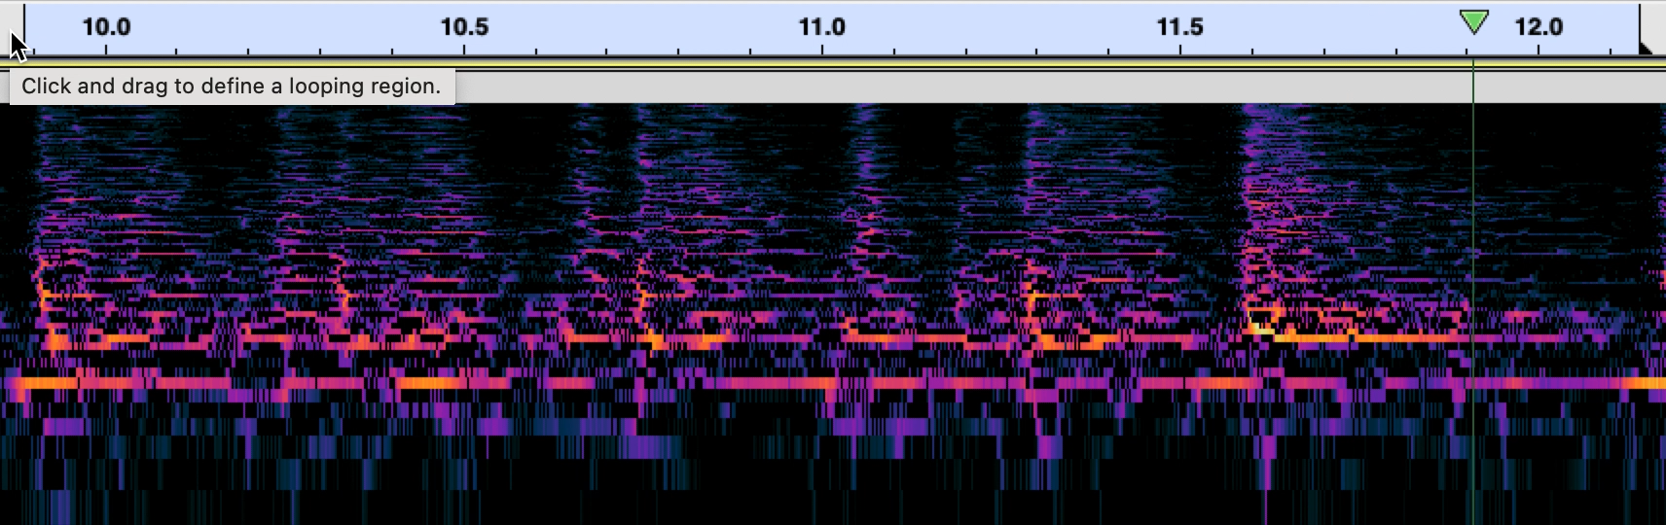
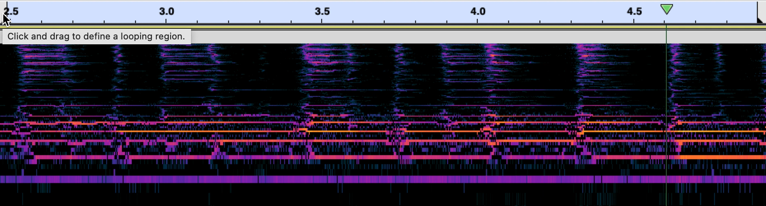
What is rhythm?: Bo Diddley
Chess records, 1955, alt. take
Ed Sullivan Show 1955
Full band + audience clapping
Drums alone
1977 Documentary
Full band (drums, bass, guitar, shaker)
Guitar and bass only
Notes:
We could look at sound signals to learn more about the rhythm. Here is a single measure of the rhythm first from the original recording, which starts with drums alone, then with the full band.
[Play 2 exx.]
One thing we notice is that the rhythm can be played on drums or guitar, so in that sense it is abstracted from timbre. But there are other things in it that are not represented in our notation. Some onsets are always louder than others, and there are events that occur in other places than those five onsets. The five onsets themselves are not all equally weighted. In the next example from the Ed Sullivan show, we note that the audience does, however, pick up on the five onsets and claps along in that rhythmic pattern.
[Play 3rd Ex.]
And here's the rhythm from the later documentary played just on guitar. Notice how the strumming pattern includes upstokes that are not part of the five-onset rhythm.
[Play 4th Ex.]

Slide 6
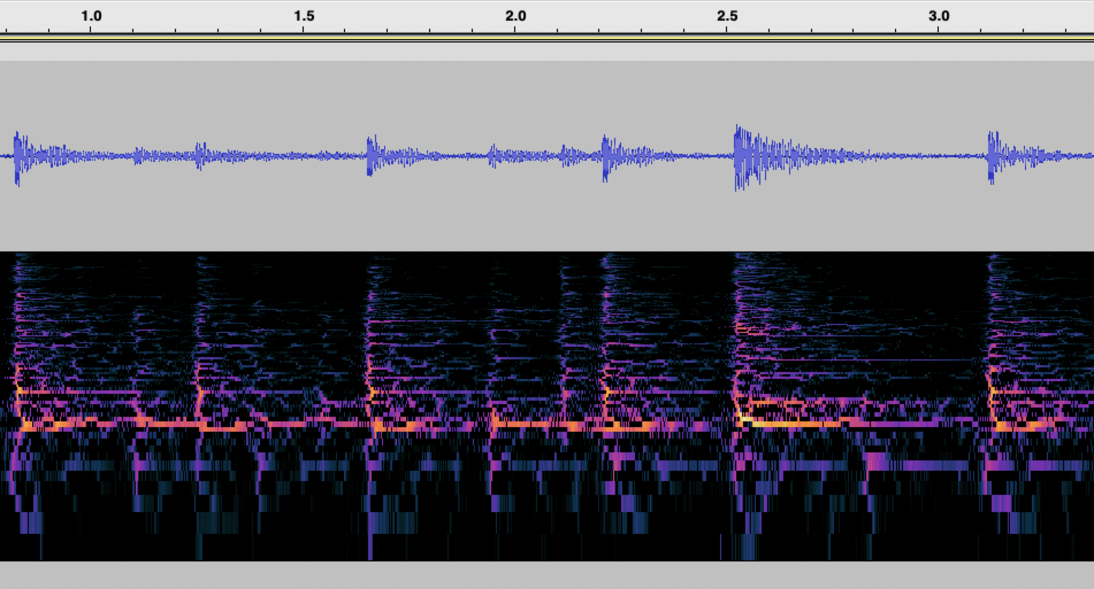
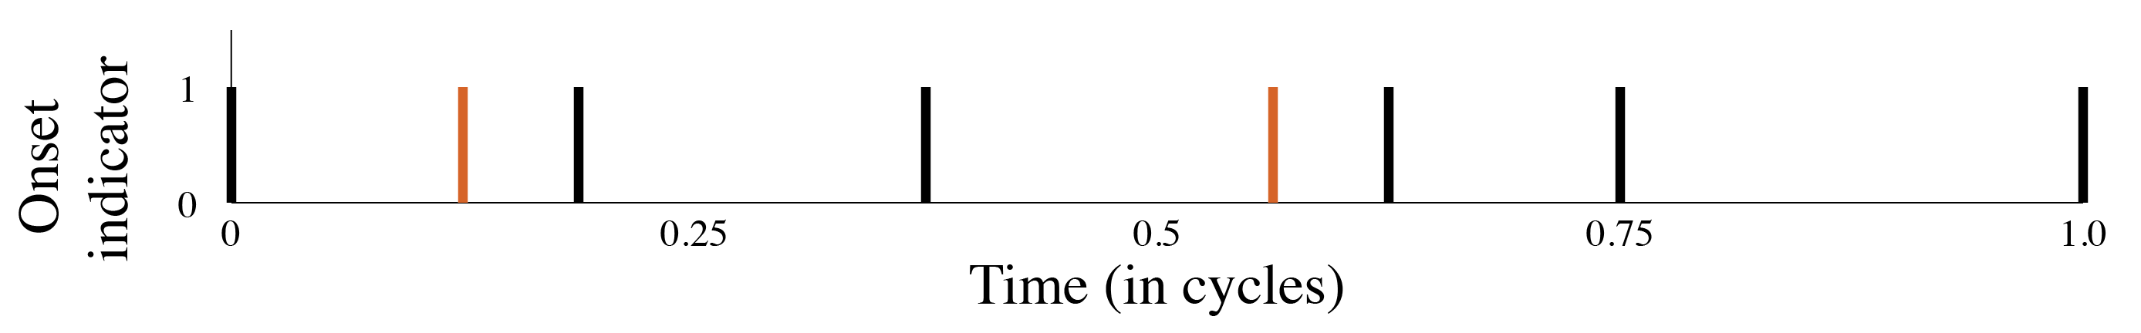
What is Rhythm?: Bo Diddley
Early strikes
Notes:
Another thing about sound is that it represents time as continuous, and where the onsets occur doesn't totally line up with the isochronous grid implied by the notation. These deviations from isochrony are consistent, and they are not measured in rational notatable quantities.

Slide 7

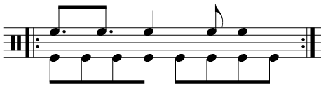

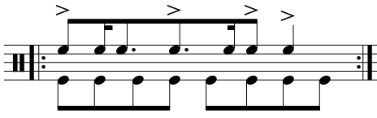



What is rhythm?: Bo Diddley
Other possible notated representations:
Emphasized onsets:
With bass:
All onsets:
Emphasis as accents:
Showing microrhythm?:
Or just a meter indication:
Notes:
We can try various ways of enhancing our notation to reflect some of these aspects of the rhythm. We could use accents to show the weighting of certain onsets, which is a coarse tool but helps. To show microrhythmic nuance we have to use complicated divisions. We can also show the bassline, or give a time signature to indicate the 4/4 metrical context that the bass provides.

Slide 8
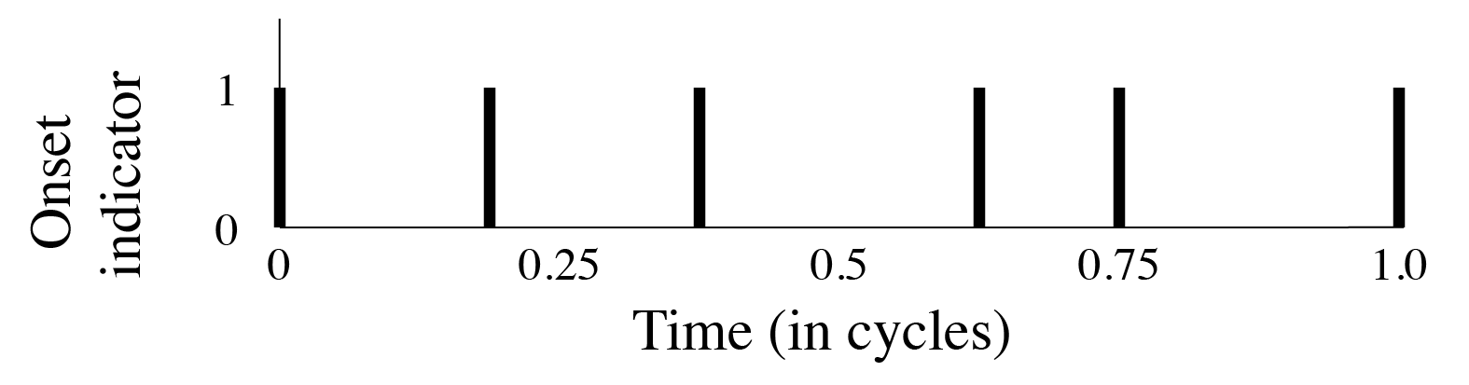
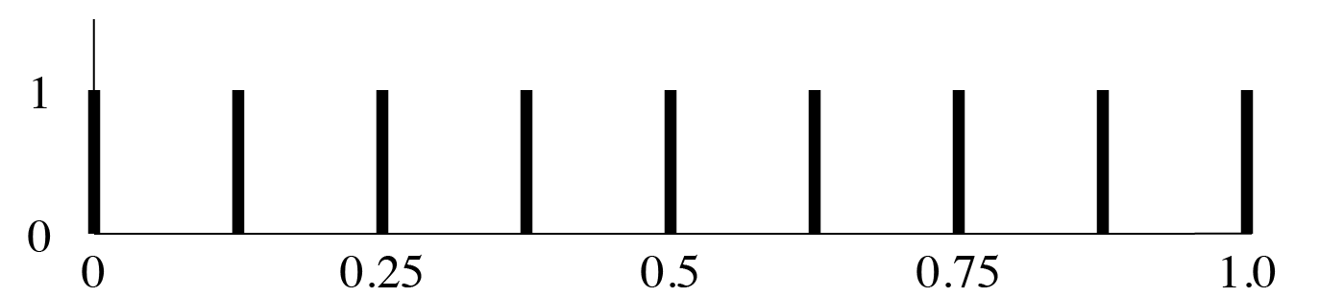
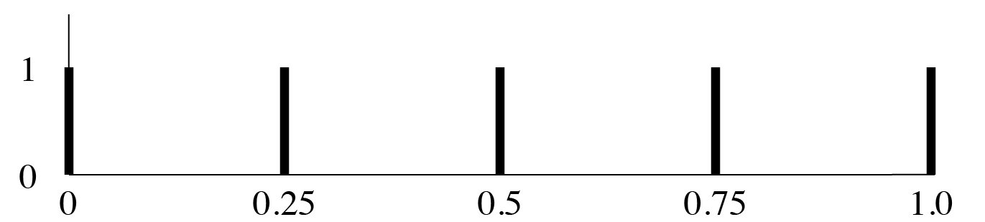
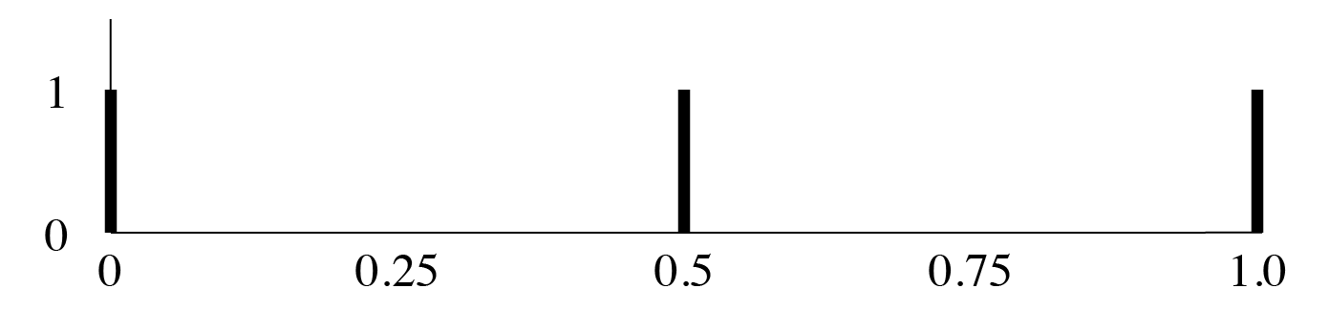
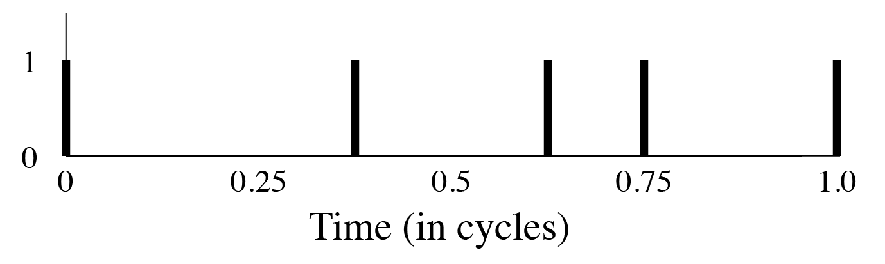
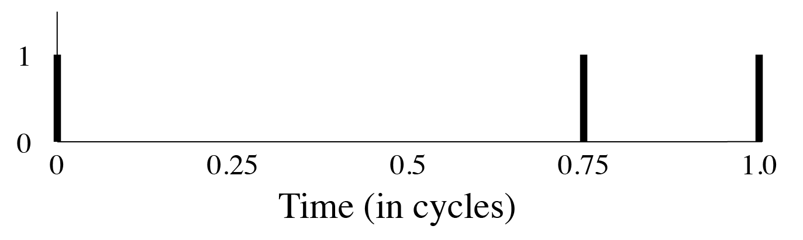
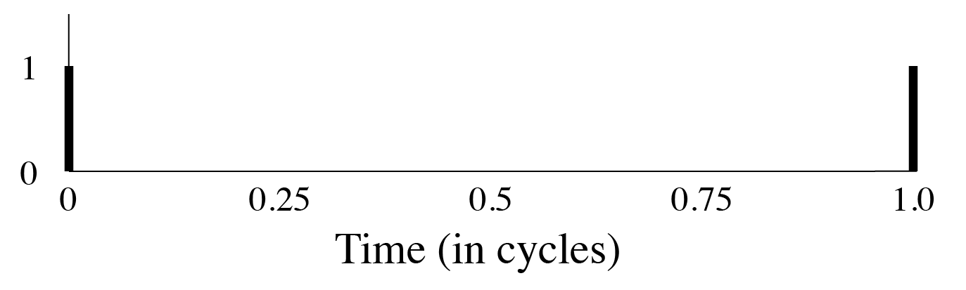
What is meter?
Meter is a kind of interpretation of a rhythm, which we can represent with a filtering function.
The Euro-classical concept of meter is notation-oriented, and based on the principle of isochronous layers (metronome model).
✕
✕
✕
=
=
=
The rhythms and filters are both discrete indicator functions.
Notes:
Let's dig in on that concept of meter a little bit more. Meter is a kind of interpretation of a rhythm, and one way to think about interpretation is as a filter. Here I show these filters as functions, and by multiplying the rhythm by these filter functions, we extract different metrical levels of the rhythm. The rhythm here is the clave, and we see that four of the five onsets pass the eighth-note filter, only two pass the quarter-note filter, and one the half-note filter. This is an adequate representation of the meter as a regulative component of European notation.
Notice that both the rhythm itself and the filter are discrete indicator function. This leads to an important flaw of notation.

Slide 9

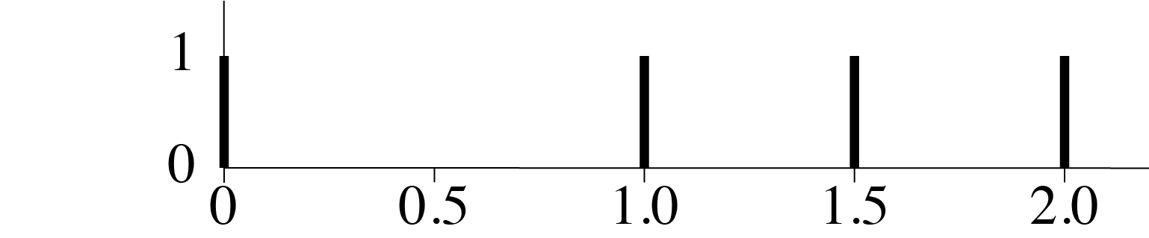
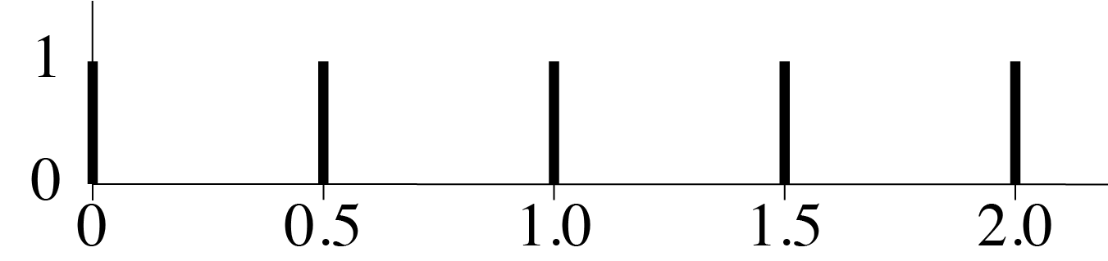
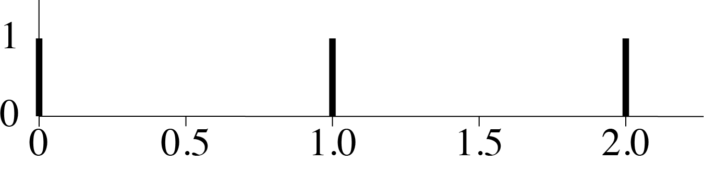

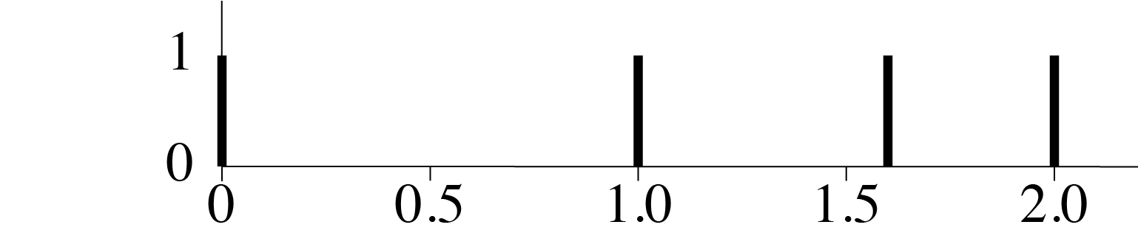
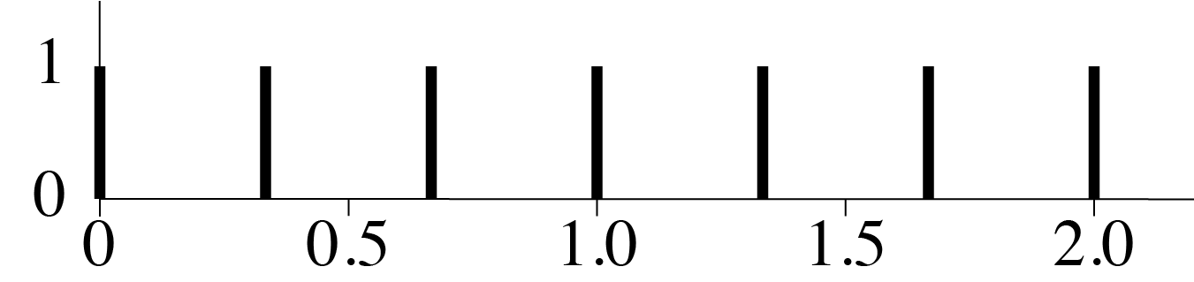

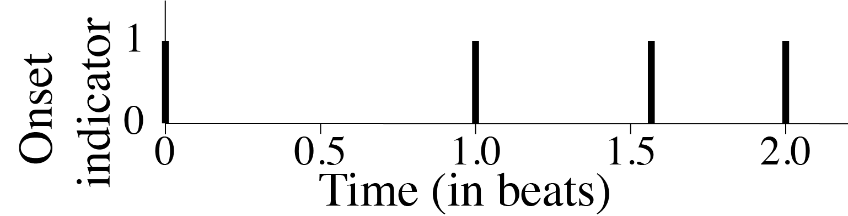
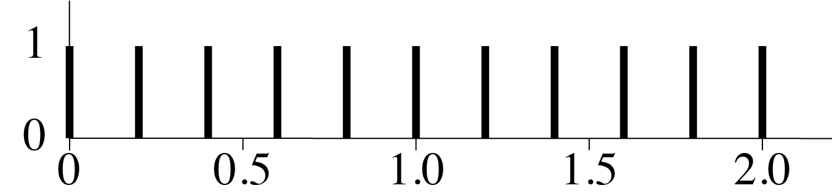
Continuity of time
Discrete filters on discrete signals do not reflect time as a continuous space.
1:1
Example: Swing ratios (See Benadon Forthcoming!)
=
✕
2:1
=
✕
✕
=
3:2
=
✕
✕
=
In the method of metrical notation, greater precision requires greater complexity.
European notation is optimized as a prescriptive, rather than descriptive, system.
Notes:
One way to appreciate this flaw is to consider the phenomenon of swing in jazz and popular music. I recommend the Fernando Benadon's book on this topic, soon to be published by Oxford University Press. Swing is sometimes described by means of simple ratios, and it is possible to show these in musical notation. In practice, of course, these ratios are only ever approximations to what is actually happening in the music. There are times when thinking of a 2:1 ratio, or triplet swing, can be musically productive -- for instance with swing near this ratio an improviser might fill in the triplets. But to continue to use ratios to try to capture the timing patterns in-between these simple ones quickly becomes an empty exercise. The metrical filter functions help us understand why. The only way to preserve the off-beat note is to add more onsets to the filtering function. Additional precision requires additional complexity. But a subdivision of the beat beyond a certain point is unrealistic. Notation works this way because it's designed for production, not description. Subdivision is a method a musician can use to achieve a certain timing pattern. But when we use this to describe timing patterns, we loose continuity of time, because there is no concept an onset being close to where it belongs in the model. It either exactly matches it, or not at all.

Slide 10
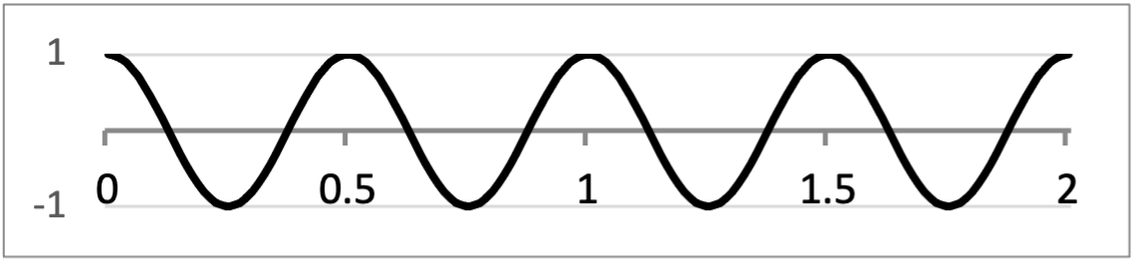
Isochrony vs. Periodicity
The traditional European concept of meter is based on Isochrony (discrete filters). An alternative (more general) concept is periodicity.
Instead of a discrete filter:
Consider a continuous filter:
(simple periodicity, AKA
simple harmonic oscillator)
Notes:
So here is my proposal; this is the basis of my whole talk this morning. Instead of the discrete filters implied by the notation-based concept of meter, I would like us to consider a continuous function. Specifically, I will make the case that one kind of continuous function, a simple sinusoidal function, is especially useful for this.

Slide 11
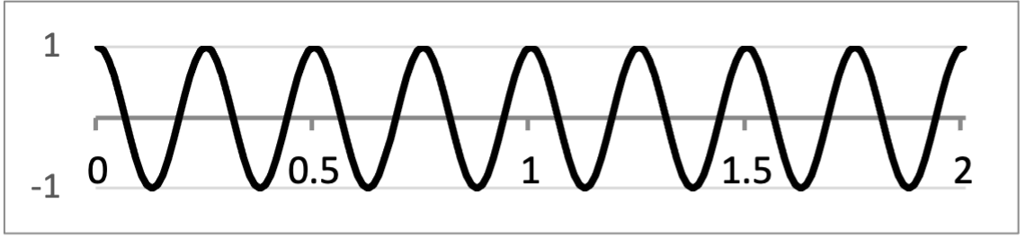
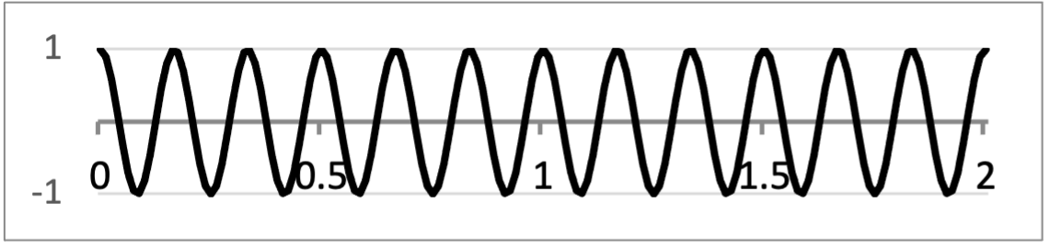
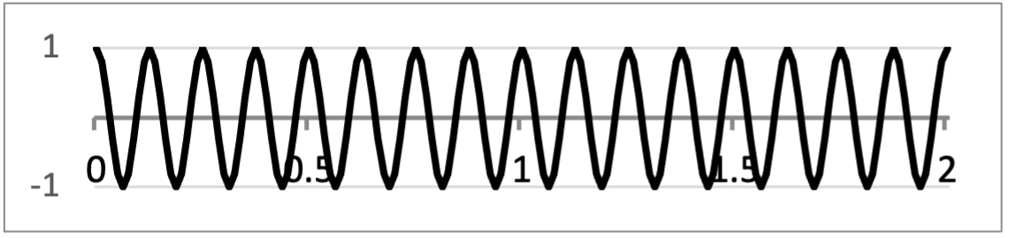
Isochrony vs. Periodicity
We can recover discrete isochronous functions from simple periodic ones.
=
Temporal precision can be modeled by high-frequency cutoff (low-pass filter) or sample rate.
+
All periodic functions are sums of simple periodic (sinusoidal) functions.
+
+
+ . . .
Notes:
One reason why sinusoidal function are useful, what makes them simple periodic functions, is that we can get other periodic functions as sums of them. This is true of our discrete indicator function. Ultimately, we might understand that function better by recognizing that it is the sum of an infinite number of simple periodic functions, all multiples of the base frequency.

Slide 12
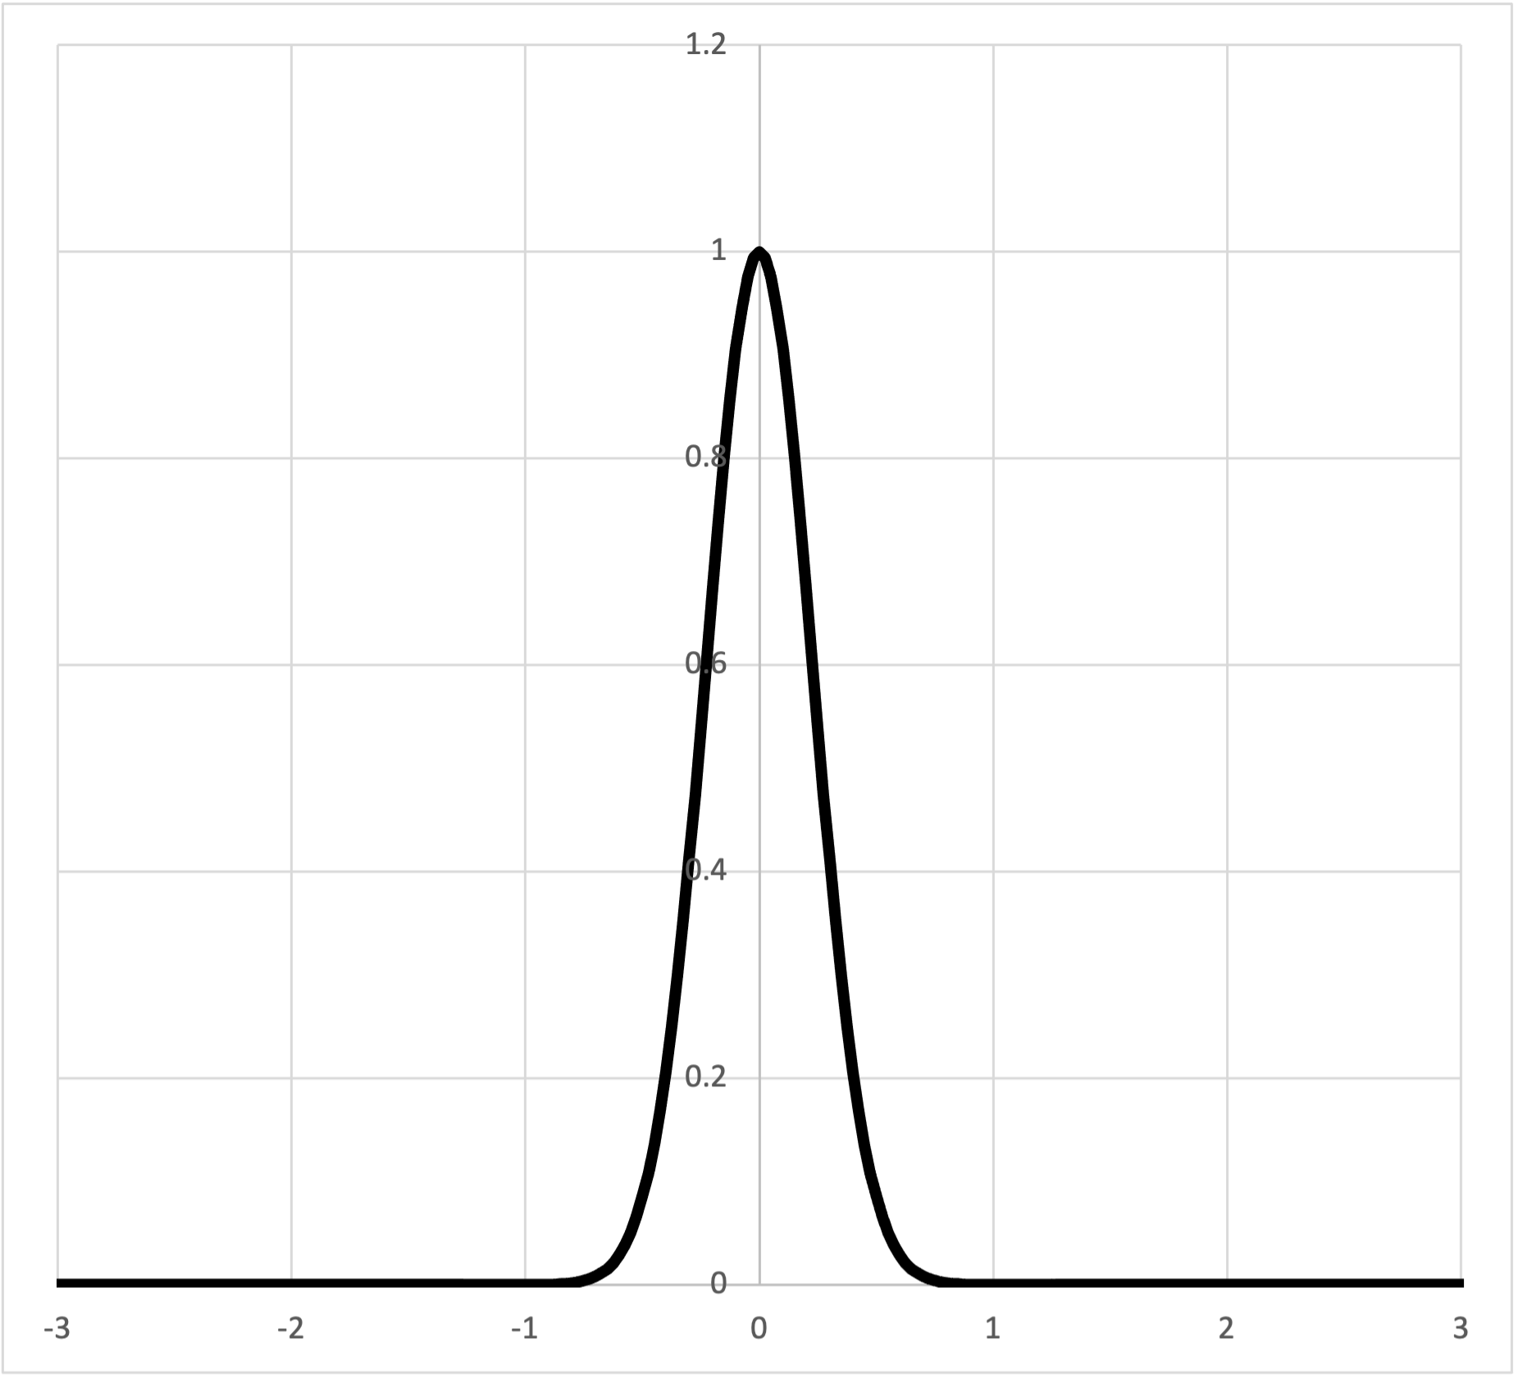
Beat bins
Anne Danielsen’s concept of beat bin or Chris Stover’s beat span
can be represented as a Gaussian filter:
Notes:
Many other theorists have noticed the problems with the discreteness of the notation based concept of meter, especially as research on microrhythmic aspects of music performance has grown. One proposed solution is Anne Danielsen’s concept of beat bin, or Chris Stover's similar idea of beat span. Thinking in functions, we might say that a beat bin is a Gaussian function, also known as a normal curve or bell curve. If we replace the instantaneous spikes of our indicator functions with Gaussian curves, they allow onsets to fall in some region around the idealized metrical position, and they say how close the onset is to the center of the beat bin.
I will return to this idea in a moment and show that it is helpful to think of beat bins in terms of simple periodic functions also.

Slide 13
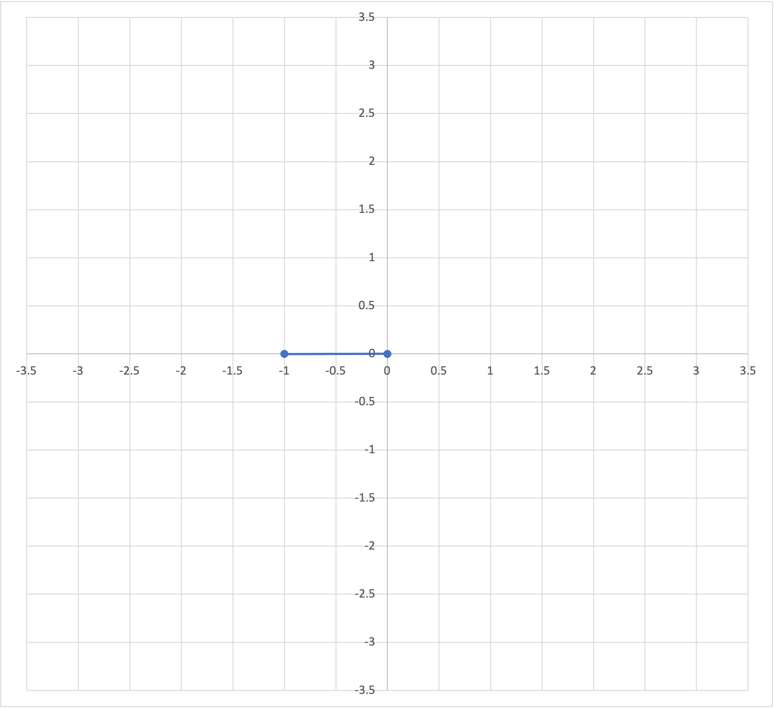
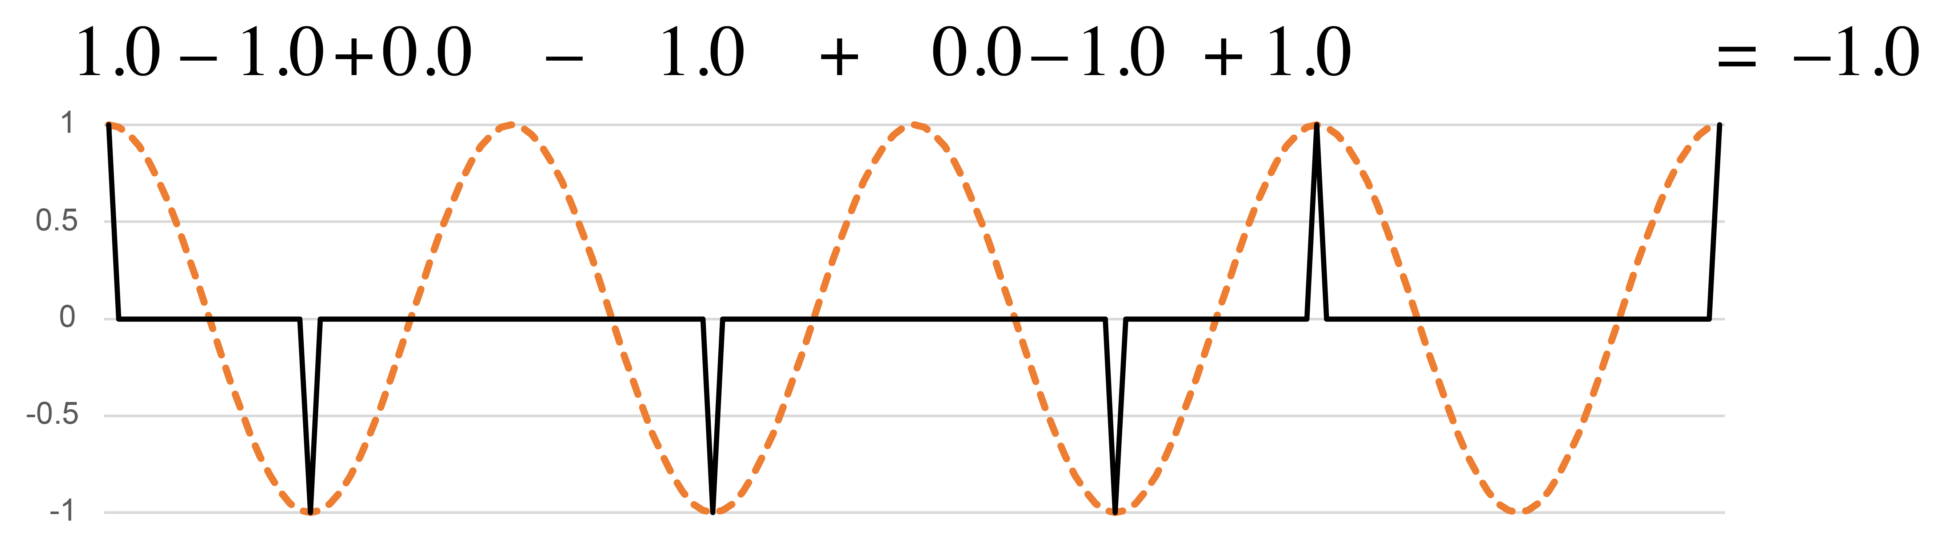
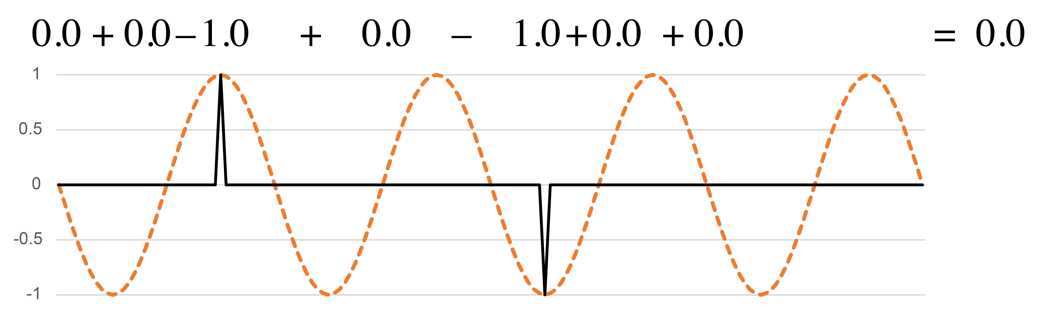
Sine and Cosine functions
Periodicities are two-dimensional.
On xy plane:
q periodicity
(cosine):
Before beat
Off beat
On beat
q periodicity
(–sine):
After beat
Frequency 4
Notes:
Let's have a look at how simple periodic functions act as interpretive filters. These two functions both have a wavelength that corresponds to the quarter note beat. I'll refer to that as the periodicity of the functions. I will also sometimes refer to the frequency of the function, which here is 4, meaning that it divides the full cycle by 4. The first function, the cosine has its peaks lined up with the beats, and valleys at the midway point of the beats. This rhythm has more onsets in the valleys, so when we multiply the rhythm by the cosine function, it sums to a negative value. The minus-sine function below is the same as the cosine shifted back by a quarter cycle. The peaks and valleys of this function line up with the zeros of the cosine function. They show if onsets happen more often before or after the beats.
The two resulting sums give a point in a two-dimensional space which tells us how the rhythm expresses this frequency. [Animation 1] Moving to the left in the space corresponds to more on-beat onsets, to the right more off-beat onsets. [Animation 2] Upward indicates more onsets ahead of beats, downward more onsets after the beats. [Animation 3] This version of the Bo Diddley rhythm is a little more off-beat, and is balanced between the two sides of the beat. The point in the 2-dimensional space shows this.

Slide 14
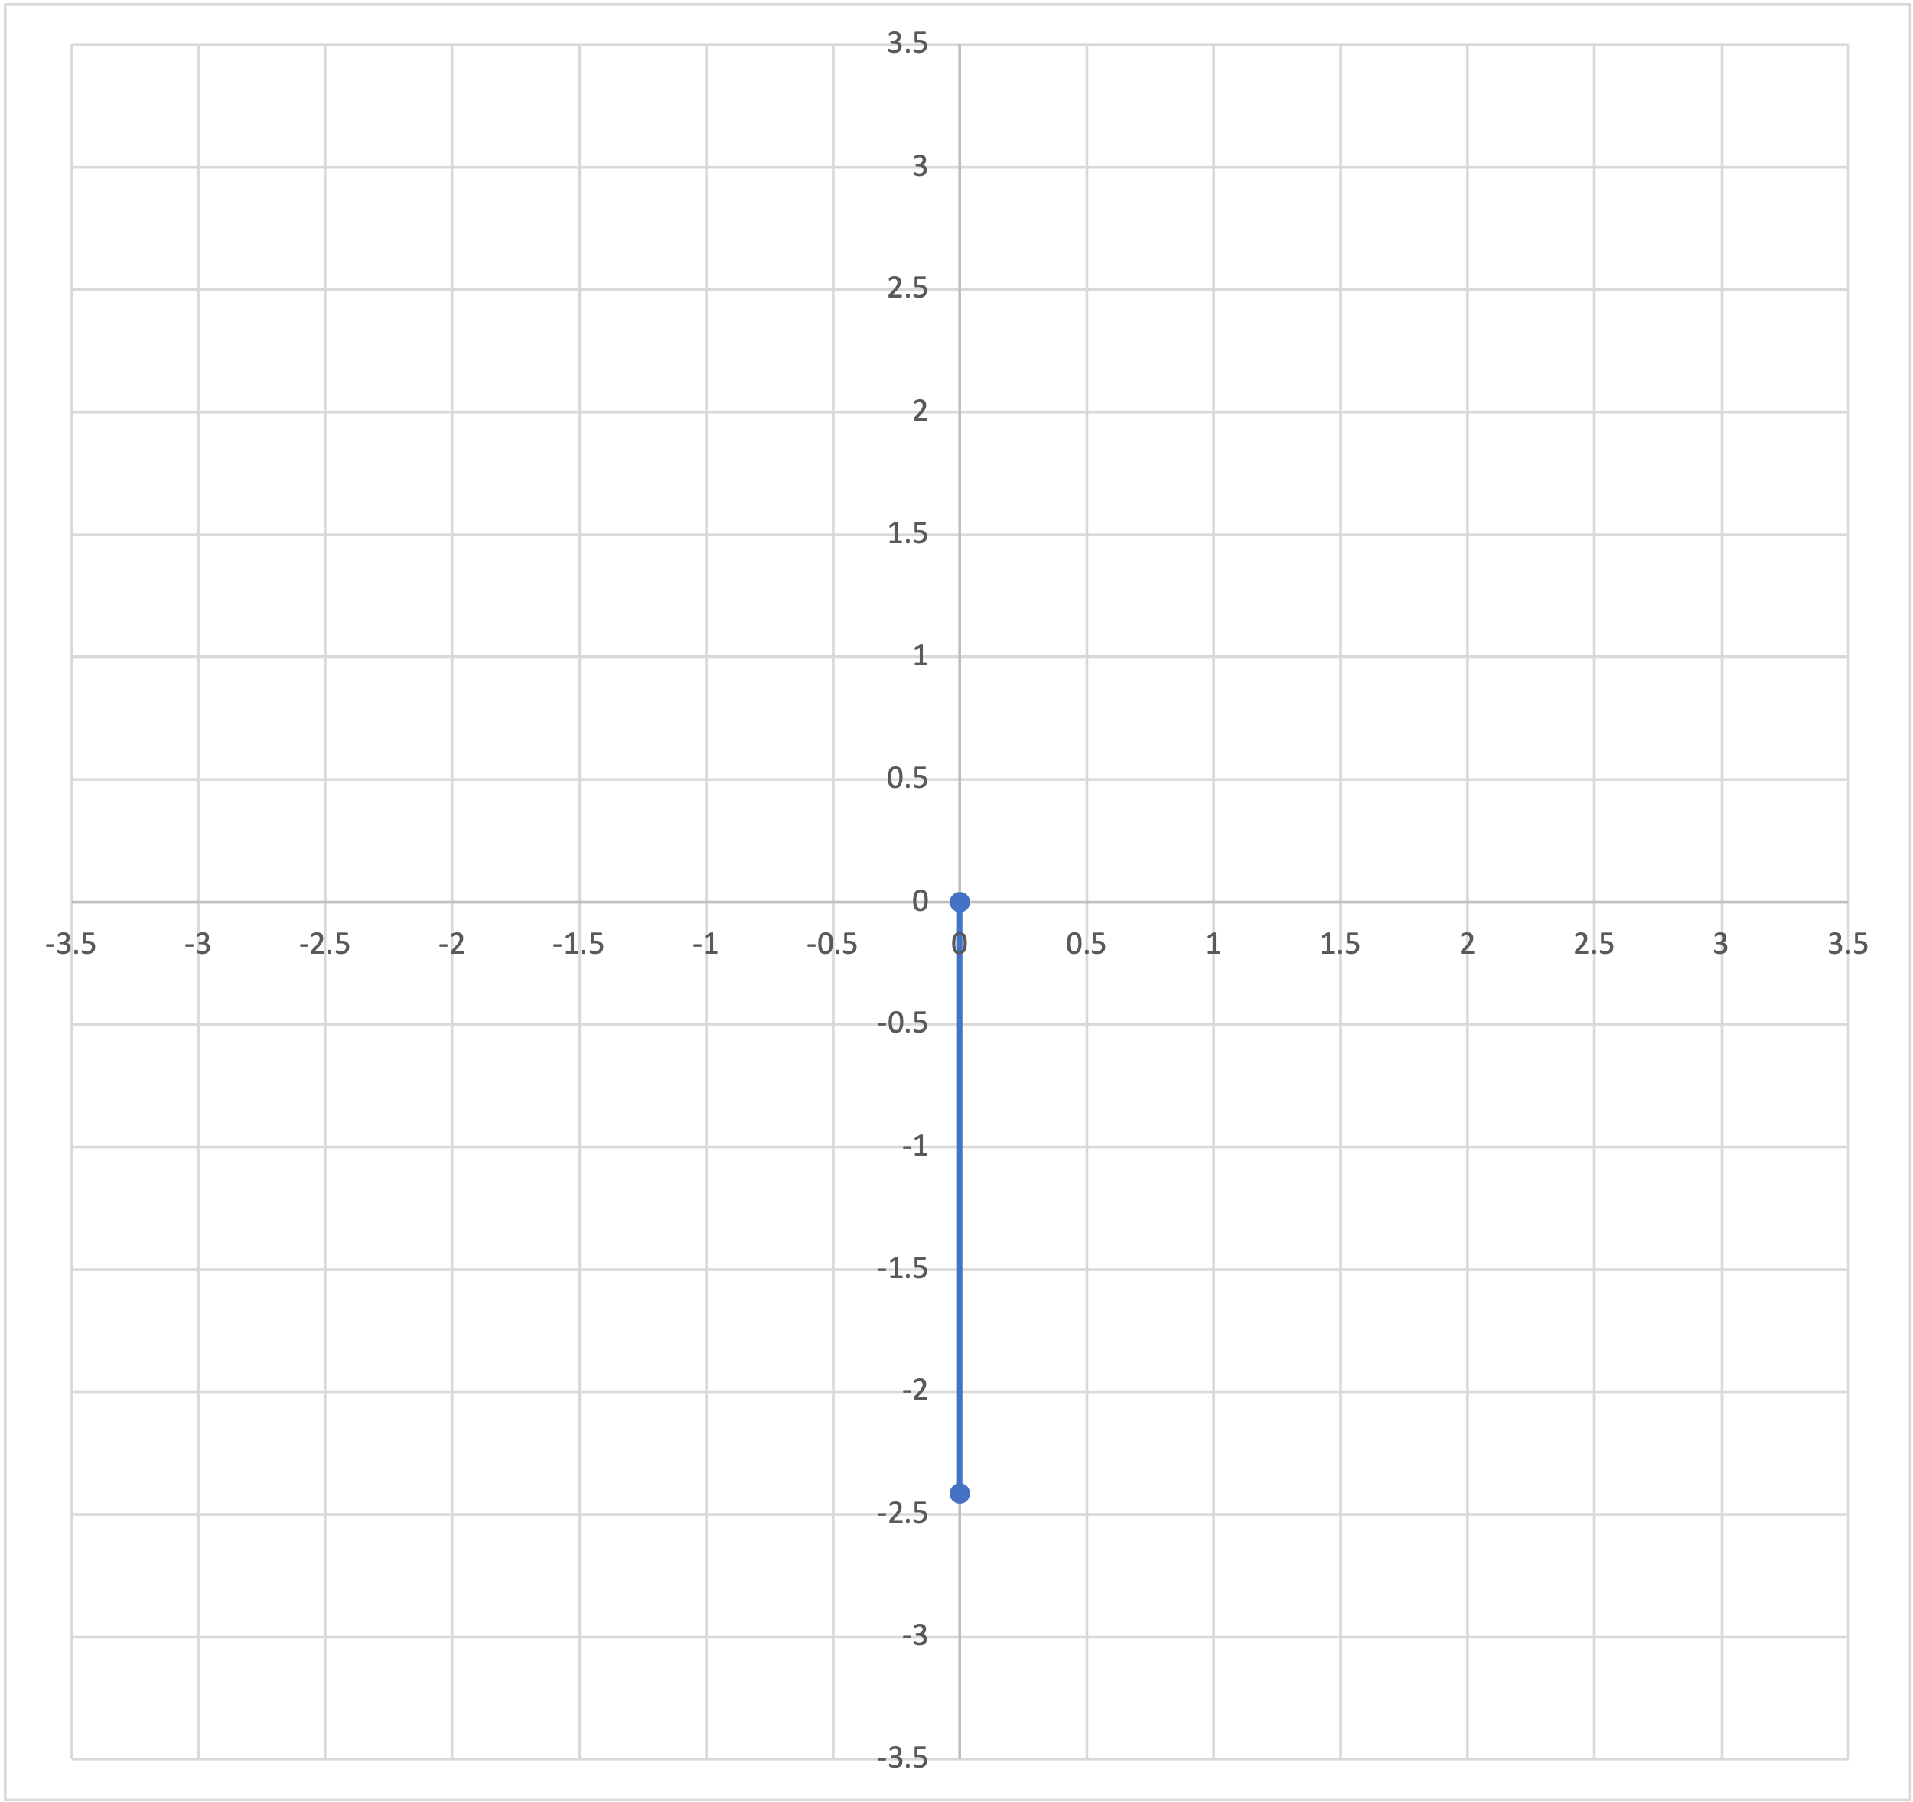
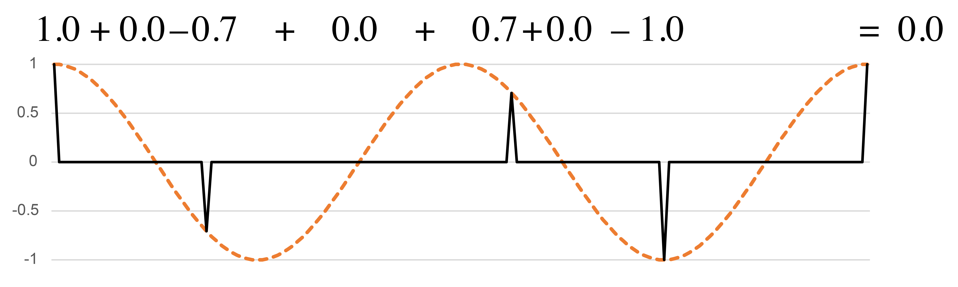
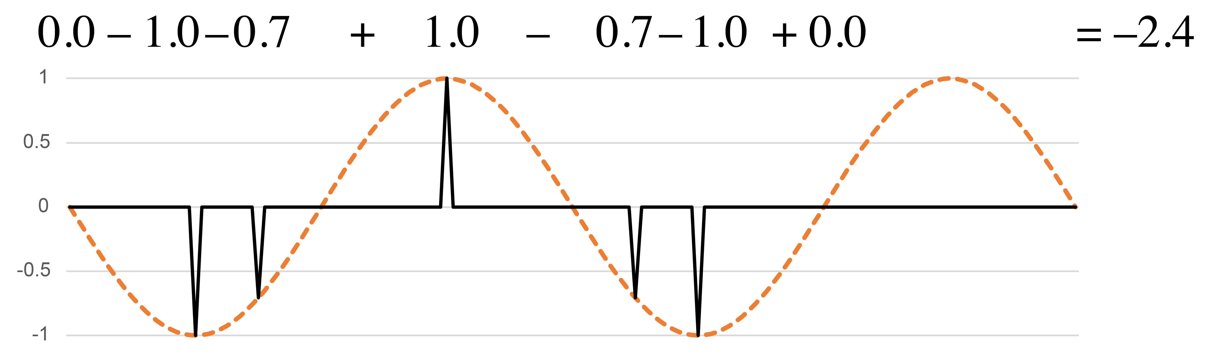
Sine and Cosine functions
Periodicities are two-dimensional.
On xy plane:
h periodicity
(cosine):
h periodicity
(–sine):
Frequency 2
Notes:
We can do the same thing for other periodicities. Here we consider frequency 2, or a half-note periodicity. The position of a rhythm in the space is totally independent of where it falls in the space for the quarter-note periodicity. A rhythm could be off-beat at one level and on-beat at the other. This rhythm gives zero on the cosine function, meaning it is balanced between strong and weak beats. But it strongly favors the zone after the strong beat to the zone before it, because the two double-strums, the sixteenth notes, both fall ahead of strong beats.

Slide 15
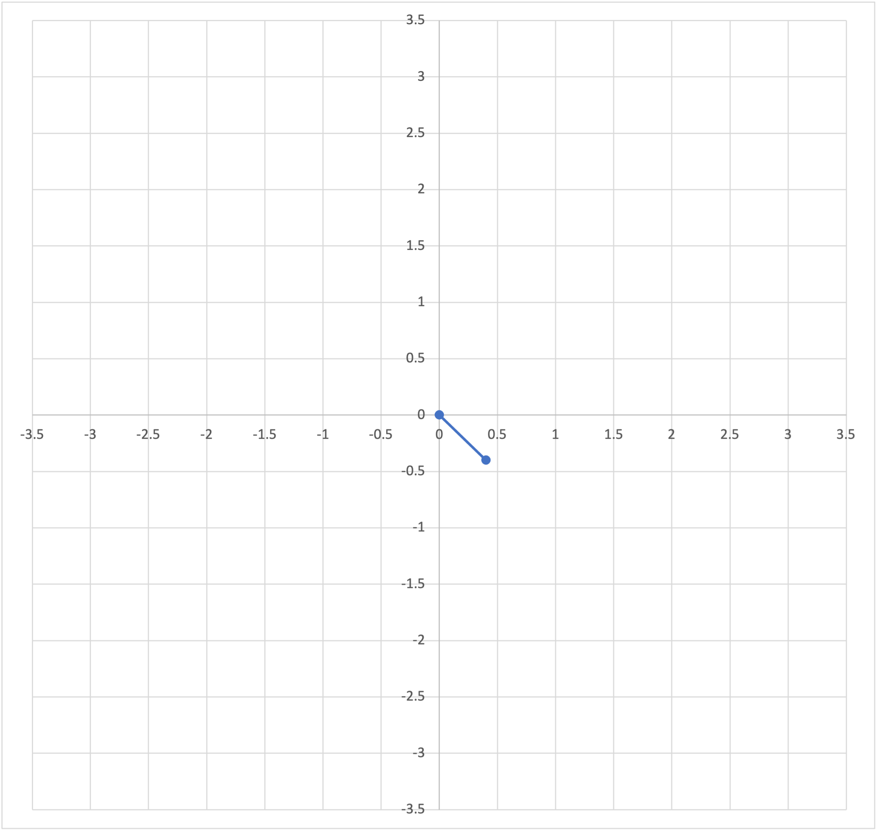
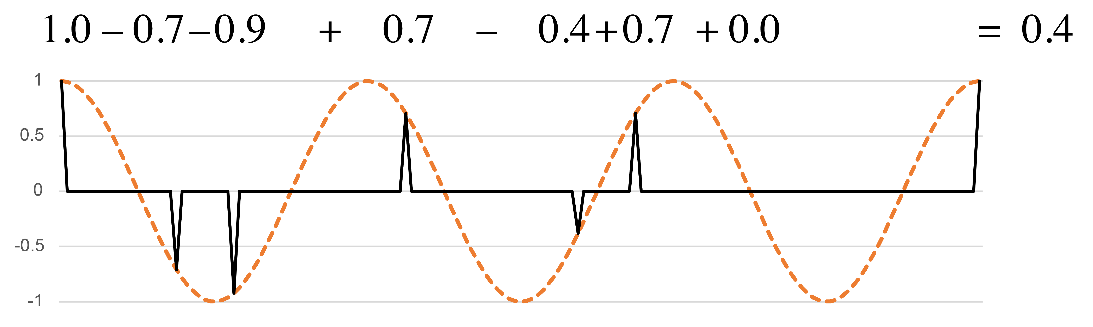
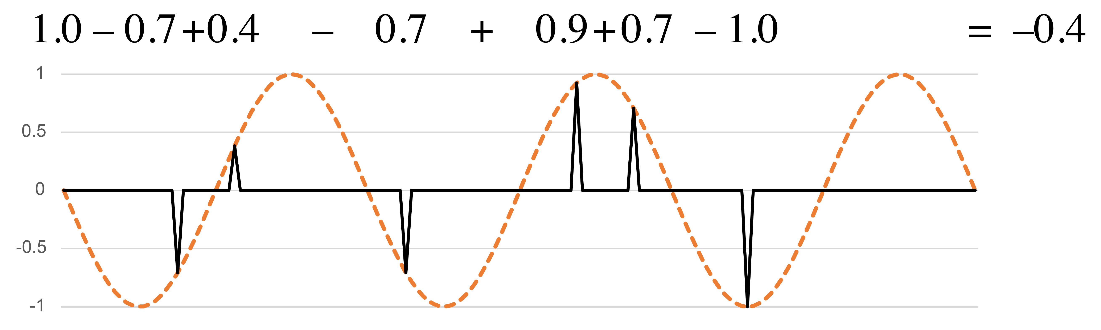
Sine and Cosine functions
Periodicities need not be integer multiples of the minimal duration.
On xy plane:
1⅓q periodicity
(cosine):
1⅓q periodicity
(–sine):
Frequency 3
Notes:
The two periodicities we just considered correspond to traditional metrical levels. There are periodicities for any possible division of the cycle, however. For example, we can divide the measure by three. The resulting periodicity is not an integer multiple of sixteenth notes. If a rhythm is limited to a sixteenth-note grid, it can get close to the peaks of this function, but not exactly coincide with them except at the downbeat. This rhythm is relatively balanced at this frequency. The closest approximation to the wavelength using sixteenth notes is an interval of 5 sixteenth notes, and that interval does not occur anywhere in the rhythm.

Slide 16
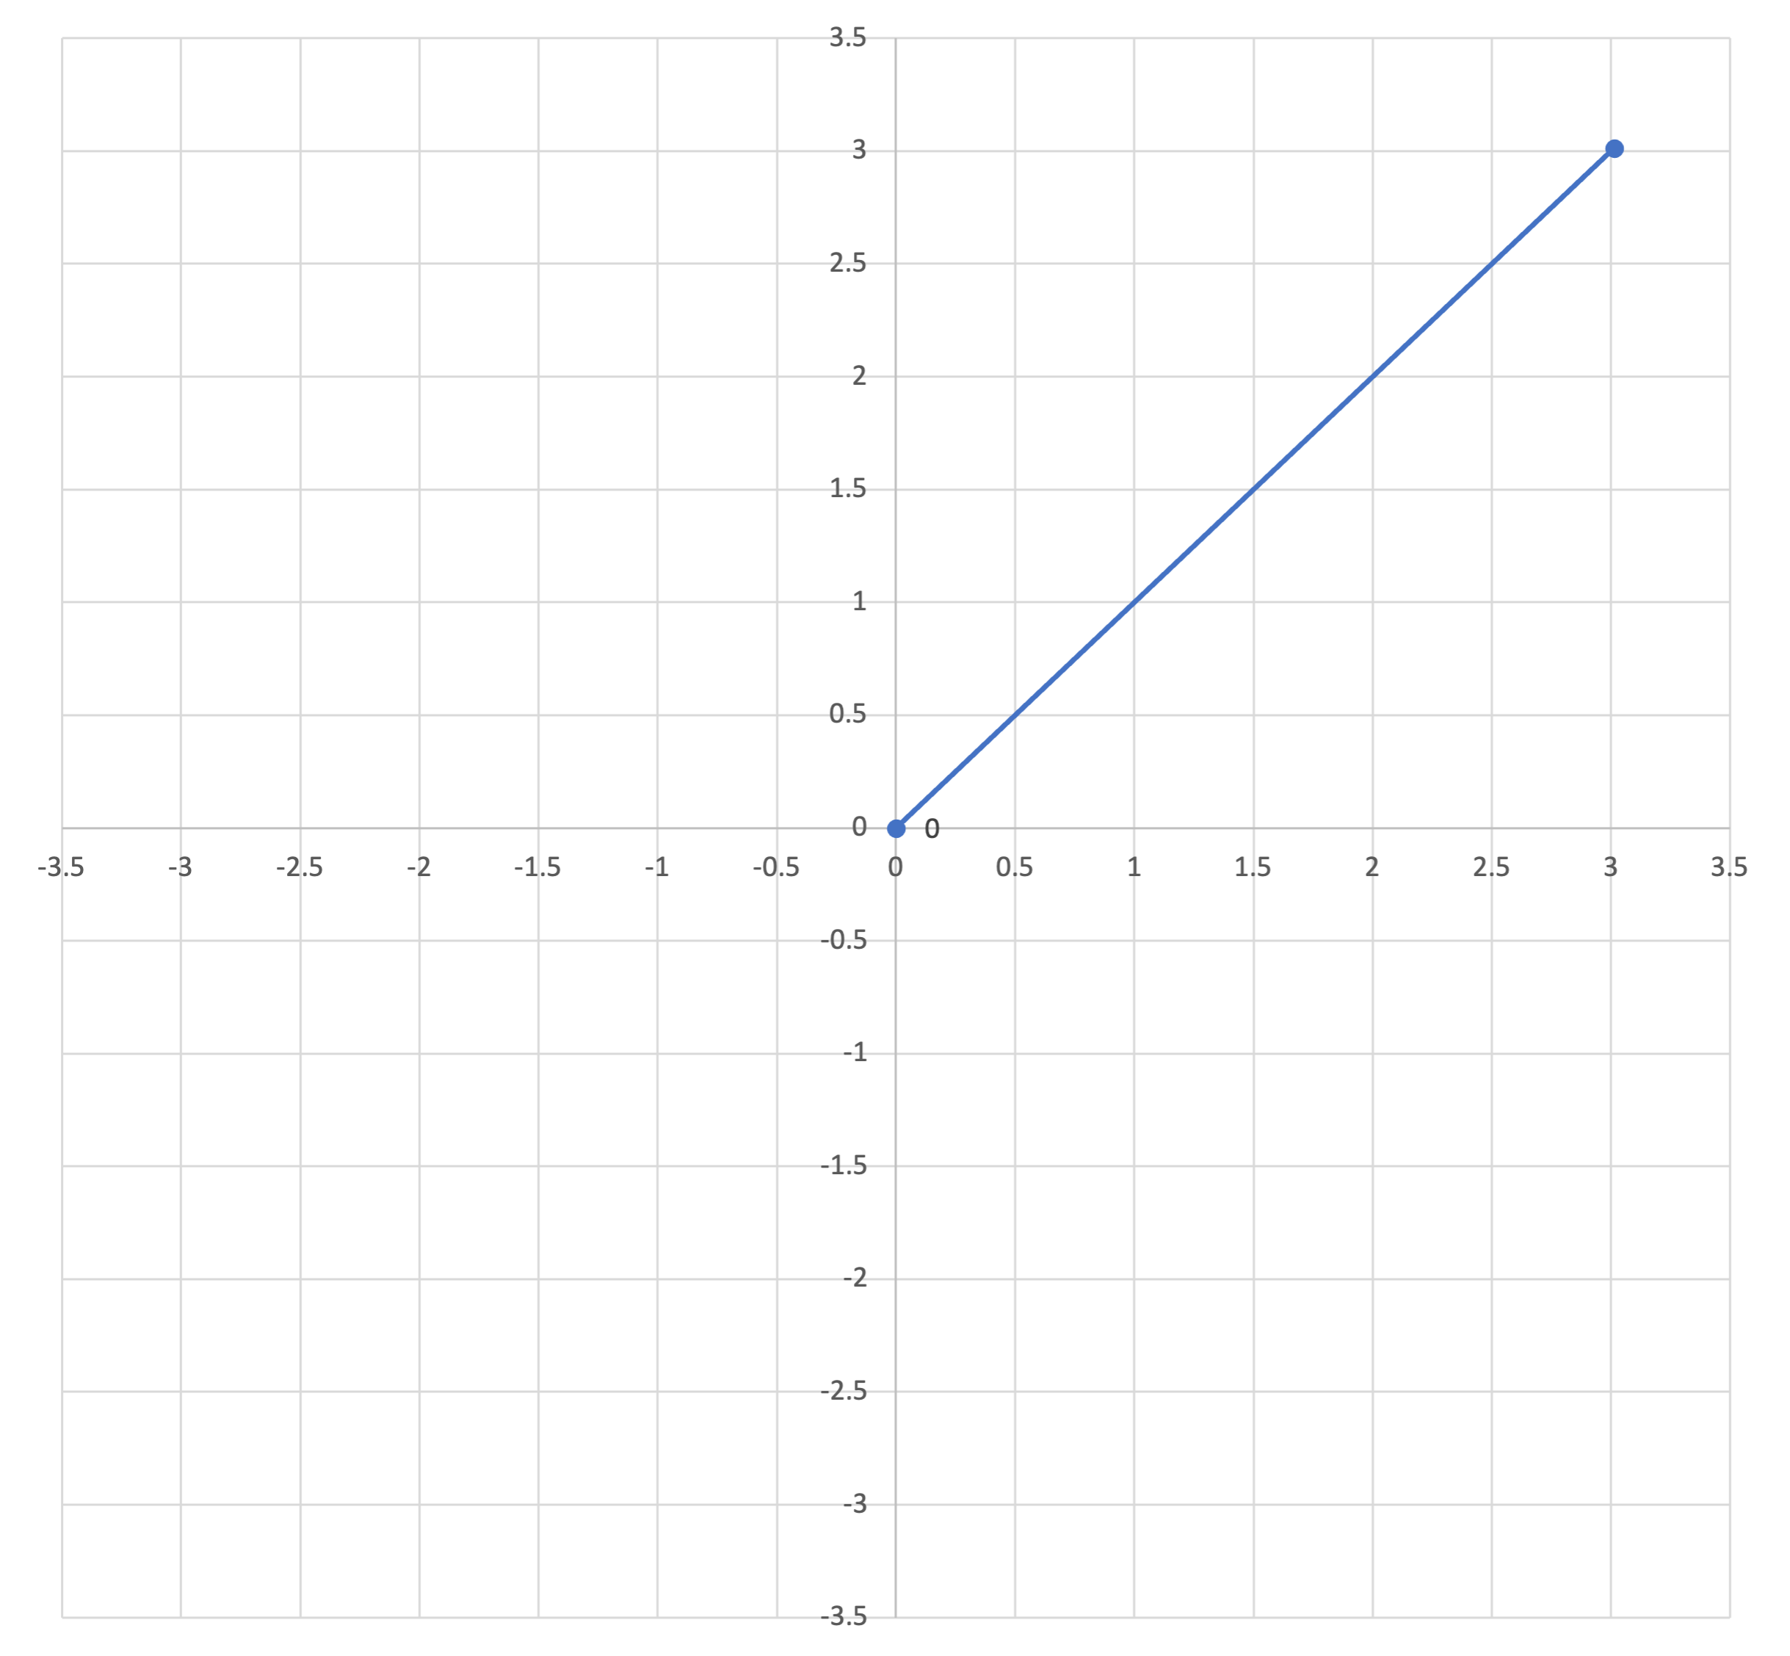
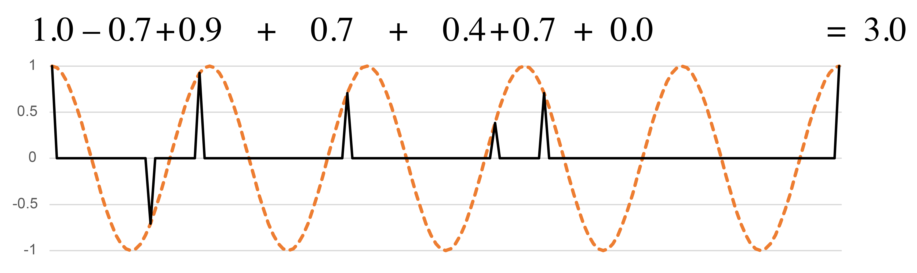
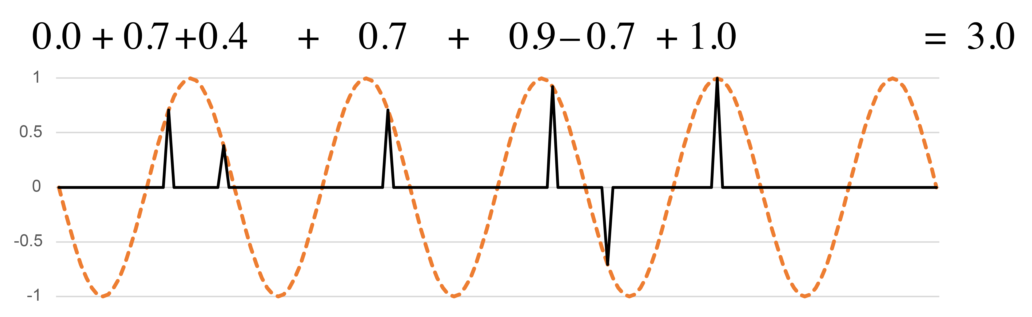
Sine and Cosine functions
Periodicities need not be integer multiples of the minimal duration.
On xy plane:
⅘q periodicity
(cosine):
⅘q periodicity
(–sine):
Frequency 5
Notes:
Here's another periodicity that doesn't line up with the sixteenth-note grid, a division of the measure by 5. The rhythm has a very strong profile on this periodicity. A lot of notes line up with the peaks of both the cosine and sine functions. These are at distances of 3 sixteenth notes from one another, or multiples of that. Three sixteenth notes is a best approximation to the wavelength of 4/5 quarter note. The corresponding point on the xy plane is far away from the origin and in the upper left quadrant.

Slide 17
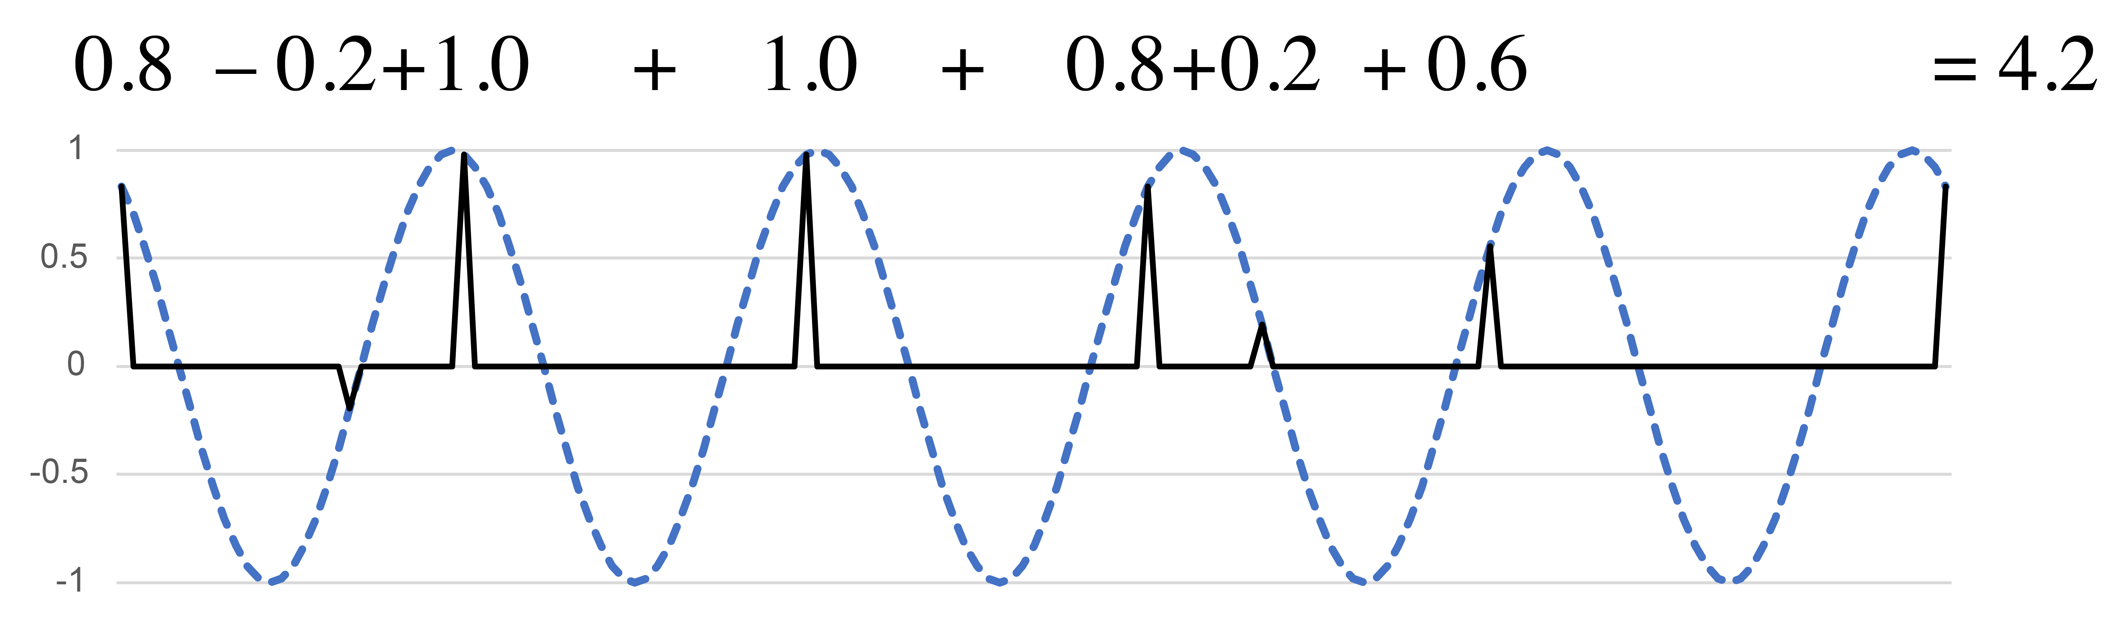
Phase and magnitude
Angle in 2-d space corresponds to the phase of the best-matching wave.
Length
Magnitude
Phase shift
Angle
Notes:
I located all of these rhythms on the xy plane using two simple periodic functions, but once we know where a point is in the space, we can express it with just a single simple periodic function, because a rotation in the xy-plane corresponds to a phase shift in the sine curve. Here, because the point is at a 45 degree angle from the positive x axis, shifting the sine curve back by one-eighth of a cycle gives a curve that aligns as well as possible with all of the onsets of the rhythm. [Animation 1] This is what we call the phase of the rhythm at that frequency. The way that a rhythm expresses each possible periodicity can thus be expressed using two numbers, a magnitude, giving the total weight of the rhythm at that periodicity [Animation 2], and a phase showing where it is oriented within the cycle.
These two-dimensional spaces are the first of two tools of rhythmic analysis that I want to share today. They give a complete description of the rhythm, but they have the drawback that we have to consider each possible periodicity one at a time. The other tool I will share summarizes all of the possible frequencies at once.

Slide 18
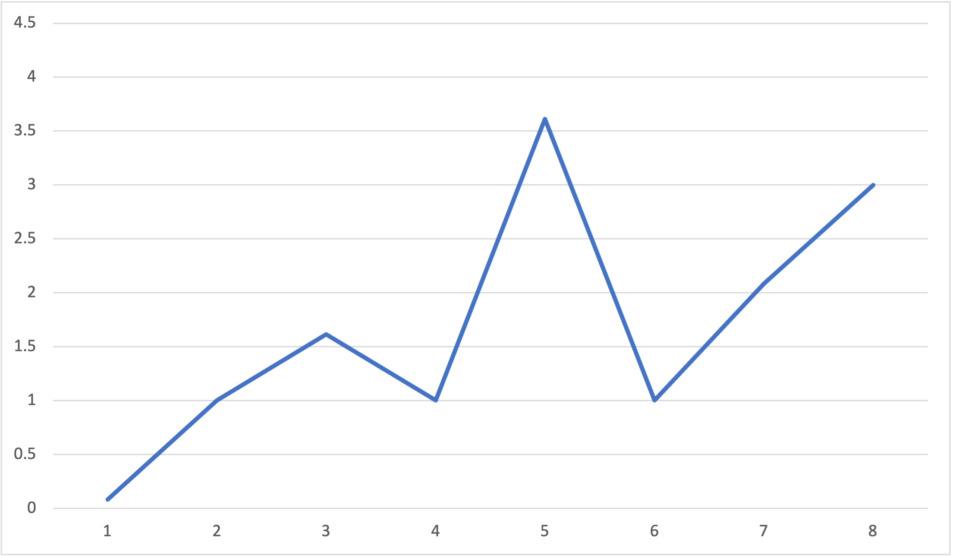
Rhythmic spectrum
The rhythmic spectrum shows the magnitudes at all possible frequencies
The strongest frequency (periodicity w/5) shows that
clave is close to 5 equally spaced onsets
Rhythmic spectrum for the clave rhythm:
e. e. q e q
Mostly on-beat at e level
Embedded tresillo (w/3 periodicity)
Magnitude
Low w periodicity:
Relatively even distribution of onsets
Mix of on- and off-beat at q level
Frequency (/16e)
N.B.: Periodicities are the reciprocals of frequencies
Notes:
This is called the rhythmic spectrum. It is a function that shows the magnitude of the rhythm at each possible frequency. Frequency is on the x axis, and magnitude on the y axis. All of the rhythms I'll consider in this paper are cyclic, meaning they can be understood to repeat indefinitely. Most of them will also be restricted to some isochronous grid within that cycle. For instance, the clave rhythm here has onsets that all fall on a sixteenth-note grid. Since there are sixteen possible positions in the cycle, the number of ways to divide that cycle is limited to 8, half the length of the cycle. If we were to continue the spectrum with frequencies larger than 8, then we would simply repeat information that is already shown. However, I have just argued that it is important to have a theory that doesn't limit us to isochronous grids like this, and allows us to imagine what happens when we make microrhythmic variations in the rhythm. It's also possible to make spectra for these, the difference being that there is not necessarily a limit on how high of frequencies we could consider. We can extend the spectrum as far as we want to the right without duplicating information.
Let's explore what we can learn from the spectrum of the clave rhythm shown here. [Animation 1] The largest frequency is the fifth. This indicates that the five onsets of the clave rhythm are relatively evenly spaced.
[Animation 2] The next largest frequency is 8, which corresponds to the eighth-note periodicity. This is because the onsets of the clave mostly fall on the eighth-note grid.
[Animation 3] On the other hand, onsets fall in a variety of places in relation to the quarter-note grid, so frequency 4, which corresponds to quarter-note periodicity, is small.
[Animation 4] The smallest coefficient is the first, showing that the rhythm has a balanced distribution throughout the entire cycle.
[Animation 5] Finally, there is another smaller peak at frequency 3. This comes from the embedded tresillo rhythm in the first, third, and fifth onsets. The addition of the other two onsets weakens frequency 3, but doesn't eliminate it completely.

Slide 19
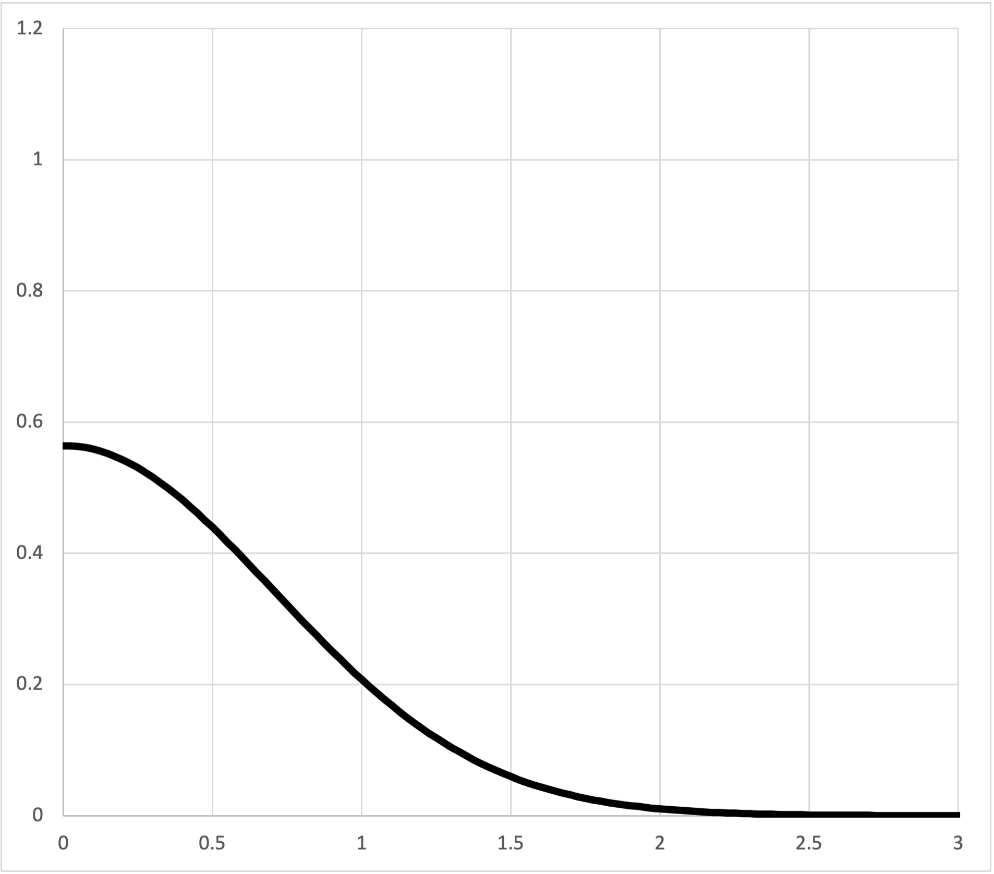
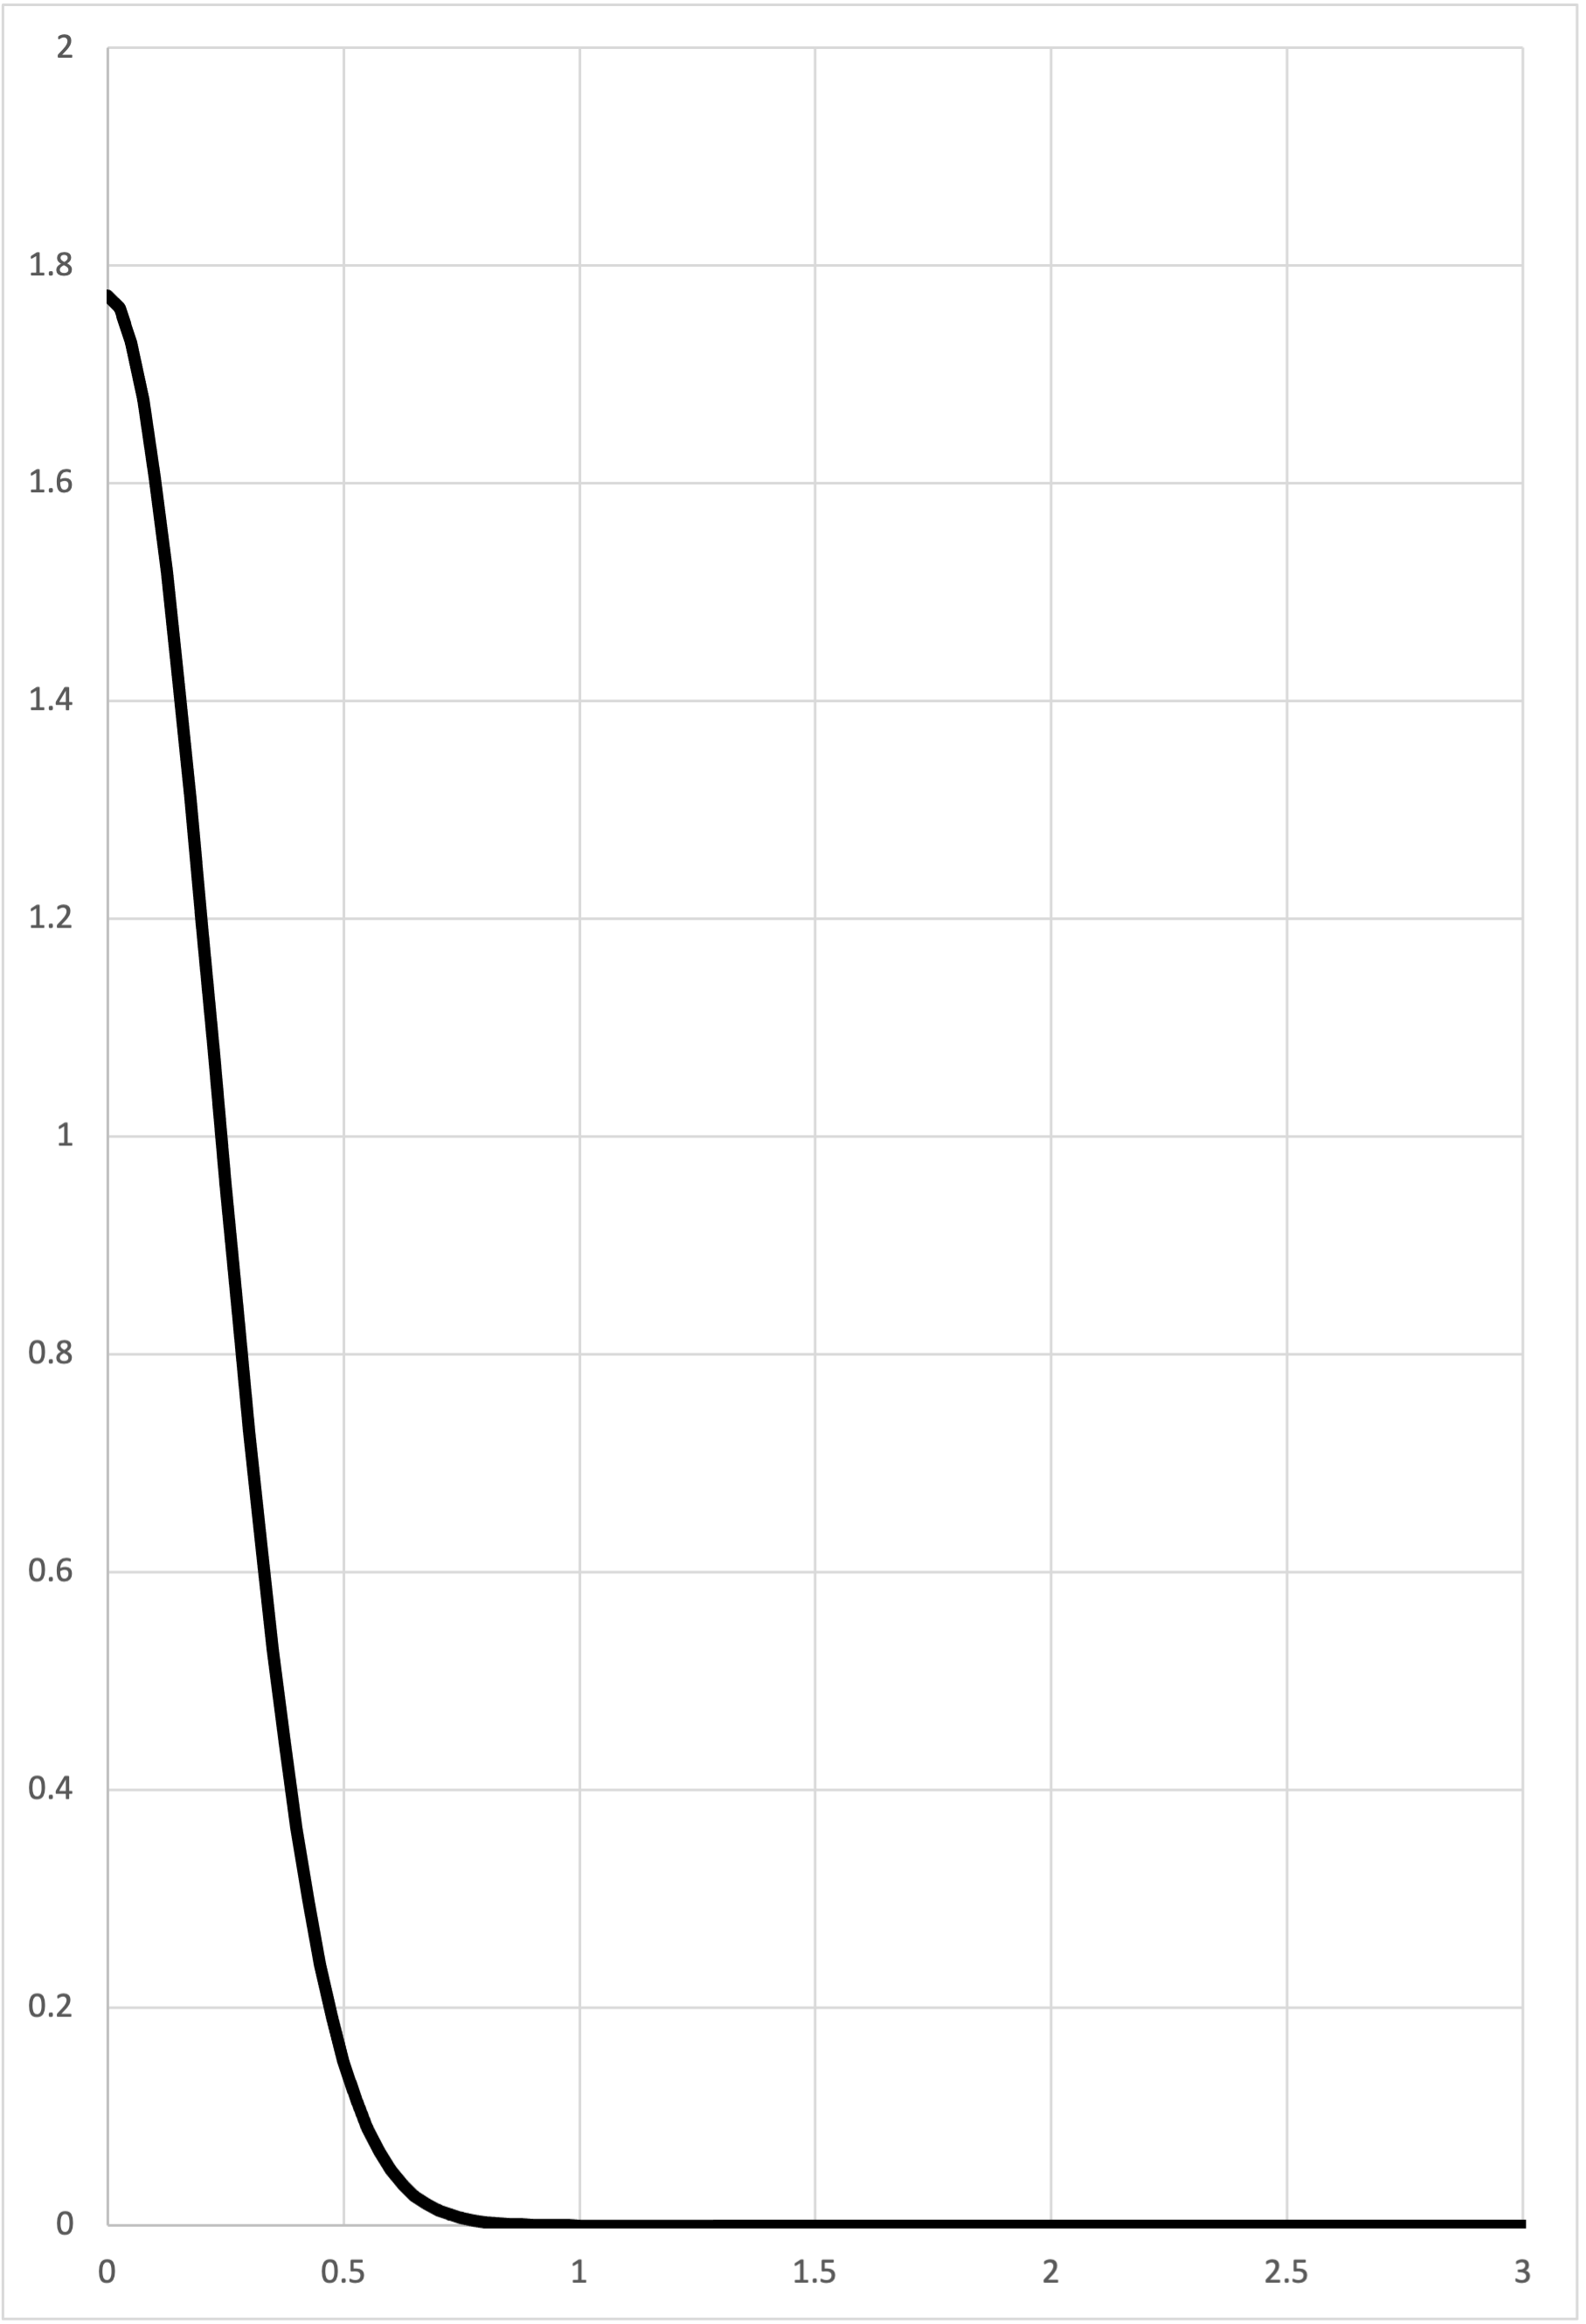
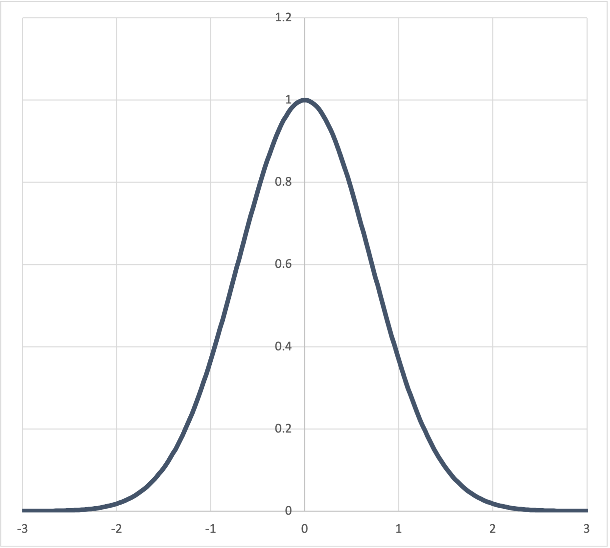
Beat bins
The spectrum of a Gaussian function is another Gaussian function with inverse width
⇒
Time
Frequency
⇒
This is Heisenberg uncertainty for rhythm:
More precision in time ⇔ Less precision in frequency
More precision in frequency ⇔ Less precision in time
Time
Frequency
Notes:
Now to return to the topic of beat bins briefly. I suggested before that we could model beat bins with Gaussian functions. We could also model onsets themselves with Gaussian functions, in recognition of the fact that we can never pinpoint their location with 100% precision. Fortunately there's simple way to represent a Gaussian function with simple periodic functions. The spectrum of a Gaussian function is itself a Gaussian function. As we narrow the temporal curve the spectral curve gets wider and vice versa, meaning that the more precisely we locate events in time the flatter the frequency curve gets and the more high frequencies we can take into account. This is a statement of the Heisenberg uncertainty principle, which, although it comes from particle physics, is actually a mathematical fact about the relationship between time and frequency.

Slide 20
Maximal Evenness
Notes:
In the next part of the talk I would like to explore the phenomenon of rhythmic maximal evenness and use the tools I've just described to explain why it is an important and common musical feature.

Slide 21
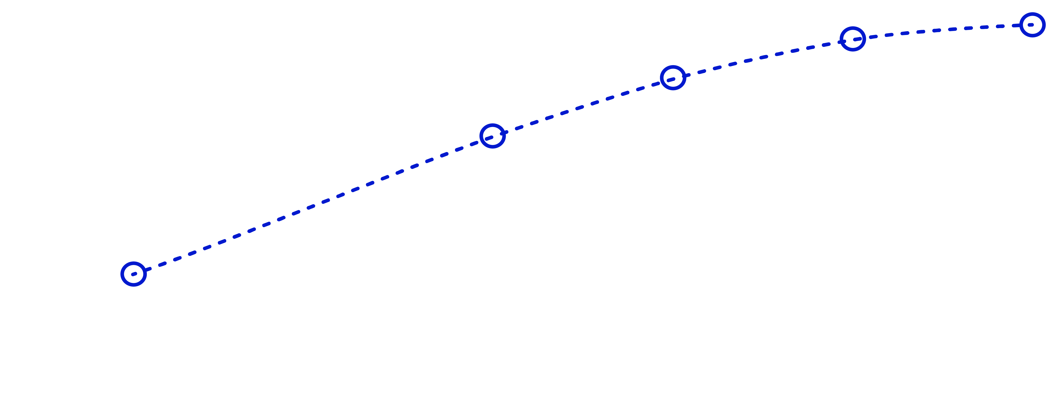
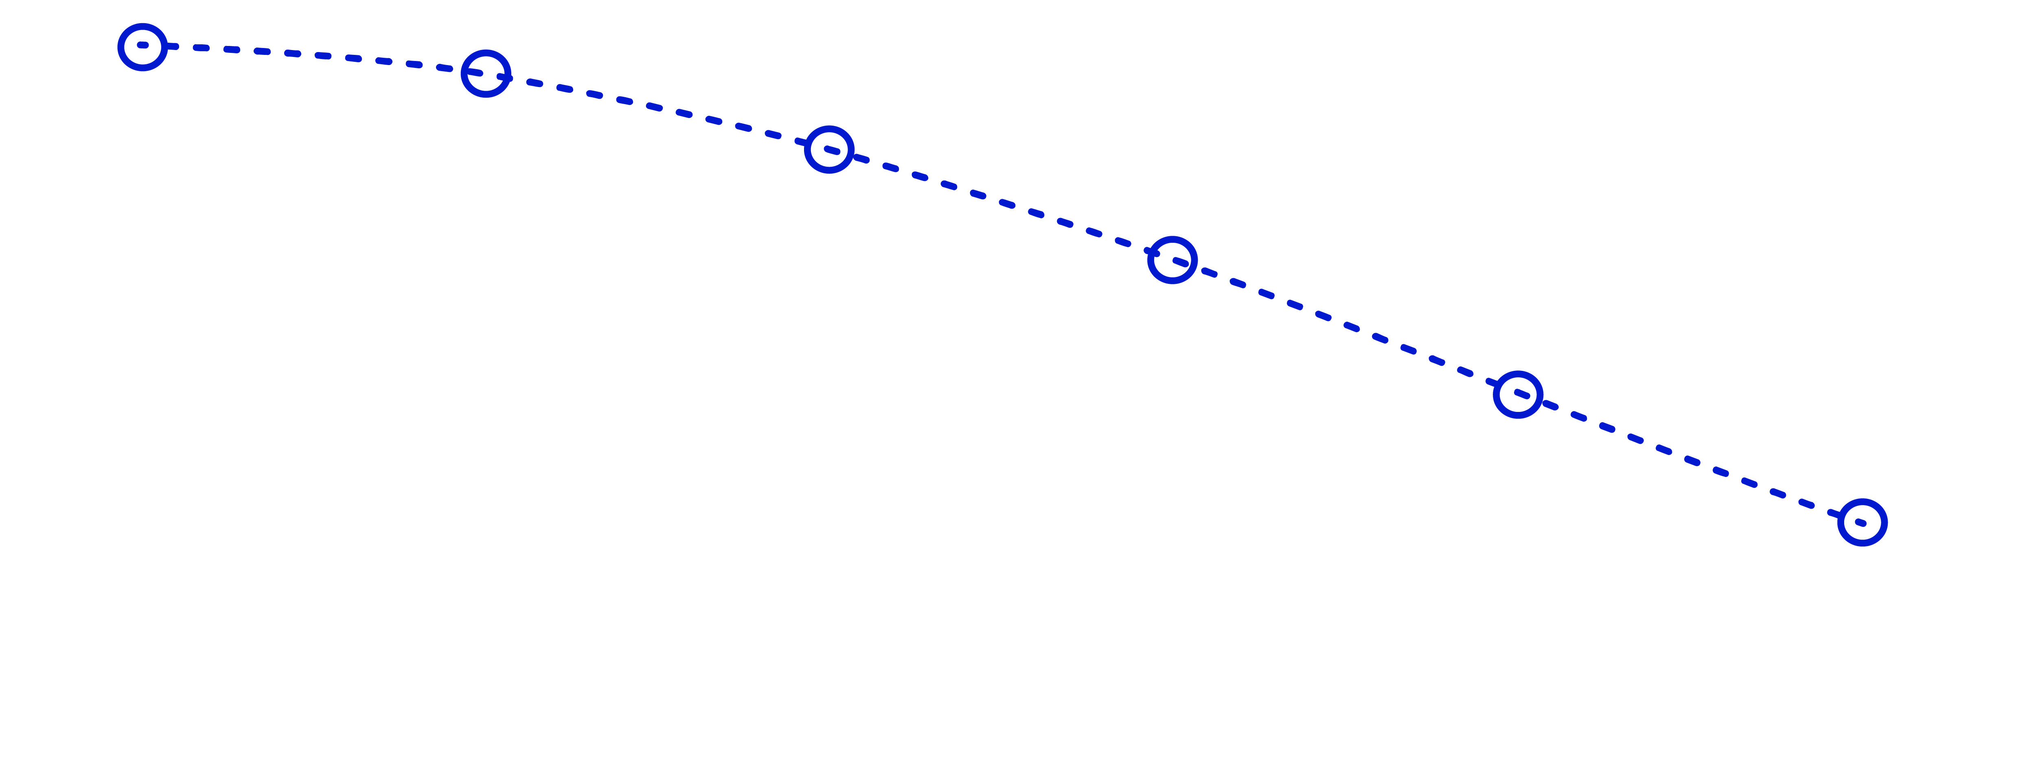
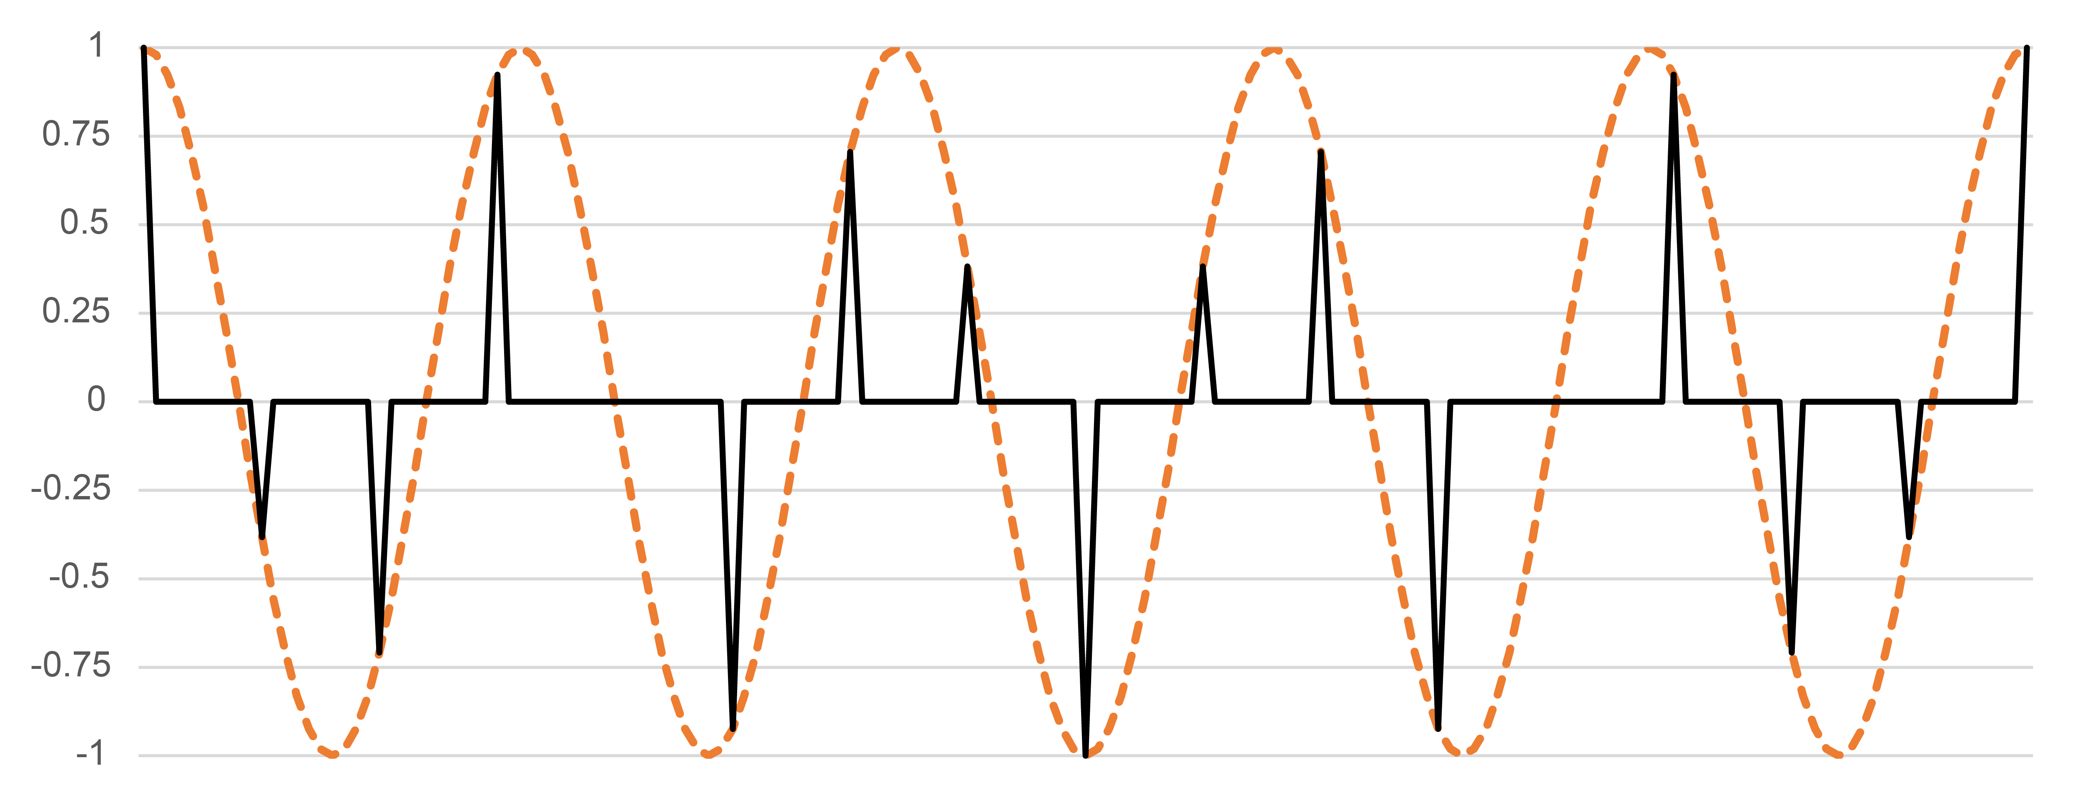
Discretizing a periodic function
What happens when we sample a sine function along a discrete grid with a different period?
3x = closest x-grid approximation to freq.-5 peak
Intervals are ordered by multiples of 3x
Ascending or descending
Freq.-5 periodic function sampled on 16th-note grid
Notes:
Suppose we are interested in rhythms that express a certain frequency as strongly as possible, but we are also limited to some isochronous grid. If the size of the rhythm does not evenly divide the frequency, then it is not possible to align the onsets precisely at the peaks of the curve. For instance here we have a sixteen unit grid and a frequency of 5.
[Animation 1] The best we can do is find the multiple of a sixteenth note that gives the best approximation to some multiple of the periodicity. Here, 3 sixteenth notes is close to a fifth of the measure.
[Animation 2] As we add more notes the onsets get further away from peaks of the function.
[Animation 3] And the same thing happens in the opposite direction.

Slide 22

Generated and maximally even rhythms
Generated rhythms maximize the corresponding frequency.
They are prototypes of the corresponding rhythmic quality.
Maximally Even rhythms are a special case of generated rhythms
with exactly one onset for each peak of the periodic function.
Notes:
This means that generated rhythms, ones that are made by repeating a single durational interval, give the largest possible values for that frequency. Maximally even rhythms are a type of generated rhythm, specifically one that has exactly one onset for each peak of the function.

Slide 23





Generated and maximally even rhythms
Example: Tresillo (3-in-8) and Cinquillo (5-in-8)
Complement
Rotate
Complementation and rotation affect phases only
Notes:
A lot of very common and very important rhythms are maximally even. The 3-in-8 maximally even rhythm, commonly known as the tresillo, is ubiquitous in Latin music, American popular music, and elsewhere. The complement of a maximally rhythm is also maximally even, and the larger maximally even rhythm always contains the smaller one, so we can think of it as an extension. The complement of the tresillo is known as the cinquillo and is also a common rhythm in many types of music.

Slide 24




Generated and maximally even rhythms
Example: Standard Pattern (7-in-12 and 5-in-12)
Rotated
complement
Notes:
Another important maximally even rhythm is the standard pattern, which occurs as a timeline in many African and African-diasporic musics. The standard pattern is 7-in-12 maximally even and is often referred to as the diatonic rhythm, because it's the rhythmic analogue of a diatonic scale. The 5-in-12 complement substitutes for it in many contexts.

Slide 25


Generated and maximally even rhythms
Example: Samba Timeline (9-in-16) (from Stover forthcoming)
“Alvorada” by Cartola
Notes:
The two examples we've just considered are maximally even with one more or one fewer onset in the rhythm than half the size of the metric grid. The three onsets of the tresillo is one less than 4, which is half of 8, and the 7 onsets of the standard pattern is one more than 6, which is half of 12. In this example from the Samba repertoire, which I'm borrowing from Chris Stover's forthcoming book on timeline music, the timeline is maximally even with 9 out of 16 onsets, also one more or less than half the total. The song is Alvorada by the important Samba composer and singer Cartola. The tamborim, on the second line, plays the timeline.
[Play example]

Slide 26

Generated and maximally even rhythms
Example: Samba Timeline (9-in-16) (from Stover forthcoming)
Stover’s prototype:
9-in-16 ME
2 2 1 2 2 2 1 2 2
Complements
Performed rhythm:
7-in-16 ME
2 3 2 2 2 3 2
Notes:
Stover gives an idealized prototype rhythm in addition to transcribing the player's variations in the recording. The prototype is 9-in-16 maximally even, while the performed rhythm in the initial bars is a 7-in-16 maximally even subset.

Slide 27




Generated and maximally even rhythms
Example: Rudresh Mahanthappa, Waltz for the Anatomically Correct (5-in-13)
Mod 26
complement
8-in-13 ME
Mod 13
complement
5-in-13 ME
Notes:
Here's a more complex example from contemporary jazz composer and saxophonist Rudresh Mahanthappa, in an unusual 13-beat meter. The rhythm of the bass fills all the off-beat eighth-notes, but omits one or two on-beat onsets per chord. The omitted onsets constitute a 8-in-13 ME pattern, where we embed the rhythm in the quarter-note grid instead of the eighth-note grid. The 5-in-13 ME rhythm is the complement of this, and that's the harmonic rhythm of this section of the tune.
[Play example]

Slide 28

Spectrum of a maximally even rhythm
Maximally even rhythms emphasize a single frequency
High value at principal periodicity (w./5)
Rhythmic spectrum for the standard pattern:
q q eq q q e
Or its complement:
q q q. q q.
(w./4 = q. )
(w./6 = q )
Especially low value at 1
Low values at nearby periodicities
Magnitude
Frequency (/12e)
N.B.: Periodicities are the reciprocals of frequencies
Notes:
Maximally even rhythms all have similar spectra, with one prominent spike at the frequency corresponding to the number of onsets. All of the other values are low, especially coefficient 1.

Slide 29





Near-ME rhythms
Rhythms close to ME also have large values at that frequency
12-cycle Son clave:
ME 5-in-16
(Bossa Nova)
(half spectra)
Full (2-sided) spectrum
Son Clave,
near-ME
Notes:
The maximally even rhythms are a small and special group, so of course many rhythms we encounter are not maximally even. Because they act as prototypes of a particular rhythmic quality, however, they act as important reference points. Other rhythms that are similar to maximally even ones will also express that quality. For instance, on the left here is a 5-in-12 maximally even rhythm. I've extended the spectrum to show the mirror symmetry of the spectrum up to 12. Normally I will cut this off halfway to avoid the redundancy, as I have with the other spectra on this slide.
The 5-in-12 rhythm is common in different musics in Africa and also acts as a clave timeline in some folkloric Cuban styles. When the governing meter changes so that we have a 16-element grid instead of 12, the usual way to adjust the clave is the familiar Son clave on the bottom right. This is not maximally even, but because it is similar to maximally even rhythms, it also has a prominent peak in its spectrum at 5. The actual 5-in-16 maximally even rhythm is one that acts as a timeline in Bossa Nova music, shown here on the upper right. The bossa nova rhythm has a larger spectral peak at 5 than the standard clave, and lacks the subsidiary peaks that we find in the clave spectrum.

Slide 30





Near-ME rhythms
Subsets of ME rhythms also have large values at that frequency
12-cycle Son/
Rumba clave:
ME 7-in-16
Full (2-sided)
spectrum
Subset
(half spectra)
Rumba clave
Son Clave
Notes:
The reason I'm showing the full 2-sided spectrum for the 12-cycle clave is to draw our attention to the fact that the peak at 5 is also mirrored by a peak at 7. This is a given when we're restricted to a 12-place grid, but versions of the clave rhythm also exist in a 16-place grid. In that context frequencies 5 and 7 are decoupled, and it is not obvious whether we want to preserve the peak at 5 or 7. Whether we are treating the rhythm as an approximation of 5 equally spaced onsets, or as a subset of 7 approximately equally spaced onsets. Son clave keep the peak at 5 and flattens out the peak at 7 so that it becomes more of a peak at 8, a weighting of the eighth-note grid. There is another type of 4/4 clave in Cuban music called the rumba clave. This one is a subset of a 7-in-16 ME rhythm. The ME rhythm itself has only the one peak at 7, but rumba clave adds a peak at 5, so that it preserves both of the peaks that occur in the 12-cycle clave.

Slide 31


ME and near-ME rhythms on 2-d. planes
The maximally even rhythms strongly favor one division or the other.
Freq.-5 space
Freq.-7 space
Notes:
Comparing all of these in the 2-dimensional spaces for frequencies 5 and 7, we see how the maximally even rhythms favor one frequency over the other. Remember that the distance from the origin is the magnitude at that frequency.

Slide 32
ME and near-ME rhythms on 2-d. planes
The shift from 12-cycle to 16-cycle moves onsets forward.
Clave rhythms that move between duple and triple feel occupy these intermediate spaces.
Freq.-5 space
Freq.-7 space
Notes:
The two 12-cycle rhythms are related by rotation, so they differ only in phase. In the frequency-5 space, the shift from 12 to 16 also acts like a phase shift. It's a clockwise phase shift because it involves moving onsets back in time. In the frequency-7 space, the shift is angled more towards the origin for son clave, which means it loses magnitude in addition to the phase shift.

Slide 33





Back to Bo Diddley . . .
Frequency 5
3⅕x periodicity
Frequency 8
e periodicity
4 emphasized
onsets
Full 7-onset
rhythm
Added onsets:
Frequency 3
5⅓x periodicity
• Reduce frequency 3
Clave
• Enhance frequency 5
• Preserve balance at q level
Tresillo
• Preserve weighting at e grid
Frequency 4
q periodicity
Rhythmic spectra
Notes:
Now let's come back to the Bo Diddley rhythm with the tools I've just described. Here's the spectrum for the tresillo rhythm.
[Animation 1] and the four note that Diddley emphasizes. These both have mirror symmtery because they are fully on the eighth-note grid.
[Animation 2] Here's he five-note clave.
[Animation 3] and the full 7-onset rhythm.
[Animation 4] First we see that the strength of frequency 3, the main peak of the tresillo rhythm, gradually diminishes as we add notes.
[Animation 5] On the other hand the peak at frequency 5 does the opposite and gets more intense.
[Animation 6] The peaks corresponding to metrical qualities are relatively unaffected. Frequency 4, the quarter-note periodicity, is relatively weak,
[Animation 7] And the eighth-note periodicity remains relatively strong.

Slide 34



Back to Bo Diddley . . .
Frequency 5:
Full 7-onset rhythm agrees with tresillo in phase these spaces (unlike clave).
Microrhythmic variation induces additional phase shift.
Frequency 3:
Frequency 4:
Notes:
In the frequency 3 and 5 spaces, to the left and right, the full 7-onset rhythm does something interesting which is to shift the phase of these frequencies back to where it was in the tresillo rhythm, where the four or five emphasized notes have a different phase. However we can also consider the microrhythmic variations we noticed in the audio signal earlier, which induce another phase shift. In the frequency-5 space they also increase the magnitude.

Slide 35
Flow in Jazz, Old and New:
Donald Byrd and Marquis Hill, “Fly Little Bird Fly”
Notes:
Now I would like to apply this to an interesting example of rhythmic transformation from the young jazz trumpeter Marquis Hill.

Slide 36




Flow in jazz: Byrd/Hill “Fly Little Bird Fly”
Donald Byrd’s “Fly Little Bird Fly” (1967) has a distinctive melodic rhythm in the head.
Conventional notation:
With triplet swung eighths:
Alternate triplet rhythm:
Approximately as measured
from the studio recording:
Notes:
On his 2017 album he covers a tune from one of his heros, Donald Byrd, called “Fly Little Bird Fly.” Here's the way that Byrd played the head of the tune. At the top is how it would conventionally be notated, but it's supposed to be played with a swing feel which we could model with triplet, as in the second example. In that context, though, you could also play the end the first measure as a triplet division of the half-note, and that approximately what Byrd does. However, when I measure the onsets from the studio recording, I find that he plays the second measure closer to straight eighths. Here's the studio recording. [Sound]

Slide 37

Flow in jazz: Byrd/Hill “Fly Little Bird Fly”
Marquis Hill’s version (2016) puts the whole tune in 7/4.
Marquis Hill on Donald Byrd:
“Just talking about the similarities in the music, definitely the groove aspect. Even his bebop, straight-ahead stuff of that era still had that aspect of groove. That essence was from where this music comes. And I try to capture that in my music—even my more hip-hop or funky stuff to my more swinging jazz stuff. It’s all about capturing that feeling and being able to transfer it to people.
Byrd:
or
Hill:
Jazz Times Oct. 24, 2017
Notes:
Hill changes the metrical context of the tune entirely, establishing a 7-4 grove, and playing it with a notably smaller set of basic onset-to-onset durations. [Sound] It's interesting to consider what Hill says about Byrd's music and how it influenced him. He focuses on the uniqueness of Byrd's rhythmic feeling, his groove.

Slide 38






Flow in jazz: Byrd/Hill “Fly Little Bird Fly”
Frequencies 7 and 9 are prominent in all spectra
The version with standard swing is similar, except with a single broad peak across 7–8–9
The alternate swung version weakens frequency 9, favoring 7
The onsets as measured from the recording favor frequency 9
Notes:
Without swing Byrd's rhythm is on a 16-place grid. Peaks at 7 and 9 are the main feature of this rhythm's spectrum.
[Animation 1] When we add the conventional swing, however those peaks become more of a single flattened peak around 8.
[Animation 2] The alternate way of playing the rhythm in a swing context favors frequency 7. [Animation 3] But the rhythm I measured from Byrd's playing actually favors 9, and very strongly so.
[Animation 4]
[Slide 39]

Slide 39
Flow in jazz: Byrd/Hill “Fly Little Bird Fly”
Frequencies 7 and 9 are prominent in all spectra
Hill’s recomposed rhythm favors frequency 9 like the Byrd’s recorded rhythm, but also includes frequency 7 as the underlying beat
Notes:
Hill's recomposed version has a much smoother spectrum with a single broad bump in the middle, and it also favors frequency 9 over 7. The lower-numbered frequencies are all reduced, meaning his rhythm is more even overall.

Slide 40


Flow in jazz: Byrd/Hill “Fly Little Bird Fly”
Frequencies 7 and 9 as interpretations of the rhythm
Both frequencies emphasize these notes.
Frequency 7 groups the other two pairs of onsets.
Frequency 9 splits them up.
Notes:
Here's how we can think about frequencies 7 and 9. [Animation] Both are centered on these three notes. The other notes are grouped in pairs in a single peak of the frequency-7 wave. The frequency-9 wave divides them up between adjacent peaks in the wave.

Slide 41


Flow in jazz: Byrd/Hill “Fly Little Bird Fly”
Frequency-7 space
Frequency-9 space
In both spaces, Hill’s rhythm is closer to the measured one than other notatable versions.
Notes:
In the 2-dimensional space for each of these frequencies, Hill's rhythm is closer in phase to Byrd's performed rhythm than any of the notated models of Byrd's rhythm that I considered.

Slide 42
Interaction of Frequencies
Hidden polyrhythm in Timeline Music, Ligeti, Dave King, Miles Okazaki
Notes:
Now I'm going to focus on a particular aspect of simple periodicity that turns out to be of significant musical interest, the interaction of frequencies.

Slide 43




Interaction of frequencies
When two frequencies are close together, we get a slow phase shift.
Example: Standard pattern against 4 main beat, 6 secondary beats
Out of phase
In phase
In phase
Out of phase
See Ladzekpo 1995, Peñalosa 2009, Stover Forthcoming
Notes:
This might be a familiar phenomenon to some of you: it's the same phenomenon as acoustical beats. If you heard Miles tuning his guitar yesterday you heard acoustical beats. I'm going to talk about the same thing at the timescale of rhythm. When two frequencies are close together, they gradually go in and out of phase. That phase shift occurs at a frequency corresponding to the difference between the two frequencies, so the closer together they are, the slower the phase shift.
This is an important feature of timeline music, such as African dance drumming. Many authors describe how the standard pattern gradually goes off the beat and back on to the beat. This is true whether we consider the actual beats, four per measure, or the six-beat cross rhythm. We already saw how the standard pattern maximizes frequency 5. This is one more than four, and one less than six. So in both cases, the frequency of the phase shift is one, meaning over a period of one measure.

Slide 44
Interaction of frequencies
C.K. Ladzekpo (1995) on cross-rhythm in Anlo-Ewe thought:
“In aesthetic expression, a moment of resolution or peace occurs when the beat schemes coincide and a moment of conflict occurs when the beat schemes are in alternate motion. These moments are customarily conceived and expressed as physical phenomena familiar to a human being. A moment of resolution is expressed as a human being standing firm or exerting force by reason of weight alone without motion while moment of conflict is expressed as a human being travelling forward alternating the legs.
“In the cultural understanding, the technique of composite rhythm embodies the lessons of establishing contact between two dissimilar states of being, or in particular, the right way to look at despair. . . . Those in despair recognize the facts of their existence, rather like a drowning swimmer admitting the water is there. If you block off the despair, you block off the joy. More simply, an avoidance of contrasting obstacles is an avoidance of the real challenges of life. It will only stifle progress.”
Notes:
C.K. Ladzekpo's aethetic interpretation of this phenomenon I find especially revealing. Ladzekpo is a Ghanaian master drummer and pedagogue from the Anlo-Ewe tradition. He pursues an elaborate metaphor comparing the evolution of a cross rhythm over the measure to human life. The rhythms being out of phase is like human suffering or despair. Without suffering, there is no pleasure in the parts coming together.

Slide 45


Interaction of frequencies
Example: Samba Timeline (9-in-16) (from Stover forthcoming)
Out of phase
In phase
Notes:
Other timelines have a similar way of interacting with the beat. I showed you this example from Chris Stover's forthcoming book earlier. The main frequency of these maximally even rhythms is 7 (or 9). That's one more or less than 8, the eighth-note periodicity. This is then similar to the standard pattern in how it goes in and out of phase with the eighth notes once per cycle.

Slide 46





Interaction of frequencies
Ex.: “You Can’t Say Poem in Concrete” by Dave King Trucking Company
Pt. 2 guitar ostinato
Pt. 3 melody
Spectrum
Spectrum
Approximates 14-in-32 maximally even rhythm:
Approximates 5e-generated rhythm:
Notes:
Here's an example from one of Dave King's recent projects, Dave King Trucking Company. The tune has three parts and the second part has this guitar ostinato which is not maximally even, but is close to maximally even, so it has a strong spectral peak at frequency 14. [Sound] The next part has a repeated melody in 13/8 which is close to a generated rhythm, giving it a prominent peak at frequency 5. [Sound]

Slide 47


Interaction of frequencies
Ex.: “You Can’t Say Poem in Concrete” by Dave King Trucking Company
In
phase
Out of
phase
In
phase
Out of
phase
In
phase
Frequency
difference of 2
(period 32/2 = 16e)
Frequency
difference of 1
(period 32/1 = 32e)
In phase
Out of phase
In phase
Spectrum
Notes:
The bass drum in this passage plays a simple rock pattern that expresses quarter-note and half-note periodicities. The quarter-note periodicity is close to the main peak of the ostinato, at a frequency distance of 2. This leads to a pattern in which the ostinato shifts from the bass drum to the backbeat snare and back twice per repetition.
[Animation] There is also a smaller peak in the spectrum at 7. This periodicity becomes much clearer if we reduce the rhythm to its harmonic rhythm. The frequency of 7 is at a frequency difference of 1 from the half note. This pattern therefore shift from bass to snare once over the whole cycle.

Slide 48
Interaction of frequencies
Ex.: “You Can’t Say Poem in Concrete” by Dave King Trucking Company
Pt. 2 guitar ostinato
Pt. 3 melody
Spectrum
Spectrum
Despite having very different cycles (32e vs. 13e), the principal frequency is very close.
The band also speeds up slightly from e = 230 to e = 236, making
2²/₇ e ≅ MM101 and 2³/₅ e ≅ MM91
Notes:
Here's an interesting feature of how this ostinato relates to the melody in the third part. Notice the periodicities associated with the spectral peak of each. They are very similar, a little more than a quarter note. In fact the tempo speeds up a little bit in the third part, bring the two periodicities even closer together. This periodicity therefore acts as a thread between the parts that otherwise contrast in many ways: a long cycle to a short cycle, a strong quarter-note beat to an odd meter, and different tempos.

Slide 49

Interaction of frequencies
Ex.: Ligeti, Etude 8, “Fém”
Frequency
difference of 1
(period = 144e)
Frequency difference of 4
(period = 36e)
Spectra
Notes:
If you know Ligeti's music you know that he did a lot with polyrhythm in his later music. Polyrhythm can involve strictly isochronous layers, but in pieces like this there is a more varied, timeline-like rhythm in the two parts. In this Etude, the two parts each repeat their own rhythm, one cycle repeats after 18 eighth-notes and the other after 16. To compare spectra for rhythms like this that share a common smallest unit rather than sharing a cycle, we have to adjust the spectra proportionally so that they're aligned by periodicity. When we do that we see a couple juxtapositions of nearby periodicities. One creates an interaction over a long 12-measure cycle, and the other a shorter 3-measure cycle.

Slide 50


Interaction of frequencies
Ex.: Ligeti, Etude 8, “Fém”
36e wave:
Interlocking
Together
Interlocking
144e wave:
Mostly interlocking
Together
Interlocking
More together

Slide 51


Interaction of frequencies
Frequency
differences of ¹/₆₀
(period = 60q)
Ex.: Ligeti, Piano Concerto Mvt. 1
3 3 3 2 3 3 3 4 2 2 2
3 3 3 4 2 2 3 2 2
Notes:
1 Animation

Slide 52


Interaction of frequencies
Ex.: Ligeti, Piano Concerto Mvt. 1
. . . 2 2 2 3 3
. . . 2 2 2 3 3 3 2 3 3 3 4 2 2 2
. . .
. . . 2 3 2 2
. . . 4 2 2 3 2 2 3 3 3
Interlocking
Coinciding attacks

Slide 53

Interaction of frequencies
Ex.: Okazaki, “Box in a Box” (2017)
Bass and Piano LH: 8q ostinato
Drums and Piano RH: 7q ostinato
Notes:
Animations!

Slide 54

Interaction of frequencies
Ex.: Okazaki, “Box in a Box” (2017)
Frequency difference ⁵/_{112x}
⇒ Periodicity 1²/₅ meas.
Frequency difference ¹/_{112x}
⇒ Periodicity 7 meas.
Rhythmic spectra

Slide 55



Interaction of frequencies: “Box in a Box”
Bass/
Piano LH
Bass Drum
1²/₅ meas.
periodicity
C
I
(C)
I
C
I
More interlocking
More coinciding
7 meas.
periodicity
C
I
(C)
I
C
I
C
More interlocking
I
C
(I)
C
I
(C)
I
More coinciding

Slide 56
Composite Rhythm in Adowa
Analysis of a transcription by Willi Anku
Notes:
Akan traditional dance

Slide 57















Adowa
The Adowa ensemble (in Anku’s transcription)
Rhythmic spectra:
Bell 2
Petia
Apentemma
Donno 2
Donno 1
Bell 1
Petia alt.
Frequencies 4 and 5 are prominent and represented by multiple parts
Notes:
6 Animations and sound

Slide 58


Adowa
The Adowa ensemble on 2-d. planes
Frequencies 2 and 5 (periodicities h. and ⅘q.) are both represented by just 2–3 parts, similar in phase.
Frequency-2 space
Frequency-5 space

Slide 59
Adowa
The adowa ensemble on 2-d. planes
Frequency 4 represents the periodicity of the beat (q.) and here multiple parts cover different regions of the space (on-beat, off-beat, ahead of beat, behind beat).
Frequency-4 space

Slide 60
Adowa: Atumpan (lead drum)
Anku’s transcription of a performance by Solomon Amonquandoh divided into 4 sections
Amonquandoh begins centered on the main two beats.
Then he explores each region of the space in turn: off-beats, ahead of the beat, and behind the beat.
mm. 38–58
mm. 1–19
mm. 20–37
mm. 59–74
(Values summed over 3½ cycles)
Frequency-2 space

Slide 61
Adowa: Atumpan (lead drum)
Anku’s transcription of a performance by Solomon Amonquandoh divided into 4 sections
Frequency 4 measures orientation with respect to the main 4 q. beats.
The performance also explores all the regions of this space in sequence.
The first two sections are consistently ahead of the beat,
the third section behind, and the last section on the beat.
mm. 20–37
mm. 1–19
mm.
38–58
mm. 59–74
(Values summed over 3½ cycles)
Frequency-4 space

Slide 62
Adowa: Atumpan (lead drum)
Anku’s transcription of a performance by Solomon Amonquandoh divided into 4 sections
This is frequency articulated by the timeline rhythm of the bell, which is in the upper right quadrant of the space. Amonquandoh starts in the vicinity of the bell and explores all the adjacent regions, avoiding the half of the space across from the bell.
mm. 1–19
mm. 59–74
mm. 38–58
mm. 20–37
Frequency-5 space
(Values summed over 3½ cycles)

Slide 63
Iqa’at

Slide 64


Arabic Iqa’at
Examples are all taken from Farraj and Shumays, Inside Arabic Music, and maqamworld.com (excellent resources!)
Musicians describe rhythmic types as a pattern of “Dums” (low resonant strokes), “Taks” (high-energy strikes) and rests.
Um Kulthum, Darit el-Ayyam:
Example: Maqsum
Spectra
Normalized magnitude
The Dum rhythm has only even frequencies. The Tak rhythm emphasizes the odd frequencies and this is preserved in the sum

Slide 65


Arabic Iqa’at
Examples are all taken from Farraj and Shumays, Inside Arabic Music, and maqamworld.com (excellent resources!)
Hassan al-Hafar,
Talumuni Wa Lam Tarthu Li Hali
Example: Baladi
Spectra
Normalized magnitude
The sum is a cinquillo rhythm

Slide 66


Arabic Iqa’at
Examples are all taken from Farraj and Shumays, Inside Arabic Music, and maqamworld.com (excellent resources!)
Ensemble Markos
Muwashah Jalla Man Qad Sagha Badran
Example: Nahwakht
Spectra
Normalized magnitude
Frequency 2 is prominent in all components of the rhythm.

Slide 67

Arabic Iqa’at
Descriptive analysis of 37 iqa’at included in Farraj and Shumays Inside Arabic Music.
Here I average frequencies as divisions of the cycle.
The even-numbered frequencies clearly favor Dum while 3 and 5 favor Tak.
We see destructive interference at 2: Dum and Tak tend to be large but opposed in phase so they sum to a small value.
Averaged spectra
(unadjusted frequency numbers)
Normalized magnitude

Slide 68

Arabic Iqa’at
Averaged spectra
Grouped by periodicity
Here I align spectra based on periodicity (multiples of e) rather than frequency number.
This requires grouping nearby periodicities into 8 bins, so periodicities are approximate.
The lower frequencies tend to have destructive interference.
Both individual parts peak at h and Dum peaks at q
Normalized magnitude
q
h
w

Slide 69

Arabic Iqa’at
Averaging values in 2-d. space shows phase values.
Frequency 2 (Averages and standard deviations)
–A clear on-beat/off-beat division between Dum and Tak.
–The resulting sums are weakly on-beat.

Slide 70

Arabic Iqa’at
Averaging values in 2-d. space shows phase values.
Frequency 4 (Averages and standard deviations)
–Frequency 4 has a similar division between Dum and Tak, although Tak is not exclusively off-beat.

Slide 71

Arabic Iqa’at
Averaging values in 2-d. space shows phase values.
Frequency 6 (Averages and standard deviations)
The Dum-Tak division is also very clear in Frequency 6

Slide 72

Arabic Iqa’at
Averaging values in 2-d. space shows phase values.
Periodicity ≅ w (Averages and standard deviations)
We get similar Dum-Tak divisions grouping by approximate periodicity.

Slide 73
Arabic Iqa’at
Averaging values in 2-d. space shows phase values.
Periodicity ≅ h (Averages and standard deviations)
Of the periodicity-grouped data, the h periodicity has the clearest Dum-Tak division.

Slide 74
Summary
• Traditional concepts of meter originate in the European notational system, which has a problematic time-discrete basis.
• Simple periodicity can both recast traditional concepts of meter and lead to new ones. It can deal with microtiming.
• Individual periodic functions relate in a two-dimensional space.
• A rhythmic spectrum summarizes all the periodicities of a rhythm.
• Maximally even and near-maximally-even rhythms are important in many kinds of music, because they articulate periodicities that are not simple multiples of a basic time unit.
• When music incorporates multiple nearby periodicities, they interact to produce slower periodic processes.
• Rhythms with different cycles can be compared as periodicities or frequencies.

Slide 75
Thanks!
Preprints and powerpoints here:
sites.bu.edu/jyust

