Slide 1

Windows into Musical Time
Jason Yust, .
Música Analítica 2023: Interdisciplinary Approaches to Musical Time
Coimbra, Portugal, Oct. 14, 2023

Slide 2
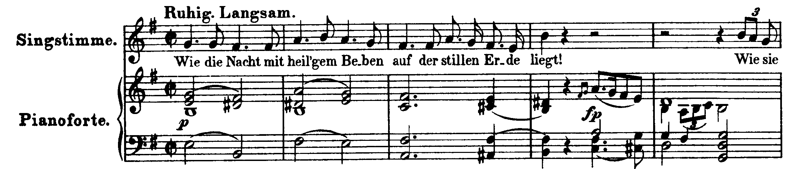
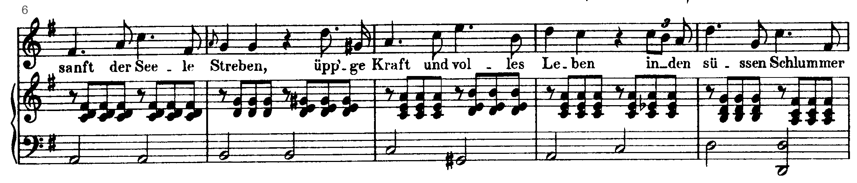
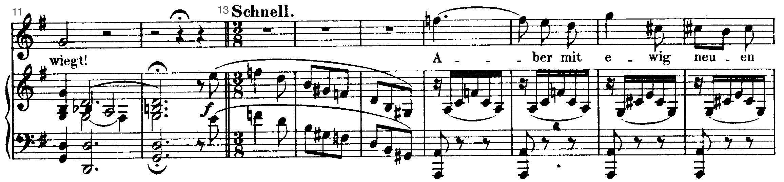
Schubert, Sehnsucht der Liebe (1815)
E minor → G major
D minor . . .

Slide 3
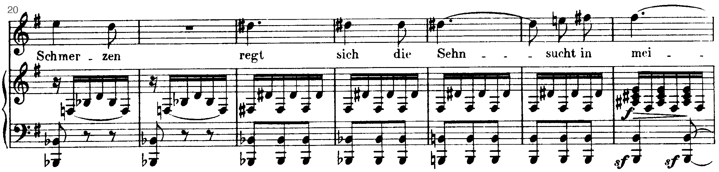
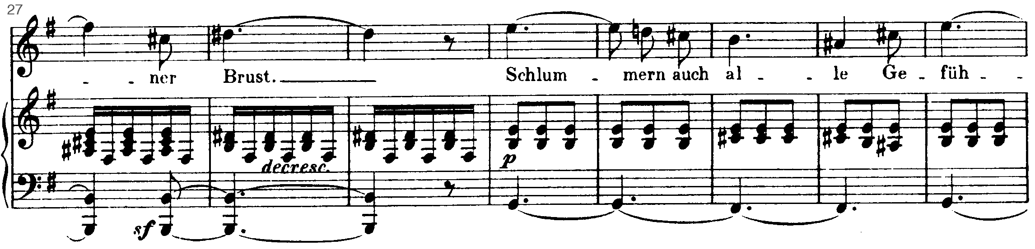
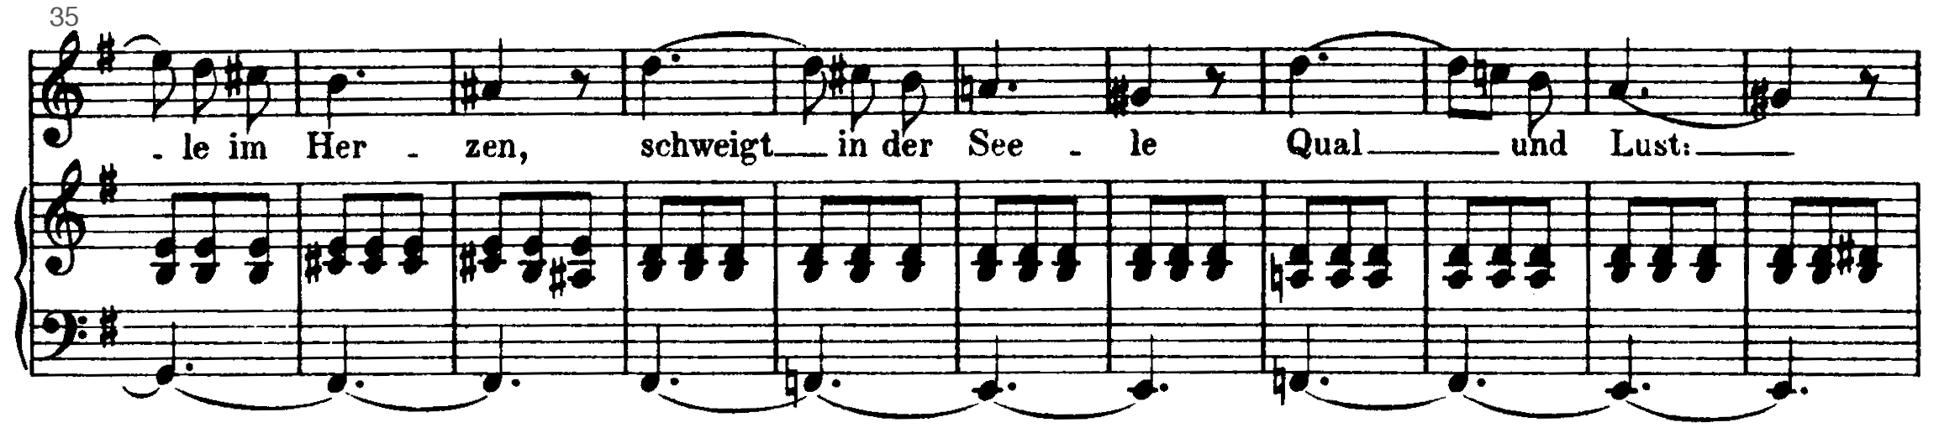
Schubert, Sehnsucht der Liebe (1815)
Eb → D#
Bb major → Eb minor → B major
B minor . . .
A minor . . .

Slide 4
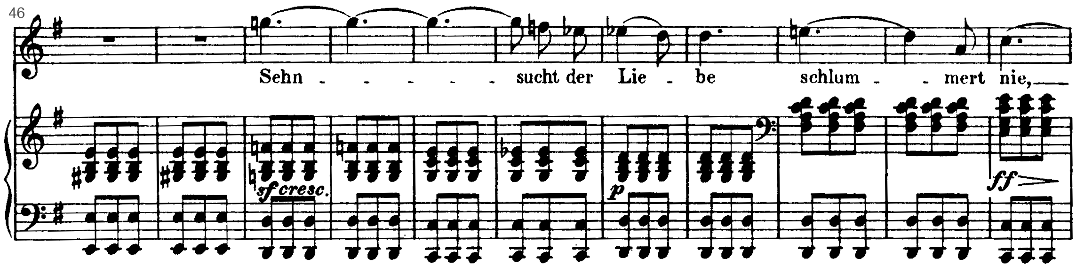
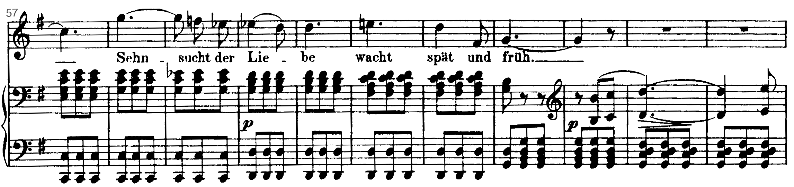
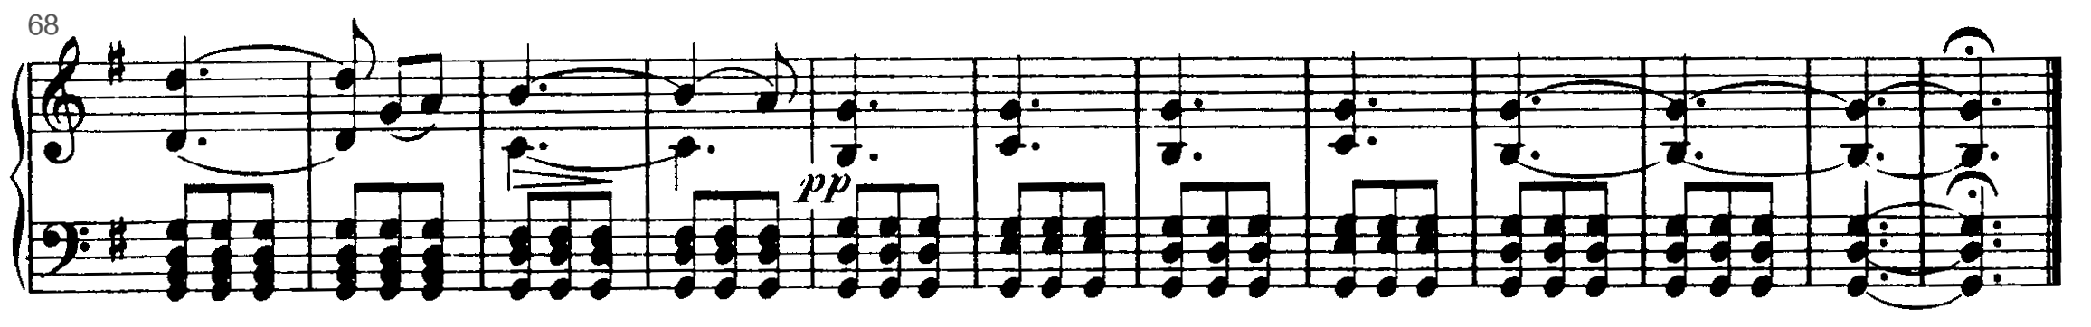
Schubert, Sehnsucht der Liebe (1815)
Eb
C major – G major

Slide 5

Schubert, Sehnsucht der Liebe (1815)
Eb
Eb → D#
Bb major → Eb minor → B major
C major – G major
E minor → G major
B minor . . .
D minor . . .
A minor . . .

Slide 6
Schubert, Sehnsucht der Liebe (1815)
A diatonic (circle-of-fifths) space illustrates aspects of key and enharmonicism.
Major and minor key contexts are represented by a sum of tonic triad notes and 0.5-weighted scale tones.
In G major or other context on the right, pc 3 resolves counter-clockwise, as an Eb.
In E minor or other context on the left, it resolves clockwise, as a D#.

Slide 7
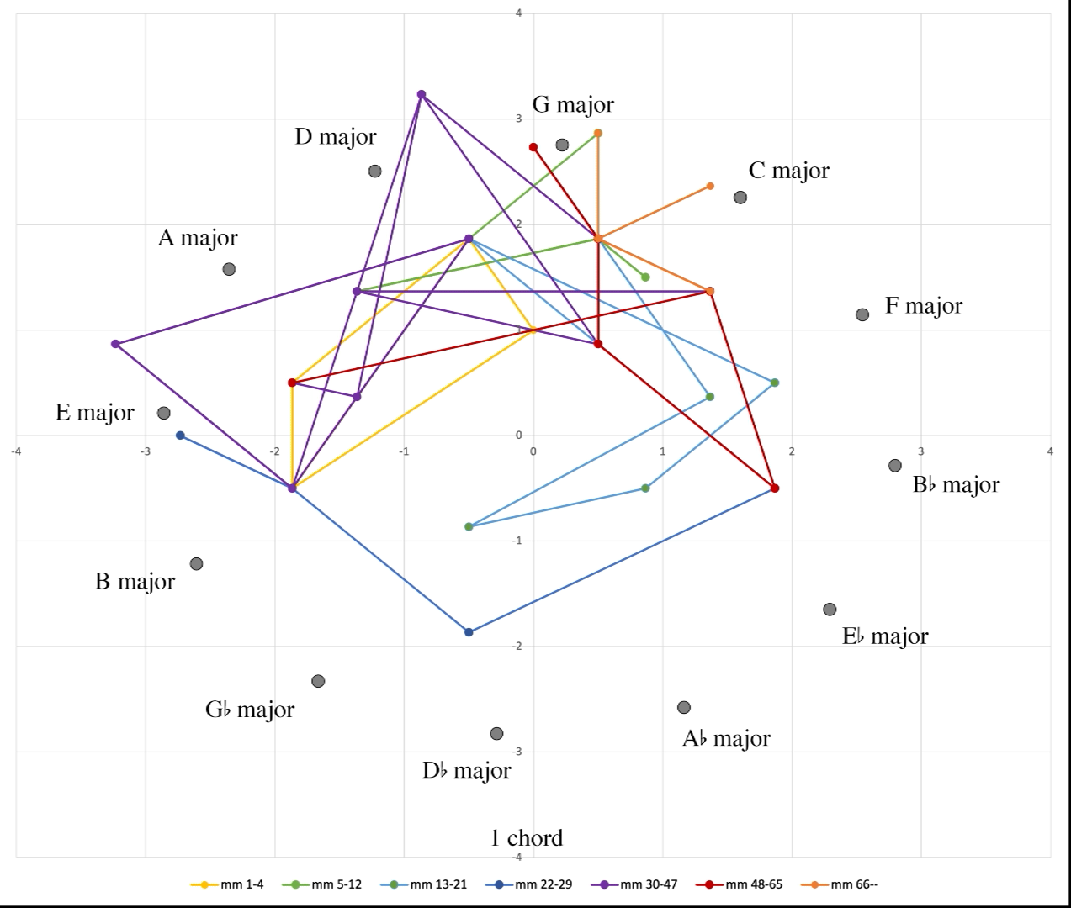
Schubert, Sehnsucht der Liebe (1815)
Here is Schubert’s chord progression in the diatonic space. As we average together more adjacent chords (increase window size) the progression smooths out.
The progression in phrases 1–3 is an enharmonic cycle. Up to the phrase-length window, the beginning of phrase 2 is either Eb minor or D# minor depending on context.
Alla breve introduction, E minor → G major
Phrase 1, D minor→ Bb major, Phrase 2, D# minor→ B major,
Phrases 3–4 E minor, A minor
Phrases 5–6 C major, G major, Coda, G major

Slide 8
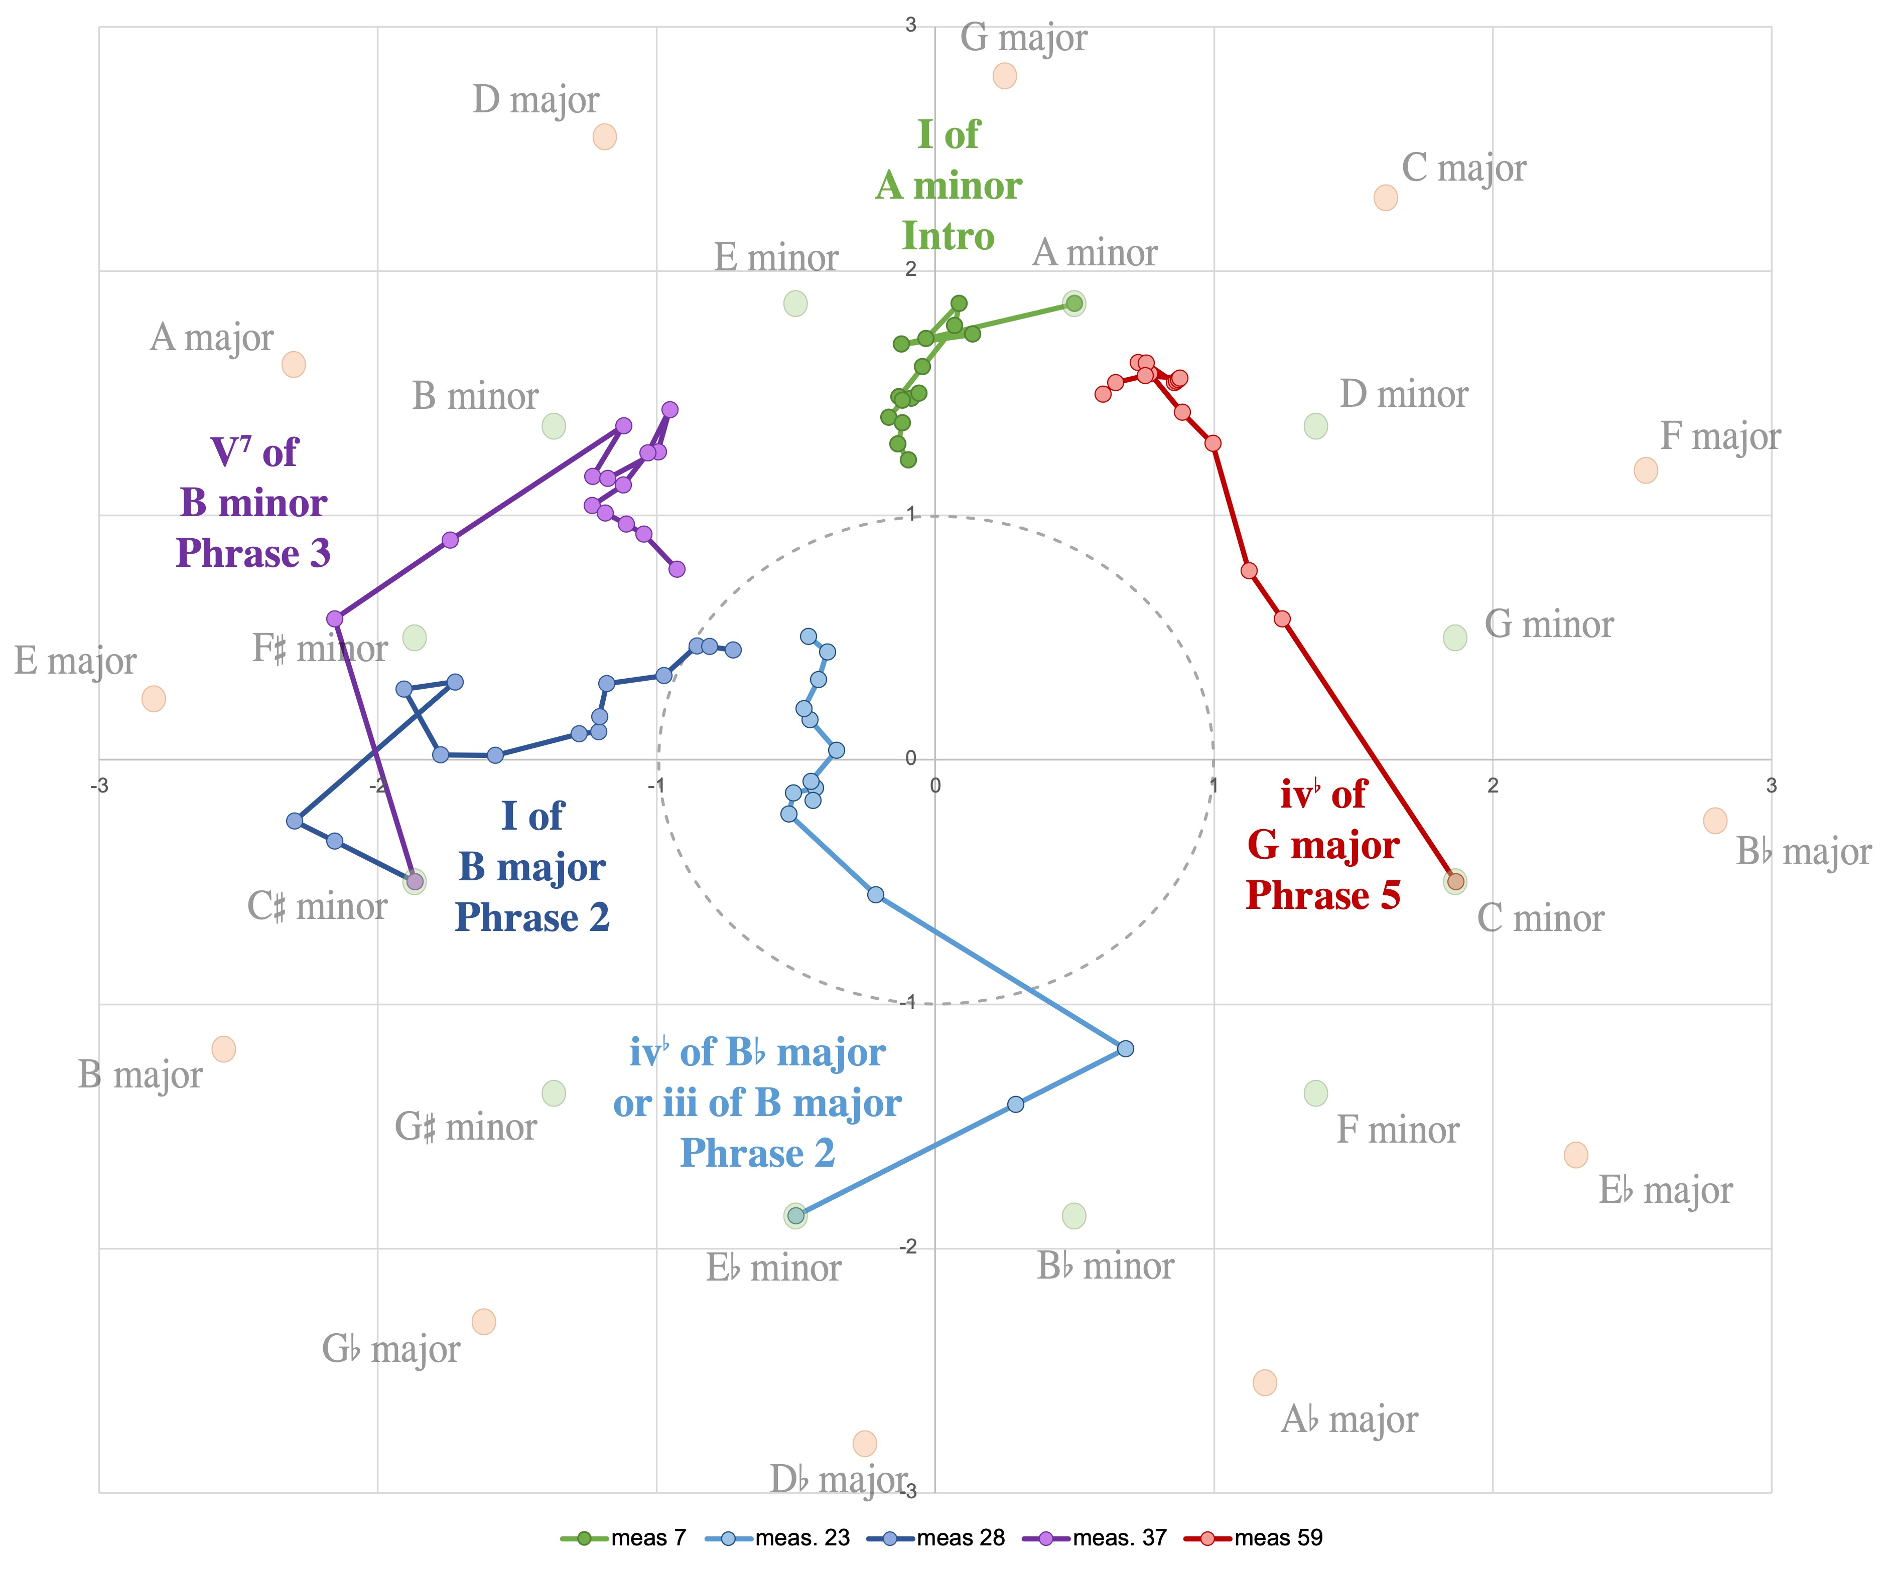
Schubert, Sehnsucht der Liebe (1815)
We can also represent this vertically, by showing increasing window size around a given moment.
• Events near the central G major context are relatively stable.
• A slice centered on a dominant in its immediate context initially moves clockwise before stabilizing.
• Slices involving D#/Eb have the most oblique motion.
• The Eb minor chord is subdominant in its immediate context (goes counter-clockwise), but ultimately D# minor in the larger context.

Slide 9
Vertical Time

Slide 10
Vertical time
Craig Sapp’s keyscapes show key estimates at different points in time (horizontal) and different sizes of window (vertical).
A vertical slice expands the temporal contexts around a single moment, rather than showing successions.
This is a form of temporality, which I’ll refer to as vertical time.
G major, D major,
C major, E minor,
A minor
J.S. Bach Cello Suite BWV 1007, Prelude

Slide 11
Vertical Time
Jonathan Kramer coined the term vertical time.
“a single present stretched out into an enormous duration, a potentially infinite ‘now’ that nonetheless feels like an instant.”
“A vertically conceived piece . . . does not exhibit large-scale closure. It does not begin but merely starts. It does not build to a climax, does not purposefully set up internal expectations, does not seek to fulfill any expectations that might arise accidentally, does not build or release tension, and does not end but simply ceases. . . . An entire composition is just one large event.”
—Kramer, The Time of Music (1988)
• Non-teleological: Time without direction (before or after)
• Full temporal experience contained within a single instant.

Slide 12
Vertical time
Suppose we are given some sequence of events.
Is the linear sequence retrievable from two vertical slices?

Slide 13
Chord loops
Two common popular music progressions use the same four chords but in different orders.
Doowop:
I – vi – IV – V :||
“Axis”:
I – V – vi – IV :||
Example, “Sh-boom”
by the Chords (1954)
Example, “Where is the Love?”
by the Black Eyed Peas (2003)

Slide 14
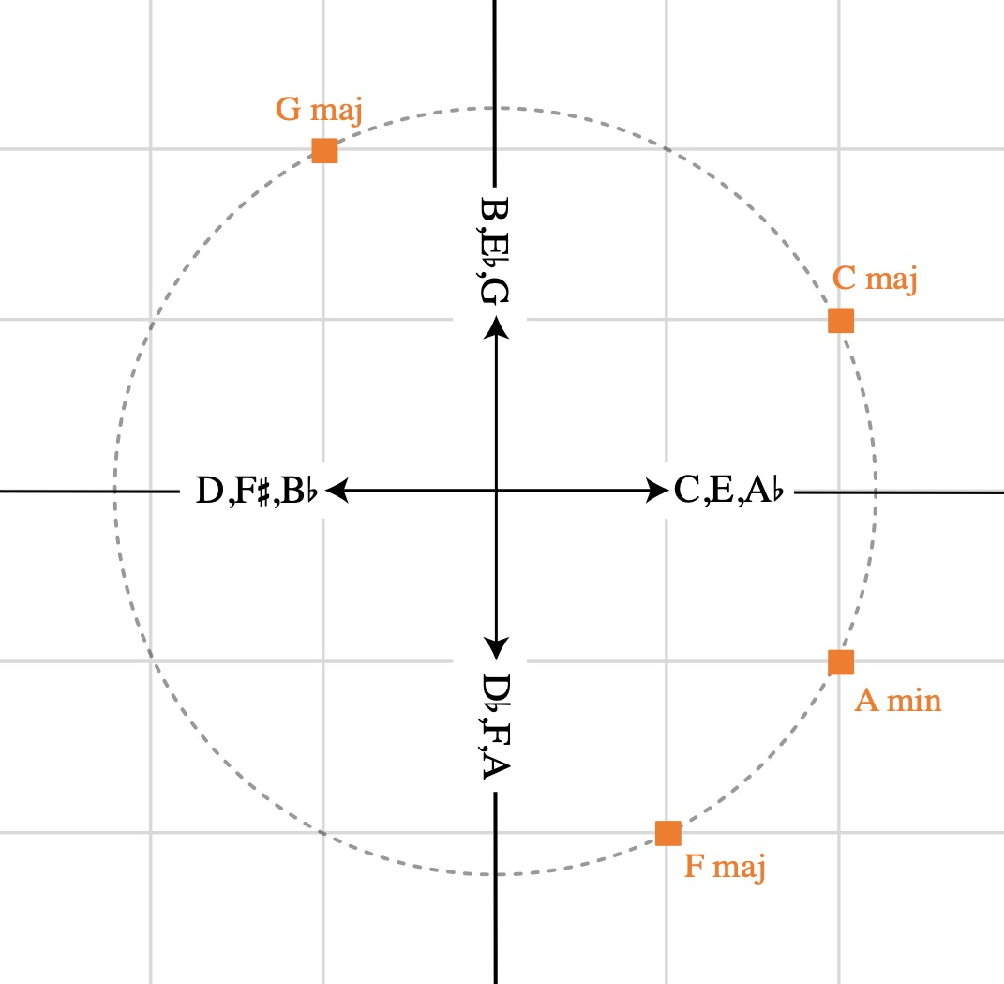
Chord loops
A triadic space is useful for plotting these.
—Pcs are arranged in major-third cycles.
—Chords are sums of their pcs.
—Clockwise motion is ascending triadic voice leading.
—Triads arranged in circle-of-thirds order.

Slide 15
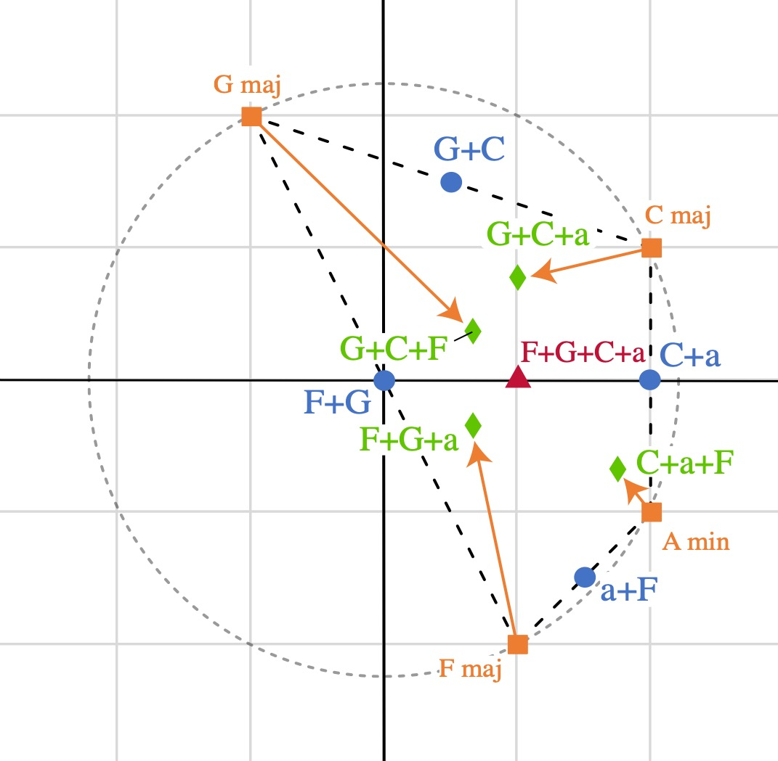
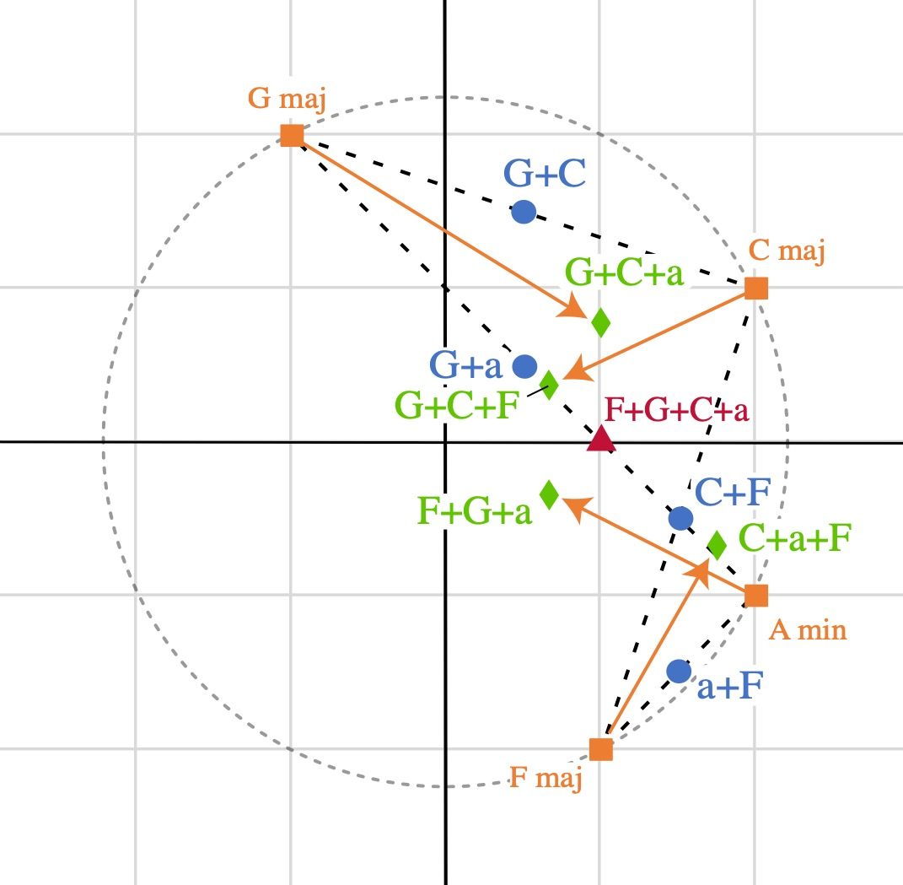
Chord loops
—Dashed lines show linear progressions.
—Arrows show vertical slices.
Doowop: Axis:
• Doowop progression is more cyclical.
• Vertically, doowop arrows point in towards centroid.
Axis arrows are more oblique to the centroid.

Slide 16
Temporal properties of ragas

Slide 17
Temporal properties of ragas
Many ragas use essentially the same notes, but are still distinctive to practitioners. They must be distinguished by temporal properties.
Example:
Gaud Sarang:
vs.
Kamod:
Ascent–Descent from The Raga Guide (Bor 1999)

Slide 18
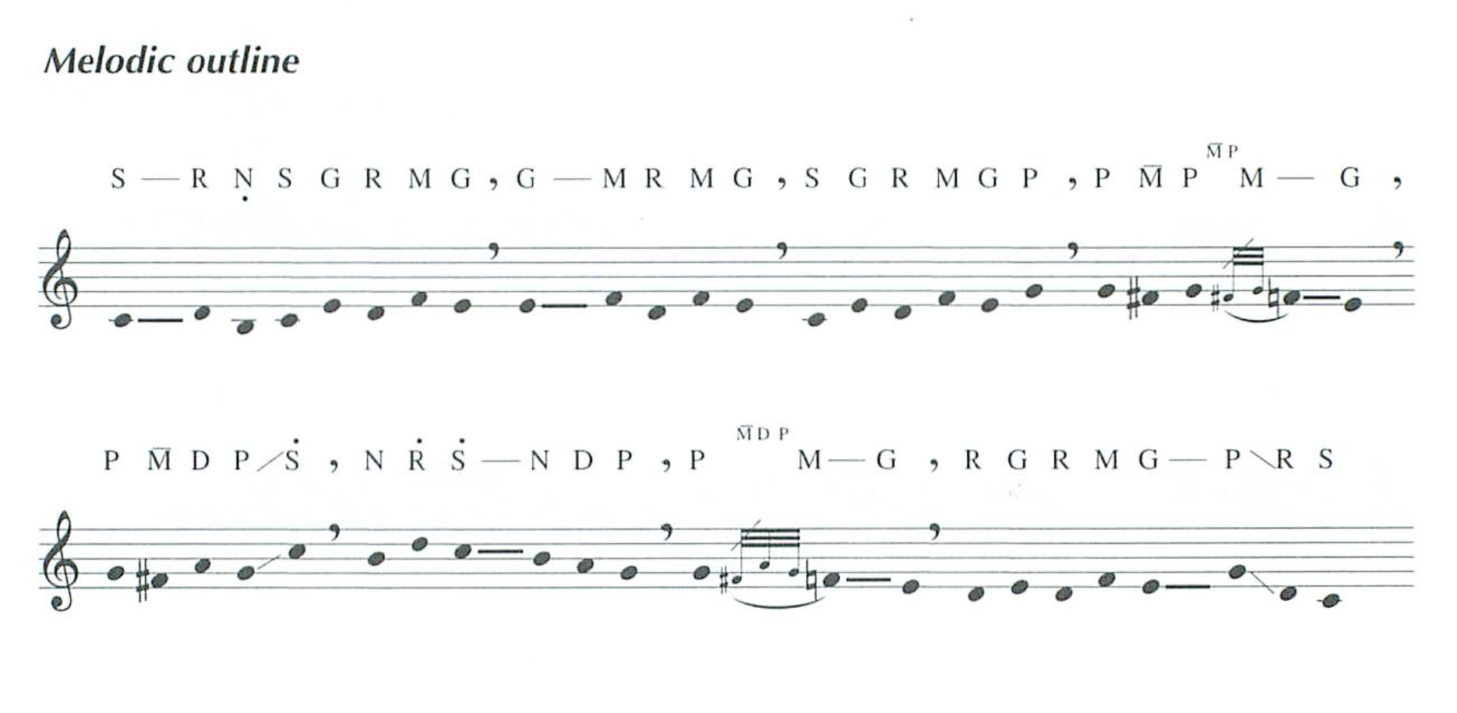
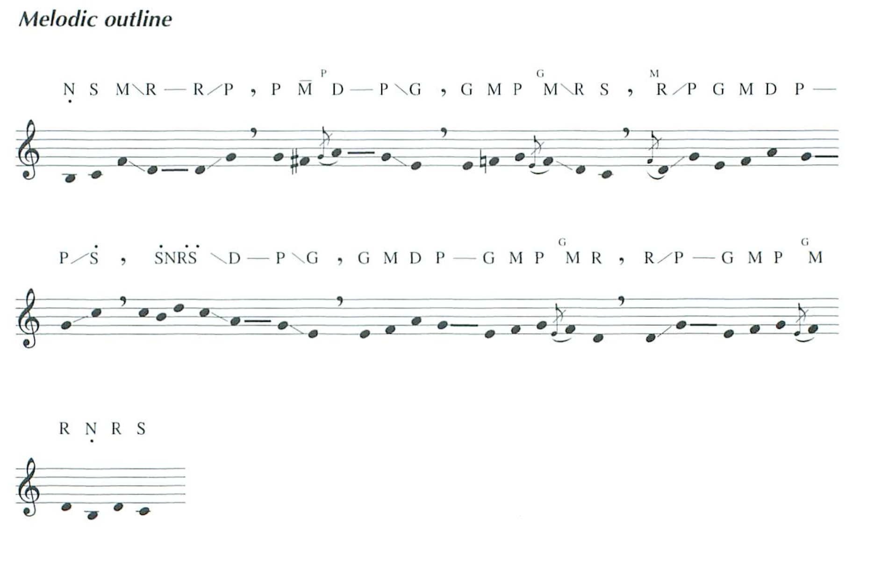
Temporal properties of ragas
More extensive summaries of the ragas’ melodic shapes for analysis:
Gaud sarang:
Kamod:
from The Raga Guide (Bor 1999)

Slide 19
Temporal properties of ragas
Because ragas are melodic and relatively conjunct, the basic pitch-class space is useful.
Descending scale
Ascending scale

Slide 20
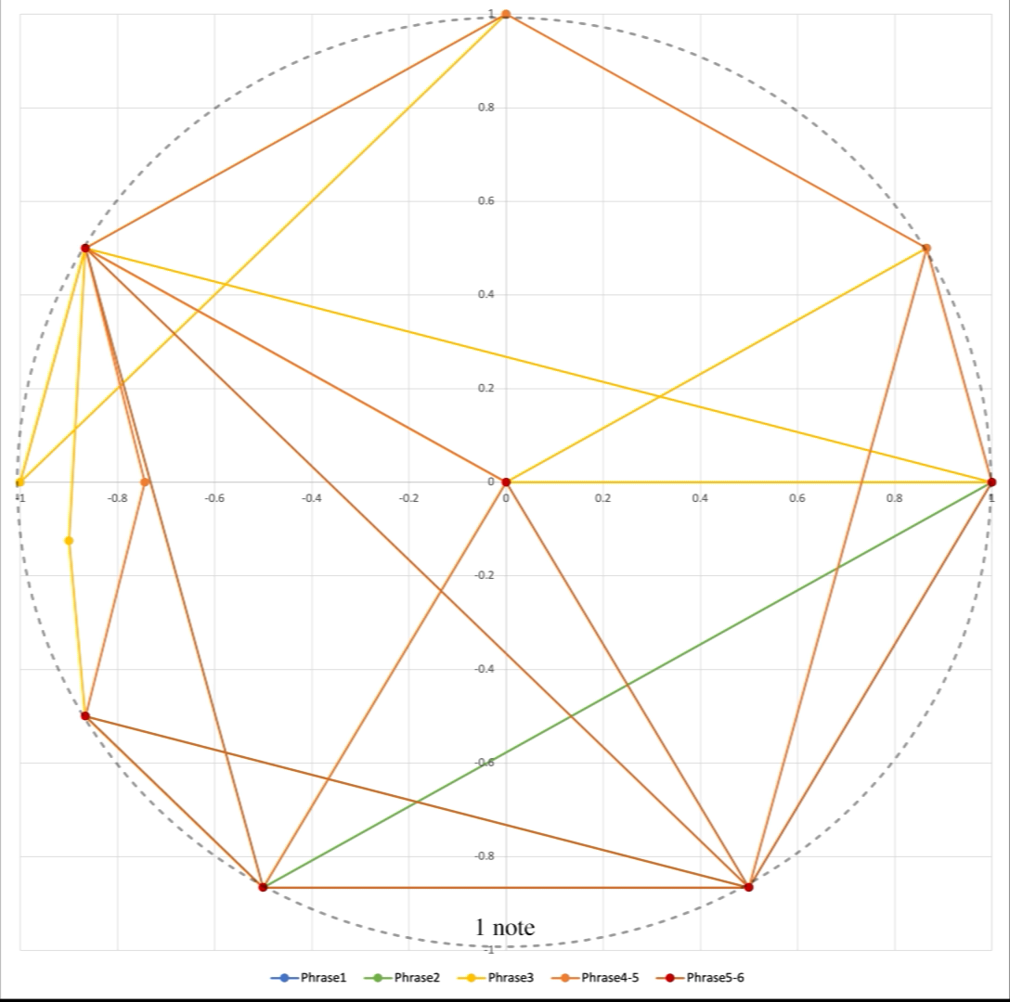
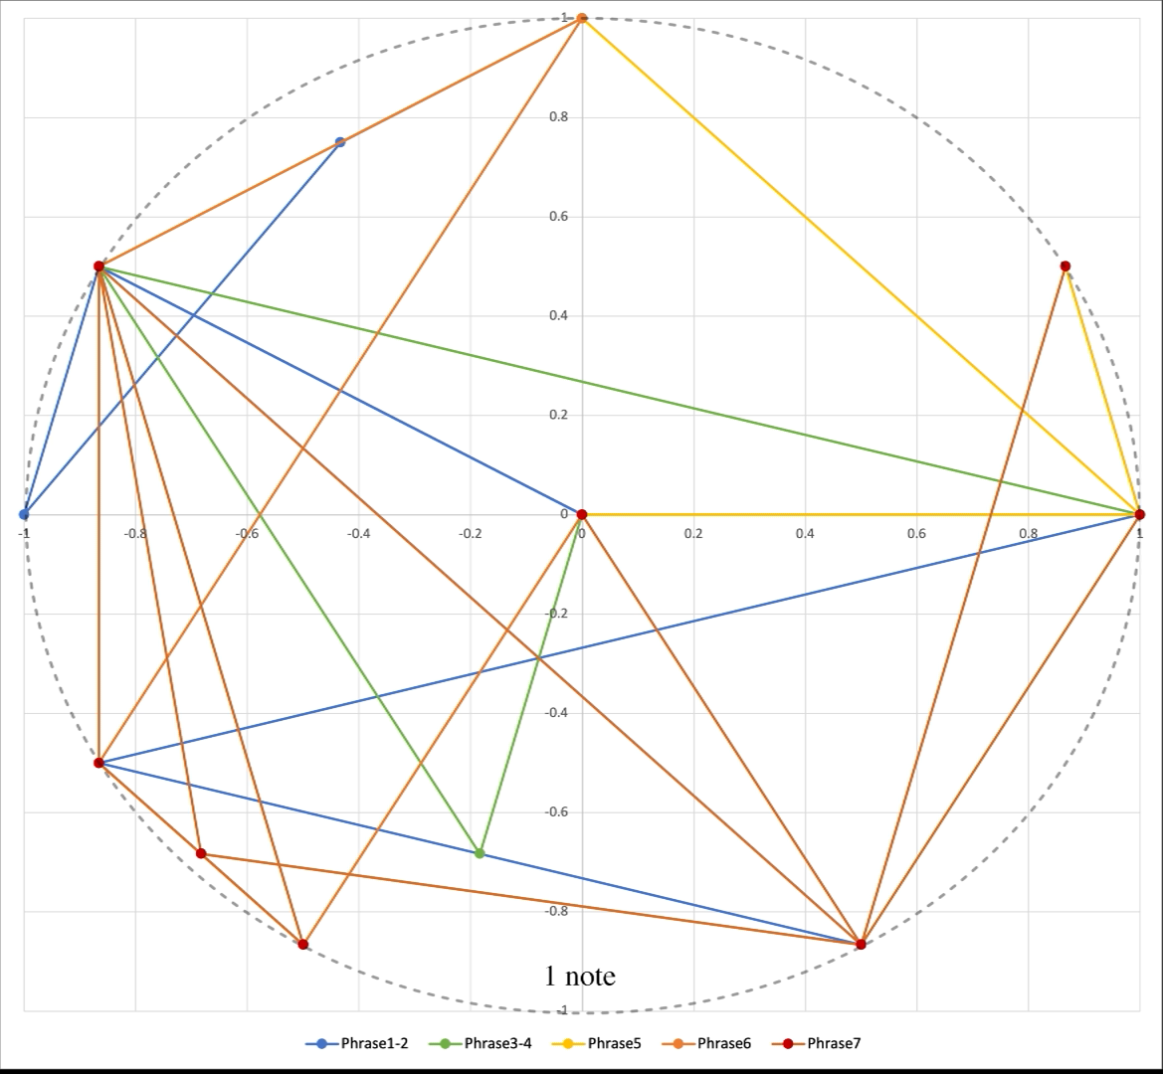
Temporal properties of ragas
Linear-time representation at different window sizes, basic pc space.
Gaud sarang:
Kamod:

Slide 21
Temporal properties of ragas
Vertical time representation
vv
Both resolve ultimately to the mid-octave.
Immediate context of descending Dha in Gaud sarang is above and resolution to mid-octave is long.
In Kamod it is below and resolution is fast.
Gaud
Sarang
Kamod
Immediate context of ascending Pa is below in Gaud sarang and above in Kamod.

Slide 22
Temporal properties of ragas
A half-octave cycle can reflect the tetrachordal vadi-samvadi theory
Ascending tetrachords

Slide 23
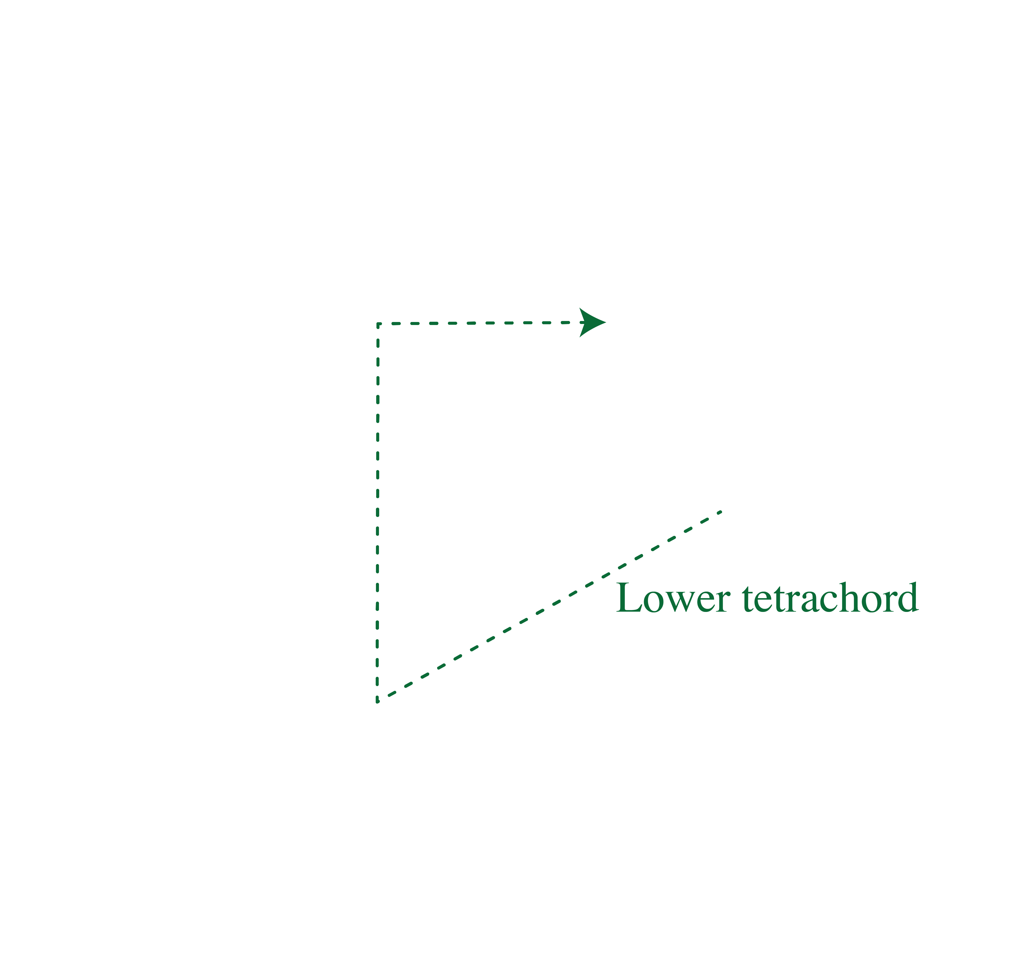
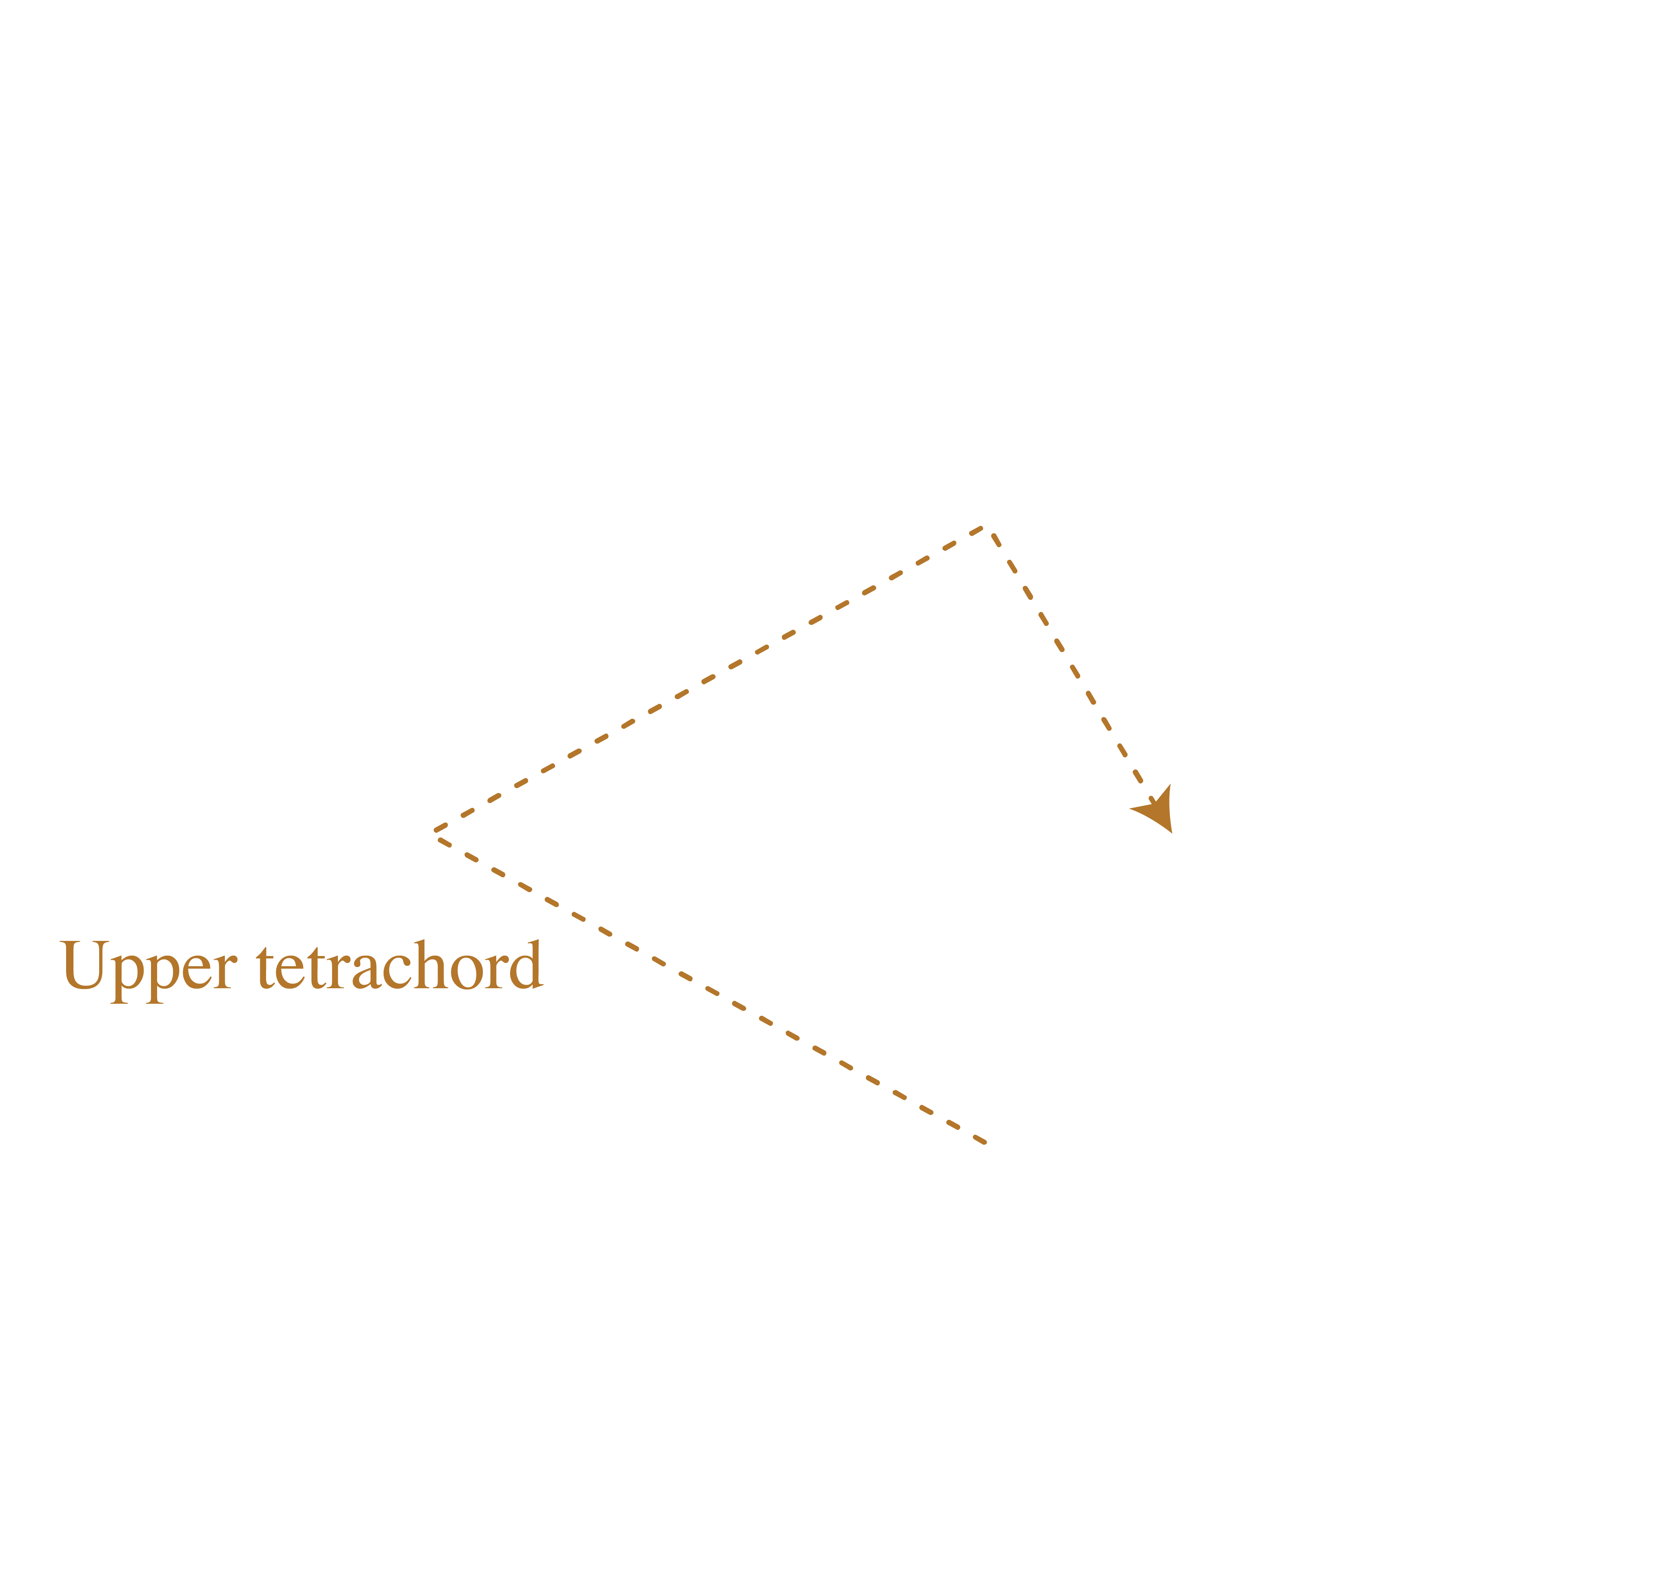
Temporal properties of ragas
A half-octave cycle can reflect the tetrachordal vadi-samvadi theory
Ascending tetrachords

Slide 24
Temporal properties of ragas
Linear representation of melodic outlines at window size 13, half-octave space
Gaud sarang:
Kamod:
Vadi
Samvadi
Samvadi
Vadi

Slide 25
Temporal properties of ragas
Vertical representation in half-octave space
Vadi
(Ga)
In Gaud Sarang the Re notes of the ascent and descent both go up towards the Vadi, In Kamod they go down.
Gaud sarang:
Kamod:
Samvadi
(Dha)
Samvadi
(Re)
Vadi
(Pa)

Slide 26
Adowa
Rhythmic spaces

Slide 27
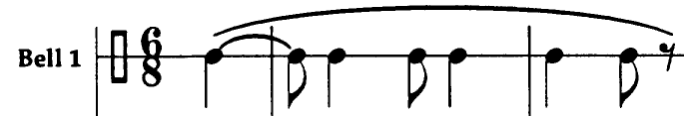
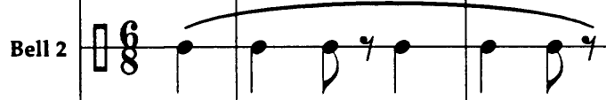
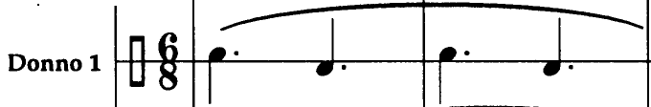
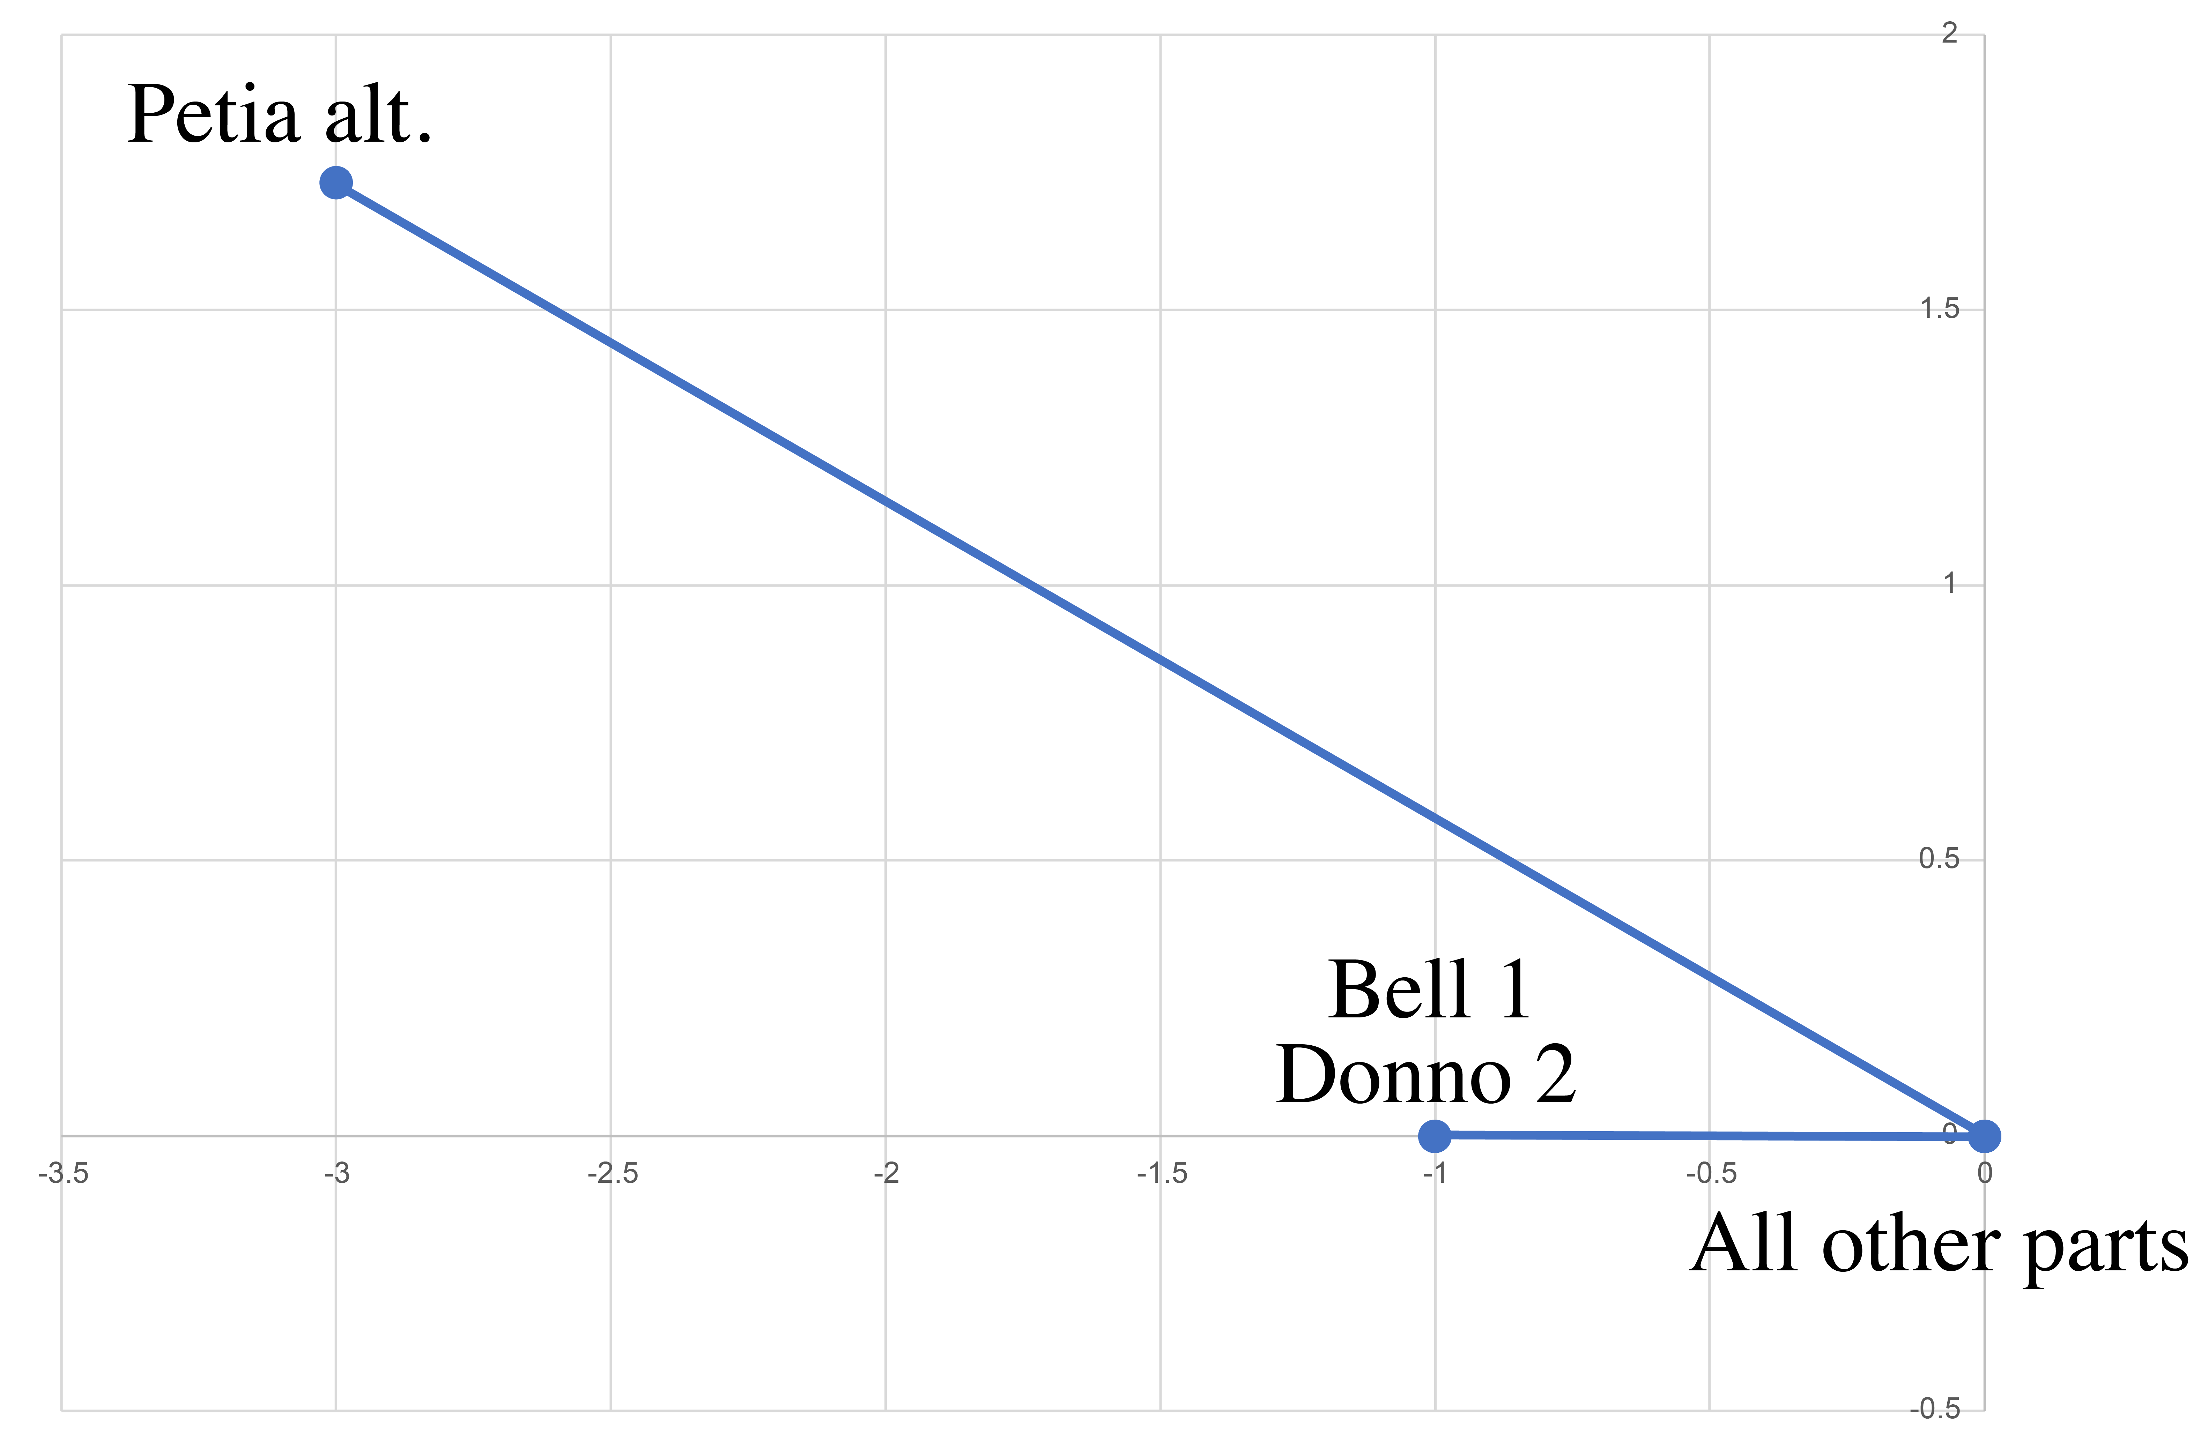
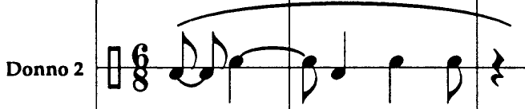
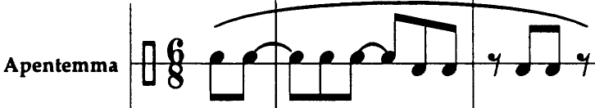
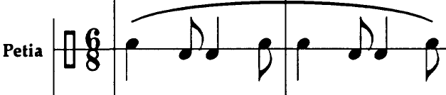
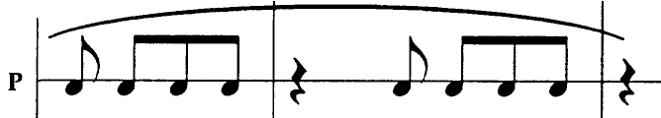
Adowa ensemble (Anku transcription)
4,10
5,11
Half-cycle space (measures):
3,9
0,6
2,8
1,7
{2,3,4,5,
8,9,10,11}
Bell 1: {0,2,4,7,9,10}
Donno 2: {2,4,7,9,11}
Beat classes: 0 1 2 3 4 5 6 7 8 9 10 11

Slide 28
Adowa ensemble (Anku transcription)
Quarter-cycle
space (beats):
{0,2,3,5,6,8,9,11}
{2,3,4,5,
8,9,10,11}
{1,2,4,5,7,8,10,11}
{2,4,7,9,11}
{0,3,6,9}
2,5,8,11
{0,2,4,7,9,10}
0,3,6,9
Beat classes: 0 1 2 3 4 5 6 7 8 9 10 11
1,4,7,10

Slide 29
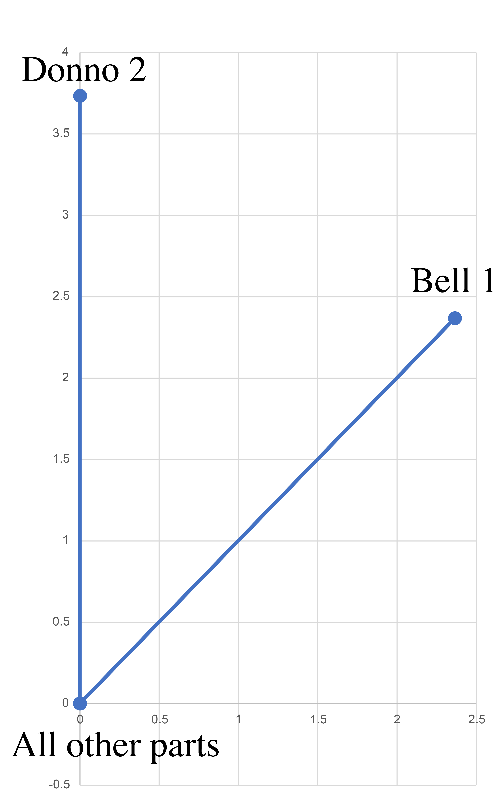
Adowa ensemble (Anku transcription)
⅕-cycle space (timeline):
9
4
2
11
7
{2,4,7,9,11}
6
0
1
5
8
3
10
{0,2,4,7,9,10}
Beat classes: 0 1 2 3 4 5 6 7 8 9 10 11

Slide 30
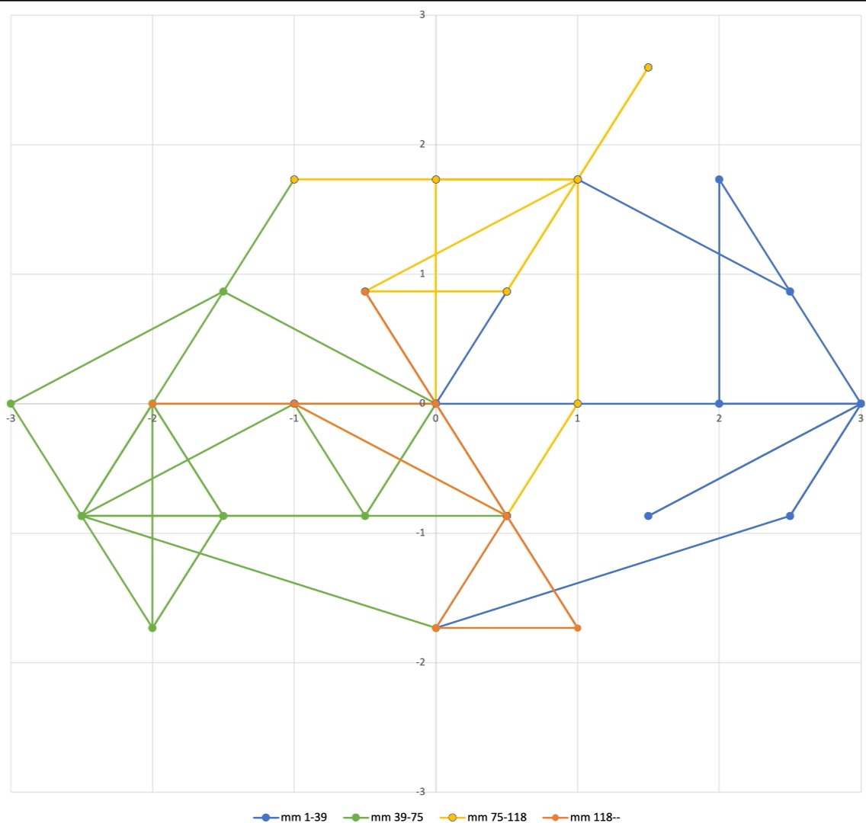
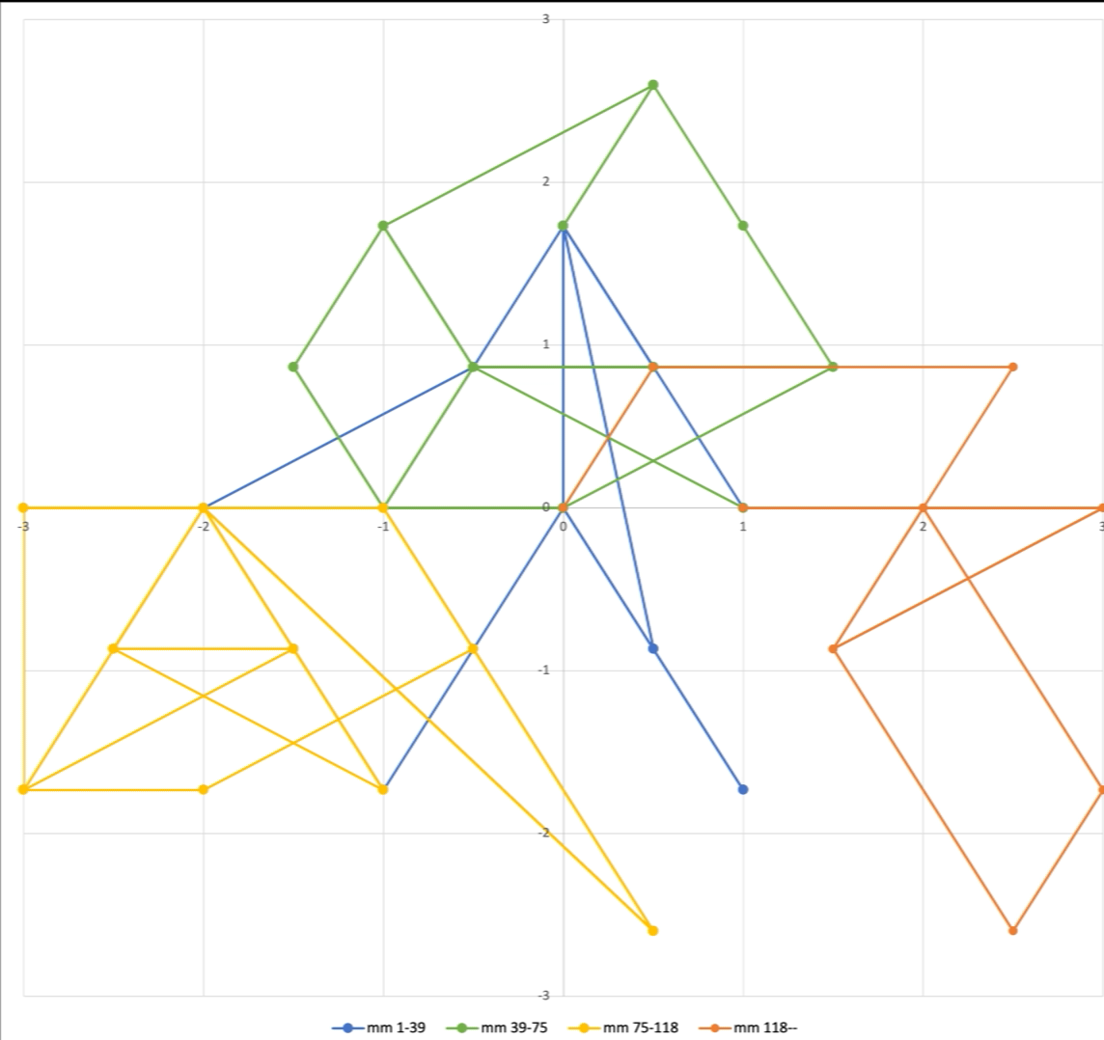
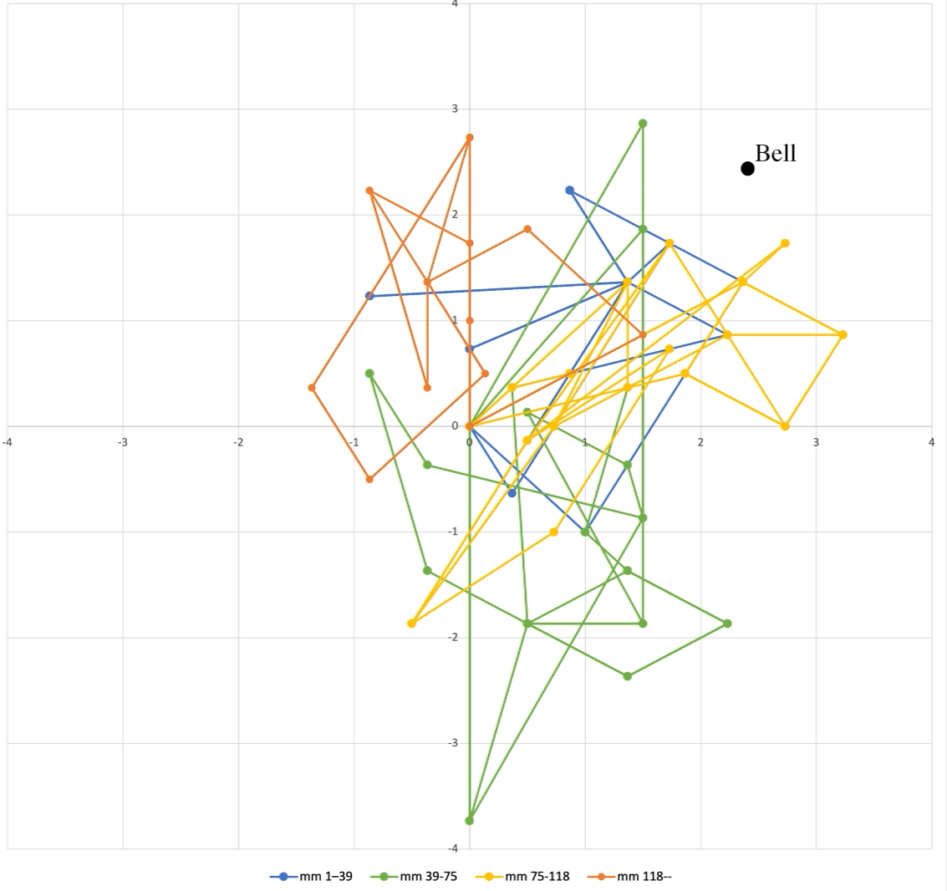
Atumpan (Adowa lead drum)
Linear representation of Atumpan performance by Solomon Amonquandoh transcribed by Anku
Half-cycle space (meas.):
Quarter-cycle space (beats):
⅕-cycle space (timeline):

Slide 31
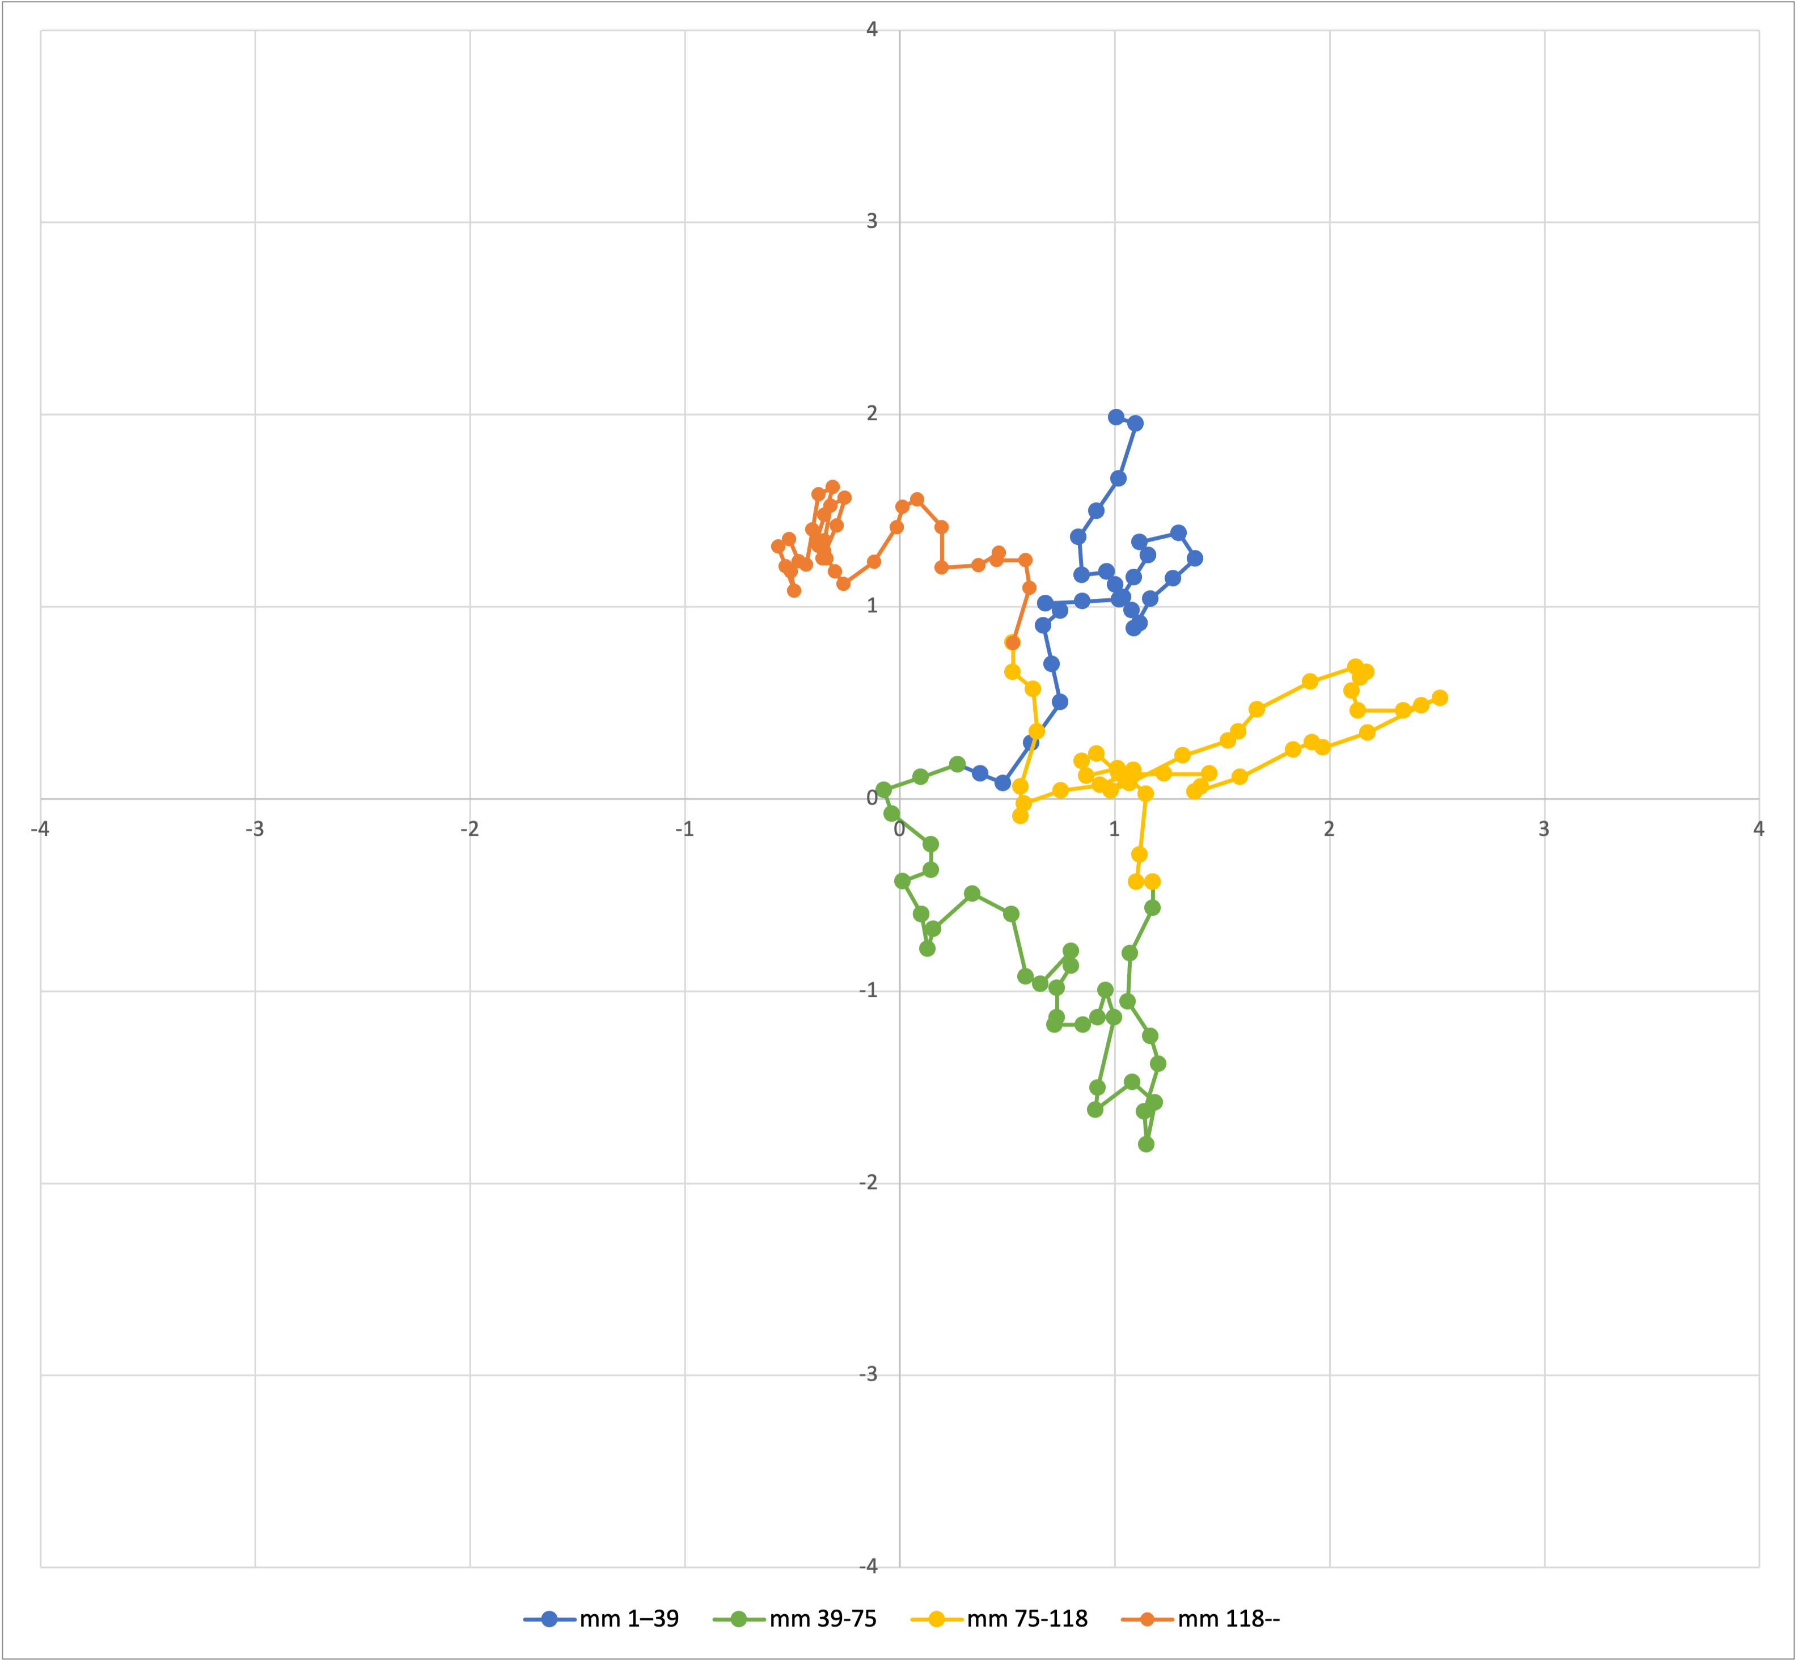
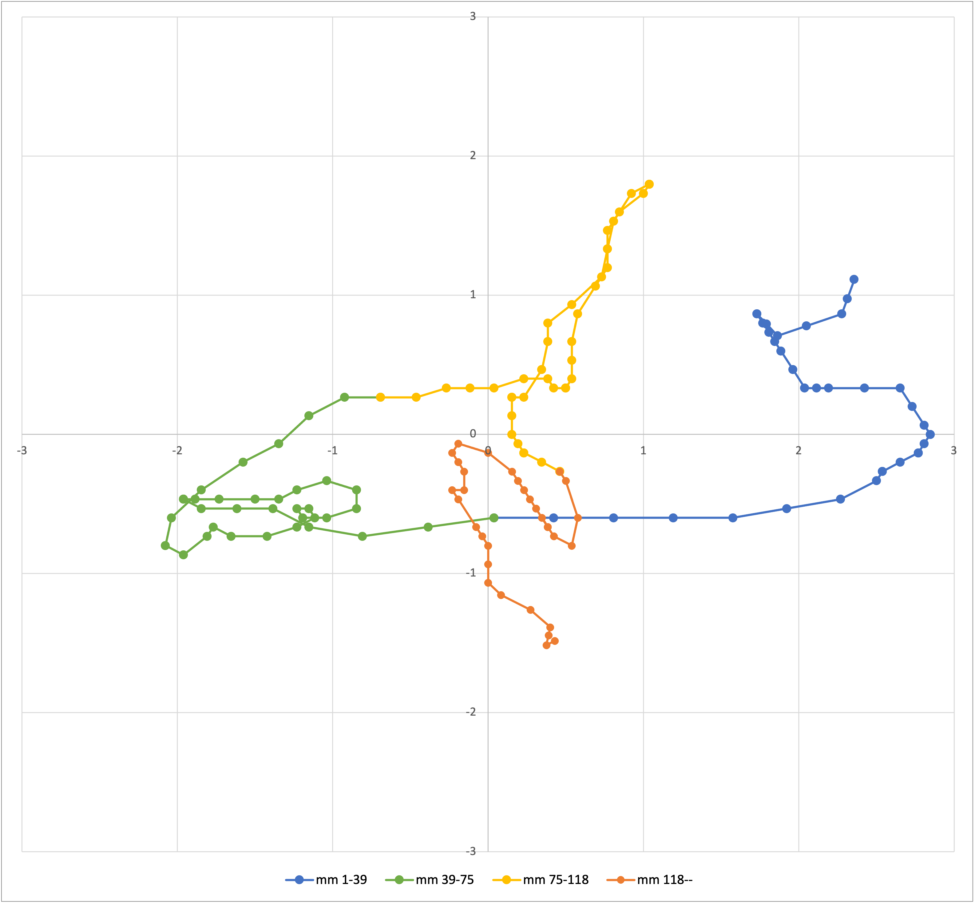
Atumpan (Adowa lead drum)
Linear representation of Amonquandoh’s performance, 13-meas. window
Half-cycle space (meas.):
⅕-cycle space (timeline):

Slide 32
Atumpan (Adowa lead drum)
Vertical representation of Amonquandoh’s performance
Half-cycle space (meas.):
Quarter-cycle space (beats):
⅕-cycle space (timeline):

Slide 33
Summary
We can profitably distinguish “vertical” temporal properties, relating an event to its different contexts, from the “horizontal” aspect of time, its directedness.
Many affective qualities of chromatic harmony have to do with how a note or chord relates (e.g. as a leading tone or dominant) to its context, and a single note can relate in opposite ways at different levels.
Other typically linear concepts, like characteristic melodic motions in a raga, can be substituted by relating events to their contexts.
Motion in rhythmic spaces can involve similar ideas of resolution at different levels. Positions in these kinds of rhythmic spaces is very salient in African drum improvisation.

Slide 34
Thanks!
Preprints and powerpoints here:
sites.bu.edu/jyust

Slide 35
