Slide 1
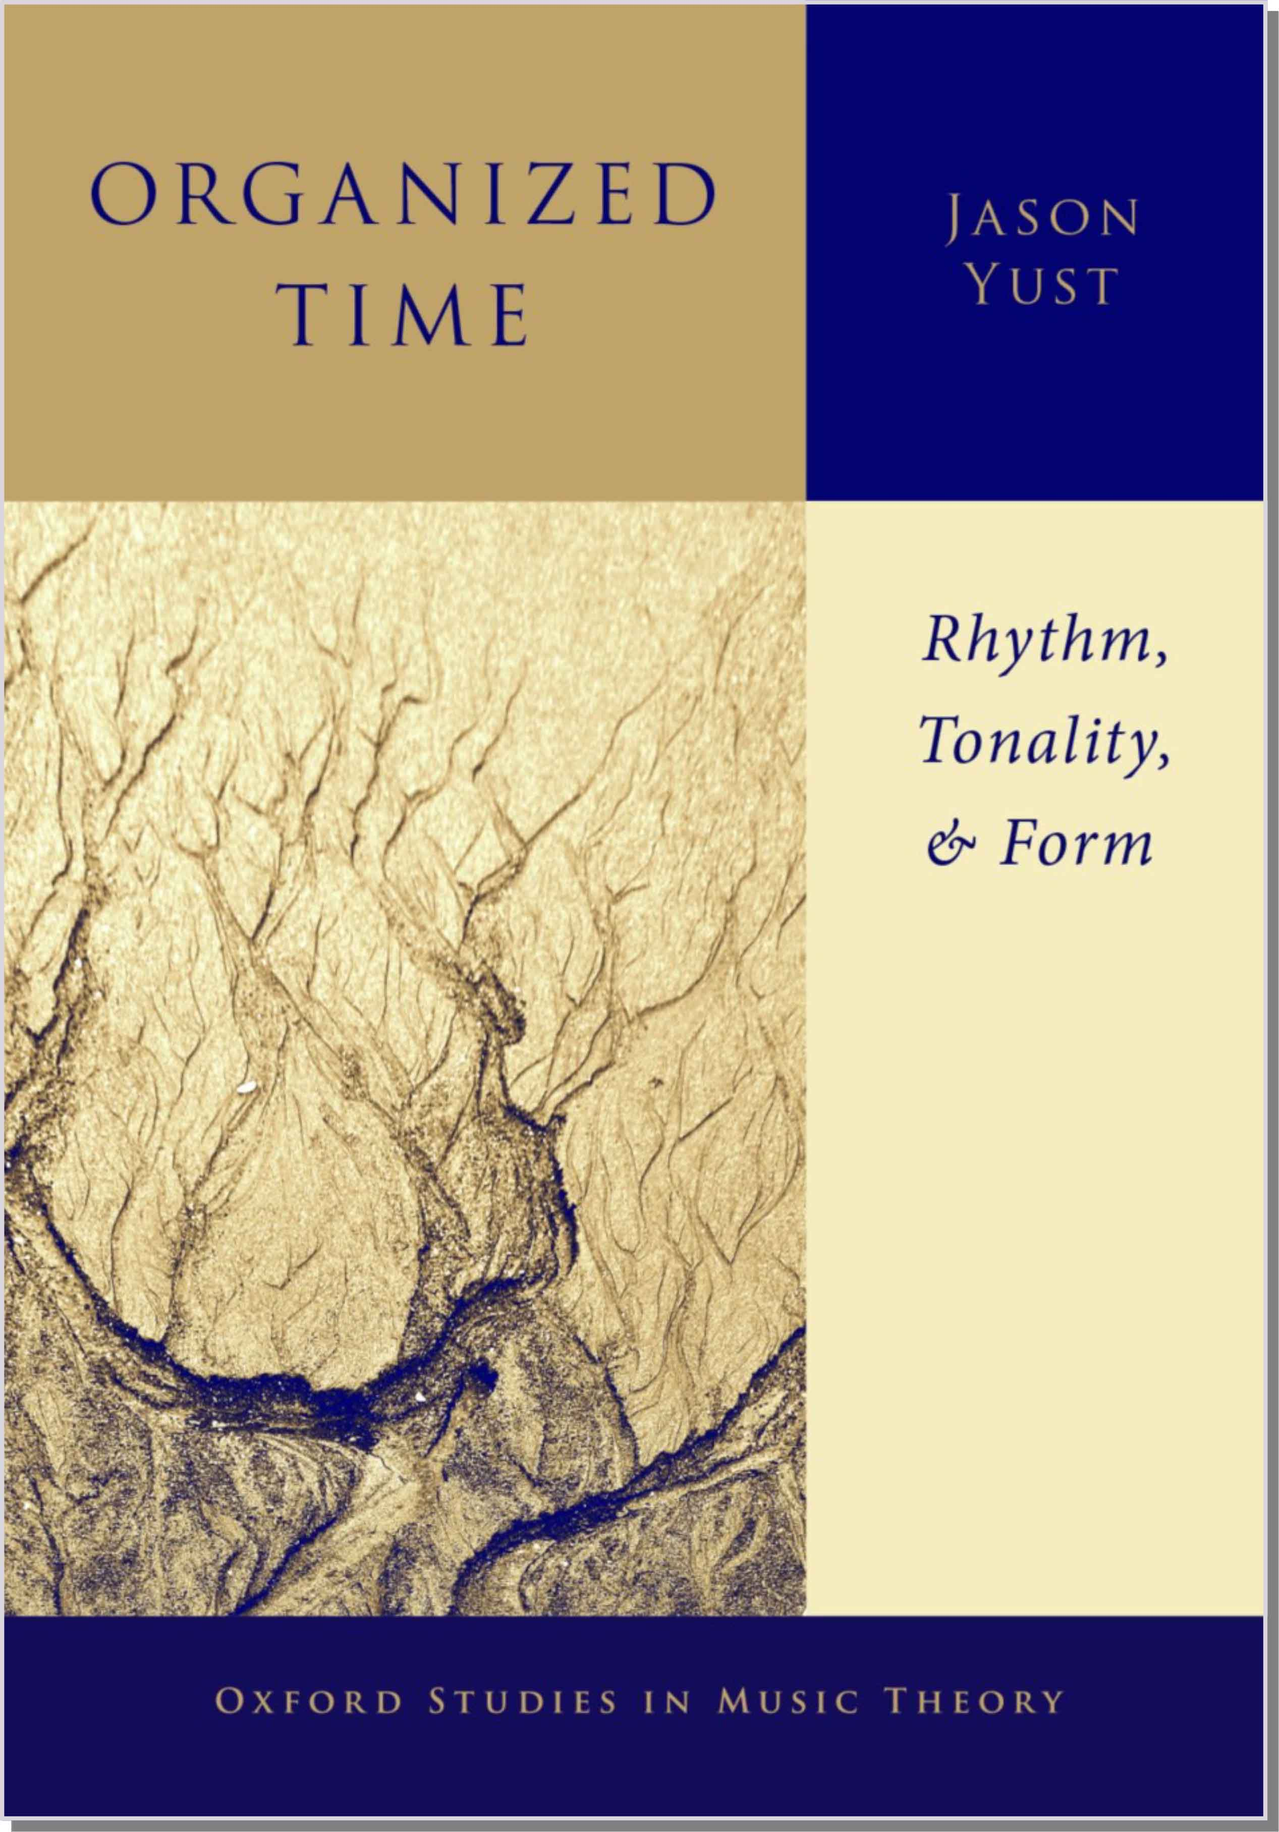
Multivalent Displaced Hemiolas in Brahms’s Late Songs
Brahms’s Hybrid Metric Dissonances Brahms 2022: New Paths, New Perspectives American Brahms Society
Jason Yust, .
http:/sites.bu.edu/jyust
jason.yust@gmail.com
Notes:
Thanks to Rick and Ryan and the organizers

Slide 2
Outline
Displacement and hemiola on the “metric cyclone”
“Auf dem See,” Op. 106/2 (1886)
“Keine Haus, Kein Heimat,” Op. 94/5 (1884)
“Mein Herz is Schwer,” Op. 94/3 (1884)

Slide 3
Displacement and Hemiola on the “Metric Cyclone”

Slide 4
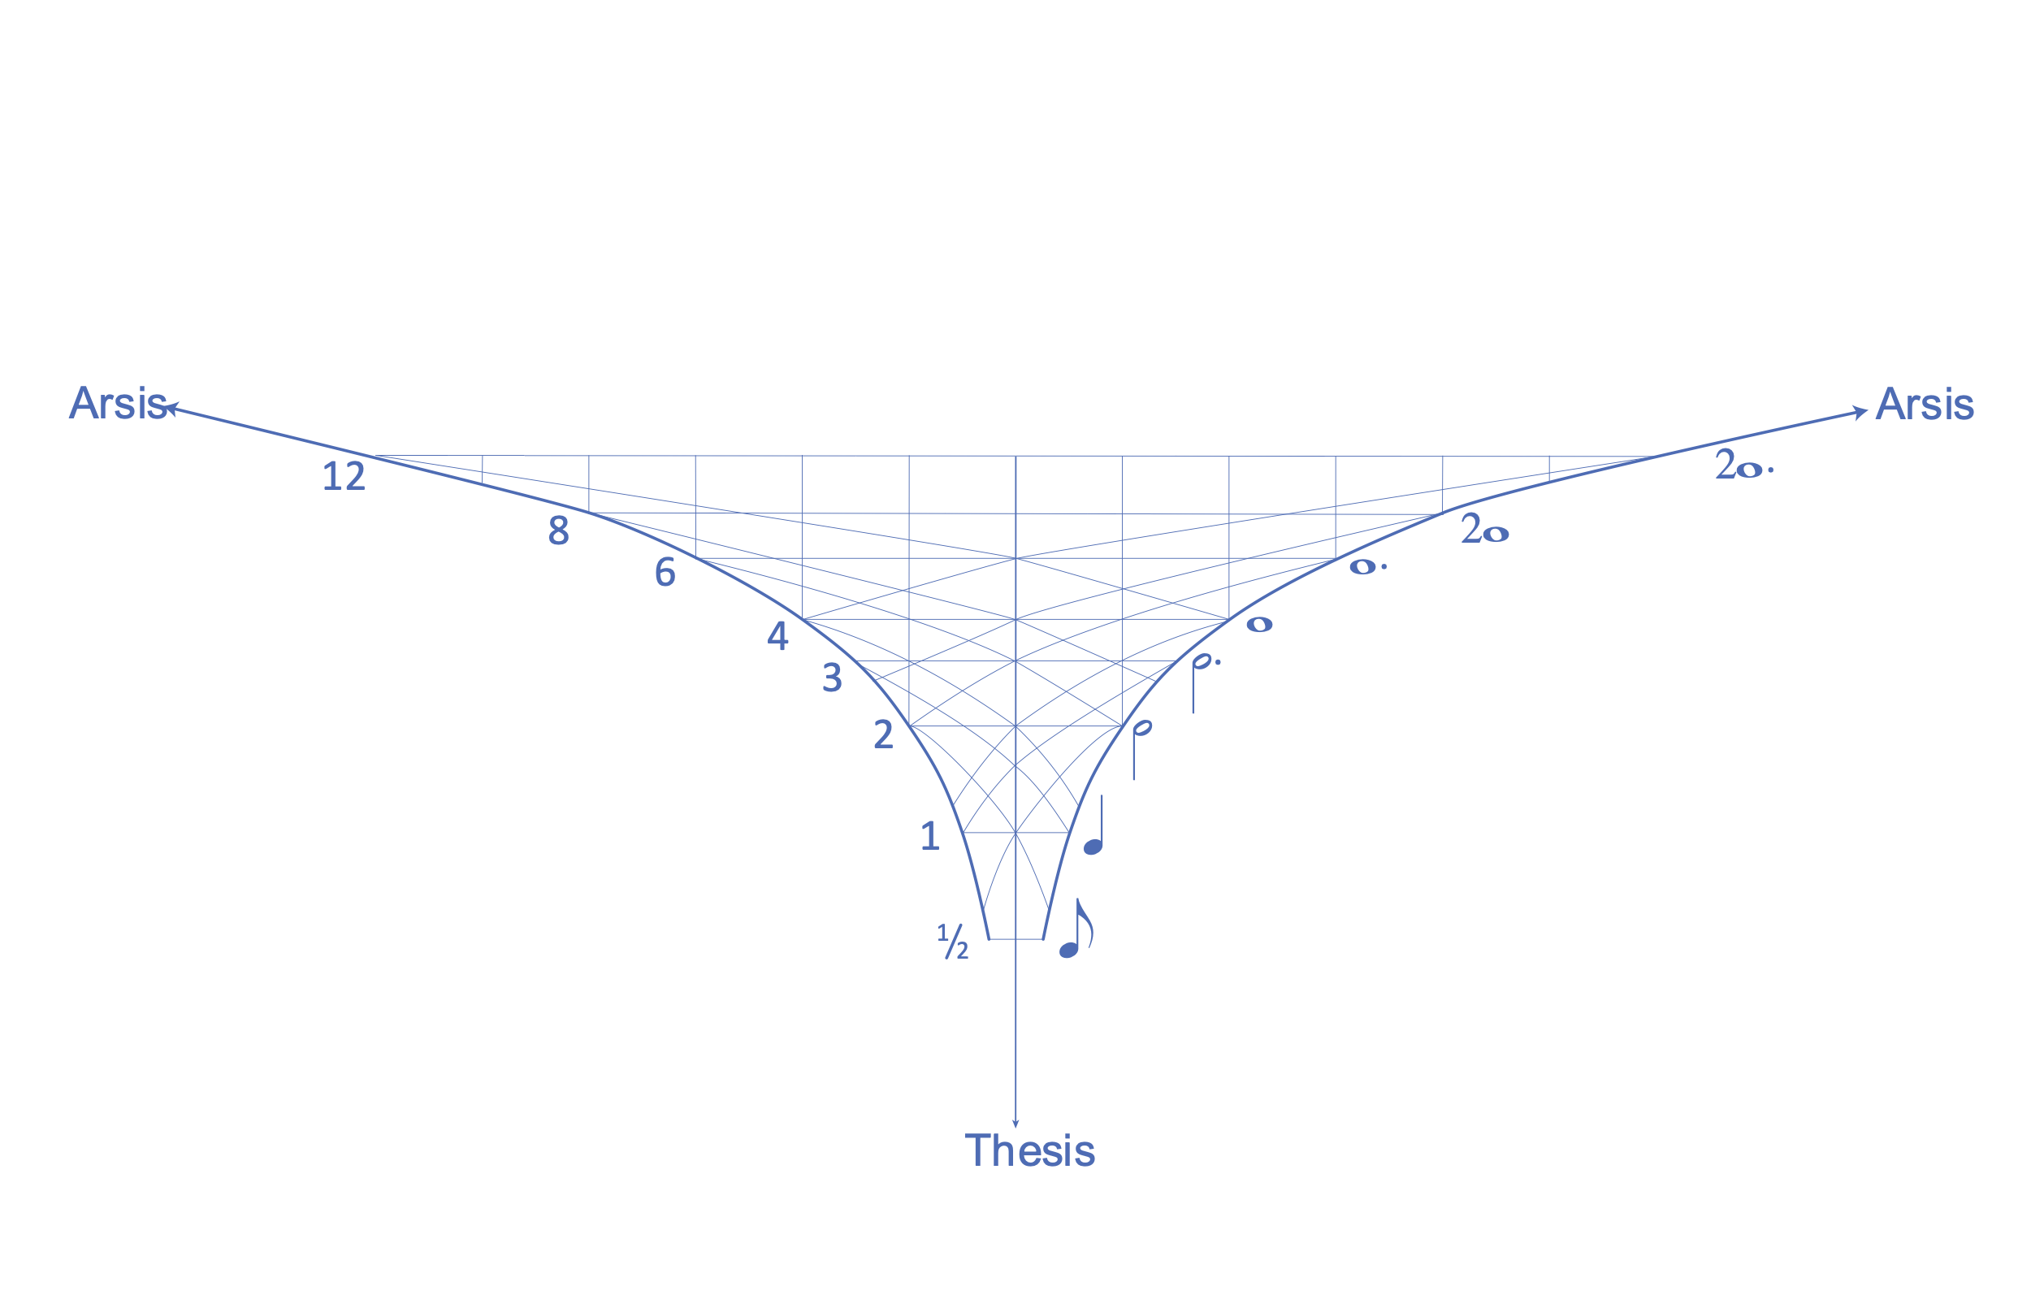
The Metric Cyclone
The metric cyclone is a graphical representation of metric relationships.
A point in the space represents a metrical layer.
Half note displaced by a quarter note
Vertical position represents duration
(log scale)
Half note aligned with the downbeat
Quarter note aligned with the downbeat
Horizontal position represents
displacement from downbeat

Slide 5
The Metric Cyclone
An ordinary meter is represented by a straight line down the middle.
Spacing shows the meter type.
3
2
meter
6
4
meter
4
4
meter

Slide 6
Displacement
Displacement shifts the meter off the center line.
When the displaced meter hits the arsis line it jumps to the opposite side and changes to a curved trajectory.
6
4
meter
displaced by h

Slide 7
Hemiola
Ordinary hemiola is overlapping meters.
The interior points are separated by ³/₂
3
2
meter
6
4
meter

Slide 8
Hemiola
Ordinary hemiola is overlapping meters.
I show this with doubled line of length ³/₂
6
4
meter
Hemiola of and meters
3
2
6
4

Slide 9
Displaced hemiola
Displaced hemiola lifts to a higher-level displacement
w. w.
h h h h h h
Œ w. w.
h. h. h. h.
Displacement of w. layer by q
Displaced hemiola
lifts to a displacement
of w. layer back by h
Different subdivisions
(duple, triple)
Notes:
In the three examples we’ll look at from Brahms’s lieder, he uses this technique to connect different displacements of metrical layers, each of which is endowed with a distinct expressive meaning in connection with the text setting.
The metric cyclone helps us visualize this process of “lifting” the displaced hemiola

Slide 10
“Auf dem See,”
Op. 106/2

Slide 11
“Auf dem See” Op. 106/2
An dies Schifflein schmiege,
Holder See, dich sacht!
Frommer Liebe Wiege,
Nimm sie wohl in Acht!
Deine Wellen rauschen;
Rede nicht so laut!
Laß mich ihr nur lauschen,
Die mir viel vertraut!
Deine Wellen leuchten,
Spiegeln uns zurück
Tausendfach die feuchten
Augen voller Glück!
Nestle up to this little boat,
Lovely lake, gently!
Cradle of holy love,
Take good care of it!
Your waves are roaring;
Do not speak so loudly!
Just let me listen to her,
Who is confiding so
much to me!
Your waves sparkle,
Reflecting back at us
A thousand moist
Eyes full of happiness!
Deine Wellen zittern
Von der Sonne Glut;
Ob sie’s heimlich wittern,
Wie die Liebe tut?
Weit und weiter immer
Rück den Strand hinaus!
Aus dem Himmel nimmer
Laß uns steigen aus!
Fern von Menschenreden
Und von Menschensinn,
Als ein schwimmend Eden
Trag dies Schifflein hin!
Your waves tremble
From the heat of the sun,
Could it be they secretly sense
How love works?
Farther and farther,
Draw us away from the shore!
From this heaven
Never let me descend!
Far from human speech
And human thoughts,
Like a floating Eden,
Carry this little boat away!
—Christian Reinhold
Notes:
The poem is about a love affair, but it is addressed to the lake, not the beloved
Note idea of reflection in the 3rd stanza — the water imagery links waves to narrator’s feelings (tears of happiness)
At the end, love and the lake are identified with heaven, a place of pure feeling apart from rational thought.

Slide 12
“Auf dem See” Op. 106/2
Mm. 5–8 (lines 1–2)
Displaced echo in piano
. . . becomes an independent line in ¹₁²₆
Subdivision in piano creates a new coincidence on weak beats
Notes:
Long arpeggios in piano represent waves, piano = lake
Simple rhythm in vocal line = narrator
Displaced echo is initially justified by the texture
Technique learned from Schumann.
Single melodic line ⇒ One-sided conversation, lake reflects narrator’s thoughts back

Slide 13
“Auf dem See” Op. 106/2
Mm. 9–14 (lines 3–4)
Notes:
The effect of the two meters uniting in their weak beats represents the image of floating to a heaven of pure love described in the text. Or, the narrator being carried away by his own thoughts of love, disconnected to reality.

Slide 14
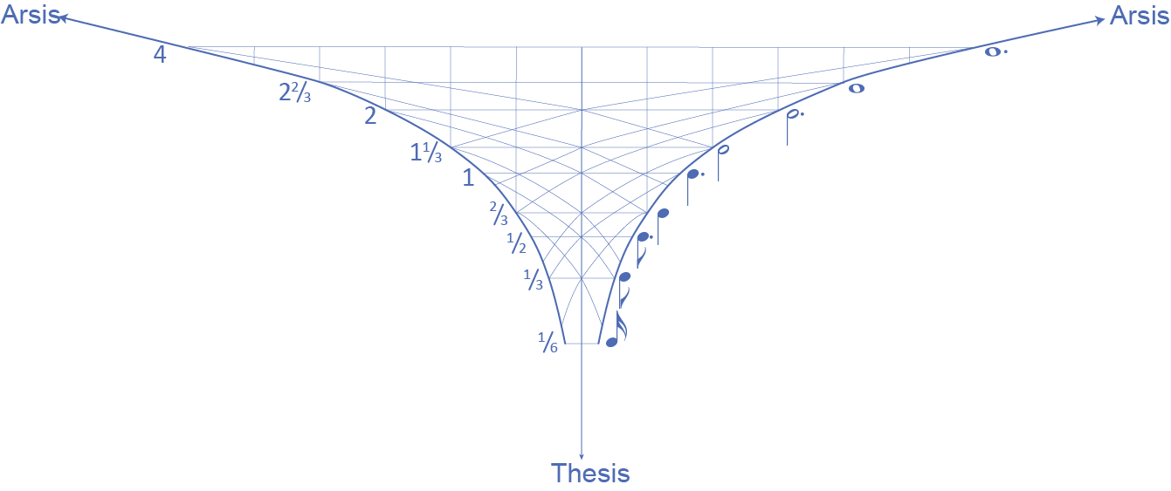
“Auf dem See” Op. 106/2
Basic ⁶₈ meter
Displacement of beat
ahead by x
Displaced hemiola
lifts to displacement
of q. back by e
Duple subdivision of q.
Notes:
The displaced meter in red is conceptually linked to the lake (through the wave figure in the piano).
Displacement represents the narrator’s act of externalizing his own thoughts.
The green point is associated with the simple pastoral character of the narrator and his vocal rhythm.

Slide 15
“Auf dem See” Op. 106/2
Piano introduction and interludes
Emphasis on weak eighth
Oom-pah figure gives rise to ³₄ meter
Notes:
This figure remains in play throughout the song.

Slide 16
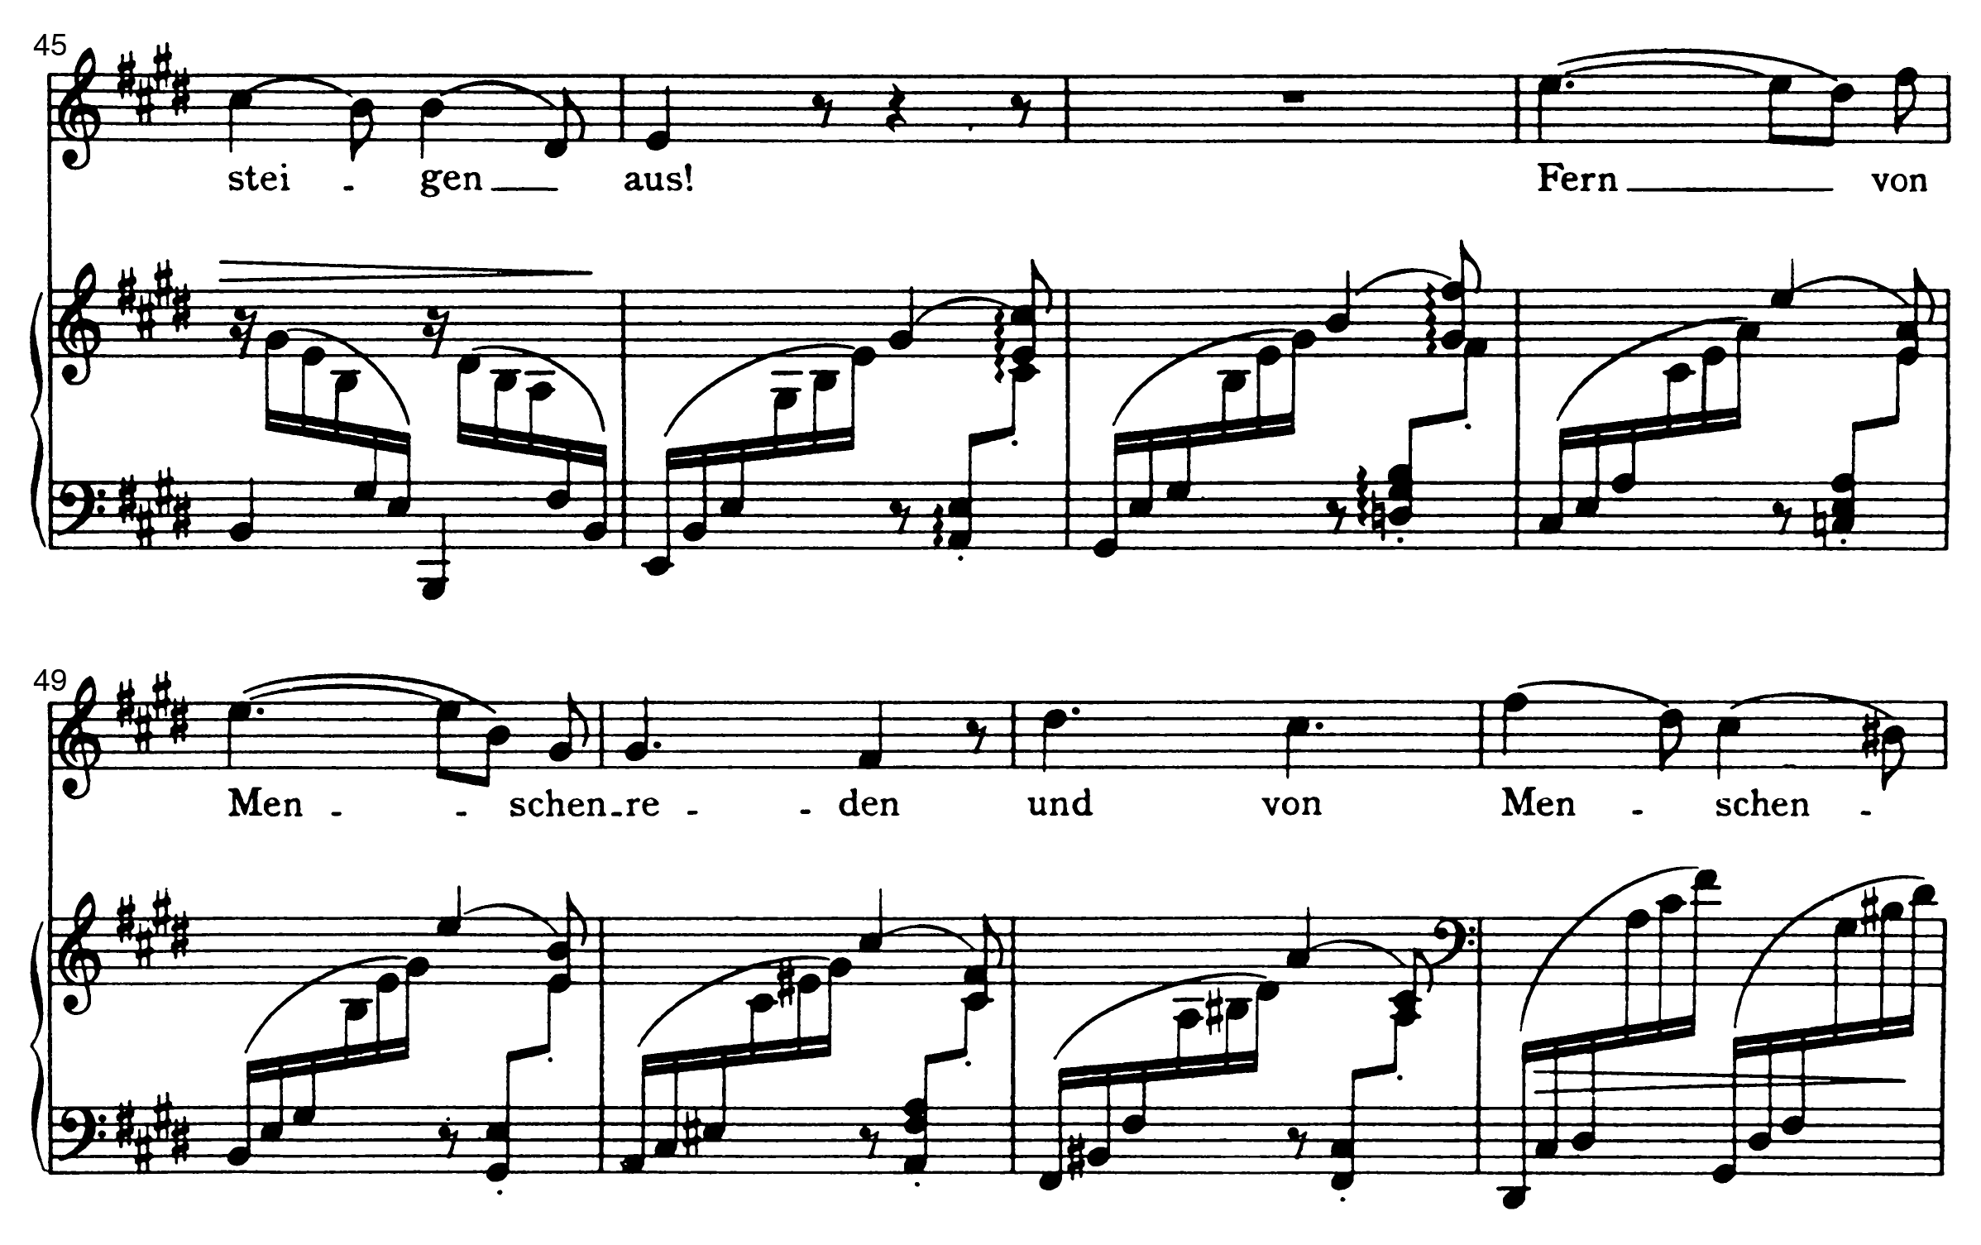
“Auf dem See” Op. 106/2
Final strophe (6), interlude figure accompanies the vocal line. “Far from human speech and human thoughts.” Vocal phrase extended (3 meas. phrase).
Notes:
Previous stanzas are all strictly set two measures per line with the rhythm q e q e q. q.
In the last stanza accented syllables are all on downbeats, by augmenting the q e q e rhythm to h e e
Note how the last eighth is separated in phrasing, it is not h q h q
Play from 1:25

Slide 17
“Kein Haus, keine Heimat,”
Op. 94/5

Slide 18
“Kein Haus, keine Heimat” Op. 94/5
Friedrich Halm (“In der Südsee”)
Kein Haus, keine Heimat,
Kein Weib und kein Kind,
So wirbl’ ich, ein Strohhalm,
In Wetter und Wind!
Well’ auf und Well’ nieder,
Bald dort und bald hier;
Welt, fragst du nach mir nicht,
Was frag’ ich nach dir?
No house, no homeland,
No wife and no child,
So I whirl, like a piece of straw,
In rain and wind!
Ebb and flow,
Soon there and soon here;
World, if you do not ask after me,
Why should I ask after you?
Notes:
From a long-form narrative poem, sung by a black sailor, Jupiter, who sacrifices himself for a white girl he loves but cannot have because of his race.
(Youens, “Of cannibalism, the abolitionist movement, and Brahms: An unlikely connection” http://www.sparksandwirycries.org/magazine/2018/6/6/susan-youens-on-song )
Focus is on Jupiter’s lack of worldly anchor which might also be a commentary on slavery (slavery creates a homeless race).

Slide 19
“Kein Haus, keine Heimat” Op. 94/5
³₂ meter hidden in opening (rep. of D). Displaced by h.
Displaced hemiola emphasizes hypermetrically weak measures
Two-measure hypermeter, ³₄ meter
Displaced hypermeter subdivided by h
Hypermeter displaced by q

Slide 20
“Kein Haus, keine Heimat” Op. 94/5
Regular ³₄ meter
Displaced ³₄ meter
Hypermetrically displaced ³₂ meter
(“hidden” meter in mm. 2–5)
Subdivision by h
Displaced hemiola
Notes:
The displaced meter represents the chaos of Jupiter’s unmoored existence, “whirling like a piece of straw in rain and wind.”
The displaced hypermeter gives the vocal line its heavy and assertive quality. The singer always leaps down to a low D at the points.
By connecting them, the displaced hemiola paradoxically associates two of Jupiter’s essential qualities, his strength and moral clarity, and his inability to resist the whims of fate (straw in the wind).

Slide 21
“Kein Haus, keine Heimat” Op. 94/5
Second verse:
Unarticulated hypermetric strong beat
Inconclusive (questioning) ending (I = V/iv?)
Last chord
is a weak beat
in all meters
(untethered
narrator)
h layer extended
Notes:
The text ends with an unanswered and unanswerable question: “World, why should I ask after you?” For the first time the vocal line does not leap down at the end of the line. The ending piano chord on a weak beat in all meters portrays the death of Jupiter as the apotheosis of his existence, unanchored by downbeat or tonic note. This supports Susan Youens’ characterization of Jupiter as a black Christ figure (whose essence is fully realized in death).

Slide 22
“Mein Herz ist schwer,”
Op. 94/3

Slide 23
“Mein Herz is schwer” Op. 94/3
Mein Herz ist schwer, mein Auge wacht,
Der Wind fährt seufzend durch die Nacht;
Die Wipfel rauschen weit und breit,
Sie rauschen von vergangner Zeit.
Sie rauschen von vergangner Zeit,
Von großem Glück und Herzeleid,
Vom Schloß und von der Jungfrau drin—
Wo ist das alles, alles hin?
Wo ist das alles, alles hin,
Leid, Lieb und Lust und Jugendsinn?
Der Wind fährt seufzend durch die Nacht,
Mein Herz ist schwer, mein Auge wacht.
My heart is heavy, my eyes keep watch,
The wind goes sighing through the night.
The treetops murmur far and wide;
Murmuring of times now past.
Murmuring of times now past,
Of great happiness and heartache,
Of the castle and the maiden within –
Where has all this, all this fled?
Where has all this, all this fled?
Grief, love and joy and youth?
The wind goes sighing through the night,
My heart is heavy, my eyes keep watch.
Emanuel Geibel
trans. Richard Stokes
Notes:
Wing Lau, Composing Declamation: Notated Meter Changes in Brahms’s Lieder. MTO 2015: https://www.mtosmt.org/issues/mto.15.21.2/mto.15.21.2.lau.html

Slide 24
“Mein Herz is schwer” Op. 94/3
Poetic structure:
Song Form:
Mein Herz ist schwer, mein Auge wacht,
Der Wind fährt seufzend durch die Nacht;
Die Wipfel rauschen weit und breit,
Sie rauschen von vergangner Zeit.
Sie rauschen von vergangner Zeit,
Von großem Glück und Herzeleid,
Vom Schloß und von der Jungfrau drin—
Wo ist das alles, alles hin?
Wo ist das alles, alles hin,
Leid, Lieb und Lust und Jugendsinn?
Der Wind fährt seufzend durch die Nacht,
Mein Herz ist schwer, mein Auge wacht.
Mein Herz ist schwer, mein Auge wacht,
Der Wind fährt seufzend durch die Nacht;
Die Wipfel rauschen weit und breit,
Sie rauschen von vergangner Zeit.
Sie rauschen von vergangner Zeit,
Von großem Glück und Herzeleid,
Vom Schloß und von der Jungfrau drin—
Wo ist das alles, alles hin?
Wo ist das alles, alles hin,
Leid, Lieb und Lust und Jugendsinn?
Der Wind fährt seufzend durch die Nacht,
Mein Herz ist schwer, mein Auge wacht.
Notes:
Brahms violates his principle of strophic setting in this song (Jenner), motivated by the repetitions in the text.
Wing Lau, Composing Declamation: Notated Meter Changes in Brahms’s Lieder. MTO 2015: https://www.mtosmt.org/issues/mto.15.21.2/mto.15.21.2.lau.html

Slide 25
“Mein Herz is schwer” Op. 94/3
Song Form:
Mein Herz ist schwer, mein Auge wacht,
Der Wind fährt seufzend durch die Nacht;
Die Wipfel rauschen weit und breit,
Sie rauschen von vergangner Zeit.
Sie rauschen von vergangner Zeit,
Von großem Glück und Herzeleid,
Vom Schloß und von der Jungfrau drin—
Wo ist das alles, alles hin?
Wo ist das alles, alles hin,
Leid, Lieb und Lust und Jugendsinn?
Der Wind fährt seufzend durch die Nacht,
Mein Herz ist schwer, mein Auge wacht.
9
4
meter, 1 line per 2 meas.
6
4
meter, displaced hemiola
6
4
meter, 1 line per 2 meas.
Parallelism
Closing gesture (broadening)
Piano interlude recalls displaced meter
Return to meter and opening melody
9
4
Notes:
Wing Lau, Composing Declamation: Notated Meter Changes in Brahms’s Lieder. MTO 2015: https://www.mtosmt.org/issues/mto.15.21.2/mto.15.21.2.lau.html

Slide 26
“Mein Herz is schwer” Op. 94/3
Strong ⁹₄
Weak ⁹₄
Strong ⁹₄
Weak ⁹₄
⁶₄ meter
Displaced ³₂ meter
Notes:
The opening 9-8 section represents the narrator’s inner turmoil, with an unstable rhythm.
Although the first section cadences on the notated strong 9-4 meter, 6-4 meter of “die Wipfel rauschen” starts from the weak 9-4.
This becomes a consistent meter for entire middle section. The shift of downbeat along with the triple-to-duple change, create the effect of entering a different world, the imagined happy past.
The relatively inactive texture at “die Wipfel rauschen” seems at first to be poor text painting.
Notice the hairpins which emphasize the second beat of the 3-2 meter.

Slide 27
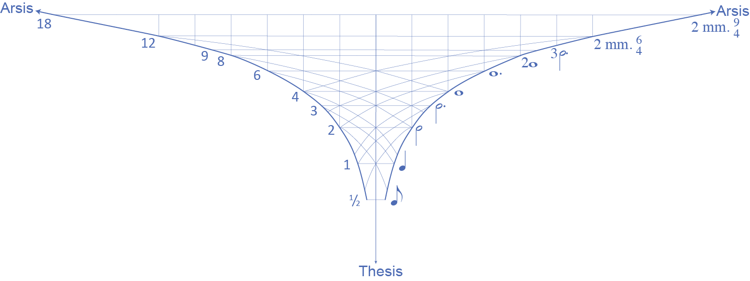
“Mein Herz is schwer” Op. 94/3
Weak beat
of ⁹₄ intro
Strong beat
of ⁹₄ intro
Main ⁶₄ meter
Displaced ³₂
Notes:
The displaced 3-2 lifts to a displacement ahead by a dotted half.
This is the same displacement that occurs in the opening 9-4 meter.
The 6-4 meter, however, lines up with the weak beat of the 9-4 section, so it reproduces the dotted half-note displacement shifted ahead by a dotted half.
The implied motion of the metric shift represents the rustling in the treetops at a deeper level, despite a texture that on the surface reflects the stillness of the night. Brahms thereby represents the “rustling” as something interior, having more to do with the narrator’s psychological state.

Slide 28
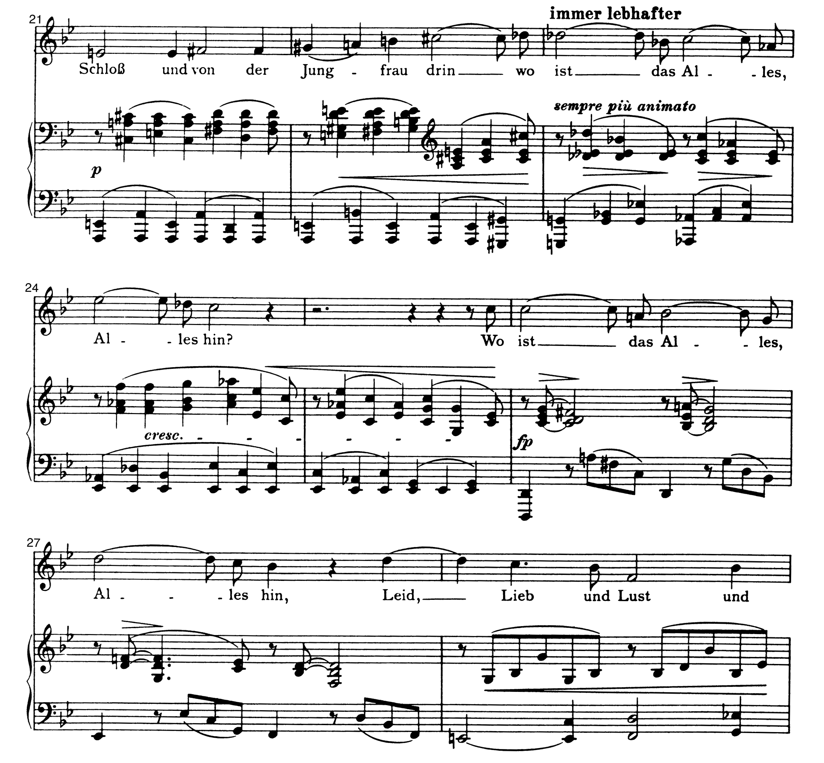
“Mein Herz is schwer” Op. 94/3
2 m. phrase
3 m. phrases
Notes:
The latter part of the middle section expands to three-measure phrases, which match the two-measure hypermeter of the 9-4 meter. This happens where the poem starts to return to the narrator’s present state: “Where has all this fled.”
Recording from 0:51

Slide 29
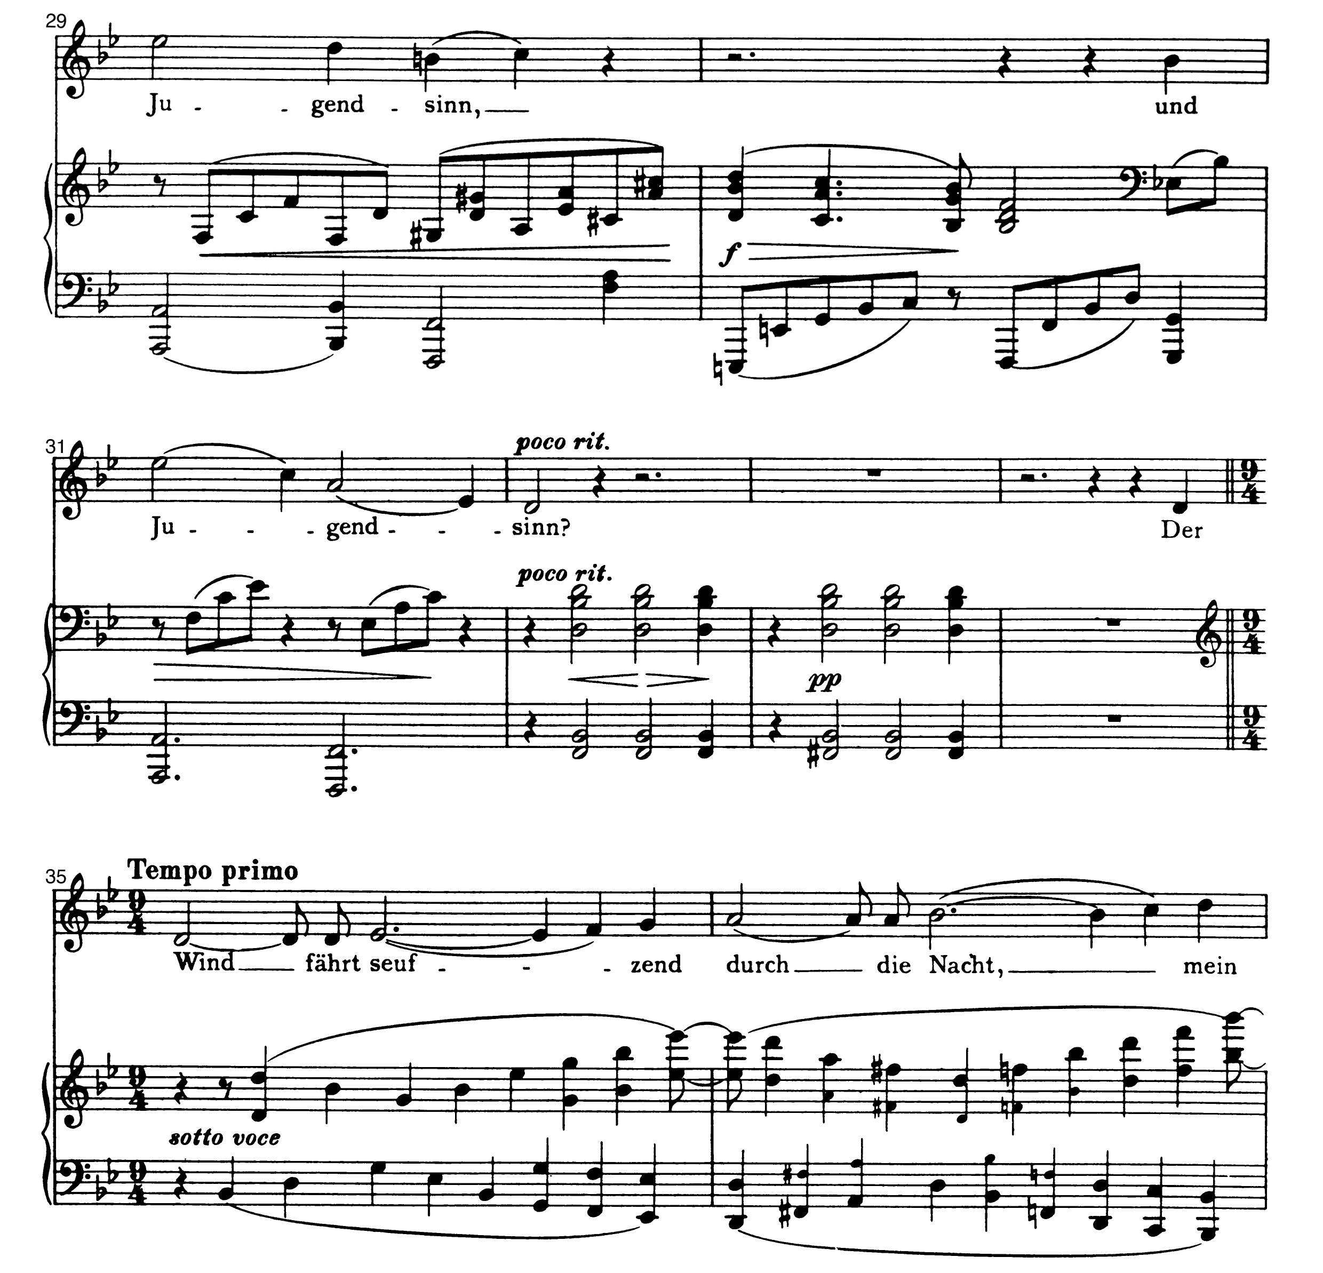
“Mein Herz is schwer” Op. 94/3
3 m. phrases
⁶₄ meter
Displaced
³₂ meter
Strong ⁹₄
Weak ⁹₄
Notes:
Return to 9-4. The three-measure phrases match the two-measure phrases of 9-4. The main beat of the 6-4 meter lines up with the main beat of the 9-4 meter. The coincidence of the 6-4 and displaced 3-2 meters lines up with the weak 9-4 beat.

Slide 30
“Mein Herz is schwer” Op. 94/3
Strong beat
of ⁹₄ outro
Weak beat
of ⁹₄ outro
Main ⁶₄ meter
Displaced ³₂
Notes:
The displaced 3-2 lifts to the same dotted-half displacement as before but with the shift to three-measure hypermeter, it can also be attributed to a larger three-measure unit.
When the 9-4 meter returns the strong metrical position lines up with the 6-4 meter.
Therefore the shift induced by the 3-2 meter is now the same as the displacement in the 9-4 meters.
This unites the turbulence of the narrator’s present state with the feelings of loss brought on by his memories of the past.

Slide 31
Conclusions
• Displaced hemiola plays an important role in multiple of Brahms’s late songs.
• Displaced hemiolas give rise (“lift”) to a new displacement, a coincidence point between weak beats.
• The “metric cyclone” is a good way to visualize this process.
• In the songs, different meters, displacements, and weak beats, can all have important poetic associations, so the “lifting” effect may engender a musical interpretation of the text.

Slide 32
Selected Bibliography
Cohn, Richard. 1992. “The Dramatization of Hypermetric Conflicts in the Scherzo of Beethoven’s Ninth Symphony.” 19th-Century Music 15 (3): 188–206.
———. 2001. “Complex Hemiolas, Ski-Hill Graphs and Metric Spaces.” Music Analysis 20 (3): 295–326.
———. 2018. “Brahms at Twenty: Hemiolic Varietals and Metric Malleability in an Early Sonata.” Brahms and the Shaping of Time ed. Scott Murphy. Univ. of Rochester Press: 178–204.
Jenner, Gustav. 2009. “Johannes Brahms as Man, Teacher, and Artist,” Trans. S. Gillespie and E. Kaestner. In Brahms and his World, ed. W. Frisch, K.C. Karnes. Princeton University Press: 381–424.
Krebs, Harald. 1999. Fantasy Pieces: Metrical Dissonance in the Music of Robert Schumann. Oxford University Press.
Lau, Wing. 2015. “Composing Declamation: Notated Meter Changes in Brahms’s Lieder.” Music Theory Online 21 (2).
Lewin, David. 1981. “On Harmony and Meter in Brahms’s Op. 76, No. 8.” 19th-Century Music 4 (3): 261–265.
Malin, Yonatan. 2006. “Metric Displacement Dissonance and Romantic Longing in the German Lied.” Music Analysis 25 (3): 251–288.
McClelland, Ryan. 2018. “Hemiola as Agent of Metric Resolution in the Music of Brahms.” Brahms and the Shaping of Time ed. Scott Murphy. Univ. of Rochester Press: 143–177.
———. 2010. Songs in Motion: Rhythm and Meter in the German Lied. Oxford University Press.
Murphy, Scott. 2009. “Metric Cubes in Some Music of Brahms.” Journal of Music Theory 53 (1): 1–56.
Platt, Heather. 2018. “Temporal Disruptions and Shifting Levels of Discourse in Brahms’s Leider.” Brahms and the Shaping of Time ed. Scott Murphy. Univ. of Rochester Press: 49–82.
Popoff, Alexandre, and Jason Yust. 2019. “Meter Networks” Journal of Mathematics and Music
Youens, Susan. 2018. “Of Cannibalism, the Abolitionist Movement, and Brahms: An Unlikely Conjunction. Sparks and Wiry Cries 6 (6). sparksandwirycries.org/magazine/2018/6/6/susan-youens-on-song
Yust, Jason. 2018. Organized Time: Rhythm, Tonality, and Form. Oxford University Press.

Slide 33
Multivalent Displaced Hemiolas in Brahms’s Late Songs
Brahms’s Hybrid Metric Dissonances Brahms 2022: New Paths, New Perspectives American Brahms Society
Jason Yust, .
http:/sites.bu.edu/jyust
jason.yust@gmail.com

