Slide 1

Tetrachordal Folding operations Applied to Morton Feldman’s For stefan Wolpe
Jason Yust, .
Conference in Honor of Jonathan Bernard
University of Washington, Seattle, 6/17–18, 2022

Slide 2
Overview
• Bernard’s trichordal infolding and unfolding: Relating sets by intervallic similarity
• Generalization from pitch sets to pitch-class sets
• Generalization of folding to tetrachords
• Morton Feldman’s For Stefan Wolpe (for SATB choir and vibraphones)

Slide 3
Trichordal Folding

Slide 4
Trichordal Folding
Examples from Bernard, Music of Edgar Varése
“Unfolding”
“Infolding”
Ex. 3.2:
Intervals: {3,8,11}➞{3,11,14} {3,8,11}➞{8,11,19} {3,8,11}➞{3,5,8}
PC intervals: {1,3,4}➞{1,2,3} {1,3,4}➞{1,3,6} {1,3,4}➞{3,4,5}
Ex. 3.3:
Folding relations are invariant with respect to inversion

Slide 5
Trichordal Folding
Examples from Bernard, Music of Edgar Varése
Ex. 3.5:
{1, 7, 8}
{1, 5, 6}
➞
Intervals:
{1, 6, 7}
{6, 7, 13}➞{1, 6, 7}
➞
{1, 4, 5}
{1, 5, 6}
➞
PC intervals:
{1, 5, 6}
{1, 5, 6}➞{1, 5, 6}
➞

Slide 6
Trichordal Folding
Examples from Bernard, Music of Edgar Varése
Ex. 3.6 (Nocturnal):

Slide 7
Trichordal Folding
Examples from Bernard, Music of Edgar Varése
Ex. 3.9:
(Offrandes)

Slide 8
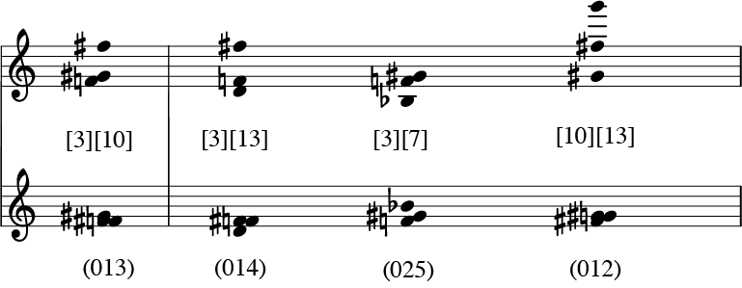
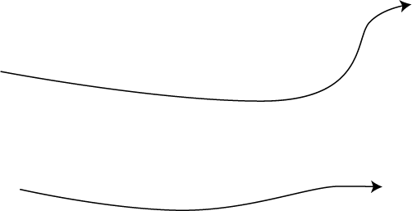
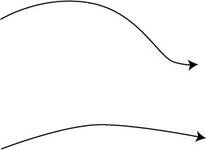

Trichordal Folding
Pitch space foldings generalize to pitch-class foldings

Slide 9
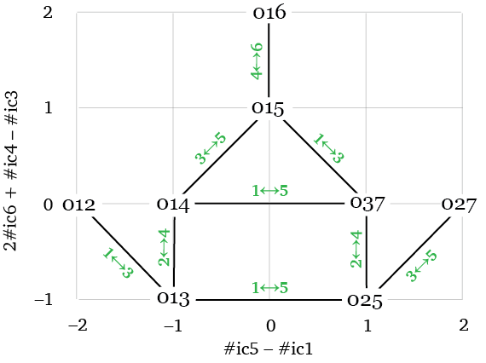
Trichordal Folding
Network of trichordal folding relations between pcsets

Slide 10
tetrachordal Folding

Slide 11
generalization of folding
For a set of size n:
Choose two subsets of size n – 1 whose intersection (size n – 2) is inversionally symmetrical.
Invert one subset around the axis of the shared size-(n – 2) set.
• One note moves.
• The sets share two subset types of size n – 1.
• The sets share all interval types except one.
For tetrachords:
Choose two trichordal subsets.
Invert one trichord around the axis of the shared dyad.

Slide 12
Tetrachordal Folding
Examples
w
w
#
w
#
#
#
w
w
w
w
w
#
#
#
w
w
9
1
4
9
4
1
4 1 9
5 10
14
4 9 1
10
14
5
10
13
1
<2,2,1,1,0,0>
<1,2,1,1,1,0>

Slide 13
Tetrachordal Folding
Examples
w
w
#
w
#
#
w
#
w
w
w
#
w
#
w
w
9
1
4
9
5
5
1
4 5 5
9 10
14
4 1 9
5 10
14
14
1
<0,2,1,1,2,0>
<1,2,1,1,1,0>

Slide 14
Tetrachordal Folding
Examples
w
#
w
#
w
w
w
w
w
#
#
#
w
w
w
#
9
1
4
10
4
1
4
9
1 4 10
5 14
15
4 1 9
5 10
14
<1,2,1,1,1,0>
<1,2,1,1,1,0>
1

Slide 15
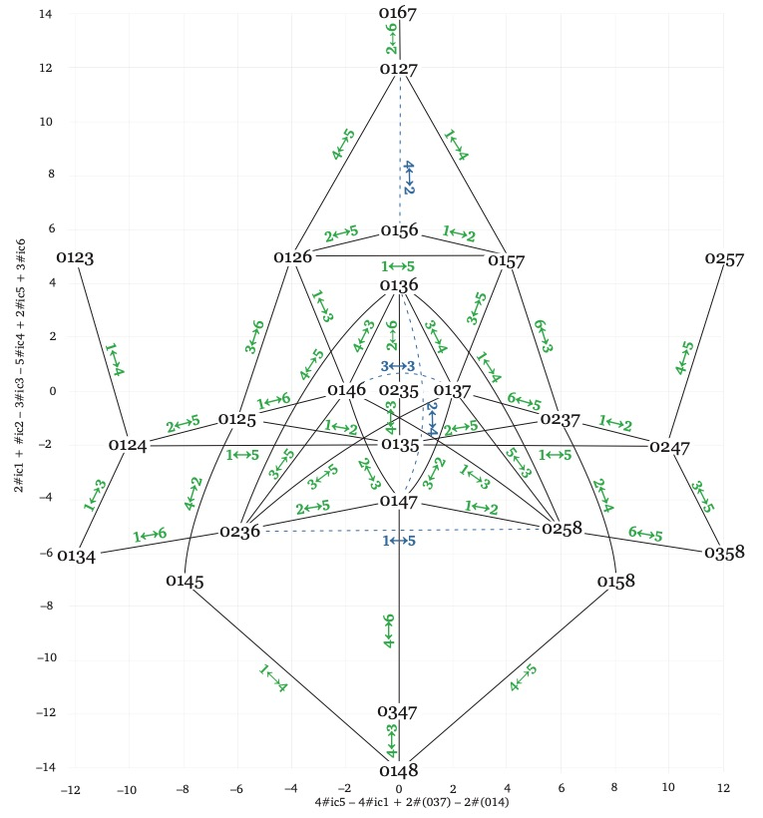
Tetra-chordal Folding
Network for pcsets

Slide 16
Morton Feldman
For stefan Wolpe
Part 1

Slide 17
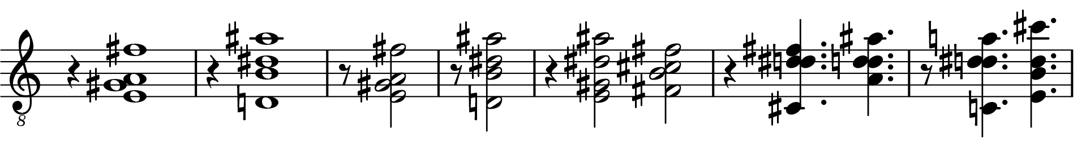
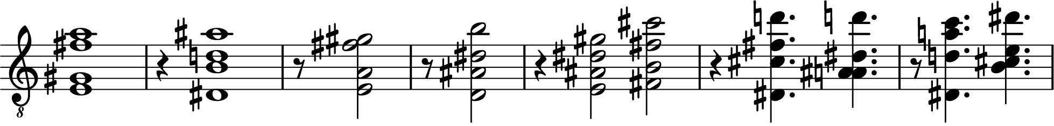
“For stefan Wolpe,” First half
Phrase 1:
Set classes: (0135) (0145) (0135) (0145) (0157) (0125) (0125) (0135)
(0277) (0136)
Phrase 2:
Feldman’s procedure here is similar to other late pieces.
• Voicing (pitch space) is important as the parameter that is varied over the course of the section, but
• Set class is also important, as the aspect of the progression that is preserved.

Slide 18
“For stefan Wolpe,” First half
Phrase 1:
Set classes: (0135) (0145) (0135) (0145) (0157) (0125) (0125) (0135)
(0277) (0136)
The first half of the piece consists of 17 varied repeats of this progression.
Phrase 2:
Phrase 2 contains most of the variant voicings common throughout the section. Together these voicings account for 11–13 out of the 17 repetitions of the progression.

Slide 19
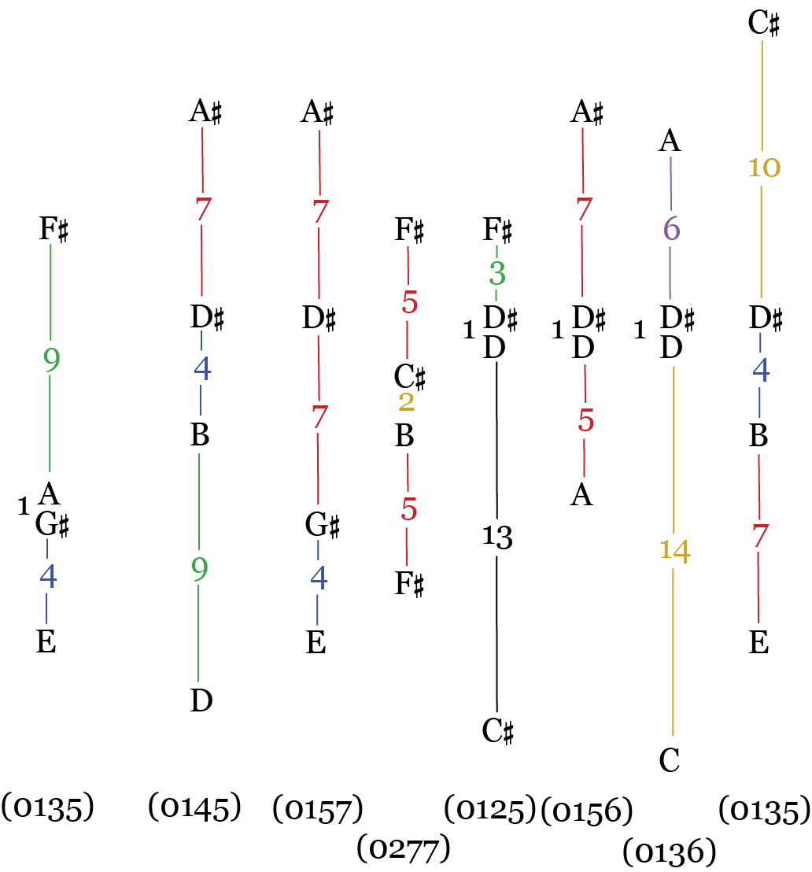
“For stefan Wolpe,” First phrase
(0277) (0136)

Slide 20
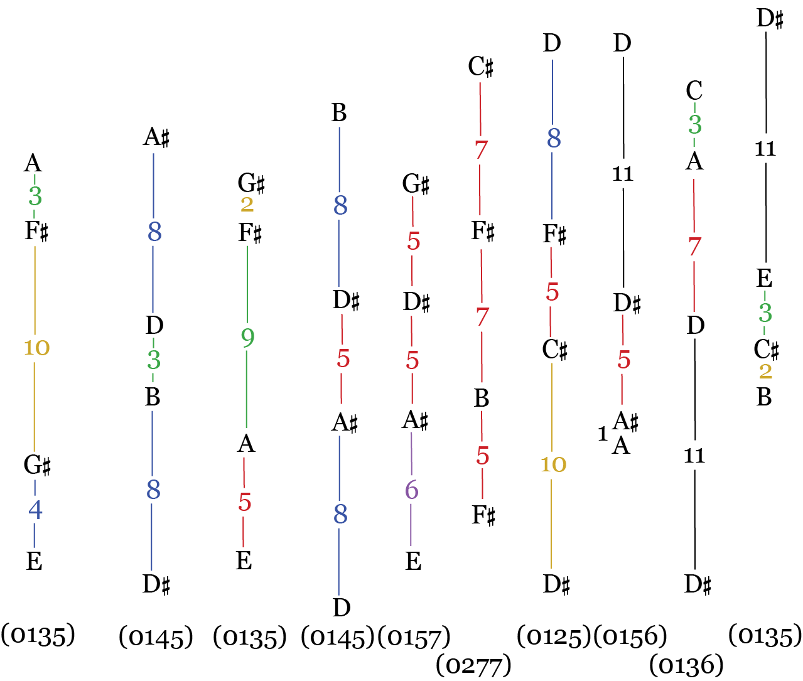
“For stefan Wolpe,” second phrase

Slide 21
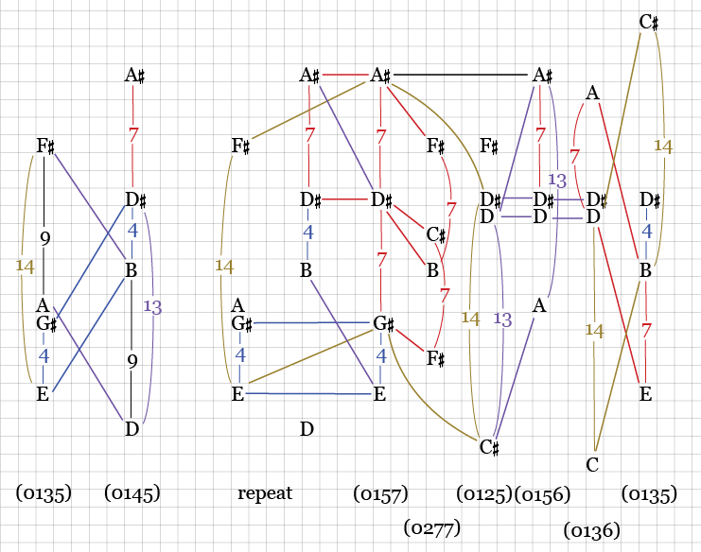
“For stefan Wolpe,” First phrase
Phrase 1:
Pitch intervals often recur between nearby chords.

Slide 22
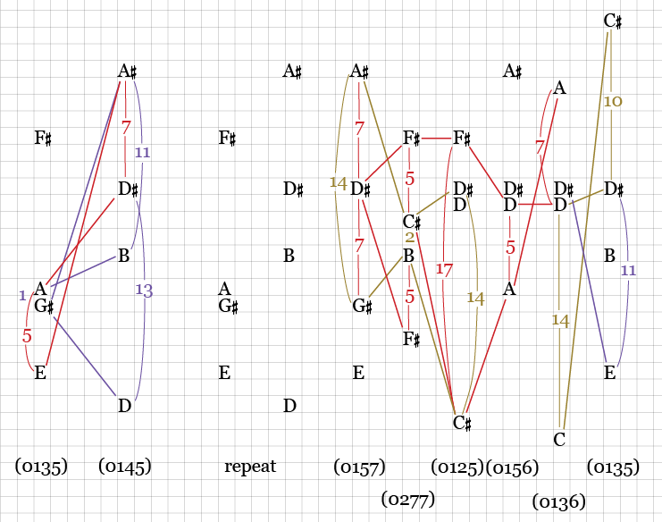
“For stefan Wolpe,” First phrase
Phrase 1:
The progression also preserves some intervals under inversion or compounding.

Slide 23
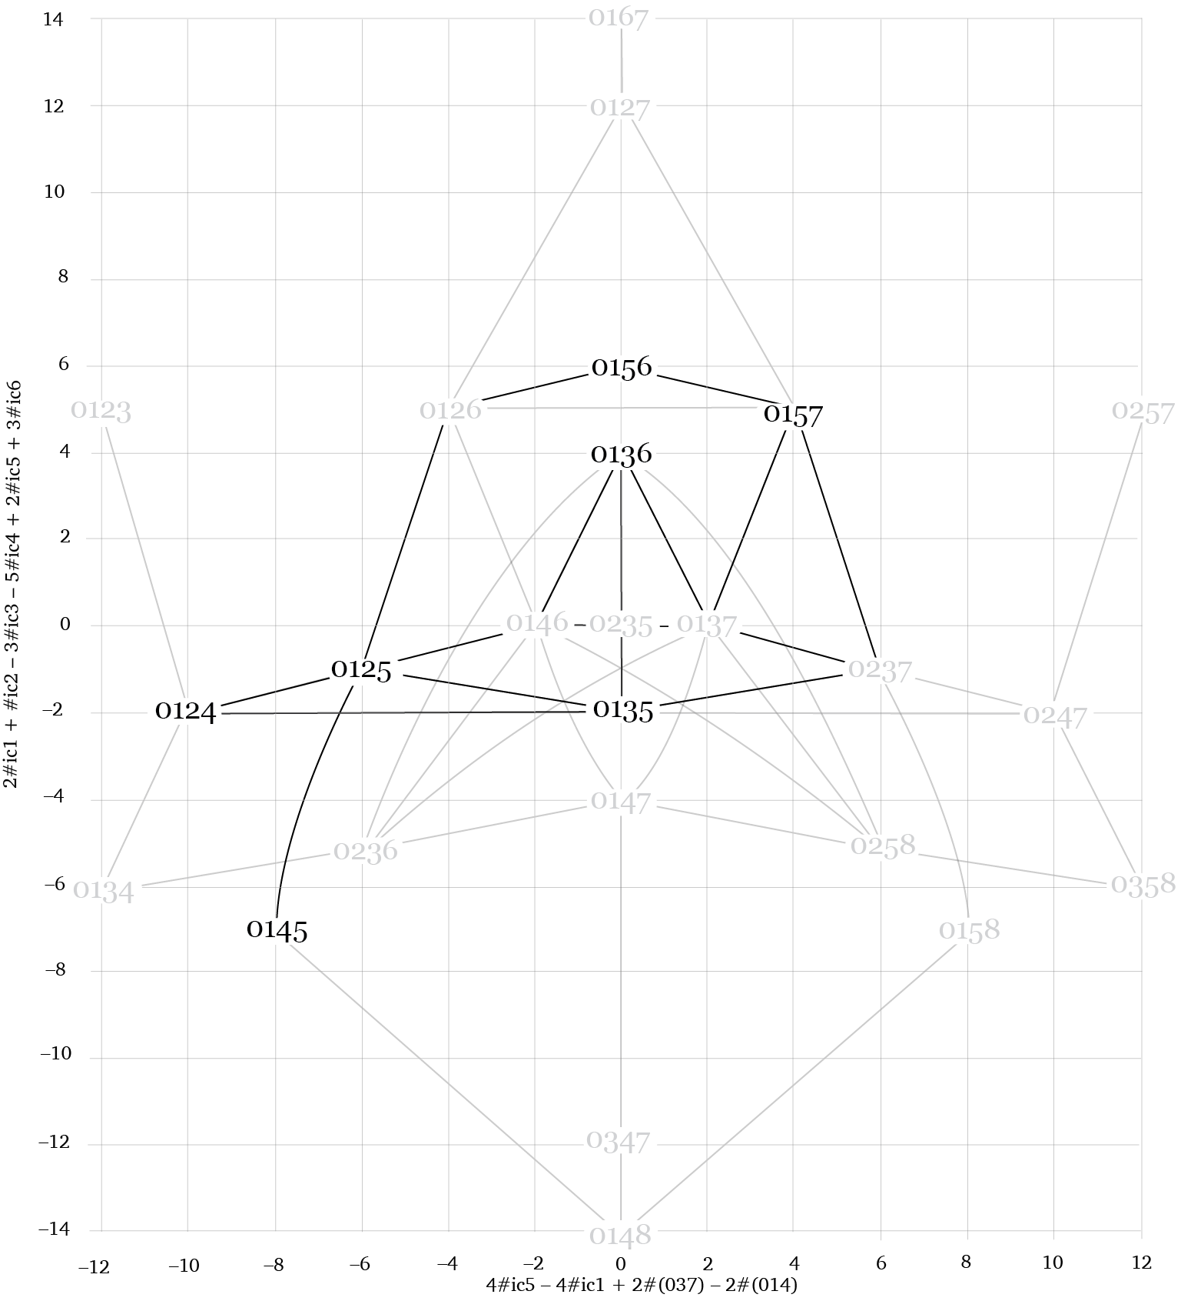
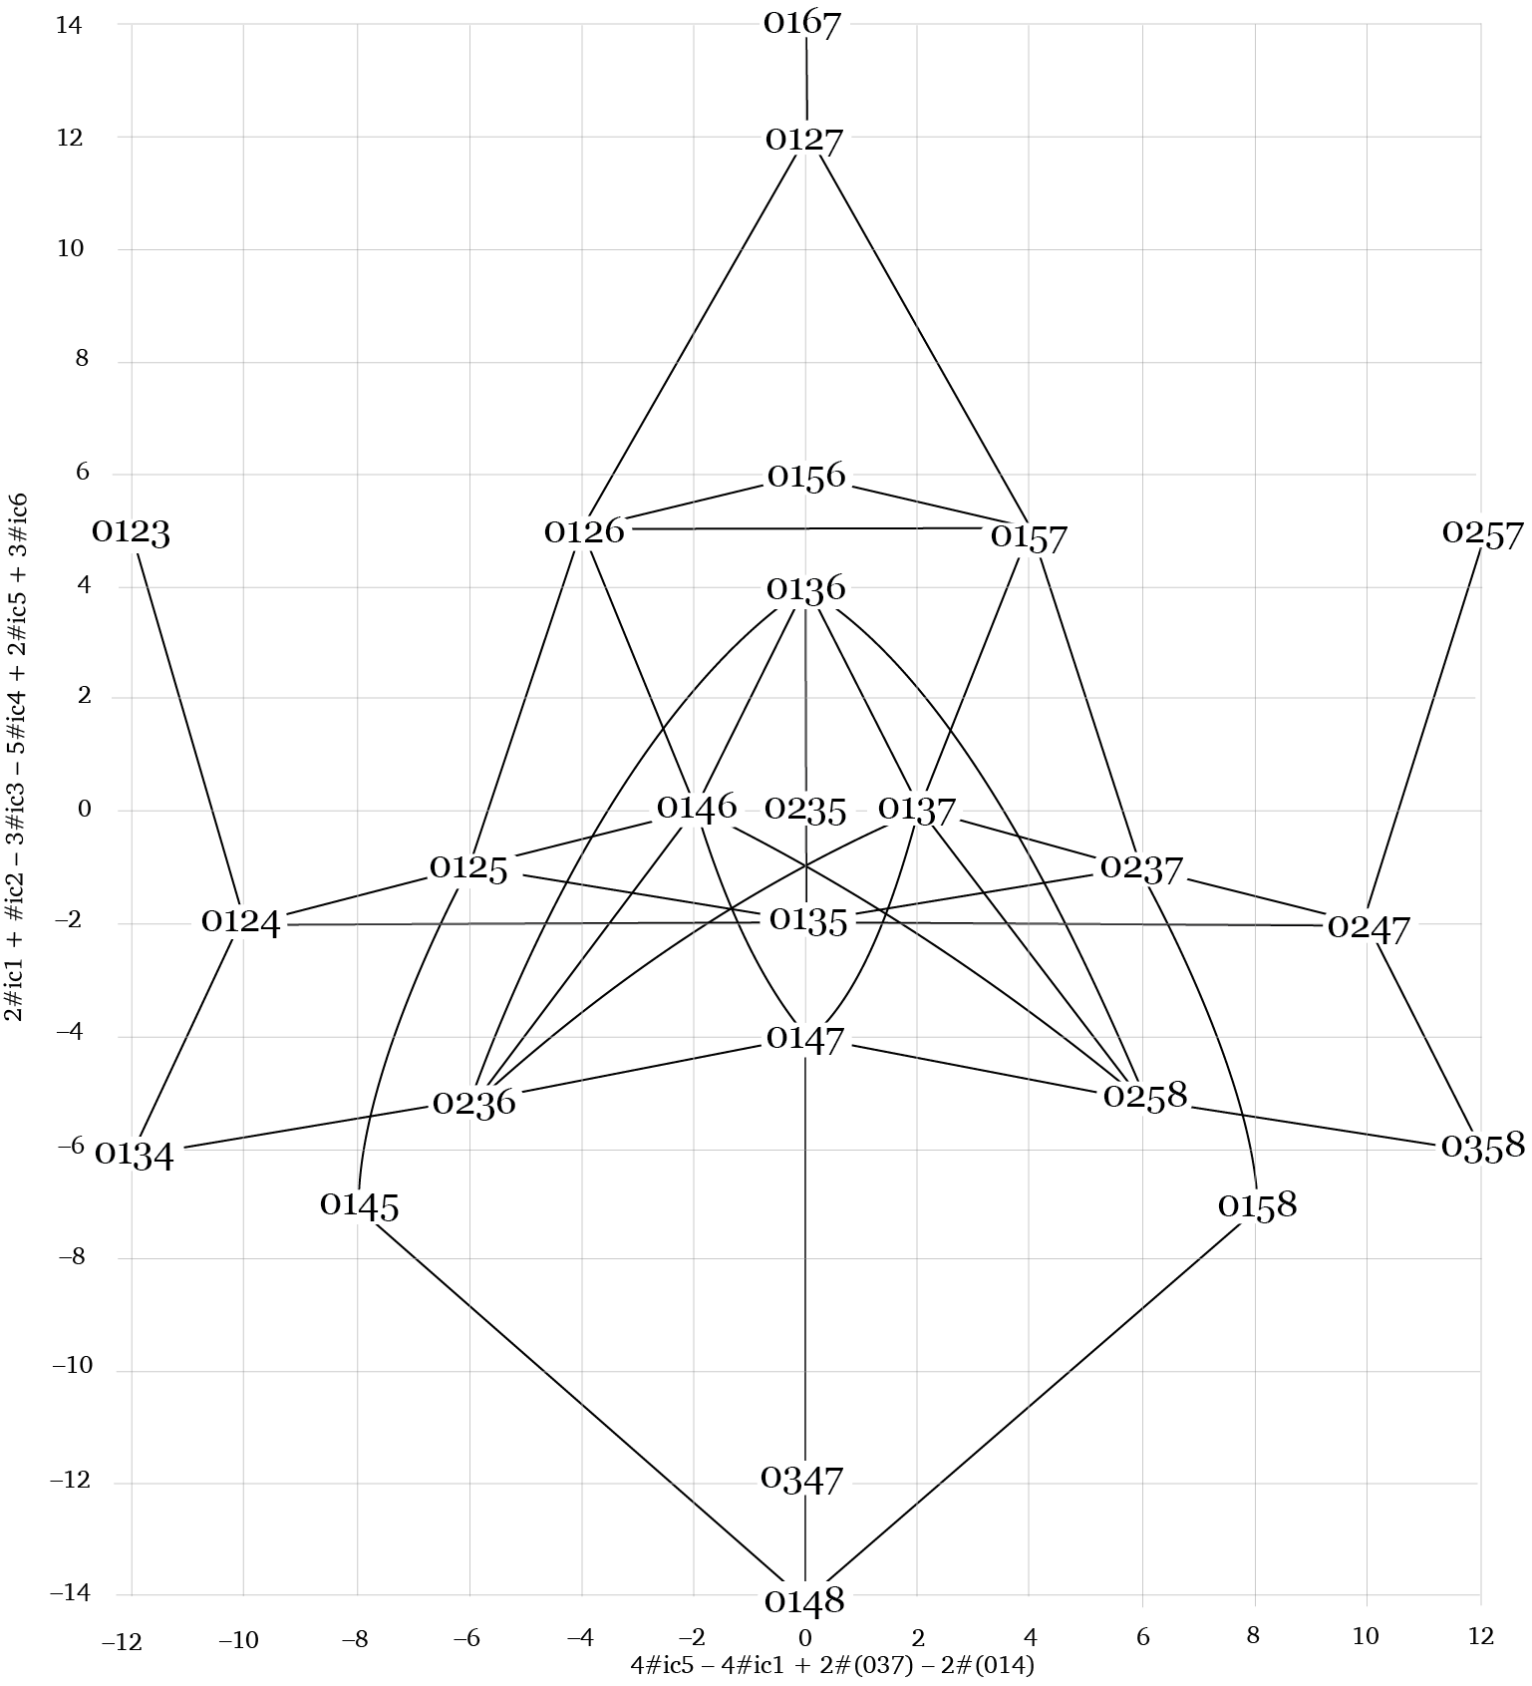
Tetra-chordal Folding
Network for pcsets
Feldman uses a limited set of nearby pcsets in the progression.

Slide 24
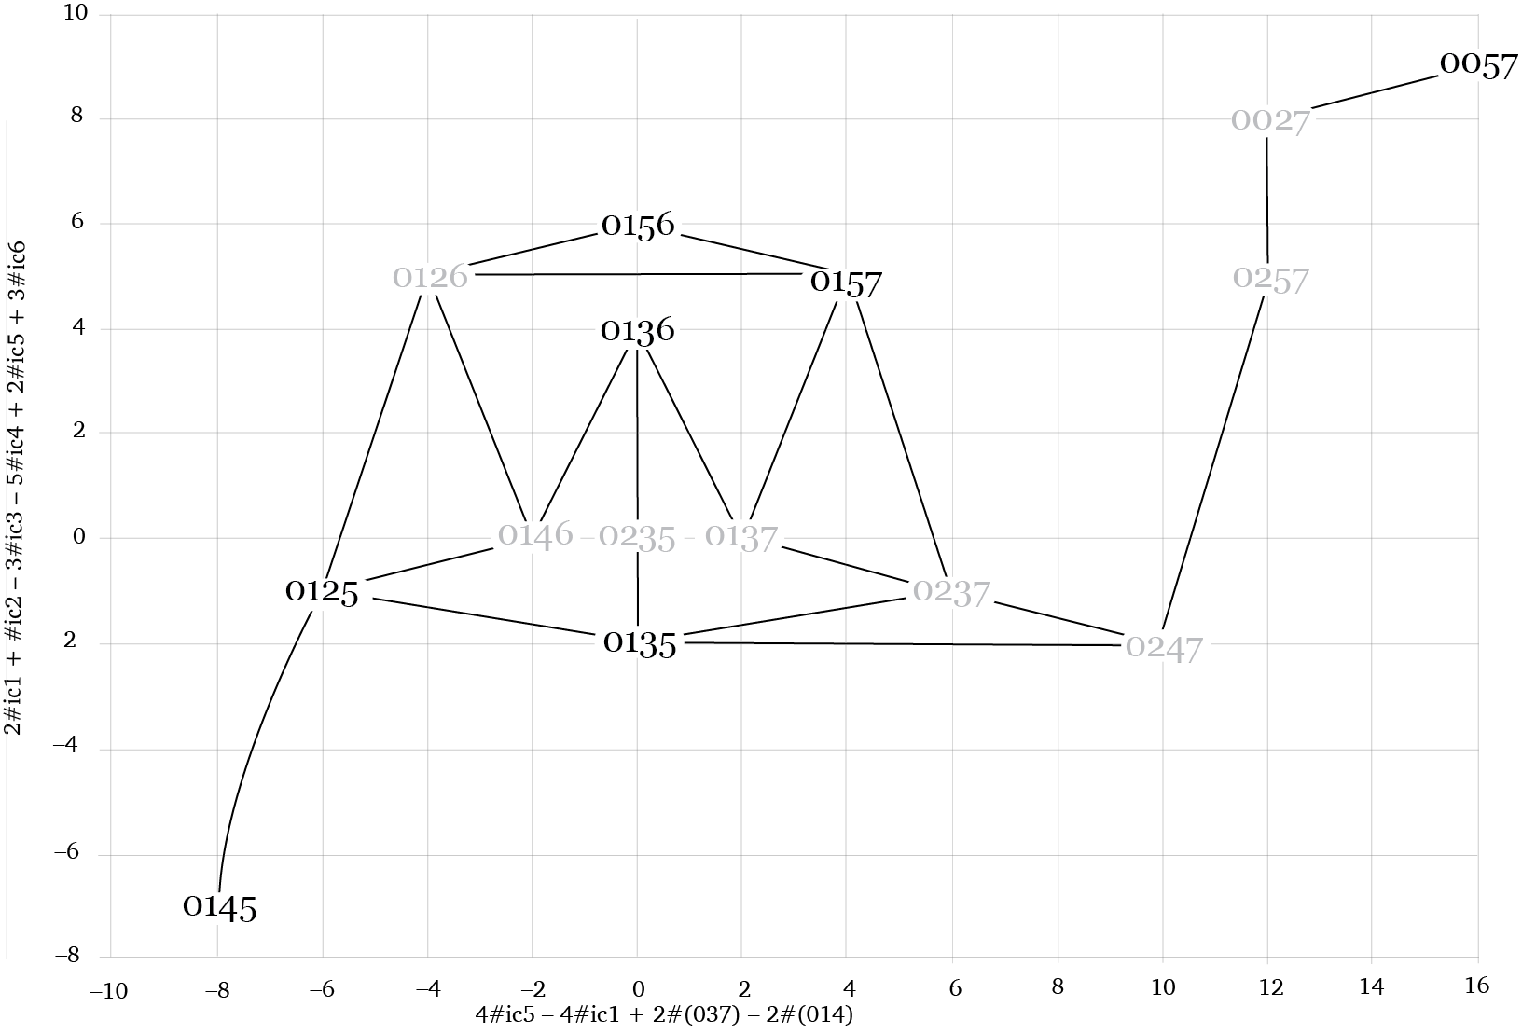
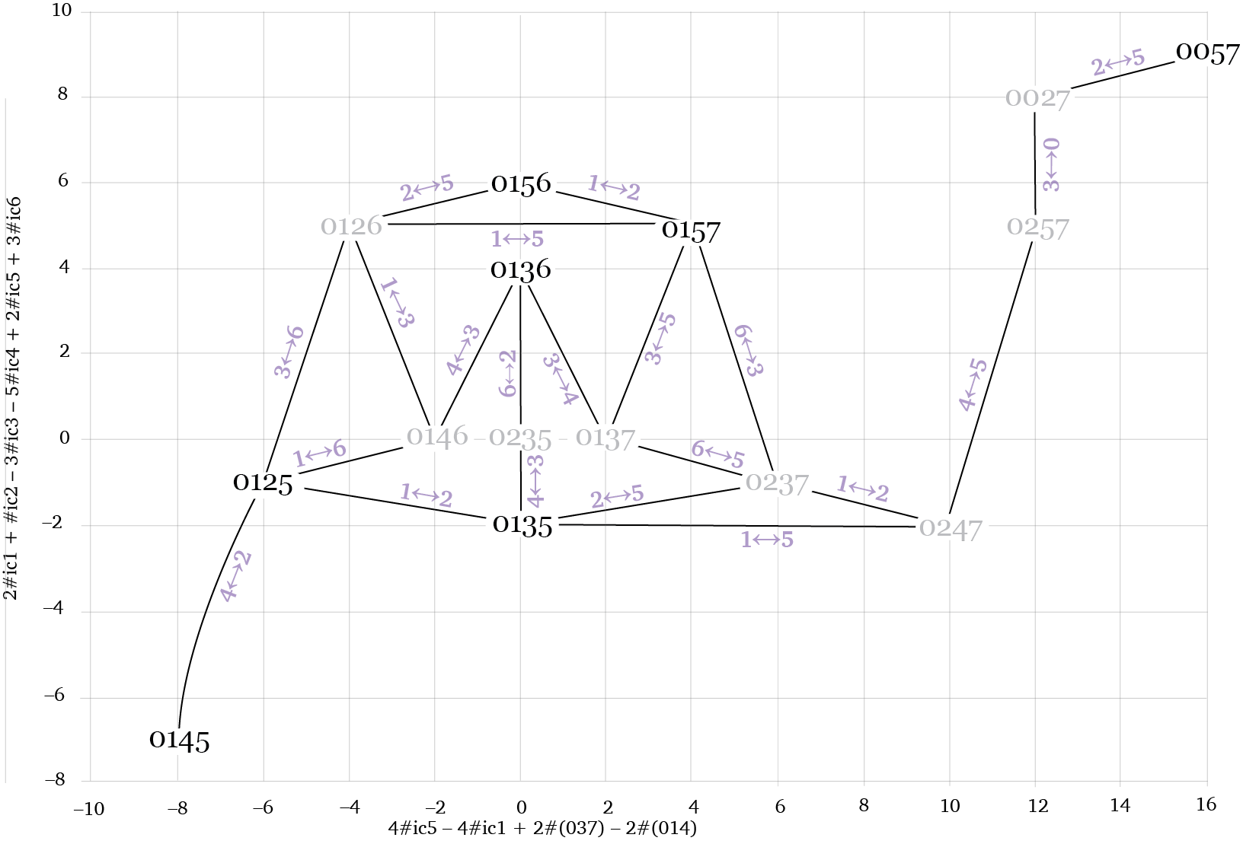
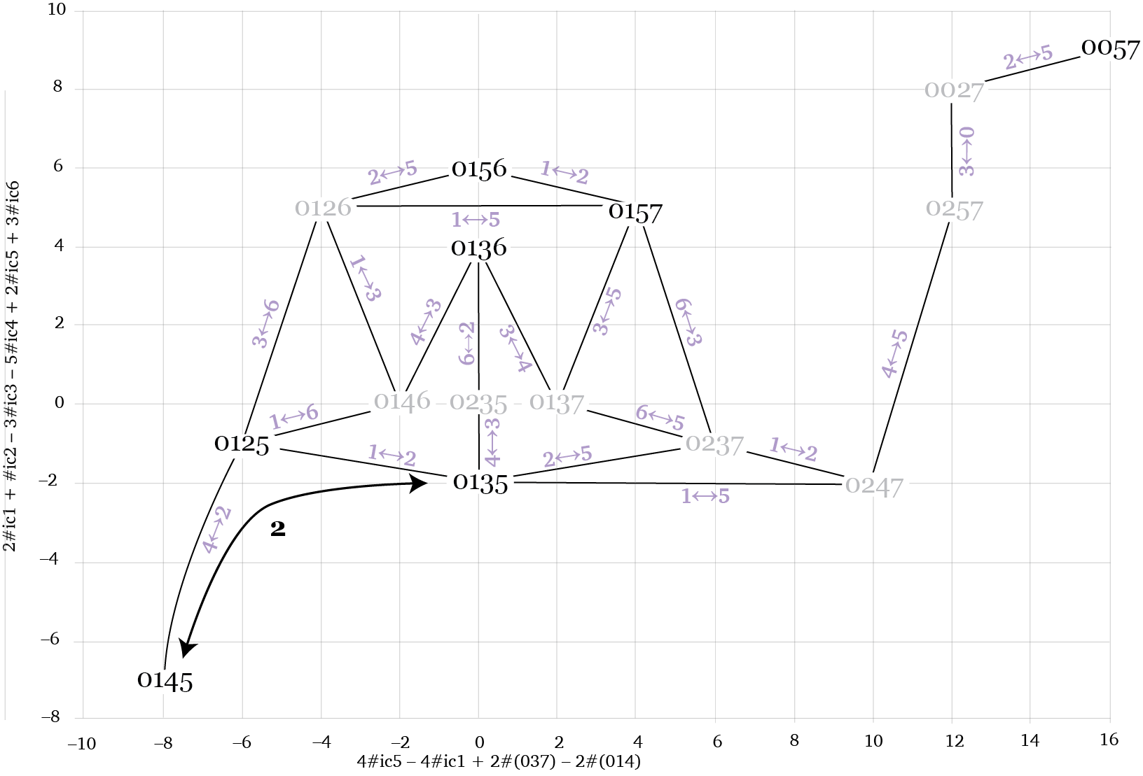
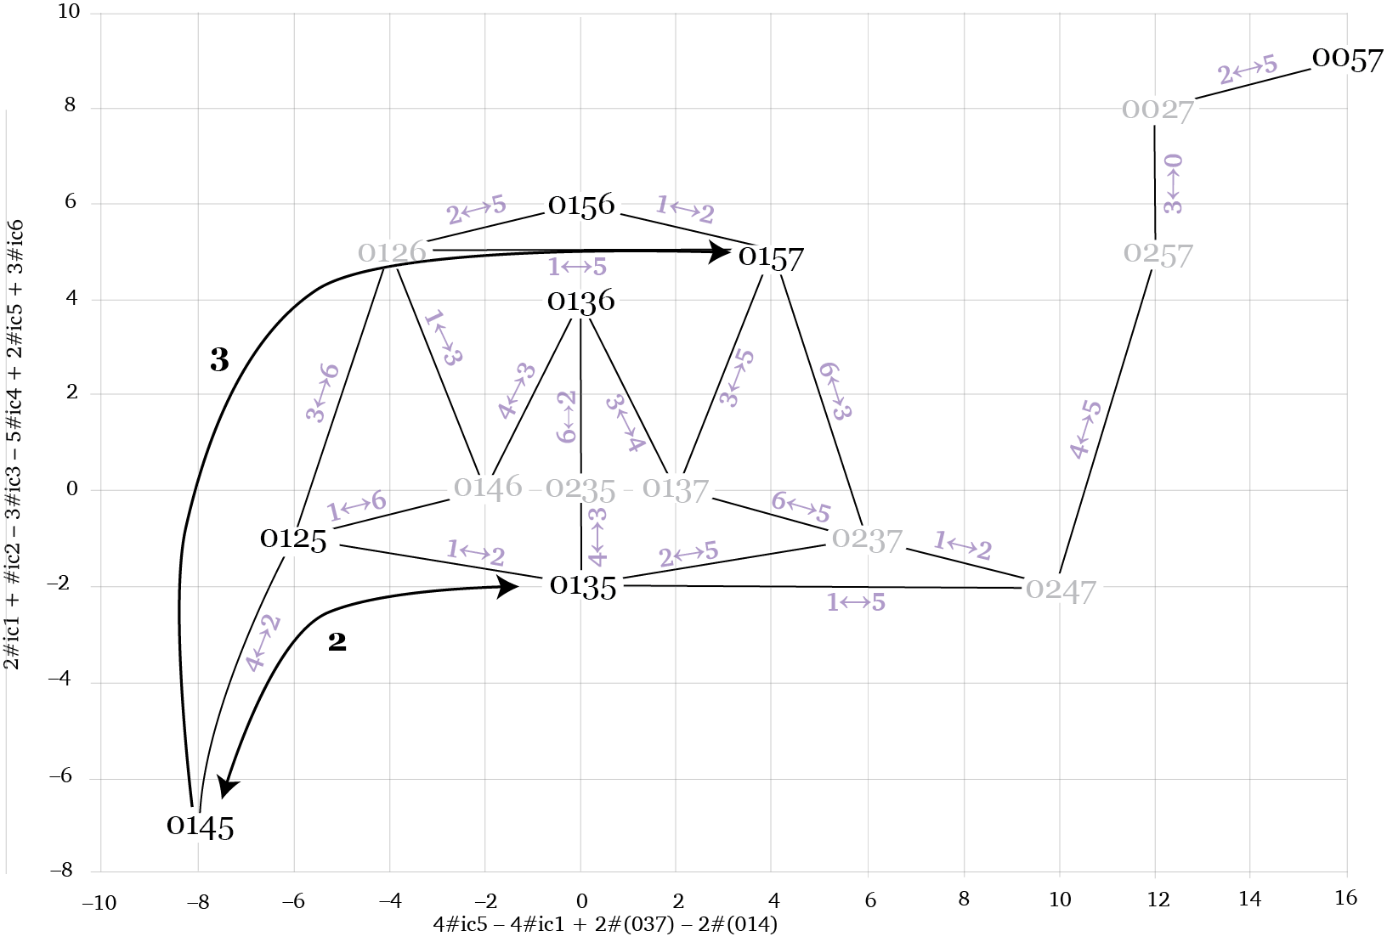
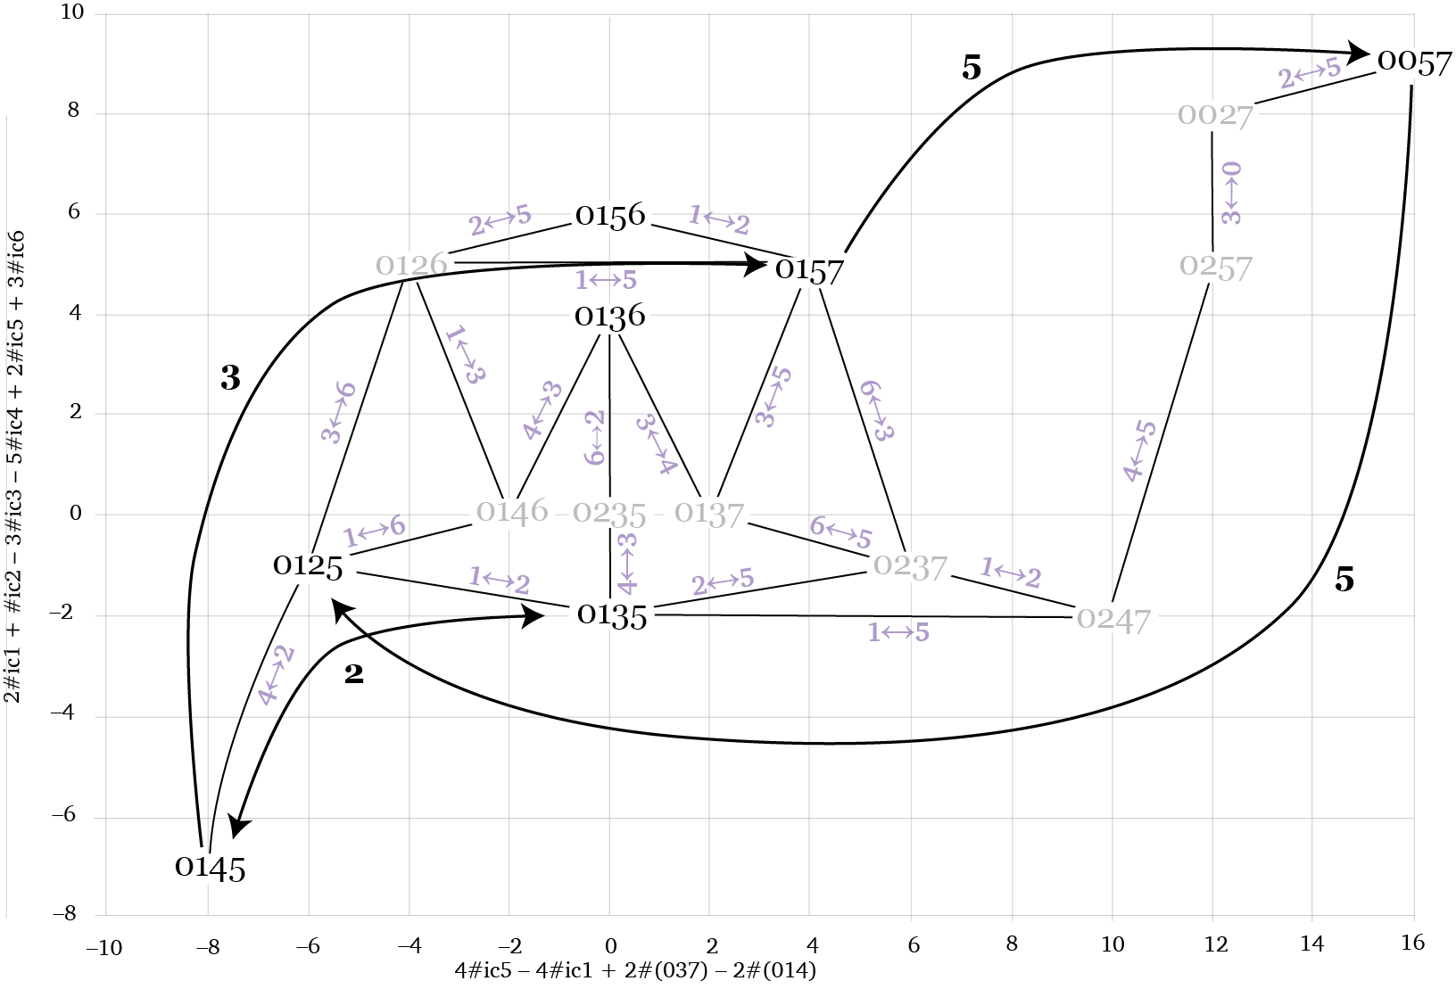
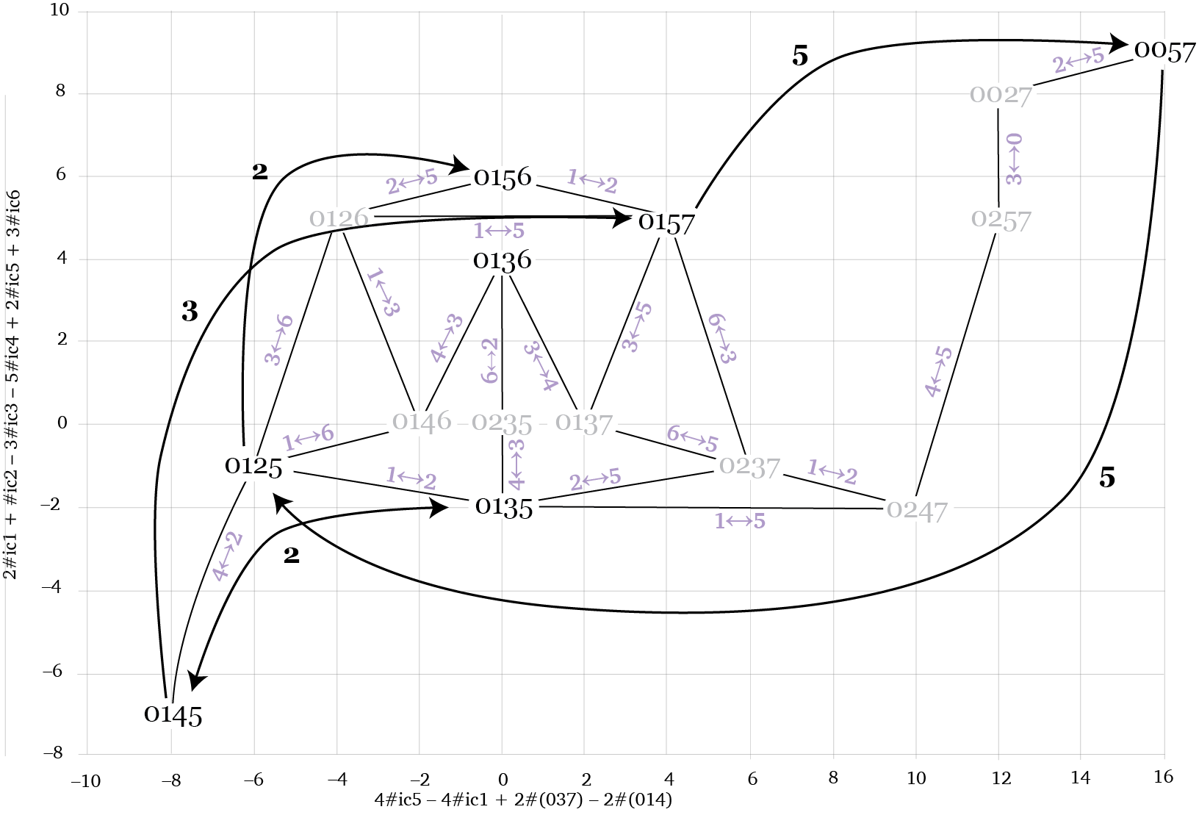
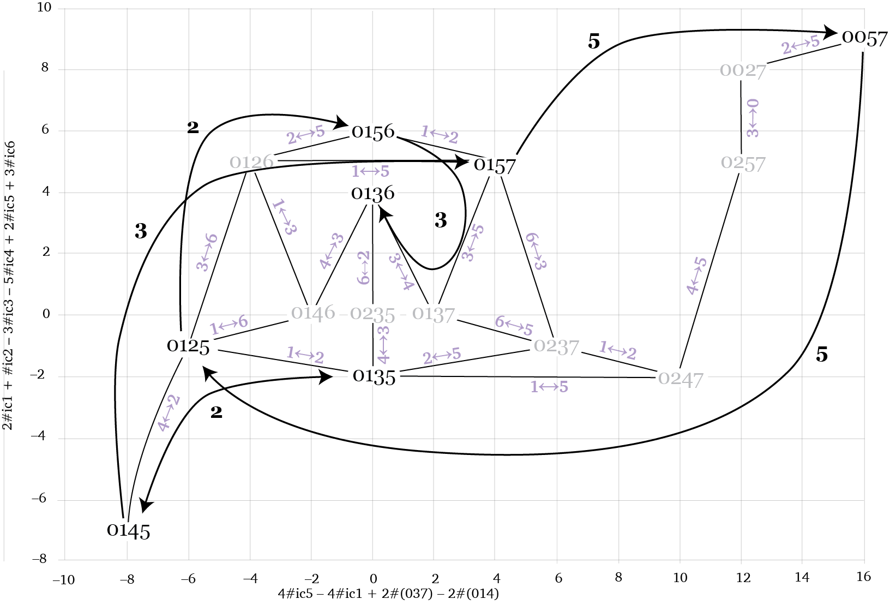
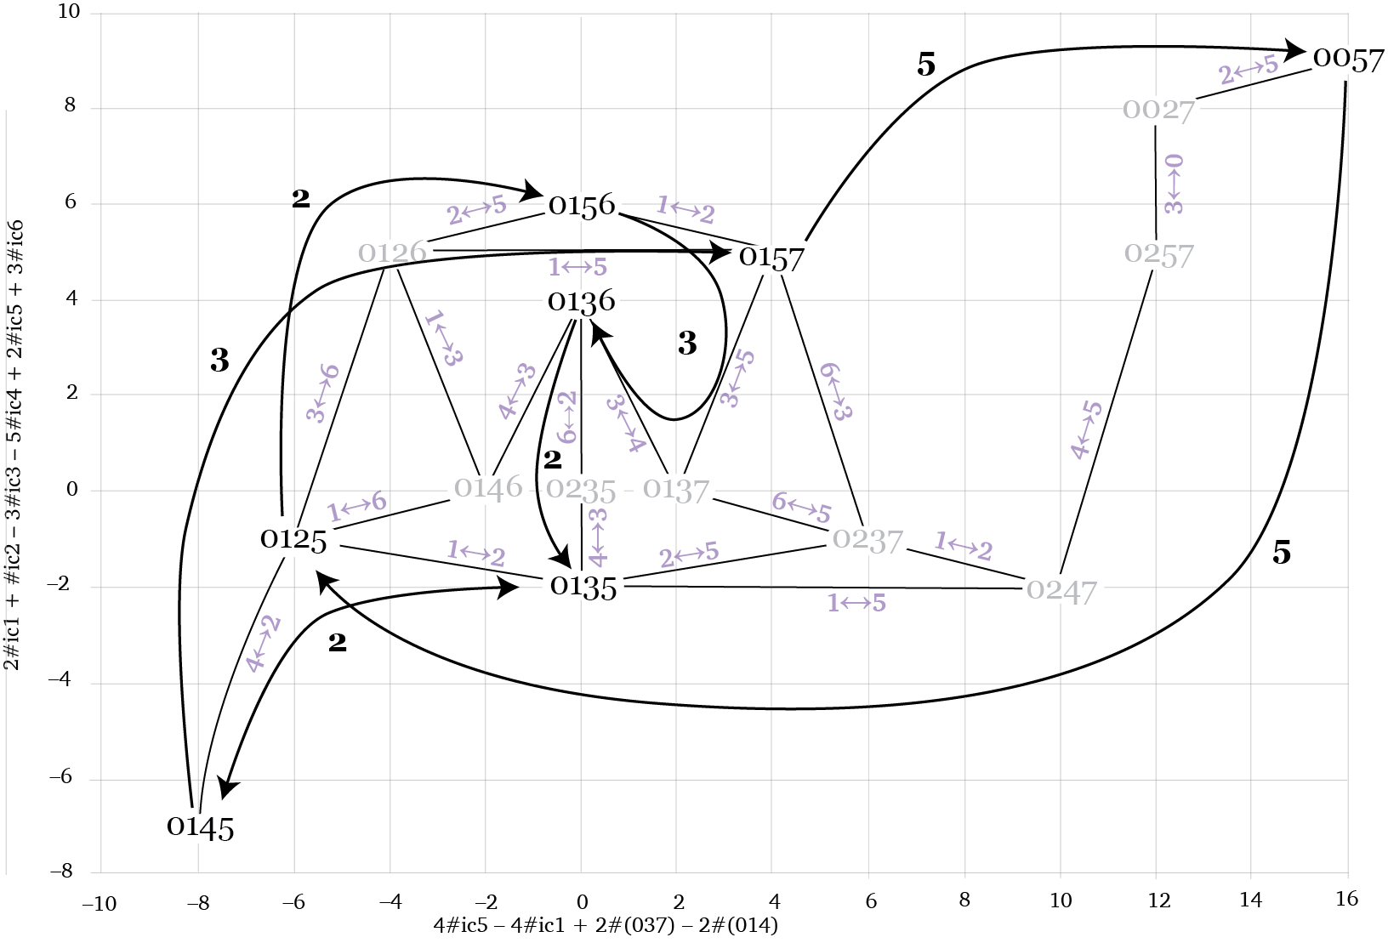
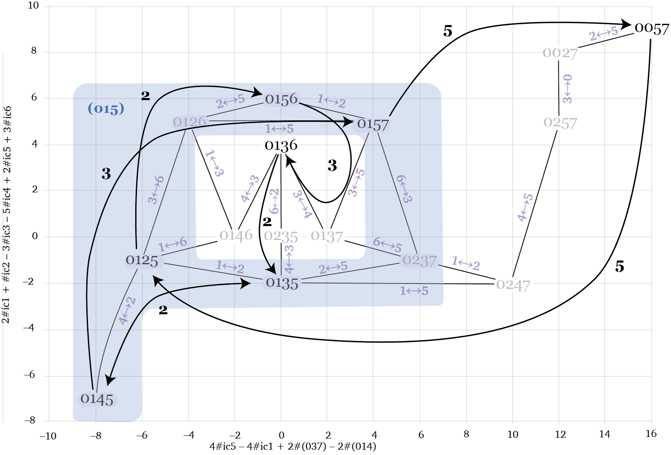
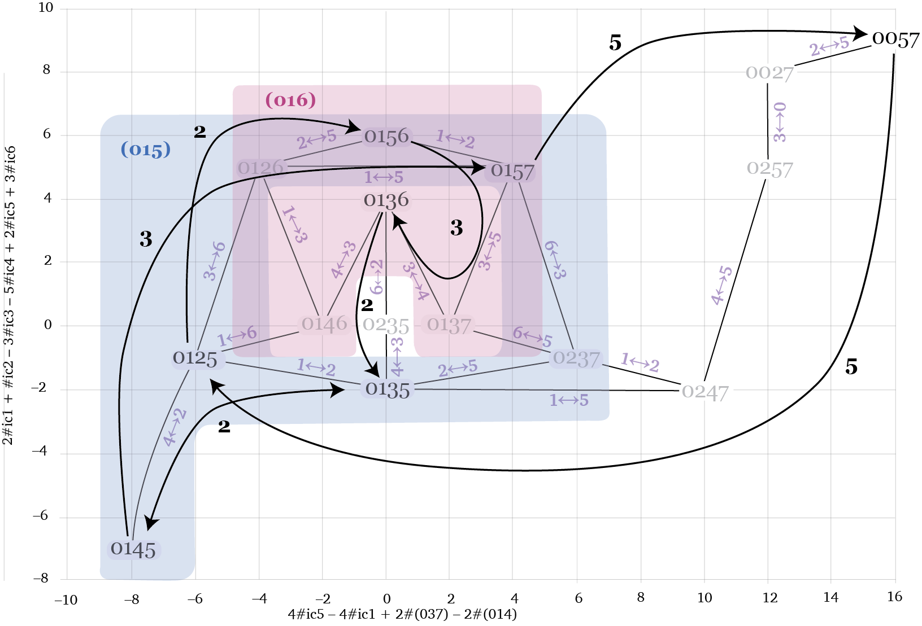
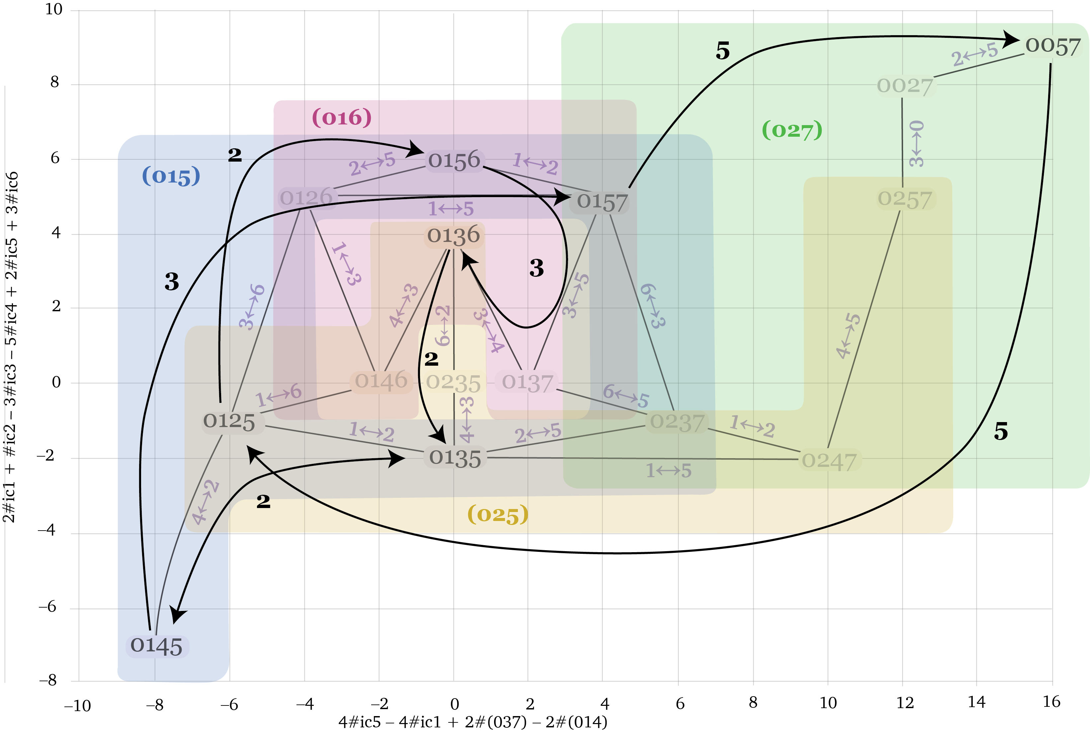
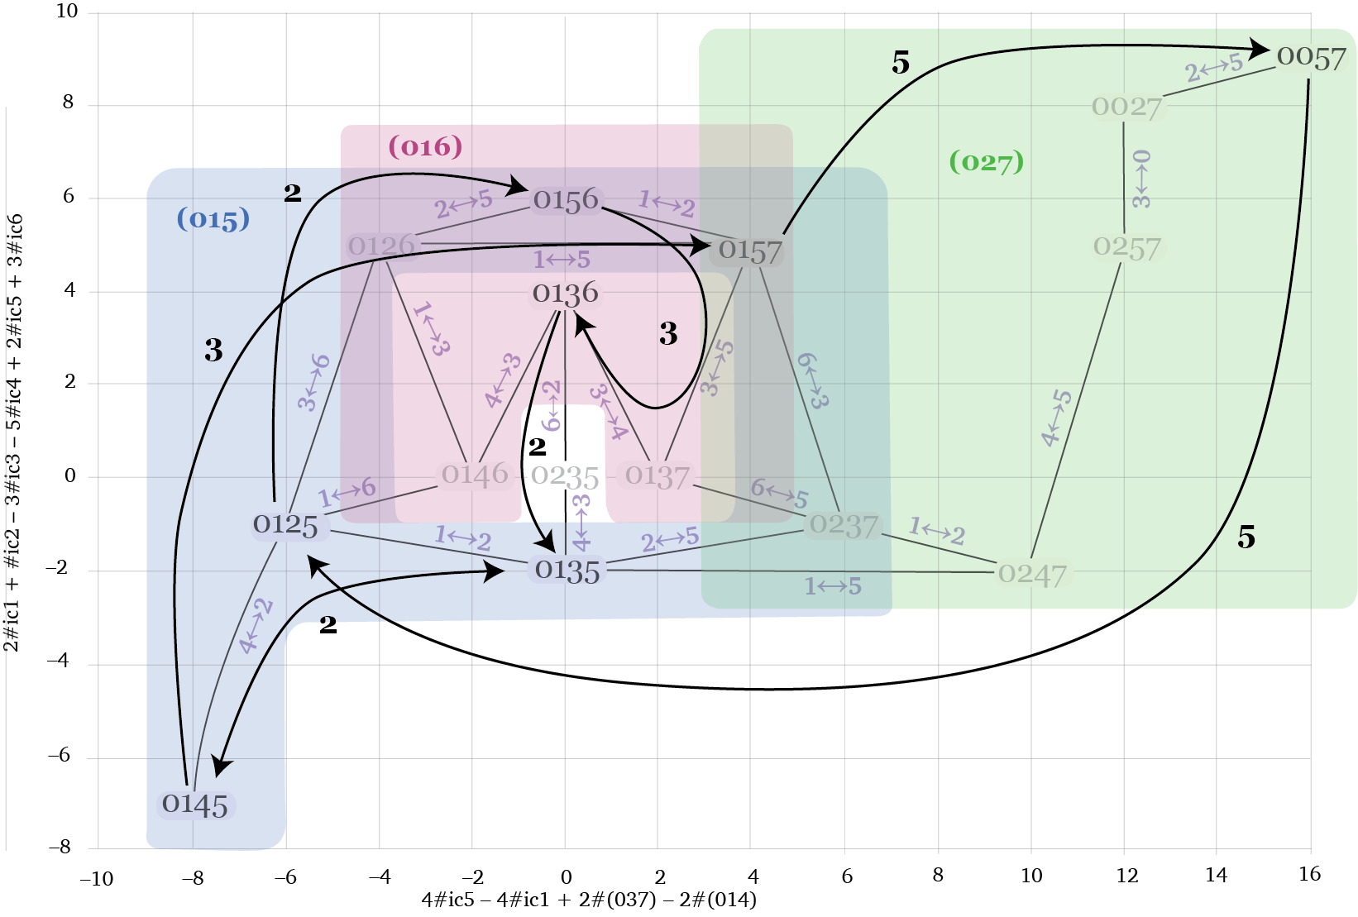
Subnetwork for Part One

Slide 25
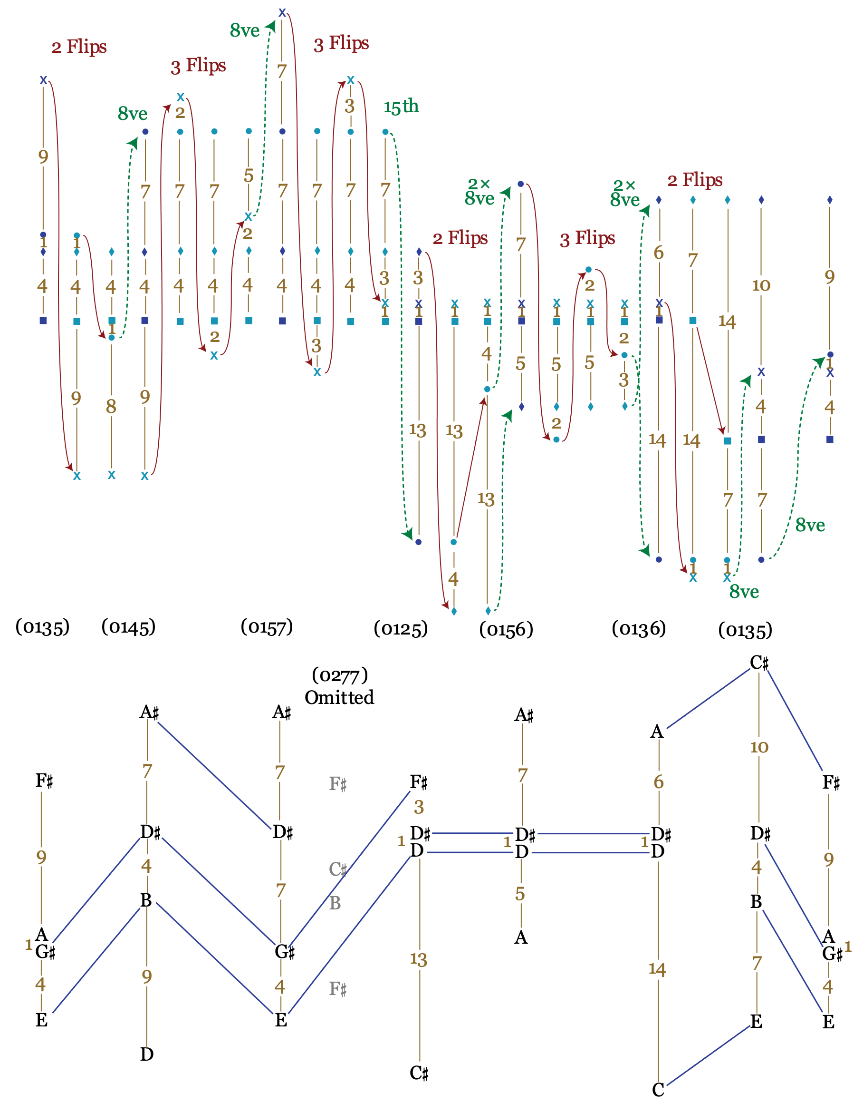
Derivation of the first phrase
Each chord progression derived through
• 2 or 3 flips and
• 1 or 2 8ve shifts
(omitting (0057))

Slide 26
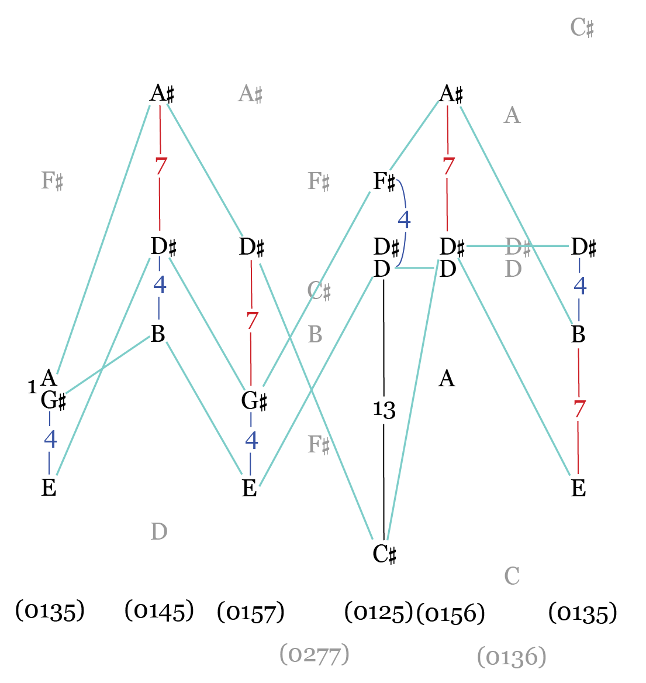
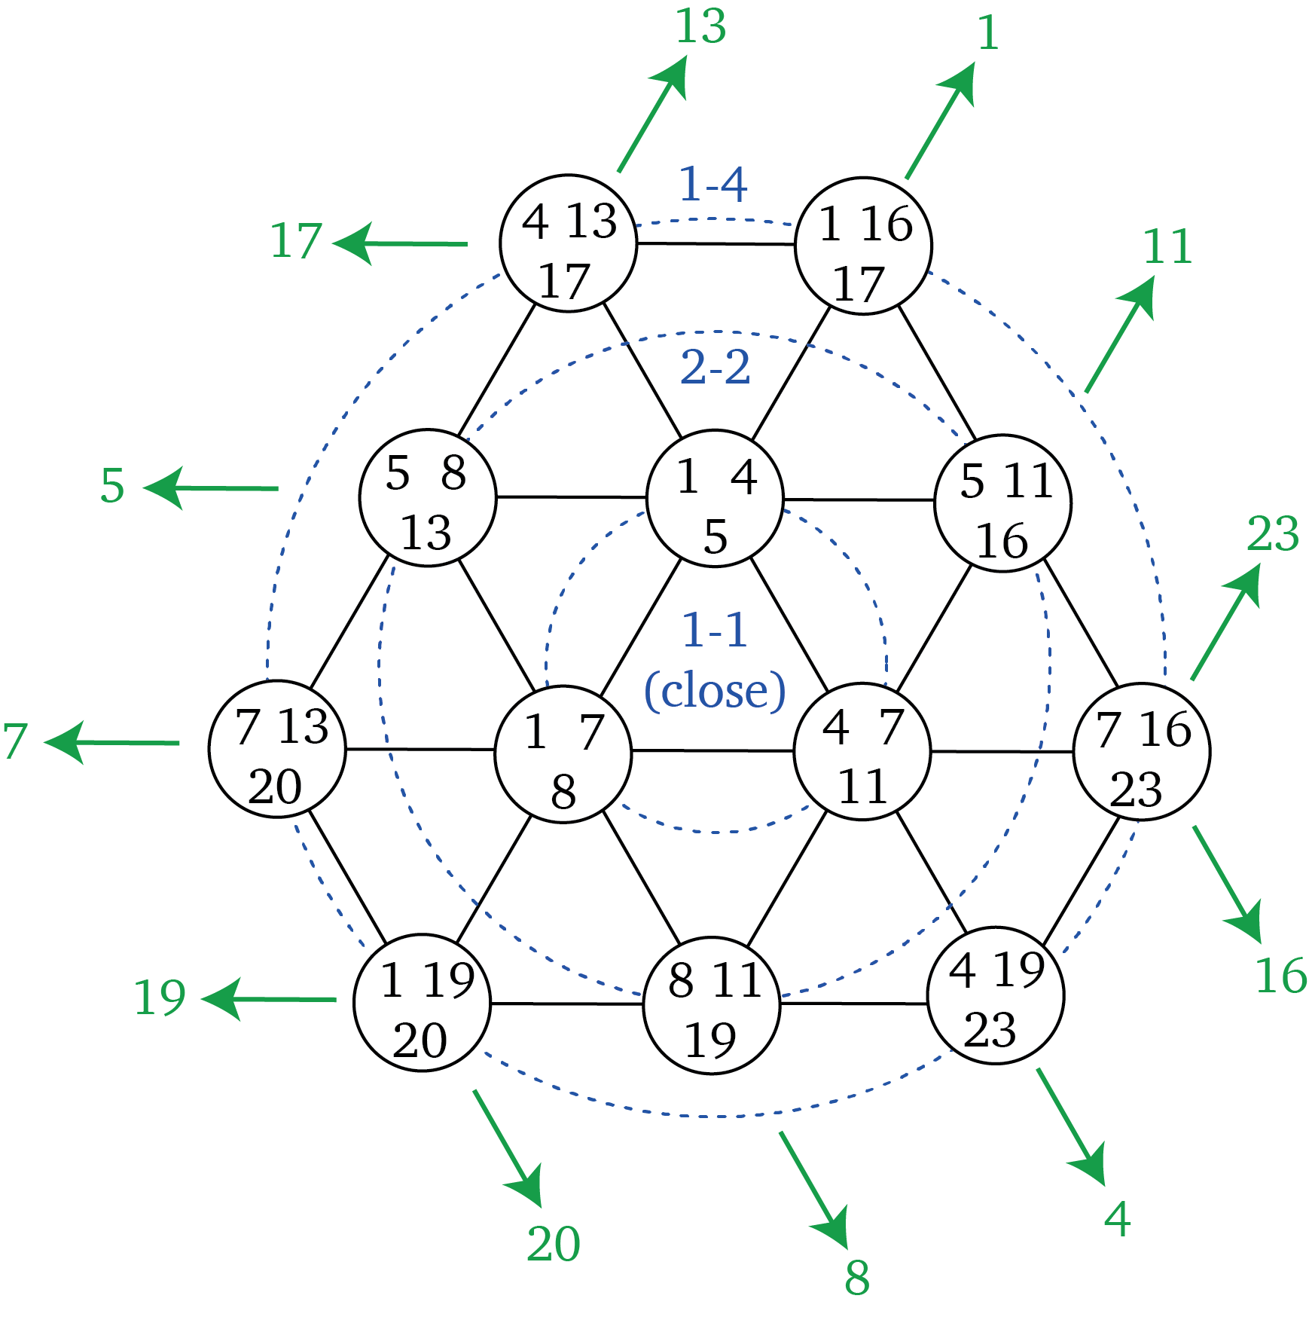
Phrase 1: (015)s in voicing space

Slide 27
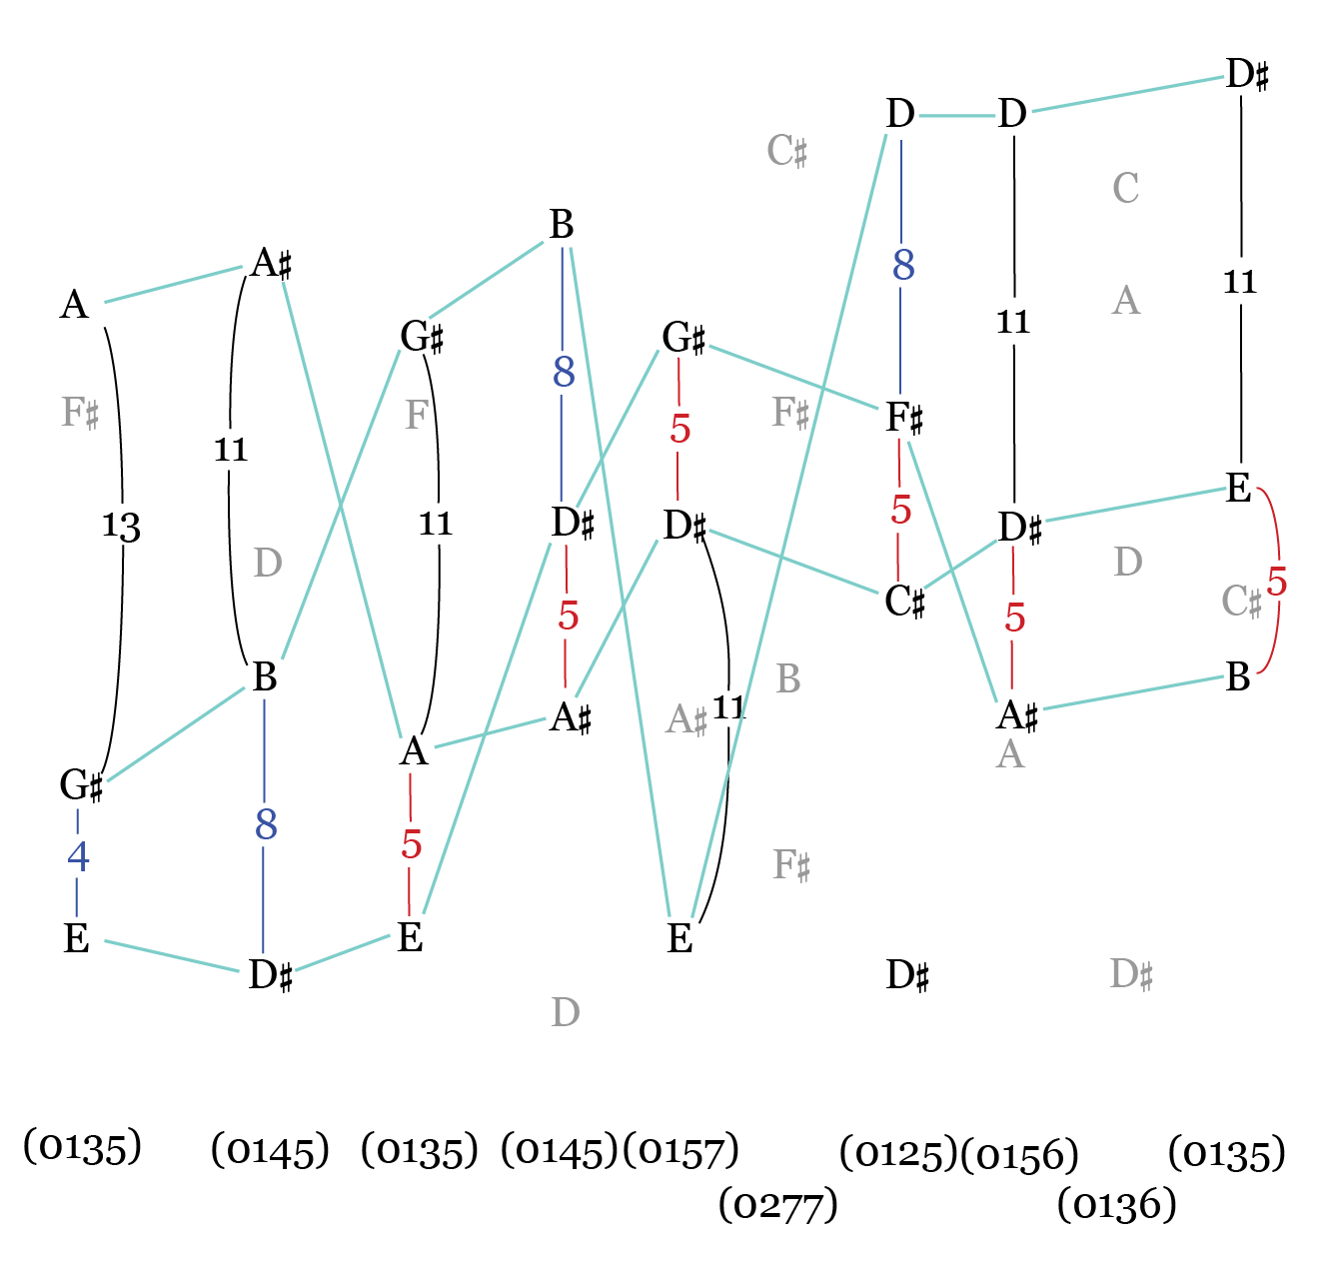
Phrase 2: (015)s in voicing space

Slide 28
Morton Feldman
For stefan Wolpe
Part 2

Slide 29
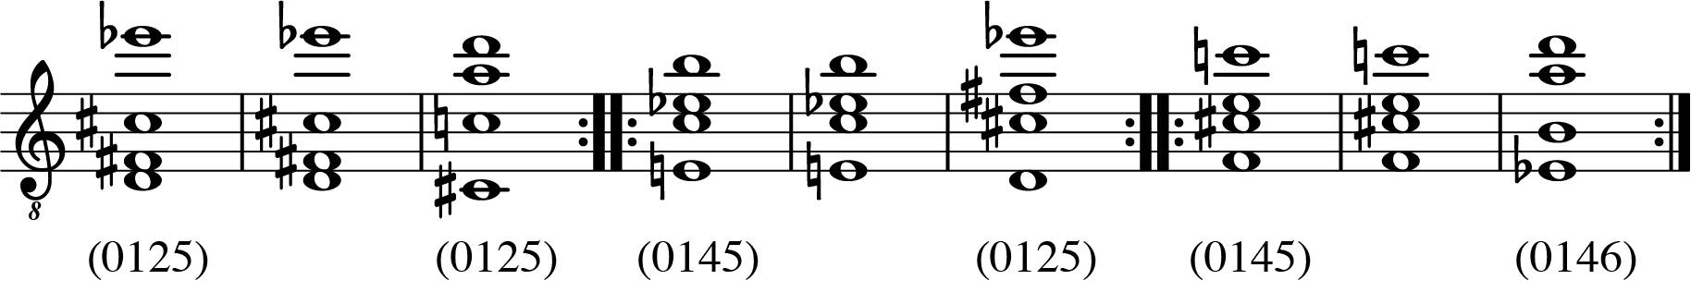
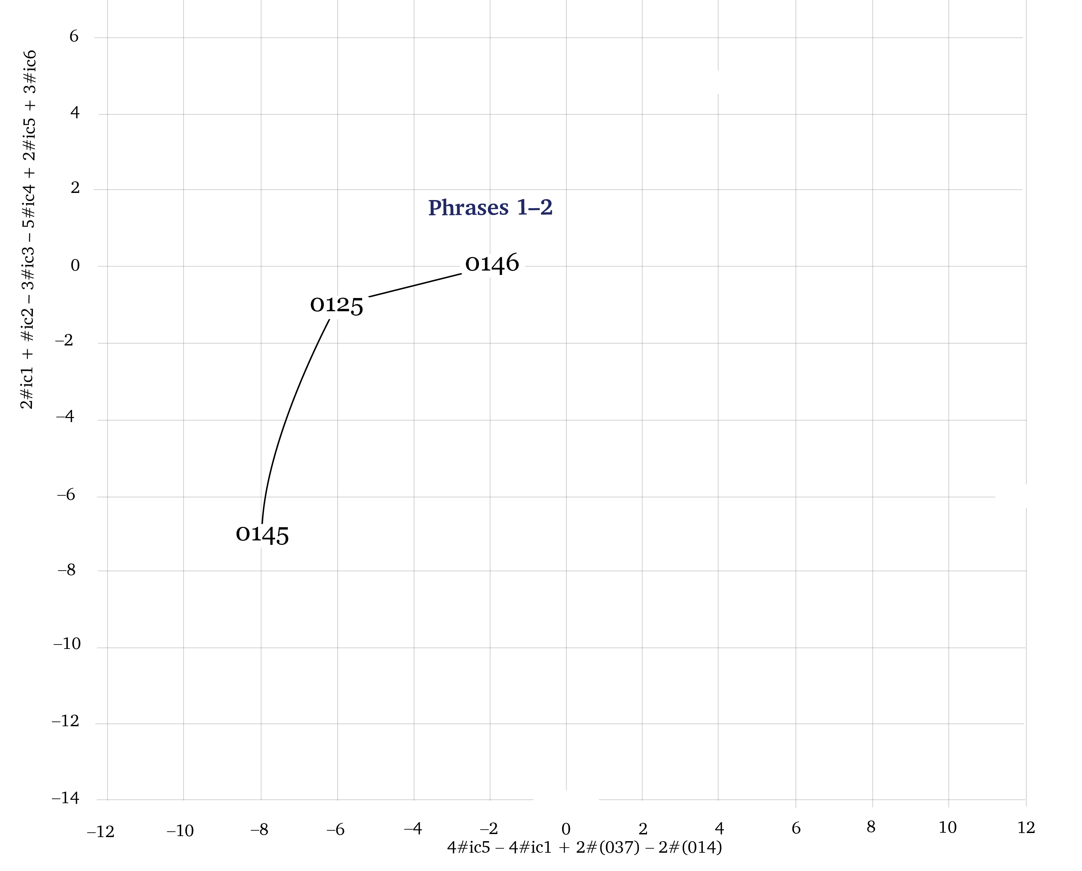
For stefan Wolpe, Part 2
Phrase 1:

Slide 30
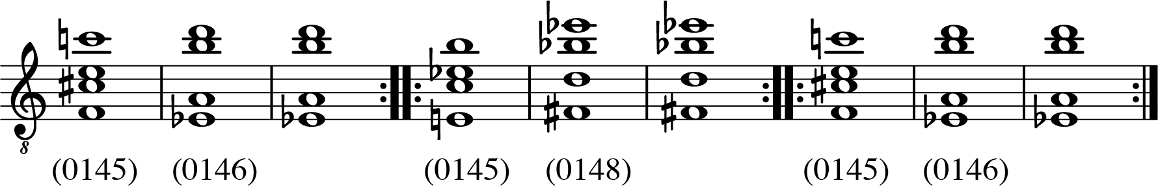
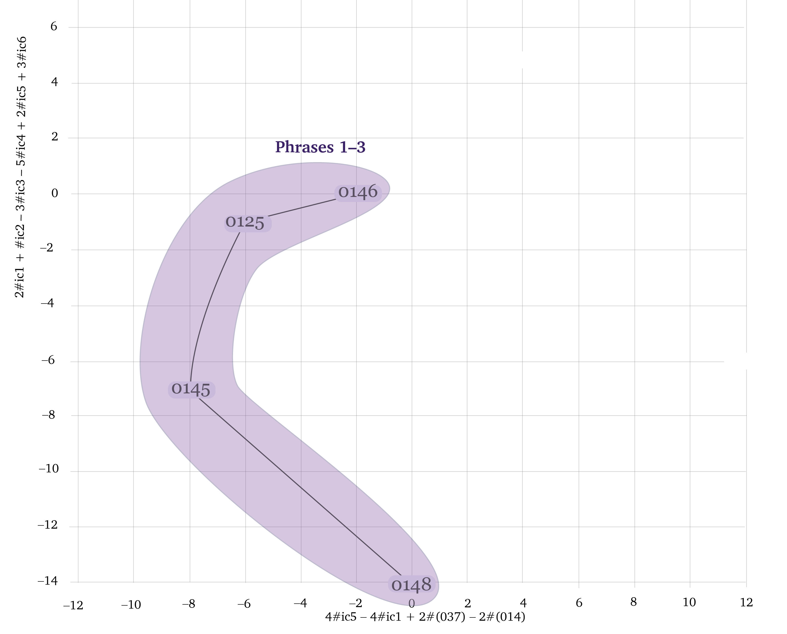
For stefan Wolpe, Part 2
Phrase 3:

Slide 31
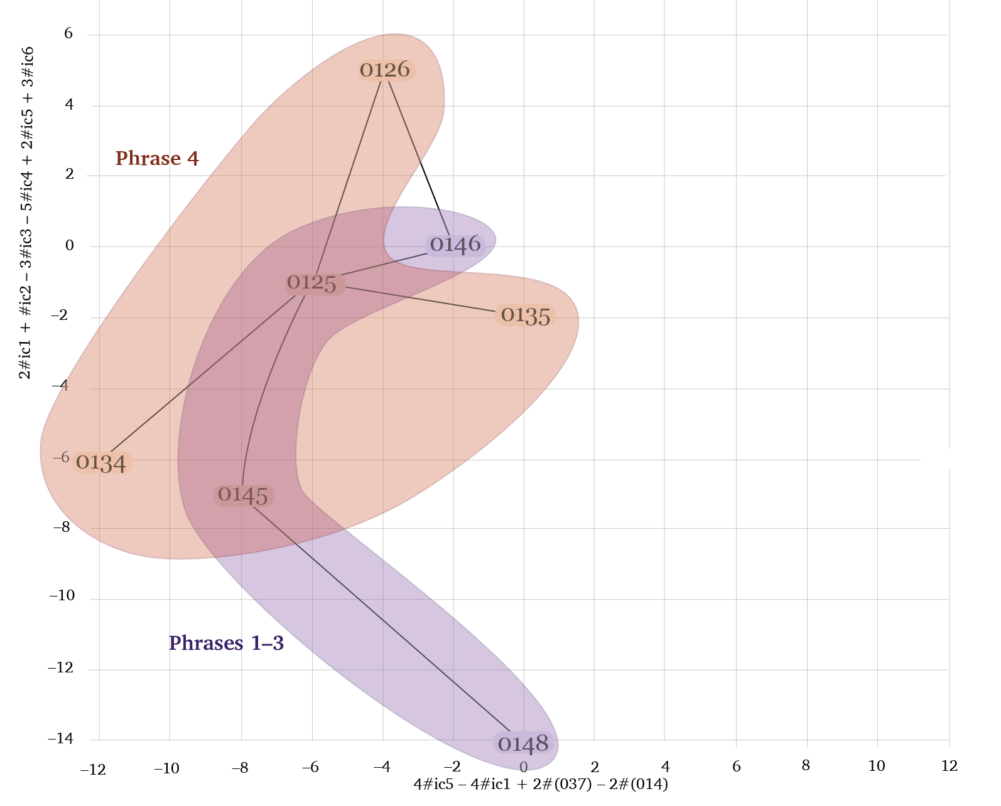
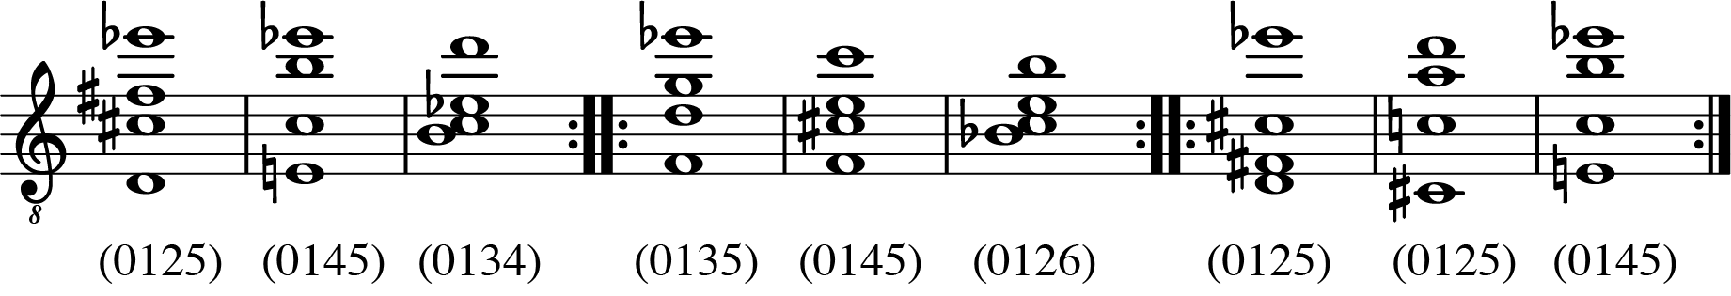
For stefan Wolpe, Part 2
Phrase 4:

Slide 32
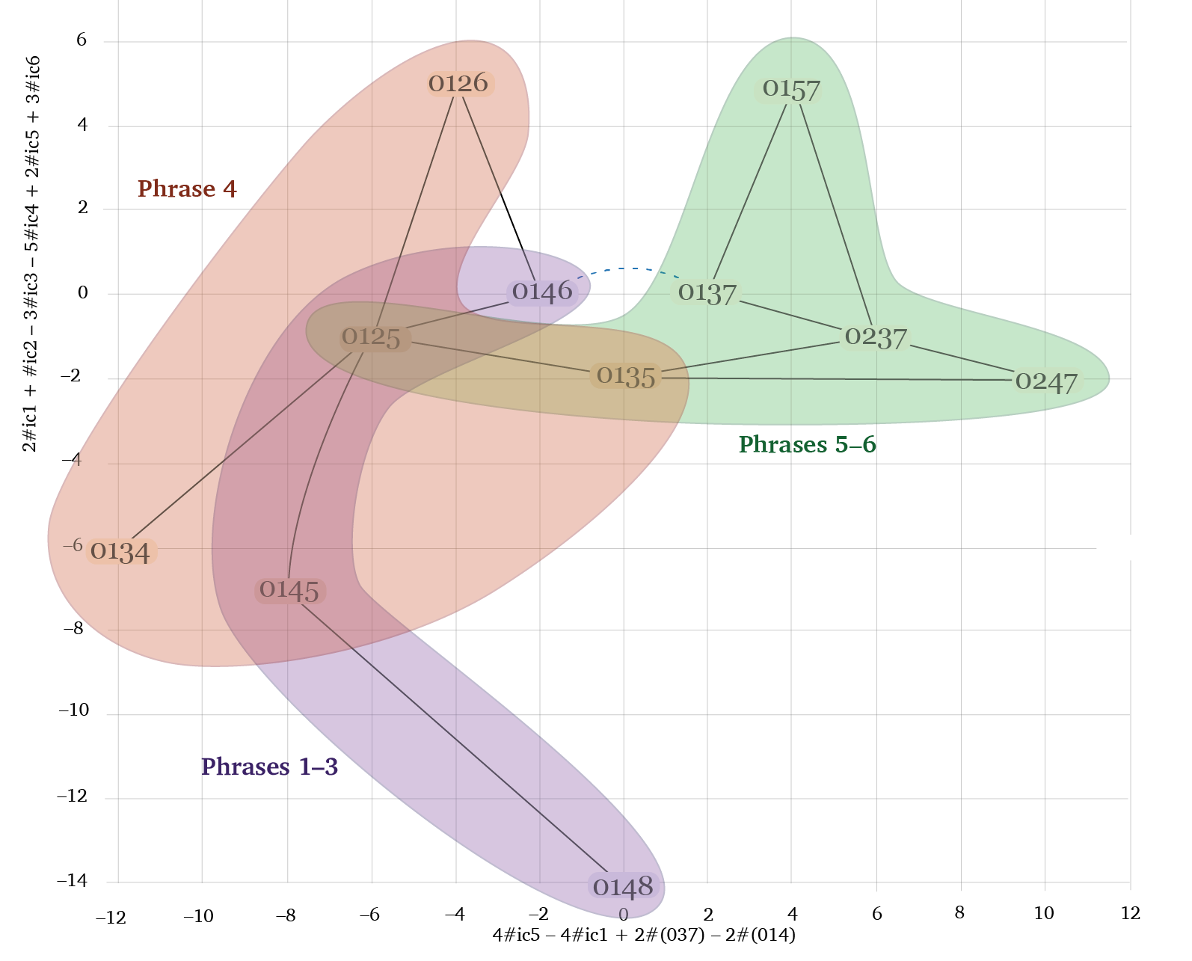
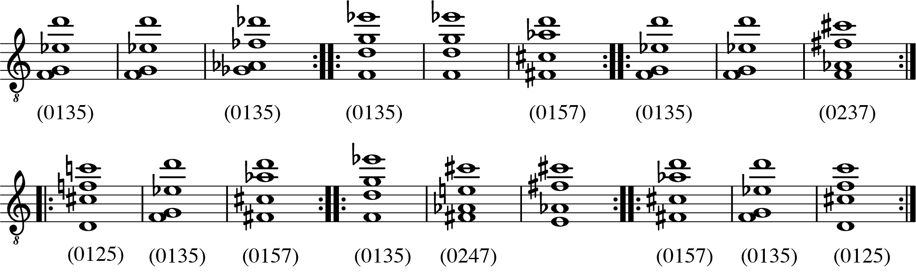
For stefan Wolpe, Part 2
Phrase 5:

Slide 33
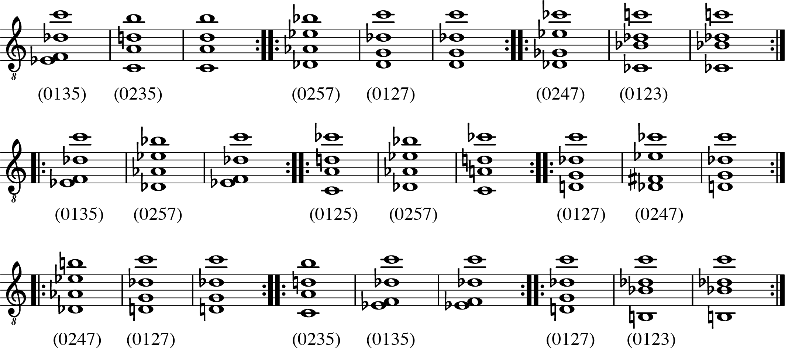
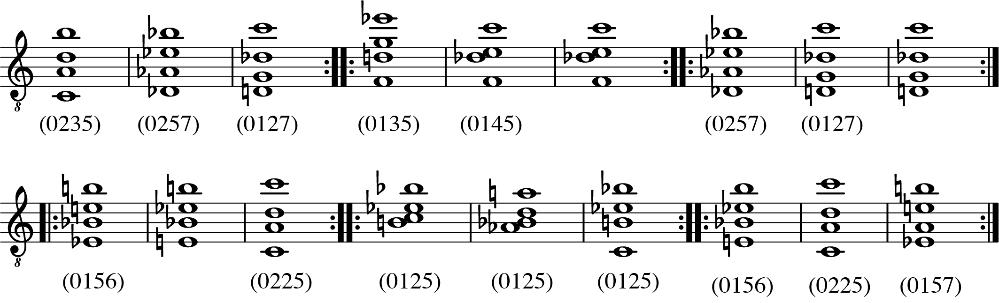
For stefan Wolpe, Part 2
Phrase 7:
Phrase 8:

Slide 34
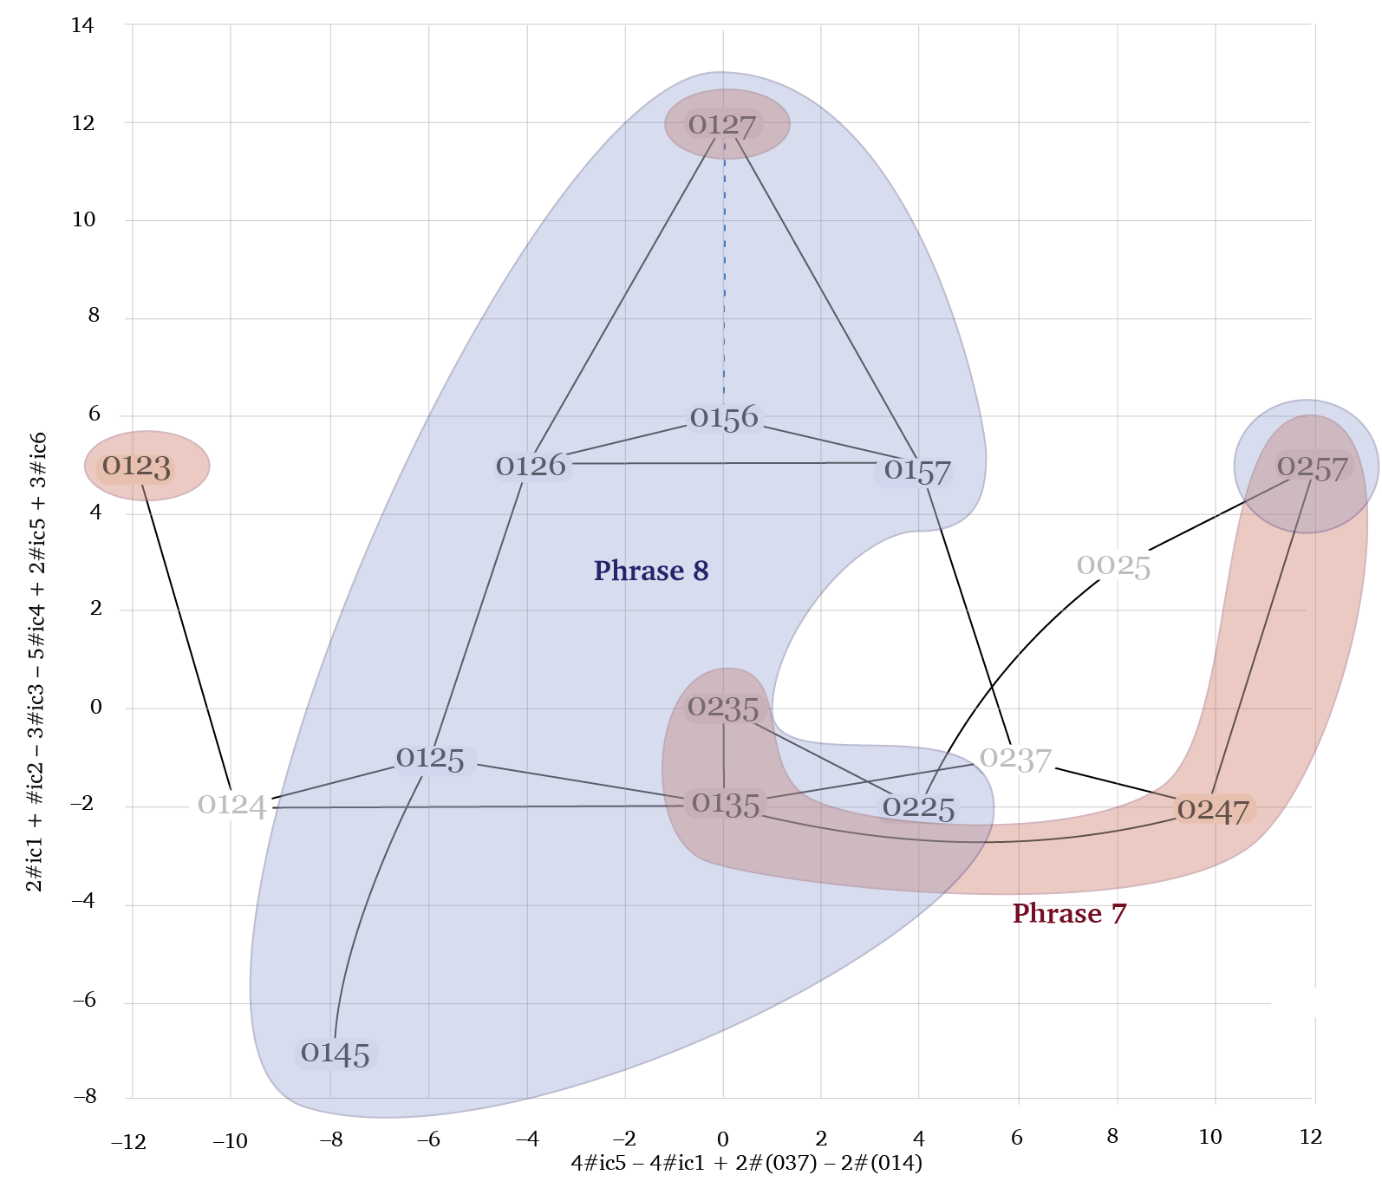
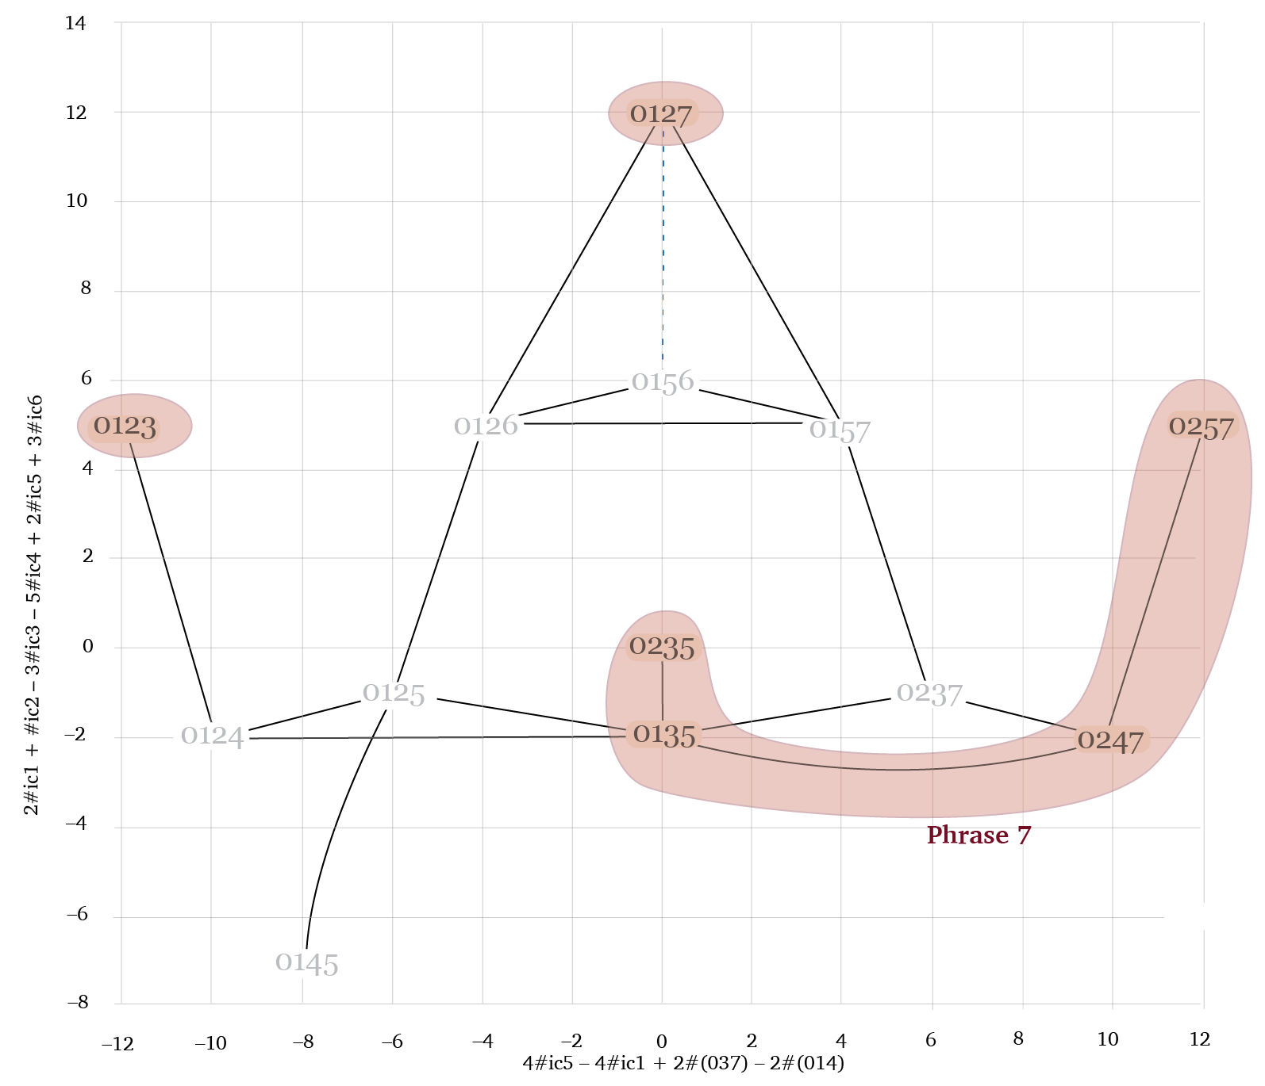
For stefan Wolpe, Part 2

Slide 35
Summary
—Bernard’s infolding/unfolding operations are special as maximal interval-preserving operations
—They naturally generalize to pitch-class sets.
—They also generalize to larger cardinalities (folding operations).
Analysis of For Stefan Wolpe:
—Feldman explores a connected region of the folding network centered on (0125), favoring chords • with (015) subsets and
• avoiding (037) subsets.
—Progressions consistently involve • 2–3 flips and • 1–2 octave shifts.
—The second half of the piece has a definite structure with
• an initial expansion in the folding network, • a fragmentation, and
• a consolidation and return to harmony similar to the first half.

Slide 36
Tetrachordal Folding operations Applied to Morton Feldman’s For stefan Wolpe
Jason Yust, .
Conference in Honor of Jonathan Bernard
University of Washington, Seattle, 6/17–18, 2022

