Slide 1
Wrangling Environmental Exposure Data
Kathryn Rodgers, MPH
9/24/24

Slide 2
Big picture
Look for metrics of accuracy and precision for any primary exposure data
If it’s your own data:
Using tidyverse in R makes life easier
Data formatted “long” is often more versatile (use pivot_longer to make data long)
Make plots of your data. Plotting guide: http://www.sthda.com/english/wiki/be-awesome-in-ggplot2-a-practical-guide-to-be-highly-effective-r-software-and-data-visualization

Slide 3
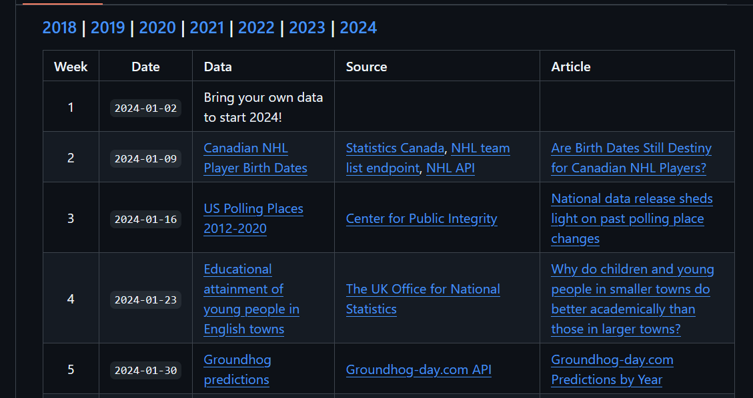
Plotting is fun!
Practice with Tidy Tuesday datasets https://github.com/rfordatascience/tidytuesday

Slide 4
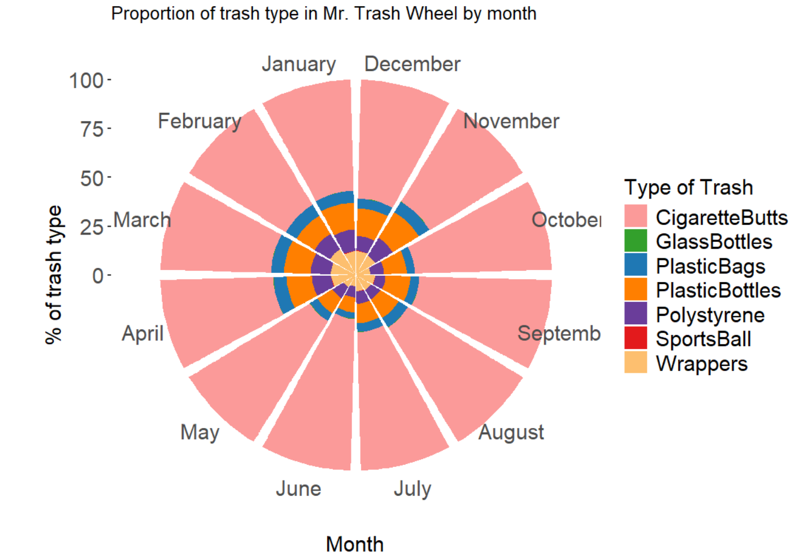

Slide 5
Objectives
Discussion of exposure misclassification requires precise knowledge of exposure measurement in environmental studies
BPA discovery https://www.ehn.org/bpa-science-fda-safe-2641150483.html
Epi review tools (eg ExpoQual) evaluates quality of epi studies with biomonitoring data
Navigation Guide QA/QC criteria for systematic reviews
Example: In review of environmental chemicals and breast cancer, 15 of 30 the studies with biomonitoring data did report QA/QC information needed for “low risk of bias”, including studies from CDC (Rodgers 2018).
Example: In review of BPA and neurodevelopmental and respiratory health, QA/QC issues related to contamination not well-reported (LaKind 2015).

Slide 6
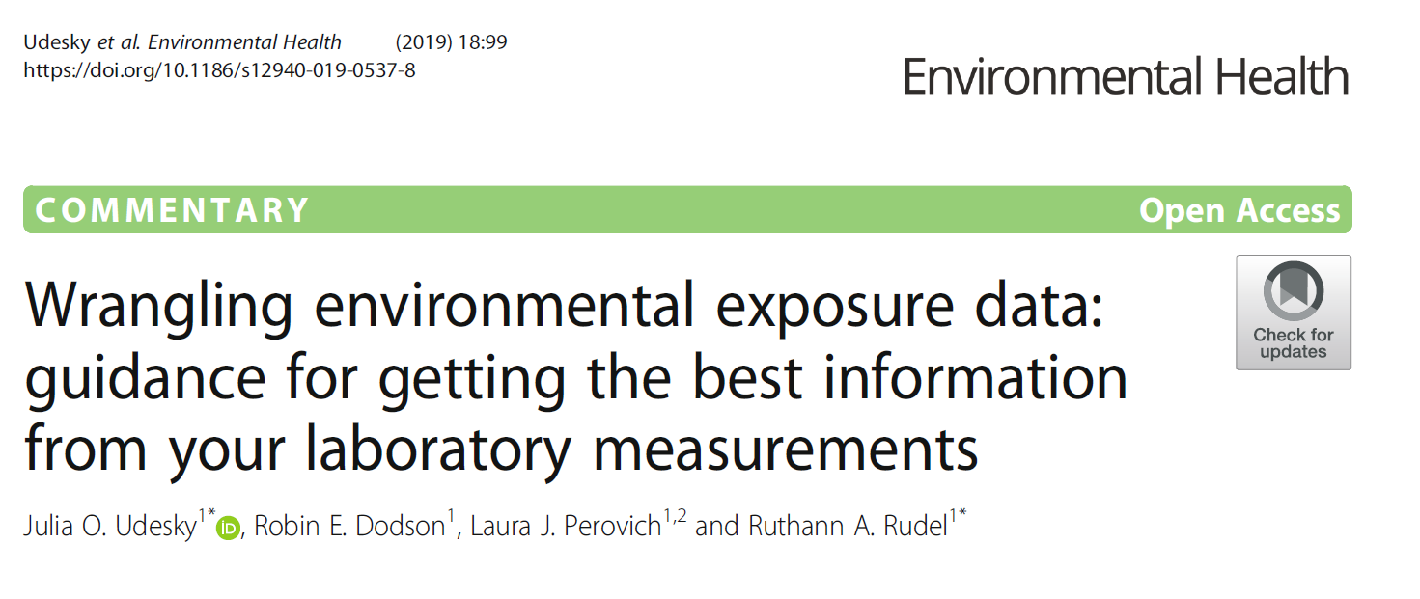
Overview
Accuracy
Precision
Measurement quantification
Making your report
Notes:
This presentation will cover how to evaluate precision and accuracy in environmental exposure data, as well as how to interpret your own exposure data from laboratory data. Any exposure or epidemiological study is dependent on how well the exposure was measured. There are several ways to gauge this with laboratory measurements, though they are often overlooked. We will discuss data validation procedures for assessing analytical accuracy, extraction efficiency, contamination, and precision. We will also go through a step-by-step guide (in R) on how to create your own quality control report for your data. Beginner R experience is useful, though not necessary.

Slide 7
Accuracy and precision

Slide 8
Accuracy – are measurements near the bullseye?
Lab control sample recoveries = is spiked quantity same as measured quantity in a blank matrix?
Matrix spike recoveries = checks extraction efficiency for a complex sampling matrix (eg house dust)
Certified or standard reference material (CRM or SRM) = matrix comparable to sample matrix (eg synthetic urine for urine) that you buy (or make, if needed)
Surrogate spike recovery = surrogates spiked into each sample prior to extraction to identify individual samples with errors
Isotope dilution quantification = labeled isotopes of target compounds added to sample before extraction. Internal standards monitor the loss of labeled isotopes, and those are subtracted. Good, but not available for all compounds. Less worried about surrogates is this method is used.

Slide 9
Accuracy – are measurements near the bullseye?
Field blanks = captures all potential contamination during sample collection and analysis. Should be 10% of samples and blinded to the lab (minimum of 3).
Method/solvent blanks = captures contamination during sample extraction.
Storage blanks = captures contamination during storage.
**If there’s consistent contamination, subtract from sample measurement**

Slide 10
Precision – consistent measurements?
Duplicates = field samples collected side-by-side. Should be done at least every 20 samples collected and blinded to the lab, when possible.
Looking for relative percent difference <30%
Reference samples / SRMs = run in each batch to measure analytical batch differences

Slide 11
Measurement quantification
Instrument detection limit (IDL) = smallest true signal that can be distinguished from background noise
Method detection limit (MDL)/Limit of detection (LOD) = IDL + error from extraction process
Often calculated for each compound as standard deviation of at least 7 method blanks x 3 and reported as “estimated”
Method reporting level (MRL)/Limit of quantification (LOQ) = smallest concentration that can be detected in the amount detected
Often calculated for each compound as standard deviation of at least 7 method blanks x 10
Notes:
These will vary across batches

Slide 12
Measurement quantification: what to do with values <LOD or LOQ?
Evaluate quality control metrics and talk with lab to determine if values should be cutoff at >LOD or >LOQ.
Replacing <LOD with LOD/sqrt(2) has important ramifications.
Forces unrealistic distribution
Creates artificially small confidence intervals
See https://practicalstats.com/ for more
Check out NADA in R for better ways to deal with
left-censored data

Slide 13
Example lab correspondence (SI)

Slide 14
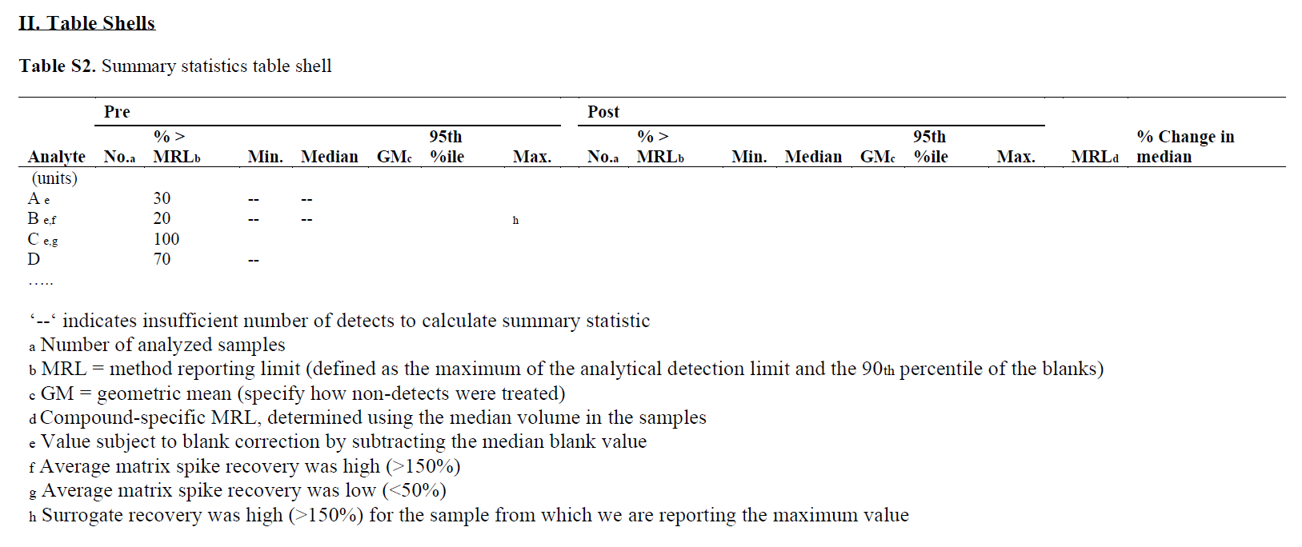
Summary statistics table shell (SI)

Slide 15
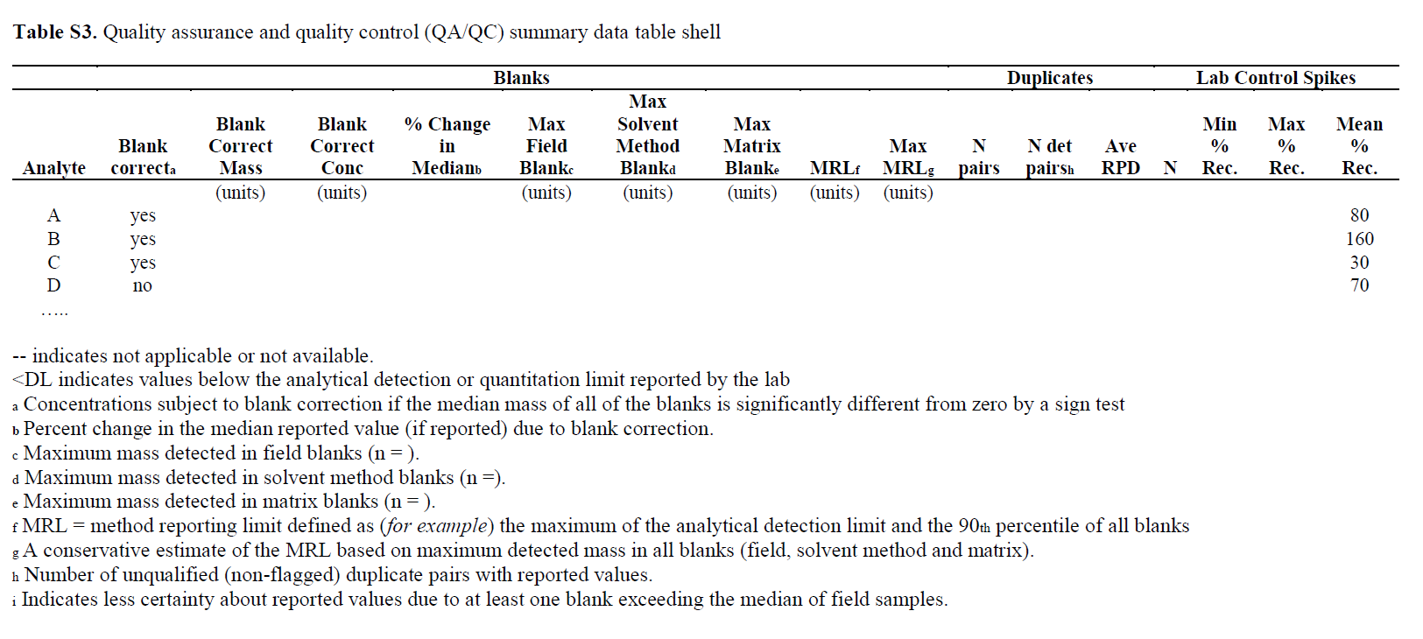
QA/QC table shell (SI)

Slide 16
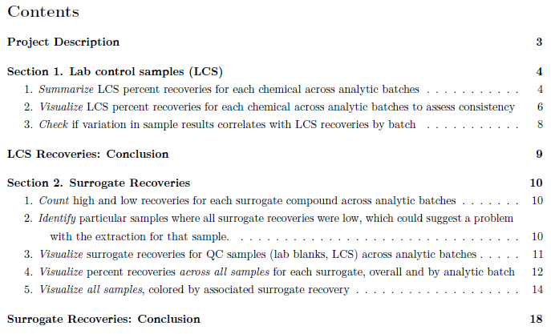
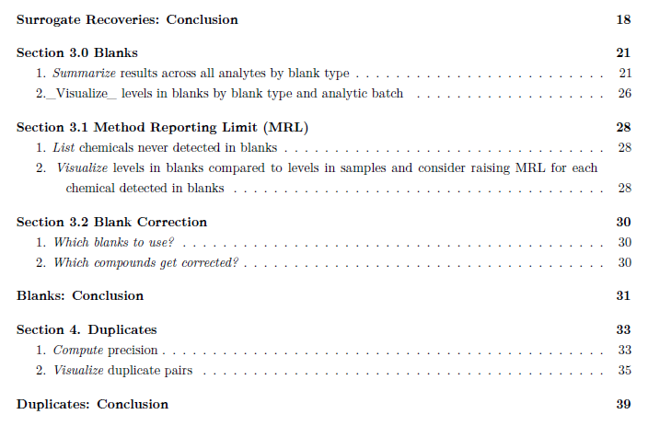
QA/QC Report Guide
R markdown code available at https://github.com/SilentSpringInstitute/QAQC-Toolkit/

Slide 17
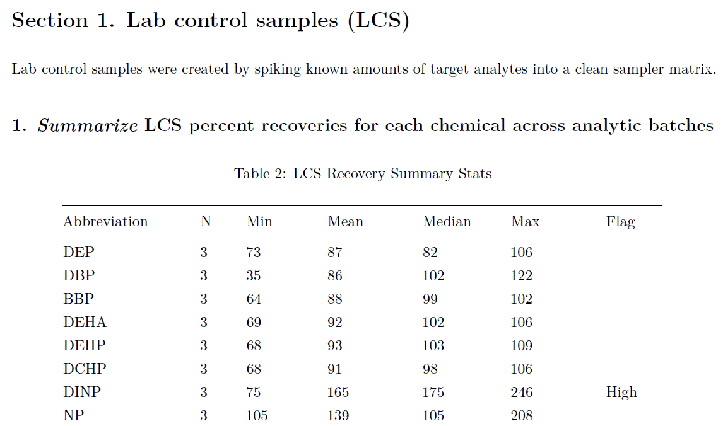
QA/QC Report Guide step 1

Slide 18
QA/QC Report Guide step 1.1

Slide 19
QA/QC Report Guide step 1.2

Slide 20
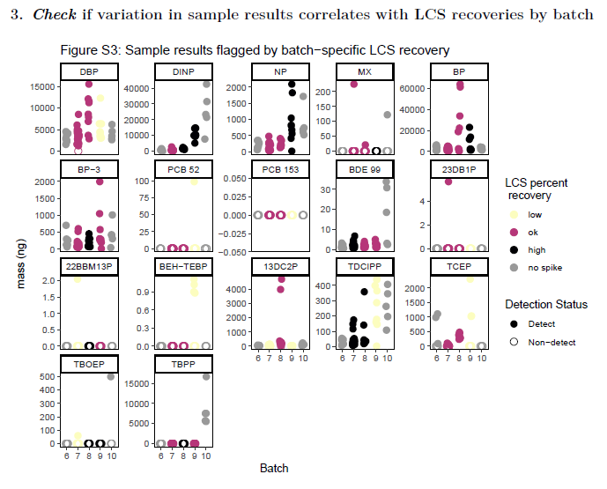
QA/QC Report Guide step 1.3

Slide 21
QA/QC Report Guide step 1.3
Batch 9- high LCS recovery with high sample results for EHTBB, DINP, TBB

Slide 22
QA/QC Report Guide step 1.3
Batch 9- high LCS recovery with high sample results for EHTBB, DINP, TBB

Slide 23
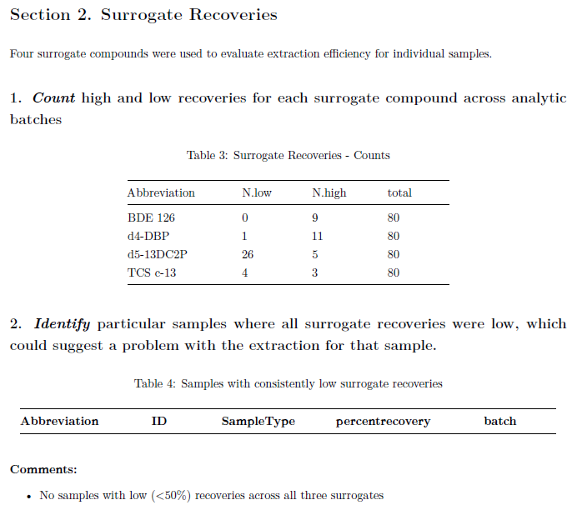
QA/QC Report Guide steps 2.1 & 2.2

Slide 24
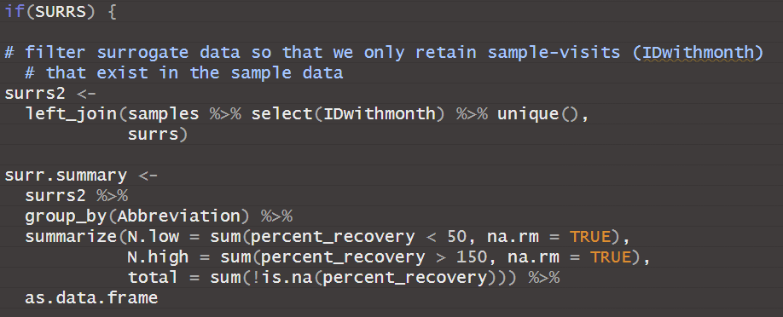
QA/QC Report Guide steps 2.1 & 2.2

Slide 25
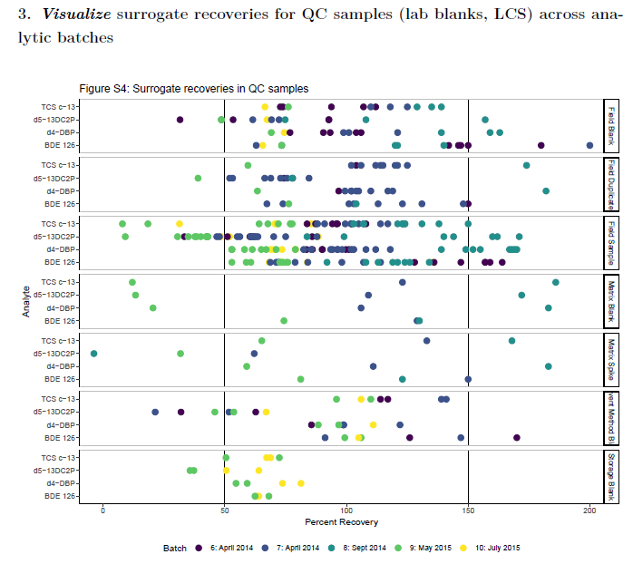
QA/QC Report Guide step 2.3
Low surrogate recoveries in Batch 9- consistent with pattern in samples

Slide 26
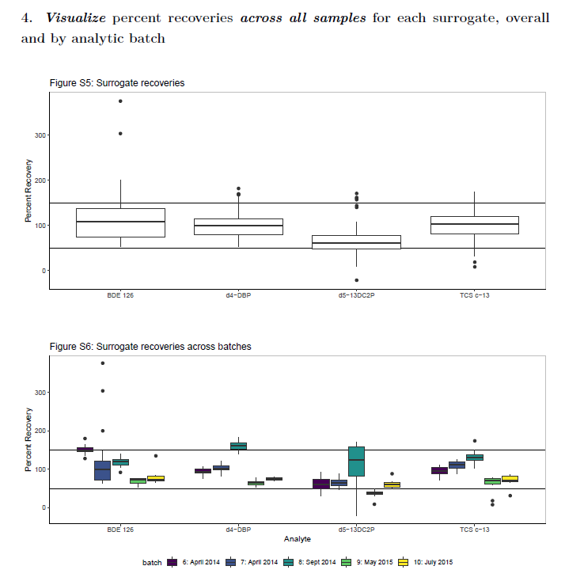
QA/QC Report Guide step 2.4

Slide 27
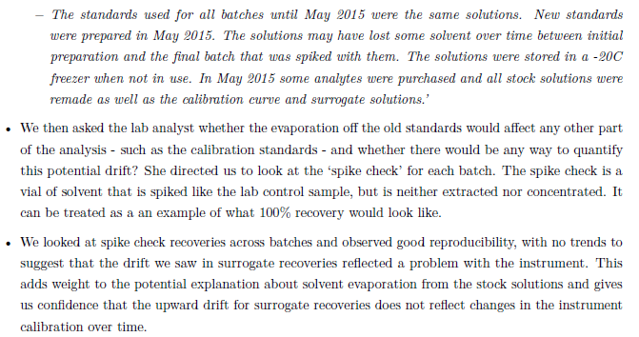
QA/QC Report Guide step 2.4

Slide 28
QA/QC Report Guide step 2.4

Slide 29
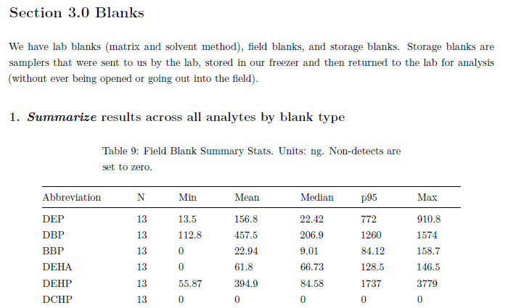
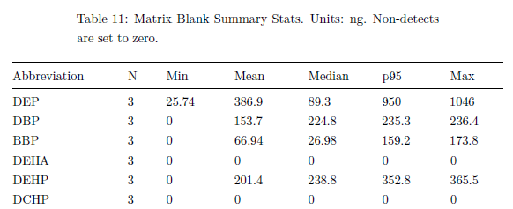
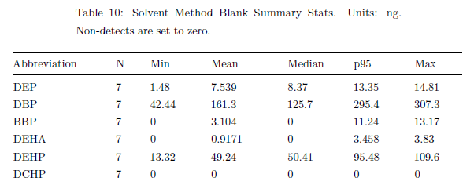
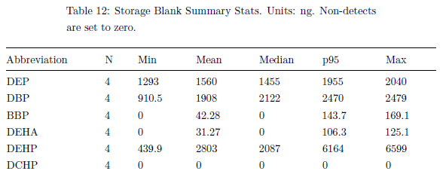
QA/QC Report Guide step 3.1

Slide 30
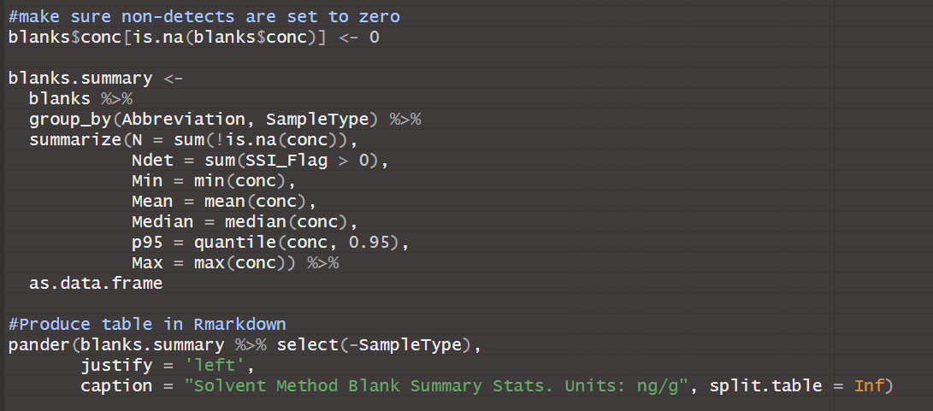
QA/QC Report Guide step 3.1

Slide 31
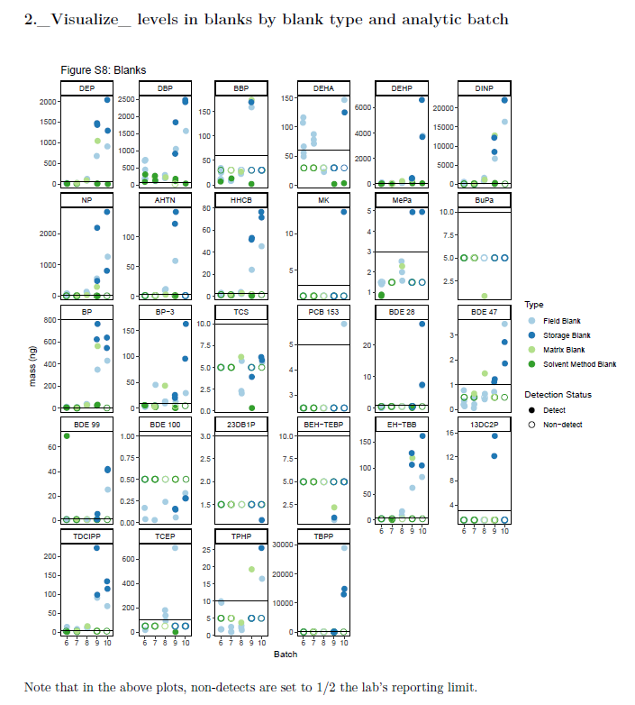
QA/QC Report Guide step 3.2

Slide 32
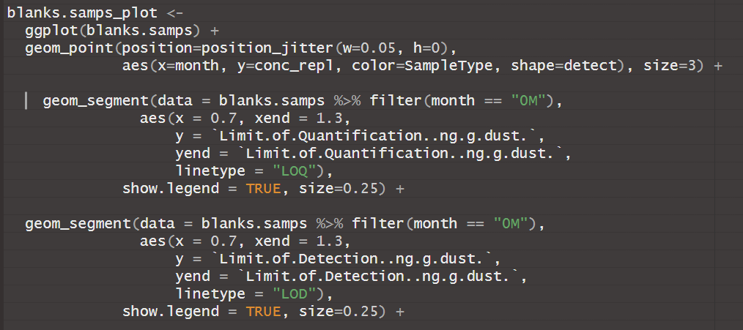
QA/QC Report Guide step 3.2
Lots of detects in storage blanks in batches 9-10.
Lots of detects in field and matrix blanks in batches 9-10.

Slide 33
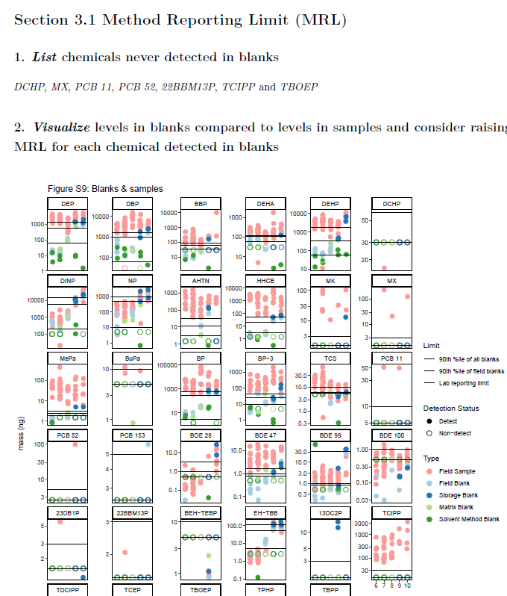
QA/QC Report Guide step 3.1.2

Slide 34
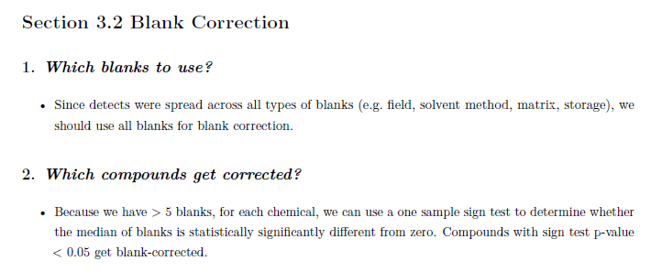
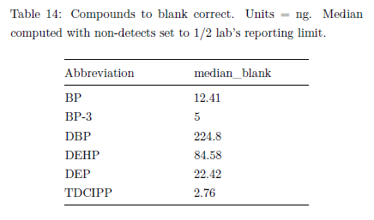
QA/QC Report Guide step 3.2

Slide 35
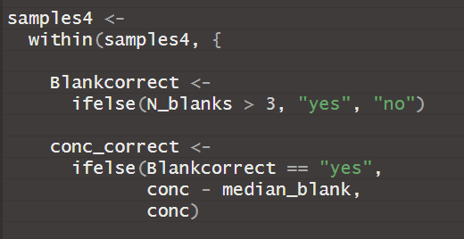
QA/QC Report Guide step 3.2

Slide 36
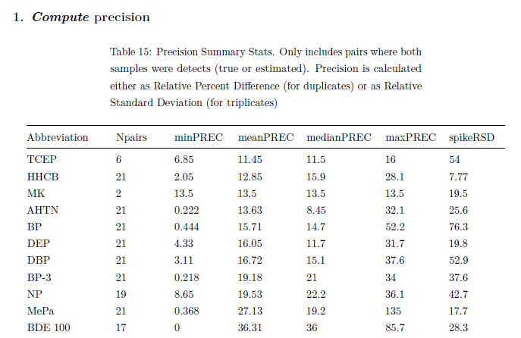
QA/QC Report Guide step 4.1

Slide 37
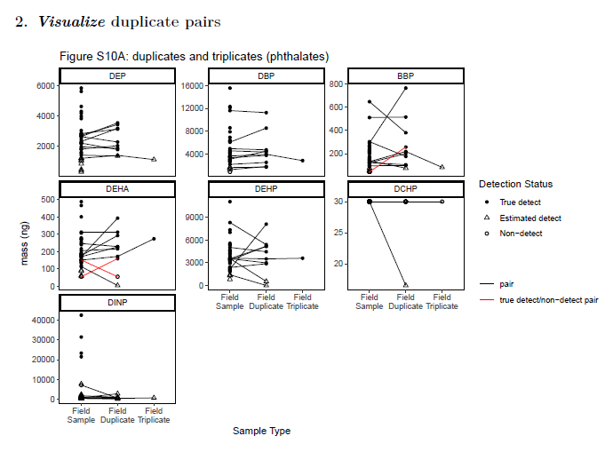
QA/QC Report Guide step 4.2

Slide 38
QA/QC Report Guide step 4.2

