Slide 1
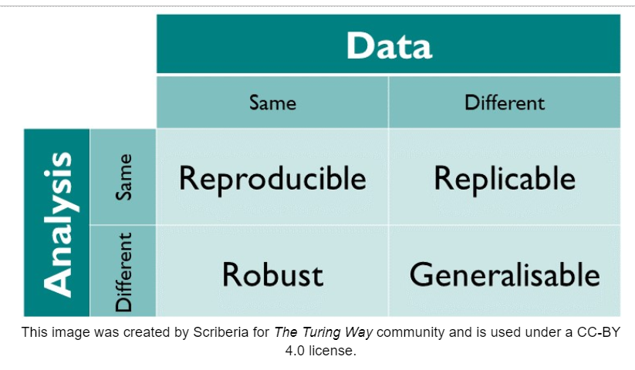
Coding for Reproducibility
BOSTON UNIVERSITY SCHOOL OF PUBLIC HEALTH
Dr. Chad Milando, EH
10.22.2024

Slide 2
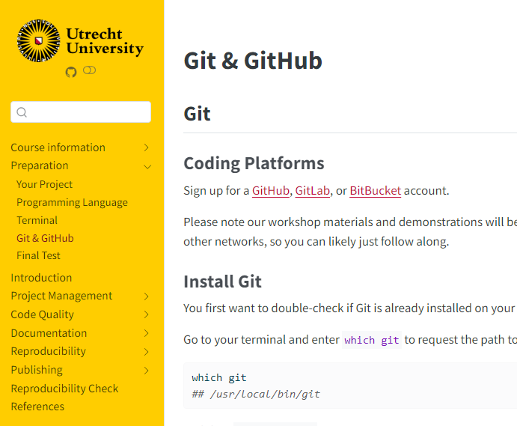
References
https://shorturl.at/lQm5s
https://utrechtuniversity.github.io/workshop-computational-reproducibility/

Slide 3
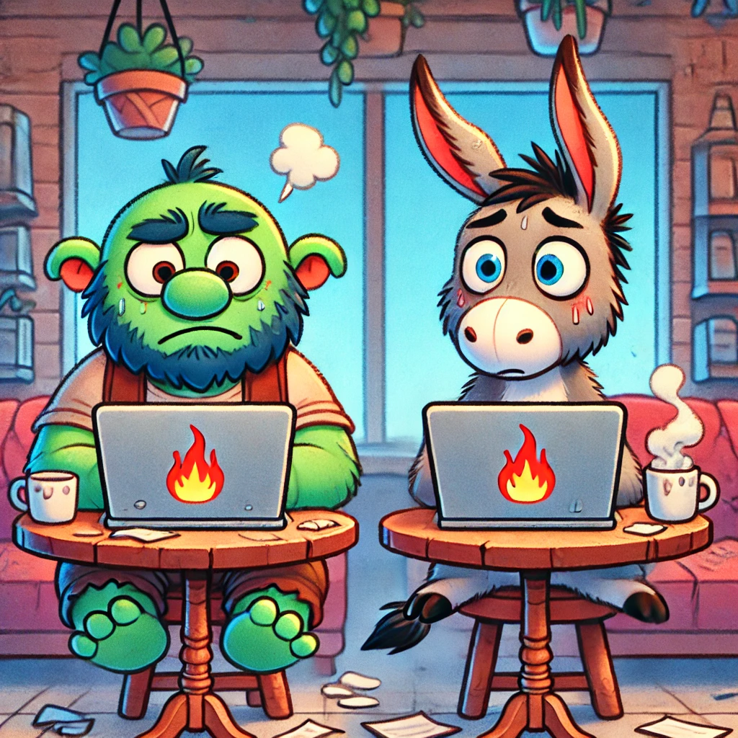
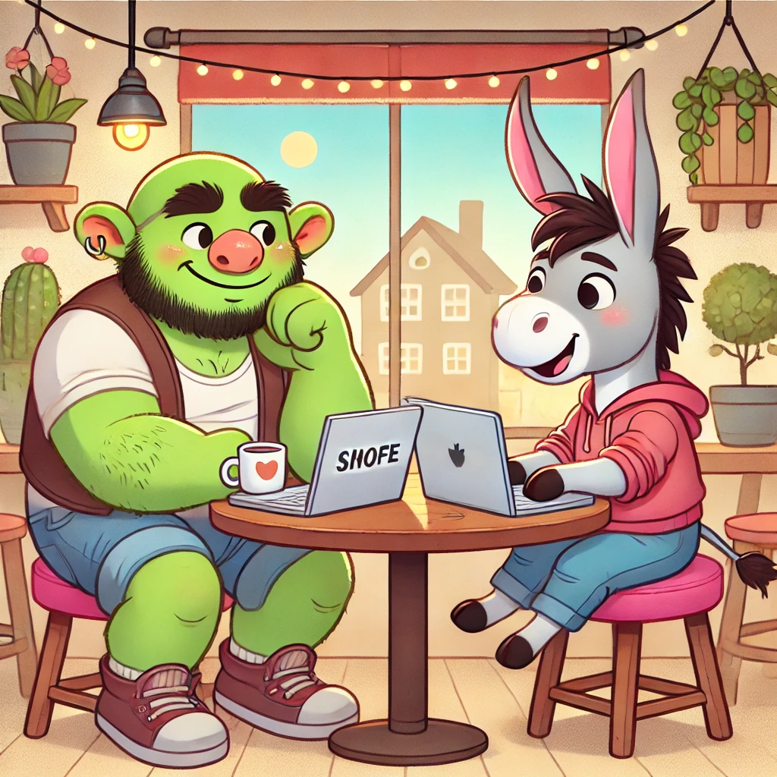
Goals for today
a.
b.
Hands on!
“Layers” of reproducibility
Your code
Github
Figure 1. working on projects where the “layers” of reproducibility are (a) not understood and (b) understood.

Slide 4
Why make code reproducible?

Slide 5
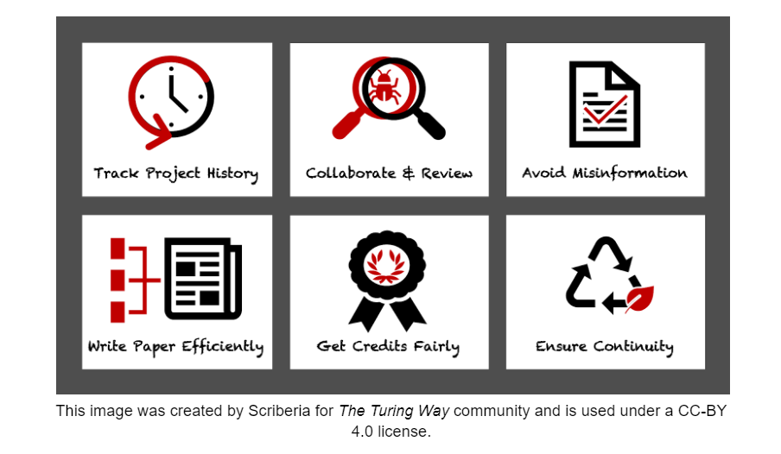
https://shorturl.at/lQm5s

Slide 6
Who are you making things reproducible for?

Slide 7
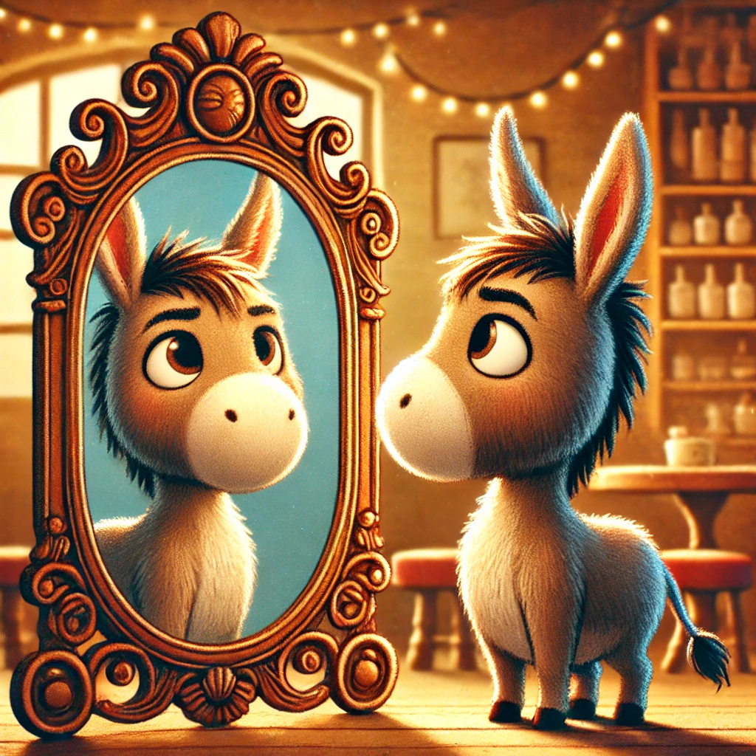
Figure 3. Sometimes others
Figure 2. Mostly yourself

Slide 8
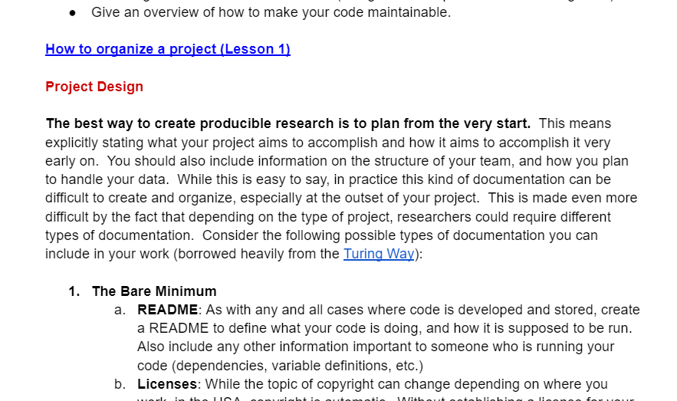
Layers
Action: write out what the goal of your project is
Examples:
Purpose
Author
Meta level of “why” you are doing analysis
(doesn’t address reproducibility of the study)
Version control (** We’ll come back here **)
Project

Slide 9
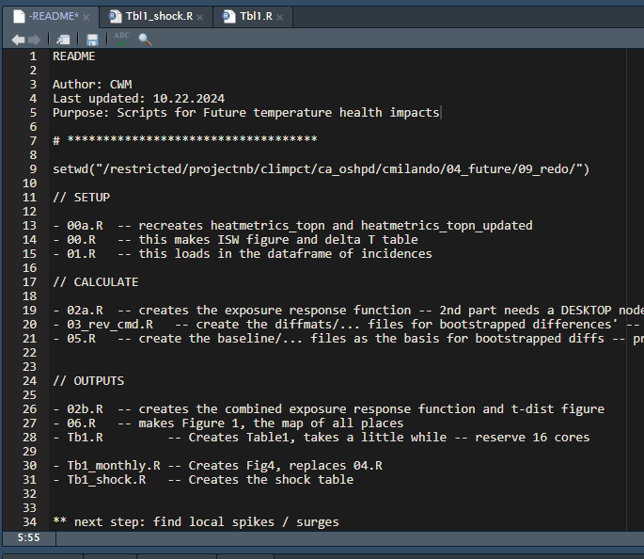
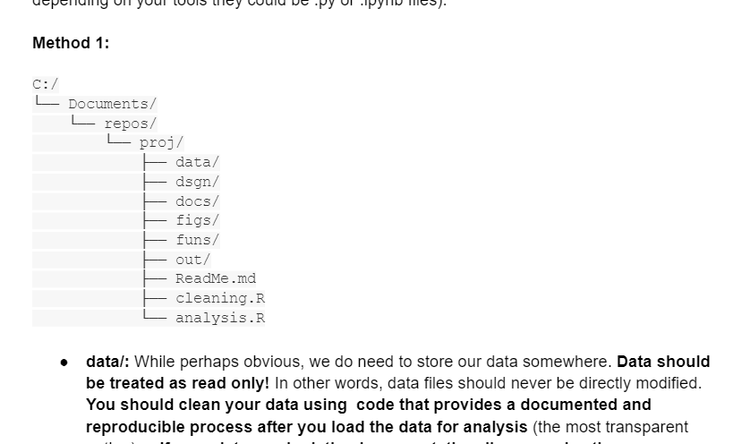
Layers
Action: Add a README and start detailing what each file does
Examples:
A -README at the top
Subfolders for
Inputs
Outputs
Project
Folders

Slide 10
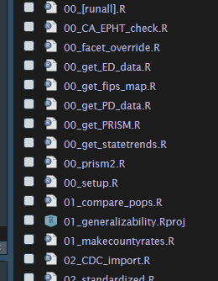
Layers
Action: in your README start ORDERING (but not changing) the names of your scripts. Changing names can break things, so its best do this one at a time
Examples:
Add a 2 digit numeric prefix to your files
File names should be a concise description of the action being taken
“01_clean_housing_data.R”
Project
Folders
File names

Slide 11
Layers
Action: In your README, start writing out which files you could break into smaller chunks. Can you describe each new chunk in 1 sentence?
Examples:
Nothing longer than
100 lines “works”
1 file = 1 job, should generally be able run without needing to run others
E.g., save outputs along the way
so that you can start with 02_ if the outputs from 01_ have been saved
Project
Folders
File names
Files

Slide 12
Layers
Action: Pick one file. Identify all the places where small changes might have a big impact on results. Put comments there. Set seeds. Add in error conditions.
Examples:
Make functions for repeated actions
Where are the places where small changes have a large impact on results
Model parameters / fitting
Random seeds ( set.seed(…) )
Merges & joins
Catch your future self (“prophylactic coding”)
stopifnot(assumption == TRUE)
Writing good code → style guide
Project
Folders
File names
Files
Functions & Scripts

Slide 13
Other tips
If you can’t share your data, simulate a cohort to show methods: library(eesim)
You can use ChatGPT to help comment old code but recommend doing new code yourself
Its ok to Start Fresh!
All of this evolves over time, so the best thing you can do is be as explicit as you can be in your commenting so you / others can know what you were thinking, even if you figure out a more correct way to do it later

Slide 14
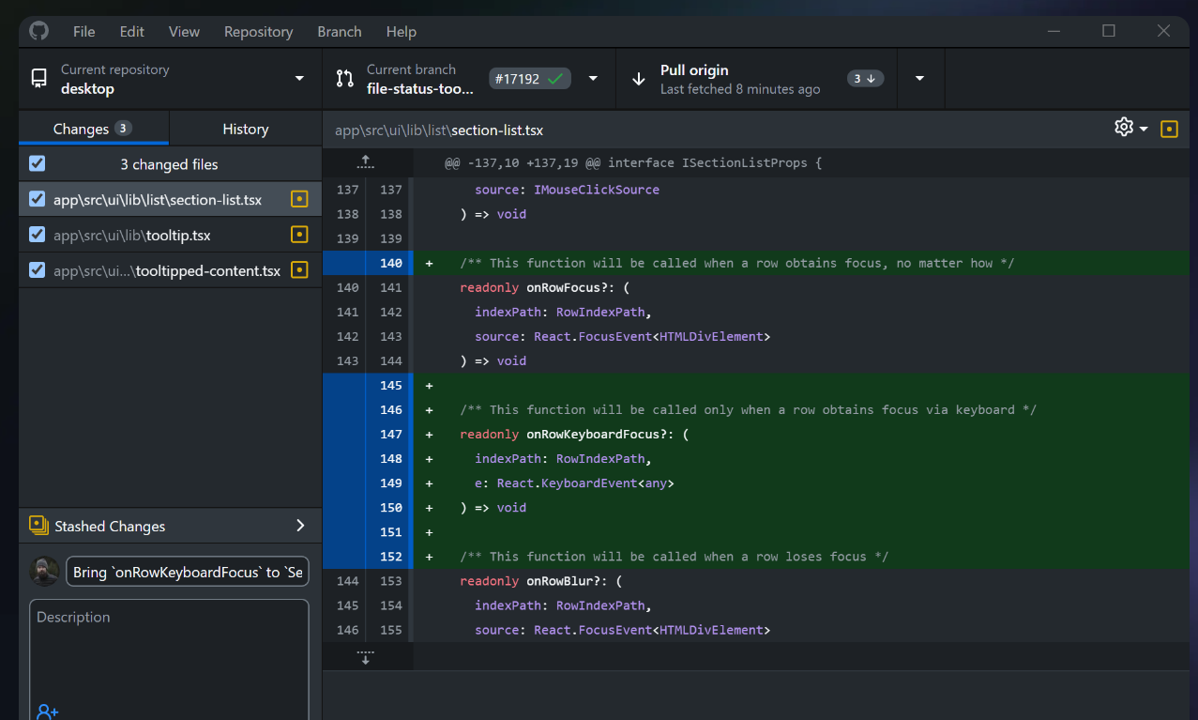
Version control
Action: Make a github login. Download github desktop. Go to one of your project folders and type “git init” in the terminal or cmd. Add a file called .gitignore and make sure to exclude any files that are not code. In Github desktop do `add repository’. Commit your changes and push.
Github – like OneDrive or Dropbox, except you “manually” press “sync”
General guidelines
Use .gitignore to exclude large data files
Easiest way to use it:
Github desktop

