Slide 1
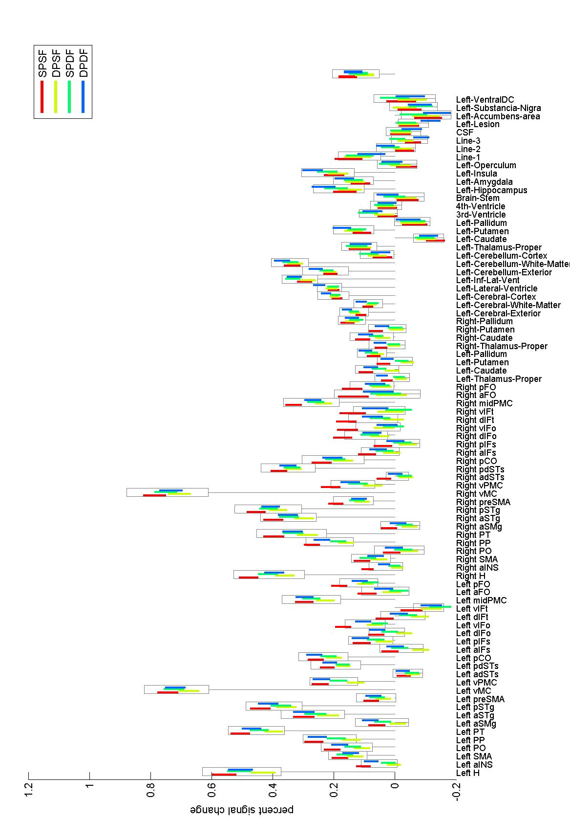
Original analyses
Box: standard error of mean effect across-conditions (e.g. one-sample t-test)
Color lines: standard error of between-condition differences (e.g. paired t-test)
All ROIs

Slide 2
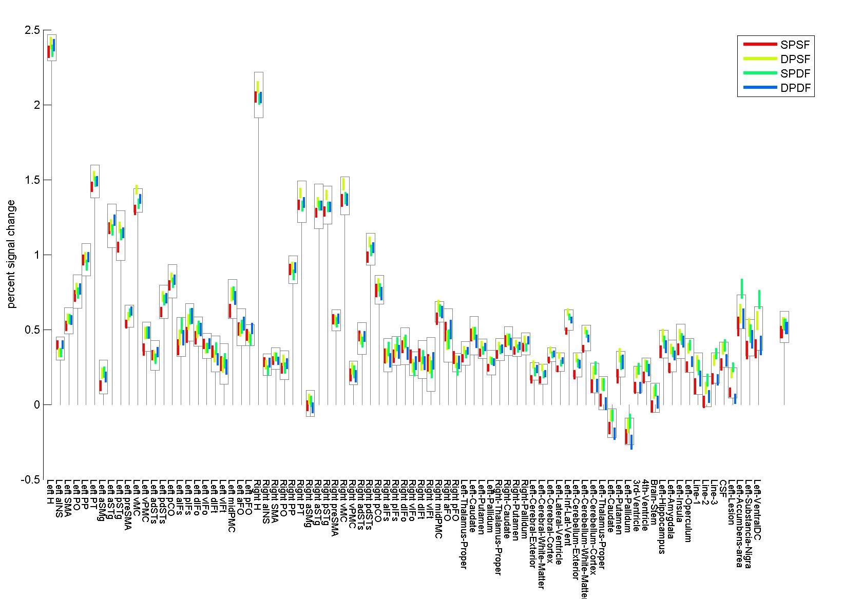
Modified analyses:
Time-shift experiment design by ~0.7s (in order to match the centering slice used during the slice-timing correction preprocessing step)
Remove ‘first-production’ event-related regressors (they tend to introduce noise and potential biases due to lack of jitter in combination with block length -15s- being a fixed multiple of TR -2.5s-)
Contrast estimation over ‘early’ within-block response only (first component of the block response –see next slide)
Box: standard error of mean effect across-conditions (e.g. one-sample t-test)
Color lines: standard error of between-condition differences (e.g. paired t-test)
All ROIs

Slide 3
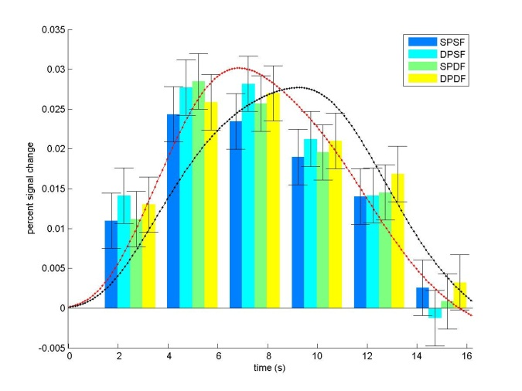
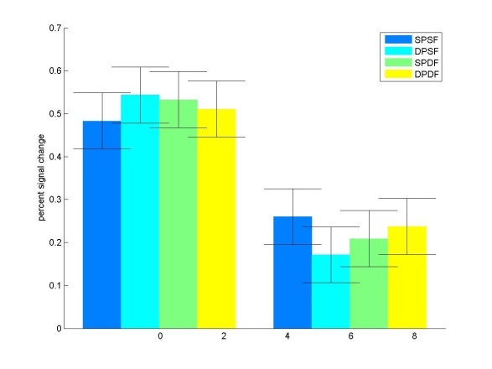
Temporal response within each block
Finite impulse response fit
6th order: one response per acquisition, TR=2.5s, length=15s
Results shown averaged across all ROIs
The observed FIR response does not seem to be well fit by a standard block response (12s block convolved with hrf; best fit shown in black). The standard block response assumes a constant effect within the block, the fit can be improved using a two-component model that allows differential early vs. late effects within the block (shown in red)
Two-component response fit
Response within block broken in two components (early/late; block=12s, two ‘half’ blocks of 6s each, convolved with hrf). Both components are entered in the first-level models (separately for each condition).
Results shown averaged across all ROIs (previous slide shows first-component-only results for each ROI)
Differences in early vs. late components (relative reversal of condition-specific suppression)
Issues: Within each 12s block the subject repeats 3 times the same speech production pairs; late component could be modulated by a relative drop in attention, long-range suppression, and/or higher top-down expectation/preparation effects

Slide 4
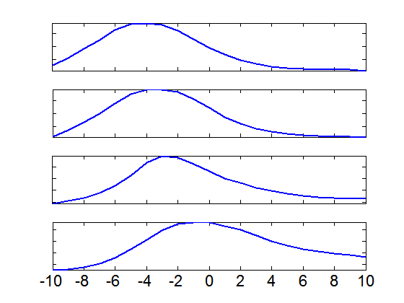
The strange ‘model delay’ issue explained?
One of the early indications that there was some form of model misspecification was the observation that the first-level model fits improved when artificially adding a delay to the design matrix regressors (e.g. by changing the specified onsets of the conditions). This is shown in the ‘initial model’ plot below (optimal model shift seemed to be ~5s).
That observation seemed to be caused not by any single issue or problem in the model but rather by a combination of different effects, each adding a small contribution to the overall observed delay (which just happened to be all in the same direction). The plots below show how each of the ‘corrections’ included in the modified model (when added sequentially one at a time) seem to reduce this observed delay (despite most of these ‘corrections’ being motivated by other issues):
1) Time-shift to match the centering slice used during slice-timing correction (this modification accounts for about 0.7s of the observed ~5s shift)
2) Removal of ‘first-production’ event-related regressors (this reduces the observed shift by 1-2s, likely due to the associated earlier peak of the hrf-convolved block response, which now starts 2s earlier than in the previous model)
3) Separation of early/late responses (this reduces the observed shift by an additional 1-2s, likely due to the earlier peak of the two-component model fit compared to the full-block regressor model –see first plot in previous slide-)
Initial model:
After time-shift:
Model fit
After removing event-related regressors:
After separating early/late responses:
Delay added to the design matrix regressors (s)

Slide 5
Additional Info

Slide 6
Original analyses

Slide 7
Modified analyses (slice-acquisition centering + remove first-repetition regressors)

Slide 8
Modified analyses + first half only

Slide 9
Modified analyses + second half only

Slide 10
Original analyses
Box: standard error of mean effect across-conditions (e.g. one-sample t-test)
Color lines: standard error of between-condition differences (e.g. paired t-test)
All ROIs

Slide 11
Modified analyses
Experiment design lag matching the slice-timing correction centering slice
Remove ‘first-repetition’ regressors
Estimate initial response only (first half of the block response –see next slide)
Box: standard error of mean effect across-conditions (e.g. one-sample t-test)
Color lines: standard error of between-condition differences (e.g. paired t-test)
All ROIs

Slide 12
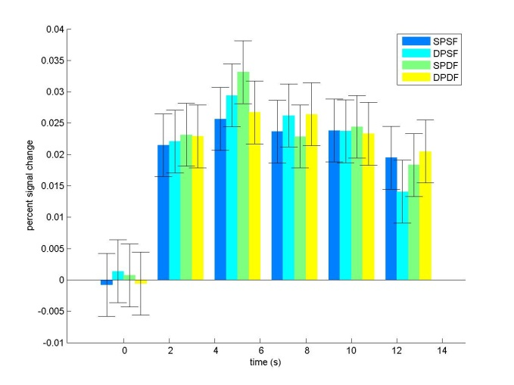
Temporal response within each block
Finite impulse response fit
6th order: one response per acquisition, TR=2.5s, block=15s (12s speech + 3s silence)
Averaged across all ROIs
Two-component response fit
Response within block broken in two components (early/late) (block=12s, two ‘half’ blocks of 6s each, convolved with hrf)
Averaged across all ROIs
Differences in early vs. late components (relative reversal of condition-specific suppression)
Issues: Within each 12s block the subject repeats 3 times the same speech production pairs; late component could be modulated by a relative drop in attention, long-range suppression, and/or higher top-down ‘expectation’ effects

