Slide 1
Tidy Data
Global Health 811
April 9th, 2018

Slide 2

Happy families are all alike; every unhappy family is unhappy in its own way — Leo Tolstoy

Slide 3
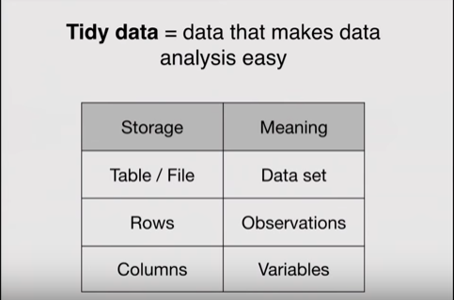
Concept of Tidy Data
Data is often messy!
We need a precise way to talk about “Tidy” data
Goal: Represent one fact in one place
If one fact in multiple places, chance to record
different values!

Slide 4
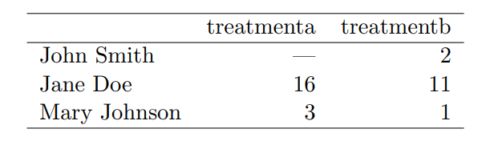
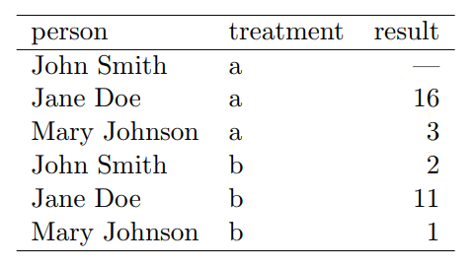
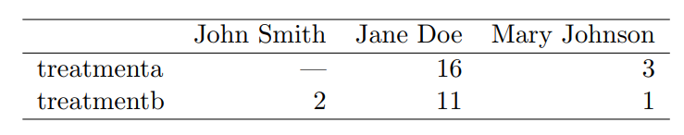
Data Semantics
The dataset contains 18 values representing three variables and six observations. Information remains the same in the tidy dataset, but values, variables, and observations are more clear.

Slide 5
Common problems with messy data
• Column headers are values, not variable names.
• Multiple variables are stored in one column.
• Variables are stored in both rows and columns.
• Multiple types of observational units are stored in the same table.
• A single observational unit is stored in multiple tables

Slide 6
Columns are values, not variables
Cases in which you may come across data of this nature:
• Tabular data designed for presentation
• Sometimes used to record regularly spaced observations over time

Slide 7
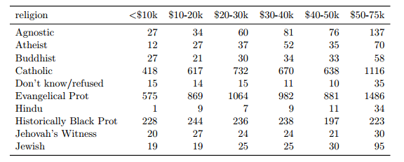
Example 1: Pew Survey Data
What are the variables & observations in this dataset?
What would the tidy version look like?

Slide 8
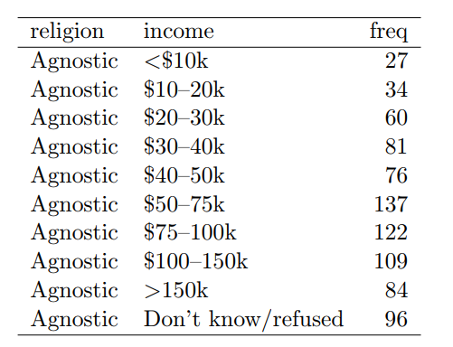
The Tidy Version
The first ten rows of the tidied survey dataset on income and religion.
This version is tidy because each column represents a variable and each row represents an observation.
In this case a demographic unit corresponding to a combination of religion and income

Slide 9
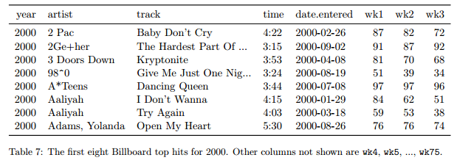
Example 2: Billboard Data

Slide 10
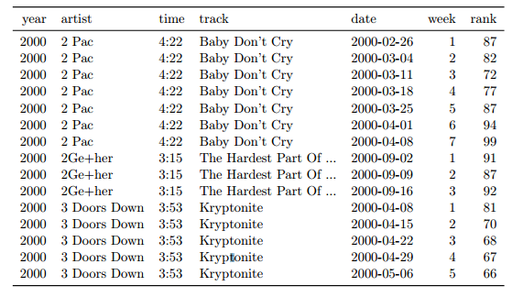
The Tidy Version

Slide 11
Your reward. Thank me later!
https://youtu.be/F7lfNXddV6A

Slide 12
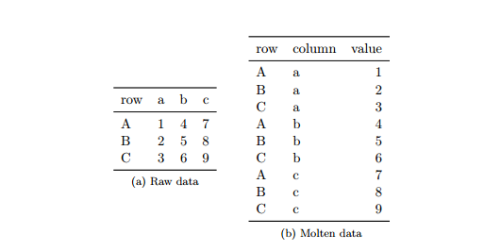
“Melting” Data

Slide 13
Multiple variables stored in one column
After melting (reshaping) data, the column variable often becomes a combination of multiple underlying variable names.

Slide 14
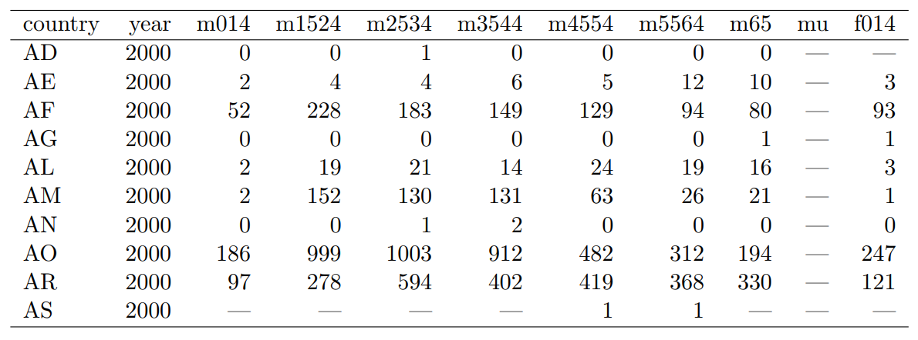
Example: WHO TB Dataset

Slide 15
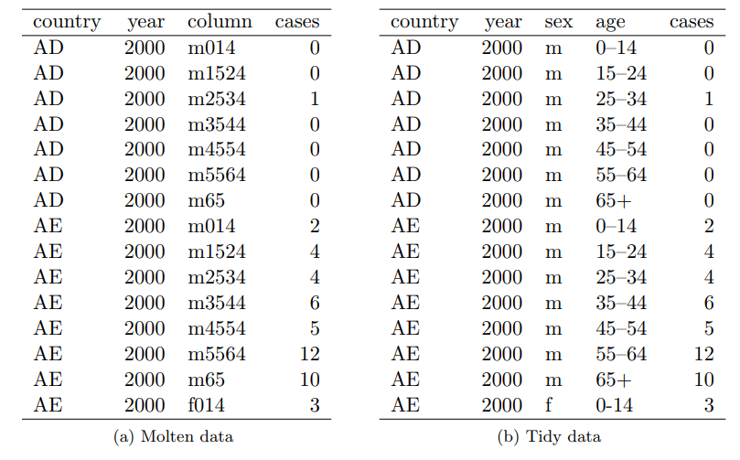
After melting, the data still need tidying

Slide 16
Variables stored in both rows & columns
The most complicated form of messy data occurs when variables are stored in both rows and columns

Slide 17
Example: Climate Database
- Data are drawn from the Global Historical Climatology Network
- One weather station (MX17004) in Mexico
- Five month period in 2010

Slide 18
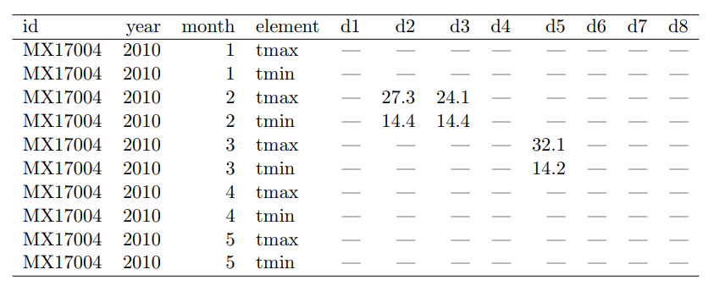
Example: Climate Database

Slide 19
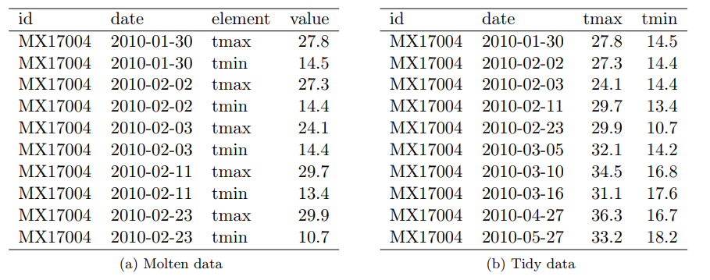
Example: Climate Database
In the tidy dataset, each row represents the meteorological measurements for a single day. There are two measured variables, minimum and maximum temperate; all other variables are fixed.

Slide 20
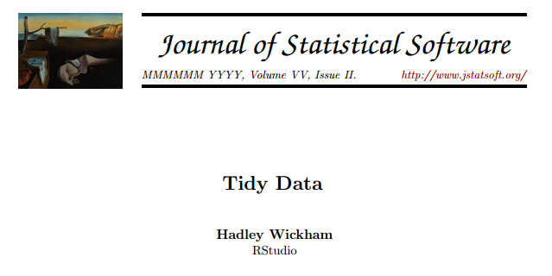
For more on tidy data
…see the link on the GH 811 site

Slide 21
R Tidyr Interactive Demo
- gather()
- separate()
- spread()

Slide 22
Installing packages
Install the whole tidyverse (warning: this takes a while):
install.packages(“tidyverse”)
OR
Just install tidyr:
install.packages(“tidyr”)

Slide 23
Upcoming deadlines
Sunday, November 4th at 5pm
Data dictionary
Table shells
Methods section
Team charter review
Tuesday, November 6th at 2pm
Journal 2

