Slide 1
Collecting data from existing databases
Prof. Andrew Stokes
Department of Global Health
BUSPH
November 20, 2018

Slide 2
Types of secondary data
Survey data
Vital statistics
Administrative data
Digital data

Slide 3
Types of survey data
National health surveillance
  NHANES
  NHIS
  BRFSS
  HRS
  PATH
Prospective cohort studies
  FHS
  BWHS
  NHS/HPFS
  WHS
Global health surveys
  DHS/MIS
  MICS
  STEPS

Slide 4
National health surveillance surveys
Advantages
  High-quality data
  Easy to use (many data cleaning steps have already been performed)
  Generalizable to US population (usually non-institutionalized)
Disadvantages
  Most surveys in this category are repeat cross-sections (not longitudinal)
  Breadth over depth (surveys cover large range of topics rather than any particular topic in detail)
  To maintain minimal risk of respondent identification, certain variables are available as restricted-access files only

Slide 5
National Health and Nutrition Examination Survey (NHANES)
Survey lead: National Center for Health Statistics (CDC)
Survey design: Complex, multistage probability design to sample the noninstitutionalized civilian resident US population, with oversampling of certain groups based on race/ethnicity and socioeconomic status.
Years of data collection: 1960-present
Sample size: ~5000 individuals per year
Modes of data collection: in-home interviews, mobile examination units
Major types of data: self-reported data, exam results, labs
Linkages: multiple cause of data (1992-present)

Slide 6
NHANES
Major data types include demographics, dietary, examination, laboratory, questionnaire, limited access variables
Demographics: age, gender, race/ethnicity, country of birth, marital status, socioeconomic status, etc.
Examination: anthropometry measures, systolic & diastolic blood pressure, dual-energy x-ray absorptiometry, and muscle strength assessment.
Laboratory: exposure and health biomarkers, including cotinine, HPV, HbA1c, blood glucose, cholesterol, etc.
Questionnaire: health behaviors, cardio-metabolic risk factors, social determinants, insurance status, disability, and morbidity.

Slide 7
NHANES – Pros and Cons
Pros
  Integration of extensive exam and lab data with information collected in interviews
  Survey design allows for pooling of multiple waves of data
    Increases sample sizes
    Enables analysis of trends over time
  Although not longitudinal, can be made into prospective cohort through linkage to mortality files
  Recall questions permit analysis of health across life course
Cons
  Sample sizes are relatively small compared to other national health surveillance surveys
  Does not survey institutionalized populations, including patients residing in long-term care facilities, persons on active military duty, persons incarcerated in the prison system, and citizens of US residing in other countries

Slide 8
National Health Interview Survey (NHIS)
Survey lead: US Census Bureau
Survey design: complex, multistage probability sample of US noninstitutionalized population with oversampling based on age and race/ethnicity.
Years of data collection: 1957 to present
Sample size: ~35,000 households containing about 90,000 persons per year
Modes of data collection: personal household interviews with computer assisted interviewing mode (CAPI)
Linkages: multiple cause of death data (1992-present)

Slide 9
NHIS vs. NHANES
Consider using the NHIS when…
  Project requires large sample sizes (data can be pooled similar to NHANES) and can generate very large datasets (90K per year X 20+ years of data = 2 million + observations)
  Project requires data on a special topic of interest included in a NHIS supplement
  Project does not require use of exposure or health biomarkers or exam data
  Project focuses on subnational patterns (regional or state level)
In some instances, the two surveys may be equally advantageous for answering the study question in which case the researcher may consider performing parallel analyses of both datasets

Slide 10
Behavioral Risk Factors Surveillance System (BRFSS)
Survey lead: CDC in coordination with other federal agencies and state health departments
Survey design: Implemented at state-level with random-digit dialing and post-stratification
Years of data collection: 1984-present
Sample size: ~400,000 adults per year
Modes of data collection: Telephone survey
Major types of data: self-reported data

Slide 11
Advantages and Disadvantages of the BRFSS
Advantages
  BRFSS is the only large national study designed to produce representative estimates at the state level
  BRFSS is sufficiently large to examine health behaviors and outcomes at the county level
  BRFSS can also be used to examine health patterns of selected metropolitan and micropolitan statistical areas (MMSAs) with 500 or more respondents.
Disadvantages
  Mode effects (telephone interviews vs. in-person interviewing)
  Low response rates in some states

Slide 12
Other notable national health surveys
Health and Retirement Study (HRS)
  Longitudinal study of older Americans
  Biennial assessment, 1992 to present
  Tracks multiple birth cohorts. The oldest is the cohort of 1931-1941
  Includes exam data and biomarkers and extensive data on aging and disability
  Counterpart surveys have been developed in China, South Korea, and several other countries enabling cross-national comparisons
The Population Assessment of Tobacco and Health (PATH) Study
  Longitudinal study of tobacco use and health
  Three waves of data are currently available, spanning 2013-2016

Slide 13
Prospective Cohort Studies
Examples:
  Framingham Heart Study (1949-present)
  Black Women’s Health Study (1992-present)
  Nurses’ Health Study (1972-present)
Most prospective cohort studies are not nationally representative, although exceptions exist (HRS, PATH).
More often they focus on particular communities (FHS) or demographic (BWHS) and occupational groups (NHS)

Slide 14
Advantages and disadvantages
Advantages:
  Valuable for investigating disease etiology
  Enables measurement of disease incidence and progression
  Enables studying risks and outcomes as they unfold over life course and during critical life course transitions (e.g. transition to adulthood; divorce, widowhood, retirement, etc.)
  Often cohort data are very well characterized. Some cohort studies, such as the FHS, include rich genetic data
Disadvantages
  Data often have limited generalizability.
  Examples: FHS is limited to residents of Framingham, MA; the Nurses’ Health Study is largely non-Hispanic white; the HPFS is mostly non-Hispanic white and high SES

Slide 15
Global Health Surveys
Demographic and Health Surveys (DHS)
  The DHS program includes more than 300 surveys from over 90 LMICs
  Nationally-representative surveys, with special focus on women and children
  Data are standardized, facilitating data pooling and cross-national comparison
  In some countries where DHS data are collected, it represents the only source of national health and demographic data independent of government administrative records
  In more recent waves of data collection, surveys incorporate examination (e.g. hypertension) and laboratory testing (e.g. disease markers for malaria, diabetes, etc.)

Slide 16
Vital Statistics
Vital statistics data seek to capture all events of a particular nature that occur in the population
  Births
  Deaths
  Migration
Cause of death data are especially valuable for population health research, providing:
  Date of death
  Cause of death (underlying and contributing causes)
  State of residence of decedent

Slide 17
Administrative data
Administrative data refer to sources of data collected mainly for administrative vs. research purposes.
The two most commonly used sources of administrative data for population heath research include:
  Claims data
  Electronic health records
Claims data are generated when health plans submit bills for patient services, including visits to a primary care doctor, specialist care, hospitals, labs, imaging, pharmacies, etc.
Electronic health records represent a digital version of a patient’s chart and contain information on medical history, diagnoses, medications prescribed (not filled), treatment plans, immunizations, allergies, radiology images, and exam and laboratory results.
Examples: VA, Optum, Medicare, Truvia, athenahealth, etc.

Slide 18
Digital data
Digital data are generated in real time as people browse and interact in digital spaces
Examples:
  Yelp, Facebook, Twitter, Reddit
Pros
  Extremely large samples
  Potential for real-time monitoring of population health
  Potential to capture information not available from surveys
  Excellent for prediction
Cons
  Selection biases and generalizability issues
  Difficult to establish causality

Slide 19
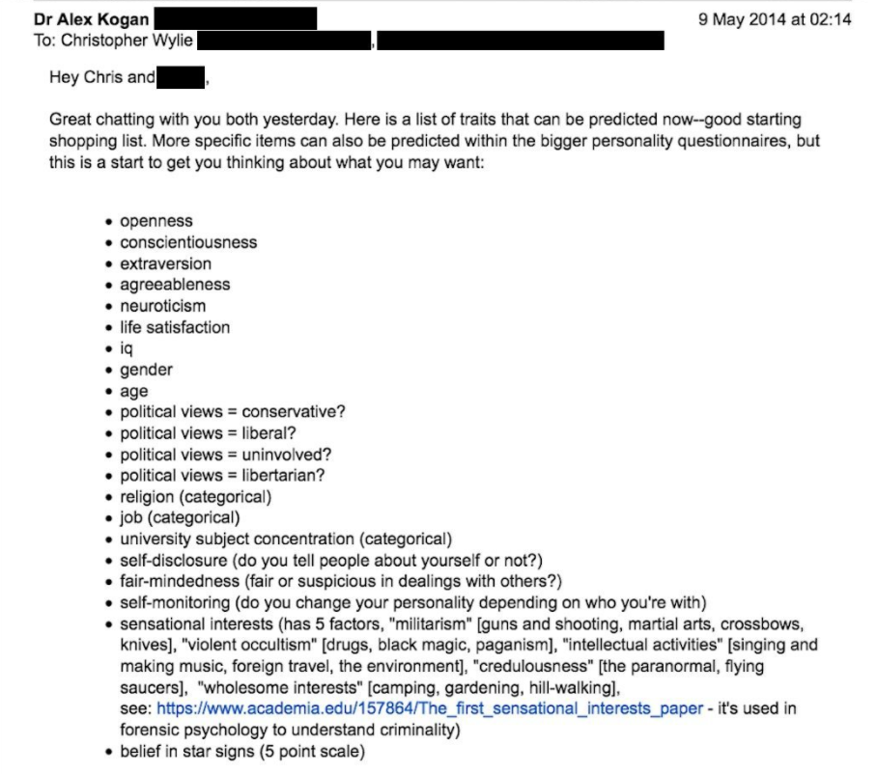
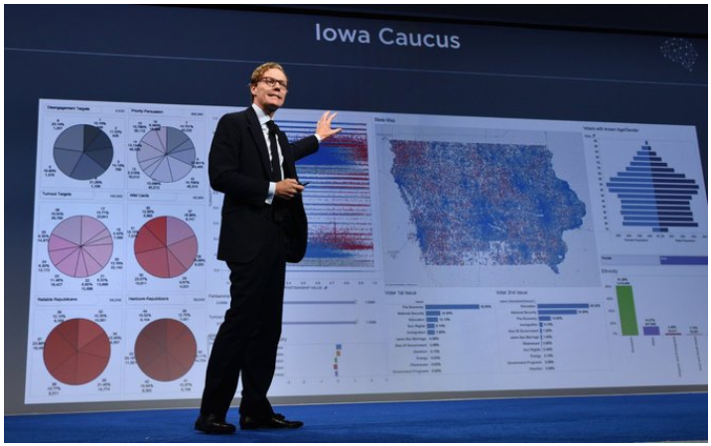
Example 1: Predicting personality traits
Source: Rosenberg et al. How Trump Consultants Exploited the Facebook Data of Millions. The New York Times. March 17, 2018.

Slide 20
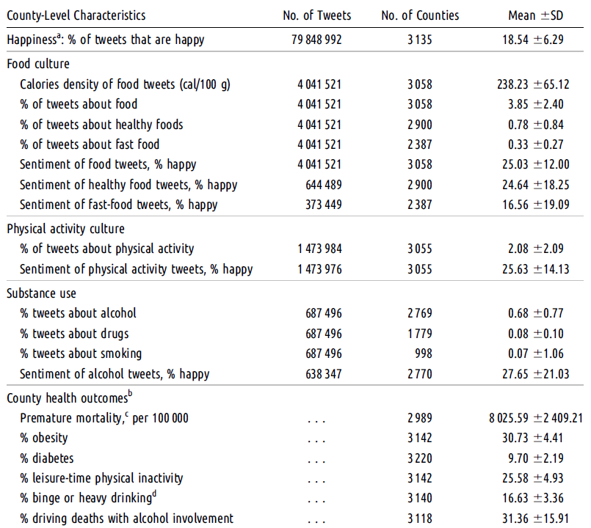
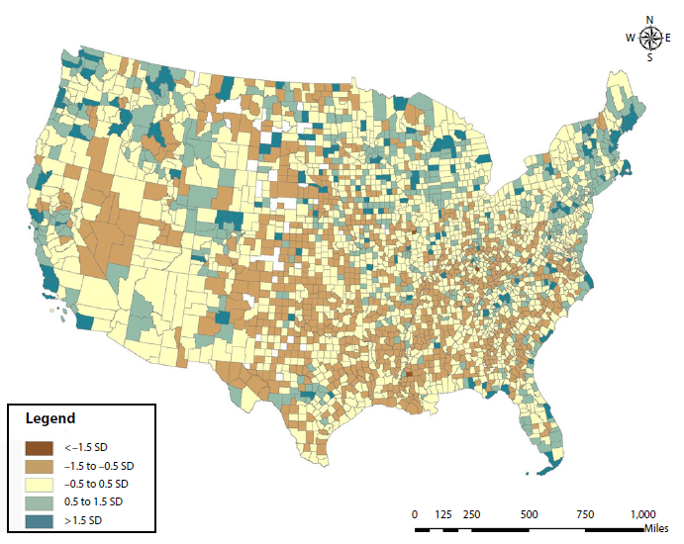
Example 2: Predicting health at local level
Source: Nguyen et al. Geotagged US Tweets as Predictors of County-Level Health Outcomes, 2015–2016. AJPH. 2017

Slide 21
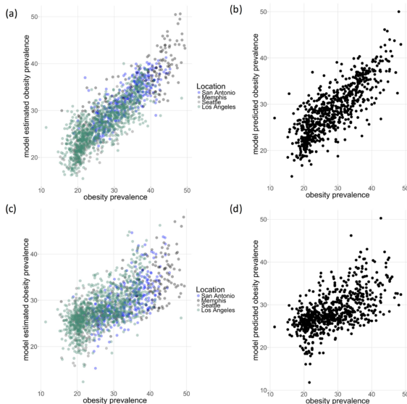
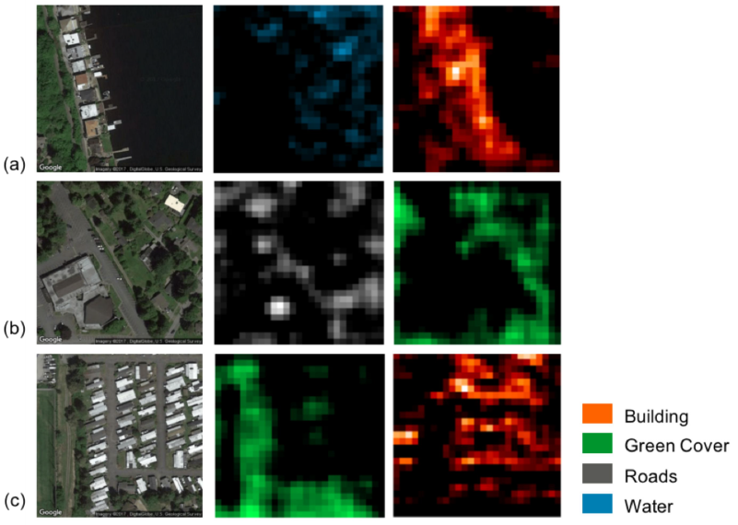
Example 3: Identifying features of the built environment that predict obesity

Slide 22
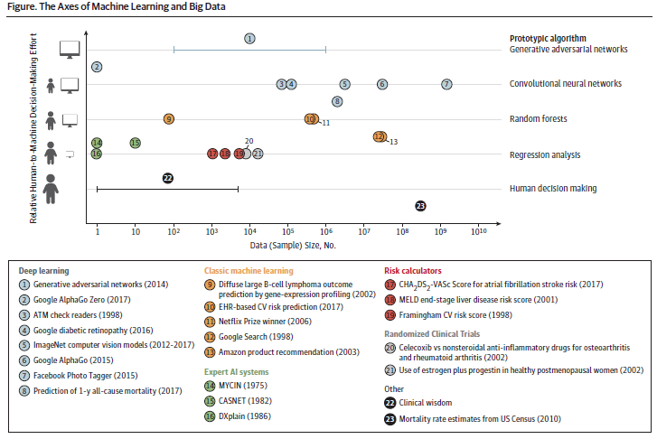
From heuristics to deep learning: the machine learning spectrum

