Slide 1
Does Mediterranean Diet Correlate with Incident Frailty?
Sarah King, MD
Journal Club
September 2020

Slide 2

Our patient
72 year old woman with h/o HTN, HLD, OA of right knee
Concerned about “slowing down”. Asks what she can do to stay healthy
Meds: amlodipine, atorvastatin, acetaminophen
Lives alone in 2nd floor apartment
Diet: “I like my sweets”
Notes:
No recent admissions
Able to climb flight of stairs, but gets more tired
Energy level is ok overall
Walks around the block once a day

Slide 3
Learning Objectives
Understand background knowledge about frailty prevention and the Mediterranean diet
Analyze systematic review/meta-analysis
Appraisal of evidence and application to clinical case
Description of resources available for our patients at Boston Medical Center

Slide 4

What do we know about Frailty Prevention?
Decreased frailty incidence:
  Group physical activity programs
  Nutritional supplements, increasing protein-calorie and micronutrient intake
  Cognitive training
No correlation with frailty incidence:
  Hormone replacement therapy
  Group sessions focused on ageing process and health
Apostolo, et al. JBI Database of Systematic Reviews and Implementation Reports. 2018.

Slide 5

What do we know about the Mediterranean diet?
No single definition
Reduction in risk of CVA, mild reduction in cholesterol
Absent or minor adverse effects
Limited data on cost or health-related quality of life
Rees, et al. Cochrane Database. 2019.
Notes:
high in fruits, vegetables, whole grains, beans, nuts, and seeds, includes olive oil
low to moderate amounts of fish, poultry, and dairy products, with little red meat
uncertain if a single component of the Mediterranean diet offers the protective benefit or if the benefit results from an aggregation of effects
Mixed data for CV and overall mortality

Slide 6
PICO Question
Patient, Problem, Population | In community dwelling older adults
Intervention | does adherence to the Mediterranean diet
Comparison or Control | compared with regular diet
Outcome | decrease incidence of frailty?

Slide 7
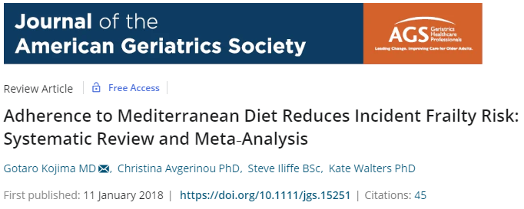

Slide 8
Study Design
Objective:
  Review of the literature of prospective cohort studies examining associations between adherence to a Mediterranean diet and incident frailty
Systematic review and meta analysis

Slide 9

Study Design
Eligibility criteria:
  Community dwelling older adults (OAs)
  Mean age 60 or older
  Assessment of adherence to Mediterranean diet
  Prospective examination of risk of developing frailty
Exclusion criteria:
  Defined frailty according to a single factor
  Used selected cohorts with specific disease conditions
  Review papers, RCTs

Slide 10
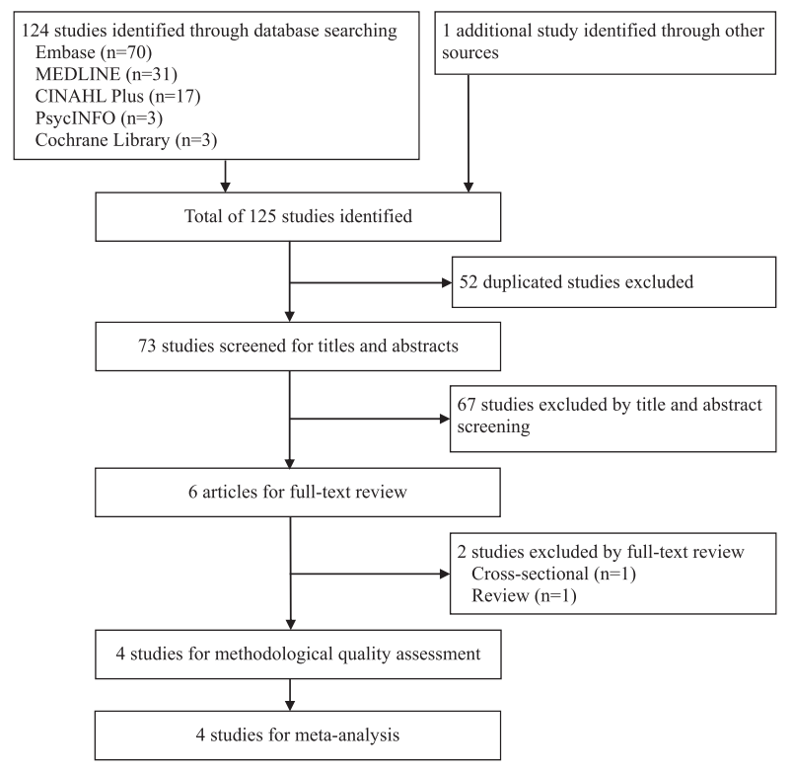
Methods
Searched for studies published 2000 or later
Two independent reviewers
Notes:
The most commonly used frailty phenotype criteria published in 2001

Slide 11
Statistical Analysis
The presence and degree of heterogeneity between studies were assessed using the chi-square test and I² statistic
Publication bias assessed by visual inspection of funnel plots
Notes:
I² values of 25%, 50%, and 75% were considered to be low, moderate, and high degrees of heterogeneity

Slide 12
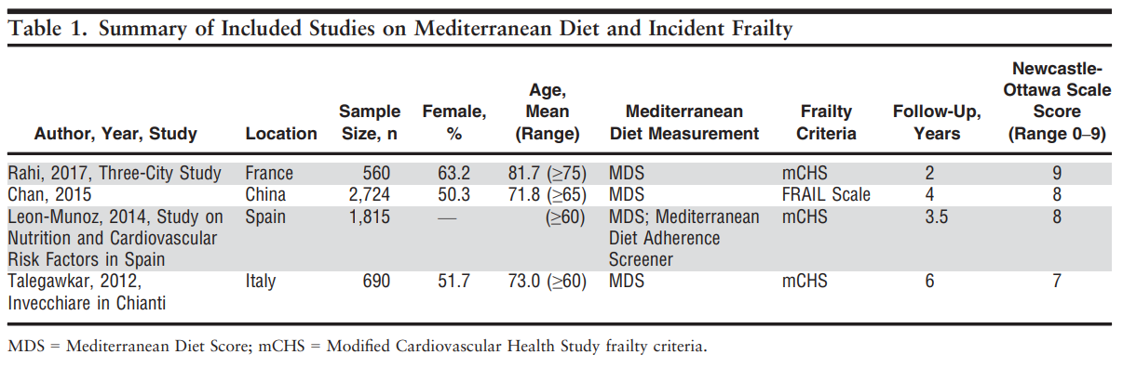
Study characteristics
4 studies included in meta-analysis
5,789 older adults included with a mean follow-up of 3.9 years
Notes:
- No studies conducted in the US
Leon Munoz study % female and mean age
All studies use MDS
3 of 4 studies modified CV health study frailty criteria

Slide 13

Frailty assessment
Cardiovascular Health Study frailty criteria
  Unintentional weight loss
  Self-reported exhaustion
  Weakness
  Slow walking speed
  Low physical activity
FRAIL scale
  Fatigue – Easily fatigued?
  Resistance – Able to walk up one flight of stairs?
  Ambulation – Able to walk one block?
  Illnesses – More than five illnesses?
  Loss of weight – Lost >5% weight in 3 months?
Notes:
CV HS: one of the most widely used measures to define physical frailty based on 5 criteria
Frail scale – score >3 = frail

Slide 14

Mediterranean Diet Score
A scale to indicate degree of adherence to the Mediterranean diet, as constructed by Trichopoulou, et al.
MDS – 1 point for each “yes”
Vegetables | Two or more cups of vegetables a day
Fruit | Two or more pieces of fruit a day
Whole grains | 2 or more whole grains a day
Wine | ½ to 1 drink a day for women, 1 to 2 for men (but no more)
Fish | Fish 2 or more times a week
Legumes / beans | 2 or more servings a week
Nuts / Seeds | A handful of nuts most days
Fat | Lots of olive oil and few other fats
Red or Processed Meat | 2 servings or fewer a week
Trichopoulou, et al.. BMJ 1995
Notes:
Typically the values are assigned based on median intake of the included study population
0-3 – low adherence
4-5 – moderate adherence
6-9 – high adherence

Slide 15
Results
Odds Ratio (OR) was used for meta-analysis as all four studies provided ORs of incident frailty risks and used the MDS to measure adherence to a Mediterranean diet
All ORs adjusted for multiple confounders
Notes:
age, sex, education, marital status, body mass index, smoking, alcohol, living status, energy intake, medication, physical activity, and comorbidities

Slide 16
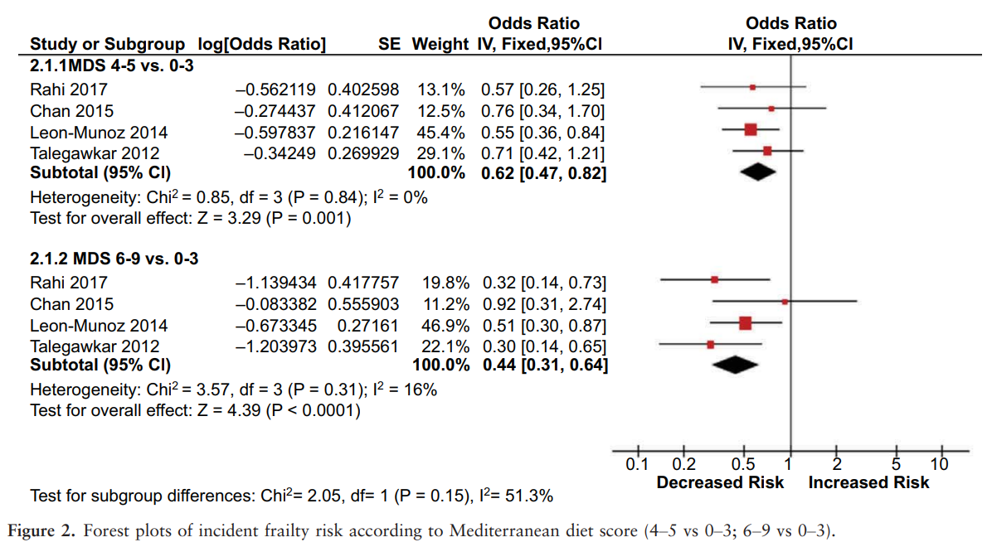
Results
Notes:
Forest plot: left (decreased risk of frailty), Right (increased risk of frailty)
Top – moderate adherence to low
Bottom – high adherence to low
Visual inspection of forest plot
Heterogeneity – I squared statistic – quantify heterogeneity
Both groups statistically significantly decreased odds of frailty incidence

Slide 17
Results
There was a ~50% decrease in the odds of incident frailty in patients who were most adherent to the Mediterranean diet.
Overall, this study found that greater adherence to the Mediterranean diet was associated with lower incidence of frailty.

Slide 18
Results
Assuming frailty incidence of 10%:
Moderate adherence:
NNT = 28 patients to prevent one incident case of frailty
High adherence:
NNT = 19 patients to prevent one incident case of frailty
Collard, et al. JAGS. 2012
Notes:
JAGS 2012 community dwelling patients without specific disease target, “all comers”

Slide 19
Strengths and Limitations
Strengths:
Independent review of search results and data extraction
All four studies were included in the meta-analysis
Low degree of heterogeneity across results
Limitations
Differences in measurement of MDS between studies – median values vs specific cutoff
Follow-up time of 3.9 years
Notes:
Considering all studies afer 2000, good to be able to include 4 studies

Slide 20
Our patient
72 year old woman with h/o HTN, HLD, OA of right knee
Concerned about “slowing down”. Asks what she can do to stay healthy
Meds: amlodipine, atorvastatin, acetaminophen
Lives alone in 2nd floor apartment
Diet: “I like my sweets”
Notes:
No recent admissions
Able to climb flight of stairs, but gets more tired
Energy level is ok overall
Walks around the block once a day

Slide 21
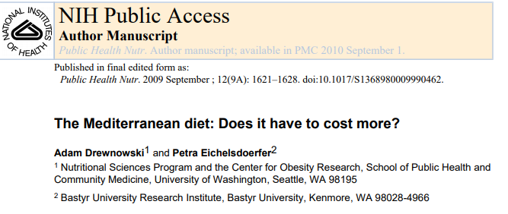
Critical Appraisal
Is our patient similar to those included in the study?
  Yes, mostly
Is the intervention feasible in our setting?
Notes:
None in US
Community dwelling, average age the same, 50% female
Washington state
Calorie per dollar

Slide 22
Critical Appraisal
What are our patient’s potential benefits and harms from the intervention?
  No report of adverse events within the included studies. Potential benefits to increased adherence to Mediterranean diet extend beyond decreased incidence of frailty such as decreased risk of stroke, cardiovascular mortality and overall mortality.
What are our patient’s values and expectations for both the outcome we are trying to prevent and the adverse effects we may cause?
  She ultimately was interested in trying to make some changes to her diet, but did not want to give up sweets.

Slide 23
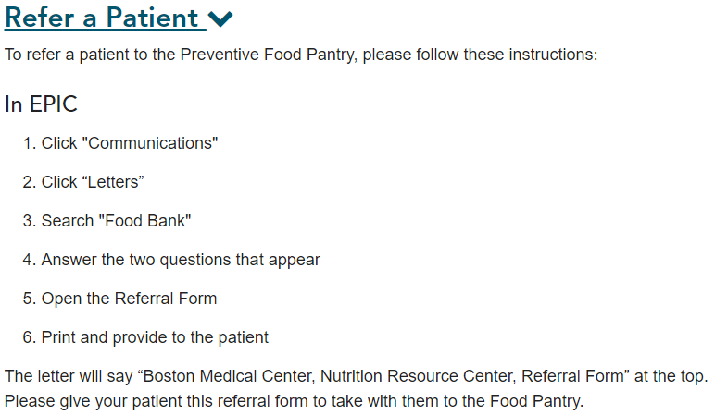
BMC Food Pantry
Notes:
Families can visit twice/month
3-4 days of food per visit
Latchman Hirallal

Slide 24


Slide 26

Future Directions
What specific components of Mediterranean diet that are most associated with decreased incident frailty?
What components of frailty are most affected by diet?
Are there adverse outcomes associated with adherence to the Mediterranean diet?

