Slide 1

Journal Club
Maya Abdallah, MD
Geriatric Oncology Fellow

Slide 2
Case
76-year-old female with newly diagnosed Myelodysplastic Syndrome (MDS) is seen for an initial visit in heme/onc clinic.
  Initial diagnosis at a rural hospital
  Treatment options were briefly discussed
  Patient was interested in a second opinion regarding prognosis to help make an informed decision
The oncologist explains how the following affect expected complications and survival:
  disease biology
  chronological age, &
  performance status

Slide 3
Research Question
In patients 75 years and older with myelodysplastic syndrome/leukemia, lymphoma, or myeloma, does frailty (as measured by gait speed and grip strength) predict survival and unplanned healthcare utilization at 6 months, independent of performance status?

Slide 4
Learning Objectives
In older adults with hematologic malignancies:
  Recognize that frailty screening is key to prognostication, &
  Assess the utility of gait speed assessment as a rapidly conducted frailty assessment measure

Slide 5
Scope of the question

Slide 6
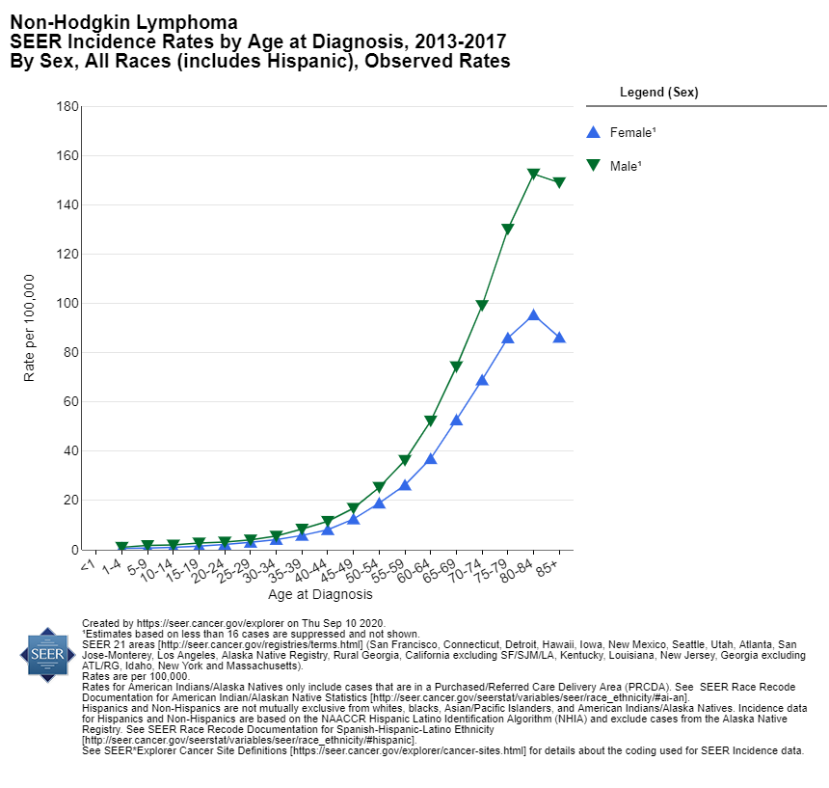
As age increases, risk for cancer increases

Slide 7
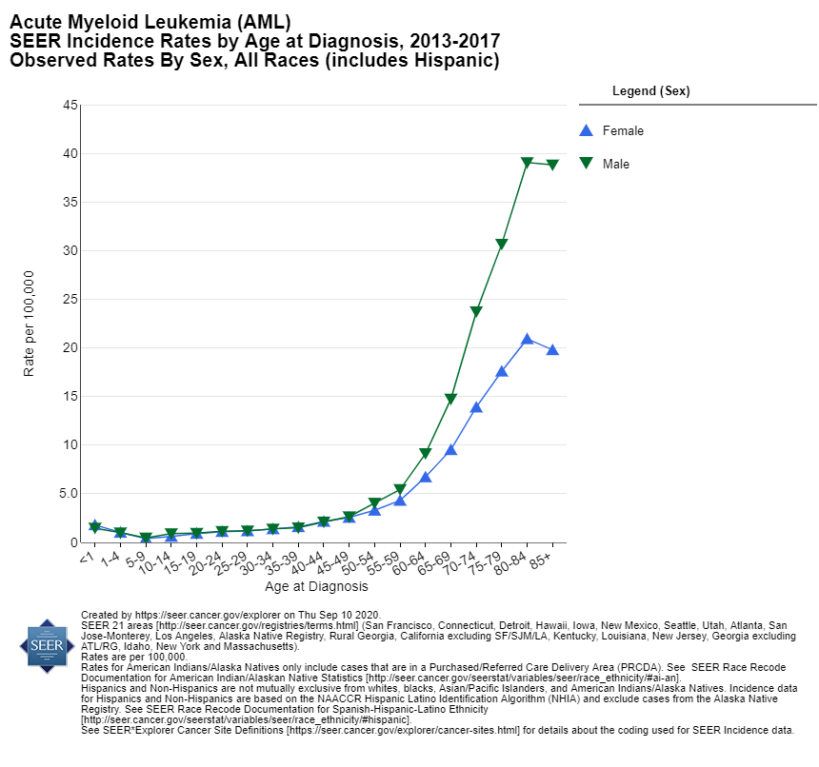
As age increases, risk for cancer increases

Slide 8
Age & Frailty
Frailty:
  A state of decreased physiologic reserve associated with vulnerability to disability and death
  Prevalence increases with age
    Particularly prevalent among older patients with hematologic
    malignancies
      > 50% have malnutrition, >33% have impaired physical function
      AND malignancy and its treatment lead to frailty

Slide 9
Frailty matters!
Associated with increased chemotherapy-related toxicity, poor response to therapy, & mortality
ASCO and NCCN recommend geriatric and frailty assessment as part of the routine care of older patients with cancer

Slide 10
Current landscape

Slide 11
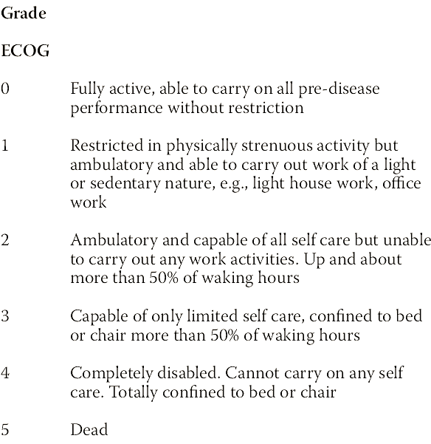
Routinely used:
Performance status & chronologic age
Neither adequately capture frailty
Both are inferior to frailty assessments
What’s missing:
Frailty assessment
Not done due to lack of:
time, resources, or experience
Proposed:
Assessment of gait speed & grip strength to screen for frailty
Easily obtainable objective measures of physical function
& measurement does not take longer than a typical vital sign

Slide 12
Routinely used:
Performance status & chronologic age
Neither adequately capture frailty
Both are inferior to frailty assessments
What’s missing:
Frailty assessment
Not done due to lack of:
time, resources, or experience
Proposed:
Assessment of gait speed & grip strength to screen for frailty
Easily obtainable objective measures of physical function
& measurement does not take longer than a typical vital sign

Slide 13
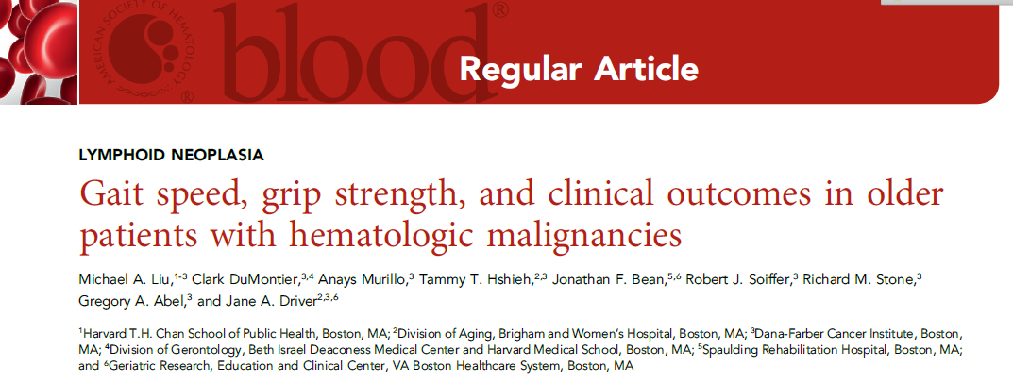
Assessment of gait speed & grip strength to screen for frailty

Slide 14
Methods
Eligible participants:
  ≥ 75 years presenting for initial consultation at the MDS/leukemia, myeloma, or lymphoma clinic of a large tertiary hospital
  1 February 2015 and 31 October 2017
  Excluded if referred for transplant eval
Prospectively recruited 448 patients
  541 approached, 464 consented, 16 lost to follow-up, ➔ 448 (83%) for analysis
  Of the 448, 272 had ECOG PS scores by their oncologist
  Gait speed & grip-strength were measured for all

Slide 15
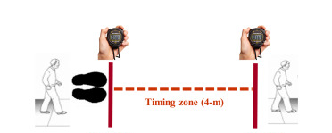

Gait speed assessment
Requires only a stopwatch and a short 4-m course
Online, royalty-free assessment tools
Notes:
Recorded as 0 for non-ambulatory (n=31)

Slide 16

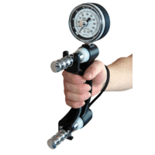
Grip strength
Primarily a measure of physical function
Not as well established as gait speed as a marker of frailty
  may be useful in nonambulatory patients
Quantified in a few seconds using a dynamometer

Slide 17
Phenotype frailty model
Includes
  unintentional weight loss,
  self-reported exhaustion,
  low energy expenditure,
  slow gait speed,
  and weak grip strength
≥3 factors ➔ Frail
1-2 factors ➔ Pre-frail
0 factors ➔ Robust

Slide 18
Outcome measures
Survival status (n=448)
  Followed for 6-months
  Combination of chart review & calls to PCP
ED visits and unplanned hospitalizations (n=314)
  Only patients within health care system (restrictions in requesting records from outside institutions)

Slide 19
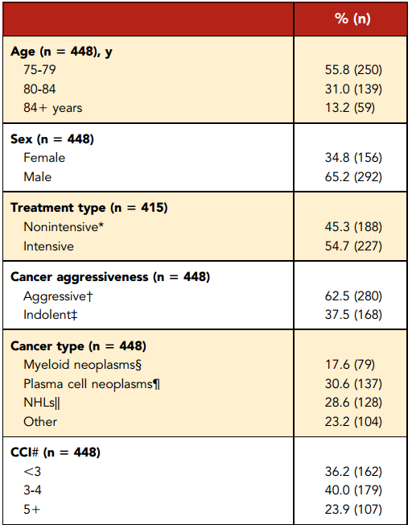
Nonintensive includes
No treatment (including surveillance)
Supportive (erythropoiesis-stimulating agents, transfusions)
Less intensive chemo: significantly dose-reduced or hypomethylating agents
Aggressive (diffuse large B cell lymphoma, mantle cell lymphoma, multiple myeloma, AML, ALL)
or
Indolent (marginal zone lymphoma, follicular lymphoma, CLL, MGUS, MDS, myeloproliferative neoplasm/ myeloproliferative disease, Waldenstrom hypergammaglobulinemia, hairy cell leukemia).
Charlson Comorbidity Index
Points assigned to comorbidities based on severity then summed using Charlson criteria

Slide 20

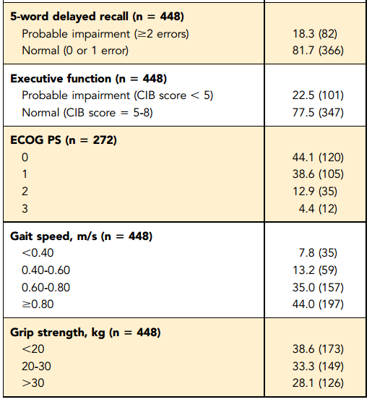
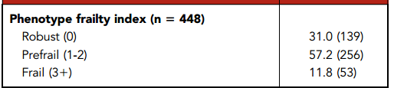
Notes:
Charlson comorbidity index (CCI)

Slide 21
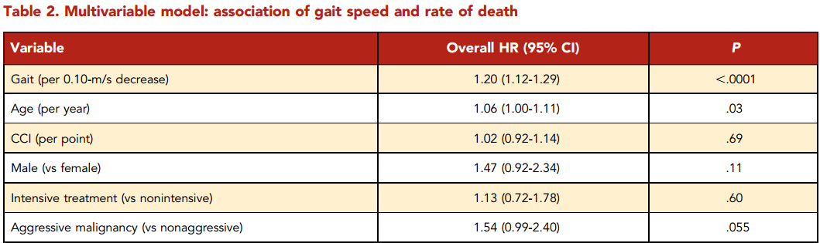
Every 0.1-m/s decrease in gait speed was associated with increased HR for death

Slide 22
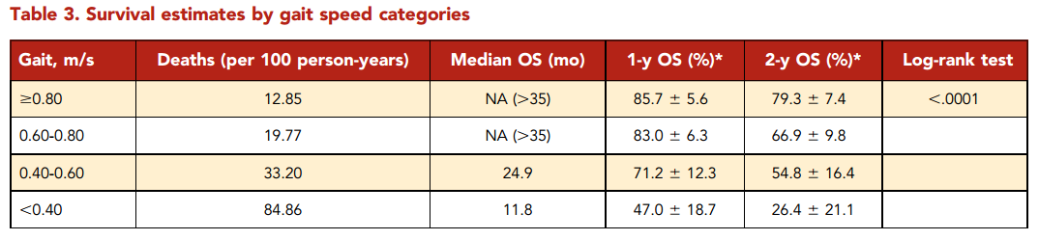

Slide 23
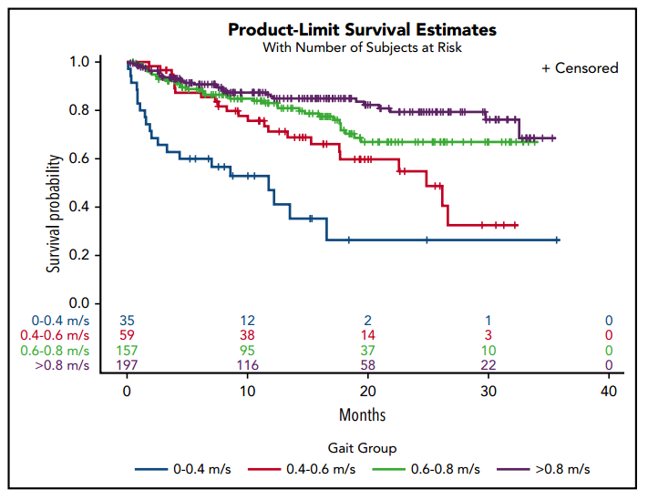
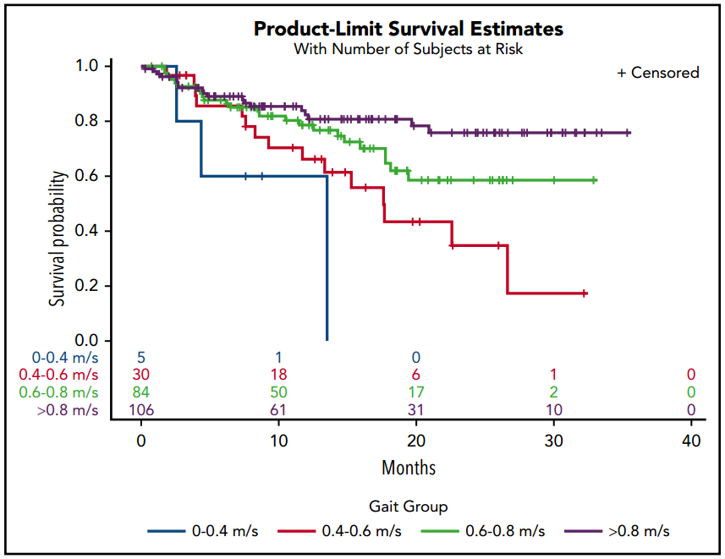


Gait speed (per 0.1-m/s decrease) remained an independent predictor of mortality after including ECOG PS in the fully adjusted model (HR, 1.12; 95% CI, 1.01-1.24; P=.03)
In the subset of patients with very good PS, gait speed had an even greater predictive value, with each 0.1-m/s decrease corresponding to an HR of 1.27 (95% CI, 1.10-1.48) in the fully adjusted model

Slide 24
Gait speed: ED visits & unplanned hospitalizations
Every 0.1-m/s decrease in gait speed was associated with
  33% increase in odds of unplanned hospitalization (OR, 1.33; 95% CI, 1.16-1.51)
  34% increase in odds of ED visits (OR, 1.34; 95% CI, 1.17-1.53)
Remained an independent predictor of utilization after including ECOG PS in the fully adjusted model

Slide 25
Grip strength
A decrease in grip strength of 5 kg was associated with a 24% increased rate of death in the fully adjusted model (HR, 1.24; 95% CI, 1.07-1.43)
  Remained a significant predictor of mortality after controlling for ECOG PS (HR, 1.26; 95% CI, 1.04-1.52)
Grip strength was not associated with the odds of ED visits or unplanned hospitalizations.

Slide 26
Findings summarized
Gait speed was predictive of survival & acute care utilization
  independent of cognitive status, demographic, and cancer-related risk factors
Grip strength was predictive of survival but not acute care utilization

Slide 27
A quick critical appraisal of this study that evaluated a prognostic tool

Slide 28
Is the evidence about prognosis valid?
Was a defined, representative sample of patients assembled at a common point in the course of their disease? Yes
Was follow-up of study patients sufficiently long and complete? Yes
Were objective outcome criteria applied in a “blind” fashion? No
If subgroups with different prognoses are identified:
Was there adjustment for important prognosis factors? Yes
Is this valid evidence about prognosis important?
How likely are the outcomes over time? Mortality of 25% in the cohort
How precise are the prognostic estimates? Gait speed decreases of 0.1 m/s affected outcomes
Can we apply this valid, important evidence about prognosis to our patient?
Is our patient so different from those in the study that its results cannot apply? Applicable to our patient
Will this evidence make a clinically important impact on our conclusions about what to offer to tell our patients? Yes! Key to informed shared decision-making
Notes:
Removed: Was there validation in an independent group of “test-set” patients?

Slide 29
Applying these findings to our patient
Our patient received information on survival & acute care utilization based on
  disease biology
  chronological age – 74 y.o.
  performance status – ECOG 1
Measurement of gait speed to assess frailty may improved prognostic accuracy
  which in turn may have affected shared decision-making

Slide 30
Thank you for your attention!
Questions?

Slide 31
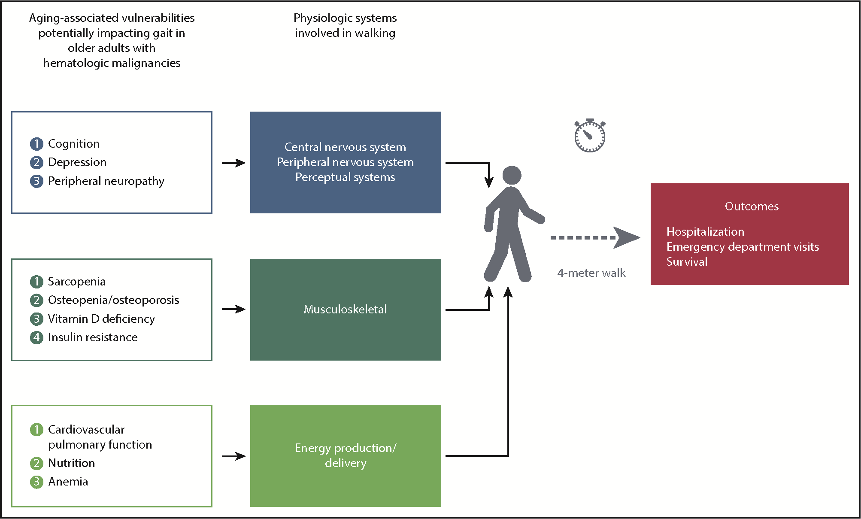

Visual abstract from “Make time for gait speed: vital to staging the aging”
- comment on this article in the issue of Blood
Tanya M. Wildes, Make time for gait speed: vital to staging the aging, Blood, 2019,
Copyright © 2020 American Society of Hematology
Notes:
Figure Legend: Slower gait speed results from convergence of aging-associated vulnerabilities on physiologic systems involved in walking.
Although measuring gait speed is simple, walking is quite complex, with multiple systems working in concert to effect locomotion (see figure). Six different physiologic systems contribute to ambulation: the central nervous system, the peripheral nervous system, the perceptual system, muscles, bones/joints, and energy production/delivery

Slide 32
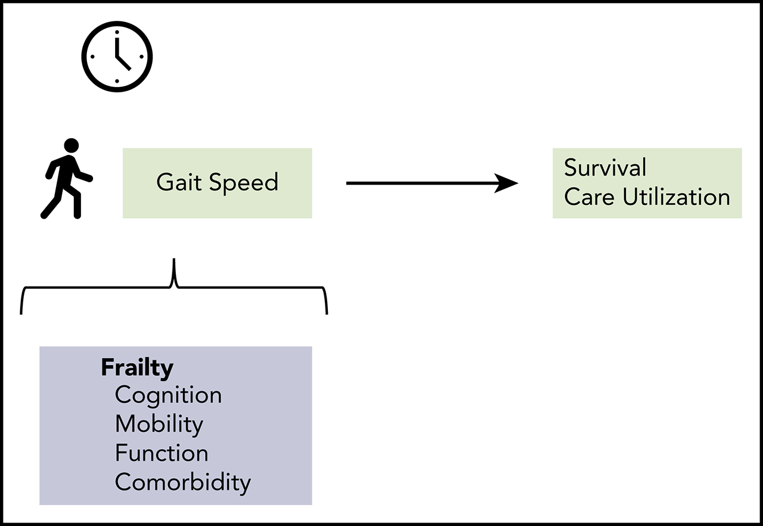
Michael A. Liu,Clark DuMontier,Anays Murillo,Tammy T. Hshieh,Jonathan F. Bean,Robert J. Soiffer,Richard M. Stone,Gregory A. Abel,Jane A. Driver, Gait speed, grip strength, and clinical outcomes in older patients with hematologic malignancies, Blood, 2019,
Copyright © 2020 American Society of Hematology

Slide 33
Take-home key points
Gait speed is a marker of frailty and can independently predict survival and hospital utilization among older patients with blood cancers
Assessing gait speed in oncology clinics may substantially improve patient assessment, prognostication, and individualization of care

