Slide 1

Journal Club
Evgenia Granina

Slide 2
Patient
70 year old male with a PMH of chronic back pain, HTN, HLD, >30 pack year smoking history presenting for routine follow up.
BP at visit 139/70. BP at subsequent appointments with specialists 150-170/90.
Medications:
Diclofenac gel
Amlodipine 5mg daily

Slide 3
Clinical Question:
What should the goal blood pressure be for this patient given his age and co-morbidities?

Slide 4
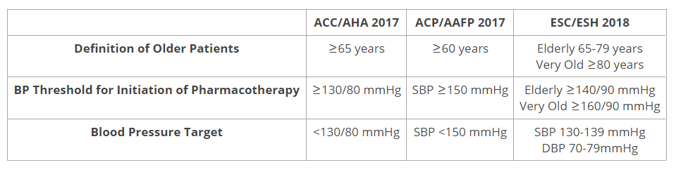
Current Guidelines
In November 2017, the American College of Cardiology/American Heart Association (ACC/AHA) hypertension guideline introduced new definitions for BP management. Blood pressure is now categorized as normal, elevated, and stage 1 or 2 hypertension. Normal BP is defined as <120/80 mmHg while elevated BP is 120-129/< 80 mmHg. Stage 1 hypertension is defined as SBP 130-139 mmHg and/or diastolic BP (DBP) 80-89 mmHg. Stage 2 hypertension is defined as SBP ≥140 mmHg and/or DBP ≥ 90 mmHg. Based primarily on results from the Systolic Blood Pressure Intervention Trial, for most adults ≥65 years old, a more aggressive SBP target <130 mmHg is recommended. However, the ACC/AHA guideline advises clinical judgement and patient preference to determine BP targets in older patients with limited life expectancy and multiple co-morbidities. It acknowledges the lack of randomized controlled trials (RCTs) for patients with history of frequent falls, advanced cognitive impairment, and those living in nursing homes or skilled nursing facilities.

Slide 5
STEP:
Strategy of Blood Pressure Intervention in Elderly Hypertensive Patients

Slide 6
Study Design
Multicenter, open-label, randomized controlled trial
N= 8,511 patients 60-80 yo with HTN (SBP 140-190) or taking anti-HTN medications
  Intensive, target SBP 110 to <130 mm Hg (n=4,243)
  Standard, target SBP 130 to <150 mm Hg (n=4,268)
Setting: 42 clinical centers in China
Enrollment: Jan 10, 2017 – December 31,2017
Median follow-up: 3.34 years (stopped prematurely; goal 4 years)
Analysis: Intention-to-treat
Primary outcome: 1st occurrence of stroke, ACS, ADHF, coronary revasc, A.fib, death from CV causes

Slide 7
Interventions
Patients randomized in an open label fashion to a group:
  Intensive - Target SBP 110 to <130 mm Hg
  Standard - Target SBP 130 to <150 mm Hg
Antihypertensives were encouraged per standard practice:
  Omelsartan
  Amlodipine
  Thiazide diuretics
Study medications were provided free of cost to participants

Slide 8
Study Design
After randomization, all participants were scheduled for follow-up at 1, 2, and 3 months, and every 3 months thereafter until 48 months or the end of the study.
Patients began treatment with olmesartan medoxomil tablets (20 mg, once daily) as the preferred ARB, or amlodipine besylate tablets (5–10 mg, once daily) as the preferred CCB.
Other antihypertensive drugs, such as β-blockers, were permitted when an investigator deemed it necessary and appropriate.
For patients in the intensive-treatment group, drug doses were increased and/or additional antihypertensive treatment was added carefully at each visit until the target of 110 mm Hg ≤ SBP < 130 mm Hg was reached.
Medication adjustment to targeted SBP was based on the office blood pressure measurements.
Notes:
Hydrochlorothiazide was not administered as an initial therapy.

Slide 9
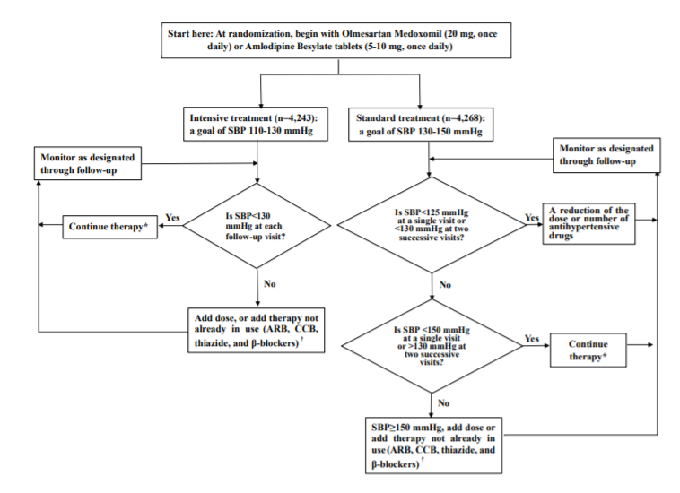
Figure S2 from supplementary appendix

Slide 10
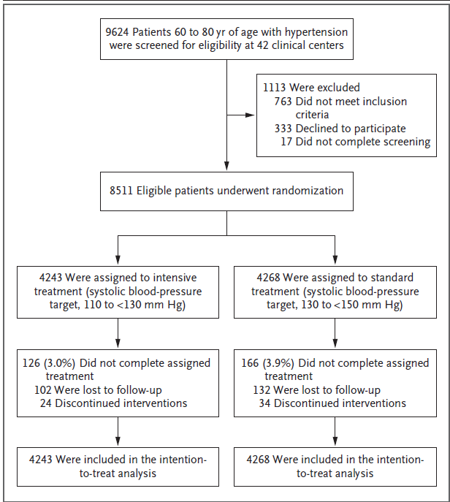
Figure 1
Notes:
In patients who discontinued interventions, the trial interventions were discontinued because of adverse effects related to the systolic blood pressure target or anti-hypertensive drugs, but follow up visits were still attended. In patients who were lost to follow up, contact was lost and data regarding the primary outcome were not ascertained from the certain follow up visit until the end of the trial. Patients who were lost to follow up were included in the intention to treat analysis, with data censored a the time of the last follow up visit.

Slide 11
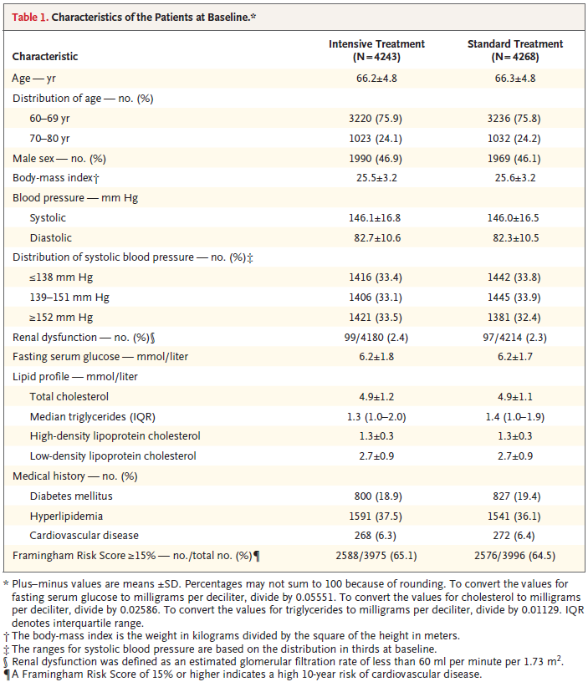
Table 1

Slide 12
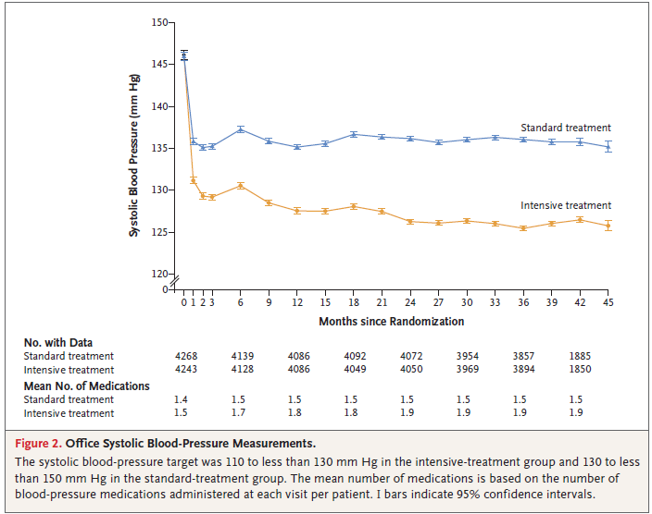
Figure 2
Notes:
At 1 year of follow-up, the mean systolic blood pressure was 127.5 mm Hg in the intensive-treatment group and 135.3 mm Hg in
the standard-treatment group.
During the median follow-up period of 3.34 years, the mean decrease in systolic blood pressure from baseline was 19.4 mm Hg in the intensive-treatment group and 10.1 mm Hg in the standard-treatment group. Throughout follow-up, the mean systolic blood pressure was 126.7 mm Hg in the intensive treatment
group and 135.9 mm Hg in the standard- treatment group; the mean diastolic blood pressure was 76.4 mm Hg and 79.2 mm Hg, respectively
In the intensive-treatment group, the percentage of patients who reached the systolic blood-pressure target (110 to <130 mm Hg) was 67.2% at 1 year
of follow-up, 70.4% at 2 years, and 77.2% at 3 years.

Slide 13
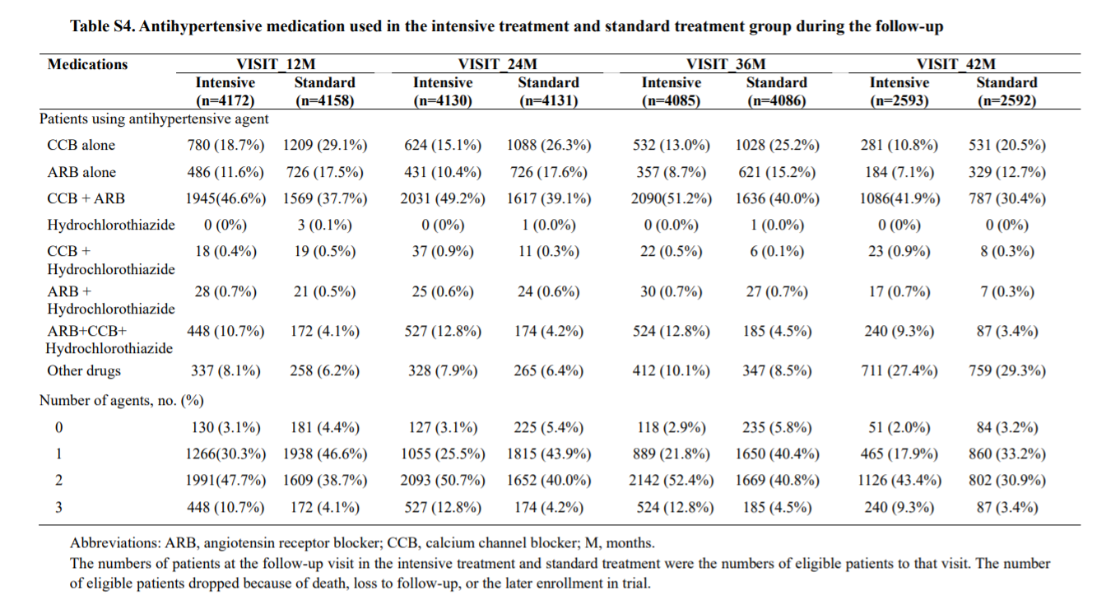
Table S4

Slide 14
Primary Outcomes
A composite of the first occurrence of stroke (ischemic or hemorrhagic), acute coronary syndrome (myocardial infarction and hospitalization for unstable angina), acute decompensated heart failure, coronary revascularization (PCI or CABG), atrial fibrillation, or death from cardiovascular causes.
Secondary Outcomes
First occurrence of symptomatic stroke (ischemic or hemorrhagic stroke)
Acute coronary syndrome (myocardial infarction and hospitalization for unstable angina)
Hospitalization for acute decompensated heart failure
Coronary revascularization (PCI or CABG)
Atrial Fibrillation
Cardiovascular death
All cause mortality
Major adverse cardiac events
A composite of first occurrence of acute coronary syndrome (myocardial infarction and hospitalization for unstable angina), acute decompensated heart failure, coronary revascularization (PCI or CABG), and death from cardiovascular causes.
9. Decline in renal function or development of end stage renal disease
For patients with chronic kidney disease (estimated glomerular filtration rate[eGFR] < 60 ml per minute per 1.73 m2 ) at baseline, a decrease in the eGFR of ≥ 50% (confirmed by a subsequent laboratory test) or the development of end stage renal disease requiring long-term dialysis or kidney transplantation. For participants without chronic kidney disease at baseline, a decrease in the eGFR of ≥ 30% to a value of < 60 ml per minute per 1.73 m2
Serum creatinine increases 1.5 mg/dL or more in men, > 1.3 mg/dL or more in women
eGFR < 30ml/min/1.73 m2
10. Decline in cognitive function (as evaluated by MMSE)
11. Major artery stiffness.
Major artery function changes are assessed by a composite of decrease in the ankle brachial index (ABI) and brachial ankle pulse wave velocity (baPWV).
12. First occurrence of diabetes mellitus

Slide 15
Statistical Analysis
Planned to conduct 4 years of follow-up through December 31, 2021.
Estimated that a sample of 8000 patients (4000 in each trial group) would provide the trial with 90% power to detect a 20% lower risk of a primary-outcome event in the intensive-treatment group than in the standard-treatment group.
The estimated annual event rate was 2.5% for primary outcome events in patients 60 years of age or older with hypertension in China.
The anticipated rate of loss to follow-up was 0.5% per year.
In the analyses of the primary outcome and secondary outcomes except for death from any cause, the Fine–Gray sub-distribution hazard model was used to account for the competing risk of death.
For death from any cause, the Cox regression model was used.
Notes:
A total of 234 patients (2.7%) were lost to follow-up before the end of the trial.
Although patients could have had multiple events, only one event of any type per patient (the event that occurred first) was used in the analysis.
Patients who were lost to follow-up WERE included in the final analysis, with data censored at the time of the last follow-up visit.
Subgroup analyses were performed for the primary outcome, according to age (<70 years vs. ≥70 years), sex, systolic blood pressure at baseline (distribution in thirds), history of diabetes mellitus at baseline (yes vs. no), 10-year cardiovascular risk on the basis of the Framingham Risk Score (<15% [low or moderate risk] vs. ≥15% [high risk]), and random assignment to app management (yes vs. no).
To examine the effects of app management on blood-pressure control, the 42 participating clinical centers were randomly assigned, in a 1:1 ratio at the center level, to be either an app-management center or a usual-care center. The app had a patient portal and a doctor portal. Through the patient portal, patients could receive alerts about blood-pressure control and reminders about adherence and could communicate with doctors; these options were available to patients at app-management centers but not to patients at usual-care centers. Through the doctor portal, doctors could receive monthly reports regarding patients’ home blood pressure; the plan had been to send these reports only to doctors at app-management centers, but a decision was made to send the reports also to doctors at usual-care centers to monitor home blood pressure in the entire trial population. Patients were not enrolled in the trial unless they could use the app or had a family member who could use it on their behalf. The effects of app management on blood-pressure control will be further studied and are not presented here.
Both survival analyses modeling approaches are based on the cumulative incidence function. Cum incidence describes the odds of an event occurring over time, with a total of 1. (So over time, the incidence will continue to accumulate or increase for some theoretical length of time until it reaches 1). The Fine-Grey subhazard model accounts for two separate events (CV outcome and death), where the sum of both hazards equals 1 over time. Generally, for a given point in time, as the risk of one event increases the other will decrease and vis-versa (thus they are competing events).

Slide 16
Hazard Ratio
Time to event analysis (outcome measure)
- How long it takes for an event to occur (in contrast to RR in which timing of events is not taken into account)
Ratio of Hazards (hazard in tx. Arm/hazard in cntrl. Arm)
Hazard – Instantaneous event rate
Probability that an individual at time t has an event at that time (assuming event free survival to time t)

Slide 17
Hazard Ratio
HR = 1 (event rates are the same in both arms)
HR = 2 (at any time, twice as many patients in the treatment group are having an event proportionally to the comparator group)
HR = 0.5 (at any time, half as many patients in the treatment group are having an event proportionally to the comparator group)

Slide 18
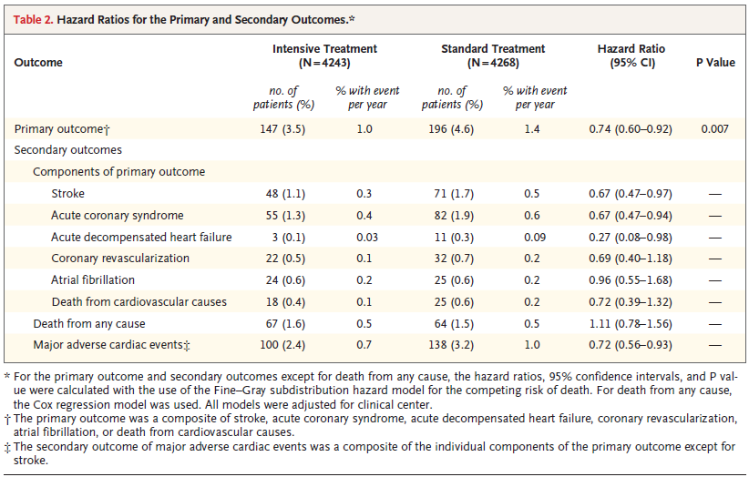
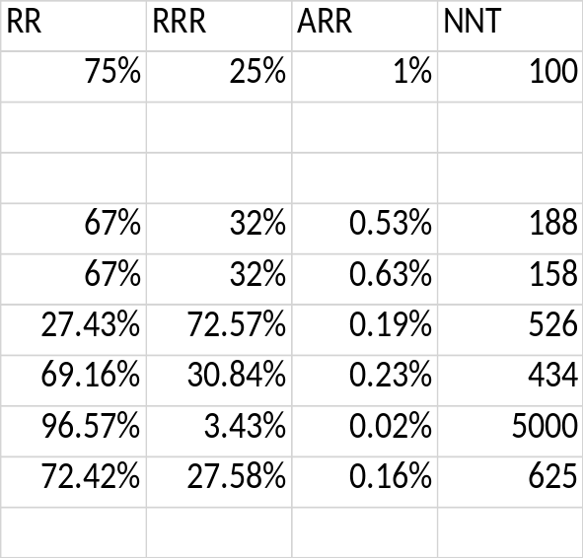
Table 2
Notes:
The incidence of primary-outcome events was significantly lower in the intensive-treatment group than in the standard-treatment group, with an absolute difference of 1.1 percentage points.
If the confidence interval crosses 1 (e.g. 95%CI 0.9-1.1) this implies there is no difference between arms of the study.
The numbers needed to treat to prevent a primary outcome event, death from any cause, and death from cardiovascular causes during the median 3.26 years of the trial were 61, 90, and 172, respectively. SPRINT
A primary outcome event was confirmed in 562 participants — 243 (1.65% per year) in the intensive-treatment group and 319 (2.19% per year) in the standard-treatment group (hazard ratio with intensive treatment, 0.75; 95% confidence interval [CI], 0.64 to 0.89; P<0.001) SPRINT
During the median follow-up period of 3.34 years, primary-outcome events occurred in 147 of 4243 patients (3.5% [1.0% per year]) in the intensive treatment
group, as compared with 196 of 4268 patients (4.6% [1.4% per year]) in the standard treatment group (hazard ratio, 0.74; 95% CI,0.60 to 0.92; P = 0.007). STEP

Slide 19
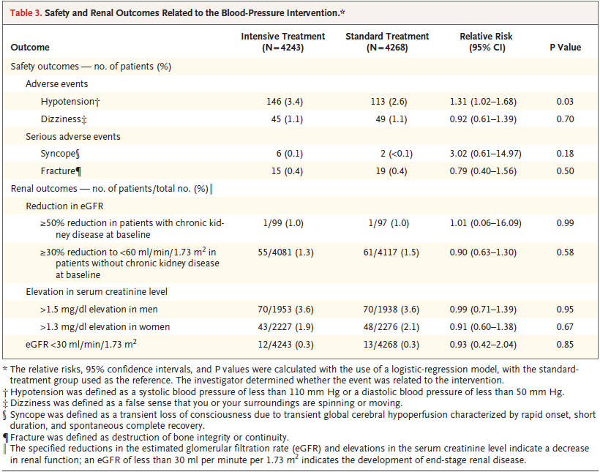
STEP
SPRINT
Serious adverse event (SAE)
  38.3% vs. 37.1% (HR 1.04; P=0.25)
  Hypotension: 2.4% vs. 1.4% (HR 1.67; P=0.001; NNH 100)
  Syncope: 2.3% vs. 1.7% (HR 1.33; P=0.05; NNH 167)
  Bradycardia: 1.9% vs. 1.6% (HR 1.19; P=0.28)
  Electrolyte abnormality: 3.1% vs. 2.3% (HR 1.35; P=0.02; NNH 125)
  Fall with injury: 2.2% vs. 2.3% (HR 0.95; P=0.71)
  AKI/ARF: 4.1% vs. 2.5% (HR 1.66; P<0.001; NNH 63)
    SAE possibly or definitely associated with the intervention
    4.7% vs. 2.5% (HR 1.88; P<0.001; NNH 45)
NNH: 125
Table 3
Notes:
A P-Value of .05 simply means that assuming the individual data points are Normally distributed (which they almost always are) then there is at most a 5% chance that there is no correlation between the manipulated variables and the results observed.

Slide 20
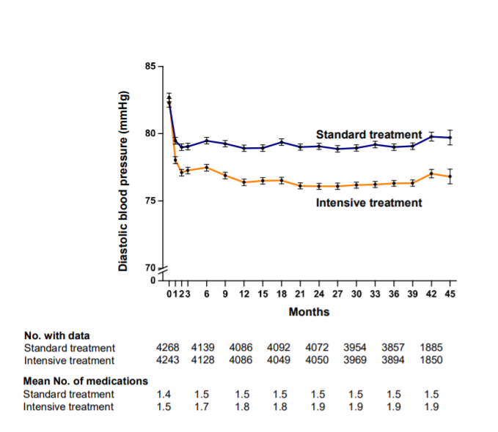
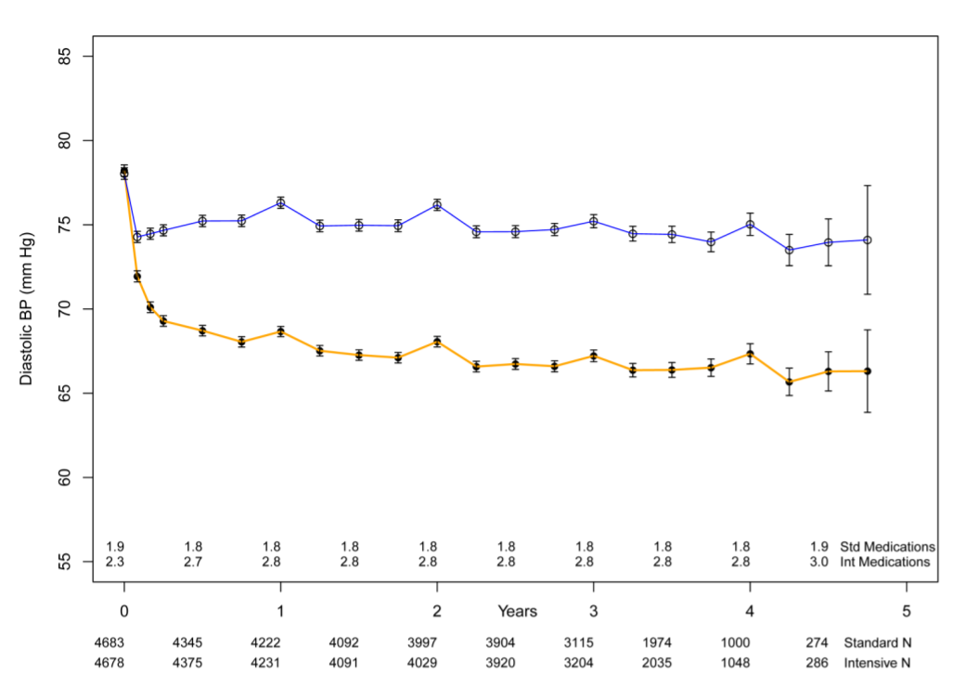
STEP
SPRINT
Figure S4
Figure S4

Slide 21
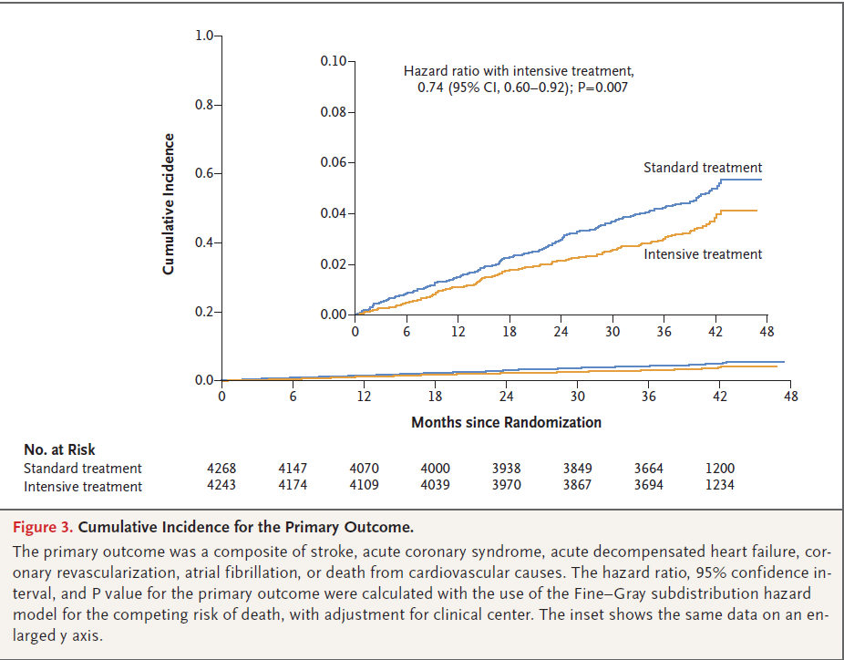
Figure 3
Notes:
Intensive treatment did not have a significant effect on the risk of death from cardiovascular causes (hazard ratio,0.72; 95% CI, 0.39 to 1.32) or the risk of death
from any cause (hazard ratio, 1.11; 95% CI, 0.78 to 1.56).
In addition, the annual event rates for the primary outcome in the intensive-treatment group and the standard-treatment group observed in the STEP trial (1.0% per year and 1.4% per year, respectively) were lower than those observed in SPRINT (1.77% per year and 2.40% per year, respectively), a finding consistent
with lower cardiovascular risk in Asian populations than in U.S. and European populations

Slide 22
Comparison
 | SPRINT | STEP
Total Enrollees | 9,361 | 8,511
Duration of follow up | 5 years (median 3.26 yrs). Stopped early. | 4 years (median 3.34 yrs). Stopped early.
Population studied | Patients age >50 years old at high risk for CVD. | Han Chinese pts 60-80 years old with HTN.
Study Design | Patients randomized to intensive SBP lowering (target <120 mm Hg) or routine SBP management (target <140 mm Hg). | Patients randomized to intensive SBP lowering (SBP 110-130), or standard treatment (SBP 130 to <150).
Inclusion Criteria | * | *
Exclusion Criteria | * | *
Primary outcome | 1st occurrence of stroke, ACS, CHF, MI, death from CV causes | 1st occurrence of stroke, ACS, ADHF, coronary revasc, A.fib, death from CV causes

Slide 23
 | SPRINT | STEP
Inclusion Criteria | Age ≥50 years SBP (mmHg) in a range: - 130-180 on ≤1 medication - 130-170 on ≤2 medications - 130-160 on ≤3 medications - 130-150 on ≤4 medications ≥1 of the following CVD risk criteria: Clinical CVD (non-stroke): Prior MI, PCI, CABG, CEA, or carotid stenting Revascularized PAD ACS ± EKG changes, EKG changes on a stress test, or ischemic findings on other cardiac imaging ≥50% stenosis of coronary, carotid, or LE artery, or AAA ≥5 cm Subclinical CVD: Carotid artery calcium score ≥400 in prior 2 years ABI ≤0.90 in prior 2 years, or LVH on EKG, echocardiogram, or other imaging in prior 2 years CKD: eGFR 20-59 mL/min/1.73 m² on MDRD in prior 6 months Framingham estimated 10-year CVD risk ≥15% in prior 12 months Age ≥75 years | Age 60-80 years SBP (mmHg) in a range: 140 to 190 during 3 screening visits OR Taking anti-HTN medications Han Ethnicity

Slide 24
 | SPRINT | STEP
Exclusion Criteria | 1. DM 2. Stroke 3. Not on disease-appropriate antihypertensives (eg, beta blocker and recent MI) 4. Secondary cause of hypertension 5. If able to stand, 1 min standing SBP <110 6. Proteinuria in any of the following ranges: ≥1g/day urine protein ≥600 mg/day urine albumin Spot protein:creatinine ≥1g protein/g creatinine Spot albumin:creatinine ≥600 mg/g creatinine Urine dipstick ≥2+ protein if none of the above are available 7. Polycystic kidney disease | 1. SBP ≥ 190 mm Hg, or diastolic blood pressure (DBP) < 60 mm Hg 2. Diagnosed secondary hypertension 3. History of large atherosclerotic cerebral infarction or hemorrhagic stroke (not including lacunar infarction AND transient ischemic attack [TIA]) 4. Hospitalization for myocardial infarction (MI) within the last 6 months, but remote MI events were included 5. Coronary revascularization (percutaneous coronary intervention [PCI] or coronary artery bypass grafting [CABG]) within the last 12 months. 6. Planned to perform PCI or CABG in the next 12 months. 7. History of sustained atrial fibrillation or ventricular arrhythmias at entry influencing the measurement of electronic blood pressure.

Slide 25
 | SPRINT | STEP
Exclusion Criteria | 8. Glomerulonephritis treated with or likely to be treated with immunosuppressive agents 9. eGFR < 20 mL/min/1.73 m² OR ESRD 10. CV event, procedure, or UA hospitalization in prior 3 months 11. Symptomatic HF in prior 6 mo 12. LVEF <35% 13. A medical condition likely to limit survival to <3 years or a malignancy other than nonmelanoma skin cancer within the last 2 years 14. Poor adherence 15. Organ transplant 16.Unintentional weight loss >10% in prior 6 months 17. Pregnancy | 8. New York Heart Association (NYHA) class III-IV heart failure or hospitalization for exacerbation of chronic heart failure at entry. 9. Severe valvular disease or valvular disease likely to require surgery or percutaneous valve replacement during the trial. 10. Hypertrophic cardiomyopathy (HCM), a disease characterized by unexplained left ventricular (LV) hypertrophy associated with non-dilated ventricular chambers in the absence of another cardiac or systemic disease. 11. Dilated cardiomyopathy, rheumatic heart disease, or congenital heart disease . 12. Uncontrolled diabetes mellitus (serum fasting glucose ≥ 200 mg/dl [11.1 mmol/L], glycated hemoglobin [HbA1] > 8%). 13. Severe liver or kidney dysfunction (Alanine aminotransferase [ALT] ≥ 3 times the upper limit of normal value, or end stage renal disease on dialysis or estimated glomerular filtration rate [eGFR] < 30 mL/min/1.73 m2, or serum creatinine > 2.5 mg/dl [> 221 mol/L]). 14. Severe somatic disease such as cancer. 15. Severe cognitive impairment or mental disorders. 16. Participating in other clinical trials.

Slide 26
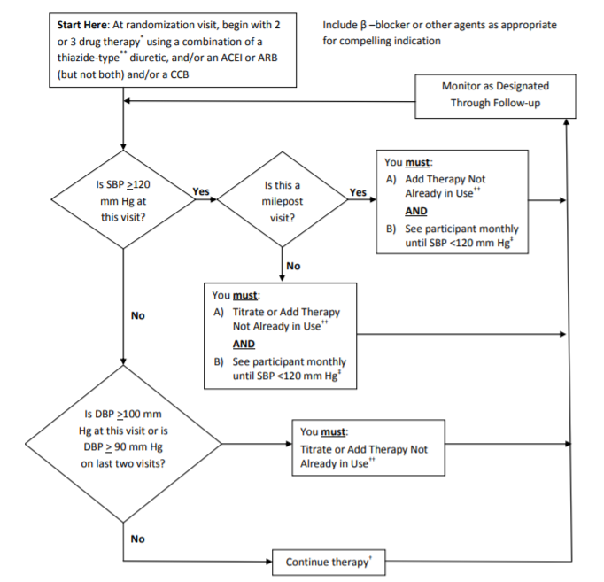
SPRINT
Figure 1

Slide 27
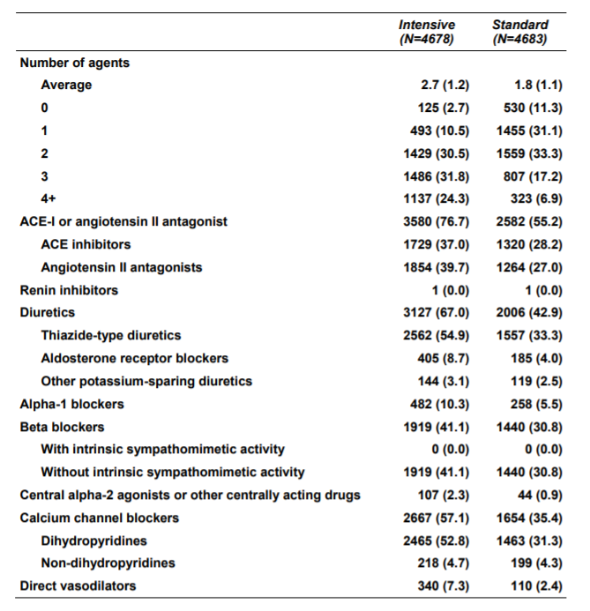
SPRINT
Table S2

Slide 28
Conclusions
In patients 60 to 80 years of age with hypertension in China, reduction of the systolic blood pressure to a target of 110 to less than 130 mm Hg (intensive treatment) resulted in a significantly lower incidence of cardiovascular events than reduction to a target of 130 to less than 150 mm Hg (standard treatment).
The risk of death from any cause did not differ significantly between the two trial groups.
Hypotension occurred more frequently in the intensive-treatment group than in the standard-treatment group, but the incidences of other intervention-related safety outcomes (dizziness, syncope, and fracture) and the results for renal outcomes did not differ significantly between the two groups.
Intensive treatment did not have a significant effect on the risk of death from cardiovascular causes (hazard ratio,0.72; 95% CI, 0.39 to 1.32) or the risk of death from any cause (hazard ratio, 1.11; 95% CI, 0.78 to 1.56).
Notes:
During a median follow-up period of 3.34 years, primary-outcome events occurred in 3.5% of the patients in the intensive-treatment group,
as compared with 4.6% of the patients in the standard-treatment group (absolute difference, 1.1 percentage points).
The annual event rates for the primary outcome in the intensive-treatment group and the standard-treatment group observed in the STEP trial (1.0% per year and 1.4% per year, respectively) were lower than those observed in SPRINT (1.77% per year and 2.40% per year, respectively), a finding consistent with lower cardiovascular risk in Asian populations than in U.S. and European populations

Slide 29
Patient
70 year old male with a PMH of chronic back pain, HTN, HLD, >30 pack year smoking history presenting for routine follow up.
BP at visit 139/70. BP at subsequent appointments with specialists 150-170/90.
Medications:
Diclofenac gel
Amlodipine 5mg daily

Slide 30
Application
Is this evidence about therapy (from an individual randomized trail) valid?
Can we apply this valid, important evidence about therapy in caring for our patient?
Our patient:
Framingham risk score 26.2% (10 year risk of MI or death), BMI 27.8

