Slide 1

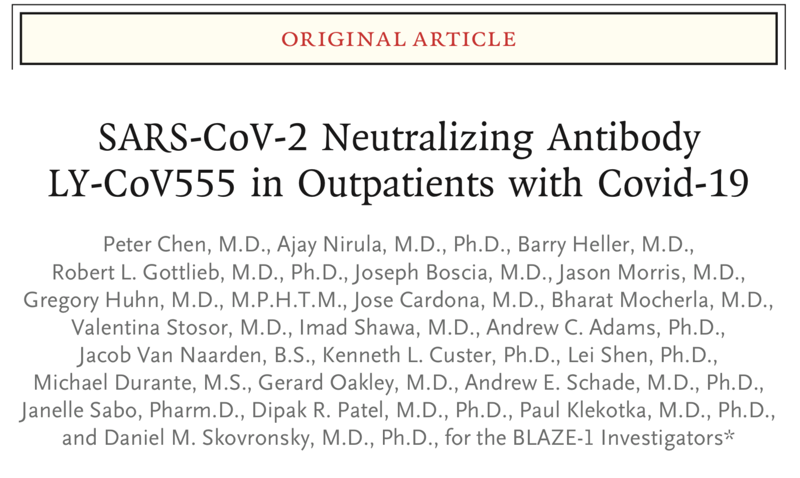
SARS-CoV-2 Neutralizing Antibody LY-CoV555 in Outpatients with Covid-19
Shravya Budidi
Geriatric Medicine Fellow

Slide 2


Case
80M PMH of HTN, HLD, DM, HFpEF, CAD s/p CABG, who lives in a multigenerational home with his wife, daughter and granddaughter, called clinic for worsening cough and fatigue for 3 days.
  12/18/20: Patient - SARSCoV2 NP PCR Positive
  12/21/20: Patient’s wife - SARSCoV2 NP PCR Positive
Family worried and asks the team regarding therapeutic options

Slide 3
Clinical Question
In older, community dwelling adults with co-morbidities with mild to moderate COVID-19, does outpatient monoclonal Ab therapy lead to a reduction in severity of disease and in hospitalizations?

Slide 4
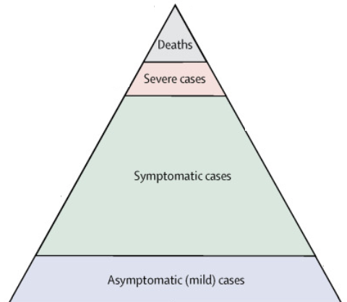
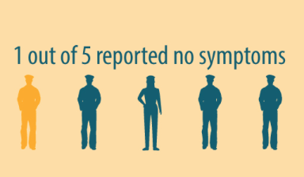
COVID-19 Fast Facts
December 2019: Severe acute respiratory syndrome coronavirus 2 (SARS-CoV-2).
Covid-19 hypoxemia --> immune system hyper response to viral infection
Notes:
Severe acute respiratory syndrome coronavirus 2 (SARS-CoV-2), a novel coronavirus first identified in December 2019, is the causative agent of coronavirus disease 2019 (Covid-19).
After becoming infected, most people have few or no symptoms and their condition can be managed on an outpatient basis.
In a smaller number of persons, hypoxemia develops, leading to hospitalization and requiring supplemental oxygen.
Thats what these two images are here to illustrate:
1 in 5 people that have COVID report no symptoms
This pyramid (this is data from early on in the pandemic) is here to illustrate that many more people have mild disease and
Disease severity:
Mild disease is characterized by fever, malaise, cough, upper respiratory symptoms, and/or less common features of COVID-19, in the absence of dyspnea. Most of these patients do not need hospitalization.
If patients develop dyspnea, that raises concern that they have at least moderate severity disease, and these patients often warrant hospitalization.
Severe disease
Hypoxia (oxygen saturation ≤94 percent on room air)
Need for oxygenation or ventilatory support
An early hypothesis regarding the pathogenesis of Covid-19 hypoxemia pointed to an immune system hyper response to viral infection;
More recent data have shown high viral titers in hospitalized patients compared to non hospitalized patients- suggesting that the virus is in part responsible for ongoing hypoxemia.
So this sets the agenda for our treatment targets: which includes reducing viral titers, managing hypoxemia, and targeting the hyper-responsive immune system
———————————————————————————————————————————-
Note: Adapted from Expert Taskforce for the COVID-19 Cruise Ship Outbreak. Proportion of fatal, severe, mild, and asymptomatic COVID-19 cases among 544 passengers and 143 crew. Open access journal; all content freely available.
https://www.thelancet.com/journals/laninf/article/PIIS1473-3099(20)30243-7/fulltext?te=1&nl=debatable&emc=edit_db_20200713

Slide 5
Potential Therapies
Notes:
https://www.nejm.org/doi/full/10.1056/NEJMcp2009249

Slide 6
Evaluated across spectrum of COVID-19
Monoclonal Ab
Therapy
Inpatient
Outpatient
ACTIV-3
(Bamlanivimab)
BLAZE-1
(Bamlanivimab)
REGENERON
(Casirivimab + Imdevimab)
REGENERON
(Casirivimab + Imdevimab)
Notes:
——————————————————————————————————————————————————————————————————
Two MAT on the forefront
Lilly Ly-CoV555 (bamlanivimab)
- single target ab
- Was used in Activ-3 trial – use in inpt setting
- Halted to lack of efficacy / no safety problems
And
Regeneron followed closely
Dual monoclonal ab (casirivimab + imdevimab)
On hold for pts in ICU and on highflow o2 – due to unfavorable risk/benefit and potential safety signal.

Slide 7


Monoclonal Ab Therapy
https://www.youtube.com/watch?v=3pFQpiawX80

Slide 8
Monoclonal Ab Therapy
Laboratory produced antibodies with targeting SARSCoV2 spike protein
Single Ab or "Cocktail" combination
  Lily Ly- CoV555: Single Target Ab – Bamlanivimab
  Regeneron: Dual Target Ab- Casirivimab + Imdevimab
Pharmacokinetics:
  IV or subcutaneous administration
  Half-life = weeks to months
Safety:
  Generally well tolerated
  Rare risk of allergic reaction - Antibody-dependent enhancement (ADE)
Notes:
Monoclonal antibodies are laboratory-produced molecules engineered to serve as substitute antibodies that can restore, enhance or mimic the immune systems attack on cells.
They can be made as a single ab like the Lilly COV555 (bamlinivimab)
Or as a cocktail - meaning more than one ab combination like Regeneron did with Casiriviman and imdevimab
Antibody-dependent enhancement (ADE) of infection represents a paradoxical phenomenon in host–pathogen biology, in which, antibody, an important pillar of the host defense against invading pathogen, actually allows entry of the pathogen into host territory.

Slide 9

BLAZE-1

Slide 10
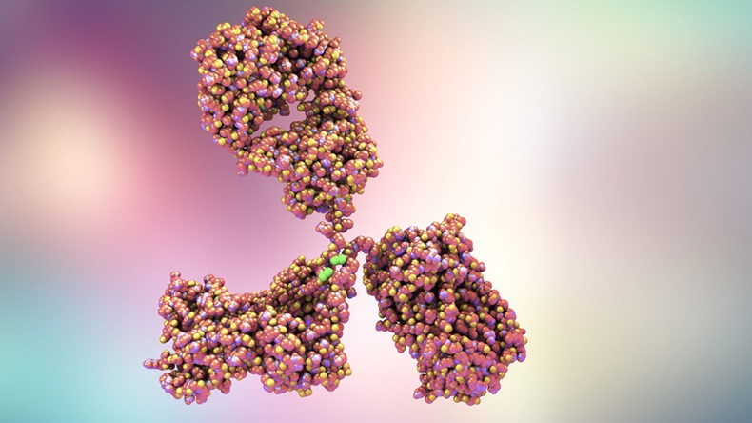
Study Aim
To investigate weather virus-neutralizing monoclonal antibodies (LY-CoV555)
  Reduce viral load
  Ameliorate symptoms
  Prevent hospitalization
Notes:
This study aims to evaluate the impact of LY3819253 on viral clearance and clinical outcomes in patients with mild to moderate COVID-19 illness.

Slide 11

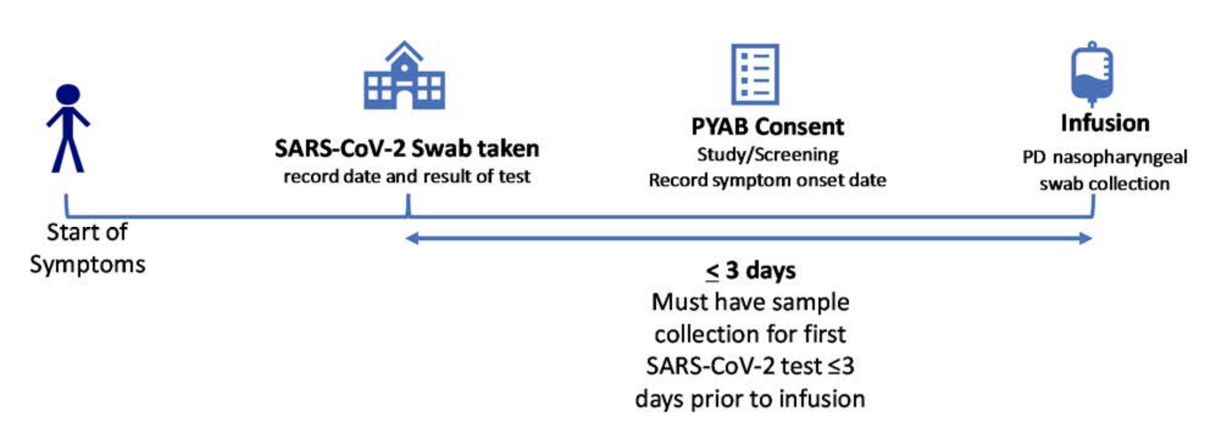
Design
Multi-center
Randomized
Double-Blind
Placebo-Controlled
Phase II Trial
Notes:
It was designed as a Multicenter, randomized, double-blind, placebo-controlled
41 centers across the US were included in the study
All participants were centrally randomized to study intervention using an Interactive Web Response System (IWRS)
Participants were stratified by duration since symptom onset to randomization (≤8 days versus >8 days).
All eligible participants were randomized, initially following an equal allocation to treatment arms. There were 4 treatment arms (placebo and the other three arms were were different doses of Lily CoV5 - 700mg, 2800mg, and 7000mg).
Neither participants, nor investigators, nor the sponsor study team will be aware of treatment assignments
This is a PHASE TWO TRIAL: Testing of drug on participants to assess efficacy and side effects. Determines whether drug can have any efficacy; at this point, the drug is not presumed to have any therapeutic effect

Slide 12
Enrollment
Inclusion Criteria
    Age > 18
    Currently NOT hospitalized
    One or more mild or moderate COVID-19 sx
    First positive SARS-CoV-2 viral infection determination ≤3 days prior to start of the infusion
Exclusion Criteria
    Hospitalized or O2 < 94%
    Have any serious concomitant systemic disease, condition, or disorder that, in the opinion of the investigator, should preclude participation in this study.
    Received other COVID-19 therapies/involved in COVID-19 studies
Notes:
Inclusion criteria included
-Those AGe > 18
-Men or nonpregnant women
-Not currently hospitalized
-First positive test <4 days prior to start of infusion
-Had one or more mild Symptoms to moderate symptoms:
i. Fever
ii. Cough
iii. Sore throat
iv. Malaise
v. Headache vi.
Muscle pain
vii. Gastrointestinal symptoms
viii. Shortness of breath with exertion
Exclusion criteria - essentially excluded hospitalized and severe cases of COVID and anyone included in any other COVID-19 studies.
-O2 <94, other infections, other trials, hospitalized
-What’s interesting to note and keep in mind for later is that one of the exclusion criteria was “having any serious concomitant systemic disease, condition, or disorder that, in the opinion of the investigator, should preclude participation in this study.” The protocol doesn’t give any more details on this.

Slide 13

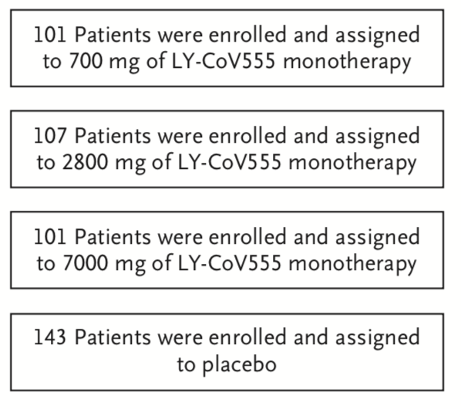
Enrollment
Notes:
Enrollment took place From June 17 through August 21, 2020
Total of 452 met criteria for inclusion in the primary analyses and underwent randomization to receive either LY-CoV555 (309 patients) or placebo (143 patients), and the patients in the LY-CoV555 group were assigned to one of three dose subgroups.

Slide 14

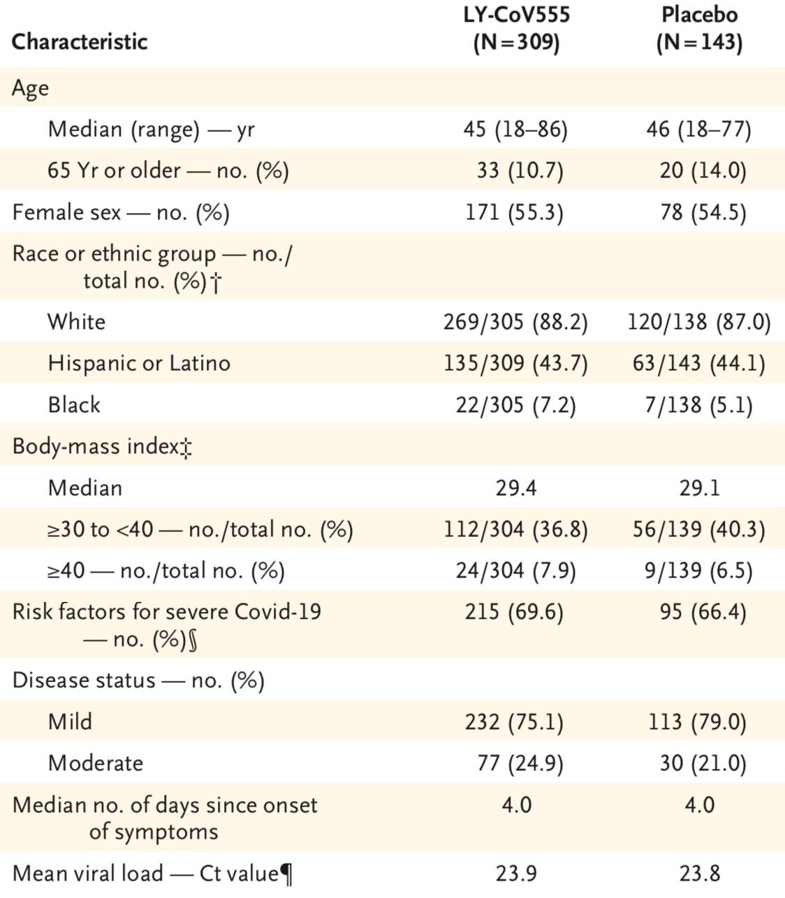
Baseline Characteristics
Notes:
Looking at the baseline characteristics:
Average age was around 45-46 yrs meaning Patients were relatively young and at low risk of severe disease.
Treatment group did include pt as old as 86 and only about 10% of the population was >65
Majority were white
69% had risk factors for severe covid (age >65/BMI>35, one co-exisitng illness)
75% had mild sx
Mean viral load was similar in both groups: 23.9

Slide 15
Cycle Threshold
Sars-COV2 Cycle Threshold
  Number of cycles needed to amplify viral RNA to reach detectable levels
Lower Ct values indicate more viral RNA
    Low: Ct ≥35
    Intermediate: 25<Ct<35
    High Ct≤ 25
Notes:
Ct value - cycle threshold - This refers to the number of cycles needed to amplify viral RNA to reach a detectable level.
Specimens with lower Ct values generally have MORE viral RNA
(less cycles needed to amplify the viral means more severe).
Ct<=25 is high viral load
Ct>= 35 is considered low viral load
In this study the mean Ct score was 23 - so high viral load

Slide 16
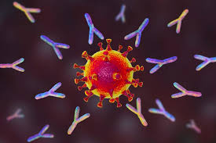
Results
Primary Outcome
    Change from baseline in the SARS-CoV-2 viral load at day 11 (±4 days) after positive results on testing.
Secondary Outcomes
    Safety profile
    Symptom burden
    ED visits, hospitalization, death
Notes:
Primary outcome was a change in viral load at 11 days.
The study was powered to detect a reduction of 0.9 logs of virus (87% absolute reduction).
Secondary outcomes include more clinical outcomes: such as safety profile, symptom burden, and ER visits/hospitalizations/death.

Slide 17

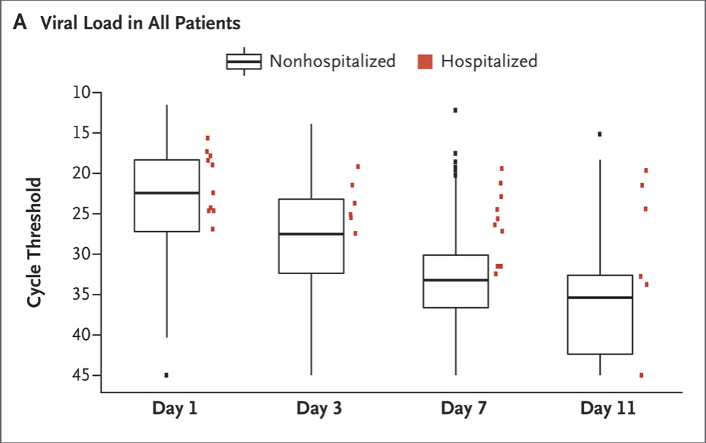
Primary Outcome
Notes:
Ct – cycle threshold : higher is better.
Here we are looking at the viral load in hospitalized vs non hospitalized pt’s at different days.
It just drives home the point that in non severe COVID - the CT threshold rises (viral load decreases) at day 7 and day 11 - when compared to the hospitalized patients.
——————————————————————————————————————————————
2A:
presents the absolute viral load among hospitalized patients (pooled across randomization strata) as well as a box plot of viral loads among nonhospitalized patients. On day 7, all the available measures of viral load among hospitalized patients were higher than the median values among the nonhospitalized patients.
Figure 2B shows the cumulative probability that patients in each trial group would have the indicated cycle threshold of viral load on day 7.

Slide 18

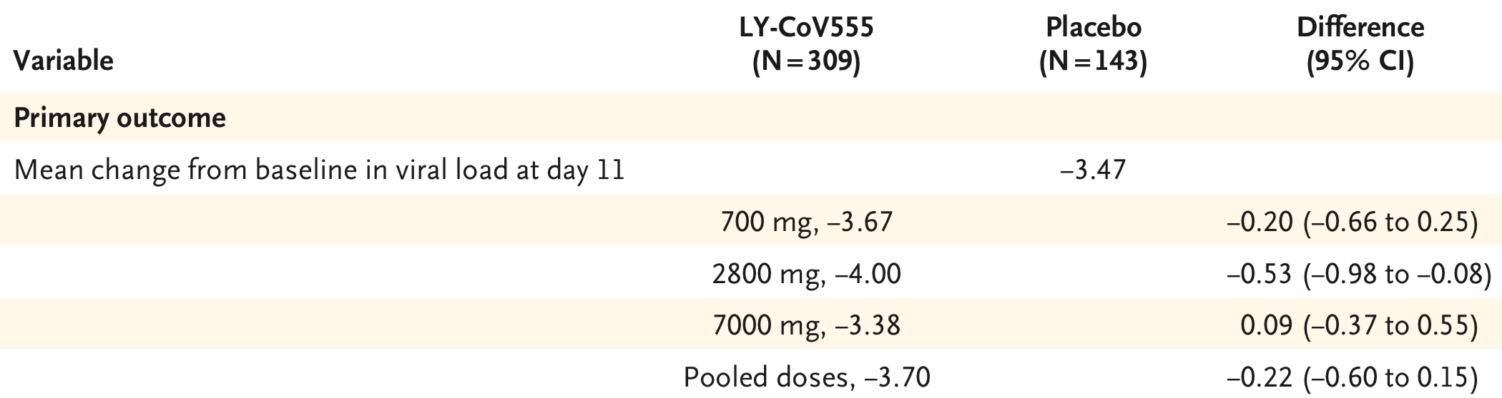
Primary Outcome:
Change from Baseline in Viral Load
Notes:
Looking at all 4 arms you can see what you would expect to see with the natural course of disease - which is that the viral load comes down in all groups including the placebo.
The only group that we actually see a statistically significant reduction is in the Lilly COV5 dose 2800mg (P value of 0.02)
Which should give us a pause because there really is not a sensible pharmacological rationale for why the intermediate-dose group would show the greatest effect –because you would expect if the intermediate group shows such a great effect then the high dose should as well -
So this could be due to chance rather than causality.
Also concluding that this is not a clinically meaningful end point,
————————————————
The primary endpoint was a change in viral load at 11 days. This basically wasn’t met (table below). You may recall from above that the study was powered to detect a reduction in viral load of 0.9 logs. In all cases, the differences in viral load were well below 0.9 logs. At 11 days, one of the groups did have a reduction in viral load, with a p-value barely below 0.05. However, when corrected for the multiple comparisons performed here, that isn’t actually statistically significant (e.g., a Bonferroni correction for four comparisons would drop the p-value cutoff to 0.05/4 = 0.01). Furthermore, there’s no sensible pharmacological rationale for why the intermediate-dose group would show the greatest effect – so this seems more like the play of chance than causality.
By day 11, the majority of patients had a substantial trend toward viral clearance, including those in the placebo group.
The observed mean decrease from baseline in the log viral load for the entire population was −3.81 (baseline mean, 6.36; day 11 mean, 2.56);
this value corresponded to a decrease by more than a factor of 4300 in the SARS-CoV-2 burden, for an elimination of more than 99.97% of viral RNA.
For patients who received the 2800-mg dose of LY-CoV555, the difference from placebo in the decrease from baseline was −0.53 (95% confidence interval [CI], −0.98 to −0.08; P=0.02), for a lower viral load by a factor of 3.4 (Table 2). However, smaller differences from placebo in the decrease from baseline were observed among the patients who received the 700-mg dose (−0.20; 95% CI, −0.66 to 0.25; P=0.38) and the 7000-mg dose (0.09; 95% CI, −0.37 to 0.55; P=0.70).

Slide 19
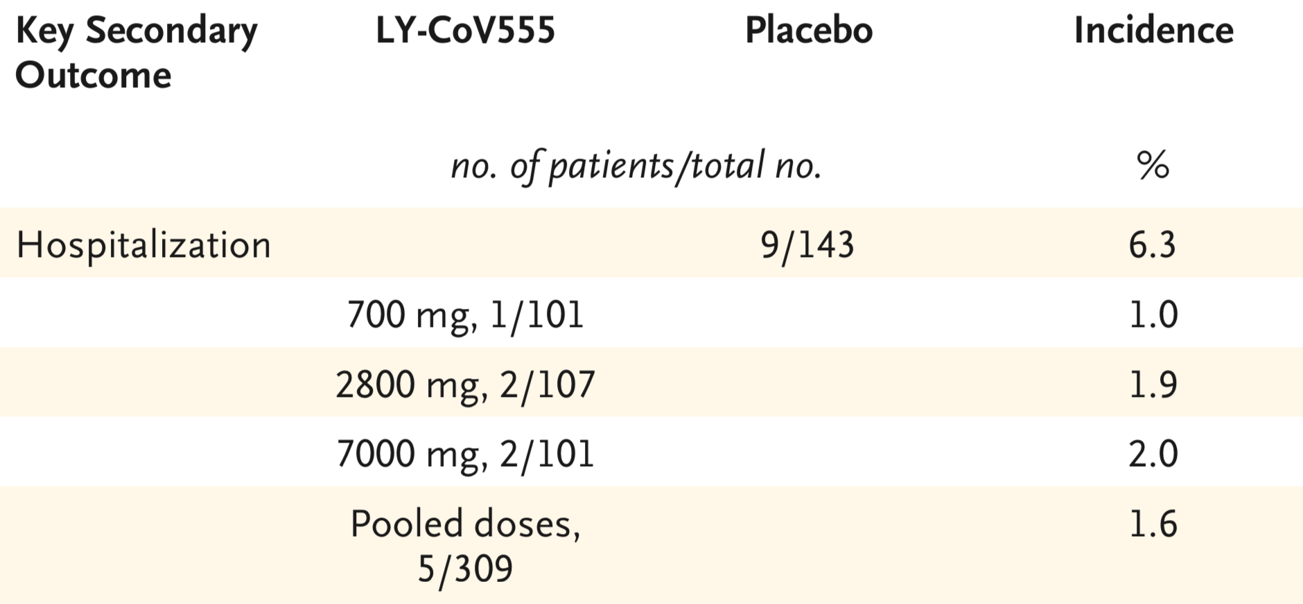
Secondary Outcomes: Hospitalization/ER visits
Reduction in hospitalization/ER
1.6% vs 6.3% overall, mAbs vs. Placebo
4.2% vs 14.6% high risk (>64 or BMI >34) post hoc analysis
Notes:
Moving onto the secondary outcomes: one of which was was ER visits and hospitalizations
In this study they combined both ED and hospitalization into one
Overall there was what looked like a statistically significant reduction - and i say this because the statistical significance was seen in the POOLED doses - not necessarily in one of the treatment arms.
At day 29, the percentage of patients who were hospitalized with Covid-19 was 1.6% (5 of 309 patients) in the LY-CoV555 group and 6.3% (9 of 143 patients) in the placebo group
This is a pretty big reduction but as you can see this is only a small amount of people who needed to be hospitalized or go to the ER in the overall study itself.
So they also did a post hoc analysis where they looked at those who are HIGHEST risk (older age/comorbidities/BMI) - Diff here is larger - Those hospitalized were 4% (4 of 95) in the LY-CoV555 group and 15% (7 of 48) in the placebo group.
Only 1 patient in the trial (in the placebo group) was admitted to an intensive care unit.

Slide 20
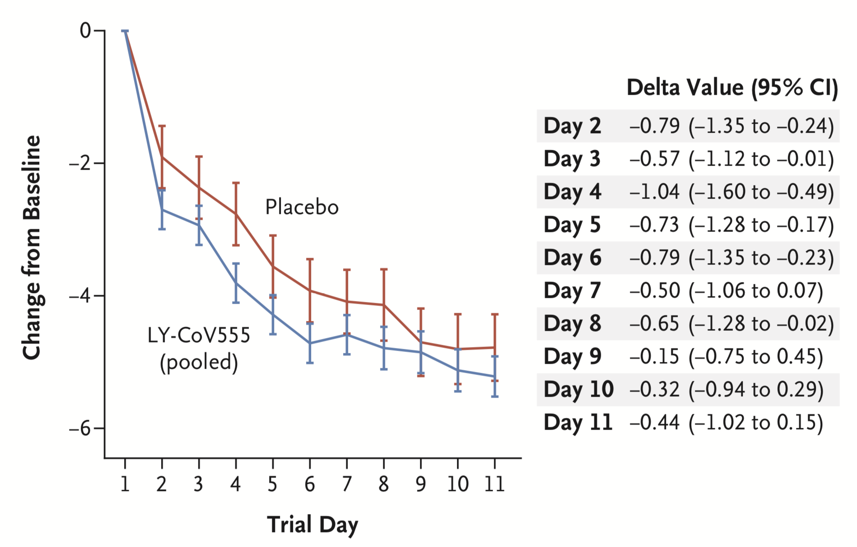
Secondary Outcomes: Symptoms
Notes:
Another secondary outcome is symptoms.
Here we see that the severity of symptoms is much better in patients the treatment arm compared to the placebo group (esp up to day 7-8)
However notice that again they started combining all the treated patients into one.—————————————————————————————————————————————————
The symptom score ranged from 0 to 24 and included eight domains that were graded from 0 (no symptoms) to 3 (severe symptoms). From day 2 to day 6, the change in the symptom score from baseline was better in the LY-CoV555 group than in the placebo group, with values of −0.79 (95% CI, −1.35 to −0.24) on day 2, −0.57 (95% CI, −1.12 to −0.01) on day 3, −1.04 (95% CI, −1.60 to −0.49) on day 4, −0.73 (95% CI, −1.28 to −0.17) on day 5, and −0.79 (95% CI, −1.35 to −0.23) on day 6. The change from baseline in the symptom score continued to be better in the LY-CoV555 group than in the placebo group from day 7 to day 11, although by these time points most of the patients in the two groups had fully recovered or had only very mild symptoms.

Slide 21
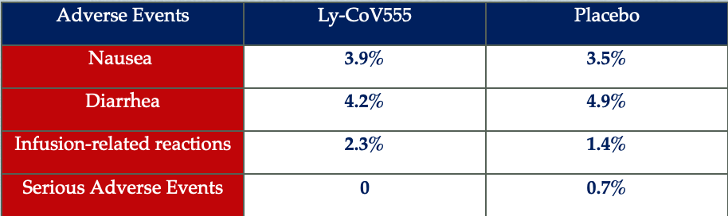
Secondary Outcome - Adverse Events
Notes:
The third secondary outcome was adverse events.
There is a more comprehensive/exhaustive list in the paper that you can look at but I summarized the key points in this table.
The most frequently reported adverse event in the LY-CoV555 group was nausea (3.9%), whereas diarrhea (4.9%) was the most frequent adverse event in the placebo group. Keep in mind these symptoms could also be due to COVID-19.
Infusion-related reactions were reported in 2.3% of the patients (7 of 309) in the LY-CoV555 group and in 1.4% (2 of 143) in the placebo group.
Serious adverse events: Death/life threatening/requires hospitalization or prolongs hospitalization/results in disability or incapacity
This serious adverse event in the placebo group was - 1 person who had abdominal pain and had to be hospitalized for it.
————————————————————————————————————————————————————————————————
Mild: Mild symptoms causing no or minimal interference with usual social and functional activities, with intervention not indicated.
Moderate: Moderate symptoms causing greater than minimal interference with usual social and functional activities, with intervention indicated.
Severe: Severe symptoms causing inability to perform usual social and functional activities, with intervention or hospitalization indicated.
An event is defined as ‘serious’ when it meets at least 1 of the predefined outcomes as described in the definition of an SAE, NOT when it is rated as severe.

Slide 22
Strengths
Randomized, double-blind, placebo-controlled trial
Groups were well balanced at the time of enrollment in regard to risk factors
Enrolled patients had recent disease onset to evaluate the effect of early intervention
Notes:
Strengths:
Randomized, double-blind, placebo-controlled trial - with both participant and investigator blinded.
Groups were well balanced in regard to risk factors at the time of enrollment (i.e. disease status, no of days since onset of symptoms, and mean viral load)
Enrolled patients with recent disease onset to evaluate the effect of early intervention
Patients were analyzed to the groups to which they were randomized for the primary outcome
-Both treatment and placebo groups were treated equally otherwise.
——————————————————————————————

Slide 23
Limitations
Funding: Eli Lilly - creator of the antibody
Sample size
    Approximately 100 patients per arm of study
    Not large enough to comment on safety
Primary outcome - reduction in viral load
    Not a clinical outcome
    Challenging to interpret
    Biologic plausibility issue
Secondary outcomes
    Pooled doses (symptoms and adverse effects)
    Hospitalizations + ER visits analyzed as the same
    Numerous comparisons among a variety of secondary endpoints - significance is questionable.
Notes:
Funded by Eli Lilly the creator of the neutralizing antibody, which does not negate the results, but should give some level of pause in interpreting the results
Appears to be a convenience sample based on how few patients are in the study (100pts per arm of the study)
Not large enough study to comment on safety
Viral load is NOT patient-oriented outcome - Non clinical outcome
This Study was powered to primary outcome - the primary outcome was challenging to intpret and if not negative given that there was only a statistically sig decrease in viral load in ONE of the dosage arms— Meaning when we really need to take it with a grain of salt when looking at secondary outcomes to which study is not targeted against.
Biologic Plausibility Issue: Why would the middle dose be more effective than the higher dose? It is reasonable that the higher dose would have more side effects (although it doesn’t appear to) but here, the middle dose was better at clearing virus. This makes no sense and speaks to the randomness of this finding
Challenging primary end point: It would be nice if statistically significant in all of the arms and if there was a very big signal but we already know that this is the direction that pts are going in when they are recovering from covid.
However, given the numerous comparisons among a variety of secondary endpoints, it’s significance is questionable.

Slide 24
Summary
First phase of trial showed:
  Primary endpoint essentially negative
  Some signals of potential benefit in some secondary endpoints.
Second phase:
  Combine bamlanivimab with second antibody into a cocktail. Will test: two-antibody cocktail compared to bamlanivimab alone or placebo.
November 9th, 2020 - Bamlanivimab received emergency use authorization (EUA) from the US FDA.
Notes:
On November 9th, 2020, bamlanivimab received emergency use authorization (EUA) from the US FDA
EUA is for high risk patients:
- >65
Dosage approved was 700mg In HIGH RISK PATIENTS
Reason for 700mg is due to: A flat exposure- response relationship for efficacy was identified for bamlanivimab within this dose range, based on viral load and clinical outcomes. This means that no meaningful differences were seen between doses with respect to key endpoints. The effects on viral load and on reduction in hospitalizations and ER visits, and the safety profile, were similar in patients receiving any of the three bamlanivimab doses.
————————————————————————
BLAZE-1 is an adaptive trial – so Eli Lilly is shaping the trial as it goes along. That’s fine – that’s the way an adaptive trial is supposed to work. In fact, the way the trial is being adapted speaks volumes.
So perhaps bamlanivimab works – but not as well as was initially hoped.
So, Eli Lilly has decided to combine bamlanivimab with a second antibody into a cocktail. The next phase of the study will test this two-antibody cocktail, compared to bamlanivimab alone or placebo. This seems like an entirely logical next step.

Slide 25
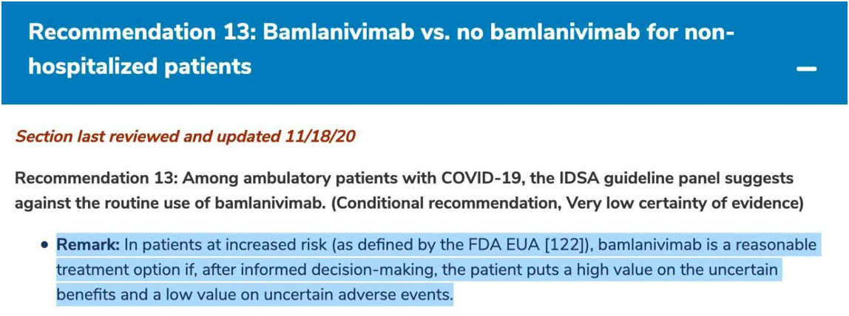
Guidelines
NIH Guidelines
    Bamlanivimab should not be considered the standard of care for treatment of patients with COVID -19
IDSA Guidelines
Notes:
The NIH guidelines admit that there isn’t enough data to know whether bamlanivimab works:
Bamlanivimab should not be considered the standard of care for the treatment of patients with COVID-19.
An interim analysis of the BLAZE-1 study, a Phase 2, randomized, placebo-controlled trial, suggested a potential clinical benefit of bamlanivimab for outpatients with mild to moderate COVID-19. However, the relatively small number of participants and the low number of hospitalizations or emergency department visits make it difficult to draw definitive conclusions about the clinical benefit of bamlanivimab.
The IDSA guidelines likewise recommend against using bamlanivimab (see below). However, they add an interesting phrase: people may want it anyway, if they put a high value on “uncertain benefits” and a low value on “uncertain adverse events.”

Slide 26
Back to Our Patient
Are results from this trial applicable to this patient: Debatable
Is treatment feasible in our setting: Yes
What are our patient's potential benefits and harms from the therapy?
    POTENTIAL clinical benefit
    Anticipated risk: low
    Theoretical risk: antibody-dependent enhancement (ADE) of viral replication.
Notes:
Age/co-morbidities may not be applicable as it used mostly younger pt population
But Setting and severity of disease meets criteria
Treatment is feasible
Potential benefits and harms - decisions.
Talk about potential harm:
Anticipated risk is considered low and is based on the known mechanism of action for human derived neutralizing antibodies in acute viral disease states. LY3819253 and LY3832479 consist of highly specific mAbs directed at foreign (non-human) epitope(s). The complementarity determining regions (CDRs) of the mAbs were derived from B lymphocytes of a convalescent naturally SARS-CoV-2-infected patient and, thus, have undergone natural positive and negative selection pressures in vivo, unlike humanized antibodies generated in mice. No clinically relevant off-target binding has been observed in tissue cross reactivity studies of membrane targets in human tissues. Therefore, off-target binding and tissue cross-reactivity are considered unlikely.
A theoretical risk is that these interventions may cause antibody-dependent enhancement (ADE) of viral replication. This is based on responses observed to some monoclonal antibody therapies used in other unrelated viral diseases. To address this risk, LY3819253 and LY3832479 have been assessed with in vitro cell culture models and, for LY3819253, an in vivo nonhuman primate model.
The risk of clinical ADE for either intervention or in combination is considered low due to
• the structural features of LY3832479, which is engineered to suppress its binding to Fc receptors and C1qm
• the absence of ADE from in vitro studies, and
• the absence of ADE from in vivo nonhuman primate studies for LY3189253.
LY3819253 will also be administered to participants at sufficiently high dose levels to neutralize SARS-CoV-2 and avoid sub-neutralizing concentrations in the presence of virus that are typically associated with ADE.
Additional manageable risks associated with most therapeutic monoclonal antibodies are the potential for infusion-related hypersensitivity and cytokine release reactions. The infusions in this study will be administered at a controlled rate, the study participants will be monitored closely, and adjustments in the infusion rate will be made and/or the infusion stopped, if indicated. Additional information regarding infusion reaction management options is in Section 6.1.1.
Given the data on LY3819253 and LY3832479, the well described safety profile of other therapeutic mAbs, and the lack of disease directed therapeutic options for patients with COVID- 19 illness, the overall benefit-risk assessment this study is considered favorable.

Slide 27
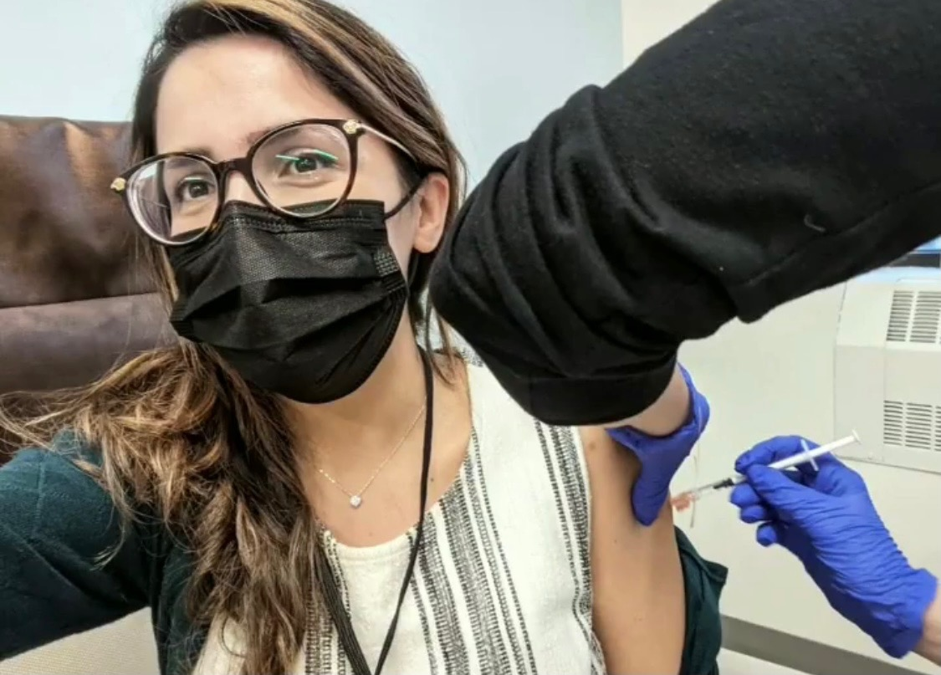
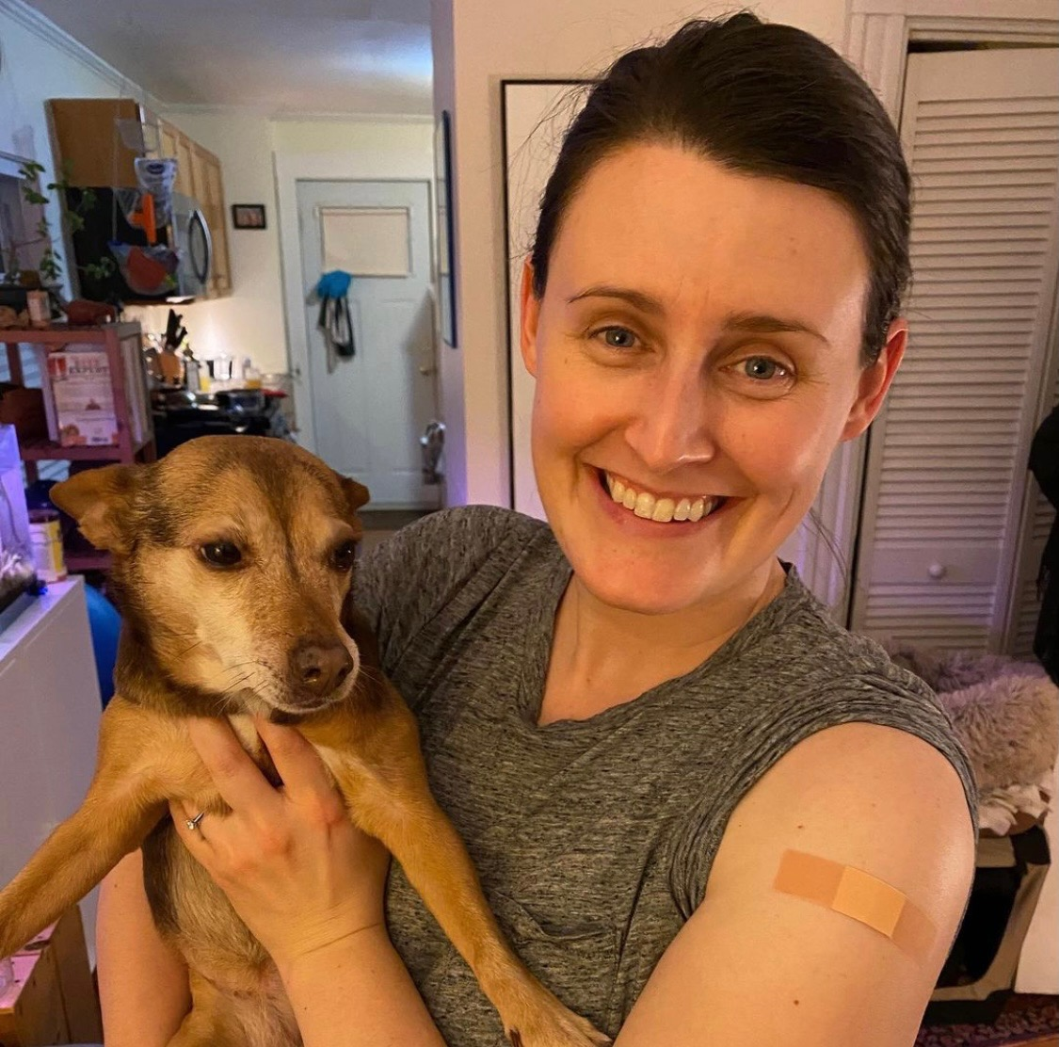
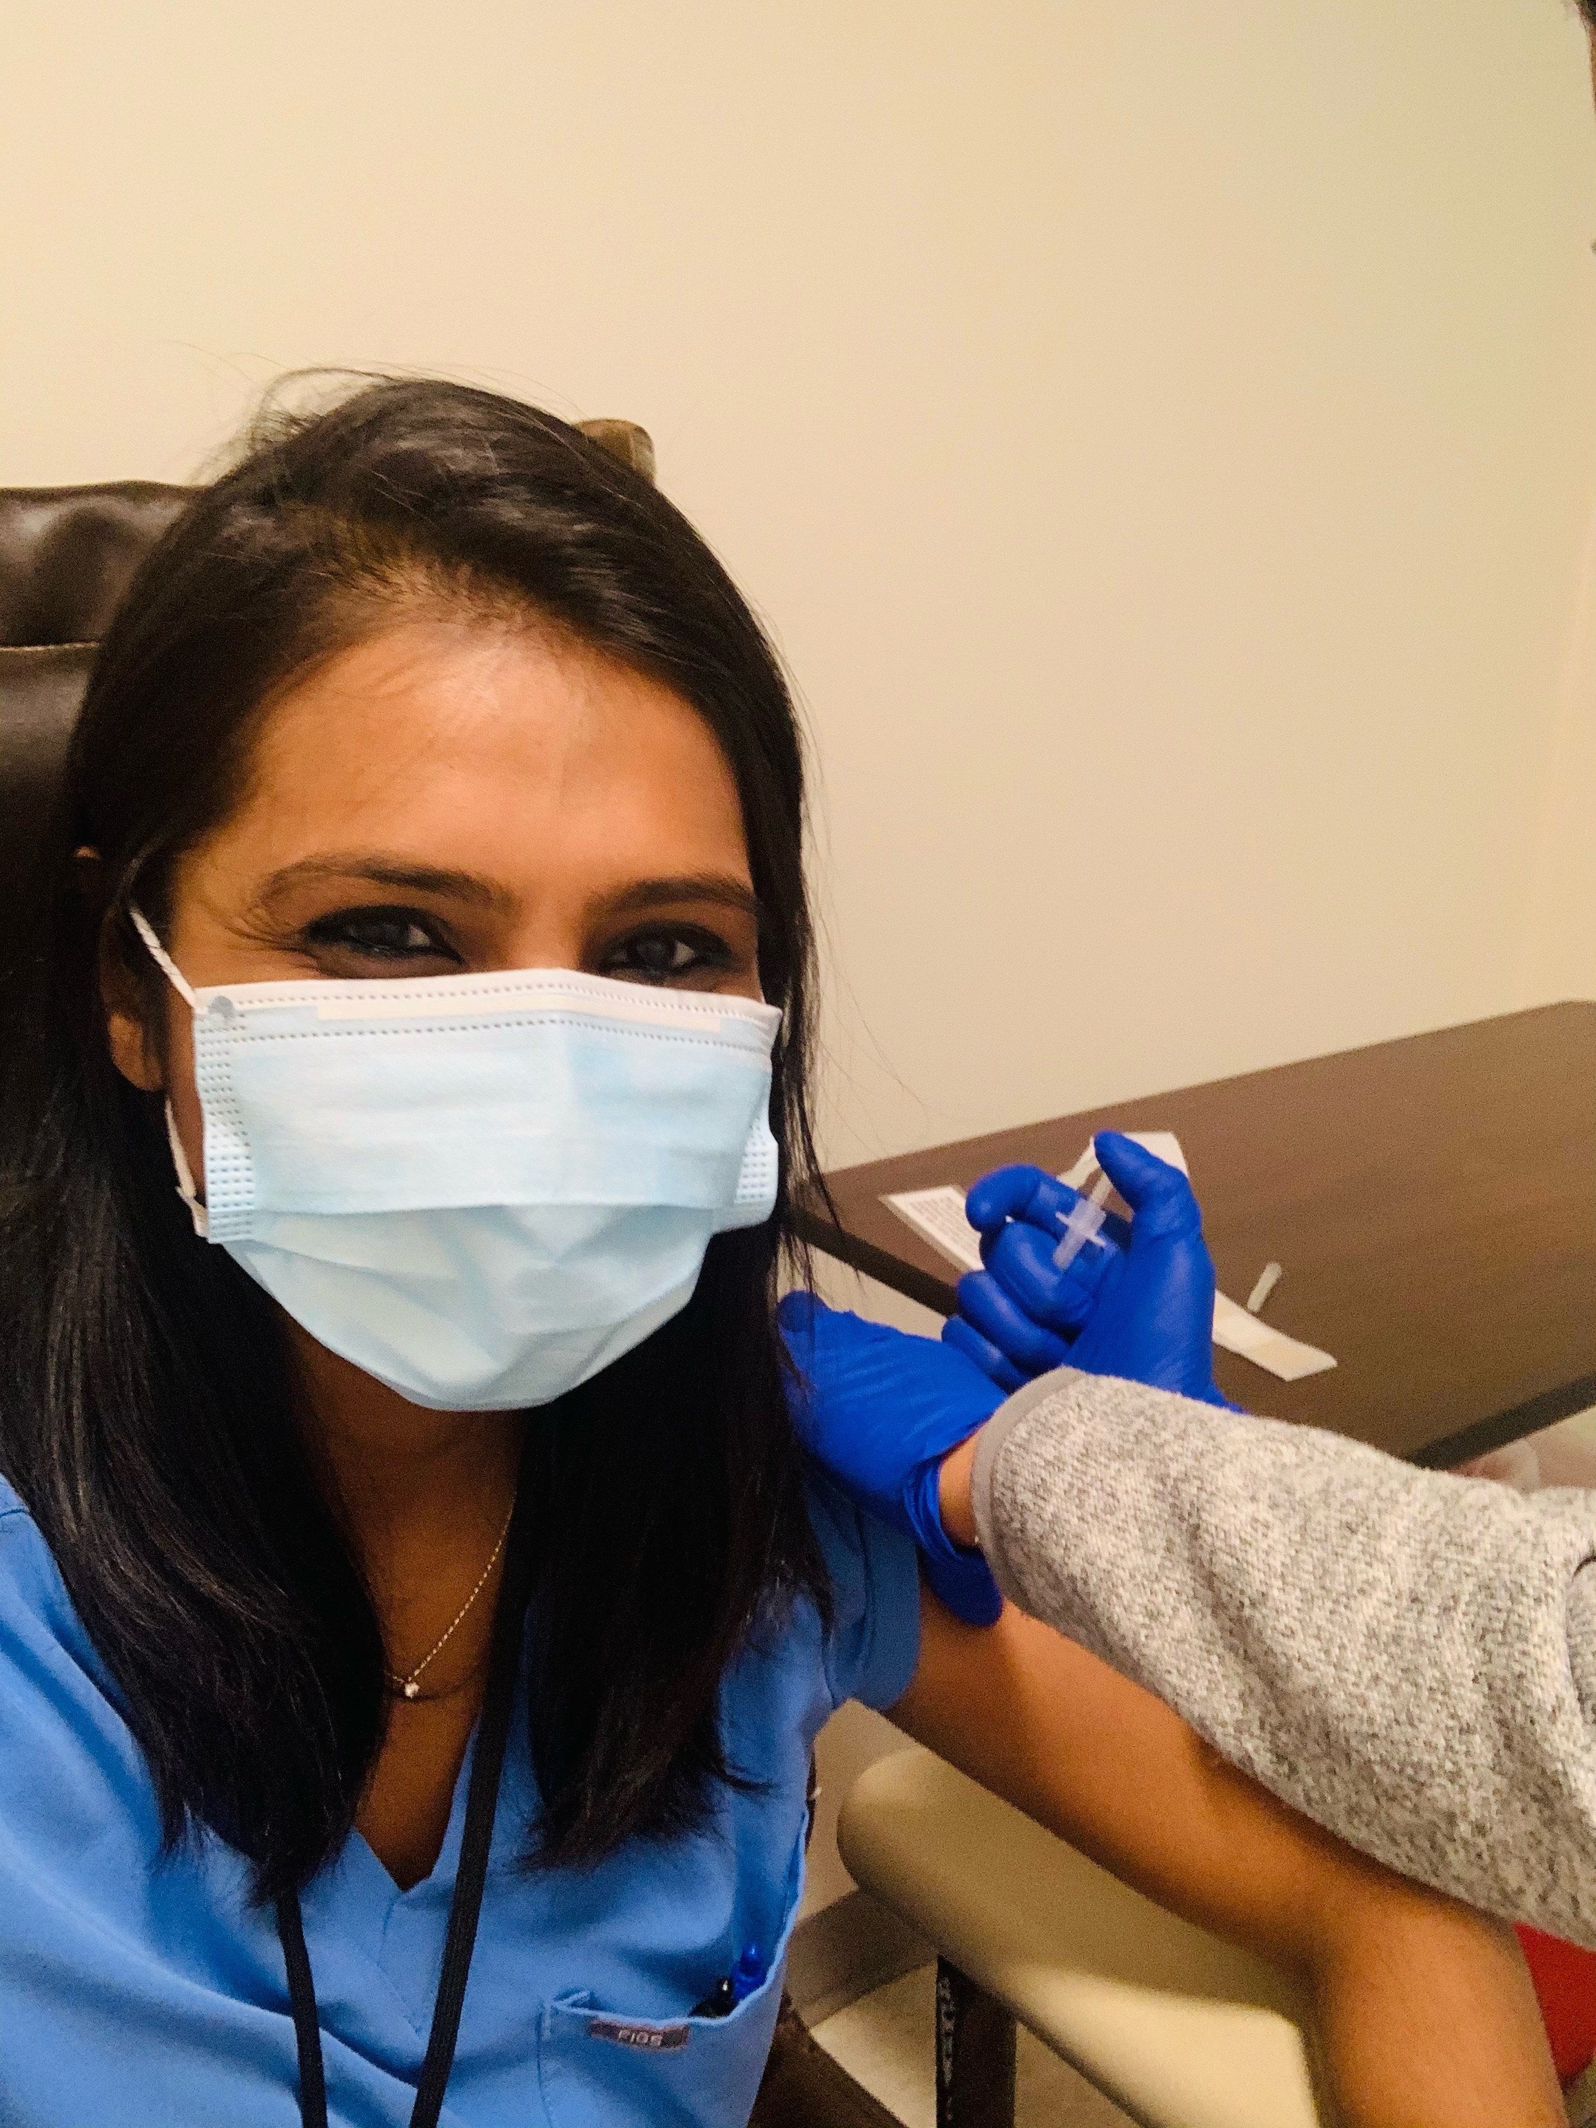

THANK YOU!!!

Slide 28
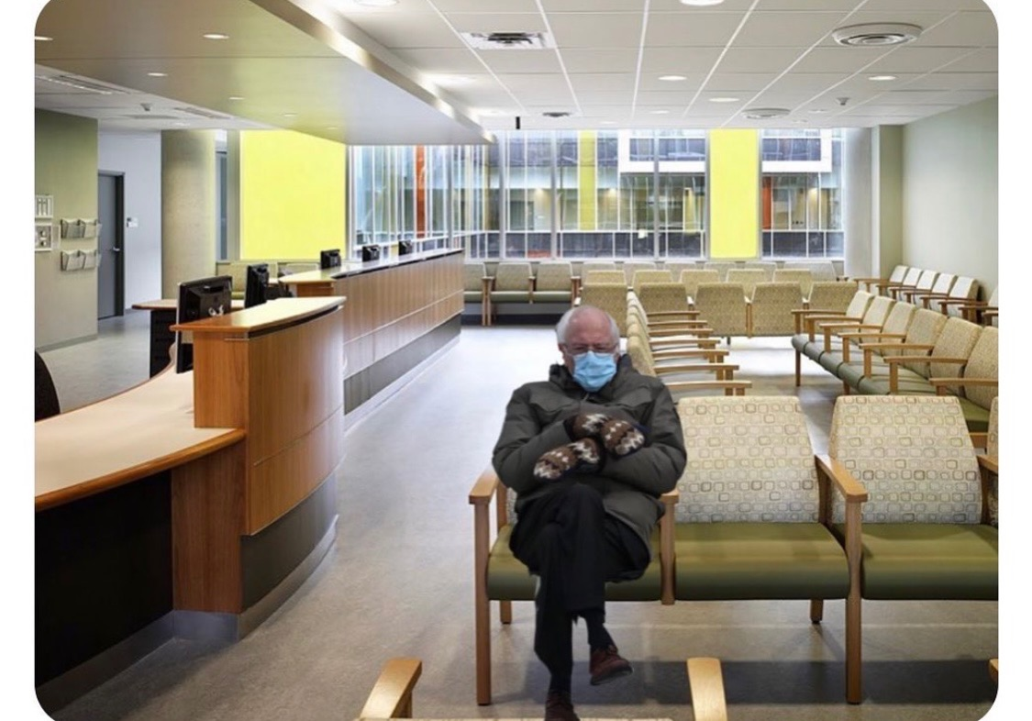
When your tele-med appointment shows up to clinic because they heard that we received vaccines!

