Slide 1
Sweetening the pot: more evidence for sGLt-2 inhibitors?
Emily Cetrone, MD
Geriatrics Fellow
Boston Medical Center
Journal Club
December 11, 2020

Slide 2
Goals
Review the current guideline-directed medical treatment for heart failure with reduced ejection fraction and the previous evidence for SGLT-2 inhibitors.
Define the term composite outcome.
Analyze and appraise a randomized controlled trial.

Slide 3
Our Patient
66F with hx of HFrEF (EF 35%), mitral valve regurgitation s/p mitral clip, pHTN, and Type II DM
NYHA Class II
Hospital visits this year:
  Heart failure inpatient admission
  Hypoglycemia observation admission
  Hyperglycemia ED visit
Medications
  Metoprolol 100 mg daily
  Lisinopril 10 mg daily
  Atorvastatin 40 mg daily
  Lasix 60 mg daily
  Metformin 1000 mg BID
  Glargine 19 units daily
  Lispro 5 units TID with meals
Notes:
NYHA Classification - The Stages of Heart Failure:
Class I - No symptoms and no limitation in ordinary physical activity, e.g. shortness of breath when walking, climbing stairs etc.
Class II - Mild symptoms (mild shortness of breath and/or angina) and slight limitation during ordinary activity.
Class III - Marked limitation in activity due to symptoms, even during less-than-ordinary activity, e.g. walking short distances (20—100 m).Comfortable only at rest.
Class IV - Severe limitations. Experiences symptoms even while at rest. Mostly bedbound patients.

Slide 4
Patient, Problem, Population | In community dwelling older adults with a history of heart failure with reduced ejection fraction,
Intervention | does the addition of an SGLT-2 inhibitor to guideline-directed medical therapy (GDMT)
Comparison or Control | compared to GDMT alone
Outcome | reduce the risk of heart failure exacerbations?

Slide 5
What do we already know about the management of HFrEF?

Slide 6

Guideline-Directed Medical Therapy
ACE inhibitor or ARB
Beta blocker
Mineralocorticoid receptor antagonist
CRT
ICDs
Angiotensin-neprilysin inhibitors
Notes:
CONSENSUS in 1987, confirmed in SOLVD in 1991 for ACEs
CIBIS-II and MERIT-HF in 1999, later COPERNICUS in 2002
RALES in 1999
PARADIGM-HF in 2019 for Angiotensin-neprilysin inhibition

Slide 7
What has been studied about SGLT-2 inhibitors?

Slide 8
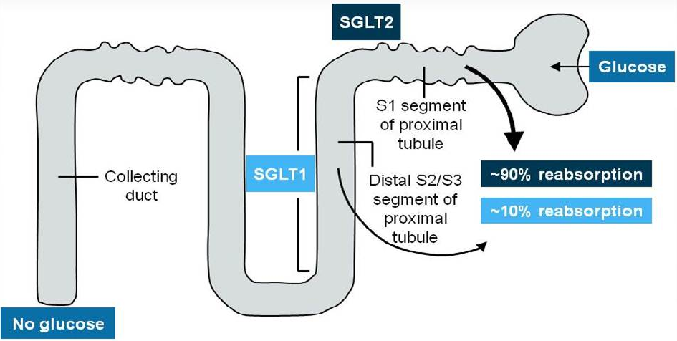
Canagliflozin/Invokana
Empagliflozin/Jardiance
Dapagliflozin/Farxiga
Notes:
Glucose transporter in the proximal tubule responsible for 90% of glucose reabsorption
David L. Joffe, BS Pharm, CDE, FACA. “SGLT2 Inhibitors: A New Class of Diabetes Medications.” Diabetes In Control. 6 Dec 2020. http://www.diabetesincontrol.com/sglt2-inhibitors-a-new-class-of-diabetes-medications.
ADD IN NAMES OF DRUGS

Slide 9
CREDENCE (2019)
DAPA-HF (2019)
CANVAS (2017)
EMPA-REG (2015)
Canagliflozin: reduced CV events and HF admissions, slowed progression of kidney disease, increase risk of amputation
Canagliflozin: reduced risk of composite renal outcome, no increased risk of amputation
Empagliflozin: reduced CV events, slowed progression of kidney disease
Dapagliflozin: reduced CV death or worsening heart failure, reduced all-cause mortality
Notes:
EMPA-REG: empagliflozin reduced the rate of CV events and slowed the progression of kidney disease among patients with T2DM and high CV risk (patients in this study had known CAD, with history of ACS, multivessel disease, previous stent, etc)
CANVAS: Among patients with T2DM at high risk for CV events, canagliflozin had a lower risk of cardiovascular events and reduced the rate of renal decline and heart failure hospitalization compared to those who received placebo but a greater risk of amputation.
DAPA-HF: Among individuals with HFrEF (NYHA II-IV, LVEF ≤40%) with or without T2DM, the addition of the SGLT-2 inhibitor dapagliflozin decreased rates of CV death or worsening HF, as well as all-cause mortality
CREDENCE: canagliflozin 100 mg/d reduces the risk of the composite end-point of end-stage kidney disease, doubling of serum creatinine from baseline, and death from renal or cardiovascular disease when compared to placebo
Zinman B, et al. "Empagliflozin, Cardiovascular Outcomes, and Mortality in Type 2 Diabetes". The New England Journal of Medicine. 2015. 373(22):2117-28.
Neal B, et al. "Canagliflozin and cardiovascular and renal events in type 2 diabetes". The New England Journal of Medicine. 2017. 377(7):644-657.
McMurray JJV, et al. "Dapagliflozin in Patients With Heart Failure and Reduced Ejection Fraction". The New England Journal of Medicine. 2019. 381(21):1995-2008.
Perkovic V, et al. "Canagliflozin and renal outcomes in diabetic nephropathy". The New England Journal of Medicine. 2019. 380(24):2295-2306.

Slide 10
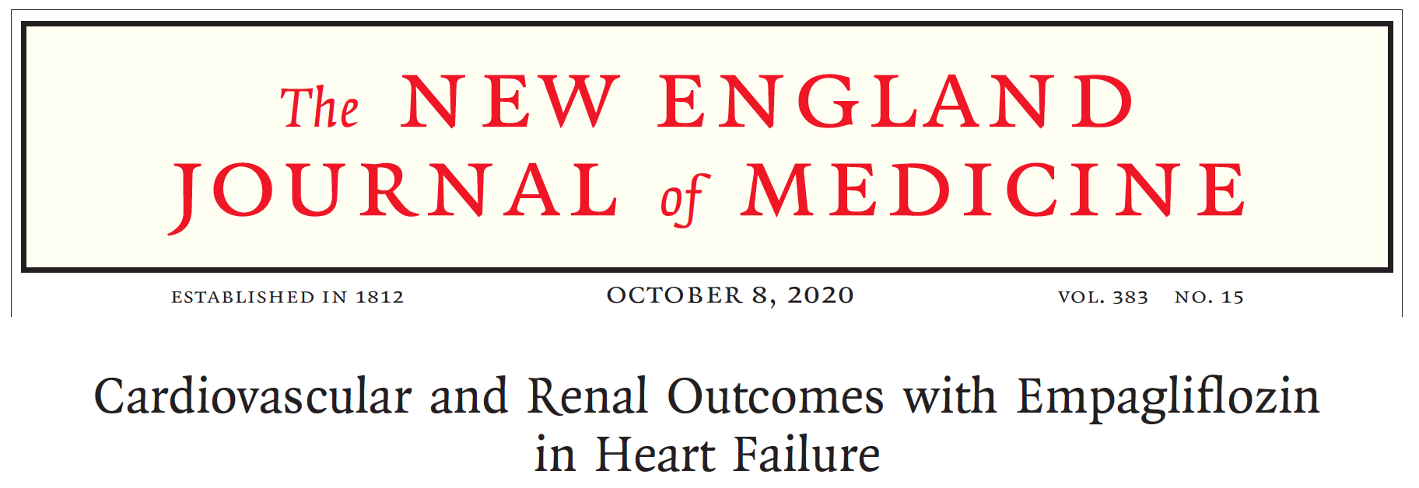

EMPEROR-Reduced

Slide 11

Did you know that emperor penguins can dive deeper than any other bird?

Slide 12
Study Design
Design: Randomized, double-blind, parallel-group, placebo-controlled, event-driven trial
Setting: Multicenter trial in 20 countries
Participants: 3730 patients with HFrEF (with EF <40%)
Sponsors: Boehringer Ingelheim and Eli Lilly, pharmaceutical companies
Notes:
520 centers in 20 countries
Companies:
Both make Jardiance (empagliflozin)
Eli Lilly in news lately because of COVID-19 monoclonal antibody treatment

Slide 13
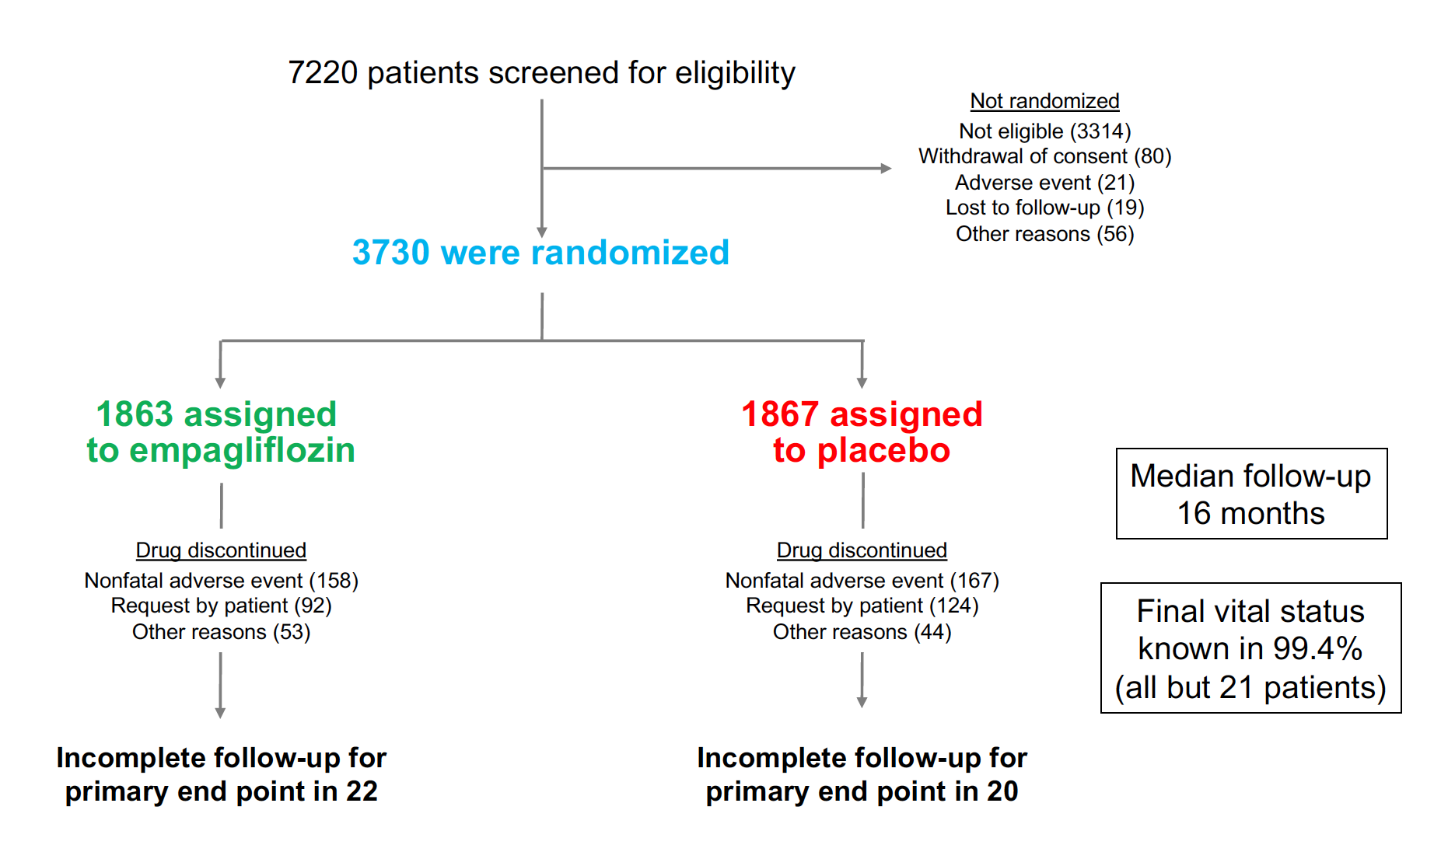
Notes:
Empagliflozin 10 mg chosen based on dose in EMPA-REG
WHAT ADVERSE EFFECTS LED TO THE PATIENTS LEAVING THE STUDY

Slide 14


Inclusion Criteria
Exclusion Criteria (abbreviated list)
EF </= 40% with hospitalization in last 12 months for heart failure or elevated NT-proBNP
NYHA functional class II, III, IV
On appropriate medical therapy
MI, cardiac surgery, TIA, or stroke in past 90 days
Heart transplant or LVAD
HOCM, infiltrative cardiomyopathy, peripartum or chemo related cardiomyopathy
Severe valvular dysfunction with planned surgery
COPD requiring home oxygen or hospitalization within past 12 months
Dialysis
Acute or chronic liver disease
History of ketoacidosis

Slide 15

Outcomes
Primary outcome = composite of cardiovascular death or hospitalization for heart failure
Selected secondary outcomes
  All hospitalizations for heart failure
  Rate of the decline in the estimated GFR
Notes:
Chose the composite outcome so they could reach the power sooner
Hierarchical testing

Slide 16

Methods
Enrollment: April 2017 through November 2019
Initial appointment with a health care provider
Data collection: evaluation of participants every 2 to 3 months
Final data collection date: April 29, 2020
Median follow up: 16 months
Notes:
- After randomization, at the initial appointment, all appropriate treatments for heart failure or other medical conditions could be initiated or altered at the clinical discretion of the health care provider, according to each patient’s needs.
- periodically evaluated vital signs, body weight, HgbA1c, NT-proBNP level, renal function, quality of life using the Kansas City Cardiomyopathy Questionnaire.

Slide 17
results

Slide 18
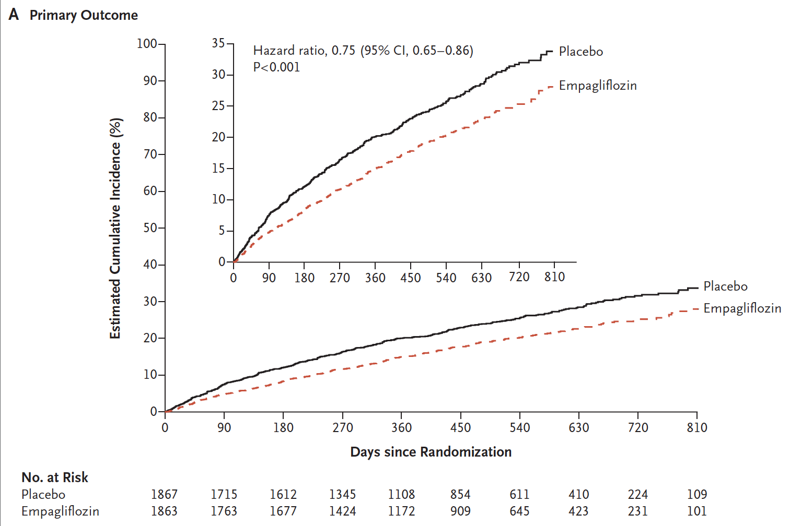
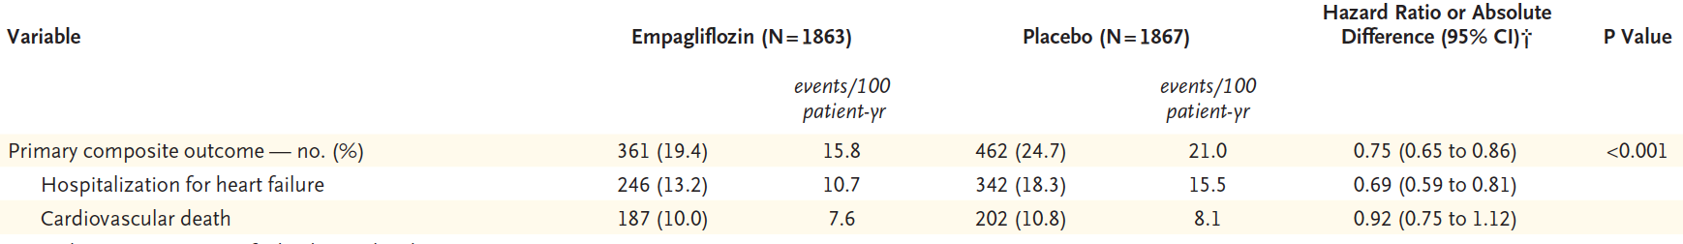
Notes:
The primary composite outcome of death from cardiovascular causes or hospitalization for heart failure occurred in 361 patients (19.4%) in the
empagliflozin group and in 462 patients (24.7%) in the placebo group (hazard ratio, 0.75; 95% confidence interval [CI], 0.65 to 0.86; P<0.001)
(Table 2 and Fig. 1A). The hazard ratios for the
effect of empagliflozin on cardiovascular death
and on the first hospitalization for heart failure
were 0.92 (95% CI, 0.75 to 1.12) and 0.69 (95% CI,
0.59 to 0.81), respectively (Table 2 and Figs. S2
and S3). During the trial period, the number of
patients who would need to have been treated with
empagliflozin to prevent one primary event was
19 (95% CI, 13 to 37).

Slide 19
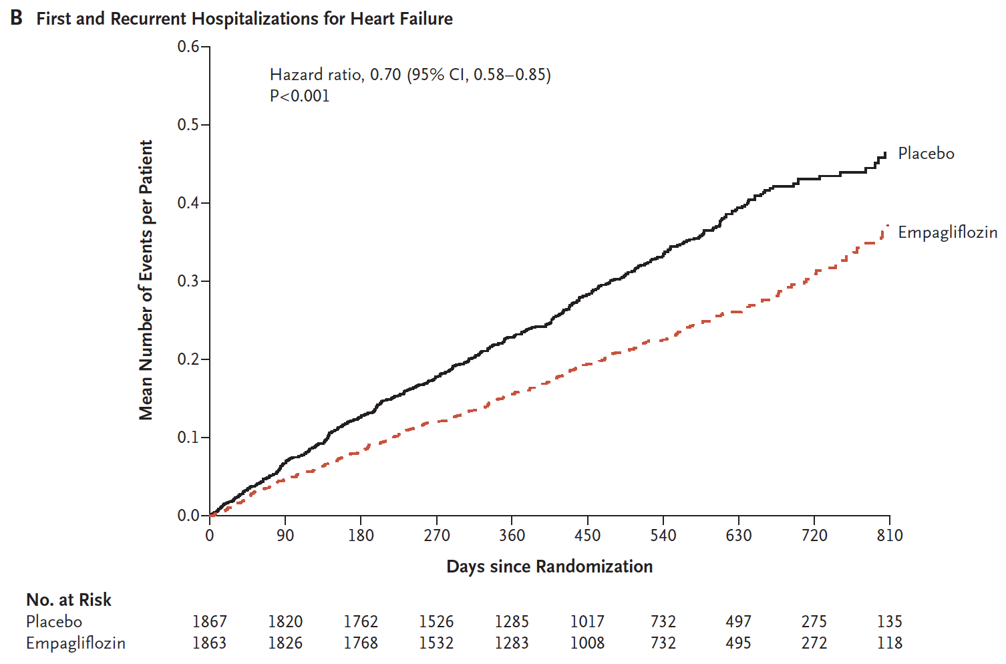

Slide 20
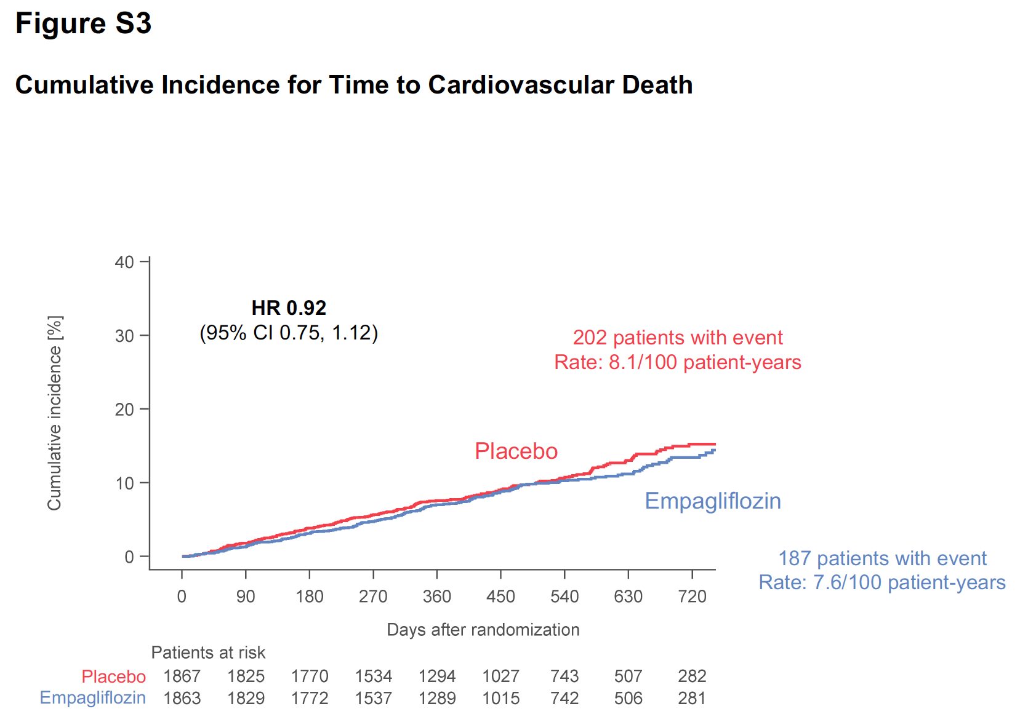

Slide 21
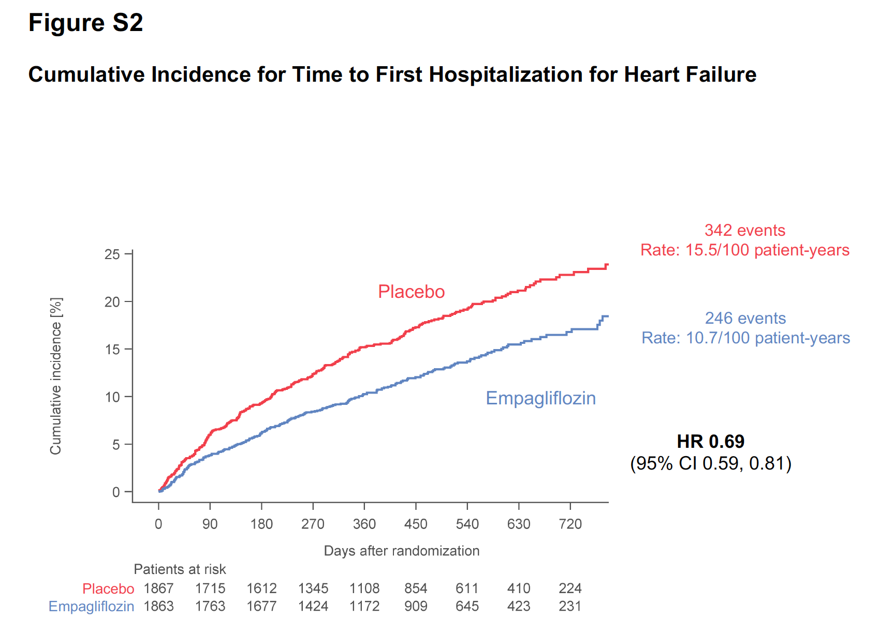

Slide 22
Critical appraisal

Slide 23
Is this evidence about therapy valid?
Was there a fair start?
Was the assignment of patients to treatment randomized?
Was the assignment concealed?
Were the groups similar at the start of the trial?
Was there a fair race?
Was follow-up of patients sufficiently long and complete?
Were all patients analyzed in the groups to which they were randomized?
Notes:
Some finer points:
Who was blinded: were patients, clinicians, and study personnel kept blind to treatment?
Were groups treated equally?

Slide 24
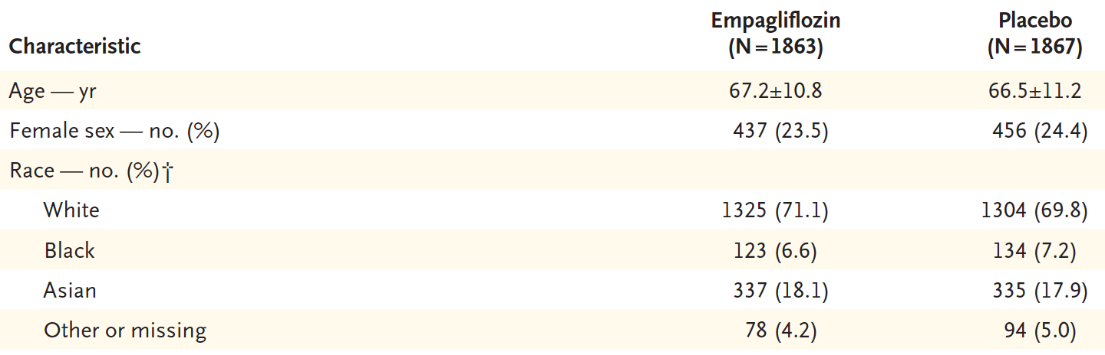
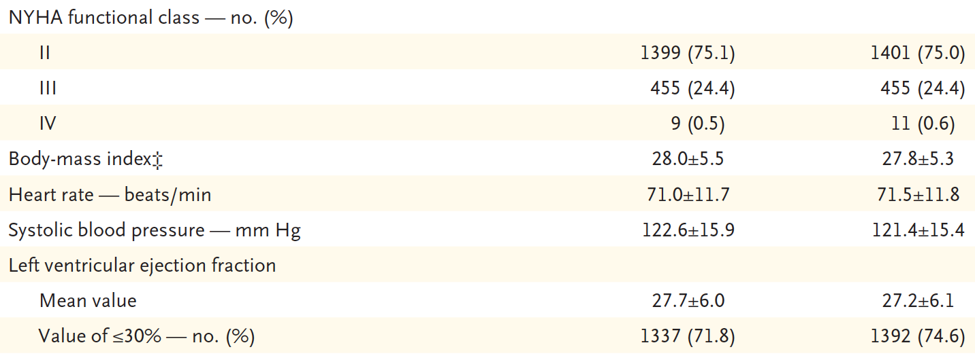
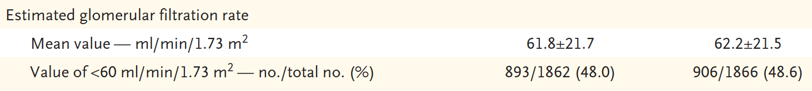

Slide 25
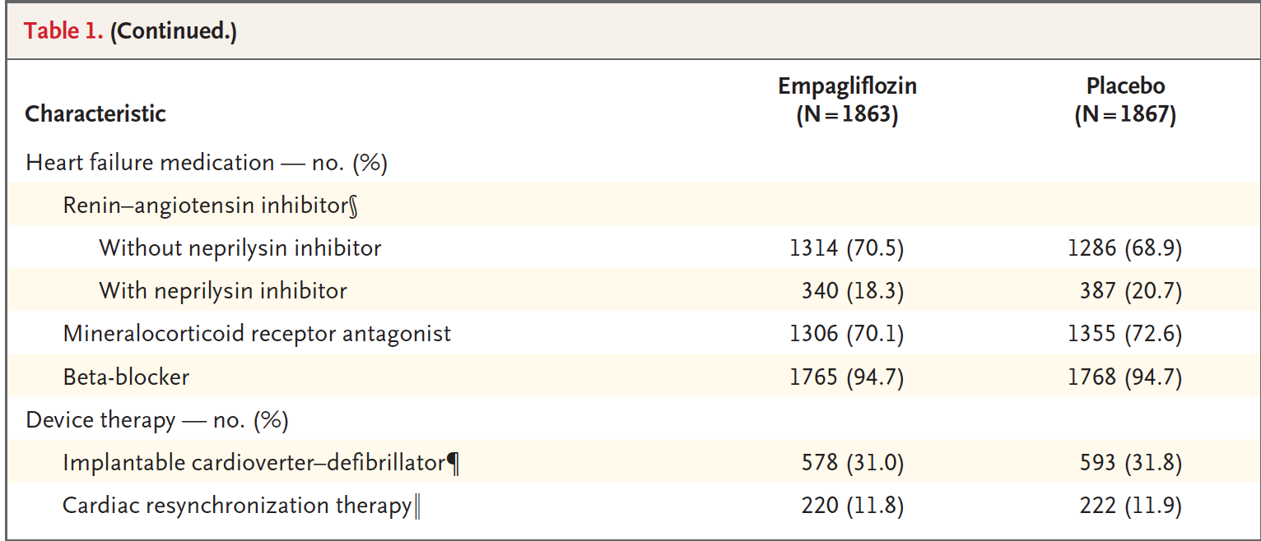
Notes:
~20% on Entresto – pretty advanced heart failure

Slide 26
Is this evidence about therapy valid?
Was there a fair start?
Was the assignment of patients to treatment randomized? yes
Was the assignment concealed? yes
Were the groups similar at the start of the trial? yes
Was there a fair race?
Was follow-up of patients sufficiently long and complete?
Were all patients analyzed in the groups to which they were randomized?
Notes:
Some finer points:
Who was blinded: were patients, clinicians, and study personnel kept blind to treatment?
Were groups treated equally?

Slide 27
Notes:
I think if you just look at the primary outcome, the curves separate pretty early, definitely by the time of that median follow up so long enough

Slide 28
Is this valid evidence about therapy important?
What is the magnitude of the treatment effect?
How precise is the estimate of the treatment effect?

Slide 29
ARR = 24.7% - 19.4% = 5.3%
NNT = 1/5.3% = 19
19 people would need to be treated with empagliflozin to prevent one primary outcome
Notes:
CALCULATE NNT FOR HF HOSPITALIZATIONS

Slide 30
Can we apply this valid, important evidence about therapy in caring for our patient?
Is our patient so different from those in the study that its results cannot apply?
Is the treatment feasible in our setting?
What are our patient’s potential benefits and harms from the therapy?
Whare are our patient's values and expectations for both the outcome we are trying to prevent and the treatment we are offering?

Slide 31
Our Patient
66F with hx of HFrEF (EF 35%), mitral valve regurgitation s/p mitral clip, pHTN, and Type II DM
NYHA Class II
Hospital visits this year:
  Heart failure inpatient admission
  Hypoglycemia observation admission
  Hyperglycemia ED visit
Medications
  Metoprolol 100 mg
  Lisinopril 10 mg
  Atorvastatin 40 mg
  Lasix 60 mg
  Metformin 1000 mg BID
  Glargine 19 units
  Lispro 5 units TID
Data:
  BMI 30
  Last Hgb A1c 10.1%
  Urine microalbuminuria 164
  GFR in 50s
Notes:
NYHA Classification - The Stages of Heart Failure:
Class I - No symptoms and no limitation in ordinary physical activity, e.g. shortness of breath when walking, climbing stairs etc.
Class II - Mild symptoms (mild shortness of breath and/or angina) and slight limitation during ordinary activity.
Class III - Marked limitation in activity due to symptoms, even during less-than-ordinary activity, e.g. walking short distances (20—100 m).Comfortable only at rest.
Class IV - Severe limitations. Experiences symptoms even while at rest. Mostly bedbound patients.
“Severely” increased albuminuria = >300 for the most renal benefit

Slide 32

Average Baseline Characteristics
Mean age: 67 years
75% male
NYHA II 75%, NYHA III 24.5%, NYHA IV 0.5%
Mean LVEF 27%
Mean NT-proBNP 1900pg/mL
50% pts diabetic

Slide 33
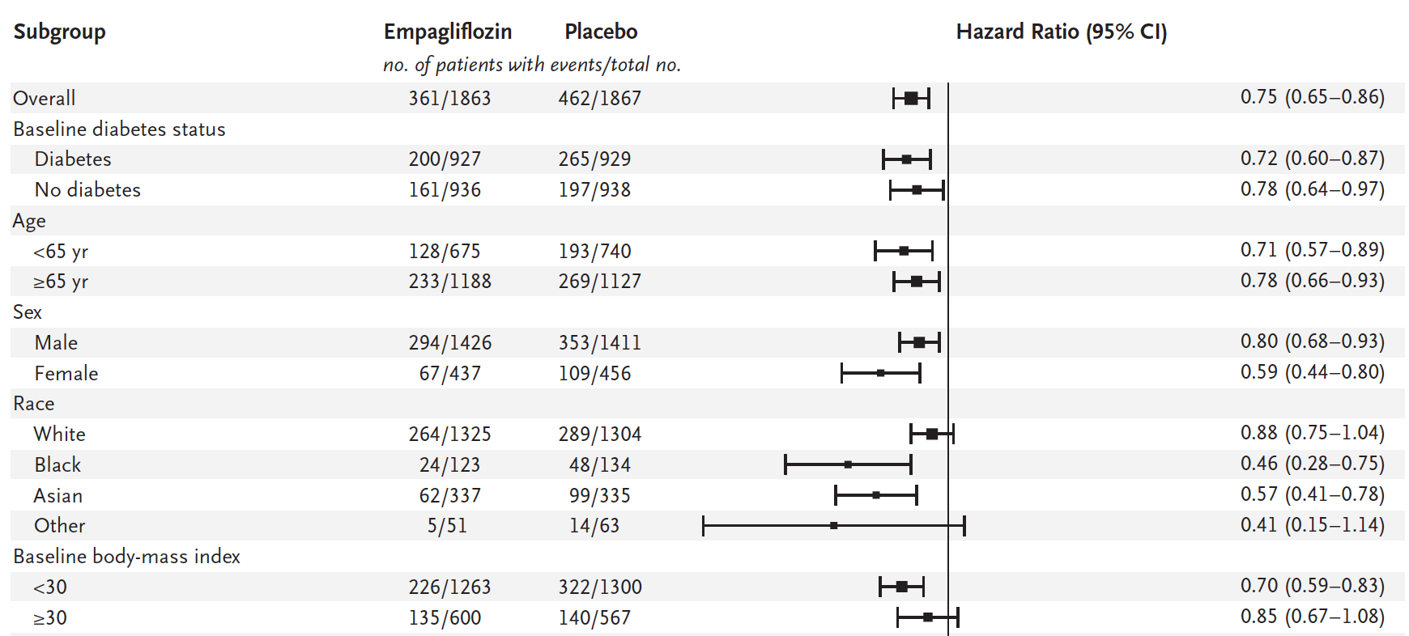
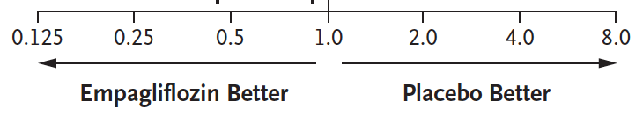

Slide 34
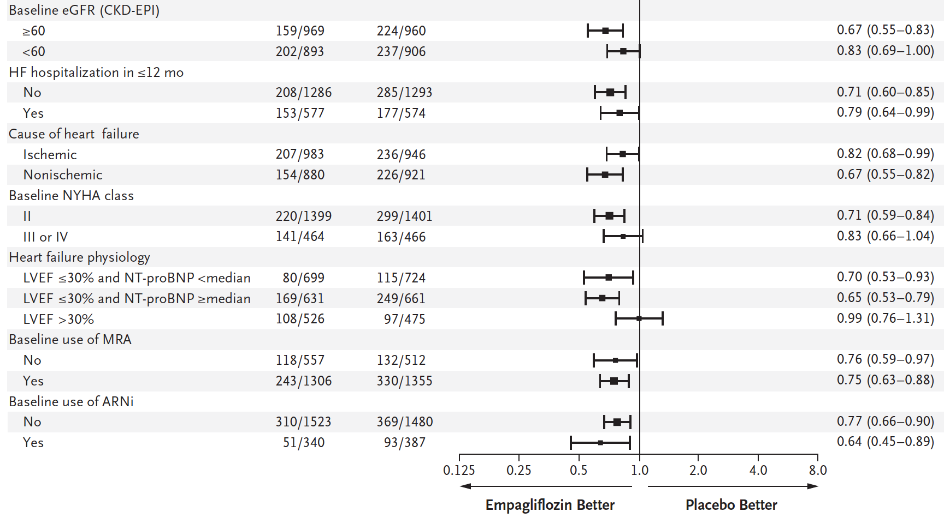

Slide 35
Can we apply this valid, important evidence about therapy in caring for our patient?
Is our patient so different from those in the study that its results cannot apply?
Is the treatment feasible in our setting?
What are our patient’s potential benefits and harms from the therapy?
Whare are our patient's values and expectations for both the outcome we are trying to prevent and the treatment we are offering?
Notes:
MENTION THAT THIS MED IS PO

Slide 36
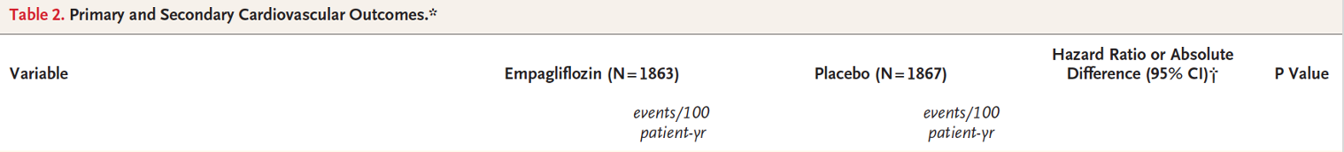
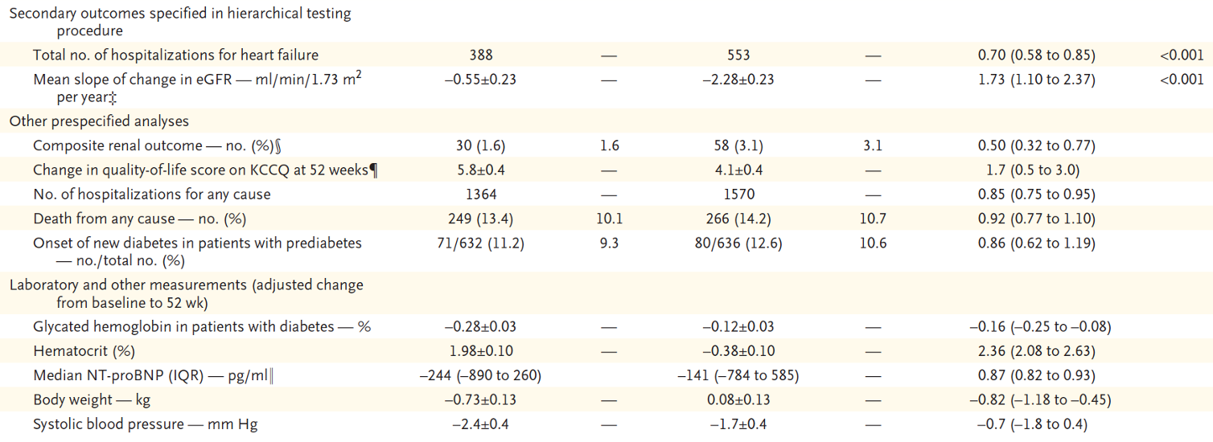
Notes:
The composite renal outcome includes chronic dialysis or renal transplantation or a sustained reduction of 40% or more in the estimated GFR or a sustained estimated GFR of less
than 15 ml per minute per 1.73 m2 in patients with a baseline estimated GFR of 30 ml per minute per 1.73 m2 or more or a sustained estimated GFR of less than 10 ml per minute per
1.73 m2 in those with a baseline estimated GFR of less than 30 ml per minute per 1.73 m2

Slide 37
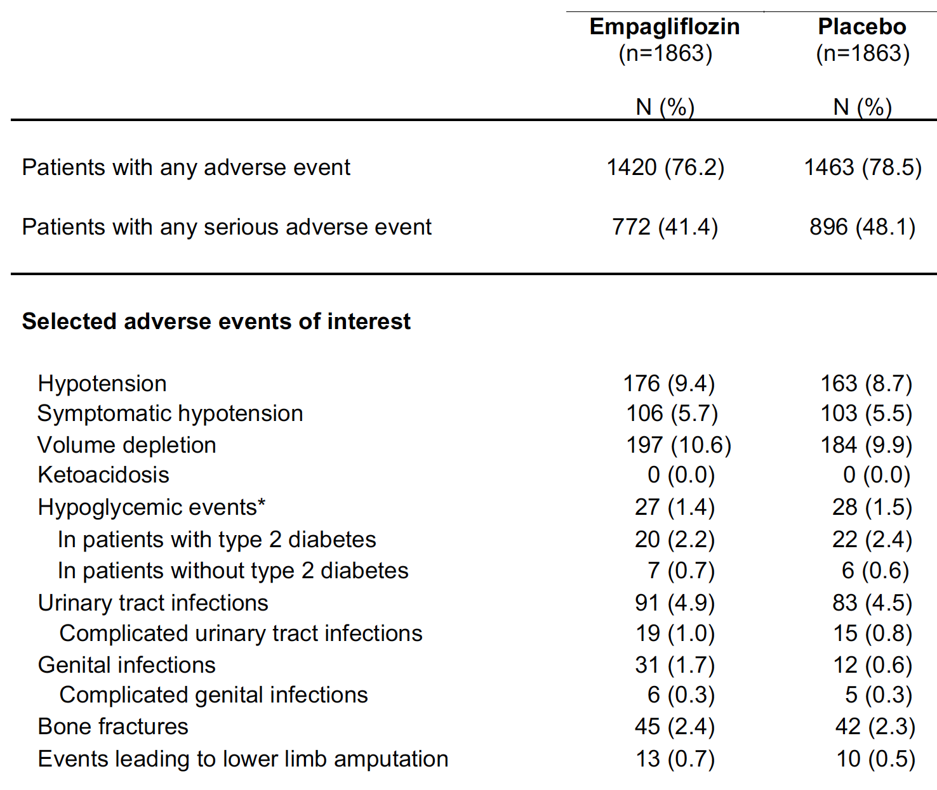
Notes:
There was no statistical difference

Slide 38
What about our patient?
  Last Hgb A1c 10.1%
  Valvular dysfunction getting worse?
  Challenges with current insulin regimen
  Stopped mealtime insulin
  Started a GLP-1 agonist
  Lasix increased
Notes:
BRING IT BACK TO PATIENT

Slide 39

Thank you
Anne Hennigan, PharmD, BCPS
Vassiliki Pravodelov, MD
Heidi Auerbach, MD
A group of emperor penguins at sea is called a “raft”

Slide 40

Thank you!
Questions?

