Slide 1
COVID-19 Vaccination A New Hope?
Sarah King
Journal Club
January 2021

Slide 2
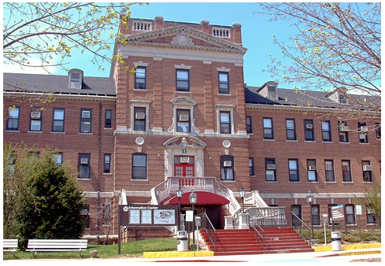
Our Patient
76-year-old African American male with history of CHF, DM2, alcohol use disorder in remission, current smoker.
Asks about the COVID-19 vaccine: “Should I take it, doc?”

Slide 3
PICO Question
Patient, Problem, Population | In community dwelling older adults
Intervention | does mRNA vaccination against COVID-19
Comparison or Control | compared with no vaccine
Outcome | decrease incidence of COVID-19?

Slide 4

Learning Objectives
Understand mechanism and basic history of the mRNA vaccine
Explore safety and efficacy data for the Pfizer/BioNTech and Moderna COVID mRNA vaccines
Apply safety and efficacy data to our patient population
Review other vaccine options

Slide 5
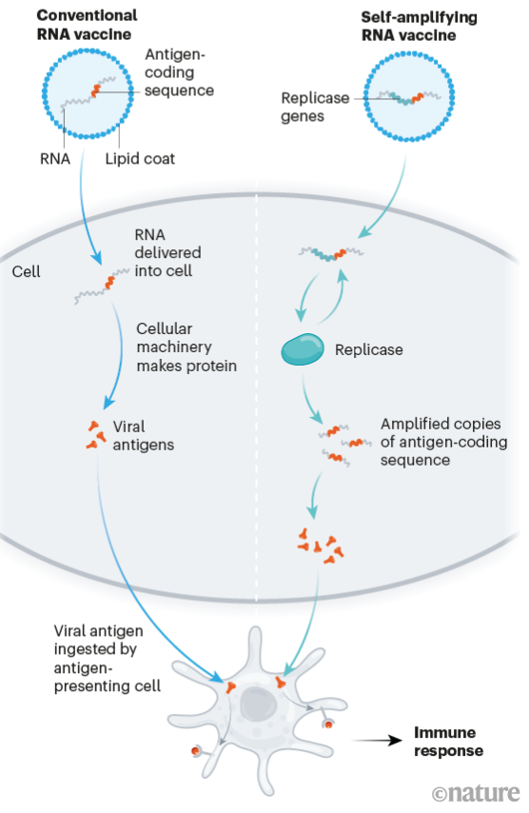
Background: RNA vaccines
First RNA based vaccine developed in 1990s by Sanofi Pasteur – influenza antigen in mice
2012: Geall et al described first lipid nanoparticle capsule (LNP)
2020: COVID-19 pandemic
Challenges: cold storage, double dose requirement, reactogenicity
Notes:
Lipid delivery system too toxic in humans
Continued small trials of RNA vaccines: CMV, chikungunya, zika, rabies
highlighted need for fast and adaptable vaccine development
Moderna isolate antigen encoding segment for spike protein within 4 days of receiving SARS-CoV-2 genome sequence
Side effects: contaminants into RNA sequence and LNP delivery system main sources of reactogenicity

Slide 6
Overview of Vaccine Development
Pre-clinical
  Vaccine candidates administered to small animals, immune response measured, toxicity evaluation
Phase I: Safety trials
  Healthy human subjects, n<100
Phase II: Expanded safety trials
  Larger group of healthy human subjects, evaluate safety in larger population (sometimes children, older adults included)
Phase III: Efficacy trials
  Designed to measure prevention of predefined end point related to infection, blinded, RCT, n=thousands

Slide 7
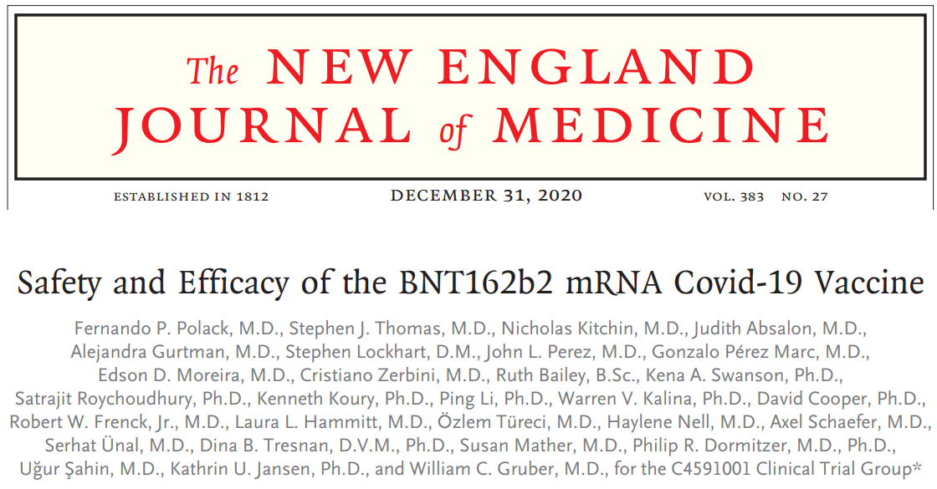
Study
Notes:
Pzifer vaccine

Slide 8
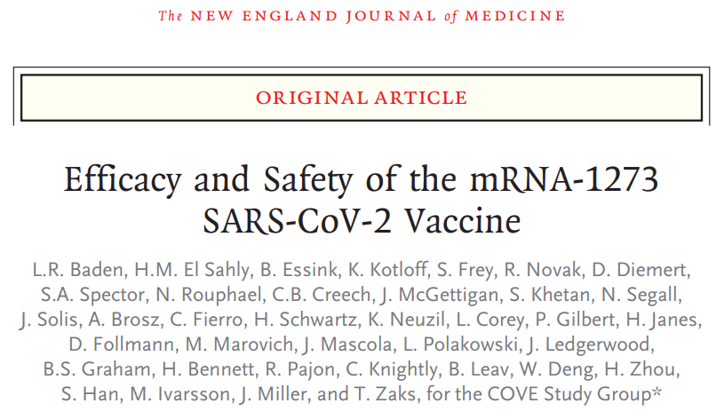
Update: January 15, 2021
Notes:
Moderna

Slide 9
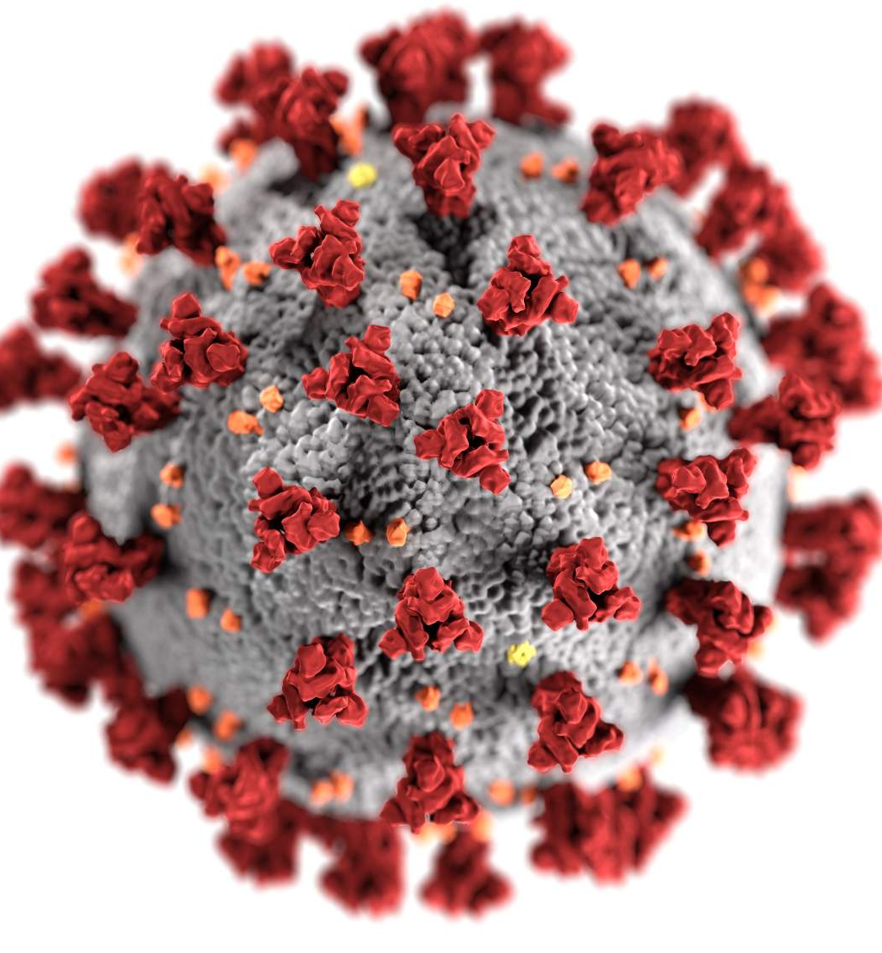
Study Design
Pfizer – BNT162b2
Moderna – mRNA1273
Double-blinded placebo-controlled trial
Phase 2/3
Assess safety and efficacy of two intramuscular 30µg injections of the BNT162b2 vaccine vs placebo
Doses given 21 days apart
Inclusion:
  16 or older, healthy or stable chronic conditions (including HIV, HBV, HCV)
Exclusion:
  History of COVID-19, on immunosuppressive therapy, diagnosed immune compromising condition, pregnant
Double-blinded placebo-controlled trial
Phase 2/3
Assess safety and efficacy of two intramuscular 100µg injections of the mRNA1273 vaccine vs placebo
Doses given 28 days apart
Inclusion:
  18 or older, healthy or stable chronic conditions
Exclusion:
  History of COVID-19, immunosuppressive therapy, diagnosed immune compromising condition, pregnant

Slide 10
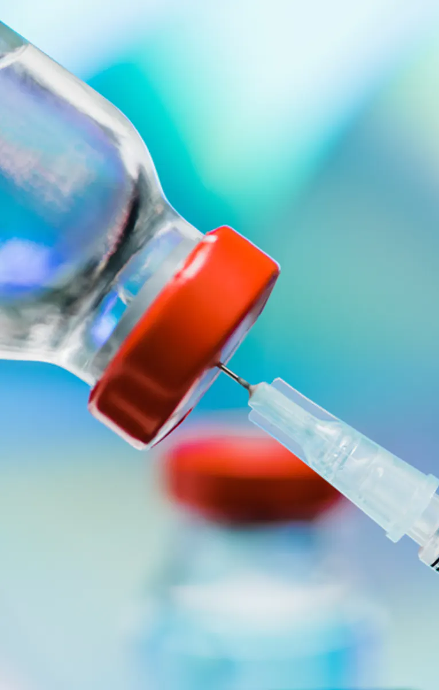
Methods
Study participants randomly assigned in 1:1 distribution to receive the vaccine or saline placebo
Site staff and study participants were blinded
Patients monitored for 30 minutes after injection
Moderna study: Patients had SARS-CoV-2 antibody and nasopharyngeal testing prior to each dose
Notes:
Pfizer – 30 minutes monitoring

Slide 11
Study Design
Primary endpoint
  Safety:
    Local or systemic adverse events within 7-28 days following each dose
  Efficacy:
    Protection against COVID-19 at least 7-14 days after second dose
Secondary endpoint
  Efficacy:
    Protection against severe COVID-19 infection

Slide 12
Definitions
Confirmed Covid-19: defined according to the Food and Drug Administration (FDA) criteria:
  Positive respiratory specimen for SARS CoV-2
  Presence of at least one of the following symptoms:
    Fever or chills
    New or increased cough, shortness of breath or muscle pain
    New loss of taste or smell
    Sore throat
    Diarrhea, or vomiting,
Severe COVID-19:
  Respiratory failure
  Evidence of shock
  Significant acute renal, hepatic, or neurologic dysfunction
  Admission to an intensive care unit
  Death
Notes:
No screening of asymptomatic patients

Slide 13
Statistical analysis
Pfizer: Efficacy calculated using incidence rate ratio
Moderna: Efficacy calculated using hazard ratio
Both analyzed using modified intention to treat (mITT)
Notes:
Incidence rate ratio and hazard ratio same

Slide 14
Results
Pfizer
Moderna
Enrolled July-November 2020
43,548 participants underwent randomization, age ≥16
  Reactogenicity subset of 8,183 participants
152 sites worldwide
Median of 2 months of safety data at time of reporting
Enrolled July-October 2020
30,420 participants underwent randomization, age ≥18
  No separate reactogenicity group
99 sites within US
Average duration of follow-up 62 days
Notes:
– Received prompts from electronic diary, unsolicited adverse events were those reported by participants without prompts from electronic diary

Slide 15
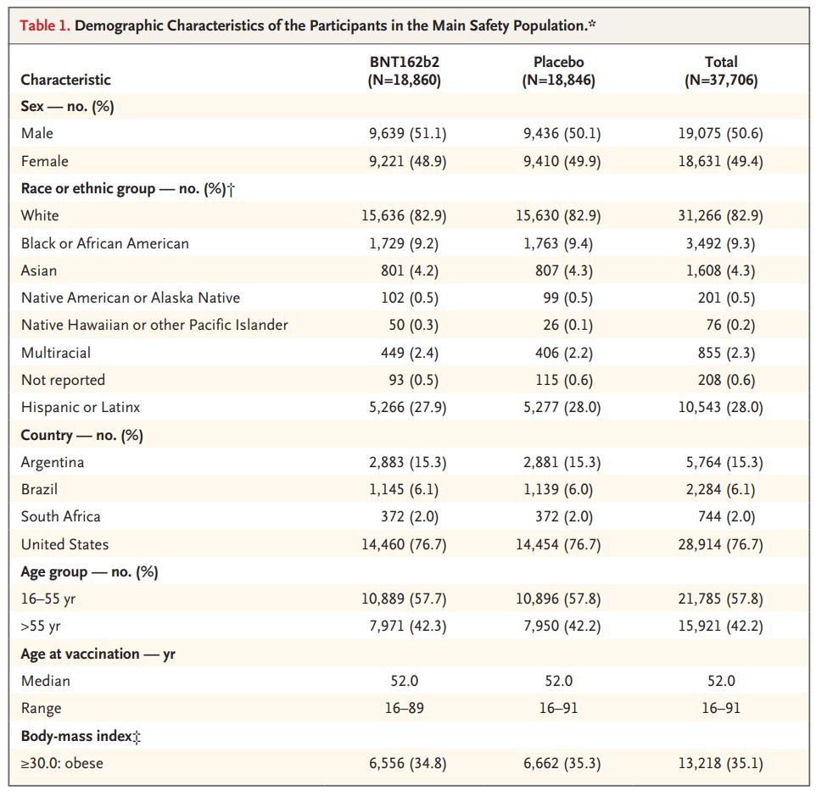
Pfizer
Notes:
Even distribution male/female
83% white
76% in US
Just more than 50% 16-55, median age 52

Slide 16
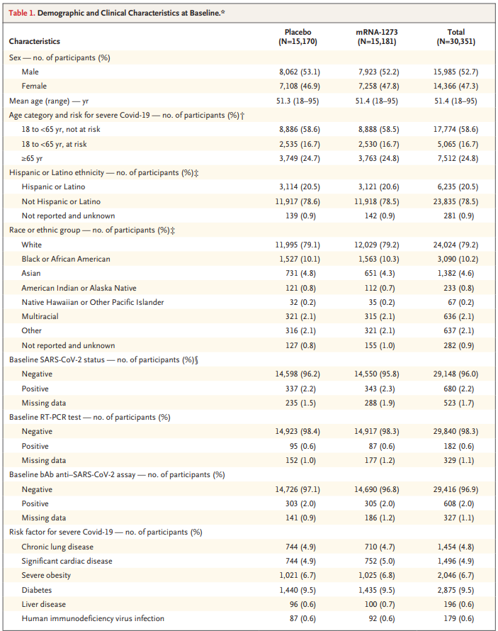
Moderna
Notes:
Equal male/female
Comparable proportion of patients >65
Similar racial distribution
Patients with positive Ab or PCR test excluded from second dose
Conditions putting people at risk for severe disease
Mean BMI 29

Slide 17
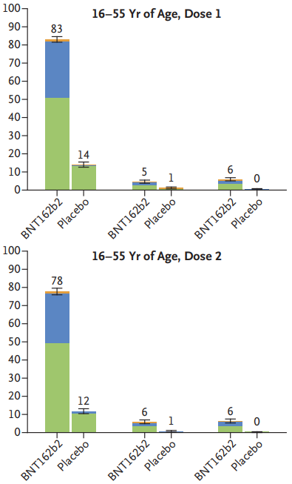
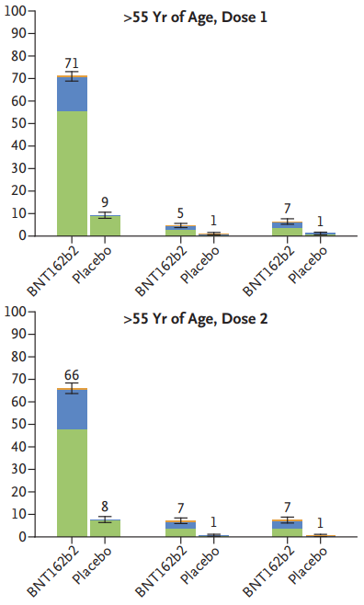

Pfizer
Local reactions within 7 days
Notes:
Data from reactogenicity subset (8183 participants)..
Left: first and second doses aged 16-55, Right: >55
Pain at injection site: Mild: does not interfere with activity, moderate: interferes with activity, severe: prevents daily activity, grade 4: ED visit or hospitalization
Pain reported less frequently in participants >55yo
No increase in injection site reactions after 2nd dose, no grade 4 local reaction
Mostly mild/moderate

Slide 18
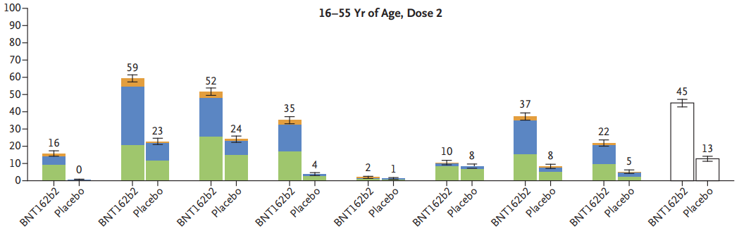
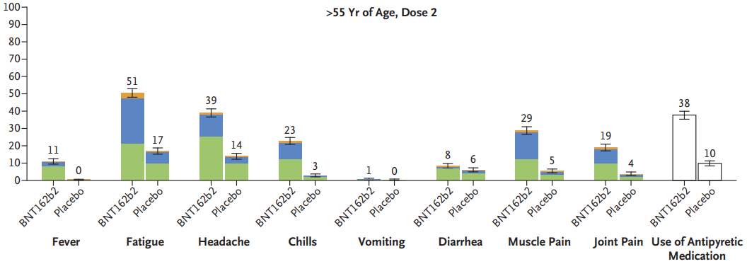
Pfizer Systemic reactions within 7 days
Notes:
Top 16-55, bottom >55, after second dose
Fatigue/HA, muscle/joint pain: Mild: does not interfere with activity, moderate: interferes with activity, severe: prevents daily activity, grade 4: ED visit or hospitalization
More systemic reactions reported in younger cohort, more often after dose 2 than dose 1 (not included in slide)
Most common: fatigue, headache in both groups, but also high placebo report of fatigue and headache
Fever reported 16% younger vs 11% older cohorts
Relatively high use of antipyretic
Adverse events (included all participants, not solicited): 27% vaccine group, 12% placebo – distribution reflective of reactogenicity group

Slide 19
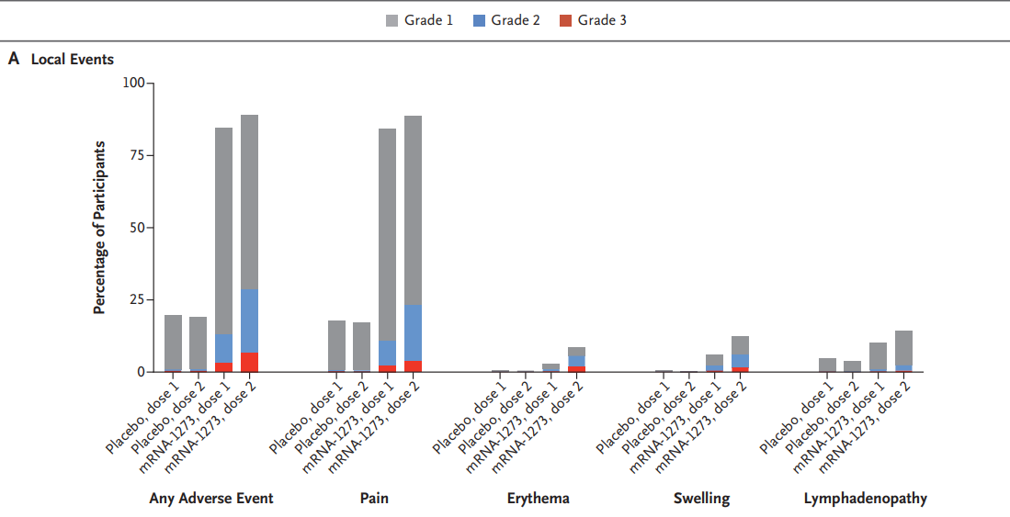
Moderna Local reactions within 7 days
Notes:
No reactogenicity group, this represents all ~30,000 participants – 7 days solicited symptoms, 28 days unsolicited – graphs represent 7 days, but following 28 days had similar distribution.
Pain: Grade 1: does not interfere with activity, Grade 2: interferes with activity or repeated use of OTC pain med, Grade 3: Prevents daily activity or any use of prescription pain med, Grade 4: ED visit or hospitalization
Did not have any grade 4 reactions, mostly grade 1-2

Slide 20
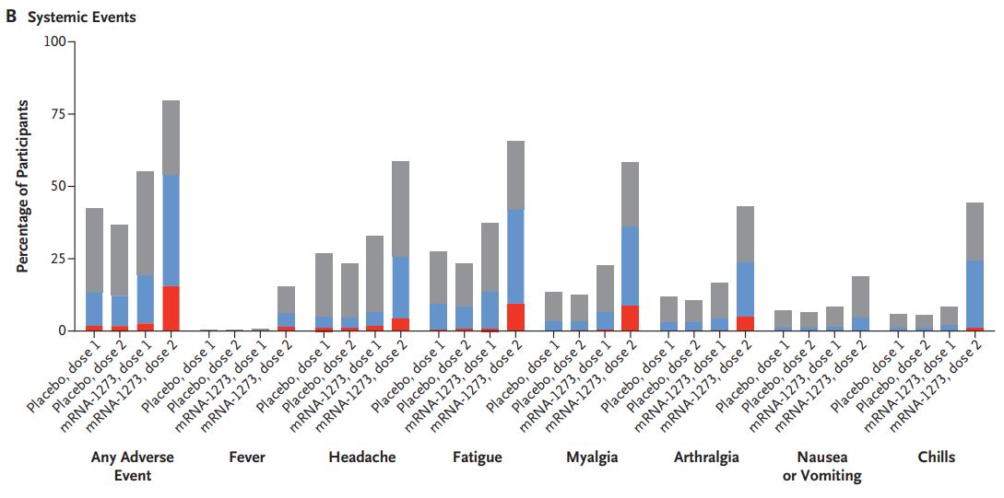

Moderna Systemic reactions within 7 days
Notes:
HA/fatigue, myalgia/arthralgia, chills: Grade 1: no interference with daily activity, Grade 2: some interference, requires OTC pain med, Grade 3: Prevents daily activity or any use of prescription pain med, Grade 4: ED visit or hospitalization
Mostly grade 1-2
Much higher instance of systemic reactions with 2nd dose, with increase in grade 2 events from 16% to 38%
Lasted mean of ~3 days after first and second doses
Both injection site and systemic adverse events more common in younger (18-65) vs older (>65) participants
Adverse events less common in participants who were positive at baseline for SARS-CoV2
0.5% patients in placebo and 0.3% patients in vaccine group had adverse events that resulted in them not receiving the second dose

Slide 21
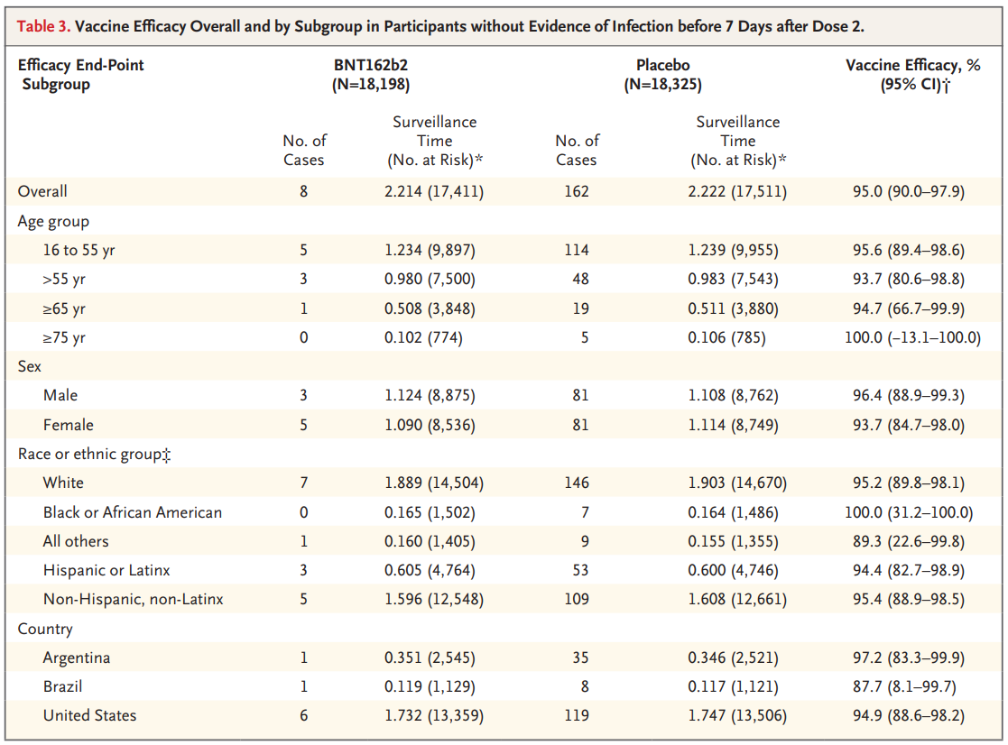
Pfizer Vaccine Efficacy
Notes:
Vaccine efficacy calculated using incidence rate ratio
Overall efficacy 95% in patients without baseline evidence of infection
>65: 7,728, 1 case in vaccination group, 19 cases in placebo group
>75: 1,559, 0 case in vaccination group, 5 in placebo, not statistically significant

Slide 22
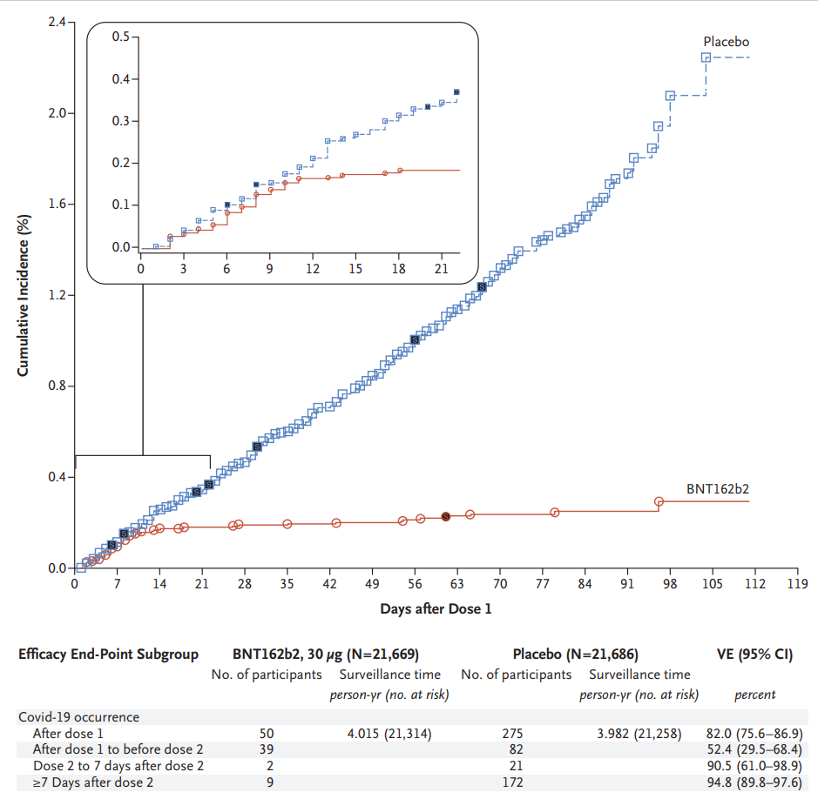
Pfizer Vaccine Efficacy
Notes:
Cumulative incidence plot
Days after 1st dose
Divergence 12 days after dose 1

Slide 23
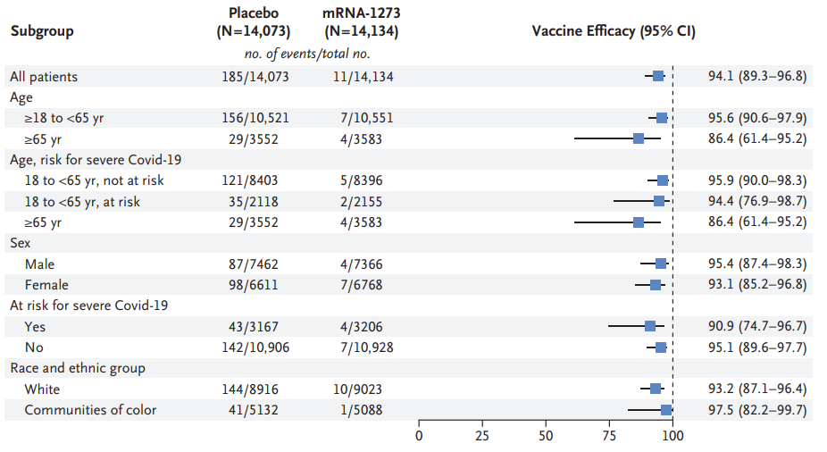
Moderna Vaccine Efficacy By Subgroup
Notes:
- Efficacy calculated using hazard ratio
- Very similar efficacy for patients >65 with wider CI that includes efficacy rate from Pfizer vaccine, did not report >75

Slide 24
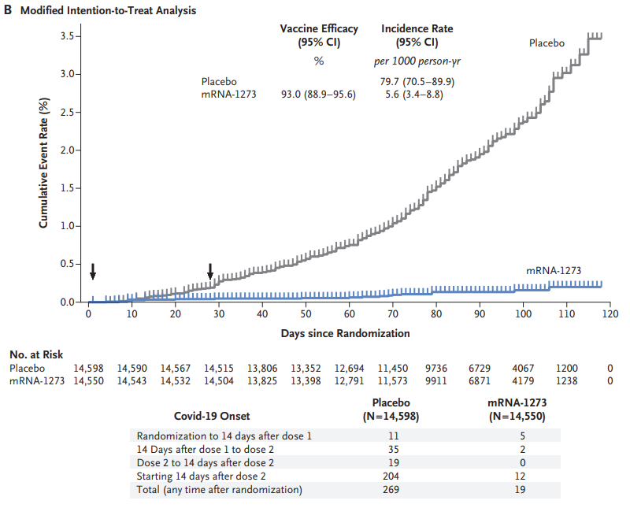
Moderna Vaccine Efficacy Per Protocol
Notes:
Arrows represent injections, does not include asymptomatic patients with positive respiratory swab (as not within their definition of COVID-19)
Similarly, around 15 days after 2nd dose there is divergence between placebo and vaccine groups

Slide 25

Important Takeaway Points
Some efficacy seen after 1st dose
Systemic side effects greater after second dose
Older adults experienced less severe side effects in both trials
Both vaccines appear to be effective at decreasing incidence of severe COVID-19
Notes:
Divergence 12 days after 1st dose of Pfizer, ~14-15 days after 1st dose of Moderna
Unclear if side effect severity is a marker of efficacy or sign of immunoscenescence

Slide 26
Limitations
Neither study powered to detect rare adverse events.
No identified correlate of protection.
No serologic or PCR testing of study participants in Pfizer trial and rare testing in Moderna trial which limits understanding of protection from asymptomatic infection.
Limited data in patients >75 years old due to low infection rates.
Unclear duration of protection.
Notes:
Not large enough to detect less common adverse events reliably.
Unclear duration of efficacy given short follow-up time. Both studies plan to continue for 2 years, but are unblinding participants as they become eligible for vaccines

Slide 27
Our Patient
76-year-old African American male with history of CHF, DM2, alcohol use disorder in remission, current smoker.
Asks about the COVID-19 vaccine: “Should I take it, doc?”

Slide 28
Critical Appraisal
Is this evidence about therapy valid?
  Yes, mostly. Assignment to treatment was randomized, double-blinded, groups were mostly similar demographically. Although groups analyzed by modified intention to treat.
  Average follow-up time was 2 months which may limit understanding of duration of efficacy.
Is this valid evidence about therapy important?
  Yes. Efficacy ~95% in both trials.
  Efficacy of older adults generally preserved, though limited information in patients older than 75.
Notes:
Both trials suggested protection against severe COVID-19 infection.

Slide 29
Critical Appraisal
Can we apply this valid, important evidence about therapy in caring for our patient?
  Vast majority of study participants were white, low case rate in older adult population.
Is the treatment feasible in our setting?
  Yes, mostly. Storage requirements may cause difficulty with distribution. Two-dose requirement also increases risk of non-adherence.
What are our patient’s values and expectations for both the outcome we are trying to prevent and the treatment we are offering?
  Mitigate risk of morbidity and mortality of COVID-19 with low chance of adverse reactions.
Notes:
~3,000 Black/African American patients included in study

Slide 30
Vaccine | Schedule | Efficacy | Storage | Type
Pfizer/BioNTech* | 2 doses, 3 weeks apart | 95% | Freezer only at –94°F (–70°C) | mRNA
Moderna* | 2 doses, 4 weeks apart | 94.5% | 30 days with refrigeration, 6 months at –4°F (–20°C) | mRNA
Oxford/AstraZeneca | 2 doses, 4 weeks apart | 62% to 90%, depending on dosage | Stable in refrigerator for at least 6 months | Viral vector
Johnson & Johnson/BIDMC | 1 dose | Unknown – results expected end of January | Up to two years frozen at –4° F (–20° C), and up to three months refrigerated at 36–46° F (2–8° C) | Viral vector
Novavax | 2 doses, 3 weeks apart | Unknown | Stable in refrigerator | Protein based
Notes:
- Pfizer (94.7% for >65yo)
- Moderna (86.4% for >65yo), though not statistically significantly different

