Slide 1
Geriatric Assessment and
Frailty in Cancer Patients
Hossein Sadrzadeh, MD
The Section of Geriatrics
11/09/2018

Slide 2
My Patient
76 year old male
  Crohn's disease (chronic prednisone 5mg daily)
  Seronegative spondyloarthritis
  Grade I diastolic heart failure
  CKD stage III
  HTN
  HLD
  4.3 cm Aortic Aneurysm
  ADLS :12/12
  IADLS: 10/16

Slide 3
My Patient
Newly diagnosed Stage IIIB RUL SCC
  Detected on CT to monitor aortic aneurysm
Tumor board
Trimodality therapy
(Surgery after completion of definitive chemoRT)

Slide 4

Seriously??
Chemo – Radiation then Surgery ??

Slide 5
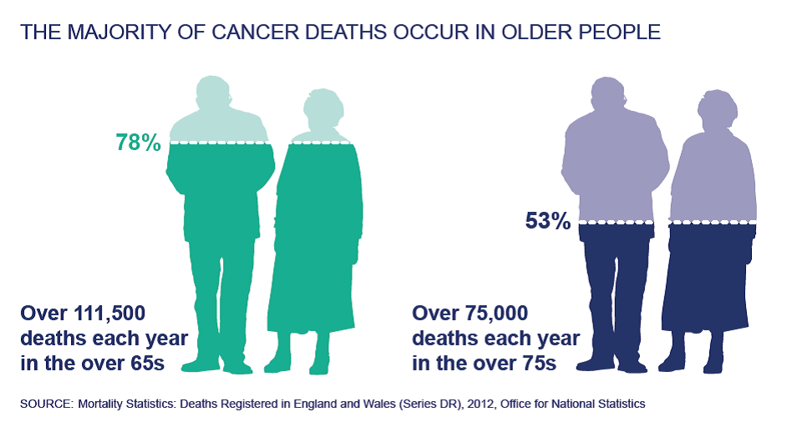
Cancer in older adults
Incidence 11-fold higher
Over 60% of newly diagnosed cancer
Heterogeneous
Medical oncologists often tend to overestimate patients fitness for chemotherapy *

Slide 6
cancer acts differently in older adults
Heterogeneity of health status
Panoply of physiologic changes
Atypical presentations of common illnesses
Increased importance of social support
Increased rate of adverse events to medications or therapies
Goals of therapy
Notes:
It is also necessary to determine how unique geriatric conditions and/or comorbidities may predispose to effects of chemotherapy leading to specific toxicities
it is also critical to determine how the patient's status may be improved, to define what remedial measures might be instituted and to identify appropriate social support arrangements that may improve opportunities for better outcomes
Of even greater significance is the need to identify prognostic factors in the elderly that may be predictive of short-term mortality. Thus, it is important to distinguish between chronologic age, physiologic age and associated geriatric conditions and comorbidities to more effectively decide when and with what to treat older cancer patients.

Slide 7
Need for better risk stratification and treatment selection based on frailty status
Screening for frailties

Slide 8
Frailty
Frailty is a state of extreme vulnerability to stressors that leads to adverse health outcomes
Approximately 10% to 20% of ≥65 years
Incidence doubles in those ages 85 years and older

Slide 9
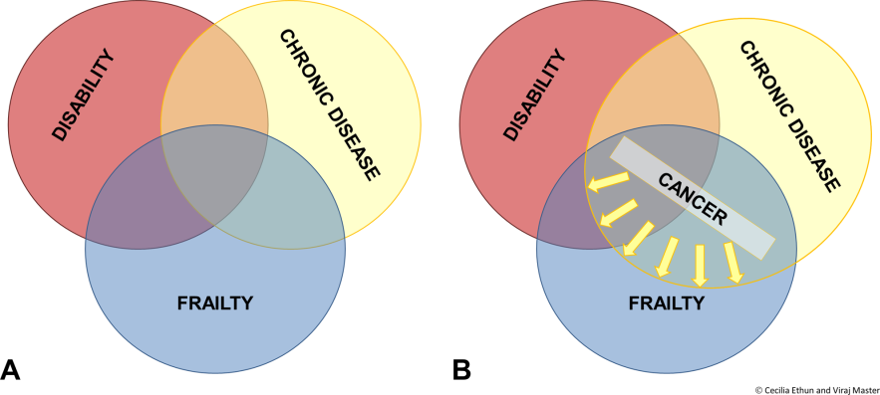
Frailty and cancer: Implications for oncology surgery, medical oncology, and radiation oncology
(A)The Overlapping Existence of Frailty With Disability and Chronic Disease.
(B)When chronic disease includes cancer, patients are at greater risk of having disability and frailty.
Frailty and cancer: Implications for oncology surgery, medical oncology, and radiation oncology, Volume: 67, Issue: 5, Pages: 362-377, First published: 21 July 2017, DOI: (10.3322/caac.21406)
Notes:
The Overlapping Existence of Frailty With Disability and Chronic Disease (A). When chronic disease includes cancer, patients are at greater risk of having disability and frailty (B).
IF THIS IMAGE HAS BEEN PROVIDED BY OR IS OWNED BY A THIRD PARTY, AS INDICATED IN THE CAPTION LINE, THEN FURTHER PERMISSION MAY BE NEEDED BEFORE ANY FURTHER USE. PLEASE CONTACT WILEY'S PERMISSIONS DEPARTMENT ON PERMISSIONS@WILEY.COM OR USE THE RIGHTSLINK SERVICE BY CLICKING ON THE 'REQUEST PERMISSIONS' LINK ACCOMPANYING THIS ARTICLE. WILEY OR AUTHOR OWNED IMAGES MAY BE USED FOR NON-COMMERCIAL PURPOSES, SUBJECT TO PROPER CITATION OF THE ARTICLE, AUTHOR, AND PUBLISHER.

Slide 10
Tools used to identify frailty
The FRAIL Scale
The Vulnerability Elders Survery‐13 (VES‐13)
Phenotypic Frailty
The Frailty Index and the Modified Frailty Index
The Comprehensive Geriatric Assessment
Notes:
F Fatigue (Do you feel tired most or all the time?)
R Resistance (Can you climb 1 flight of stairs without difficulty?)
A Ambulation (Can you walk 1 block without assistance?)
I Illness (Do you have greater than 5 illnesses?)
L Loss of weight (Have you lost > 5% of your usual weight in the last year?)
a Scoring: 0 indicates robust; 1‐2, prefrail; ≥ 3, frail.
Phenotypic Frailty
Shrinking (weight loss) ≥10‐lb weight loss in past y
Weakness Grip strength in lowest 20% based on sex and body mass index
Exhaustion Self‐reported exhaustion, fatigue, and/or loss of motivation
Slow gait speed Time it takes to walk 15 ft at normal speed
Low activity Kilocalories of expenditure based on self‐reported physical activities

Slide 11
lack OF EVIDENCE
Retrospective nature of these studies
Small sample size
Lack of power to determine clinically relevant changes

Slide 12
Commonly uses tools by oncologist
Clinical Judgment
Performance Status (ECOG – Karnofsky)
CARG score Cancer and Aging Research Group
Notes:
0
Fully active, able to carry on all pre-disease performance without restriction
1
Restricted in physically strenuous activity but ambulatory and able to carry out work of a light or sedentary nature, e.g., light house work, office work
2
Ambulatory and capable of all selfcare but unable to carry out any work activities. Up and about more than 50% of waking hours
3
Capable of only limited selfcare, confined to bed or chair more than 50% of waking hours
4
Completely disabled. Cannot carry on any selfcare. Totally confined to bed or chair
5
Dead

Slide 13
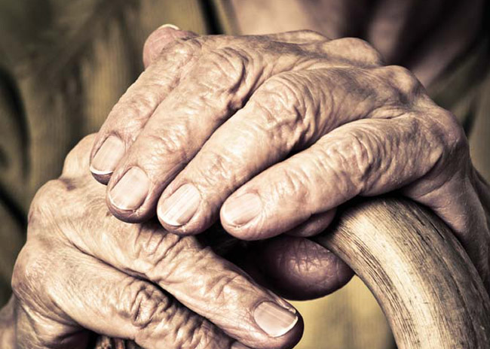
Isn`t he FRAIL?
Would any “FRAILTY TOOL” predict his outcome and help him with decision making?
What “FRAILTY TOOL” to use?

Slide 14
pico
P:
    Older adults with newly diagnosed cancer
I:
    Geriatric Focused Assessment to aidentify FRAILTY
C:
    Current commonly used means of assessment tools such as clinical judgment , ECOG or Karnofsky PS
O:
    Better mortality and morbidity outcome

Slide 15


Slide 16
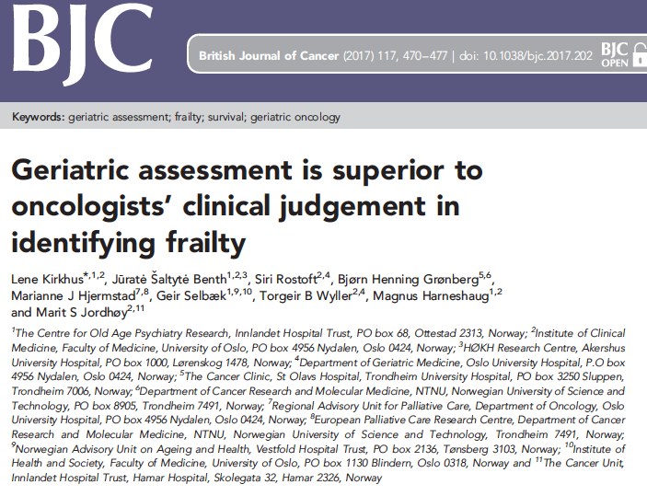

Slide 17
Study
Prognosis Research ??
A prospective cohort study
307 patients ≥ 70 years with a histologically confirmed solid tumor
Consecutively recruited at eight different outpatient onc clinics
Norwegian hospital system
Published in BJC in 2017

Slide 18
Study goals
Compare oncologists` classification of frailty with a systematic modified geriatric assessment (mGA) of frailty
Describe what information oncologists emphasize when rating frailty
Investigate the associations of these frailty classifications with overall survival (OS)

Slide 19
Geriatric assessment
  Diagnostic and treatment process that identified medical, psychosocial, functional limitations of older frail adults
  Goal is to create a comprehensive and coordinated treatment plan for a frail adult
  Identifies a variety of treatable health problems and lead to better health outcomes
Notes:
GA can reveal/detect previously unknown and potentially reversible geriatric problems not found by routine oncology care
GA can predict toxicity/adverse effects from cancer treatment or decrease in QOL, enabling more targeted use of preventive measures
GA has important prognostic information that can be helpful in estimating life expectancy, which is of paramount importance when making treatment decisions
GA can influence/improve treatment decisions
GA allows targeted interventions, which can improve QOL and compliance with therapy

Slide 20
domains
  Core components:
      Functional capacity
      Fall risk
      Cognition
      Mood
      Polypharmacy
      Social support
      Financial concerns
      Goals of care
      Advance care preferences

Slide 21
STUDY POPULATION
≥70 years with a histologically confirmed solid tumor
  Newly diagnosed or first relapse after previous curative treatment

Slide 22
methods
January 2013 to April 2015
By referral
Baseline interviews and mGA-testing done by Oncology nurses with specific training
Baseline clinical data
Modified GA (Not performed by geriatric team)

Slide 23
Modified GA
Nutrition
Patient-Generated Subjective Global Assessment (PG-SGA)
Medication
Anatomical Therapeutic Chemical Classification System
Physical function
Timed Up and Go test
Cognition
Norwegian Revised Mini Mental State Examination (MMSE-NR)
Falls
Comorbidity
Older Americans’ Resources and Services Questionnaire (OARS)
ADLs
q 5 - EORTC QLQ C30
Depression
GDS-15
Last 6 months
Notes:
The PG-SGA includes two parts. One is a patient questionnaire about weight loss and nutritional symptoms, whereas the other is filled in by health professionals and includes a categorization of a patient’s overall nutritional status into (A) well-nourished, (B) moderately malnourished/suspected malnutrition and (C) severely malnourished.
The Physical Health Section of OARS consists of a list of 15 diseases/conditions as well as a grading of how these conditions affect daily activities.
FALLS: unintentional events resulting in a laying position on the floor, the ground or other lower level, and the number of falls the last 6 months was registered.
EORTC QLQ: European Organisation for Research and Treatment of Cancer Quality of Life Core Questionnaire : ‘Not at all’, ‘A little’, ‘Quite a bit’ and ‘Very much’.
integrated system for assessing the health- related quality of life (QoL) of cancer patients participating in international clinical trials.
MMSE-NR consists of 20 items and the total score ranges from 0 to 30

Slide 24
Oncologist
Fit
Intermediate
Frail
Fit
Frail

Slide 25


Slide 26
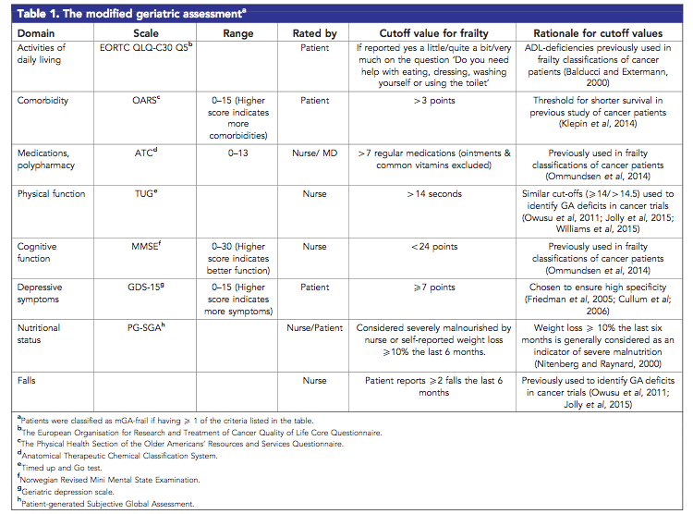

Slide 27
Methods
Survival time Time from inclusion until death or the last observation date
Treatment
  1) Curative treatment
  2) Palliative chemotherapy
  3) Other palliative systemic cancer treatment
  4) Non-systemic palliative treatment the first two months after inclusion

Slide 28
Methods
Cox regression
Multiple Cox regression
  Adjusted for
    Sex
    Age
    Cancer type
    PS
    Stage
    Treatment
Kaplan–Meier

Slide 29
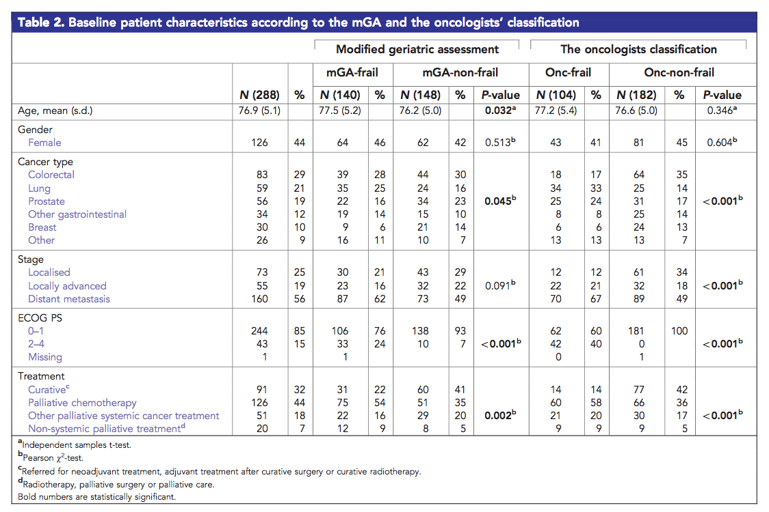
Results
15 Frail (14 had poor PS)
89 intermediate
68% Palliative care
Almost all patients lived at home (n.275, 96%)

Slide 30
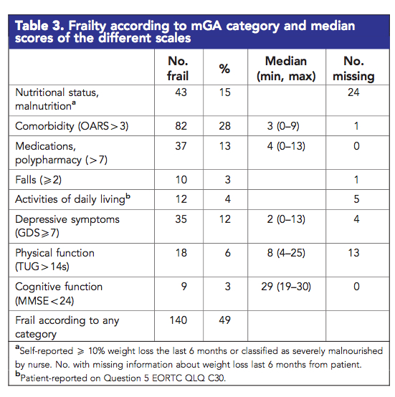
Results
67 (23%)
mGA-frail but onc fit
Most
common
The kappa statistic
0.30 (95% CI 0.19; 0.41)
Notes:
Cohen's Kappa : measures inter-rater agreement for qualitative (categorical) items.
indicating only fair agreement between the oncologists’ clinical judgment and the mGA.

Slide 31
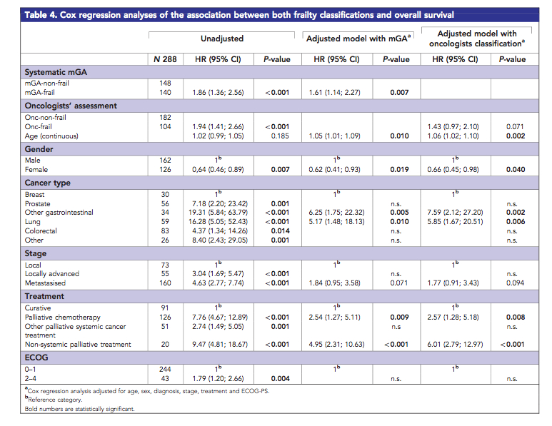
Results
Notes:
- Median OS : mGA- frail: 15.0 months, mGA-non-frail: 29.1 months ---- onc- frail: 12.9 months, onc-non-frail: 27.4 months
-mGA-frail and onc-frail were both significantly negatively associated with OS
-Adjusting for age, sex, cancer type, PS, stage and treatment, only mGA frailty was an independent negative prognostic factor for OS with a HR of 1.61 (95% CI 1.14; 2.27) (P 1⁄4 0.007).

Slide 32
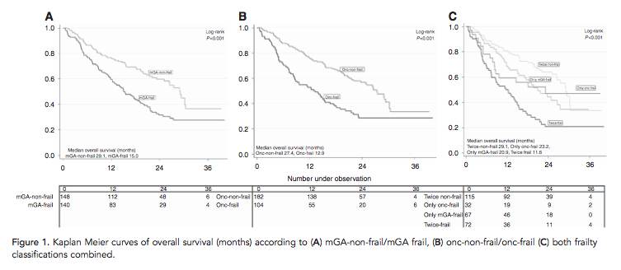
Results
Notes:
Frail according to both assessments,
non- frail according to both assessments,
frail according to only the mGA,
frail only according to our onc-frail definition

Slide 33
Only fair agreement between frailty classified
Oncologists missed almost half of the mGA frail patients
Suggests that oncologists emphasize more on cancer-related factors
Only mGA was an independent negative prognostic factor for OS
Notes:
Median OS was 21.5 months, 93 (32%) patients died within their first year of follow-up.

Slide 34
Does the study address a clear question?
Patients
Disease/Condition
Outcome

Slide 35
Study Validity
Was a defined, representative sample of patients assembled at a common (usually early) point in the course of their disease?
Was the follow-up of these patients sufficiently long and complete?
Were objective and unbiased outcome criteria used?
Blinded – [ Selection , Interviewer, recall biases ]
Was there adjustment for important prognostic factors?

Slide 36
Results
How likely are the outcome event(s) over a specified
period of time?
How precise are the estimates of this likelihood?
confidence intervals

Slide 37
Implications for patient care
Were the study patients similar to my patient?
Will the results lead directly to selecting or avoiding
a treatment?
Are the results useful for reassuring or counseling my patient?

Slide 38
Study validity
Was there an independent, blind comparison with a reference standard?
Did the patient sample include an appropriate spectrum of patients to whom the diagnostic test will be applied in clinical practice?
Did the results of the test being evaluated influence the decision to perform the reference standard?
Were the methods for performing the test described in sufficient detail to permit replication?

Slide 39
Results
Are likelihood ratios for the test results presented or data necessary for their calculation provided?

Slide 40
Implications for patient care
Will the reproducibility of the test result and its interpretation be satisfactory in my setting?
Are the results applicable to my patient?
Will the results change my management?
Will patients be better off as a a result of the test?

Slide 41
strengths
Multicenter
Heterogeneous ??
Large population
Prospective - Blinded

Slide 42
Limitations
No standard frailty index
Tools used
28 Oncologists with varied experience

