Slide 1
LET SLEEPING DOGS LIE?
Warren Backman MBBS
Fellow in Geriatric Medicine
Notes:
duhfwehfwe

Slide 2


THE CLINICAL CASE
77yo
Old left stroke, A Fib, HTN, CAD, moderate dementia
Walks with cane
Right carotid bruit; duplex showed 70% stenosis.
Left has CTO.
ASPIRIN
WARFARIN
ATORVASTATIN
LISINOPRIL
METOPROLOL
…
Notes:
dnfo isf

Slide 3
GIVEN ASYMPTOMATIC, SHOULD CAROTID ENDARTERECTOMY (CEA) BE CONSIDERED?

Slide 5
THE EXPERIMENTAL QUESTION (PICO)
Population
Intervention
Comparison
Outcome

Slide 6






THE ACST-1 TRIAL
Asymptomatic Carotid Surgery Trial
Randomized trial, 126 centers in 30 countries
3120 participants
Immediate vs deferred CEA
Median follow up 9 years

Slide 7
Who is asymptomatic (for purpose of trial)
Had an ipsilateral ischemic stroke 9 months ago, has residual hemiparesis since then
Had an ipsilateral ischemic stroke 5 months ago, but has no residual neuro deficits
No history of clinical stroke but ipsilateral brain infarct seen on imaging, unclear when it happened

Slide 8
Who is asymptomatic (for purpose of trial)
Had an ipsilateral ischemic stroke 9 months ago, has residual hemiparesis since then
Had an ipsilateral ischemic stroke 5 months ago, but has no residual neuro deficits
No history of clinical stroke but ipsilateral brain infarct seen on imaging, unclear when it happened

Slide 9
Eligibility
Unilateral or bilateral stenosis. The severity of stenosis was not defined.
No symptoms in past 6 months. Can have residual neurologic signs from prior stroke.
3) No hx of ‘ipsilateral disabling’ or ‘severe contralateral’ stroke
4) Substantial uncertainty

Slide 10
POPULATION – OTHER EXCLUSION CRITERIA
Smooth calcified plaque, no significant stenosis
Recent MI
Life threatening disease (not stroke)
Restenosis after previous CEA
Cardiac source of likely emboli
Intracerebral neoplasia or aneurysm

Slide 11
INTERVENTION AND COMPARISON
‘Immediate’ CEA
vs
Deferred CEA

Slide 12
OUTCOME
Perioperative mortality/morbidity (death or stroke within 30 days)
Non-perioperative stroke
Disability free survival
Notes:
Inability or severe difficulty performing 1 of the 6 Katz ADLs
Deficit must persist in the same ADL for 6 months
OR
Admission to nursing home

Slide 13
PARTICIPANTS BY AGE (n=1560 each group)

Slide 14
ALLOCATED
AND ACTUAL USE OF CEA
Any CEA (immediate group)
Any CEA (deferred group)
CEA for symptoms (deferred group)

Slide 15
RESULTS: PRIMARY OUTCOMES

Slide 16
RESULTS: PRIMARY OUTCOMES

Slide 18


Slide 20
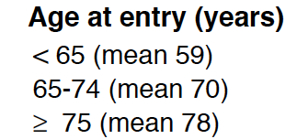
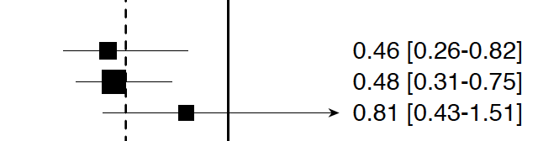
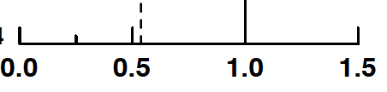
Effect of age on non-perioperative stroke

Slide 21
TRIAL VALIDITY
Randomization? | Yes – minimized approach
Blinded? | No
All accounted for? | Intention to treat
Both group similar at baseline? | Yes
Majority followed up? | Not traced last 2 yrs: 90 vs 105
NNT (prevent 1 stroke) | 20 (15 if correcting for noncompliance)

Slide 22
TRIAL CAVEATS
Most nowadays take statin
3% perioperative risk of stroke/death
Takes appx 2 years before benefits outweigh risks
Surgery less safe outside trial setting?
Ethnic differences?

Slide 23
THE CLINICAL CASE
77yo
Old left stroke, A Fib, HTN, CAD, moderate dementia
Walks with cane
Right carotid bruit; duplex showed 70% stenosis.
Left has CTO.
ASPIRIN
WARFARIN
ATORVASTATIN
LISINOPRIL
METOPROLOL
…
Notes:
dnfo isf

Slide 24
CONCLUSION
Notes:
This large, randomized, double blinded trial of relatively healthy, fully independent, predominantly white Australians, showed no beneficial effect of aspirin 100mg on disability free survival over 5 years.

Slide 25

Questions?

Slide 29
Other clinical trials of asymptomatic CEA
Mayo Clinic Trial (MACE) – aspirin vs surgery – terminated after only 71 patient entered due to excess MI in surgical group
CASANOVA: stopped early. 122 surgery vs 111 medical available for comparison. Only about 10% in each group reached an endpoint. Not enough power.
The VA trial. Men only. 444 patients. Surgery halved rate of stroke or TIA (13% vs 25%) but not enough power to determine just stroke
ACAS – 1662 pts, ipsilateral stroke 2% per annum vs 1% per annum, median follow up 2.7 yrs

