Slide 1

Grand Rounds: Journal club
Vivian chan, MD, Geriatrics fellow

Slide 2

Case:
78 year old gentleman with PMH of HTN, knee osteoarthritis, DM 2, hearing loss, depression
CC: Memory loss
Social history: He moved from Cape Verdi to Boston 2 years ago and currently lives with his daughter
Goes to Cape Verdean Adult day center 3 times a week
Independent for all ADLs
Needs assistance with medication, preparing meals and finance.
Dependent on groceries
RUDAS: 13/30
Diagnosis: Dementia, likely Alzheimer’s type
Notes:
Cut off: < 22/30

Slide 3


What matters to him?
Does a particular anti-dementia medication prevent him from going to the nursing home?
He wishes never to live in a nursing home
Her daughter has heard of a few different anti-dementia medications and would like his father to try.
Notes:
His daughter then asked me a question that made me ponder. She asked

Slide 4
PICO:
P - Older adults with Alzheimer’s Disease
I – Donepezil
C – Memantine
O - Nursing home long term admission

Slide 5
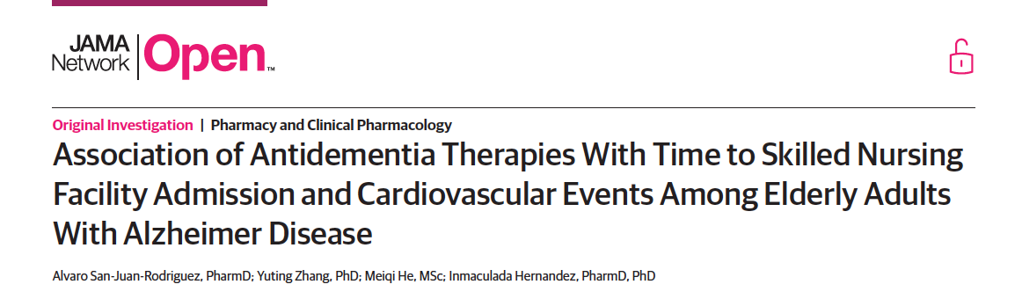
Retrospective cohort study
Published March 1st, 2019
Notes:
Retrospective cohort study

Slide 6
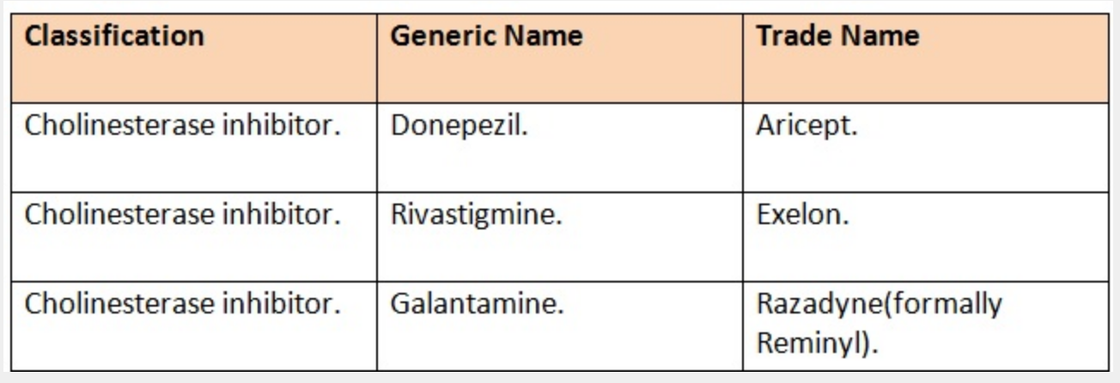
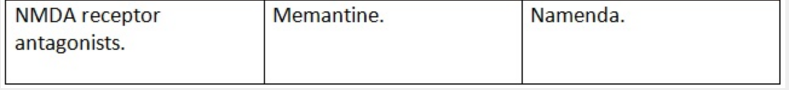
Anti-dementia medications

Slide 7
Methods
Used claims data through period of January 1, 2007, to December 31, 2013 from a 5% random sample of Medicare beneficiaries
Inclusions
Exclusions
A new diagnosis of Alzheimer's disease (AD)
Used CMS Chronic Conditions Data Warehouse definition of AD of ICD9 331.0.
Patients with prescriptions filled for antidementia drugs.
Patients that did not fill prescription
Those who filled 2 different AChEIs on the day of therapy initiation

Slide 8
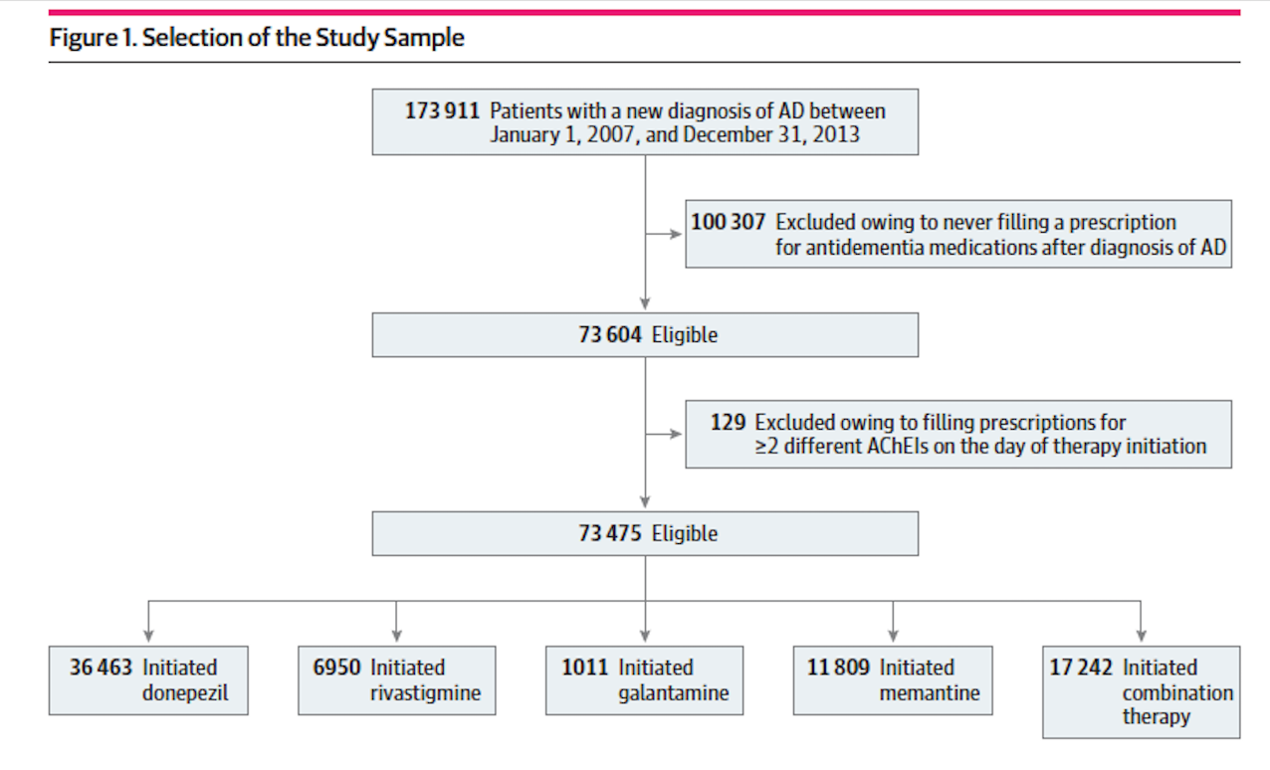
Methods:
Notes:
They found 173 911 patients with new diagnosis of Alzheimer Disease the study period
Then they collected prescriptions filled with anti-dementia drugs between the day of 1st AD diagnosis and the end of the study period
Excluded patients that did not fill prescription
Those who filled 2 different AChEIs on the day of therapy initiation were excluded.
Combined therapy – used prescription fill dates & days of supply, calculated the concurrent therapy.

Slide 9
Methods:
All patients were followed up until the first of:
  Switch to a different treatment
  Discontinuation of treatment (no medication supply for > 60 days)
  Death
  End of study period
Statistics
Hazard Ratios: the chance of an event occurring in the treatment arm divided by the chance of the event occurring in the control arm
Cox proportional hazards regression models: to compare across each treatment groups
Notes:
This study followed the Strengthening the Reporting of Observational Studies in Epidemiology (STROBE) reporting guideline for cohort studies.

Slide 10

Outcome:
Primary outcome: Time to Senior Nursing Facility admission
  Using short stay/long stay/SNF variable captured in the Medicare Provider Analysis and Review data file

Slide 11
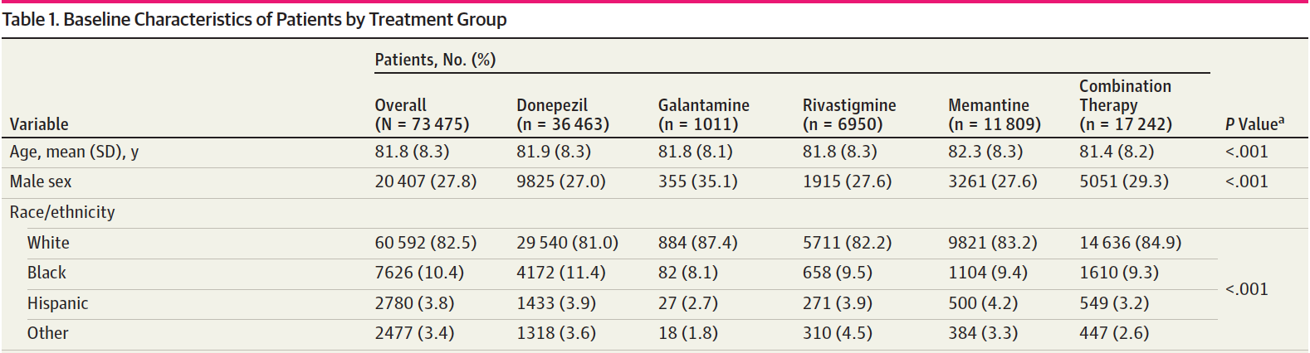
Baseline characteristics
Notes:
In general: average age was 81, roughly 28% male sex, predominately cacausians

Slide 12
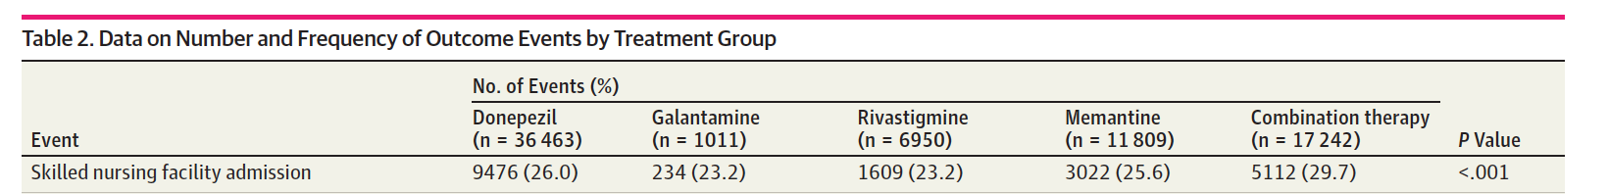
Results
Notes:
Raw data regarding number of nursing home admission during the study period:

Slide 13
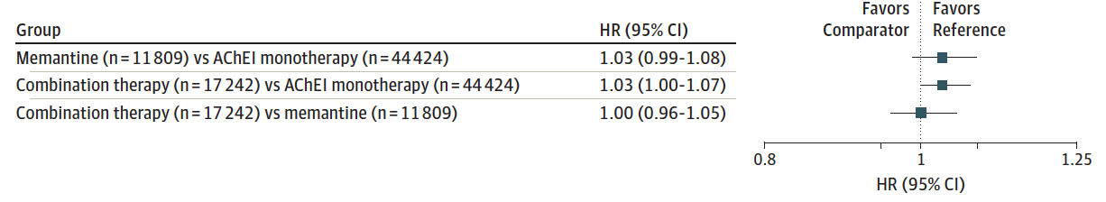
Results: Adjusted hazard ratios (Fig 2)
Notes:
Compared hazard ratios across the different drug classes (AChEI, mementine and combo therapy)
All crosses 1 = therefore, time to SNF admission did not different between the treatment groups.
Hazard Ratios: the chance of an event occurring in the treatment arm divided by the chance of the event occurring in the control arm, or vice versa, of a study
Comparator group is the 1st item and the reference group is the 2nd item
Adjusted HRs obtained from Cox proportional hazards regression models that controlled for age, sex, race/ethnicity, disability, history of acute MI, history of bradycardia, history of syncope, history of AV block, history of QT prolongation, history of VT and each of 25 center for Medicare and Medicaid services priority conditions

Slide 14
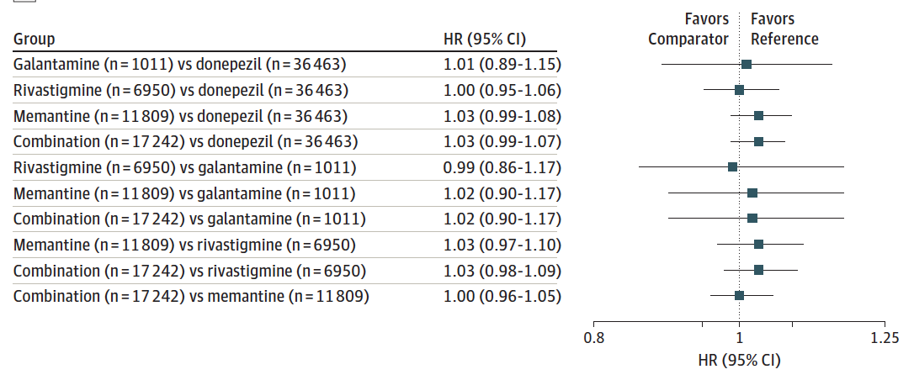
Results: Adjusted hazard Ratios by Treatment groups (Fig 3)
Notes:
Figure 3: looked more in depth in comparing hazard ratios across the each individual drug
All crosses 1 → no difference

Slide 15
Results
Overall, time to SNF admission DID NOT differ between treatment groups whether comparing across the different drug class or individual medications

Slide 16
Clinical appraisal:
Was a defined, representative sample of patients assembled at a common point in the course of their disease?
  Sample of patients are all newly diagnosed at the enrollment of the study
  However, no cognitive, functional or neuropsychological assessment results → Selection bias
  Also DID NOT capture severity of dementia
  Also, they did not restrict the number of days between diagnosis of AD and first anti-dementia medication prescription → selection bias
Notes:
Sample of patients are all newly diagnosed at the enrollment of the study
However, no cognitive, functional or neuropsychological assessment results → Selection bias
Also DID NOT capture the severity of dementia
With dementia, it is hard to determine if they are in the same course of their disease
Also, they did not restrict the number of days between diagnosis of AD and first anti-dementia medication prescription → selection bias

Slide 17
Clinical appraisal:
Was follow-up of study patients sufficiently long and complete?
  Criteria for follow up was until discontinuation of treatment, switch of treatment, death or end of study period
  However, the mean (SD) follow-up period was limited (1.5 [1.2] years)
  Heterogeneity of dementia makes it difficult to predict
Were there adjustment for important prognostic factors?
  Yes, results are adjusted for age, sex, race/ethnicity, disability, history of acute MI, history of different arrhythmias and each of 25 center for Medicare and Medicaid services priority condition
Notes:
Was follow-up of study patients sufficiently long and complete?
Criteria for follow up was until discontinuation of treatment, switch of treatment, death or end of study period
However, the mean (SD) follow-up period was limited (1.5 [1.2] years)
Heterogeneity of dementia makes it difficult to predict how long follow up should be
Were there adjustment for important prognostic factors?
Yes, results are adjusted for age, sex, race/ethnicity, disability, history of acute MI, history of different arrhythmias and each of 25 center for Medicare and Medicaid services priority condition

Slide 18
Clinical appraisal:
Were outcome criteria objective?
  Using short stay/long stay/SNF variable captured in the Medicare Provider Analysis and Review data file
  Reason of nursing home admission not capture
How likely are the outcomes over time?
  Clinically from my experience, very high chance
How precise are the prognostic estimates?
  Confidence interval is 95%
Notes:
Does that mean it also capture SHORT term stay? My understanding is that any patient that walk to the door of the nursing home is accounted for whether it is short or long term stay
Back in 2006 – 2013, are there different of nursing home admission criteria? Dr Caruso

Slide 19

Clinical appraisal:
STRENGTHs:
Limitations:
  Large numbers patients
  Verified dementia, prescriptions as best as they could
  Good method of gathering a large amount of patient data
  Good capture of nursing home admissions
  No cognitive, functional or neuropsychological assessment results
  Follow up period was limited (1.5 years)
  Should have compared to patients that were NOT on Anti-dementia medications
  Did not include reason or duration for nursing home admission
Potential conflicts:
Funded by grants from Alzheimer’s Association and National Heart, Lung and Blood Institute
One of the authors was receiving personal fees from Pfizer outside the submitted work
Notes:
Strength:
It is a strong study as it had a large numbers patients
Verified dementia, prescriptions as best as they could
Good method of gathering a large amount of patient data
Good capture of nursing home admissions

Slide 20
Clinical appraisal:
Can we apply this valid, important evidence about prognosis to our patient?
  In general yes!
  However, it does not specify severity of dementia, cognitive testing results and functional abilities
  Data limited but for a epidemiology study this is what we have so far
Notes:
In general yes! Looking at the baseline characteristics: average age 80, 27% male, similar to our patient.

Slide 21
Discussion with patient
  In summary, the data we have and from what we know, anti-dementia medication does not prevent nursing home in 1 year
  Since there is no difference in the different medication, Started on Donepezil
  There are now many support systems and community resources that are trying to keep patients’ with dementia out of nursing homes

Slide 22
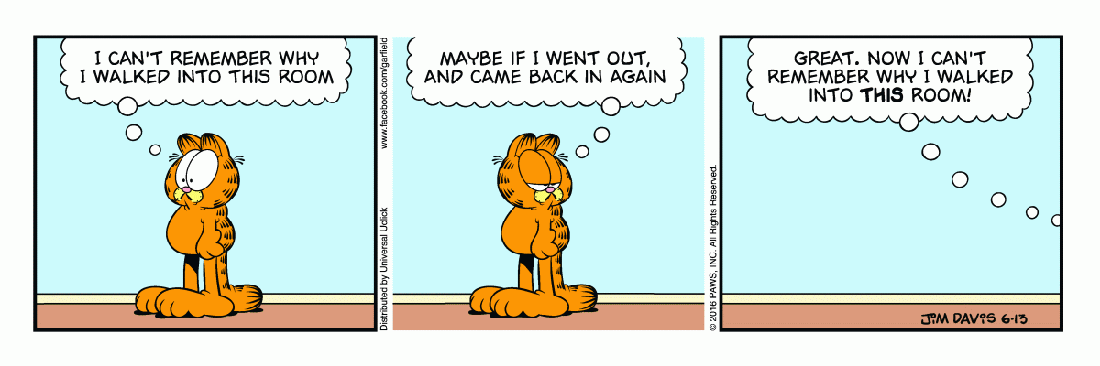
Questions??

Slide 23
