Slide 1
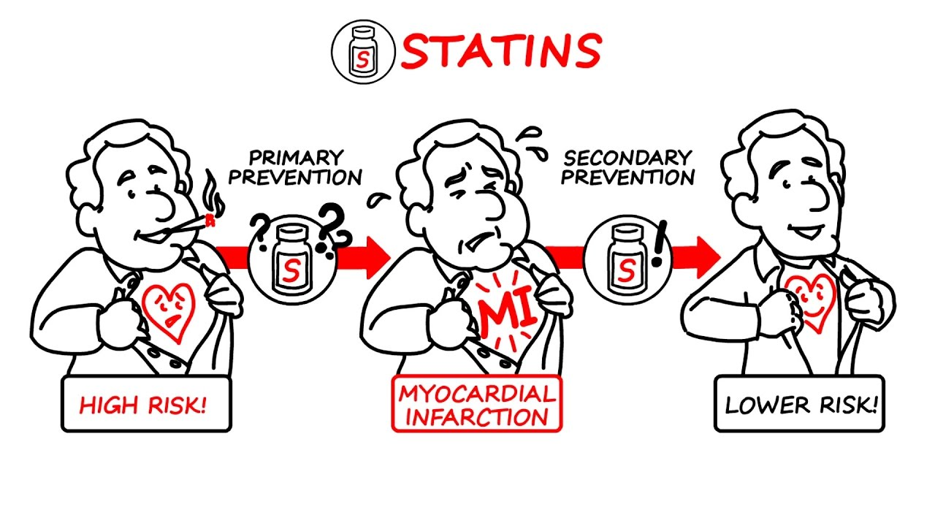
Journal Club
Vivian Chan, MD
Geriatrics Fellow

Slide 2
Objectives:
To discuss statin use in the elderly
To analysis this article
To apply outcomes from article to our patient

Slide 3

Case: 78 y/o Chinese female
PMH:
Type 2 Diabetes
HTN
HLD
Paroxysmal atrial fibrillation
Osteoarthritis
history of TIA without residual weakness 10 years ago
Medications
Tylenol PRN
Amiodarone
Amlodipine
Atorvastatin
Colace
Vitamin B12
Vitamin D supplement
Losartan
Metformin
Metoprolol
Miralax
Xarelto
Social history
Husband passed away 3 months ago, lives alone
Children lives out of state
Independent of all ADL and iADLs
Uses a cane to walk
Notes:
She is complaining that she is on many medications every day.

Slide 4
PICO
P: Older adults age 78 with Diabetes type 2 and history of TIA
I: Statin therapy
C: No medication
O: Preventing stroke

Slide 5
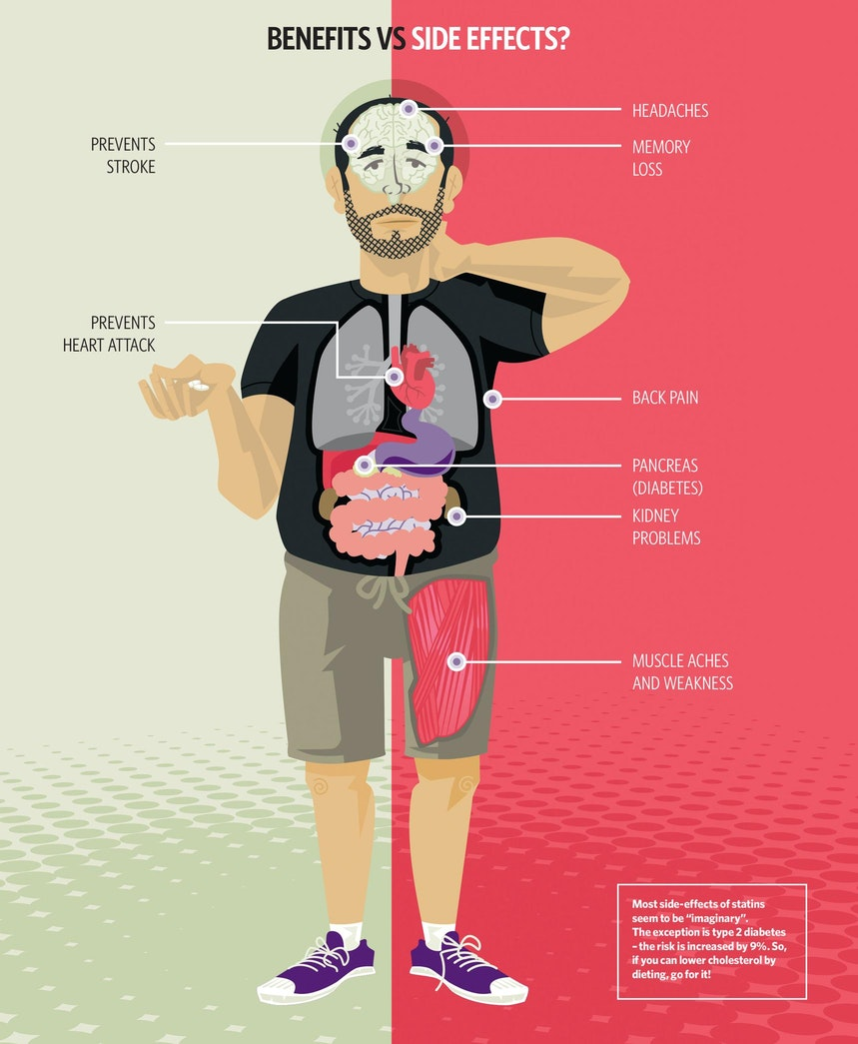
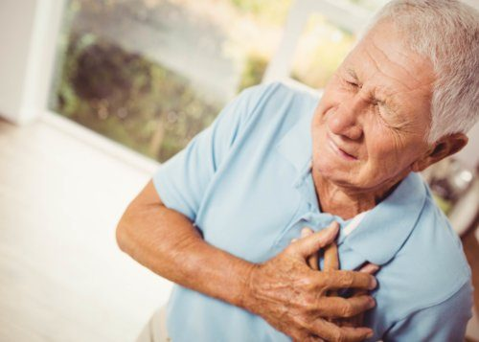
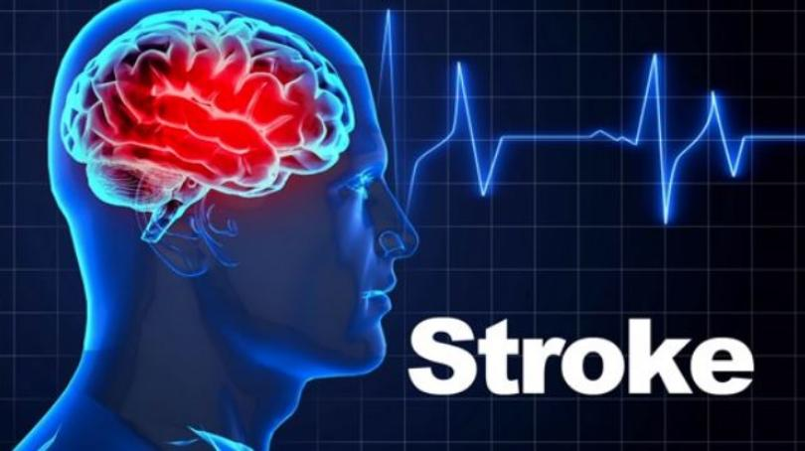
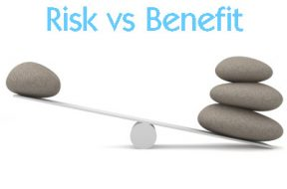
Statin therapy
Many research included subjects up to 75 years but does not specifically focus on patients > age 75. There remains uncertainty about statin efficacy and safety among older people.
Notes:
As we all know, statin therapy has been shown to prevent cardiovascular disease in most population. Most studies include subjects up to 75 years but does not specifically focus on patients > 75.
There remains uncertainty about statin efficacy and safely among older people. It is controversial whether to prescribe or continue statin in old patients. As you can see, statin has its benefits but also has a lot of side effects especially memory loss, muscle aches and falls in the elderly. Many statin therapy is often discontinued in older patients in part due to its question around risk & benefit.

Slide 6
ACC/AHA guideline 2018: Secondary prevention

Slide 7
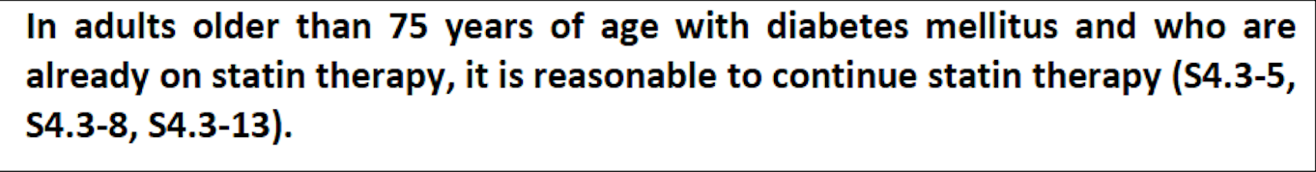
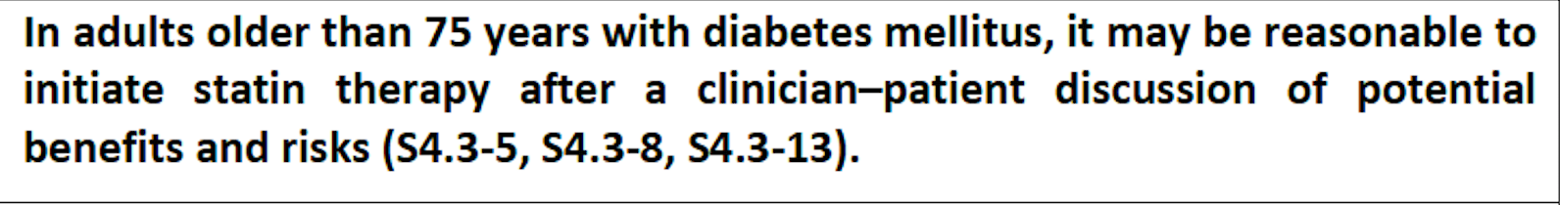
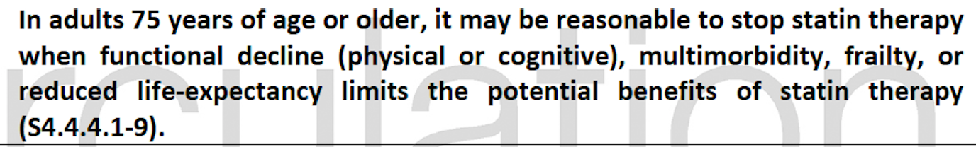
ACC/AHA Guidelines 2018: Diabetes

Slide 8
2019 ACC/AHA Guideline on the Primary Prevention of Cardiovascular Disease
For patients aged >75 years, assessment of risk status and a clinician-patient risk discussion are needed to decide whether to continue or initiate statin treatment.
Notes:
Although the guidelines leans towards continuing statin, I want to know how much statin can prevent MI, strokes in the elderly. So I found this paper.

Slide 9
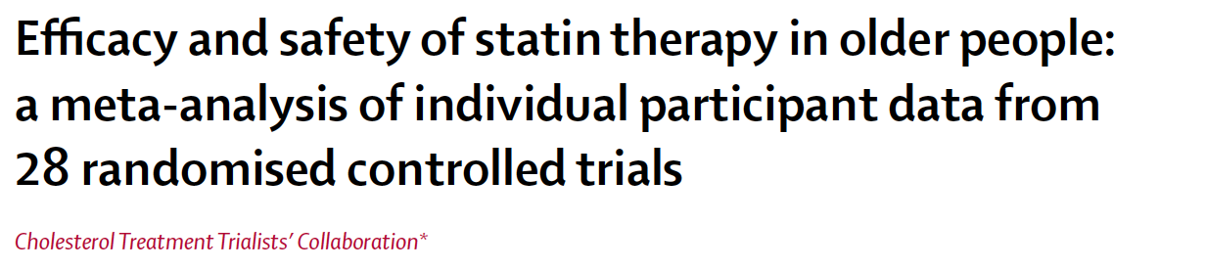
Published in Lancet on February 2019
Conducted by the Cholesterol Treatment Trialists’ Collaboration
  a group that includes the principle authors of nearly all of the major statin trials, which allowed the study group access to individual data in each study
Notes:
Cholesterol treatment Trialist’s collaboration which is a group that includes the principle authors of all the major statin trials, which allowed the study group access to individual data in each study. Funded by Australian national health, UK medical research council and British heart foundation.

Slide 10
Methods
Analyzed individual-participant data from 28 large randomized statin trials
  14,500 of about 187,000 total participants were > age 75
Median treatment duration was 5 years
Aim is to compare the effects of statin therapy at different ages and explore the effects of statin therapy among older individuals.
Notes:
Some studies looked at statin vs placebo / usual care while some trials looked at a higher intensity statin compared to a standard statin.
The median treatment duration was 5 years.

Slide 11
Outcomes
The estimated effects on:
  major cardiovascular events (CVEs) (major coronary events, strokes, and coronary revascularizations)
Reported as the rate ratio per 1.0 mmol/L reduction (about 40 mg/dl) in low-density lipoprotein cholesterol (LDL-C)
Notes:
So, the outcomes that they looked at which we will focus today is the major cardiovascular events
All outcomes were reported as the rate ratio per 1.0 mmol/L reduction (about 40 mg/dl) in LDL.

Slide 12
Statistics
They used log-rank statistics
  To establish the efficacy of a new treatment in comparison with a control treatment when the measurement is the time to event (such as the time from initial treatment to a heart attack)
Rate ratio (risk ratio):
  If the rate ratio is 1,it suggests no difference
  A rate ratio > 1 suggests an increased rate of that outcome in the exposed group.
  A rate ratio < 1 suggests a reduced rate in the exposed group
Notes:
They used log-rank statistics to establish the efficacy of a new treatment in comparison with a control treatment when the measurement is the time to event (such as the time from initial treatment to a heart attack). They mainly looked at rate ratio (commonly known as risk ratio):
If the rate ratio is 1,it suggests no difference
A rate ratio > 1 suggests an increased rate of that outcome in the exposed group.
A rate ratio < 1 suggests a reduced rate in the exposed group

Slide 13
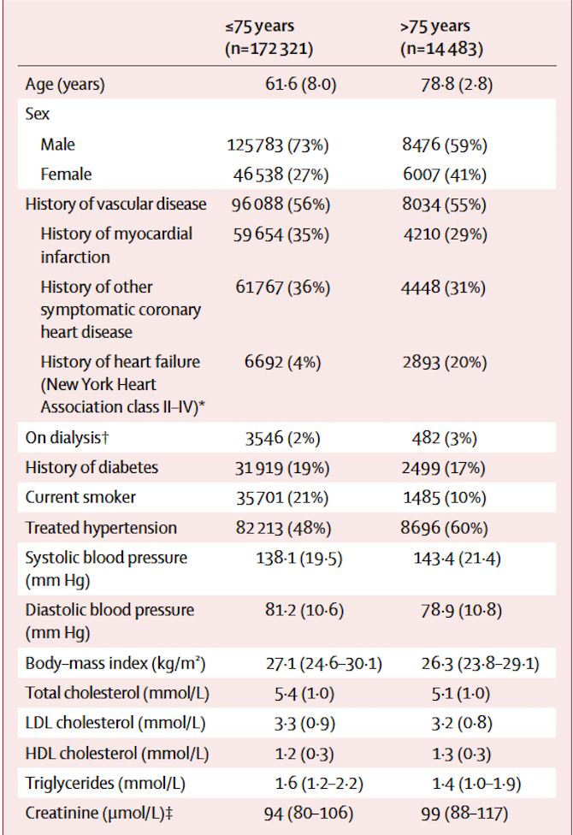
Baseline Characteristics
The 186,854 patients were subdivided into six groups
The 186,854 patients were subdivided into six groups
Age group | < 55 | 56-60 | 61-65 | 66-70 | 71-75 | > 75
% of Participants | 21% (39,242) | 17% (31,434) | 20% (37,764) | 20% (36,567) | 15% (27,314) | 8% (14,483)
Notes:
They had total of 187,000 patients subdivided into six groups, including 14,483 participants who were age 75 years or older. Looking at the > 75 patient group, 41% are female, 55% history of vascular disease, 17% has Diabetes, 60% has HTN, average LDL was 128.

Slide 14
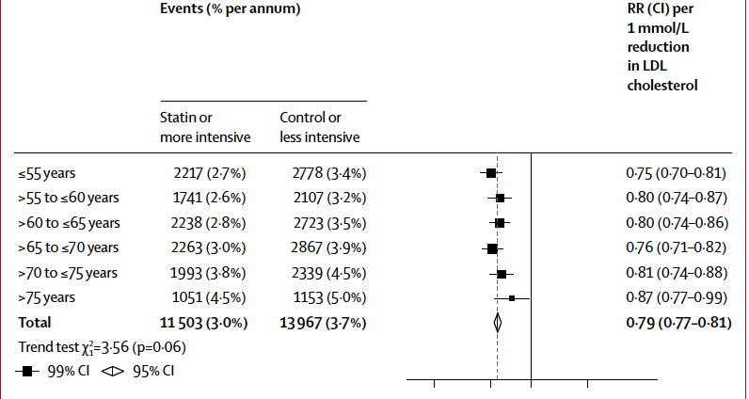
Outcomes
1mmol/L = 40mg/dl
13%
21%
In the older group, the 13% relative reduction corresponded to an absolute reduction of 0.5% vascular events per year.
Notes:
Fig 1: Combining primary and secondary prevention population, statin therapy produced a 21% proportional reduction in the risk of a 1st major vascular event.
Basically saying that per 40mg/dl decrease in LDL, patient is 21% less likely to have major vascular events.
In age group >75, the 13% relative reduction corresponded to an absolute reduction of 0.5% vascular events per year.

Slide 15
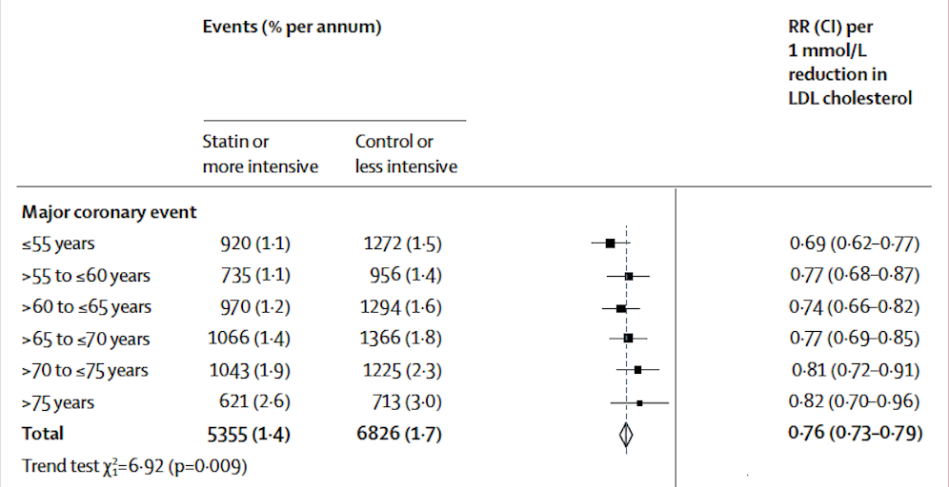
Outcomes
Notes:
Fig 3:
Looking at specific outcomes, like major coronary events, statins and more intensive statins were associated with a 24% reduction in proportional risk. For > 75 group, there was still 18% reduction.

Slide 16
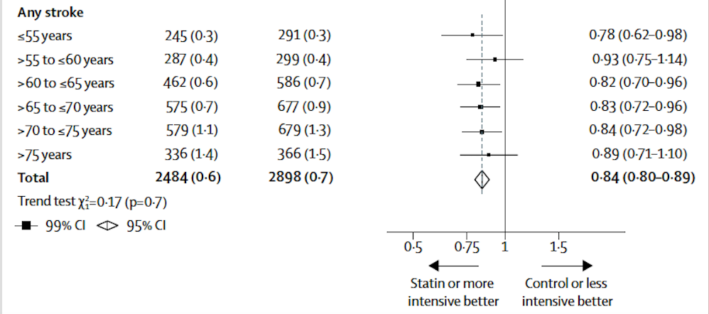
Outcomes
Notes:
Fig 3, For Strokes which our patient is interested in, overall, there is 16% decrease in general. But looking at the >75 group, there seems to be 11% risk reduction, but it crosses 1. The authors confirmed that there were too few stroke events that occurred among patients older than 75 for them to assess the effects on stroke outcome directly.

Slide 17
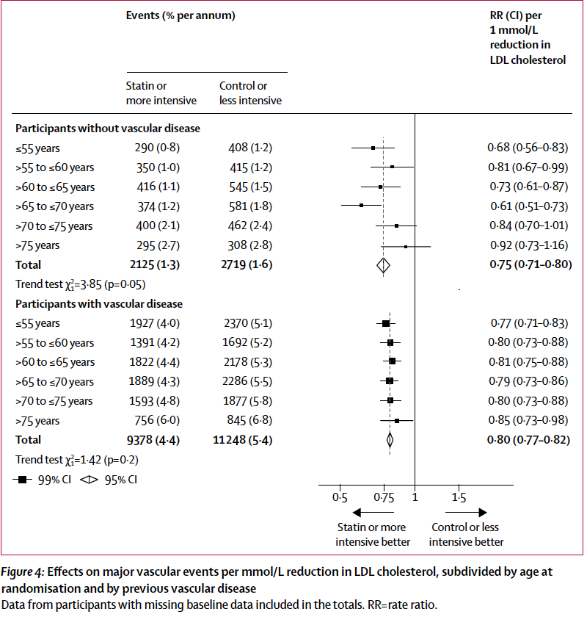
Outcomes
Primary prevention
Secondary Prevention
Notes:
Fig 4: With no history of vascular disease (primary prevention), there is significant trend towards smaller proportional risk reductions with increasing age. For patients > 75, it crosses 1. So, there seems to have no significant reduction in major vascular events conferred by statin therapy.
With known vascular disease (secondary prevention, which is the case for our patient), total population had 20% proportional reduction in major vascular events while > 75 group had 15% reduction in major vascular events.
Therefore, this study showed that statin therapy produces significant reductions in major vascular events irrespective of age, but there is less direct evidence of benefit among patients >75 years without established ASCVD.

Slide 18
Clinical Appraisal
Were individual patient data used in the analysis?
  Yes
What is the magnitude of the treatment effect?
  In general, statin therapy provides ~ 13-20% proportional risk reduction depending on age
How precise is the treatment effect?
  It is not very precise and has lots of variation
Notes:
How precise is the treatment effect? No, It is not very precise and has lots of variation
Looking at overall major vascular events: range from 0.77-0.99
Looking at stroke: range from 0.71-1.10

Slide 19
Clinical Appraisal
Is our patient so different from those in the study that its results cannot apply?
  No, our patient is 78 year old. In this study, they looked at patients > 75
  Our patient has history of TIA and Diabetes
  In the study: 41% are female, 55% history of vascular disease, 17% has Diabetes
Is the treatment feasible in our setting?
  Yes
What are our patient’s potential benefits and harms from the therapy?
  Benefits is preventing vascular events such as MI and stroke in the future
  Harms: side effects

Slide 20
What are our patient’s values and expectation for both the outcome we are trying to prevent and the adverse effects we may cause?
She is most worried about getting another stroke
She is independent with her ADLs currently, and wants to be as independent as long as possible
She is tolerating statin without any side effects
Evidence:
In general, statin has significant reduction in overall vascular events even in patients > 75
But when you just focus on stroke outcome, there is no difference because there was too few stroke events that occurred to give it enough power to the study
Recommendation: Will continue her statin
Notes:
Prevent debility
Combination of MI, coronary revasculation and stroke, there is significant risk reduction in all ages. But when you just focus on stroke outcome, there is a much smaller risk reduction, especially when there was too few stroke events that occurred to give it enough

Slide 21

Questions:

